Slide 1
Addressing the Gaps in the Johari window:
Perception vs Reality for Incident Commanders
Dr Amanda Davies
School of Policing, Charles Sturt University, Australia

Slide 2
Why Use Simulation Based Exercises
Why do we use simulation-based learning in Incident Commander training?
Opportunity to practice application of knowledge and skill
Provide multiple different scenarios/situations in a ‘safe environment’
Opportunity to visualize the potential landscape of real-world incidents (cannot practice in the public domain)
Test/Assess

Slide 3
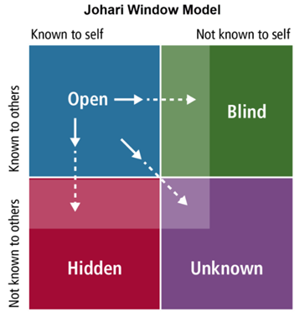
Johari Window Concept
What we know about ourselves and other also know
What we know about ourselves, and others do not know
What others know about us, and we do not know about ourselves
What neither we or others know about us
How does this relate to simulation-based learning?

Slide 4
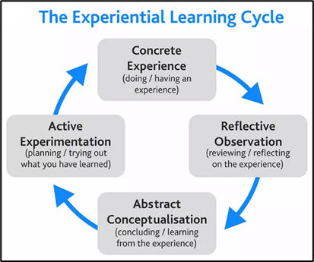
Experiential learning
Phase 1 the initial experience
Phase 2 reflection on and review of the initial experience
Phase 3 interpreting the experience – what has been learnt and what knowledge and skill has been demonstrated
Phase 4 applying modification and or adjusting understanding in preparation of a further application of knowledge and skill based on what has been learnt from the initial experience
Phase 5 replicating the adjusted knowledge and skill – hence closing the learning cycle

Slide 5
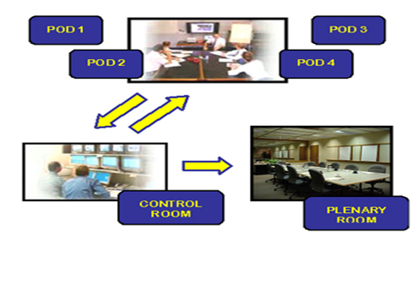
The Case Study
33 Senior Officers undertaking Incident Command Training (average length of service 26.5 years)
* Real-time; emerging information feeds, police radio; live streaming; media units

Slide 6
Setting the Scene – Pre-Simulation
100% agreement the simulation exercise was realistic
Pre simulation Profile (Quadrants 1,2,3)
100% agreement the officers were confident with decision making skills
99-100% agreement the officers were perceived by their peers as competent and reliable with decision making
“I felt under pressure, was very realistic in the sense of phone calls coming in just like they do in the real world and for example when I was trying to get a busy, I couldn’t get a bus”;
“as soon as we started the [police] radio started blaring as we started working on the map, time logs, listening, making decisions, it was like we were there

Slide 7
Setting the Scene
Elements influencing good decision making:
Personal attributes influencing decision making
Personal characteristics
Strength of character
Humility
Analytical skills
Trust in others
Operational Police experience
Observing other officers, senior and junior
Education and training
Mentoring from senior officers

Slide 8
Setting the Scene
Elements influencing good decision making:
Personal attributes influencing decision making
Personal characteristics
Strength of character
Humility
Analytical skills
Trust in others
Operational Police experience
Observing other officers, senior and junior
Education and training
Mentoring from senior officers

Slide 9
Setting the Scene
Elements influencing good decision making:
Personal attributes influencing decision making
Personal characteristics
Strength of character
Humility
Analytical skills
Trust in others
Operational Police experience
Observing other officers, senior and junior
Education and training
Mentoring from senior officers

Slide 10
The Reality
Elements influencing good decision making during the simulation
100% agreement fully engaged and immersed
100% agreement able to apply decision making knowledge and skills

Slide 11
Johari Window Quadrant 4
Participation in the simulation revealed strengths and weaknesses unknown to the participant or to others = populating Johari Window Quadrant 4
Post simulation Question:
What were the most valuable aspects for your future policing practice
gained from participating in the simulation exercise for you?
95% stated it was learning about their strengths and weaknesses
Participant 21 | …the simulation-based process was valuable for understanding where we are at, our strengths and to work on any perceived weaknesses
Participant 16 | …the opportunity to participate in a simulation exercise that resembles real life helped me to identify the stressors I would be under in such a situation which has helped me to understand my strengths in this area and what I need to work on to be able to handle a situation like this in real life
Participant 14 | …my knowledge of Incident Command and Control prior to attending this course was minimal. Learning the structure and application of the model and putting it into practice in the simulation, I am now more confident and comfortable if I am faced with a situation to run an Incident Management Team

Slide 12
Lessons Learnt
What does this mean?
Reveals previously unknown capabilities, competence, strengths and weaknesses
Populates Johari Window Q4
Populates EL Phase 4
Closes the loops, empties Johari Window 4 and the cycle begins again
Enables the next cycle

Slide 13

Lessons Learnt
and
Potential to expand the application of the Johari Window model to simulation-based exercises to examine and identify leader characteristics and attributes including, for example
unconscious bias
Integrity
courage
respect
compassion
and resilience.
Research connecting ‘practice’ through simulation-based exercises models such as the Johari Window
leads to informing continuous improvement strategies for developing leaders
leads to understanding leadership capabilities

