Slide 1
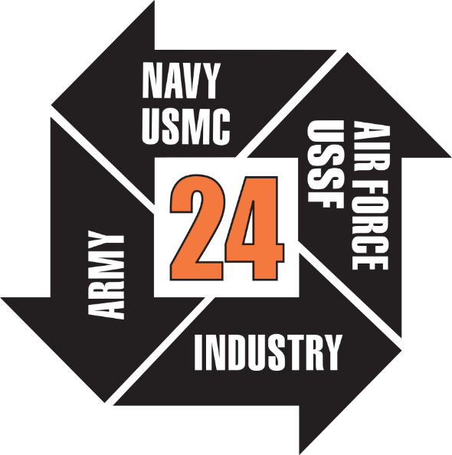

Model-Based Systems Engineering (MBSE) Approach to Model & Simulate Space Experiments using Teamwork Cloud
Paper No. 24171
Capt Christopher Reed, USAF
Air Force Research Lab, Space Vehicles Directorate (AFRL/RV)

Slide 2
Overview
Foundation – Model “Literature” Review
Application – AFRL Space Vehicle Methods
  The Space Vehicles Reference Architecture
  Class Models
  Enterprise Model
Conclusion – Why MBSE Matters to us

Slide 3
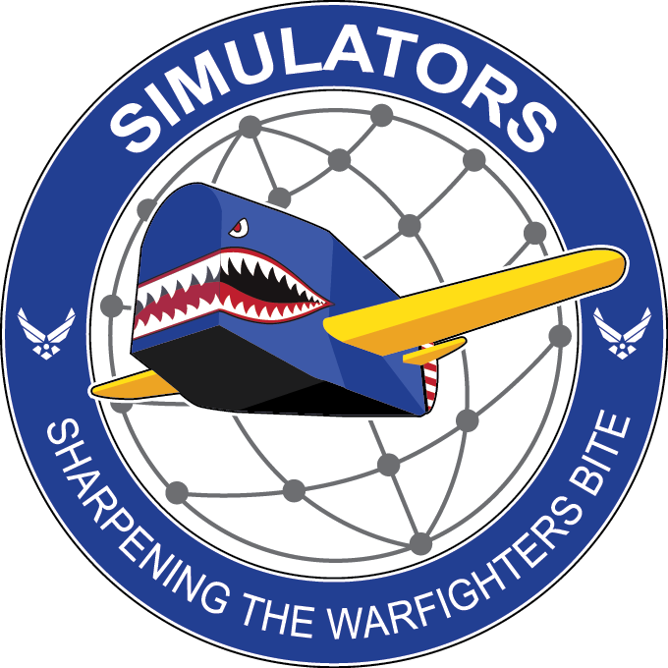

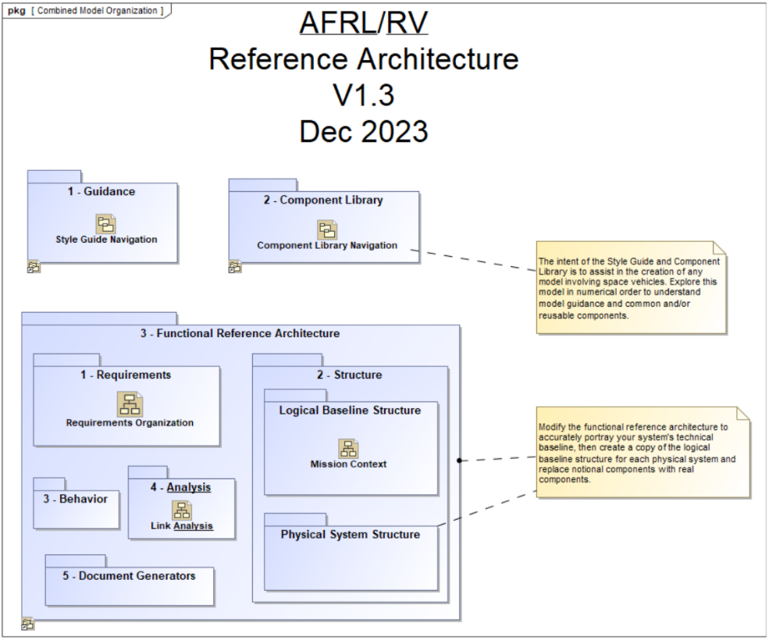

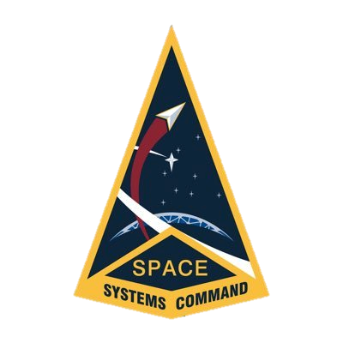
Foundation
WNS MBSE
Modeling Guide
Satellite Reference Architecture
Space Vehicles Reference Architecture (SVRA)
US Space Force Processes & Guides

Slide 4
Application
Project Usage
Project Usage
Component Library
Reference Architecture
Style Guide
Branch from RA
Reuse in RA
Mission Models
Project A
Project B
Project C
AFRL Ground
Review, Approve, and Merge models into EM
Transfer Common Components to CL
Enterprise Model
AFRL/RV
Open Use
Mission Use

Slide 5
Application
Project Usage
Project Usage
Component Library
Reference Architecture
Style Guide
Branch from RA
Reuse in RA
Mission Models
Project A
Project B
Project C
AFRL Ground
Review, Approve, and Merge models into EM
Transfer Common Components to CL
Enterprise Model
AFRL/RV
Open Use
Mission Use

Slide 6

Space Vehicles Reference Architecture
Provides an advanced starting point for space vehicle baseline modeling
Includes a read-only Style Guide and Component Library for assistance in generating models
The Functional Reference Architecture is the editable and entirely tailorable container for a project

Slide 7
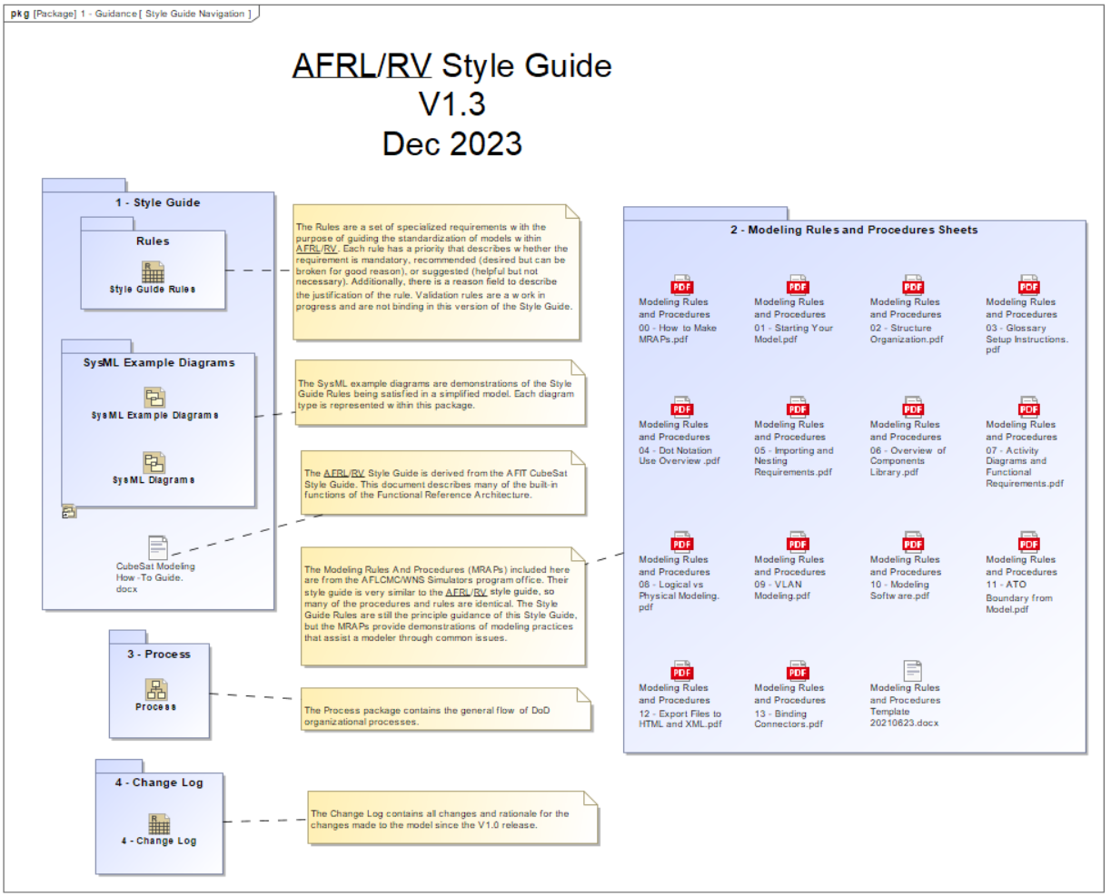
SVRA: Style Guide
The Style Guide is a collection of modeling rules, examples, and reference documents that aid a modeler in making an AFRL/RV standard model
Rules are custom SysML requirements with traceability to example diagrams that depict the rule used in context
Includes a Change Log that points to every change made in the SVRA

Slide 8
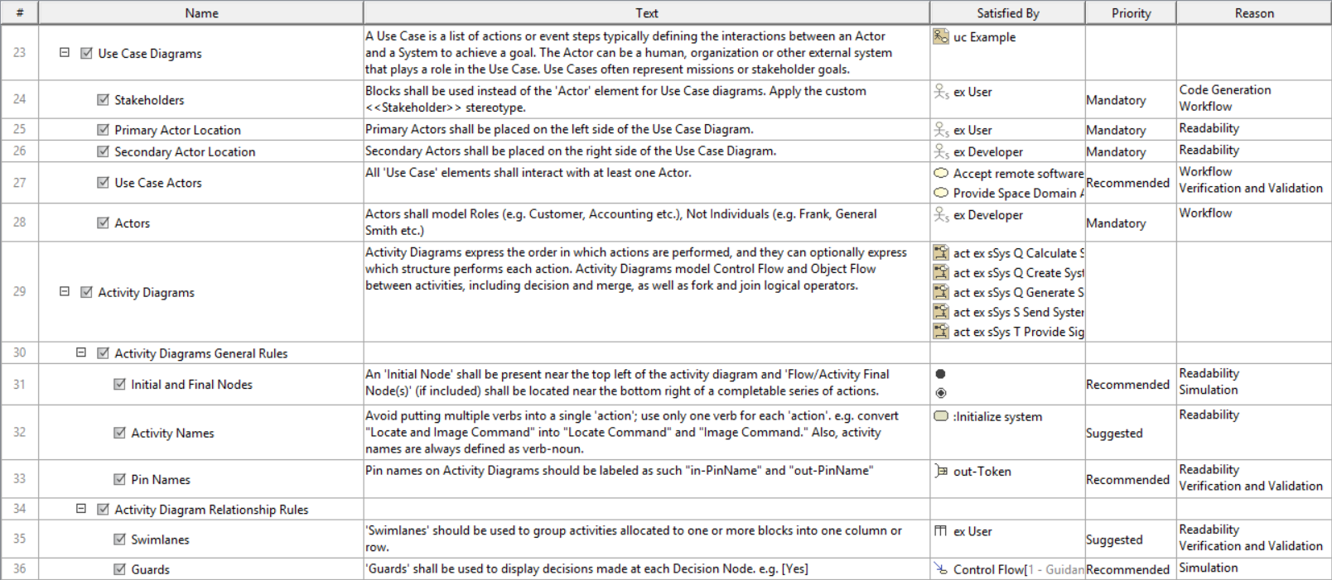
SVRA: Style Guide Rules

Slide 9
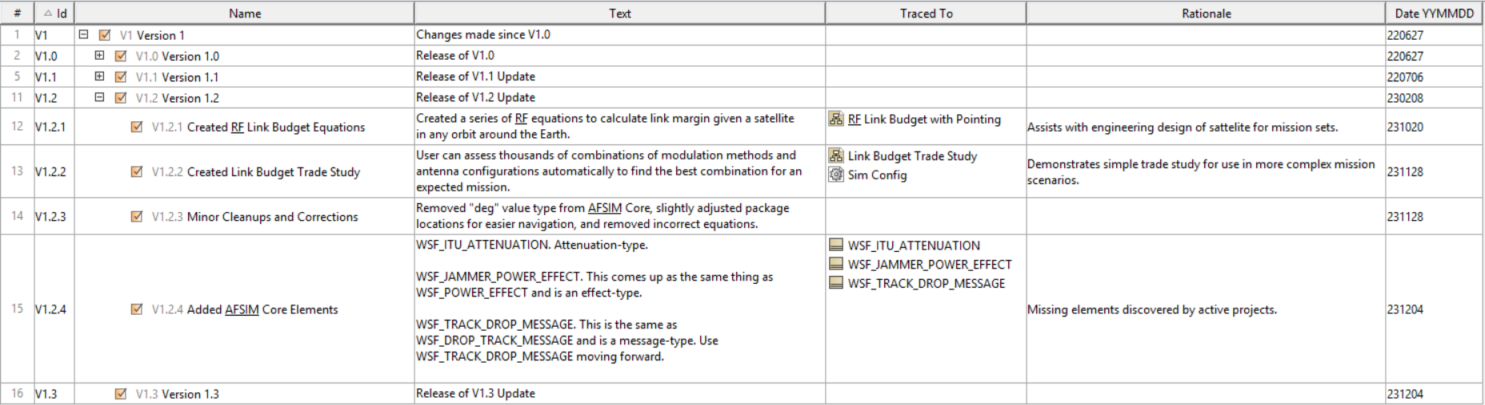
SVRA: Style Guide Change Log
Every change in the SVRA since the V1.0 release
Changes are linked to actual locations of the changes

Slide 10
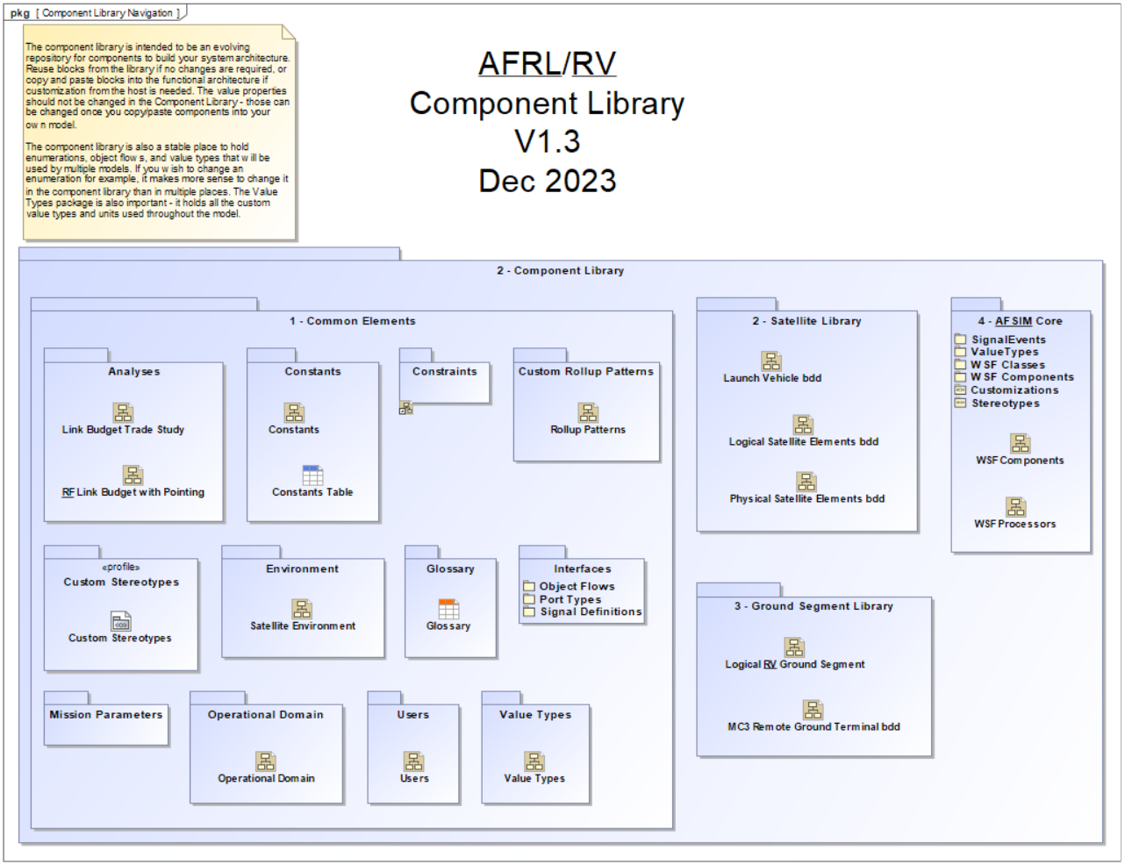
SVRA: Component Library
A collection of reusable elements that help speed up model creation
Includes numerous mathematical functions, value types, and patterns to aid system and mission analyses

Slide 11
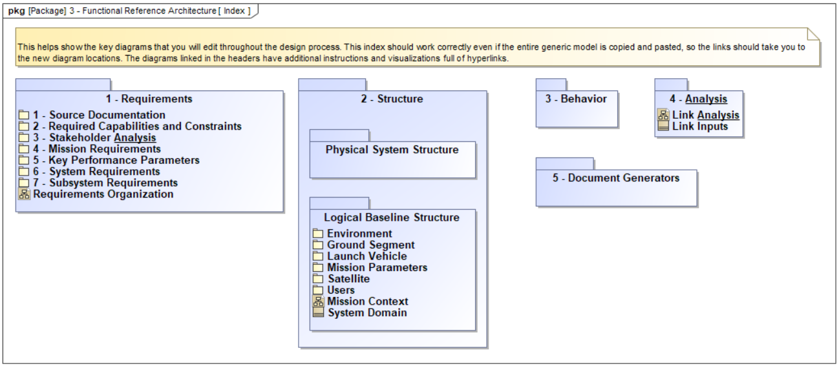
SVRA: Functional Reference Architecture

Slide 12
Application
Project Usage
Project Usage
Component Library
Reference Architecture
Style Guide
Branch from RA
Reuse in RA
Mission Models
Project A
Project B
Project C
AFRL Ground
Review, Approve, and Merge models into EM
Transfer Common Components to CL
Enterprise Model
AFRL/RV
Open Use
Mission Use

Slide 13
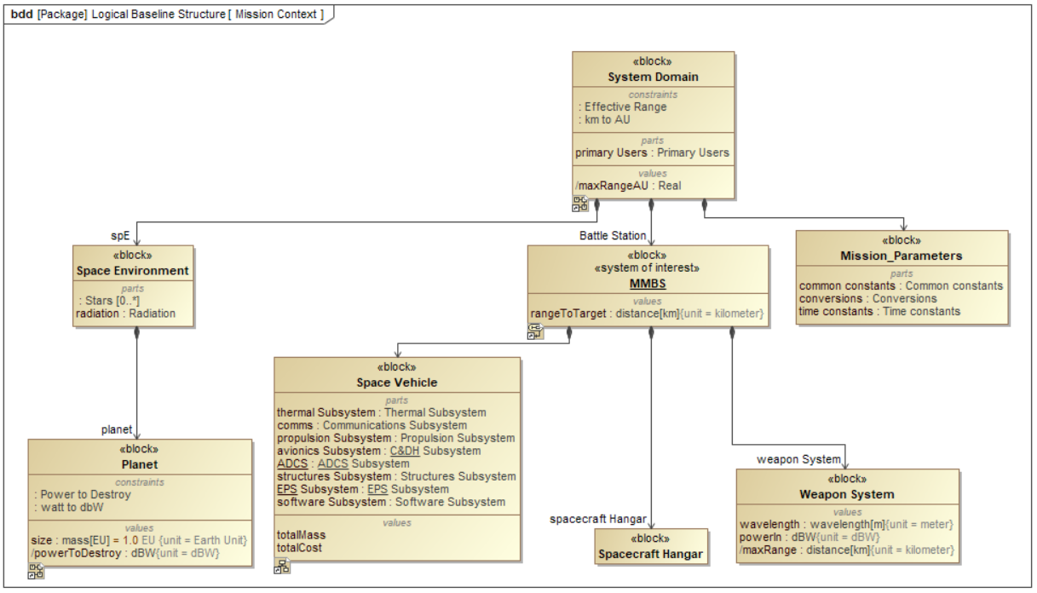
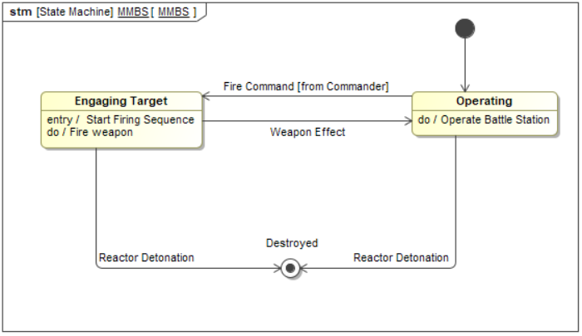
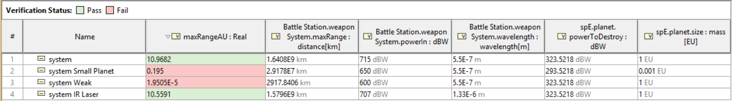
Class Models
Mega Moon Battle Station
  “You may fire when ready”

Slide 14
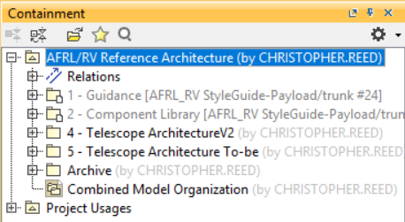
Class Models
Mega Moon Telescope System
  Focused on model management
  Model sparked development by group for real US Space Force telescopes

Slide 15
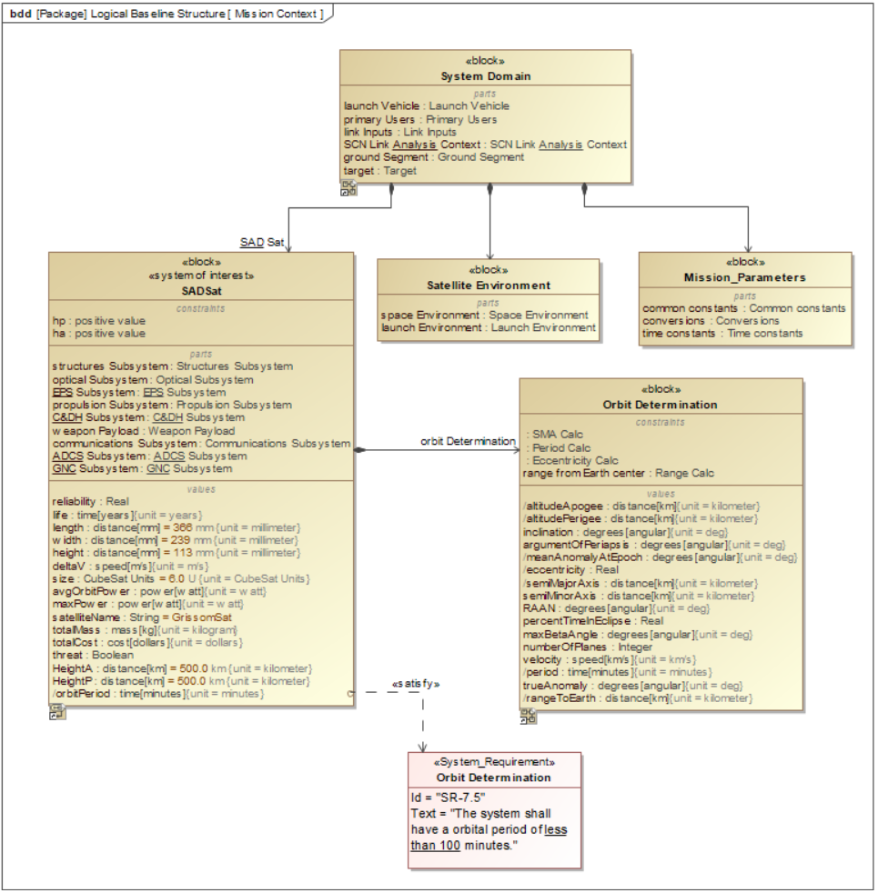
Class Models
Sad Satellite
  Efficient use of Teamwork Cloud
  Best use of SVRA Component Library

Slide 16
Enterprise Model
Project Usage
Project Usage
Component Library
Reference Architecture
Style Guide
Branch from RA
Reuse in RA
Mission Models
Project A
Project B
Project C
AFRL Ground
Review, Approve, and Merge models into EM
Transfer Common Components to CL
Enterprise Model
AFRL/RV
Open Use
Mission Use
Notes:
Create a sandbox of reviewed & approved program models
Single source of truth for portfolio baselines
Enables larger scale analyses using integrations with purpose-built tools (e.g., AFSIM)
Feeds into Component Library with non-proprietary reusable components

Slide 17
Conclusion
AFRL/RV is using MBSE to:
  Assist in space vehicle systems engineering
  Act as a digital repository of our missions
  Answer mission analysis questions
  Support the unique needs of each mission
The SVRA acts as the starter model for our current and future MBSE models
The model management framework enables snowballing MBSE knowledge and quicker model development cycles

Slide 18
Questions?

