Slide 1

Bridging the Interoperability Gap Using Large Language Models and STITCHES
Javier Garza, Lockheed Martin
Sekinat Quadri, Independent Researcher

Slide 2
Agenda
Introduction
Background
Methods
Results
Conclusion and Future Work

Slide 3
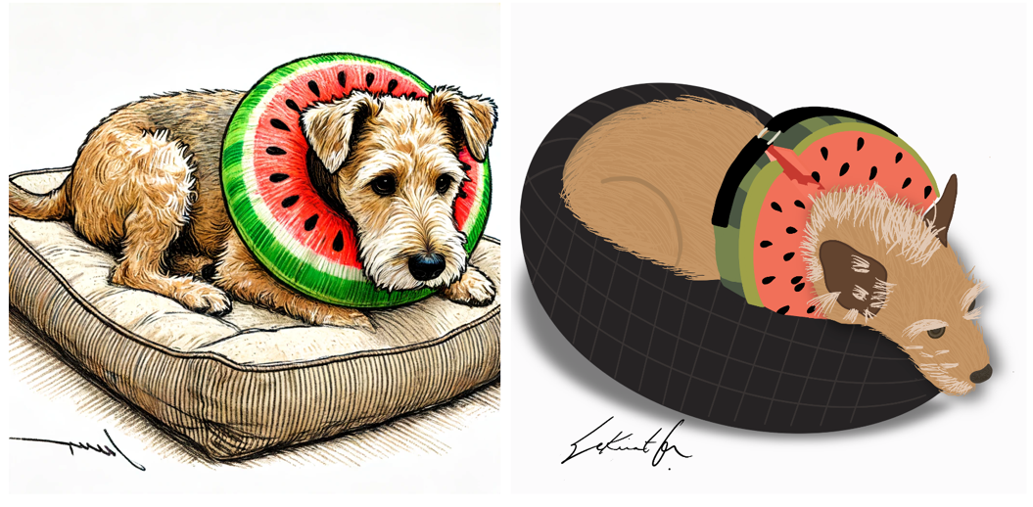
Introduction
Generative AI has exploded in popularity recently
Tools such as OpenAI’s DALL-E can generate images using descriptive prompts
DoD recognizes the importance of Generative AI, including Large Language Models (LLMs)
However, most pre-trained LLMs use closed datasets whose lineage is difficult to track, much less understand
One of these is human generated…

Slide 4
Background
How can one take these technologies and apply them to a DoD-specific use case?
New technology integration with existing DoD systems is historically difficult
LLMs can generate domain specific data, including source code
STITCHES, developed by Apogee Research through DARPA, requires the use of a Domain Specific Language (DSL) to create transforms between messages
Message
B
Message
B
Message
B
Message
A
Message
C
Message
A
Global
Standard
Message
C
Message
A
Message
C
Message
D
Message
D
Message
D
Local Standards
Global Standards
Incremental Standards

Slide 5



Background
Example: Real-World Airplane Data Feeding a Simulation
Distributed Interactive Simulation (DIS) provides standardized messages, known as Protocol Data Units
Automatic Dependent Surveillance-Broadcast (ADSB) provides airborne position messages
Both standards use different coordinate systems and encode their values differently
ADSB Aircraft State Message
DSL Transform inside STITCHES Field and Transform Graph
DIS Entity State PDU

Slide 6
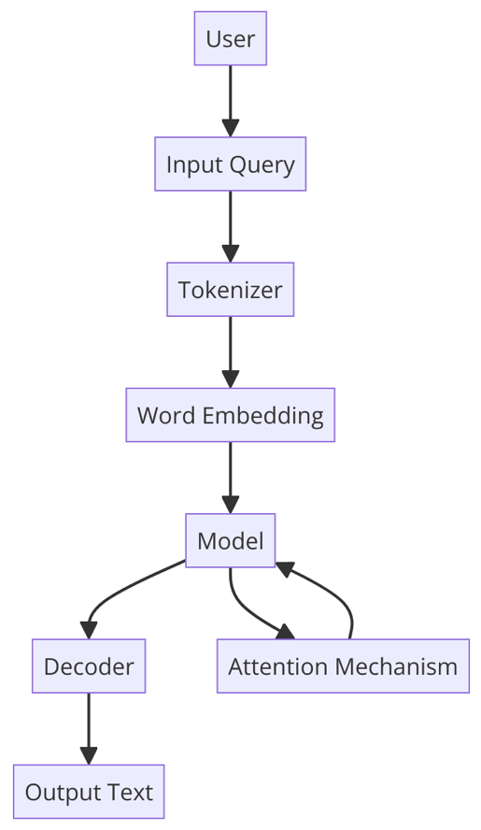
Background
The Transformer network architecture (Vaswani et al., 2017) was a key enabler to initial development of LLMs
Pre-training bidirectional representations from unlabeled text led to BERT model; performed well on Natural Language Processing (NLP) tasks (Devlin et al., 2019)
Providing multiple example prompt and response pairs correlates to improved performance with larger models (Brown et al., 2020)
LLM Information Flow

Slide 7
Background
In-context learning using multimodal sources can enhance performance on various tasks (Huang et al., 2023)
Fine-tuned model for Verilog code completion resulted in 41% performance increase over GPT 3.5 (Thakur et al., 2023)
Smaller models like Phi-3 match LLM performance using filtered public and synthetic data, enabling edge deployment (Microsoft, 2024)
LLM Information Flow

Slide 8
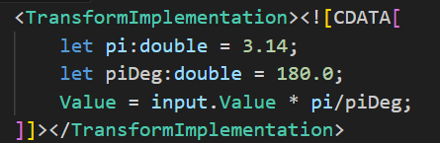
Methods
Initial Data Collection
Python script used to extract all transforms from Field and Transform Graph (FTG) XML files
Extracted 324 domain-specific language code snippets, specifically from Distribution A STITCHES release
Each snippet contains varying complexity
Simple DSL Example

Slide 9
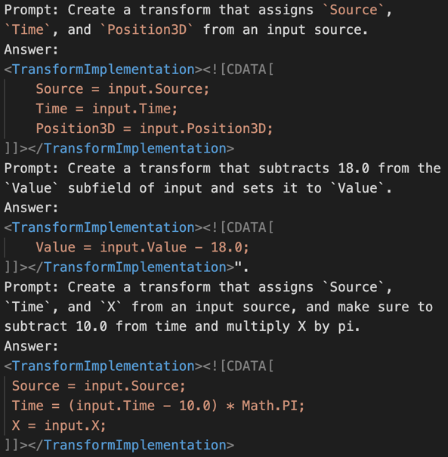

Methods
In-Context Learning (ICL)
No training required, just provide samples and see what the model can do
ICL Results
Context Examples

Slide 10
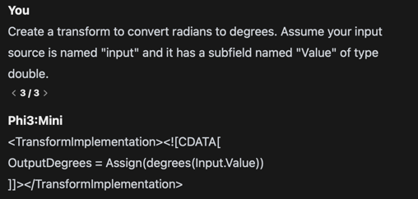
Methods
Retrieval Augmented Generation (RAG) from Field & Transform Specification
Give the model a document one might give to a human, and a prompt
RAG from Specification - Results

Slide 11
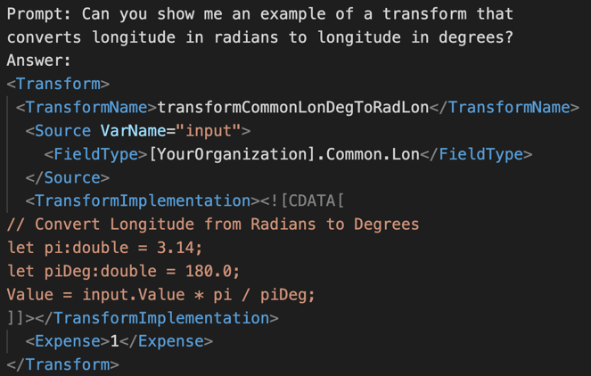
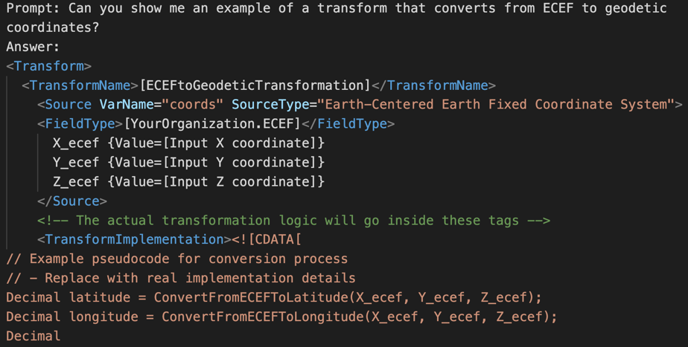

Methods
Retrieval Augmented Generation (RAG) from Examples
Give the model many examples and then a prompt
RAG from Examples - Results

Slide 12
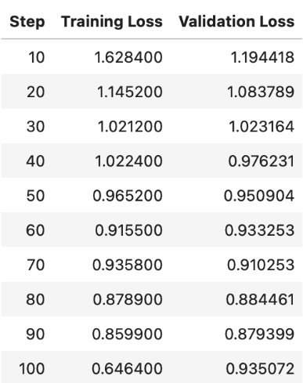
Methods
Previous methods work well in pre-defined cases; however, insufficient data exists in this case
Could RAG be used to generate an augmented dataset for fine-tuning?
Yes! Unfortunately, generated labels were too verbose
Validation loss was not showing improvement during training
Training Setup
Supervised Fine-Tuning Trainer (SFTT)
80% training, 20% evaluation, batch size: 7
Learning rate: 0.0001, max sequence length: 128
Gradient accumulation steps: 4
Training with Autogenerated Labels

Slide 13
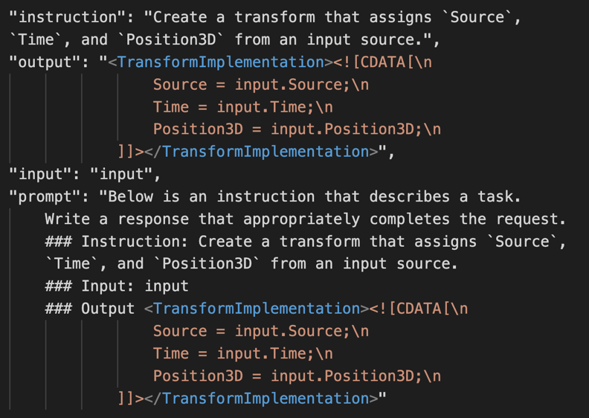
Methods
New approach: select subset of available transforms and manually label them
Selected 42 transforms with increasing complexity, then labeled
Augmented into 1,680 total transforms, resulting in balanced class distribution
Manually Labeled Snippet Sample

Slide 14
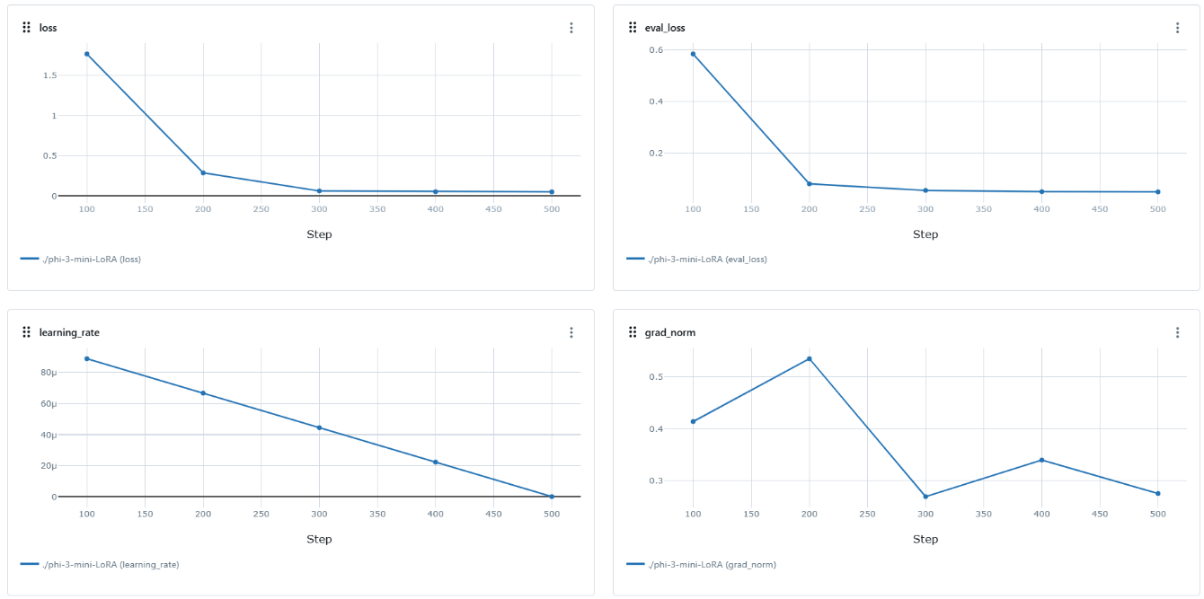
Methods
Fine Tuning: Low-Rank Adaptation (LoRA)
Batch size: 8
Learning rate: 0.0001
Epochs: 10
Alpha: 16
Dimension attention: 16
Dropout probability: 0.05
95% training split
5% validation split
Training Metrics

Slide 15
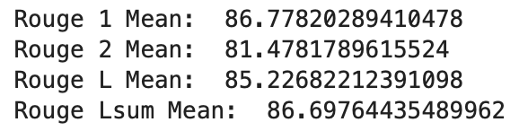
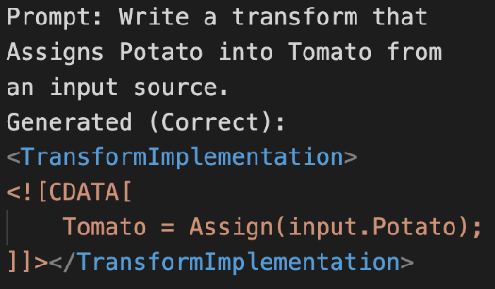
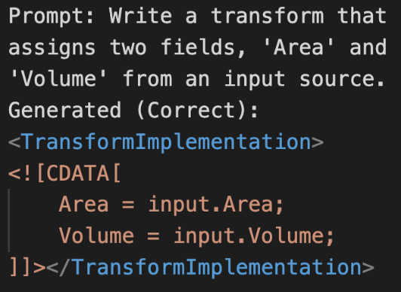
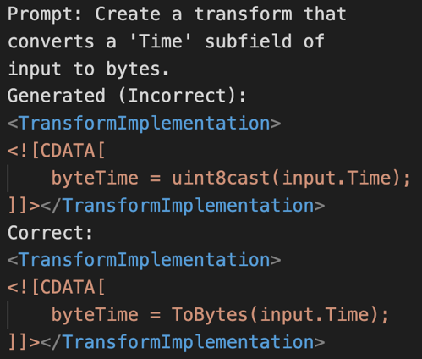
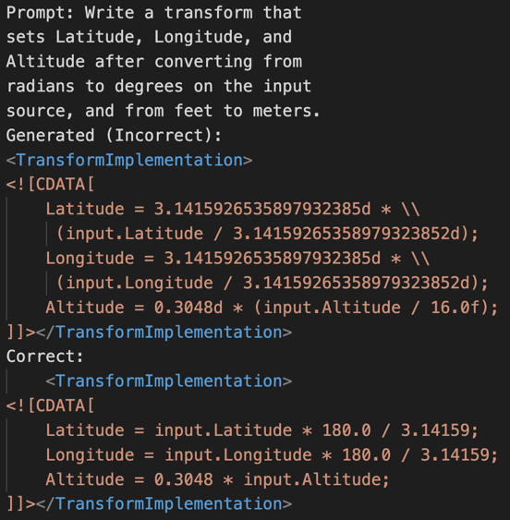
Results
ROUGE metrics evaluate generated text against reference text to assess model retention post-fine-tuning and integration with the base model
Test Setup – temperature: 0.3, max tokens: 256
ROUGE Metrics
Post Fine-Tuning Test Results

Slide 16
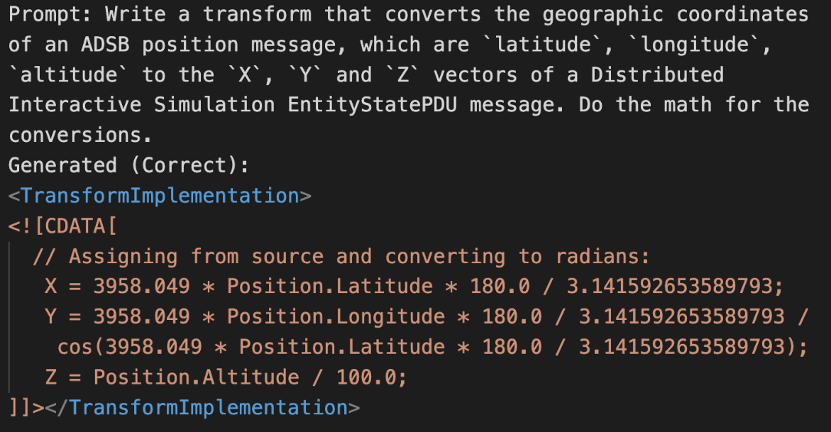
Results
What about the use case?
Important factors:
Prompt verbosity
Instruction quality
Training data quality
Syntax correct, math not verified
Generated ADSB to DIS Transform

Slide 17

Conclusion and Future Work
None of the training, validation, or test data included DIS or ADSB information, suggesting base model contained those standards in original training
LLMs can be harnessed as tools by DoD and industry to solve the most relevant problems such as platform integration
Data lineage is important when working with AI/ML models, especially in a DoD context
Usage of the internal DoD STITCHES graph for future efforts could enable code generation capabilities on par with other programming languages
Future integration into a front-end framework, such as Ollama, would ensure fine-tuned model could be more easily accessible
Image Courtesy of: Microsoft

