Slide 1



Context-Sensitive Attribute and Competency Assessment
Jayne L. Allen Ph.D., U.S. Army Research Institute for the Behavioral and Social Sciences

Slide 2
Acknowledgements
Co-Authors
Randy J. Brou, Ph.D. (U.S. Army Research Institute)
Krista L. Ratwani, Ph.D. (Aptima, Inc.)
Frederick J. Diedrich, Ph.D. (Independent Consultant)
MSG (R) Scott M. Flanagan (Sophia Speira, LLC)
Tatiana H. Toumbeva, Ph.D. (Aptima, Inc.)
DISCLAIMER
The research described herein was sponsored by the U.S. Army Research Institute for the Behavioral and Social Sciences, Department of the Army (Contract No. W911NF220031). The views expressed in this presentation are those of the author and do not reflect the official policy or position of the Department of the Army, DOD, or the U.S. Government.

Slide 3


The Challenge
Context matters

Slide 4
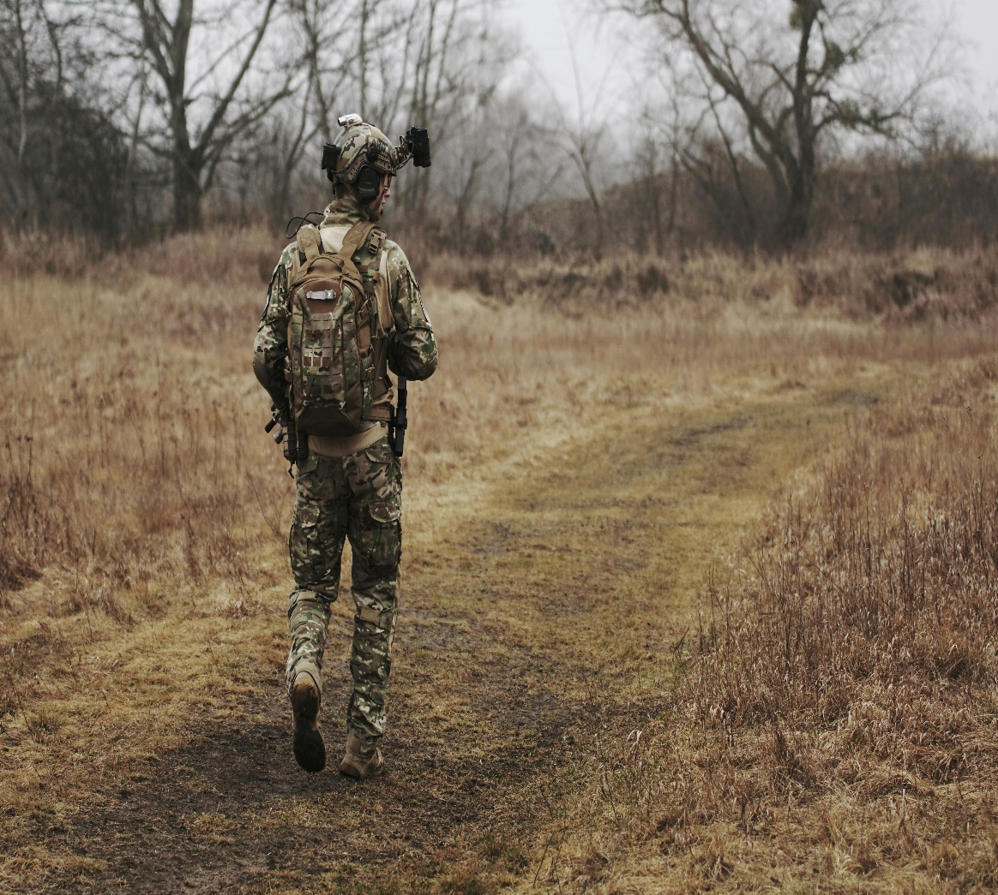
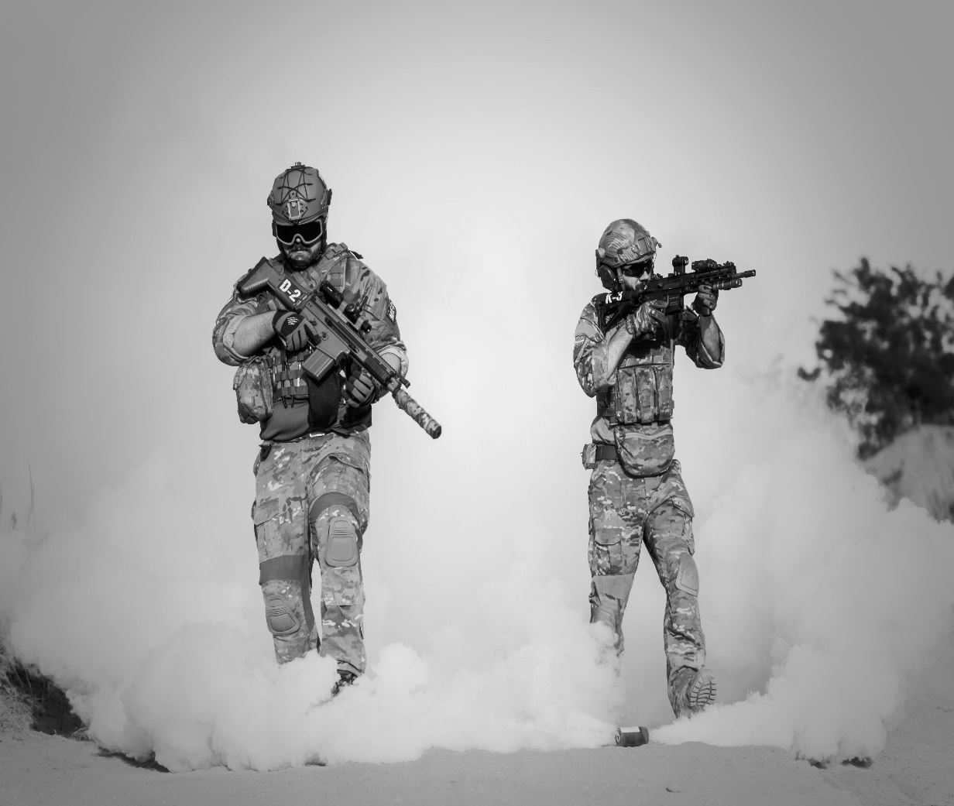
The Challenge
Training Performance

Slide 5



Further Complicating Matters
Contextual Effects Vary by Individual

Slide 6
The Military Problem
How will a warfighter perform in an ambiguous, complex, multidomain operational environment?
Assessment and training under fixed, limited conditions is insufficient and will not adequately prepare warfighters for a dynamic battlefield
“Train as you fight” implies an understanding of likely conditions on the battlefield.
If the battlefield is complex, then the likely conditions will be dynamic, differentially drawing on attributes and competencies based on the situation (i.e., who, what, where, and how).

Slide 7
Theory
Soldier development is likely to be nonlinear and characterized by context dependencies (Brou et al., 2022)
It is insufficient to think of Soldiers as simply “having” or “not having” attributes and competencies
Rather, leveraging if-then relationships (Mischel & Shoda, 1995), the assessment challenge becomes better understanding the probability of whether a Soldier will behave in accordance with a desired attribute or competency under different conditions
Context-sensitive assessment can further inform an understanding of readiness and enable targeted instructional intervention

Slide 8
A Method of Assessment
Situational Judgement Tests (SJTs)
Short vignettes (scenarios) that describe the context of a problem followed by a series of question
Allow systematic manipulation of contextual demands thought to create a priori difference in response

Slide 9
Example: Struggling Student
As an advisor, you are tasked with assisting coalition partners in an assessment of the security of a unit’s compound that is located next to a busy market area in a village with little distance from multiple shops and vendors. It is 1600 and the busiest market day of the week begins in the morning [time pressure]. You’ve been working with the coalition commander for a few months but recently the relationship has been strained [relationship tension]. The commander tells you that he is concerned about vulnerabilities because of decentralized insurgents in the area of operations (AO) [threat]. He wants you to teach his staff a process that they can use now and in the future for how to conduct a good assessment to inform security enhancements…

Slide 10
Struggling Student (cont’d)
You start to take the staff through the new assessment process, and it’s clear that members of the staff do not understand. One Soldier starts the process but keeps reverting to their original approach rather than the one you are teaching. The commander loses his patience, berates the Soldier in front of others, and demands that he quickly follow your instructions.
(1) What would you do in this situation?
(2) How did you come to that decision?
(3) What are the consequences of your decision? If any negative consequences, what would you do about it?

Slide 11
Developing Initial Situations and Variants
Scenarios based on the needs of the target population, situational elements, and targeted attributes/competencies
Four baseline situations
Call For Fire, Struggling Student, Medical, Site Survey
Manipulated situational elements
Threat Level, Time Pressure, Relationship Tension
Low, High

Slide 12
SJTs as Assessment/Development Tools
Used with Rubrics
Behaviorally-based descriptors of attributes/competencies
1 to 5 Likert-type scale
Developed with SME input building on doctrine

Slide 13
General Rubric for Empathetic
1 | 3 | 5
Does not ask about, listen to, or acknowledge others' perspectives | Listens to and acknowledges others but may not always probe for additional information | Proactively requests, actively listens to, and tactfully acknowledges others' perspectives
Ignores, dismisses, or belittles the opinions and practices of others | Accounts for the opinions and practices of relevant parties but may take too much time doing so | Accounts for the opinions and practices of relevant parties when taking actions without compromising the mission timeline
Uses a one-size-fits-all approach when assigning roles/tasking | Considers strengths and weaknesses of partners, peers, or subordinates when assigning roles or tasking | Actively looks for opportunities to utilize strengths and develop weaknesses when assigning roles or tasking
Allows others to fail unnecessarily | Helps others who are struggling but not at the optimal time | Anticipates when others may struggle and helps at the "right" time

Slide 14
Scenario-Specific Rubric
Perspective Seeking | Perspective Taking | Help at the Right Place/Time | Aware of Others' Strengths/Weaknesses
Where/How | Where/How | Where/How | Where/How
Trying to figure out why the Soldier is shutting down | Acknowledgment that the U.S. process is new/different from what the coalition partners usually do; it may not work for them and/or it may take time | Pulling the commander aside to discuss | Helping the student to problem solve/learn the new process
Trying to figure out why the commander is getting so upset | Acknowledging the feelings/perspective of someone else (e.g., commander) and/or threat situation | Taking the student aside to discuss challenges; following up with student after the fact | Adjust instructional approach
 |  |  | Mention of helping the commander learn or develop

Slide 15
Data Collection
Objective: Explore reliability of assessment approach
Participants/Method
173 Soldiers enrolled in a course
Each Soldier completed two SJT variants for a total of 345 responses
30 minutes to complete
Coding
Scored narrative responses to open-ended prompts
Used rubric with 5-point scale for multiple attributes
Six different trained coders, pairs randomly assigned, rated independently

Slide 16
Percent Agreement
Agreement between raters was 97% within one point on a five-point scale
Note. N = 345 responses for each attribute. No ratings were 4 points apart.

Slide 17
Interrater Reliability
Intraclass coefficients (ICCs) ranged from .74 to .79 across attributes reflecting excellent levels of interrater reliability (Cicchetti, 1994).

Slide 18
Discussion/Future Research
SJTs with open-ended responses and rubrics provide a viable context-sensitive assessment approach
Systematic
Reliable
The method increases probability that technologically advanced simulations are effective for the individual
Future work
Explore developmental changes with respect to contextual dependencies
Changes in if-then patterns over time
Individual differences
Automated scoring

Slide 19
So What?
What needs to be developed, under what conditions, for what operational reality?
Move away from framing as “having” or “not having” an attribute to knowing the probability of when a warfighter is likely to thrive given a context.
Target instructional interventions (live and virtual) based on a nuanced understanding of attribute-context interaction to further support readiness for complex, large-scale, multidomain operations.
Include context in assessments, including automated assessments – Otherwise, the understanding of warfighter state will be incomplete.

