Slide 1


Systematic Approach to Upskilling Learning Professionals for the Development of Modernized Training
LCDR Christie Smith, United States Coast Guard
Courtney Zollicoffer, United States Coast Guard

Slide 2
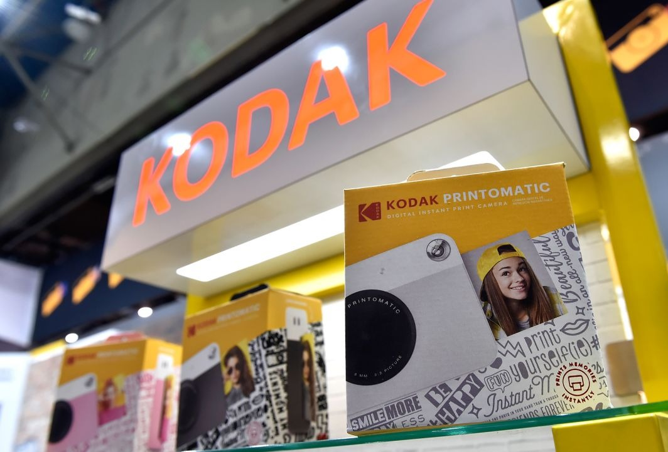
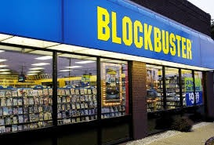

Cue for a Call to Action
Notes:
Start painting the picture of the problem, which is:
Organizations that fail to innovate or adapt fail. Slide 3 addresses the status quo. and need to identify all stakeholders.
A Call to Action cannot be met without defining measurable goals – and the analysis we conducted provides a roadmap line all paths toward meeting the goal.
What do KODAK, Blockbuster, and Xerox have in common?
Put in an interactive survey?
–
State the problem.

Slide 3

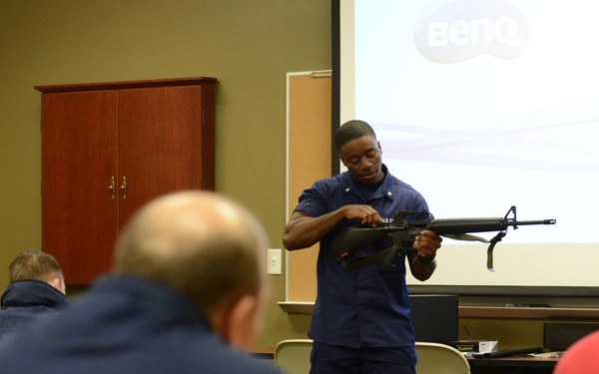


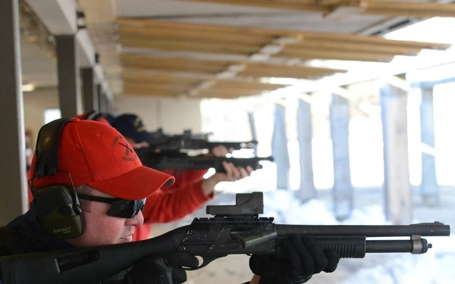
Traditional Model
“Butts in Seats”
Rigid Career Progression
Notes:
[Background slide of status quo]
Scenario 1a: You are a new employee at an organization.
Scenario 1b: You are a new Active Duty member in the military. This is your first job and you have no work experience.
Scenario 2a: You are a working professional who has been a gainfully employed contributor for (10?) years. You are ready for a new opportunity and look first to your current organization for options.
Scenario 2b: You are an experience Active Duty member in the military for (10?) years. You are ready for a new opportunity and look first to your current organization for options.
Scenario 2c: You are a working professional who has been a gainfully employed contributor for (10?) years. You are ready for a new opportunity and look at joining the military for options.
How do you want your professional development / professional development plan to look?
Was it effective?

Slide 4




Four Tenets of Modernized Ready Learning
Advance workforce resilience through training
Maximize training opportunities
Modernize training delivery
Tailor training programs
Theory/Approach
Instructor-Led
Blended Facilitated, Self-paced
Modality
Physical Classroom
Blended Virtual/Physical
Strategy
Real-world
Digital
Traditional
to
Modernized
Notes:
We're not saying that traditional training is ineffective.
But clearly there is research that indicates virtual training CAN be more effective -- not because the tech is “cool” , but because it enables an opportunity to implement effective instructional strategies.
Recognizing that training is the backbone of a mission ready workforce framework,
(the problem): Senior leaders recognized the necessity to innovate to maintain currency.
Today's training experiences in the Coast Guard are just in its infancy of aligning with a future world that is increasingly virtual and customizable.

Slide 5
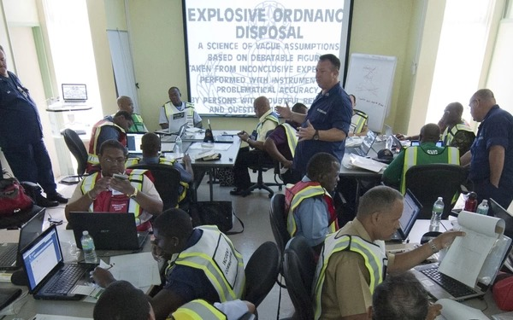
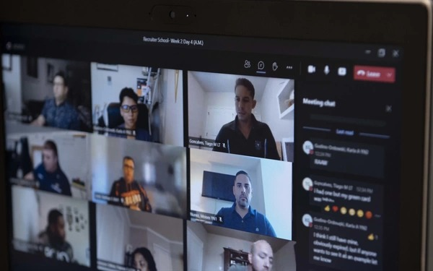
Challenges
Notes:
[The purpose of this slide is to address the impact of failing to create a shared vision.]
In some cases, there was pushback from stakeholders – namely the Instructors – in changing the way that we train.
Which was a fair claim – after all, instructors, largely propelled by the pandemic, were force to trade in-person lectures for Teams calls.
As soon as the state of world was closer back to normalcy, there was a push to return facilitated-online training back to in-person training.
Also, largely due to the rapid transition, curriuculum designers and developers like Instructional Systems designers didn’t redesign training for consideration in this new modality.
Multimedia developers weren’t employed to improve media for new modality.

Slide 6


Response to MRL
Virtual learning is more effective!
Traditional learning is more effective.
My name is MRL
Notes:
[The purpose of this slide to address the impact of not defining measurable goals]
Why isn’t “MRL” happeninig?
There were two responses:
Without really changing anything that was already happening, stayed the course with claims that modernized ready learning was already happening
Started buying VR headsets, drones and gopros in the name of MRL
Is this the answer? If the goal is MRL, how do we know MRL is achieved?
We’re seeking to resolve two problems: align the stakeholders with the vision, and provide a path forward to achieving the vision by examining the impact of the skills of the personnel in achieving MRL.

Slide 7




Upskilling Needs Assessment Driving Factors
MRL Strategy Document
USCG Commandant’s Intent
&
Directed Action
for Upskilling
MRL Upskilling Charter
Notes:
The Modernized Ready Learning document defined the tenants and overarching vison of a modernized training system, but as we have previously highlighted the organization was just scratching the surface for MRL’s potential.
Ms. Zollicoffer highlighted many ongoing efforts to modernize enterprise performance solutions, but to meet the Commandant’s Intent of “developing individually tailored, on-demand, and modernized learning for the continuous professional and personal growth of our workforce,” the CG must ensure our ISDs, instructors, and multimedia developers have the required skills and resources to succeed. Therefore, an MRL Upskilling Charter was established across FORCECOM to conduct a needs assessment to identify performance gaps and the associated barriers, as well as recommend improvements.
The goal of the MRL Upskilling Needs Assessment, conducted by the charter was to better equip FORCECOM staff and remove any barriers preventing the continued development and sustainment of the USCG Modernized Training Ecosystem.

Slide 8
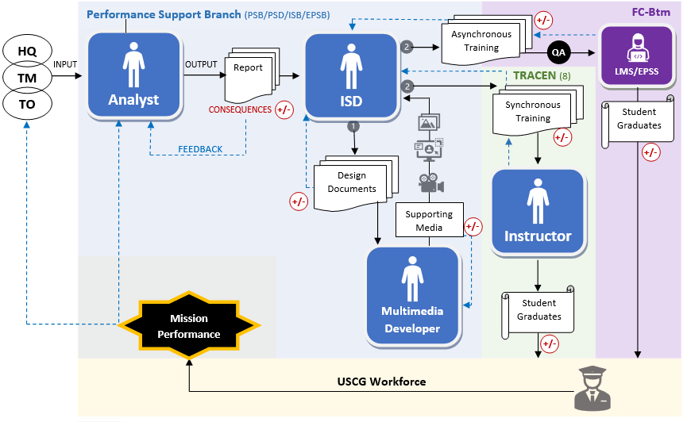
Systematic Approach to Upskilling
Needs Assessment
Headquarters level staff
& policy
Notes:
The Charters target audience scope of the upskilling needs assessment was broad: To ensure organizational alignment among upskilling efforts the charter used Rummlers Anatomy of Performance framework to map out the interdependencies between our needs assessments target audiences. This was particularly essential for Senior Leadership buy-in on the upskilling scope. Using this perspective, the organization became an arrangement of systems, while MRL was contextualized as the ultimate output (or deliverables) of the system.
This graphic shows the relationship between roles… you can see how the deliverable of one role become the input of the next. This is key when systematically addressing performance of upskilling of any given role.
Ex. We can NOT expect to see results if we only focus our efforts on upskilling an instructor's ability to facilitating online training, if the instructional designer has not designed or developed the course efficiently for that modality.
Therefore, to diagnose why the organizations staff has not yet reached the full potential of MRL, the charters objective was to focus on the roles (people) as interdependent systems as well as the associated processes that contribute to their desired outputs.

Slide 9
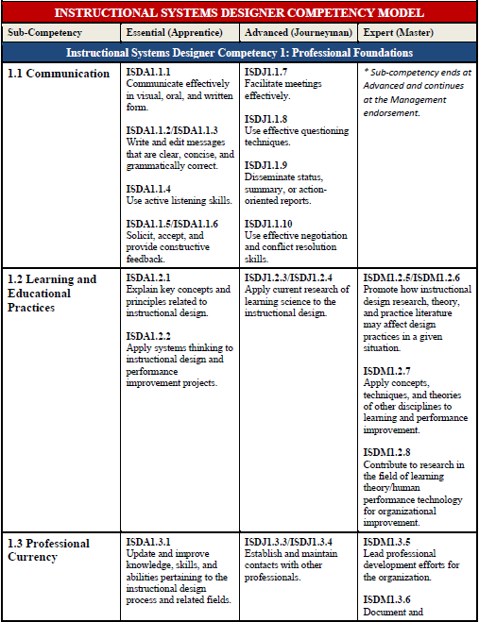
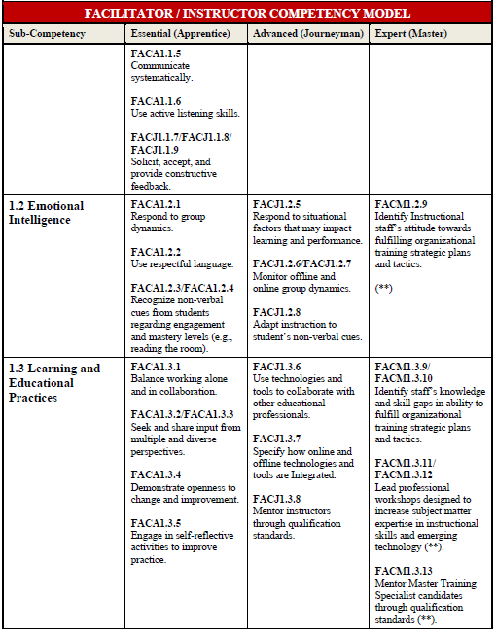
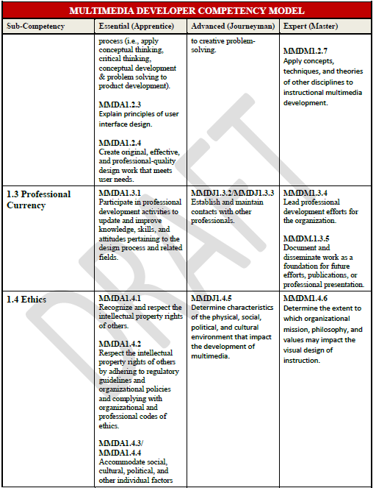
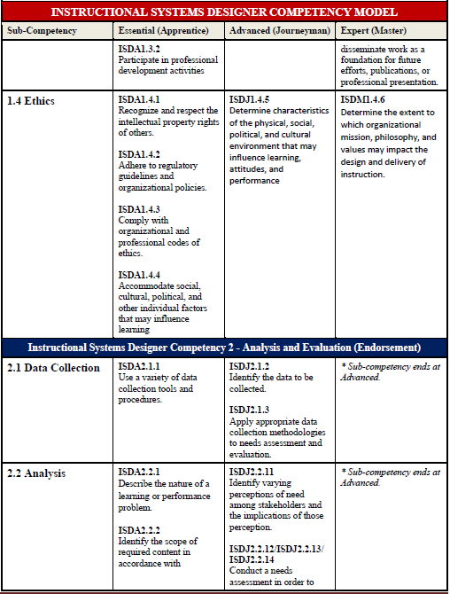
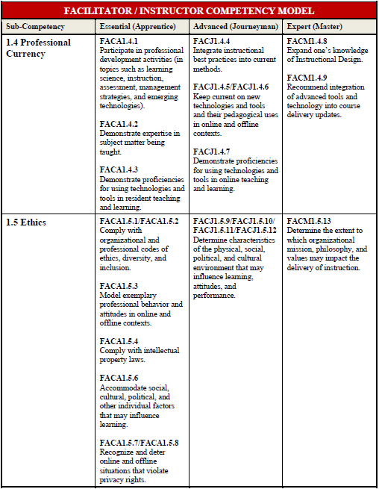
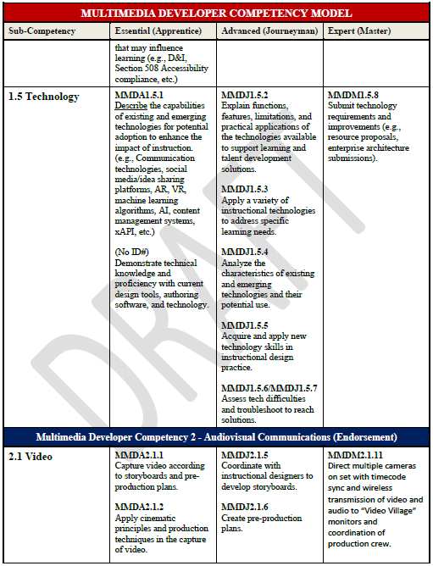
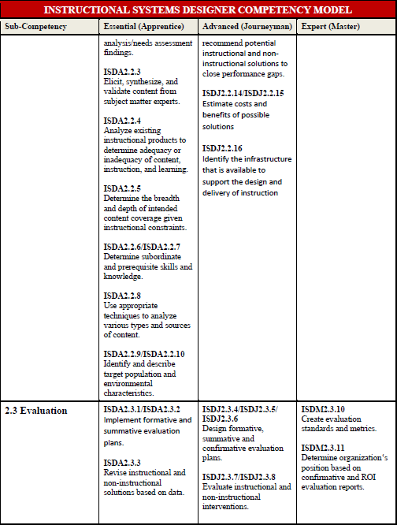
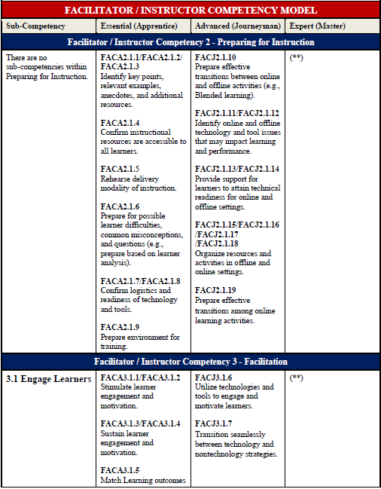
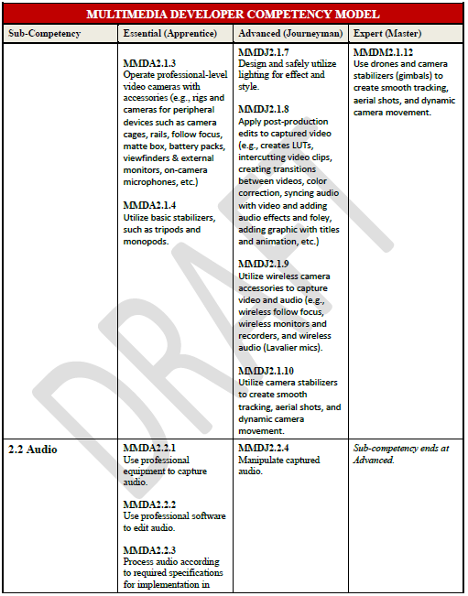
Development of Desired State
Instructional Designer
Instructor
Multimedia Developer
Notes:
The four tenants of MRL as described in our strategic document were not yet defined as measurable goals, which presented the charter with a challenge. The basis of every needs assessment is to identify the gap between the current and desired state, yet our desired state was not fully defined.
In order to identify performance gaps for upskilling opportunities, the Charter required a more prescriptive optimal state to measure the current state against. Therefore, a competency model approach was used to define the optimal state of performance, within each role, that leads to the *four tenets of MRL ( *major accomplishment).
The competency models were influenced by the:
• Organizational Strategy Documents
• US Air Force’s GS-1750 competency study structure
• International Board of Standards for Training competency (IBSTPI) models
• Association for Talent Development (ATD) Capability Model
• Various Higher Education Course Requirements & Curriculum
• USCG FORCECOM SOP Vol 13. Professional Development
• SME and AP Charter Members’ input
*NOTE: Since the MMD competency model includes modalities and/or interventions that we have not created internally, such as complex/interactive 3D models and AR/VR, these competencies still require further analysis and validation that exceeded the targeted scope and deadline of this analysis.

Slide 10
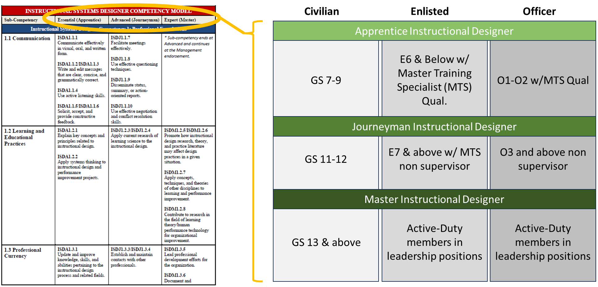
Continued Professional Development Ex.
Notes:
To encourage continued professional development throughout one’s career and to maintain currency with industry, the competency models were developed to show progressive skill acquisition from apprentice and journeyman through mastery.
The criteria for apprentice, journeyman, and master differ between the ISD, INST, and MMD competency models. The example on this slide shows the career profession of proficiency in skill throughout a FORCECOM staff member’s (GS, enlisted, and officer) career.
(The example on the screen is for instructional designers)

Slide 11
Findings: Instructional System Designers
Average ISD Competency Domain Gaps (N=71)
Program Management 50%
Project Management 49%
Resource Management 92%
Enterprise Technology 86 %
Training Development 31%
Technology 29%
Design 16%
Evaluation 36%
Analysis 16%
Data Collection 17%
Ethics 24%
Professional Currency 30%
Learning & Educational Practices 26%
Communication 18%
4/14
Domains w/ 40% or >
Performance Gap
+ Design/Analysis
- Tech Application
Notes:
We measured current state performance against the desired state competency models for each of the organization's roles. This level of detail can be harnessed as evaluation data to tailor upskilling efforts. The next three slides provide broad perspective of the organizations upskilling needs (regardless of a members proficiency level.
This slide shows the overall strengths and weakness of instructional designers within our training system. As you can see from the results, advances in tools and technology do not change the fundamental elements of design. Our upskilling efforts need to target an instructional designer's ability to integrate technology into instructional strategies and expanding their development skills using industry equivalent tools and technology.
It is important to note that management competencies are defined in all the competency models as endorsements, since they are specific to responsibilities of specific positions and therefor a defect is expected when looking at the data representing the entire sample population.
Historically, most of the performance standards within, 4.1 Enterprise Technology, fall with LMS Administrator roles and responsibilities

Slide 12
Findings: Instructors
Average Instructor Competency Domain Gaps (N=123)
Program Management 66%
Course Management 64%
Evaluating Instructional Effectiveness 60%
Evaluating Instruction 62%
Course Design Evaluation 62%
Classroom Management 23%
Promote Transfer 27%
Promote Retention 25%
Feedback 26%
Adapt Instruction 29%
Engage Learners 22%
Preparing for Instruction 32%
Ethics 41%
Professional Currency 50%
Learning & Educational Practices 43%
Emotional Intelligence 42%
Communication 40%
9/17
Domains w/ 40% or >
Performance Gap
+ Facilitation
- Evaluation
Notes:
Contradicting the current perception surrounding instructor upskilling gaps within the organization, the facilitation competency remains a strength among CG instructors.
The Facilitation Competency strength includes the domains 3.1-3.6. Many of the domains have performance standards that address skillsets in a resident or online training environment.
*Due to the increase in facilitated online training courses in the CG, it may be of interest to highlight that there was only about a 1-6% increase in performance gap, when comparing the differences between the results of resident facilitation performance standards to online facilitation performance standards.
The evaluation competency including 4.1-4.3 identify an opportunity for upskilling, while further investigating the causal factors that contribute barriers to course evaluation implementation.

Slide 13
Findings: Multi-Media Developers
Average Multi-media Developer Competency Domain Gaps (N=12)
Program Management 28%
Project Management 20%
AR/VR Developer 87%
Mobile Development 100%
Web Development 80%
Programing Languages 88%
3D Modeling 45%
Animation 40%
Web Design 29%
Design 3%
Typography 6%
Photography 0%
Audio 19%
Video 14%
Technology 49%
Ethics 44%
Professional Currency 44%
Design Thinking 44%
Communication 2%
10/19
Domains w/ 40% or >
Performance Gap
+ Photo/Video
- Mobile/AR/VR
/Programming
Notes:
Multimedia support directly impacts the development of a courses design. Traditionally multimedia develops are supporting instruction through photographs, infographics, and training videos. This data confirms that even if our ISDs design instructional strategies that harness the use of microlearning through apps, AR, VR, and AI…. The organization lack the development competencies and supporting resources.

Slide 14

Performance Gap Causal Factors
53 Total Causal Factors (CF)
Performance Dimensions
 | GOALS | DESIGN | MANAGMENT
ORGANIZATION | Alignment | (5 CF) | (3 CF)
PROCESS | (7 CF) | (8 CF) | (8 CF)
JOB | (5 CF) | (8 CF) Skills & Knowledge | (9 CF)
Levels of Performance
Notes:
Once the analysts qualified the gap in performance, the team conducted focus groups to identify the contributing causal factors beyond skills and knowledge.

Slide 15
Way Forward
Establish clear and adaptable competency models
Invest in comprehensive, structured professional development
Address multi-level causal factors
Notes:
Establish clear and adaptable competency models: Develop progressive competency models that evolve alongside career paths to ensure employees are encouraged and empowered to stay current and consistently upskill. This enables a workforce that is resilient and agile in the face of technological and organizational changes.
Invest in comprehensive, structured professional development: Prioritize and institutionalize regular, meaningful professional development programs. These programs should not be seen as optional, but as essential to fostering a culture of lifelong learning and growth, ensuring that employees remain relevant and equipped to meet future challenges.
Address multi-level causal factors: It is critical to address the causal factors that affect performance at the job, process, and organizational levels. By identifying and mitigating these issues, we can enhance the effectiveness of training and upskilling efforts, ensuring they align with the overarching goals of the organization.
Final Call to Action: "In closing, the MRL upskilling needs assessment has provided us with a roadmap to strengthen our workforce’s readiness. By establishing clear career progression pathways, investing in continuous development, and addressing key performance barriers, we can create a training ecosystem that supports both individual growth and organizational success. I encourage you to take these insights back to your teams and begin embedding them into your own strategic planning to ensure we are all ready for the future demands of our industry."

Slide 16
Q&A
Questions?

