Slide 1

A method to assess barriers to implementing training technologies:
A study of two cases in the Canadian Armed Forces
Blake Martin PhD, Defence Research and Development Canada
Jerzy Jarmasz PhD, Defence Research and Development Canada

Slide 2
Overview
Defence Research and Development Canada
Why a Barriers analysis?
What is a Barriers analysis?
What are the results?
Discussion

Slide 3
Choosing an Instructional Solution
How does one decide what solution to use for instruction?
Scientific study?
SME recommendation?
Clever sales pitch?
What about return on investment?

Slide 4
Choosing an Instructional Solution
Existing models and approaches:
Theory of Reasoned Action (TRA; Fishbein and Ajzen, 1975), Technology Acceptance Model (TAM; Davis, 1989), and the Unified Technology Adoption and User Theory (UTAUT; Venkatesh et al., 2003), System Usability Scale (SUS; Brooke, 1986)
Consideration of specific utility for instruction
Cognitive load theory (Chandler and Sweller, 1991)
Instructional Affordances (Bower, 2017), both intended and unintended
Consideration of the ‘instructional ecosystem’
The lesson of Exercise Virtual

Slide 5
Barriers to Implementing Training Technology:
Based on literature examining failure to implement instructional technology (Reid, 2014)
Major categories:
Technology
Process (added Collective Training sub-category)
Administration
Environment
Training Stakeholders (originally ‘Faculty’)

Slide 6


Good and Bad Technology:
created with chatGPT

Slide 7
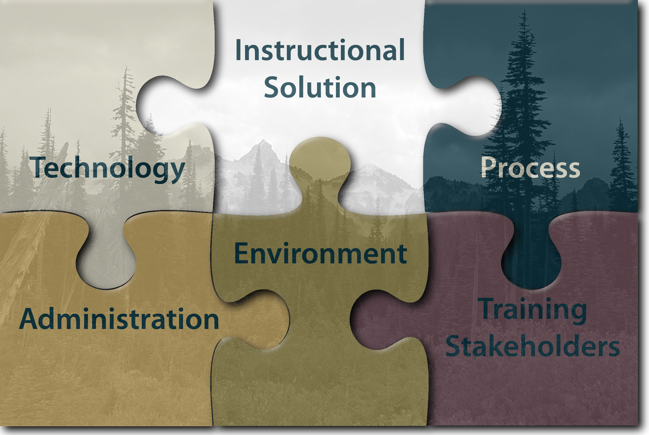
The Ideal Learning Ecosystem

Slide 8
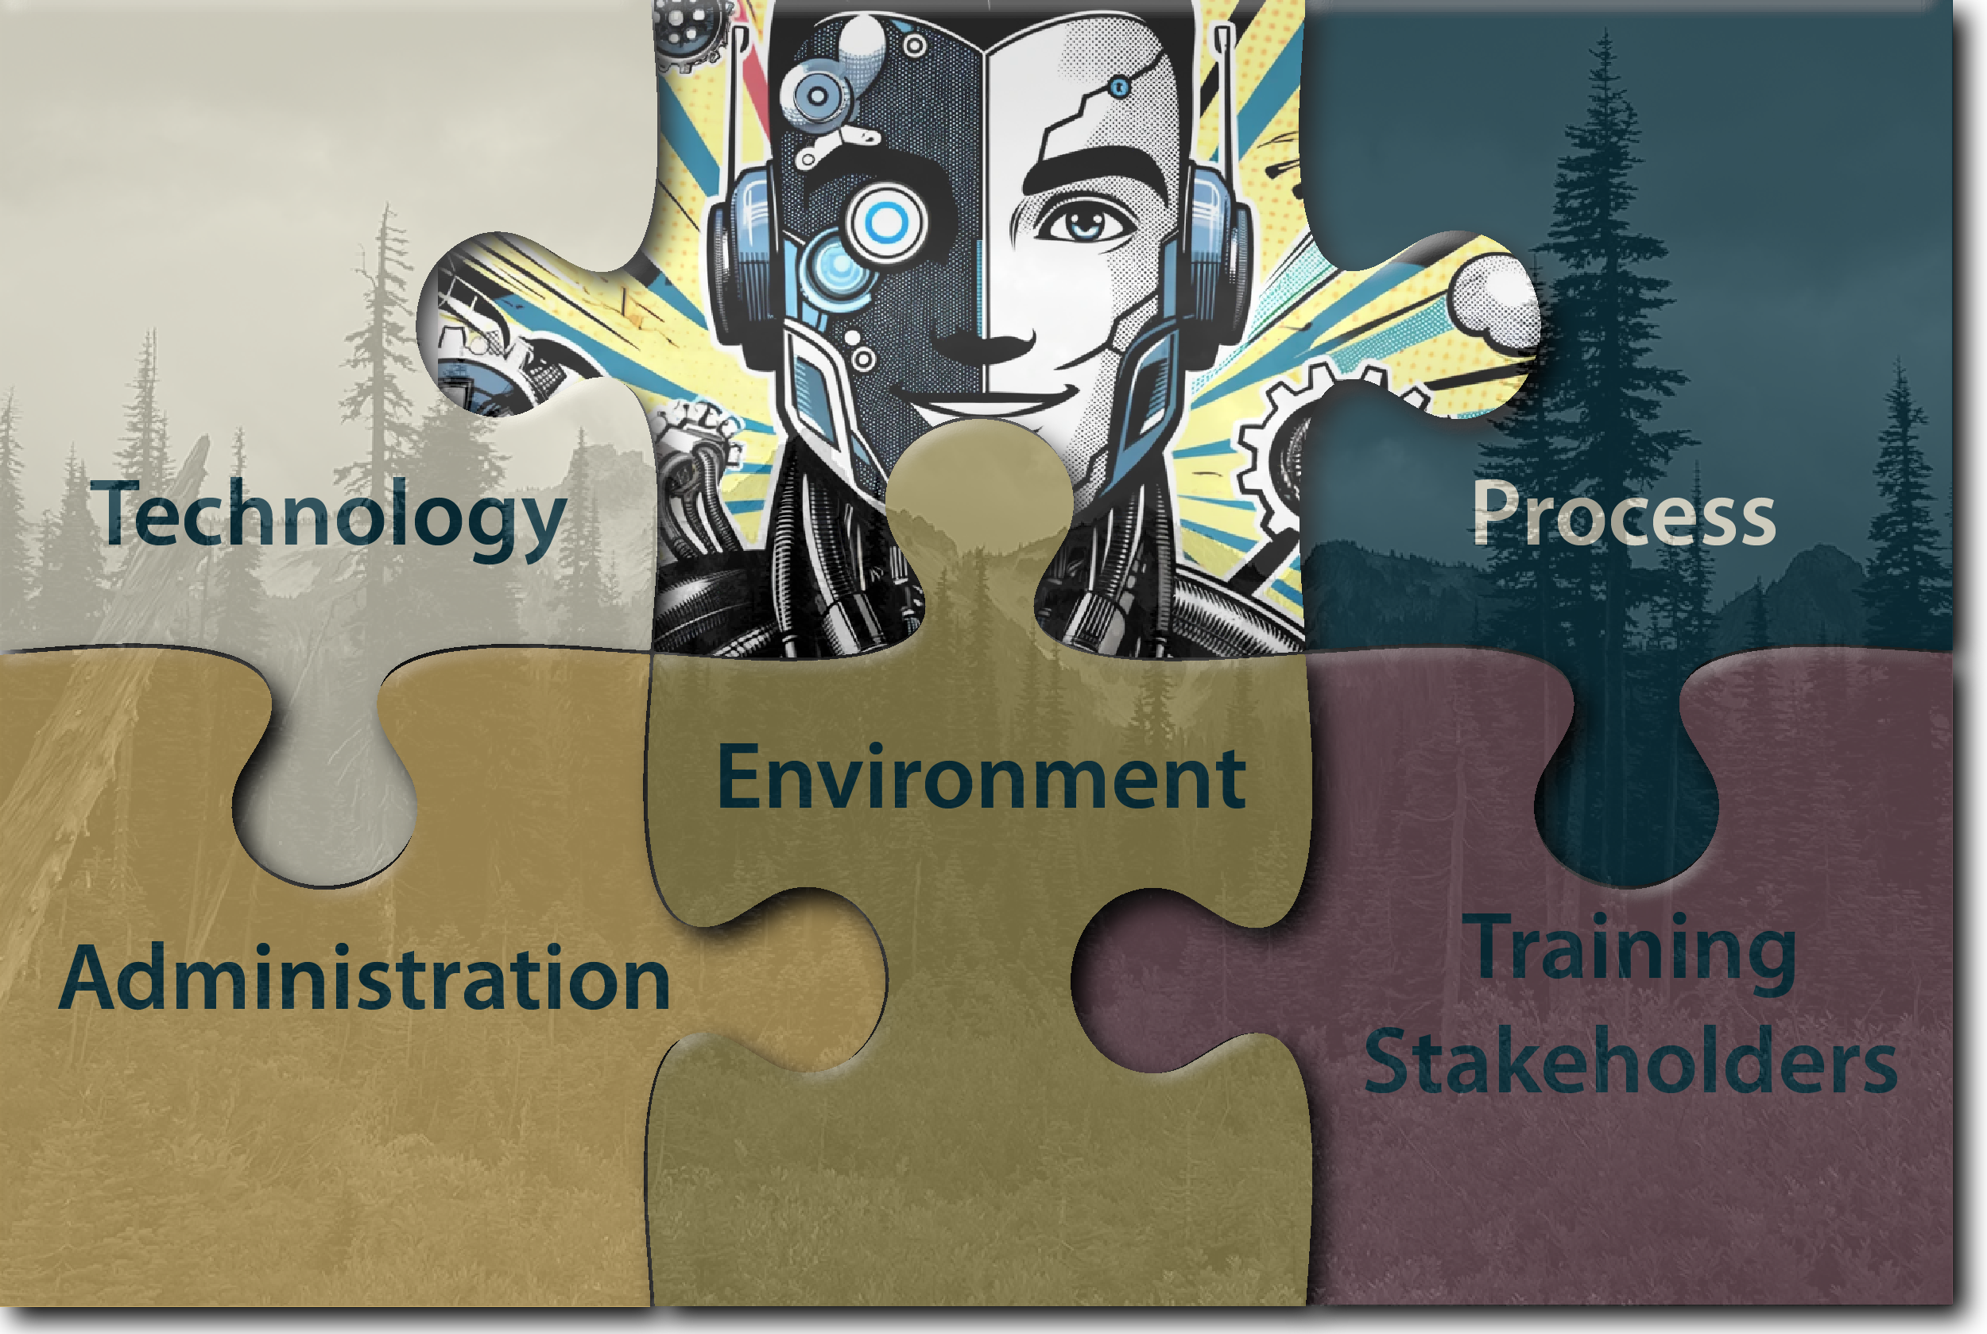
A Good Technology in an Ideal Ecosystem

Slide 9
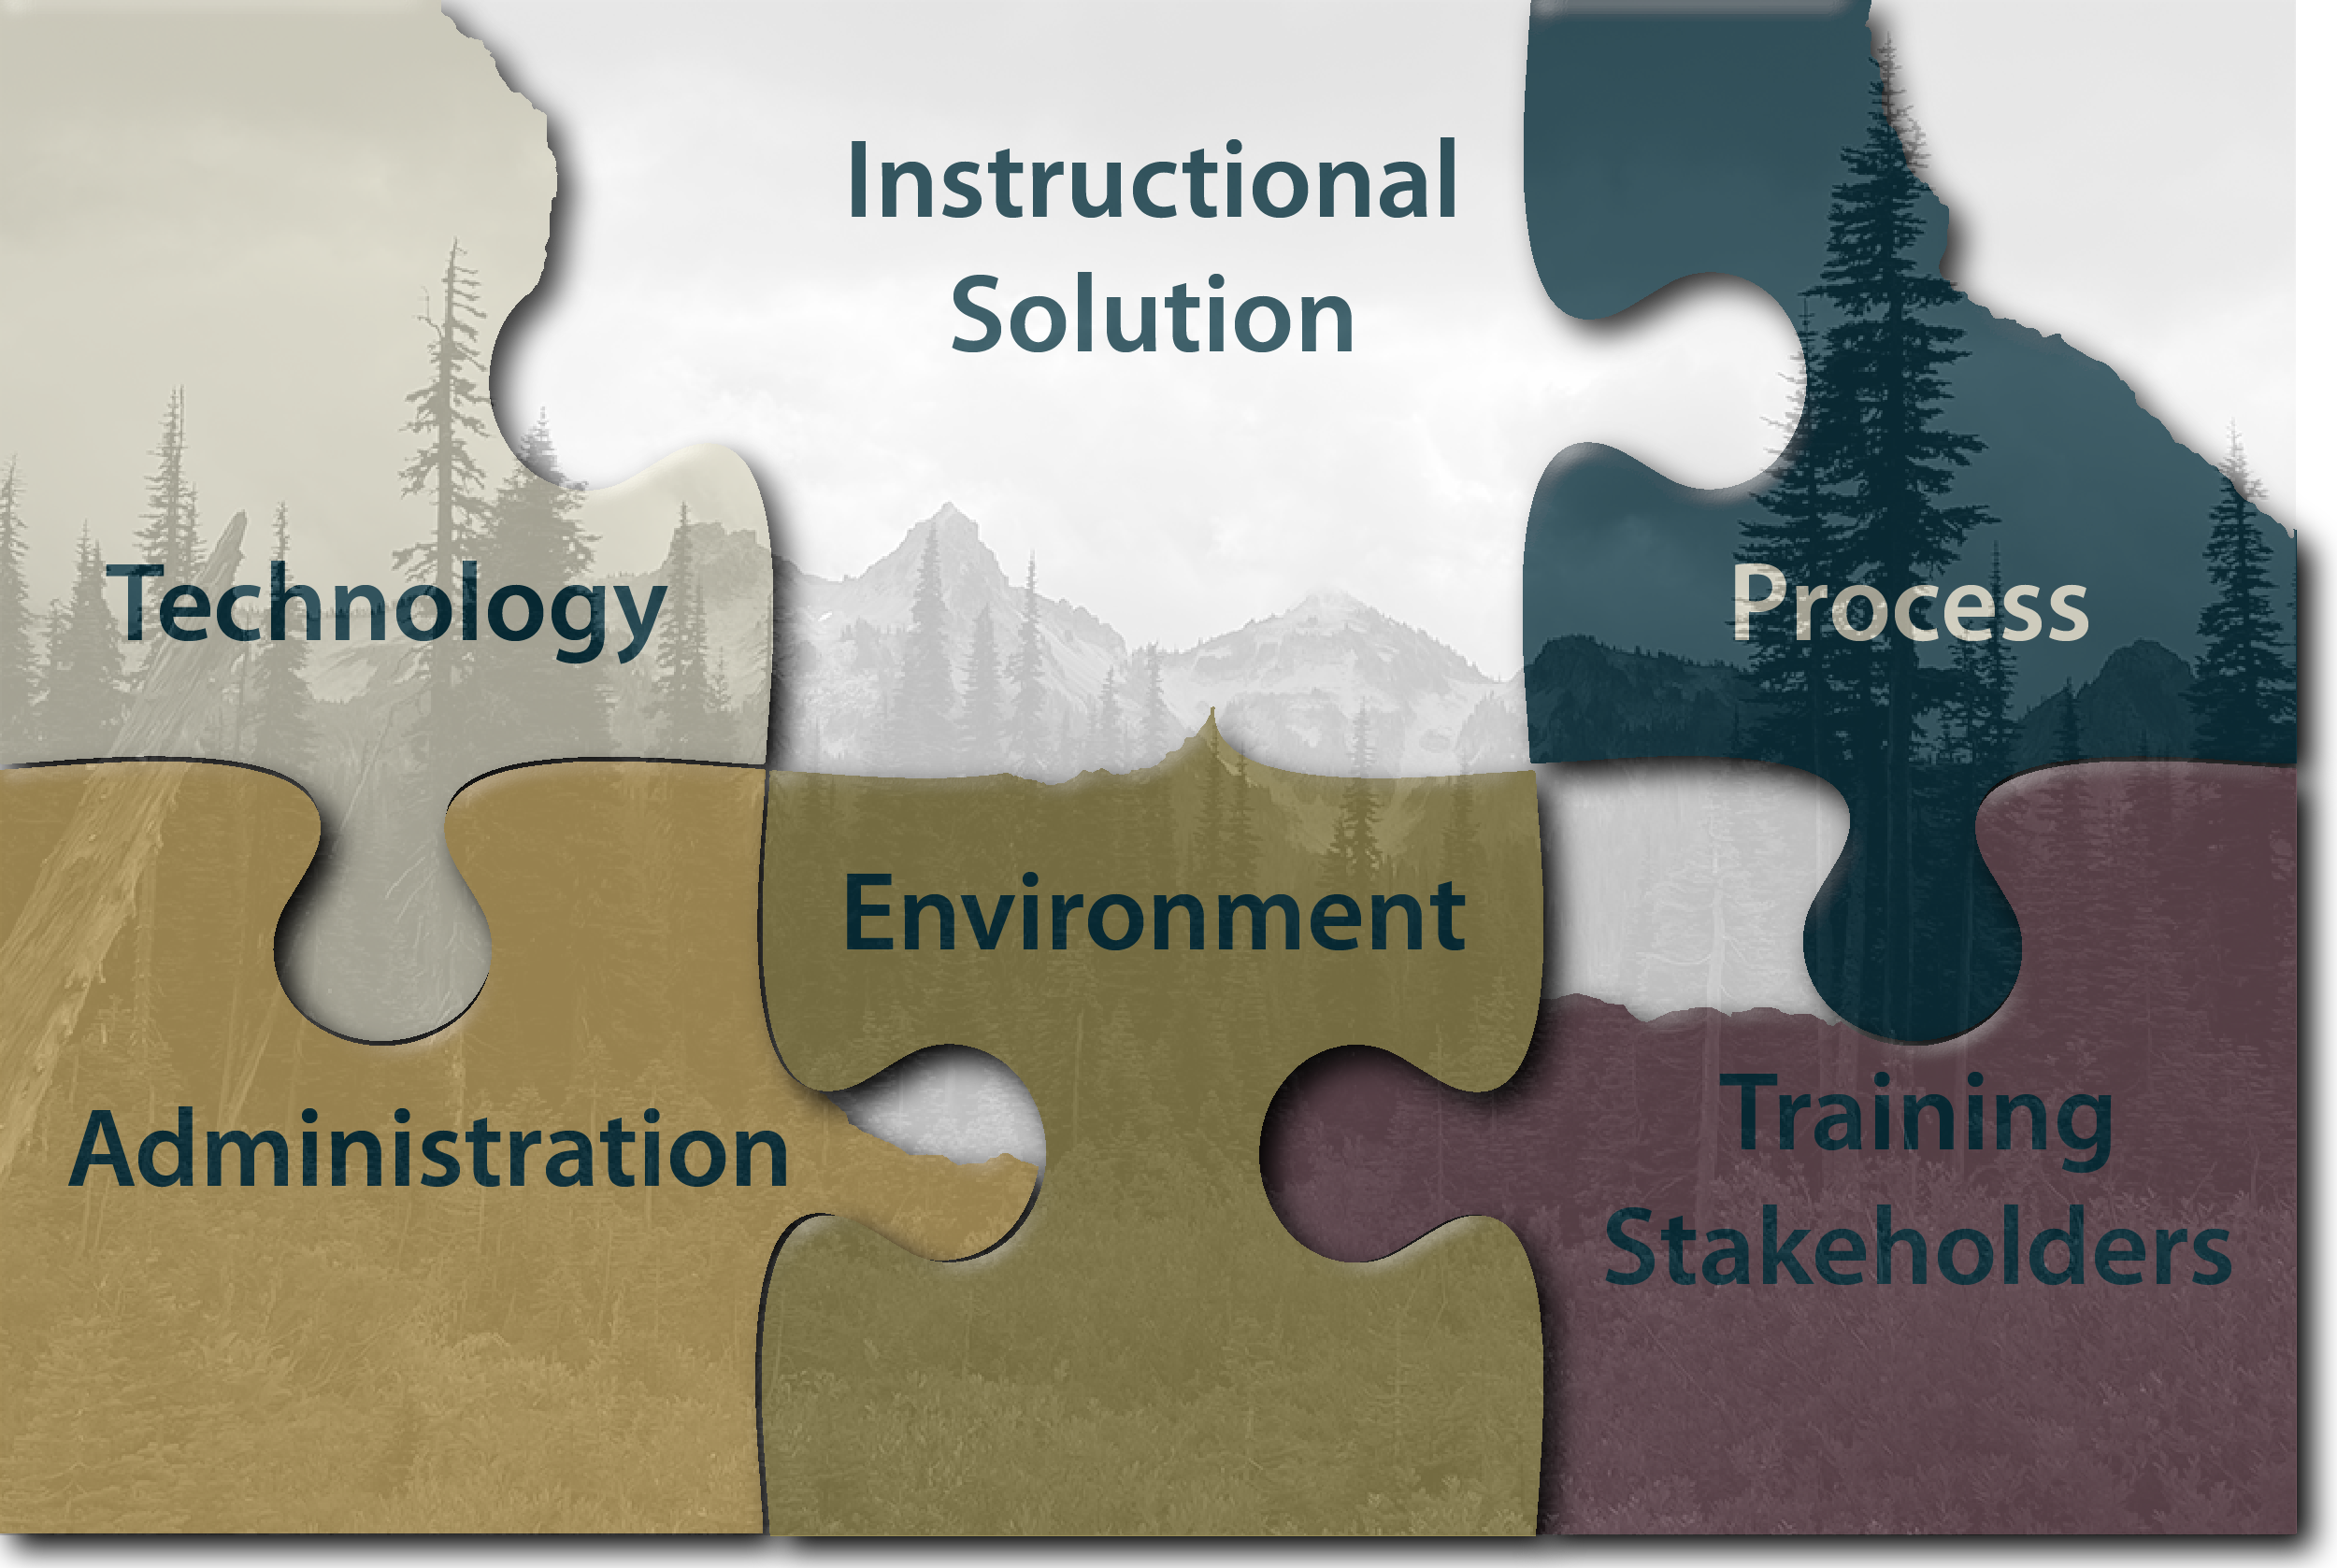
A Typical Instructional Ecosystem

Slide 10
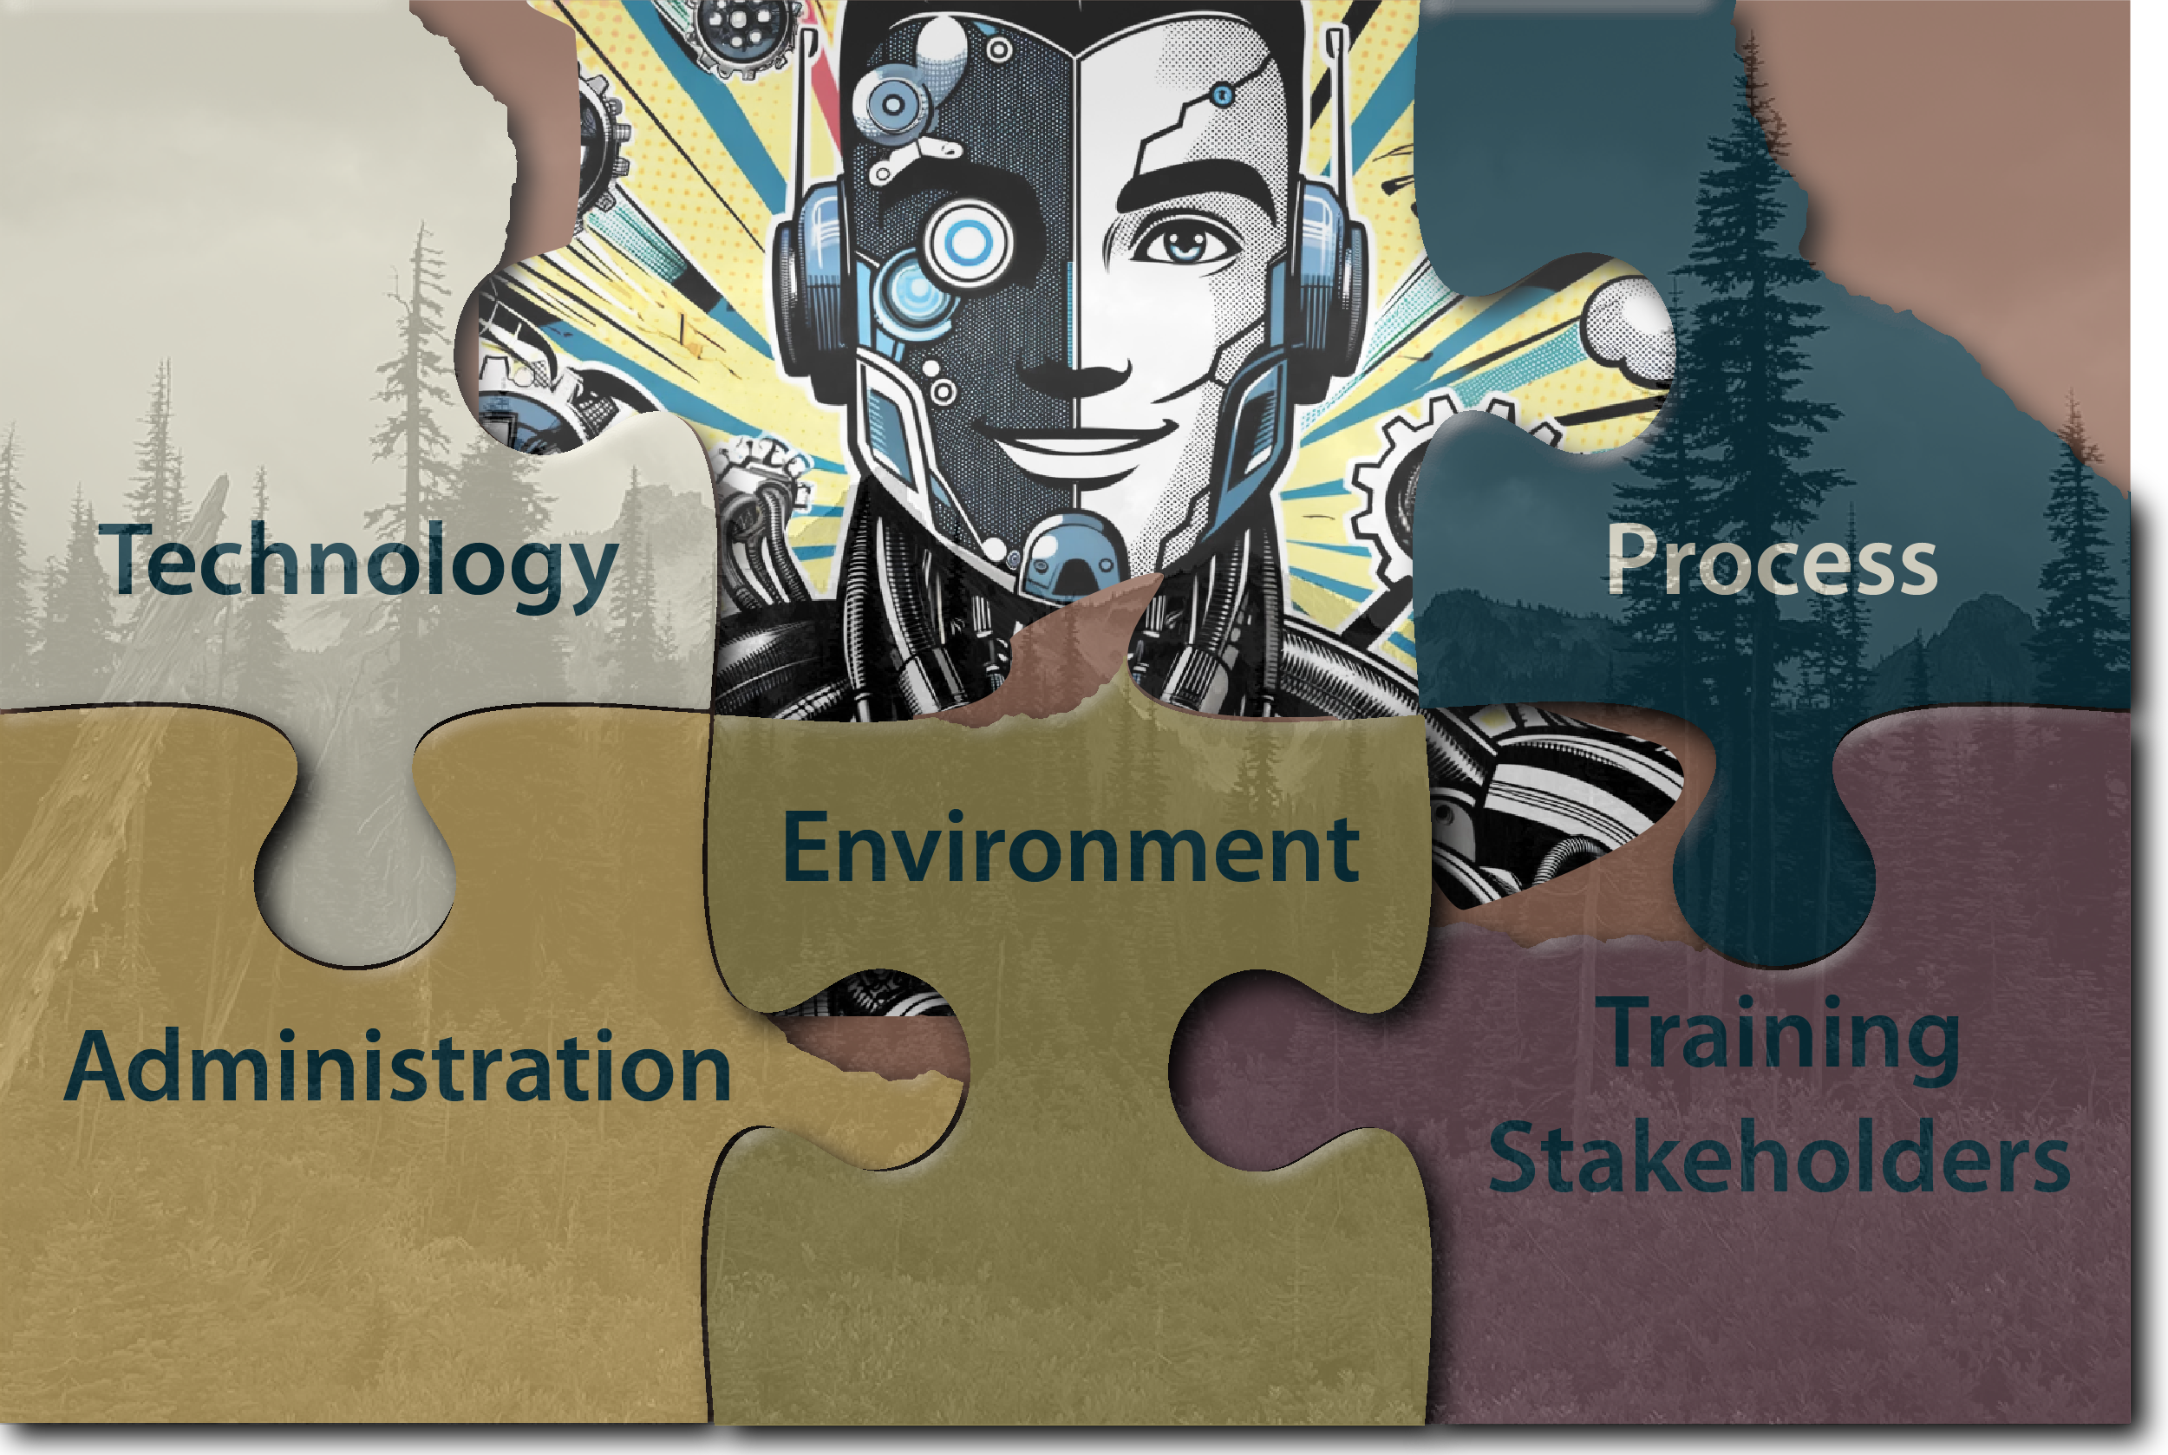
Stretching Instructional Solutions Into the Gaps

Slide 11
Barriers Methodology Development
Created Questionnaire
Technology
Process
Administration
Environment
Training Stakeholders
Further subdivided into minor categories
Two-day focus group
Day 1: Technology Introduction, Use Cases, Key Functionalities
Day 2: Barriers questionnaire, Open-Space Forum

Slide 12
Barriers Methodology Development
Applied to two major capital acquisitions for Canadian Army
Solution 1: 4 locations, 56 participants
primary training audience, instructors, training development officers, technical personnel and those involved in oversight of training
ranking from Private to Captain.
Solution 2: 3 locations, 49 participants
primary and secondary training audience learners, Observer Controller Trainers (OCT), Observer Analysts (OA), Combat Support Services (CSS) personnel, technical personnel, training leaders, exercise planners, site service management personnel and others, and ranged in rank from Private to Lieutenant Colonel
Both solutions had one collection in French only

Slide 13
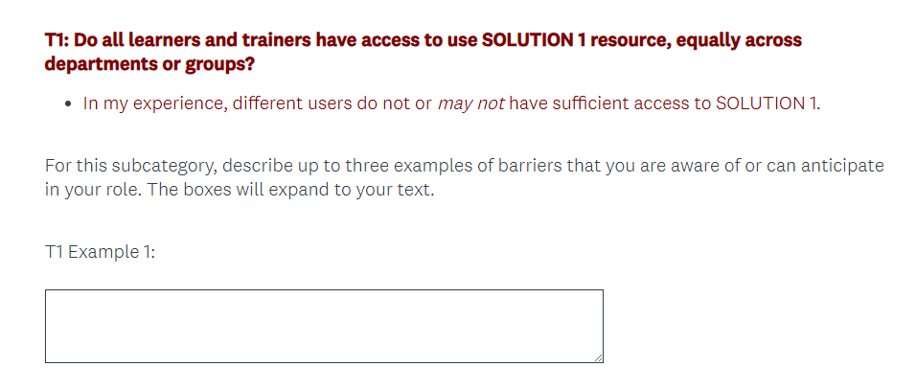
Barriers Questionnaire

Slide 14
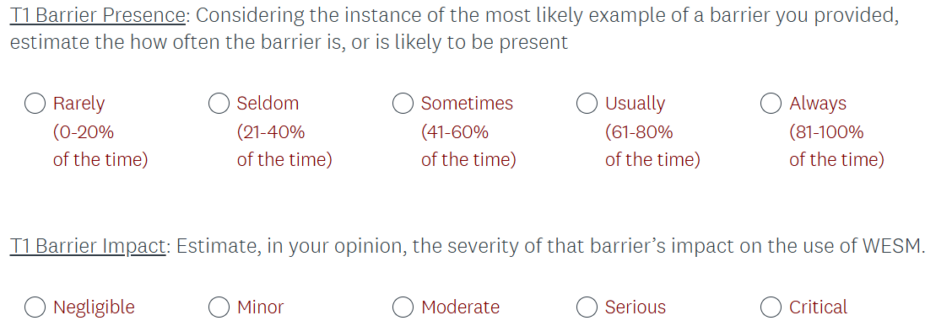
Barriers Questionnaire

Slide 15
Barriers Questionnaire

Slide 16
Likert Analysis
Likert items scaled from 1-5
Presence score of “5” means the Barrier was always present
Impact score of “5” means the Barrier imposed critical impact on delivery

Slide 17
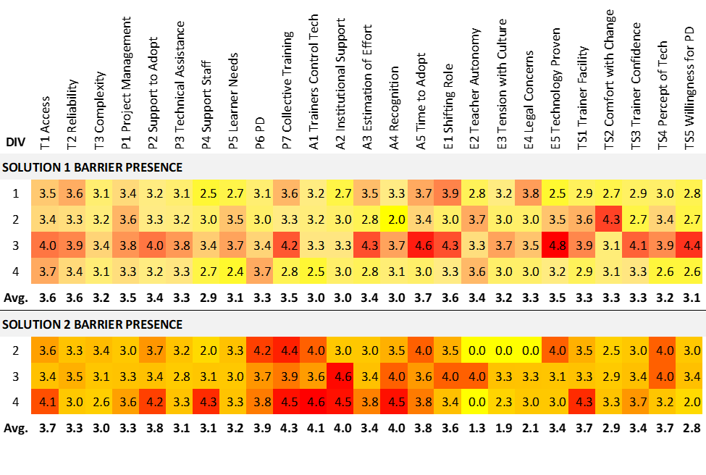
Likert Analysis: Barrier Presence by Division

Slide 18
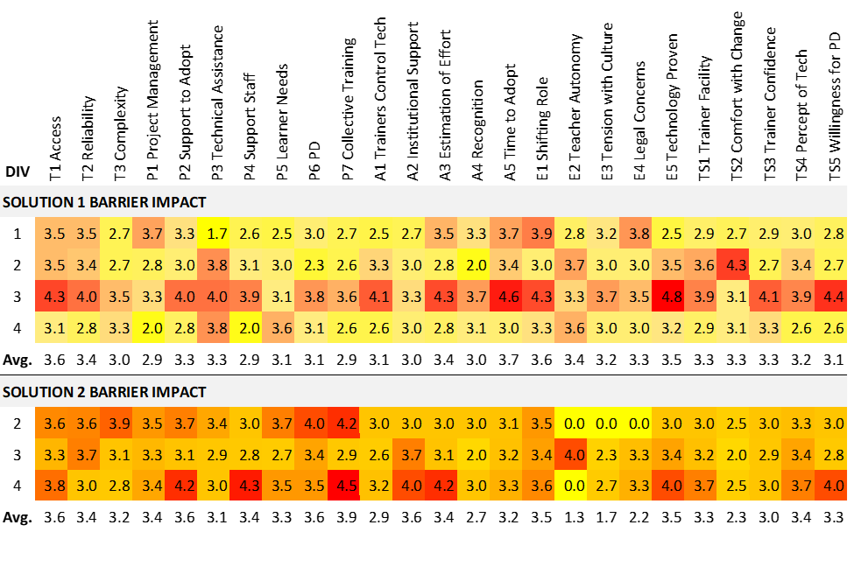
Likert Analysis: Barrier Impact by Division

Slide 19
Open Answer Analysis
All references coded by Barrier subcategory
Some items coded into more than one category
Subsequently, references placed into themes inductively
Grounded Theory approach (Singh & Estefan, 2018)

Slide 20
Barrier References: Category by Technology
 | Sol. 1 | % | Sol. 2 | %
Technology | 116 | 24.3% | 241 | 32.0%
Process | 169 | 35.4% | 245 | 32.6%
Administration | 65 | 13.6% | 114 | 15.2%
Environment | 50 | 10.5% | 54 | 7.2%
Training Stakeholder | 77 | 16.1% | 98 | 13.0%
Total | 477 |  | 752

Slide 21
Categorizing Barrier Items
T1 Access
“Our unit always gets bumped by other units.”
“The kit is located too far away from us to ever use.”
P4 The presence and availability of support staff
“We can never get the Edmonton support staff out here.”
“Support staff are only for Reg Forces. Reservists are out of luck.”

Slide 22
Categorizing Barrier Items into Themes
Priorities
“Our unit always gets bumped by other units.”
“Support staff are only for Reg Forces. Reservists are out of luck.”
Centralization/Location
“We can never get the Edmonton support staff out here.”
“The kit is located too far away from us to ever use.”

Slide 23
Solutions Based on Themes
Priorities
Difficult to change
Define priorities to be perceived as equitable
Mitigated with Request for Proposals
Develop a better scheduling tool to improve access
Specify support contract that includes Reservist schedules

Slide 24
Solutions Based on Themes
Centralization/Location
Difficult to change
Geographical size of Canada
Locations of units
Mitigated with Request for Proposals
Smaller scale kit for all units
Decentralization of kit infrastructure
Contract specifies training CAF members as first line techs

Slide 25
Themes: Solution 1
Time Scarcity (Op Tempo, Scheduling, Real-time constraints, Personnel time)
System reliability (maintenance, supply chain/procurement, computer problems)
Personnel (expertise and specialization: Technical, Pedagogical, Content)
Communications (Acceptance and Buy-in, Familiarization, Information Management)

Slide 26
Themes: Solution 2
After-Action Review and Learning Data Access and Content
Restrictive Administration and Stewardship
Contracting Constraints
Infrequent Use vs System Familiarity, Training Application, Acceptance and Buy-In
Sufficiency
Succession and Posting

Slide 27
Limitations
Categories may be impossible to validate
Not all ‘ecosystem’ members represented
Data collection is long and complex
Repeatability
Data analysis requires domain, pedagogical, and content knowledge

Slide 28
Future Directions
Standardizing and streamlining data collection
Possibility of abbreviated survey
Use of large language models and machine learning

Slide 29
Conclusions
Research methods reveals significant barriers in ecosystem
Generates actionable insights
Discriminates between technologies and locations using tech
Might be used to perform wholistic analysis of training ecosystem

Slide 30
Thank you!
Questions?
blake.martin@forces.gc.ca

