Slide 1

Interaction Design for Binary Reverse Engineering in Virtual Reality
Presenter: Dennis G. Brown
Contributors: Julian C. Bauer, Kevan D. Baker, Luke J. Wittbrodt, Dr. Samuel Z. Mulder
Dept of Computer Science & Software Engineering

Slide 2

BLUF
Applying a hybrid DT/CSE framework to address cognitive limitations:
  CSE provides solid foundation and start to UCD process
  DT ensures user-focused continuous refinement
Discover: Performed indirect Cognitive Task Analysis and Stakeholder Analysis to identify salient elements
  Cognitive limitations of task (empirical, theoretical)
  UI affordances that may remediate limitations based on theory
Define: Synthesized three primary themes from discovered elements to inform initial backlog of requirements
Develop → Deliver: Build, test, feedback, repeat
Validation: User study planned to start Jan 2025
WIP video

Slide 3
Outline
Our Problem
User-Centered Design Approach
Discovery and Definition
  Literature Survey
  Stakeholder Analysis
  Synthesis on Themes
  Prioritized Affordances
Development and Delivery
  Iteration 1 (MVP) Implementation and Feedback
  Iteration 2 status
Validation: Proposed User Study

Slide 4
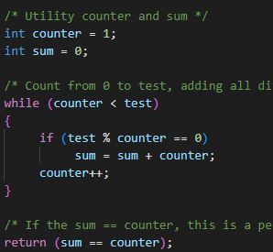
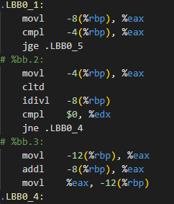
Our Problem
Reverse-engineering (RE) binary software—aka binary program comprehension or understanding—is critical to maintaining legacy systems and to cybersecurity
Binary RE is difficult! All context from source code is lost
  Compounded uncertainty going from binary → disassembly → low-level decompilation → higher-level structures
ONE WAY

Slide 5
General Approach
Investigate augmenting the cognitive process of RE practitioners
  Specifically, reducing cognitive complexity via employment of virtual reality affordances in an immersive environment
Being a cross-discipline problem increases the complexity of this approach:
  Software reverse engineering and program understanding
  Cognition and Cognitive modeling; sensemaking
  Human-Computer Interaction

Slide 6
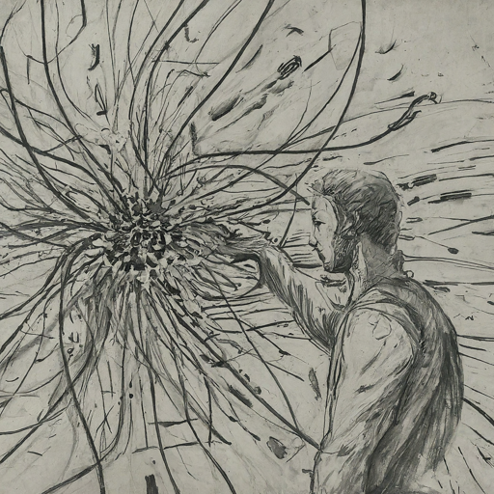

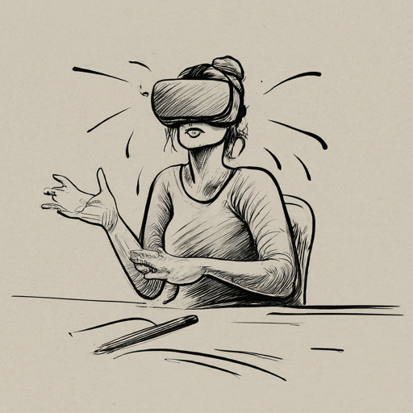
User-Centered Design Approach
Apply Cognitive Systems Engineering (CSE) and Design Thinking (DT) in parallel to provide a highly usable experience with a very complex system
Cognitive Systems Engineering
improve human interaction with complex systems based on cognitive analysis
improve user experience based on human-centered design and iteration
Design Thinking

Slide 7
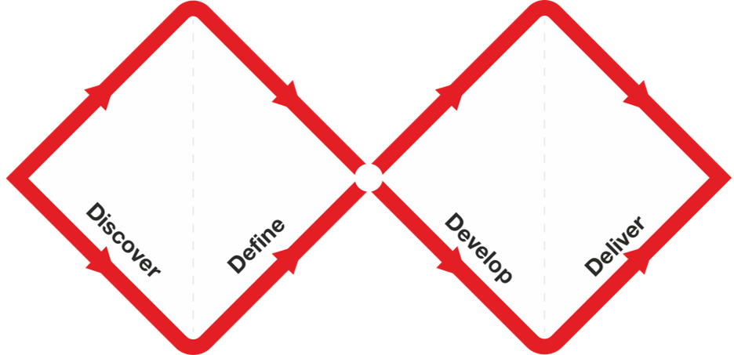

User-Centered Design Approach
Apply Double Diamond as our overarching Design Thinking approach, iterating the right-side diamond
Attribution: The Double Diamond by the British Design Council [CC-BY-4.0] https://www.designcouncil.org.uk/our-resources/the-double-diamond/

Slide 8
User-Centered Design Approach
Discover | Define | Develop | Deliver
Indirect Cognitive Task Analysis via literature survey | Synthesis of survey findings into themes | Inform iteration requirements | Ensure system is ready for user study
Understand problem context | Prioritize VR affordances for Binary RE | Build initial requirements backlog | Build VR MVP, get feedback, iterate
Stakeholder Analysis | Integrate SA with CSE Synthesis | Brainstorm iteration requirements | Build and test
CSE
Hybrid
DT

Slide 9
Discover: Survey
Literature Survey as a composite and indirect Cognitive Task Analysis
Searched, filtered; analyzed 85 matching publications
Identified distinctive and relevant elements in 3 successive areas:
  Cognitive models of software Reverse Engineering: 15 elements
  Related cognitive phenomena: 15 elements
  VR affordances that can affect those phenomena: 24 elements
Resulting elements to be discussed in “Define” section coming up

Slide 10
Discover: Stakeholder Analysis
RE Workflow - “as-is”
  Created composite workflow for basic and advanced static analysis from inputs of several practitioners
Empathy Map - impacts of the “as-is”
  What practitioners Say, Think, Do, and Feel executing the workflow
Contextual Inquiry - “to be”
  Brainstorming capabilities of an immersive RE tool

Slide 11
Define
Identify threads, via affinity mapping, that link the elements from the three categories of the Survey
Cluster the threads into themes
Prioritize VR Affordances
Integrate findings from Stakeholder Analysis

Slide 12
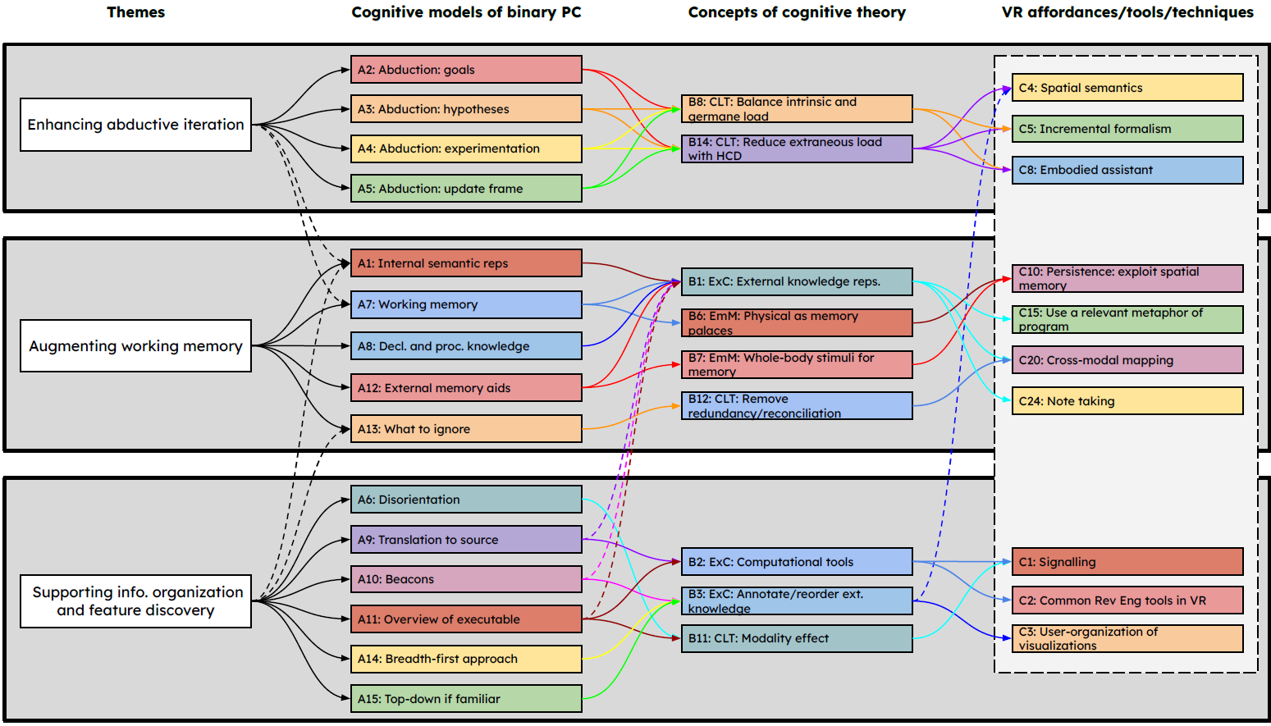
Define: Themes of Threads

Slide 13
Develop → Deliver
Approach:
  Execute multiple iterations of the “Develop → Deliver” diamond
  Start with a “minimally viable product” (MVP) with basic interactive features that facilitate a very bare-bones RE process
  Get feedback to drive improvements to each successive iteration
  Goal is to build a system ready for a formal effectiveness study

Slide 14
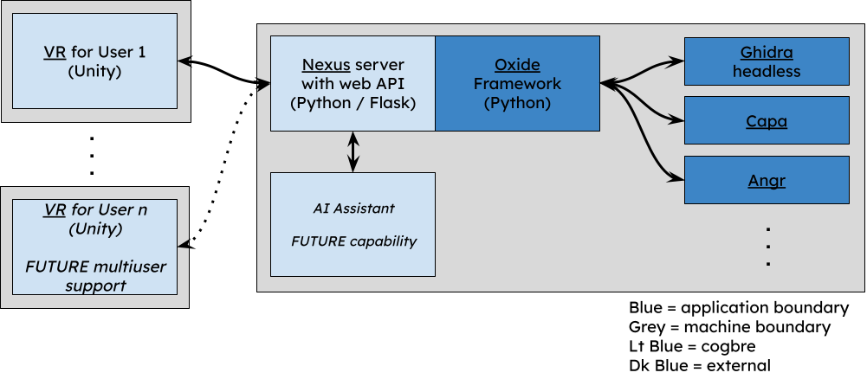
Iteration 1: MVP Architecture

Slide 15
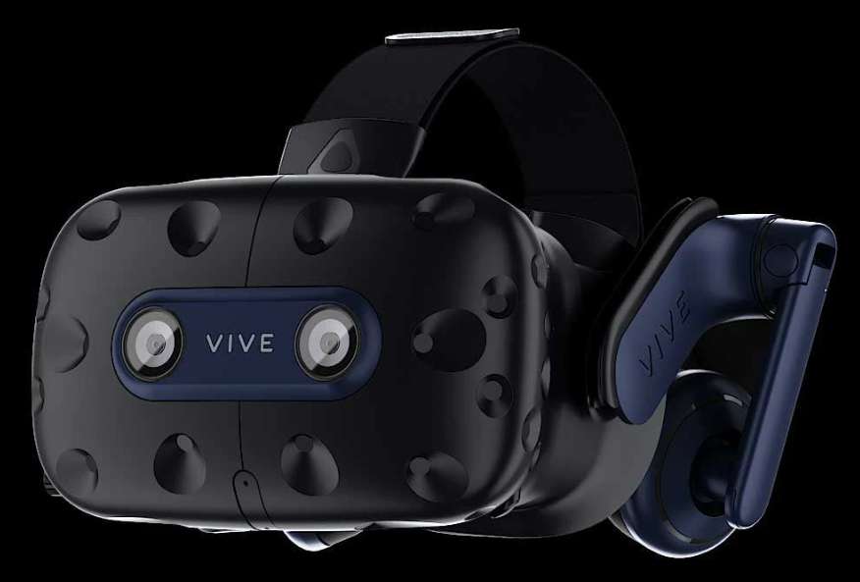
MVP VR Considerations
Provides fully immersive VR experience
  Developed in Unity + MRTK2
  Targets SteamVR devices
    HTC Vive Pro 2 HMD: high res and FOV
Maintains interactive frame rate at all times
  Leverages multithreading and coroutines
Minimizes size of client session state
  Nexus fills that role
    Minimizing VR state reduces exposure to state sync errors
  Leverages Oxide’s smart caching
  Streamlined + on-demand pulling of session state

Slide 16
MVP Affordances
Theme | Affordance | MVP Implementation
1. Enhancing abductive iteration (hypothesis loop) | C4. Spatial semantics (understanding) | Hierarchical (Sugiyama) graphs of function calls and control flow
 | C5. Incremental formalism | User can manually explore Call Graph → CFG → Code
 | C8. Embodied assistant | (not yet)
2. Augmenting working memory | C10. Persistence: exploit spatial memory (remembering) | Environment provides basic tools for user-managed placement
 | C15. Use a relevant metaphor of program | Basic hierarchical (Sugiyama) graphs only
 | C20. Cross-modal mapping | (not yet)
 | C24. Note taking | (not yet)
3. Supporting information organization and feature discovery | C1. Signalling | (not yet)
 | C2. Common Rev Eng tools | Exploit via chain of Nexus → Oxide → Ghidra
 | C3. User-organization of visualizations (expressing) | Create, Move, Delete slates and graphs arbitrarily in 3D space

Slide 17
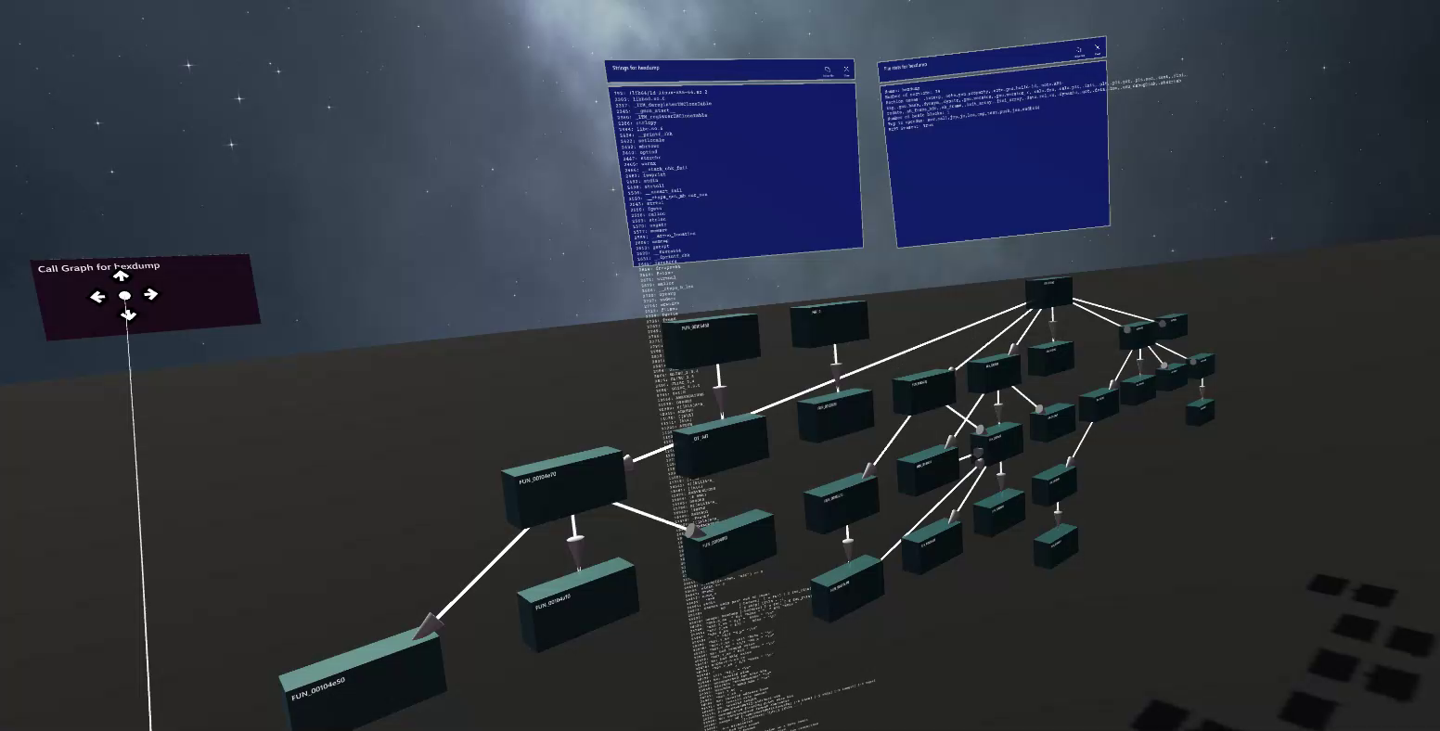
MVP VR Affordances

Slide 18
MVP Feedback
In-person discussions with the VR system as a probe
Ask questions about usefulness of the tool and suggested improvements
Make observations
  What did they say?
  What did they do?
  What did they think?
  How did they feel?

Slide 19
MVP Feedback
What did they say?
  “It’s fun”
  “Why is everything blue?”
  “Easier to use than videos implied”
  “This flexibility doesn’t exist in current tools”
What did they do?
  Learned how to navigate and interact with objects with little-to-no assistance
  Tried all features for multiple files and functions
  Struggled with very large graphs and small text
What did they think? -- (next slide)
How did they feel?
  Avoids VR due to nausea, but didn’t feel nauseous in this case
  Felt guided by the options presented in the program

Slide 20
MVP Feedback
Would you use this tool as-is when trying to comprehend a binary program?
  1 Yes; 2 Maybe; 2 No
What is better in the VR environment than tools and processes you usually use?
  Bigger space to work in
  More intuitive than 2D tools
  Open multiple programs at once
What is worse?
  Readability, both with HMD resolution and text angle
  Can’t make annotations or take notes
  Missing ability to edit: fix disassembly errors, rename variables, etc.
Solicited ideas for minor and major improvements
  Usability & QoL improvements
  Access to more features of analysis tools

Slide 21
Iteration 2 Affordance update
Theme | Affordance | MVP Implementation
1. Enhancing abductive iteration (hypothesis loop) | C4. Spatial semantics (understanding) | Hierarchical (Sugiyama) graphs of function calls and control flow
 | C5. Incremental formalism | User can manually explore Call Graph → CFG → Code
 | C8. Embodied assistant | (not yet)
2. Augmenting working memory | C10. Persistence: exploit spatial memory (remembering) | Environment provides basic tools for user-managed placement
 | C15. Use a relevant metaphor of program | Basic hierarchical (Sugiyama) graphs only
 | C20. Cross-modal mapping | (not yet)
 | C24. Note taking | Notepad
3. Supporting information organization and feature discovery | C1. Signalling | Call graph node colors and markings indicate Capa findings
 | C2. Common Rev Eng tools | Exploit via chain of Nexus → Oxide → Ghidra
 | C3. User-organization of visualizations (expressing) | Create, Move, Delete slates and graphs arbitrarily in 3D space

Slide 22
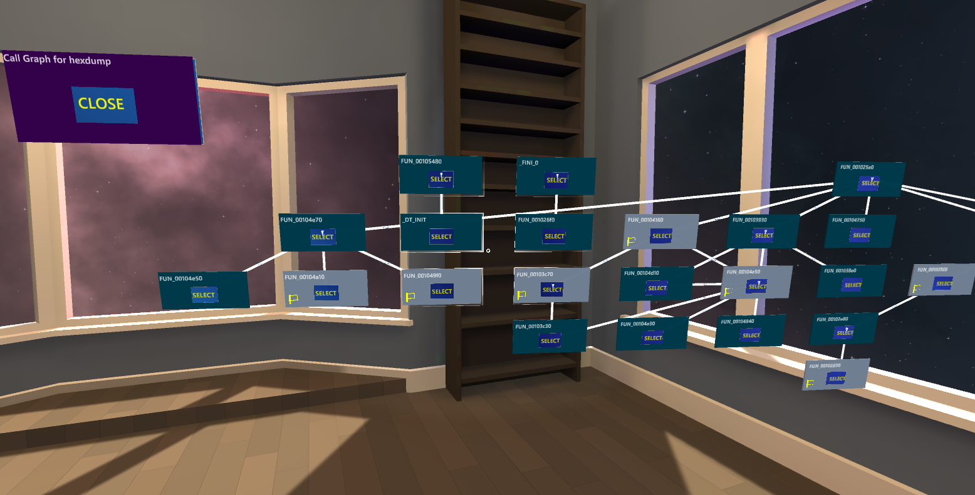
Iteration 2

Slide 23
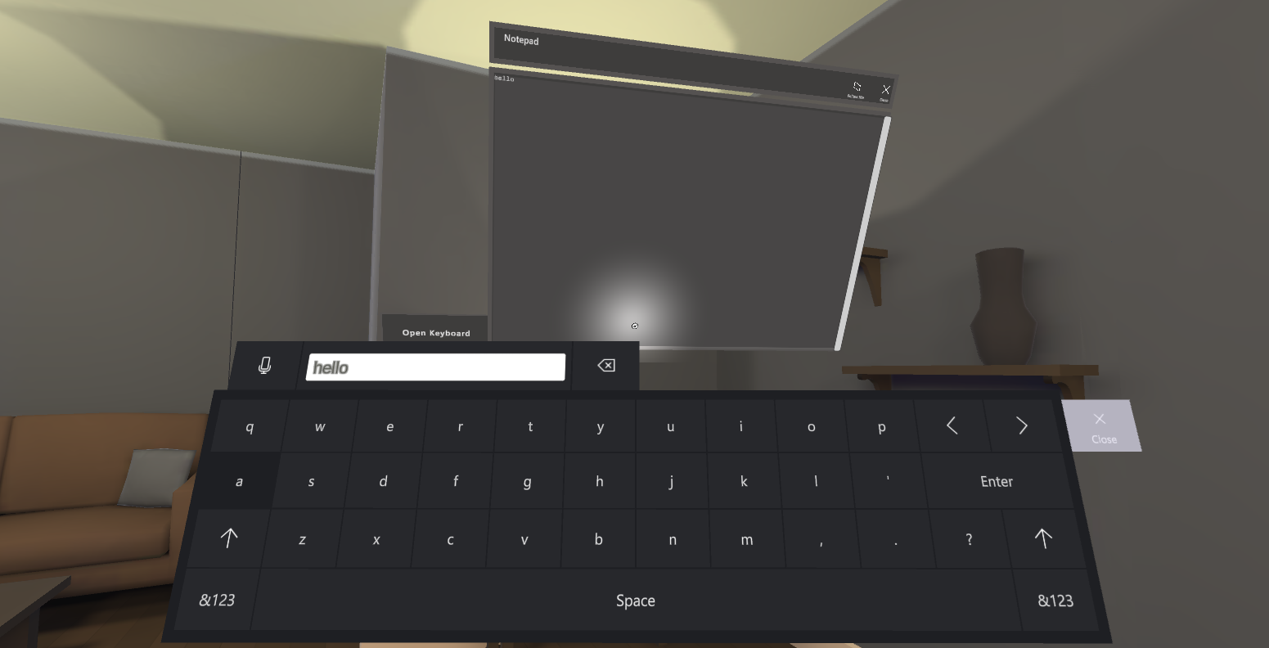
Iteration 2

Slide 24
FUTURE User Study Hypotheses
Hypotheses:
Participants will have better task completion metrics with certain levels of affordances in VR.
Cognitive load will vary by level of affordances in VR.
Participants will rate certain affordances in VR (e.g., user organization, spatial memory, signalling) higher than others in terms of usefulness.
Participants who have better performance in the immersive environments will have used more of the VR space.

Slide 25
FUTURE User Study Conditions
Conditions (choice of condition is independent variable):
Traditional desktop tools
Basic VR environment -- to compare against environment 1
Advanced VR environment -- to compare against environment 2
Participants will solve an RE challenge in their assigned environment. Sessions are expected to last 30 minutes and capped at 60.
The exact configurations of these environments are still to be determined through further refinement.

Slide 26
FUTURE User Study Measures
Dependent variables:
Task performance metrics (e.g., accuracy and speed)
System usability (survey: System Usability Scale (SUS)) [Brooke 1996]
Cognitive load (survey: NASA Task Load Index (TLX)) [Hart 1986]
Immersiveness (survey: Presence Questionnaire) [Witmer, Jerome, Singer 2005]
VR feature rating (survey: bespoke Likert)
VR activity patterns (logging)

Slide 27
FUTURE User Study Participants
Recruiting from Auburn student population; primarily CSSE
Expect medium-to-high magnitude of differences (est d=0.7) [Cohen 1969]
Will analyze the results using Analysis of Variance (ANOVA) (3 groups)
With statistical power = 0.8, significance level ⍺= 0.05, and d =
0.7, power analysis shows we need 18 samples per condition
  Need 54 total valid sessions---will recruit 70 participants
Two similar studies of testing VR for program comprehension in three conditions had numbers of participants in this same range [Romano 2019, Hoff 2022]

Slide 28
Conclusion
Applying a hybrid DT/CSE framework to address cognitive limitations:
  CSE provides solid foundation and start to UCD process
  DT ensures user-focused continuous refinement
Discover: Performed indirect Cognitive Task Analysis and Stakeholder Analysis to identify salient elements
  Cognitive limitations of task (empirical, theoretical)
  UI affordances that may remediate limitations based on theory
Define: Synthesized three primary themes from discovered elements to inform initial backlog of requirements
Develop → Deliver: Build, test, feedback, repeat
Validation: User study planned to start Jan 2025
WIP video

