Slide 1

Surpass the Adversary
Enhanced Mission Training through Digital Engineering
Viruben Watson, Thales Australia

Slide 2
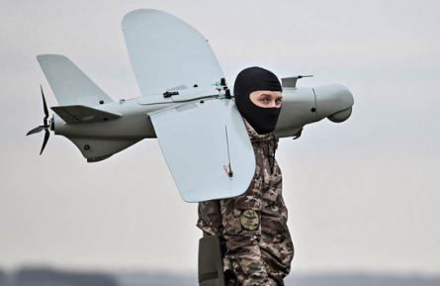
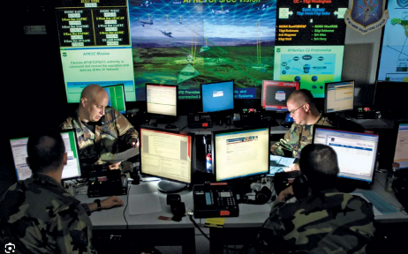

A Changing Strategic Environment
Novel technologies shifting the nature of warfare
Changing strategic environment

Slide 3
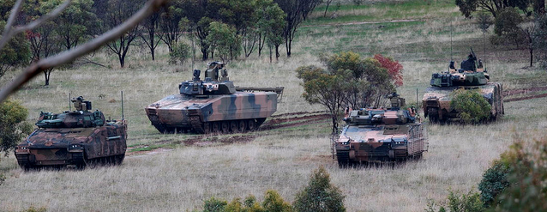
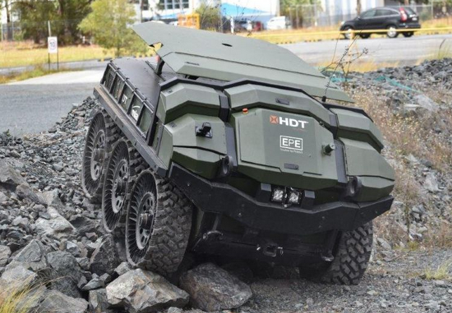
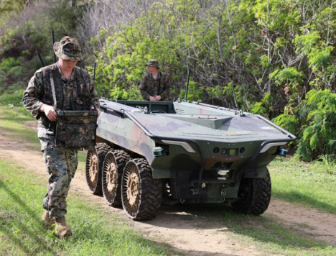
A Changing Strategic Environment
Training using Crewed Tactics
Novel Autonomous Platform
Balance of both
Training on use of Uncrewed Systems
But how do we deliver this training as part of the new capability?

Slide 4
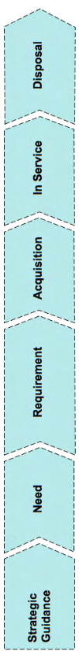

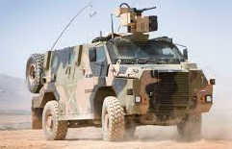
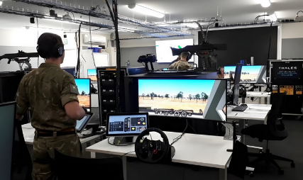
Delivering Capability: Legacy Methods
How are capabilities currently being delivered in the Australian Defence context?
How does training get delivered with these capabilities?

Slide 5
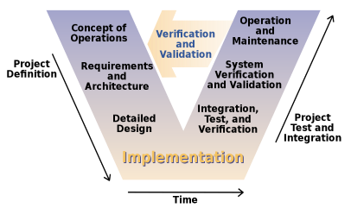
Delivering Capability: Legacy Methods
How does Systems Engineering enable the capability delivery process?

Slide 6
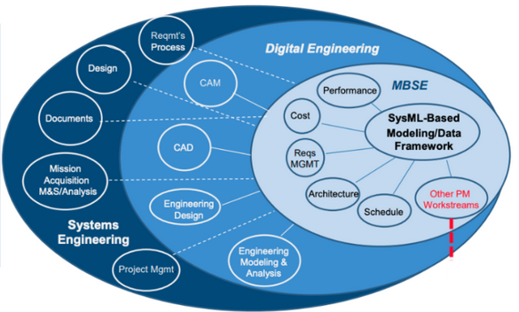
Delivering Capability: Digital Methods
How can we enhance and modernise the systems engineering process?
Enter…Digital Engineering
Source: JAMA Software

Slide 7
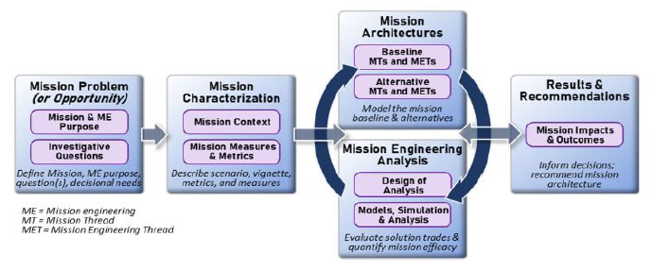
Delivering Capability: Digital Methods
What is Mission Engineering?
Digital Engineering methods

Slide 8
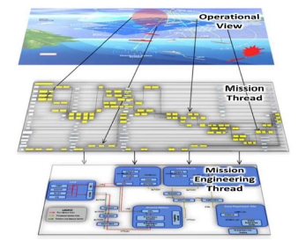
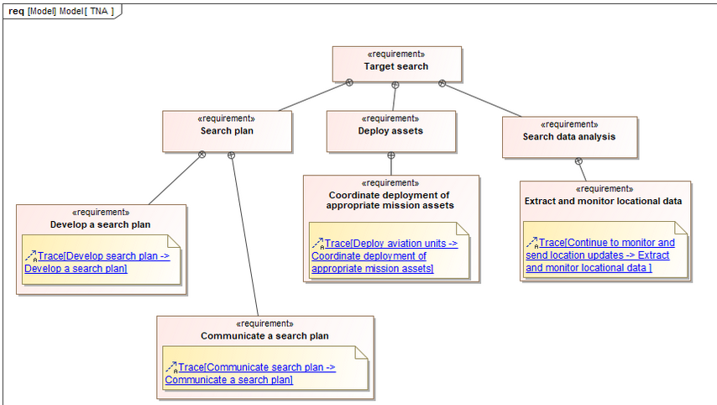
Delivering Capability: Digital Methods
Using Mission Engineering (through Digital Engineering methods) to streamline capability delivery
Digital model representation
SYNERGY
Digitally engineered model of a capability

Slide 9
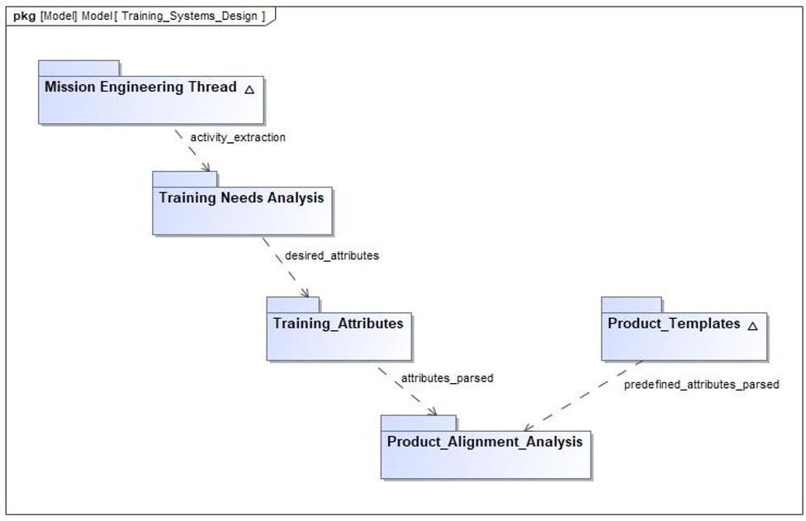
Delivering Capability: Digital Methods
So how can this streamlined capability delivery allow us to deliver on training more effectively?
  Apply digital engineering to the training capability and integrate with Mission Engineered model

Slide 10
The Digital Advantage
Combine concepts of systems engineering to both training and mission engineering
Analogous to
Training Needs Analysis
User Requirements
Links the training goals with the operational context
Links the digital and
mission engineering concepts
Defines
Mission Engineering Thread
Mission Activity

Slide 11
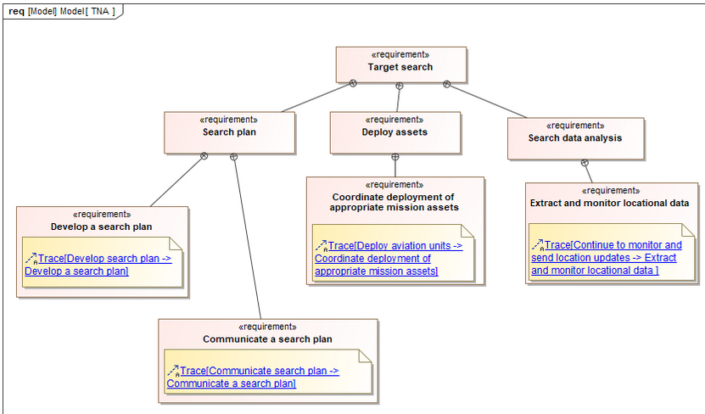
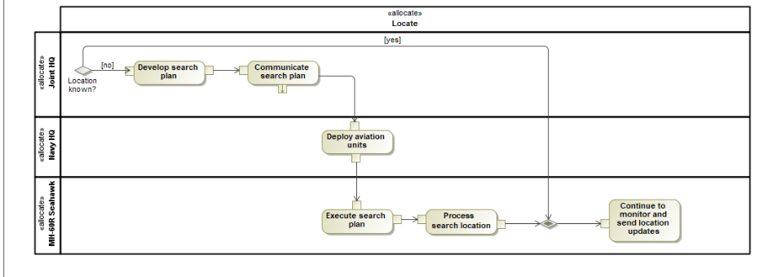
The Digital Advantage
Mission Engineering Thread (MET) and Training Needs Analysis (TNA) relationship

Slide 12
Training Characterisation
Combine concepts of systems engineering to both training and mission engineering
Training Attributes
Analogous to
Functional and Performance Specification
Links the training characteristics with mission activities
Links the digital and
mission engineering concepts
MET Activity
Defines
Mission Task

Slide 13
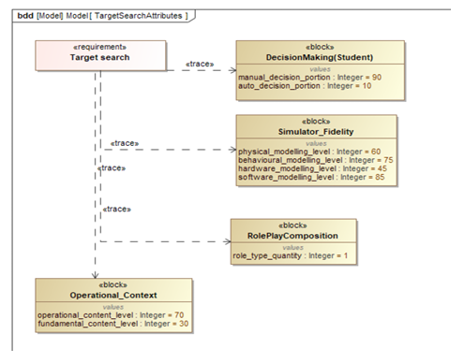
Training Characterisation
Functional Performance Specification and Training Attribute relationship

Slide 14
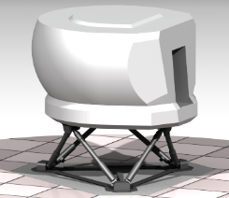
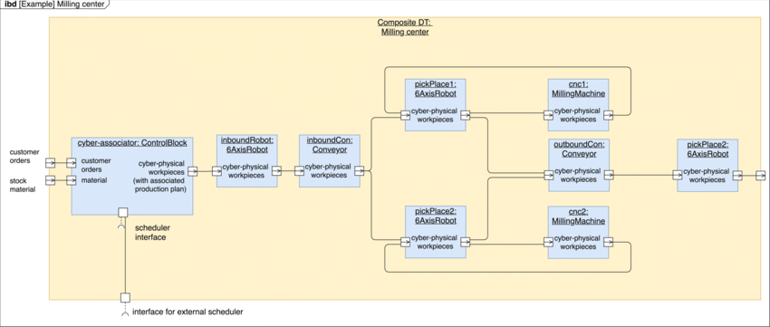
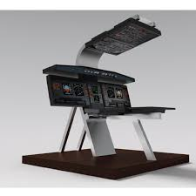

Building the Tangible Product
Product Alignment Analysis – What device meets our digital representation?
Digital attribute instantiation
Product Representation
Comparison digital model to digital model

Slide 15
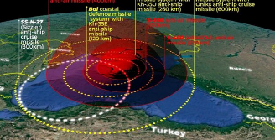
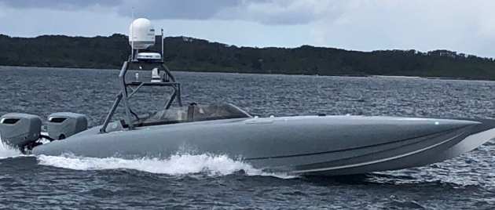
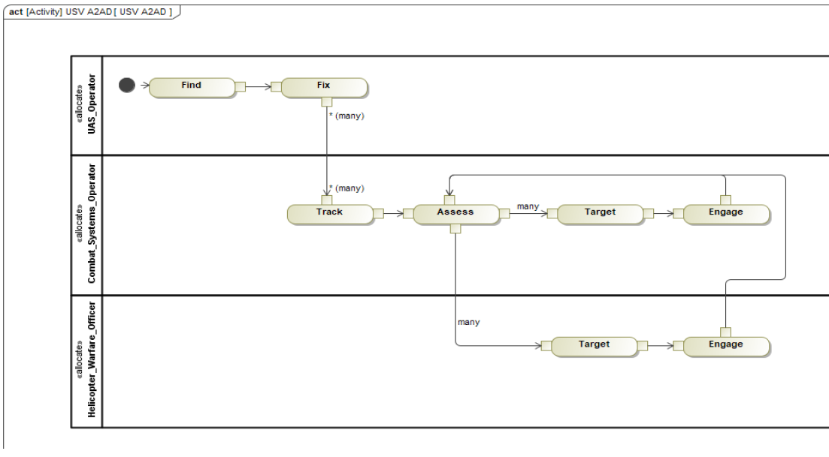
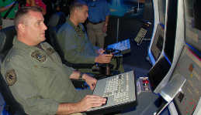

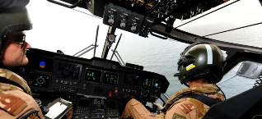
USV A2/AD Example
Anti-Access/Area Denial
Kill Chain Coordination

Slide 16
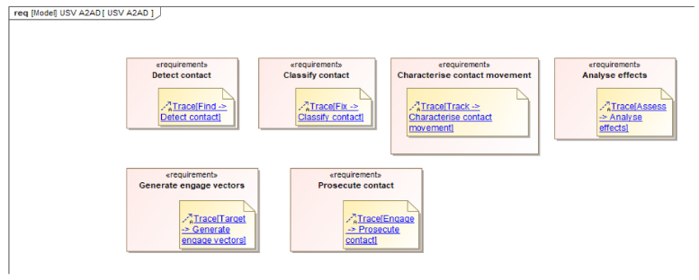
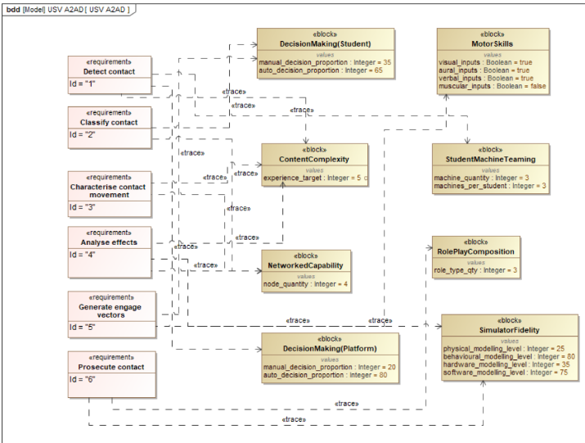
USV A2/AD Example
MET (Kill Chain) to TNA
TNA to Training Attributes

Slide 17
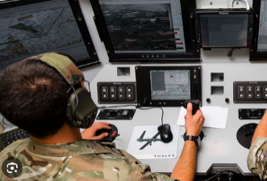
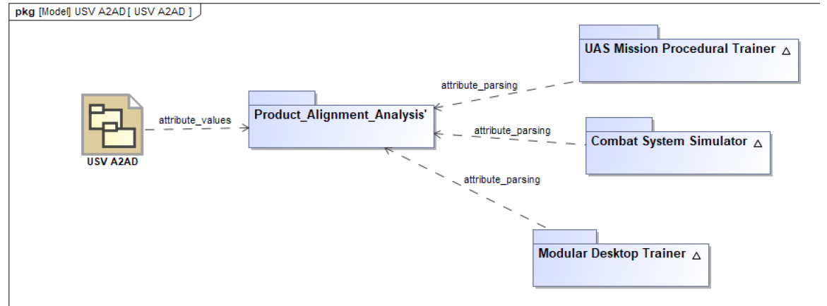
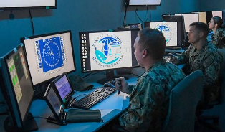
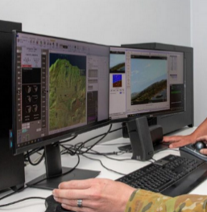
USV A2/AD Example
Attributes to Product Alignment

Slide 18
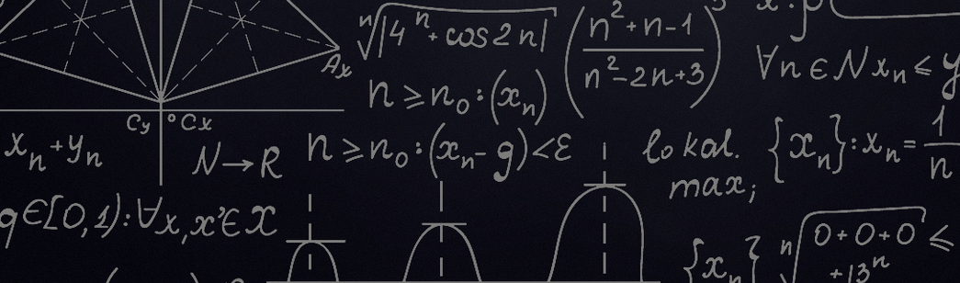
Future Work
Applicable to weapons systems and major platforms, as well as training
Use of more sophisticated analytical concepts, such as machine learning to conduct product alignment

Slide 19
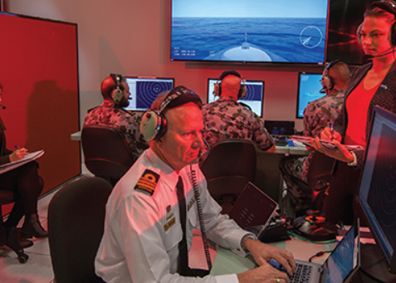
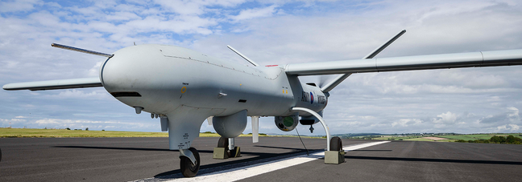
Conclusions
More effective and targeted training that delivers operational outcomes for the student
A traceable and justifiable approach that aligns with mission objectives
Adaptability and agility for an strategic urgent need

Slide 20

Questions

