Slide 1

Leveraging Data Center Architectures for Full Flight Simulators
Jean-Philippe Arbic
Co-authors: Ghislain Boivin, Nick Giannias
Notes:
I/ITSEC 2024 Paper No. 24155

Slide 2
Contents
Traditional Deployment for Simulator
Data Center Architecture and Reuse on Full Flight Simulator
What is Virtualization
Challenge of Virtualization for Full Flight Simulator
Virtualization Implementation and Results
Containerization – Another Approach
Containerization Implementation and Results
Conclusion

Slide 3

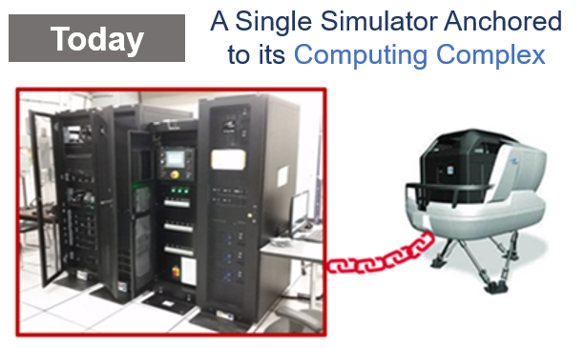
Traditional Simulator Deployment
Requires multiple physical computers occupying floor space next to the simulator
Hardware upgrades require update of the simulation software
Hardware failures take a long time to resolve

Slide 4





Data Center Architecture
Centralized processing, storage, transmission and management of information
Aims at reducing footprint and cost, simplifying deployment and upgrades
Uses virtualization to achieve higher density

Slide 5
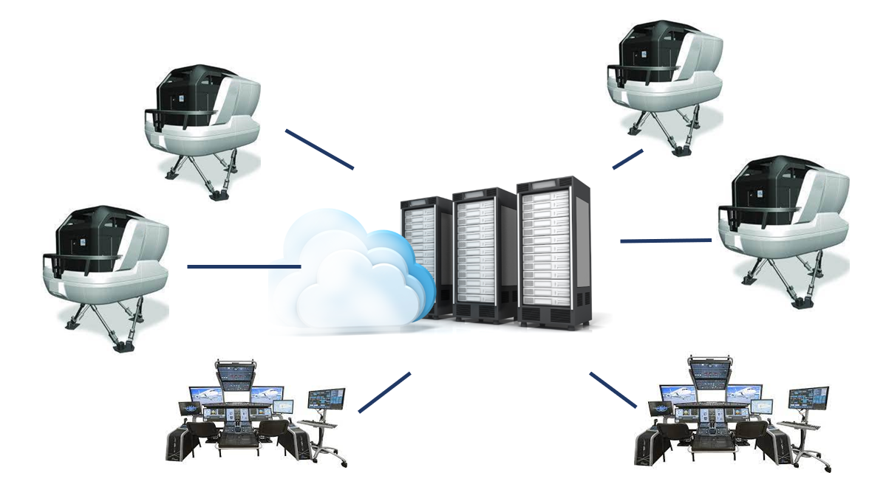
Why not on Full Flight Simulator?
Multiple Simulators Connected
to a Data Center
Tomorrow

Slide 6
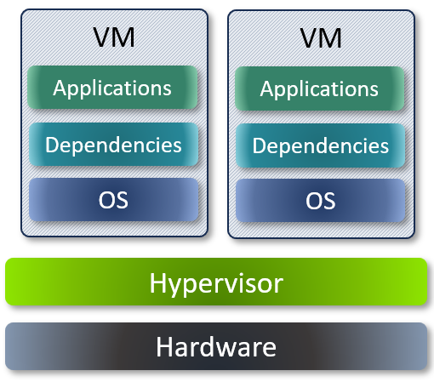
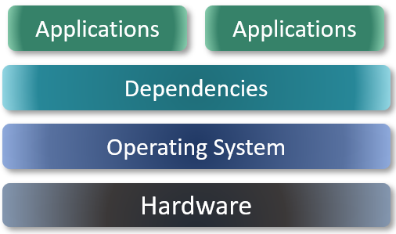
What is Virtualization
Native Architecture
Virtualization Architecture

Slide 7
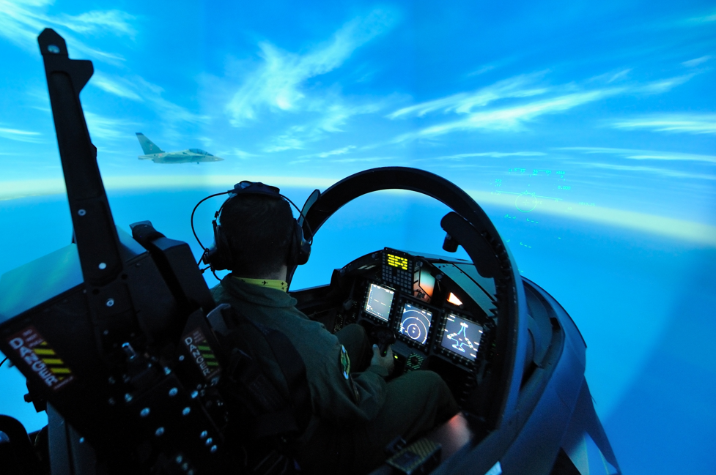
Not so fast!
Full flight simulators are fully immersive systems that must react in real time to human inputs

Slide 8
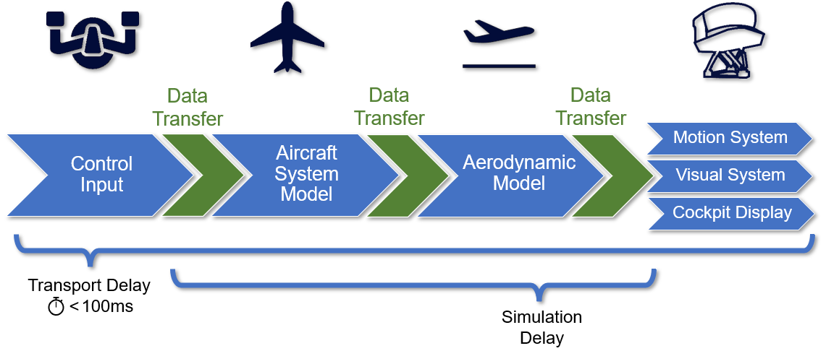
Simulation Delay
Challenge 2:
Synchronization
Processes must
start in sync
Challenge 1:
Scheduling
Process must
run on time

Slide 9
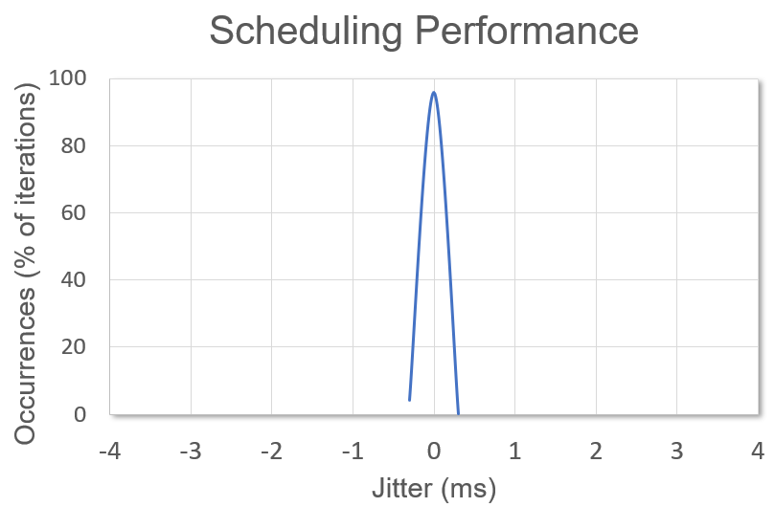
Results - Scheduling
Bare metal
Tight Scheduling

Slide 10
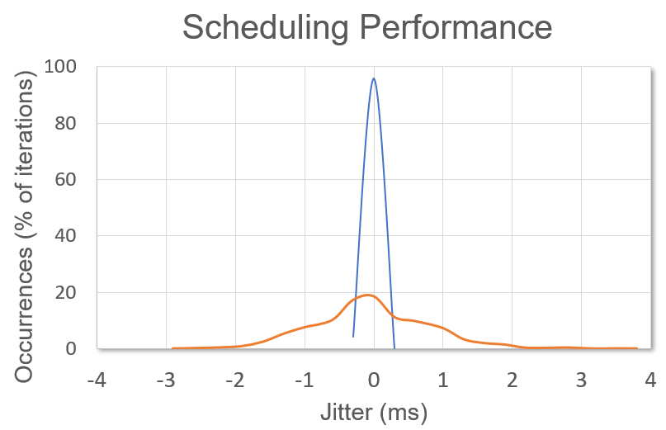
Results - Scheduling
Bare metal
Tight Scheduling
Naive Virtualization
Timing Glitches

Slide 11
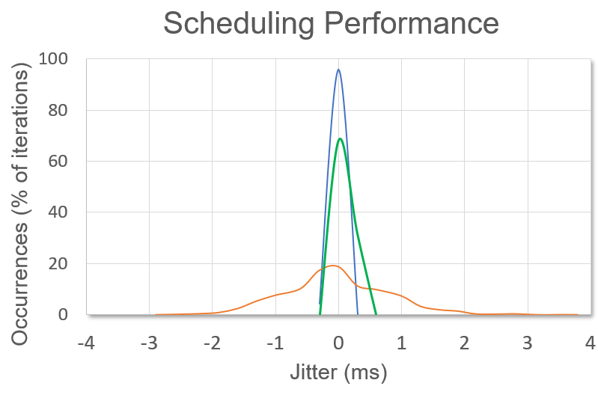
Results - Scheduling
Model
Bare metal
Tight Scheduling
Achieve scheduling performance by:
Binding virtual CPU to
dedicated HW CPU
Optimized Virtualization
Tight Scheduling
Achieved
Naive Virtualization
Timing Glitches

Slide 12
Simulation Delay
Challenge 2:
Synchronization
Processes must
start in sync
Challenge 1:
Scheduling
Process must
run on time

Slide 13
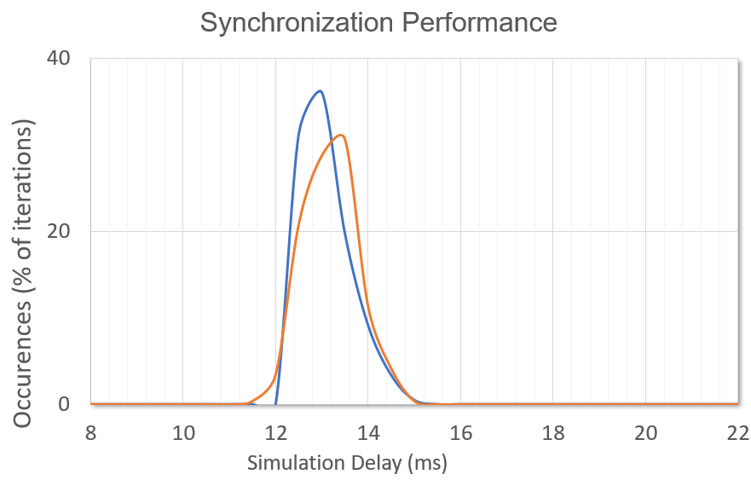
Results - Synchronization
Data Transfer
Identical
performance:
Tight Synchronization
Achieve synchronization performance by:
Careful network prioritization
Keep enough spare CPU capacity

Slide 14
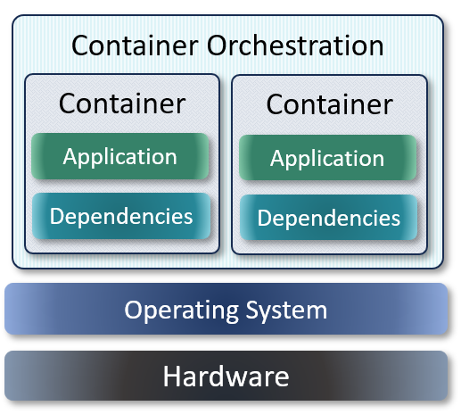



Can we do differently?
Containerized Architecture
Application runs directly on the OS without virtualization layer
Requires splitting a system into independent modules
and upgrades
Application health and deployment overseen by orchestrator

Slide 15
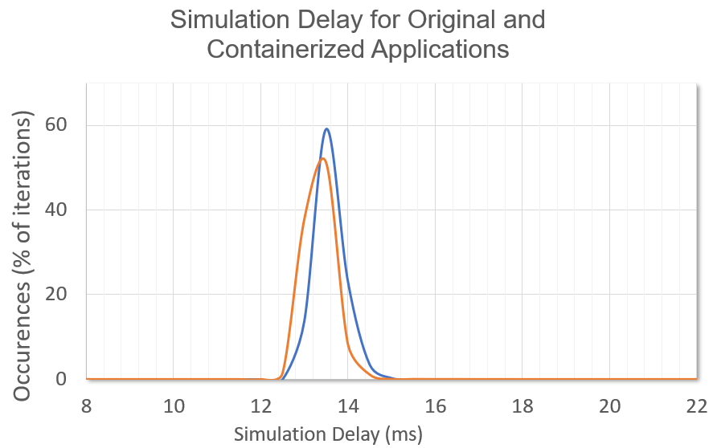
Results - Containerization
Performance considerations
Model
Adjusting container engine options
related to kernel
Identical
performance:
Tight Scheduling
& Synchronization
Data Transfer
Allowing containerized application to use host HW resources directly

Slide 16
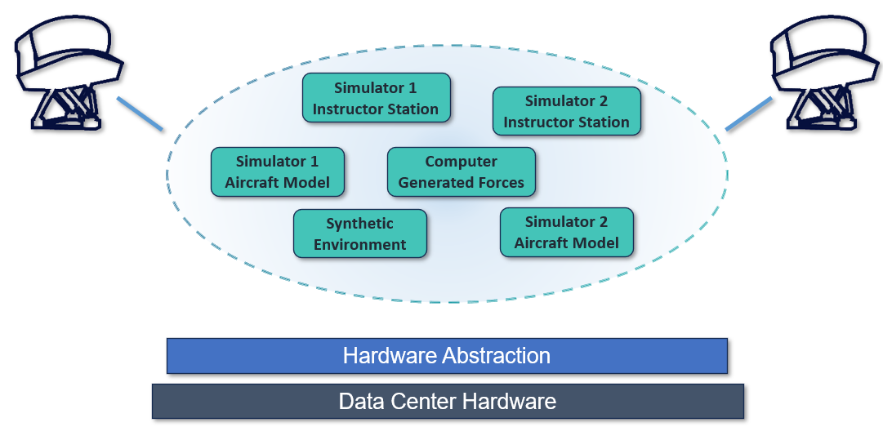
Simulators of the Future

Slide 17
Conclusion
Data Center architectures allow higher density for lower operation costs which would be helpful on simulator as well
Applying this virtualization to real-time systems is complex,
but feasible as demonstrated in the results
Containerization is an other way to achieve the same goal, trading complexity of performance implementation with complexity of software architecture
Qualified FFS using virtualization in use for training!

