Slide 1

Shelly Blake-Plock
Yet Analytics
Scotty D. Craig, Ph.D
Arizona State University
Erin Czerwinski
Carnegie Mellon University
Jim Goodell
QIP & INFERable
Jodi Lis
Arizona State University
Katherine McEldoon, Ph.D
Federation of American Scientists
Kevin Owens
Applied Research Laboratories, The University of Texas at Austin
Julian Stodd
Sea Salt Learning
Sae Schatz, Ph.D.
Partnership for Peace Consortium
Wendy Walsh, Ed.D.
U.S. Air Force Air Education and Training Command
Generalizable
Learning Engineering
Adoption Maturity Model

Slide 2
learning engineering [ˈlərniNG ˌenjəˈniriNG]
Learning engineering is a process and practice that applies the
learning sciences, using human-centered engineering design methodologies and data-informed decision-making, to support learners and their development.
Goodell et al. (2022), Learning Engineering Toolkit
Notes:
Learning engineering is…

Slide 3
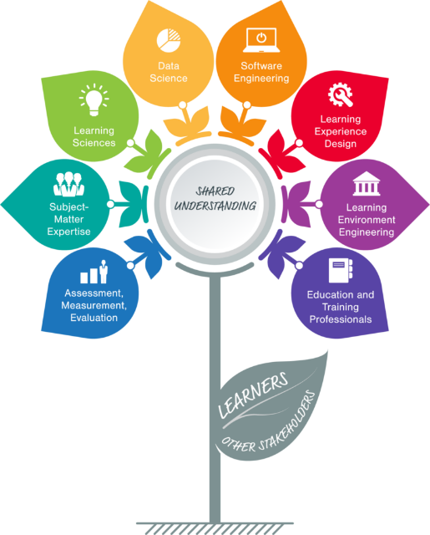
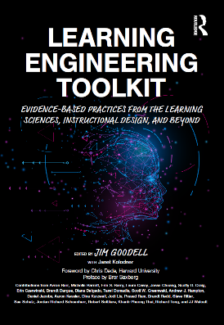

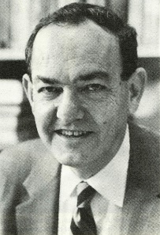

Emergence of Learning Engineering
Air Force AETC announces plans for an Enterprise Learning Engineering (ELE) Center of Excellence (CoE)
“Learning engineering”
coined by Nobel laureate Herbert Simon at Carnegie Mellon University
“Learning Engineering” definition adopted at the first IEEE International Consortium for Innovation and Collaboration in Learning Engineering (ICICLE) conference
Learning Engineering Institute
1967
2019
2022
2023
2024

Slide 4
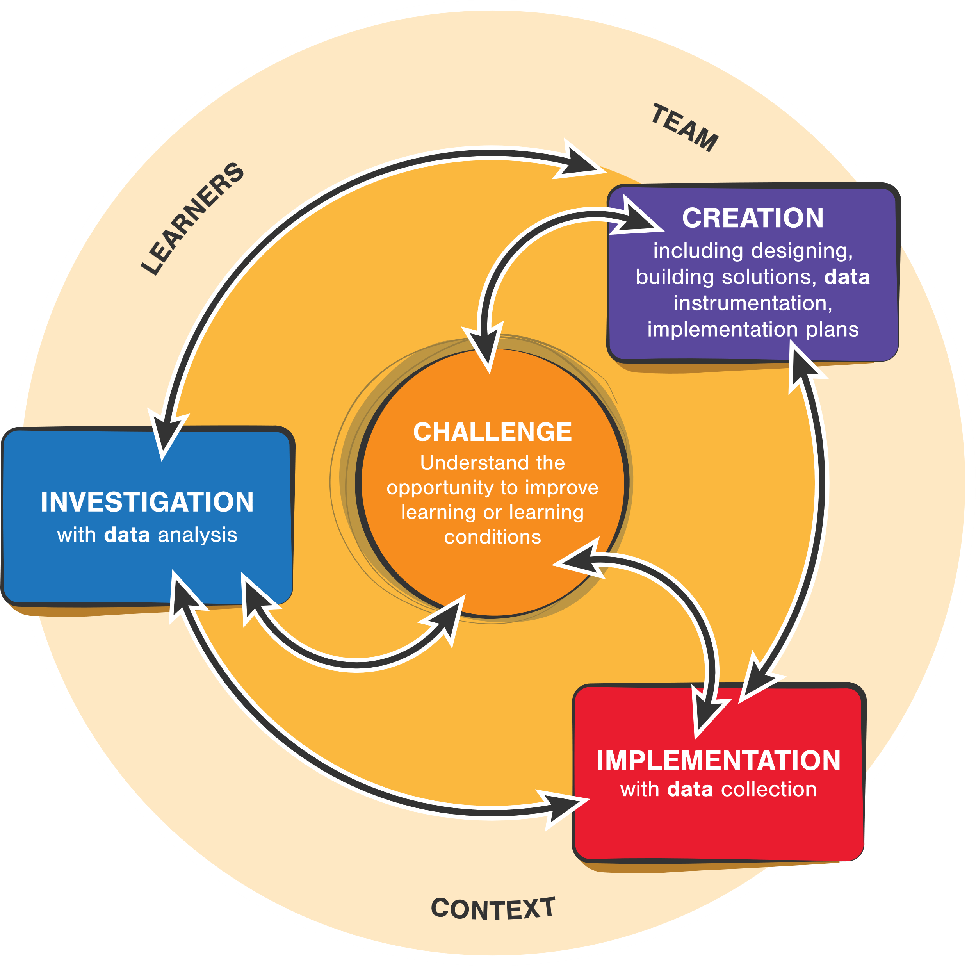
Learning engineering is a contextualized, iterative, data-driven, outcomes-focused process
CC-BY Aaron Kessler and Jim Goodell
4
Notes:
The principles of learning engineering include tenets such as these:
● Be data-driven throughout the entire learning lifecycle
● Continuously improve learning activities – like development operations (DevOps) for learning
● Incorporate UI/UX throughout all aspects (human-centered design)
● Use learning activities to reach a goal (not solely an end to themselves)
● Actively intertwine learning science, technology, data, UI/UX, and organizational performance principles.

Slide 5
Why adopt a maturity model?
Help organizations and multi-organization enterprises
evaluate their internal progress
make systematic decisions on where to invest future resources
implement learning engineering solutions at scale
Notes:
As a new and complex discipline organizations and multi-organization enterprises may find it difficult to implement learning engineering, particularly at scale.
The adoption maturity model helps these organizations evaluate their internal progress, and make systematic decisions on where to invest future resources. This is where a Maturity Model can help.

Slide 6


Purpose, Approach, and Goals
Focus on adoption: the extent to which an organization is doing learning engineering
Design for practical use, emphasizing utility and usability
Notes:
The tool defined in our paper is designed to assess the level at which an organization or enterprise has adopted
learning engineering processes and practices, i.e. the extent to which the organization is doing learning engineering.
We intentionally focused on organizational adoption recognizing that there are other tools being developed to gauge an organization or enterprise’s capabilities related to specific aspects of learning engineering. This model is not about what an organization might be able to do but about what it is actually doing.
Priority design goals for the tool were utility and usability, making it as easy as possible to assess generally where an
organization is on a continuum from non-adoption to full-adoption of key learning engineering practices.

Slide 7
Building on Prior Work
Definition of Learning Engineering
Advanced Distributed Learning (ADL) Initiative Distributed Learning Capability Maturity Model
Learning Engineering Virtual Training Systems with Learning Science, Data Standards and a Capabilities Maturity Model
Learning Engineering Team Competencies – Work of the ICICLE Competencies Curriculum and Credentials Special Interest Group
Notes:
PRIOR WORK
The tool has been informed by concepts from previous work, as described below, including the definition of learning
engineering as a process and practice (IEEE ICICLE, n.d.), the ADL Initiative Distributed Learning Capability
Maturity Model (Malone et al., 2020), “Learning Engineering Virtual Training Systems with Learning Science, Data
Standards and a Capabilities Maturity Model” (Owens, et al., 2023) and the IEEE ICICLE Competency, Curriculum,
and Credentials Special Interest Group’s definition of learning engineering competencies.

Slide 8
Dimensions of Learning Engineering Adoption
Maturity of an organization in
adopting learning engineering as a multidisciplinary practice
adopting the learning engineering process
adopting and applying the learning sciences
adopting human-centered design practices
adopting systems engineering
adopting data-informed decision-making
Notes:
DIMENSIONS OF LEARNING ENGINEERING ADOPTION
Based on the official IEEE ICICLE definition of learning engineering the adoption maturity model is divided into six separate rubric criterion to guage:
A. maturity of an organization in adopting learning engineering as a multidisciplinary practice
B. maturity of an organization in adopting the learning engineering process
C. maturity of an organization in adopting and applying the learning sciences
D. maturity of an organization in adopting human-centered design practices
E. maturity of an organization in adopting systems engineering
F. maturity of an organization in adopting data-informed decision-making

Slide 9
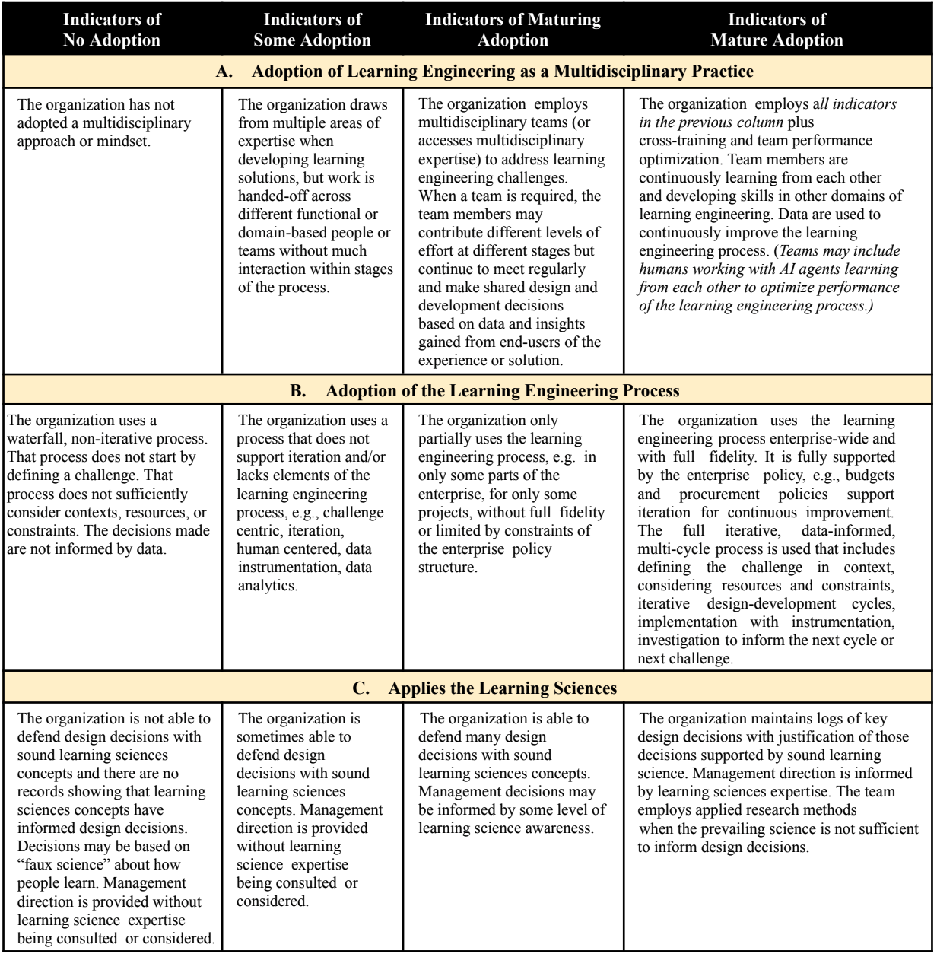
Early Iteration of the Model
Notes:
Building on prior work and
ITERATING FOR A MORE USABLE MODEL
With the primary design goal of “utility and usability” in mind the authors reviewed the rubrics above and
considered alternative formats. One format included only the “Indicators of No Adoption” and “Indicators of Mature
Adoption” columns. The next iteration focussed on observable “Indicators of Mature Adoption.” The following
further simplified checklist format includes all of the “Indicators of Mature Adoption” from the above rubrics. When
using this checklist, unchecked boxes represent potential areas for developing greater maturity.

Slide 10



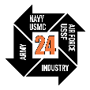
Early Iteration of the Model
@IITSEC
NTSAToday
10
Notes:
Building on prior work and
ITERATING FOR A MORE USABLE MODEL
With the primary design goal of “utility and usability” in mind the authors reviewed the rubrics above and
considered alternative formats. One format included only the “Indicators of No Adoption” and “Indicators of Mature
Adoption” columns. The next iteration focussed on observable “Indicators of Mature Adoption.” The following
further simplified checklist format includes all of the “Indicators of Mature Adoption” from the above rubrics. When
using this checklist, unchecked boxes represent potential areas for developing greater maturity.

Slide 11

Iteration for a More Usable Instrument
Notes:
We’ve developed the GLEAMM to give organizations a usable tool to guide the process of adopting the complex discipline of learning engineering…particularly at scale. Our process has led to developing a checklist for ease of use.
We expect this to be immediately helpful for organizations like the U.S. Air Force in establishing the principles and practices of LE. But like any LE endeavor, we are not resting on our laurels. We don’t expect this checklist to be perfect yet. We’ll want to field test it in various contexts and collect data to inform future improvements and/or context-specific adaptations.

Slide 12
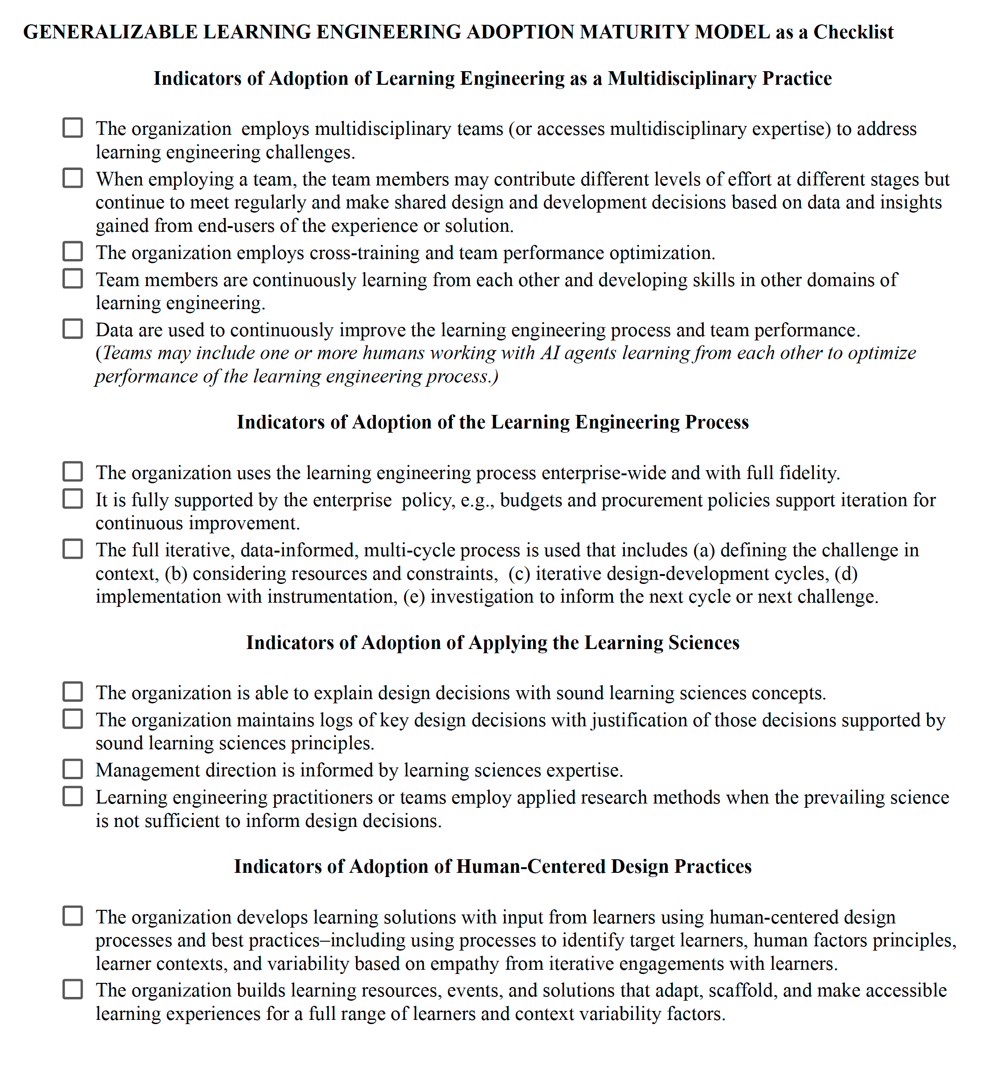

Iteration for a More Usable Instrument

Slide 13
Iteration for a More Usable Instrument

Slide 14
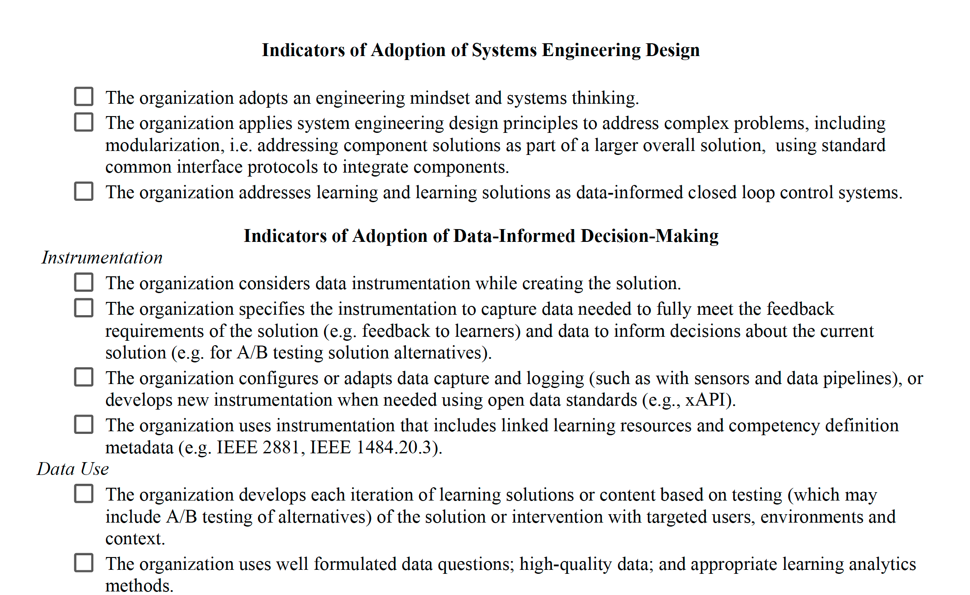
Iteration for a More Usable Instrument

Slide 15
Long-Term Benefits
We’ve developed the GLEAMM to give organizations a usable tool to guide the process of adopting the complex discipline of learning engineering—particularly at scale.
We expect this to be helpful in establishing the principles and practices of Learning Engineering, BUT . . .
Notes:
We’ve developed the GLEAMM to give organizations a usable tool to guide the process of adopting the complex discipline of learning engineering…particularly at scale. Our process has led to developing a checklist for ease of use.
We expect this to be immediately helpful for organizations like the U.S. Air Force in establishing the principles and practices of LE. But like any LE endeavor, we are not resting on our laurels. We don’t expect this checklist to be perfect yet. We’ll want to field test it in various contexts and collect data to inform future improvements and/or context-specific adaptations.

Slide 16








Future Research Needs
A-B test practical utility and usability of alternate formats
Best format and process for formative feedback to an organization to advance its maturity
Additional research on what helps or hinders success in organizational adoption
Discover additional dimensions of mature and effective learning engineering
Add tools that help organizations reach higher levels of maturity
Notes:
Here are some areas of future research that can help advance the value and benefits of the model and tool…
First, from a human-centered design perspective, we have
limited data from few non-author ICICLE participants pointing to the checklist as potentially the preferred format.
More formal research is needed comparing the perceived and practical utility and usability of the proposed formats.
Further testing will be needed to determine if a given iteration of the tool is valuable for formative feedback to the
organization in its growth toward learning engineering maturity.
While the authors had stories of exemplar organizations and the processes they use in mind, e.g. as documented in Learning Engineering Toolkit),
we recognize the need for additional case studies on organizations that have adopted and are
adopting learning engineering processes and practices, and more research on what makes them successful and what
hinders success. This research could discover additional dimensions of mature and effective learning engineering
organizations not covered in the current model.
Furthermore, research is needed to identify characteristics of
organizations that are at different levels of maturity and to develop additional tools that help organizations reach
higher levels of maturity. Further development of standards could be paired with exemplar assessments for
organizations in various contexts to review and use as a guide.

Slide 17
Learning Engineering Maturity Roughly Applied
PfPC- ADL Working Group
 | No adoption | Some adoption | Maturing adoption | Mature adoption | Total Votes
Adaptation of learning engineering as a multidisciplinary practice | 0 | 10 | 2 | 2 | 14
Adaptation of the learning engineering process | 3 | 9 | 5 | 0 | 17
Applies the learning sciences | 1 | 7 | 9 | 0 | 17
Using human-centered design process | 1 | 8 | 10 | 1 | 20
Using systems engineering | 0 | 15 | 4 | 1 | 20
Data informed decision making | 1 | 15 | 4 | 0 | 20
We hosted a workshop to share learning engineering as a sense making model and human-centered design. As an activity we discussed the narrative learning engineering maturity model and then did a self assessment of our organizations based on the check list.
A few limiting factors- 1) Timing 2) Language 3) Psychological Safety
Notes:
The workshop activity for feedback on the maturity model was complex and challenging to digest in the short time- we should have gone with the check list version. We did get some useful feedback:
Language is not clear- what is meant by enterprise, instrument…
What level should we be thinking about in applying the model- Joint and individual organizations may need to be measured differently
It was too late, and we went over time.
There was synergy in some of the challenges, opportunities, risks and ways to mitigate risks-
needing to strengthening the learning continuum, think more deeply about how to measure collective and individual competency & create psychological safety to ensure we are being honest with each other

Slide 18
Questions?
Notes:
As a new and complex discipline organizations and multi-organization enterprises may find it difficult to
implement learning engineering, particularly
at scale.
The adoption maturity model helps these organizations evaluate their internal progress, and make systematic decisions on where to invest
future resources. This is where a Maturity Model can help.

Slide 19

Shelly Blake-Plock
Yet Analytics
Scotty D. Craig, Ph.D
Arizona State University
Erin Czerwinski
Carnegie Mellon University
Jim Goodell
QIP & INFERable
Jodi Lis
Arizona State University
Katherine McEldoon, Ph.D
Federation of American Scientists
Kevin Owens
Applied Research Laboratories, The University of Texas at Austin
Julian Stodd
Sea Salt Learning
Sae Schatz, Ph.D.
Partnership for Peace Consortium
Wendy Walsh, Ed.D.
U.S. Air Force Air Education and Training Command
Generalizable
Learning Engineering
Adoption Maturity Model

