Slide 1

The Potential of LVC for Creating Air Power
Beyond Adversaries
Arjan Lemmers, Royal NLR
Bastiaan Petermeijer, Zeeger Lubsen, Jelke van der Pal, Royal NLR

Slide 2
Contents
Introduction
LVC potential for training
A conceptual LVC training use case
LVC architecture design
A future integrated LVC environment
Development and next steps in The Netherlands
Conclusions

Slide 3
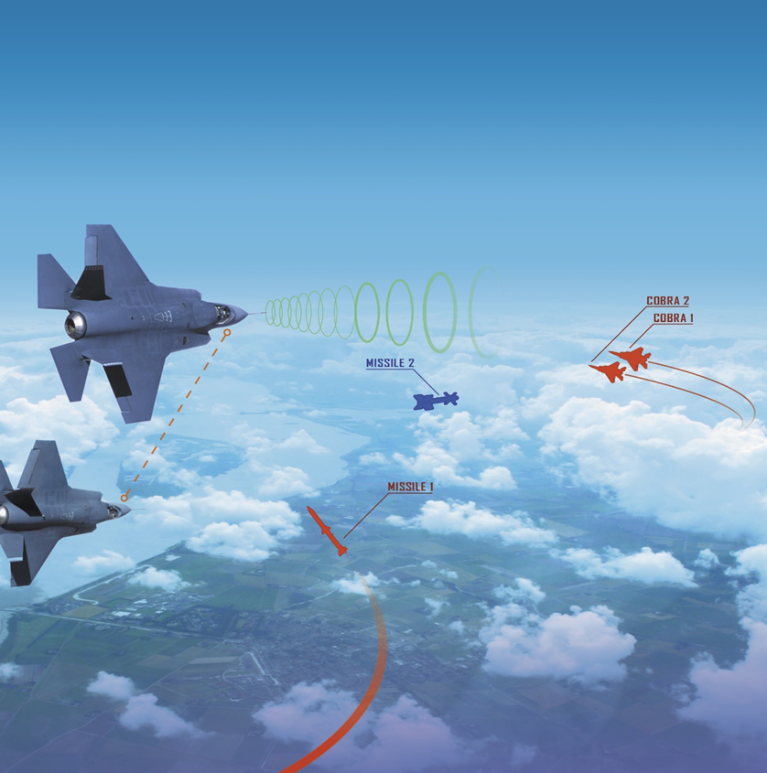
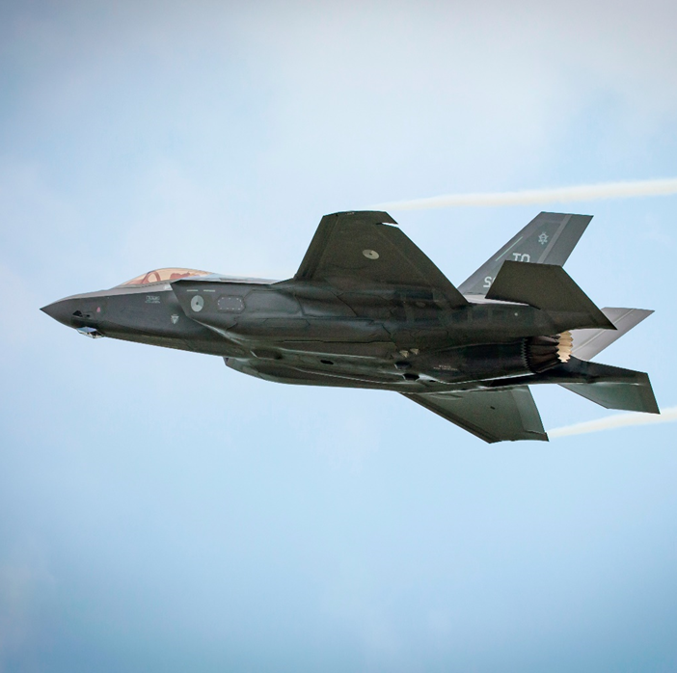
LVC Potential

Slide 4
Challenges for Air Operations Training
Changing situation:
Geopolitical situation increases the likelihood of near-peer threats
5th generation platform offer new capabilities to counter such threats
Challenge for Royal Netherlands Air Force (RNLAF):
Current day-to-day training is lacking capabilities to do high-end 5th generation training
Limited by available platforms, training areas and facilities, and personnel
Complex missions, at scale, can be trained during Large Scale Exercises
But these are costly and logistically challenging to organize

Slide 5
LVC Environment
Solution – Integrated LVC environment for Joint Air operations:
Flexibility, scalability, data-centric
Fit-for-purpose, all domain, effective
Sustainable, CD&E opportunities
An LVC environment integrates Live entities with simulated entities (Virtual and Constructive) to facilitate training and CD&E:
Live – a real-world player operates a real-world platform
Virtual – a real-world player operates a simulated platform
Constructive – a simulated player operates a simulated platform

Slide 6
LVC Potential for Training
The training potential of mature LVC is evident:
Training needs can be fulfilled faster and better
Higher training value can be achieved by more realistic scenarios
A personalized, flexible approach is possible for maintaining readiness
This highly adaptive training approach requires:
Solving the technological challenges facing todays large scale LVC
Development in intelligent, realistic behavior of constructives
Developing robust infrastructures that also supports a proficiency based training concept

Slide 7
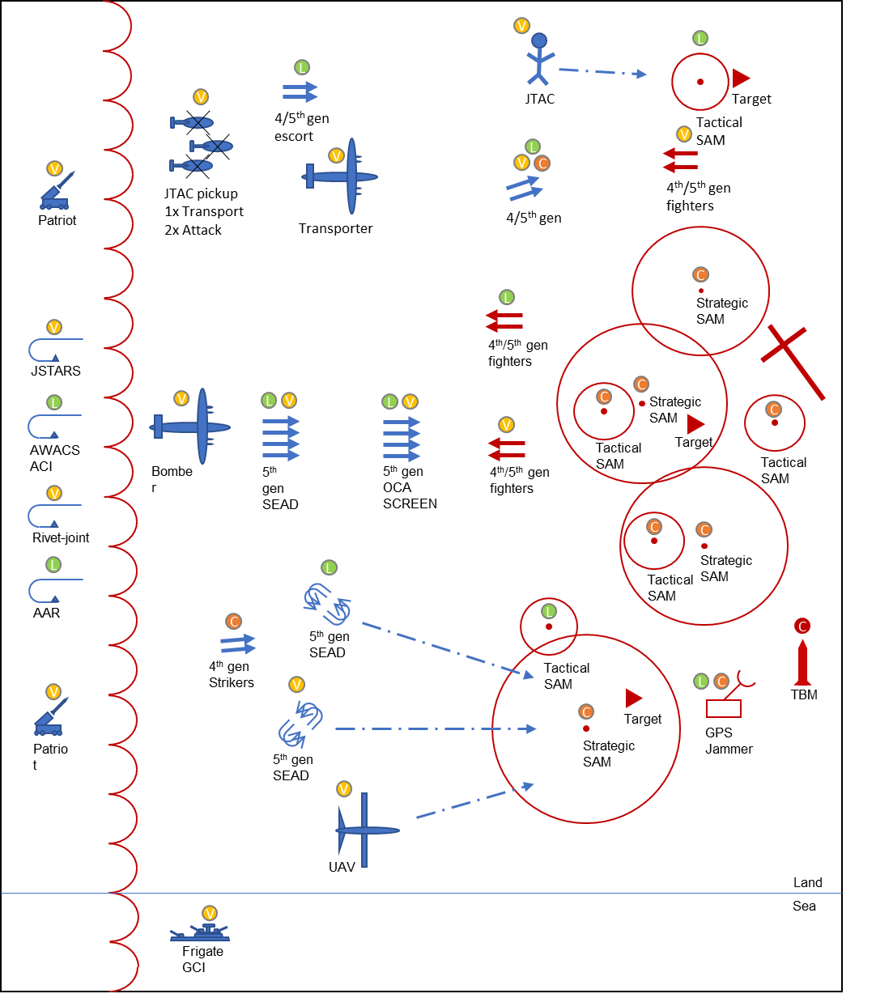
LVC Training Use Case
The whole use case sets the stage for the research questions:
What kind of tooling does one need to organize LVC exercises of this scale?
How does a white cell operate during LVC exercises?
What are the requirements to join international LVC exercises?

Slide 8
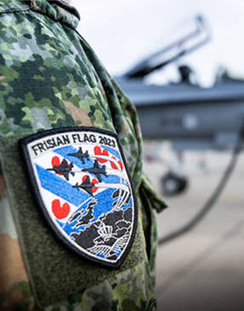
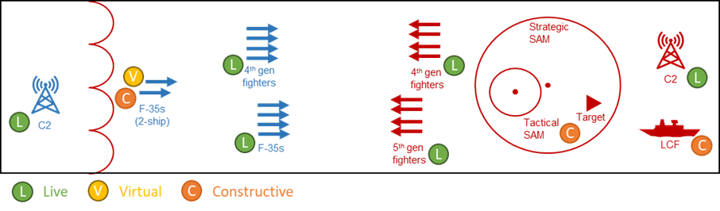
Practical Research Experiment
Practical research experiment during Live large-scale exercise Frisian Flag 2023:
Proof of concept for LVC over Link-16
Aimed at Live training and training benefit for Live players
Main benefit is increased complexity of scenario
Benefits in the planning phase also for Virtual pilots

Slide 9
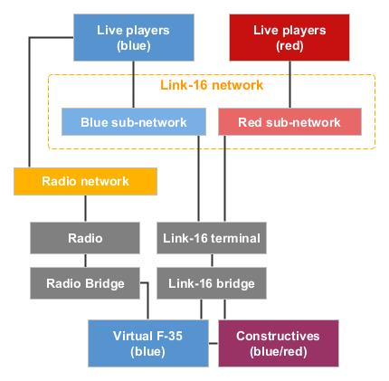
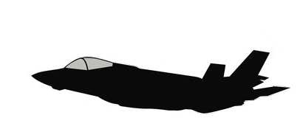






Concept LVC Architecture for Frisian Flag 2023

Slide 10
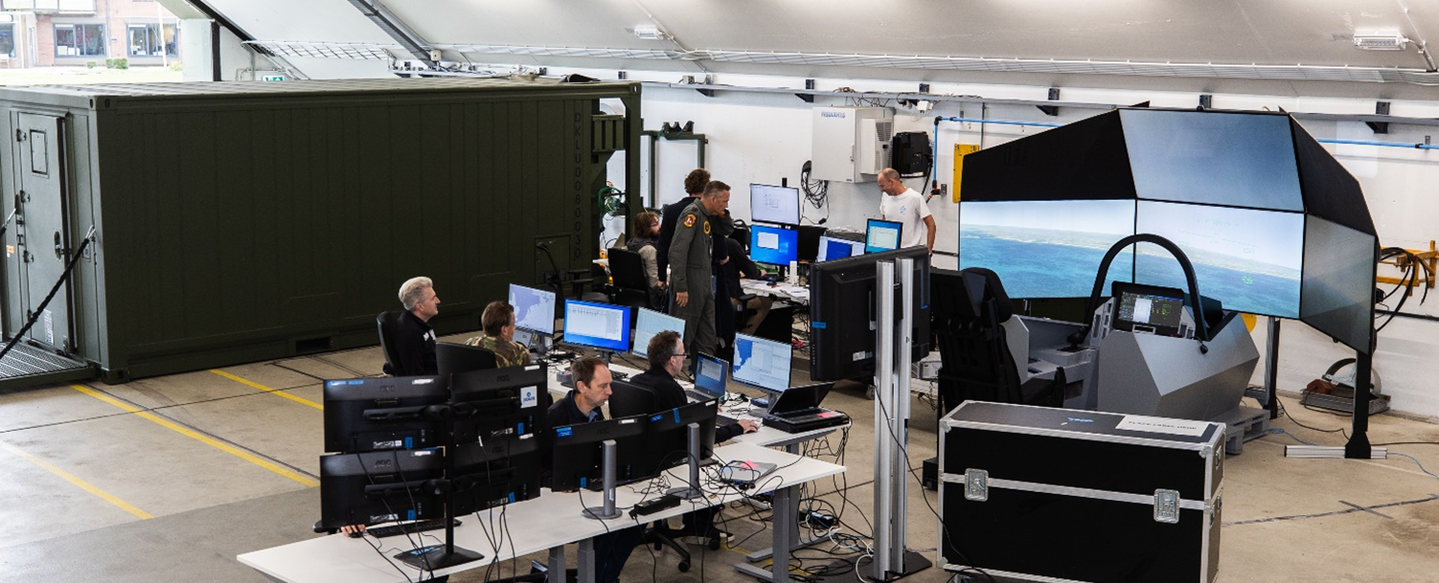
LVC Architecture Design
Design Methodology:
Description of the current architecture
Definition of use case scenario
Identification of required interactions
Determination of data exchange requirement
Design of high-level technical architecture

Slide 11
Future Integrated LVC Environment
Key principles:
Modularity
Modular architecture allowing to easily add extra LVC elements
Standards for training data streams allowing free flow of data
Scalability
Facilitating small day-to-day and large-scale international exercises
Flexible in terms of numbers and capable of handling varying workloads
Mobile Infrastructure
Mobile racks for servers and Link-16 terminals
Transportable simulators

Slide 12

Next Steps
Maturing the employed technology and concept of operation
Setting up a capable permanent operational centre
Adding virtual entities into the training scenarios
Identifying training value associated with performing a task live or virtually
Gathering evidence and best practices in safely operating LVC environments

Slide 13
Conclusions
Key findings:
LVC over Link-16 works
Virtual players benefit from LVC
Leveraging existing infrastructure
Technical support costs
Virtual players should be fully integrated into the mission cycle
Overall conclusion:
Potential of LVC over Link-16 for day-to-day training demonstrated
Dedicated training data link is needed to unlock full potential of LVC

