Slide 1
Exploiting Experimentation:
A Managerial Challenge
S K Numrich, PhD, CMSP
Institute for Defense Analyses
Alexandria, VA

Slide 2
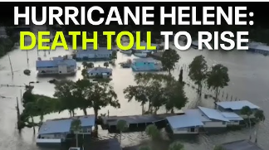
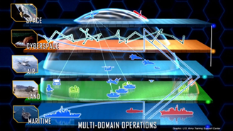
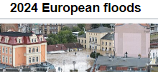

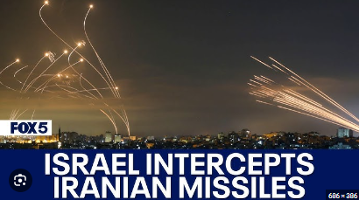

Our World Is Complicated and Dynamic
Military Operations,
no longer constrained to “lanes,”
use yesterday’s technology
in a richly connected context
to address a rapidly changing world,
until tomorrow’s tech emerges
The civil crises that drive political unrest are many, varied, and highly changeable at the hands of humans and nature
Global food demand will increase by more than 50 percent in 2050, but due to climate change, agriculture yields of major crops could decrease over that same period.
This dangerous combination could lead to price spikes, food insecurity, social unrest, political tensions, and conflict.
Political Unrest Worldwide
Is Fueled by High
Prices and Huge Debts
Global Economy
in a Sticky Spot
Graphic developed by the Army as a vision of collaboration across land, sea, and air as well as space and cyberspace (Freedberg, 2020)
Displaced
Persons

Slide 3
The Tyranny of Time
Time colors our perspectives on the operational environment
If the clouds of war are looming over us
Our focus becomes winning tomorrow’s battle.
There is little time to conceive of or develop new capabilities,
We approach the impending confrontation with current capabilities or minimal improvement upon them; adjusting tactics, techniques, and procedures (TTPs)
Events observed assume the role of Lessons Learned – without benefit of analysis
Strategic focus takes a back seat
When the world around us seems calm and there is no looming struggle
We have the luxury of being capability-driven and
Technologists are free to develop new capabilities simply because they can do so
Unconstrained or led by warfighting concepts
Larger, longer-term challenges involving all pillars of power: political, economic, and information as well military rise to the fore
Strategic focus takes a back seat

Slide 4
Tools
Wargames:
Subject Matter Experts (SMEs)
Simulations:
Data and Algorithms
Strategic Gaming
Path Games
Strategy Wargames
Foci: geopolitical shifts,
adversary goals,
reactions to US moves
LVC Sims
Foci: test new concepts
with warfighters, utility of
new tools, training
Wargames
Capitalize on human
ingenuity and expert
experience to explore
paths forward
Can deal with things
hard to model
Lack physics focus
Simulations
Can provide physics-
based interactions
At entity level let
humans interact with
devices and systems
Can be run repeatedly
for statistical analyses
Theater Sims
Foci: force structure,
combined arms, effects
orientation
Operational Wargames
Foci: new TTPs, emerging
weapons, force structure
Needed tech check
Mission &
Engagement
Foci: physical
performance
We need both kinds of tools
used together
in a well-designed methodology
to yield operational planning and acquisition based on strategic insight

Slide 5
Defining Experimentation
DoD uses three primary types of experimentation (definitions used in following slides come from CCRP* Code of Best Practices: Experimentation (COBP)
Hypothesis testing experiments: traditional laboratory experiment to challenge concepts
Demonstration experiments: taking a prototype into the field
Discovery experiments: explore novel ideas and refine them into usable concepts
Each type of experimentation
Has specific uses within DoD
Is characterized by the type of knowledge in hand at the outset
Makes different demands on data collection
The different types of experiment can be combined into a campaign in the quest for increased capability for the military using tools just presented
*Command and Control Research Program (CCRP)

Slide 6
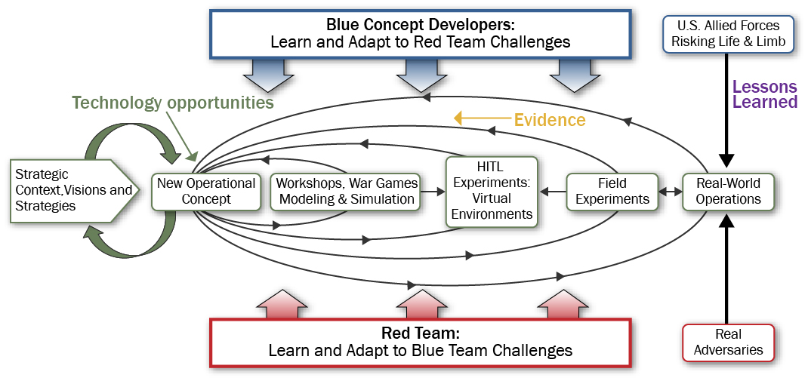
Experimentation Campaign
The real power behind experimentation is development of an experimentation campaign
Discovery
Experimentation
Hypothesis
Testing
Demonstration
Experiments
Mission &
Engagement
Foci: physical
performance
LVC Sims
Foci: test new concepts
with warfighters, utility of
new tools, training
Strategic Gaming
Path Games
Strategy Wargames
Foci: geopolitical shifts,
adversary goals,
reactions to US moves
Operational
Wargames
Foci: new TTPs,
Emerging weapons,
force structure
Grey
Actions/Reactions
Theater Sims
Foci: force structure,
combined arms, effects
orientation

Slide 7
Please Note
The following comments are NOT indicating that current doctrine and policy are wrong
To the contrary, they are
Informed by strategy
Grounded in operational understanding
What we are saying is that the implementation
Has bent to the tyranny of time
Starts past the middle of the ideal process
Requires full coordination: both painful and time-consuming
Lacks whole of government and joint participation at the concept stage
Typical contracting processes and coordination militate against developing a full experimentation campaign

Slide 8
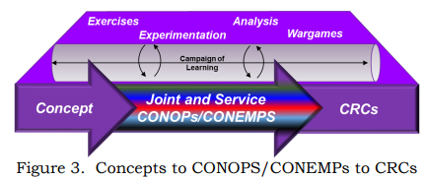
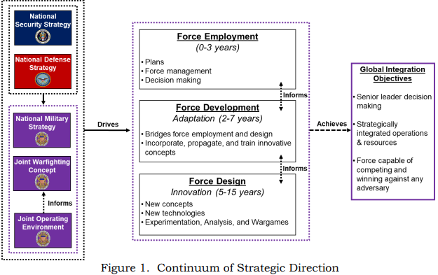
Current Processes
GUIDANCE FOR JOINT FORCE DEVELOPMENT AND DESIGN
CJCSI 3030.01A 3 October 2022
CAMPAIGN OF LEARNING
CJCSI 3030.01A 3 October 2022
CONOPS: concepts of operation
CONEMPS: concepts of employment
CRC: concept-required capabilities
As currently implemented
Exercise planning and coordination dominates the process
With the focus on possible near-term hostilities, CRCs are modifications to current technologies
IMPLEMENTING JOINT FORCE DEVELOPMENT AND DESIGN
CJCSI 3030.01A 3 October 2022

Slide 9
Management vs the Tyranny of Time
Embracing the notion of an Experimentation Campaign is the first step in defeating the Tyranny of Time
The Campaign of Learning embraces the concept of an Experimentation Campaign
The implementation is stuck in usual methods – largely do to the press of Time
Using wargaming and simulation in direct collaboration may avoid the time and resources spent trying to simulate such difficult things as human decision making, cyber operations, electromagnetics, etc.
Problems
Contracting makes it hard to create an ecosystem of wargaming and simulations that are not always in competition with each other for funding
Maybe OSD needs to create a Federally Funded Tools Ecosystem Center – analogous to Federally Funded Research and Development Centers (FFRDCs)
Path Games once used actively need to be reactivated to develop strategy in a testable manner
Whole of Government participation in the development of Joint strategy is important for understanding the competition phase of military operations and difficult to achieve (conflicting priorities)
Release, at least partially, the Campaign of Learning from the bonds of current bureaucratic processes

Slide 10
Quick and Agile
Technology is easy; management, particularly managing future development is hard
Every time OSD tries to make something quick and agile it morphs into slow and bureaucratic
What might a Campaign of Learning entity look like?
Small, but funded amply and with authority to accomplish its purpose
Have experts (or ready access to SMEs) in economics, politics, culture, futurist thought, and military, to create the strategic visions*
Have ready access to wargaming and simulation capabilities to hammer the visions into concepts
Have access to training to move concept to prototype
Repeat on a continuing, perhaps moderately overlapping basis and deliver to Joint Staff for scheduling demonstration experiments
In this way, use the part of the experimentation campaign from the start and deliver the product for use in current practices
Perhaps have a 10 or 15 year sunset clause, disappearing when the above processes become part of common practice
*Tetlock, P.E. & Gardner, D. (2015). Superforecasting: The Art and Science of Prediction. New York City: Crown Publishing Group.

Slide 11
Contacts and References
S K Numrich, IDA Kevin Woods, PhD
Institute for Defense Analyses Institute for Defense Analyses
snumrich@ida.org kwoods@ida.org
References
Alberts, D. S., & Hayes, R. E. (2002). Code of Best Practices for Experimentation. CCRP Publication, http://internationalc2institute.org/codes-of-best-practice/
Angevine, R. G.. (2020, January 23). “Time to Revive Joint Concept Development and Experimentation,” War on the Rocks.
https://warontherocks.com/2020/01/time-to-revive-joint-concept-development-and-experimentation/
Budge, L. D.. (2002). Future Joint Force I Experiment: Final Report (FOUO), IDA Paper P-3738. Institute for Defense Analyses.
Freedberg, S. J. Jr. (2020, July 29). Army Future Ops Depend on Cloud—But Not on JEDI. Breaking Defense. https://breakingdefense.com/2020/07/army-future-ops-depend-on-cloud-but-not-on-jedi/
Joint Staff. Implementing Joint Force Development and Design, CJCSI 3030.01A. (2022). Implementing Joint Force Development and Design. https://www.jcs.mil/Portals/36/Documents/Library/Instructions/CJCSI%203030.01A.pdf
Numrich, S. K., & Woods, K. M. (2017, November 27). Discovery Experimentation: What, Why, How [Tutorial]. Interservice/Industry Training, Simulation and Education Conference (I/ITSEC), Orlando, FL
Office of the Secretary of Defense. (2021). Final Report of the Defense Science Board (DSB) Task Force on Gaming, Exercising, Modeling, and Simulation, (GEMS)—Executive Summary. https://dsb.cto.mil/wp-content/uploads/dsb/site/wwwroot/reports/2020s/GEMS%20Executive%20Summary%20FINAL.pdf
Office of the Under Secretary of Defense for Acquisition, Technology, and Logistics. (2003). Phase I Report of the Defense Science Task Force on Joint Experimentation, September 2003. https://dsb.cto.mil/wp-content/uploads/dsb/site/wwwroot/reports/2000s/ADA429018.pdf.

