Slide 1

Integration of first person view drones in live training simulation
Peter Hafeneder

Slide 2
Table of contents
Table of contents
FPV drones
Live training
Prerequisites
Limitations
Scenarios
Reconnaissance
Artillery support
Loitering munition

Slide 3
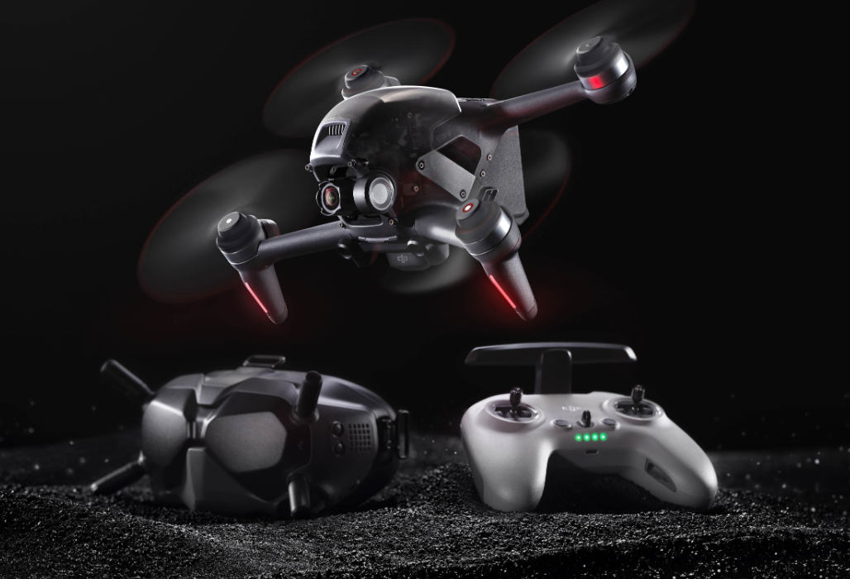
First Person View Drones
What is a first person view drone (FPV)?
Lower video stream latency ~20ms
that enables piloting with very high accuracy
and responsiveness
System consists of
Drone
Manpad
FPV helmet

Slide 4
Live training center
What is a live training center?
Training in the real world not a synthetic environment
All actors and environment elements are instrumented
Soldiers
Vehicles
Buildings
Rifles
Tank’s Guns
Improvised Explosive Devices, grenades

Slide 5
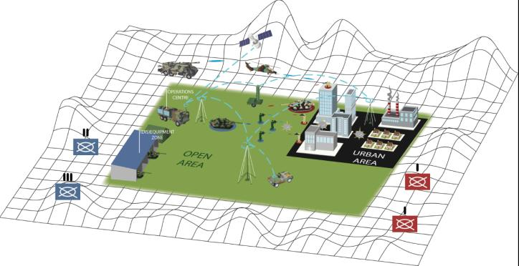
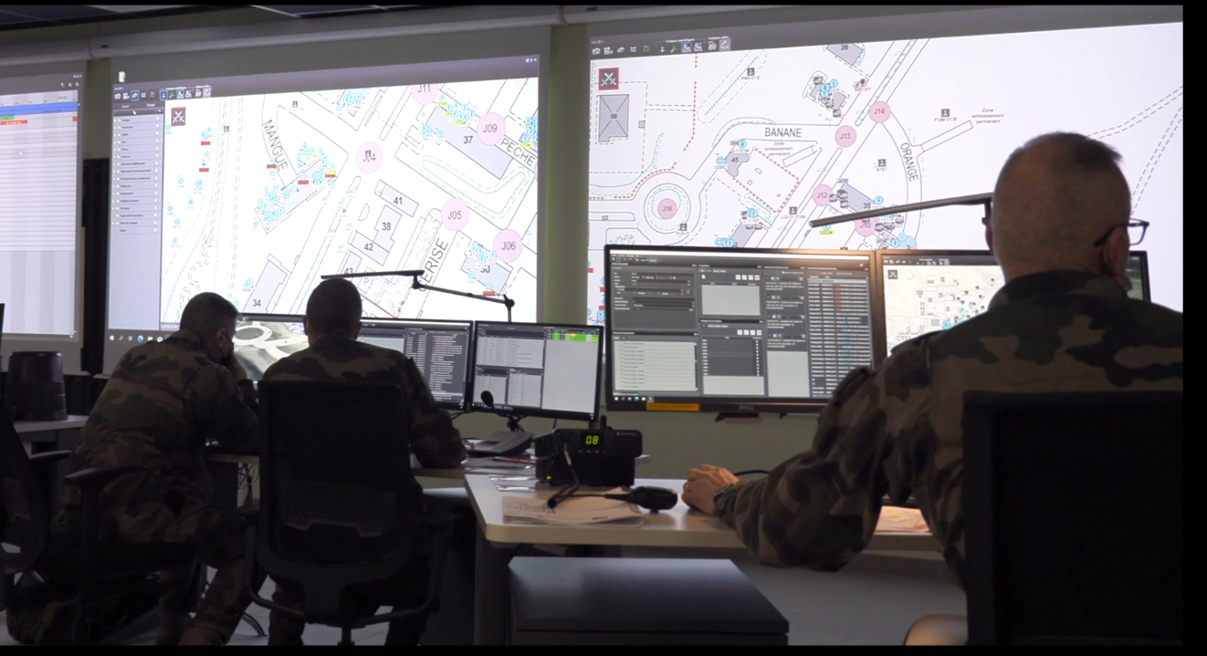
Live training center
All data are centralized and computed in a command center
Instructors can supervise the battle, interact with it, record key moments and replay it to arbitrate and evaluate

Slide 6
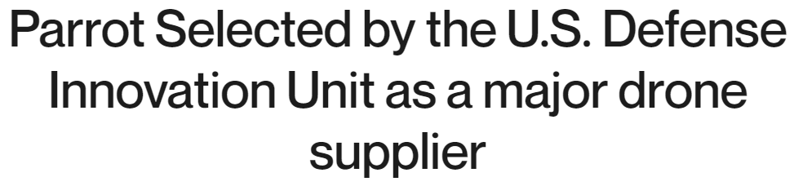
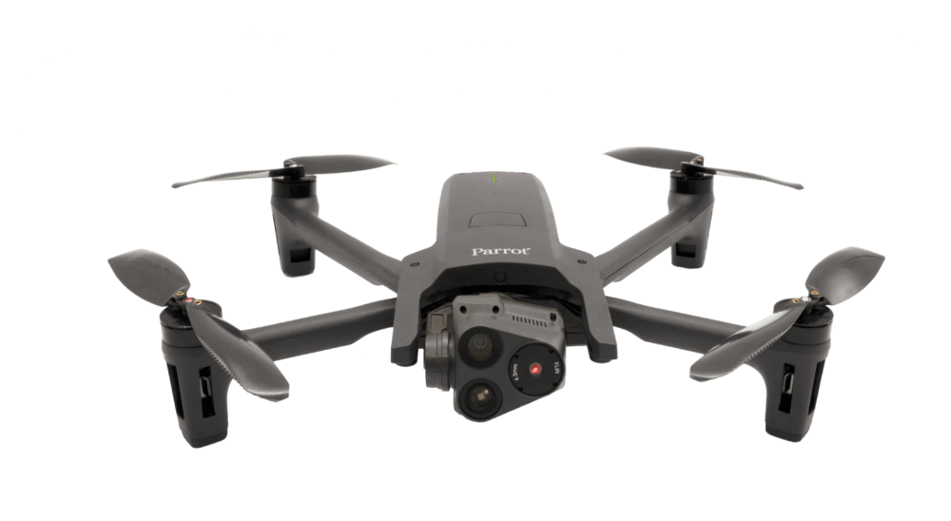
Prerequisites
Make or Buy?
We are “simulatorists” not a drone manufacturer
Train as you fight: better to train with the actual drone whenever it’s possible
Cheap
Safe
Open vs closed architecture
All data accessible through API (application program Interface):

Slide 7
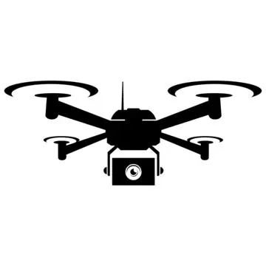
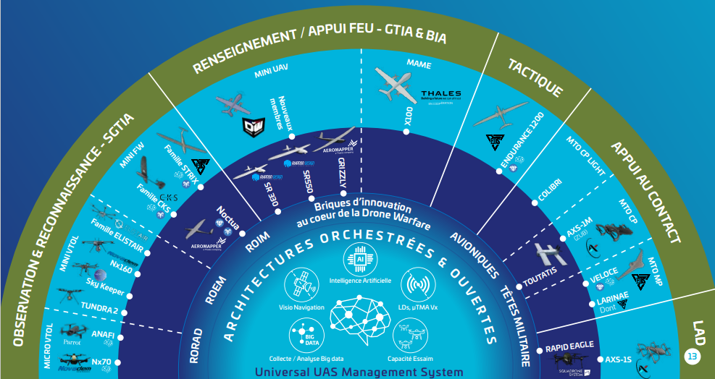



Limitations
Multiplicity of platforms
Short life cycle
Updated every 3 months
Outdated after 3 years
Simulator impossible to maintain
Solution: make drone makers agree on common API

Slide 8

Reconnaissance
Mission: drone operator must reach designated target and keep it in sight
KPIs for evaluation
Elapsed time to arrival at target
Battery management
Stealth
Global Navigation Satellite System position
recovery

Slide 9





Reconnaissance
Sequence:
Instructor designates a target in the Interface
Geographical area
Moving target
Drone takeoff triggers chronometer
Along the flight the following data are recorded
Battery level
global navigation satellite system
connection in non jamming environment
Explosions or health status notifications around the pilot
Drone’s integrity status (intact/destroyed)

Slide 10

Reconnaissance
Sequence
Once target is seen by the drone
Target position included in camera’s field of view
Image recognition software validates presence of target
Notification is sent to Instructor for mission success confirmation
Instructor validates the success of the mission
Chronometer is stopped

Slide 11
Artillery support
Mission: drone operator supervises the artillery strike and assists the artillery operator in striking their target
KPI for evaluation
Number of shots required to hit the target

Slide 12


Artillery support
Sequence: In the command center, instructor commands a virtual artillery strike in the simulation
They select a target
The simulation generates a random error and makes the first strike miss

Slide 13


Artillery support
Sequence
Thanks to Augmented reality, a virtual impact and blast of the shell is incrusted in the drone operator’s helmet
The drone operator corrects the strike position by giving North/East corrections to the Instructor
Corrections are set in the system and a new virtual strike is performed

Slide 14
Artillery support
Sequence
The N shot hits the target
Thanks to Augmented reality, destruction effects such as flames and smoke are added in simulation
Damage assessment : drone operator confirms damage of the target

Slide 15
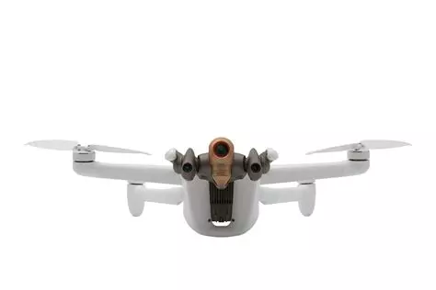
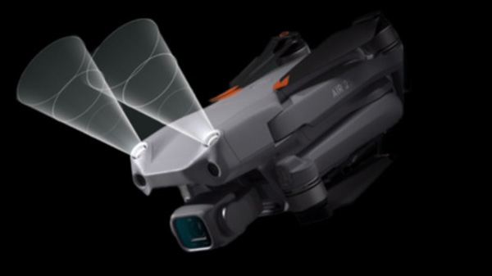
Loitering munition
Mission: hitting designated target
KPI for evaluation
Target Hit Yes/No
Target Damaged/Destroyed
MANDATORY: training to strike without arming trainees
Solutions: obstacle avoidance system equipped on small drones

Slide 16

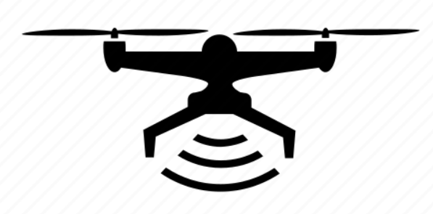

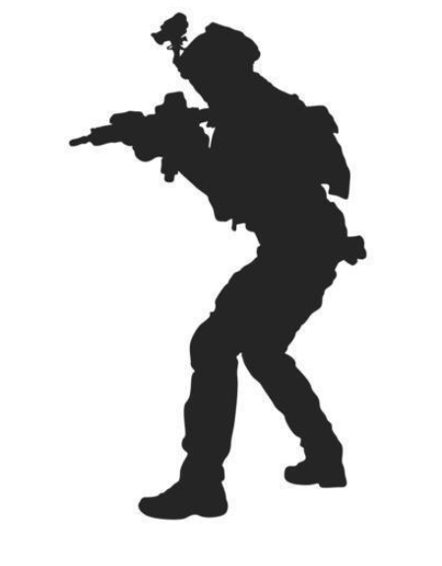
Loitering munition
Sequence:
Pilot flies toward the target
When obstacle warning system is triggered, drone stops and emits several radio bubbles
Depending on distance and orientation, entity destroyed or damaged
Drone’s LEDs blink to inform other trainees that it’s out of the simulation
Total destruction radio bubble
Wounded/ damaged radio bubble

Slide 17
Conclusion
Prerequisites
Drone
With open architecture API
Sensors that enable distance measurement
Controllable LEDs
Need to limit the number of interfaces despite the number of different platforms
Augmented reality
Inertial system

Slide 18
Questions
Any questions?
Feel free to contact me
Email : peter.hafeneder@thalegroup.com

