Slide 1



Warfighter Digital Twins for Simulating Mission Performance
Paulien E. Roos, PhD, Garrett M. Tuer, MS, Ryan J. Middle, BS, Nathan T. Pickle, PhD
CFD Research Corporation, Huntsville AL
James Yang, PhD
Texas Tech University, Lubbock TX
Gary P. Zientara, PhD
U.S. Army Research Institute of Environmental Medicine, Natick MA

Slide 2
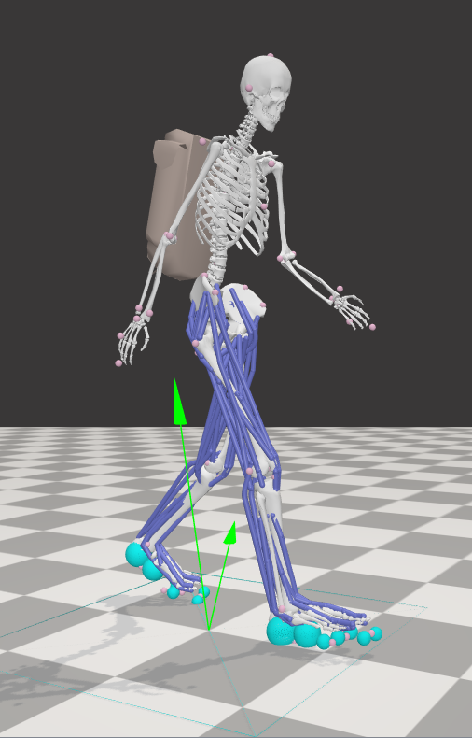
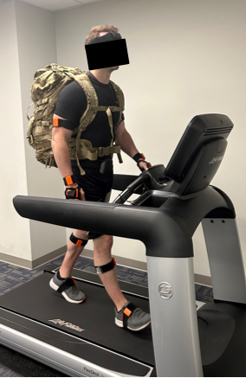
What is a “Digital Twin”?
Simulation
Virtual Model
Input data are predefined
Model may be highly complex
Used to study specific scenarios that inform general use cases
Predictive for a general class of real-world objects
Digital Twin
Virtual Model + Real-Time Data
Input data are continuously updated
Model must run in real-time
Intended to remain with the physical counterpart throughout the lifecycle
Predictive for a specific real-world physical system
Sensor data
Internal state

Slide 3
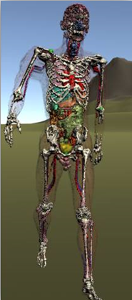
Unique Challenges of Human Digital Twins
Model creation
  Personalized parameters
  System complexity
Data collection and storage
  Limited access to internal body state
  Aversion to many wearables
  Health data are sensitive
Computational complexity
  Virtual models are complex
  Need rapid computation for real-time, portable systems
Lack of existing tools
  Limited software tools for comprehensive human digital twins

Slide 4



Project Motivation
Goal
Develop comprehensive warfighter avatars for use in digital twin applications
Industry
Academia
Defense Health Agency
Benefits
Personalized mission forecasting
Real-time health status monitoring
Enhanced medical records
Current Status
TRL 4
Notes:
This project is a collaborative effort between the US department of defense, industry and academia.
The ultimate goal is to Develop an easy-to-use interactive graphical interface for planning and assessing simulated mission with warfighter avatars.
This came to fruition through the SBIR program.
SBIR projects directly address needs identified by the DoD and the goal is to transition this technology to the DoD to benefit the Warfighter.
So in contrast to fundamental research where you answer a research question, this project has a scientific basis, but a technology development and real-world application is the end-goal.
It is an active collaboration where the development team communicates regularly with USARIEM to ensure that DoD needs are met.
It started with the United States Army Research Institute for Environmental Medicine identifying a critical need for the warfighter.
CFD Research Responded to the needs identified by USARIEM:
They developed software for generating dynamic, mission-relevant avatar movements using USARIEM’s static finite element avatars through a Phase II SBIR
Currently they are advancing their animated Warfighter avatars into complete virtual humans with biomechanics and physiology through a Sequential Phase II SBIR
They collaborate with TTU on this work who provide their expertise in developing models for metabolic cost and muscle fatigue estimation that will be integrated in the Warfighter avatar simulation technology.
SBIR - These competitive programs are Congressionally authorized set-asides established to encourage domestic small businesses to engage in research and development with the potential for commercialization. The SBIR/STTR programs support scientific excellence and technological innovation through the investment of Federal research funds in critical American priorities to build a strong national economy and accelerate capabilities to the warfighter. ​

Slide 5
Project Objective
Human Virtual Model (Avatar)
Physiology
Biomechanics
Anatomy
Simulation Applications
Mission Planning
Research
Equipment Design
Digital Twin Applications
Performance Forecasting
Injury Detection
Health Records

Slide 6

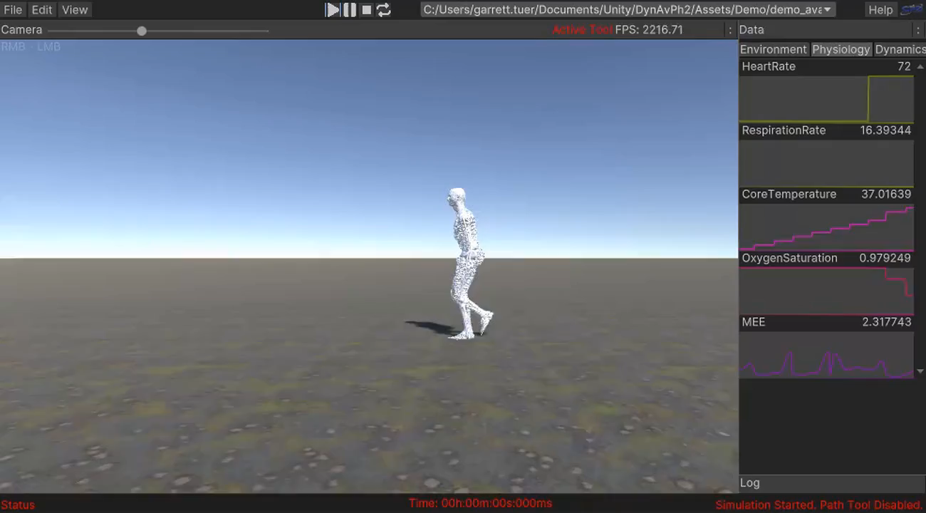
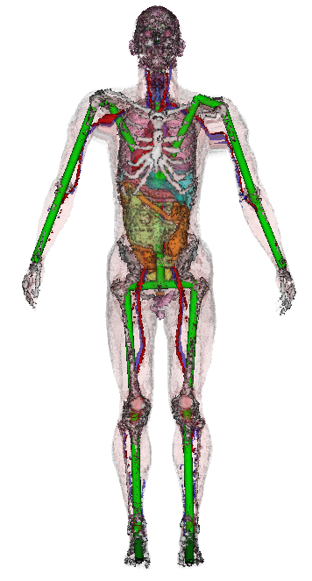
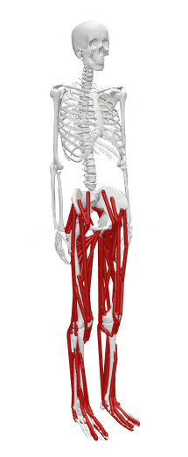
Human Avatar Software Architecture
Simulated Physiology (BioGears)
Unity-based user interface
Internal Anatomy
(USARIEM)
Musculoskeletal biomechanics (OpenSim)

Slide 7
Software Design Objectives
Utilize widely used open-source tools where possible
  Leverage latest advances
  Promote collaboration
  Enables integration of custom plugins for advanced functionality
Direct integration of external software through SDK
  C# bindings for OpenSim and BioGears
  Avoid replication of functionality in Unity
Designed for either pure simulation or digital twin applications
  Unity visualization frontend for simulations
  Sensor integration hub for wearable sensors

Slide 8
Integrating Biomechanics and Physiology
Biomechanics (OpenSim)
Metabolic energy expenditure (MEE)
Fatigue
Environment
Exercise intensity
Physiology (BioGears)

Slide 9
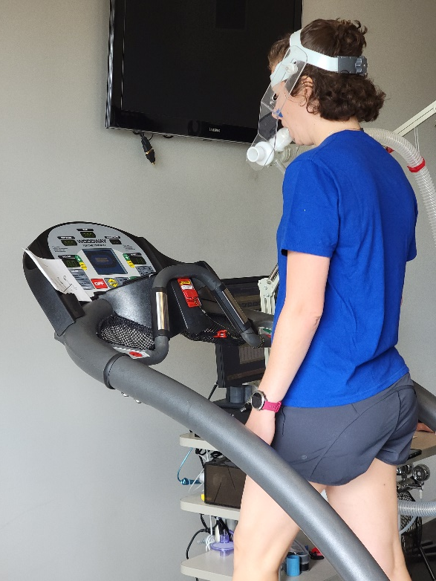
How to Model MEE?
Current MEE (calorimetry) measurement cumbersome and expensive
  Impractical for field applications
  Low-cost, portable systems are not yet field-ready
Regression-based models [1, 2]
  Task specific (e.g., walking uphill)
Muscle-based models [3, 4]
  Computationally intensive
Joint torque-based model [5, 6]
  Task-independent
  Computationally efficient
1. Pandolf, et al., Journal of Applied Physiology 43(4), (1977); 2. Looney, et al., Medicine and Science in Sports and Exercise 54(4), (2022); 3. Bhargava, et al., Journal of biomechanics 37(1), (2004); 4. Umberger, et al., Computer methods in biomechanics and biomedical engineering 6(2), (2003); 5. Kim, Roberts, International Journal for Numerical Methods in Biomedical Engineering 31(9), (2015); 6. Cruz, Yang, PLoS ONE 17(4), (2022).
Notes:
The gold standards for determining MEE is using direct or indirect calorimetry
Both require expensive equipment that is difficult, if not impossible, to use outside of a laboratory setting
Multiple MEE estimation models have been developed to subvert this restriction
Regression-based models are formulated from extensive experimental data collected while varying only a few simple parameters, such as walking speed, terrain, incline, and carriage load. They are popular for simple field applications, such as military marches, because of their simplicity and ease of use. However, they are valid only for conditions that fall within the bounds of the experimental data used in their calibration.
Examples: Pandolf equation, Load Carriage Decision Aid (LCDA)
Muscle-based models estimate MEE based on muscle activations. These muscle activations can be computed from measured electromyography (EMG) signals or estimated using time-consuming simulations that require significant expertise to run properly. Because energy consumption due to muscle activation is generally task-independent, these models are applicable across a broad range of activities.
Examples: Bhargava, Umberger
The model selected for analysis in this study estimates MEE from joint torque values. Similar to muscle-based models, the joint torque-based model is widely applicable to various physical activities as the energy required to exert a given joint torque is task-independent. However, unlike the muscle-based models, the joint-based model requires minimal equipment, expertise, and time to use.
The only inputs needed for the model are subject age and anthropometry, the kinematics (joint angles) of the task in question, and the joint torques caused by the task.
An inverse dynamics analysis can be used to quickly and easily compute joint torques for provided kinematics and ground reaction force (GRF) data, which are two of the most fundamental measurements used in biomechanics research.
GRFs are typically measured using very expensive force plates. This cost presents a barrier of entry to biomechanics research and also limits the otherwise unrestricted muscle-based and joint torque-based MEE models to a laboratory setting. Here we present an alternative approach, in which we use simulated GRF data to estimate subject joint torques throughout the analyzed tasks.

Slide 10
Integrating Biomechanics and Physiology
Biomechanics (OpenSim)
Metabolic energy expenditure (MEE)
How do we obtain biomechanical data in the field?
Fatigue
Environment
Exercise intensity
Physiology (BioGears)

Slide 11
Task Space Control
Conventional simulation approach
  Track experimental joint angles
Task space control
  Track “task” positions (e.g., hand or foot position)
  Widely used in robotics
  Experimental data not required
    Sensor data can be used when available
  Tasks can be prioritized
Tasks used in preliminary gait simulations.
Priority level | Task | Type
0 | Torso orientation | Orientation
0 | Pelvis forward progression | Position
0 | Pelvis height | Position
0 | Pelvis orientation | Orientation
1 | Swing foot position | Position
1 | Swing foot orientation | Orientation

Slide 12
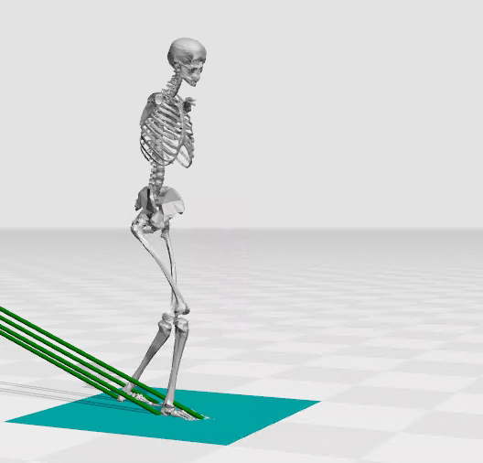
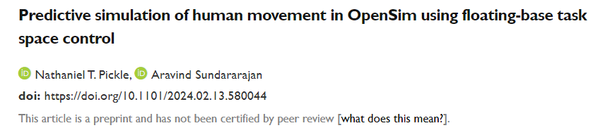

Implementation in OpenSim
Extended existing task space control framework [1] to support whole-body movements
  Tasks can be derived from sensor data
Code under review for integration into OpenSim Core
Mathematical derivations provided in preprint
Ongoing development of movement controllers
Preliminary gait simulation generated with task space control.
Preprint
[1] Stanev and Moustakas, 2018, IEEE Trans Biomed Eng.

Slide 13
Integrating Biomechanics and Physiology

Biomechanics (OpenSim)
Metabolic energy expenditure (MEE)
Exercise intensity
Physiology (BioGears)

Slide 14

Joint-based MEE Model
Values calculated based on subject age and anthropometry and joint torques produced during task [1]
Model was implemented in C++ and compiled into OpenSim [2] plugin for convenient use in biomechanics simulations
To convert MEE to exercise intensity:
Total Energy Expenditure
Mechanical Work
Heat Transfer
Resting Metabolic Rate
$$VO_{2, current}=\frac{MEE}{69.78∗5}$$
$$EI=\frac{VO_{2, current}}{VO_{2,max}}∗0.6$$

Slide 15
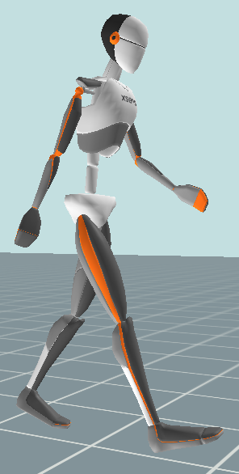
Experiment Design
Single male participant (Participant 1)
  Age: 24 years
  Weight: 79.4 kg
  Height: 1.88 m
Five level-ground treadmill walking trials
  Three unloaded: 0.8, 1.3, and 1.8 m/s
  Two loaded at 1.3 m/s: 9 and 18 kg backpack loads
Simulations in OpenSim Moco
Xsens MVN Analyze
OpenSim Moco
Notes:
Participant 1 provided written informed consent to participate in the experimental protocol approved by the Institutional Review Board at CFD Research Corporation
Goal: Determine the joint-based MEE model’s sensitivity to changes in speed and carried load in comparison to other commonly used MEE estimation models

Slide 16
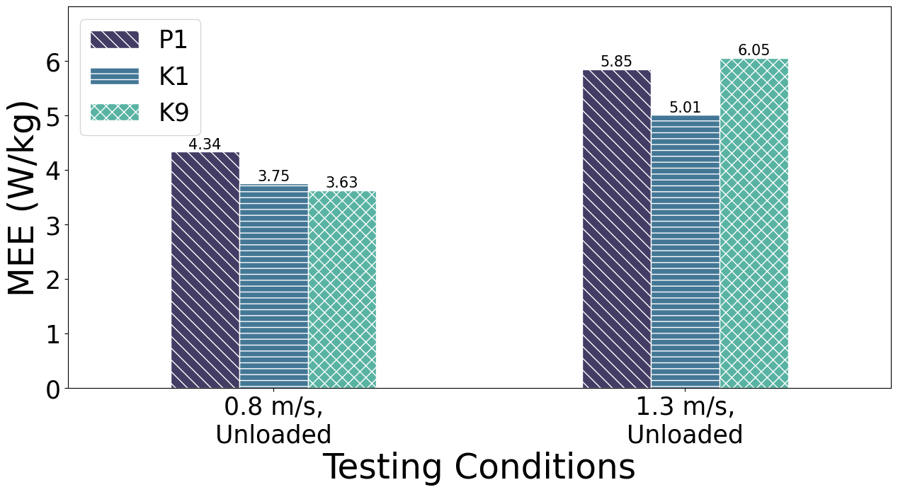
Preliminary Results
Compared joint-based MEE (P1) to published data (K1 and K9) [1]
Qualitatively good agreement
Further validation needed
1. Koelewijn, et al., PLoS ONE 14(9), (2019).
Notes:
The joint-based model’s MEE estimates for P1 in the 0.8 and 1.3 m/s unloaded trials showed both similarities and differences relative to the measured MEE values of K1 and K9.
The total estimated MEE for P1 was 16-17% larger than that of K1 in the analyzed trials. Both of these subjects showed a similar percent increase (35% vs 34%) in MEE from the 0.8 m/s trial to the 1.3 m/s trial. A similar pattern was shown between these trials for eleven of the twelve subjects in the Koelewijn data set. K9 was the only major outlier from this trend, with a 67% increase in measured MEE between the two trials.
While K9’s measured MEE for the 0.8 m/s trial was similar to that of K1, K9’s measured MEE for the 1.3 m/s trial was more comparable to the estimated MEE of P1.

Slide 17
Integrating Biomechanics and Physiology

Biomechanics (OpenSim)

Metabolic energy expenditure (MEE)

Exercise intensity
Physiology (BioGears)

Slide 18
Simulated Physiology
Open source BioGears engine [1]
  Available parameters
    Fitness and anthropometry
    Temperature and humidity
    Clothing thermal properties
    Oxygen levels
  Mobile and desktop platforms
Sensor integration framework
  Java-based sensor integration hub
  Heart rate, pulse oximeter, skin temperature
  Modular and extensible design for adding new sensors and analyses
1. Baird, A., McDaniel, M., White, S., Tatum, N., & Marin, L. (2020). BioGears: A C++ library for whole body physiology simulations. Journal of Open Source Software, 5(56), 2645. https://doi.org/10.21105/joss.02645

Slide 19
Integrating Biomechanics and Physiology

Biomechanics (OpenSim)

Metabolic energy expenditure (MEE)

Exercise intensity

Physiology (BioGears)

Slide 20
Conclusions
Summary
Integrated all software components of a virtual human avatar for use in digital twin applications
Conducted preliminary validation testing
  Predictive gait simulation
  Joint-based MEE calculation
  Full computational physiology engine
  Application Areas
Health status monitoring
Real-time injury detection
Mission planning
Future Work
Closed-loop physiology simulation
Fully implement real-time sensor-driven digital twin
Validation in laboratory and field tests
Point of contact:
Paulien Roos, PhD
Manager, Biomechanics
paulien.roos@cfd-research.com
Avatar simulation with real-time physiology and biomechanics readouts

