Slide 1
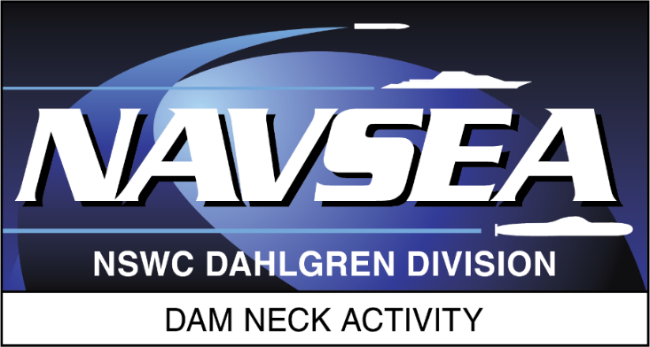
Advanced Navigation Team Shipboard Simulation
(ANTS2)
Matthew Legg, NSWCDD Dam Neck Activity (DNA20)
Corey Guilbault, NSWCDD Dam Neck Activity (DNA20)
Rick Gaughen, NSWCDD Dam Neck Activity (DNA20)

Slide 2
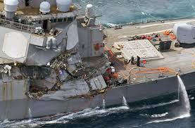
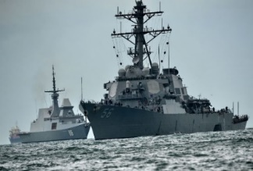
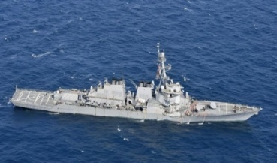
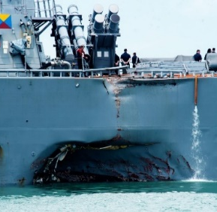
Background
Tragic collisions of USS Fitzgerald (DDG-62) and USS McCain (DDG-56) in two separate instances
Training for watch standing personnel not a part of Live Virtual Constructive(LVC)
No ability to provide out the window stimuli reflecting an active training scenario
No ability to stimulate bridge equipment with tactical cues during training
US Navy has identified navigation and seamanship as a focus for improvement
Convention on the International Regulations for Preventing Collisions at Sea (COLREGS)
Enable watch teams to exercise skills consistent with United States Navy Surface Ship navigation Department Organizations and Regulations Manual (NAVDORM)
Goal is full emersion of the watch standing team integrating USN Fleet Synthetic Training (FST) architectures state of the art technology
AR/VR
Fleet Synthetic Training protocols

Slide 3
Phase One Technical Approach
Proof of Concept Demonstration (FST RDTE 20-1 / AUG 2020)
Who: Ship’s Restricted Waters (<2NM) Watch stations
Navigation Evaluator, Quartermaster of the Watch, Bearing Recorder, Bearing Taker, Fathometer Operator,
Phone Talker, Lookouts (Port, Starboard, & Aft), Bridge/CIC/TOP Phone Talker/Communicator
Where:
FY19 Demonstration at Naval Simulation Center ATLANTIC (NSCLANT)
FY20 Demonstration onboard a DDG (TBD) pierside NAVSTA San Diego – Supported by COMNAVSURFOR
How:
Distributed Training Center – Naval Simulation Center Pacific (NSCPAC) via Navy Enterprise Tactical Training Network (NETTN) supported by NCTE-Corona & Tactical Training Group Pacific (TTGP)
Incorporate Mixed Reality, Virtual Reality, and Augmented reality to simulate a ship underway

Slide 4
Technical Approach High Level

Slide 5
Phase One Technical Approach Requirements Analysis
Which systems will we need to emulate or stimulate
Internal bridge systems in port are often offline
Would we have access or be able to stimulate any of the stations
How would we handle the bridge window views, bridge wings, aft...
Which watch stander will utilize what equipment
Navigation equipment gyro compass, helm, Voyage Management System (VMS),
RADAR stimulation or emulation
External navigation equipment binoculars, big eyes (large pedestal mounted binoculars), alidade...
External navigation cues
Landmarks for harbor navigation buildings, geographic features, bridges etc..
External navigation cues day shapes, running lights, buoys not to mention environmentals

Slide 6
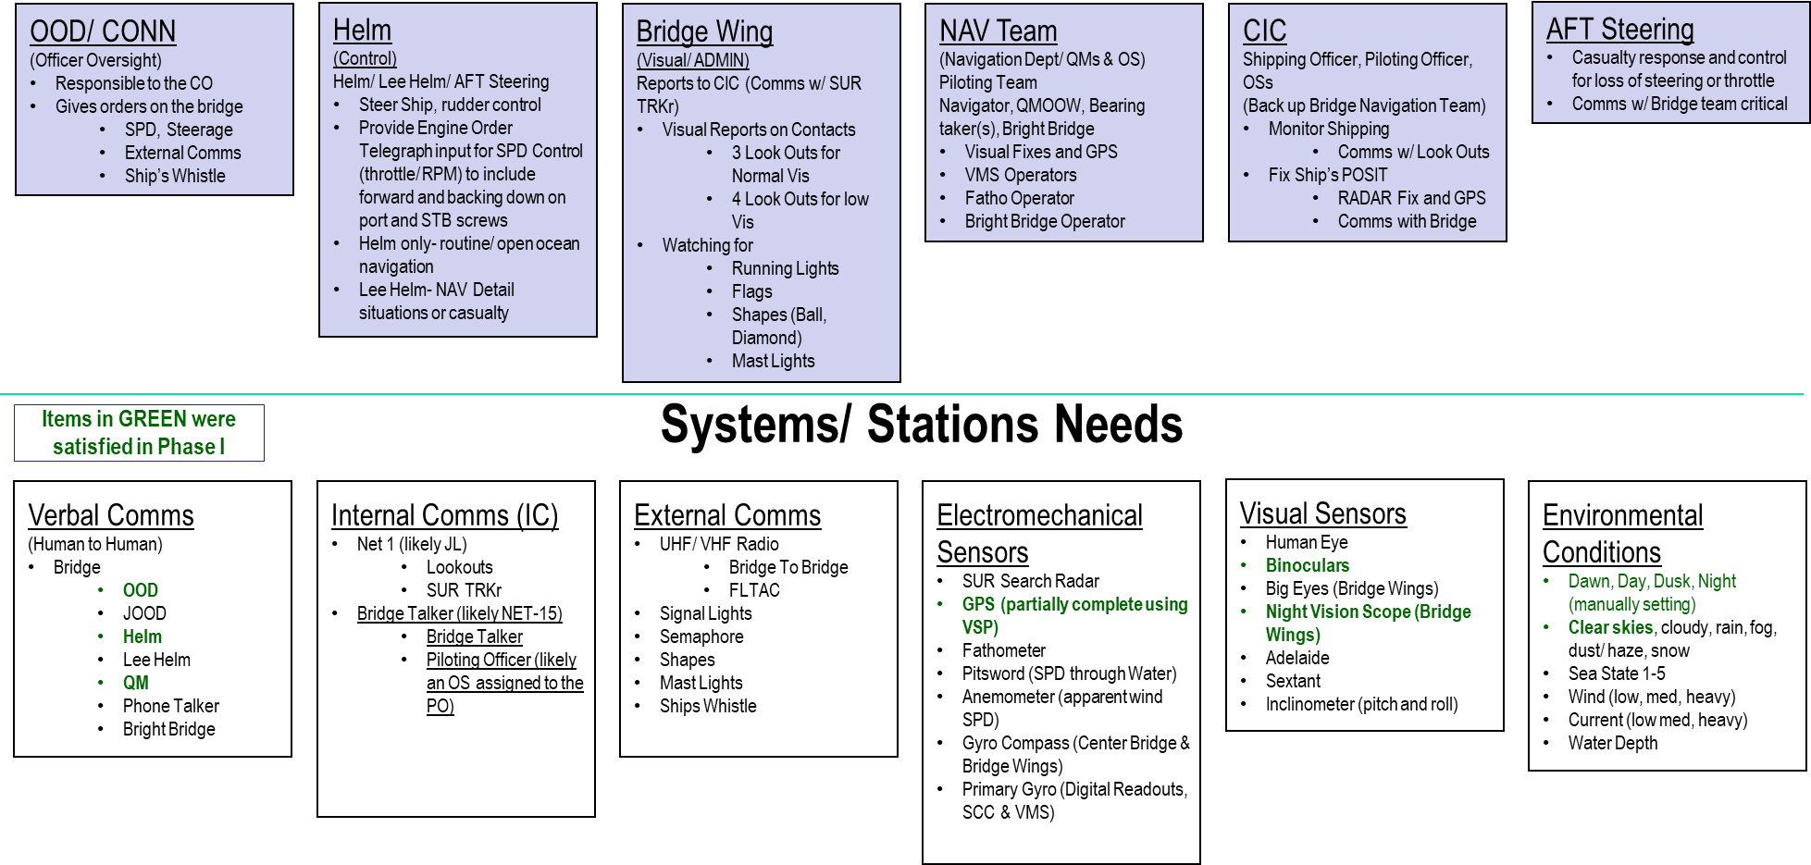
Technical Approach Requirements Analysis
6

Slide 7
Technical Approach
Scenario Generation (S&G) and distribution utilizing Navy Training Baseline (NTB) tools
Joint Semi Automated Forces (JSAF) S&G tool for Navy Continuous Training Environment
Joint Bus (JBUS) handles and translates protocols
Visual display and MR/VR technologies
Unity game engine and development environment
Realtime Automated Virtual Environment (RAVE) NTB tool, Unity written
HTC Vive Pro headset with Zed Mini for enhanced MR resolution
HP Backpack PCs for free movement and graphics processing power
Secure wireless solution implementation

Slide 8
Technical Approach
Vive Pro Headset
Allowed full VR or MR
480p MR resolution was not sufficient
Large user group most prolific
Incorporated sound and visuals
Uses lighthouses for location mapping
Developed and integrated occlusion, video pass through, and depth sensing
Zed Mini
SDK available for Unity and Vive dev.
720p resolution not ideal but better
Zed Mini brought occlusion capability

Slide 9
Technical Approach
Developed and integrated occlusion, video pass through, and depth sensing

Slide 10
System of Systems Application
Battle Force Tactical Trainer (BFTT)
Ship Trainer for the Navy acted as our own ship
ANTS2 directly sent navigation messages to BFTT which then acted as the "ship" for the entire simulation
Mariners Skill Suite (MSS)
NAWCTSD developed application
Simulates multiple ship sensors, surface search radar, navigation aids, Automatic Identification System (AIS) display capability and many more
Added HLA interface to allow the MSS to federate with the JSAF S&G
Voyage Management System (VMS) ship charting application
Many systems were able to be overlayed in our game view for use in the simulation

Slide 11
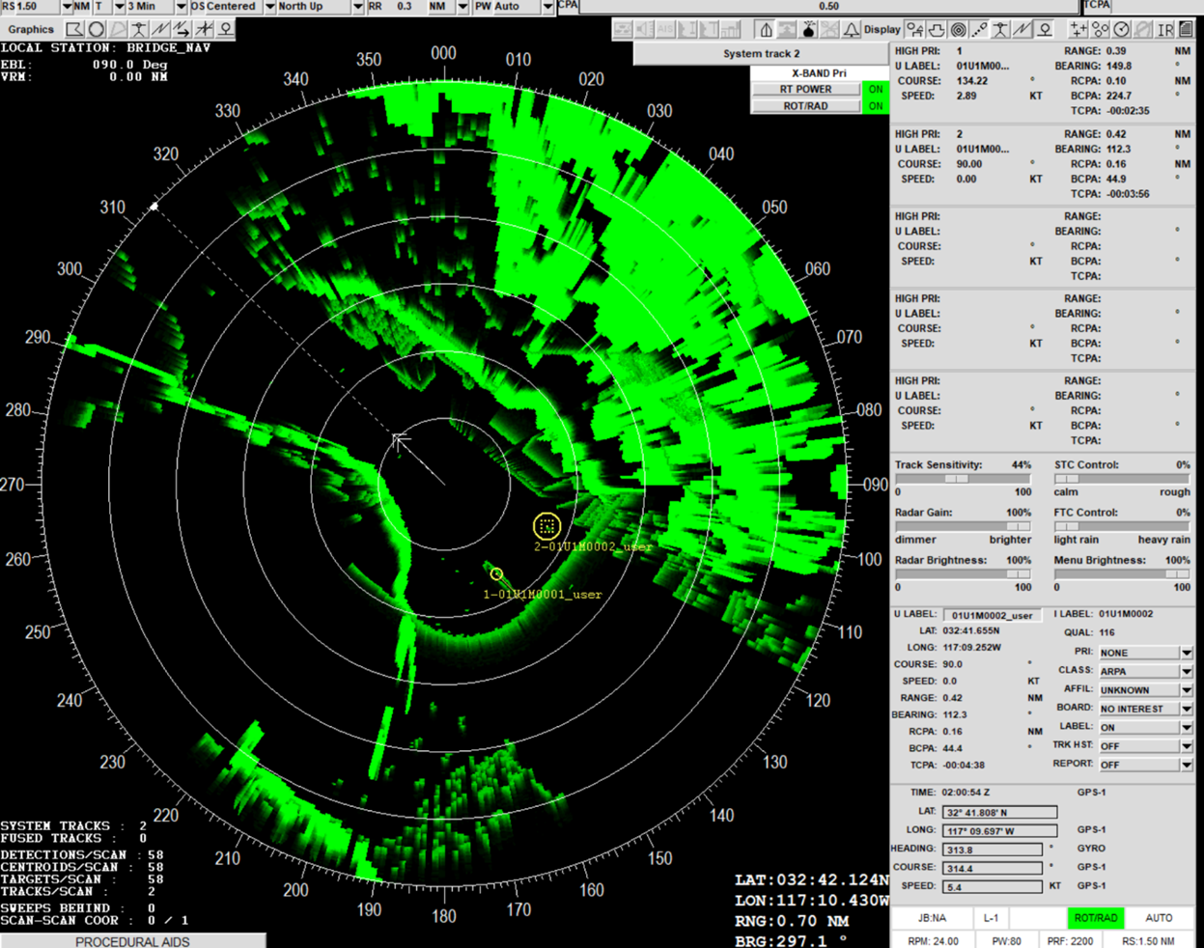
MSS Surface Search Radar Emulator
Mariners' Skills Suite (MSS) RADAR Display
Application superimposed into ANTS2 Unity scene
Visual resolution limited to the available technology at the time (note overall display is useable, but small font is blurry
ANTS2 "watch standers" were still able to interact within the virtual scene

Slide 12
Other Technologies and Accomplishments
Raspberry Pi
Low-cost credit card sized computer with many purposes
Helm Simulation System
Repurposed old navigation trainer Navigation Seamanship and Ship handling Trainer(NSST)
Raspberry Pi interpreted the analog potentiometer positions of throttle and wheel and converted those to digital, which were subsequently converted to messages for injection
High fidelity San Diego Bay Unity scene distance, depth and landmarks
Informed and validated by Afloat Training Group San Diego (ATG SD)
Navy Training Baseline HLA Object Model compliant with NCTE standards for day shapes and running lights

Slide 13
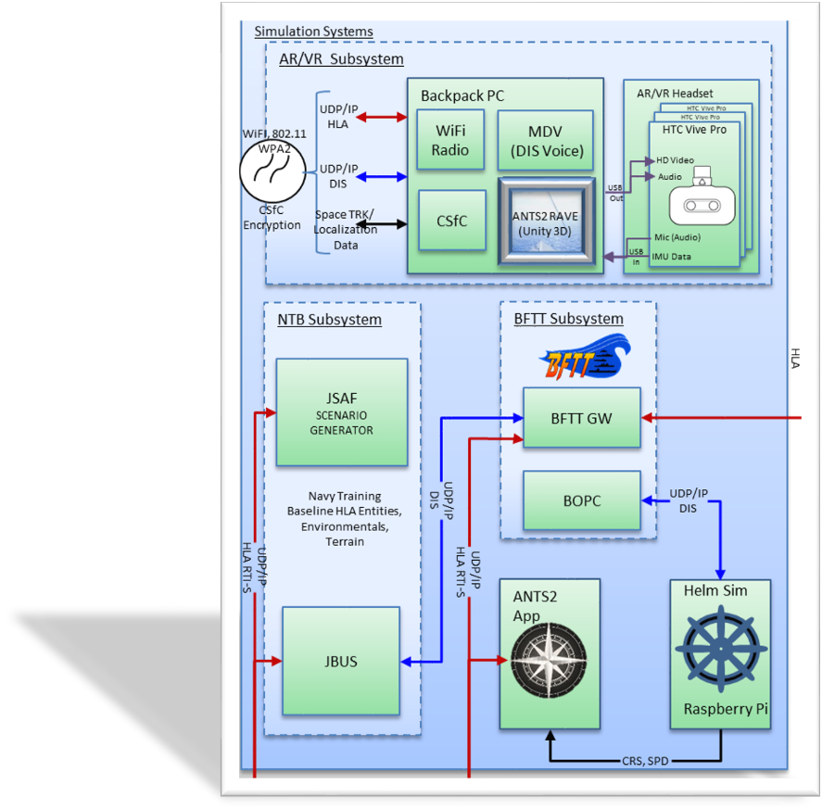
Tying It Together: The Core Systems
Scenario Generation and Control
Navy Training Baseline (NTB) JSAF and JBUS Applications
BFTT acts as ownship and is injected into the scenario
Helm Sim provides inputs into ANTS2 App for messages to BFTT
Image Generation and 3D Modeling
ANTS2 Application handles overall simulation processing built upon Unity3D
Secure wireless
Scenario, audio and AR data encrypted transport
Untethered backpacks and Headsets

Slide 14
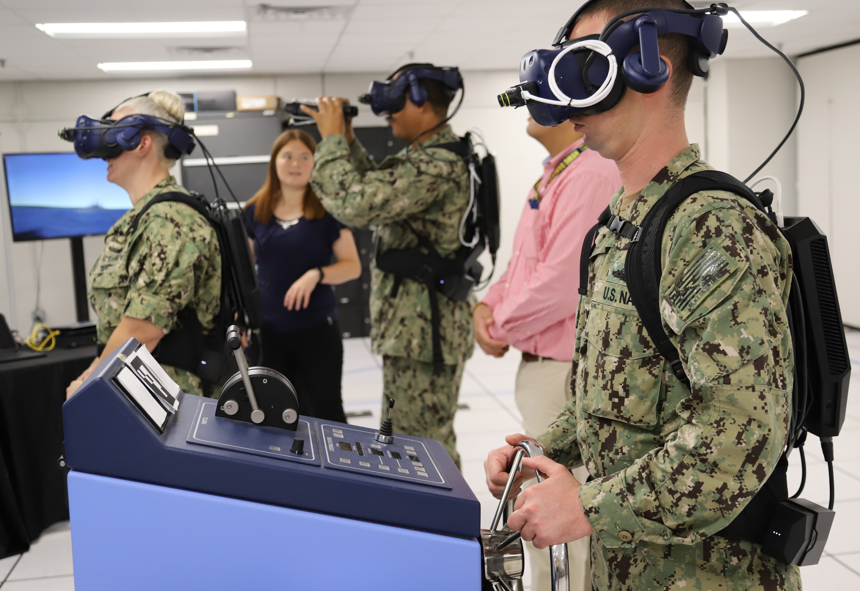
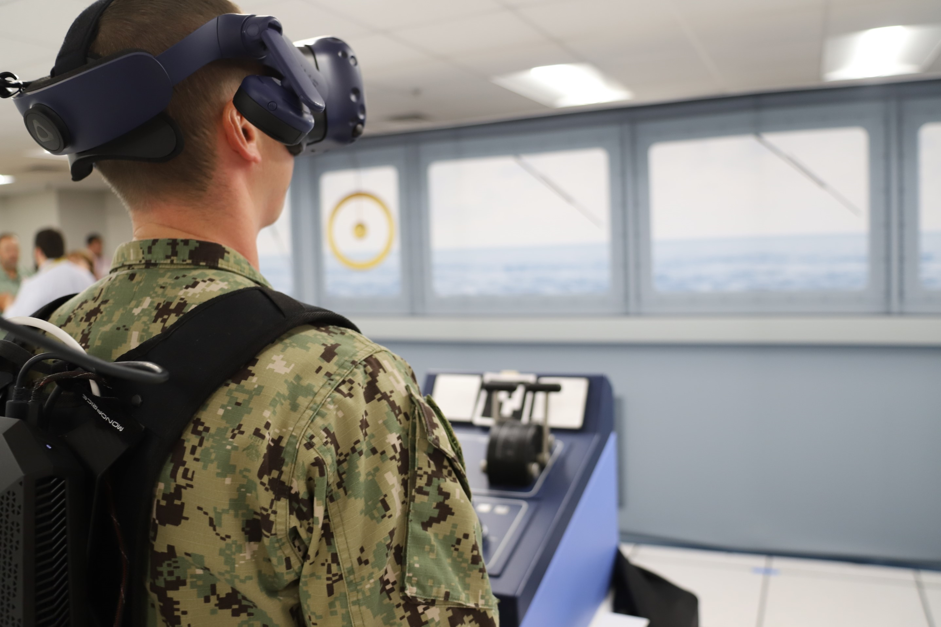
ANTS2 System in use
14

Slide 15
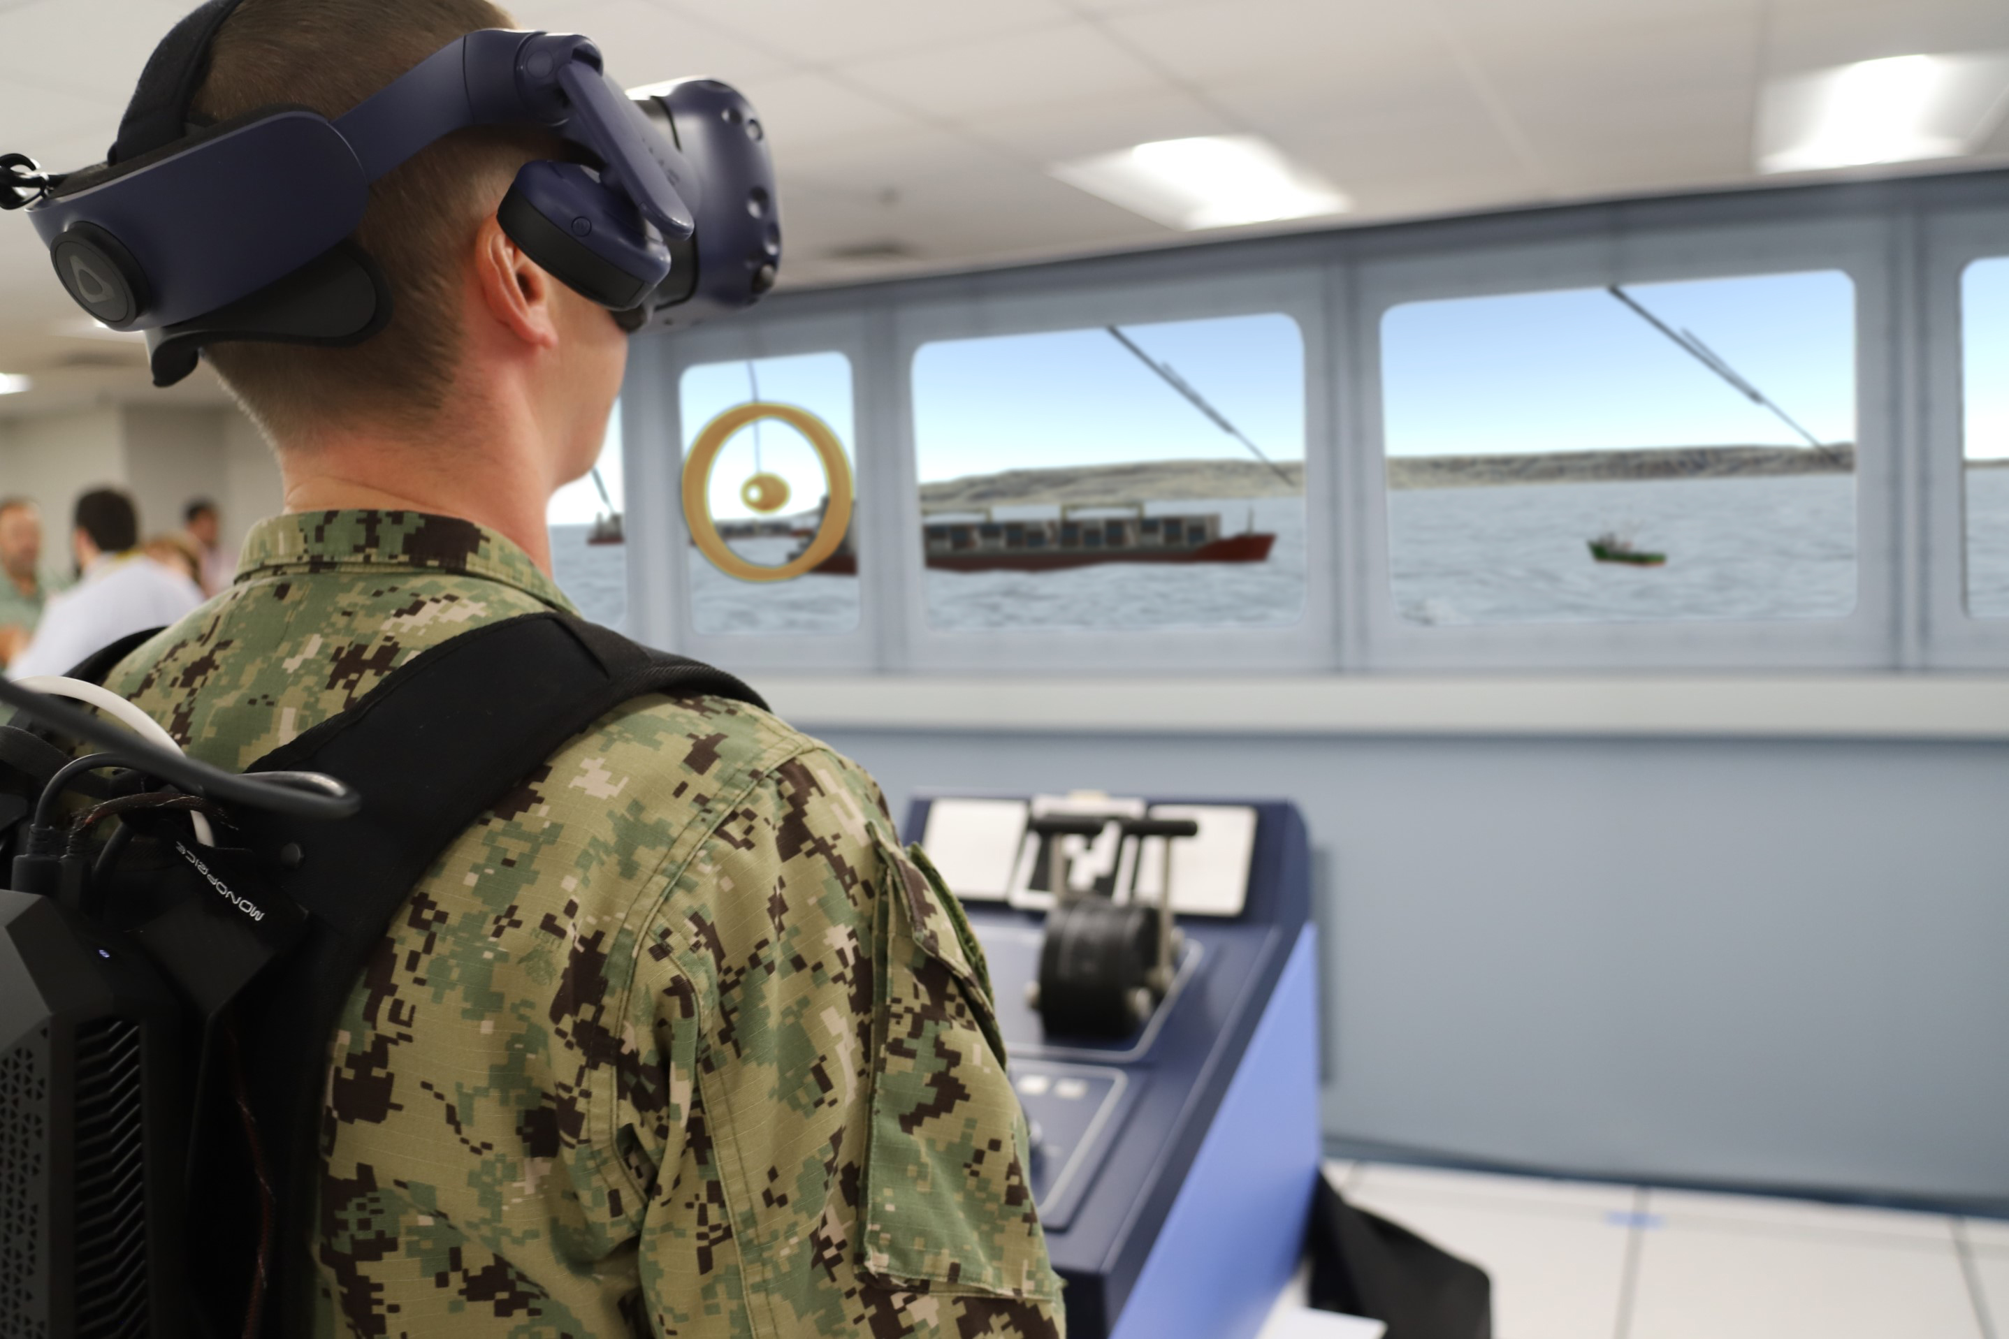
ANTS2 System in use with San Diego Harbor Unity Scene

Slide 16
Fully Immersive Simulation Headset View

Slide 17
Accomplishments and Conclusions
Successfully demonstrated the capability to tie a bridge team into a Navy training scenario leveraging FST architectures
Watch standers were able to perform their expected rolls with simulated systems and equipment provided by the virtual environment
Use of VR/ MR enabled by the Unity3D and simulated communication circuits provided a suitable environment for navigation team training
All systems were synced from surface search radar, charting software (VMS), and all visuals (bridge, aft, port/stbd lookouts)
Unable to test on ship due to COVID restrictions at the end of the project. A laboratory bridge scene was used to prove the capability.

Slide 18
Acknowledgements
Office of Naval Research – Code 34
Naval Surface Warfare Centers Dahlgren Division Dam Neck Activity (NSWCDD DNA)
Naval Simulation Centers Atlantic/Pacific
Joint After Action Review (JAAR)
Naval Air Warfare Center Training Systems Division (NAWC TSD)
Naval Surface Warfare Center Philadelphia Division (NSWC PD)
Naval Surface Warfare Center Corona
Huntington Ingalls Industries (HII)
Arorae Corporation (ARO)
Discovery Machine Interactive (DMI)

Slide 19
Contact Information
Matthew Legg
Naval Surface Warfare Centers Dahlgren Division Dam Neck Activity
Virginia Beach, Virginia
Matthew.f.legg2.civ@us.navy.mil
Corey Guilbault
Naval Surface Warfare Centers Dahlgren Division Dam Neck Activity
Virginia Beach, Virginia
Corey.a.guilbault.civ@us.navy.mil
Richard Gaughen
Naval Surface Warfare Centers Dahlgren Division Dam Neck Activity
San Diego, California
Richard.t.gaughen.civ@us.navy.mil

