Slide 1

Requirements for Simulation of the Future Operating Environment and Multi-Domain Operations
Per-Idar Evensen & Helene Rødal Holhjem
Norwegian Defence Research Establishment (FFI)

Slide 2
Agenda
Background
The future operating environment 2025–2045
Characteristics
Important technologies
Multi-domain operations (MDO)
Underlying idea
Challenges
The way forward
Simulation of MDO
Typical use cases for experimentation within MDO
Requirements for synthetic environment
Notes:
(Per-Idar – 0:30)
First, we will go through the background for this work.
Then, we will look at how the future operating environment is envisioned to be like in a 20-year perspective and what technologies are expected to dominate on the battlefield.
Next, we will look at the underlying idea of multi-domain operations, challenges with MDO, and the way ahead.
Finally, we will discuss simulation of MDO, typical use cases for experimentation within MDO, and requirements for a synthetic environment.

Slide 3

Background
Need to establish a capability for simulation of the future operating environment and MDO for concept development, experimentation, and analysis
Study:
Envisage/describe:
- Future operating environment
- Multi-domain operations
Define requirements for synthetic environment:
- Tactical/engagement level
- Operational level
Evaluate available simulation tools based on the requirements
Notes:
(Per-Idar – 1:00)
There is now a big focus on MDO, and we need to establish a capability for simulation of MDO at FFI.
We are therefore conducting a study that has three phases:
1. Envisage the future operating environment and MDO based on recent literature.
2. Define requirements for a synthetic environment for simulation of the future operating environment and MDO at the tactical and operational levels.
3. Evaluate available simulation tools based on the requirements.
<Click!>
This paper describes the results from the first two phases of this study.

Slide 4
The Future Operating Environment 2025–2045
Characteristics (1 of 2):
Increasingly complex, lethal and ambiguous
Adversaries will adopt hybrid strategies that blur the distinction between war and peace
Increased operational tempo
Effects will be delivered in all domains (land, sea, air, space and cyberspace)
Space and cyberspace will become increasingly important
Include dense urban environments
More and better sensors, networked and combined with AI for data analysis, are expected to enable very good situational awareness, in near real time
Increasingly difficult for military forces to stay hidden
Surprising an adversary will be more difficult
Notes:
(Per-Idar – 1:00)
Overall, the future operating environment is expected to become increasingly complex, lethal, and ambiguous.
Adversaries will adopt hybrid strategies that blur the distinction between war and peace.
The operational tempo in high-intensity operations is expected to increase.
Effects will be delivered in all domains, and the space and cyberspace domains will become increasingly important.
Because of population growth and increased urbanization, the future operating environment can be expected to include dense urban environments.
More and better sensors, connected through networks and combined with AI for data analysis, are expected to enable very good situational awareness, in near real time. This will make it increasingly difficult for military forces to stay hidden, and surprising an adversary will be more difficult.

Slide 5
The Future Operating Environment 2025–2045
Characteristics (2 of 2):
Adversaries are expected to make extensive use of anti-access (A2) and area denial (AD) capabilities
Technology will be essential and a key driver of military change
Technological developments are expected to be increasingly intelligent, interconnected, decentralized, and digital
Will lead to military capabilities that are increasingly autonomous, networked, multi-domain, and precise
Increased proliferation of technology will make gaining and sustaining technological advantage increasingly challenging
Notes:
(Per-Idar – 1:00)
Adversaries are expected to make extensive use of sophisticated anti-access and area denial capabilities.
Technology will be essential and a key driver of military change.
Overall, technological developments are expected to be increasingly intelligent, interconnected, decentralized, and digital, and this, in turn, will lead to capabilities that are increasingly autonomous, networked, multi-domain, and precise.
Finally, it is expected that increased proliferation of technology will make gaining and sustaining a technological advantage increasingly challenging.

Slide 6
The Future Operating Environment 2025–2045
Important technologies:
Artificial intelligence (AI)
Autonomous and unmanned vehicles
Quantum technologies
Sensor technology
Information technology (IT)
Bio and human enhancement technologies (BHET)
Additive manufacturing
Hypersonic technologies
Advanced long-range precision fires
Directed energy weapons
Cyber and electronic warfare tools
Anti-satellite weapons
Important technologies:
Artificial intelligence (AI)
Autonomous and unmanned vehicles
Quantum technologies
Sensor technology
Information technology (IT)
Bio and human enhancement technologies (BHET)
Additive manufacturing
Hypersonic technologies
Advanced long-range precision fires
Directed energy weapons
Cyber and electronic warfare tools
Anti-satellite weapons
Important technologies:
Artificial intelligence (AI)
Autonomous and unmanned vehicles
Quantum technologies
Sensor technology
Information technology (IT)
Bio and human enhancement technologies (BHET)
Additive manufacturing
Hypersonic technologies
Advanced long-range precision fires
Directed energy weapons
Cyber and electronic warfare tools
Anti-satellite weapons
Notes:
(Per-Idar – 0:30)
These are the technologies that are anticipated to be most important for the future operating environment in a 20-year perspective.
Disruptive effects will often occur through combinations of new technologies, and two examples of combinations that have the potential to highly influence the development of future capabilities are:
<Click!>
- IT, AI, and autonomous and unmanned vehicles
<Click!>
- Sensor technology, quantum technologies, and AI

Slide 7
Essential question:
How can we conduct successful military operations in this envisioned future operating environment?
Proposed solution:
Multi-domain operations (MDO)
Notes:
(Per-Idar – 0:30)
An essential question is: How can we conduct successful military operations in this envisioned future operating environment?
<Click!>
The proposed solution is multi-domain operations.

Slide 8
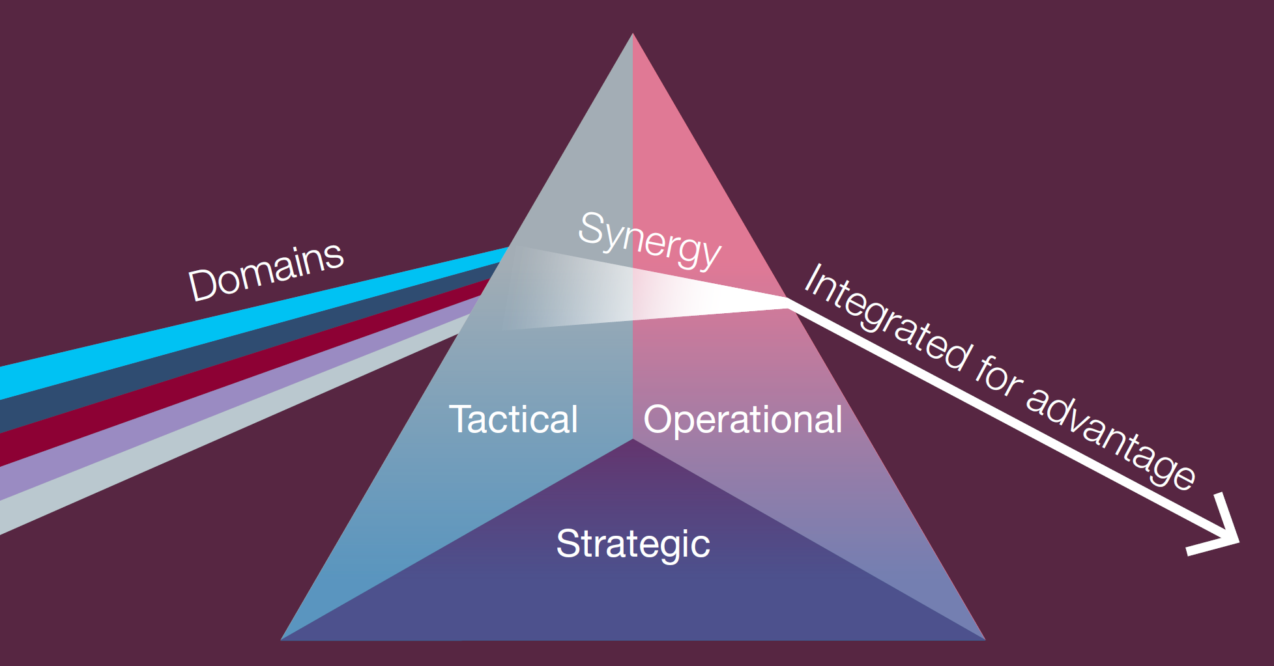
Multi-Domain Operations (MDO)
Underlying idea:
Seamless integration of capabilities and activities in all the operational domains (land, maritime, air, space, and cyberspace), to present the enemy with multiple simultaneous dilemmas and achieve overwhelming superiority in time and space on the battlefield
(UK MOD, Multi-Domain Integration, Joint Concept Note 1/20, 2020)
Notes:
(Per-Idar – 0:30)
The underlying idea of MDO is seamless integration of capabilities and activities in all the operational domains, to present the enemy with multiple simultaneous dilemmas and achieve overwhelming superiority in time and space on the battlefield.

Slide 9
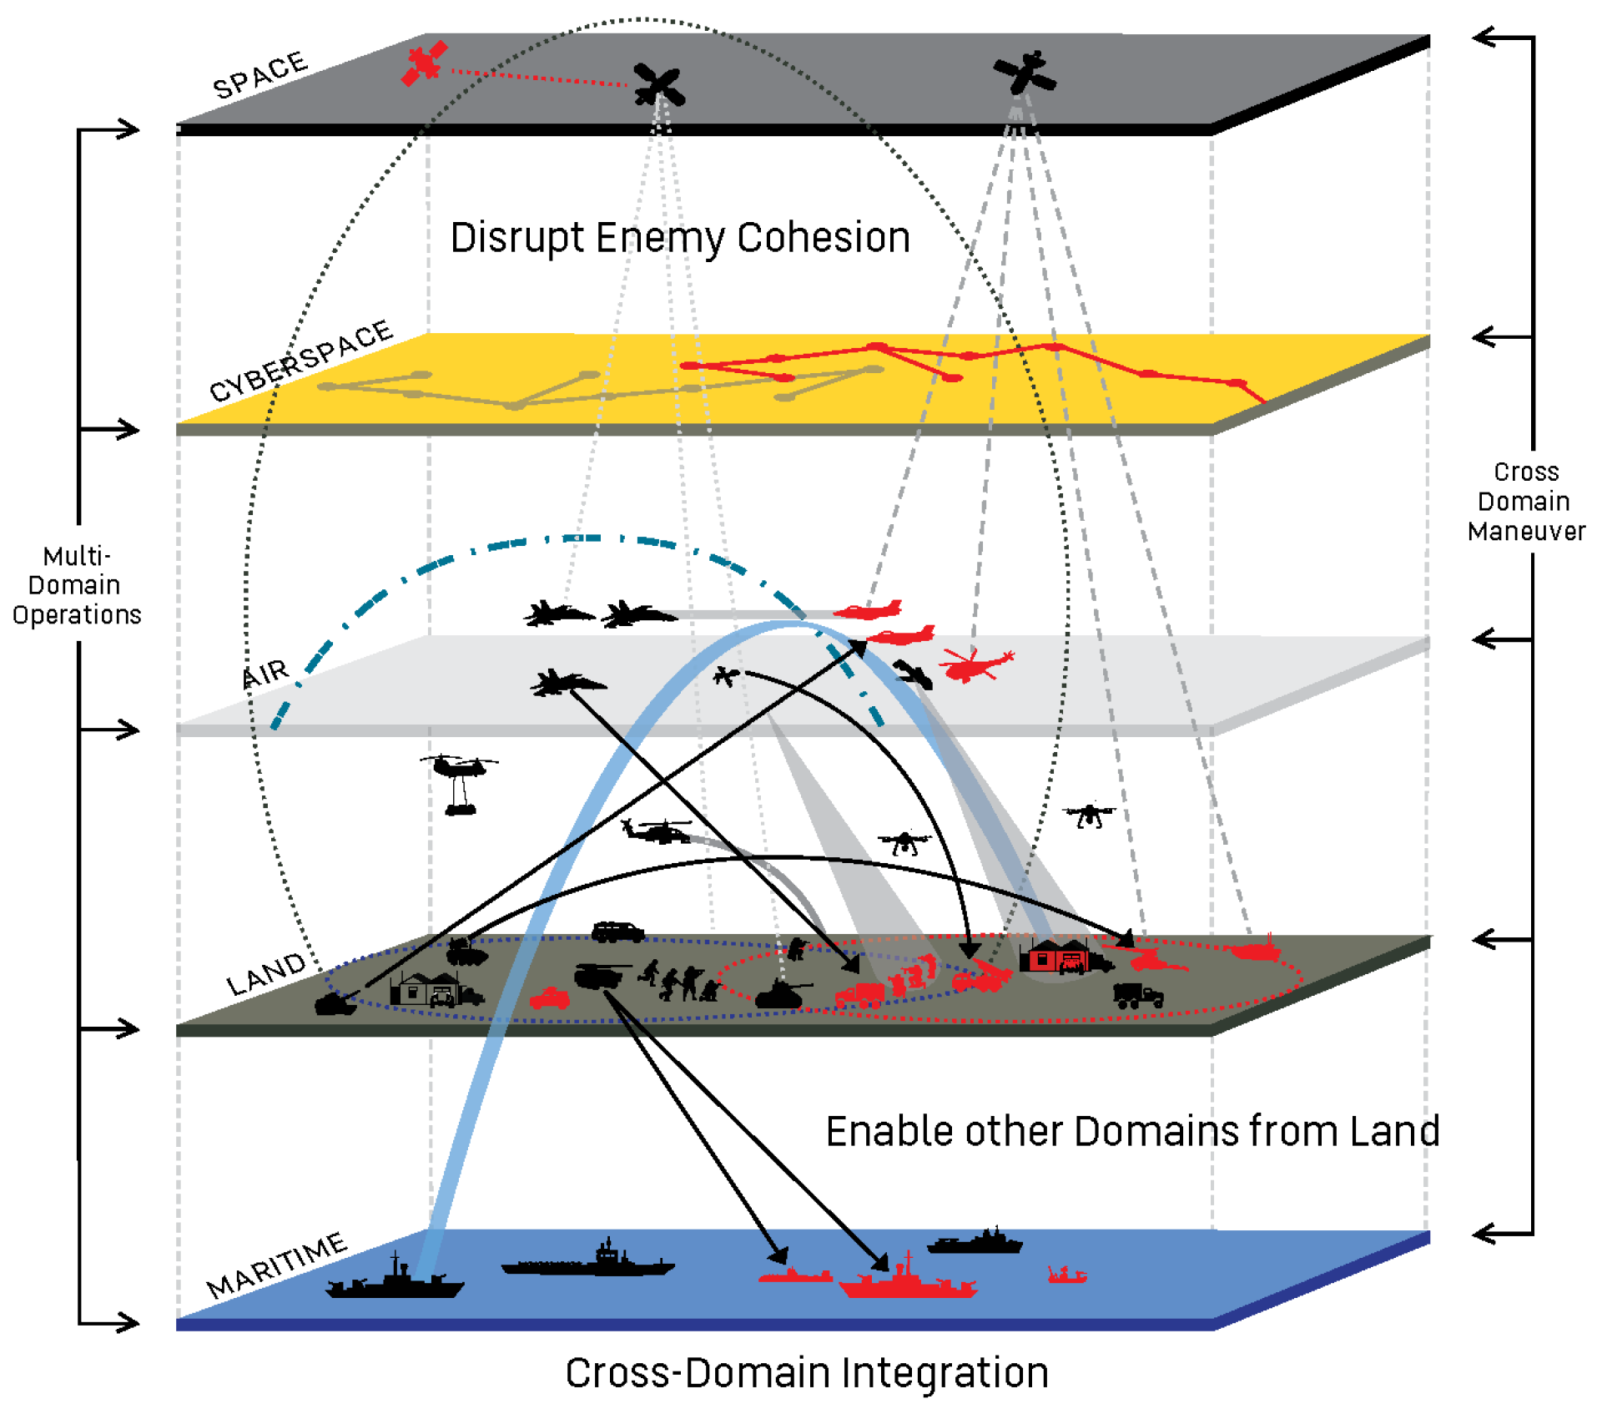
Multi-Domain Operations (MDO)
Concept for future operations
Natural evolution of joint operations
Increased emphasis on the space and cyberspace domains
More focused on:
Seamless integration and synchronization of capabilities from all domains at all levels of warfare
Increased operational tempo
Synchronization with non-military activities
(U.S. Army, America’s Army: Ready Now, Investing in the Future, FY19-21 Accomplishments and Investment Plan, 2020)
Notes:
(Per-Idar – 0:30)
MDO can be seen as a natural evolution of joint operations, but it has increased emphasis on the space and cyberspace domains.
It is also more focused on:
- Seamless integration and synchronization of capabilities from all domains at all levels of warfare
- Increased operational tempo
- Synchronization with non-military activities

Slide 10
Multi-Domain Operations (MDO)
Challenges:
Requires synchronization of capabilities, activities and actions that literally range from the speed of light to walking pace
Key challenge: integration and synchronization of kinetic actions with non-kinetic actions
Requires highly trained commanders and personnel that can think, plan and act across all domains and environments
Effective multi-domain command and control (C2) requires a resilient technical architecture, flexible command relationships, and multi-domain control measures
NATO: interoperability, shared situational awareness, coordinating synchronic operations, and training for conducting MDO
Maturity of the technology which effective MDO will rely upon, e.g., a high level of assured communications connectivity
Notes:
(Per-Idar – 1:30)
The concept of MDO is quite ambitious, and there are several challenges that need to be resolved to conduct effective MDO.
It requires the synchronization of capabilities, activities, and actions that literally range from the speed of light to walking pace. A key challenge is effective integration and synchronization of kinetic actions with non-kinetic actions in the cyberspace domain and information dimension.
It also requires highly trained commanders and personnel that can think, plan, and act across all domains and environments.
Effective multi-domain C2 requires a resilient technical architecture, flexible command relationships, and multi-domain control measures.
Critical challenges for NATO are interoperability, shared situational awareness, coordinating synchronic operations, and training for conducting MDO.
There are also concerns regarding the maturity of the technology which effective MDO will rely upon, for example a high level of assured communications connectivity.

Slide 11
Multi-Domain Operations (MDO)
The way forward:
MDO is an operational concept
The MDO concept must be further developed, tested, and validated through experimentation
M&S and wargaming will be essential in this work
A successful concept, that demonstrates significant credible improvement, will ultimately be transitioned into operational doctrine
Notes:
(Per-Idar – 0:30)
MDO is an operational concept.
Going forward, this concept must be further developed, tested, and validated through experimentation.
M&S and wargaming will be essential in this work.
A successful concept, that demonstrates significant improvement, will ultimately be transitioned into operational doctrine.

Slide 12
Simulation of MDO
Very few of the simulation tools currently available can represent combat elements, capabilities, and effects in all operational domains at a sufficient and balanced level of fidelity:
E.g., very few simulation tools include models of capabilities in the space and cyberspace domains
Future MDO will be inherently much more complex to execute than current operations of the same scale:
Higher diversity of combat elements and capabilities from all operational domains
Higher requirements for synchronization of capabilities, activities, and actions
Higher requirements for operational tempo
In the same way, M&S of MDO will also be much more complex
Notes:
(Per-Idar – 1:00)
Very few, if any, of the simulation tools currently available can represent combat elements, capabilities, and effects in all domains at a sufficient and balanced level of fidelity. For example, very few simulation tools include models of capabilities in the space and cyberspace domains.
Future MDO will be inherently much more complex to execute than current operations of the same scale, due to:
- Higher diversity of combat elements and capabilities from all domains
- Higher requirements for synchronization
- Higher requirements for operational tempo
In the same way, M&S of MDO will also be much more complex.

Slide 13
Typical Use Cases for Experimentation within MDO
Need for experimentation with:
New C2 solutions
New technologies
Tactics, techniques, and procedures (TTP)
Synchronization of effects from multiple domains
Coordination and synchronization of activities
Handling increased complexity
Resource allocation between parallel missions
Combat structures
Force structure elements
Notes:
(Per-Idar – 0:30)
Typical use cases within MDO where there is need for experimentation are:
- New C2 solutions
- New technologies
- Different tactics, techniques, and procedures
- Synchronization of effects from multiple domains
- Coordination and synchronization of activities
- Ways of handling increased complexity
- Resource allocation between parallel missions
- Different combat structures
- Different force structure elements
Helene will now go through the requirements for a synthetic environment.

Slide 14
Requirements for Synthetic Environment
When using simulation for experimentation and analysis, the specific requirements for the synthetic environment will ultimately depend on the objective of the simulation (e.g., to answer a specific research question)
Overall requirements:
Holistic synthetic environment as a basis for experimenting with, and analyzing, combat across all operational domains in an operating environment 5–20 years into the future
Support for simulations at the tactical/engagement level and operational level
Preferable with one single simulation system that supports all domains
Support both human-in-the-loop simulations and fully automated closed-loop simulations
Notes:
(Helene – 1:30)
When using simulation for experimentation and analysis, the specific requirements for the synthetic environment will ultimately depend on the objective of the simulation, for example to answer a specific research question.
Nevertheless, the overall requirement is that we need a holistic synthetic environment as a basis for experimenting with, and analyzing, combat across all domains in an operating environment five to twenty years into the future.
We prefer to use the same simulation system for simulations at the tactical level and operational level, because acquiring, administering, and maintaining only one main simulation system will be cheaper and require fewer human resources.
For the same reasons, and since the interactions between the domains will be much more extensive in MDO, we also prefer to use one single simulation system that supports all domains, instead of connecting two or more simulation systems that only support a subset of the five domains.
Furthermore, we need a simulation system that supports both human-in-the-loop simulations and fully automated closed-loop simulations.

Slide 15
Requirements for Synthetic Environment
Aggregation level:
Individual vehicles (ground vehicles, aircraft, ships, etc.)
Number of entities:
Minimum 10,000 entities (Norwegian and allied forces + symmetric adversary + civilian entities)
Resolution and fidelity:
Preferable with physics-based models
Resolution and fidelity must be:
Sufficient to represent the difference in performance between combat systems
Balanced throughout the model to avoid systematic biases
Notes:
(Helene – 1:30)
It would be problematic to use aggregate-level models for detailed simulations of MDO, due to lack of calibration data and need for higher flexibility in more ad hoc composition of different combat elements, so the synthetic environment must represent individual vehicles.
The sum of Norwegian and allied forces, a symmetric adversary, and civilian entities implies a requirement of at least 10,000 entities.
We prefer physics-based models because it is usually easier to find data for configuration and calibration of such models, but probability-based models at the entity-level are also acceptable.
The resolution and fidelity must be both:
1. Sufficient to represent the difference in performance between combat systems
2. Balanced throughout the model to avoid systematic biases

Slide 16
Requirements for Synthetic Environment
Synthetic natural environment:
Spherical whole earth model (for realistic simulation of satellites, aircraft, missiles, long-range fires, and long-range sensors)
Represent areas of interest at DTED Level 3, or better (for realistic simulation of movement, cover and concealment, and coverage of sensors and communication systems)
Different land-cover materials with different trafficability (for realistic simulation of movement of ground forces)
Vegetation and bodies of water
Static human-made structures and dense urban environments
Underwater environment with bathymetric data at DTED Level 1, or better
Weather and climate (for realistic simulation of movement of forces and effectiveness of sensors)
Notes:
(Helene – 0:30)
Regarding the synthetic natural environment, it must use a spherical whole earth model and represent:
- Areas of interest at DTED Level 3
- Different land-cover materials with different trafficability
- Vegetation and bodies of water
- Static human-made structures and dense urban environments
- Underwater environment with bathymetric data
- Weather and climate

Slide 17
Requirements for Synthetic Environment
Simulation models of capabilities and effects in all domains:
Military platform types from the three traditional domains (including weapons/effectors and effects and passive and active sensors)
Satellites and anti-satellite weapons
Communication systems and infrastructure and capabilities and effects in the cyberspace domain
C2 units; intelligence, surveillance, target acquisition, and reconnaissance (ISTAR) units; combat engineering units; logistics and supply units; and medical units
Flexible C2 structure, which enables representation of a cross-domain kill web of sensors, C2 nodes, and effectors, where combat elements from different domains can be transferred between commanders and put together for different tasks/missions during runtime
Notes:
(Helene – 1:30)
For simulation of MDO it is crucial with representation of capabilities and effects in the three traditional domains at a balanced level of fidelity, in addition to representation of capabilities and effects in the cyber and space domains.
The synthetic environment must include:
- Simulation models of all main military platform types from the three traditional domains, including effectors and effects, countermeasures and protection systems, decoys, and sensors
- Simulation models of satellites and anti-satellite weapons
- Simulation models of communication systems and infrastructure, communication and data transfer, and the most important capabilities and effects in the cyberspace domain for conducting electromagnetic warfare and cyberspace operations.
- Basic simulation models of C2, ISTAR, combat engineering, logistics and supply, and medical units.
It must also support a flexible C2 structure that enables representation of a cross-domain kill web of sensors, C2 nodes, and effectors, where combat elements from different domains can be transferred between commanders and put together for different tasks/missions during runtime.

Slide 18
Requirements for Synthetic Environment
Behavior models:
For most important tasks/missions for different types of entities in all domains
For pattern of life for civilian entities
Preferable with AI-based behavior models where the entities can make intelligent decisions
User interface (UI) for human-in-the-loop simulations:
Easy-to-use UI for commanding and controlling forces in all domains
Planning operations (assigning orders, synchronizing capabilities, activities, and actions)
Customization:
Configuration of entities, weapons, sensors, and behavior models
Application programming interface (API) for developing own models and extensions
Notes:
(Helene – 1:30)
Human behaviors are complex and very challenging to model, and the increased complexity of MDO will entail even more complex behavior models with more factors to consider, for example synchronization of effects and threats from all domains.
The synthetic environment must include basic behavior models for the most important tasks/missions for different types of combat entities in all domains and basic behavior models for pattern of life for civilian entities. We prefer AI-based behavior models where the entities can make intelligent decisions.
For human-in-the-loop simulations, it must have an easy-to-use user interface for commanding and controlling forces in all domains. It must also have tools for planning operations, including assigning orders to forces and synchronizing capabilities, activities, and actions.
We currently do not know exactly what future platform types, effectors, sensors, and behavior models we want to experiment with going forward. The synthetic environment must support customization of entities, weapons, sensors, and behavior models, and it must have an API for developing own models and extensions.

Slide 19
Requirements for Synthetic Environment
Interoperability:
Distributed Interactive Simulation (DIS) and High Level Architecture (HLA)
C2 systems
Data collection:
Logging of relevant data, including events, actions, effects, and entity state variables
Playback capabilities of logged data for after-action review (AAR)
Real-time visualizations of combat performance and effectiveness data
Notes:
(Helene – 0:30)
It must support existing interoperability standards for distributed simulations such as DIS and HLA and preferably also be interoperable with C2 systems.
It must support logging of relevant data, including events, actions, effects, and entity state variables.
It should support playback of logged data for after-action review and real-time visualizations of combat performance and effectiveness data.

Slide 20
Summary and Conclusion
Future MDO will be much more complex to execute than current operations:
In the same way, M&S of MDO will also be much more complex
We have outlined a set of general requirements for a synthetic environment for simulation of the future operating environment and MDO
We will use these requirements to evaluate available simulation tools and finally test the most promising candidates more thoroughly
A single simulation system that meets all our requirements may not yet exist:
May have to go for an interim solution that meets as many of the requirements as possible
Notes:
(Helene – 1:00)
Future MDO will be much more complex to execute than current operations, and in the same way, M&S of MDO will also be much more complex.
We have outlined a set of general requirements for a synthetic environment for simulation of the future operating environment and MDO.
We will use these requirements to evaluate available simulation tools and finally test the most promising candidates more thoroughly.
We prefer to have one simulation system that supports all domains, but a single simulation system that meets all our requirements may not yet exist. Still, we need to establish a capability for simulation of MDO at FFI as soon as possible, so we may have to go for an interim solution that meets as many of the most important requirements as possible.

Slide 21
Questions?
Contact info:
per-idar.evensen@ffi.no
helene-rodal.holhjem@ffi.no

