Slide 1

Human-AI Common Ground for Training and Operations
Paper 24-135
Presented by: Spencer Lynn, PhD¹
^{SLynn@cra.com}
with Susan Latiff, PhD¹; William Norsworthy, Jr¹; Mark Turner, PhD²; and Peter Weyhrauch, PhD¹
¹ Charles River Analytics, Cambridge, MA
² Case Western Reserve University
Notes:
I’m Spencer Lynn,
and my colleagues and I are thrilled to tell you about our approach and designs
for Human-AI Common Ground for Training and Operations

Slide 2
Human-AI Common Ground
How do we create AI teammates capable of meaningful and trusted teaming with humans?
Goals of this talk:
Describe characteristics of human concepts and categorization that set them apart from most work in AI
Illustrate design principles and a novel computational approach to implementing those characteristics
Notes:
So: How do we create AIs capable of meaningful and trusted teaming with humans?
“Common ground” is a metaphor central to answering this questions because it’s central to how humans working together effectively
It refers to congruent knowledge, beliefs, and assumptions among a team about their objectives, context, and capabilities.
[click]
In this presentation, I’ll:
Describe characteristics of human concepts and categorization that set them apart from most work in AI
And illustrate design principles for a novel computational approach to implementing those characteristics
The characteristics evolved in animals over 500 MY of needing to operate bodies the in the world
So, rather than being evolved to be “intelligent” as we think of intelligence now, brains evolved to support what’s sometimes called the “four Fs”
Feeding, Fighting, Fleeing, … and reproduction (that’s not my joke)
The approach is based on this evolutionary, embodied perspective on intelligence, in which the primary “goal” of organic intelligence is basically maintenance of physiological allostasis.

Slide 3


Human-AI Common Ground
Between humans and machines
Common ground is about setting and exchanging information about the machine’s state
Among humans
Common ground occurs at the level of concept structure – we construct and shape concepts in the listener’s mind
“Hey Siri, take me
to the airport.”
Notes:
Current AI possesses impoverished conceptual structures relative to a human teammate and this is one reason human-AI common ground has been limited.
Current examples we’re all familiar with are often about UI-related issues
For example, parsing variable input: Getting directions to the airport might be said as: “Take me to the Orlando Airport”, or “Show me directions to MCO”.
Or, making output transparent: A human using a device geolocated to Orlando says: “Take me to the airport” and the AI responds: “Okay, getting directions to the Orlando International Airport.”
But among humans
An instructor uses dialog to activate and shape concepts in the student’s mind, contextualizing and refining concepts until shared perceptions are categorized (that is, understood) in a common way.
Human concepts are not merely variables to be parameterized but are constructed during perception to support behavior (such as the four Fs).
This talk is about how human concepts come to be this way, and how we might provide a similarly constructive architecture for AI.

Slide 4


Two Points About Brains and Organic Intelligence
Perception is goal-oriented
How we understand what we see (or hear, etc.) is guided by our current goals
A chair can be categorized (i.e., understood) as a stepstool when you need something to stand on.
Notes:
So, two points about brains and organic intelligence:
First, how we understand what we see is dependent on our goals
For example, if your task is to change a lightbulb, you might look around the environment to see what affords achieving that goal/solving that problem. If there’s no step stool around, you could use a chair.
Think about what that means: you don’t have a dictionary entry that says chairs are for sitting, but, secondarily, can be used as stepstools.
Instead, you have a problem whose solution matches your needs to decompositions of what you see in the environment, and those decompositions (e.g., structural support of chair legs and seat) are identified with respect to your body (e.g., shape, weight, range of motion, sensory capabilities).
The significance of this point is that:
What we call “properties” and “functions” of an object are not intrinsic to the object but temporary/ad hoc, “situated” features of the shape of the object, the body, and the affordances required by current goals.

Slide 5




Two Points About Brains and Organic Intelligence
2. Categories are constructed
Spawned at the time of perception from prior knowledge and current context to understand or explain sensory input with respect to goals
Game-show example: Ad hoc categories
“Things you forget to pack for a trip”
Constructed at the time of need
Serves a goal
Enables reasoning
Notes:
The 2nd point is that categories (the understanding we impose on our perceptions) are generated or “constructed” at the time of need from prior knowledge and current context
“Ad hoc” categories such as the “things you forget to pack for a trip” are an obviously constructed example.
Generated on-the-fly to serve a current goal, like to reason about packing for home before you leave IITSEC
No preexisting label
Clearly subjective
The significance of this point is that:
Categories constructed to understand and reason about the world with respect to one’s goals (at least on the embodied cognition view I’m outlining here)
Like properties of objects, categories themselves are not objectively real in some Platonic sense, even though we train AIs on them as if they were

Slide 6
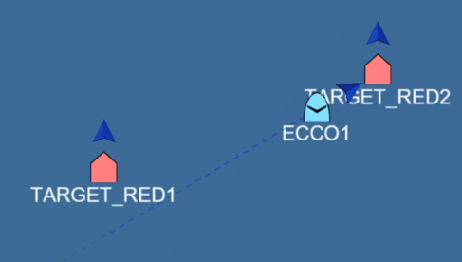
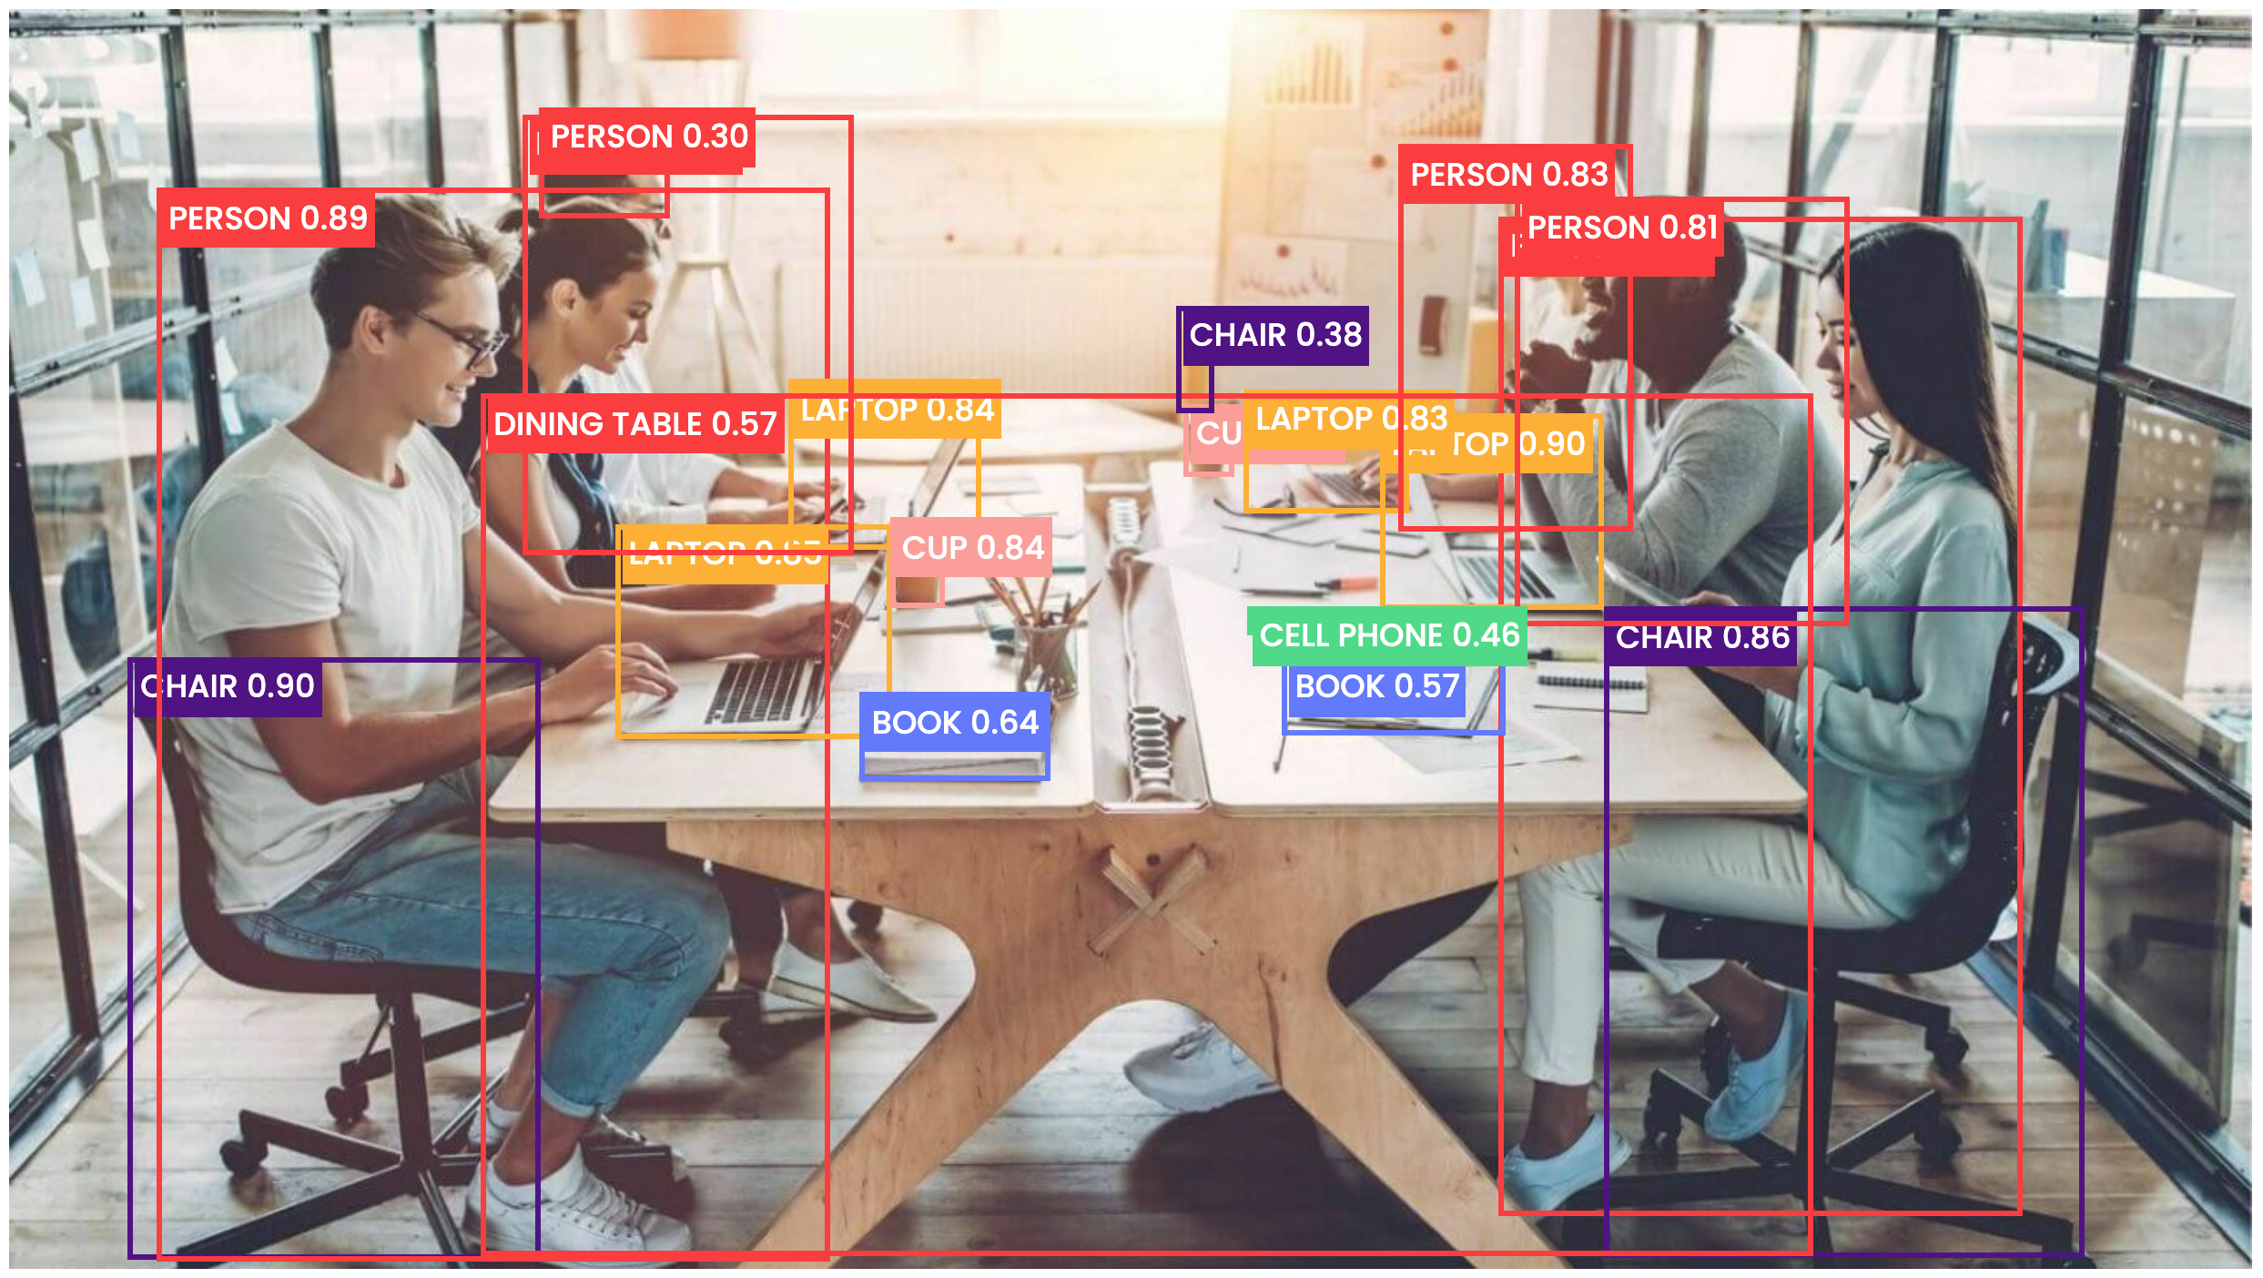
Two Points About Brains and Organic Intelligence
Let’s consider that all categories are constructed ad hoc
Is drone ECCO1 “near” target RED2? It depends on ECCO1’s goal
Conventional labeled categories are the minority: static, brittle concepts
Notes:
So, this flexibility of constructing categories to understand perceptions based on needs is part of the challenge for human-AI common ground. Human conceptualization is malleable in this way -- we easily categorize and act on a “chair”-shaped blob as if it were a step tool when it suits our needs.
And what if all categories are constructed like this? The “meaning” of words exchanged in discourse is constructed and malleable.
Can we understand the perception of the spatial relationship between ECCO1 and RED2, on the left here, as an example of the concept [near]?
Not without a goal, even if we knew the size and distances of ECCO1 and the targets
Conventional labeled categories, on the right, are the minority – they are useful shortcuts….until they aren’t, at which point they are brittle and common ground breaks down.
It doesn’t break down because, “Hey, that’s an oddly shaped chair the vision system can’t recognize”
It breaks down because to achieve my goal I need to put that chair to some other use.
But AI concepts are fixed to the goal of the person who labeled the training data or designed the unsupervised reward function
What will it take to have AI with flexible enough conceptual structure that different goals can lead it to understand the environment with respect to those goals – and so have teammate-like common ground?

Slide 7

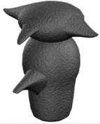

Three characteristics of human concepts that AI concepts will need for common ground
Concept Blending
  Combine features of known objects in novel configurations or combinations: Creates a new concept, the blend
  Reason about the blend by applying the knowledge and entailments inherited from the contributing source concepts
A greeble
Notes:
It will take implementing characteristics of human conceptual structure that are the mechanisms behind goal-oriented perception and category construction
A first characteristic is the blending of conceptual knowledge
Blending combines features of existing concepts in ad hoc or even novel configurations to create a new concept, the blend
Many blends are conventionalized in language
Compound nouns are an example: house-boat, boat-house, mother-ship
But others are “living”
Like, prepositions and other polysemous words, so: “on the table” “on target” and “on time”– are not unrelated meanings of “on” and “on” is blended with the other concepts to construct a meaning for the phrase
Blending raises a question: what motivates the inheritance of specific features from the source concepts into the blend?
A mothership is not the union of necessary and sufficient properties of “mothers” and “ships”
It’s one’s goals that motivate the blend
The goal foregrounds particular features to create a blend that has meaning with respect to the goal (that might sound circular but it’s related to causal modeling)
If your goal is to understand the flight characteristics of an Osprey, you blend relevant knowledge of heavy lift helicopters and fixed-wing transports, not irrelevant knowledge, such as #windows and their cost): The goal directs the categorization of the perception – so, a novel compound like “heliplane” might typically refer to flight characteristics.
I’m about to start talking about greeble. And, unless you are a perceptual neuroscientist or scifi special effects nerd, you probably don’t know what greeble is. I assert that, because I’m talking about it in this context and you don’t know what it is, you have spawned an implicit “goal” to try to understand something about it.
[click] Here’s a greeble (from neuroscience). It decontextualized: It might be a 15-ton stone monolith.
But, when you hear the sentence “The greeble is on the table” you infer features of greebles by blending the concept [on] with [the table] and use those inferences to create a novel concept of [greeble], with uncertain, yet experientially constrained, attributes.
[click] Specifically, you might infer that greebles are physical objects and their size and mass is small enough to fit on and be supported by your prototypical concept of a table.
In a Human-AI teaming context, concept blending provides the flexibility to construct and refine concepts out of prior knowledge. The blend is a categorization of recognized elements into a new concept.
[Skip?] Among humans, that’s often done through dialog, as we’ve just illustrated explaining this slide: taking a concept you already have, “to blend,” (like with a blender) and refining it into a novel bit of technical jargon. We’ve taken some features of the source concept and added other knowledge to it by way of example. And you might see that this new concept of blending is different – it’s more generative than the destructive connotation of using a blender. The jargon term is not a secondary definition nor an ontological child or subclass. It’s a new concept constructed on-the-fly from parts and attributes of multiple prior-known concepts.

Slide 8
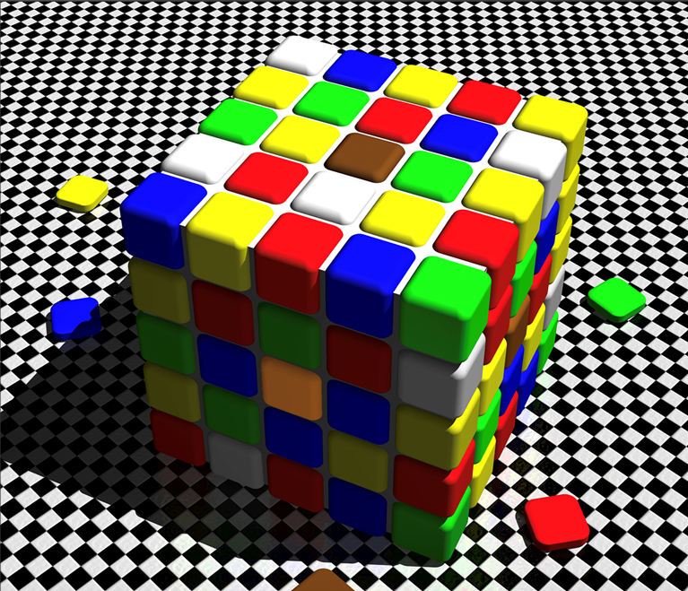
Three characteristics of human concepts that AI concepts will need for common ground
Situated Categorization
  Context influences which concepts are used to categorize (understand) a percept
    Chair vs stepstool
    Flight characteristics of an Osprey
labofmisfits.com
Notes:
Another characteristic of human conceptual structure critical for human-AI common ground is
the influence of context on categorization
“Context” includes the environment, activated concepts, and goals (an “internal” context)
These influence which concepts are used to categorize (understand) a percept
Illustrated with the chair vs stepstool and Osprey examples
Here’s an example of environmental context influencing categorization of color percepts
[click] Many people see the circled tiles as brown and yellow
That’s an act of categorization: applying your concepts of brown and yellow to these tiles to “understand” your perception of them and reason about them.
“Reasoning” is, e.g., saying things like “They’re different” or “I like one more than the other”. You’d take action on them that is driven by how you categorized them.
In this example, the neighboring colors are influencing your understanding
[click] When we drop this brown swatch down across the cube, you can see that what you may understand to be a yellow tile in the lower part of the image is in fact they same pixel value as what you understand to be a brown tile in the upper part of the image.
In a Human-AI teaming context, the situation constrains category construction (e.g., by influencing what source features contribute to a blend) and so influences the resulting understanding of the sensor inputs
The color example raises an interesting issue: Should an AI report pixel values or human color categories? Maybe both: Here, it would be useful for the AI to recognize that the perceived yellowness of the tile is a crafted illusion.

Slide 9
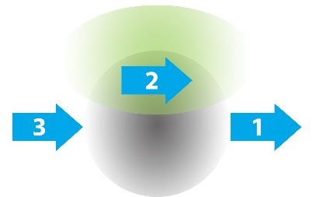
Three characteristics of human concepts that AI concepts will need for common ground
Concept Degeneracy
  Degeneracy refers to the partial overlap of function by multi-functional components
  Different concepts can sometimes be applied equally well to categorize the same perception
  Percepts can be suitably categorized in more than one way
    “more than one way to understand the world”
    The right way is the one that is relevant to your current goals
Is UAV 2 between or beside UAVs 1 and 3?
Notes:
Skip if >12 min in / <13 min remaining to leave a few min for questions
The last characteristic I’ll describe is concept degeneracy,
which means that different concepts can be applied equally well to categorize the same perception
By way of example, here, we’re looking down on three drones traveling in the same direction at the same altitude in a staggered formation and the question is:
What’s the spatial concept relating drone 2 to drone’s 1 and 3?
Drone 2 might between or beside the others
The grey region represents the density function of [between]
The green region represents the density function of [beside]
Darker shading corresponds to higher prior expectation
So here, drone 2 is equally likely to be between or beside the others
In a human-AI teaming context, concept degeneracy allows the teammates to disagree without anyone necessarily being “wrong” in an objective sense. They can then justify their differing categorizations to one another to align their perspectives.
One point of this example is that either concept could suitably be applied; which category you apply may lead to different consequences.
Another point is that perceptions (chair-shaped blobs, colors, spatial relations) don’t have an objective category or true nature
Instead, the “correct” understanding depends on one’s goals, capabilities, and situation

Slide 10
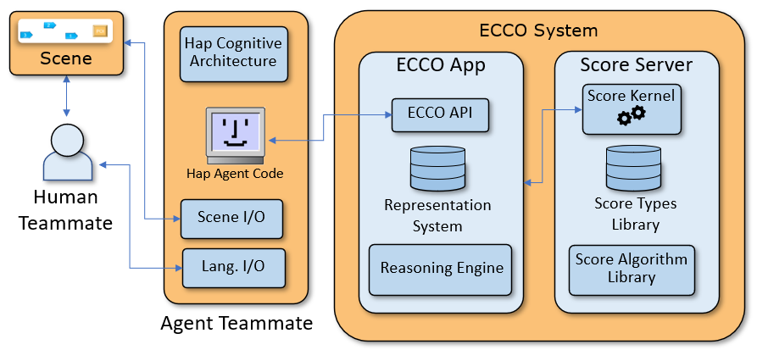
Design Characteristics
Component Architecture
Notes:
Alright, many of these points – about goal-driven perception and categorization, ad hoc nature of properties, constructionism, situatedness, and degeneracy – do not feel intuitive to humans. Nonetheless, they are supported by physiology, neuroscience, and linguistics, and are largely missing from AI.
So, how might they be implemented?
We designed and demonstrated the feasibility of an Embodied Common Concept Ontology, ECCO.
ECCO uses a types-based probabilistic knowledgebase to achieve human-AI common ground at the level of concepts
Our domain of application was scoped to spatial conceptualization and reasoning for a human teamed with an autonomous drone.
For example, our teammates engage in tactical spatial configurations with respect to targets and one another
The team develops common ground concerning simulated scenes that they observe
A controlled language provides a means of communication, but the main focus of ECCO is on congruence of variable conceptual structures (like near, between, and beside) rather than on parsing variable language input
In fact, the language is just ECCO’s underlying programming language; ECCO’s inputs and outputs are very clearly defined, which let us focus on designing data types and interactions to model the conceptual features I’ve been describing.
The ECCO system itself doesn’t care about the agent architecture (that’s the Hap stuff in the middle orange box): it’s intended to provide any agent with concepts that structure a domain of human experience.
ECCO has two main parts:
The ECCO Application maintains a Representation System and a Reasoning Engine
The Score Server (an existing Charles River ontology backend) supports the ECCO Application with a kernel, programming language, and libraries of primitive ontological types and type-specific algorithms.
We have an early prototype of the architecture, which I’ll tell you about.

Slide 11
Design Characteristics: Representation System
Feature | Description
Types | Ontology entries (concepts) are computational types: supports creating new knowledgebase entries that can inherit features of their parent entries
Internal structure | Types have annotations, parts, and attributes that can be distributions, in support of blending, situated categorization, and degeneracy
Depth | Parts and attributes are themselves ontological entries (with their own parts and attributes), to support situated categorization
[context] types | Types that contain an ontology, a language/algorithms that maps symbols to ontology entries, and facts expressed in the language and assigned to exemplars of types
Runtime creation | Novel combinations of ontology parts and attributes can be created programmatically by the system to support blending
Multiple inheritance | A blend is the child of its source types but is not necessarily a strict subtype or example of any of them
Notes:
Cover only 1-4
The representation system is a typed ontology.
ECCO concepts are computational types, and like integers and strings, are built from more primitive types to support creating new types that can inherit from their parents, in support of blending
ECCO types have internal structure: parts and attributes (which can be probabilistic distributions) in support of blending, situated categorization, and degeneracy
And parts and attributes are themselves ontological entries (with their own parts and attributes), to support situated categorization
An example complex type is [context] datatypes, which themselves contain an ontology, a language that maps symbols to ontology entries, and facts expressed in the language and assigned to exemplars of types

Slide 12
Design Characteristics: Reasoning Engine
Key Functions | Description
Categorize observations | Match observed spatial relationships to concepts in the representation system, measure likelihood that a concept explains an observation
Blend concepts | Construct a new concept that has attributes and parts from known types but replaces the parent distributions with observed values and the parent parts with observed instances of those parts
Perform situated categorization | Allow other concepts involved a task or scene to influence categorization by adjusting the distributions of the attributes of candidate concepts
Answer questions | Query the knowledgebase about categorized observations
Infer attribute values | Use information from a blend’s inputs to estimate unknown attribute values
Support action | Solve for relative spatial positions to enable the agent to attain a required spatial relationship with respect to some target
Support lexical entrainment | Interact with human teammate to determine which concept to apply in cases of disagreement or to elicit labels for novel blended concepts
Notes:
Cover only 1-3
The reasoning engine handles type manipulations.
It categorizes observations, which involves matching observed spatial relations to types on the representation system
It blends concepts, constructing a new type that has attributes and parts from known types but replaces the parent distributions with observed values and the parent parts with observed instances of those parts
It performs situated categorization, in which other types involved a task or scene influence categorization by adjusting the distributions of the attributes of candidate types

Slide 13
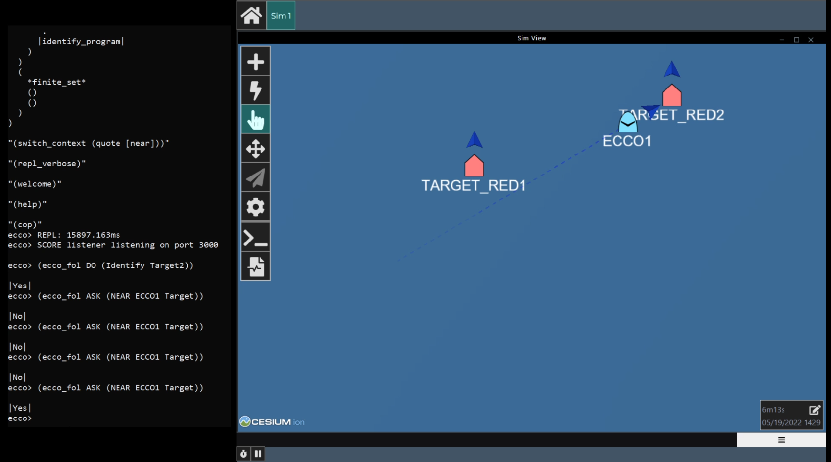
Feasibility Assessment
  Evaluation of ECCO situated categorization
  Established common ground of [near] as situated by mission objective
  Maintained common ground as the objective changed
Notes:
In a simulator, we created an operational vignette illustrating situated categorization.
We asked subject matter experts in computer science, cognitive linguistics, human factors, and other stakeholders to evaluate ECCO human-AI common ground.
In the vignette, mission objectives influence the meaning of the concept [near].
Specifically, ECCO’s current objective situates how ECCO understands its observation of a spatial relationship in response to a human teammate’s query (e.g., Is the agent “near” the target?).
Mission objectives are implemented as a [context] data structure.
One objective was to identify Target 1 using a camera that required the agent to be within ~500 m of the target.
A second objective was to use locate Target 2 using a camera that required a distance within ~1.5 km.
The concept [near] was represented as a function requiring three inputs: two entities and a critical distance.
To ask ECCO if the agent is “near” a target, the human teammate executed a query at the ECCO command line
ECCO extracts the entities (ECCO1 and TARGET) from the query, looking to the currently active [context] datatype for assignment of the lexical entries “ECCO1” and “TARGET” to knowledge present in the [context]’s ontology.
The query also prompts ECCO to categorize the observed relationship between ECCO1 and the target as instance of [near], which involves assessing the observation’s goodness-of-fit to the meaning of [near] as situated by the current mission objective.
Because [near] requires a critical distance, ECCO must search the [context] for knowledge that expresses a distance relationship between the entities. That association is provided in details of the objective:
Observe a target using a particular method.
The method itself (use of a particular sensor, which is a type in the ontology) contains information about the distance that the method requires.
ECCO correctly responded to queries about being near three possible targets contingent on the current mission objective.
Evaluation showed
establishment of common ground understanding of [near] as situated by a mission objective and
maintenance of common ground as the objective changed.
Likely Skip:
These common ground processes were enabled by technical successes, including:
integration of ontology, agent, and simulator technologies enabling the system to direct agents to take action;
distributional attributes and their use in the goodness-of-fit algorithm to assess likelihood that an observation is an example of alternative spatial configurations;
an algorithm for goal-directed blending of known types into a novel type; and
encoding of scenes in the ontology

Slide 14
Contrast to Large Language Models
LLM goals are encoded in training
The LLM goal is to produce naturalistic sequences of words, trained by ingesting vast amounts of natural language to learn what can come next, phrase-by-phrase
This goal does not include being factual or accurate, leading to frequent misalignment with human goals
LLMs have brittle common ground
Prompt engineering, guard-rails, and post-hoc verification of output are attempts to align LLM output with human goals
LLMs read-in and produce content rich with blends
Language expresses blends that reflect interactions among human concepts
LLMs blend by dint of having implicit associations about what can come next during sentence production, having been trained on content that contains blends
LLMs are not blending parts of models nor creating blends to understand their perceptions
LLM-like generativity is part of the solution
Where LLMs generate surface behavior (language), the generativity of organic intelligence starts at perception and extends through behavior
ECCO is an approach for increasing the utility of generative architectures for human-AI teaming and common ground
Notes:
So that’s the theoretical framework and design for our approach to human-AI common ground.
With the advent of LLMs as a form of generative AI, it’s useful to compare and contrast them with a system like ECCO.
LLM have goals, of course – they are encoded in training
They are trained to learn what can come next, phrase-by-phrase, to produce naturalistic sequences of words
This goal does not include being factual or accurate
Which leads to frequent misalignment with human goals
[click] So, LLMs have brittle common ground
Prompt engineering, guard-rails, and post-hoc verification of output are attempts to align LLM output with the goals humans want to use LLMs for
[click] But, LLMs read-in and produce content rich with blends
Language expresses blends that reflect interactions among human concepts
So LLMs blend by dint of having implicit associations about what can come next during sentence production, having been trained on content that contains blends
But LLMs are not blending parts of models nor creating blends to understand their perceptions
[click] Nonetheless, LLM-like generativity is part of the solution
Where LLMs generate surface behavior (language), the generativity of organic intelligence starts at perception and extends through behavior
ECCO is an approach for increasing the utility of generative architectures for human-AI teaming and common ground at the concept level

Slide 15
Summary
Human Conceptual Structure Captured by ECCO | Traditional AI Concepts
Function: Concepts provide understanding of perceptions given perceiver’s goals | Function: Concepts are used to classify perceptions (including commands) as if the classes are objective
Blended: Real-time construction of concepts (categories) is constrained by current goals | Static: A class is pre-defined by a collection of features that is necessary and sufficient for membership
Situated: Context informs construction and can be a feature of the concept | Situated: Context used to condition classification
Degenerate: Multiple concepts may validly “explain” a given perception | Non-degenerate: One-to-one mapping between concept and perception; exceptions are “noise” rather than functional variability
Moving human-AI common ground from UI transparency to concept congruency
requires capturing the goal-driven composability of human conceptual structure
Notes:
Likely skip this slide

Slide 16
Thank You
We thank Dr. Sarah Bibyk for her support and direction on this project and our extended project team, including Richard Weyhrauch and Chris Muller, for their technical contributions.
Spencer Lynn
^{slynn@cra.com | 617-234-1544}
Reach out to continue the discussion
This material is based upon work supported by the United States Air Force under Contract No. FA8650-22-P-6413 with the Air Force Research Laboratory, RHW/RHWM Cognitive Models Branch, 711th Human Performance Wing, Wright-Patterson Air Force Base. Any opinions, findings and conclusions or recommendations expressed in this material are those of the authors and do not necessarily reflect the views of the United States Air Force.
Notes:
Please be in touch if you’d like to continue the conversation.
Thank you very much.

