Slide 1

PINNball Wizard: Conjuring Digital Twins with Physics-Informed Neural Networks
Ted McRobie, Thales Training & Simulation

Slide 2
Digital Twins
AI/ML
Digital
Twins
Physics
Models

Slide 3




Digital Twins

Slide 4
Digital Twins
Digital Twins are not new.
$6.5 billion in 2021
$125.9 billion in 2040.
Every Tesla ever sold
The whole of Shanghai
NeuroTwin: A human brain
Navantia: F-110 Frigate
Formula 1

Slide 5
Digital Twins
Why are they important?
IDC: 30% improvement in critical process and product cycle times.
Intel: Situational Awareness - Safer
More autonomy
PwC survey - 1000 Senior Execs:
3x more likely better decisions, made quicker.

Slide 6
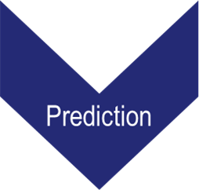
A Brief Explanation of Neural Networks
Uses inferences from a large amount of historical observations to make predictions.
Observation
The Sun has risen every morning for the previous 10,000 days.
Inference
The Sun rises every day.
Prediction
The Sun will rise tomorrow morning.

Slide 7
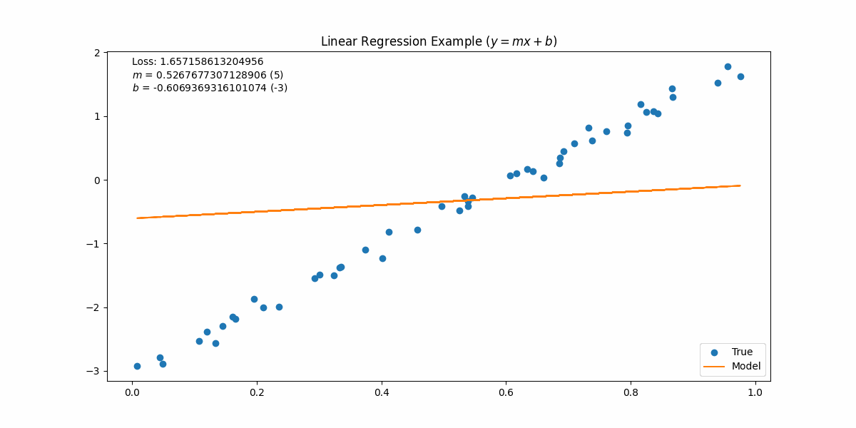
A Brief Explanation of Neural Networks
A statistical “guessing” game.
Random guess for m and b.
Predictions based on guesses.
Measures error between guess and observed results.
Adjusts next guess, based on previous error

Slide 8
Physics-Informed Neural Networks
Combines data-driven techniques with trustworthy and proven Physics and Math.
Provides network with Physics equation
Leverages autodifferentiation functionality of ML framework
Network fits derivative of output w.r.t. input to Physics Equation
Distrust
“Black Box” nature
Poor out-of-distribution inferences
More trustworthy
Explainable
Gap filling

Slide 9
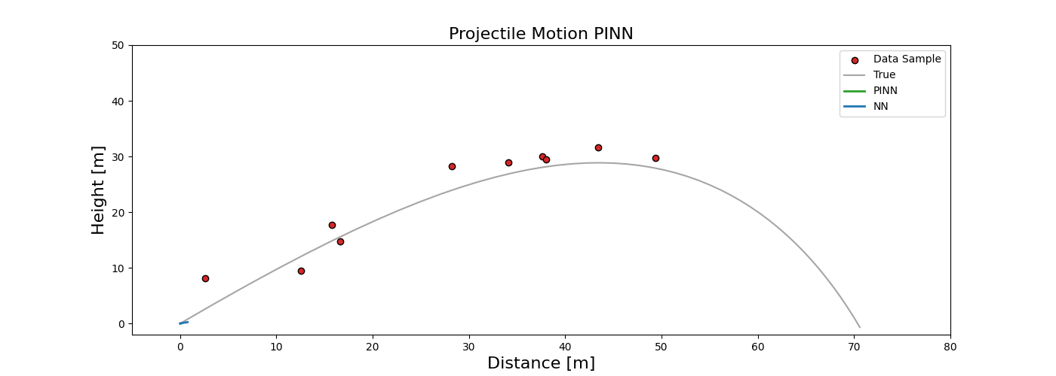
Projectile Motion

Slide 10
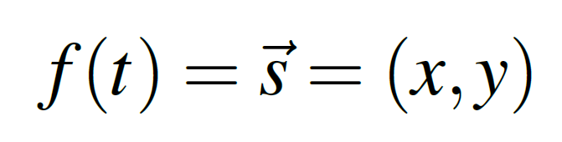
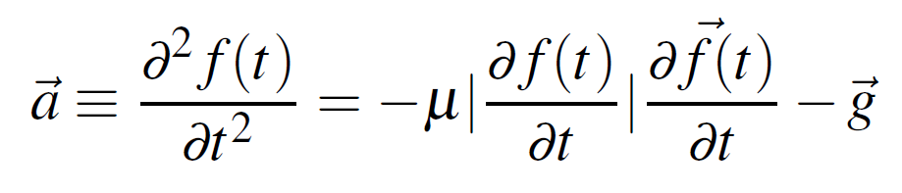
Projectile Motion
}
velocity

Slide 11

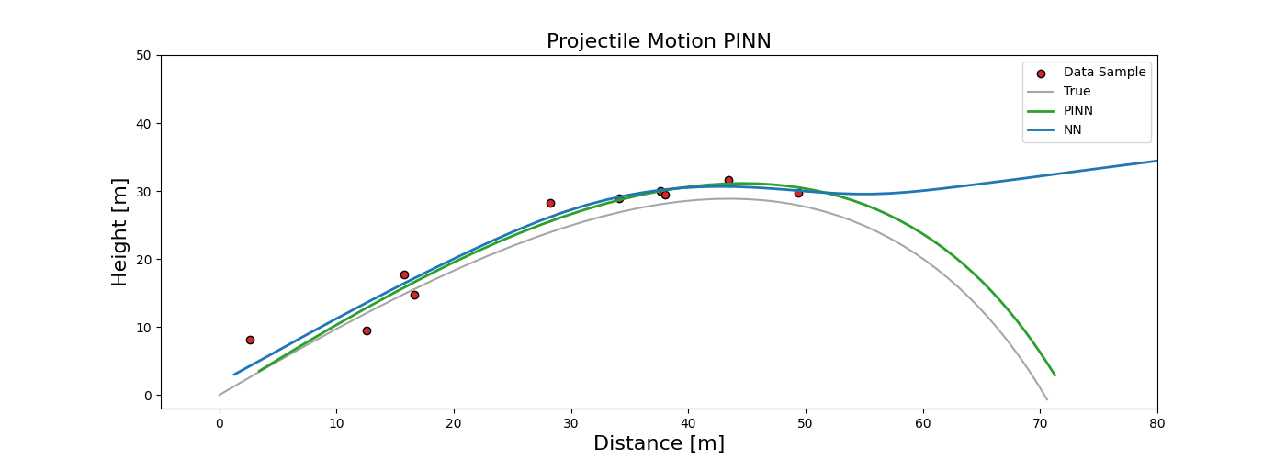
Projectile Motion

Slide 12
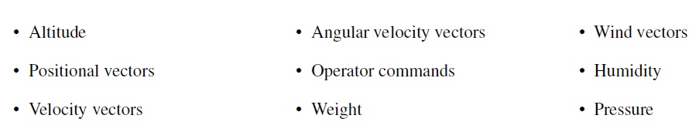
UAS Twin
Inputs
Outputs

Slide 13
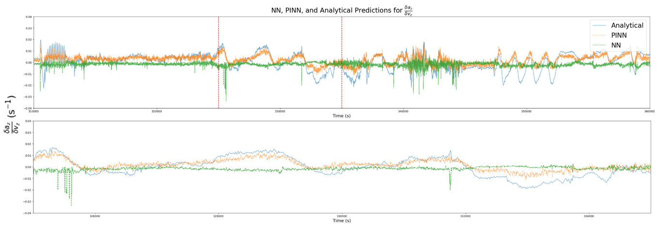
UAS Twin
Validation of PINN
Analytical
PINN
NN
PINN fits to Physics function
NN ignores Physics function as only fits to data points.

Slide 14
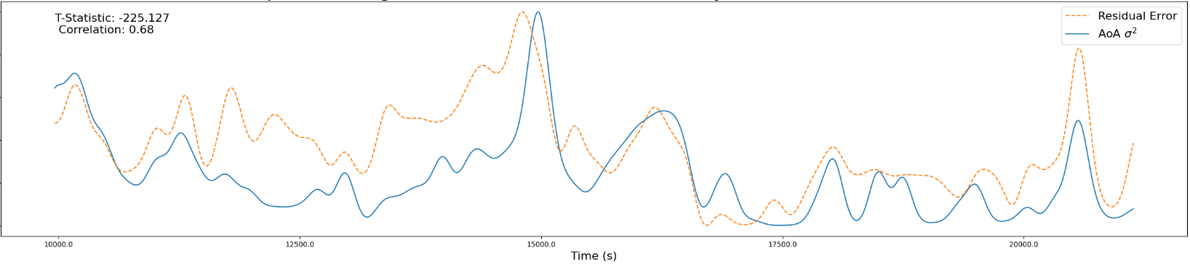

UAS Twin
Validation of PINN
T-statistic: -255.127
Correlation: 0.68
Comparing error between Physics function output and test data.
Error correlates to angle of attack variance (flight stability)

Slide 15
UAS Digital Twin
Reward
Synthetic Environment
State
AI Agent
∆State
PINN
Actions

Slide 16
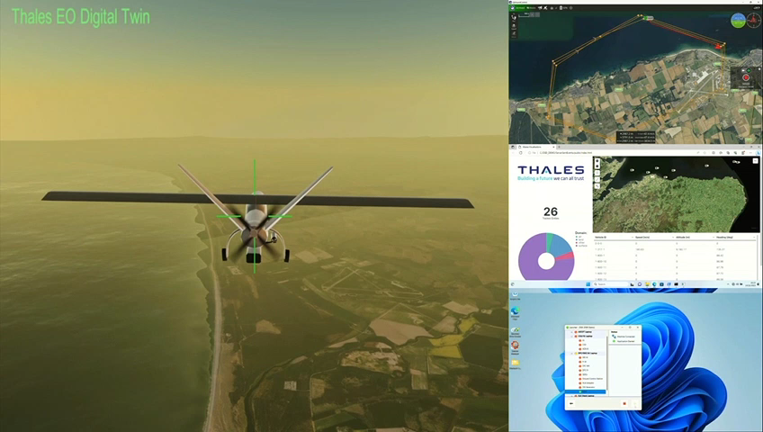
UAS Digital Twin

Slide 17
What Next?
Improved/more Equations
Diminishing returns, but valuable for special cases
Situational Awareness
Dead Reckoning
Other Use Cases
Commercial UAS drone

