Slide 1
Training effectiveness and validation of a Virtual Reality Head mounted display-based simulator for Air Force Pilot​s: Preliminary Findings
Ramy Kirollos, PhD - Defence Research and Development Canada (DRDC), Toronto Research Centre (TRC)
Wasim Merchant – DRDC, TRC

Slide 2
Introduction and Background​
The Royal Canadian Air Force (RCAF) is modernizing training​
Virtual Reality Head-Mounted Display (VR HMD) is a big part of that​
There is a strong business case for VR HMD based-simulation training:​
Can potentially be used somewhere in training pipeline between classroom training, chair flying and Flight Training Devices (FTD)
Bottleneck and scarcity/access issues with FTD
VR may increase access to safe training environment ​
Lower operating cost (time and $$) of VR compared to FTD

Slide 3
Problems
VR HMD-based simulators tend to be lower fidelity​ than FTDs and actual aircraft being simulated
How do we know this doesn't come at a training cost?​
There is little empirical research on VR HMD for pilot training​ effectiveness, validity and safety
It is important for there to be a robust scientific literature (e.g. many high quality journal publications) to ensure VR HMD-based sim validity and training effectiveness​
There are known major issues with VR HMD – in particular cybersickness

Slide 4
Objective
An experiment assessed the training effectiveness, validity and safety of a VR HMD trainer for RCAF pilots

Slide 5
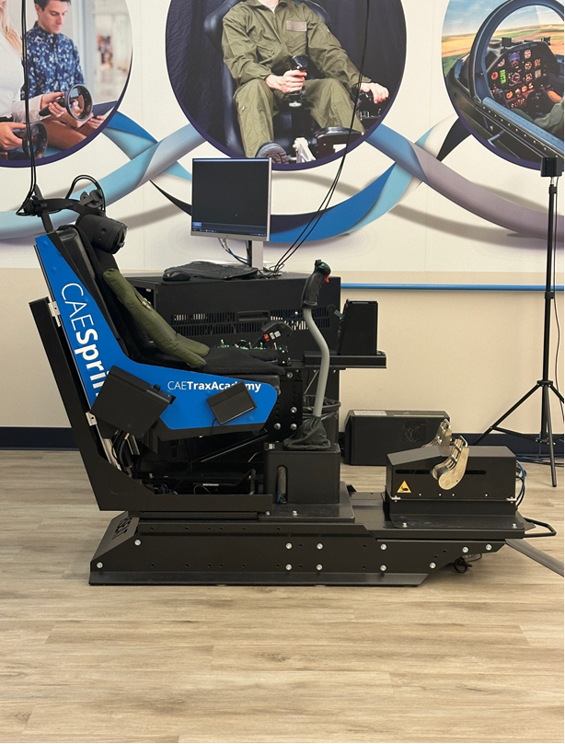
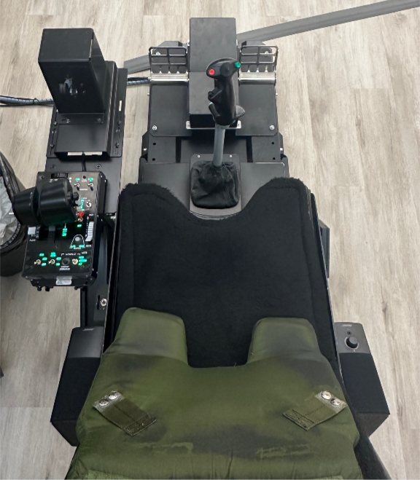
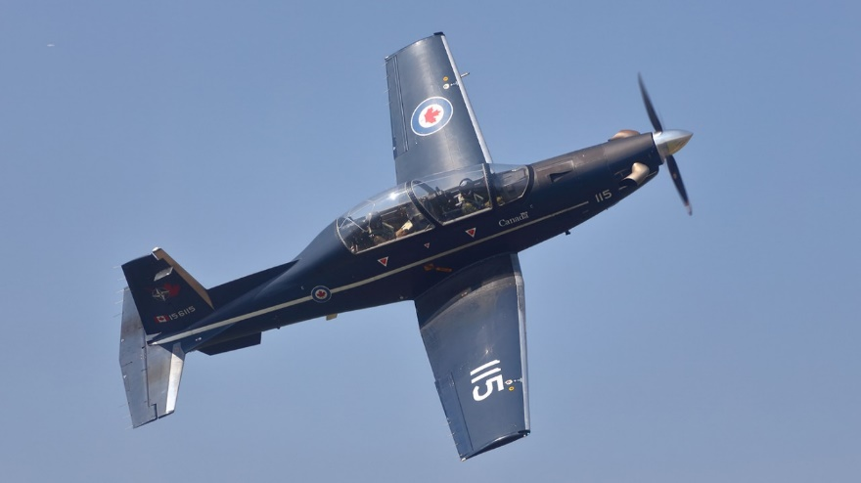
Methods – Device: Sprint Chair
The Sprint Chair: VR HMD trainer assessed​
Employs Varjo VR 3 HMD
Physical flight equipment (e.g. rudder, pedals, throttle)
Audio provided by speakers
Sprint Chair replicates the Harvard II Aircraft

Slide 6
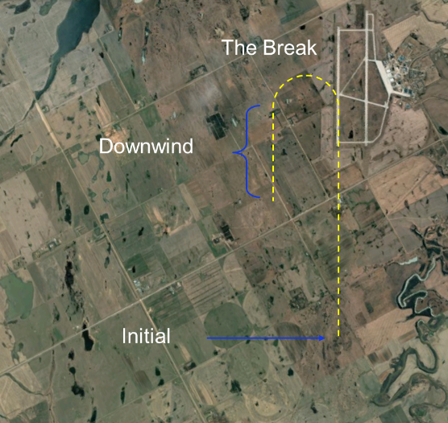
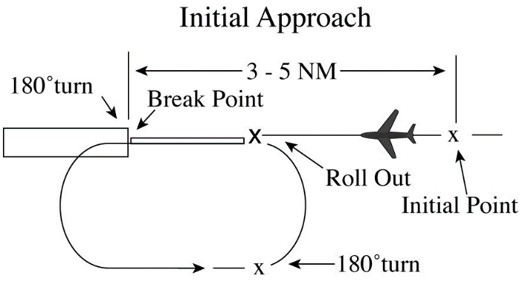
Methods (cont’d) – Task: Overhead break
Overhead Break: Method of depleting aircraft’s energy via 180° turns for faster, more efficient landing
Applied the RCAF flying proficiency criterion that defines Overhead Break standard (RCAF, 2014)
FAA, 2021

Slide 7
Methods (cont’d) - Measures
Flight Proficiency Scores (FPS): 1-5 point scale used by the RCAF to assess and qualify pilots (RCAF, 2014)
Simulator Sickness Questionnaire (SSQ): Recognized 16-question self-report measure for motion/simulator/cyber sickness symptomology. Participants completed this before and after the experiment (Kennedy et al. 1993)
Simulator Fidelity Scale (SiFi):​ Self-report scale completed by pilots to compare simulator to aircraft and rate their similarity on 5 dimensions of physical and cognitive fidelity (Bush et al. 2022)

Slide 8
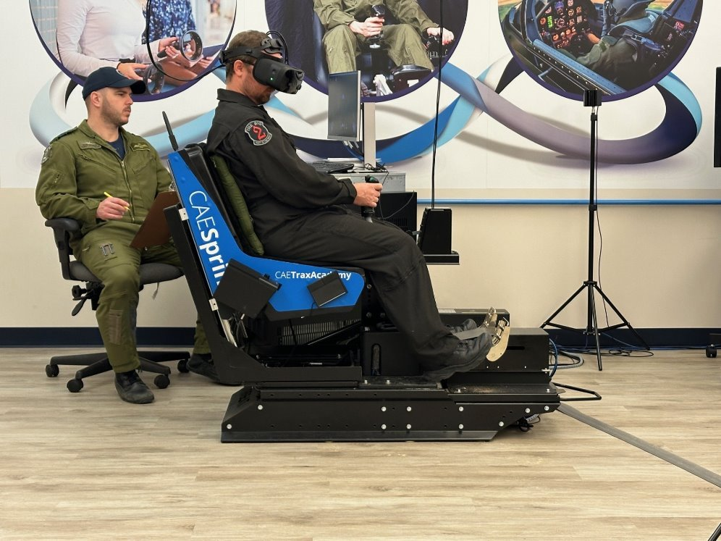
Methods (cont’d) – Conditions and Task
All participants were from the 2 Canadian Forces Flight Training School pilot community
2 Conditions:
Novice Pilots (n=9): Students beginning Phase 2 pilot training ​- no Sprint Chair, FTD or live fight hours
Expert Pilots (n=14): Instructor Pilots with 100s of FTD and live flight hours in Harvard II
Experimental Task: Both repeated the Overhead Break 7 times each

Slide 9
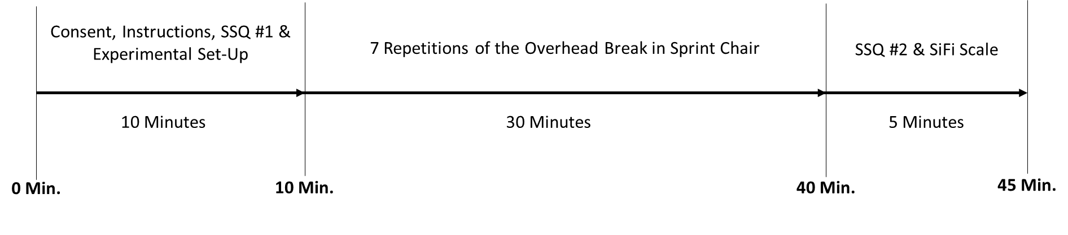
Methods (cont’d) – Conditions and Task
Instructor Pilot
An Instructor Pilot assigned a Flight Proficiency Score for each participant’s Overhead Break repetition
Flight Proficiency Scores between Novices and Experts were recorded and compared​ in a mixed factors ANOVA
Participant

Slide 10
Experimental Design and Main Hypotheses
Used Reverse Transfer of Training (RToT) design ​
Main hypotheses:
RToT design hypothesizes that: If experimental intervention (i.e. Sprint Chair) is valid, Experts should perform at a high level early and plateau quickly (AGARD,1980; Cain et al. 2012; Korteling et al. 2013)
Experts would perform better than Novices

Slide 11
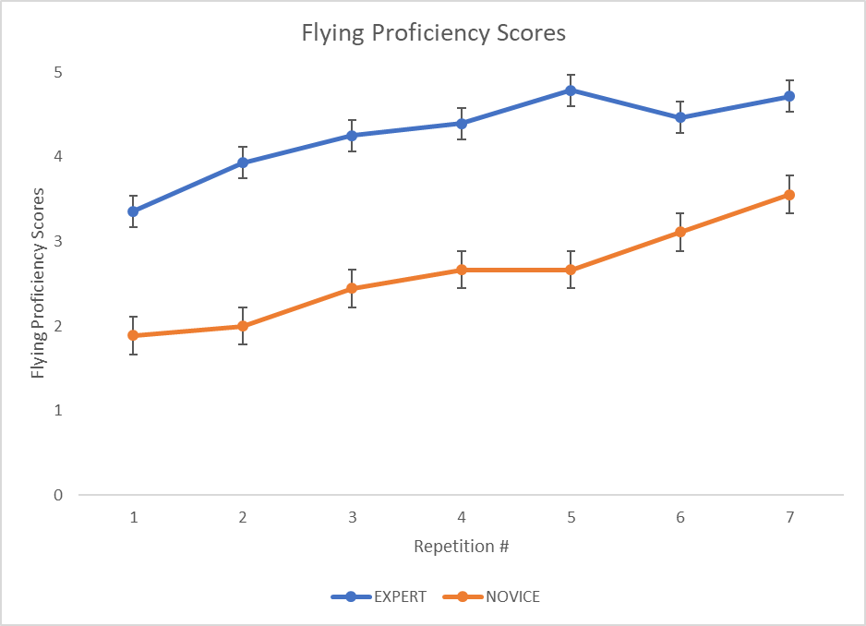
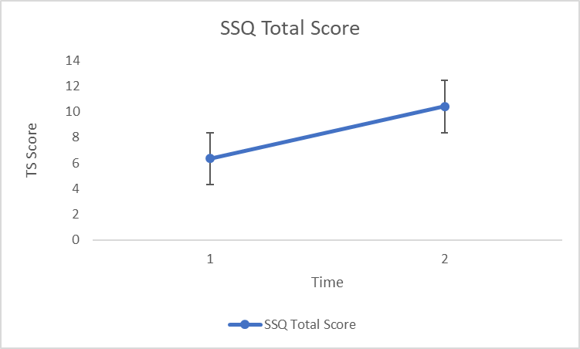
Results
*Significant Interaction effect between Condition (Expert v Novice) and Repetition (1-7)
F(6, 126) = 2.55, p = .02, η² = .11 (medium effect size according to Cohen, 1988)
Non-significant and negligible cybersickness/ SSQ scores according to Kennedy et al. (2003) and Stanney et al. (2006) recommended sickness severity cut-offs

Slide 12
Results (cont’d) – SiFi correlations and other correlations
SiFi was administered to Expert group only to assess similarity of Sprint Chair to Harvard II aircraft in the perceptual and cognitive domain (Bush et al. 2022)
Physical Elements |  |  | Cognitive Elements
Visual | Auditory | Tactile | User Interaction | System Behaviour
3 | 4 | 2
Enter rating here

Slide 13
Results (cont’d) – SiFi correlations and other correlations
Looked at Correlations between
SiFi ratings and FPS scores: to understand the relationship between simulator fidelity and pilot performance
SiFi ratings to Live Flight Hours: to understand if familiarity with aircraft (based on live flight hours) related to perceived Sprint Chair fidelity
Live Flight Hours to FPS: to understand if time in live flight correlates with task performance in the Sprint Chair

Slide 14
Results (cont’d) – SiFi correlations and other correlations
Looked at Correlations between
SiFi ratings and FPS scores: to understand the relationship between simulator fidelity and pilot performance
*ρ(12) = -.547, p = .043
SiFi ratings to Live Flight Hours: to understand if familiarity with aircraft (based on live flight hours) related to perceived Sprint Chair fidelity
Expert Live Flight Hours to FPS: to understand if time in live flight correlates with task performance in the Sprint Chair

Slide 15
Results (cont’d) – SiFi correlations and other correlations
Looked at Correlations between
SiFi ratings and FPS scores: to understand the relationship between simulator fidelity and pilot performance
*ρ(12) = -.547, p = .043
SiFi ratings to Live Flight Hours: to understand if familiarity with aircraft (based on live flight hours) related to perceived Sprint Chair fidelity
no significant correlation
Expert Live Flight Hours to FPS: to understand if time in live flight correlates with task performance in the Sprint Chair

Slide 16
Results (cont’d) – SiFi correlations and other correlations
Looked at Correlations between
SiFi ratings and FPS scores: to understand the relationship between simulator fidelity and pilot performance
*ρ(12) = -.547, p = .043
SiFi ratings to Live Flight Hours: to understand if familiarity with aircraft (based on live flight hours) related to perceived Sprint Chair fidelity
no significant correlation
Expert Live Flight Hours to FPS: to understand if time in live flight correlates with task performance in the Sprint Chair
no significant correlation

Slide 17
Summary of Results
Statistically significant difference between Novice and Expert pilot group Flight Proficiency Scores ​
Both Novices and Experts showed statistically significant improvements over the course of the experiment​
Cybersickness was negligible throughout​ experiment
SiFi and FPS correlated negatively and significantly in Expert pilots

Slide 18
Discussion of Results
Statistically significant difference between Novice and Expert pilot group Flight Proficiency Scores ​
Possible evidence supporting simulator validity based on RToT hypothesis​
Both Novices and Experts showed statistically significant improvements over the course of the experiment​
Possible evidence supporting simulator training effectiveness​
Cybersickness was negligible throughout​ experiment
Possible evidence supporting simulator safety
SiFi and FPS correlated negatively and significantly in Expert pilots
Possible evidence that higher performing participants notice more subtle differences in Sprint Chair

Slide 19
Strengths and Limitations of Study
Strengths | Limitations
Used RToT design which mitigates risk posed by traditional transfer experiments | Preliminary findings presented here
Strict definition and inclusion of ‘Expert’ and ‘Novice’ participants | Warthog Throttle used instead of Harvard II Throttle
 | Limited to 1 flight task (e.g. overhead break) and 1 weather condition (e.g. clear daytime conditions) therefore must be cautious in how we generalize and extend these results

Slide 20
Conclusions
VR HMD-based simulators, in this instance the Sprint Chair, may be a valid training adjunct based on expert pilot performance
Student pilots may be able to safely rehearse the overhead break in the Sprint Chair
Cybersickness appears to be negligible for durations of approximately 45 min in VR

Slide 21
Future Work
Complete data collection (n = 42 total participants) + additional experiment/analyses and submission to journal
Currently under journal peer review
Similar studies should expand on other flight maneuvers and weather conditions for more generalizable results and better understand where VR HMD simulators can be used in the pilot training pipeline
Apply RToT design to smaller form factor and lower fidelity VR-based simulators
Forward transfer studies extending current work to provide secondary validation of simulators

Slide 22
Acknowledgements
The authors would like to thank the 2 Canadian Forces Flight Training School, Moose Jaw pilot community including all study volunteers, technical staff, and School house Command for their hospitality and support during data collection. In particular, the authors would like to thank Capt. Devin McKenna, David Kanz and Brent Peardon for their critical assistance throughout data collection campaigns.

Slide 23
References
AGARD. (1980). Fidelity of simulation for pilot training: Annex A - Assessment of Training Effectiveness, pp-36-41
Bush, D., Lamb, C., & Braun, A. (2022). Interrater Reliability of the Simulation Fidelity (SiFi) Scale. Proceedings of the 66th Human Factors and Ergonomics Society Annual Meeting, pp.1982-1986
Cain, B., Magee, L., & Kersten, C. (2012). Validation of virtual environments incorporating virtual operators for procedural learning, DRDC, TM 2011-132
Kennedy, R. S., Drexler, J., Compton, D., Stanney, K., Lanham, D., & Harm, D. (2003). Conﬁgural scoring of simulator sickness, cybersickness and space adaptation syndrome: similarities and differences. In Virtual and Adaptive Environments. CRC Press
Kennedy, R. S., Lane, N. E., Berbaum, K. S., & Lilienthal, M. G. (1993). Simulator sickness questionnaire: An enhanced method for quantifying simulator sickness. The International Journal of Aviation Psychology, 3(3), 203-220
Korteling, H. J. E., Oprins, E. A. P. B., & Kallen, V. L. (2013). Measurement of Effectiveness for Training Simulations (RTO-SAS-095)
Royal Canadian Air Force. (2014). Integrated Training Plan – Phase 2 Harvard. Ottawa, Canada
Stanney, K., Graeber, D., & Kennedy, R. S. (2006). Virtual environment usage protocols. In Handbook of standards and guidelines in ergonomics and human factors. Lawrence Erlbaum Associates

Slide 24
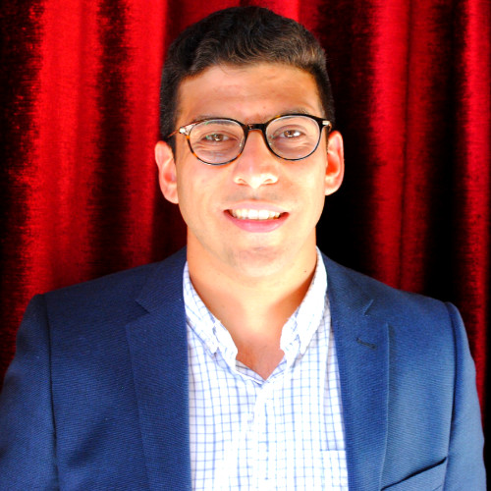
Thank you!
Questions?
Information and Contact
Name: Ramy Kirollos, PhD
Title: Defence Scientist, Defence Research & Development Canada, Toronto
Email: Ramy.kirollos@forces.gc.ca

