Slide 1

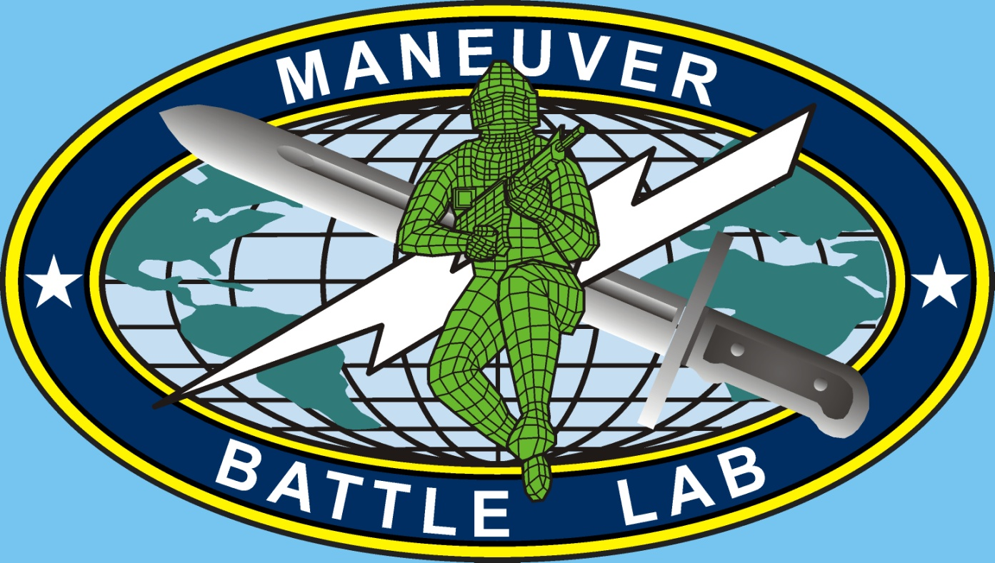
Artificial Intelligence and The Boyd Loop for Policy Makers
Tom Yanoschik, SAIC, Maneuver Battle Lab (MBL)
Peter Jones, SAIC, MBL

Slide 2
Agenda
Introduction and background
The Boyd Loop
The Boyd Loop Empowered by AI
System of Systems Enhanced Small Unit (SESU) - A Case Study
Russian Use and Developments of AI
China Use and Developments of AI
Final thoughts
Acknowledgements

Slide 3
Introduction and Background
Army Experimentation- how will the US Army fight in 2030-2040- and beyond?
Maneuver Battle Lab (MBL)
Future Studies Program (FSP)
Concepts and Capabilities Development
Artificial Intelligence (AI) and Machine Learning (ML)- Concept or Capability?

Slide 4
The Boyd Loop
Observe
Act
Orient
Decide

Slide 5
The Boyd Loop- Accounting for Threat
Observe
Observe
Act
Orient
Act
VS
Orient
Decide
Decide

Slide 6
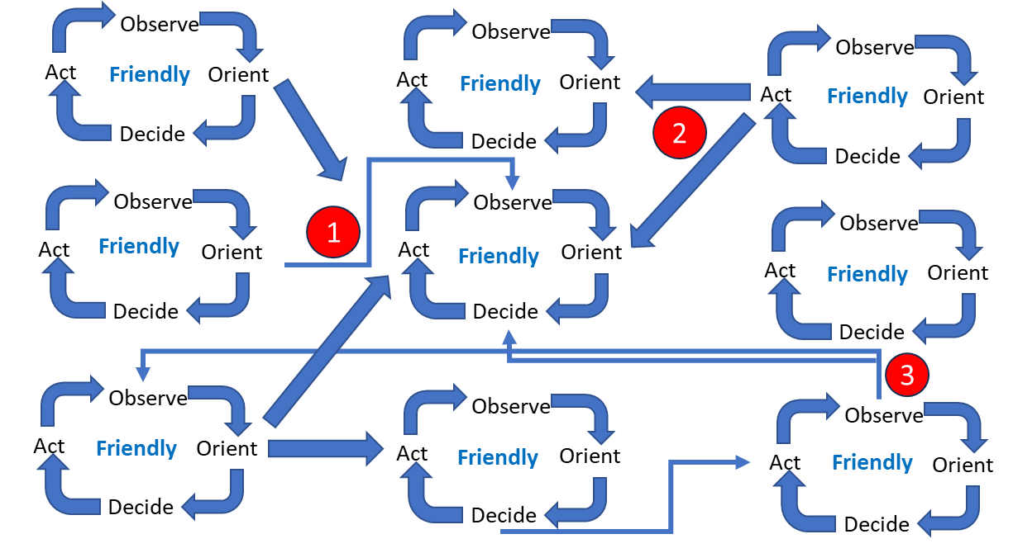
The Boyd Loop Empowered by AI

Slide 7
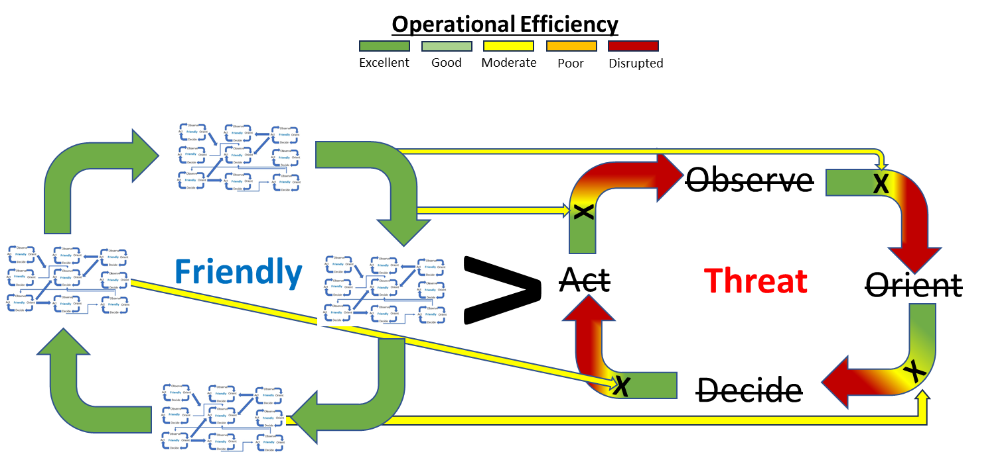
The AI-Empowered Boyd Loop Attacking the Threat

Slide 8
SESU Campaign of Experimentation 2019 -2023
Assessed the implications of enabling a small unit using autonomous and semi-autonomous air and ground platforms to deny, degrade, defeat, disrupt, or destroy the enemy’s Anti-Access/Area Denial (A2AD) capability.
Started as Tabletop (non-simulation based) experiments, followed by simulation experiments, and culminated with live demonstrations
Focused on the use of an AI-enabled advanced command and control web (AC2W) and how it facilitated both mission planning and execution
Successfully showed such capability could create windows for tactical and operational Joint Force Operations.
Provided Requirements leading to the development of an advanced command and control web (AC2W) enabled by artificial intelligence.

Slide 9
Russian Use and Developments of AI
“Artificial intelligence is the future, not only for Russia, but for all humankind. It comes with colossal opportunities, but also threats that are difficult to predict. Whoever becomes the leader in this sphere will become the ruler of the world.”
Russian President Vladimir Putin – 1 September 2017
Russia’s focus is on enhancing tactical and operational unmanned systems, facilitating intelligence, surveillance, and reconnaissance, and management of electronic warfare
Russia is employing AI and ML into cyber and influence operations
Russia is learning from their own operations and the Ukrainians use of AI/ML to improve their own operations and doctrine

Slide 10
Chinese Use of AI and ML
Necessary steps to move from current Mechanized Warfare through Informatized Warfare to ultimately Intelligent Warfare (weapons systems, formations and even process will be enhanced through the application of AI and ML)
$150 Billion in government funding
Focus is on autonomy of unmanned weapons, processing of large data sets, and accelerating military decision-making
“…intelligent warfare will bring about an acceleration of the entire observe, orient, decide, act (OODA) loop process from intelligence collection to transmittal, processing, and decision-making”

Slide 11
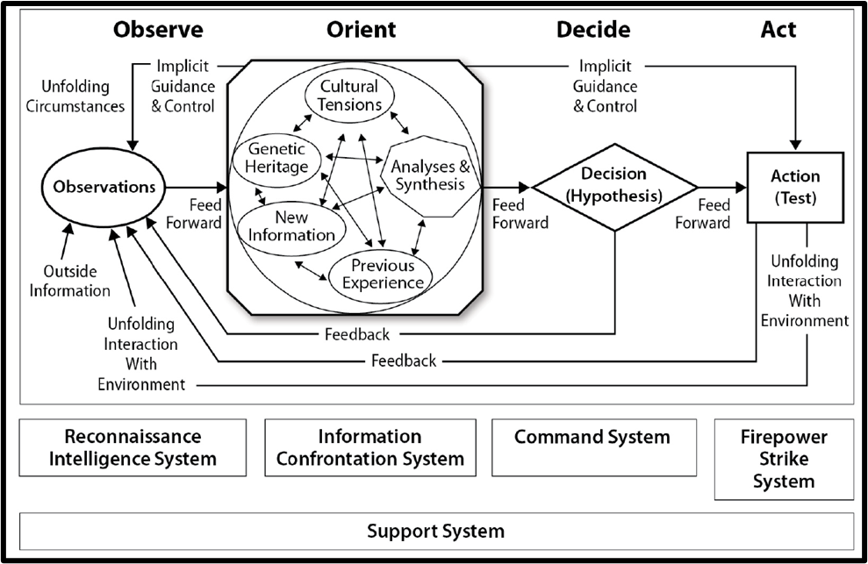
Friedman’s View of the Chinese System Warfare

Slide 12
Final Thoughts
Future tactical and operational impacts of AI/ML for the U.S. Army
Future tactical and operational impacts of AI/ML for China and Russia
Implications of AI/ML for maneuver warfare in 15-20 years

Slide 13
Review
The Boyd Loop
The Boyd Loop Empowered by AI
SESU - A Case Study
Russian Use and Developments of AI
China Use and Developments of AI

Slide 14
Acknowledgements
We would like to thank the following individuals for their support in the publishing of our paper:
Our Birddog from the PSMA Subcommittee: Dr. Leili Green
T.J. Sabau for his help in graphically representing the concept
Tollie Strode and Chris Willis for their feedback during the editorial process

Slide 15
Questions

