Slide 1
Data Analytic Considerations for Audio, Video, and Simulation Trace Data: Enabling Decisional Advantage
Jennifer Winner, 711th Human Performance Wing
Cameron Roudebush, Aptima
Randall Spain, Ph.D. U.S. Army DEVCOM Soldier Center – STTC
Ian Davis, BAE Systems, Inc
Kent Etherton, Ph.D. & Katelyn Kay 711th Human Performance Wing
Erin Baker, Naval Air Warfare Center Training Systems Division (NAWCTSD)
F. Eric Robinson, Ph.D., Naval Medical Research Unit - Dayton
Benjamin Goldberg, Ph.D., U.S. Army DEVCOM Soldier Center – STTC

Slide 2
Overview
Introduction
Joint medical readiness tracking
Data repositories
Audio file formats, audio tracks, audio analysis
Natural language processing (NLP)
Video data requirements, computer vision
Simulation trace data
Conclusions

Slide 3
Disclaimer
The views expressed in this article reflect the results of research conducted by the authors and do not necessarily reflect the official policy or position of the Department of the Air Force, Department of Defense, the Department of the Army, the Department of the Navy, nor the United States Government.
DISTRIBUTION A: Approved for public release. Distribution Unlimited. AFRL Case Number: AFRL-2024-5208.

Slide 4
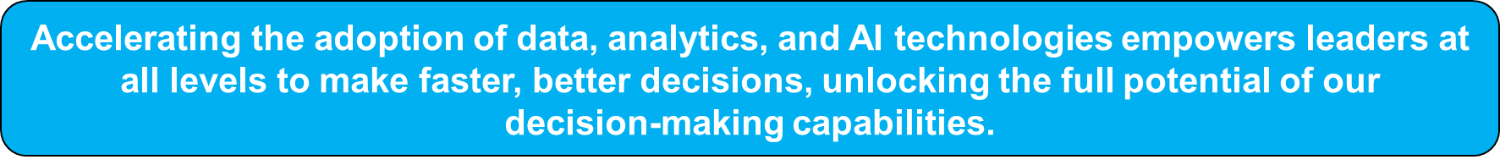
Introduction
Inspiration: Lessons learned when applying advanced analytics
Challenge: Data analytics and data export are an afterthought
Strategic Reality: Systems are producers & consumers of data
Aim: Improve future requirements & resolve data issues
How: Provide data analytic perspective for PMs and system developers to avoid repeat of data traps & quality issues

Slide 5
Data Repository
Bottom line: Data Repositories are not a solution purchased off-the-shelf
  More than the sum of the hardware and software
Does: Require personnel and processes
  Compliance with regulations related to the use of human performance data (Intuitional Review Board)
  Manage informed consent, including permission for future use
  Address protection/handling of data; catalog of shared data
  Design sufficient metadata
Does not: Reduce data protection requirements
Does: Enable strategic future use & data sharing
Notes:
Feeding data repositories just any human performance data is not enough. Front-end organization of data must enable long-standing data use and reuse.
Metadata enables participant tracking, connecting corroborative data of varying types (e.g. demographics and videos), and identifying data provenance.

Slide 6


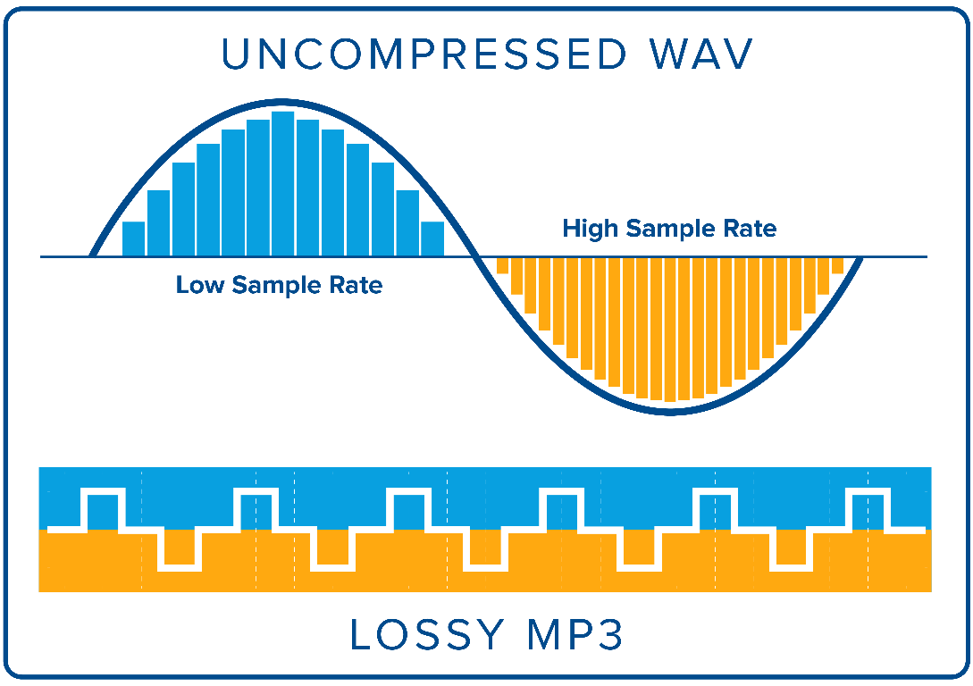
Audio Quality: File Formats & Standards
Format quality is essential
  Compressed
    MP3
    Lose audio detail
    Heavily reduces accuracy
    Should be actively avoided!
  Uncompressed
    WAV
    Retain all original data
    Crucial for accuracy
  Lossless compressed
    FLAC
    Smaller sizes, good quality
    Require conversions
    Good alternative when storage space matters
Sampling Rate Matters
  16kHz: This minimal sampling rate is supported by majority of applications, but data quality can be hindered.
  44.1kHz: Widely adopted best practice sampling rate, preferred to ensure maximal accuracy.
Figure 2. Illustration of format quality and sampling rates. Graphic by Will Graver.
Notes:
Audio recordings provide a rich source of information for understanding training performance
High-quality audio is vital
Storage formats and sampling rates are key considerations

Slide 7
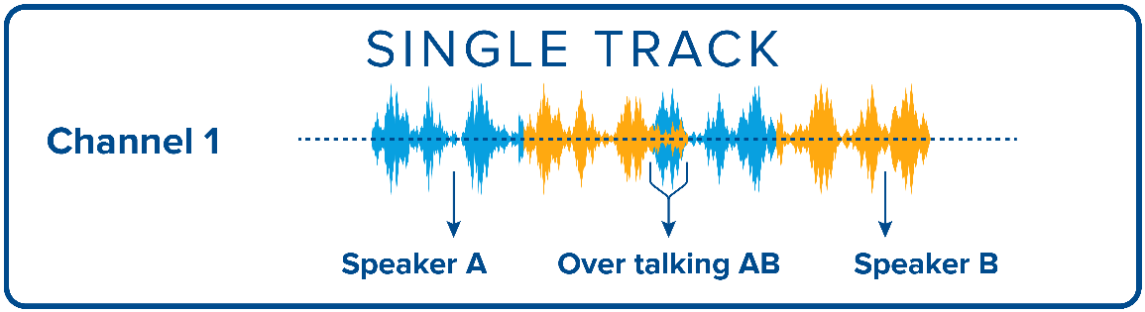
Optimizing Audio Capture
Single track, multi speakers
Pros:
  Storage savings; maximal support with external application
Cons:
  Meaningful analysis requires diarization (isolating individual speakers from each other)
  Requires domain specific models that are difficult to train
  Inaccurate diarization results in exponential losses at higher levels of audio analysis, such as transcription
  Overlapping speech (step-ons) further impact the accuracy of diarization and can be lost in analysis
Figure 3. Illustration of multiple speakers’ data stored in a single track. Graphic by Will Graver.
Cost, schedule, performance impact:
Increases costs due to additional post-processing
Reduces feasibility, accuracy, and timeliness of audio analytics
Notes:
Single track, multiple speakers
One microphone
Audio files recorded with a single track for multiple speakers
One microphone, all participants mixed together
Not recommended for audio analysis purposes

Slide 8
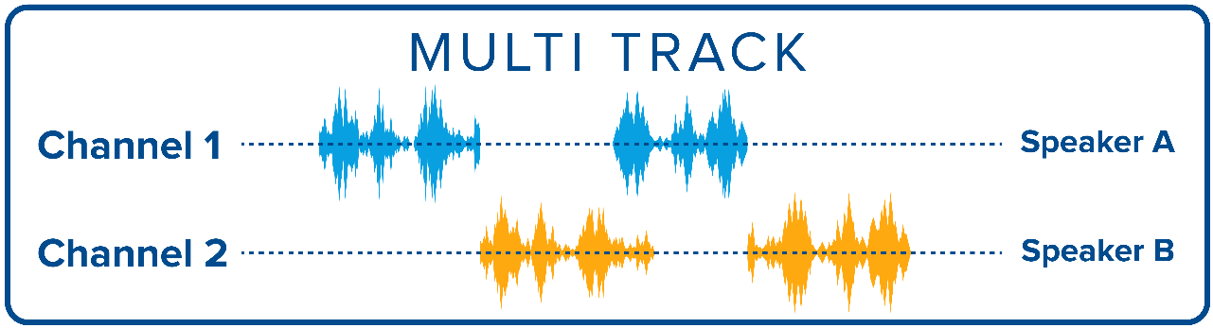
Optimizing Audio Capture (cont.)
Multi-track, multi speakers
Pros:
  Greatly improves transcription accuracy
  Captures overlapping speech accurately
  Removes need for additional pre-processing to prepare data for analysis
Cons:
  Each participant requires a dedicated microphone
  Consumes additional storage space
  More time consuming to recombine data
    Dependent on implementation
Figure 4. Illustration of multiple speakers’ data stored in separate tracks. Graphic by Will Graver.
Notes:
Audio files recorded with individual tracks for each speaker
Each participant has a dedicated microphone (headset)
Recommended for audio analysis

Slide 9
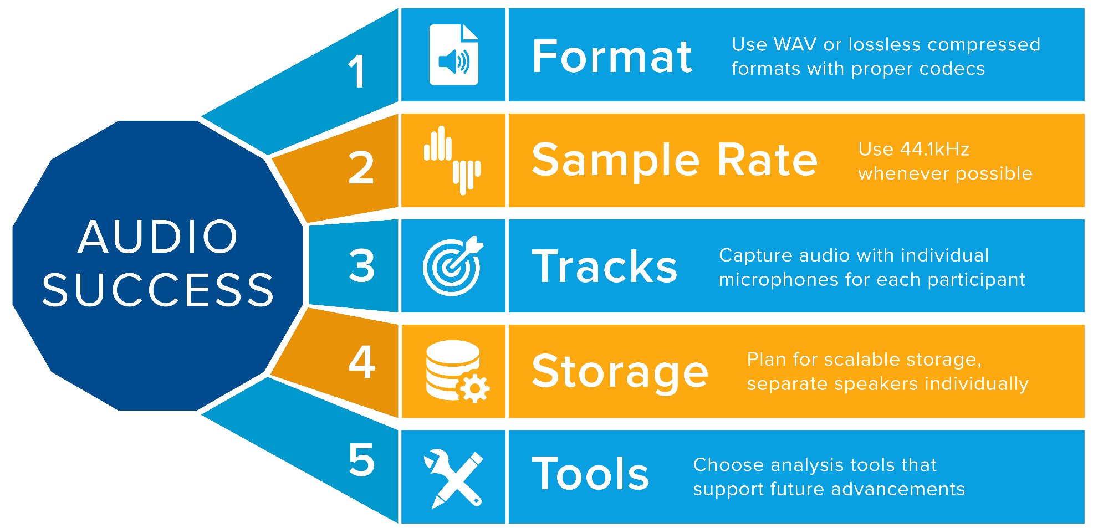
Recommendations for Audio Success
Lossless audio & adequate sampling rates are vital
  Retain as much of the original data as possible
Multi Track recording simplifies analysis
  Accuracy will be improved utilizing individual channels per speaker
  Anticipate future changes & improvements
Figure 5. Recommendations to enable successful analytics on audio data. Graphic by Will Graver.
Notes:
Lossless audio & adequate sampling rates are vital.
The goal is to retain as much of the original data as possible.
Multi Track recording simplifies analysis.
Accuracy will be improved utilizing individual speakers per channel.
Plan for the future!
Audio recording and quality can change a lot over time.
Improvements in machine learning can help speaker identification and transcriptions.
Shouldn’t be solely relied upon..

Slide 10
Natural Language Processing
Analyzes what is said by trainees or teammates
Can support quantitative and qualitative analysis of individual- and team-level processes
Key considerations:
  Communication modality should support transcription/diarization
  Data should support timestamps and alignment across data sources
  Handling of step-ons
Respiratory Therapist | 0:34:05 | Sure.
Male ? | 0:34:12 | Can you let us know?
Male ? | 0:34:25 | <inaudible>
Respiratory Therapist | 0:34:28 | So, he's still febrile.
Doctor | 0:34:31 | We need to start the Tylenol.
Nurse | 0:34:36 | <inaudible>, I'm gonna need you to help with the Tylenol.
Notes:
Excerpt taken from a transcript of critical care air transport simulations demonstrates the types of information that can be gained from NLP, but also data loss when transcription and diarization are not adequately supported. We can capture how information is shared and how activities are coordinated across the team, but in this case we don’t know who is speaking for part of the transcript, what a request was, or who the nurse was trying to communicate with at the end

Slide 11
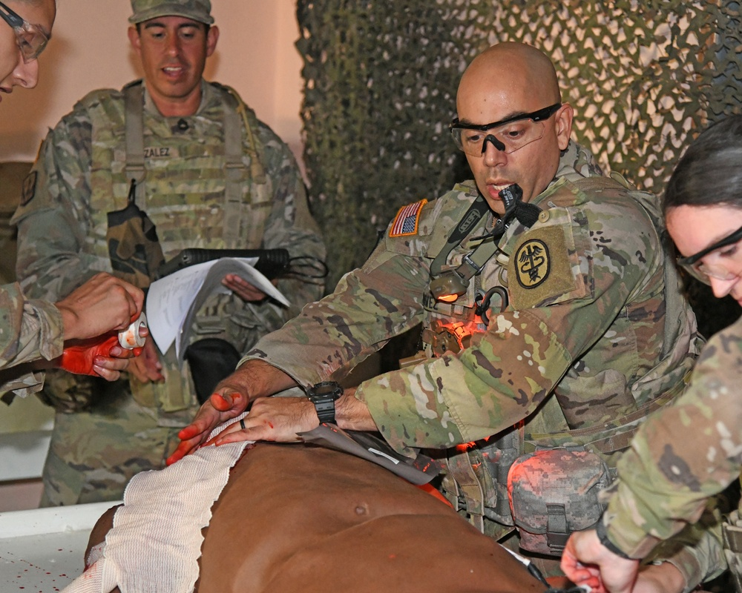
Video Data
Quality
  Resolution and frame rate
Lighting
  Enhance contrast
Placement
  Exocentric vs. egocentric
Data Standards
  Formatting and compression
Reference points
  Fiduciary marking for tracking and calibration
Video-based performance assessment
  Computer vision techniques
Figure 6. U.S. Army medics performing in simulated environment. Photo credit: Ruediger Hess.
Notes:
Video based performance analytics
Action recognition
Affect detection

Slide 12
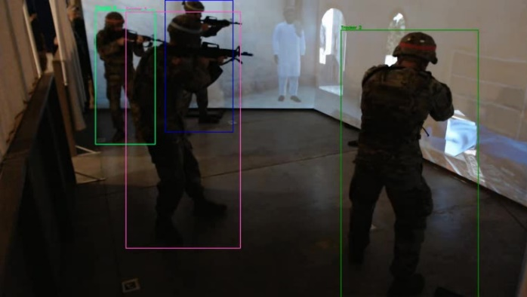
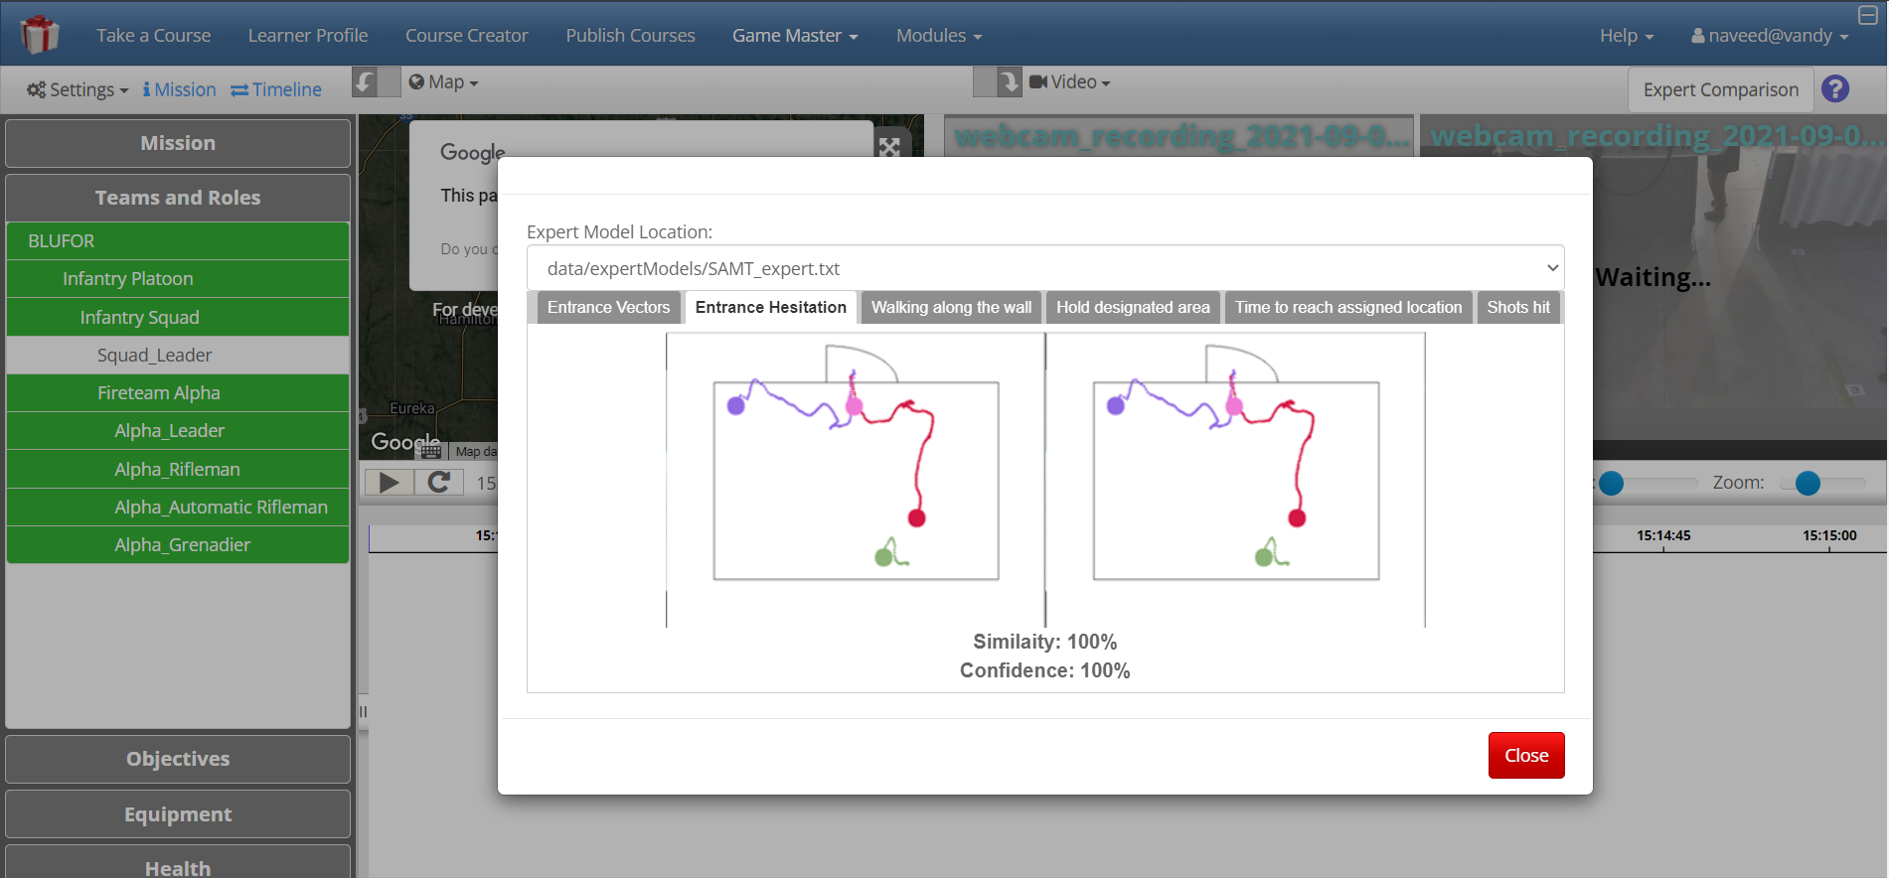
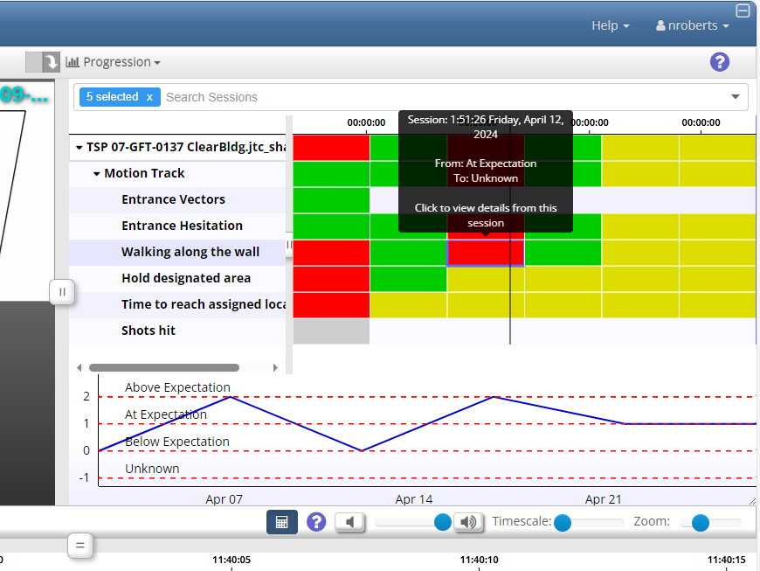
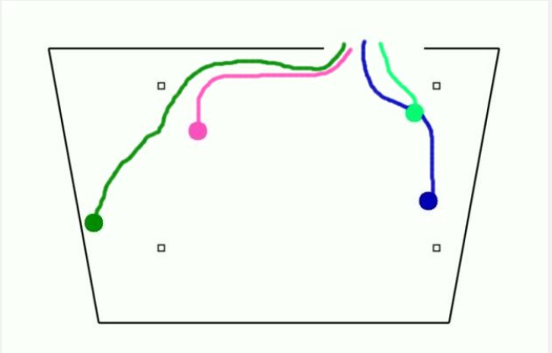
Detecting and Tracking with Computer Vision
Video data is captured, processed, and used in GIFT to assess performance
Feature extraction: Motion features, spatial features, temporal features, behavioral features
Figure 7-10. Expert-referent visual feedback in GIFT. Images reproduced with permission from : US DEVCOM Soldier Center.
Notes:
Battle Drill 6.
Enter and Clear Room
Example features are in the slide on the right
Entrance vectors
Position and location
Distance metrics
Spatial relations
Event timing
Activity recognition

Slide 13
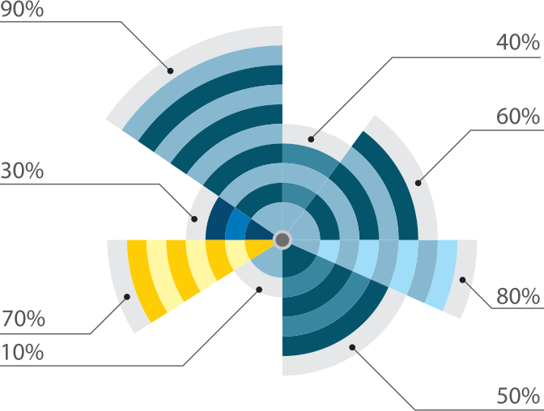
Simulation Trace Data in
Adaptive Instructional Systems
Learner effect chain showing how simulation trace data informs domain specific assessments, learner state inferences, and instructional tactic selection in adaptive instructional systems
Assessment Model
Composed of
Metrics and Conditions
xAPI
Instructional Strategy
+
Instructional Context
Informs
Instructional Tactic Selection
Simulation
data
Informs
Informs
Learner States
Informs
Tutor Planning
Action Processes
Skill Definition
Desired Reward
Activity
Context
Profile
Figure 11. Learner effect chain. Image credit: US DEVCOM Soldier Center.

Slide 14
Conclusions
Questions & Considerations for Future Requirements
Questions | Considerations
How will the system support data availability and export? | Which data does the system produce? Which data are critical for export (e.g., metadata for context)? Define the real-time and post simulation data access needs. Define the expertise requirements relevant for data export use cases. Clarify the unique HIPAA, PII, or security requirements.
How will the system support synchronization? | Identify meaningful timestamp or synchronization needs. Define the role time plays in reconstruction of events and analyses.

Slide 15
Conclusions
Questions & Considerations for Future Requirements
Questions | Considerations
How will the system make quality data available for analytic tools? | Identify critical data formats that enable or hinder analytic approaches. Evaluate open standards and application programming interface needs. Identify the formats that result in a loss of data or specificity. Are there relevant data post-processing hurdles? Identify data provenance needs to enable later apples-to-apples comparisons.
How will the system enable export to external stores? | Clarify the unique IRB requirements associated with data repositories. Identify metadata requirements necessary for consent tracking.

Slide 16
Questions
We invite you to help increase the availability of quality data.
Thank you!
jennifer.winner.1@us.af.mil

Slide 17
Backup Slides

Slide 18
Acknowledgements
Cameron Roudebush, Aptima
Randall Spain, U.S. Army DEVCOM Soldier Center – STTC
Ian Davis, BAE Systems, Inc
Kent Etherton, 711th Human Performance Wing
Katelyn Kay, 711th Human Performance Wing
Erin Baker, Naval Air Warfare Center Training Systems Division (NAWCTSD)
F. Eric Robinson, Naval Medical Research Unit - Dayton
Benjamin Goldberg, U.S. Army DEVCOM Soldier Center – STTC
United States School of Aerospace Medicine

Slide 19
Joint Medical Readiness Tracking
Training & Education Databases: Legend
Digital interfaces (solid lines)
Manually entered data (dashed lines)
Service data (color)
Data analytics and export as an afterthought (an illustration)
Figure 1. Naval Air Warfare Center Training Systems Division & Katmai Corporation. (2023). Interoperable Networking for Training Readiness and Education in Medicine Data Strategy and Architecture Report.

Slide 20
Simulation Trace Data
Examples
  Event records, entity state information
  Weapon and damage events
  Timing information
  Interactivity
Standards
  Formal guidelines to enhance interoperability and enforce distributed simulation environments (example Google Protobuf, DIS, HLA)
Can be used in adaptive training systems to
  Assess performance
  Personalize feedback
  Generate adaptive learning pathways
  Generate dashboards and data visualizations for AARs

Slide 21
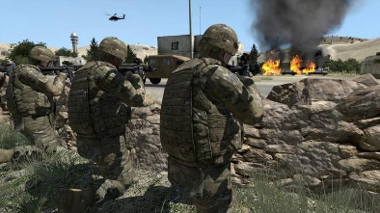
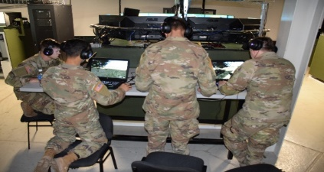
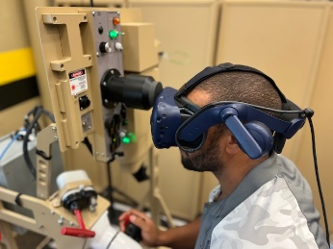

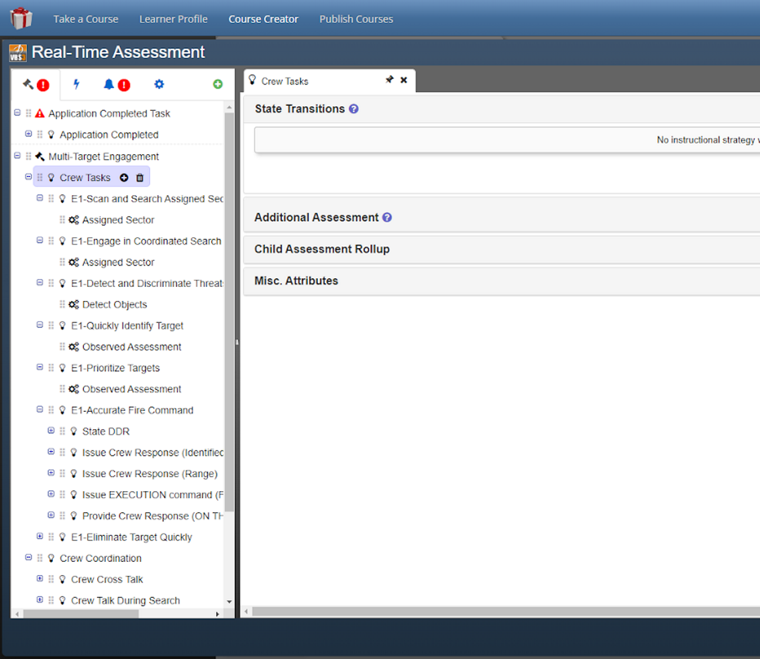

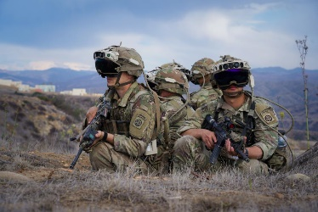
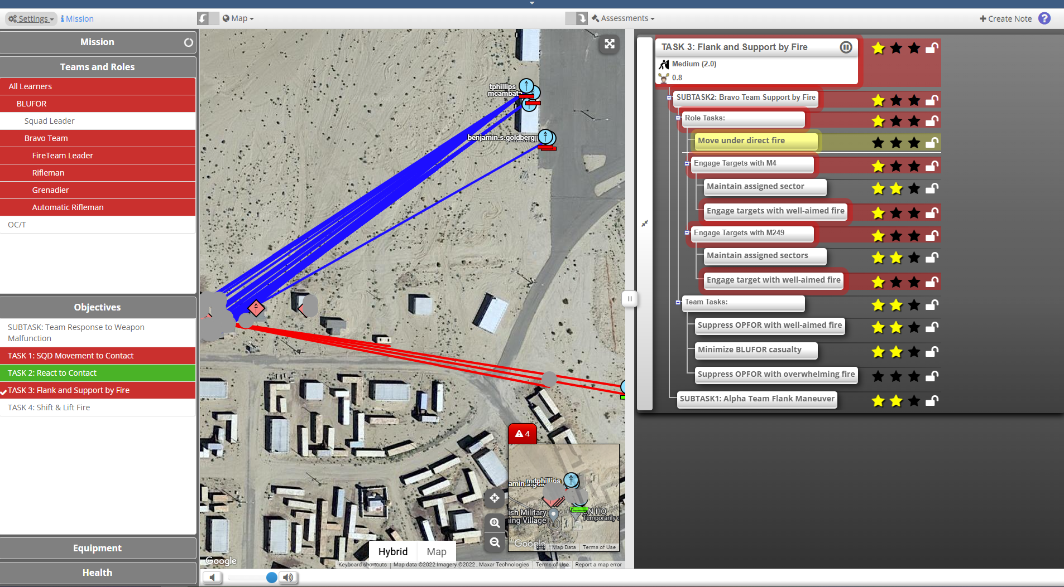

Multimodal Data Pipeline Exemplar
Training Modes
Data Sources
Domain Representation and Assessment
STEEL-R Data Management
Framework
GIFT
Task (Concept)
Tasks, Concepts, and Data Sources
xAPI Performance Statements
Concept
…
Concept
Concept
…
Concept
Virtual
Learner Record Store
Simulation trace data
Condition Classes
Align data from external sources and sensors to support analytics
Competency and Skills System (CaSS)
Video data
Learning Analytics
Mixed Reality
Assess performance and capture key action points
Audio data
Competency Predictions
Competency Dashboard
Live
OC ratings
Figure 12. Multimodal Data Pipeline. Image credit: US DEVCOM Soldier Center.

Slide 22
Data Standards
LTSC Standards for xAPI
LTSC Standards for TLA
Semantic Data
xAPI Profiles
Data Preparation
Business Intelligence
Purpose
Describe Activity
Define Experience
Automate Interoperation
Ensure Accessibility
Role within
the TLA
    RDF-BASED INTEROP
    Actor : Verb : Object + Add’l Fields & Metadata
    DOMAIN-BASED MODEL
    Vocabulary, Patterns, Sequences, Concepts
    INTEGRATED LOGIC
Data Validation, Interop, & Business Logic Filtering
    ALIGNED OUTPUTS
    Validation to Evidence & Summation Frameworks
Filtering Layer
01.
02.
03.
04.
IEEE Standards
xAPI Baseline
IEEE P9274.1.1
xAPI Profiles
IEEE P9274.2.1
xAPI Filtering / LX Metadata
IEEE 9274 & P2881
Sharable Competencies & ELR
IEEE P1484.20.3 & P2997
Learning Record Providers
Learning Record Stores
Noisy/TXN LRS / LRSPipe
CaSS / ELRR
Figure 13. Data Standards comparison. Image credit: US DEVCOM Soldier Center.

