Slide 1

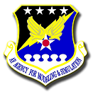
Revolutionizing Simulation:
Pioneering a Data-Centric Future in Defense Training Environments​
Sonia R. von der Lippe
James Torgler
FuturaSage, LLC
J. Russell Hutt
Air Force Agency for Modeling & Simulation (AFAMS)

Slide 2
Background
“
“Department of Defense (DoD) has fallen far behind in modeling data-centricity and facilitating data access. Today, first-rate companies demand interoperability within their software; within DoD, organizations remain riddled with systems that are incapable of data integration via Application Programming Interfaces (APIs).”
“Data innovation is happening in vertical silos, and data access remains the central enterprise-level obstacle to the sharing and use of data for the warfighter” Defense Innovation Board: Building a DoD Data Economy, Feb 2024
“The lack of shared data standards and architectures within the Air Force, across the services, and across other mission partners is a significant impediment to distributed training.” Air Force Operational Test and Training Infrastructure: Barriers to Full Implementation, RAND Research Report RRA992-1, 2022
“There are lessons learned built into that data. There’s the wingman that did the wrong thing. There’s the bad radio call. There is the signal that we’ve never seen before… The problem — there is a high probability that every bit of that valuable data will never ever see the light of day.”
Gen James Slife AFCEA Feb 2024
“
Legacy simulators/simulations rely on tightly coupled systems and lack the flexibility for data-centric, modern warfare needs

Slide 3
Emerging Defense Priorities​
SAF Chief Information Office (CIO) Strategy -- 2022
“Provide the foundation for a secure, digital, and data-centric Air & Space Force on which our competitive advantage relies.”
DAF Data Fabric Memo -- 2021
Provide “enterprise capabilities that enable sharing and reuse of data and data tools interconnecting artificial intelligence (AI) users, data, environments, and resources across the DoD.”
Data Services Reference Architecture (DSRA) -- 2019
“A capability-oriented architecture and support the implementation of diverse Solution Architectures for scalable data management”
DoD Zero Trust Reference Architecture (ZTRA) -- 2022
“Next generation cybersecurity architecture that precludes default trust of any actor, system, network, or service operating outside or within the security perimeter using a data-centric approach to establish continual verification of each user, device, application, and transaction”
DoD Enterprise DevSecOps Reference Design -- 2019
“Provides implementation and operational guidance to Information Technology (IT) capability providers, IT capability consumers, application teams, and Authorizing Officials.”

Slide 4
Why Data-Centric?
Strategic use of data as a core asset.
Leverages AI, machine learning, and big data analytics improving decision-making and operational efficiency
Data-centric warfare leverages data for sustained operational advantages.
Effective training depends on realistic, adaptable simulation environments.

Slide 5
Data-Centric Warfare Simulation Requirements
Data-Centric Warfare: A Paradigm Shift
Emphasizes the strategic use of data as a critical asset.
Simulation environments must replicate real-world conditions for effective training.
Key Features:
Dynamic training environments
Real-time data integration
Focus on interoperability
Challenges:
Enhanced cybersecurity measures
Effective data management

Slide 6
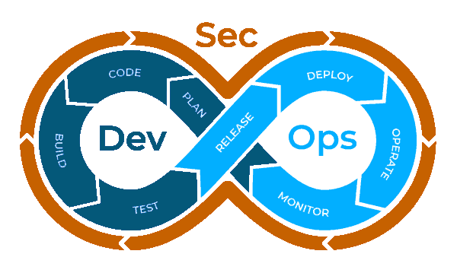
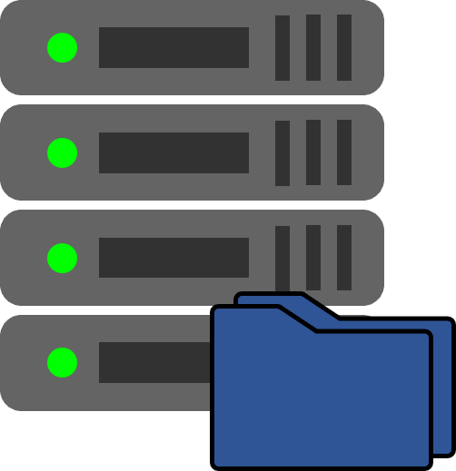

AF Priorities Push Toward a New Approach
Traditional Approach
New Approach
Waterfall
DevSecOps
Development
Multiple developers
Dynamic Integration
Supports Innovation, Flexibility, and Agility
Data-Centric Enabling Data-Driven Decisions
Individualized User Experience (AR/VR, Simulator)
Development
Single developer
End-to-End Solution
App-Level Integration
Simple Modification Involves Whole System
Hosted On-Prem
Cloud
Deployment And Packaging
Deployment And Packaging
Comingled
Data and Application
Edge Multi-Cloud Service Mesh
Increasing Flexibility and Composability

Slide 7

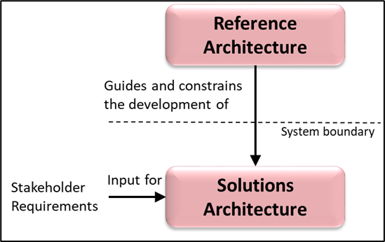
GRA Term Clarity
RA: An authoritative source of information about a specific subject area that guides and constrains the instantiations of multiple architectures and solutions^{1,2}
GRA: Government-owned, authoritative source of information about a specific subject area that guides and constrains the instantiations of capability architectures and solutions²
Implementation:
Per the Mission Eng Guide: a GRA integrates the data, information, boundary conditions and rules that describe the mission capability needed by the warfighter in sufficient detail to allow for transition of technology-based solutions
Reference Architecture Purpose³
¹DoD Reference Architecture Description, June 2010 ²Mission Engineering Guide, November 2020
³DoD Reference Architecture Purpose June 2010
Retrieved from 2021 AFMC/ENS Briefing by Robert Bond.

Slide 8

Opportunity for Transformational Changes: Composable Systems
Enhanced Mission Agility
Increased Innovation Velocity
Improved Interoperability
Cost Efficiency
Strategic Advantage
Future-proofing the Force
Optimized Training and Readiness
Quality and Reliability
Resource Allocation
Notes:
Enhanced Mission Agility: Rapid reconfiguration of M&S capabilities to support diverse and evolving mission require
Increased Innovation Velocity: Shorter development cycles and quicker integration of new technologies and data sources.
Improved Interoperability: Seamless interaction between different systems, branches of the military, and allied forces.
Cost Efficiency: Reduction in redundant systems and the ability to scale resources dynamically to match current needs.
Strategic Advantage: Gaining a competitive edge by leveraging data-centric insights for strategic and tactical decision-making.
Future-proofing the Force: Establishing a flexible foundation that can quickly adapt to future technologies and threats.
Optimized Training and Readiness: Creating realistic and adaptable training environments that accurately reflect current operational scenarios.
Quality and Reliability: Enhancing the fidelity and dependability of simulations through consistent and accurate data.
Resource Allocation: More efficient use of resources by repurposing and recombining existing assets as needed.

Slide 9
Modular vs. Composable Systems
Modular
Composable
Granularity
Coarse-grained – focusing on encapsulating related functions or features
Fine-grained - allowing for precise customization
Interchangeability
Modules can be replaced but may require more effort to ensure compatibility and integration
Components are swapped or replaced without affecting the entire system's functionality
Flexibility
Flexibility may require more planning and effort to modify
Highly flexible allowing for rapid adaptation and reconfiguration to accommodate changing need
Integration
Integration may still require careful consideration of dependencies and interfaces
Achieved through well-defined interfaces and standards, reducing integration complexity
Scalability
Scaled by adding more instances of modules
Scale more efficiently by adding or removing components as needed
Use-Case
Traditional manufacturing in which stability and reliability are paramount
Digital transformation, microservices architecture, and agile development

Slide 10
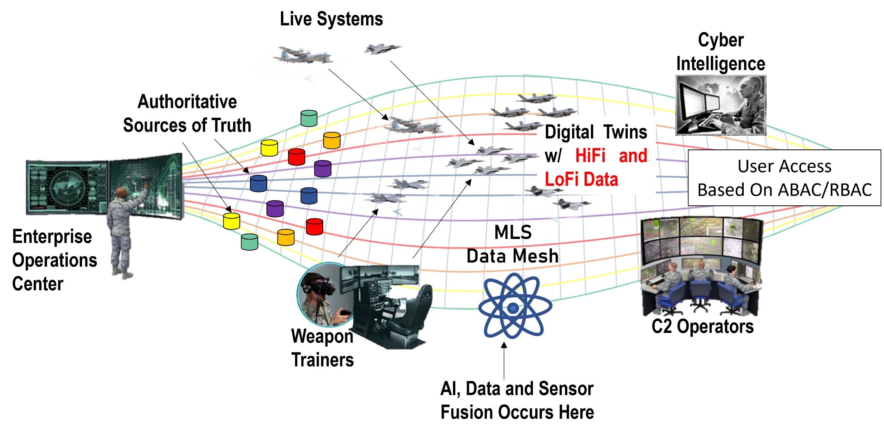
M&S GRA for Synthetic Training Vision​

Slide 11
Architectural Patterns
Encapsulates Best Practices
Facilitates Integration
Ensures Scalability and Flexibility
Initial Patterns Identified:
Data Patterns
Integration Patterns
Migration Patterns

Slide 12
Data Fabric
Unified framework for seamless data access and integration across multiple sources.
Centralized data ownership and management
Central integration with a unified management layer
Scales through centralized infrastructure
Less flexible but consistent and reliable
High interoperability through central standards and integration layers
Slower to adapt due to central control.
Data Mesh
Decentralized approach treats data as a product.
Decentralized ownership by domain teams.
Decentralized integration using APIs and services.
Scales by distributing management across domains.
Highly flexible and adaptable to changes.
Interoperability achieved through common data standards and APIs.
Rapid adaptability with minimal dependencies.
CENTRALIZED
DECENTRALIZED

Slide 13

Integration Patterns
Benefits
Ensure Consistency and Interoperability
Facilitate Seamless Data Exchange
Promote Flexibility and Scalability
Enhance Resilience and Reliability
Support Legacy and Modern Systems Coexistence
Key Patterns
Mesh App and Service Architecture (MASA)
Edge-Hybrid
Hyperconverged Infrastructure (HCI)

Slide 14

Migration Patterns
14
Rehost (Lift and Shift) – move simulation software to another platform (physical, virtual, or cloud) without modifying the code, features, or functions
Replatforming (Lift and Reshape) – move to another platform and recode some software, but not the code structure, features or functions
Refactoring (Restructure and optimize) – modification of existing code to meet modern standards without changing external behavior to remove technical debt and improve nonfunctional attributes
Incremental Migration – gradual transition with the Strangler Pattern—incrementally replacing legacy systems with new functionalities.

Slide 15

Current Applications of Design Patterns
Live Mission Operations Center (LMOC)
Data Mesh
Command and Control Simulation Environment for Training (C2SET)
Data Fabric
Strangler Pattern
Simulator Common Architecture Requirements and Standards (SCARS)
Hyperconverged Infrastructure

Slide 16
Foundational Changes Needed for Data-Centric Transformation
Unified Data Governance
Standardized Data Architecture
Advanced Analytics and AI Integration
Scalable Infrastructure

Slide 17


