Slide 1
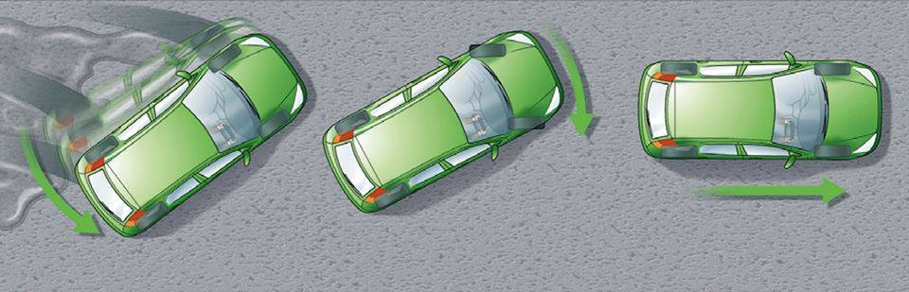
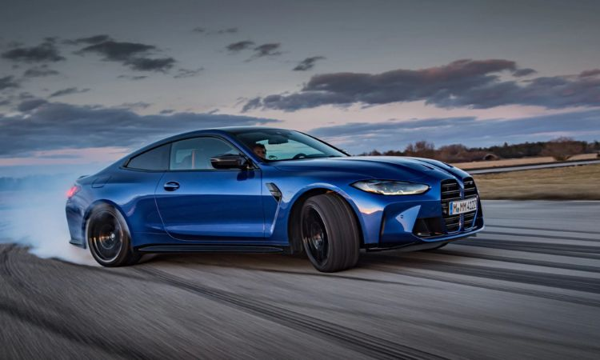
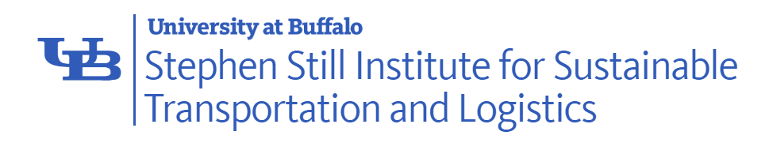

Implementation of Game-based M&S Tools to Enhance K9-12 Science, Technology, Engineering, and Mathematics (STEM) Learning Effectiveness
Kevin F. Hulme, Ph.D., CMSP (presenter)
Qian Wang, Ph.D. | Gongda Yu | Aaron Estes, Ph.D. | Irina Benedyk, Ph.D. Presentacion Rivera-Reyes, Ph.D. | Vidhi Solanki | Emeric Humbert (co-authors)

Slide 2
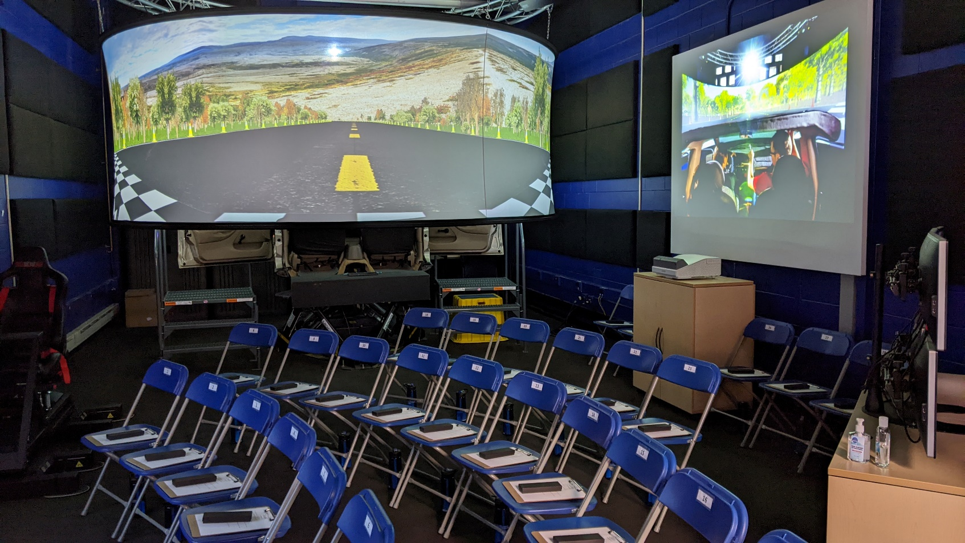
Agenda
Introduction
Broader Impacts
Experimental Design
Study Cohort
Results and Discussion
Summary/Conclusions
Future Work
Acknowledgements

Slide 3
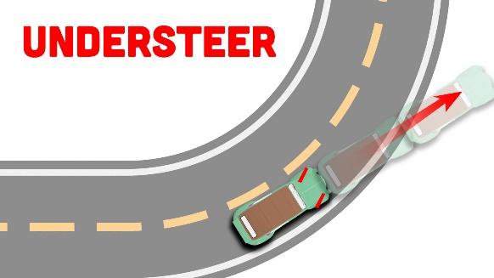
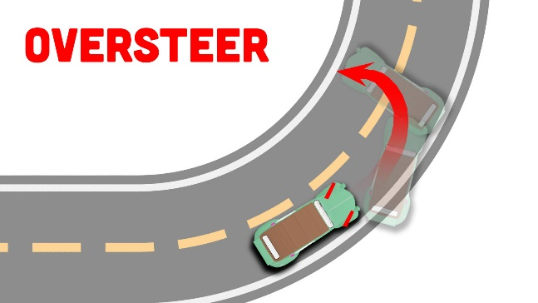
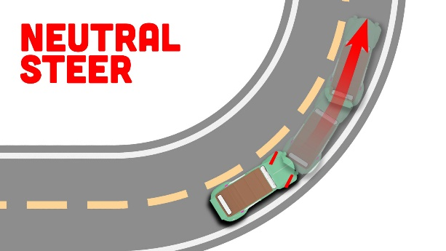
Introduction
Didactic instruction (i.e., lectures) is the most prevalent mode of teaching in STEM courses
Passive classroom environment | students less motivated/engaged | substandard learning outcomes
Game-based Learning (GBL) is gaining interest in K9-12 STEM
Digital/non-digital gameplay to target specific learning outcomes
We evaluated the effectiveness of GBL, physics-based modeling and high-fidelity simulation
GOAL: convey vehicle design and motion dynamics to a high-school STEM cohort

Slide 4

Broader Impacts
With GBL, traditional training becomes more engaging and enjoyable
Often leads to elevated participation and performance levels
Our implementation addresses various Education subcommittee priorities
Instruction strategies/best practices
STEM implementations to accelerate learning
Training strategies staged within individual and team-based settings
Conceptual parallels to other I/ITSEC subcommittees
GBL implementations to improve driver education (Training/PSMA)
Gaming approaches to advance the science of learning (Education/ECIT)
Applied M&S to enhance safe mobility (Simulation/HPAE)
Training, Simulation,
Education
Human Performance
(HPAE)
Policies & Standards
(PSMA)
Emerging Concepts
(ECIT)

Slide 5
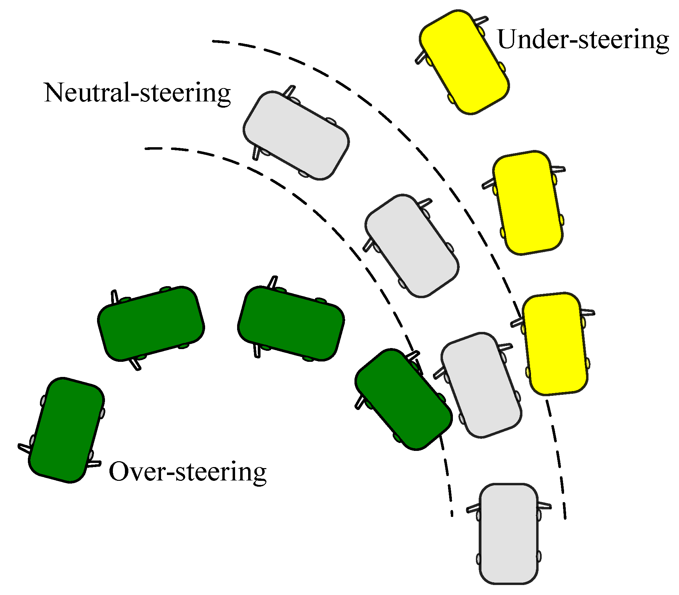
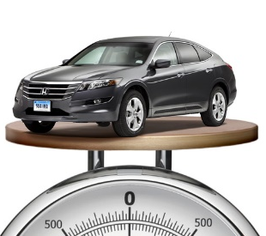
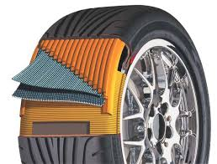
Background Theory
Vehicle sensitivity to steering input: understeer and oversteer
Understeer - car steers less than the driver’s input
Oversteer - car steers more than the driver’s input
Neutral steer - car steers comparable to the driver’s input
Impact variable #1: Weight distribution (center-of-gravity | CG)
A front-heavy vehicle is more stable (i.e., understeer)
However – also less maneuverable
Impact variable #2: Tire stiffness distribution (TSD)
Cornering stiffness determines vehicle response on a turn
Stiffer front tires (i.e., understeer) imply stability, but less maneuverability
#1:
#2:

Slide 6
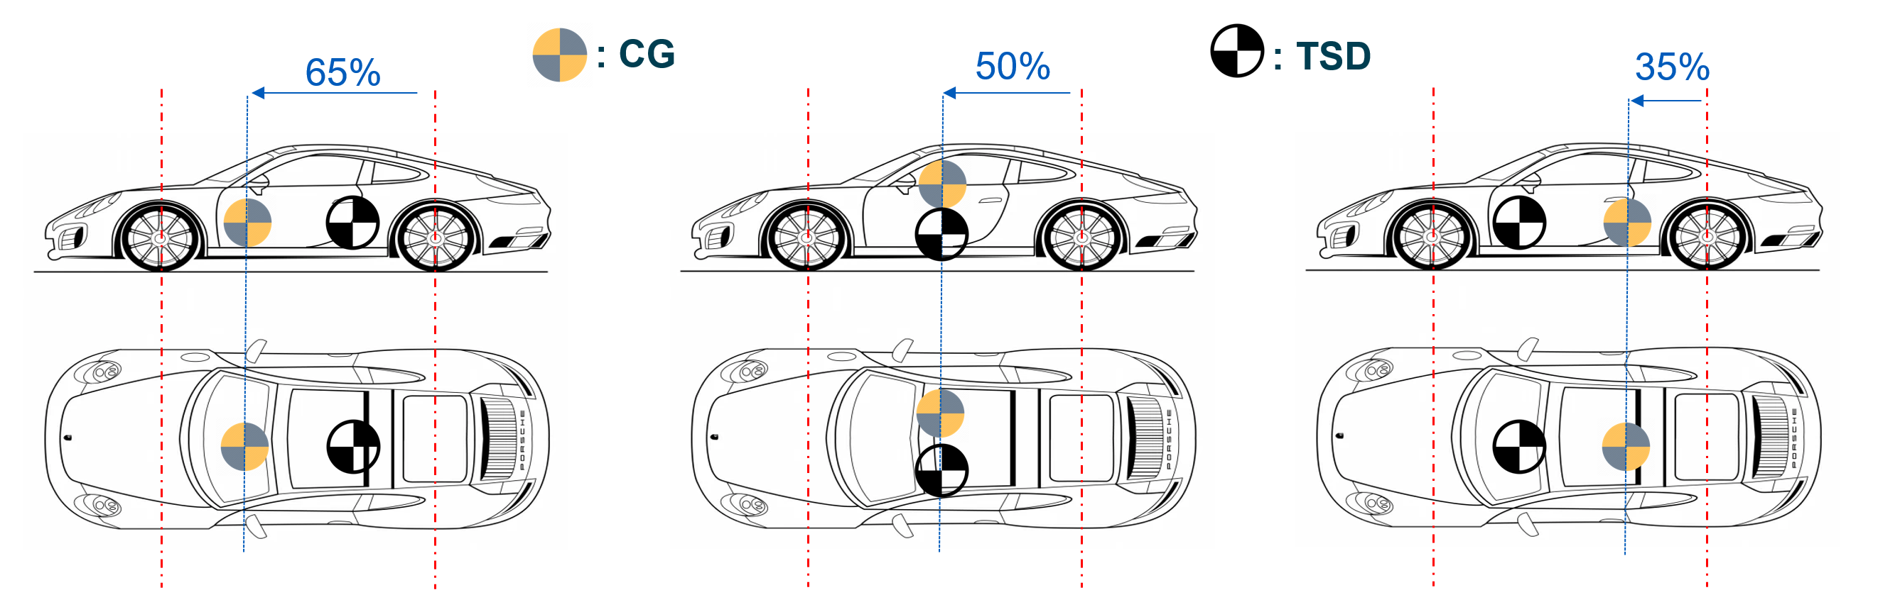
Background Theory
Understeer
Neutral steer
Oversteer
The inter-relationship between CG and TSD is critical for determining vehicle performance

Slide 7
Background Theory Experimental Grid
Drive # | % front CG | % front TSD | Condition | comment
1 | 65 | 35 | Understeer | Stable, but underperforming
2 | 65 | 50 | Understeer | Stable, and more easily driven by novices
3 | 65 | 65 | Neutral steer | Partially stable; challenging to drive
4 | 50 | 35 | Understeer | Stable, easily driven by novices
5 | 50 | 50 | Neutral steer | Partially stable, but easy to drive
6 | 50 | 65 | Oversteer | Not stable, challenging to drive at elevated speeds
7 | 35 | 35 | Neutral steer | Partially stable; challenging to drive
8 | 35 | 50 | Oversteer | Not stable, challenging to drive at elevated speeds
9 | 35 | 65 | Oversteer | Not stable, incredibly challenging to control
The expected within-condition variances observed across understeer and oversteer
Elevated stability is expected the closer the parameters are towards the front of the vehicle
Larger (% front) difference between CG/TSD implies more pronounced handling deviations
Comparison of the three neutral steer conditions is more nuanced (see paper for details)

Slide 8
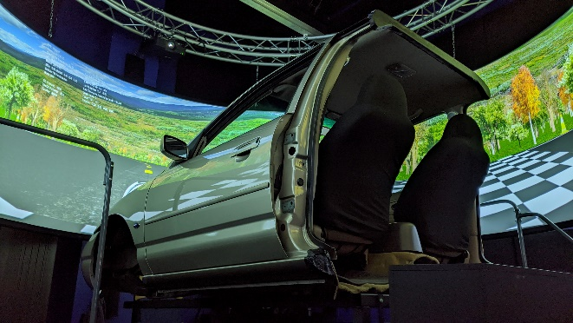
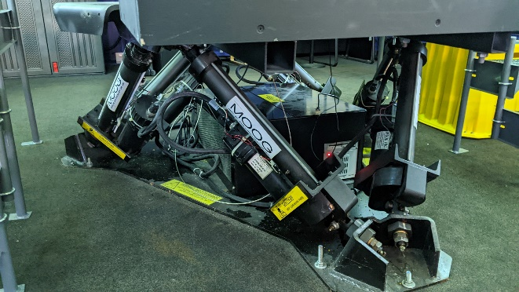
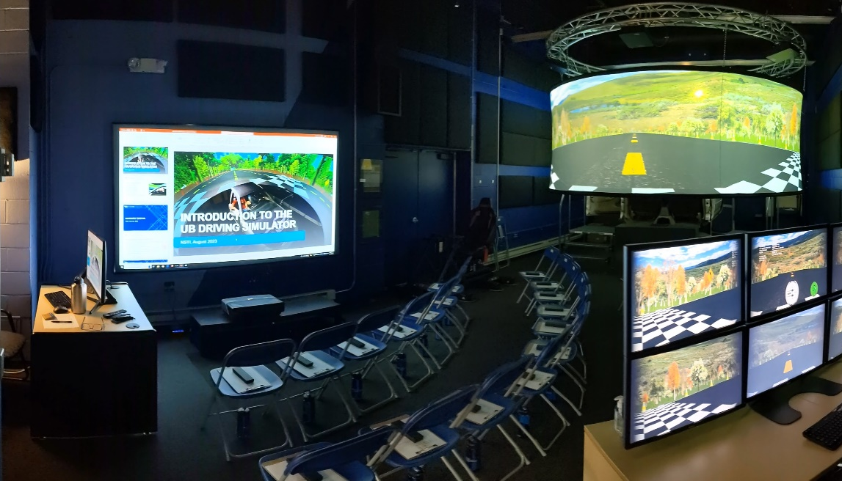
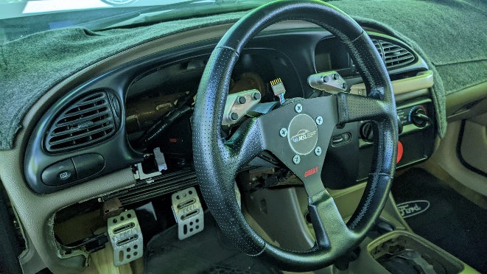
Supporting Hardware
Experiment was performed on a high-fidelity driving simulator:
360-degree, 16’ diameter, 6’ high, six-channel display system
1920x1080p | composite image: 11520x1080p @ 50Hz
Ford Contour vehicle (driver/passenger) cabin
High-fidelity USB input navigation controls
6-DOF motion cueing and washout filtering
Stereo system for aural cueing (e.g., speed, turns, collisions)

Slide 9
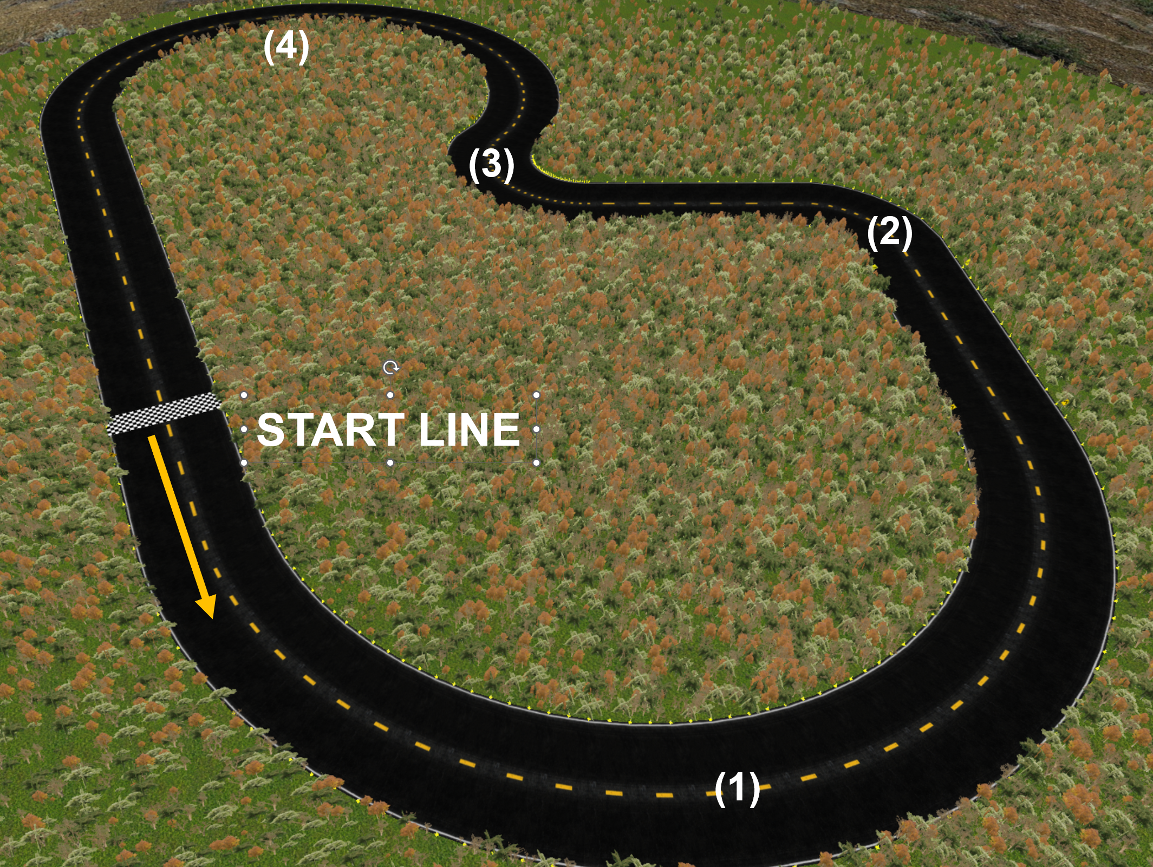
Driving Task
Racetrack: The Quad-radial speedway
Designed in-house (w/ C++ OpenGL API)
An easy-to-learn track with 4 varying difficulty turns
Primary experimental goal: maximize legal laps achieved
Each driver assigned vehicle parameters (% front CG/TSD)
2.5 minutes on the speedway
Quantitative driver performance rating
A heuristic weighted sums scoring (“gamification”) model
Component | Description | Rating type | Weighting
Legal laps | How many legal laps achieved in allotted time? | Interval (x/9) | 30%
Fastest lap | What was the fastest (legal) lap achieved? | Ordinal (x/12) | 30%
Handling | How difficult were the assigned handling characteristics? | Ordinal (x/12) | 30%
Crash metric | How many critical mistakes were made in allotted time? | Interval (x/9) | 5%
Travel speed | How consistent was the overall rate of travel? | Ordinal (x/9) | 5%
GAMIFICATION RATING |  | TOTAL (x/51) | 100%

Slide 10
Conceptual Quiz
The supplementary conceptual quiz contained four questions on:
The underlying theory relating to steering | handling | performance
The primary variables that influence these characteristics
The multiple-choice questions each had a range of three to five possible responses
Quiz (pre/post) was issued to gauge overall improvement of conceptual understanding
Upon reflection, questions 3/4 both had candidate responses that deserved partial credit
Were rated as such during the final tally
Question # | Conceptual Query | Correct response
1 | Which vehicle configuration is less maneuverable, but more stable? | Understeer
2 | Which vehicle configuration is favored for balanced performance? | Neutral steer
3 | Does a more front CG make a car more stable or less stable? | Depends on tires*
4 | Do stiffer tires towards the front make a car more stable or less stable? | Depends on CG*

Slide 11
Study Cohort
The National Summer Transportation Institute (NSTI) at the University at Buffalo
Enables high school students to explore the current state-of-practice with Transportation Science
N=23 participants (16 male, 7 female) were enrolled in the summer 2023 NSTI program
Average cohort age was 15.05 years (σ=1.20) | N=12 self-reported some driving experience
Activity | Description | Duration
Overview/briefing | Description and overall purpose of experiment | 5 minutes
Entrance surveys | Conceptual Quiz (PRE), basic driver demographics | 10 minutes
Simulator introduction | Description of Lab, Simulator operation, Quad-radial track | 10 minutes
Conceptual overview | Oversteer, understeer, neutral steer (theory) | 10 minutes
Simulator drives (Part I) | Simulator Drives #1-3 | 15 minutes
Conceptual reinforcement (Part A) | Weight Distribution (CG); vehicle performance/stability (theory) | 10 minutes
Simulator drives (Part II) | Simulator Drives #4-6 | 15 minutes
Conceptual reinforcement (Part B) | Tire stiffness distribution (TSD); relationship to CG (theory) | 10 minutes
Simulator drives (Part III) | Simulator Drives #7-9 | 15 minutes
Exit surveys | Conceptual Quiz (POST), learning preferences, satisfaction survey | 10 minutes
Q/A and Conclusion | Lab walkthrough, concluding remarks | 10 minutes
TOTAL EXPERIMENT DURATION |  | 120 minutes

Slide 12
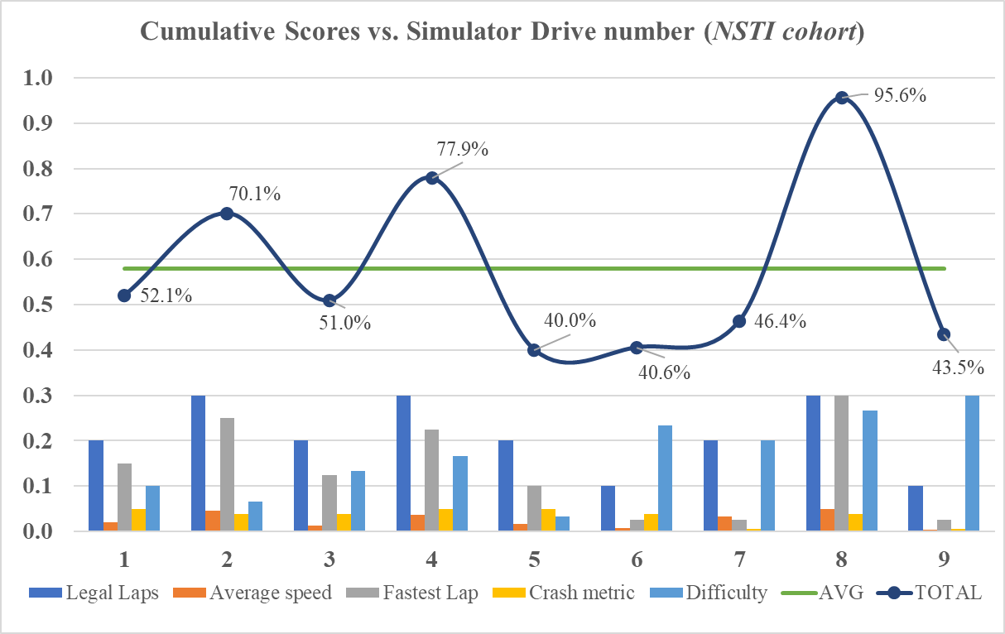
Results & Discussion
Simulator scoring model
X-axis: rating components (i.e., for each of the 9 individual NSTI student drives)
Y-axis: the scoring model (0.0 to 1.0) with a cumulative simulator rating (i.e., dark blue curve)
The green horizontal line is the calculated cohort average (μ=0.58/1.0; σ=0.17)
General observations:
Wide variance in simulator performance
Above average: two (#2 and #4) were understeer vehicles, and one (#8) was moderate oversteer
Below average: one understeer (#1); two oversteer (#6 and #9); three neutral steer vehicles (#3, #5, #7)

Slide 13
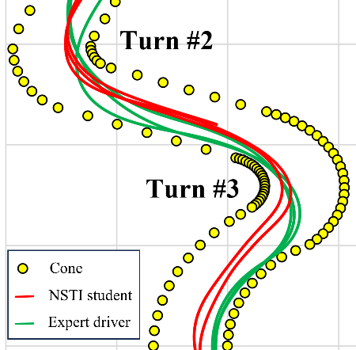
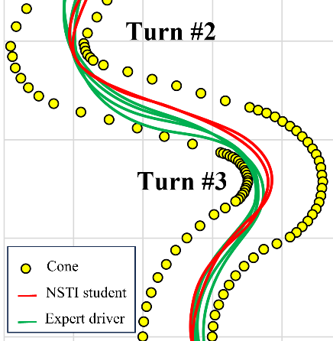
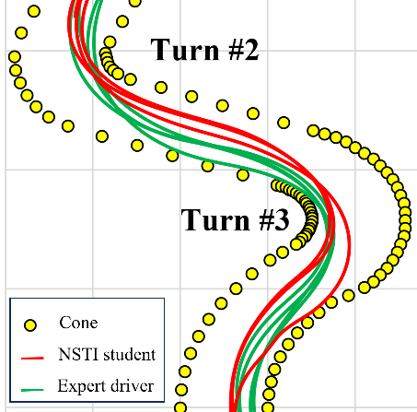
Results & Discussion
Position Traces
Turn 2 and Turn 3 transitions:
Understeer vehicle: linear | undamped (i.e., no oscillatory behavior) | late exits
Neutral steer vehicle: constant apex | slightly damped oscillations | controlled/consistent exits
Oversteer vehicle: wider variability | moderately damped oscillations | exits have less control and more variance
Drive #1: (understeer)
Drive #5: (neutral steer)
Drive #8: (oversteer)

Slide 14
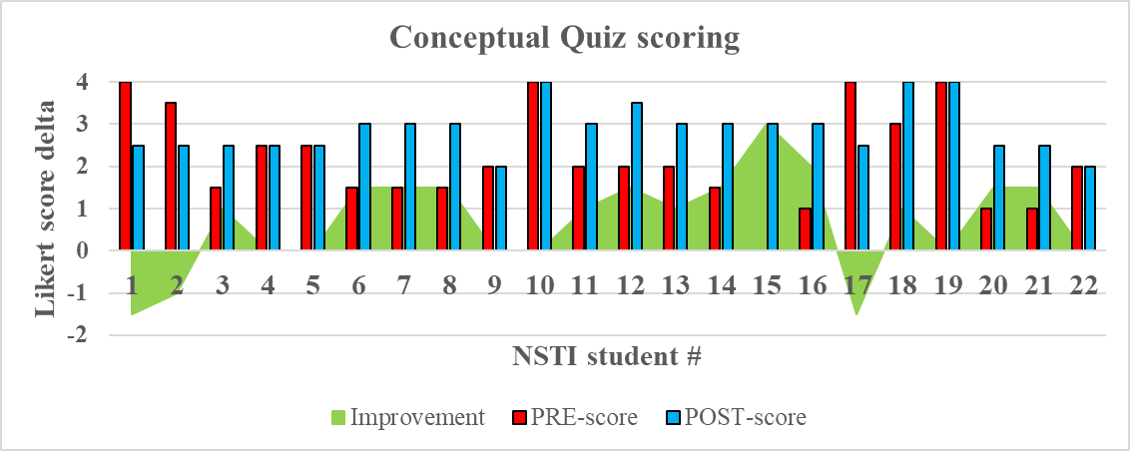
Results & Discussion
Conceptual Quiz (pre/post)
Cohort mean increased from μ=2.18 to 2.89 (σ=1.14 to 0.58)
A possible indicator that NSTI conceptual understanding improved due to GBL exposure
N=13 improved {+} | N=4 remained the same {=} | N=3 decreased {-} | N=2 perfect (Pre and Post) {++}
N=3/3 (-) and N=2/4 (=) had the exact same responses on their POST conceptual quizzes
Questions #1 and #2: correct (i.e., differences between vehicle conditions - over/under/neutral steer)
Question #3: partial credit | Question #4: incorrect (i.e., parameters that influence these conditions - CG/TSD)

Slide 15
Summary and Future Work
I/ITSEC (Education subcommittee) priorities:
Novel implementation of active learning (vehicle design/motion dynamics) for K9-12 STEM
GBL | physics-based modeling | high-fidelity simulation
STEM implementations to accelerate learning | Training within diverse (individual/team-based) constructs
Primary experimental outcomes:
Rating model to quantify driver performance indicated a general preference towards understeer
The four-item conceptual quiz cohort mean increased from μ=2.18 to 2.89 from Pre to Post
N=13/22 students demonstrated improvement – possibly due to experiment participation
Some aspects of “negative training” observed with regards to CG/TSD parameter influence
Future Work:
Implementation of a mixed cohort approach
Students divided into two groups (experimental/control)
Groups then swap (i.e., all students receive both training types)

Slide 16

Acknowledgements
Primary author contact:
Kevin F. Hulme, Ph.D., CMSP
Program Manager
University at Buffalo
The Stephen Still Institute for Sustainable Transportation and Logistics (SSISTL)
204 Ketter Hall
716-645-5573
hulme@buffalo.edu

