Slide 1
Practical Guide to
LEARNING ENGINEERING
Sae Schatz Co-Founder, Chief Product Officer Bedrock Learning, Inc. sae@theknowledgeforge.com | Jim Goodell Director of Innovation Quality Information Partners jimgoodell@qi-partners.com
Notes:
0:00-0:05 – Introduction to the Tutorial
Introduce speakers
What will you learn today?
0:05-0:10 – What is learning engineering?
Short definition
Share the penicillin story to clarify distinctions between “science” and “engineering”
0:10-0:20 – Learning engineering process
Introduction to the learning engineering process model
CHALLENGE: Understand the opportunity to improve learning or its conditions
CREATION: Designing, building solutions, data instrumentation, and plans
IMPLEMENTATION with data collection
INVESTIGATION with data analysis
Input-Process-Output model (i.e., basic engineering feedback loops)
Learning engineering process vs. ADDIE (traditional) process
Application of learning engineering at different scales (e.g., learning activity vs. career)
0:20-0:25 – Learning engineering team
Learning engineering team composition
Importance of include learning and other stakeholders too
0:25-0:40 – Executing human-centered design for learning
Purpose and principles of human centered design
The broad scope of the learning “human-system”
Consider the learner characteristics: personal capabilities, traits, and states
Consider the learning activity and how it interacts with a learners’ characteristics
Consider the broader context
Human-centered design process
Tools for human-centered design (e.g., stakeholder analysis, personas, user testing)
Story about donkey carts in Gambia solving some early-childhood education issues
0:40-0:50 – Integrating learning science
Purpose and principles of learning science
Learning science tools (e.g., instructional tactics, motivational principles)
0:50-1:10 – Integrating learning technologies and learning analytics
Design patterns – Common principles of engineering disciplines
Engineering principles can inform learning—learning engineering!
Learning engineering must be data-driven
Often, “data driven” means technology-based instrumentations; here’s what that means
Technology considerations for learning at scale (e.g., open-architecture, data standards)
Using data for learning analytics and continuous optimization
1:10-1:30 End/Q&A
Brief summary of key points
Where to find more information
Formative assessment
Open Q&A (10 min)

Slide 2


I can confidently (and correctly)…
…explain the purpose, scope, and characteristics of learning engineering
…compare and contrast learning engineering to other disciplines (e.g., learning science)
…help organize a team for and execute a learning engineering process for a real-world project
…fish for myself (find resources to continue to improve my learning engineering capabilities)
Notes:
Define the purpose, scope, and distinct characteristics of the learning engineering field.
Explain the benefits of learning engineering (over and above subordinate or related fields).
Design a learning engineering team and process for a practical training/education goal.
Explain how to find additional learning engineering information for practical applications.
MORE: Look smart in front of your boss and colleagues, when you know how to explain how all of the pieces of pedagogy, cognition, technology, data, and organizational design fit together. You’ll be one of the first to know about this hot new emerging discipline!

Slide 3
learning engineering [ˈlərniNG ˌenjəˈniriNG]
Learning engineering is a process and practice that applies the
learning sciences, using human-centered engineering design methodologies and data-informed decision-making, to support learners and their development.
Goodell et al. (2022), Learning Engineering Toolkit
Notes:
In other words, it’s about solving problems related to learning and development – at a system level – with all of the tools in a toolkit

Slide 4
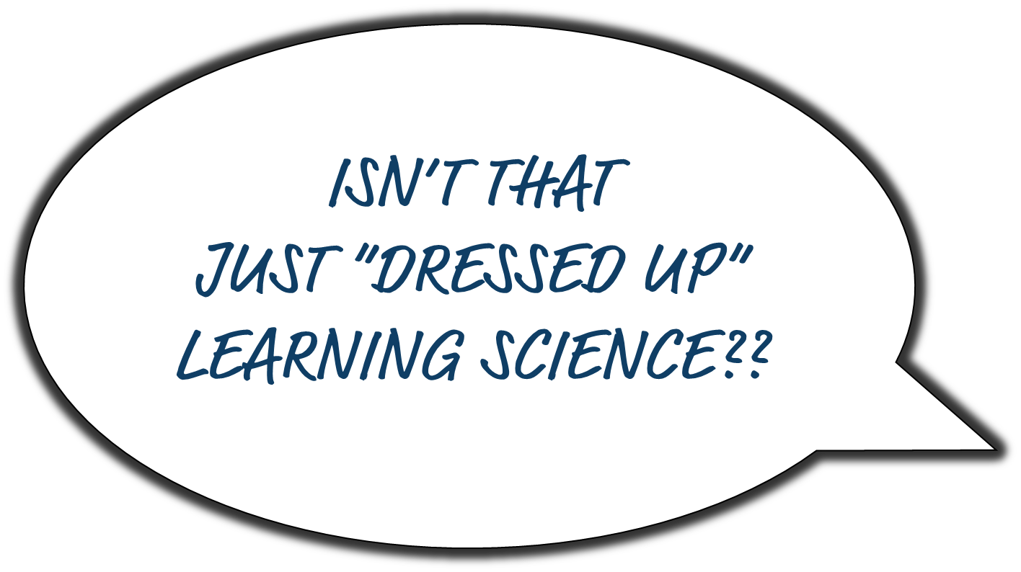

learning engineering [ˈlərniNG ˌenjəˈniriNG]
Learning engineering is a process and practice that applies the
learning sciences, using human-centered engineering design methodologies and data-informed decision-making, to support learners and their development.
Goodell et al. (2022), Learning Engineering Toolkit
Notes:
Now wait a minute. Isn’t this just a talk about “fancy learning science”?

Slide 5

Learning Science
Learning Engineering
Notes:
Science vs. Engineering…

Slide 6

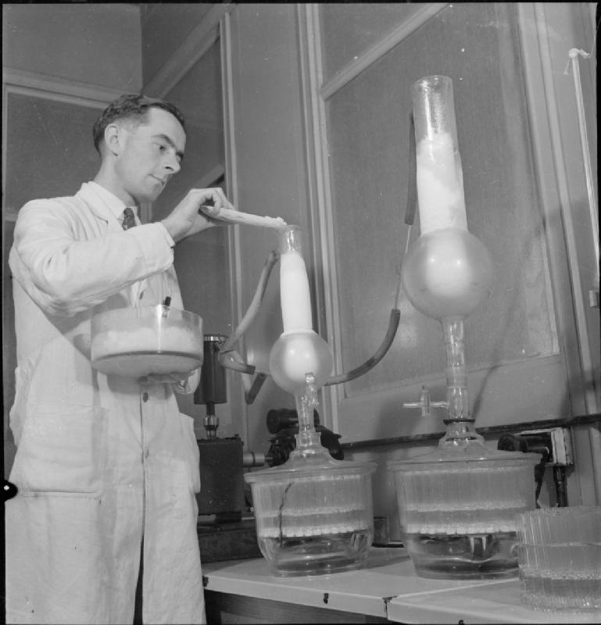
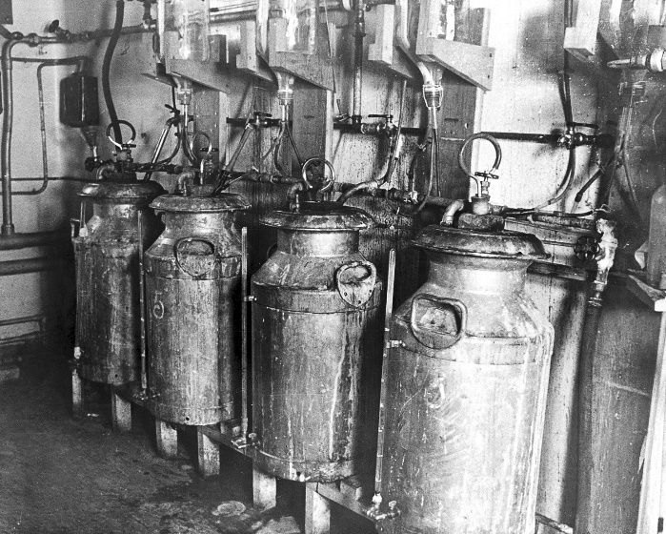
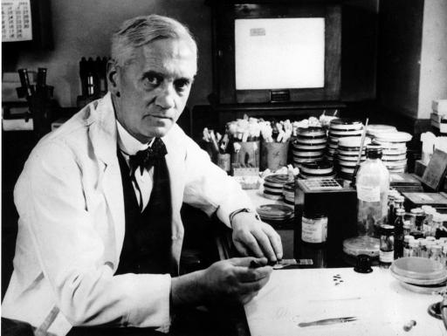
Engineers Begin to Scale
1928
WWII
First Factory Opens
Dr. Alexander Fleming
1939
1941
1944
Notes:
In 1928, Alexander Fleming discovered penicillin. However, the Nobel Prize–winning scientist and his colleagues never developed the ability to produce the drug at scale. By June 1942, US labs had only enough penicillin available to treat about ten patients. The urgency of lives being lost in the war meant that production of penicillin needed to move out of the laboratory and into mass-production. This was no longer just a scientific endeavor; it required engineering. The goals of science and engineering are different. The goal of science is to discover the truth about the world as it is. The goal of engineering is to create scalable solutions to problems using science as one tool in that endeavor.
PHOTOS:
Engineering photo (“at scale”) from Imperial War Museum on the IWM Non Commercial Licence.
Equipment used for making early forms of penicillin photo from Wellcome Images. Creative commons.
Penicillin Discovered
“In the war, penicillin proved its mettle. Throughout history, the major killer in wars had been infection rather than battle injuries. In World War I, the death rate from bacterial pneumonia was 18 percent; in World War II, it fell, to less than 1 percent. From January to May in 1942, 400 million units of pure penicillin were manufactured. By the end of the war, American pharmaceutical companies were producing 650 billion units a month. …as we celebrate Alexander Fleming’s great accomplishment, we will recall that penicillin also required the midwifery of Florey, Chain and Heatley, as well as an army of laboratory workers.” (PBS, 2013, https://www.pbs.org/newshour/health/the-real-story-behind-the-worlds-first-antibiotic)
First Factory Opened
“In September 1943 it [Pfizer] purchased the old Rubel Ice Plant on Marcy Avenue in Brooklyn, a nearby building that had the refrigeration equipment required, rebuilding it into the world’s first large-scale penicillin factory. On March 1, 1944 Pfizer’s penicillin plant opened.” (https://www.acs.org/content/acs/en/education/whatischemistry/landmarks/penicillin.html#:~:text=In%20September%201943%20it%20purchased,1944%20Pfizer's%20penicillin%20plant%20opened.)

Slide 7
First At-Scale Process
Science
Engineering
1928
The goal of science is to discover the truth about the world as it is.
The goal of engineering is to create scalable solutions to problems using science as one tool in that endeavor.
WWII
First Factory Opens
Dr. Alexander Fleming
1939
1941
1944
Notes:
The goals of science and engineering are different. The goal of science is to discover the truth about the world as it is. The goal of engineering is to create scalable solutions to problems using science as one tool in that endeavor.

Slide 8


Tutorial Outline
Learning engineering process
Learning engineering teams
Human-centered design for learning
Integrating learning science
Integrating technologies and analytics
Q&A
Notes:
What we’ll discuss today….

Slide 9

learning engineering [ˈlərniNG ˌenjəˈniriNG]
Learning engineering is a process and practice that applies the
learning sciences, using human-centered engineering design methodologies and data-informed decision-making, to support learners and their development.
Learning engineering is a repeatable process intended to iteratively design, test, adjust, and improve conditions for learning.
Goodell et al. (2022), Learning Engineering Toolkit
Notes:
Learning engineering is a process...

Slide 10



A process is a series of actions or steps taken in order to achieve a particular end.
A process has:
inputs
process steps
outputs

Slide 11





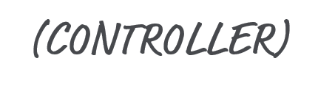
An iterative process uses feedback loops to continuously inform and improve the output.

Slide 12
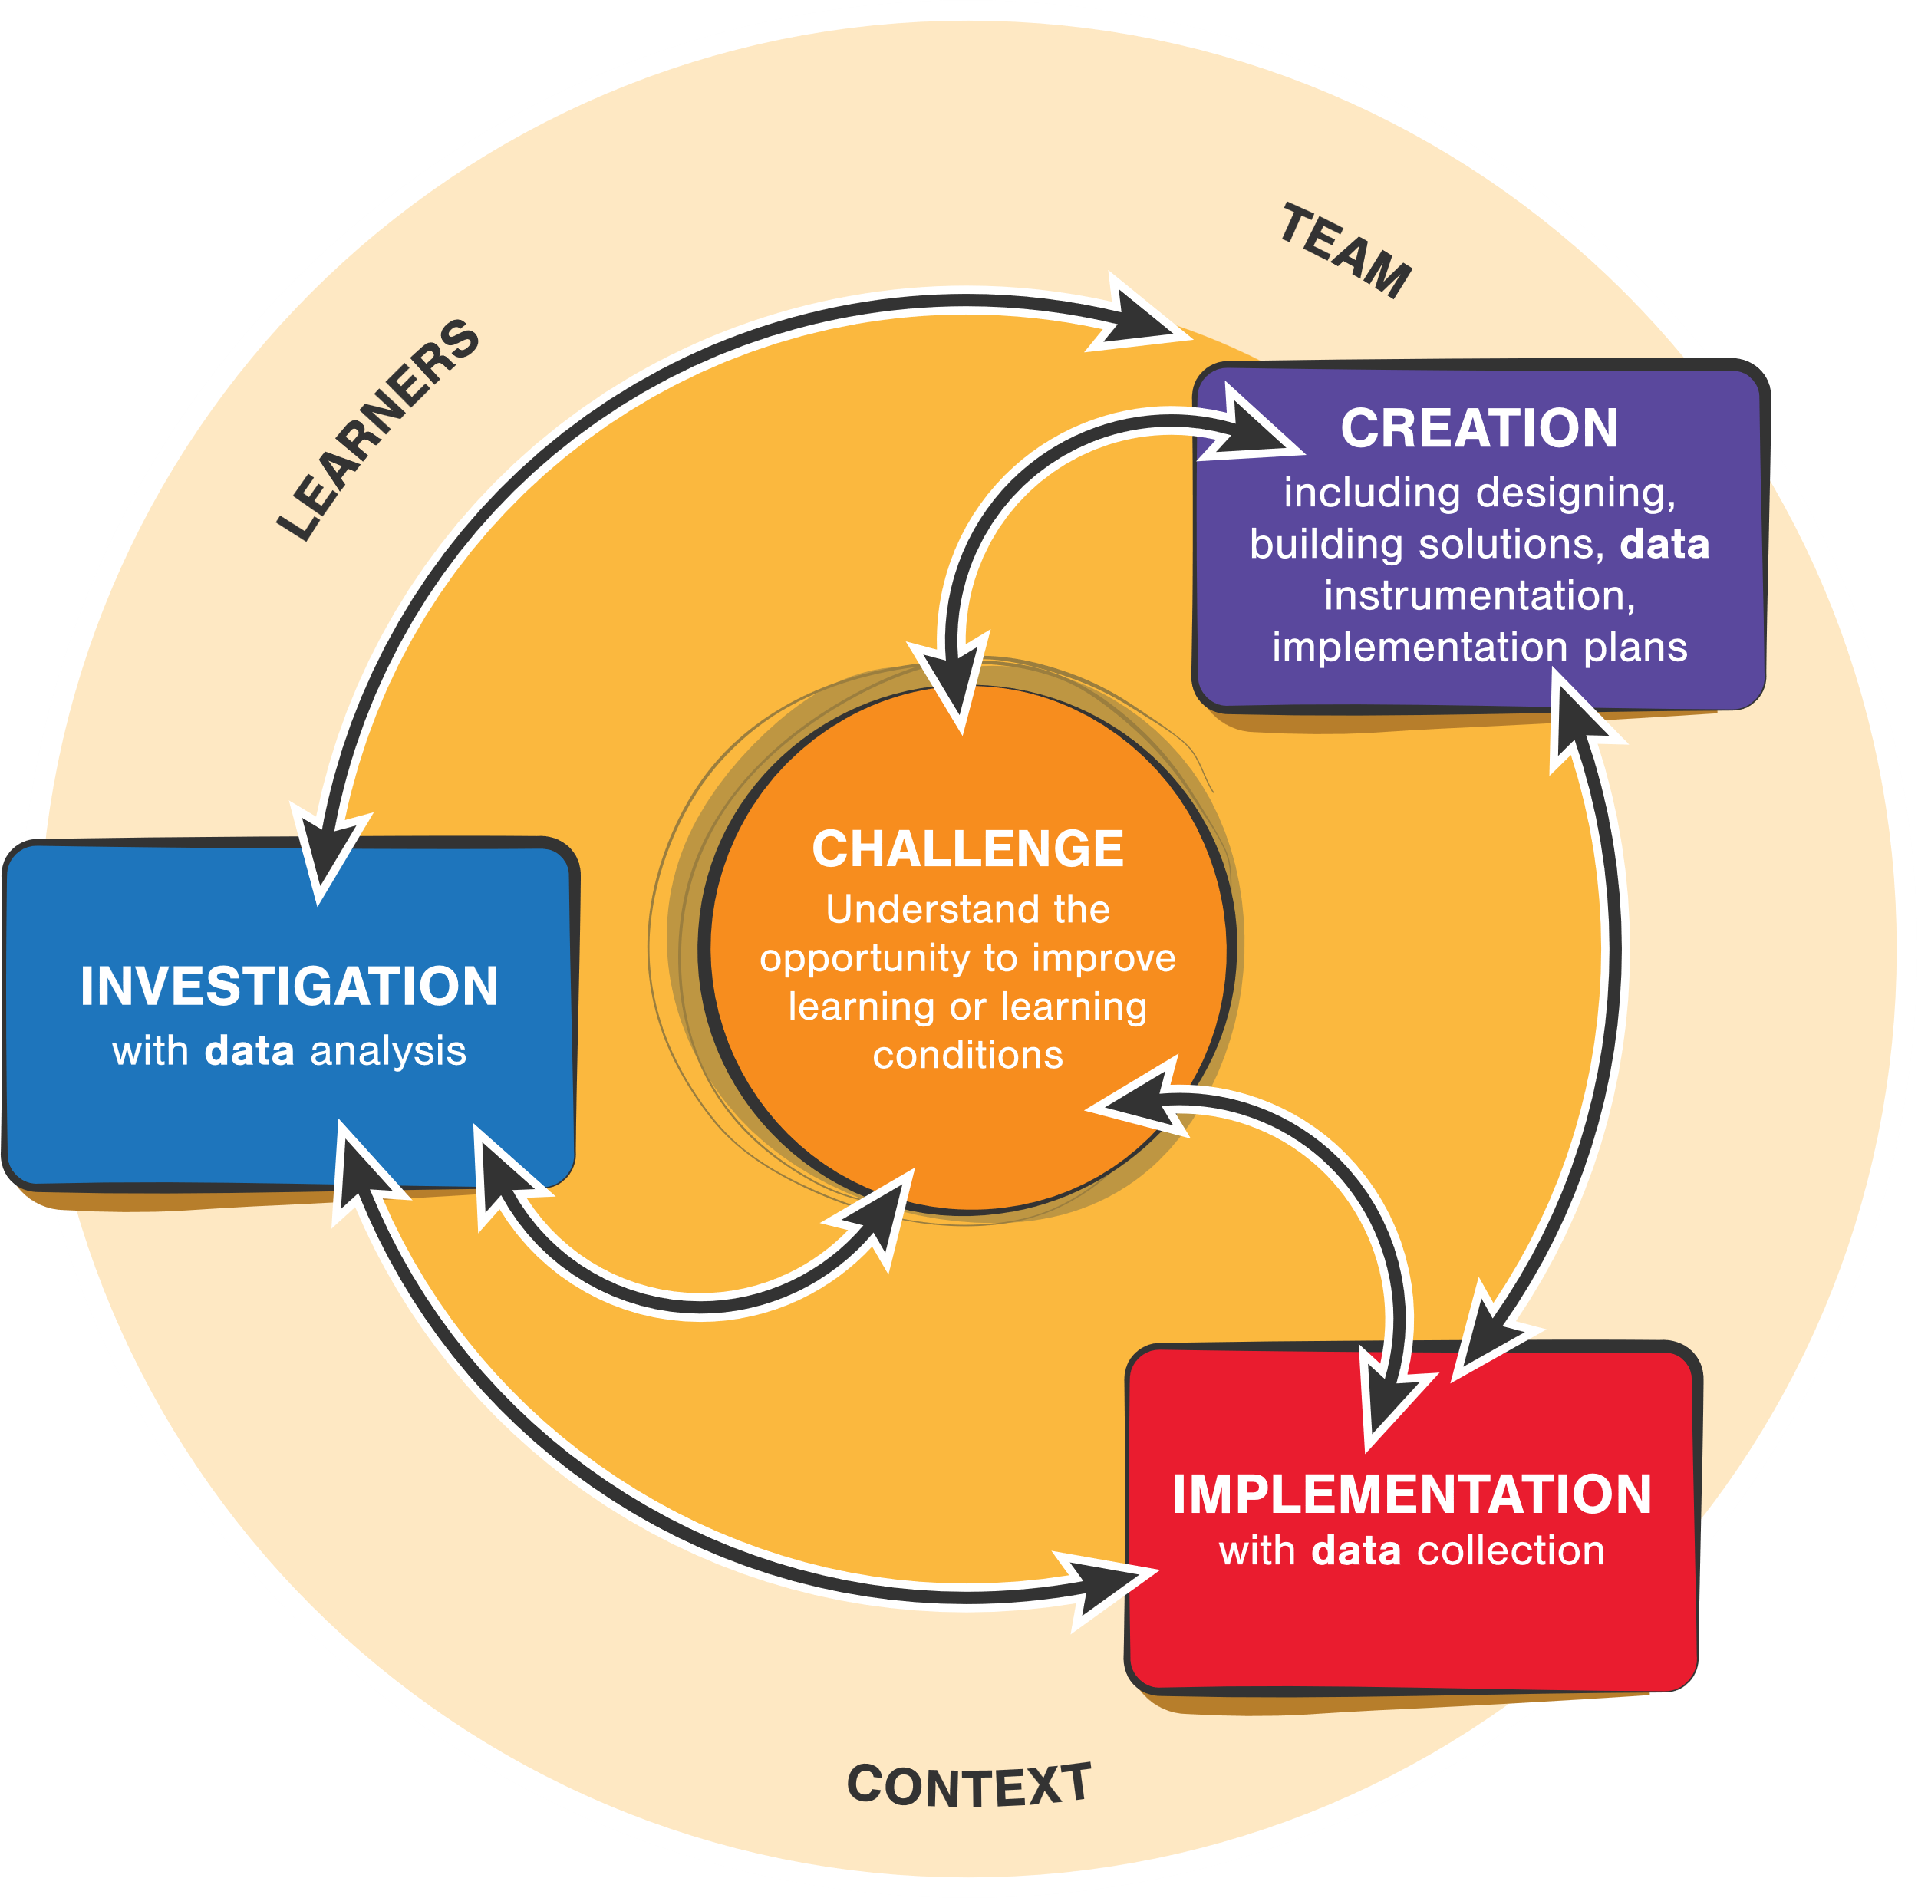
Learning engineering is a contextualized, iterative, data-driven, outcomes-focused process
CC-BY Aaron Kessler and Jim Goodell
Notes:
This is the learning engineering process diagram… let’s walk through it.

Slide 13
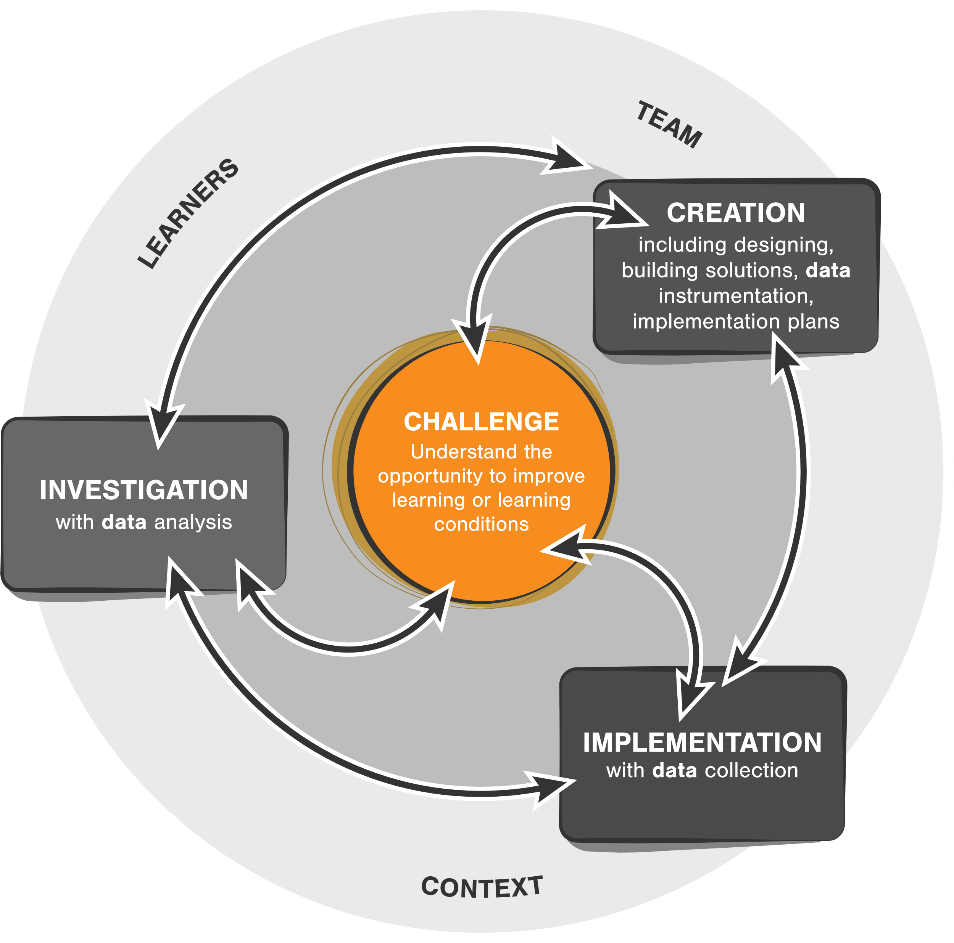
Start with the challenge or problem associated with learners and learning; in other words, be goal oriented
CC-BY Aaron Kessler and Jim Goodell

Slide 14
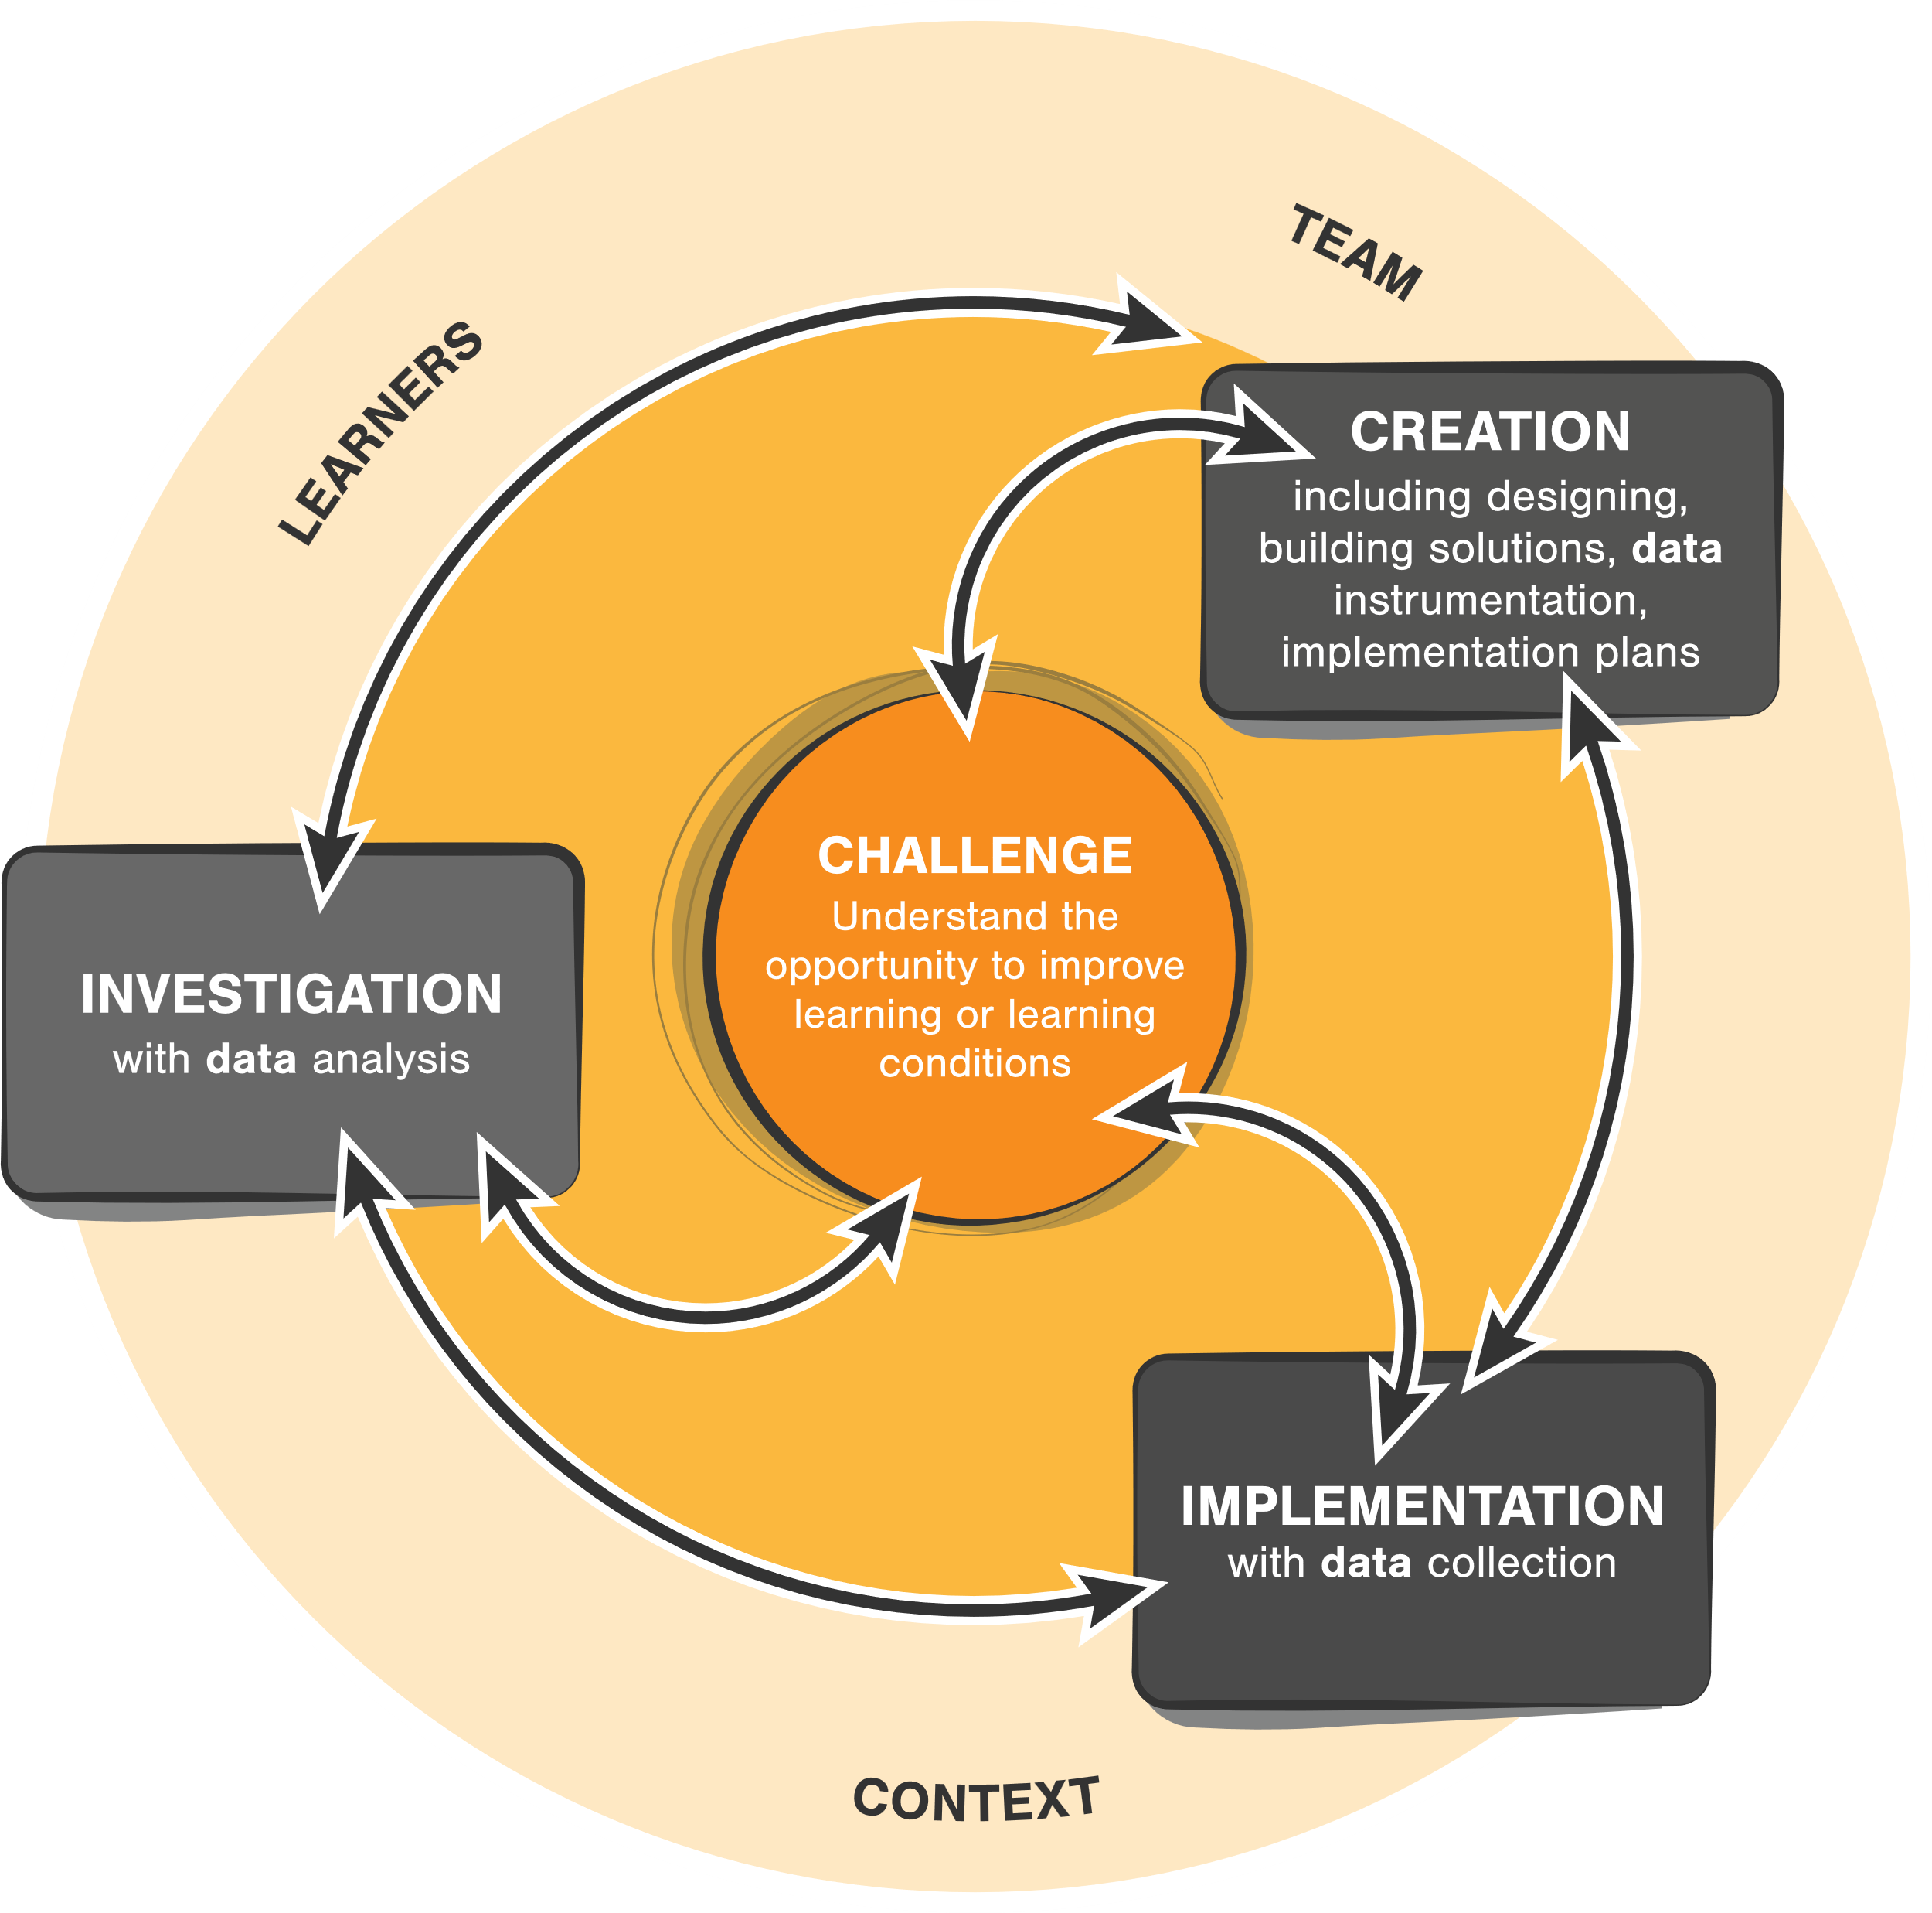
Start with the challenge or problem associated with learners and learning; in other words, be goal oriented
Learning is situated. Understand the context, not only the learners and content but of the full system
CC-BY Aaron Kessler and Jim Goodell

Slide 15
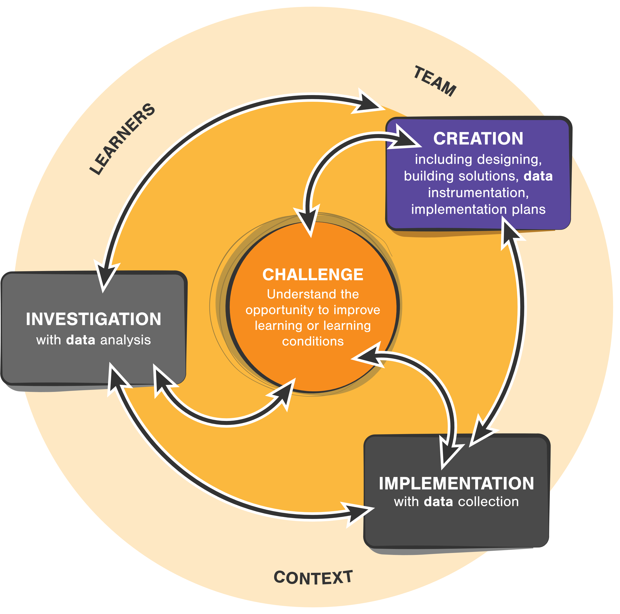
Start with the challenge or problem associated with learners and learning; in other words, be goal oriented
Learning is situated. Understand the context, not only the learners and content but of the full system
Design, develop, instrument, test in a series of mini processes
CC-BY Aaron Kessler and Jim Goodell

Slide 16
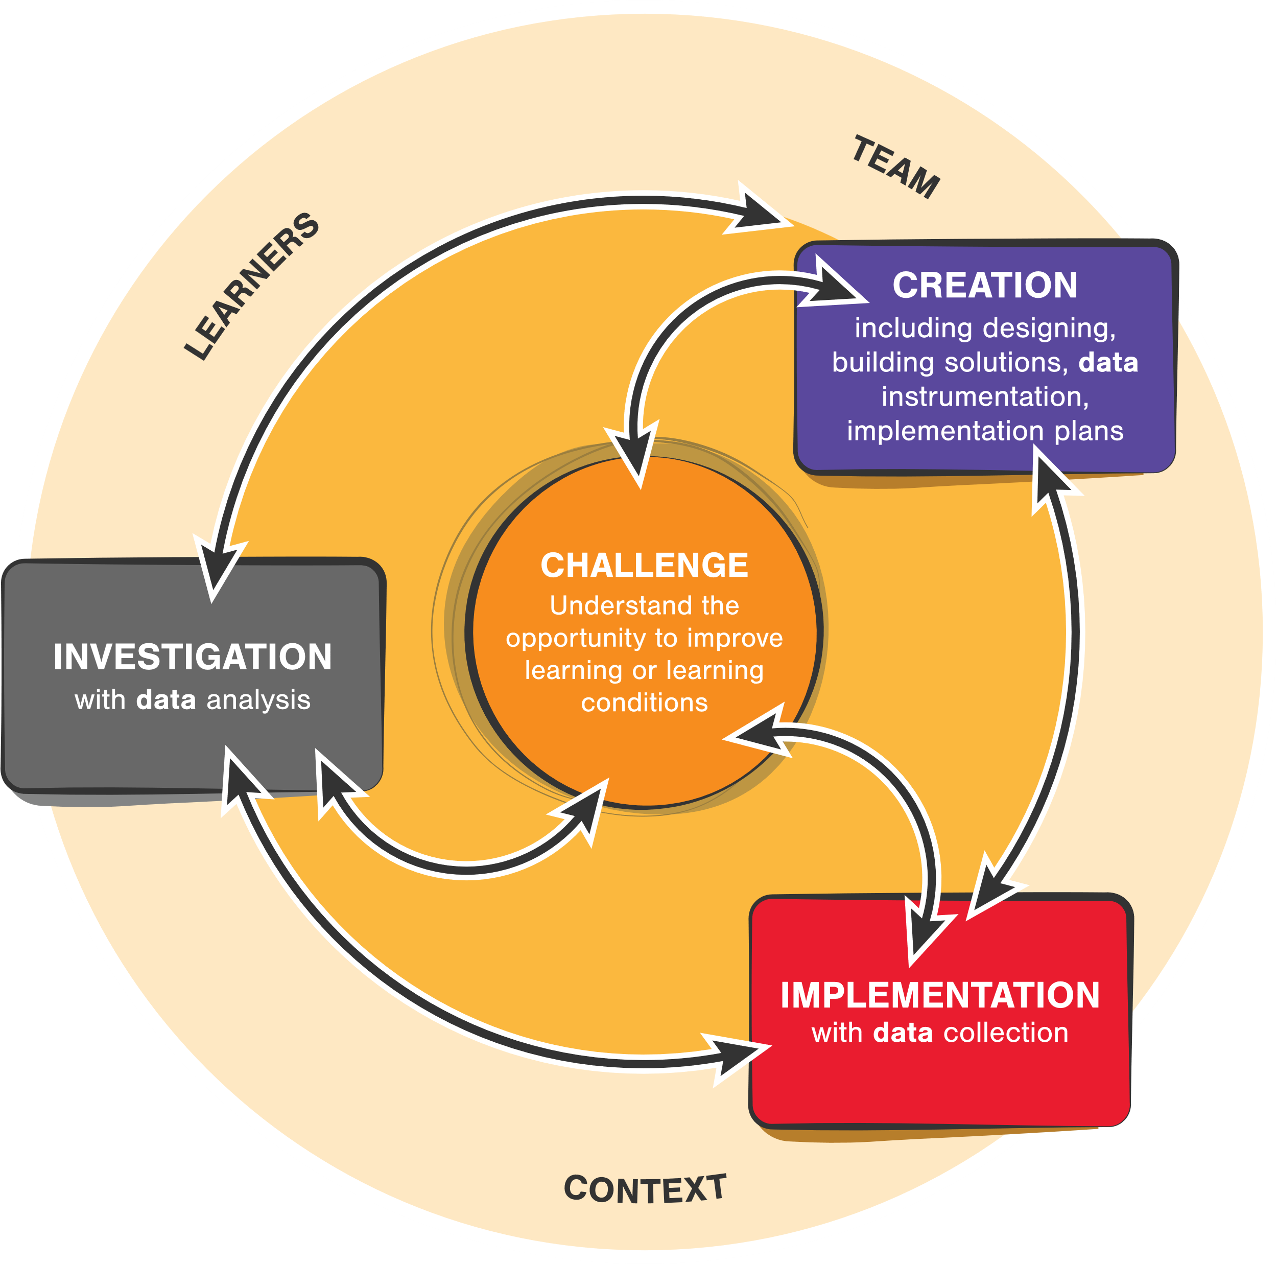
Start with the challenge or problem associated with learners and learning; in other words, be goal oriented
Learning is situated. Understand the context, not only the learners and content but of the full system
Design, develop, instrument, test in a series of mini processes
Implement with real learners in real contexts—with drafts and prototypes and also iteratively once released
CC-BY Aaron Kessler and Jim Goodell

Slide 17
Start with the challenge or problem associated with learners and learning; in other words, be goal oriented
Learning is situated. Understand the context, not only the learners and content but of the full system
Design, develop, instrument, test in a series of mini processes
Implement with real learners in real contexts—with drafts and prototypes and also iteratively once released
Collect data, analyze, identify ways to continuously improve
CC-BY Aaron Kessler and Jim Goodell

Slide 18
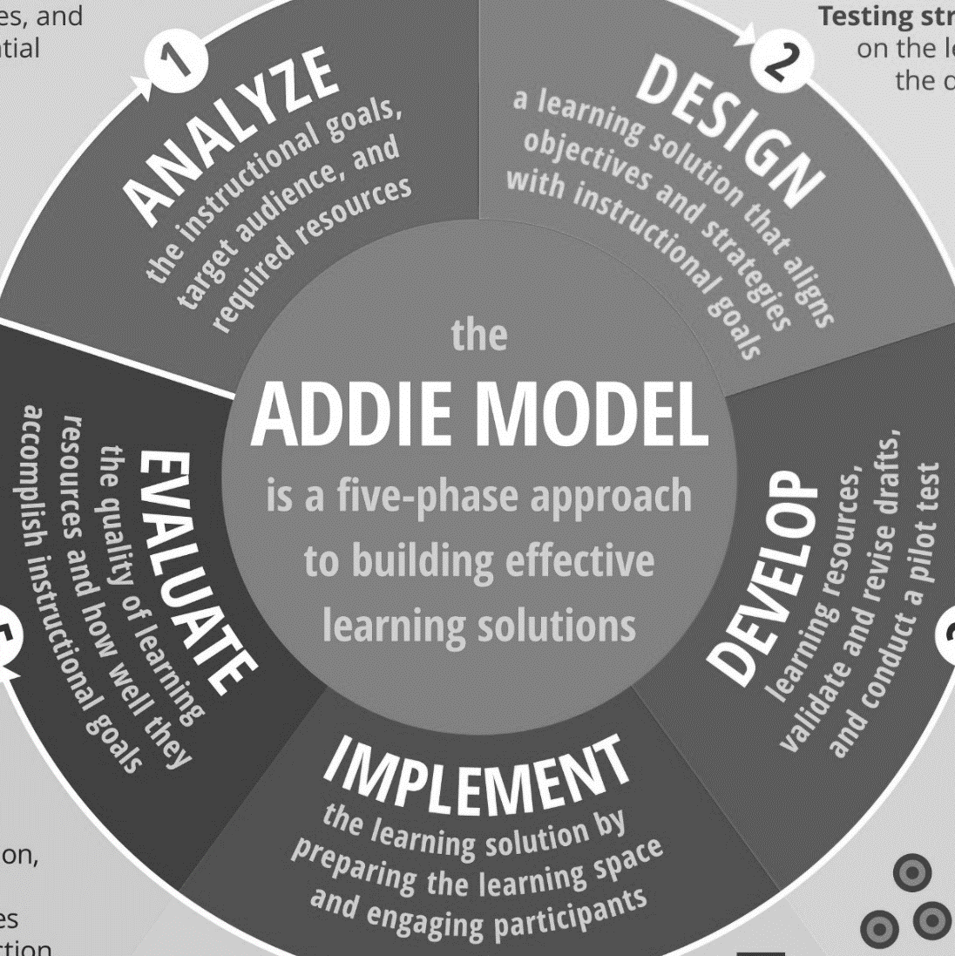
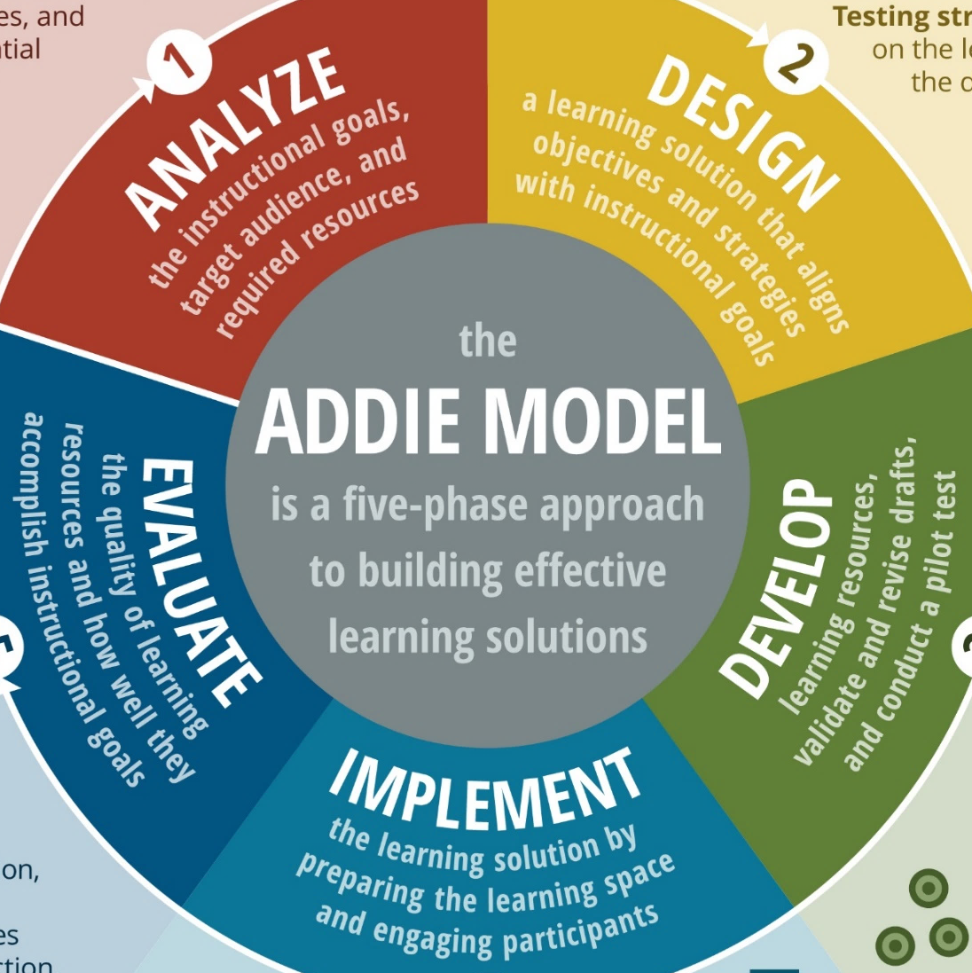
ADDIE and
Instructional Design
Learning Engineering
Process
vs
Notes:
You might be wondering, how does learning engineering compare to ADDIE?

Slide 19



Tends to be content focused
Tends to be linear
Once product is created, it ends
More limited in scope
Includes explicit assessments
Lacks emphasis on data
Is outcomes focused
Is iterative and concurrent
Continuous improvement
Broader, contextual scope
Assessments + instrumentation
Focuses on data throughout
vs
Notes:
Warning: Of course, there are great practitioners who use ADDIE effectively. So, this is a little exaggerated for effect. However, the ADDIE process, in real-world practice, is often diluted as you see highlighted on this slide. That’s not to say that everyone who uses ADDIE makes data-less or linear content.

Slide 20





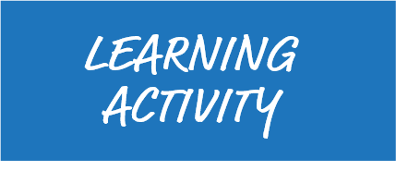



Notes:
The standard Input-Process-Output (IPO) model can be directly used within a learning context.

Slide 21

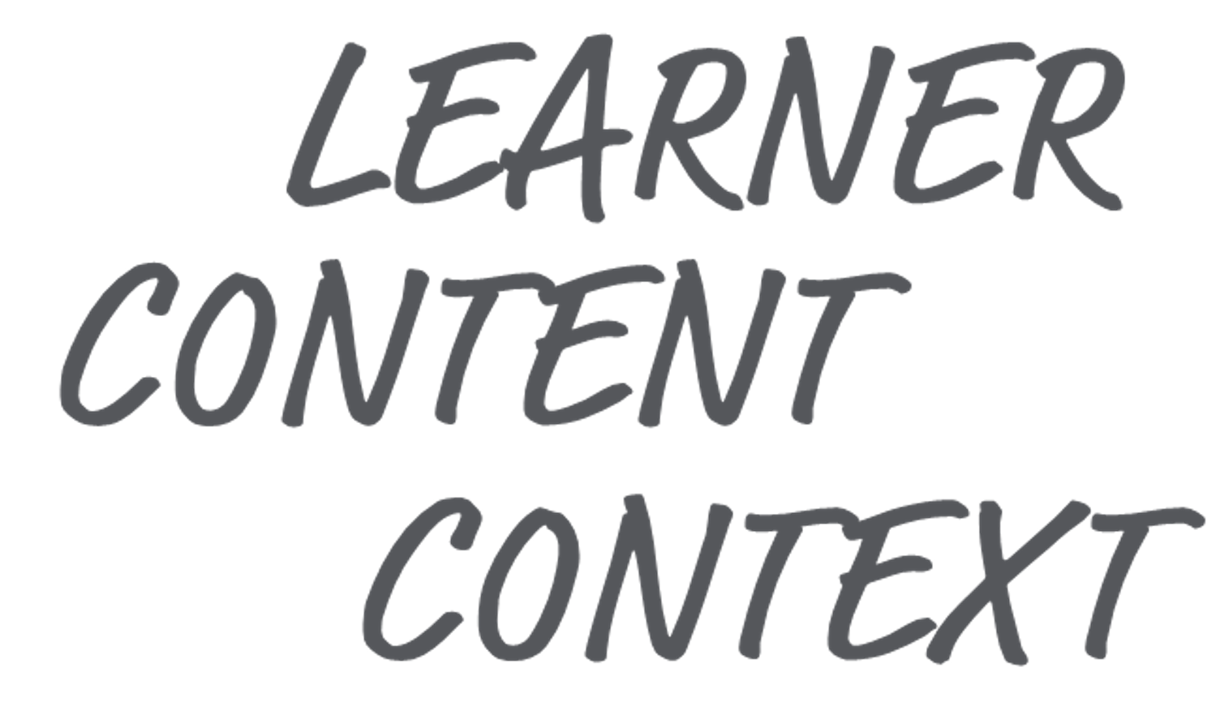





Notes:
That IPO model can occur at the learning activity (e.g., a single math problem) level, and many of those learning activities might occur in a course. The IPO model can also apply at the course level.

Slide 22

Notes:
Many courses might comprise a credential, like a university degree. And the IPO model can also apply at that feedback loop level.

Slide 23


Notes:
And many credentials might comprise a career. The model can apply to upskill and life-long learning within a career field.

Slide 24


Notes:
And we all might have several different careers within our lifetime, and the IPO process can even apply at that scale.

Slide 25


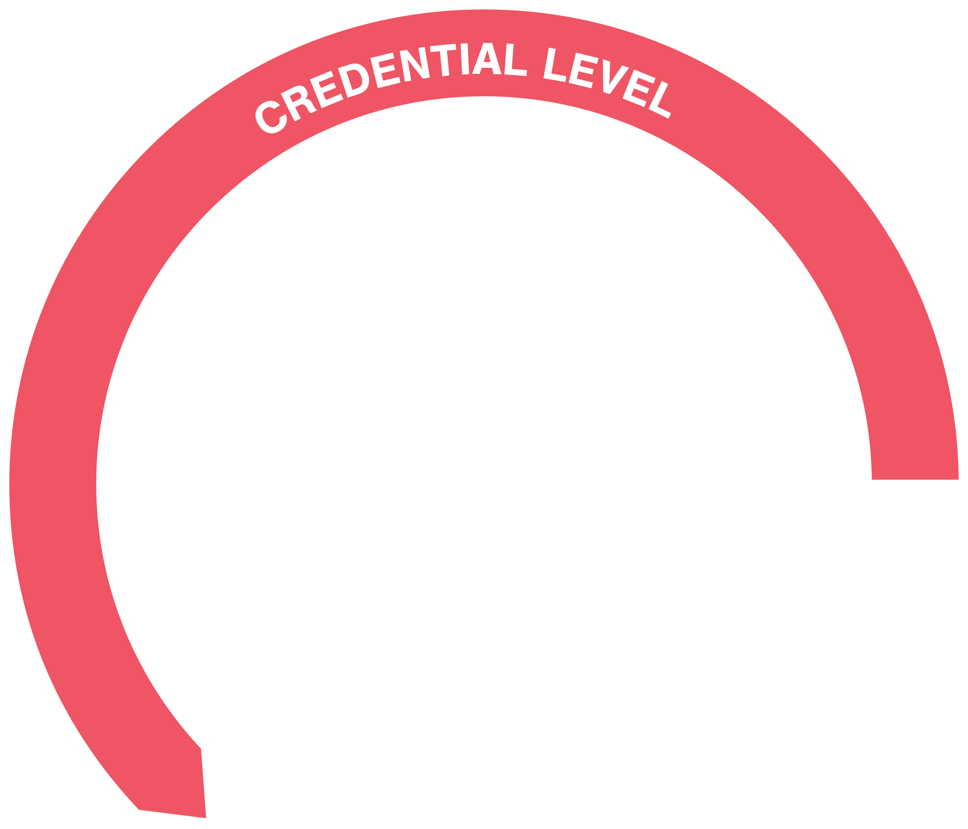
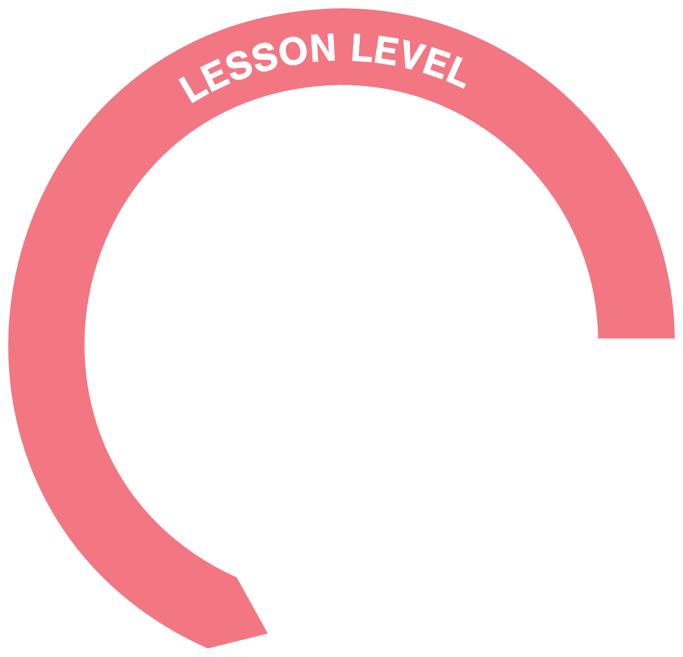
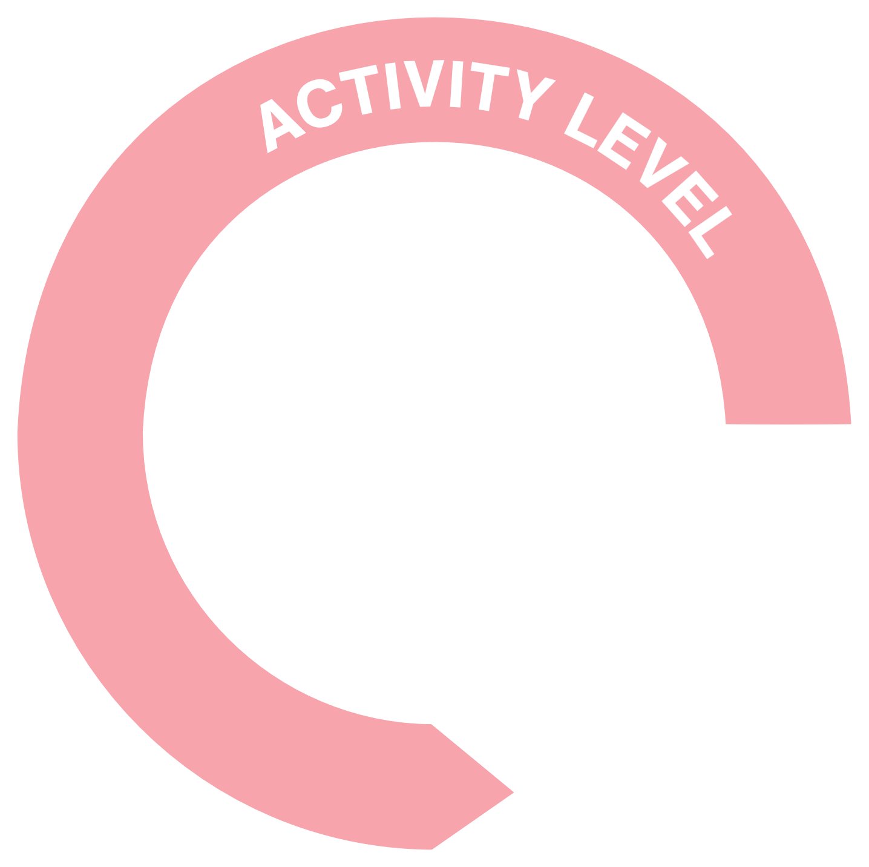


Notes:
Basically, you can imagine a series of nested feedback loops surrounding a lifelong learner, with each potentially optimized through learning engineering processes.

Slide 26

Notes:
OK, so that sounds pretty complicated. Who’s doing all of this??

Slide 27

Learning engineer as consultant
Learning engineer as a member of a team to coordinate across specialists
Notes:
The likelihood that you’ll find a unicorn—a single person who can do all of the parts of the LE process—is unlikely. It’s possible that you might have someone who is an LE specialist who consults with a team or who, at least, represents the LE perspective on a multi-displinary IPT.

Slide 28

Learning engineering team: Multiple professionals with a base set of common competencies and shared vocabularies, with different roles and areas of expertise
Notes:
In all likelihood, an LE team will be comprised of multiple learning engineering professionals, each having a base set of common competencies and shared vocabularies for the practice of learning engineering while having different roles and areas of expertise

Slide 29







Assessment, Measurement, Evaluation Expertise
Subject-matter Expertise
Learning Sciences
Data Science
Software Engineering
Learning Experience Design
Learning Environment Engineering
Education and Training Professionals
Notes:
Learning engineering is a team sport requiring expertise from different fields, including
Learning sciences
Learning experience design
Learning environment engineering
Education and training professionals
Assessment, measurement, evaluation
Data science
Software engineering
Subject-matter expertise

Slide 30

Notes:
Critically, this team needs to have a base set of understanding about LE and shared understanding—that is, actively working toward the same unified goal, not just executing their individual tasks in silos.

Slide 31
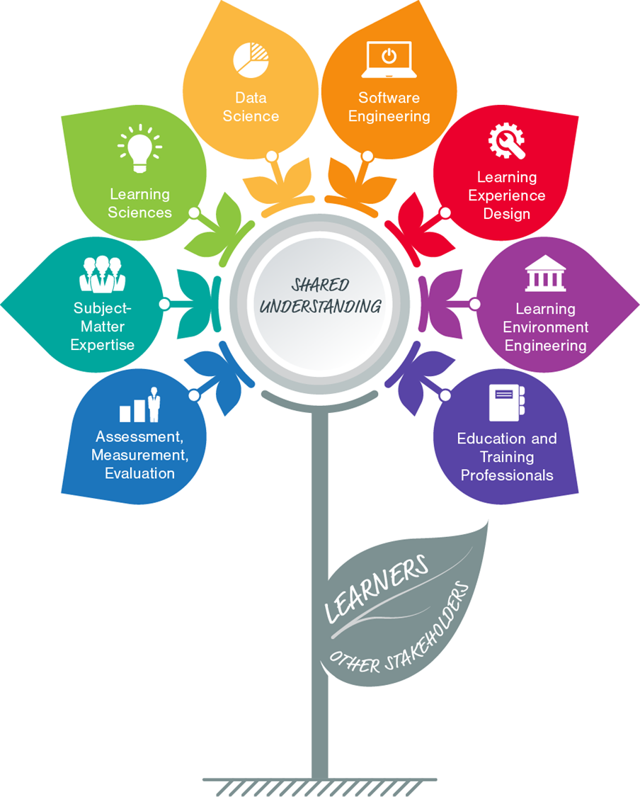
Here’s a popular graphic used by the Learning Engineering professional community
Learning Engineering isn’t “done to” learners and other stakeholders. It’s accomplished by, with, and through them.
Learners and stakeholders are part of the team!
CC-BY Jim Goodell
Notes:
Make sure to include learners and stakeholders on the team too!

Slide 32
Notes:
(This black slide is a break between sections.)

Slide 33

learning engineering [ˈlərniNG ˌenjəˈniriNG]
Learning engineering is a process and practice that applies the
learning sciences, using human-centered engineering design methodologies and data-informed decision-making, to support learners and their development.
Notes:
Learning engineering is human-centered, that is:
Uses the principles of human centered design
Leverage specific tools from human-centered design fields (e.g., stakeholder analysis, personas, user testing)
Uses ethical decision-making for learning design

Slide 34

Before beginning to design, it’s important to understand the context:
Learning is situated. Understand the context, not only the learners and content but of the full system
Learners’ interests
Capabilities
Developmental stages
Probable prior knowledge
Everyday experiences
Support needs
Attitudes and beliefs
Time constraints
Learning environment
Faculty and mentor availability
Teachers’ capabilities
Social context
Technology availability
Digital literacy
Sometimes their living conditions
This is intentionally running off the page, because that’s a bit of a joke (i.e., there is a lot to consider)
Notes:
NOTE: This is intentionally running off the page, because that’s a bit of a joke (i.e., there is a lot to consider)

Slide 35
It’s useful to envision the context as a human-centric system.

Slide 36













Identity
Interests
Culture
Sensory Abilities
Mental
Models
Cognitive
Abilities
Experiences
Fatigue
start with the learner
Knowledge + Skills
Motivation
Notes:
Start with the learner, who has a wealth of personal capabilities, traits, and in-the-moment states.

Slide 37









INV vs. GROUP
OTHER TASKS
MODALITY
COMPLEXITY
TACTICS
TIME PRESSURE
consider the learner in combination with the learning activity
SUBJECT
COGNITIVE
REQUIREMENTS
INTERACTIVITY
Notes:
Then consider the context surrounding the learner and the learning activity

Slide 38












INV vs. GROUP
OTHER TASKS
MODALITY
SOCIAL
ENVIRONMENT
COMPLEXITY
TACTICS
HUMAN-TECH
INTERFACES
PHYSICAL
ENVIRONMENT
TIME PRESSURE
…as well as the context surrounding the learning experience
…and even all of this is situated within a larger context
SUBJECT
COGNITIVE
REQUIREMENTS
INTERACTIVITY
Notes:
But then you also need to consider the context surrounding the learner and the learning activity.
The physical environment:
Noise
Lighting
Temperature
Layout
Distractions
Accessibility
The social environment:
Authority gradients
Social climate
Psychological climate
Safety and wellbeing
Available mentors
Peer interactions
Interfaces
Classroom tools
IT Access
Internet Access
EdTech Options
User Interfaces
Accessibility features

Slide 39
Public Health
Conditions
Job
Market
Organizational
Processes
Organizational
Leadership
Faculty
Workload
All of this
combined leads to the performance, behaviors, and learning outcomes of the experience
Educational
Policies
Economic
Pressures
Resource
Availability
Government
Initiatives

Slide 40



Slide 41





DRAW TECHNIQUES FROM:
User-Centered Design
User Experience Design
Human-Systems Integration
Human Factors and Ergonomics
Design Thinking
Participatory Design
Design Justice
Universal Design For Learning
Learning Experience Design
Design-Based Research
DISCOVER
IDEATE
FEEDBACK
TESTING
ITERATE
MATURE
Research
Interviews
Design Cards
Personas
Use Cases
Logic Models
Wireframes
Prototypes
Discussions
Think Aloud
Outcomes
Usability
Stay focused on the actual challenge to be solved

Slide 42




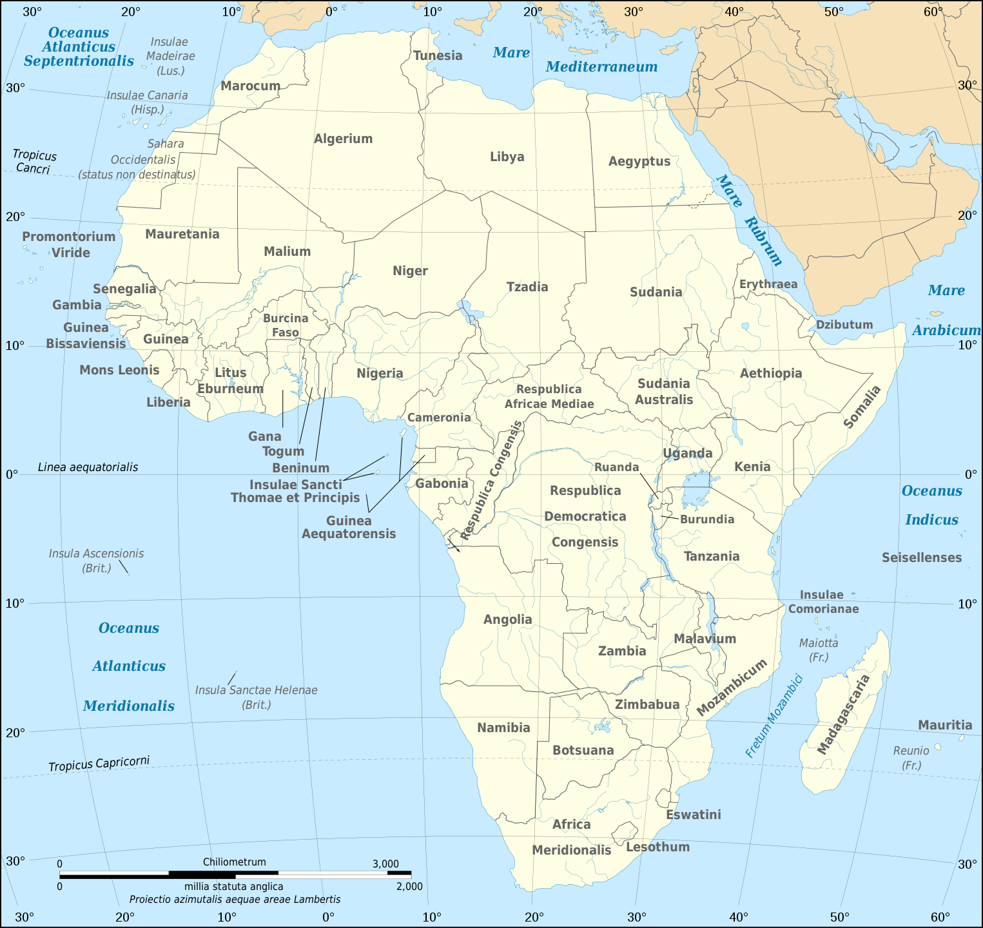
Photo and project information courtesy of the World Bank
Notes:
Storytime: How donkey carts helped advance education in Gambia.
PHOTO: https://blogs.worldbank.org/education/how-donkey-school-buses-benefit-early-grade-children-gambia
Learning engineers design learning experiences, but that’s not all they do. They also address the contexts and conditions that lead to great learning. These might include the architecture of physical or virtual learning environments, social structures, and learners’ mindsets as well as more obvious targets such as curriculum design, educational technology, and learning analytics.
In the West African country of Gambia, the problem to be solved was student access to local schools. “In a concerted effort to reduce inequity, the government abolished school fees and increased the number of communities that have schools within three kilometers from 83 percent in 2013 to 95 percent in 2018,” according to a story posted to the World Bank website. However, nearly 30 percent of school-aged children still didn’t attend classes. A problem was that a three kilometer walk to school was too far for three- to eight year-old students. Parents were concerned about their children’s safety over the long
distances.
The problem was framed by the context of poorly developed or nonexistent roads. “Donkeys, a common means of transport in The Gambia, were a natural, yet innovative, choice,” according to the World Bank article, “and different communities across the country were enthusiastic about the idea.” Donkey carts were engineered to carry ten young children each and could be driven by an older student.
A key strategy in any engineering design is iterative improvement. The low-tech donkey cart solution used an iterative process. “An initial pilot revealed that while the original carts were an effective means to transport children to school, these were too heavy and needed to be redesigned. As a result, a lighter 2.0 model of the cart was launched in 2015. Built with locally sourced materials, the revamped carts handle more easily, have a seat for each child, and incorporate important safety features such as a gate and easy-to-grab handles.”

Slide 43

learning engineering [ˈlərniNG ˌenjəˈniriNG]
Learning engineering is a process and practice that applies the
learning sciences, using human-centered engineering design methodologies and data-informed decision-making, to support learners and their development.

Slide 44


Applied, ecological discipline
Education
A body of knowledge
Anthropology
…about…
Neuroscience
How people learn and how to enhance learning
Year: 1990
is
Design Science
Interdisciplinary field, including…
…derived from…
Cognitive Science
Human cognition and learning
Scientific Research
Formally Established
Computer Science
Applied Linguistics
(linked together)
on
Continuously improve instructional methods
Education theory and practice
is not
Goals
Create and discover learning innovations
Just anecdote and tradition
Apply it to create effective, efficient, and affordable learning
Focused on isolated parts of the instructional system
Expecting “perfect” one-and-done solutions
Where?
Areas of study
Formal schools
Online / distributed
The way people learn
Factors that affect learning
Instructional methods to enhance learning
Technology to facilitate learning
Methods to evaluate learning objectives
On the job
Informal settings
(basically anywhere)
Notes:
Here is a concept map of Learning Science.
Learning Science is a systematically organized body of knowledge built from a variety of other fields such as human cognition, social sciences, education, and user experience design. It gives us an evidence-base foundation and set of principles to help optimize the design, delivery, assessment, and ultimately outcomes of learning experiences.
Let’s walk through the five areas of focus (i.e., the pink boxes at the bottom).

Slide 45

The way people learn
Factors that affect learning
Instructional methods to enhance learning
Technology to facilitate learning
Methods to evaluate learning objectives
Notes:
First, learning science teaches us about how people learn, that is, the cognitive and neuroscience about acquiring (and eventually forgetting) knowledge and skill.
Principles in this area include:
Human development stages
Cognitive information processing (e.g., attention, encoding, retrieval)
Perception and sensemaking
Transfer of learning
Forgetting and retention (e.g., forgetting curve)
System 1 and System 2 brain processes
Expertise and mastery

Slide 46

The way people learn
Factors that affect learning
Instructional methods to enhance learning
Technology to facilitate learning
Methods to evaluate learning objectives
Notes:
Learning science has evidence about the factors that affect (or moderate) learning.
Principles in this area include:
Prior experiences
Mental models
Cognitive biases
Motivation
Locus of control
Intrinsic, extraneous, and germane cognitive load
Metacognitive processes

Slide 47

The way people learn
Factors that affect learning
Instructional methods to enhance learning
Technology to facilitate learning
Methods to evaluate learning objectives
Notes:
Learning science has collected a portfolio of techniques that help us enhance learning.
Principles in this area include:
Pedagogy, andragogy, and heutagogy techniques
Instructional strategies and tactics
Reflection and practice
Zone of proximal development
Scaffolding
Instructional design processes
Learning taxonomies (e.g., Bloom’s Taxonomy)

Slide 48

The way people learn
Factors that affect learning
Instructional methods to enhance learning
Technology to facilitate learning
Methods to evaluate learning objectives
Notes:
Learning science also has a branch dedicated to technologies that help us design, deliver, and improve learning.
Areas of consideration in this area include:
Traditional “technologies” like paper, books, and chalkboards
Distributed and blended learning
Adaptive learning and intelligent tutors
Games for learning (e.g., gamification, wargames, serious games)
Microlearning
Simulations and scenario-based learning
Live, virtual, and constructive training

Slide 49

The way people learn
Factors that affect learning
Instructional methods to enhance learning
Technology to facilitate learning
Methods to evaluate learning objectives
Notes:
Finally, what is a formal learning activity without a corresponding assessment? Learning science has a lot to say about assessment principles.
Areas of consideration in this area include:
Summative and formative assessments
Adaptive assessments
Stealth assessments
Physical and behavioral sensors
Neurophysiological measures
Credentials and micro-credentials
Competency-based and mastery learning

Slide 50
Notes:
(This black slide is a break between sections.)

Slide 51

learning engineering [ˈlərniNG ˌenjəˈniriNG]
Learning engineering is a process and practice that applies the
learning sciences, using human-centered engineering design methodologies and data-informed decision-making, to support learners and their development.

Slide 52



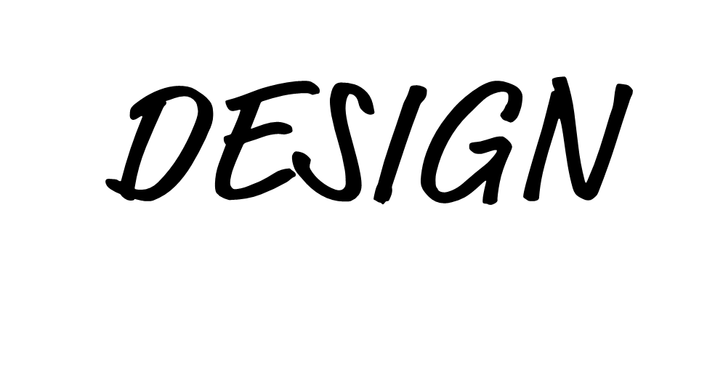





Notes:
Design patterns are repeatable solutions to commonly occurring engineering problems. A civil engineer is familiar with common bridge architectures and which types work best in certain contexts. In software engineering, design patterns establish best practices and promote shared understanding that improves the quality, consistency, and maintainability of code. Software engineers use named design patterns so that everyone on the team can work together and employ consistent coding approaches based on those known patterns.
Consider a bridge: Every bridge is different. Each has to contend with the local environment, intended use, and available materials. But there is still a professional practice of bridge building (of civil engineering), and there are repeatable templates and rules used in that discipline.

Slide 53


Instrumentation uses sensors to capture data along with software and hardware to process and store data for analysis.
A transfer function is a mathematical description of the relationship between the input and the output of a system.
The time from the moment an output is measured to a resulting change in the input is called a propagation delay.
Learning Engineering uses design patterns and other transferable concepts common to engineering disciplines. It requires an engineering mindset.
Notes:
Learning engineering borrows concepts and terminology from other branches of engineering. For example, in a system or process a transfer function is a mathematical description of the relationship between inputs and outputs. And in a closed loop control system, ”propagation delay” is the time it takes for measurement in output to feedback and change the input. Constraints (like cost or time) and trade-offs are central to any branch of engineering. As a branch of engineering, learning engineering requires engineering mindsets, including a systems perspective, ability to envision the future, and an applied scientific approach using experimentation, measurement, and data.

Slide 54




Slide 55
Step 1: Get data
Notes:
Sensors and their data pipelines have limits and require trade-offs.

Slide 56
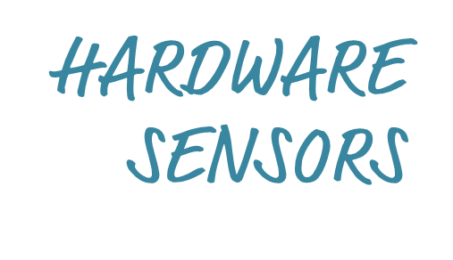



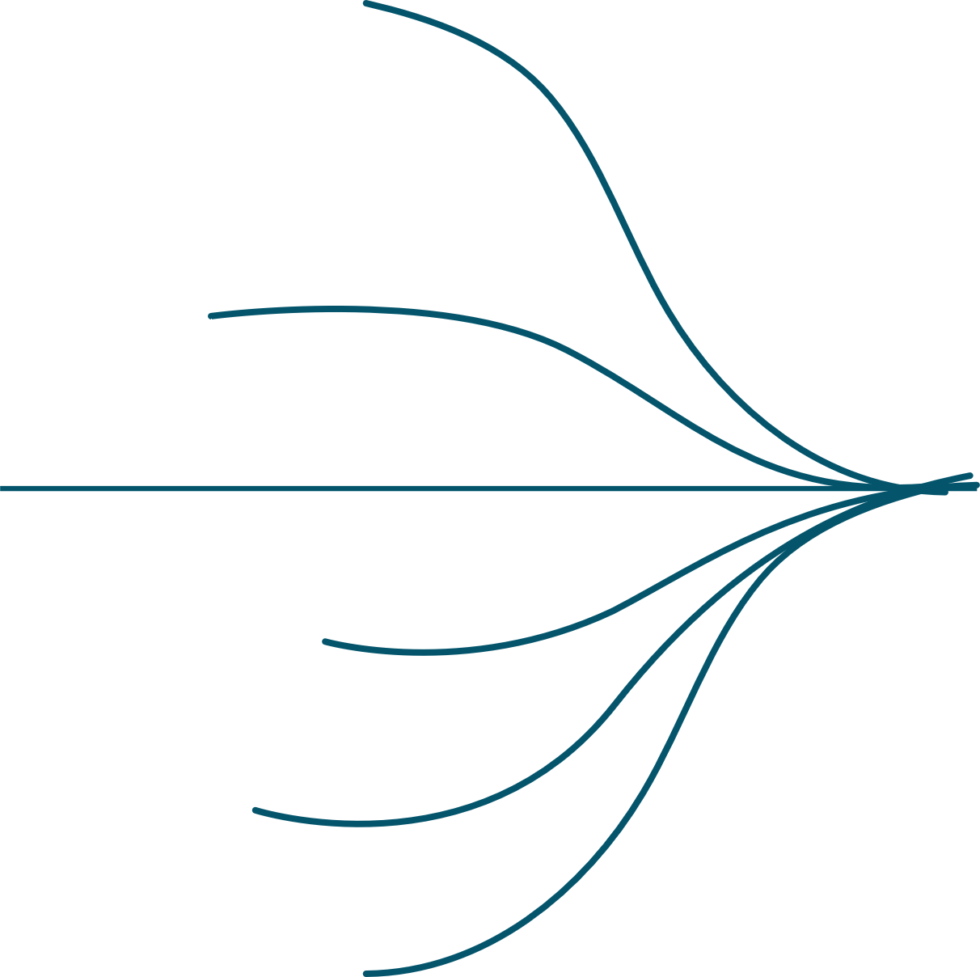
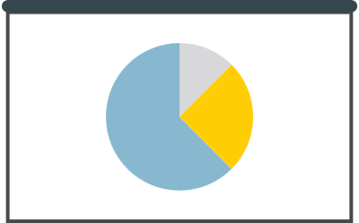



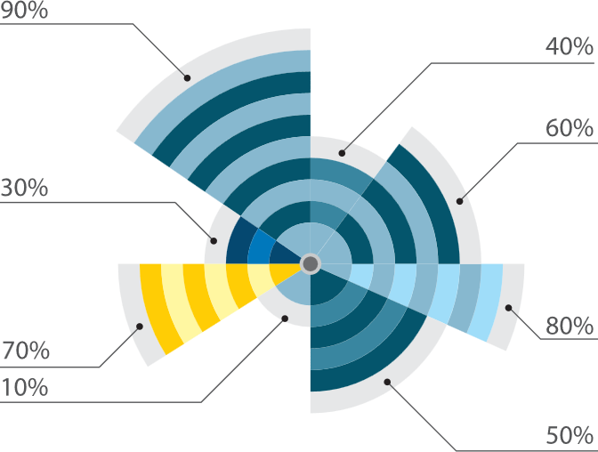






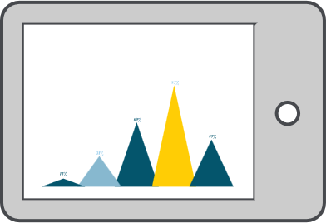


Who
What Action
What Activity
What Context
What Result
xAPI
xAPI
xAPI
xAPI
xAPI
xAPI
xAPI
Notes:
Sensors and their data pipelines have limits and require trade-offs.

Slide 57
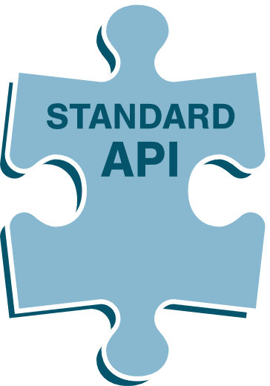











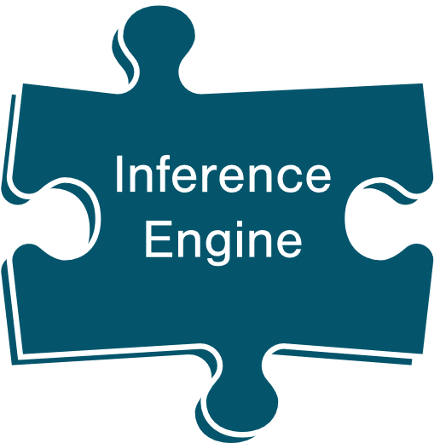





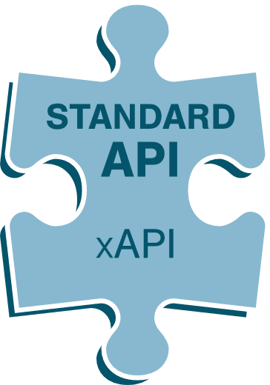


Skill Definition
Activity
Linked Data Stores (Knowledge Model)
Connected via Standards for Linked Metadata
Inferred Data Store
(Learner Model)
INFERENCES
STORED HERE
Context
Detector
Perishability
Standard Detector Plug-ins
Adaptive Engine
Skill Definition
Latent Knowledge Inference
Event Data Store
(xAPI Learning Record Store)
Activity
Misconception Inference
Context
Forgetting Curve
xAPI
Profile
Latent Behavior Inference
Sensors
(Interfaces)
Nudge Impact Predictor
xAPI
xAPI
Notes:
Standard Detector Plug-in Types: One or more algorithms that interpret observed sensor data to predict, classify, infer relationships, or make other extrapolations. Example plug-in algorithms:
• Latent knowledge inference
• Misconception missed step inference
• Forgetting curve
• Latent behavior inference
• Metacognitive nudge impact predictor
Standards for instrumentation are used to collect data used by adaptive systems that adjust learning experiences in near-real time. [click] These systems use artificial intelligence to infer if a learner knows or can do something, how well, and what kinds of experiences might best help the learner develop a particular competence.

Slide 58
Step 1: Get data
Step 2: Use data
Notes:
Sensors and their data pipelines have limits and require trade-offs.

Slide 59
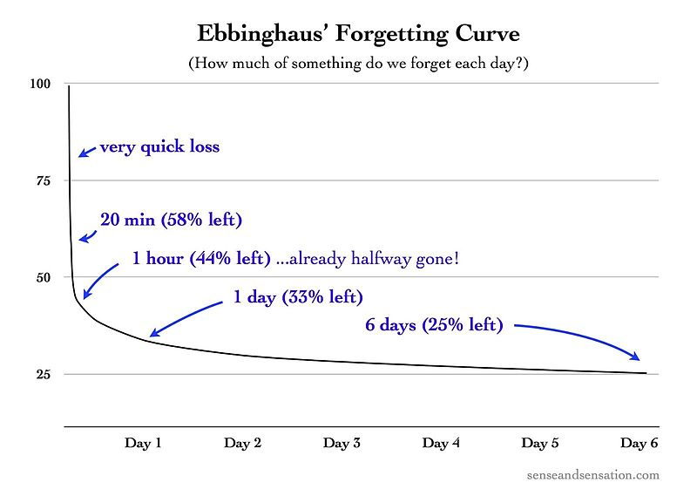
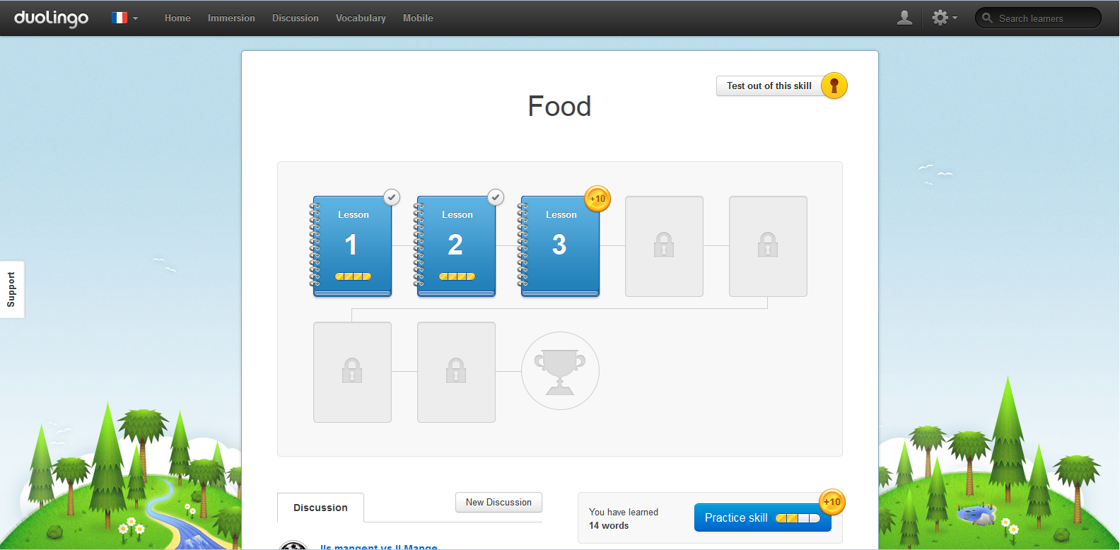


Learning Analytics to Optimize Spaced Repetition
EXAMPLE Learning Analytics to Optimize Spaced Repetition
Notes:
A great example of automated learning analytics used to apply learning science is what happens within the language learning app Duolingo. In 1879 German psychologist Hermann Ebbinghaus pioneered what we know about learning curves, how fast people learn new facts, and forgetting curves, how fast people forget what they’ve learned. More recent research indicates that an efficient time to practice knowledge retrieval is right before forgetting it. Duolingo applies this learning science finding using big data analytics to predict when a learner is about to forget a word. Burr Settles co-developed the trainable spaced repetition model that uses machine learning and data from millions of learners to make personal predictions about the best time for each learner to do retrieval practice for each word in their new vocabulary.

Slide 60

Learning Analytics Process Model
1. What question do we want the data to answer?
2. Do we have the data to answer this question?
No = Instrument to collect data
3. Translate into data questions.
Real-world question: Which students need intervention?
Data questions: How do I predict the probability? What’s the cutoff for intervention?
Notes:
In the Learning Engineering Toolkit we have a learning analytics process model. It’s a kind of recipe for doing common kinds of learning analytics. The process starts with identifying what question we want the data to answer? [click]
Then we ask, “do we have the data to answer the question?” If not, we need to develop instrumentation to collect the data. If we think we have the data. [click]
Next we need to translate the operational question into a data question.
If the operational question is which learners need intervention. The data question might be “How do we predict the probability that an intervention will benefit a person’s learning?” Another data question is, once we have predictions where do we draw the line on giving the intervention? 50%, 60% 80% chance of benefit? Are there resource constraints that need to be factored into that cut-off? Here’s were engineering principles are needed. The decision is not theoretical. There are resource constraints that must be considered. [click]

Slide 61

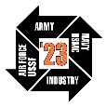





@IITSEC
NTSAToday
Answer
the Question
How can I accurately predict new data points (e.g. learner outcomes)?
What meaning can be inferred from the data?
How can I isolate the most useful information from a large data set?
Goals
A model to predict a single aspect of the data (value or category) with high accuracy and low error
An estimate of association between an outcome variable and predictor variables.
Discover features, patterns, correlations, or anomalies of a data set useful for decision making or further analysis
Examples
What’s the probability a learner will successfully complete this course? Should we classify the learner as “likely” or “unlikely” to complete?
Do the data indicate that a learner is bored or frustrated?
Do the data indicate that the learning activity results in learning?
What features of the data are most useful for creating a predictive model? What interactions between learners engaged in collaborative learning are most productive?
Notes:
In the Learning Engineering Toolkit we have a learning analytics process model. It’s a kind of recipe for doing common kinds of learning analytics. The process starts with identifying what question we want the data to answer? [click]
Then we ask, “do we have the data to answer the question?” If not, we need to develop instrumentation to collect the data. If we think we have the data. [click]
Next we need to translate the operational question into a data question.
If the operational question is which learners need intervention. The data question might be “How do we predict the probability that an intervention will benefit a person’s learning?” Another data question is, once we have predictions where do we draw the line on giving the intervention? 50%, 60% 80% chance of benefit? Are there resource constraints that need to be factored into that cut-off? Here’s were engineering principles are needed. The decision is not theoretical. There are resource constraints that must be considered. [click]

Slide 62
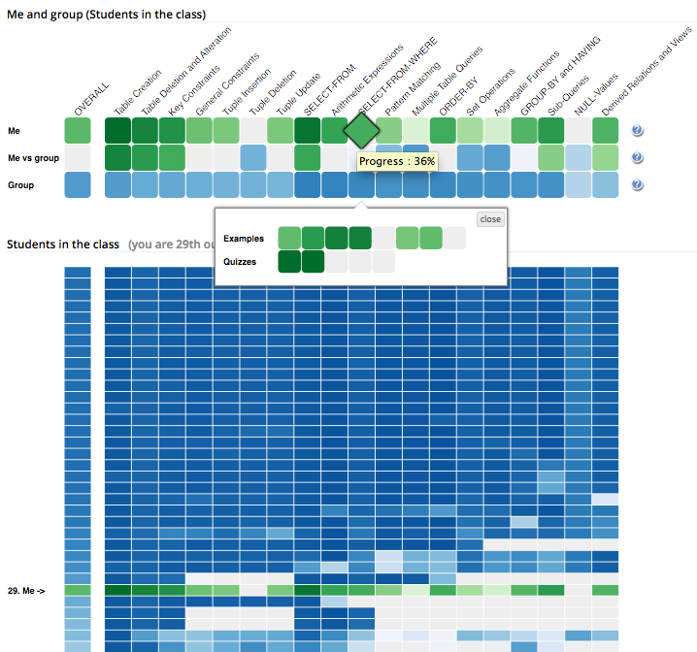
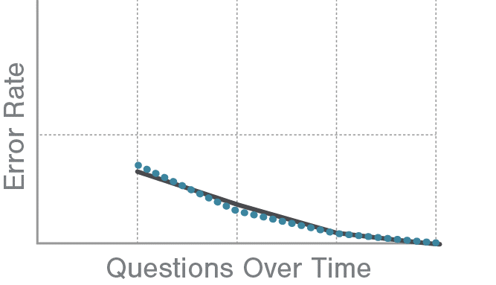

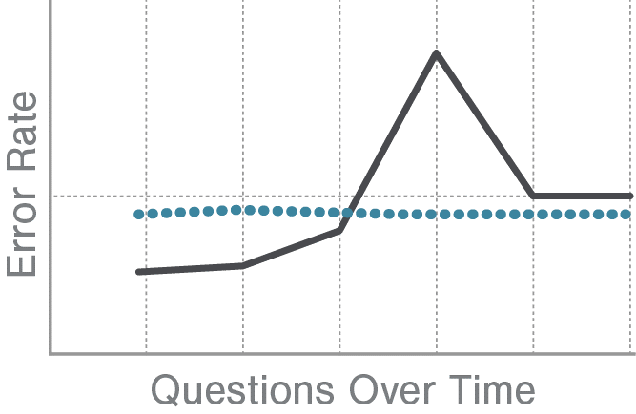

Choose method and data set
Predictive Modeling
Inference Modeling
Feature Mining
informs modeling
Mining
Preprocessing
• Analyze variables
• Data reduction
Data Mine
Rules from training discovery
• Anomalies
• Association rules
• Clustering
• Classifying
• Regression (model building)
• Summarizing
…in a new data set
Test
with 3rd data set
Create a model using data
Regression Prediction
Classification
Knowledge Inference
Behavior Detection
Methods, e.g.
• BKT +variants
• PFA
• IRT
• DKT
Check model
goodness
Methods, e.g.
• Step regression
• Logistic regression
• Decision trees
Methods, e.g.
• Carelessness detection algorithms
Use different data to test the model than to create or train it
Methods, e.g.
• Linear regression
• Support-vector machines
examples:
• Linear correlation
• MAD
• RMSE
• AIC
examples:
• Accuracy
• Kappa
• ROC
• AUC ROC
Check model based on how well it predicts performance
Check model based on how well it predicts behavior
Confidence
Confidence
Generalizability, Cross-learner validity, Ecological validity, Construct validity, Predictive validity, Substantive validity, Content validity, Conclusion validity, Cross validation methods (e.g. K-fold)
Visualize (sometimes)
Notes:
Once we have data questions, we can determine what type of analysis is needed. In our example, we might want to choose an analysis method to predict the probability that a learner will benefit from the intervention (the output is a single number). Or we can use that probability with a classification method that’s sets thresholds and determines which learners should get the intervention and which should not. [click]
For each type of data question there are applicable models and methods.

Slide 63
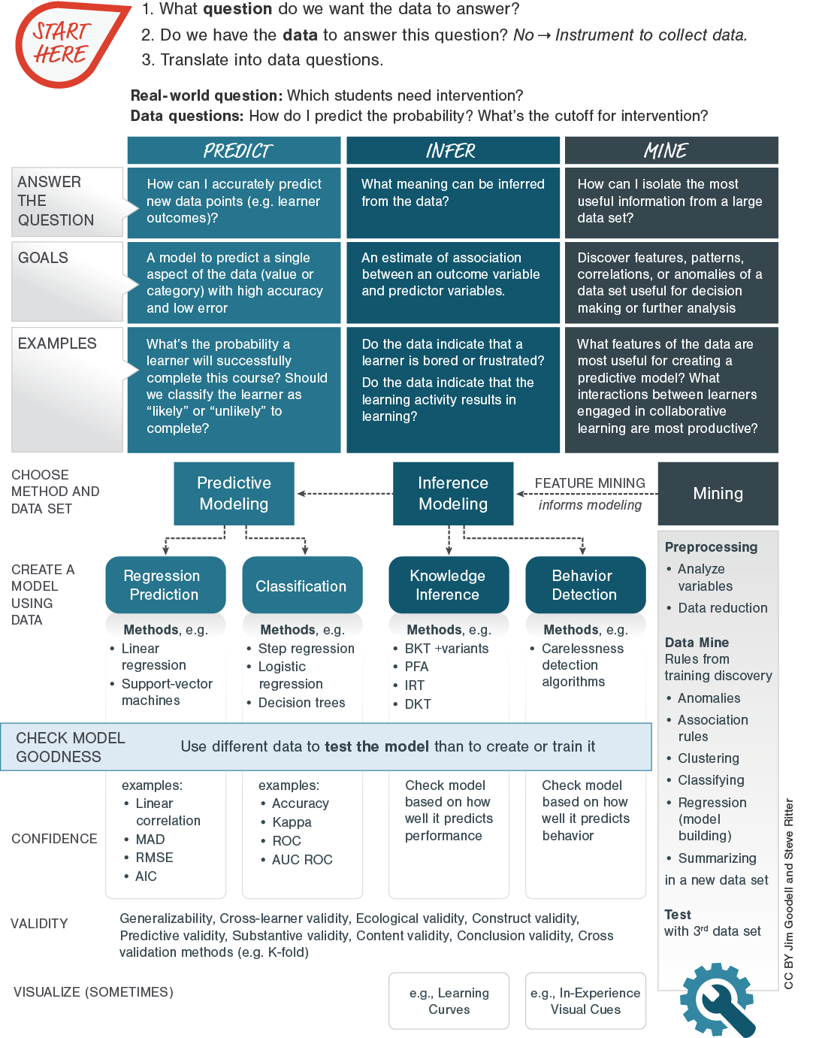


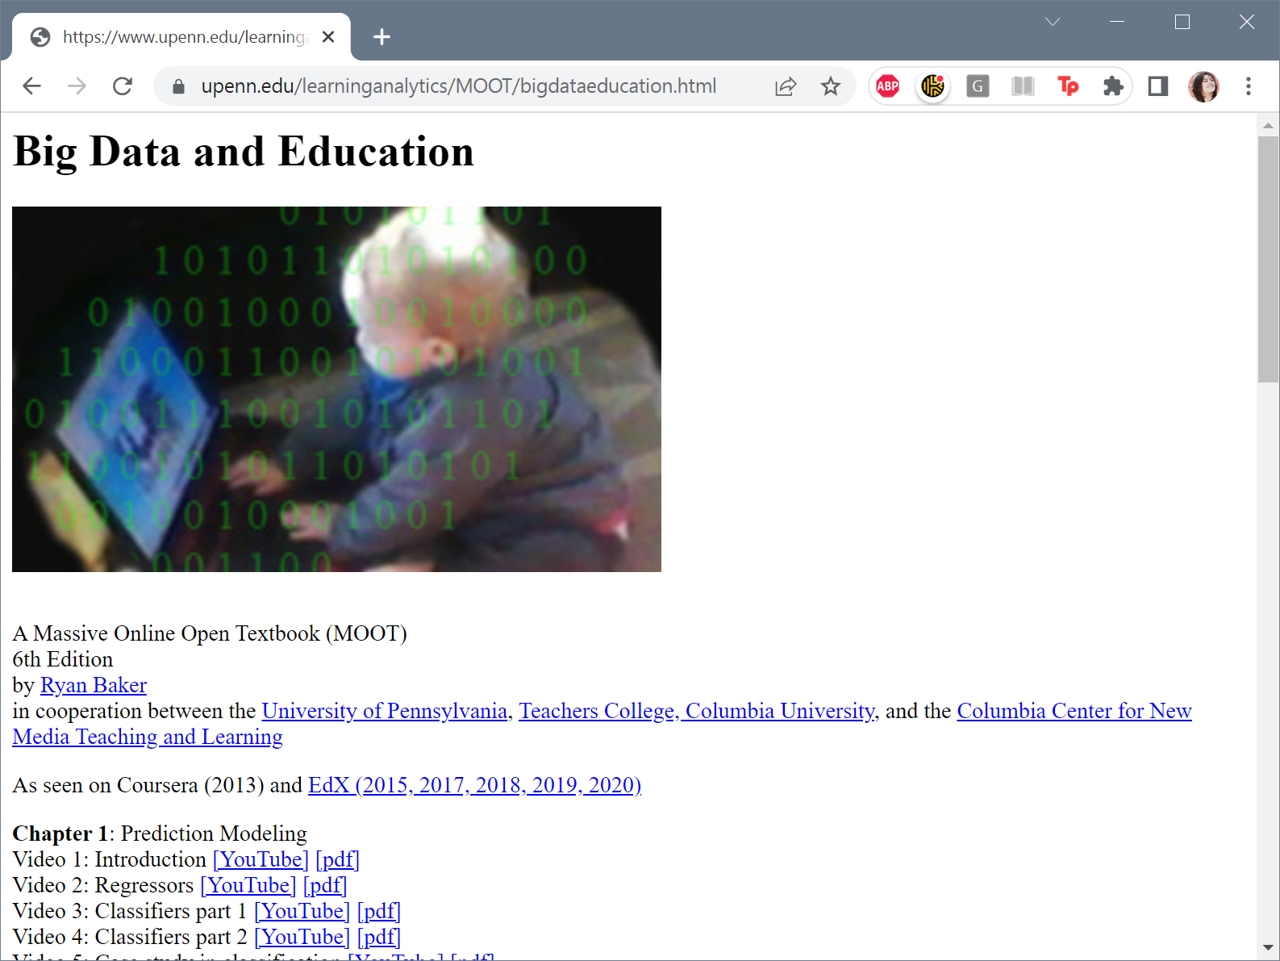



Slide 64


Slide 65



Learning engineering is a process
Focused on outcomes that involve learning
…but using a wide variety of tools, including (but not only) the learning sciences
Learning engineering is human-centered
Learning engineering is also data-centered
ISSUES BEYOND CURRICULUM
LEVERAGE MODERN TOOLS
SCALE QUALITY
Notes:
Summary
LE is a process—iterative process that continuously uses Inputs to improve Outputs across various levels
LE focuses on learning outcomes, even if achieving them means nontraditional solutions
And is data-driven, using data to drive those iterative improvement loops
…so that we can scale quality learning experiences, like penicillin outside of a single laboratory
…so that we can address issues beyond just the curriculum, like donkey carts in the Gambia
…and so that we can best integrate modern technologies effectively

Slide 66
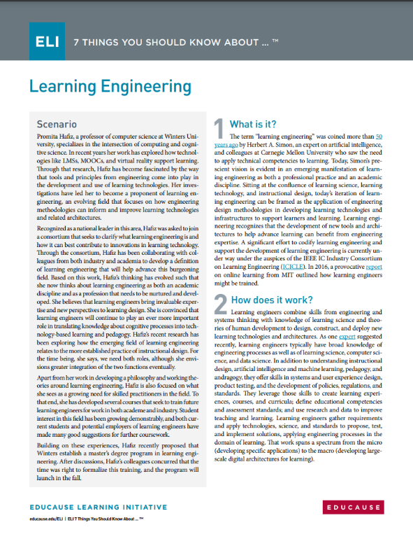
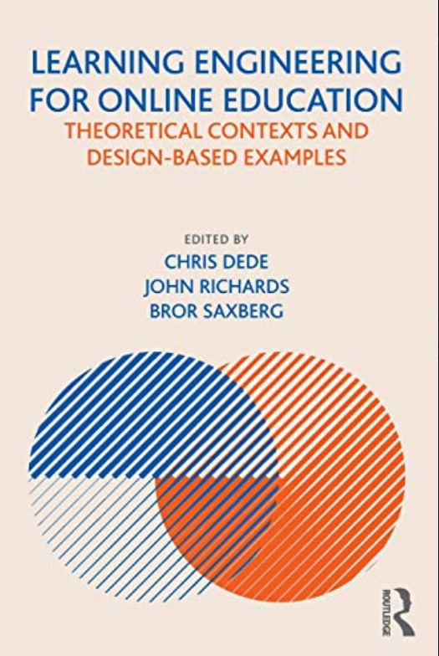
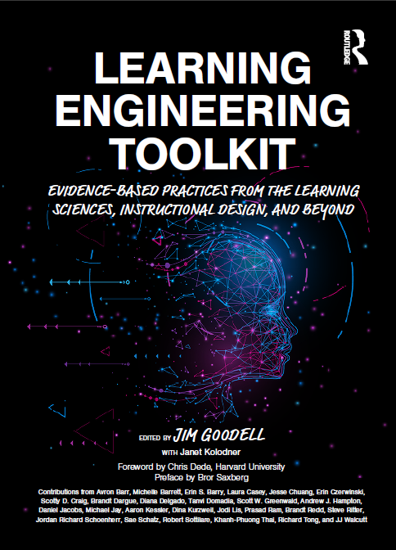

Useful References
7 Things You Should Know About Learning Engineering
Educause Learning Initiative
Learning Engineering for Online Education
By Chris Dede, John Richards, Bror Saxberg
Learning Engineering Toolkit
Edited by Jim Goodell
with Janet Kolodner
IEEE IC Industry Consortium on Learning Engineering
http://ieeeicicle.org
Notes:
See also ICICLE Online Community
For Learning Engineering Practitioners (Discord Server)
https://discord.gg/jhZpUfa4FR

Slide 67
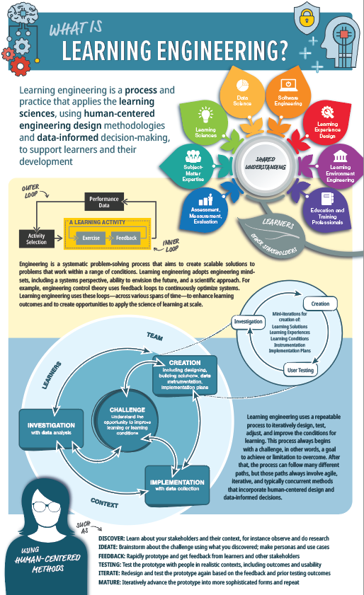
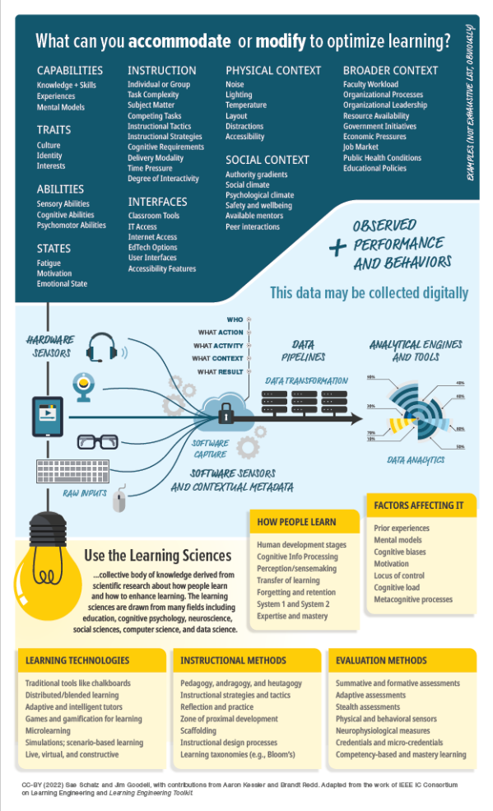

Useful References
7 Things You Should Know About Learning Engineering
Educause Learning Initiative
Learning Engineering for Online Education
By Chris Dede, John Richards, Bror Saxberg
Learning Engineering Toolkit
Edited by Jim Goodell
with Janet Kolodner
IEEE IC Industry Consortium on Learning Engineering
http://ieeeicicle.org
What is Learning Engineering?
(Printable Infographic)
Made for you at I/ITSEC by Sae and Jim
Notes:
See also ICICLE Online Community
For Learning Engineering Practitioners (Discord Server)
https://discord.gg/jhZpUfa4FR

Slide 68





Practical Guide to
LEARNING ENGINEERING
are we done yet?
Sae Schatz Co-Founder, Chief Product Officer Bedrock Learning, Inc. sae@theknowledgeforge.com | Jim Goodell Director of Innovation Quality Information Partners jimgoodell@qi-partners.com
Notes:
Tutorial Outline:
0:00-0:05 – Introduction to the Tutorial
Introduce speakers
Share the penicillin story to clarify distinctions between “science” and “engineering”
What will you learn today?
0:05-0:15 – What is learning engineering?
Short definition
Purpose and benefits of learning engineering
Brief history (goes back to Herb Simon back in the late 1960s)
Fields that inform it: Assessment, learning sciences, data science, software, etc.
0:15-0:25 – Learning engineering process
Introduction to the learning engineering process model
CHALLENGE: Understand the opportunity to improve learning or its conditions
CREATION: Designing, building solutions, data instrumentation, and plans
IMPLEMENTATION with data collection
INVESTIGATION with data analysis
Case study walking through each piece of the process
0:25-0:30 – Practical: Assembling a learning engineering team
Learning engineering team composition
Managing a learning engineering team (lean-agile)
0:30-0:40 – Practical: Executing human-centered design for learning
Purpose and principles of human centered design
Tools for human-centered design (e.g., stakeholder analysis, personas, user testing)
Ethical decision-making for learning design
0:40-0:55 – Practical: Integrating learning science
Purpose and principles of learning science
Learning science tools (e.g., instructional tactics, motivational principles)
Learning experience design
0:55-1:15 – Practical: Integrating learning technologies and learning analytics
Introduction to learning technologies
Technology considerations for learning at scale (e.g., open-architecture, data standards)
Instrumenting learning for data collection
Using data for learning analytics and continuous optimization
1:15-1:30 End/Q&A
Brief summary of key points
Where to find more information
Open Q&A

Slide 69






learning engineering [ˈlərniNG ˌenjəˈniriNG]
Learning engineering is a _______ and practice that applies the _______________, using _____________ __________ design methodologies and ___________ decision-making, to support learners and their development.

Slide 70

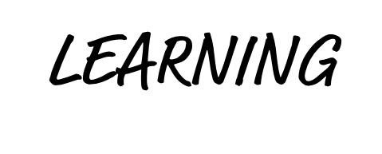



Slide 71

How’d we do?
…explain the purpose, scope, and characteristics of learning engineering
…compare and contrast learning engineering to other disciplines (e.g., learning science)
…help organize a team for and execute a learning engineering process for a real-world project
…fish for myself (find resources to continue to improve my learning engineering capabilities)
Notes:
Define the purpose, scope, and distinct characteristics of the learning engineering field.
Explain the benefits of learning engineering (over and above subordinate or related fields).
Design a learning engineering team and process for a practical training/education goal.
Explain how to find additional learning engineering information for practical applications.
MORE: Look smart in front of your boss and colleagues, when you know how to explain how all of the pieces of pedagogy, cognition, technology, data, and organizational design fit together. You’ll be one of the first to know about this hot new emerging discipline!

