Slide 1

Introduction to Design of Experiments
Presenter: Dr. John Haman
Co-Authors: Dr. Kelly Avery, Dr. Rebecca Medlin, and Dr. Keyla Pagán-Rivera

Slide 2







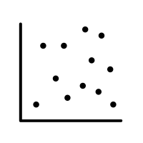


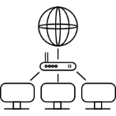
Our Experience in Experimental Design and Analyses
Program
of Record
Test
Planning
Analyze Data
DOT&E to inform Congress
Draw Conclusions & Report
Test Observation
At IDA, one of our key roles is providing technical analytical support to the Department of Defense’s Director, Operational Test & Evaluation and its mission to conduct independent assessments of the military services’ test and evaluation of new weapons systems.
Help design good tests of military systems in realistic operational environments.
Evaluate the operational effectiveness, suitability, and survivability of those systems from an objective, disinterested, and factual perspective.

Slide 3
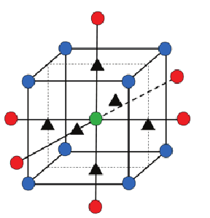
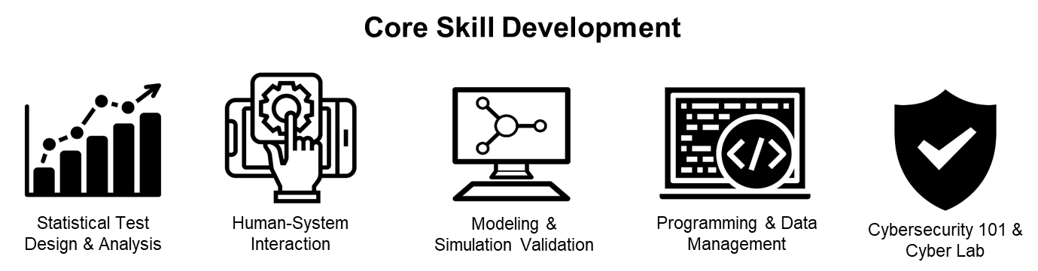


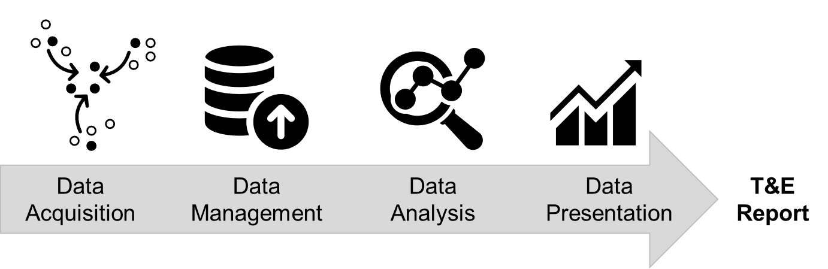
Our Areas of Expertise
Core Areas of Expertise
We develop, apply, and disseminate statistical, psychological, and data science methodologies
Statistical Test
Design
Statistical Analysis Methods
Modeling & Simulation Validation
Artificial Intelligence, Autonomy, and Machine Learning
Human-Systems
Interaction
Survey Design
Data Practices & Management

Slide 4
What Will You Learn From This Tutorial?
After this tutorial, attendees should be able to:
Explain the importance of experimental design and its link to data analysis
Identify essential elements of test design
Recognize key differences between test designs
Assess the adequacy of a test design
Apply key tips to data analysis and reporting

Slide 5
Introduction

Slide 6
General Framework For Designing A Test
Determine test objective
Mission capability to be tested; questions to ask about the system
Identify appropriate metrics
How system performance should be measured
Identify factors that affect performance
Types of data to collect; operational envelope
Develop and evaluate test design
Conduct test
Quantity of data necessary; best resource allocation; objective plans
Analyze data
Draw conclusions
Structured mathematical data analysis plan appropriate for the design
Defensible risk assessments based on test results
Adjust test execution if necessary
Experimentation
Requires Collaboration
Subject Matter
Expertise
Analytical
Expertise

Slide 7





Testing Framework: The Gold Standard Of Experimentation
The design of experiments (DOE) process, at its core, is the scientific method.
It is the gold standard for performing experiments and determining cause and effect.
What we mean by “experiment” goes well beyond the ‘chemistry lab’ scenario it often evokes.
An experiment includes any test where variables are purposely manipulated or inputs are purposely set.
So, things like simulation studies certainly count as experiments.
x
y

Slide 8

Rigorous Test Design And Analysis Techniques Facilitate Efficient, Objective, And Credible Evaluations
The test design process can be applied across multiple domains:
System Performance and Effectiveness
Modeling and Simulation Validation
Human-Systems Interaction
Cybersecurity
Reliability
Software
Live Fire

Slide 9
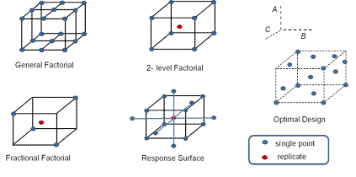
What Is Design Of Experiments (DOE)?
DOE is a branch of applied statistics that deals with planning, conducting, analyzing, and interpreting controlled tests.
Benefits of DOE:
Enables test designs that investigate multiple factors in one experiment
Provides the tester with an analytical framework to determine whether a test is good enough for their purpose
Provides the most powerful allocation of test resources for a given number of events

Slide 10
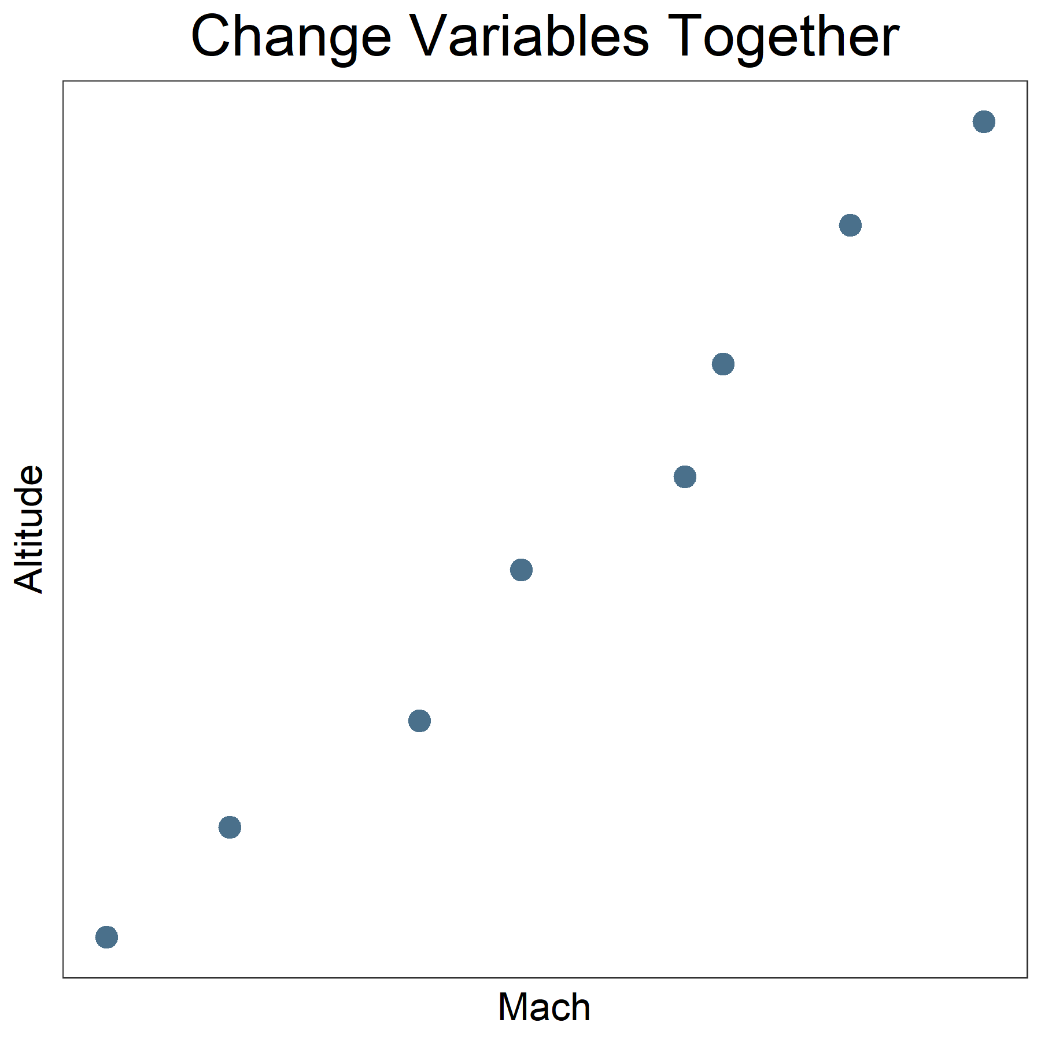
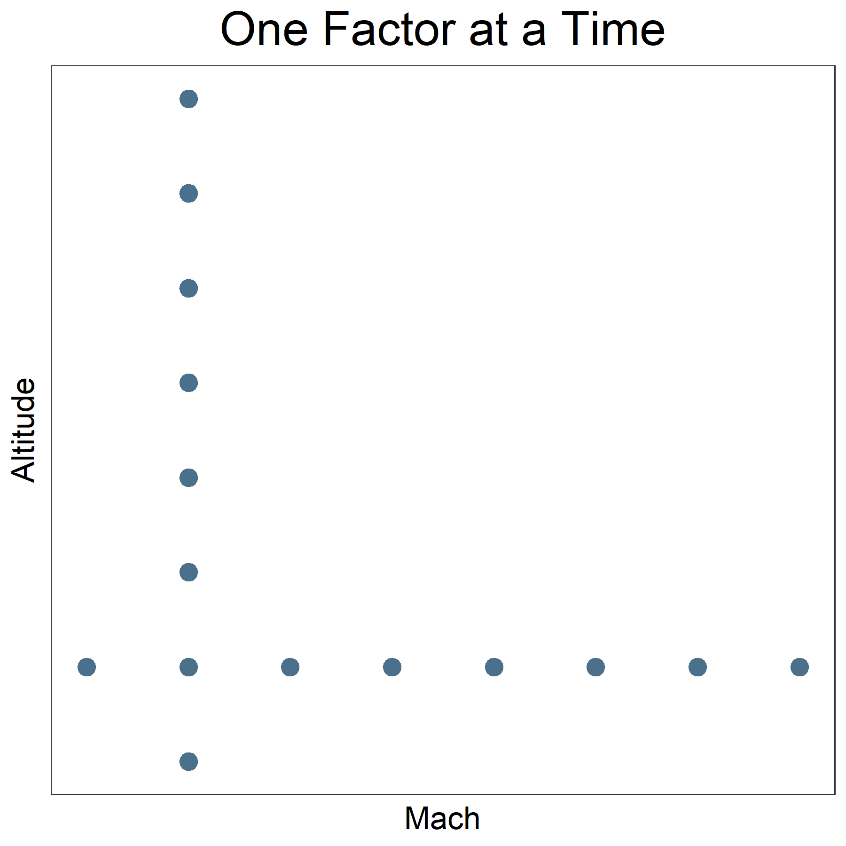
All Tests Are Designed, Many Poorly
Interactions between conditions not examined
Test is often overkill (unnecessarily large sample sizes)
Confounding variables!
Loss of ability to determine cause and effect

Slide 11
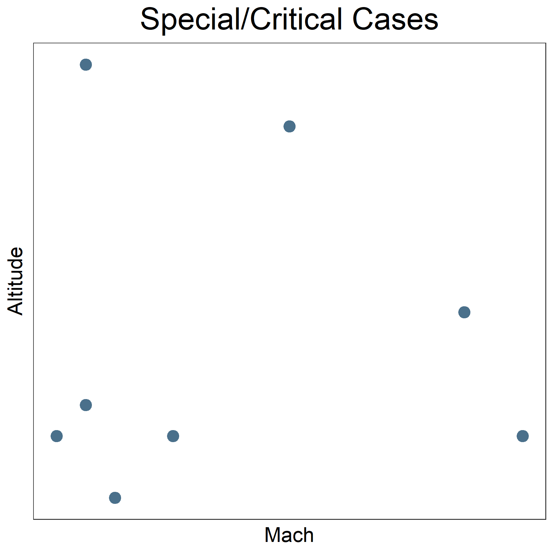
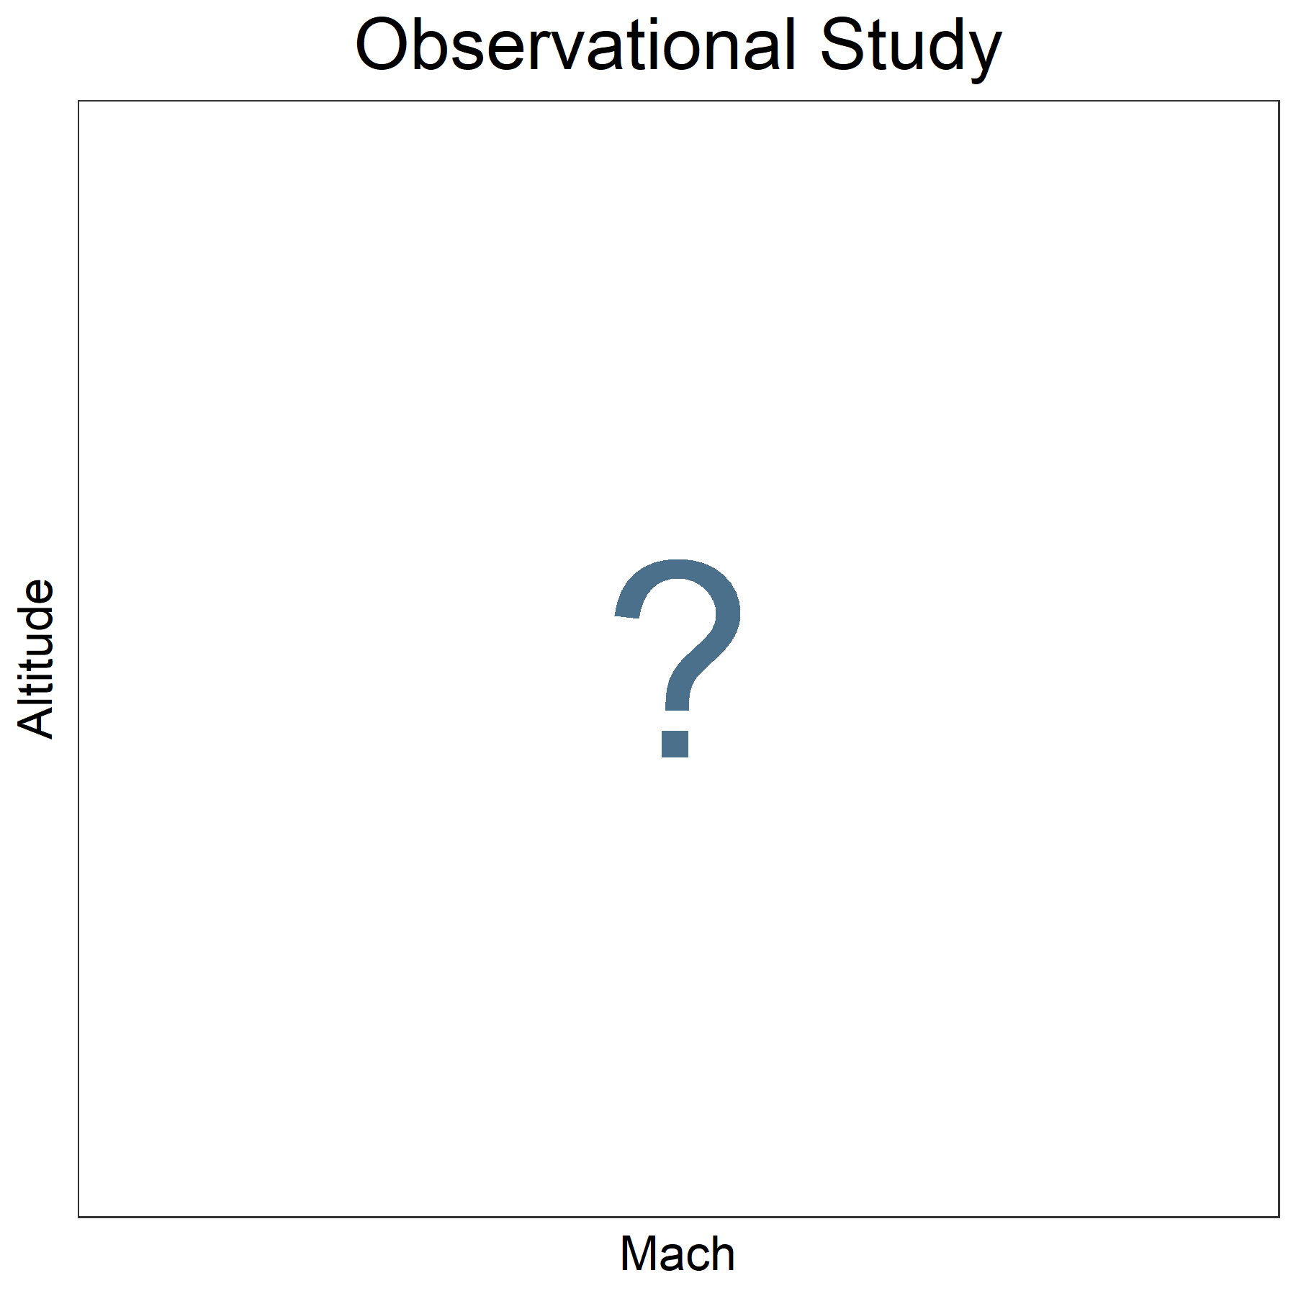
All Tests Are Designed, Many Poorly
No control over test conditions
Data left up to chance
No ability to determine cause and effect
Limited to the specific conditions selected; might miss important performance shortfalls
Often poor statistical precision
Possible loss of ability to determine cause and effect

Slide 12
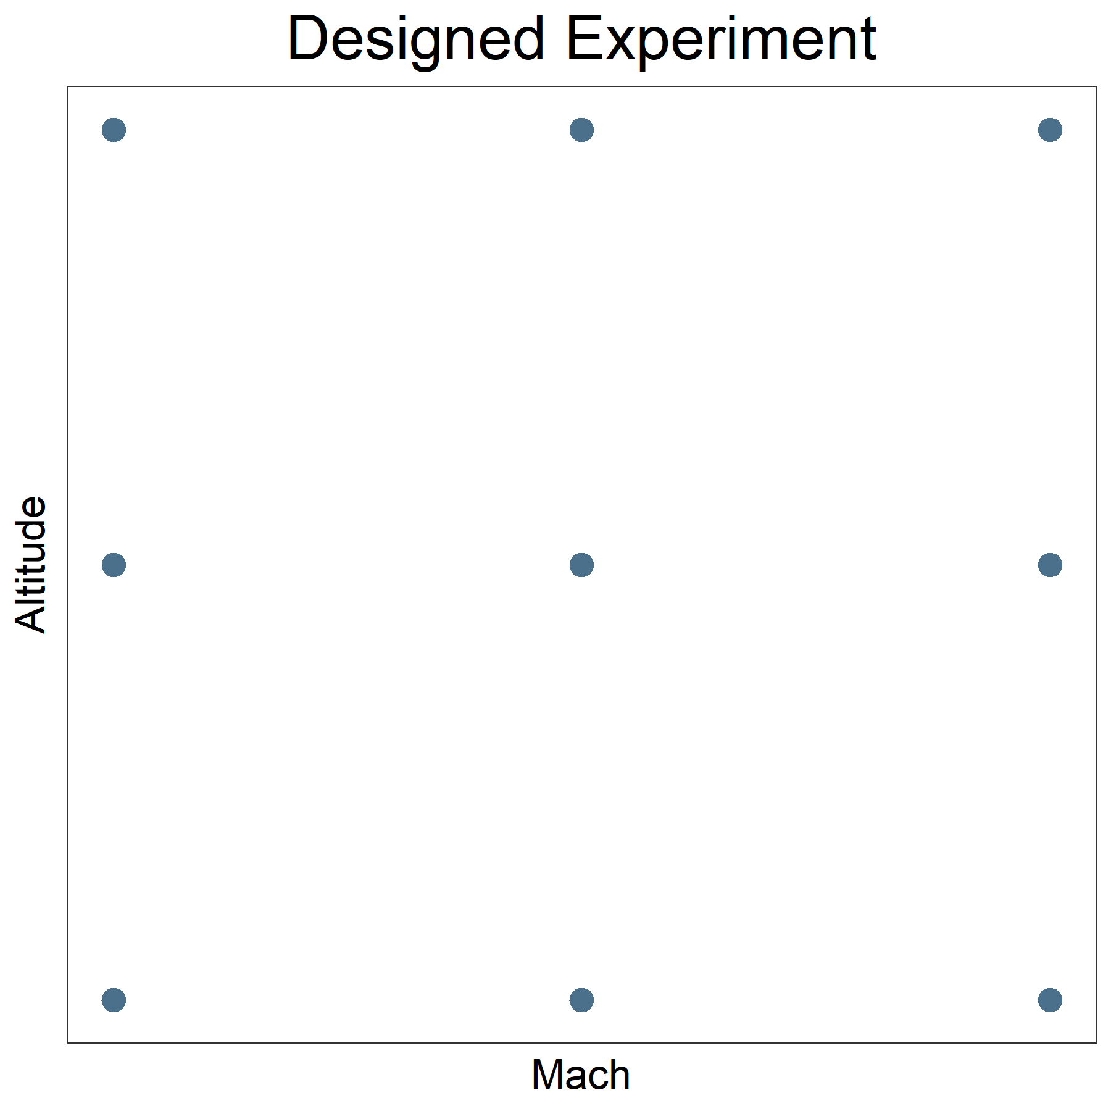
Why DOE Over Other Data Collection Methods?
Allows for inferences about causation
Can directly understand and compare the effects of different treatments
Minimizes bias/error
Maximizes efficiency

Slide 13
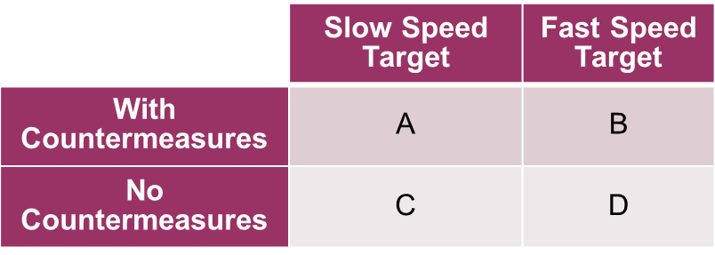
DOE Supports A More Precise Characterization
Non-DOE approach: Calculate confidence intervals using only data collected under each condition
DOE approach: Construct a model (pool the data), use the model to estimate mean values in each condition
Note the reduction in confidence interval size!
In this case, intervals reduced by 25 to 50% compared to non-DOE approach
Can now tell significant differences in performance
E.g., system is better in C than in D conditions
Rollup (global mean) tells us little about system performance

Slide 14
DOE Encompasses A Large Body Of Techniques That Support Different Types Of Data, Use Cases, And Levels Of Complexity
Classical designs (e.g. factorial, fractional factorial) are the gold standard in straightforward situations
Optimal designs allow for constrained design spaces, disallowed combinations, and custom sample sizes
Space-filling designs are specifically geared toward Modeling & Simulation experiments where outcomes are less stochastic and more complex
Sequential design strategies build on information gained from the previous experiment in considering how to plan the next test
Test
Analysis
Test
Analysis
Test
Analysis
Test
Analysis

Slide 15
General Framework For Designing A Test
Experimentation
Requires Collaboration
Determine test objective
Mission capability to be tested; questions to ask about the system
Identify appropriate metrics
How system performance should be measured
Identify factors that affect performance
Types of data to collect; operational envelope
Develop and evaluate test design
Conduct test
Quantity of data necessary; best resource allocation; objective plans
Analyze data
Draw conclusions
Structured mathematical data analysis plan appropriate for the design
Defensible risk assessments based on test results
Adjust test execution if necessary
Subject Matter
Expertise
Analytical
Expertise
Outline for rest of tutorial

Slide 16
Test Objectives
Determine test objective
Mission capability to be tested; questions to ask about the system
Identify appropriate metrics
How system performance should be measured
Identify factors that affect performance
Types of data to collect; operational envelope
Develop and evaluate test design
Conduct test
Quantity of data necessary; best resource allocation; objective plans
Analyze data
Draw conclusions
Structured mathematical data analysis plan appropriate for the design
Defensible risk assessments based on test results
Adjust test execution if necessary

Slide 17
Understanding Why We Are Testing Drives And How We Plan The Test
What questions must the study address?
What mission capabilities are we testing?

Slide 18
Common Test Objectives
Screen for influential factors driving performance.
Characterize performance across the relevant factor space.
Compare two systems (or more) across a variety of operating conditions.
Identify problems that degrade system performance.
Optimize system performance with respect to a set of conditions.

Slide 19
Identifying Metrics/Response Variables
Determine test objective
Mission capability to be tested; questions to ask about the system
Identify appropriate metrics
How system performance should be measured
Identify factors that affect performance
Types of data to collect; operational envelope
Develop and evaluate test design
Conduct test
Quantity of data necessary; best resource allocation; objective plans
Analyze data
Draw conclusions
Structured mathematical data analysis plan appropriate for the design
Defensible risk assessments based on test results
Adjust test execution if necessary

Slide 20
The Response Variable(s) Measures The Outcome Of Interest For The Test
Requirements often inform response variable selection but should not be the sole sort of metrics!
Good response variables are:
Measurable. They can be measured at a reasonable cost and without affecting the test outcome.
Valid. They directly address the test objective.
Informative. Continuous responses always provide more information per test point than pass/fail metrics.
Multiple response variables are almost always necessary!
Must think about where and when to collect desired data.

Slide 21

Who Is The Better Darts Player? (Hit = bullseye; Miss = all else)
Player 1
Player 2
Is Player 2 better because he hit the bullseye 5 of 10 times, whereas Player 1 hit the bullseye only 3 of 10 times?
We have a much better picture of the players’ abilities by looking at the miss distances from bullseye compared to just a bullseye hit/miss.

Slide 22
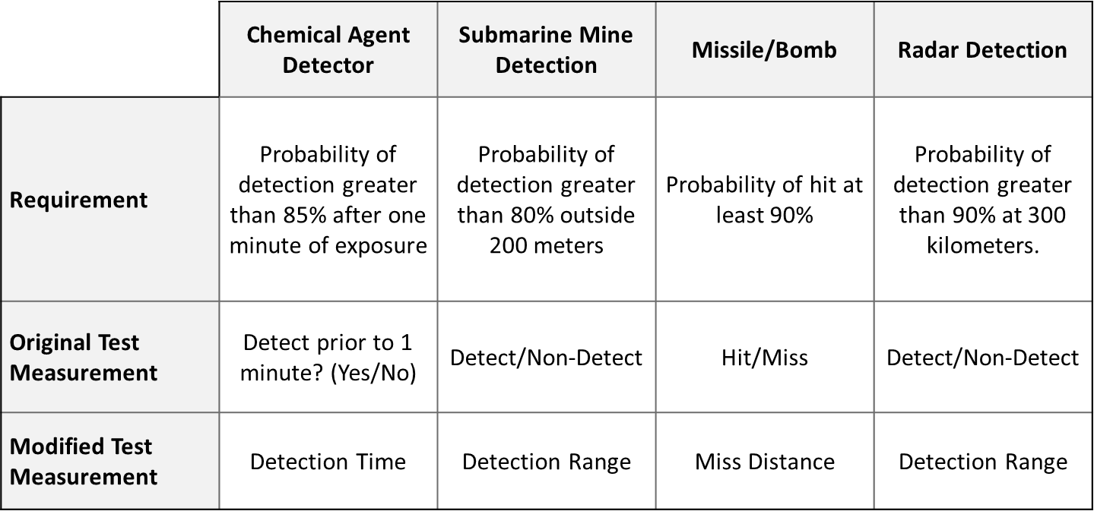
Operational Examples Of Binary Responses Converted To Continuous
Ultimately, your primary metrics should always track with the mission

Slide 23


Many Elements And Decisions Influence The Size Of A DOE
Statistical
How much power and confidence do we want?
What is the type of response variable?
Which model are we assuming? Do interactions and quadratic terms matter?
Which signal-to-noise ratio can we assume?
Effect size
Variability
Is the randomization restricted?
Practical
Do we have enough resources to collect X number of samples?
Are there any permissions we need for certain runs?
Can we collect data on all conditions or are there political, geographical, or other restrictions?
Are there disallowed combinations?
A pilot study takes out some of the guesswork

Slide 24
Determining Factors
Determine test objective
Mission capability to be tested; questions to ask about the system
Identify appropriate metrics
How system performance should be measured
Identify factors that affect performance
Types of data to collect; operational envelope
Develop and evaluate test design
Conduct test
Quantity of data necessary; best resource allocation; objective plans
Analyze data
Draw conclusions
Structured mathematical data analysis plan appropriate for the design
Defensible risk assessments based on test results
Adjust test execution if necessary

Slide 25
Sources Of Variation
A source of variation is anything that might influence the performance of the process or system under test.
Brainstorm ALL the potential sources of variation that could affect test outcomes – then decide what to control/vary during test.
A fancy statistical design cannot redeem the quality of a test if we miss an important factor in the planning process!

Slide 26
Factor Management Process
 |  | Likelihood of Encountering Level During Operations
 |  | Multiple levels occur at balanced frequencies (e.g., 1/3, 1/3, 1/3) | Some levels are balanced, others are infrequent (e.g., 5/10, 4/10, 1/10) | One level dominates (e.g., 4/5, 1/10, 1/10)
Effect of Changing Level on Performance |  | Balanced | Mixed | Dominant
Significant Effect on Performance | High | Vary all | Vary balanced levels, Demonstrate infrequent levels | Fix dominant level, Demonstrate others
Moderate Effect on Performance | Medium | Vary all | Vary balanced levels, Demonstrate others | Fix dominant level, Demonstrate others
Low Effect on Performance | Low | Fix levels or record level used | Fix levels or record level used | Fix dominant level

Slide 27
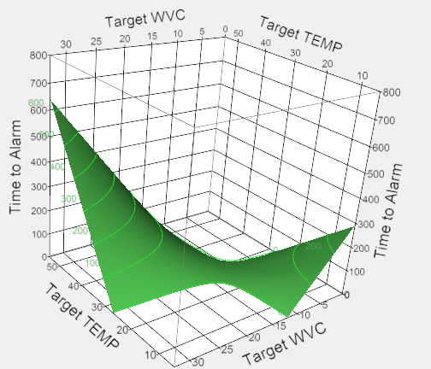
Characteristics Of Good Experimental Factors
Important: Factors are expected to have an effect on the test outcome.
Controllable: Factors can be controlled (i.e., set to a specific level) at a reasonable cost.
Easy-to-change: a factor that is easy to randomize completely
Hard-to-change: a factor that is difficult to randomize completely, often due to time or cost constraints.
When you specify factors as Hard-to-change, your design should reflect these restrictions on randomization.
And sometimes the best we can do is simply record a setting….
Informative: Continuous factors are preferred to categorical factors (e.g., if altitude is a factor, the preferable levels are 5,000, 10,000, and 15,000 as opposed to low, medium, and high).
Continuous factors allow for:
Interpolation
Explanation of change in performance
Higher power to detect significance of a factor
Strategic point placement

Slide 28
Developing the Test Design
Determine test objective
Mission capability to be tested; questions to ask about the system
Identify appropriate metrics
How system performance should be measured
Identify factors that affect performance
Types of data to collect; operational envelope
Develop and evaluate test design
Conduct test
Quantity of data necessary; best resource allocation; objective plans
Analyze data
Draw conclusions
Structured mathematical data analysis plan appropriate for the design
Defensible risk assessments based on test results
Adjust test execution if necessary
Which points?
How many?

Slide 29
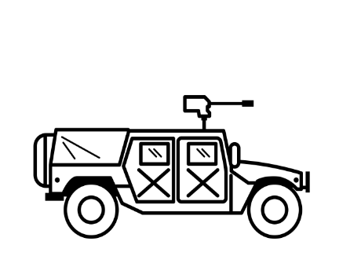


Testing A New Artillery Cannon
Response Variable
Accuracy of Fires - Miss Distance
Factor | Level
Time of Day | Day, Night
Range to Target | Short, Medium, Long
Projectile Type | A, B, C
Angle of Fire | Low, High

Slide 30
Factorial Designs - All Possible Combinations of Each Factor Level
Tests All Possible Combinations.
The first fire mission is conducted during the Day at Short Range for Low Angle using Projectile A.
 |  | Time of Day
 |  | Day |  | Night
Projectile | A | 1 | 1 | 1 | 1 | Short | Range
 | B | 1 | 1 | 1 | 1
 | C | 1 | 1 | 1 | 1
 | A | 1 | 1 | 1 | 1 | Medium
 | B | 1 | 1 | 1 | 1
 | C | 1 | 1 | 1 | 1
 | A | 1 | 1 | 1 | 1 | Long
 | B | 1 | 1 | 1 | 1
 | C | 1 | 1 | 1 | 1
 |  | Low | High | Low | High
 |  | Angle of Fire
N=36
Full Factorial Designs:
Support the test goals of characterize or compare.
Examine every possible combination of each level.
Allow for the estimation of all main effects and all possible interactions without aliasing.
Are highly efficient and informative, though potentially prohibitively costly.

Slide 31
Typically, Screening Or Characterization Experiments Involve a Fractional Factorial Design
Places test points at the right conditions to support a main effects model.
 |  | Time of Day
 |  | Day |  | Night
Projectile | A |  | 1 | 1 |  | Short | Range
 | B | 1 |  |  | 1
 | C | 1 |  |  | 1
 | A |  | 1 | 1 |  | Long
 | B | 1 |  |  | 1
 | C |  | 1 | 1
 |  | Low | High | Low | High
 |  | Angle of Fire
N=12
Fractional Factorial Designs:
Support the test goals of screen, characterize, or compare.
Require a subset of the runs required for a full factorial.
Achieve a large reduction in test points by trading off the ability to estimate high-order interaction effects.

Slide 32
Optimal Designs Are Most Useful When The Number Of Test Points Is Constrained To Preclude A Factorial Design
 |  | Time of Day
 |  | Day |  | Night
Projectile | A |  | 1 | 1 |  | Short | Range
 | B |  | 1 | 1
 | C | 1 |  |  | 1
 | A | 1 |  |  | 1 | Medium
 | B |  | 1
 | C |  | 1 | 1
 | A |  | 1 | 1 |  | Long
 | B | 1
 | C | 1 |  |  | 1
 |  | Low | High | Low | High
 |  | Angle of Fire
Places test points at the right conditions to estimate specified model terms.
N=16
Optimal Designs
Support the test goals of characterize, optimize, predict.
Useful when the number of test points is constrained to preclude a factorial design.
Requires a researcher-specified model and a fixed sample size (a subset of the runs required for a full factorial).

Slide 33
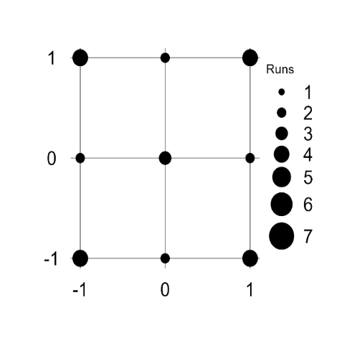
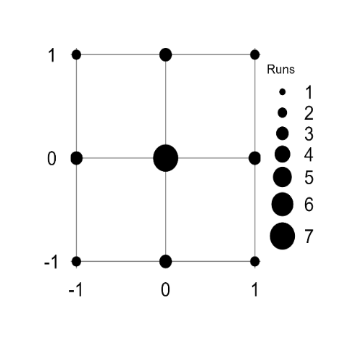
Relevant Optimality Criteria Overview
D-Optimal
I-Optimal
Alias-Optimal
D-optimal designs minimize the variance of the parameter estimates
Most useful for characterizing performance
Generally, provides the “best” power across all parameter terms
Tends to place most points on the edges of the design space
I-optimal designs minimize the average prediction variance
Most useful when you want good predictions across your design space, particularly if you want to model curvature
Tends to allocate more points on the interior
Alias-optimal designs minimize correlation between main effect and interaction terms
Most useful when performing screening experiments
Usually less power to estimate effect sizes, but can reduce overall resource requirements with sequential testing
Example:
2-factor model
with quadratic
terms and all
interactions
Only difference here in inputs is design is I-optimal—resulting in more points allocated in the interior.
Note: Here, the Alias-optimal design is the same as D-optimal design!

Slide 34
Response Surface Designs Spread Test Points Throughout The Experimental Region To Support A Detailed Model Of The Response
Includes center points to check for curvature.
 |  | Time of Day
 |  | Day |  |  | Night
Projectile | A | 1 |  |  |  |  | 1 | Long: 1 | Range
 | B | 1 |  | 1 |  | 1
 | C |  | 1 | 1 | 1
 | A |  | 1 | 1 | 1 | 1 |  | 0
 | B |  | 1 |  |  | 1
 | C | 1 |  |  |  |  | 1
 | A | 1 |  |  |  |  | 1 | Short: -1
 | B |  | 1 |  | 1 |  | 1
 | C |  |  | 1 |  | 1
 |  | Low: -1 | 0 | High: 1 | Low: -1 | 0 | High: 1
 |  | Angle of Fire
N=24
Response Surface Designs
Support the test goals of characterize, optimize, predict, improve.
One of the best designs if the researcher needs to minimize or maximize a response.

Slide 35
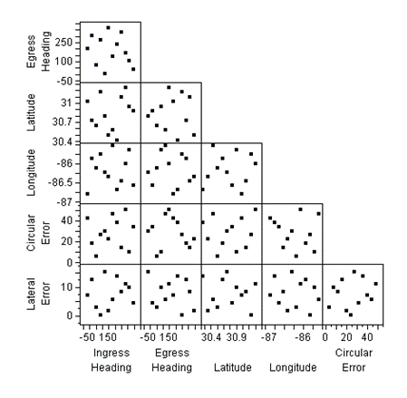
So Far All The Designs Presented Have Been Geared Toward Stochastic Outcomes
The field of DOE includes two broad classes of designs:
Classical – geared toward stochastic test outcomes
Computer – assume a (near) deterministic outcome
Space-Filling Designs
Choosing the right class of design for your specific outcome is critical!
Covering Arrays

Slide 36
Leveraging M&S To Expand Testing For New Artillery Cannon
Response Variable
Accuracy of Fires - Miss Distance
Factor | Level
Time of Day | Day, Night
Range to Target | 500 m, 4000 m
Projectile Type | A, B, C
Angle of Fire | 10, 45 degrees

Slide 37
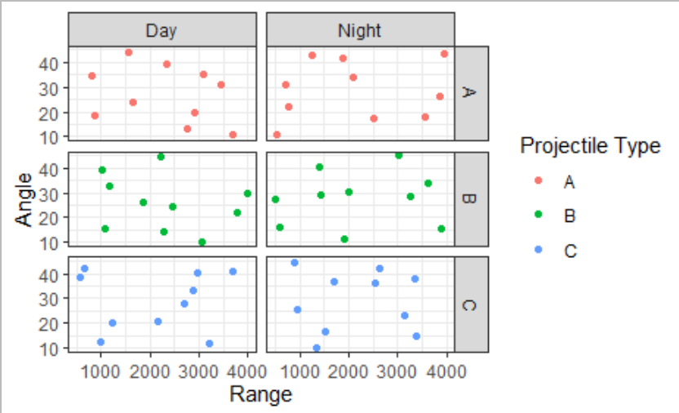
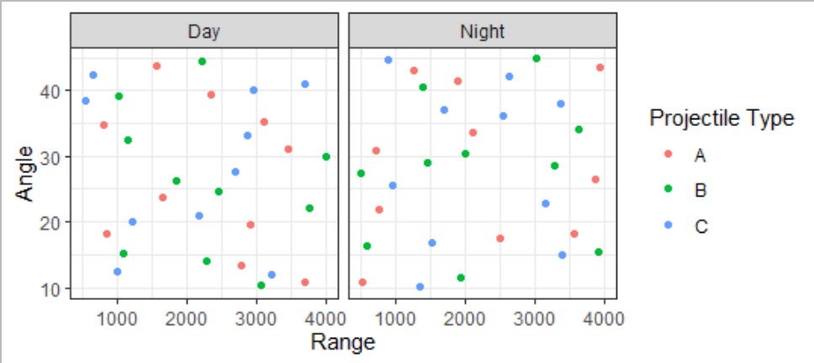
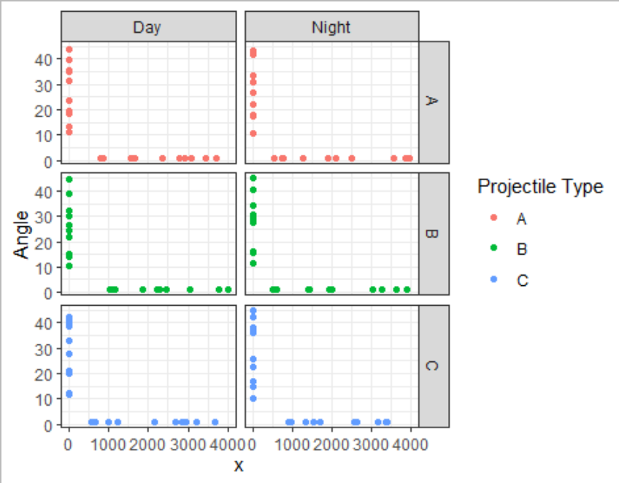
Space-Filling Designs Can Help Recover More Trends In Simulation Outputs
Smaller SFD within factor combinations
Space-Filling Designs
When designing a test that involves M&S, we should consider using space-filling designs (SFDs) to better spread out points across the factor space
Angle
60-run fast flexible space-filling design for 2 categorical and 2 continuous factors
Range
With good projection properties
Angle
Angle
Range
Range

Slide 38
Evaluating the Test Design
Determine test objective
Mission capability to be tested; questions to ask about the system
Identify appropriate metrics
How system performance should be measured
Identify factors that affect performance
Types of data to collect; operational envelope
Develop and evaluate test design
Conduct test
Quantity of data necessary; best resource allocation; objective plans
Analyze data
Draw conclusions
Structured mathematical data analysis plan appropriate for the design
Defensible risk assessments based on test results
Adjust test execution if necessary

Slide 39
Defensible Test Designs Ensure That You Get The Data You Need To Evaluate The System
When evaluating a test design, ask:
Does this design ensure that adequate data is collected? (power/confidence)
If the system doesn’t perform well, will I be able to determine why? (factor identifiability)
Does the DOE reflect the way the test will be conducted? (restricted randomization)
Will the data described in this test let me do the analysis I want to do? (characterize performance across the relevant factor space)

Slide 40
When evaluating a test design, ask:
Does this design ensure that adequate data is collected? (power/confidence)
If the system doesn’t perform well, will I be able to determine why? (factor identifiability)
Does the DOE reflect the way the test will be conducted? (restricted randomization)
Will the data described in this test let me do the analysis I want to do? (characterize performance across the relevant factor space)

Slide 41
One Of The Main Reasons To Use DOE Is To Identify The Number Of Observations Required To Satisfactorily Address The Critical Questions
To know whether you have enough data, you first need to clarify the specific questions you want to address.
Questions of common interest:
Is the new system better than the legacy version?
What is the system’s performance [according to some operationally relevant response variable] across the operational space?
Does the system’s performance meet its requirements?

Slide 42
Statistical Power Is A Tool For Telling You If You Have Enough Data To Answer Critical Questions About System Performance
True Combat Performance
Observed Test Result
Quantity
Report
Test concludes new system is better
Power
(80%)
States new system is better than legacy

New system is better than legacy
Test concludes same or worse
Risk of Incorrect Conclusion
(20%)
States system is same/worse than legacy
Test concludes better
Risk of Incorrect Conclusion
(20%)
States system is better than legacy
New system is same or worse than legacy
Test concludes new system is the same or worse
Confidence
(80%)
States system is same/worse than legacy

Stakeholder choice

Slide 43


Type-I Error α
(probability of false positive)
Type-II Error β
(probability of false negative)
“The new radar indicates incoming balloons!”
“The new radar doesn’t detect any
balloons entering our airspace.”

Slide 44
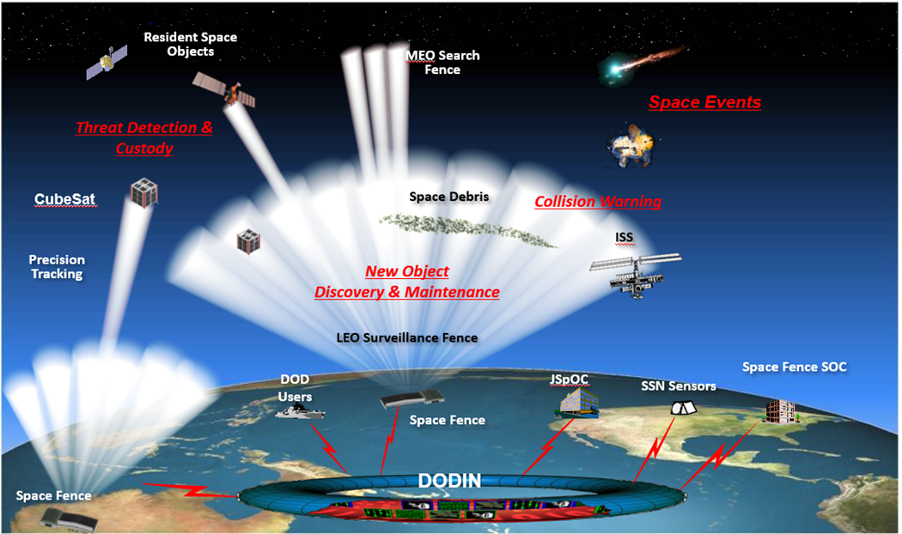
Space Fence Is A Terrestrial Space-Directed S-band (2-4 Ghz) Radar System Designed To Detect, Track, And Catalog Space Objects
DOE question: How many days do we need to test to ensure that we observe enough space objects of each type to evaluate the system?
Mission
Populate and maintain the Space Catalog (SATCAT)
Routinely detect and track smaller objects
Provide event notifications
Support safety of flight
Test Objectives
Determine probability of track for Space Fence
Determine accuracy of Space Fence’s position estimates

Slide 45
Space Fence Test Design Considerations
Challenges
Need to characterize system performance across full operational space, not just for the types of space objects most frequently observed
Cannot control which space objects are observable during a given test day
Satellite catalog analysis can provide information on the frequency with which objects meeting certain characteristics are observed
Test Design 1: Full factorial design for Probability of Track
Key Factors: Object Altitude and Inclination

Slide 46
Using Power To Design A Test Of The Right Size
Inclination (degrees) | Altitude (kilometers) | Number
9 < θ ≤ 45 | 250-550 | 22
 | 550-800 | 60
 | 800-3,000 | 37
45 < θ ≤ 80 | 250-550 | 67
 | 550-800 | 1,094
 | 800-3,000 | 1,536
80 < θ ≤ 171 | 250-550 | 156
 | 550-800 | 1,356
 | 800-3,000 | 4,039
Total |  | 8,367
Factor | Power for different test lengths (days)
 | 6 | 7 | 8 | 10
Inclination | 70.4% | 85.0% | 96.3% | 99.9%
Altitude | 62.5% | 78.1% | 92.8% | 99.5%
I × A | 46.0% | 60.7% | 79.7% | 96.1%
Comparing different test sizes, we can see that in 8 days of testing, we expect to see enough objects to fully characterize Space Fence’s Probability of Track

Slide 47
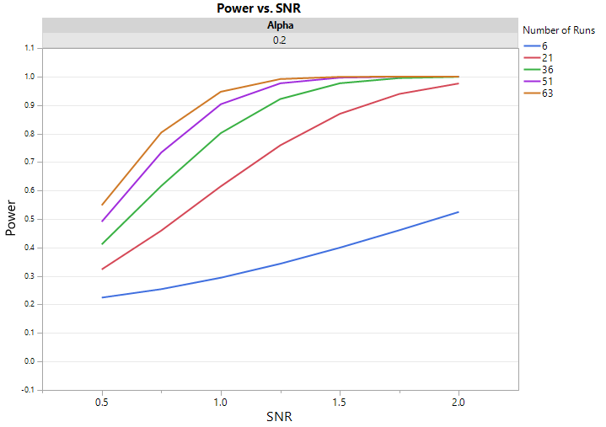
Power Curves Help Visualize And Compare Power For Different Test Designs
Power estimated by JEDIS v3.0

Slide 48
How Much Power? It’s A Balancing Act
Not enough power: Knowledge risk!
An experiment that is so small that we are unlikely to detect effects of interest is a waste of resources.
Too much power: Financial risk!
A too-large (and therefore too-powerful) experiment is also wasteful because it uses more resources than are likely to be needed for detecting the alternative.
Is there a sweet spot?
We often aim for at least 80% power and 80% confidence for screening and characterization, but there is nothing intrinsically correct about 80%! Sometimes, you may want more power if a comparison or factor is especially important.

Slide 49
When evaluating a test design, ask:
Does this design ensure that adequate data is collected? (power/confidence)
If the system doesn’t perform well, will I be able to determine why? (factor identifiability)
Does the DOE reflect the way the test will be conducted? (restricted randomization)
Will the data described in this test let me do the analysis I want to do? (characterize performance across the relevant factor space)

Slide 50
Even The Best Systems Have Missions Or Situations That Aren’t Their Strength
Defense Medical Information Exchange test report:
Operationally effective for queries of DoD and VA data, but not for queries of external partner data.
Q-53 Counterfire Radar test report:
Not effective for volley-fired mortars, but effective for other types of artillery and rockets and single-fire mortars
Tests should be designed so that we can identify the situations or missions where performance drops off

Slide 51
If You Only Ever Observe The Same Combination Of Factors, You Can’t Determine Which One Is Driving Performance
Due to concerns like convenience and resource availability, data points may be arranged in a way that precludes differentiating factor effects
Small Diameter Bomb II
12 Run Main Effects Only Design – smaller than the real design!
Time of Day | Target Speed | Target Type | Update Rate | Clutter
Day | Fast | Wheeled | 30 | Y
Day | Fast | Wheeled | 12 | N
Day | Fixed | Wheeled | 12 | N
Day | Fixed | Wheeled | 30 | N
Day | Slow | Wheeled | 12 | Y
Day | Slow | Wheeled | 30 | Y
Night | Fast | Tracked | 30 | N
Night | Fast | Tracked | 12 | Y
Night | Fixed | Tracked | 30 | Y
Night | Fixed | Tracked | 12 | Y
Night | Slow | Tracked | 12 | N
Night | Slow | Tracked | 30 | N
Poor performance during the day?
Poor performance against wheeled targets?
Poor performance against wheeled targets during the day?

Slide 52
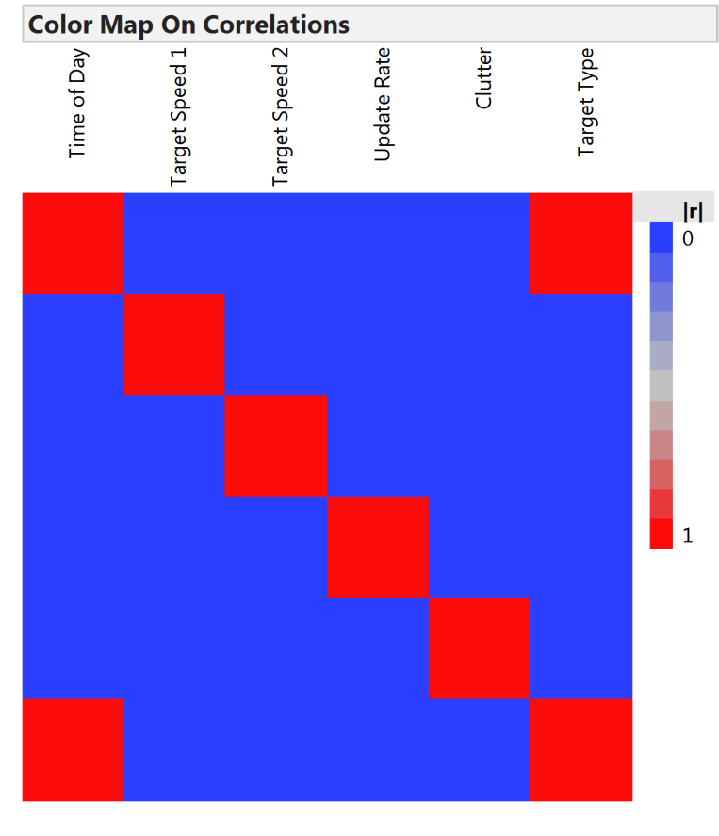

Use Correlation Maps To Quickly Visualize How Hard It Will Be To Distinguish Between Factors
Time of Day | Target Speed | Target Type | Update Rate | Clutter
Day | Fast | Wheeled | 30 | Y
Day | Fast | Wheeled | 12 | N
Day | Fixed | Wheeled | 12 | N
Day | Fixed | Wheeled | 30 | N
Day | Slow | Wheeled | 12 | Y
Day | Slow | Wheeled | 30 | Y
Night | Fast | Tracked | 30 | N
Night | Fast | Tracked | 12 | Y
Night | Fixed | Tracked | 30 | Y
Night | Fixed | Tracked | 12 | Y
Night | Slow | Tracked | 12 | N
Night | Slow | Tracked | 30 | N
Blue means perfectly uncorrelated (No problems!)
Red is perfectly (100%) correlated (Cannot differentiate)
Colors in between indicate some degree of correlation (Can differentiate but estimates may be biased/incorrect)

Slide 53
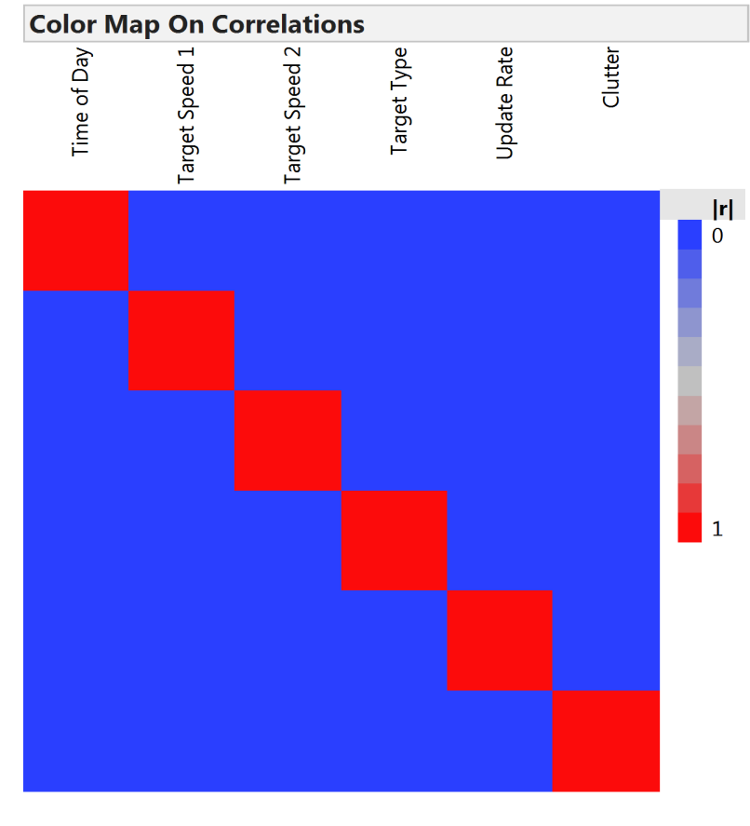
Ideally, Your Test Design Will Have Factors Completely Independent To Ensure Easy Estimation
Time of Day | Target Speed | Target Type | Update Rate | Clutter
Day | Fast | Tracked | 30 | Y
Day | Fast | Wheeled | 12 | N
Day | Fixed | Tracked | 12 | N
Day | Fixed | Wheeled | 30 | N
Day | Slow | Tracked | 12 | Y
Day | Slow | Wheeled | 30 | Y
Night | Fast | Tracked | 30 | N
Night | Fast | Wheeled | 12 | Y
Night | Fixed | Tracked | 30 | Y
Night | Fixed | Wheeled | 12 | Y
Night | Slow | Tracked | 12 | N
Night | Slow | Wheeled | 30 | N
Depending on the type of design, this ideal might be achievable
Full and fractional factorial designs
Some optimal designs

Slide 54
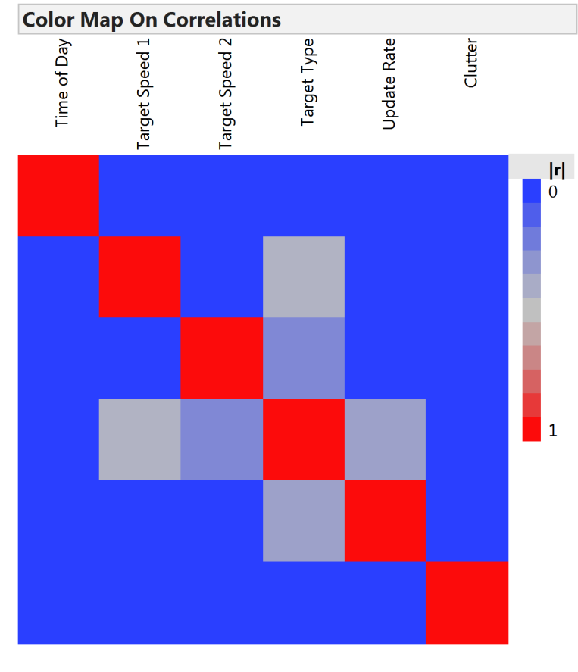
Sometimes, Practical Constraints And Operational Realism Mean That Factors Will Be Partially Correlated
This is okay! – But it means that we cannot easily separate all factor effects on the response
Time of Day | Target Speed | Target Type | Update Rate | Clutter
Day | Fast | Wheeled | 30 | Y
Day | Fast | Wheeled | 12 | N
Day | Fixed | Tracked | 12 | N
Day | Fixed | Wheeled | 30 | N
Day | Slow | Tracked | 12 | Y
Day | Slow | Wheeled | 30 | Y
Night | Fast | Wheeled | 30 | N
Night | Fast | Wheeled | 12 | Y
Night | Fixed | Tracked | 30 | Y
Night | Fixed | Wheeled | 12 | Y
Night | Slow | Tracked | 12 | N
Night | Slow | Wheeled | 30 | N
Tracked vehicles don’t have the same max speed as wheeled vehicles, so there will be no tracked targets moving at the “fast” speed.

Slide 55
When evaluating a test design, ask:
Does this design ensure that adequate data is collected? (power/confidence)
If the system doesn’t perform well, will I be able to determine why? (factor identifiability)
Does the DOE reflect the way the test will be conducted? (restricted randomization)
Will the data described in this test let me do the analysis I want to do? (characterize performance across the relevant factor space)

Slide 56
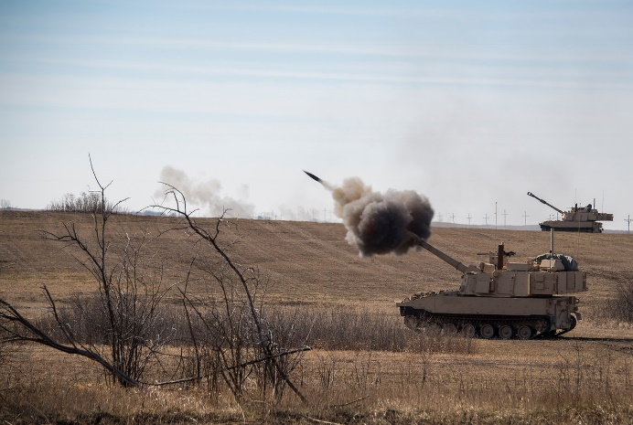
Range Limitations And System Operations May Affect The Way Factors Are Varied In An Operational Test
Artillery Cannon
Survivability Moves:
Goal is to evade enemy counterfire
Occur frequently
Cover short distances
Tactical Moves:
Goal is to reposition as battle lines move
Occur less frequently
May cover longer distances
Operations:
Fire → Move → Fire
Response Variable
Miss Distance

Slide 57
Operations
Fire platoons execute survivability moves between fire missions. These are generally short, so the range to target won’t change much.
Units will perform tactical moves once or twice every 12 hours. These are longer, meaning that the unit may move from one firing area to another.
Between tactical moves, both illumination and range to target will be more or less constant, while other factors may be randomized.

Slide 58
Our test of the new cannon includes factors that are difficult to completely randomize and have disallowed combinations
Factor | Level | Difficult to Randomize | Disallowed Combinations
Time of Day | Day, Night | Hard | Night and Short Range
Range to Target | Short, Medium, Long | Hard
Projectile Type | A, B, C | Easy | A and Long Range
Angle of Fire | Low, High | Easy

Slide 59
Split-plot designs allow your DOE to reflect your test execution
Time of Day | Range | Angle of Fire | Projectile Type
Day | Long | Low | B
 |  | Low | C
 |  | High | B
 |  | High | C
Tactical Move
Day | Short | Low | A
 |  | Low | B
 |  | High | C
 |  | High | B
Tactical Move
Night | Medium | Low | C
 |  | High | B
 |  | Low | B
 |  | Low | A
Tactical Move
Day | Medium | High | A
 |  | High | B
 |  | Low | C
 |  | Low | A
Tactical Move
Night | Medium | High | A
 |  | Low | B
 |  | Low | A
 |  | High | C
Tactical Move
Night | Long | High | B
 |  | Low | B
 |  | High | C
 |  | Low | C
Tactical Move
Night | Long | Low | B
 |  | Low | C
 |  | High | C
 |  | High | C
Tactical Move
Day | Medium | High | C
 |  | High | B
 |  | High | A
 |  | Low | B
Failing to correctly design and account for execution order could lead to wrong conclusions.
Whole-Plot
Sub-Plots
Lighting and Range are hard to change between Tactical Moves.
Angle of Fire and Projectile Type are easy to vary from one fire mission to the next.

Slide 60
Power And Restricted Randomization
If you ignore the structure of your test, the power numbers you get will look higher, but this is fool’s gold.
If you cannot vary some of your factors completely at random, your power estimates should reflect this.
Use a realistic estimate for how much group-to-group variation you can expect relative to run-to-run variation.

Slide 61
When evaluating a test design, ask:
Does this design ensure that adequate data is collected? (power/confidence)
If the system doesn’t perform well, will I be able to determine why? (factor identifiability)
Does the DOE reflect the way the test will be conducted? (restricted randomization)
Will the data described in this test let me do the analysis I want to do? (characterize performance across the relevant factor space)

Slide 62
Design Your Test To Get The Information You Need
When resources are constrained, carefully describe the conditions the system will be employed in and make sure to get the data points required to fully describe that space.

Slide 63
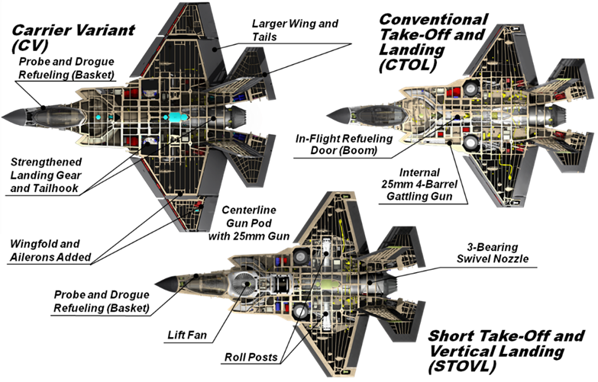
Operational Test Should Cover The Full Spectrum Of Conditions In Which Systems Will Be Employed
F-35 Joint Strike Fighter test
Goal: Evaluate effectiveness of Block 3F focusing on the core mission areas designated in the JSF Operational Requirements Document (ORD). F-35 IOT&E will evaluate the aircraft’s effectiveness in several core mission areas:
Air-to-Surface (A/S) Attack
Aerial Reconnaissance (AR) / Strike Coordination & Reconnaissance (SCAR)
Close Air Support (CAS)
Offensive Counter Air (OCA)
Defensive Counter Air (DCA)
Destruction – Suppression of Enemy Air Defenses (D-SEAD)
Combat Search and Rescue (CSAR)
Forward Air Controller – Airborne (FAC-A)
Differences between variants mean that the test must provide adequate information for all three variants in the core mission areas.

Slide 64
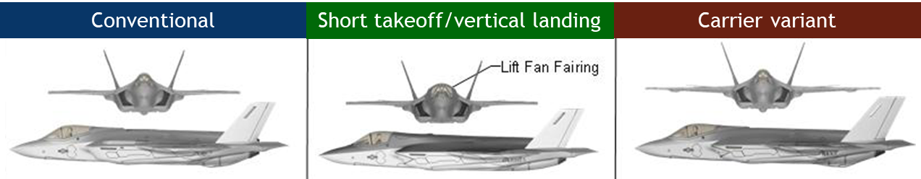
Choose Appropriate Factor Levels As Part Of Mission-Based Test Design
Test design approach leverages DOE principles to span multiple factors across missions:
F-35 Variant – All Missions
Time of Day (Day/Night) – All Missions
Ground Threat – Covered Across Missions
Air Threat Level – Covered Across Missions
Mission-specific factors allow for specific capability characterization within mission areas
E.g., close air support mission-specific factors include environment (urban/rural), target type, control type, target movement, formation size
Mission Areas | Air Threat |  | Ground Threat
Air-Surface (SCAR & AR)
Strike
Destruction/Suppression of Enemy Air Defenses
Defensive counter air
Offensive counter air
Close air support
Search and rescue

Slide 65
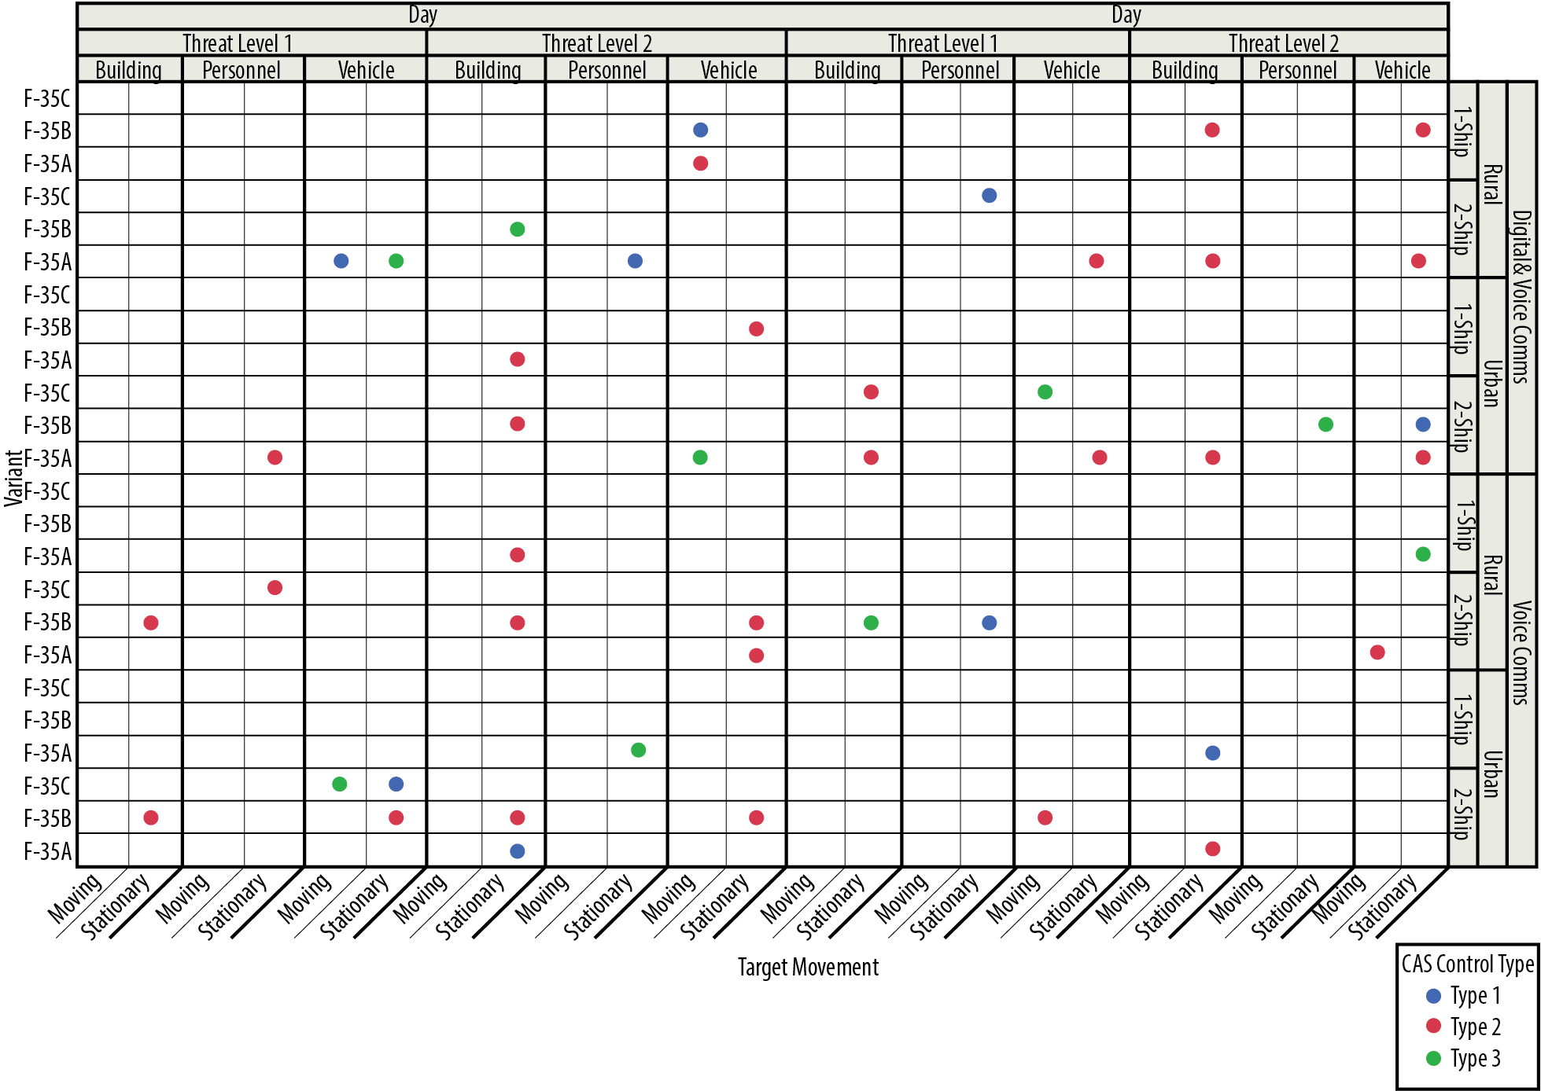
Determine What You Want To Learn From The Test And Build The Design Accordingly
Close Air Support D-Optimal Design
All main effects
Two-way interactions involving aircraft type
Certain other two-way interactions

Slide 66
Beginning With Good DOEs Allows To Produce More Accurate And Meaningful Results
A well-designed test will…
ensure enough data are collected
be able to identify the drivers of mission performance
reflect the way the test will be conducted
support a credible and defensible analysis

Slide 67



In Most Cases (If Not All) Test Designs Are Generated And Evaluated Using Statistical Software

Slide 68
Analysis and Reporting
Determine test objective
Mission capability to be tested; questions to ask about the system
Identify appropriate metrics
How system performance should be measured
Identify factors that affect performance
Types of data to collect; operational envelope
Develop and evaluate test design
Conduct test
Quantity of data necessary; best resource allocation; objective plans
Analyze data
Draw conclusions
Structured mathematical data analysis plan appropriate for the design
Defensible risk assessments based on test results
Adjust test execution if necessary

Slide 69
Motivation
A successful analysis should follow the structure of the test design.
Building a statistical model using the factors specified in our test design allows us to quantify differences across relevant conditions and draw conclusions with confidence.
All experiments are designed with an analysis methodology in mind: to reap the benefits, we need to follow through to the analysis!

Slide 70
Key Tip #1: Avoid Data “Roll-Ups”
A “roll-up” is the term for averaging or summarizing across test conditions to arrive at a smaller set of values, for example:
Reporting a mean across all conditions
Reporting a mean across all levels of one factor, ignoring “interaction” with other factors
“Roll-ups” appear simple and straightforward, but they obscure true performance and reduce information.
We want to avoid data “roll-ups” because they can:
Arrive at a summary value that represents no actual test condition
Miss potentially important conditions where performance is poor

Slide 71
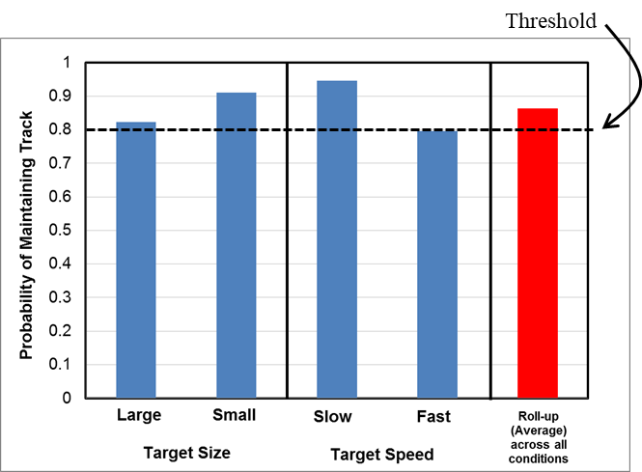
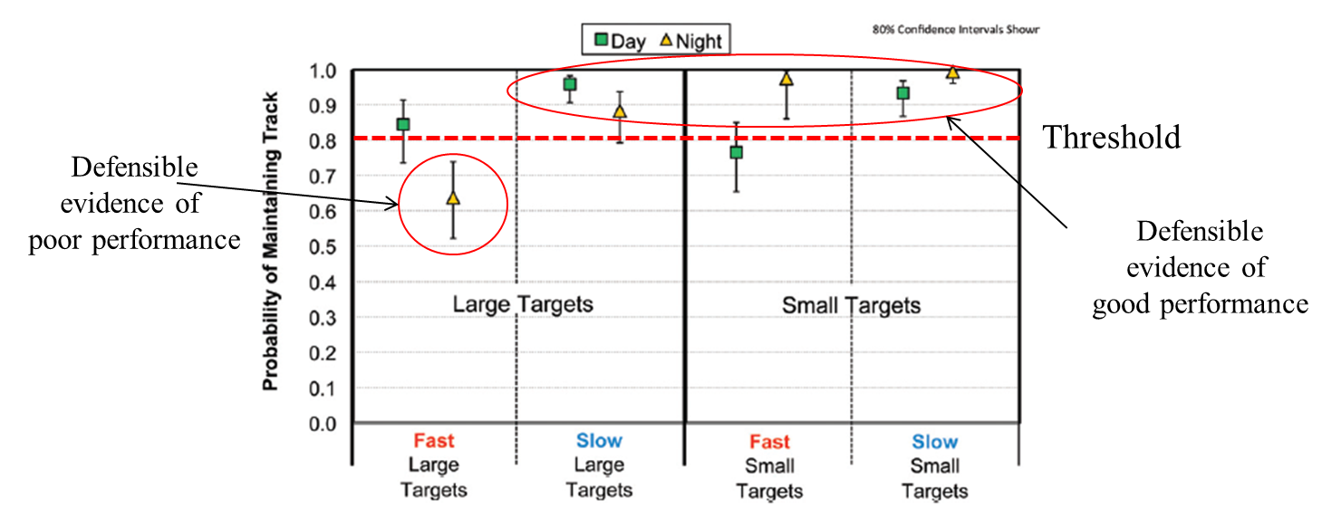
Statistical Analyses Can Summarize And Characterize Information Better Than Simple Averages And Roll-Ups
Same mean in every case, but very different distributions!
Area of poor performance would not have been uncovered without statistical modeling.

Slide 72
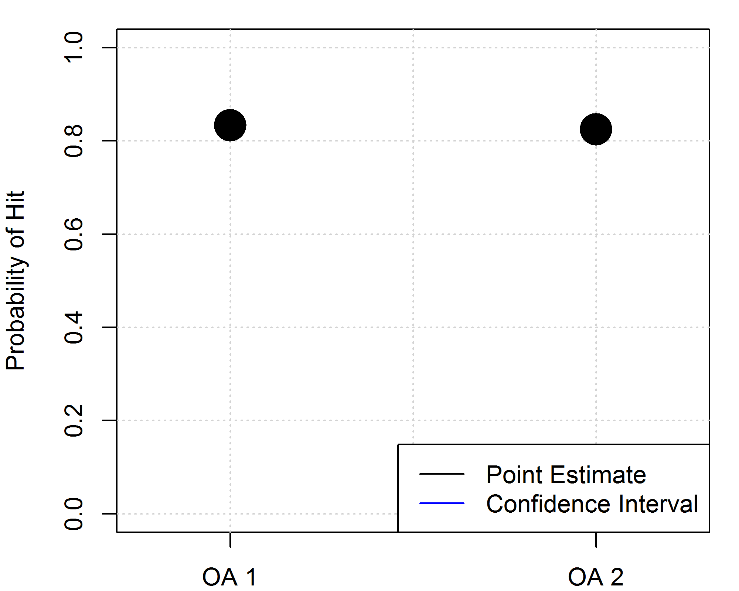
Key Tip #2: Interval Estimates Are Important!
Results from a single test event cannot predict exactly how a system will perform in the field.
Confidence intervals tell us how precise our test results are.
More data → tighter confidence bounds.
Tighter confidence bounds → better estimate of our system.
Example: New turret for LAV Anti-Tank variant (notional data)
Shoots TOW missiles
OA 1: 12 shots
10 hits
OA 2: 40 shots
33 hits

Slide 73
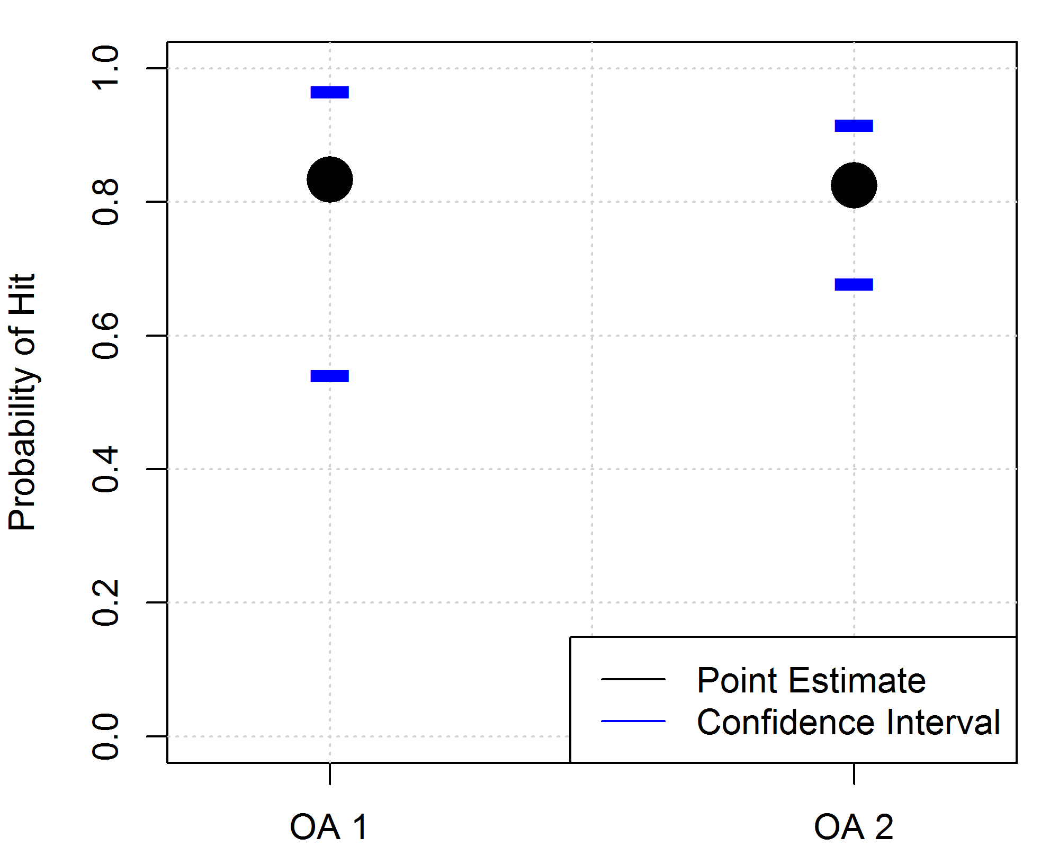
Key Tip #2: Interval Estimates Are Important!
Results from a single test event cannot predict exactly how a system will perform in the field.
Confidence intervals tell us how precise our test results are.
More data → tighter confidence bounds.
Tighter confidence bounds → better estimate of our system.
Example: New turret for LAV Anti-Tank variant (notional data)
Shoots TOW missiles
OA 1: 12 shots
Interval Width: 42.5%
OA 2: 40 shots
Interval Width: 23.8%
Interval estimates show the range of values for the system’s lifetime performance under similar conditions.

Slide 74
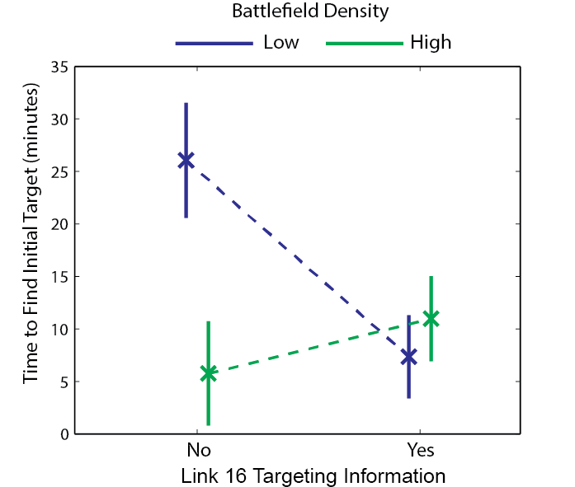
Conveying Level Of (Un)certainty In The Results Is Critical
Even without a threshold, confidence intervals quantify how accurately the metric was measured.
Confidence intervals make it clear that performance is comparable.

Slide 75
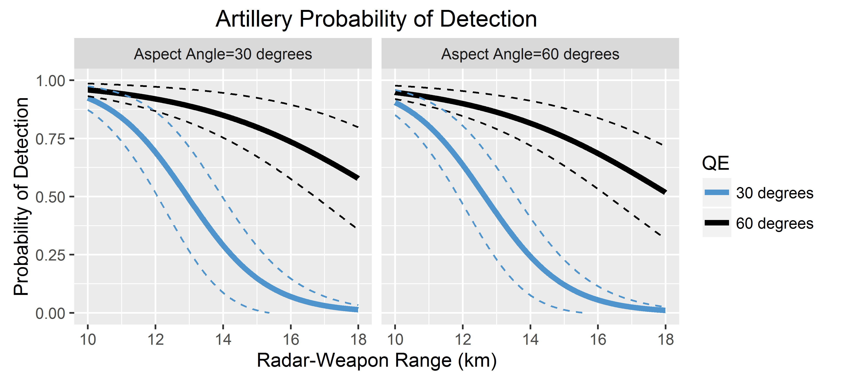
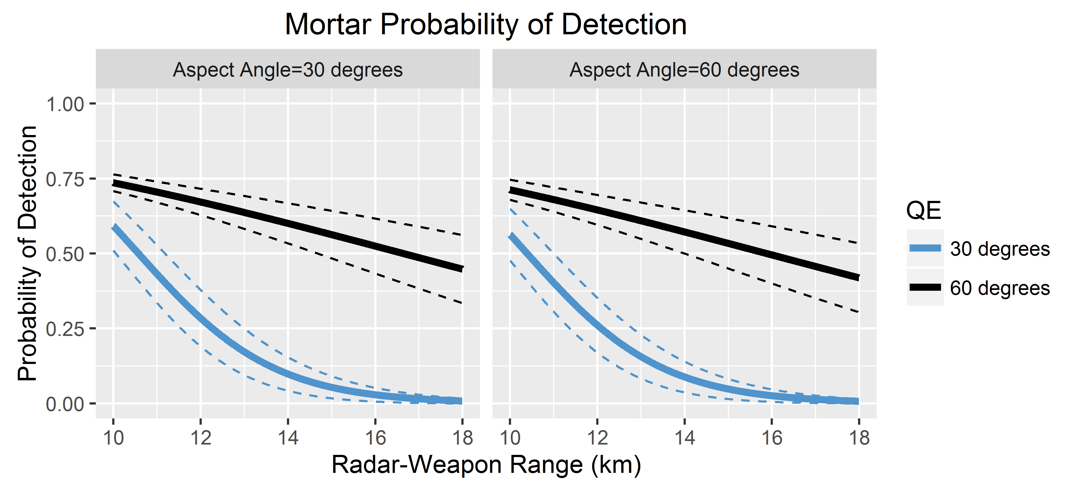
Key Tip #3: Use High-Level Graphical Summaries To Communicate Impact Across The Operational Space

Slide 76
Some Final Thoughts

Slide 77
DOE encompasses a large body of techniques that support different types of data, use cases, and levels of complexity
DOE enables you to design tests that investigate multiple factors in one experiment
DOE provides the tester with an analytical framework to determine whether a test is good enough for their purpose
A test strategy that employs DOE will provide the most powerful allocation of test resources for a given number of events
Rigorous test design and analysis techniques facilitate an efficient, objective, and credible evaluation

Slide 78
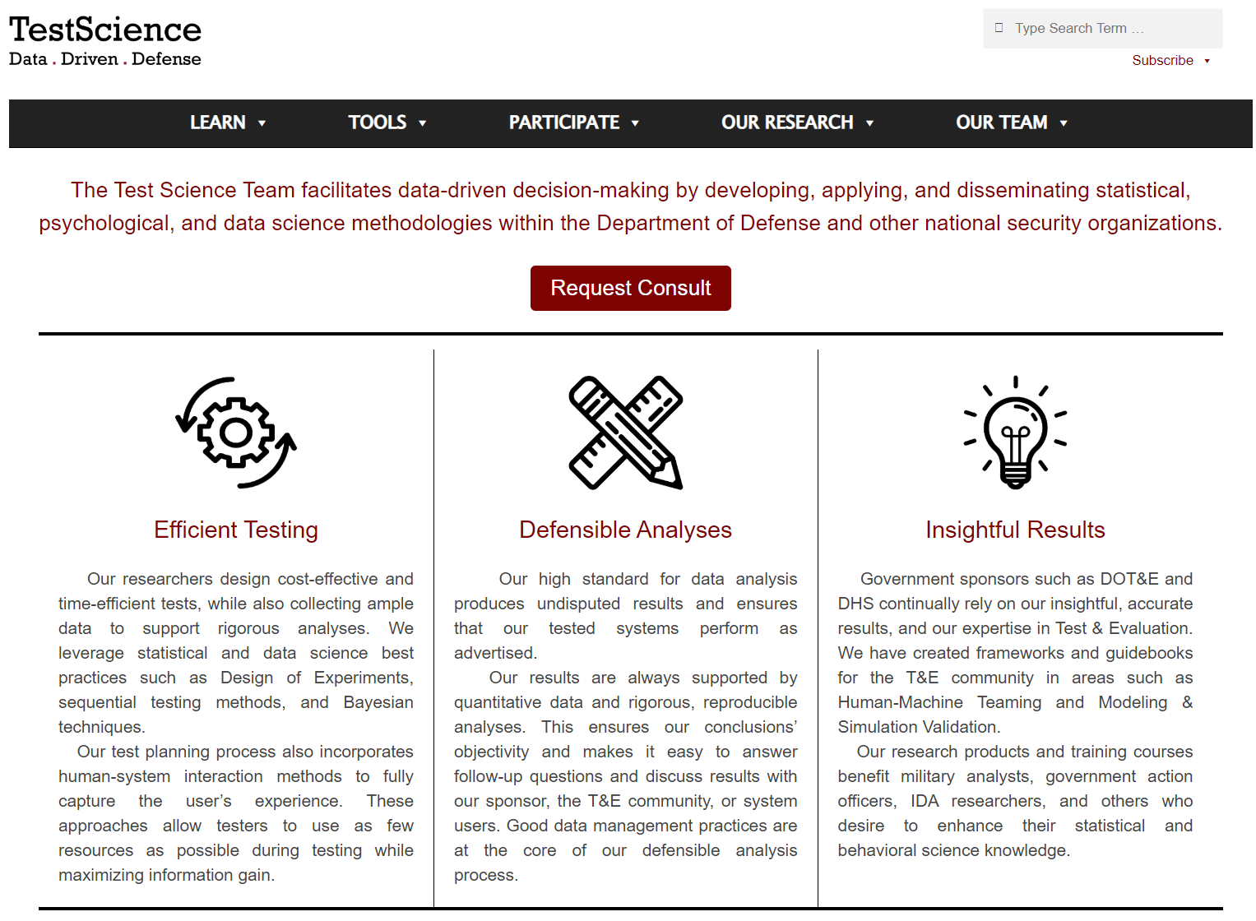
Want To Learn More? Visit Us At Testscience.org!

Slide 79
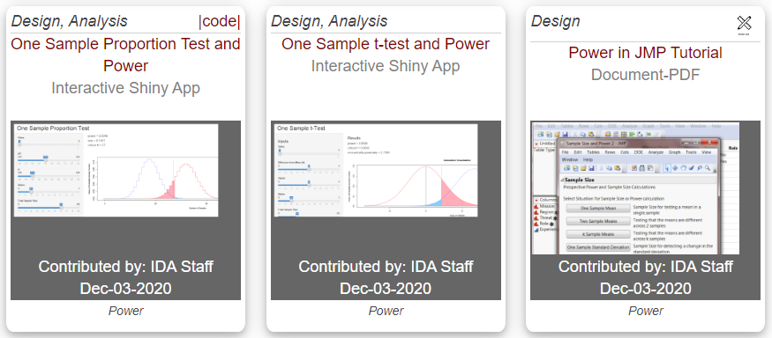
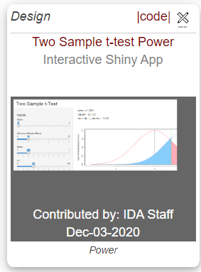
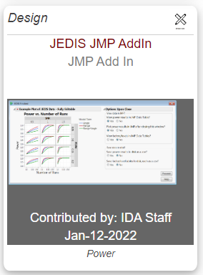
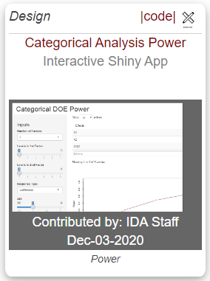

Test Science Website Tools
https://testscience.org/

Slide 80

Want To Learn More About Statistics For T&E? Join Us At Dataworks 2024!
April 16–18, 2024 Institute for Defense Analyses Alexandria, Virginia
http://dataworks.testscience.org/

Slide 81
Additional Resources
Test Science website: https://testscience.org/
Freeman, L. J., Johnson, T., Avery, M., Lillard, V. B., & Clutter, J. (2018). Testing Defense Systems. Analytic Methods in Systems and Software Testing, 441.
Montgomery, D. C. (2017). Design and analysis of experiments (Ninth ed.): Hoboken, NJ: John Wiley & Sons, Inc.
Director, Operational Test & Evaluation (2010). Guidance on the use of Design of Experiments (DOE) in Operational Test and Evaluation.
Director, Operational Test & Evaluation (2013). Best Practices for Assessing the Statistical Adequacy of Experimental Designs Used in Operational Test and Evaluation.
Ahrens, M., Medlin, R., Pagán-Rivera, K., & Dennis, J. W. (2022). Case study on applying sequential analyses in operational testing. Quality Engineering, 1–12.
Avery, K. M., Freeman, L. J., Parry, S. H., Whittier, G. S., Johnson, T. H., Flack, A. C., & Wojton, H. (2019). Handbook on Statistical Design and Analysis Techniques for Modeling and Simulation Validation. Institute for Defense Analyses D-10455.

