Slide 1



Getting User Experience (UX)
Understanding UX and How To Acquire It
Amanda Hawkins, CDR USN (ret), Presidential Innovation Fellow assigned to OUSD Research and Engineering, OASD for Mission Capabilities
Dolores Kuchina-Musina, Ph.D., Chief Disruptor, REXOTA Solutions LLC
Vel Preston, Chief of Innovation and Design, USAF CyberWorx

Slide 2
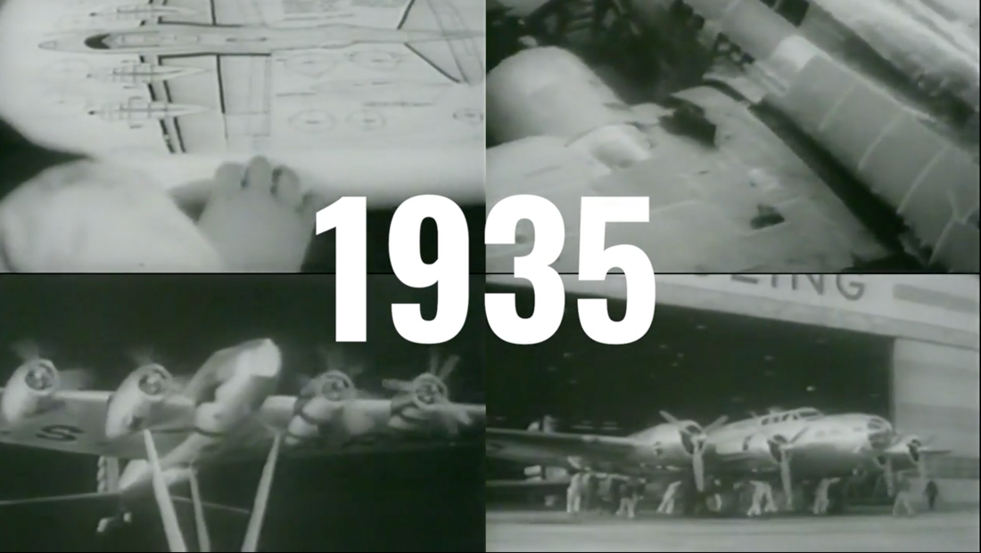
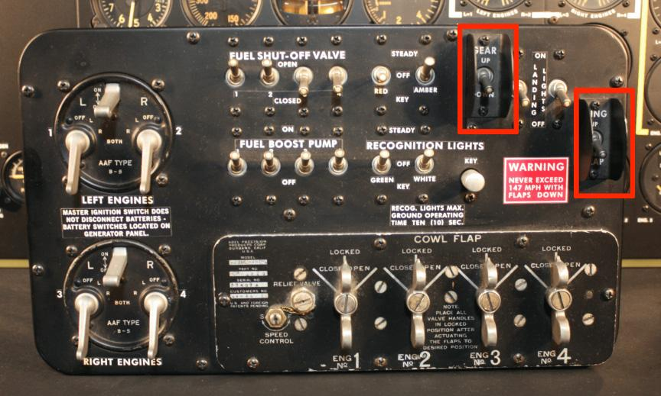
B-17 Flying Fortress
B-17 Flying Fortress – a design problem
Notes:
The B-17 was a marvel of engineering, becoming the third-most produced bomber of all time. Designed, built, and fully operationalized in under a year, the “Flying Fortress” dropped more bombs than any other U.S. aircraft in World War II.
The bomber developed a reputation for toughness, with widely publicized photographs of battered B-17s returning safely to base after sustaining heavy damage. But not all of the damage sustained by the Flying Fortress was caused by the enemy.
Over the course of the war, B-17s crashed thousands of times under peculiar but consistent circumstances. During what should have been routine landings, pilots kept doing gear up landings meaning they landed with their wheels up.
You can probably think of a few actions you’d take if this happened in the military. Maybe there would be a safety stand-down or the Safety team would launch multiple investigations. Maybe you’d review the training records and qualifications of the pilots and make recommendations to the training pipeline. Or maybe you'd look into factors like the runway conditions, maintenance and quality of consumables or environmental factors.
As it turned out, there was no evidence of a mechanical malfunction in any of the crashes, nor were there any pertinent environmental factors apart from more crash landings occurring at night. And in terms of the training pipeline, even seasoned pilots with extensive experience in multiple platforms were experiencing crashes.
Believe it or not, something far less complicated was actually at the root of the problem. A pair of psychologists, Paul Fitts and Alphonse Chapanis, found a much simpler explanation within the design of the cockpit.
What Chapanis ultimately discovered, was that two toggle switches, one for the gear and one for the flaps, were located next to each other – and they were virtually identical. The design of the cockpit made it too easy for a pilot to crash the plane. Thinking they were reaching for the switch in the cockpit to put the gear down, the pilots were actually putting the flaps down.
Solving the problem was much simpler than rolling out a new training program or recalling an entire line of aircraft for mechanical testing. Chapanis fixed the problem with two new knobs, adding a circular and triangular shape so the switch would feel different in the pilots’ hands. As a result, accidental gear up landings dropped to almost zero overnight. And this practice of incorporating tactile design is still present in modern aircraft today.
For the pilots who experienced accidental gear up landings, the B-17 didn’t work as they thought it should, despite their training and competence. The design worked against them. Unfortunately, this is something we tolerate all the time. We accommodate and accept mostly usable products and systems – even when small changes, and a little more attention to the user’s experience, could help avoid serious issues.
Why IITSEC 2023 Maintaining a Global Force in a Digital World

Slide 3
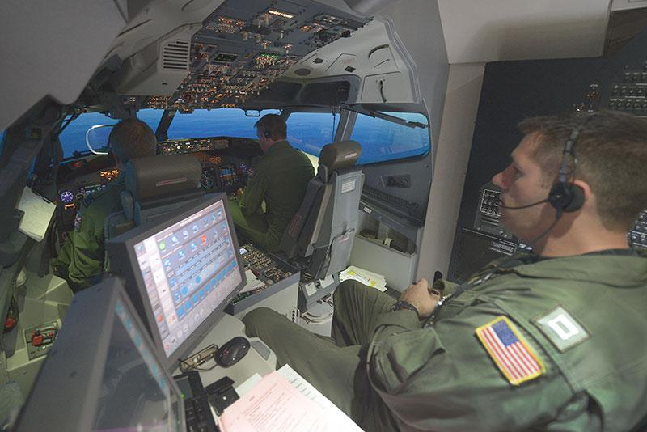
What If?
Notes:
When I was in the military, I used a simulator to help me figure out what if…

Slide 4
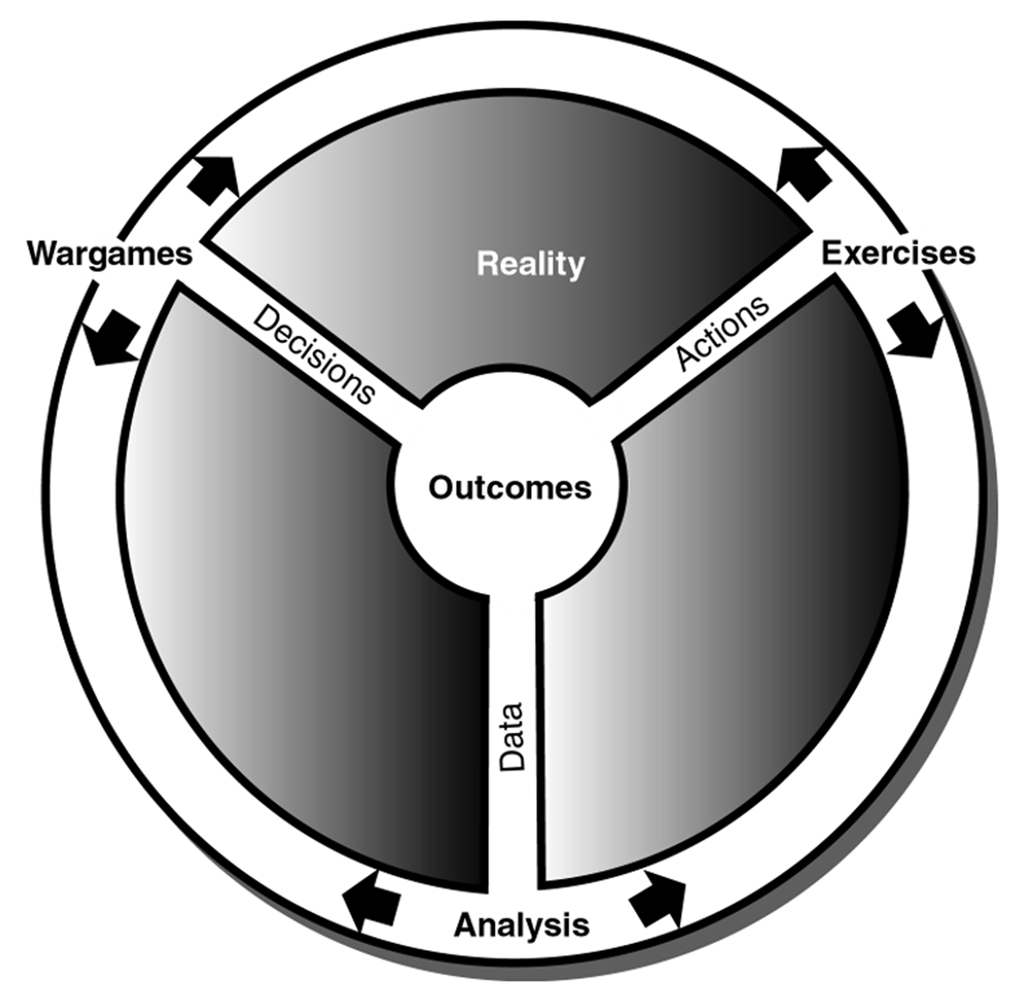
What If - Modeling and Simulation
Modeling and Simulation helps us with the
“What If…”
Concept exploration
Analysis
Planning
Operations
Training
to maintain a global force in a digital world…
*Peter Perla - Wargaming and The Cycle of Research and Learning
Notes:
Maintaining a Global Force in a Digital World

Slide 5



Presenter Intro
Amanda - Designing for Warfighter and hacking bureaucracy
Vel - Expert at designing experiences and facilitating
Dolores - Expert at commercial & federal contract strategies

Slide 6
Learning Objectives
Define core principles of User Experience (UX) and human-centered design.
Describe key UX methods and list the correct place for UX activities within the overall structure of a project.
List the benefits of a user-centered research and development approach to producing and evaluating learning, training, and simulation products.
Understand Federal acquisition authorities and strategic planning process as it applies to programs and projects.

Slide 7
Outline
Definition of UX
UX process
Benefits of UX
UX case study
Acquisition + UX
Practical tips
Summary & Conclusion
Notes:
Cradle to grave acquisition with UX
Government discovers there’s a need:
Strategic planning (What is the real problem)
Budget
Stakeholders
Value chain
Who will be end users?
Possibly acquisition strategy
Should incorporate:
- users
Industry doesn’t understand SOW
“fast” acquisition
GSA rapid acquisition
Process tends to take small businesses out of ability to compete for contracts
If you want sustainability you have to
What is the resolution of this tension…
Here is what DoD is doing here and here, i.e. ACC Orlando – interview few others,
Here is what acquisition community is doing here and here
Where do you find all these ways?
Understand where the authorities are and how to use them
How do you stack these to build a story and open other pathways

Slide 8
Outline
Definition of UX
UX process
Benefits of UX
UX case study
Acquisition + UX
Practical tips
Summary & Conclusion

Slide 9

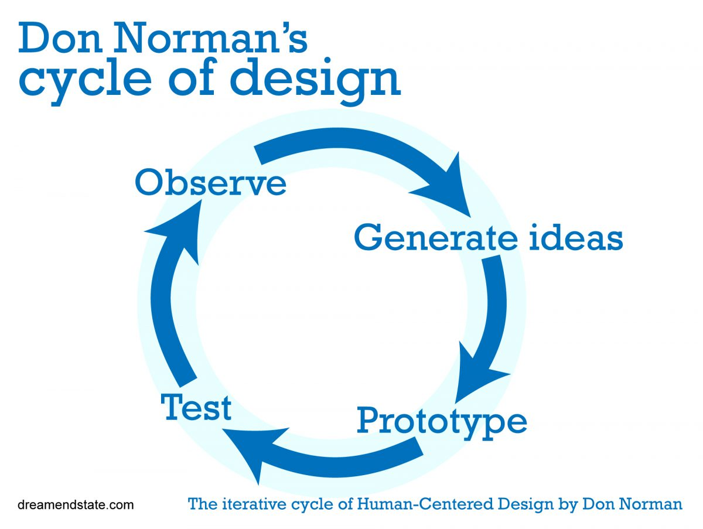
Definition of User Experience
User experience (UX) encompasses all aspects of the end-user's interaction with the company, its services, and its products.
It’s everything – it’s the way you experience the world, it’s the way you experience your life, it’s the way you experience the service, or an app or a computer system, it’s a system that’s everything. — Donald Norman
Notes:
Don Norman is considered the forefather of modern UX. Who better to define UX than him.
I invented the term because I thought human interface and usability were too narrow. I wanted to cover all aspects of the person’s experience with the system including industrial design graphics, the interface, the physical interaction and the manual….

Slide 10
Definition of User Experience
International Standards Organization – internationally agreed by experts – a formula that describes the best way of doing something
ISO 9241 Ergonomics of Human-System Interaction – key principles
The design is based upon an explicit understanding of users, tasks and environments
Users are involved throughout design and development
The design is driven and refined by user-centered evaluation
The process is iterative
The design addresses the whole user experience
The design team includes multidisciplinary skills and perspectives
Notes:
ISO standards: https://www.iso.org/standard/63500.html
2018 first update 30 years after standard created
History of ISO standard: https://measuringu.com/iso-9241/

Slide 11
Definition of UX
Hierarchy of User Needs
Functional – provides a service that is desired
Reliable – timely, consistent, as expected
Usable – right information at the time and place
Pleasurable – emotional connection layered on top
Pleasurable
Usable
Reliable
Functional
Aarron Walter’s
Hierarchy of User Needs
Notes:
https://www.nngroup.com/articles/theory-user-delight/
- A very visually appealing application, that is not functional (i.e. doesn’t have a purpose) will not satisfy users’ basic needs
- A functional interface that doesn’t work all the time, will leave users unsatisfied

Slide 12
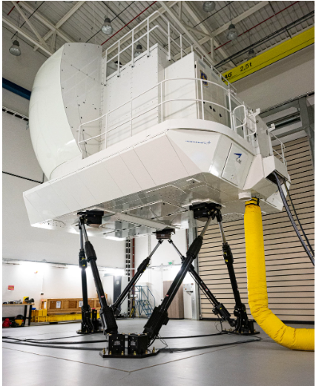
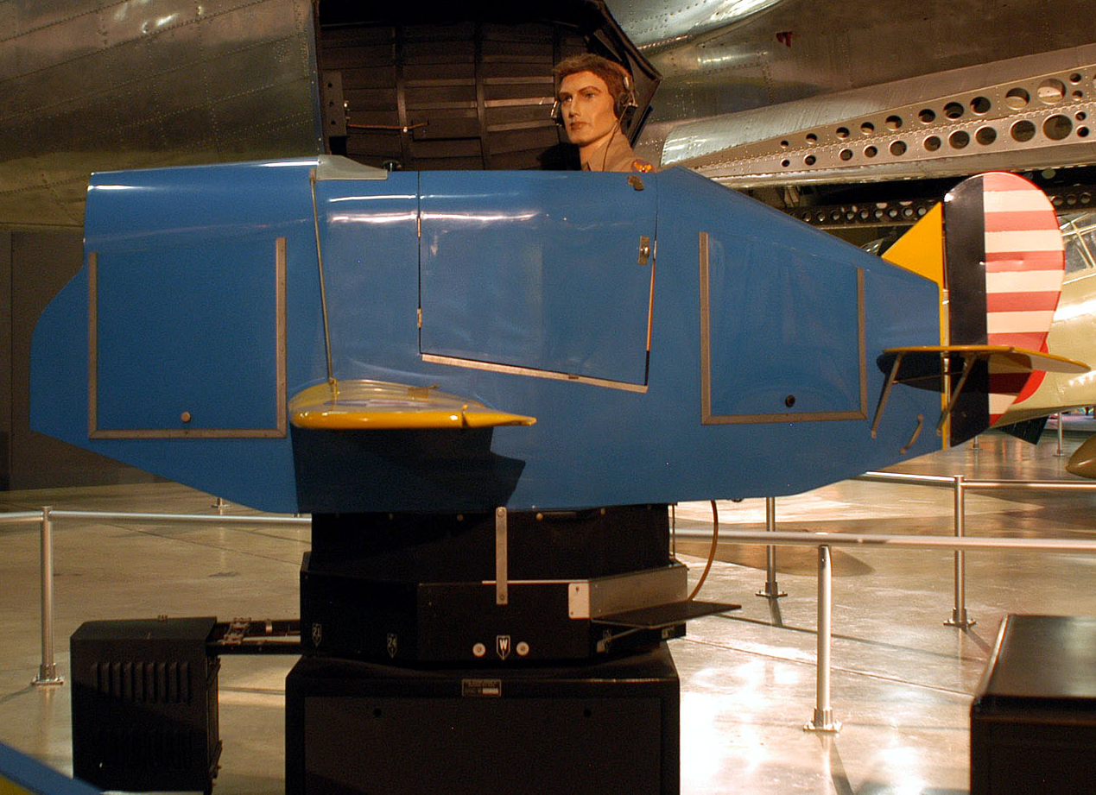
Usable vs Delightful
Minimum Viable Product
Minimum Delightful Product
Notes:
Minimum viable product https://media.defense.gov/2005/Dec/19/2000575040/-1/-1/0/051019-F-1234P-037.JPG
To a
Minimum delightful product
Use an image to help display the message. Somthing that is relatable, like a projector vs smart board OR something specific to training in mod/sim life.

Slide 13
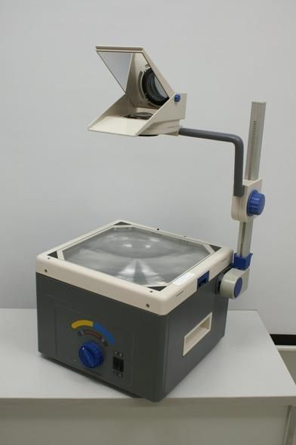
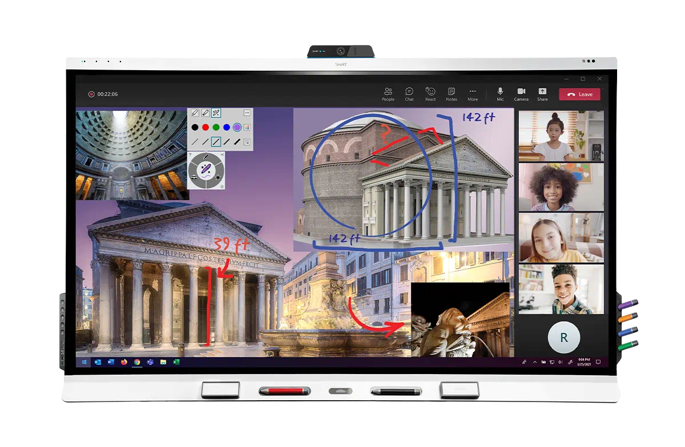
Usable vs Delightful
Minimum Viable Product
Minimum Delightful Product

Slide 14
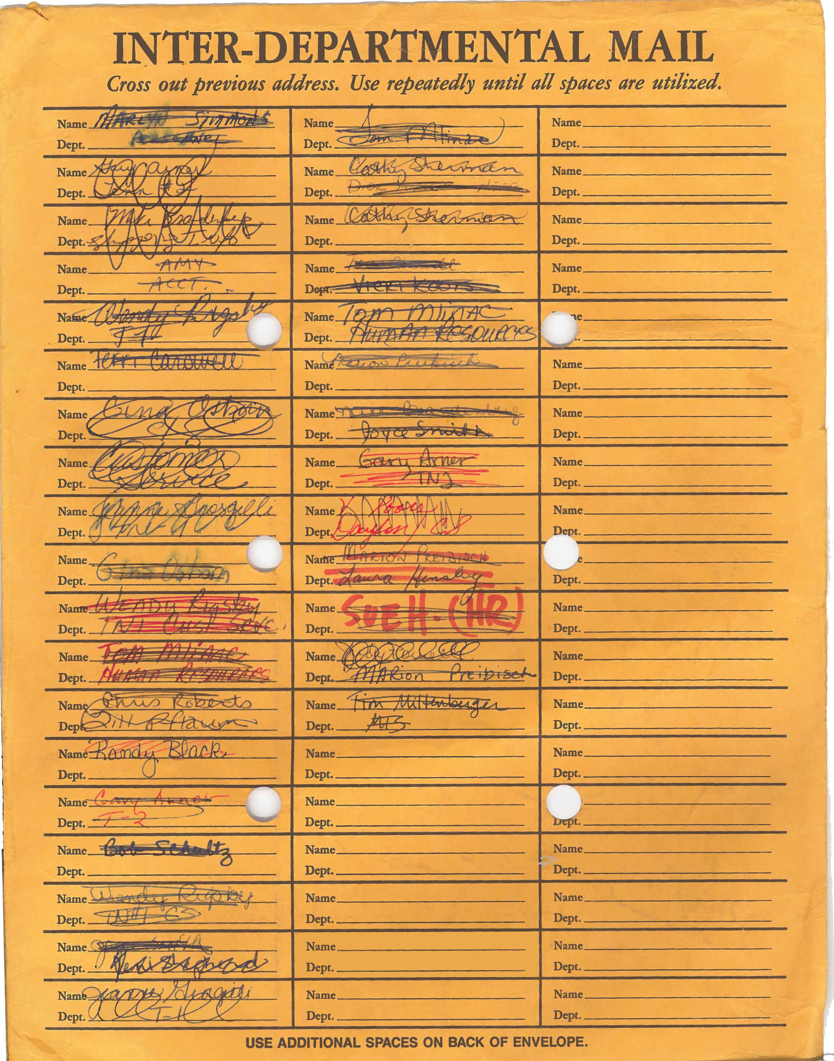
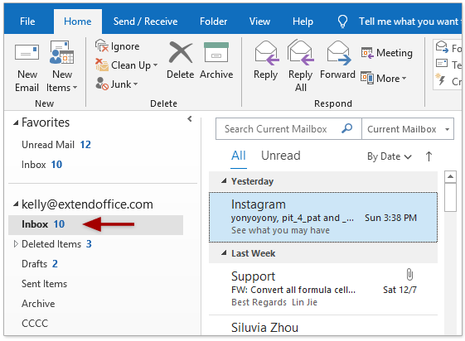
Usable vs Delightful
Minimum Viable Product
Minimum Delightful Product

Slide 15
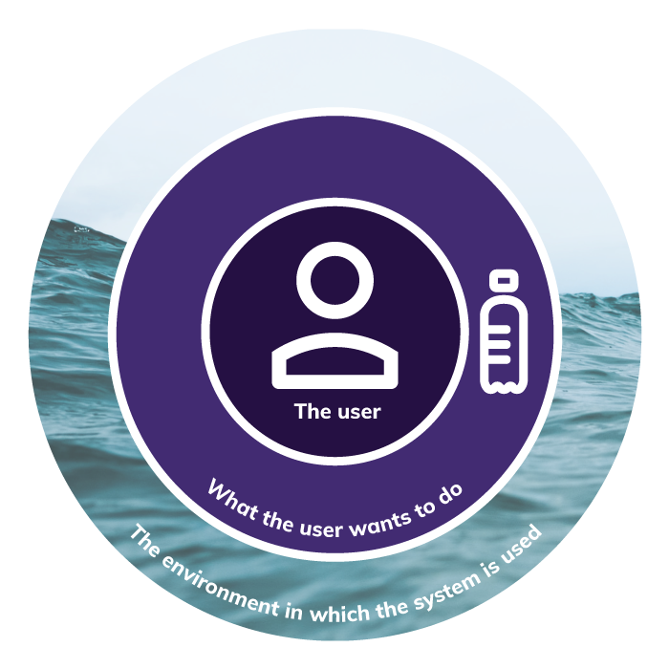

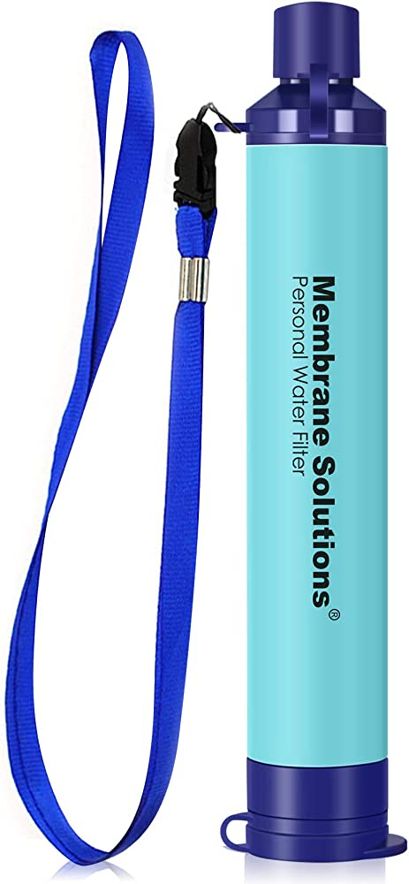
Definition of UX
Trinity
The user
What they want to do with the system/tool/software
The environment in which the system is used
+
Notes:
I’ts not enough to focus just on the user, we must also think about what the user wants to do – what effect they want to have, and the environment in which the system is used
When we are building training systems for our warfighters, it’s important to think about the same elements.
Who is the user, what do they think and feel, what do they believe – develop empathy
What is the intended impact that we are simulating.
What environment is the user and system operating in
https://www.trinityaudio.ai/what-is-user-experience-the-what-why-and-how

Slide 16
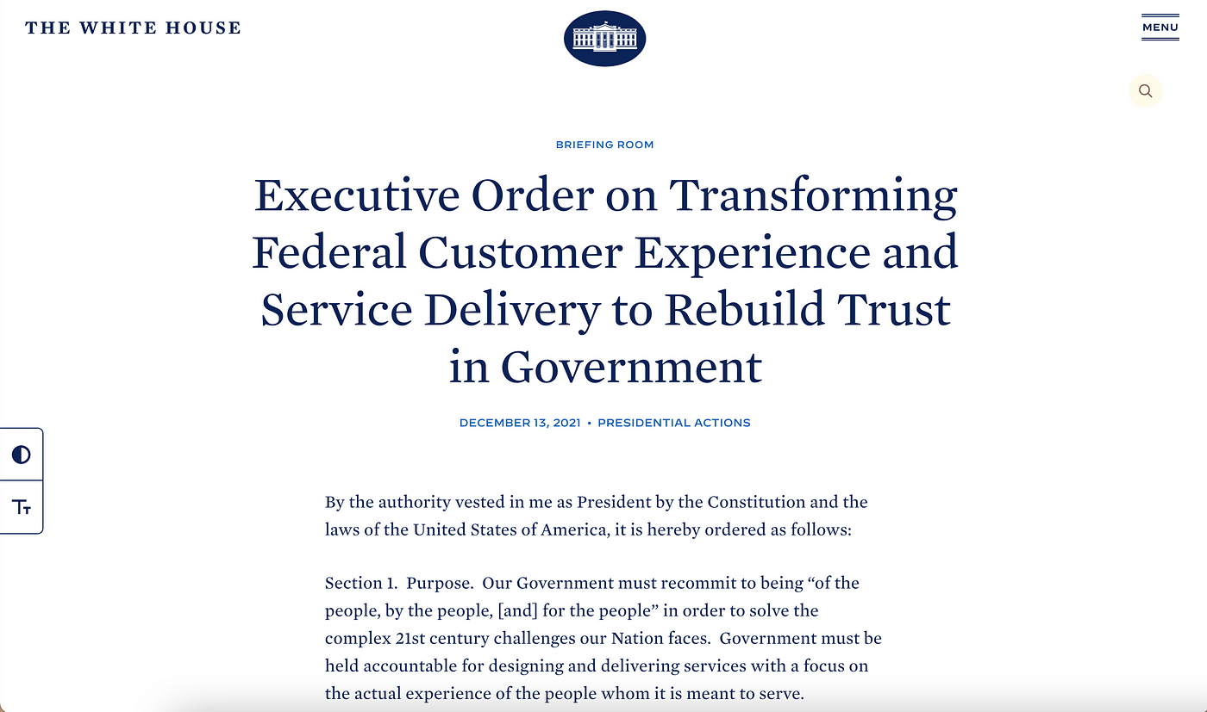
Definition of UX - EO 14058
“Government must be held accountable for designing and delivering services with a focus on the actual experience of the people whom it is meant to serve”
Notes:
For the department of defense, our warfighters increasingly depend on software to do their jobs and control their weapons systems. We have to bake in good design starting at the requirements generations phase through the sustainment phase of every system we own and operate.
poss DepSecDef quote that ties to ux/RDER
Turn over to Vel

Slide 17
Outline
Definition of UX
UX process
Benefits of UX
UX case study
Acquisition + UX
Practical tips
Summary & Conclusion

Slide 18
UX Process – Key Attributes of Processes
Key attributes of any UX process are defined by ISO 9241
The design is based upon an explicit understanding of users, tasks and environments
Users are involved throughout design and development
The design is driven and refined by user-centered evaluation
The process is iterative
The design addresses the whole user experience
The design team includes multidisciplinary skills and perspectives

Slide 19
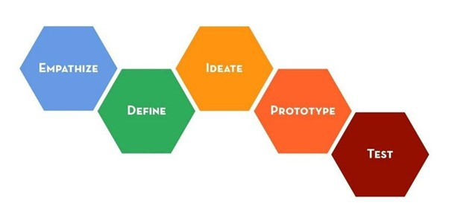
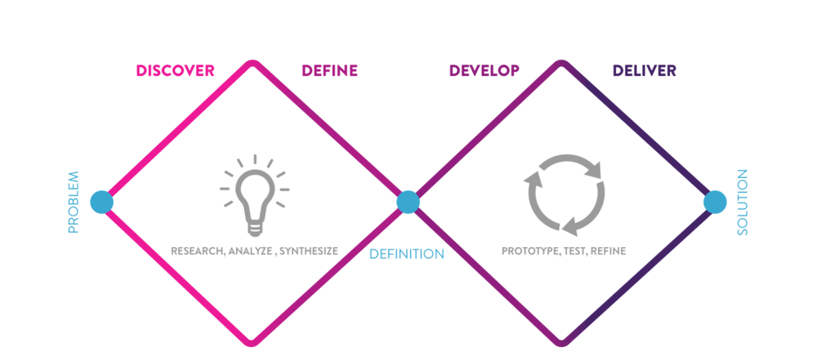
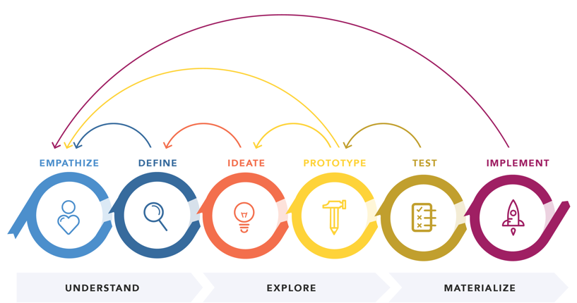
UX Process – Variety of Flavors
Research, Analyze, Synthesize
Prototype, Test, Refine
Problem
Solution
Definition
Stanford School of Design. Image credit Hasso Plattner Institute of Design
Double Diamond – British Design Council. Image credit Phylicia Flynn
Design Thinking 101. Nielsen Norman Group
Notes:
Here are a few different interpretations of the key attributes by leaders in the field
Stanford school of D -
Double Diamond –
Design thinking 101 -
https://dschool.stanford.edu/resources/getting-started-with-design-thinking
https://phyliciaflynn.medium.com/using-the-double-diamond-to-redesign-my-ux-portfolio-4905627fa1ff
https://www.nngroup.com/articles/design-thinking/

Slide 20

UX Process – Fundamental
1. Understand/relate in context
2. Get oriented
4. Observe to learn, iterate to improve
3. Do something

Slide 21
UX Process – Fundamental
1. Understand/relate in context
2. Get oriented
4. Observe to learn, iterate to improve
3. Do something

Slide 22
UX Process – Understand/Relate in Context
Discover - explicit understanding of users, tasks and environments
How do we center the user?
Conduct interviews
Observe how they perform tasks
Research their background and environment
Develop personas and user journeys
Understand/relate in context

Slide 23
UX Process - Understand/Relate in Context
Why conduct user research?
Understand users’ problems
Learn users’ motivations and mental models
Become familiar with users’ context
Validate and invalidate assumptions / biases
Input to persona development (more on this later)
Understand/relate in context

Slide 24
UX Process - Understand/Relate in Context
ATTITUDINAL
BEHAVIORAL
What users say: thoughts, feelings, impressions
What users do:
capabilities,
tendencies,
execution

Slide 25
UX Process - Understand/Relate in Context
Interview techniques
Set context for interview
Establish rapport
They are the expert of their perspective
Don’t ask leading questions
Ask about one topic at a time
Ask specific questions – not generalized ones
Ask probing and follow-up questions
Be attuned to facial expression and body language
Do read-back’s to ensure you are interpreting what you hear correctly
Understand/relate in context

Slide 26
UX Process – Fundamental
1. Understand/relate in context
2. Get oriented
4. Observe to learn, iterate to improve
3. Do something

Slide 27
UX Process – Get Oriented
Personas
Minimalist way of identifying notional user profiles
Can vary in complexity, but should at least contain:
User group name
Fictional user name (and maybe a picture)
Basic demographic information
Occupation/role and brief description
Goals and tasks related to product, system, or service
Context: physical, social, technological
Get oriented

Slide 28
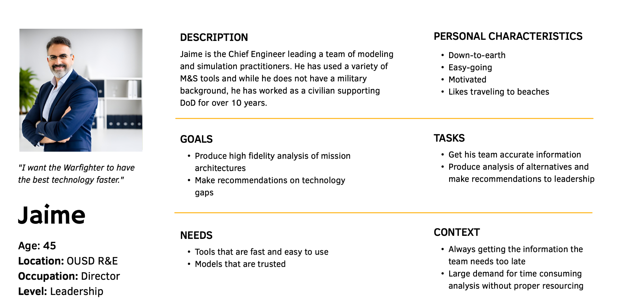
UX Process – Get Oriented (Persona)
Notes:
@amanda, make more concise, description, toals, needs

Slide 29
UX Process – Get Oriented
As a
PERSONA
I want
user story
NEED
So that
GOAL
Get oriented
Notes:
User-centered, non-technical descriptions that contextualize units of work as end goals, not features
A few sentences that articulate the value of a piece of work in a way that the end user would easily understand
Format facilitates collaboration and creative problem-solving
Can be aggregated, decomposed, and sequenced

Slide 30

UX Process – Get Oriented - User Story
As…
Jaime (Chief Engineer for Digital Mission Architecture with OUSD R&E, OASD MC)
I want to…
Use model-based systems engineering to develop mission architectures and evaluate the impact of emerging technologies on mission execution
So that I can…
Conduct gap analysis
Quantify gaps and evaluate relationships
Prioritize portfolios and identify requirements
Identify risks and conduct risk assessments
Get oriented
Notes:
Each User will have multiple stories, this should be dissected in much more detail and should follow the user journey. Along each stage what are the user needs.

Slide 31
UX Process – Fundamental
1. Understand/relate in context
2. Get oriented
4. Observe to learn, iterate to improve
3. Do something

Slide 32
UX Process – Do Something
Inventory
What actions are at your disposal?
Prioritize
What has high impact and is easy to do?
Scope
How can I break this down into a hypothesis and test a single variable at a time?
Do Something

Slide 33
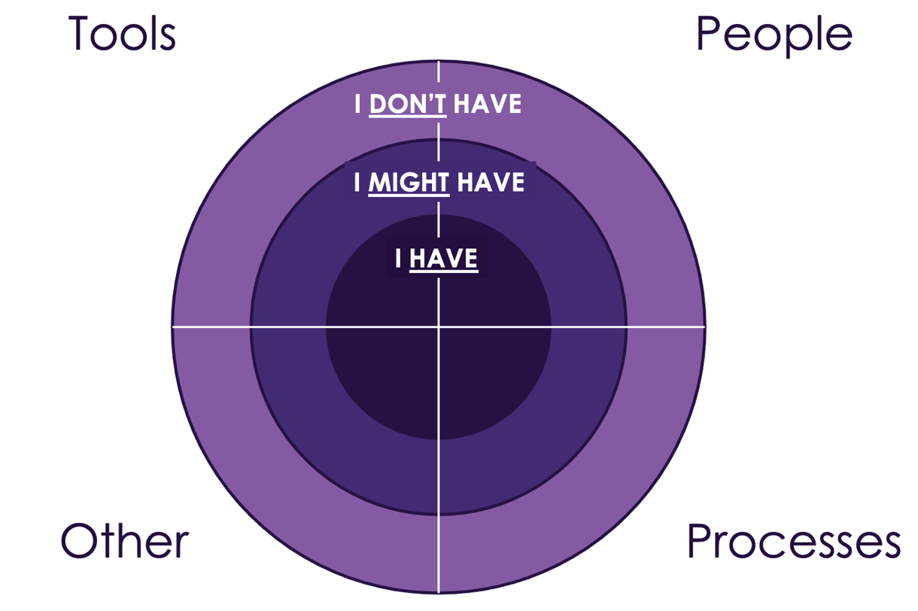
UX Process – Do Something
What actions can I take with the
Tools
People
Processes
Other (i.e. policy, training, etc…)
That I:
Have
Might Have
Don’t have
Notes:
Add visuals and break down a few techniques
- wireframe, sketches, low fidelity prototype and psychology behind

Slide 34
UX Process – Do Something
What actions can I take with the M&S tools I have?
Command Pro
STORM
AFSIM
What are my people trained to do?
Contractors
What processes do we have to do M&S?
Who is developing mission threads?
Notes:
Add visuals and break down a few techniques
- wireframe, sketches, low fidelity prototype and psychology behind

Slide 35
UX Process – Do Something
Prioritize
High impact and low effort
High Impact/ Low Effort
High Impact/ High Effort
Impact
Low Impact/ Low Effort
Low Impact/ High Effort
Effort
Notes:
It is important to specify what exactly can be adjusted and then to prioritize the items by what will have an impact that is the most aligned, while also having the lowest cost or burden to implement. Creating an impact/ doability matrix can be helpful in determining where to start and which variable to manipulate. On an impact/ doability matrix, impact is charted from least to greatest along one axis and doability is charted in terms of ease from easiest to most difficult on the other axis. By classifying the variables, the degree of lift versus impact becomes clear.

Slide 36
UX Process – Do Something
Prioritize
High impact and low effort
High Impact/ Low Effort
Alignment on mission threads earlier
High Impact/ High Effort
Build a more advanced M&S tool to do the analysis I need
Impact
Low Impact/ Low Effort
Do more runs on existing mission threads
Low Impact/ High Effort
Hire more M&S contractors
Effort
Notes:
It is important to specify what exactly can be adjusted and then to prioritize the items by what will have an impact that is the most aligned, while also having the lowest cost or burden to implement. Creating an impact/ doability matrix can be helpful in determining where to start and which variable to manipulate. On an impact/ doability matrix, impact is charted from least to greatest along one axis and doability is charted in terms of ease from easiest to most difficult on the other axis. By classifying the variables, the degree of lift versus impact becomes clear.

Slide 37
UX Process – Do Something
Scope - break down into a hypothesis testing a single variable focused on the user
Consider the total user experience
Minimum of invested time and effort for maximum value
Create low-fidelity prototypes
Determine if more understanding of the user is needed
Do Something

Slide 38
UX Process – Do Something
Scope - break down into a hypothesis testing a single variable focused on the user
Alignment on mission threads earlier…
Hypothesis:
If I send a M&S SME from my team to the working group
where they are developing the mission threads.
Then I will have the information my team needs to build
the mission threads earlier, giving my team enough time
to build the mission threads to do the required analysis.

Slide 39
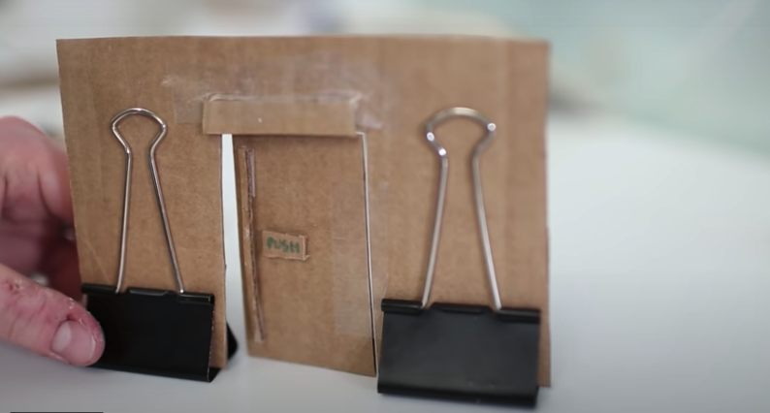
UX Process – Do Something
Cardboard
Allows a test user to accomplish a given task
Notes:
Psychology behind low fidelity prototypes
Cheap and easy to make
Fast to make a new prototype with cardboard
Users will give you feedback more readily

Slide 40

UX Process – Do Something
Low fidelity prototype

Slide 41

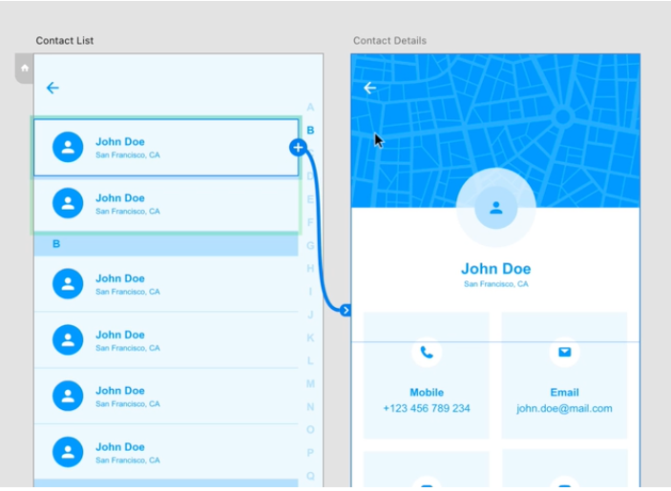
UX Process – Do Something
High fidelity prototype
Wireframe – focus on content structure and functionality
Do Something

Slide 42
UX Process – Fundamental
1. Understand/relate in context
2. Get oriented
4. Observe to learn, iterate to improve
3. Do something

Slide 43
UX Process – Observe to learn, iterate to improve
RUN A TEST
GATHER DATA
WAS MY HYPOTHESIS VALID?
O-L, I-I
Notes:
add language from P&E functions

Slide 44
UX Process – Observe to learn, iterate to improve
Not exactly “user testing,” since we’re not testing whether users perform well or poorly
Involves the presentation of tasks to end users in order to gather information about their responses and execution
In general, facilitated by a skilled UX designer who can ensure collection of unbiased, high-quality data
Get oriented
O-L, I-I

Slide 45
UX Process – Observe to learn, iterate to improve
Did we solve the pain point for the user?
What can we learn, about the user – about the prototype
How do we center the user?
Continue to monitor how users interact
Analyze user journeys holistically
Triage and patch to address emergent pain points
Decide where to go back into the process
O-L, I-I

Slide 46
Outline
Definition of UX
UX process
Benefits of UX
UX case study
Acquisition + UX
Practical tips
Summary & Conclusion
O-L, I-I
Notes:
Cradle to grave acquisition with UX
Government discovers there’s a need:
Strategic planning (What is the real problem)
Budget
Stakeholders
Value chain
Who will be end users?
Possibly acquisition strategy
Should incorporate:
- users
Industry doesn’t understand SOW
“fast” acquisition
GSA rapid acquisition
Process tends to take small businesses out of ability to compete for contracts
If you want sustainability you have to
What is the resolution of this tension…
Here is what DoD is doing here and here, i.e. ACC Orlando – interview few others,
Here is what acquisition community is doing here and here
Where do you find all these ways?
Understand where the authorities are and how to use them
How do you stack these to build a story and open other pathways

Slide 47
UX Benefits - End User
Better outcomes for end user
Reduced cognitive load
Less time to train
Better reliability of human user to achieve desired effect
Notes:
– understanding the end-users needs, constraints, and environment, before design begins improves the chances that the product will require fewer iterations.
– when a system can be used effectively and efficiently, even under stress, it produces fewer errors and roadblocks to mission completion.
- when users need less time figuring out how to do something, they can spend more time performing the required tasks.
– when an interface considers the users’ needs, it makes it more intuitive, requiring less training.

Slide 48
UX Benefits – Business Case
Effective UX is good business
Reduced development and maintenance costs
Improved productivity and operational efficiency
Increased production
Reduced training time and costs
Of the top 12 reasons that projects fail, three of the top 12 are directly related to what we would call user experience or user-centered design work, and those three are badly defined requirements; poor communication among customers, developers, and users; and stakeholder politics.
– Dr. Susan Weinschenk, analysis of IEEE article “Why Software Fails”
Notes:
– understanding the end-users needs, constraints, and environment, before design begins improves the chances that the product will require fewer iterations.
– when a system can be used effectively and efficiently, even under stress, it produces fewer errors and roadblocks to mission completion.
- when users need less time figuring out how to do something, they can spend more time performing the required tasks.
– when an interface considers the users’ needs, it makes it more intuitive, requiring less training.

Slide 49
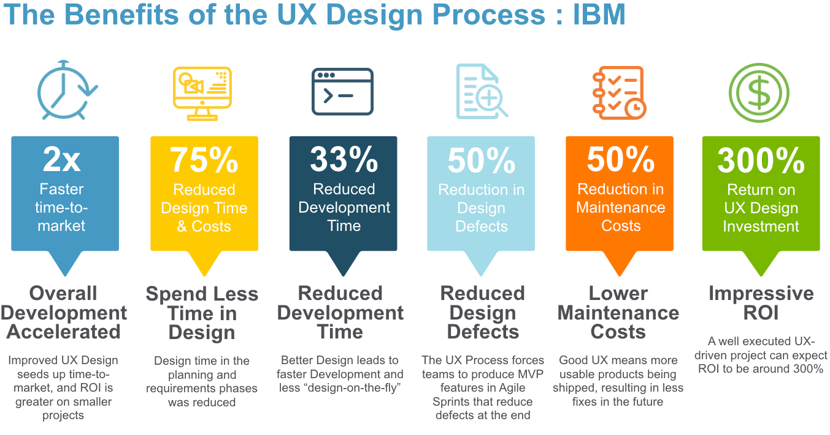
UX Benefits – Business Case
75%
Reduced
Design Time
& Costs
50%
Reduction in
Design
Defects
A Forrester Total Economic Impact Study Commissioned by IBM Feb 2018
Notes:
check for any updated studies

Slide 50
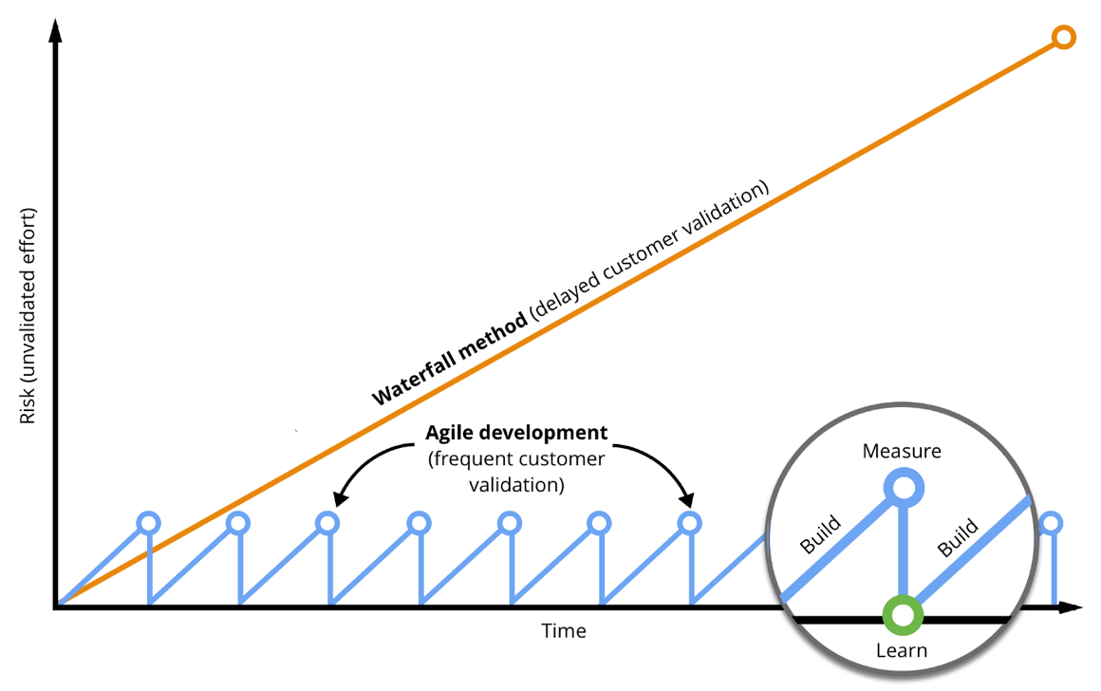
UX Benefits - Risk
Reduce risk at handoff of each cycle and to end user
Reduce Work in Progress
Graphic credit: Drew McKinney
Notes:
https://medium.com/@drewmck/lean-ux-is-about-reducing-risk-1d7d505d2881

Slide 51
Outline
Definition of UX
UX process
Benefits of UX
UX case study
Acquisition + UX
Practical tips
Summary & Conclusion
Notes:
Cradle to grave acquisition with UX
Government discovers there’s a need:
Strategic planning (What is the real problem)
Budget
Stakeholders
Value chain
Who will be end users?
Possibly acquisition strategy
Should incorporate:
- users
Industry doesn’t understand SOW
“fast” acquisition
GSA rapid acquisition
Process tends to take small businesses out of ability to compete for contracts
If you want sustainability you have to
What is the resolution of this tension…
Here is what DoD is doing here and here, i.e. ACC Orlando – interview few others,
Here is what acquisition community is doing here and here
Where do you find all these ways?
Understand where the authorities are and how to use them
How do you stack these to build a story and open other pathways

Slide 52


UX Case Studies – USS McCain
In August 2017, the U.S. Navy Destroyer John S McCain veered off course and collided with a Liberian-flagged oil tanker
The collision was the Navy's worst accident at sea in almost 40 years, both in terms of cost and loss of life
Investigators found use of the Integrated Bridge and Navigation System (IBNS) to be a major cause
Notes:
In August 2017, the U.S. Navy Destroyer John S McCain veered off course in one of the busiest global shipping lanes and collided with a Liberian-flagged oil tanker, the Alnic MC.
One of several fleet incidents during that period, the collision was the Navy’s worst accident at sea in almost four decades, with ten sailors killed, dozens more injured, and over $100 million of sustained damage to the vessel.
A National Transportation Safety Board (NTSB) examination of the root causes of the crash illuminated several errors related to a new user interface, the Integrated Bridge and Navigation System (IBNS). It led the NTSB to conclude that errors in system design contributed to the crash.
The IBNS, purchased by the Navy to reduce costs by limiting the number of sailors required to steer a ship, used touchscreen interfaces to pull together data from multiple sources in both automation-assisted and manual modes.
https://www.ntsb.gov/investigations/accidentreports/reports/mar1901.pdf

Slide 53
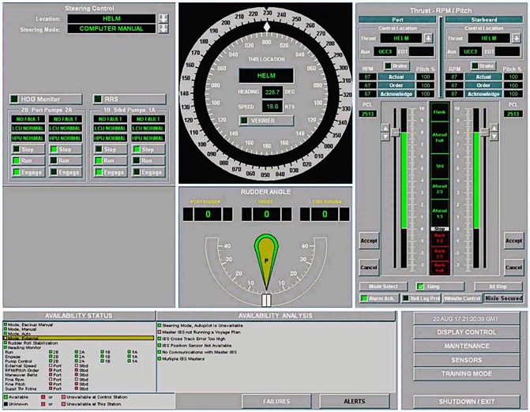
UX Case Studies – USS McCain
Many different kinds of information in single display
No clear information hierarchy
Placement of critical information in non-dominant location
Multiple typefaces
No visual difference between primary and alternate methods of control
Small font relative to real estate
Notes:
After the crash, the ensuing NTSB investigation determined that the IBNS did not conform to the industry-accepted maritime design standards outlined in Standard F1166, Standard Practice for Human Engineering Design for Marine Systems, Equipment, and Facilities approved for use by the Navy.
These standards stipulate that the design of vessels, their systems, and subsystems should place a premium on simplicity and on limiting “potential human error incidence in the operation and maintenance of the system, particularly under conditions of stress.”

Slide 54

UX Case Studies – USS McCain
Lack of faith in system reliability
Unsanctioned workarounds
Misinterpretation of system components
Policy gaps
Notes:
Instead, the IBNS design and implementation were determined to have contributed to a series of errors that led to the collision. These errors are indicative of those commonly associated with poor User Experience (UX) design. These included:
Lack of faith in system reliability – The crew reported multiple false alarms in the months leading up to the crash, reducing crew faith in the fidelity of the system.
Unsanctioned workarounds – The crew of both the John S McCain and other similar ships often used the system in unintended, non-standardized ways (e.g., putting the system in backup manual mode) to eliminate errors in automation, such as the aforementioned false alerts, or to avoid unintended actions associated with accidental screen contact.
Misinterpretation of system components – According to the NTSB, the design for the transfer of thrust between bridge stations contained a level of complexity that did not adhere to approved design principles, and the lack of mechanical throttles stripped operators of the ability to receive “both immediate and tactile feedback”. (more from the report here)
Policy gaps – The complexity of the system required extensive training to ensure user proficiency which had not been fully integrated into associated policies, and the acquisition process left end-users without a means to provide critical user feedback to decision-makers and required them to use the system, despite identified flaws.
The McCain crash underscores the risks and associated costs, including critical mission failures and even loss of life, that can be associated with a disregard for or misapplication of UX principles in the design, development, and implementation of technology.

Slide 55
UX Case Studies – USS McCain
UX process would have helped deliver software that was more delightful
Understand/relate in context
Understand the end-user and their need
Persona - Helm/lee helm very young new, tech savvy
Environment on a bridge of a ship
Get oriented
Better requirements and specification of needs
Access to training environment
Do something
Low fidelity prototypes tested with user
Usability acceptance testing vice end user testing
Observe to learn, iterate to improve
Multiple iterations and testing in environment
Pleasurable
Usable
Reliable
Functional
Notes:
What would be the strategic planning stage for the acquisition to get the optimal results in preparation for the solicitation release/award?
The first major part of this contract story is that the government did not appear to want to hear industry perspective to gain better understanding of the technology. By stating that there is no industry day planned provides a noticeable gap in the planning phases of the contract. As defined in FAR 12.202 market research is an essential part of building an effective strategy for acquisition commercial products and services. Additionally, this contract was Firm Fixed Price which means that the risk was on the contractor to perform and deliver a compliant product to the government. The statement of work on this effort would have to be well defined and explicit on the acceptance criteria and any testing the government may have needed. Without a clear statement of work the product delivered may not have met the intended need the government was requiring and the government official that signed the approval of the product did so in compliance with the contract (or at least they should have).

Slide 56
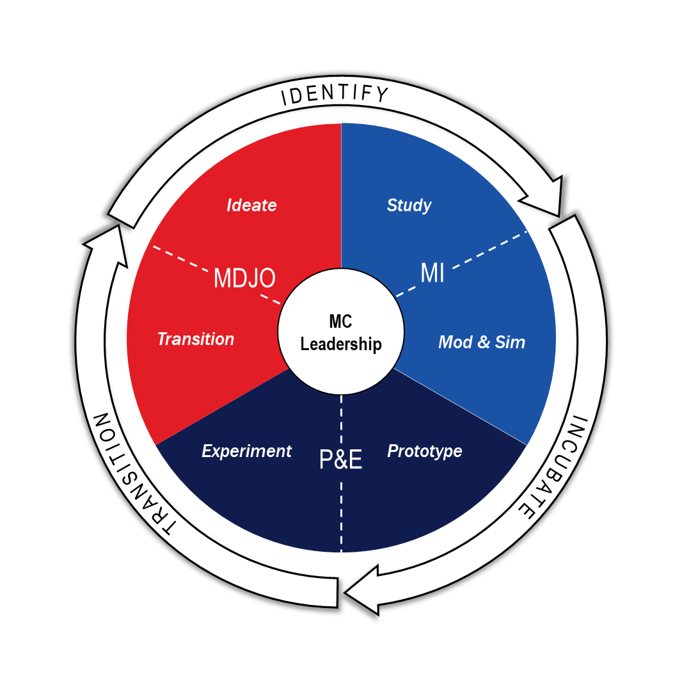
UX Case Study - OASD MC
Mission:
Deliver Joint Warfighting Concepts (JWCs) to Prototype Capabilities. Transition the Valley of Death.
Roles:
•Develop and support future warfighting concepts/integrated architectures
•Close capability gaps in support of defense modernization
•Strengthen engineering authorities and policies
•Continuous stakeholder engagement to support development and delivery of capability to the Joint force/Joint warfighter/Combatant Commanders

Slide 57
UX Case Study - OASD MC
Understand/
relate in context
Get oriented
Observe to learn, iterate to improve
Do something
Notes:
Identify: Design Working Group
Get oriented: modeling and simulation and study
Do something - Prototype
Observe to learn, iterate to improve - RDER - experiment

Slide 58
UX Case Study - OASD MC
UX process interwoven in Mission Capabilities
Understand/relate in context
Ideate with Joint Staff and CCMD’s
Design Working Group
Get oriented
Studies
Modeling and Simulation – build baselines
Do something
Rapid Defense Experimentation Reserve (RDER)
Prototypes
Industry Day
Observe to learn, iterate to improve
Testing in environment with Warfighters
Notes:
https://www.defense.gov/News/Releases/Release/Article/3397953/technology-readiness-experimentation-2023-to-showcase-cutting-edge-military-tec/

Slide 59
Outline
Definition of UX
UX process
Benefits of UX
UX case study
Acquisition + UX
Practical tips
Summary & Conclusion
Notes:
Cradle to grave acquisition with UX
Government discovers there’s a need:
Strategic planning (What is the real problem)
Budget
Stakeholders
Value chain
Who will be end users?
Possibly acquisition strategy
Should incorporate:
- users
Industry doesn’t understand SOW
“fast” acquisition
GSA rapid acquisition
Process tends to take small businesses out of ability to compete for contracts
If you want sustainability you have to
What is the resolution of this tension…
Here is what DoD is doing here and here, i.e. ACC Orlando – interview few others,
Here is what acquisition community is doing here and here
Where do you find all these ways?
Understand where the authorities are and how to use them
How do you stack these to build a story and open other pathways

Slide 60
Acquisition + UX
Combining the elements of ISO 9241 with the acquisitions process
The contract design is based upon an explicit understanding of users, tasks and environments
End-users are involved throughout design and development
The design is driven and refined by user-centered evaluation
The process is iterative
The contract addresses the whole user experience
The value system chain includes multidisciplinary skills and perspectives
Strategic planning in the acquisition process implements these principals and incorporates them in the contract writing process.
Notes:
Acquisition planning process, implementation, and execution. The principals are built into the process, just not always applied. This is where again we tie in the case studies.

Slide 61
Acquisition + UX
Requirements
Definition
Market Research/
Survey
Government Cost Estimate
Acquisition
Strategy
Solicitation
Preparation
Notes:
Most of the focus and tie it to the case studies. Also talk about who is involved…AND who should be involved.
Acquisition Planning
The Contract Lifecycle begins at the identification of the team and requirements.
The Contract Lifecycle ends with Contract Close Out.
During this stage, the government is responsible for:
Planning the acquisition
Gathering the requirements
Documenting their market research
Establishing how the goods and services will be purchased

Slide 62
Acquisition + UX
Request for Proposal
Negotiations & Discussions
Contract Award
Proposal Evaluation
Contract Management
Contract Closeout
Notes:
Show how the planning process fit into here and how it is iterative.
The Solicitation
The government has published the solicitation to gather inputs from industry
Industry finds the published requirements to respond to the government
*Note: The solicitation should include the Performance Work Statement (PWS), the response requirements (Section L), and the evaluation criteria (Section M).
Helpful hint: The government will use the solicitation as the contract upon award. The only changes are removal of Section L, M, & K.
again iterative process and based on the “Design” of the contract it determines what you can alter and adjust along the way.
Contract Award
The contract has been awarded based on the evaluation criteria to a company.
The government will provide briefs (generally this is when protests can occur).
If no protests, the contract award is made when both parties sign the agreement and performance begins upon signature.
You should not start work without either a signed contract OR authorization to proceed from the government.

Slide 63
Outline
Definition of UX
UX process
Benefits of UX
UX case study
Acquisition + UX
Practical tips
Summary & Conclusion

Slide 64
Practical Tips
Everything is designed and therefore designable
Put the lowest fidelity prototype in front of a user and ask for feedback
Mindset and culture shift – 1% change makes a big difference over time
Talk to a end user of what you are working on
Incorporate your stakeholders and value chain in the planning process
Manage risk by incrementing the larger effort

Slide 65
Practical Tips - UX Specialties
The acquisition process must combine the requirements of ISO 9241 and UX principles, especially in the strategic planning stages.
Remember, the strategic planning is at the beginning of the acquisition process and decisions made or missed during this stage will impact contract performance.
Understand the value chain involved in the contract execution, especially the end user but also the contract managers and program manager on both the government and industry side.
Testing the approach can take several forms but will especially focus on market research.
Notes:
Acquisition planning process, implementation, and execution. The principals are built into the process, just not always applied. This is where again we tie in the case studies.

Slide 66
Outline
Prelude for UX
Definition of UX
UX process
Benefits of UX
UX case study
Acquisition + UX
Practical tips
Summary & Conclusion
Notes:
Cradle to grave acquisition with UX
Government discovers there’s a need:
Strategic planning (What is the real problem)
Budget
Stakeholders
Value chain
Who will be end users?
Possibly acquisition strategy
Should incorporate:
- users
Industry doesn’t understand SOW
“fast” acquisition
GSA rapid acquisition
Process tends to take small businesses out of ability to compete for contracts
If you want sustainability you have to
What is the resolution of this tension…
Here is what DoD is doing here and here, i.e. ACC Orlando – interview few others,
Here is what acquisition community is doing here and here
Where do you find all these ways?
Understand where the authorities are and how to use them
How do you stack these to build a story and open other pathways

Slide 67
Summary
Define core principles of User Experience (UX) and human-centered design.
Describe key UX methods and list the correct place for UX activities within the overall structure of a project.
List the benefits of a user-centered research and development approach to producing and evaluating learning, training, and simulation products.
Understand Federal acquisition authorities and strategic planning process as it applies to programs and projects.

Slide 68
Conclusion
User experience (UX) encompasses all aspects of the end-user's interaction with the company, its services, and its products
UX process
Understand/relate in context
Get oriented
Do something
Observe to learn, iterate to improve
UX results in better outcomes for the end user and the business
Focus on UX in the government of renewed interest
Getting started with UX is as simple as watching and listening to users
Notes:
add something acq

Slide 69
Q&A
Any questions?
Amanda Hawkins
Amanda.a.hawkins.civ@mail.mil
Dolores Kuchina-Musina
dkuchinamusina@rexota.com
Vel Preston
Vel.Preston@afacademy.af.edu

Slide 70
Recommended Resources
Watch:
It’s not you. Bad doors are everywhere. https://www.youtube.com/watch?v=yY96hTb8WgI
This is Broken! https://medium.com/10x-curiosity/don-norman-and-the-design-of-everyday-things-d187e6a81fd8
Read:
https://www.whitehouse.gov/briefing-room/presidential-actions/2021/12/13/executive-order-on-transforming-federal-customer-experience-and-service-delivery-to-rebuild-trust-in-government/
Listen:
https://userguiding.com/blog/ux-podcasts/
Notes:
Top 5

Slide 71
Resource List
ISO standards: https://www.iso.org/standard/63500.html
Usable vs delightful: https://www.nngroup.com/articles/theory-user-delight/
UX trinity: https://www.trinityaudio.ai/what-is-user-experience-the-what-why-and-how
Mr. Colt Whittall, CXO of the USAF: https://www.youtube.com/watch?v=gaX5drlGpyQ
https://dschool.stanford.edu/resources/getting-started-with-design-thinking
https://phyliciaflynn.medium.com/using-the-double-diamond-to-redesign-my-ux-portfolio-4905627fa1ff
https://www.nngroup.com/articles/design-thinking/
https://heartofthecustomer.com/wp-content/uploads/2016/05/HOC-Meridan-Health-Case-Study.pdf
https://www.usability.gov/what-and-why/benefits-of-ucd.html
https://www.ibm.com/downloads/cas/Z4WBDR8Q#:~:text=Forrester%20concluded%20that%20IBM's%20Design,and%20an%20ROI%20of%20301%25.&text=IBM's%20Design%20Thinking%20practice%20cut%20costs%20by%20accelerating%20projects
https://medium.com/@drewmck/lean-ux-is-about-reducing-risk-1d7d505d2881
https://uxplanet.org/the-evolution-of-ux-process-methodology-47f52557178b
Notes:
Top 5

Slide 72
Resource List
https://agilemanifesto.org/
https://www.oreilly.com/library/view/designing-for-product/9781491971451/ch05.html
https://www.gv.com/sprint/
https://aktiasolutions.com/dual-track-agile/
https://www.investopedia.com/terms/s/six-sigma.asp
https://www.acqnotes.com/Attachments/DoD%20Total%20Quality%20Management%20Master%20Plan%20-%201998.pdf
https://sjms.nu/articles/10.31374/sjms.124
https://www.whitehouse.gov/briefing-room/presidential-actions/2021/12/13/executive-order-on-transforming-federal-customer-experience-and-service-delivery-to-rebuild-trust-in-government/
https://www.ntsb.gov/investigations/accidentreports/reports/mar1901.pdf
https://www.nngroup.com/articles/ux-maturity-model/
https://uxdesign.cc/understanding-ux-roles-23032b94710d
https://cyberworx-state-of-ux.netlify.app/cyberworx_state_of_ux_report.nb (password: DataSocietyCyberWorx2021!)

