Slide 1
Implementation Strategies for Creating a Sustainable xAPI Data Strategy – 23T54
Florian Tolk
Software Engineer
ADL Initiative
SETA Contractor, SimIS, Inc.
Elizabeth Bradley
Creative Director
Liz Bradley Art & Design

Slide 2
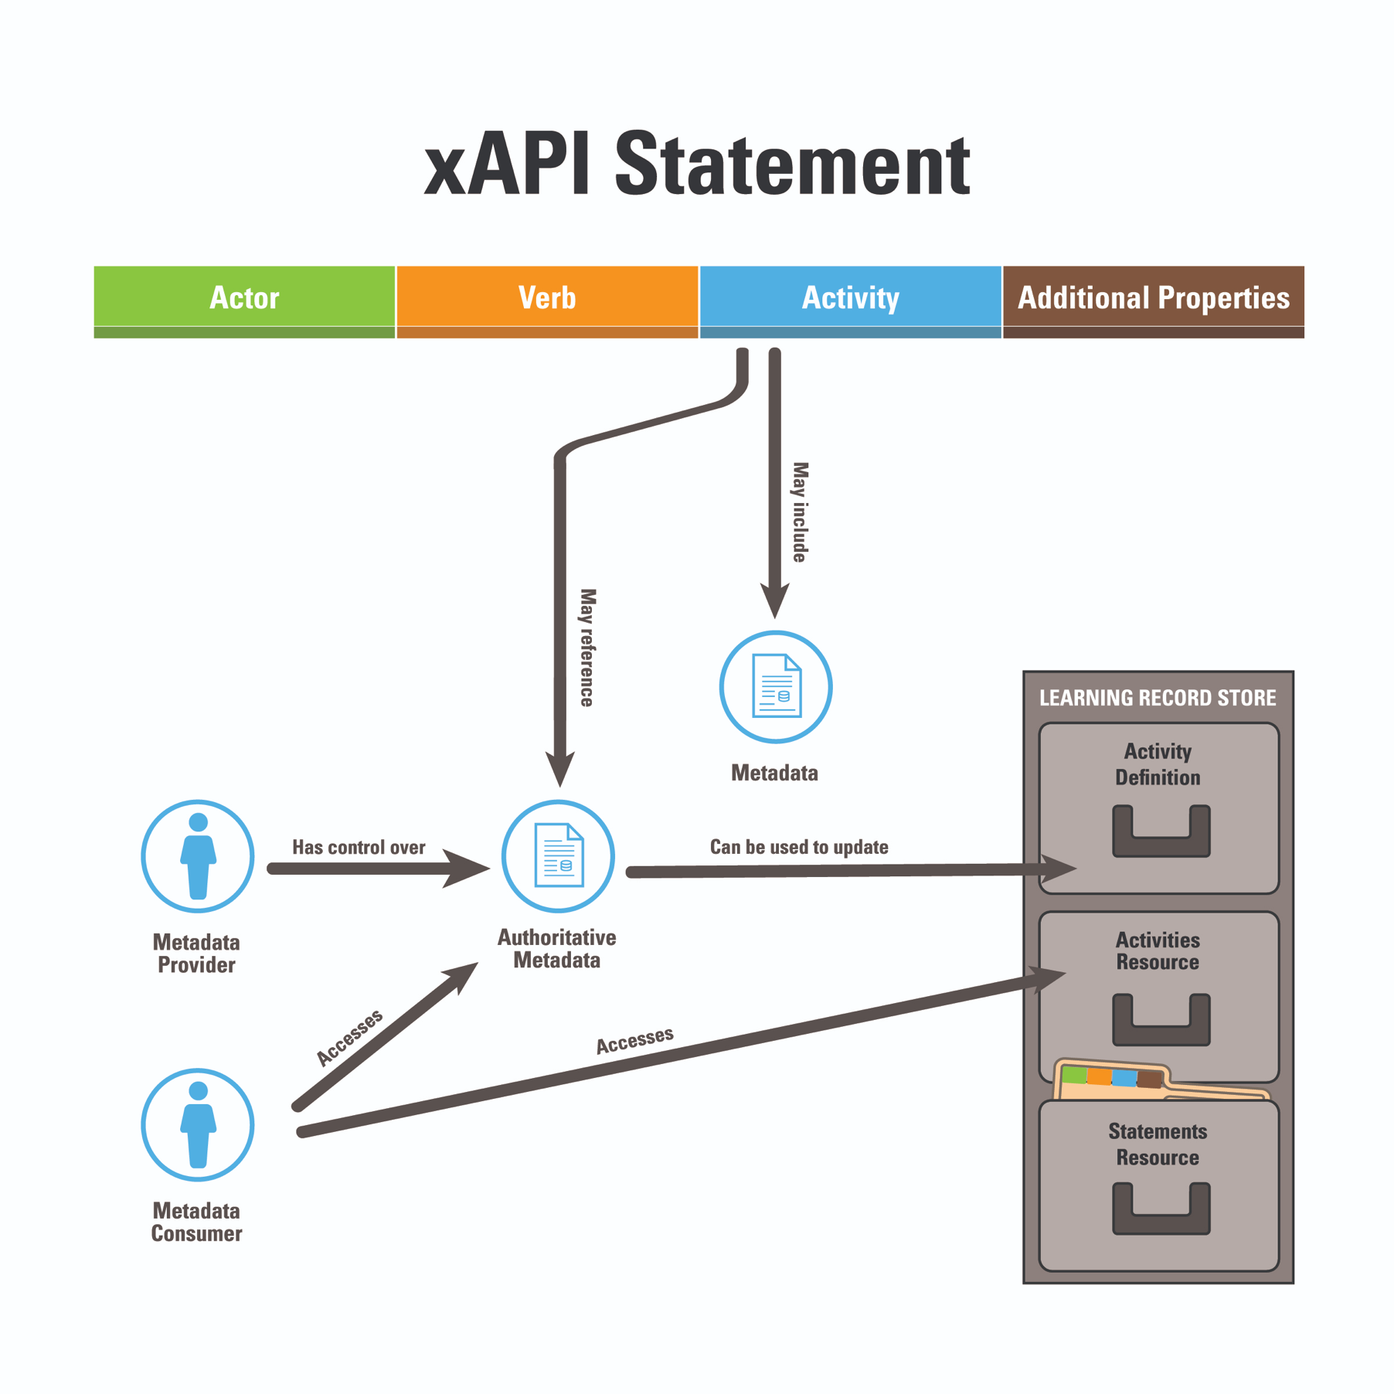
Introduction
Summary of xAPI:
A tool to track digital/nondigital performance
Activity
IEEE xAPI supported in DoD policy (p9274.1.1)
Metadata
Adoption: government, academia, & industry
Metadata Provider
Authoritative Metadata
Semantic integrity is kept across linked data
Notes:
This slide is a very short summary of where xAPI is now A tool to track human performance in any experience This is an office IEEE published standard, so it can be used in DoD Contracts
*Add in adoption bullet on screen It can be tied to linked data to create globally resolvable information without changing local taxonomies

Slide 3

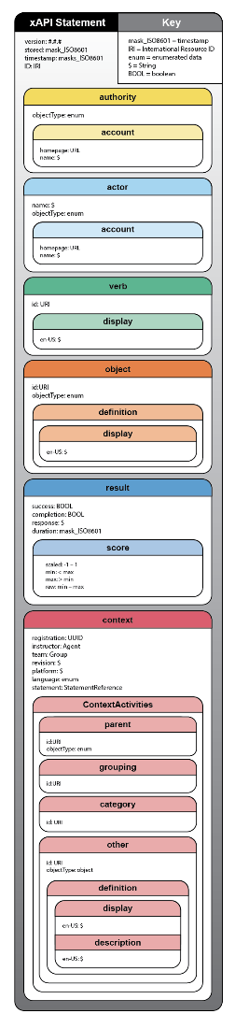
Tutorial Approach
This tutorial uses graphics using US Space Force Guardians, for the storyline of xAPI use
The tutorial is constructed to build a real data strategy using xAPI (Questions are welcome at any time!)
Each slide will include a learning objective indicator or (next slide)
1
2
Notes:
This tutorial includes a fictional narrative about capturing training data for future US Space Force Guardians, and how xAPI would be used in these situations
A large amount of detail is included in the structure of xAPI statements; then we explore how to longitudinally make sense of that data via xAPI Profiles.
The tutorial team will work to make everything relatable to building a real data strategy for leveraging xAPI – questions are welcome at any time!
Each will include a learning objective indicator 1 or 2 so you know what is being covered in the tutorial.

Slide 4
Learning Objectives Regarding xAPI
1
2
Describe the qualities of xAPI and xAPI profiles and create a data strategy
Form a comprehensive xAPI composition for experiential contexts
Notes:
These are the 2 learning objectives for this tutorial, you will see which objective is being spoken about on the top right hand corner of each slide.
Dumb it down: part 1 is how to use it and part 2 is how to build it.

Slide 5


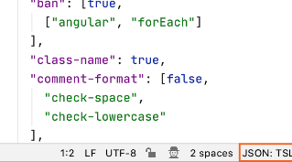


xAPI Specification
1
2
IEEE standard p9274.1.1 (Enables contract standardization)
xAPI statements formed using JavaScript Object Notation (JSON) (Both human and machine-readable data)
xAPI enables tracking both formal and informal learning (Supports metrics instrumentation)
Department of Defense (DoD) Instruction 1322.26 promotes the sharing of performance data across the DoD by use of xAPI (Industry momentum is building around xAPI adoption)
Notes:
IEEE spec that that can be used in contracts JSON is a common data format used across industry and government. While xAPI can encode data about formal learning experiences, it also can support informal learning, such as on-the-job training or self-directed learning in work environments. Department of Defense (DoD) Instruction 1322.26 recommends xAPI as the primary method for encoding and exchanging interoperable learner performance data across the DoD enterprise. (You can budget for it.)

Slide 6
Tutorial Scenario
The overarching learning objective is to teach students how to fight in a weightless exercise to develop the ability to attack and secure a space station.
Throughout this tutorial, use of the xAPI standard will be described to track the learning experience.
This is a purely fictional scenario with the same level of complexity as a modern real-world training experience.
Notes:
Slides 6-13 are a fun “scenario” loosely based off “Ender’s Game” that we use to explain how xAPI can be used in real life by the space force. 2 teams enter a 0 gravity arena, and can win in one of two ways. 1 – capture the enemy base 2 – take out the enemy team

Slide 7




Tutorial Scenario – How to Win

Slide 8


The Narrative – How to Win

Slide 9

The Narrative – How to Win

Slide 10
The Narrative – How to Win

Slide 11

The Narrative – How to Win

Slide 12


The Narrative – How to Win

Slide 13
The Narrative – How to Win

Slide 14



Multi-Model Data Collection
1
2
xAPI can capture data from all of these experiences!
Classroom/Self-Study
Simulation
CBT
The Live Arena
Notes:
It does not matter how the game is played, with xAPI you can track the learners’ performance Classroom and self study is just teacher’s input, and the logs any xAPI enabled products (Like an LMS that generates xAPI)
Simulation can natively be built to track learner performance in xAPI eBooks and Videos can also be enabled to produce xAPI, and even have profiles already built out (More on xAPI profiles to follow) CBT = Computer based Training
The arena gives us our most exciting chance to use xAPI, as while in the arena you can log not only actions such as firing your rifle, but also biometric data! The army has actually used biometrics and sensors to track learner performance with the STEEL-R project for anyone interested in using xAPI for in the field exercises More details can be seen in slide backup Slides section

Slide 15
Tutorial Key Terms
1
2
JSON - JavaScript Object Notation
Human and machine-readable way to store data
URI - Uniform Resource Identifier
A string of ASCII characters to uniquely identify something
IRI - Internationalized Resource Identifier
Builds on URI to include International characters
Inverse Identifier
A Unique Identifier an agent or group
Notes:
JSON is a way to store data in such a way that both a human and a Computer can parse the information All URLs are URIs, but not all URLs are URIs URI is built by a Scheme Name (like the https of a URL), followed by a colon, and a scheme specific string
For many web-based applications, the intention of a URI/IRI to be resolvable (but do not need to), even though we don't distinguish from URL/IRL directly
IRI’s extend what a URI can do use for descriptors, and it’s not limited to ASCII characters

Slide 16
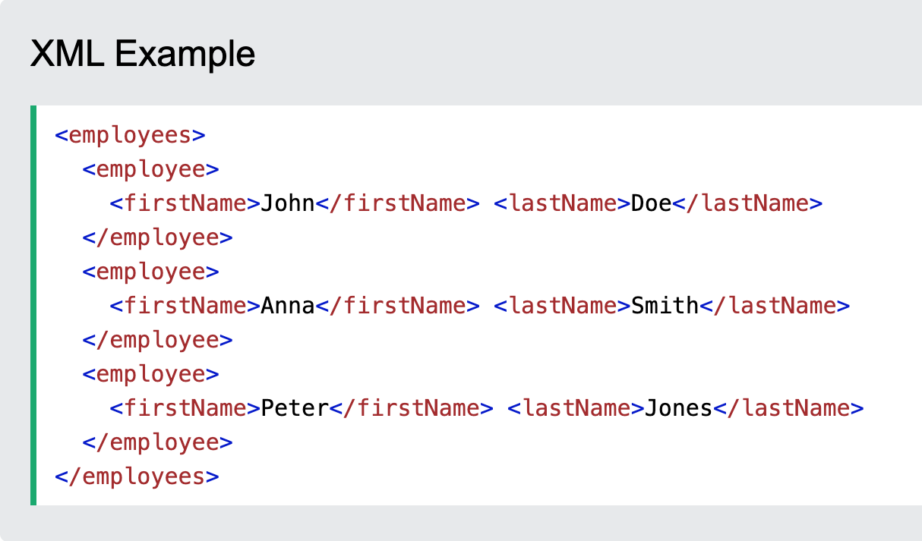
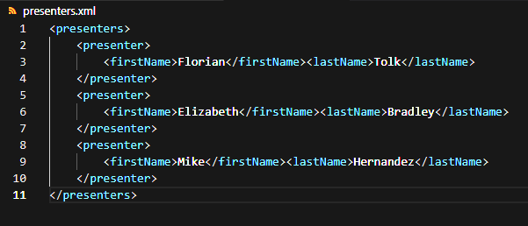

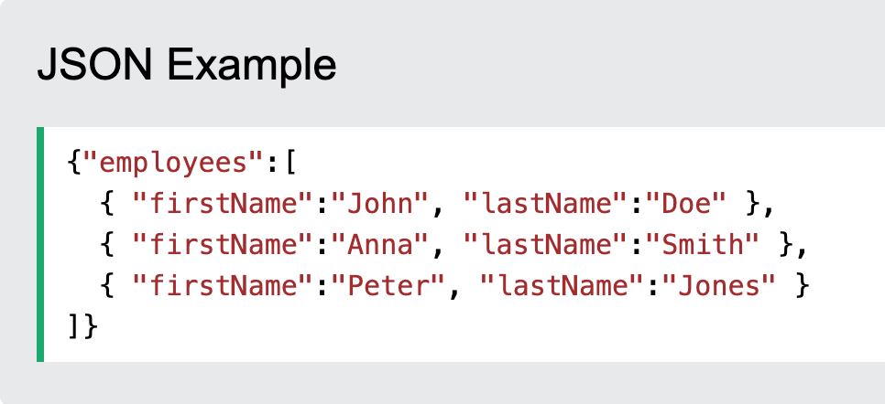
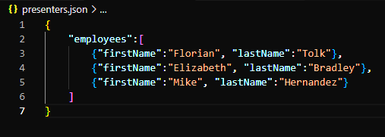
JSON is Easier to Use
1
2
vs
Notes:
This slide is to answer a question asked by one of my previous audience members, where we compare JSON to another very popular data standard: XML. This is to explain why JSON was used. (May also bring up other standards like JSON-LD)
XML and JSON are two very powerful tools, and attempt to solve the same problem: create a human and machine-readable dataset. XML is certainly a very powerful tool, but JSON has a lower barrier to entry, and the defacto spec for communication between systems via APIs.
JSON is sufficient to meet the needs of xAPI

Slide 17




What is a Learning Record Store (LRS)?
1
2
Sent to an LRS:
ONLY accepts xAPI statements
LRS
Requires secure requests
Limits allowed data modification
FIREWALL
IEEE Standard CONFORMANCE
xAPI Statements
Course
Biometrics
Game
Simulation
Notes:
This explains the “broad strokes” rules of the xAPI spec, primarily what an LRS is on xAPI (It is the database that stores the data, and has a long list of rules to keep it secure and reliable)
Broad strokes is xAPI is JSON = Extra rules, one of these is that data belongs in a Learning Record Store
These rules will be the primary portion of this tutorial LRS is a database (Or a wrapper around a database) with strict restrictions on how data can be treated For example, once a statement is stored in an LRS it may not be modified or removed

Slide 18


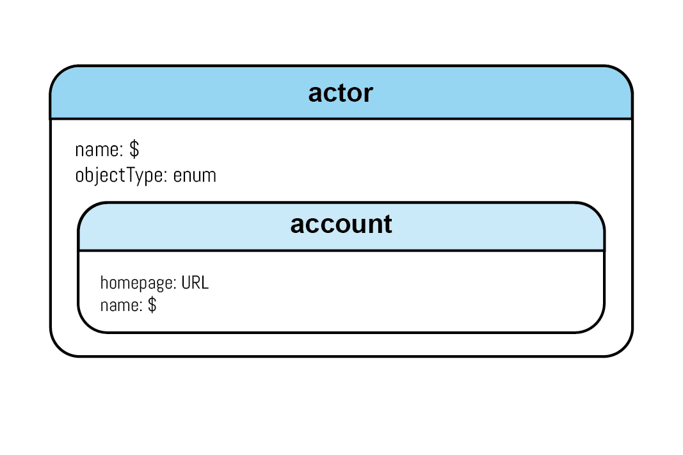
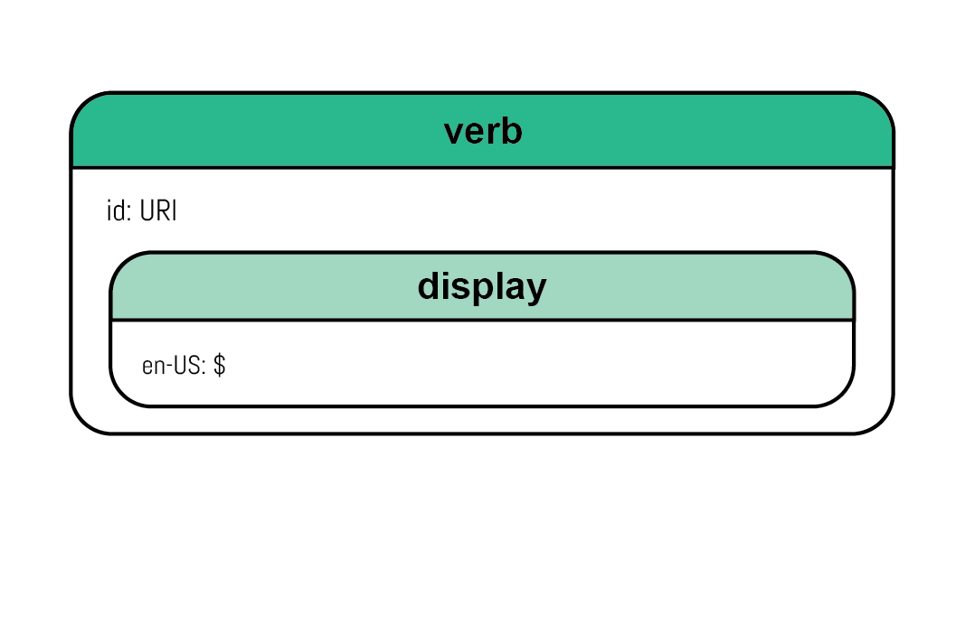
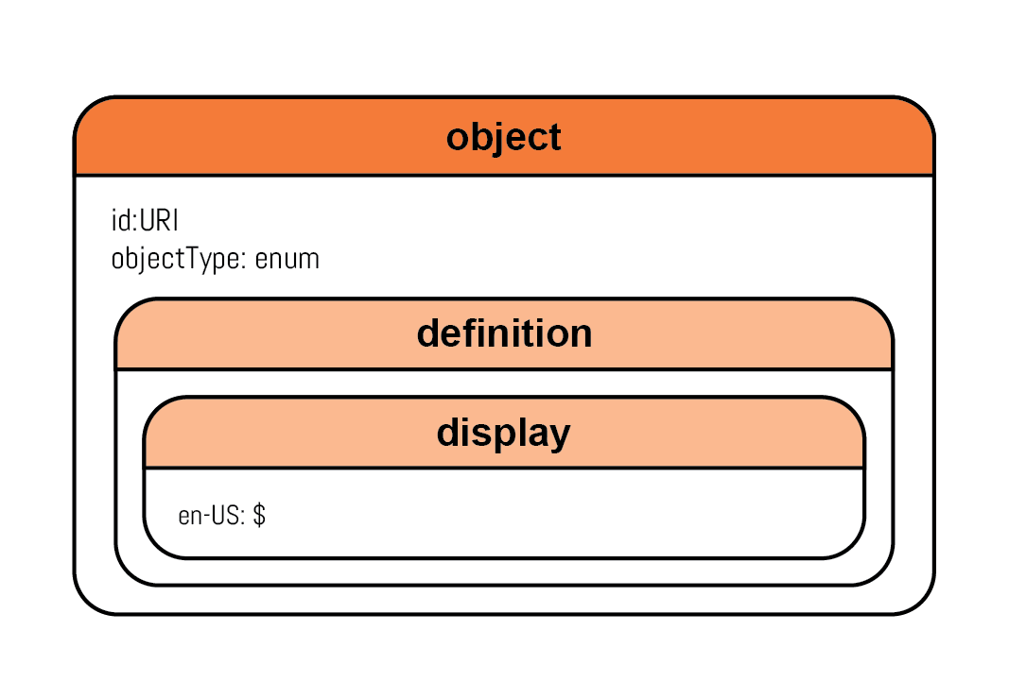
What is a Minimal xAPI Statement?
1
2
Notes:
In this slide, we cover the highest point of view regarding what an xAPI statement consists of. Actor – a person or other entity that did something Verb – an action performed by the actor Object – A person or other entity that had an action performed on them Example: The learner kicked the ball (The rest of the examples will be Ender’s game related, but we wanted to start people of easy)

Slide 19
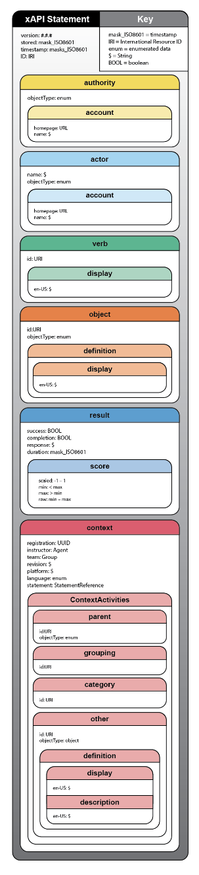

Full Statement
1
2
Notes:
The following slides zoom in on the content here, you can also see the companion document to see this full image in more detail. (QR Code will direct to a free download of the companion document)

Slide 20
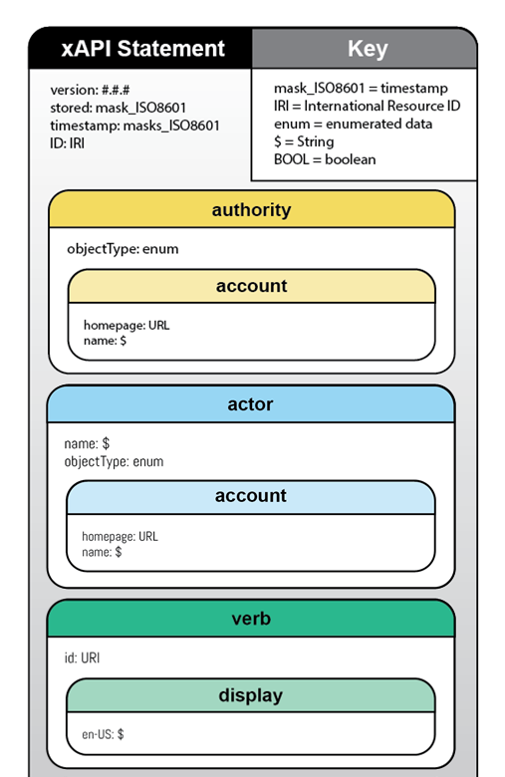
Full Statement
1
2

Slide 21
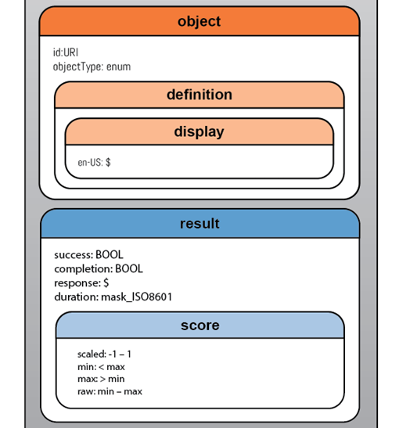
Full Statement
1
2

Slide 22
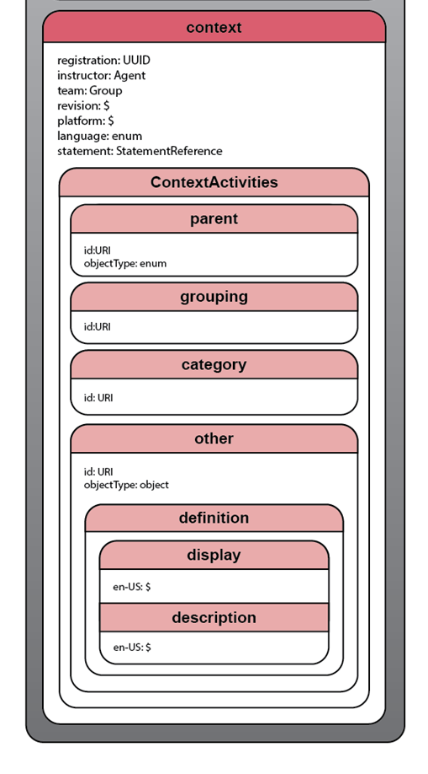
Full Statement
1
2

Slide 23
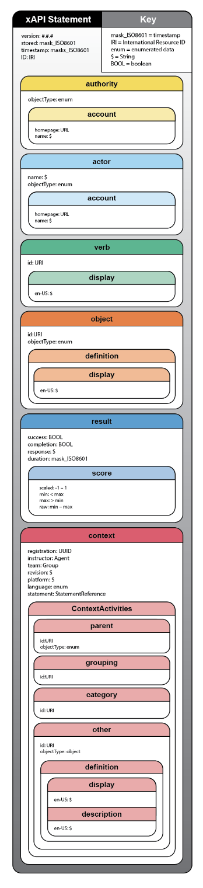
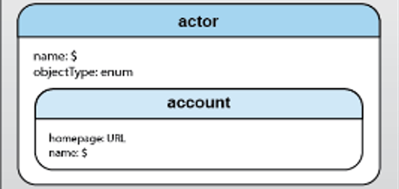
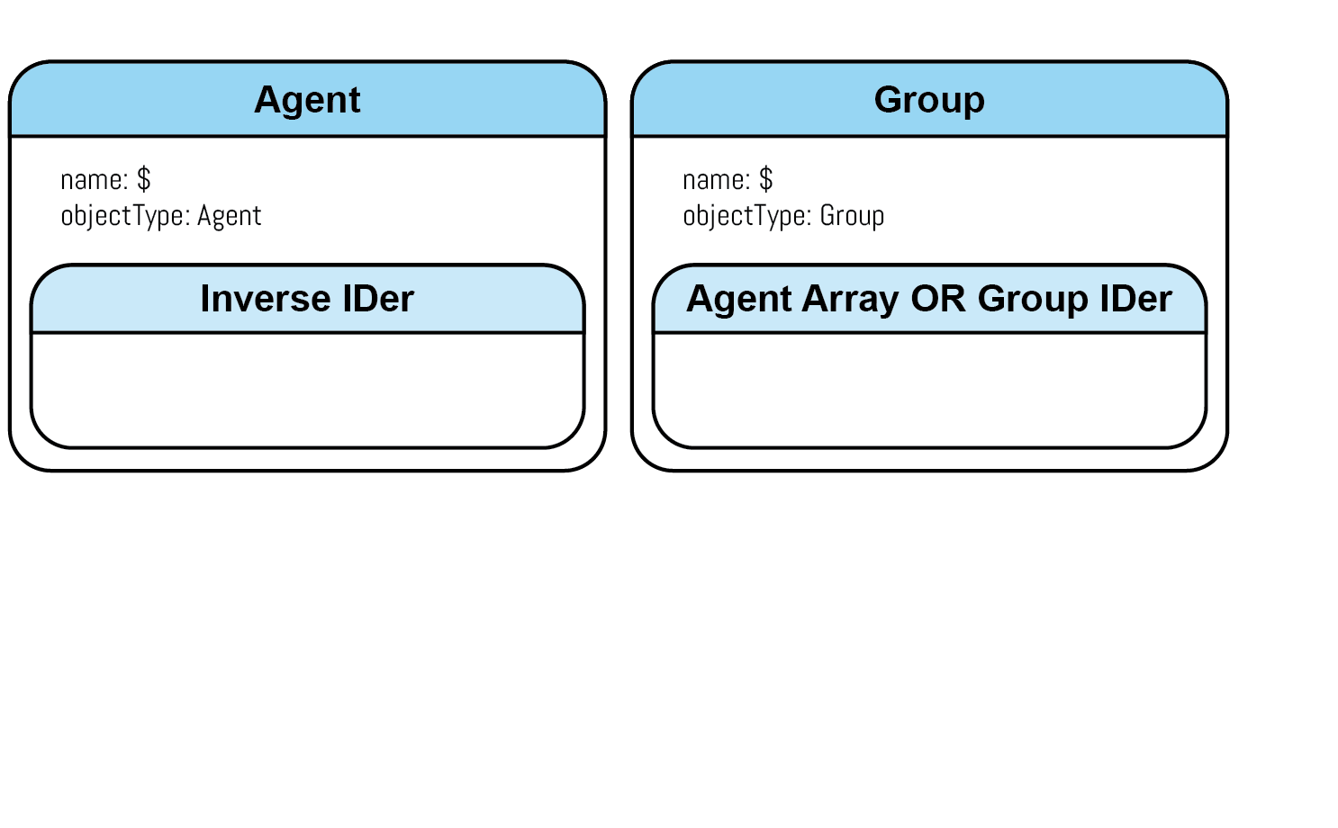
What is an xAPI actor?
1
2
Entity performing an action
“MIKE entered the arena.”
Notes:
Slides 23- 30, we look at each property of an xAPI statement, how they are formed, and what information they hold. 23-24 do not have the full graphic next to them because of the limited screen space. Actor: This is the entity that performed and action. Can be a single entity, or a group, and can be defined in a number of ways.
Actor must always include a name and an objectType but can choose between an account or another inverse identifier, which is a unique code that can be used to “look up” additional information about who or what is being identified.
Additionally, and actor can be a single entity, or a collection (group) of entities, like a team. Example: Mike entered the arena

Slide 24
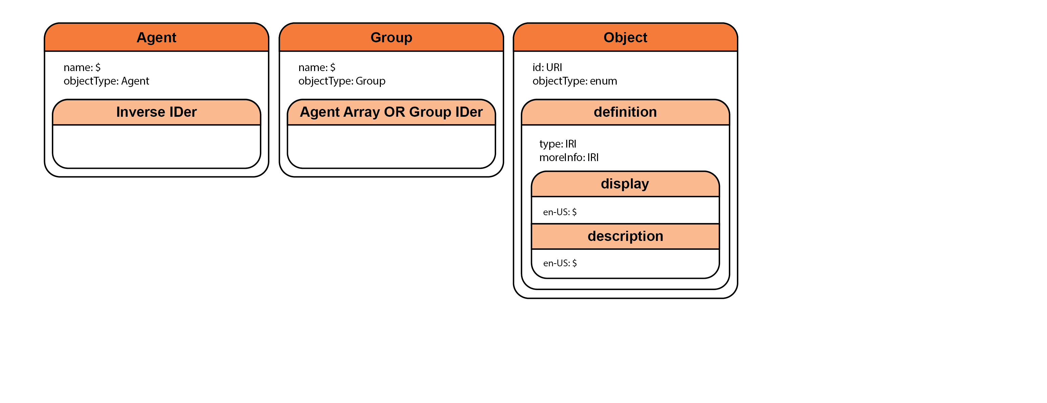
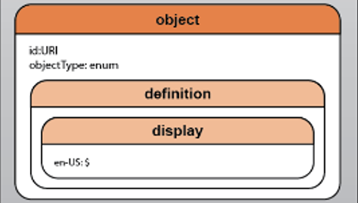
What can an object’s objectType be?
1
2
Entity being acted upon
“Mike entered the ARENA.”
Notes:
Object: This is the entity that is acted upon, can be a single actor, a group of actors or another entity
Note that when the object is of the object type, it cannot use a reverse identifier to add information, but instead uses an optional definition.
This is because the object ID should be able to act as a reverse Identifier. EX: Mike entered the arena

Slide 25
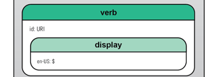
What is a verb?
1
2
The event that happened
“Mike ENTERED the arena.”
Notes:
Verb: the action being taken Example: Mike entered the arena Note how both object and verb properties have a display property. This is a language map array, to allow statements to quickly be translated into different languages
Once we reach this slide, everyone should have a 100-level view of the 3 most used properties, but this also where the most important part of the tutorial begins.

Slide 26
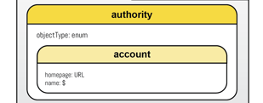
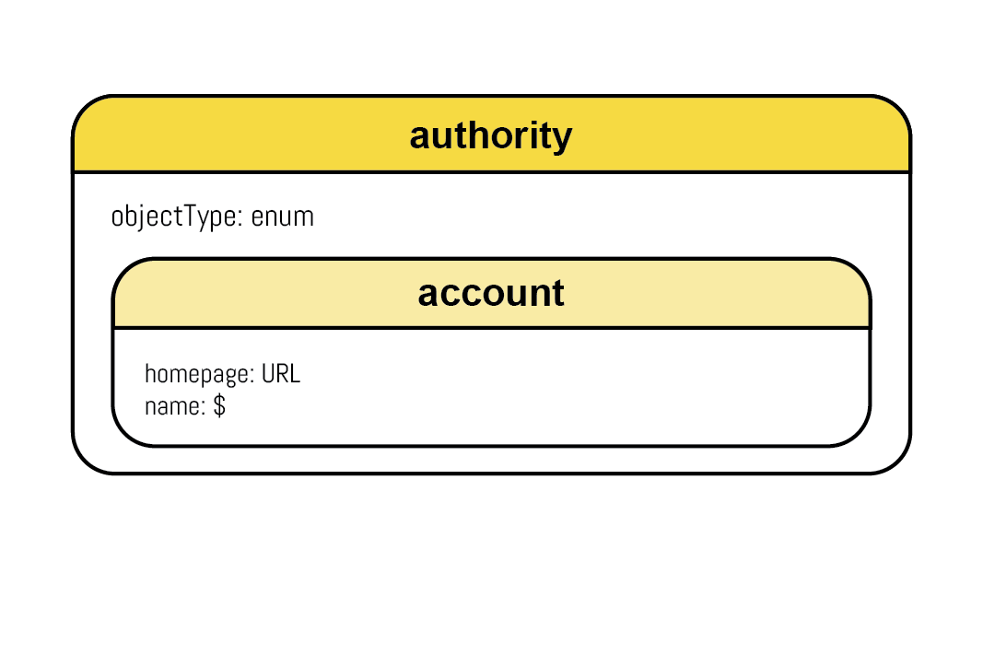

What is an authority property?
1
2
The entity (can be a system) that is reporting
Can be overridden by the LRS
FLORIAN is saying...
Mike entered the arena.
Notes:
This slide we begin to go past the “actor, verb, object” view everyone knows. Authority MUST be an Agent, except in 3-legged OAuth, where it MUST be a Group with two Agents. The two Agents represent an application and user together.
The authority is the entity that is reporting the xAPI statement, and it is the only property an LRS is allowed to change/populate
This means when planning a data strategy, the authority property may not be the best place to track the authority behind the event, as it may change
If no Authority is provided, and LRS must create one
Most LRSs that change this property, do it based on the credentials provided when the statement is sent to the LRS.

Slide 27
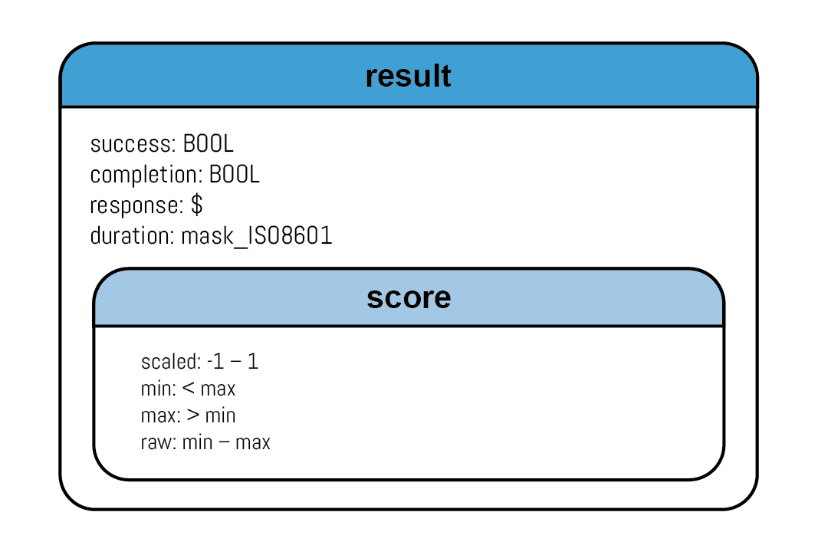
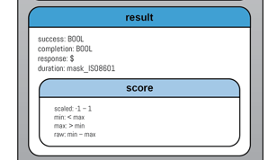
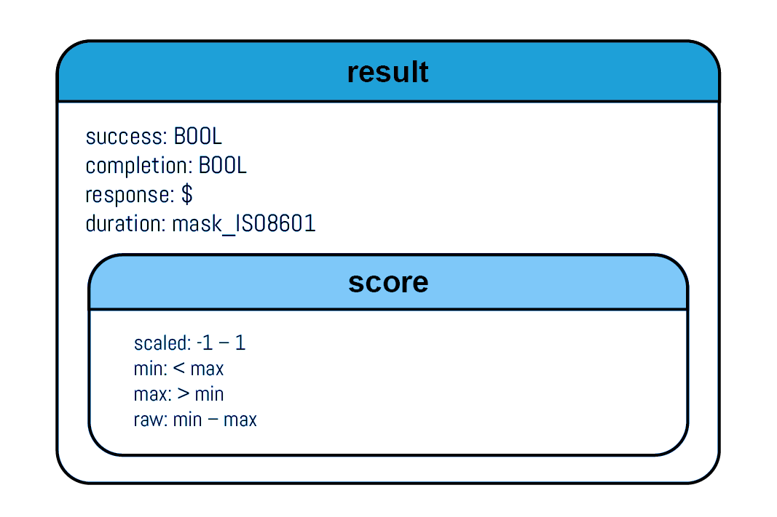
What is a result property?
1
2
The outcome of the event
Simulation Results
How long the event took
Mission Success: True Task Completed: True Unit Response: null
Duration: 00:48:00
Score:
Scaled: 0.95
Min: 0
Max: 100
Raw: 95
Notes:
This part is optional, it should be included because future data analysts will find a large amount of value in this data This is marked as optional, because not all situations would have a result! For example: “Mike Entered the arena” However, Mike Completed Match 10 should 100% have this additional data
It is important to track what statements will and won’t have specific optional portion (link to profiles)

Slide 28
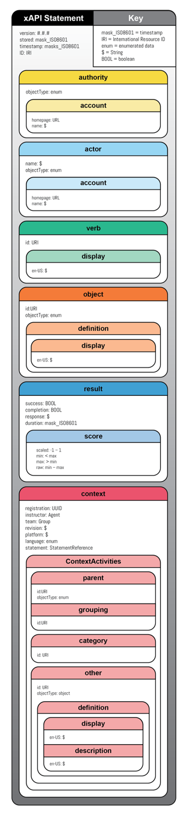
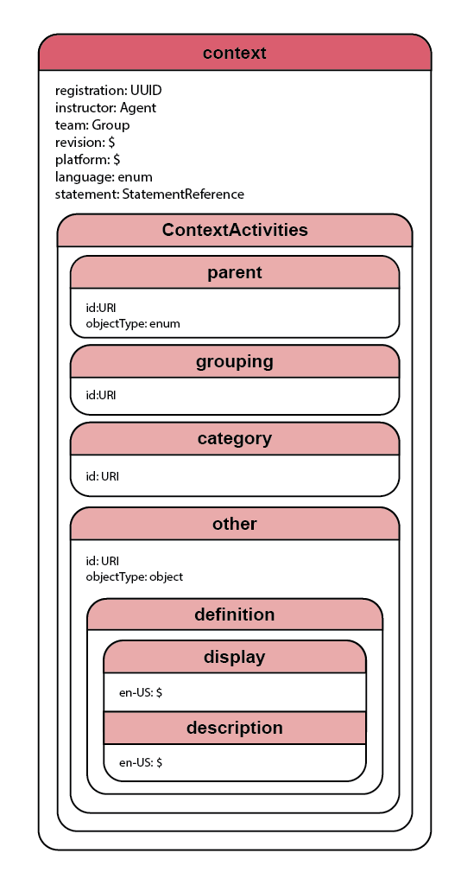









What is a context property?
1
2
Notes:
This will usually be the biggest part of the xAPI statement. It includes all the related events of a statement.
Registration: was this part of a specific planned sequence of events? If so you need to use a UUID, an 36 alphanumeric character string that is unique to this series of events.
Instructor: The person who is running the exercise. This is an agent object or a group object, like the actor of a statement
Team: This is a group object, identifiable using an array or an inverse Identifier. The group of actors that the actor was in at the time of this statement. Like the team you are on during the game.
This is a freeform string, but is the revision of the activity you did. For example, if there are multiple rulesets to the game, you could be playing a 3v3 or a 5v5 revision of the game
Platform: another freeform string. This lets us know if you are in space doing the actual simulation, on earth using VR, or Using a computer
The language used for this activity. Did you only English during this scenario, or were you asked to only speak French during the game?
Statement is just a chance to reference another statement. This can be just the id of the statement being referenced, or an entire second xAPI statement embedded in this xAPI statement. The intention of this property was once again left vague on purpose, to allow the folks who are building the data strategy to narrow down the use to what they need it for.
Context activities: These have intentionally be made somewhat vague, to allow for multiple use cases. This means it lies on the folks making the data plan to further narrow how they will be used - Parent is the activity that caused you to do this. In our game, if you capture a base, the game would be the parent activity. If you perform a penalty kick, the game is the parent activity.
- Grouping is an activity that is indirectly related. If you capture a base, the game is the parent, and the tournament is a grouping activity.
- A different session of the game that this specific team was in, could also be a grouping activity due to similar skill levels or another reason.
- Really grouping needs to be defined by the folks who are creating the data plan. - Category activity can be viewed as a "Tag" it should be used to indicate an xAPI profile. (A definition of your data plan)
- Other is any context activity that does not match the three activities above

Slide 29



What are attachments?
1
2
Can be used to sign the statement
Add videos, documents, etc.
Attachments
PDF
MP4
Signature
Notes:
Additionally, in context you can also attach files if necessary. This means, for example, that you could attach a recording of a session to the final statement, or add the actual student submission to the statement. The most interesting use though is the ability to digitally sign an xAPI statement. This has 2 important uses: - Allows for greater confidence in data with a verifiable signature - Lets you know who originally sent the statement, even if the authority property is overridden

Slide 30
What are extensions?
2
1
2
More benefit with an xAPI Profile
Use only when no native xAPI property exists
Notes:
If you have data that you want to track that does not have a place? These three properties can be extended. This allows you to define an additional property for them to hold that would normally not fit. For example in result, success is not the same as victory, and you may want to define victory as a result extension. If using extensions, it is best to clearly define the new properties you are using to extend. This is done via profiles, and we will get back to that later.
Start the message w use profiles. Mention how it will annoy your data scientist if you don’t
If there is time, pause for questions

Slide 31
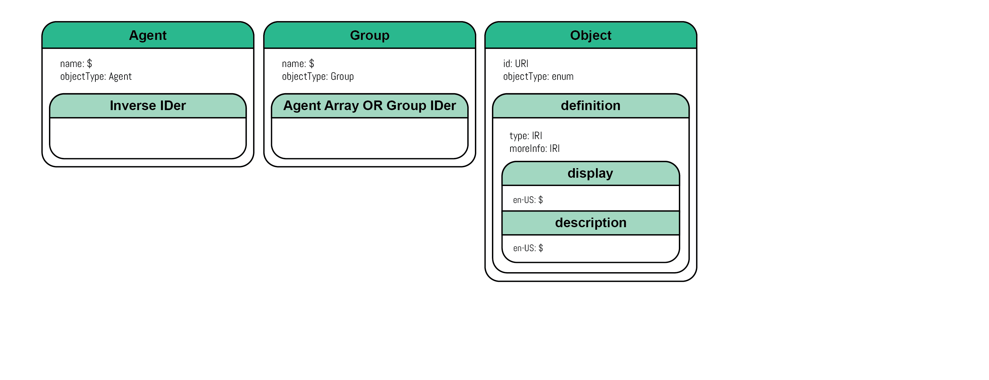

Linked Data – Identity
1
2
account
Student 24601’s marksmanship while in the arena is above average!
24601’s info.
Who is student 24601?
FIREWALL
I don’t know, go ask Mike
Hey Mike! Who is student 24601?
Student 24601 is Liz. She is in her last year at Station 1138...
Notes:
Linked data in respect to xAPI is primarily used for 2 main purposes: Identification and Vocabulary. This slide goes over the benefits of reverse identifiers, first mentioned when we bring up slide 24.
The main draw is that you can have users be anonymous in one system, while the authorized users can map info back to agents they are allowed to track.
This allows us to track our data about an individual, and if somehow this data leaks out, no PII is lost!
Linked data is an indirect reference

Slide 32









Linked Data – The Basics
1
2
Meaning is the same
Local Taxonomy
(Think local dialect)
Common Taxonomy
(Think Webster's Dictionary)
Auto / Wagon
Car
Lunar Rover
Saloon
International Definition
“Automobile”
Notes:
This explains the 2nd half of linked data, being able to create a dictionary that allows multiple groups to use the same statements, despite having their own controlled vocabulary Different languages use different words to mean the same thing. This can even be true between different branches of the military. However, we all mean the same thing.
This can be solved using xAPI profiles, schemas, and language maps. We will be discussing schemas and profiles.
With both, we assign a machine-readable unique ID, ideally a resolvable IRI, and then all the different terms to can be found alongside this definition. In a schema this is just a server, in a profile this is in a document that may be hosted on a server.

Slide 33
What is an xAPI Profile?
1
2
Why xAPI Profiles?
Tie context and linked data together
Reusability
A Profile empowers designers and developers to establish a controlled, domain-specific vocabulary and determine what data should be captured/stored and reported on. In other words, a profile really is the blueprint for a successful, semantically interoperable xAPI implementation.
Offer a common way to express controlled vocabularies.
Provide instruction on xAPI Statement formation.
Describe patterns of xAPI Statements, which are meaningful in some way to a Profile.
A Profile includes a variety of metadata, both natural language text for humans to understand the Profile, and structured data about versions and who created it.
Notes:
Why xAPI Profiles? - Establishes a controlled vocabulary for a project - Part of a good data plan
- Promotes interoperability with other projects
- Defines expected data flow (helps show when something is wrong by incorrect event order)
Reusability - A defined data plan allows similar learning content to “recycle” the data plan - Full of predefined metadata
- written in such a way that a machine can use it, and a human can parse it

Slide 34
What is an xAPI Profile?
1
2
Notes:
Linked Data, Context and Profiles
When using an xAPI Profile (which is strongly recommended) that is listed in the category context activity. All xAPI profiles have an id, which is an IRI. This should be the ID of the of the category context activity.
With this information, data scientists can then map all properties of the xAPI statement, such as verbs, extensions, and objectTypes, as to the definitions within the profile.
If the profile includes multiple languages, systems can translate how these statements are displayed depending on the data auditor’s language preferences

Slide 35
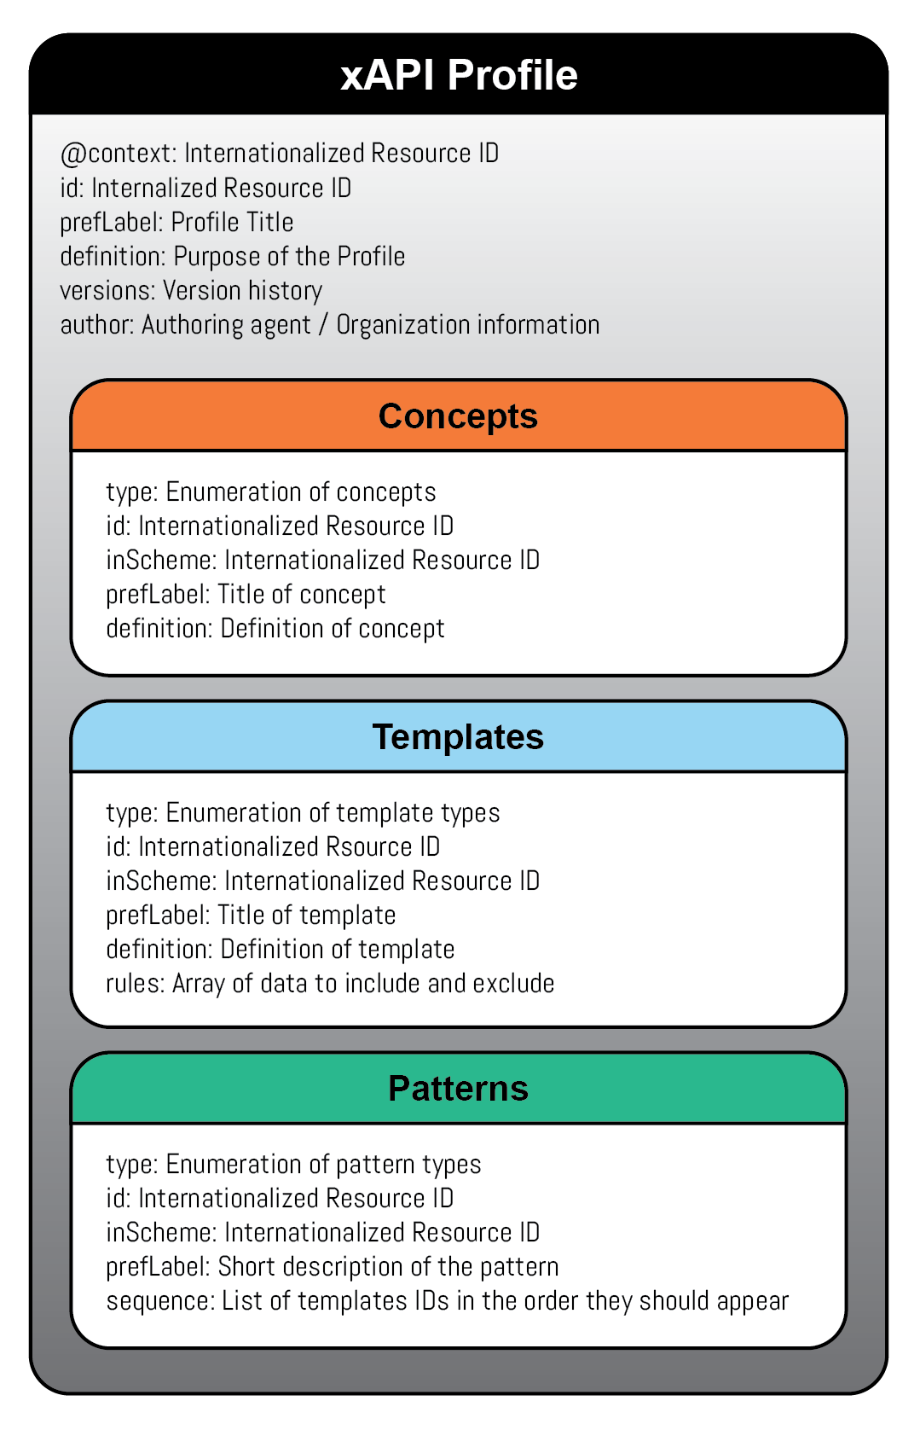
What is an xAPI Profile?
1
2
The language and purpose of your project
Profile Information
The Who, What, When, and Why of the xAPI Profile
Words
An array of words and extensions that are unique to the profile
“Learned”
Statements
An array of possible statements and the information they should hold
“Mike learned about xAPI”
Story
Sequencing of statements with added context
“Mike read the slide. Then Mike understood xAPI.”
Notes:
How xAPI Profiles are Made
Here we briefly cover what an xAPI profile is, and why they matter.
The “language” of your project
Intended to be reused in order to support interoperability
Ties back to slide 30, without a profile to define extensions they lose a lot of value
Profiles are how to extend the xAPI specification to meet your data needs
With a profile, it is best to reuse existing concepts/templates/patterns from other already existing profiles. (In fact it is encouraged)
Profiles should cover as much of your data as possible, and it is important to already have a data plan in mind when generating them.

Slide 36



Using an xAPI Profile
1
2
Designing a Learning Path
Start a Course
Various Assessment
Watch Videos
Use the Arena
Complete the Course
SCORM, biometrics, etc.
Video
New, reuse gift
Navy eLearning profile
Notes:
Profiles include an idealized path of what a student will go through as they interact with our learning content Within a learning journey they will go through multiple assessments, and a profile can be built for any type of learning environment. Using multiple profiles within a schoolhouse is common, as making a single profile to cover everything is impossible, and not recommended. These profiles create a consistency that allow for data to be leveraged across a larger organization. It is almost always better to try and reuse an already existing profile, than to build a new profile from scratch

Slide 37
ADDIE, xAPI Profiles, and a Data Strategy
1
2
 | Analyze | Design | Develop | Implement | Evaluate
For existing Training Solution | Identify what systems can generate xAPI Identify what moments of learning have value | Identify existing xAPI profiles and/or create new profiles Align new xAPI data with existing metrics | Leverage existing DIDs and one-time DIDs https://netc.usalearning.net/xapi-library/xapi-did.html | Instantiate xAPI code in the system | Leverage dashboards and conformance suites
For new Training Solution | Ensure analysis includes requirements for xAPI to support Engineering | Identify existing xAPI profiles and/or create new profiles | Leverage existing DIDs and one-time DIDs | Instantiate xAPI code in the system | Leverage dashboards and conformance suites
Notes:
For all of the ISD folks, we looked at what ADDIE would look like for xAPI, and how leveraging xAPI would look like for both new and existing training solutions.
This chart should show how the acquisition process should go
For an existing solution - Identify what data you can get
- Identify what existing profiles you can use or make new ones
- leverage existing DIDs (DATA ITEM DESCRIPTION) - DIDs define the data that are required from a contractor. - actually start using the system - Use dashboards based off the new data
For a new solution - Identify the data you want - And then all the steps become the same as if you were using an existing solution!

Slide 38
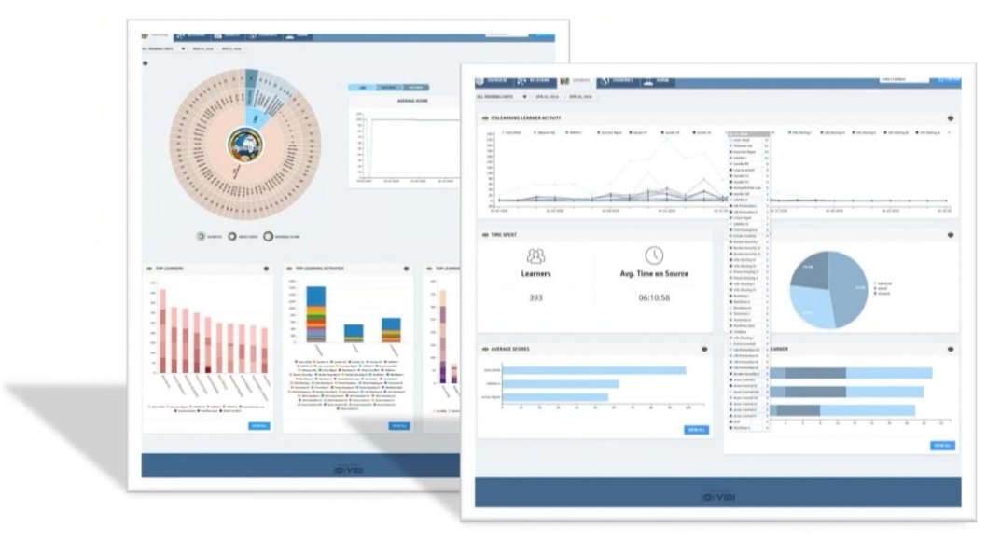
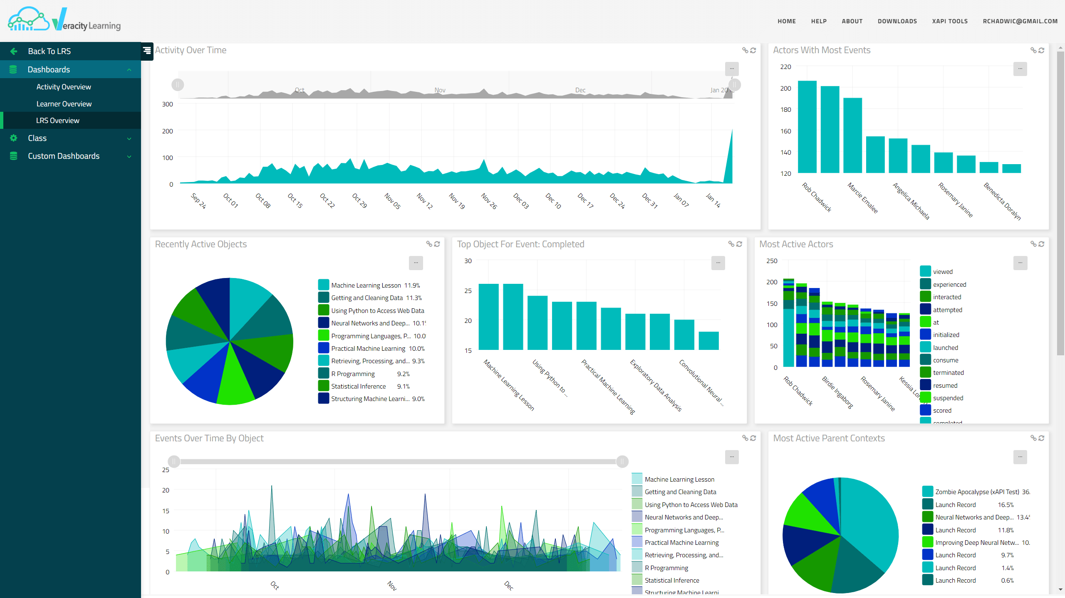
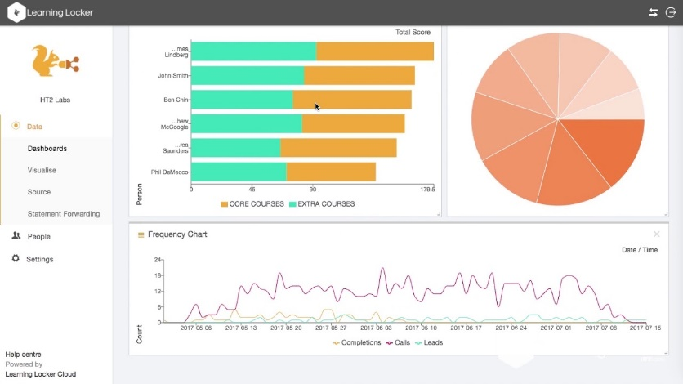
Data Strategy
1
2
A Data Strategy is only as good as the story it can tell
*these images are not an endorsement of any product
Notes:
Using these profiles and xAPI allows for better visualization of learner performance and progress. The more we use profiles, the more they increase expectations across users for the data they want, and allows for better visualization over time
When building a Data Strategy (including an xAPI Profile) you want to start with the end in mind! You do not want to create a profile, and then look at what visualizations you can generate from it. Instead, decide on what you want to visualize/display/capture, and then use that to feed what data you capture and how.
In order for us to get the information based on the data strategy xAPI collects data in a matter that is easy to share, define, and understand across our community

Slide 39
Bringing it All Together
1
2

Slide 40
The Evolution of xAPI
1
2
xAPI Profiles
Publicly published profiles help multiple organizations work together
cmi5
An Example of the limitations of an xAPI profile
IEEE standard that includes:
An xAPI Profile
Packaging Requirements for content
Course structuring
xAPI 2.0
Newest open-source release of the xAPI specification
Adds context Agents and groups
elevates interoperability
Notes:
The future of xAPI lies with 3 major projects xAPI Profiles - These allow defined vocabulary for projects - Promote interoperability of data
cmi5 - Being standardized by the IEEE - Provides the structure that was lost in the transition from SCORM to xAPI
- Includes an xAPI Profile
xAPI version 2.0 - Publicly released as an open-source IEEE standard
- Adds context Agents and groups (Not included in this tutorial, as the spec was approved after this tutorial was approved)
- In version 1.0.3, we had many SHOULD requirements, meaning some compliant implementations to not work with others. These have either be turned into SHALLs or removed entirely.

Slide 41
References

Slide 42
References
ADL Initiative (2017). Experience API Specification. Retrieved July 5, 2022, from https://github.com/adlnet/xAPI-Spec
ADL Initiative (2017). xAPI Profile Specification. Retrieved July 5, 2022, from https://github.com/adlnet/xapi-profiles
DoD (2017). DoD Instruction 1322.26 Distributed Learning. Retrieved May 6, 2019, from https://www.esd.whs.mil/Directives/issuances/dodi
W3Schools (2019). JavaScript JSON. Retrieved May 6, 2019, from https://www.w3schools.com/js/js_json.asp
ADL Initiative (2019). 2019 Total Learning Architecture Report. Retrieved July 5, 2022, from https://adlnet.gov/publications/2020/04/2019-Total-Learning-Architecture-Report/
Fleener G., Mayor. M, & Zou C. (2015) Risk management Framework (RMF) Transition Impacts in Training Simulation Systems. Proceedings of the I/ITSEC, Arlington, VA:NTSA
United States Army (2019). Personally Identifiable Information (PII). Retrieved May 6, 2019, from https://www.rmda.army.mil/privacy/PII/PII.htm

Slide 43
BackupSlides

Slide 44
Multi-Model Data Collection
1
2
Learning Environment | Value of the data | How do we capture it? | Place in a chain of evidence
Classroom Performance | Establish if the student understands underlying theory | Traditional assessments, social learning participation, instructor observation | Foundational data to inform future analysis of performance
Self-Study | Evidence if a student is self-starting to fill their own gaps in understanding | Flipping the classroom and providing materials before formal instruction | Supplements the classroom assessments. Beginning of behavioral data through their choice to study.
Simulation | Experiential learning that captures their ability to translate knowledge on the task into action | Wrappers on the simulations to generate xAPI, instructor observation | This data does not transfer the same impact as live, but informs on the students’ expected proficiency
Vicarious learning | The student’s ability to identify both positive and negative performance in recordings or demonstrations of the subject being trained. | Direct assessment, supporting data if they are replaying sections of video, and instructor documentation of their feedback after exposure | Experiential learning through observation of others. Provides supporting data at a low cost and stress level.
Actual experience in the arena | Closest data to performance in actual combat. | Video capture, direct telemetry from worn sensors, instrumented facilities and weapons, etc. | Acts as the formal measure that the supporting data is tied to for after action analysis.
Notes:
In this slide we plan to quickly cover the benefits of xAPI from an acquisition viewpoint. It has been shown in projects like ready relevant learning in the US Navy and STEELR for the US Army that there is a way to purchase xAPI data within a training system. Last year, the PSMA best paper broke this up in great detail. This data enable you to consistently sample human performance findings across multiple activities (multi model capture) This expands on slide 14

