Slide 1
Machine Learning and the Benefits of Applying it to XR Training Systems
Adam Kohl, Iowa State University
Eliot Winer, Ph.D., Iowa State University

Slide 2
Tutorial Audience
This tutorial is suitable for beginners and has no pre-requisites
For those interested in gaining a basic understanding of ML for administrative level decision making
For those seeking detailed methods and integration techniques within XR-enabled training environments
Integrating Machine Learning (ML) with Extended Reality (XR) training systems is uniquely relevant to this year’s I/ITSEC theme: Sustaining a Global Force in a Digital World
Understanding the fundamentals of ML, and its application to XR, will empower managers to make appropriate strategic and costing decisions and allow designers, developers, and engineers to successfully implement effective training systems.

Slide 3


Facilitator Introductions
Adam Kohl is a Ph.D. candidate in Mechanical Engineering and Computer Engineering at Iowa State University’s VRAC (Visualize • Reason • Analyze • Collaborate). His research focuses on utilizing machine learning and visualization techniques in the design of large-complex systems for engineering applications.
Eliot Winer, Ph.D., is the director of the VRAC (Visualize • Reason • Analyze • Collaborate) and professor of Mechanical Engineering, Electrical and Computer Engineering, and Aerospace Engineering at Iowa State University. Dr. Winer has over 23 years of experience working in XR and 3D computer graphics technologies on sponsored projects for the Department of Defense, Air Force Office of Scientific Research, Department of the Army, National Science Foundation, Department of Agriculture, Boeing, and John Deere.

Slide 4
Tutorial Overview
Learning objectives
Background – Extended Reality (XR) and Machine Learning (ML)
Benefits of using ML in XR environments
Machine learning strategies
Popular machine learning APIs & tools
Integrating ML & XR
Case studies demonstrating ML use in XR environments
Questions

Slide 5
Learning Objectives (LO)
LO1: Describe categories of machine learning technologies and several of their most used algorithm architectures
LO2: Describe how machine learning architectures can be leveraged for XR-enabled Modeling, Simulation, and Technology (MS&T) applications
LO3: List and compute savings (i.e., time, cost, etc.) from applying machine learning to relevant XR-enabled MS&T applications from recent case studies
LO4: Describe several ways of incorporating machine learning technology into warfighter training to increase efficacy, efficiency, cost, or time

Slide 6
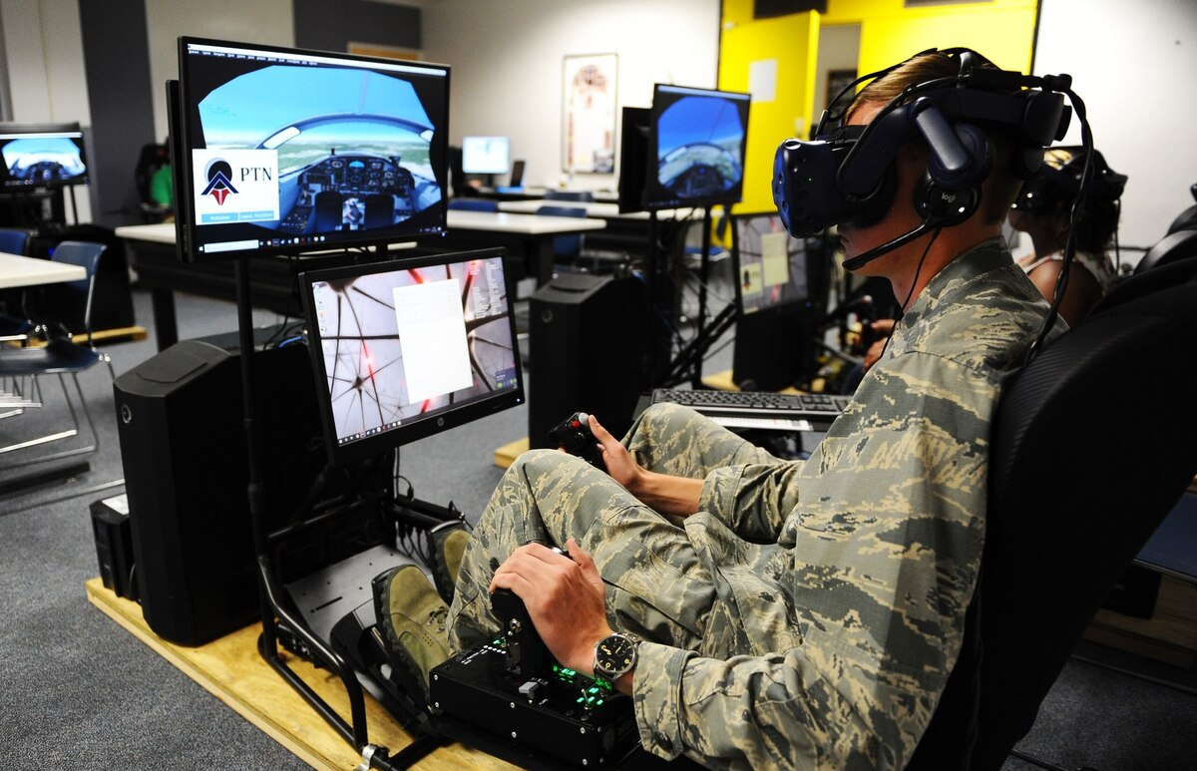
Background - XR
More and more industries are turning to XR technologies (i.e., Virtual, Augmented, and Mixed) for training
Attractive because these technologies:
Increase performance in psychomotor skills acquisition
Decrease cost due to errors
Capable of simulating uncommon and dangerous scenarios
Checa & Bustillo, 2020
Jensen & Konradsen, 2018
Lele, 2013

Slide 7
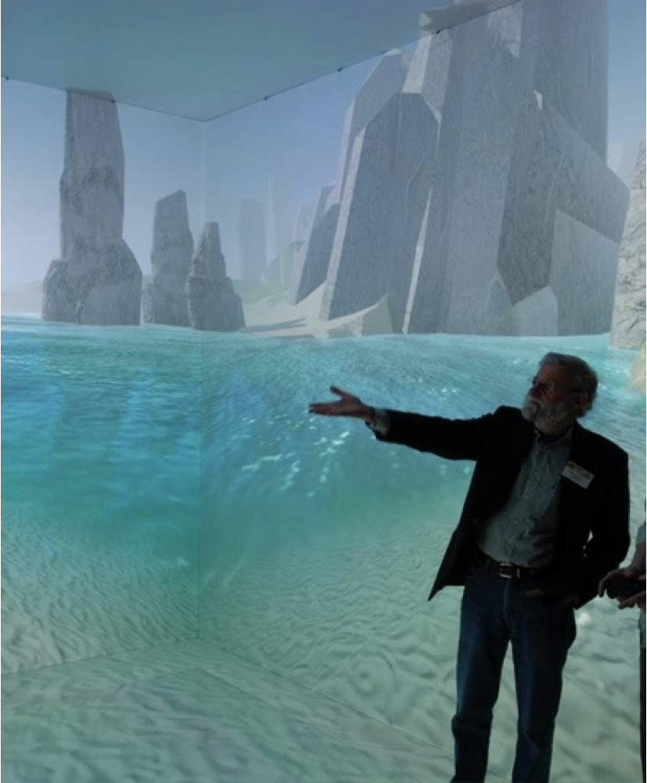
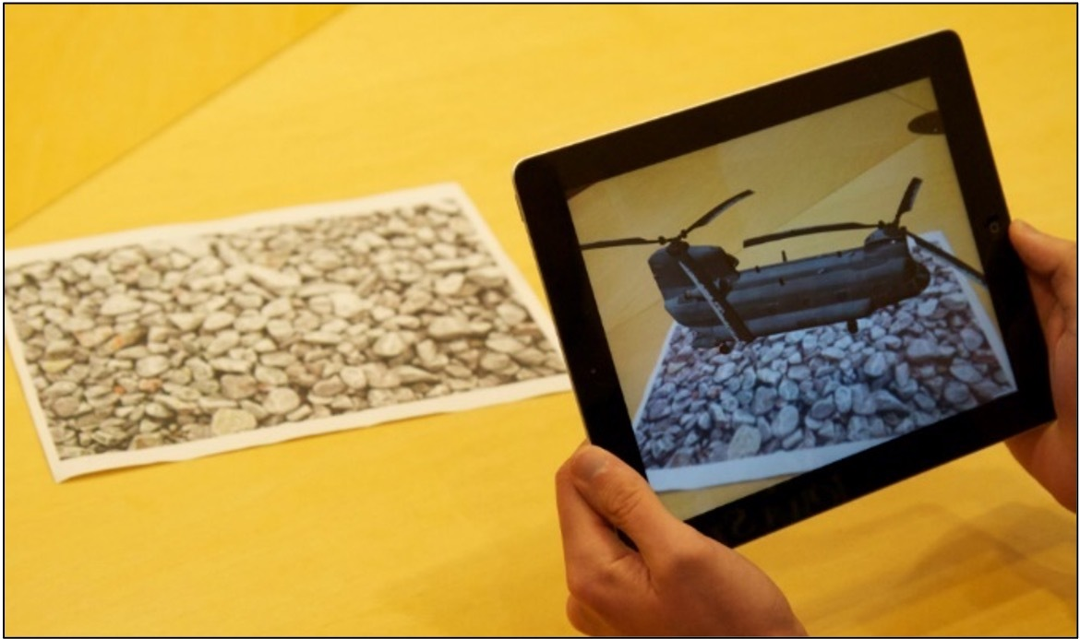
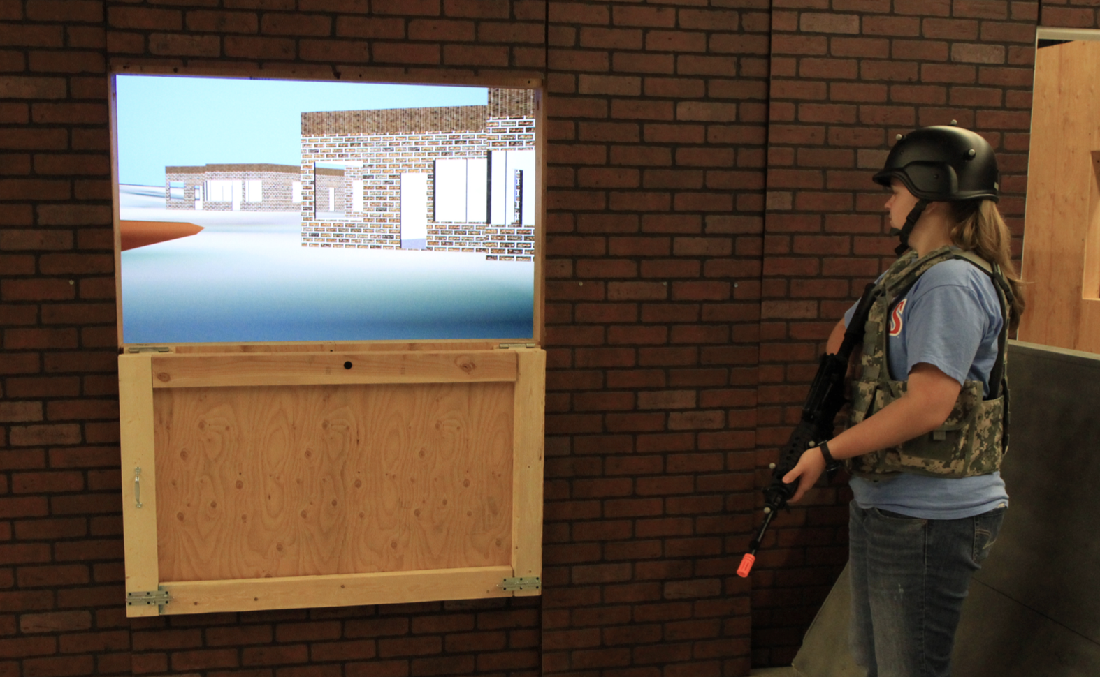
Extended Reality (XR)
Umbrella term covering the range of virtual to mixed to augmented reality
The “X” represents current and future spatial computing technologies
Head Mounted Displays (HMDs), projections systems, non-invasive brain interfaces
The Reality Continuum
Augmented Reality
Mixed Reality
Virtual Reality
Notes:
Mixed reality (MR) refers to a more sophisticated version of AR, in which certain virtual components are integrated into the physical environment to create the illusion that they are part of the real scene.

Slide 8
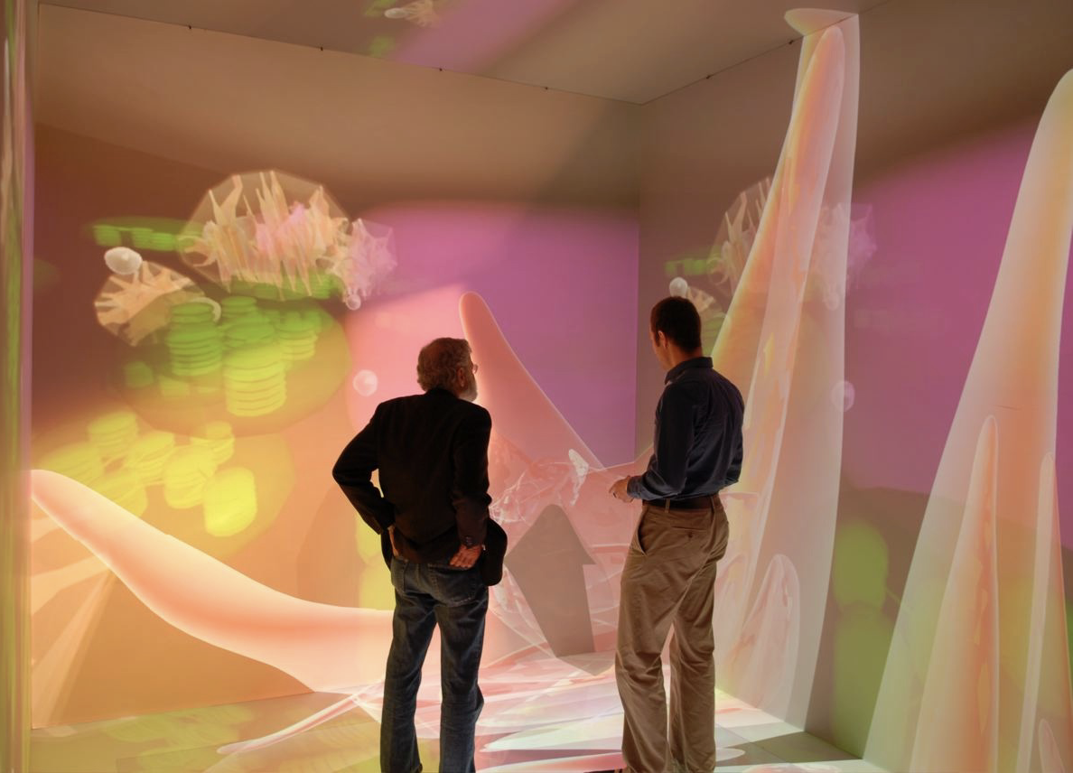
Virtual Reality (VR)
The computer-generated simulation of a three-dimensional environment that can be interacted with in a seemingly real or physical way
An artificial environment experienced through sensory stimuli provided by a computer
Ideally spans the senses
CAVE™ system at Iowa State University

Slide 9
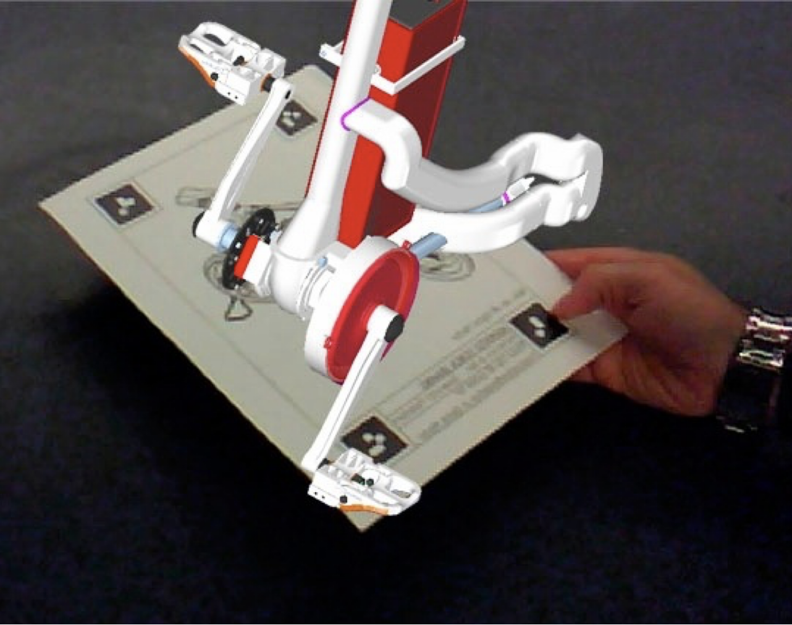
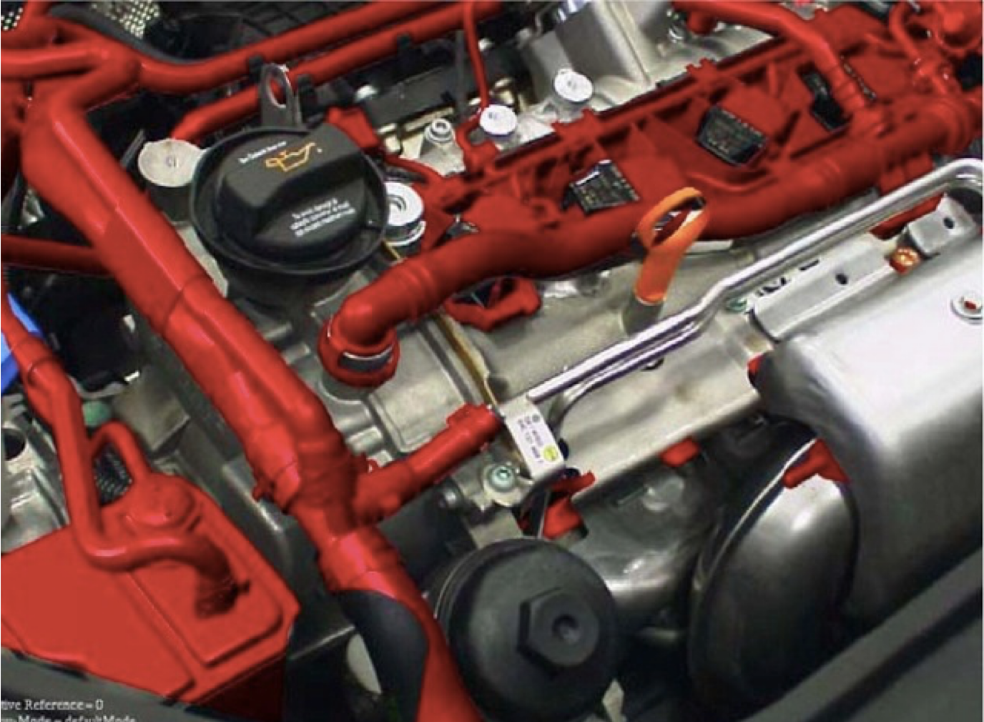
Augmented Reality (AR)
Combines real and virtual objects in a real environment
Runs interactively and in real time
Registers (aligns) real and virtual objects with each other (Azuma, 1997)

Slide 10
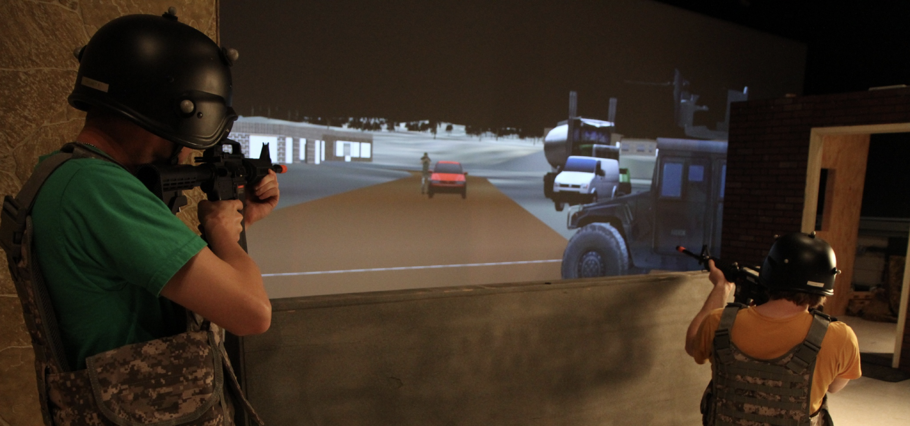
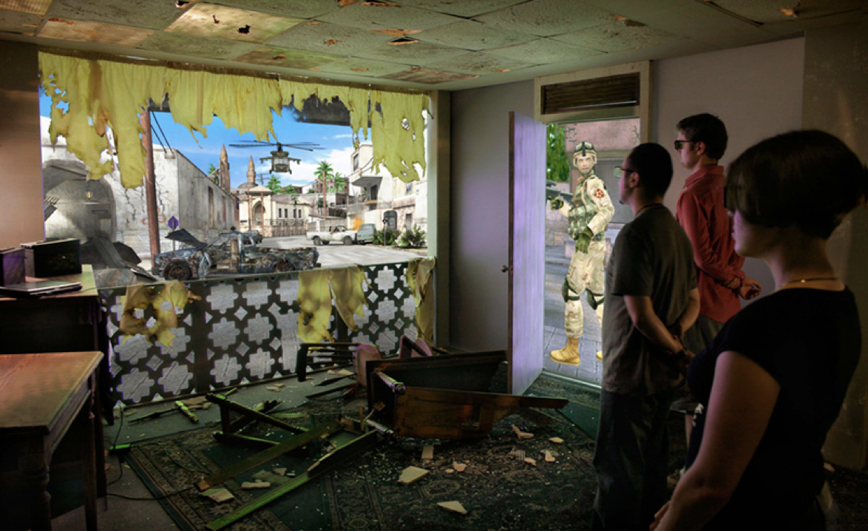
Mixed Reality (MR)
Fusion of VR, AR, and other simulation technologies with physical pieces or equipment
Reconfigurable - to avoid learning the environment
Full body tracking - environment responds to user(s)
MIRAGE - Iowa State University
Flatworld - USC Institute for Creative Technologies, https://ict.usc.edu/prototypes/flatworld/

Slide 11


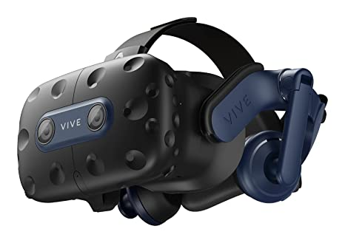
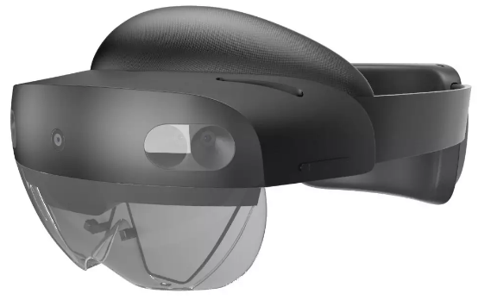
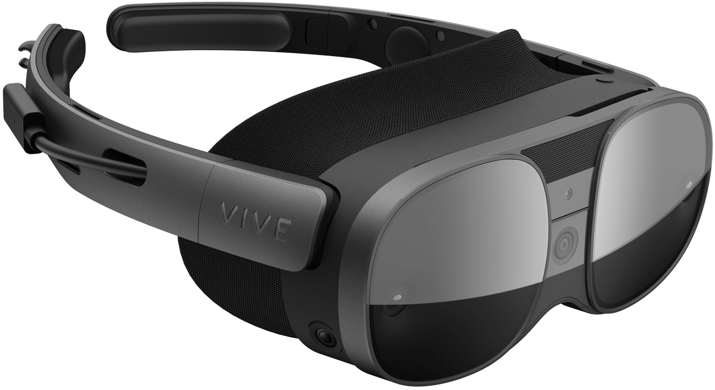
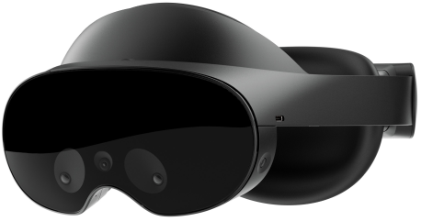
XR Software & Tools
Software development platforms
VR Head Mounted Displays (HMDs)
HTC VIVE Pro 2
Valve Index
AR HMDs
Microsoft HoloLens 2
Magic Leap 2
MR HMDs
HTC VIVE XR Elite
Meta Quest Pro
Apple Vision Pro
HTC VIVE Pro 2
HoloLens 2
HTC VIVE XR Elite
Meta Quest Pro

Slide 12
XR Software & Tools
 | HTC VIVE Pro 2 | Valve Index | Microsoft HoloLens 2 | Magic Leap 2 | HTC VIVE XR Elite | Meta Quest Pro
HMD Type | VR | VR | AR | AR | MR | MR
Connection | Tethered | Tethered | Untethered | Untethered | Untethered | Untethered
Resolution | 2448 x 2448 pixels per eye | 1440 x 1600 pixels per eye | 1440 x 936 pixels per eye | 1440 x 1760 pixels per eye | 1920 x 1920 pixels per eye | 1800 x 1920 pixels per eye
Colors/Screen | Dual RGB low persistence LCD | Dual RGB ultra-low global backlight LCD | See-through holographic lenses (waveguides) | Dual LCOS display (waveguides) | Dual LCD RGB stripe subpixel layout | Dual QD-LCD with local dimming backlight
Refresh rate | 90/120 Hz (90 Hz with wireless adapter) | 90/120/144 Hz | 120 Hz | 120 Hz | 90 Hz | 90 Hz
Cost | $799.00 | $999.00 | $3,500.00 | $3,299.00 | $1,099.00 | $999.00
Notes:
HTC Vive Pro 2: https://www.vive.com/us/product/vive-pro2/specs/
HTC Vive Focus 3: https://www.vive.com/us/product/vive-focus3/specs/
Oculus Quest 2: https://store.facebook.com/quest/products/quest-2/
Varjo XR-3: https://store.varjo.com/xr-3
Microsoft HoloLens 2: https://www.microsoft.com/en-us/hololens/hardware https://www.forbes.com/sites/solrogers/2019/09/11/what-we-know-about-hololens-2/?sh=176563cf4662 https://docs.microsoft.com/en-us/hololens/hololens2-display
Magic Leap: https://shop.magicleap.com/#/ https://www.magicleap.com/magic-leap-1

Slide 13
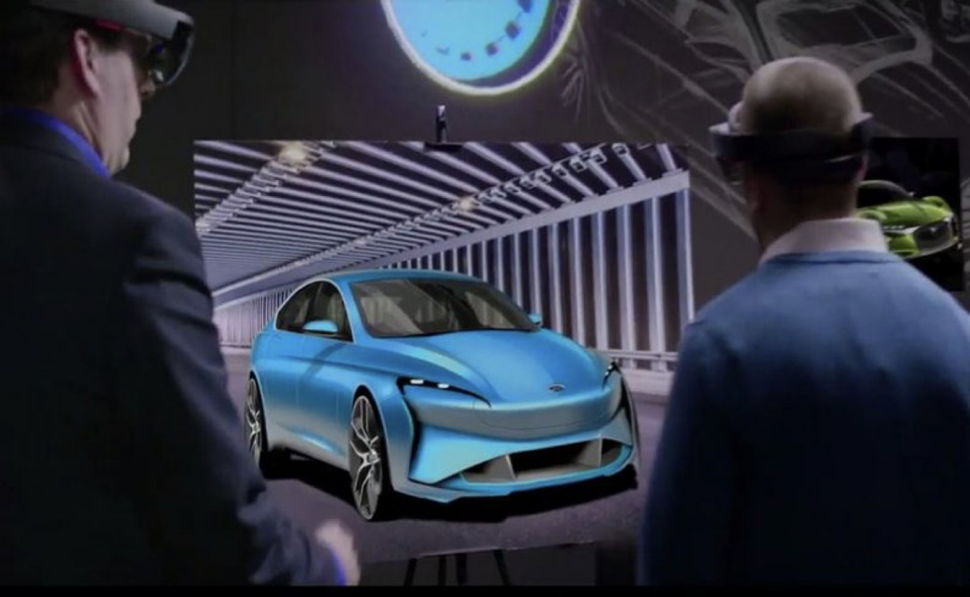
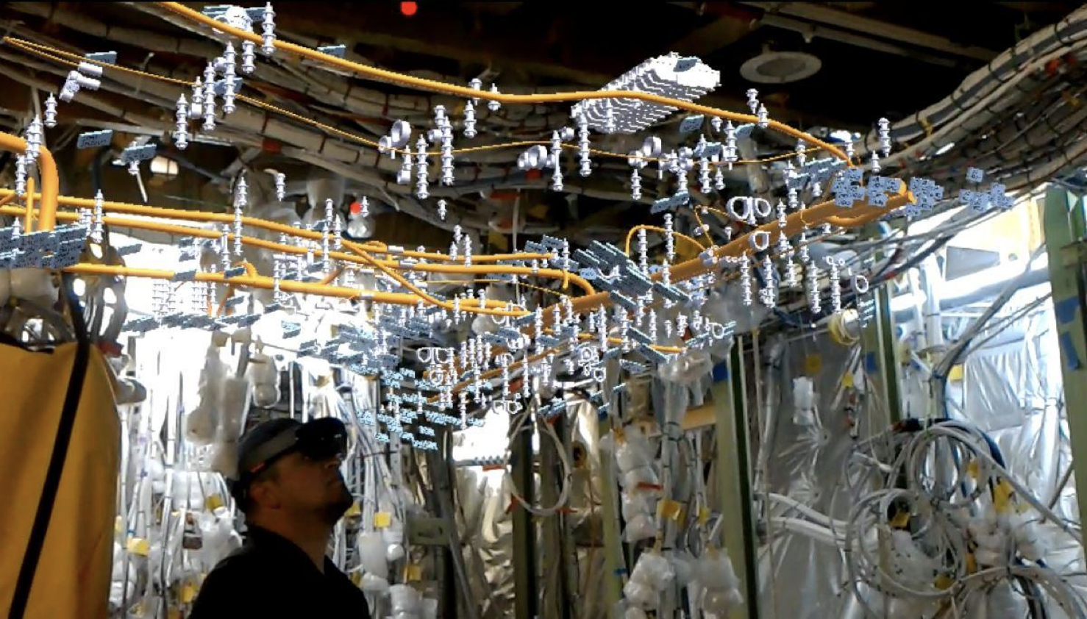
XR Environments – Out of the lab and into production
Ford Motor Company — Design (https://www.autonews.com/article/20170921/OEM03/170929971/ford-expands-use-of-augmented-reality-for-design)
Boeing — Assembly (https://www.boeing.com/features/2018/01/augmented-reality-01-18.page)

Slide 14
Benefits of Using ML in XR Environments
As XR environments become more pervasive, demands on their capabilities are increasing
People expect proper “responses” from the environment to their interactions
Impossible to program all these variations
ML provides methods to have an environment react appropriately without an explicit “rule” being put in for every potential user interaction
ML methods can address a series of highly complicated issues and make XR environments more responsive and realistic
Notes:
Eliot through 11
Hand over to me start at 12

Slide 15
Benefits of Using ML in XR Environments
Gesture and object recognition
Pose Estimation
Environmental understanding
Natural Language Processing (NLP)
Virtual agents
Content generation and synthesis
Procedural generation

Slide 16
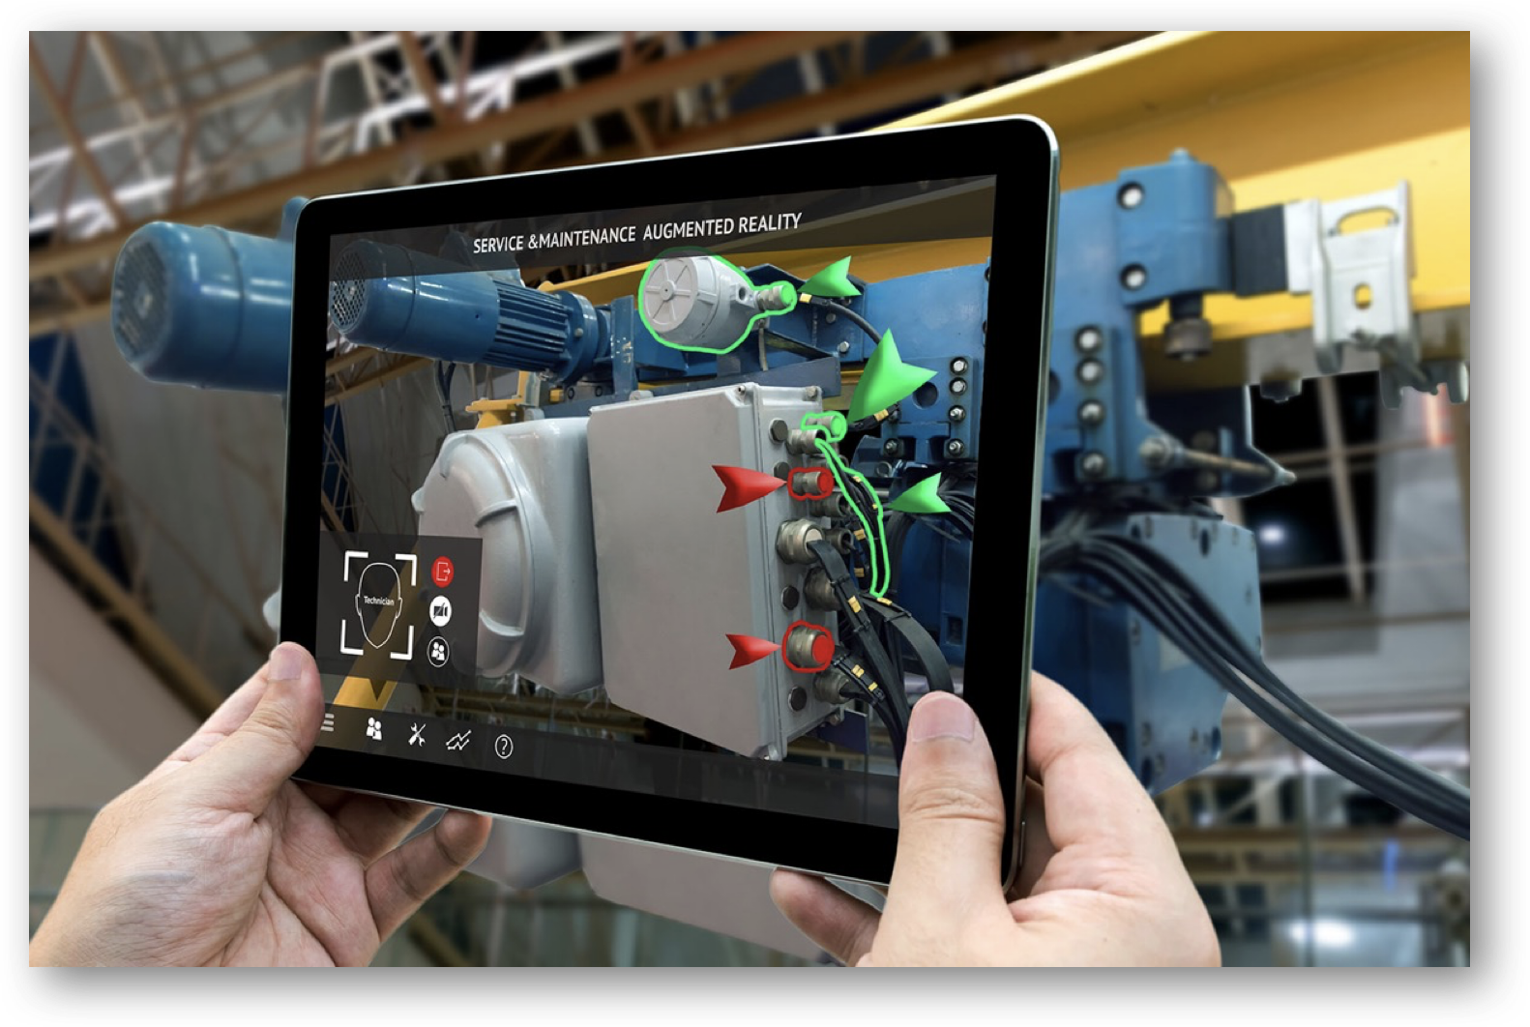
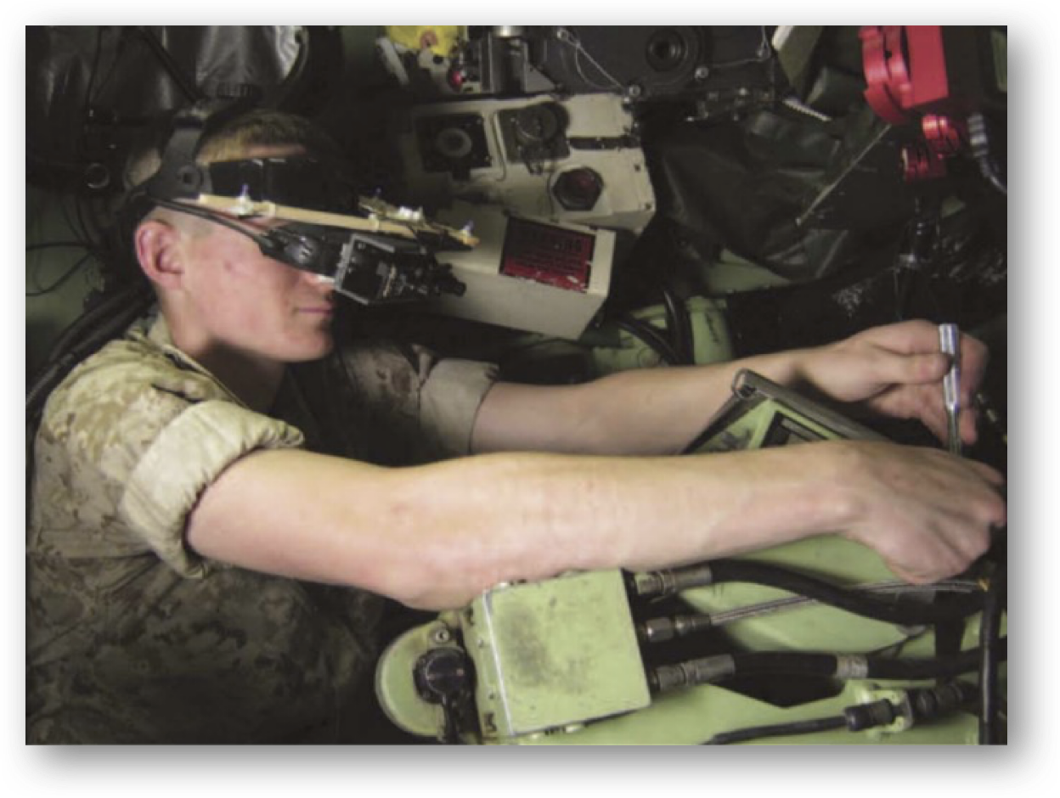
Benefits of Using ML in XR Environments
Create self-paced, autonomous XR trainers
XR Training Systems already proven to have tremendous benefits
8X faster than conventional methods (Boud, 1999)
60% reduction in error and 100% improvement in speed (Henderson, 2011)
Reduce time and errors by as much as 50% (Hou et al., 2015)
AR instructions can help eliminate time spent on classroom training (Webel et al., 2013)
LO3: List and compute savings (i.e., time, cost, etc.) from applying machine learning to relevant XR-enabled MS&T applications from recent case studies

Slide 17
Background - ML
US military
Department of Defense (DoD) is making artificial intelligence (AI) research a “top priority”
Investing ~ $1.5 billion in AI project over the next five years at the Defense Advanced Research Project Agency (DARPA)
Serious consideration must be given to how these agents will interact with humans
ML can be combined with XR environments to fundamentally change how humans interact with training systems
The technology has the potential to aide warfighter training in several key aspects
Improve efficiency
Lower costs
Reduce training time
A step towards “Obi Wan in the cockpit with Luke”
Notes:
Adam start here

Slide 18
ML Strategies
Learning addresses three main design flaws
All possible situations cannot be anticipated
All changes over time cannot be anticipated
It may not be understood how to program the solution
Feedback types determine learning strategy
No explicit feedback → unsupervised
Input-output pairs → supervised
Series of rewards punishments → reinforcement
Unsupervised
Semi-supervised
Learning Strategies
Supervised
Reinforcement
Transfer
Russell, Norvig & Davis (2010)
LO1: Describe categories of ML technologies and several of their most used algorithm architectures
Notes:
Four major factors influence learning ability
The component to be improved
Prior knowledge
Representation of the data and the component
Available feedback

Slide 19
ML Strategies - Unsupervised
Learns patterns from inputs without being provided explicit feedback
Classify unlabeled data
Reduce the dimensional complexity of data
Extract features for data-driven design
Linear and non-linear methods
Autoencoders
Common Techniques
Boltzmann Machine
Density-based clustering
Gaussian Mixture Model (GMM)
Generative Adversarial Network (GAN)
Generative Topographic Map (GTM)
K-means
Principal Component Analysis (PCA)
Self-Organizing Map (SOM)
Variational Autoencoder (VAE)
LO1: Describe categories of ML technologies and several of their most used algorithm architectures

Slide 20
ML Strategies - Supervised
Learns a function that maps from input to output based on observing example input-output pairs
Engineering applications
Classification, control and decision making, monitoring and anomaly detection, performance modeling
Identify, bound, and map feasible design space
Prevent expensive simulations and experiments
Guide and improve exploration efficiency
Common Techniques
Artificial Neural Network (ANN)
Bayesian Network
Convolutional Neural Network (CNN)
Deep Neural Network (DNN)
Hidden Markov Model (HMM)
Naïve Bayes
Random Forest
Recurrent Neural Network (RNN)
Support Vector Machine (SVM)
LO1: Describe categories of ML technologies and several of their most used algorithm architectures

Slide 21
ML Strategies - Supervised
Deep networks
> 1 stage of non-linear feature transformation
Three fundamental architecture types
Feed-forward, feed-back, and bi-directional
The reasoning encompassing why a model predicted a value cannot be simply derived
Model architecture is dependent on the data and application
New designs are constantly emerging
Input
Hidden
Hidden
Output
Feed-forward network
Feed-back layer
LO1: Describe categories of ML technologies and several of their most used algorithm architectures
Notes:
Number of trainable parameters is proportional to the number of training samples

Slide 22
ML Strategies - Reinforcement
Reinforcement learning focuses on sequential decision making
An agent is trained to optimize actions that maximize a reward in an environment
This process is done through trial and error
An agent may consist of the following attributes:
Policy: an agent’s behavior function
Value function: how good it is for an agent to be in each state or state-action pair (Q)
Model: an agent’s representation of the environment
Common Techniques
Policy Optimization
Derivative Free Optimization (DFO) / Evolution
Actor-Critic Methods
Dynamic Programming
Policy Iteration
Value Iteration
Q-Learning
Deep Q-Networks (DQN)
Actor-Critic Methods
LO1: Describe categories of ML technologies and several of their most used algorithm architectures

Slide 23
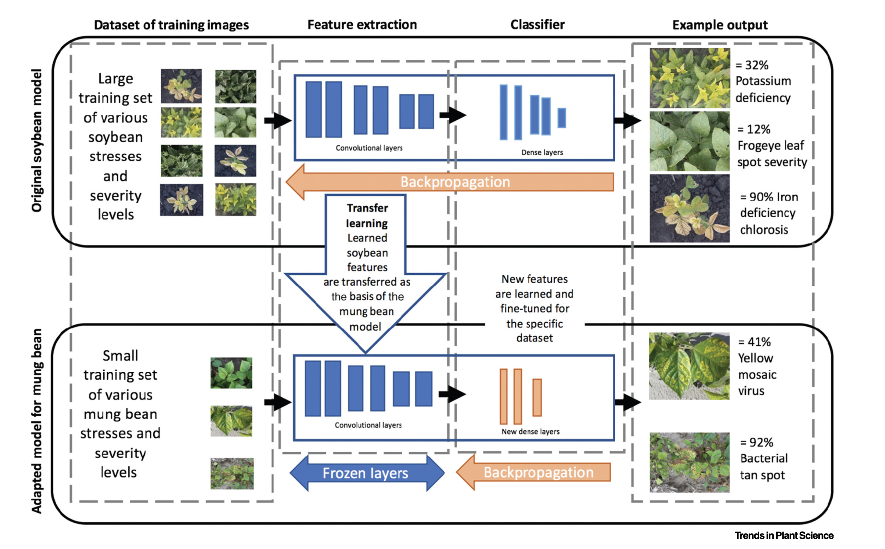
ML Strategies - Transfer
Transfer learning provides an ‘informed’ starting point for a similar design space
Helps with inadequate datasets
Utilizes pre-trained models for a different task
Saves time and eliminates prior training computation expenses
Scope of the new task is often limited by the previous training dataset
Singh et al. (2021)
LO2: Describe how machine learning architectures can be leveraged for XR-enabled Modeling, Simulation, and Technology (MS&T) applications
Notes:
Image reference: Singh et al.,2021, Challenges and Opportunities in Machine-Augmented Plant Stress Phenotyping

Slide 24
ML Strategies – Cost Factors & Limitations
Unsupervised Learning
Cost Factors
Data preparation ($$-$$$)
Computationally intensive ($-$$)
Interpretability requires domain expertise ($)
Evaluation & validation ($$)
Limitations
No ground truth & limited guidance
Curse of dimensionality
Scalability
Noise and Outliers
Supervised Learning
Data annotation ($$)
Data collection ($-$$)
Computationally intensive ($$)
Model selection & hyperparameter tuning ($$-$$$)
Labeled data dependency
Limited generalization and overfitting
Scalability
Lack of explainability

Slide 25
ML Strategies – Cost Factors & Limitations
Reinforcement Learning
Cost Factors
Simulation or real-world interaction ($$-$$$)
Data collection ($-$$)
Computationally intensive ($$)
Reward engineering ($$-$$$)
Limitations
Sample efficiency
Exploration and exploitation balancing
Partial observability
Generalization
Transfer Learning
Data annotation, collection, & compatibility ($$-$$$)
Computationally intensive ($-$$)
Model selection & hyperparameter tuning ($$-$$$)
Doman knowledge & expertise ($)
Domain shift
Catastrophic forgetting
Limited transferability
Overfitting

Slide 26
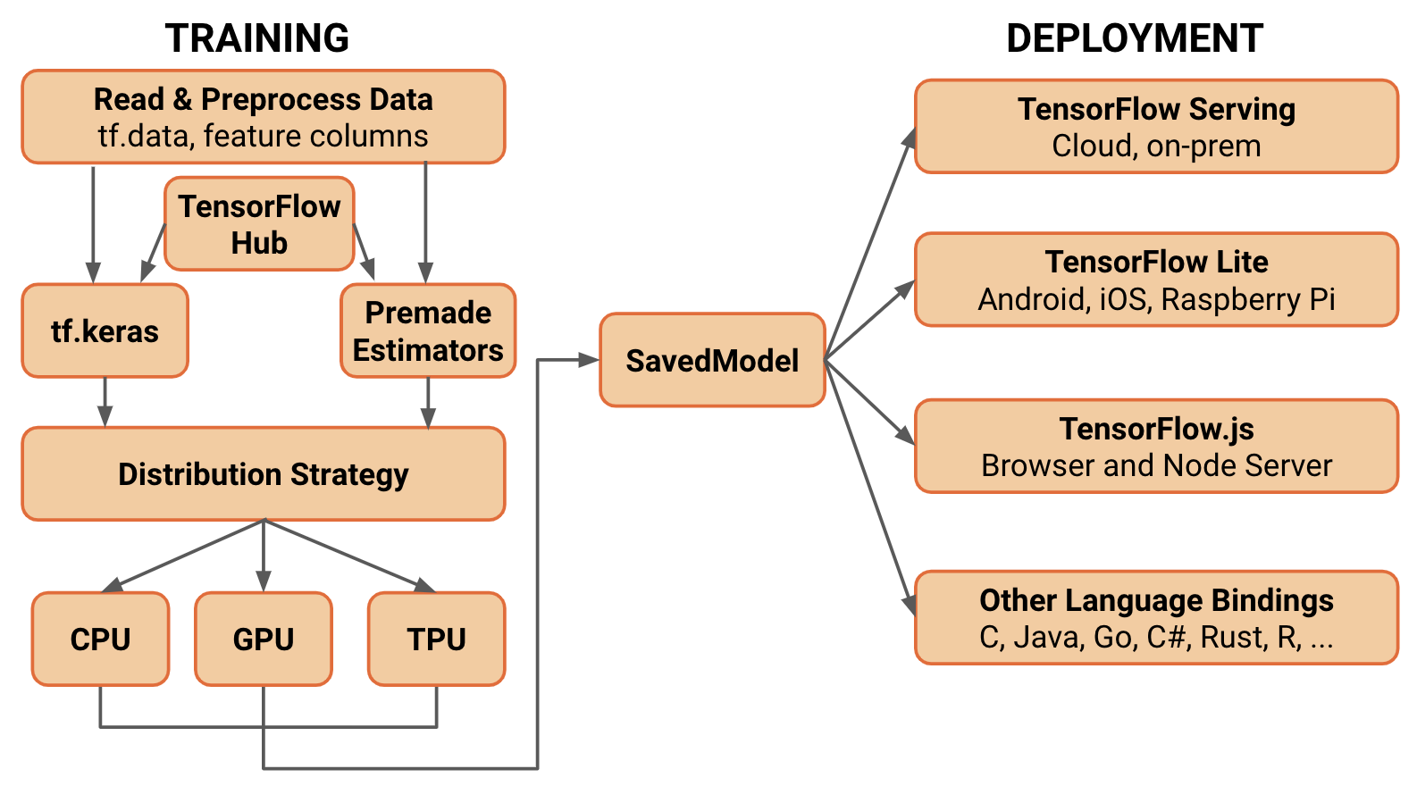
ML Software & Tools
Processing hardware
CPU, GPU, TPU
Popular libraries and APIs
Traditional machine learning: Scikit-learn, MatLab
Deep Learning: TensorFlow, PyTorch, Keras
Distributed computing
OpenMP, MPI, CUDA
TensorFlow, PyTorch - Lightning
LO2: Describe how machine learning architectures can be leveraged for XR-enabled Modeling, Simulation, and Technology (MS&T) applications

Slide 27
ML & XR Integration - Communication
Mechanisms
Allow for simulations to interact with the software encapsulating ML models
Network-based
Most flexible approach
Eliminates the need to integrate additional third-party libraries
Allows the simulation and model to communicate across different containers
IPC-based
Reduced flexibility – the simulation and model must be located on the same underlying host system
Can provide increased performance when transmitting large quantities of data
In-process
Least flexible and most brittle
In most cases, cost of engineering efforts (i.e., implementation & maintenance) outweigh performance benefits
LO2: Describe how machine learning architectures can be leveraged for XR-enabled Modeling, Simulation, and Technology (MS&T) applications

Slide 28
ML & XR Integration - Deployment
Strategies
Separate containers - loosely coupled
Supported communication: network-based
Well-suited for scenarios with a single simulation and multiple ML models
Separate containers - tightly coupled
Supported communication: network-based, IPC-based
Well-suited for scenarios where the simulation and model relationship are one-to-one
Single container
Supported communication: network-based, IPC-based, in-process
Forces one-to-one relationship between simulation and model instances
* Containers are a form of operating system virtualization
LO2: Describe how machine learning architectures can be leveraged for XR-enabled Modeling, Simulation, and Technology (MS&T) applications
Notes:
1)
Avoid scenarios where multiple agents each require rendered from a unique camera
such as when multiple autonomous agents are interacting in a single shared virtual environment
not well-suited to scenarios where multiple agents each require rendered frames from a unique camera, since the GPUs attached to the simulation container will quickly become a bottleneck as the number of connected agents increases
2)
However, simulation and model both run on host system’s GPU
grouped together using a mechanism such as a Kubernetes Pod. This ensures the containers will be scheduled on the same underlying host system and allows them to share their network and IPC namespaces, facilitating both network-based and IPC-based communication.
However, Kubernetes don’t yet support GPU accelerated Windows containers so linux is the best bet for machine learning workloads
the size of the container image for the simulation can still be kept to a minimum by excluding GPU acceleration support if the simulation does not perform rendering.
3)
Violates industry best practice of containers encapsulating a single concern
Modifications to either the simulation or the machine learning model will necessitate a rebuild of the single shared container image.

Slide 29
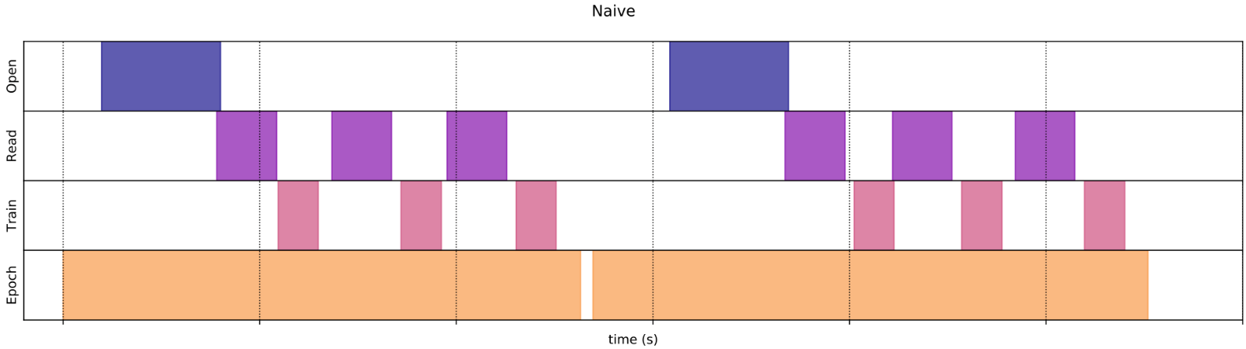
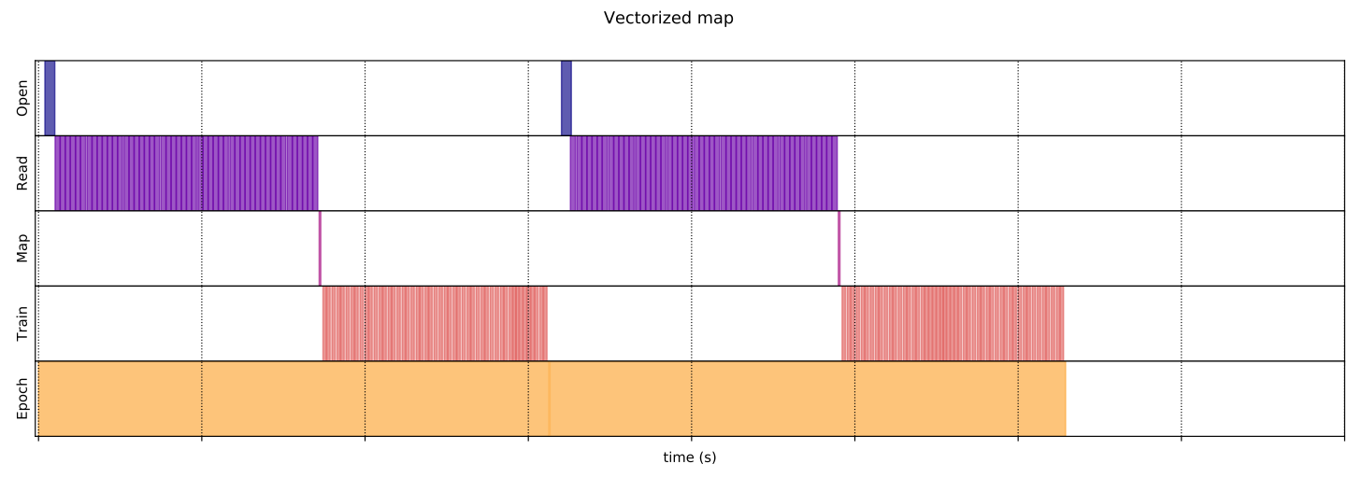
ML Challenges
Data preprocessing and input pipelines - Dependent on resource allocation
TensorFlow naive pipeline using no tricks, iterating over a dataset as-is
Execution time = 265 ms
Using the same dataset, the input pipeline uses vectorized mapping to reduce overhead and memory footprint
Execution time = 27.4 ms
LO3: List and compute savings (i.e., time, cost, etc.) from applying machine learning to relevant XR-enabled MS&T applications from recent case studies
Notes:
This time, the mapped function is called once and applies to a batch of sample. As the data execution time plot shows, while the function could takes more time to execute, the overhead appear only once, improving the overall time performance.

Slide 30
XR – Pitfalls of Utilizing ML
Data
Limited training samples
Complex or unstructured
Insufficient and low-quality
Real-time requirements
ML model size and processing time
Decreased frame-rate can lead to cybersickness
Human expertise and domain knowledge
Complex and dynamic environments

Slide 31
Case Study 1
Performance gains from adaptive eXtended Reality training fueled by artificial intelligence
Stanney, Archer, Skinner, et al. (2022)

Slide 32
ML for Adaptive Training
Project was to explore a continuum of XR technologies and how they can be coupled with numerous adaptation strategies and supportive artificial intelligence (AI) techniques to realize personalized, competency-based training solutions that accelerate time to proficiency
ML Techniques used:
Bayesian Knowledge Tracing (BKT) – uses probabilities from Bayes’ Theorem
Genetic algorithms coupled with novelty search and combinatorial optimization

Slide 33
Learning Objectives Covered
LO3: List and compute savings (i.e., time, cost, etc.) from applying machine learning to relevant XR-enabled MS&T applications from recent case studies
LO4: Describe several ways of incorporating machine learning technology into warfighter training to increase efficacy, efficiency, cost, or time

Slide 34
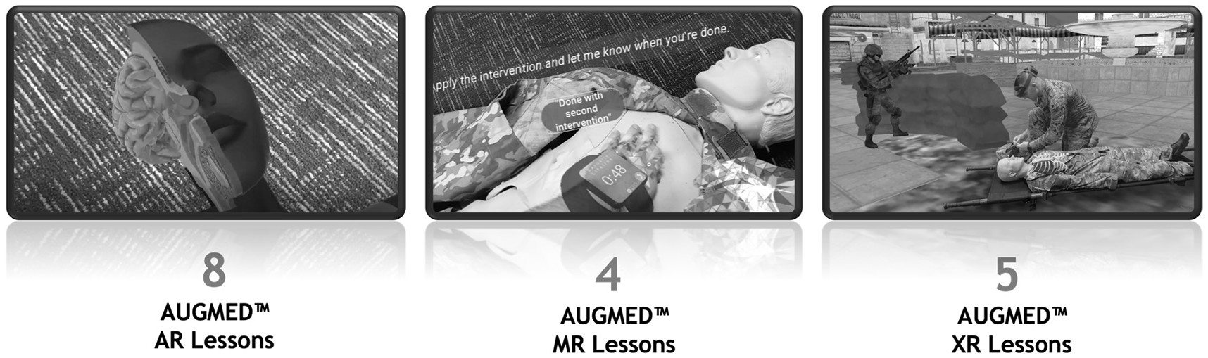
AUGMED – TCCC Training
Case Study 1
XR solution developed by Design Interactive, Inc.
Utilizes the HoloLens 2 to immerse the user
Adaptive training environment for Tactical Combat Casualty Care (TCCC)
Trains TCCC procedures by recreating operational challenges
Places the trainee on a realistic battlefield scenario

Slide 35
Adaptations Explored
Case Study 1
Mastery training
Faded worked examples
Corrective, self-regulation feedback
Real-time guidance
Self-explanations
Direct navigation support
Metacognitive prompts
Spaced repetition
Each one had a corresponding ML technique to enhance XR training
We will examine:
Mastery training
Faded worked examples
Corrective, self-regulation feedback

Slide 36
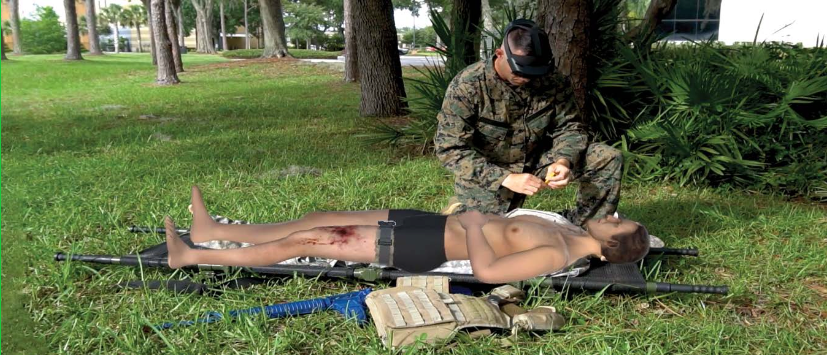
Adaptations used in XR Training
Case Study 1
Mastery Training – Match training content to trainee performance
Faded worked examples - Faded learning tasks provide individualized support depending on student progress (i.e., more or less support depending on trainee)
Corrective, self-regulation feedback – Using data generated from XR training scenarios to evaluate proficiency and provide highly personalized feedback

Slide 37
Mastery Learning Models
Case Study 1
Expertise classification, performance-based content adjustment, and real-time tracking of trainee performance
Expected learning outcome
Determined using probabilities of correctly performing task as predicted by BKT model
Decreases with each successfully completed lesson
ML technique used: Bayesian Knowledge Tracing (BKT)
Four probabilities used to predict a learner’s mastery of a topic:
P(L₀): student knowing the skill beforehand
P(T): student demonstrating knowledge of the skill after an opportunity to apply it
P(S): student mistakes when applying a known skill
P(G): student correctly applies an unknown skill
Probabilities used in Bayes’ Theorem equations to predict likelihood of a student correctly applying the skill on a future task

Slide 38
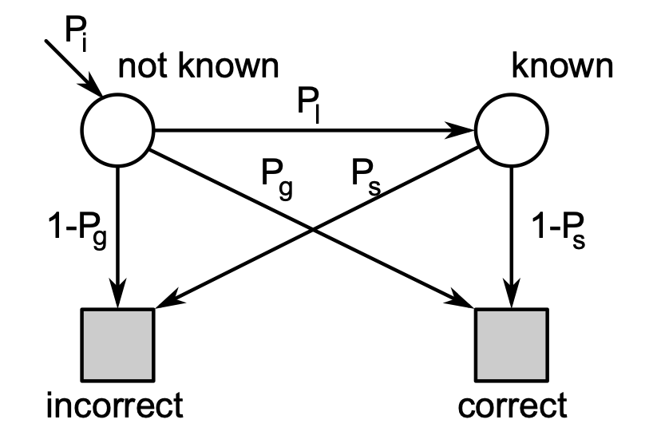
Bayesian Knowledge Tracing
Case Study 1
Specialized case of a Hidden Markov Model
Skill is modeled as binary
Known & unknown
Learning is modeled as a discrete transition from known to unknown state

Slide 39



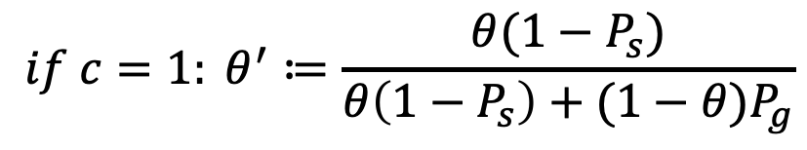
Bayesian Knowledge Tracing
Case Study 1
Update equation:
Prediction equation:
$$if c=1: θ^{′}≔\frac{θ(1−P_{s})}{θ\left(1−P_{s}\right)+(1−θ)P_{g}}$$
$$if c=0: θ^{′}≔\frac{θP_{s}}{θP_{s}+(1−θ)(1−P_{g})}$$
$$θ^{′}≔θ^{′}+(1−θ^{′})P_{l}$$
$$P_{c}=θP_{g}+(1−P_{s})(1−θ)$$
*c denotes the correctness of an observed answer

Slide 40
Mastery Learning Models
Case Study 1
Average concept knowledge score
Determined by BKT
Required for a trainee to progress to a higher proficiency level
Content mastery = BKT knowledge score > 0.9
Scheduled spaced repetitions of lessons
BKT knowledge score < 0.9
Heuristic algorithms determine the scheduling
Entire process terminates when curriculum is mastered

Slide 41
Evaluation – Mastery Learning Models
Case Study 1
Data collected from 342 simulated trainees’ trial lessons
Trainees of varying preexisting knowledge classified into proficiency levels:
Novice: 17-27 lessons
Advanced beginner: 12-16 lessons
Competent: 4-14 lessons
Automatic progression to proficiency determined using the adaptive framework
Worst case ~ 2.25 h (27 lessons @ ~5 min per lesson)
Traditional CLS classroom-based training requires ~ 20 h
LO3: List and compute savings (i.e., time, cost, etc.) from applying machine learning to relevant XR-enabled MS&T applications from recent case studies

Slide 42
Faded Worked Examples
Case Study 1
Worked examples implemented at novice and advanced beginner levels
Visually demonstrate animations of proper procedure (i.e., what success looks like)
ML technique used: Genetic algorithms coupled with novelty search and combinatorial optimization
Trainees reach levels determined by ML and worked examples are adaptively faded within XR scenarios to increase retention
ML technique used: BKT
Determines detail of animation demonstration & application activities
E.g., Applying a tourniquet on a manikin within an allotted amount of time

Slide 43
Corrective Self-Regulation Feedback
Case Study 1
ML technique used: BKT
Trainee must achieve understanding predicted by the BKT
If poor performance is observed, the BKT parameters are updated and the expected amount of learning for lessons covering the same concepts increases.
Trainee demonstrates spatial knowledge by selecting digitally rendered object
E.g., placing a needle chest decompression (NCD) at the correct injury site
Provides corrective feedback by incorporating Q&A feedback prompts
As a trainee’s proficiency increases feedback is reduced so mistakes have more dire consequences

Slide 44
Summary
Case Study 1
Mastery learning models substantially decrease time to reach proficiency
30 – 75 precent
The adaptive training system focuses on matching trainee performance to level of XR immersion
Maintains an optimal level of challenge for trainees
Provides real-time support and corrective feedback
Resolves common trainee misconceptions
Increased confidence > 35 percent
Supports military sustainability efforts by providing the correct training at the right time

Slide 45
Case Study 2
Designing a Deep Learning and Computer-Vision Based Autonomous Vehicle Within a Multimodal Traffic Simulation Framework
Kalivarapu, Kohl, Miller, & Winer (2020)
Notes:
Pass back to Eliot

Slide 46
Learning Objectives Covered
LO3: List and compute savings (i.e., time, cost, etc.) from applying machine learning to relevant XR-enabled MS&T applications from recent case studies
LO4: Describe several ways of incorporating machine learning technology into warfighter training to increase efficacy, efficiency, cost, or time

Slide 47
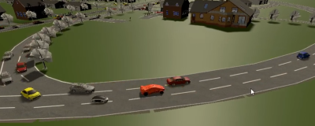
Motivation – Need for ML
Multi-modal XR environment to create, test, and study different roadway designs with all associated traffic, pedestrians, etc.
Particular emphasis on studying interactions with Autonomous Vehicles (AVs)
How to simulate AVs in this XR environment without adding more humans into a running simulation / experiment
ML Technique used:
Convolutional Neural Networks (CNN)
AV

Slide 48
Background - Simulated AVs
Case Study 2
Autonomous vehicle (AV) simulators are a platform for development, training, and validation of autonomous algorithms
CARLA, Microsoft Air Sim, NVIDIA DRIVE Platform/Constellation, Gazebo, etc.
Virtual cameras and sensors mounted on top of the vehicle capture virtual surroundings
Images processed exactly like the ones captured from a physical AV
Simulated AV + traffic simulator program
System behaves like a physical AV in real-world

Slide 49
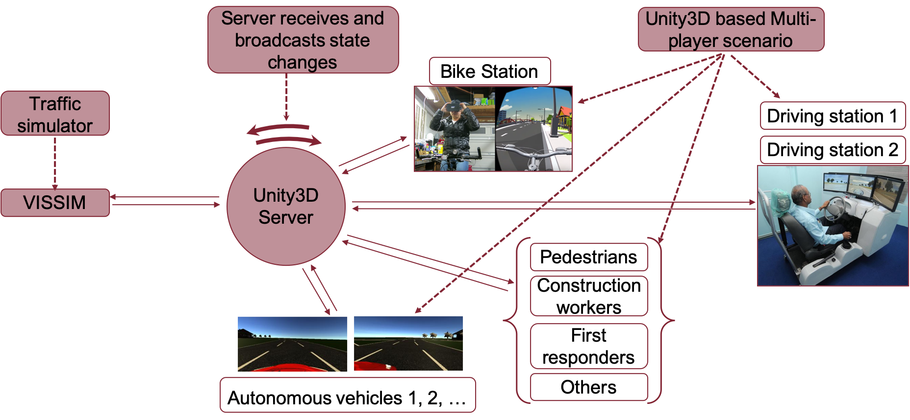
System Architecture
Case Study 2

Slide 50
System Architecture
Case Study 2
Client-server architecture doubles as the XR environment system
System platform visualization utilizes VR, AR, and desktop
Human interaction with ML AV agents is capable with multiple devices
Driving states of the physical agents and AVs are synchronized the client-server architecture with a traffic simulator
Simulator probabilistically generates vehicle and pedestrian traffic.
Generated traffic computes responses and are network synchronized to form a multimodal traffic simulation system collectively

Slide 51
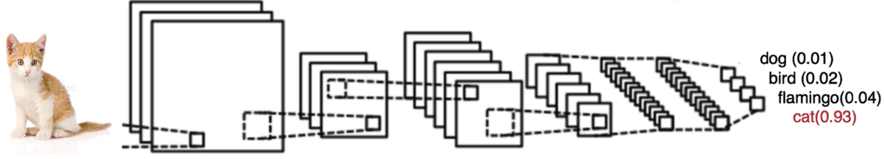
AV Design
Case Study 2
AV implemented on a single-lane road and a three-lane highway
Uses supervised and imitation based machine learning approaches
Other vehicle traffic, pedestrians, and traffic signs were not implemented
ML technique used: Deep learning using Convolutional Neural Networks (CNN)
CNNs are highly effective at image recognition and classification
Convolution
layer
Output prediction
layer
Simplified
CNN pipeline
Notes:
31 hand off potentially

Slide 52
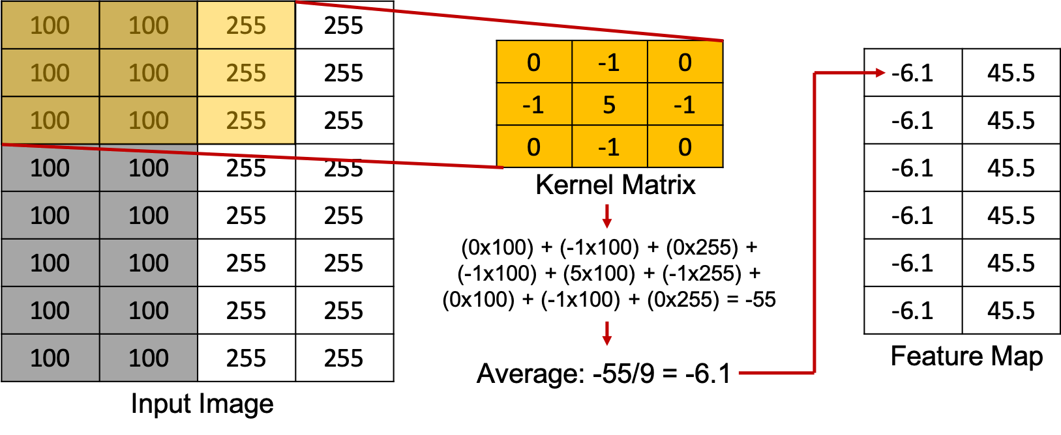
Feature Extraction
Case Study 2
Convolution layer for feature extraction
A kernel Matrix processes each input image pixel
Feature map computed via element wise matrix multiplication
Kernel matrices can be different for image sharpening, edge detection, gaussian blurring, etc.
Pooling layer shrinks the image stack by reducing the dimensionality of each feature
A series of convolution and pooling layers extracts essential features from the input image
Feature map value of -6.1 indicates asphalt road while 45.5 indicates white lane markings

Slide 53
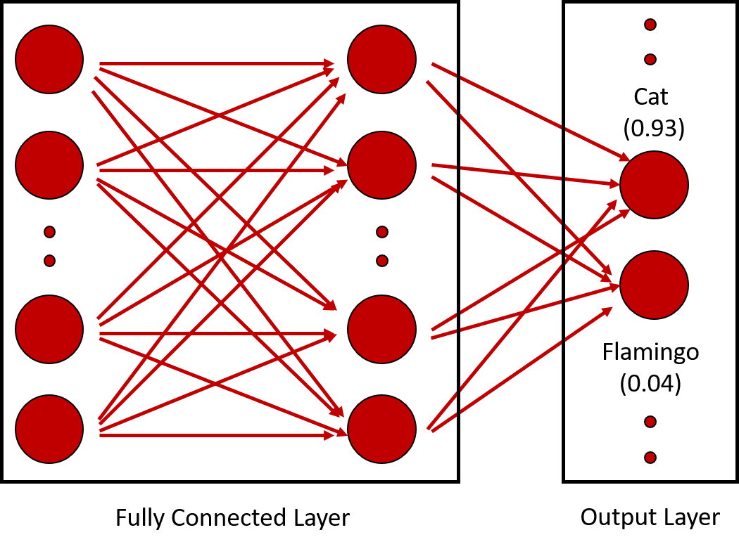
Feature Classification
Case Study 2
Output from convolution and pooling flattened into 1D array of pixels
Serves as input to the fully connected network
Each pixel corresponds to a node in the input layer
Fully connected network processes these features and outputs a probability of the class the input image belongs to

Slide 54
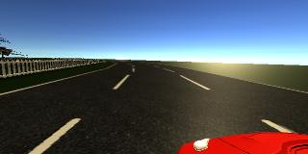
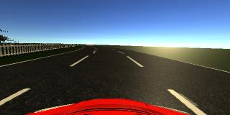
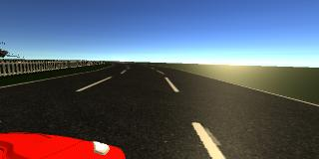
Methodology – AV Implementation
Case Study 2
Train an AV using multi-layer Convolutional Neural Network (CNN)
Required manually driving a virtual car on a specified road track
Record images and driving conditions (steering, throttle, reverse, speed) – dependent variables
Virtual cameras mounted on a Unity based car
Left, center, and right images captured as it drives – independent variables
For a given camera capture from the Unity car, what is the predicted steering value?

Slide 55
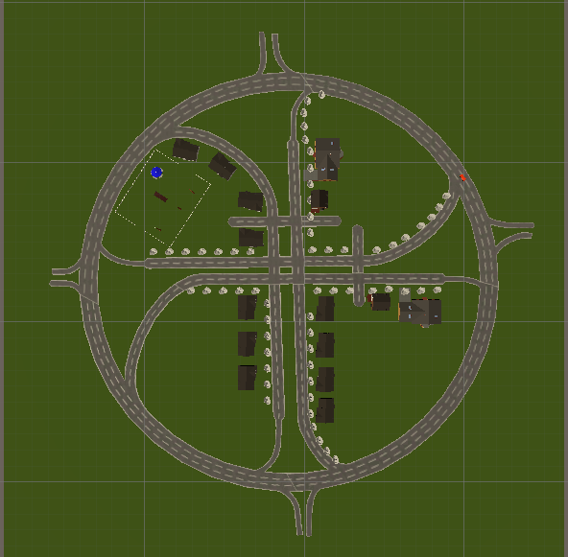
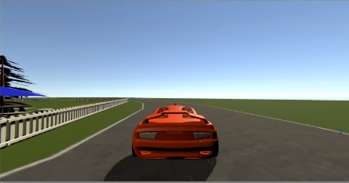
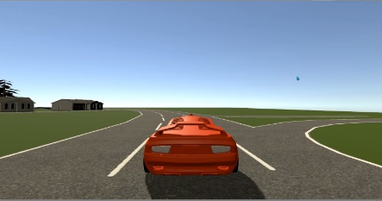
AV Implementation
Case Study 2
Two CNNs created
9-layer network Five convolutional layers Four fully-connected layers | 14-layer network Five convolutional layers, each with a batch normalization layer Four fully-connected layers
Batch normalization typically used in improving the performance and stability of a neural network
Re-centers and re-scales the input convolutional layer
Data captured with training car driving along the perimeter of a single- and a three-lane track three times CW and CCW

Slide 56
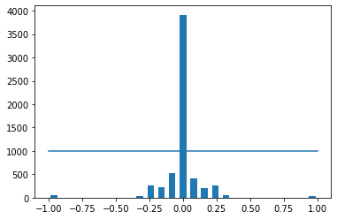
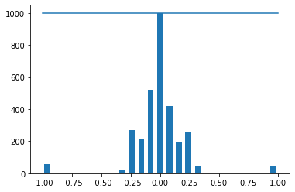
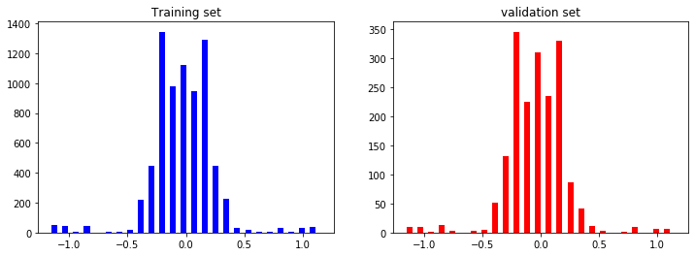
AV Implementation
Case Study 2
Biases removed
Non-zero steering values recorded due to left and right turns
Data predominantly straight steered, so straight path bias decreased (i.e., outlier reduction)
Split data into training and validation (~20% used for validation)
Training
dataset
Validation
dataset

Slide 57
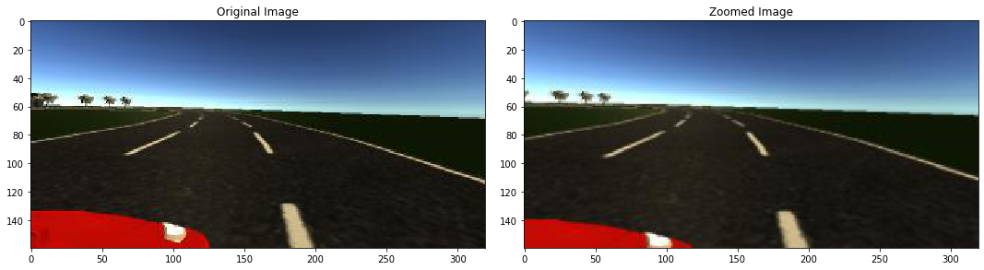
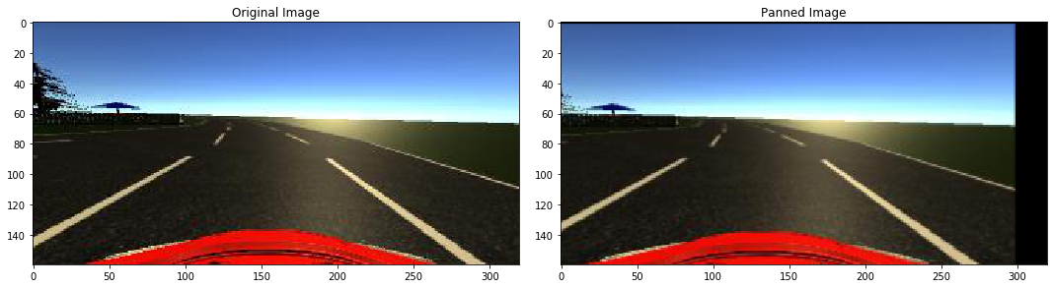
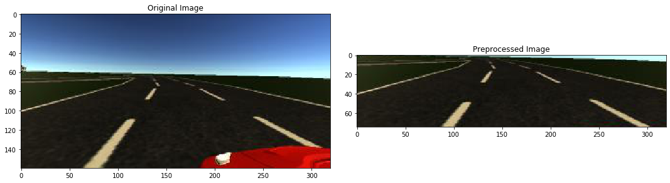
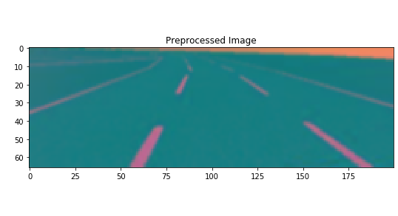
AV Implementation
Case Study 2
Augment a subset of training images to increase data diversity
Helps prevent AV drifting off-road and recover from a poor orientation
Zoom, pan, flip, brightness alter images with a 50% probability
Crop images to keep only relevant road data and convert from RGB to YUV color space

Slide 58
Results and Discussion – Testcase Setup
Case Study 2
Four exits leading in and out of the town
Evaluation metrics
Model training time
Lane departures
Did the AV exit into a local road?
Did the AV perform path correction?
Did the AV drift away?
The above metrics were evaluated for single- and three-lane AV
With and without batch normalization
With and reduced zero-steering angle bias

Slide 59
Results and Discussion – Single Lane AV
Case Study 2
Cases Metrics | With batch normalization |  | Without batch normalization
 | With zero-steer bias | Reduced zero-steer bias | With zero-steer bias | Without zero-steer bias
Model training time | 22.1 minutes | 22.3 minutes | 20.6 minutes | 20.5 minutes
Lane departures | No | No | No | No
Did the AV exit into local road? | No | No | No | No
Did the AV perform path correction? | Did not stray | Yes, recovered from the green grass area | Did not stray | Did not stray
Did the AV drift? | No | No | No | No
Computing environment: 3.6 GHz CPU, Nvidia GeForce GTX 2060

Slide 60
Results and Discussion – Three Lane AV
Case Study 2
Cases Metrics | With batch normalization |  | Without batch normalization
 | With zero-steer bias | Reduced zero-steer bias | With zero-steer bias | Without zero-steer bias
Model training time | 48.5 minutes | 47.9 minutes | 45.7 minutes | 45.8 minutes
Lane departures | Continuous fishtailing but stayed in lane | Fishtailed, and deviated | No | No
Did the AV exit into local road? | No | Yes | No | No
Did the AV perform path correction? | Corrected instantly | Eventually drove back to the 3-lane road | Corrected when the edge of lane marking reached | No correction required
Did the AV drift? | No | No | No | No
Computing environment: 4.2 GHz CPU, Nvidia GeForce GTX 1070

Slide 61
Results and Discussion
Case Study 2
PTV VISSIM traffic simulator
Can probabilistically generate 1000s of vehicles
Vehicles auto-steer based on rules stipulated by the computational road network
Synchronized traffic into Unity based visualization framework using COM server
AV integrated into VISSIM as another traffic entity via Unity and COM server
Position and direction updates from Unity are relayed to VISSIM in real-time
AV
Notes:
Each have distinguishing features. For e.g., NVIDIA DRIVE has a suite of hardware and software to perform deep neural network training and generate driving controls in real-time

Slide 62
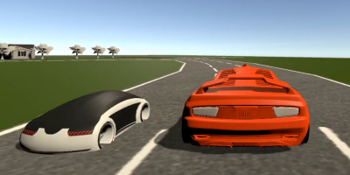
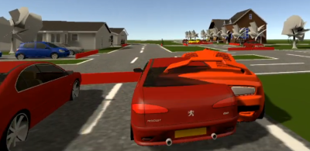
Results and Discussion
Case Study 2
VISSIM is aware of its traffic position and orientation including AV
None of the VISSIM vehicles ran into the AV
AV ran into a stopped VISSIM vehicle
It was not trained to veer around an existing vehicle
Currently, the AV behavior in such circumstances is undefined and is work in progress
VISSIM vehicles veer around the AV
AV runs into VISSIM vehicles

Slide 63
Tutorial Goal and Learning Objectives
Goal: Understanding the fundamentals of ML, and its application to XR, will empower managers to make appropriate strategic and costing decisions and allow designers, developers, and engineers to successfully implement effective training systems.
Learning objectives
Describe categories of machine learning technologies and several of their most used algorithm architectures
Describe how machine learning architectures can be leveraged for XR-enabled MS&T applications
List and compute savings (i.e., time, cost, etc.) from applying machine learning on relevant XR-enabled MS&T applications from recent case studies
Describe several ways of incorporating machine learning technology into warfighter training to increase efficacy, efficiency, cost, or time

Slide 64
Thank you for your attention
Questions?

Slide 65
References
Abadi, M., Barham, P., Chen, J., Chen, Z., Davis, A., Dean, J., Devin, M., Ghemawat, S., Irving, G., Isard, M. & others (2016). TensorFlow: A System for Large-Scale Machine Learning.. OSDI (p./pp. 265—283).
Bohemia Interactive. (2016) VBS. [Online]. Available: https: //bisimulations.com/virtual-battlespace-3.
Cameron, G. D., Duncan G. I. (1996). PARAMICS – Parallel microscopic simulation of road traffic. The journal of supercomputing, 10(1), pp. 25-53.
Casas, J., Ferrer, J. L., Garcia, D., Perarnau, J., Torday, A (2010). Traffic simulation with aimsun. In fundamentals of traffic simulation (pp. 173-232). Springer, New York, NY.
Checa, D., & Bustillo, A. (2020). A review of immersive virtual reality serious games to enhance learning and training. Multimedia Tools and Applications, 79(9–10), 5501–5527. https://doi.org/10.1007/s11042-019- 08348-9
Dosovitskiy, A., Ros, G., Codevilla, F., Lopez, A., Koltun, V. (2017). CARLA: An open urban driving simulator. arXiv preprint arXiv: 1711.03938.
End to end learning for self-driving cars. arXiv preprint arXiv:1604.07316. Kingma, D. P., & Ba, J. (2014). Adam: A method for stochastic optimization. arXiv preprint arXiv:1412.6980.
Epic Games. (2019). Unreal Engine. Retrieved from https://www.unrealengine.com
Finseth, T. T., Keren, N., Dorneich, M. C., Franke, W. D., Anderson, C. C., & Shelley, M. C. (2018). Evaluating the effectiveness of graduated stress exposure in virtual spaceflight hazard training. Journal of Cognitive Engineering and Decision Making, 12(4), 248-268.
Haas, J. K. (2014). A history of the unity game engine.
Hijazi, S., Kumar, R., & Rowen, C. (2015). Using convolutional neural networks for image recognition. Cadence Design Systems Inc.: San Jose, CA, USA, 1-12.
Ioffe, S., & Szegedy, C. (2015). Batch normalization: Accelerating deep network training by reducing internal covariate shift. arXiv preprint arXiv:1502.03167.
J. R. Koza. (1992). Genetic programming: on the programming of computers by means of natural selection. Cambridge, MA, USA: MIT Press
Jensen, L., & Konradsen, F. (2018). A review of the use of virtual reality head-mounted displays in education and training. Education and Information Technologies, 23(4), 1515–1529. https://doi.org/10.1007/s10639-017- 9676-0
Kalivarapu, V., Kohl. A, Miller. J, & Winer. E (2020). Designing a Deep Learning and Computer-Vision Based Autonomous Vehicle Within a Multimodal Traffic Simulation Framework. Interservice/Industry Training, Simulation, and Education Conference (I/ITSEC) Paper No. 20455
Kohl, A. R., & Winer, E. H. (2019). Visualizing engineering design data using a modified two-level self-organizing map clustering approach. In AIAA Aviation 2019 Forum (p. 3665)
Lele, A. (2013). Virtual reality and its military utility. Journal of Ambient Intelligence and Humanized Computing, 4(1), 17–26. https://doi.org/10.1007/s12652-011-0052-4
Li, Y. (2017). Deep reinforcement learning: An overview. arXiv preprint arXiv:1701.07274
Lockheed Martin Defense (2020). Autonomous and Unmanned Systems | Lockheed Martin. Retrieved June 17, 2020, from https://www.lockheedmartin.com/en-us/capabilities/autonomous-unmanned-systems.html

Slide 66
References
Magic Leap. (2022). Magic Leap 1 AR Information and Pricing. Retrieved from https://www.magicleap.com/magic-leap-1
Magic Leap. (2022). Shop Magic Leap 1. Retrieved from https://shop.magicleap.com/#/
Microsoft. (2022). HoloLens 2 Display. Retrieved from https://docs.microsoft.com/en-us/hololens/hololens2-display
Microsoft. (2022). HoloLens 2. Retrieved from https://www.microsoft.com/en-us/hololens/hardware
Milgram, P., Takemura, H., Utsumi, A., & Kishino, F. (1994). Augmented Reality: A class of displays on the reality-virtuality continuum. Telemanipulator and Telepresence Technologies, 2351, 282–292. http://proceedings.spiedigitallibrary.org/proceeding.aspx?articleid=981543
NVIDIA DRIVE CONSTELLATION. (2020). NVIDIA DRIVE CONSTELLATION – Virtual Reality Autonomous Vehicle Simulator. Retrieved June 17, 2020 from https://www.nvidia.com/en-us/self-driving-cars/drive-constellation/ Gazebo (2020). Gazebo Vehicle and City Simulation. Retrieved Jun 22, 2020 from http://gazebosim.org/blog/car_sim Alvarez, S. (2020). Tesla’s controversial vision-based full self-driving approach is finally paying off. Retrieved June 21, 2020. Retrieved from https://www.teslarati.com/tesla-autopilot-full-self-driving-vision-based-approach- validated-video/
NVIDIA DRIVE Platform. (2020). NVIDIA DRIVE – Autonomous Vehicle Development Platforms.
Oculus Quest 2. (2022). Quest 2 Specs. Retrieved from https://store.facebook.com/quest/products/quest-2/
Paszke, A., Gross, S., Massa, F., Lerer, A., Bradbury, J., Chanan, G., … Chintala, S. (2019). PyTorch: An Imperative Style, High-Performance Deep Learning Library. In Advances in Neural Information Processing Systems 32 (pp. 8024–8035). Curran Associates, Inc. Retrieved from http://papers.neurips.cc/paper/9015-pytorch-an-imperative-style-high-performance-deep-learning-library.pdf
Rogers, S. (2019, September 12). What We Know About HoloLens 2. Forbes. Retrieved July 7, 2022, from https://www.forbes.com/sites/solrogers/2019/09/11/what-we-know-about-hololens-2/?sh=176563cf4662
Russell, S. J., Norvig, P., & Davis, E. (2010). Artificial intelligence: a modern approach. 3rd ed. Upper Saddle River, NJ: Prentice Hall.
Shah, S., Dey, D., Lovett, C., & Kapoor, A. (2018). Airsim: High-fidelity visual and physical simulation for autonomous vehicles. In Field and service robotics (pp. 621-635). Springer, Cham.
Singh, A., Jones, S., Ganapathysubramanian, B., Sarkar, S., Mueller, D., Sandhu, K., & Nagasubramanian, K. (2021). Challenges and opportunities in machine-augmented plant stress phenotyping. Trends in Plant Science, 26(1), 53-69.
Stanney KM, Archer J, Skinner A, et al. Performance gains from adaptive eXtended Reality training fueled by artificial intelligence. The Journal of Defense Modeling and Simulation. 2022;19(2):195-218. doi:10.1177/15485129211064809

Slide 67
References
The College Tour. (2022, July 3). Graduate College and College of Veterinary Medicine at ISU | The College Tour. YouTube. Retrieved July 7, 2022, from https://www.youtube.com/watch?v=AE-9-nYBN4w
V. Mnih, A. P. Badia, M. Mirza, A. Graves, T. P. Lillicrap, T. Harley, D. Silver, and K. Kavukcuoglu. (2016). “Asynchronous methods for deep rein- forcement learning,” in International Conference on Machine Learning.
Varjo XR-3. (2022). Varjo XR-3. Retrieved from https://store.varjo.com/xr-3
Virtual Reality Applications Center. (2022). Public Tour Slide Deck.
Vive Focus 3. (2022). VIVE Focus 3 Specs. Retrieved from https://www.vive.com/us/product/vive-focus3/specs/
Vive Pro 2. (2022). VIVE Pro 2 Specs. Retrieved from https://www.vive.com/us/product/vive-pro2/specs/

