Slide 1
IEEE 1278TM Standard for
Distributed Interactive Simulaion (DIS):
Concepts and Techniques
Robert Murray, SimPhonics
bobmurray222@gmail.com
22 September 2023

Slide 2
Disclaimer
Any comments and interpretations of the IEEE Standards discussed in this tutorial do not represent the view of the IEEE, IEEE-SA, its members or affiliates

Slide 3
Learning Objectives
The student will be able to explain the capabilities of DIS
  What problems it solves
  Capabilities for Live-Virtual-Constructive (LVC) Simulation Networking
The history of DIS will allow the student to discuss:
  How it has evolved
  Its future direction
The student will be able to explain the key definitions and concepts of DIS
The student will be able to describe the technical details of:
  The type of information conveyed by DIS
  Techniques for distributing real-time high-fidelity simulation data over wide area networks

Slide 4
Intended Audience
Modeling and simulation implementors and managers who require an understanding of
  Distributed simulation in the Live, Virtual, and Constructive (LVC) domain
  Specifics of how DIS meets of the requirements of interoperability between the widely varying types of geographically distributed LVC simulations

Slide 5

Tutorial Outline
The Past
  LVC simulation and its use for training, R&D, and engineering
  History of networked simulation
The Present
  The IEEE 1278TM DIS standard and how it is developed
  Key definitions and concepts
  Function and organization of DIS Protocol Data Units
  Technical details of providing high-fidelity real-time information exchange
  Improvements from the 1995 to the 2012 DIS standards
The Future: The current development effort for the next version of the DIS standard with yet more improvements

Slide 6
LVC Simulation
Live – real humans operating real systems not in actual warfare
Virtual – real humans operating simulated systems
Constructive – simulated humans operating simulated systems
LVC is the common term for simulations suitable for:
  Human in the loop simulation used for training or engineering test
  Hardware in the loop simulation for testing real-world mission systems
  Integrating live platforms into a simulation environment
  Constructive simulations to add realism to human training or mission system test
The common denominator is real-time simulation execution with sufficient modeling fidelity to immerse a human or system under test

Slide 7
Networked Simulation for Training and Test
By the 1980’s, computers, image generators, and standard networks had become fast enough to attempt connecting separate simulators so that they could interact
Allows more simulation entities to be generated
Result is a more complex simulation environments provides better training and testing under realistic conditions
Geographically distributed simulation also becomes feasible
  Long-haul networks connect simulation facilities across the globe
  Participants can participate in large training exercises at their home base
  Connection between various types of air/land/sea assets at different locations allows more realistic training

Slide 8
Distributed Mission Operations Network

Slide 9
Desired Capabilities of LVC Networking
Real-time simulation at entity level (weapons platforms, munitions, etc.)
Generally, effects-based simulation instead of highly detailed physics models
Simulation interoperability of:
  See and be seen with accurate visual and time-space-position information (TSPI)
  Weapons engagement with fair fight damage assessment
  Radar, infrared sensors, laser designators, underwater acoustics, and associated jamming
  Radio communications for voice and datalinks
  Collisions, Logistics, Synthetic Environment, Information Operations
Simulation Management
  Start/Stop, simulator initialization and control, data logging and analysis

Slide 10
The Beginning - SIMNET
The Defense Advanced Research Projects Agency (DARPA) created the SIMNET program in the 1980’s to test simulation networking techniques
Connected simulators for tanks, helicopters, airplanes
Developed the concept of dead reckoning
Demonstrated long-haul simulation interactions using dial-up network
By the late 80’s, its success was obvious and compelling
SIMNET developers and other experts doing similar work in the defense industry organized in 1989 to create a broader standard
  This was the first DIS workshop

Slide 11
Development of DIS
The DIS workshops met twice yearly from 1989 to 1995
  Subgroups also had intermediate meetings between the regular workshops
The workshop quickly grew to over 1,000 participants attending
Decision to involve IEEE to learn how to create standards
The first standard in 1993 based on SIMNET
Significant work led to a much-expanded standard in 1995
Additions in 1998 filled out the most needed capability
The 1995/1998 standard became widely implemented

Slide 12
SISO
DIS workshops were replaced by the Simulation Interoperability Standards Organization (SISO) in 1996
SISO is an approved IEEE standards committee for simulation standards
  IEEE Std 1278™ DIS
  IEEE Std 1516™ High Level Architecture (HLA)
  IEEE Std 1730™ Distributed Simulation Engineering and Execution Process (DSEEP)
SISO also develops a wide range of non-IEEE simulation standards
  Command and Control, Distributed Debrief, Common Image Generator Interface, Coalition Battle Management Language, Military Scenario Definition Language, and many more
  Guidance and Reference products e.g., simulation enumerations
Work restarted on DIS in 2004 within SISO to develop the current 2012 standard
Anyone can join SISO and participate

Slide 13
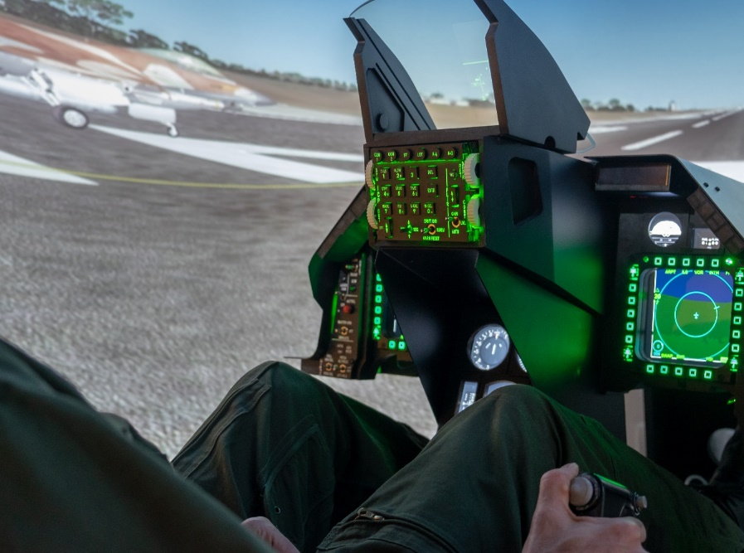
Tutorial Outline
The Past
  LVC simulation and its use for training, R&D, and engineering
  History of networked simulation
The Present
  The IEEE 1278TM DIS standard and how it is developed
  Key definitions and concepts
  Function and organization of DIS Protocol Data Units
  Technical details of providing high-fidelity real-time information exchange
  Improvements from the 1995 to the 2012 DIS standards
The Future: The current development effort for the next version of the DIS standard with yet more improvements

Slide 14
Current DIS Development Process
SISO holds a yearly workshop in Orlando in February
  Simulation Innovation Workshop (SIW)
  But most standards development work is done virtually
Weekly telecons to review proposed standards content
When a significant amount of content is ready, the drafting process starts
  This begins the formal IEEE process, expected to be done within 4 years
The draft standard content is reviewed, and comments submitted
Voting process resolves conflicts
When draft is ready, it is handed to IEEE for the final balloting process
  Balloting is open to a larger population, even outside of SISO
IEEE publishes the standards after a final edit

Slide 15
IEEE 1278 Distributed Interactive Simulation
Distributed Interactive Simulation (DIS)
  Time and space coherent synthetic representation of world environments
  Designed for linking the interactive, free-play activities of participants in operational simulation exercises
  Synthetic environment is created through real-time exchange of data units between distributed, computationally autonomous simulation applications
  Simulators may be present in one location or may be distributed geographically
  Defined by the IEEE 1278™ family of standards
DIS defines standard network Protocol Data Units (PDUs)
  Syntax (data format) and semantics (rules) for data exchange and simulation interoperability

Slide 16
Protocol Data Unit (PDU) Example
Detonation PDU (Version 8)
DIS PDUs typically use User Datagram Protocol / Internet Protocol (UDP/IP)
Operating System network stack inserts PDU in UDP/IP datagram for transfer on network

Slide 17
DIS Documentation Relationships
Distributed Interactive Simulation standards, recommended practices, and related documents
IEEE Std 1278.1TM- 2012
Standard for DIS
—
Application Protocols
IEEE Std 1278.2TM-
2015
Standard for DIS
—
Communications Services and Protocols
IEEE 1730TM-2010
Distributed Simulation Engineering and Execution Process
IEEE 1278.4TM-1997
Rec. Prac. for DIS —
Verification, Validation, and Accreditation
SISO-REF-010 Enumerations for Simulation Interoperability

Slide 18
DIS Versions
V1 - DIS PDU version 1.0 (May 1992)
V2 - IEEE Std 1278TM-1993 (Gen 1)
V3 - DIS PDU version 2.0 – draft (May 1993)
V4 - DIS PDU version 2.0 – draft (Mar 1994)
V5 - IEEE Std 1278.1TM-1995 (Gen 2)
V6 - IEEE Std 1278.1aTM-1998 (Gen 2)
V7 - IEEE Std 1278.1TM-2012 (Gen 2)
V8 - IEEE Std 1278.1TM – Next Version (Gen 3) In Work

Slide 19
Key DIS Concepts
No central computer controls the entire simulation exercise
  No single point of failure
Autonomous simulation applications are responsible for maintaining the state of one or more simulation entities
A standard network protocol is used for communicating ground truth data
  Changes in the state of an entity are communicated by its controlling simulation application
Perception of entities or events is determined by the receiving application
Dead reckoning algorithms are used to reduce communications processing
Stateful information is sent repeatedly at a heartbeat rate or faster

Slide 20
Key DIS Definitions
Simulation application:
  Executing software on a host computer that models all or part of the representation of one or more simulation entities and/or phenomena in the virtual world
  Receives and processes information concerning entities created by peer simulation applications through the exchange of DIS PDUs
  More than one simulation application may simultaneously execute on a host computer
Host Computer:
  Computer connected to simulation network that supports one or more simulation application
Simulation entity:
  A physical object in the synthetic environment that is created and controlled by a simulation application and affected by the exchange of DIS PDUs
  IEEE Std 1278.1TM-2012, Clause 3.1

Slide 21
Key DIS Definitions (cont.)
Simulation exercise:
  An exercise that consists of one or more interacting simulation applications
  Simulations participating in the same simulation exercise share a common identifying number called the exercise identifier
  Simulations utilize correlated representations of the synthetic environment in which they operate
Simulation environment:
  The operational virtual environment surrounding the simulation entities
  Includes terrain, atmospheric, and oceanographic information
  Participants in the same DIS exercise will be using environment information that is adequately correlated for the type of exercise to be performed
  IEEE Std 1278.1TM-2012, Clause 3.1

Slide 22
Network Considerations
PDUs are sent using broadcast or multicast addressing
Broadcast – every computer on the Local Area Network will receive the PDU
  Broadcast does not work on Wide Area Networks
  Some type of gateway is necessary at the LAN/WAN boundary to translate addresses
Multicast – every computer that has joined the multicast address group will receive the PDU, an efficient publish/subscribe mechanism
  Multicast on WANs is possible, or use Generic Routing Encapsulation (GRE) to tunnel
PDUs are almost always sent using User Datagram Protocol (UDP/IP) transport
  Best effort – no guarantee of delivery, but networks can be designed to be very reliable
Unicast addressing with TCP/IP* (reliable) transport can be used, but uncommon
IEEE 1278.2™-2015 has details of design for real-time networks
* Transmission Control Protocol / Internet Protocol

Slide 23
DIS PDUs
Entity information/interaction
  Entity State – fundamental position and appearance of an entity
  Collision – convey details of tactically significant collisions
  Attribute PDU (new in Version 7) – adds PDU extensibility for customization
Warfare
  Fire – launch munitions or expendables, fire a gun
  Detonation – details of a weapons hit or explosion
  Directed Energy Fire (new in Version 7) – deposition of an energy weapon
  Entity Damage Status (new in Version 7) – damage fed back to firing entity

Slide 24
DIS PDUs (Cont)
Logistics
  Service Request
  Resupply Offer, Resupply Received, Resupply Cancel
  Repair Complete, Repair Response
Simulation Management
  Create Entity, Remove Entity
  Start/Resume, Stop/Freeze
  Acknowledge
  Action Request, Action Response
  Data Query, Set Data, Data
  Event Report, Comment
  Application Control (new in Version 8)

Slide 25
DIS PDUs (Cont)
Distributed Emission Regeneration
  Electromagnetic Emission – Radar and radar jamming, Infrared Jamming
  Designator (being renamed to Laser) – all uses of lasers that are not a weapon
  Underwater Acoustics – Sonar, passive acoustic sensors
  IFF – Identification Friend or Foe, military and civilian transponders and interrogators
Radio Communications
  Transmitter, Intercom, Receiver – state of radio or communications node
  Signal – transfer of communications voice and data
Entity Management
  Aggregate State, IsPartOf – entities grouping
  Transfer Ownership – hand off control of an entity to another simulator

Slide 26
DIS PDUs (Cont)
Synthetic Environment
  Environmental Processes – smoke, contrails, dust, obscurants, toxic chemicals
  Gridded Data – dynamic terrain, soil, vegetation, wind
  Point, Linear, and Areal Objects - dynamic objects such as craters, trenches, cultural features with damage
    Environment Objects are combining with Entities in DIS Version 8
Information Operations (new in Version 7)
  Simulate the use of electronic warfare, computer network attack, military deception to influence or disrupt decision making
  Information Operations Action – transmits predicted effects of an attack
  Information Operations Response – reports actual effects

Slide 27
Entity Coordinates
Φ = latitude
North Pole
Z
λ = longitude
a = major axis
Geocentric Cartesian Coordinates
  Position and Orientation
WGS-84 elliptical Earth model
Units in meters and radians
DIS V8 will clarify that geoid gravity model is not included
  Mean Sea Level is modeled as the WGS-84 ellipsoid
  Altitude is height above ellipsoid
b = minor axis
Prime Meridian
X,Y,Z = GCC position
b
Z
r
a
Φ
a
Y
λ
p
X
Y
X
Equator

Slide 28
Entity Type Identification
Hierarchical designation of Entity Type
Enumerations are listed in SISO-REF-010
  Over 20,000 entity types
ENTITY TYPE RECORD
Entity Kind | 8-bit enumeration
Domain | 8-bit enumeration
Country of design | 16-bit enumeration
Category | 8-bit enumeration
Sub-Category | 8-bit enumeration
Specific | 8-bit enumeration
Extra | 8-bit enumeration

Slide 29
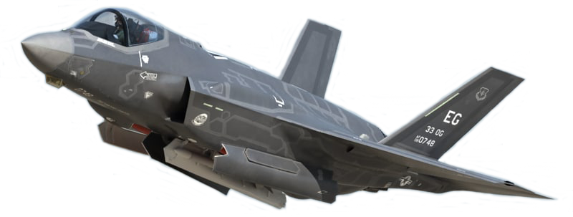
Examples of Type Enumerations
 | Kind | Domain | Country | Category | Sub-Category | Specific | Extra
F-35A CTOL | 1 | 2 | 225 | 1 | 12 | 1 | -
Notes:
Kind – 1 – Platform
Domain – 2 – Air
Country – 225 – USA
Category – 1 – Fighter/Air Defense
Sub-Category – 12 – F-35
Specific – 1 – F-35A CTOL

Slide 30
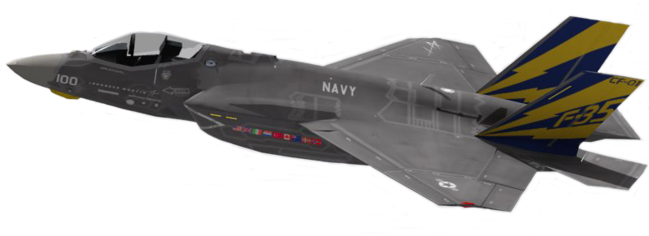
Examples of Type Enumerations
 | Kind | Domain | Country | Category | Sub-Category | Specific | Extra
F-35C Naval | 1 | 2 | 225 | 1 | 12 | 2 | -
Notes:
Kind – 1 – Platform
Domain – 2 – Air
Country – 225 – USA
Category – 1 – Fighter/Air Defense
Sub-Category – 12 – F-35
Specific – 2 – F-35C NAVAL

Slide 31
Entity Instance Identification
Combination of 3 numbers identify individual entities and objects
  Exercises assign site numbers
  Sites assign numbers to simulations at the site
  Sims assign entity numbers
Site | 16-bit unsigned integer
Application | 16-bit unsigned integer
Entity | 16-bit unsigned integer

Slide 32
Dead Reckoning Basics
Entity sender publishes state and information needed to predict state over time
  Velocity (rate of change), acceleration
Receivers dead reckon (extrapolate) between updates
Sender also extrapolates its own entity to know what receivers see
New PDU issued when error between truth and extrapolation exceeds a threshold
Dead reckoning solves three problems
  Significantly reduces the PDU issuance rate, requiring less network bandwidth
  Compensates for network latency
  Corrects position error due to unsynchronized simulation frame times

Slide 33
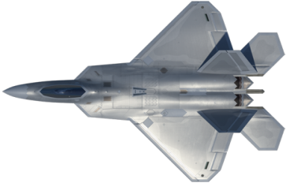
Dead Reckoning and Smoothing
Entity sends update when error > threshold
Receiver extrapolates between updates
Spatial jump at update is smoothed over the next few seconds
Green Line: Internal “truth” model (sender)
Red Line: Dead Reckoned (extrapolated) model
(sender and receiver)
Blue Line: Smoothing model (receiver)

Slide 34
Positional Dead Reckoning, “World” DRA 2-5
Dead Reckoning Algorithm 2 and 3
  P = P_{update} + VΔt
  where Δt is time since last update
Dead Reckoning Algorithm 4 and 5
  P = P_{update} + VΔt + ½AΔt²
Extrapolates to a parabolic path through space
Error checked in each of 3 axes
  If any exceeds threshold, send update
No change in DIS V7

Slide 35
Positional Dead Reckoning, “Body” DRA 6-9
DRA 6-9 use rotation rate and body coordinate velocity and acceleration to achieve better prediction of turning vehicles
Extrapolates to a circular or spiral path through space
  Math is more complicated and not used as much as DRA 2-5
  But it performs much better in some situations, should be used more
No change in DIS V7 but errors in the math formulas were fixed
See E.7.3 in IEEE Std 1278.1TM-2012

Slide 36
Rotational Dead Reckoning
DRA 2, 5, 6, 9 have no rotational dead reckoning
DRA 3, 4, 7, 8 all have the same rotational DR formula
  [R_{D}]_{w->b} = [DR][R₀]_{w->b}
  Rotation rates are required
Entity State PDU: rotation rates are given as a vector ω in body coordinates
  Direction of vector is axis of rotation
  Magnitude |ω| is rate of rotation about axis
Receivers extrapolate orientation by rotating an entity about the axis by angle |ω|Δt, used to form the [DR] matrix
There is no acceleration in this math

Slide 37
Simpler Dead Reckoning for DIS Version 8
Eight DR algorithms leaves too many choices
  Hinders interoperability
  Implementers don’t always pick the best one
DIS Version 8 makes distinction between “algorithm” and “formula”
Position DR formulas renamed
  Parabolic Formula (formerly World algorithms 2-5)
  Circular Formula (formerly Body algorithms 6-9)
Only one algorithm for moving entities
  Algorithm can choose the best DR formula
  Now called the Combined Parabolic Circular (CPC) Dead Reckoning Algorithm
  CPC algorithm enumeration is 10

Slide 38
Formula Results Comparison
This shows a 500 knot turning aircraft with 20 seconds of extrapolation
Circular vs Parabolic is apparent
See SISO paper
  2019-SIW-034
CPC algorithm in DIS Version 8 chooses the best formula
  Circular if applicable
  Parabolic otherwise

Slide 39
CPC DRA Code Implementation
A reference code implementation of the CPC DR Algorithm is available in SourceForge, Version 1.0 matches DIS Version 8 Draft 1
  https://sourceforge.net/projects/dsu/
  Written in C for easy use by multiple languages
  Implements both position extrapolation formulas
  Implements rotation extrapolation
  Includes the improved orientation threshold method
Coordinate Conversion code is included
  Not needed for CPC DRA, but helps in testing it

Slide 40
Heartbeats and Timeouts
PDUs are categorized as stateful (persistent info) or transient (one-time event)
Stateful PDUs are issued repeatedly at a minimum heartbeat rate
This solves two problems:
  Late joiners get the full state of the exercise within one heartbeat period
  If a PDU is dropped due to network error, the next update arrives within a heartbeat period
The default heartbeat period for each PDU type is listed in the DIS standard
  Heartbeats vary from 5 to 60 seconds depending on PDU type and conditions
  Exercises can change heartbeat periods by agreement
Receivers keep a timeout timer for each entity
  If no information has arrived within 2.4 heartbeat periods, the entity is discarded
  Solves the problem of simulation crashes or if the entity deactivation PDU is dropped

Slide 41
Techniques to Solve Network Issues
Network latency and jitter – due to speed of light and network processing time
  Dead Reckoning compensates for position error caused by network delay
  Issuance and receipt rules mitigate effects of latency
    e.g., sender transmits that detonation or collision hit target, receiver determines damage
Bandwidth – both the size and number of PDUs consume network resources
  Efficient PDU design with a binary format to send the minimum data necessary
  PDU sent only when a parameter change exceeds a threshold value
  Dead Reckoning - TSPI data sent every few seconds instead of every simulation frame
  Design for reduced data, e.g. receiver lookup table with a single index in PDU
Network Reliability – PDUs get lost, it’s rare but it happens
  Efficient PDU design helps prevent overloading networks, reduces dropped data
  State data repeated at a regular heartbeat interval

Slide 42
Improvements in DIS 2012 (Version 7)
New and improved rules
  Lessons learned from over 15 years of use
The 2012 standard is 747 pages
The 1995 and 1998 standards combined were 330 pages
Even if you do not need any of the new features, the 2012 standard is still extremely useful

Slide 43
Compatibility with Version 5/6
Almost every change in the PDU formats and rules are backward compatible with Version 5/6 PDUs
Most changes are also forward compatible (i.e. Version 5 simulations can still make sense of Version 7 PDUs)
Use of former padding fields
  New sims can add new information, old sims ignore it
Rules for interoperability between Version 5/6 and Version 7 are defined
  Mixed version exercises are allowed
  A single sim may issue both 5/6 and 7

Slide 44
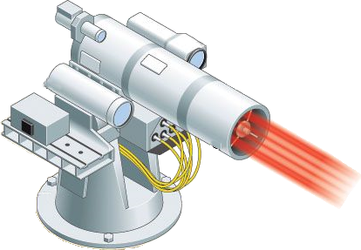
Five New PDUs in DIS V7
Directed Energy Weapons
  Directed Energy Fire PDU
  Entity Damage Status PDU
Information Operations
  IO Action PDU
  IO Report PDU
Attribute PDU
  Adds a general means of extensibility to the DIS standard

Slide 45
Some Other Improvements
DIS V7 is more easily customized
  Variable Parameter Records for Entity State, Detonation PDUs
  Standard Variable Records for Transmitter, IFF, DE Fire, Entity Damage, Information Operations
Radar
  Better description of radar beam parameters, scan volumes, phased array radar
  Jammer field redefined to better support a wider range of multi-resolution simulations
IFF
  Mode 5 and Mode S added
  The requirements related to each IFF transponder and interrogator system type are clearly specified in a new Annex
Radio
  Extensive Transmitter PDU clarifications
  New Annex for radio systems specifics

Slide 46
Other Simulation Networking Standards
Test and Training Enabling Architecture (TENA)
  Connects systems on a live training range
Common Training Instrumentation Architecture (CTIA)
  Connectivity for live soldier training
Compressed DIS
  New SISO standard that compresses DIS data to connect live entities on low bandwidth radio data links, designed to be easily translated to/from regular DIS
HLA – High Level Architecture
  IEEE Std 1516™ High Level Architecture (HLA)
  A general-purpose network solution to connect any type of simulation
  Includes time management services for discrete event simulation

Slide 47


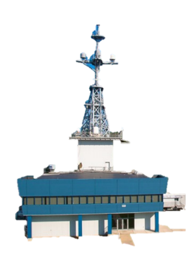





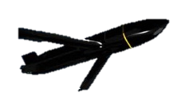



An LVC Exercise with CDIS
Atlantic Test Range (ATR)
SLATE Ground Station
& Link Inject to Live (LITL)
Westover RRU
NAS JAX
Virtual
MH-60R
SAIL
(BFTT)
Pax RRU
Live
EA-18G
Live Guised Red Air
Manned Flight Simulator (MFS)
Constructive Weapons Fly-out
(F/A-18 Cockpit Surrogates)
(F-35 Effects Based Sim)
(LCTs)
LEGEND
Virtual
F/A-18E/F
Blue Live
Blue Virtual
Red Constructive
5GATW
NCTE
SDREN
Virtual
MH-60R
Live
F/A-18E/F
Constructive Threats
Virtual
F-35
NAVAIR Public Release 2021-394 Distribution Statement A - "Approved for public release; distribution is unlimited"

Slide 48
How HLA is Different than DIS
The High Level Architecture standard has three parts
  Framework and Rules
  Application Programming Interface (API) specification
  Object Model Template specification
    Template for creating a Federation Object Model (FOM)
HLA provides publish/subscribe services for distributing data and managing time
  But doesn’t specify what that data is (syntax) or rules of using it (semantics)
Each federation of simulations is responsible for defining its FOM
  Typically, a consensus design among all the simulations that are being federated
The Run-Time Infrastructure (RTI) is middleware that implements the HLA API
  The network protocol is designed by the RTI developers, not standardized

Slide 49
RPR FOM
The LVC community can be standardized well beyond the HLA spec
  Reference FOMs were conceived as the solution for this
SISO developed the Real-time Platform Reference FOM (RPR FOM)
  SISO-STD-001
Converts DIS PDU contents into an HLA FOM
  Actual SISO standard is the Guidance, Rationale, and Interoperability Modalities (GRIM)
  Still need the DIS standard for the semantics, i.e., the rules for using the FOM
    For example, the DIS is the only standard that defines Dead Reckoning, weapon interactions, etc.
  RPR FOM Versions
    RPR FOM 2 matches DIS Version 6
    RPR FOM 3 matches DIS Version 7
    RPR FOM 4 is planned for DIS Version 8

Slide 50

Tutorial Outline
The Past
  LVC simulation and its use for training, R&D, and engineering
  History of networked simulation
The Present
  The IEEE 1278TM DIS standard and how it is developed
  Key definitions and concepts
  Function and organization of DIS Protocol Data Units
  Technical details of providing high-fidelity real-time information exchange
  Improvements from the 1995 to the 2012 DIS standards
The Future: The current development effort for the next version of the DIS standard with yet more improvements

Slide 51
Currently in Development - DIS Version 8
We have learned a lot in the 30 years since DIS was originally developed
We are running out of tricks to extend the protocol and maintain compatibility
The time is right for DIS Version 8 to have a new generation of PDU design
This requires breaking PDU compatibility with previous versions of DIS
  Version 8 is being designed for “Translation Compatibility” so that run-time translation to/from Version 7 is practical, although not necessarily trivial
Creation of DIS Version 8 is about 80% complete
  Hope to have final draft in late 2024, ready for IEEE balloting process in 2025
  But any attempt to estimate volunteer standards development is fraught with peril

Slide 52
Consistent PDU Design
Every PDU type will have this basic format:
  Header
  Fixed Body
  Any number of Extension Records – allows added fidelity & extensibility
The header is the same for every PDU type
The fixed body has the basic fidelity information
  Fixed in format and length, no variability allowed
  Quick initial processing by receiver for interest management
Extension Records allow added customization for fidelity extended use cases

Slide 53
Example of PDU Extension
Entity State PDU with Articulated Parts extension record

Slide 54
PDU Extensibility
Allows DIS users to add custom information to PDUs to meet their unique needs
Recognized during development of DIS Version 7 as an important capability
A proposal to add a variable record section to the end of every PDU was narrowly voted down
  For Version 7, compatibility with previous versions was considered more important
DIS Version 8 breaks direct compatibility so that is no longer an issue
The five new PDUs in Version 7 all had the variable record section for extensibility
This same extensibility mechanism is now available in all PDUs in Version 8
We expect many custom records in the future
  SISO-REF-030 proposed as a document to standardize extension records

Slide 55
Machine Readable Syntax Definition
Clean PDU design enables formal language to describe PDU format
<DISsyntax xmlns:xsi="http://www.w3.org/2001/XMLSchema-instance"
xsi:noNamespaceSchemaLocation="DISsyntax.xsd">
<PDU name="Entity State" PDUType="1" protocolFamily="1" baseLength=“96">
<FixedRecordField name="Header" type="HeaderRecord"/>
<FixedRecordField name="Entity ID" type="EntityIdentifierRecord"/>
<EnumField name="Force ID" type="enum8" enumTableUID="6"/>
<EnumField name="Dead Reckoning Algorithm" type="enum8" enumTableUID="44"/>
<FixedRecordField name="Entity Type" type="EntityTypeRecord"/>
<VariantRecordField name="Entity Appearance" type="EntityAppearanceRecord"
discriminant="Entity Type" field1="Kind" field2="Domain"/>
<VariantRecordField name="Capabilities" type="CapabilitiesRecord"
discriminant="Entity Type" field1="Kind" field2="Domain"/>
<FixedRecordField name="Entity Location" type=“WorldCoordinatesRecord"/>
<FixedRecordField name="Entity Orientation" type="EulerAnglesRecord"/>
<FixedStringField name =“Entity Marking” length=“12”/>
<NumericField name="Padding" type="uint32"/>
<NumericField name="Padding" type="uint16"/>
<StandardVariableRecord>
<CountField name="Number of Variable Records" type="uint16"/>
<VariableRecordFields/>
</StandardVariableRecord>
</PDU>
</DISsyntax>
  Enables auto code generation
    Wireshark dissectors
    Marshalling code

Slide 56
Interest Management
Interest Management reduces sim workload by eliminating unwanted PDUs
  Send-side interest management uses multicast addressing
    Sent only to simulators that have subscribed to that multicast address
  Receive-side interest management is commonly called filtering
    Software filters (discards) PDUs as efficiently as possible
Version 8 PDU design rules promote interest management
  Add information necessary to assign multicast address and filter PDUs
  Put it in fixed body rather than optional variable records
IEEE Std 1278.2TM-2015 DIS Communication Services and Profiles
  Formalized terminology for DIS Interest Management

Slide 57
More Improvements in DIS V8
Support for AESA radar and advanced jamming
  Re-design of EE PDU, may extension records for high fidelity radar
New SIMAN Application Control PDU
  Simulator device discovery, exercise control, and simulator health monitoring
Communications improvements
  Better definition of radio vs non-radio communication (intercom, telephone, etc.)
  Transmitter and Communications Node PDUs better align with Information Operations PDUs
Gridded Data PDU is planned to have an overhaul to simplify use

Slide 58
Yet More Improvements for DIS V8
Combine entities and environmental objects
  Point, Linear, Areal objects now use Entity State PDU
  Avoids duplication between the old environmental object types and entity types
New records to update a very large number of entities efficiently
  Large exercises of 100,000 to a million entities envisioned
Better, simpler timestamp
  64-bit integer, microseconds since Jan 1, 1970, no rollover
Single Dead Reckoning Algorithm that works for all moving entities
Eliminate redundant and unused PDUs
  Will reduce PDU count from 72 to 40

Slide 59
Status of DIS V8
7 years of work by Product Support Group (PSG) within SISO
Product Development Group (PDG) stood up in 2021, starting the IEEE drafting process (4 year time limit)
First draft published in November 2022
  About 75% of content is in first draft
  Contains general requirements, 34 PDUs, many records, 4 annexes
  Over 250 comments, most resolved and incorporated into Draft 2 (October 2023)
Remaining work
  Gridded Data PDU for weather and dynamic terrain
  IFF (2 PDUs), Transfer Ownership, Aggregate State, Receiver PDUs
  General opening clauses: Overview, Conventions, References, Definition

Slide 60
Obtaining the DIS Standard
The DIS standard can be purchased directly from IEEE
Many companies have access to IEEE products for their employees
SISO members have access to IEEE standards developed by SISO
  Annual membership is $95, less than the cost of an IEEE standard publication
  Or, 1 year of membership is included in the SISO workshop registration fee
Any SISO member can join the DIS Product Development Group (PDG) and get access to the DIS Version 8 drafts

Slide 61
What You’ve Learned
The problem DIS solves
The capabilities of Live-Virtual-Constructive (LVC) Simulation Networking
The history of DIS
  How it has evolved
  Future direction
Key Definitions and Concepts
Technical details of
  The type of information conveyed by DIS
  Techniques for distributing real-time high-fidelity simulation data

Slide 62



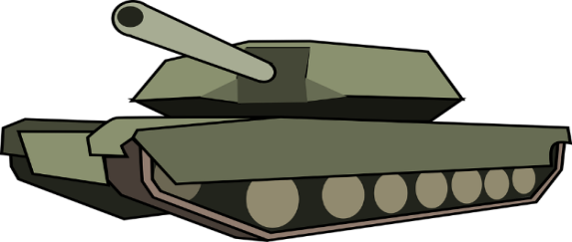
Questions?

