Slide 1

Building Trusted AI: An Introduction to Human-AI Trust
Dr. Mike van Lent, Director of AI
Dr. JT Folsom-Kovarik, Senior Scientist

Slide 2
Tutorial Outline
Introductions
Background and Key Concepts
Theoretical and Practical Trust Frameworks
Requirements for Trustworthy and Trustable AI
Measuring Trust in AI
Calibrating Trust in AI
Training and Simulation Applications and Case Studies
The Future of Trust

Slide 3
Learning Objectives
Define trustworthy, trustable, and trusted in human-AI teaming and recognize examples of each
List five theoretical and applied frameworks that are useful to evaluate trust in human-AI teaming case studies
Discuss how to incorporate trusted AI into product specifications, design requirements, objective measurements, and fielded processes

Slide 4
Audience
Operational users
When should I trust AI?
AI creators
How can we make trustworthy AI?
Training and simulation developers
How can we validate the AI?
AI requirements writers
What tests and metrics describe trusted AI?

Slide 5
Speaker Introductions
Career aspiration: “sit in a room and think about artificial intelligence.”
AI researcher
AI creator, designer, and requirements writer
AI end user
28 years of DoD-funded AI research
SoarTech (DARPA, Navy, Army, Air Force, DoD)
USC ICT (Army, DMSO, DHS, DARPA)
U of Michigan (Ph.D. student, DARPA, Navy)
Naval Research Lab (Summer Intern)

Slide 6
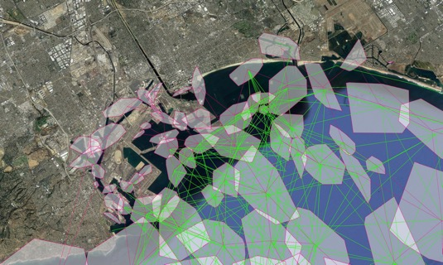
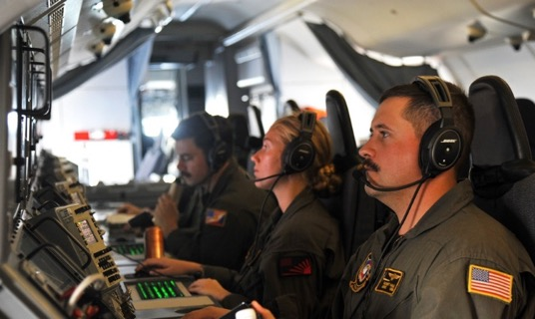
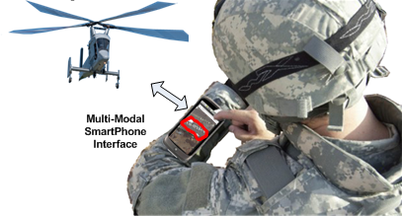
AI Force Multipliers for MS&T
Force simulation
Controlling thousands of entities and interactions
Executing realistic and training-supportive behaviors
Dialogue and speech
Role players that reduce number of people needed to train
Recognize and interact with natural-language dialogue
Platform and swarm control
Interpret high-level directives and plan low-level actions
Reduce workload and increase situation awareness
Center image credit: PO1 Kevin Flinn, https://www.dvidshub.net/image/4853738/vp-47-responds-typhoon-yutu
The appearance of U.S. Department of Defense (DoD) visual information does not imply or constitute DoD endorsement.

Slide 7

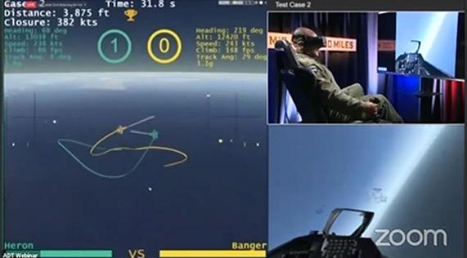
AI as a Trusted Partner
A Trusted Tool
Works as expected by always working the same way
A Trusted Partner
Works as expected by adapting to do the right thing based on context and situation
Trusted:
Predictable
Dependable
DARPA’s AlphaDogfight points the way to a future AI wingman
Image credit: Grieslightnin, https://pixabay.com/photos/hammer-nails-wood-board-tool-work-1629587/
Image credit: DARPA, https://www.darpa.mil/news-events/2020-08-26

Slide 8
Defining Trust
Trust: choosing to give someone else control
Trust arises from a belief that another person has:
Ability
Integrity
Benevolence
Trust in AI should have a similar basis:
The AI is useful for a task
The AI is reliable in certain circumstances
The AI is aligned with the user’s decision-making process and values
We’ll dive deep on definitions of trust later today

Slide 9
But in Practice AI Is Imperfect
AI missing an ability
A chat AI might answer questions or even write code, but make errors in basic math
E.g., “103 can be divided evenly by 3 and by 101, so it is not a prime number.”
AI not reliable in a situation
The first pedestrian fatality with a self-driving car
Contributing factors: nighttime, person outside crosswalk, person walking a bike
AI biased or unethical
A hospital used commercial AI to guide health decisions
The AI was trained on prior decisions. Race was never an input
However, the AI gave Black patients extra care less than half as often as White patients
Borji, Ali. "A categorical archive of ChatGPT failures." arXiv preprint arXiv:2302.03494 (2023).
NTSB report at https://data.ntsb.gov/Docket/?NTSBNumber=HWY18MH010
Obermeyer et al., Dissecting racial bias in an algorithm used to manage the health of populations. Science 366,447-453(2019).DOI:10.1126/science.aax2342

Slide 10
Over-trust and Under-trust
Over-trust
Errors, incorrect outcomes
Appropriate Trust
Using AI efficiently and without error
Under-trust
Inefficient, not taking advantage of AI capabilities
Trust axes are expressed in observable terms, such as accuracy or take rate
Over-trust
Decision to Use AI
☑
Under-trust
AI Ability

Slide 11
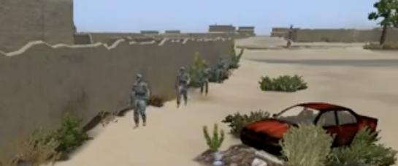

Trust Is Key to Training and Simulation
Need to know AI entities will behave realistically
Adversary tactics and capabilities
Friendly and clutter units
Understanding user speech
Playing a character
Need to trust AI assessment, diagnosis, feedback
Estimate what learners are thinking / experiencing
Measure proficiency and unit readiness
Provide training that will best help each person
Increase training impact and reuse with multiple runs
AI Behavior
☑You immediately assumed the perspective of your NCO.
This course of action will make it difficult to build rapport with the locals.
☑ You recognized that it was appropriate to favor tactics over tact in this situation.
☑ You appraised the potential outcome based on your confidence in your team’s judgment.
AI Feedback

Slide 12
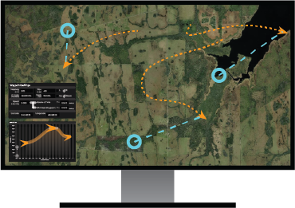
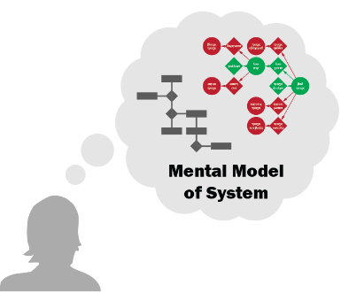
Simulation and Training Are Key to Trust
Simulations validate AI
Exercise a range of conditions
Establish proper bounds on AI
Provide evidence AI is trustworthy
Training users about AI
Build a mental model of AI behavior
Understand what the AI communicates about its ability
Control the AI
Validating AI
Mental Model of AI

Slide 13



Key Concepts
Trustworthy
When is the AI good enough to be trusted?
Trustable
Can the AI establish trust?
Trusted
How much does the human really trust the AI?
A measure of the AI
A measure of the AI focused on communication with the human partner
A measure of the human partner

Slide 14



Related Concepts
Transparency
Lets users know what AI is doing and why
Deep dive to follow
Model
An internal representation of how something works
Mental Model of AI State, Capabilities
Computational Models of:
Current Task / Situation
Rules of the World
User Goals / State
Self / Introspection

Slide 15
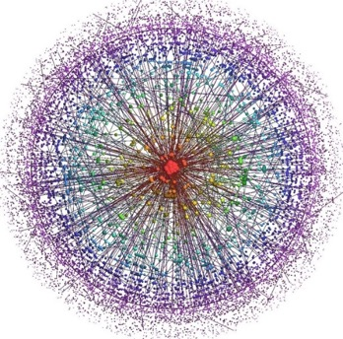
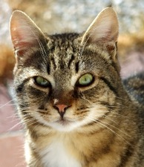
Related Concepts
Explanation / Explainability
A simplified reason the AI can give for a decision
Why simplified?
AI internals are a secret
Magic happened
Not magic but still complex
(Processing so different from ours it’s meaningless)
“These pixels were the most influential for cat detection.”
----------
Black Box
Post-hoc Explanation
Efficient Communication
Image credit: https://commons.wikimedia.org/wiki/File:A-Cat.jpg
Image credit: https://djhurij4nde4r.cloudfront.net/images/images/000/080/054/fullsize/Functional_Analysis_BV.jpg

Slide 16
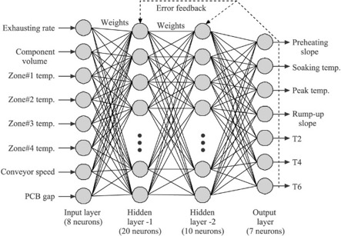
Related Concepts
Common Ground
Shared beliefs that enable communication
Two-way, real-time updates to detect and repair differences
Model Alignment with Human Partner
Similar knowledge representation and processing
Shared goals
Animal
Neural Network:
Alignment not a Priority
Aligned Internal Structure:
Inherently Explainable
Housecat
Ears
Whiskers
Claws
Image credit: Cesar Jung-Harada, https://www.flickr.com/photos/worldworldworld/7880912598

Slide 17



Related Concepts
Reliability
AI works every time or works the same way every time
Within bounds on operating conditions
Robustness
AI resists possible sources of variation
The bounds on operating conditions are less restrictive
Resilience
AI resists disruption to its components
Chair Detector
Robust to Rotation
Resilient to Sensor Failure
Image credit: objectnet.dev

Slide 18
How and Why We Trust People
Trust Formation
Personal propensity to trust
Initially may rely on socialization and broad prior experience
Swift trust in a rapidly formed team
But, compare to snap judgments
Social or systemic influences
In-group trust
Role in an org chart
Trust based on others’ judgment
Based on consequences for betrayal
Parallels for AI
Relationship to AI in daily life
Search results, driving directions, privacy of personal data
First impressions of AI
Transparency in training & manuals
Based on user interface, avatar, etc.
Social inputs to user
Reputation of the AI before use
Esteem or scorn for using AI
Authority endorsement of the AI

Slide 19
How and Why We Trust People
Trust over Time
Reinforcing 
Good performance
Positive attributions of reasons
Familiarity
Reducing 
Infrequent contact
Poor performance
Deviation from established norms: mistakes can be seen as less corrosive than willful deviation
Parallels for AI
Reinforcing 
Good performance
Transparency in explanation to inform users’ mental model of failure reasons
Transparency establishing AI’s norms
Reducing 
AI does not maintain relationships or learn to do better next time
AI does not follow team-specific norms of “how we do things around here”
AI model doesn’t match expert model

Slide 20
How and Why We Trust People
Trust in Expert Teams
Support behavior
Offering or requesting help
Delegating without checking up
Safety to express ideas / risk mistakes
Shared mental models
Volunteering needed information
Understanding implied significance
Parallels for AI
Support behavior
Adjust communication level based on user’s workload or expertise
Transparency about the AI’s confidence or uncertainty
Shared mental models
Model the user’s tasks to recognize information needs or any breakdown
Model perception, attention, & memory
Transparency of underlying beliefs

Slide 21
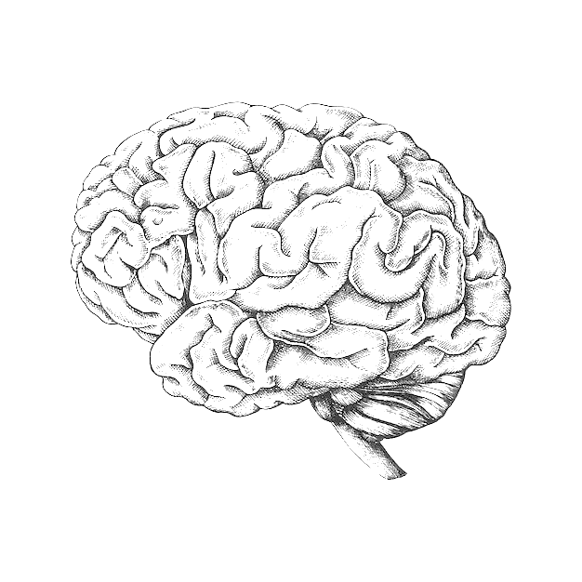
Trust Frameworks: Ajzen & Fishbein
As applied by Lee & See
Trust as an attitude, or personal evaluation
Is informed by beliefs
Has an affective or emotional component
Influences how we interpret and seek out new information
Belief
Attitude
Behavior
Intention
AI Actual Ability
Image credit: “This cover has been designed using assets from rawpixel.com on Freepik.com”

Slide 22
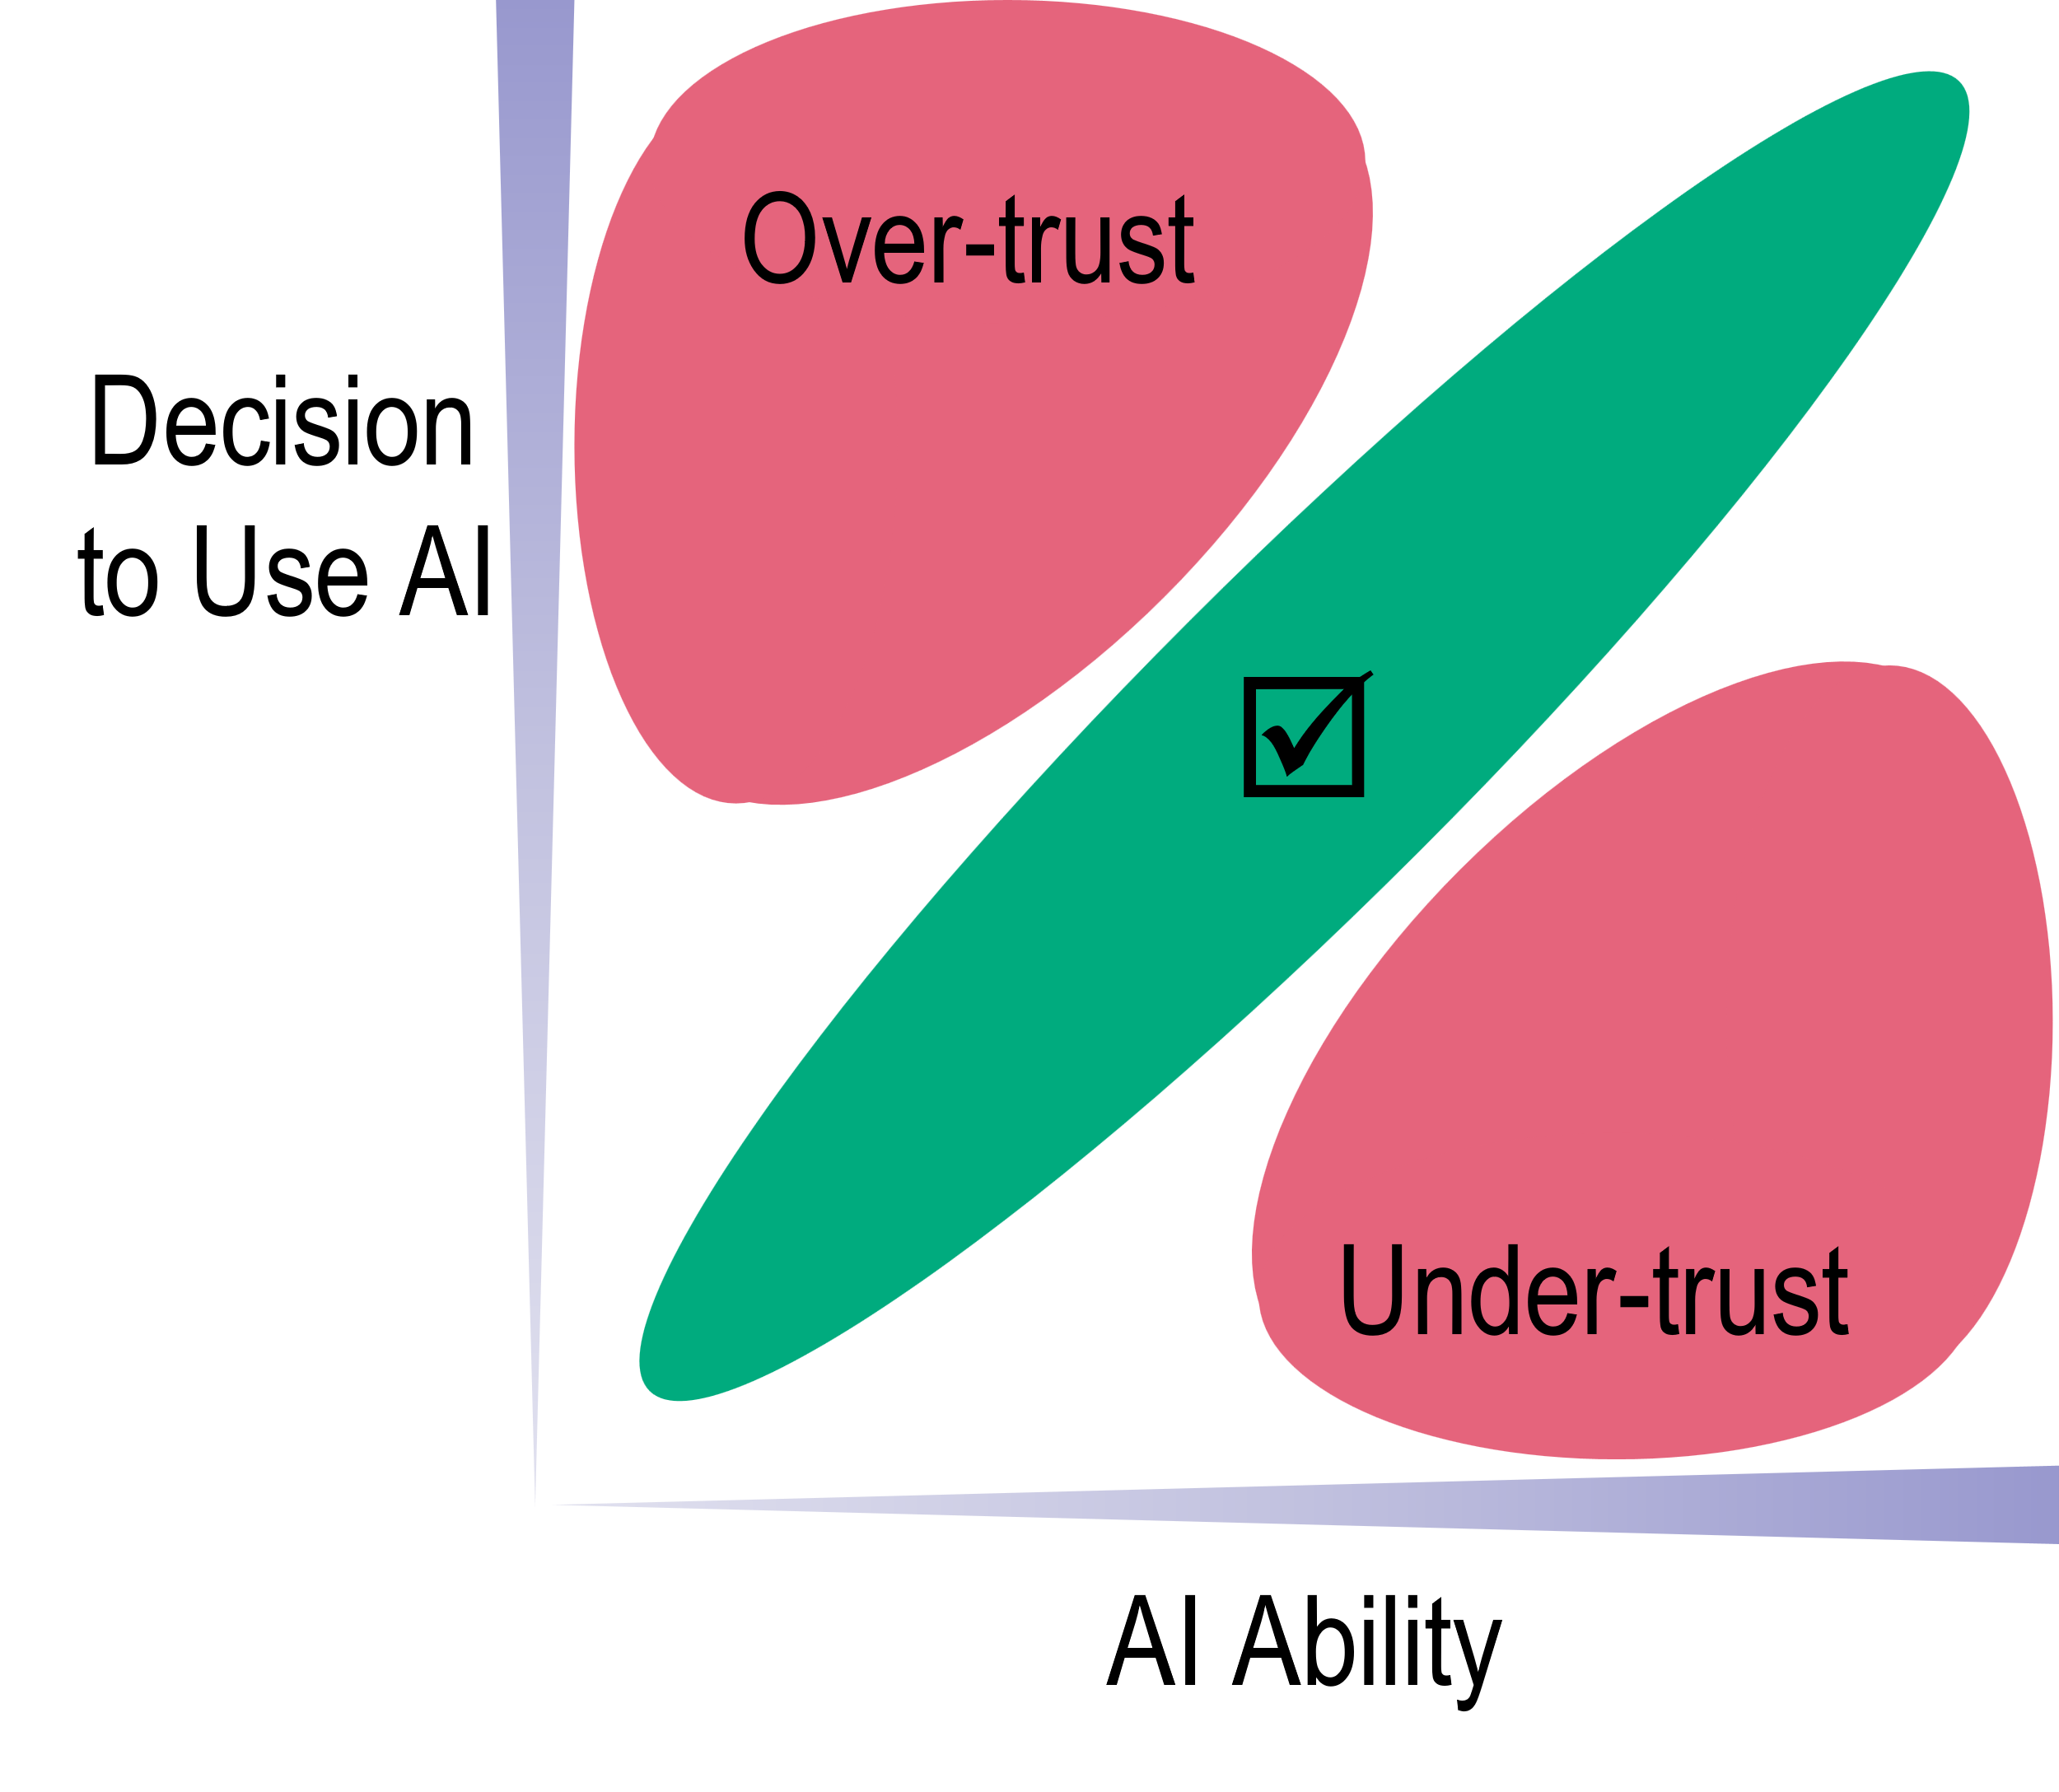

Trust Frameworks: Lee & See
In 2004, summarized concepts of:
Over-trust → Misuse of AI
Under-trust or distrust → Disuse of AI
Calibrated trust → Appropriate Use
Factors influencing trust in AI:
Individual Differences
Display Factors
Organizational / Cultural
Level of detail in describing inputs to the AI
Abstraction of the AI’s internal processing
Difference between AI acting vs asking human to act
Environmental
Feedback Loop

Slide 23
Trust Frameworks: Hoff & Bashir
Differentiated trust based on prior experiences
Learned trust: Attributing past performance to the AI’s competence
Situational: Attributing or predicting performance based on task or domain complexity
Factors influencing trust in AI:
Dispositional Trust
AI should provide:
Learned Trust
Reliability, situational reasons for reliability
Transparency
Ease of use
Anthropomorphism and politeness
Situational Trust

Slide 24


Commonalities of Trust Frameworks
Task
Setting
Belief about AI Ability
Influences
Decision to Use AI
AI Actual Ability
Feedback
Decision Outcome

Slide 25
Trust Frameworks: Chiou & Lee
AI as a partner
Interacting with AI in a complex environment informs a relationship
AI goal alignment and negotiation, shared intention, common ground
System-level outcomes such as cooperation and resilience
Factors influencing trust in AI:
Situation
Semiotics
Also influences what trust relationship is needed
Indicators of competence, intention, common ground
Sequence
Strategy
Changing relationship to match evolving situation
Intentionality in changing the trust relationship

Slide 26
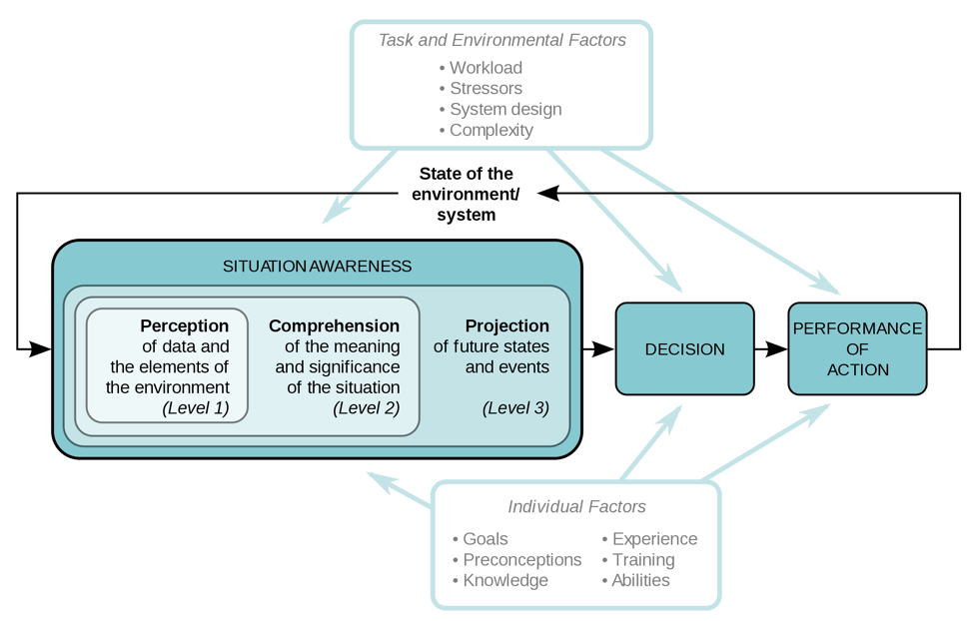
Trust and Transparency: Chen et al.
Situation Awareness (SA)
Endsley, Mica R. "Automation and Situation Awareness.” Parasuraman, R. and Mouloua, M. (Eds.), Automation and Human Performance. (1996): 163-181.
Chen, Jessie Y.C., et al. "Situation awareness-based agent transparency and human-autonomy teaming effectiveness." Theoretical issues in ergonomics science 19.3 (2018): 259-282.
Notes:
Need to add a description of SA and short synopsis of its importance from Endsley 1995, then link to SAT model (straightforwardly)
Note that in addition to the content of the SAT levels supporting SA, they support trust antecedents

Slide 27
Trust and Transparency: Lyons et al.
Robot-to-Human Transparency
Robot-of-Human Transparency
Intentional Model
Designer’s purpose, intent, & goals (high level)
Function-appearance alignment
Inferred from robot actions (task model)
Informs analysis of actions to form task model
Task Model
Understanding of current task
Task specific goals
Progress in relation to goals
Awareness of capabilities and limitations (reliability)
Analytical Model
How the robot functions (knowledge-based component)
Underlying principles that guide decision-making
Provides insight for human monitoring
Environmental Model
Contextual awareness
Implications of context
Teamwork Model
Role allocation status (LOA)
Norms to navigate work dynamics & uncertainty
Authority and etiquette
Supports predictability
Human State Model
Cognitive, emotional, physical state estimations
Implications of human state for performance/safety
Mitigating strategies

Slide 28
Requirements for Trustworthy AI
Meets or exceeds VV&A standards
Meets or exceeds user’s performance standards
Performs consistently, reliably, and robustly
Provides performance assurances for situations not explicitly tested
Real-time performance self-assessment in current situation

Slide 29
Requirements for Trustable AI
Performs as expected
Models user’s expectations to meet or communicate about them
Reasons about own performance, constraints, confidence or uncertainty
Transparent, understandable internal reasoning
Represents goals, beliefs, situation, plan, intent
Models and relates different levels of abstraction
Demonstrates shared goals
Explains internal reasoning
Communicates internal knowledge, goals, status
Internal representations align with user understanding
Communicates when violating expectations
Communicates naturally to reduce friction and load on partner
Natural language understanding, dialogue maintenance, implicit information
Posture, face and eye tracking, body language recognition
Shared attention in the task space, pointing, gestures

Slide 30
Assessment Guidelines and Playbooks
What these have in common is a requirement to interpret and apply them to your case
Domain publications
Department of Defense
Department of Education
Federal Trade Commission
Food and Drug Administration
Health and Human Services
NIST Artificial Intelligence Risk Management Framework
European Commission Ethics Guidelines for Trustworthy AI

Slide 31
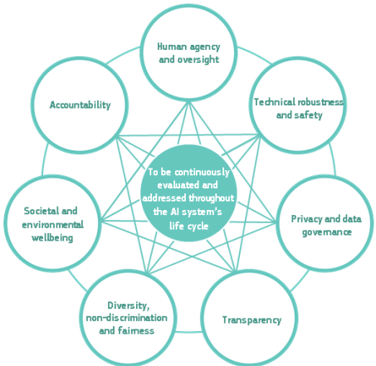
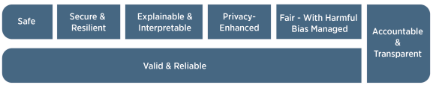
Example Guidelines
NIST Assessments
EC Assessments
Example:
The AI system to be deployed is demonstrated to be safe, its residual negative risk does not exceed the risk tolerance, and it can fail safely, particularly if made to operate beyond its knowledge limits. Safety metrics reflect system reliability and robustness, real-time monitoring, and response times for AI system failures.
Example:
Did you verify how your system behaves in unexpected situations and environments?
Tabassi, E. (2023), Artificial Intelligence Risk Management Framework (AI RMF 1.0), NIST Trustworthy and Responsible AI, NIST, Gaithersburg, MD
High-Level Expert Group on AI (2019). Ethics guidelines for trustworthy AI (Report). European Commission, Brussels

Slide 32
Subjective Measures of Trust in AI
Definition
Introspecting and reporting trust, either in the moment or in retrospect
Advantages
Latent constructs are difficult to measure directly, so subjective measures can offer the clearest, most granular insights about them
Can explain outputs from other assessment
Can provide convergent evidence a target construct is being measured
Disadvantages
Thought processes cannot be directly audited so a person must theorize about the reasons for their own attitudes when reporting, which can be unreliable
Deliberate thought can modify the nature of visceral reactions
Bias from social desirability, hoping to impress or not let down the experimenters

Slide 33
Example Subjective Measures
Checklist for Trust between People and Automation (Jian et al., 1998)
Based on 12 factors of human trust in automated systems (12-items)
Widely used (cited over 1100 times)
Trust Perception Scale (Schaefer, 2016)
40-items validated across 6 studies, or a reduced 14-item instrument
Assesses Hancock et al.’s (2011) 3-factor model of trust antecedents for trust in robots
Trust in Automation, TiA (Körber, 2018)
19-items across 6 scales (Reliability/Competence, Understandability/Predictability, Propensity to Trust, Intention of Developers, Familiarity, and Trust in Automation)
Based on Lee and See’s (2004) and Mayer et al.’s (1995) theoretical account of trust
Validation is ongoing, but several evaluations confirm criterion validity
Freeze Offline Rating (Wu et al., 2021)
AAR video-based review systematically evaluating trust-relevant events using guided interviews and retrospective subjective assessments
Involves a video-based viewing of entire tasking session followed by another review where video is stopped and key events are reviewed
Semantic differential scale technique (e.g., Tsui et al., 2010)
Semantic differential scales consist of a series of rating scales in which the respondent is asked to give a judgment about something along an ordered dimension, usually of seven points
Typically used to assess attitudes or beliefs (trust is an attitude)
Guards against acquiescence
“Area under the trust curve” (AUTC; Desai et al., 2013)
Participants report trust changes which are integrated over time
Intended to guard against issues arising from tradition post-run assessment: masking of real-time changes in trust, reduced sensitivity to factors like inertia, and biases like the primacy-recency effect.
Notes:
Prominent & innovative examples…

Slide 34
Objective Measures
Definition
Direct observation of observable variables linked to mental constructs
Either behavioral or physiological indicators (sometimes these lines are blurred, as with eye tracking)
Advantages
Can be used online without disrupting the natural flow of tasking, providing data that is more valid
Not modified by conscious reporting bias
Resists manipulation
Can address unconscious processing
Can provide verification and elaboration of subjective insights
Disadvantages
Can be difficult to disentangle multiple processes and factors for assessing a single construct (like trust)
Practical considerations limit the use of physiological equipment, especially brain activity recording devices
Behavioral observation may reintroduce subjectivity in recording and interpretation

Slide 35
Behavioral Measures
Task Intervention
Used when autonomy is performing a task a human can perform
Measures include existence of, or number of times there is an intervention
Task Delegation (Reliance)
Operator might decide to assign autonomy to a task (or not)
Operator might decide which autonomy to trust to do a task
Behavioral Change
Useful when intervention and delegation are not options
Task strategy might adapt based on expected quality of autonomy task performance
Includes response time or evidence of attention shifts
Following Advice (Compliance)
Useful when autonomy is not performing a task, but assists with tasking human is performing (e.g., decision-making support below)

Slide 36
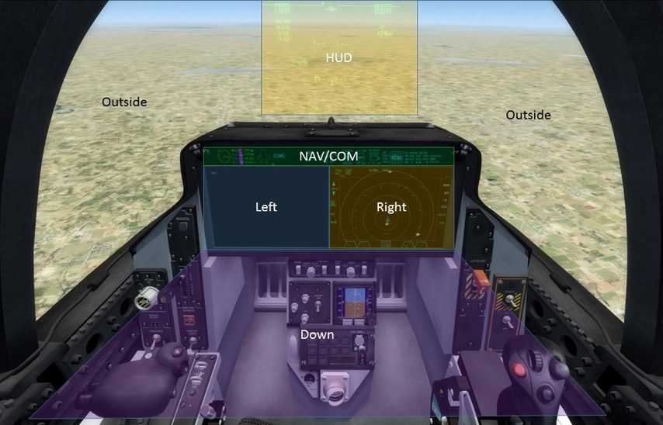
Physiological Measures
Brain/Neurological Processes
Trust and distrust processes may be distinct
Mirror neurons are involved in developing trust by processing implicit and explicit signals of collaborators
Trust calibration correlates with activations in reward-sensitive brain regions, similar to reinforcement learning
Practical In-Vivo/In-Situ Tools
Functional near-infrared spectroscopy (fNIRS)
Galvanic skin response
Heart rate / heart rate variability
Eye tracking
Dimoka, Angelika. "What does the brain tell us about trust and distrust? Evidence from a functional neuroimaging study." Mis Quarterly (2010): 373-396.
Saygin, Ayse Pinar, et al. "The thing that should not be: predictive coding and the uncanny valley in perceiving human and humanoid robot actions." Social cognitive and affective neuroscience 7.4 (2012): 413-422.
King-Casas, Brooks, et al. "Getting to know you: reputation and trust in a two-person economic exchange." Science 308.5718 (2005): 78-83.
Notes:
***need to provide citations where possible

Slide 37
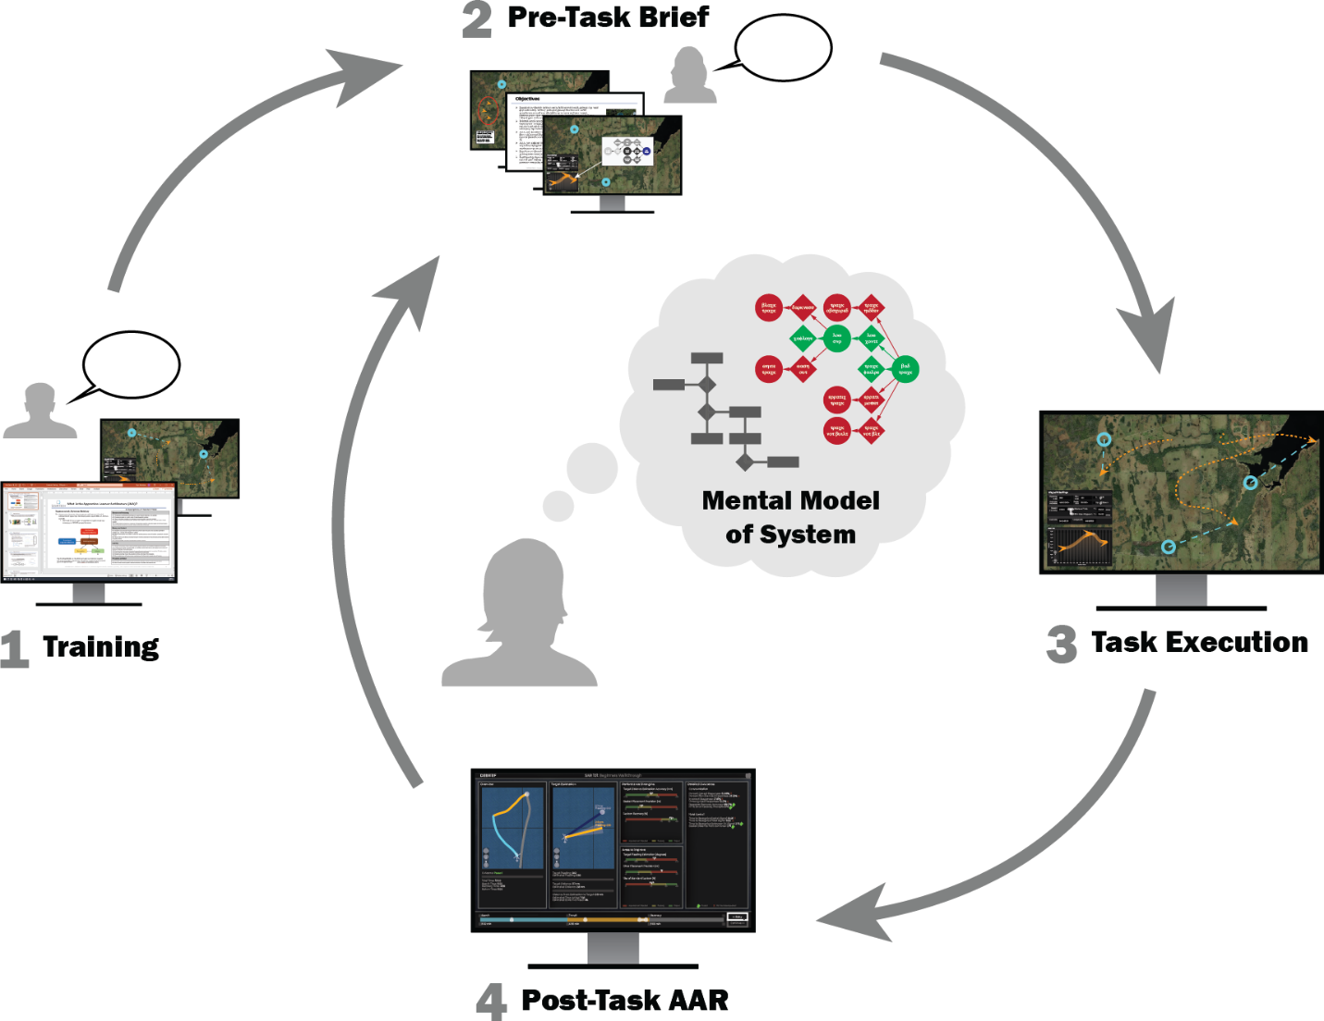
Trust Calibration
From measuring to manipulating trust
Trust can be affected throughout the lifecycle from training to task execution
Transparency during task performance
Can increase workload
Limits information absorption
Transparency during training / AAR
More time to build trust
More types of interactions possible
Prior interactions add context to interpret
Reduces need for transparency communication during task performance

Slide 38
HMI Manipulations for Trust Calibration
Transparency alerts and signals
Audible or visual alerts: can push information relevant to trust judgments
Signals, dials, dashboards: can be available when the human decides to pull information, always on, or can change salience to focus attention
Role allocation / levels of automation
Adaptable automation: Operators control the level of AI task involvement
Adaptive automation: AI dynamically adjusts role and task involvement based on operator state and/or environmental conditions
Politeness theory
Etiquette: can ease interaction and improve engagement
Tone: face threat from varied framing of utterances can establish power relationships and mitigate disuse, or encourage scrutiny of AI and mitigate misuse/abuse

Slide 39
HMI Politeness
Etiquette: prescribed and proscribed behaviors
People interpret these to assign meaning and intent to actions
Adherence to etiquette influences affective trust
Scaling information salience according to urgency
No false alarms, a trusted partner doesn’t “cry wolf”
Using in-group markers
Face Threat
Threat to social standing: criticism or reprimands, interruptions, apologies, improper address
Threat to autonomy: orders versus requests, offers to help, social expressions of thanks
Personality Matching
Similarity in personality increases trust
Tone
Establishing authority or power relationship in either direction, indicating urgency or uncertainty
Raja Parasuraman and Christopher A. Miller. 2004. Trust and etiquette in high-criticality automated systems. Commun. ACM 47, 4 (April 2004), 51–55.
Notes:
Parasuraman on Etiquette
Social Engineering includes establishing power relationships, face threat positive and negative

Slide 40
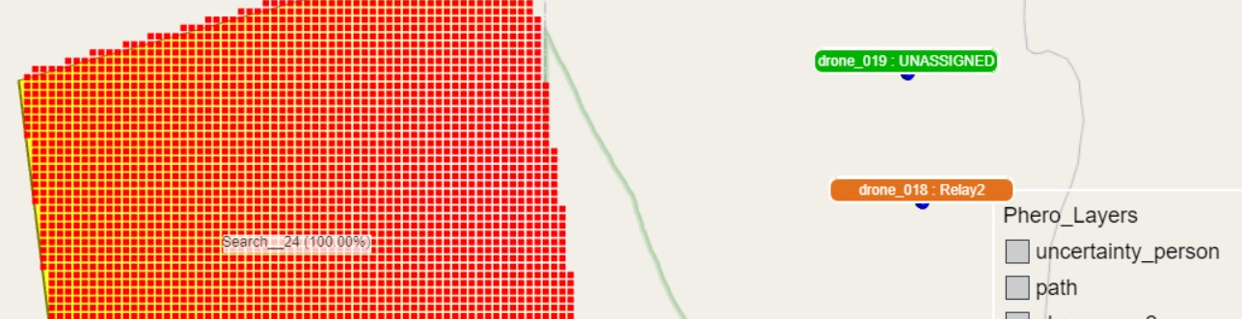
Case Study
Cost to determine whether AI is trustworthy

Slide 41
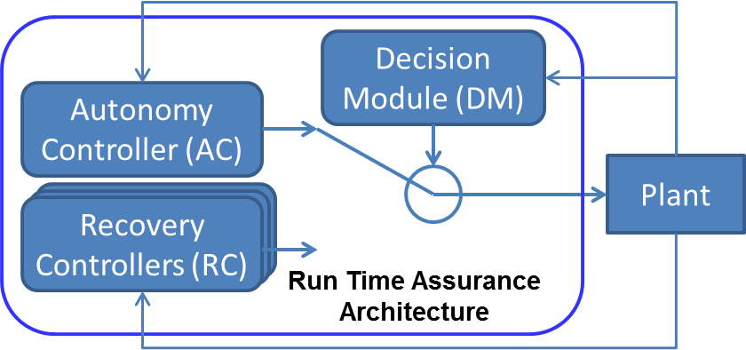
Case Study
Challenge:
Nontrivial autonomous systems are too complex to fully test or verify through formal means
High dimensional, massive state space
Adaptive, learning systems that can change their behavior
Current formal methods rely on strong simplifying assumptions
Empirical testing is costly and provides no completeness guarantees
Approach: Formal methods guide optimal planning of empirical tests
Formally verified recovery controllers – watch for safety violations and bring system to a safe state
Formal verification assumptions drive intelligent test optimization
Tests only need to probe those aspects of the system not covered by formal verification
Employs multiple strategies to reduce the number of dimensions and the size of the search space
Then employs an optimization algorithm to rapidly find and explore the failure surface of a system

Slide 42
Case Study
Treat safety testing as an optimization problem:
Define a “robustness function” which is minimal at the point that the system fails.
Formally analyze the robustness function to predict conditions that may lead to failure
Minimize the number of tests/samples to expand failure points into a failure manifold or “surface”
Results
Tested against an autonomy controller for collision avoidance on unmanned aircraft
Size of the test space: ~10¹² possible states to test
Traditional testing: 0.01% of tests were able to find a failure condition
Formally guided empirical testing: 53% of the tests were able to find failures
Conclusion
Intelligent test design combines formal methods and guided empirical testing
It is feasible to verify the trustworthiness of complex autonomous systems

Slide 43

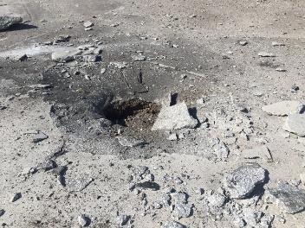

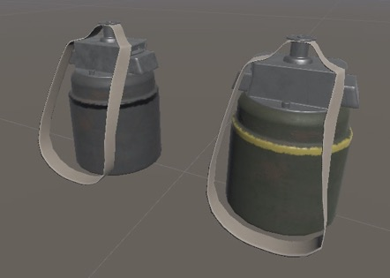
Case Study
Rapid Airfield Damage Assessment
Assess paved surfaces (airfields, taxiways, etc.) after an attack to develop an initial repair plan
Locate damage (craters, spall, etc.) and unexploded ordnance (UXO)
Dataset Challenges
Blowing up runways to gather empirical data is expensive
Need datasets covering a wide variety of environmental conditions
Lighting (time of day, clouds…), Weather (rain, snow…)
Types and age of pavement, Marks on pavement (painted lines, spills, tire marks)
Synthetic Dataset Creation
Model a damaged airfield in a very high-fidelity 3D engine (e.g. Unity)
Generate training datasets from the 3D model

Slide 44
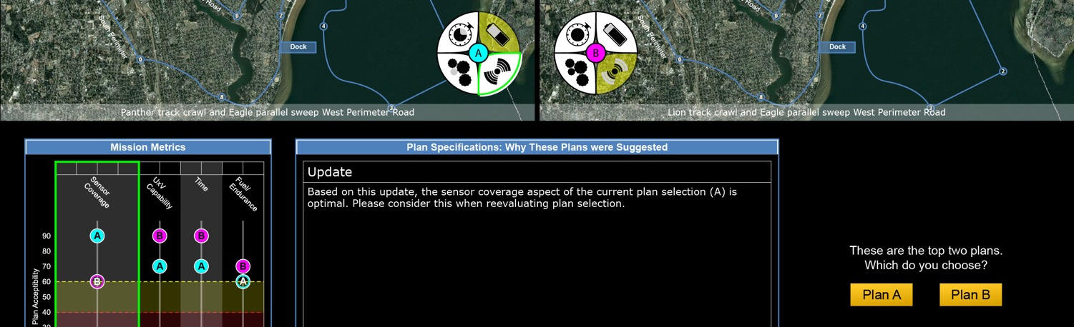
Case Study
Study 1:
Evaluating instruments to measure pilots’ trust in combat autonomy

Slide 45
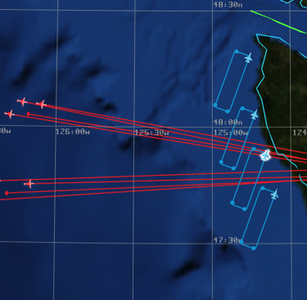
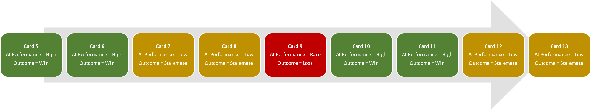
Assessment Design
Participants
N = 17
Male Air Force or Navy Fighter pilots
Age 20-60
Valid US pilot certificate and at least a current class III medical or active-duty military pilot
Simulation-based Tasking
9 dogfights (“conditions” arrow)
Primary Task: Battle Management
In cockpit, left panel
Asset Tasks (e.g., allocation)
Enemy Tracking (e.g., assign assets; authorize weapons)
Secondary Task: Monitoring progress of a dogfight performed by an autopilot system
Call for guns if the autopilot obtains lock
Take over manual control if autopilot is perceived to be in danger of losing the engagement
Battle Manager Task Interface
Conditions

Slide 46
Assessment Design
Subjective Measures
Freeze offline probe technique (Wu et al., 2021)
Modified Trust Perception Scale (Schaefer, 2016)
Bedford Workload Scale (Roscoe, 1984)
Negative Attitude toward Robots Scale (NARS; Nomura et al., 2004)
Perfect Automation Schema (PAS; Merritt et al., 2015)
Mini IPIP (Goldberg, 1999)
Big 5 Personality Inventory
Propensity to Trust (Frazier et al., 2012)
Situation Awareness Rating Scale (SART; Taylor, 1990)
System Usability Scale (SUS; Brooke, 1986)
Reliance Intention Scale (Merrit et al., 2012)
Objective Measures
Task Intervention (“paddle”)
Eyetracking
Dwell Time; Crosscheck
Empatica E4
GSR; Skin Temperature; Movement
Electrocardiogram (ECG)
HR; HRV; OPL Workload
Flight parameters
E.g., location of self & enemy
Battle Manager Task Interface
Conditions

Slide 47
Analysis
Trust was sensitive to manipulating AI competence.
…according to short refactored HRI Trust Scale items which capture trust antecedents to estimate situational trust.
Trust was sensitive to experience recency.
Generally, participants’ judgments of low-performing AI were higher following an experience with a high-performing AI and lower following an experience with a low-performing AI.
Recent past performance makes more difference in trust judgments when the AI is performing poorly than when it performs well.
Different components of trust were differentially sensitive.
While AI performance characteristics are quickly recognized and appreciated (i.e., higher ability ratings), changes in willingness to trust (i.e., trust ratings) are more gradual.
Judgements of a low performance AI following experience with a low or high performing AI
Correlation Between Subjective Trust and Post-Merge Physiological Indices
 | GSR | HRV
Card 5 (High) | .151 | -.088
Card 6 (High) | -.683** | -.184
Card 7 (Low) | -.356 | .281
Card 8 (Low) | -.427 | -.264
Card 9 (Rare) | -.292 | -.239
Card 10 (High) | -.823** | .177
Card 11 (High) | -.814** | -.398
Card 12 (Low) | -.585* | -.453
Card 13 (Low) | -.307 | -.358
Note: "Rare" involved poor AI performance resulting shoot down; *p < .05, **p < .01
Notes:
…according to short refactored HRI Trust Scale items which capture trust antecedents to estimate situational trust
Generally, participants’ judgements of low performing AI were higher following an experience with a high performing AI and lower following an experience with a low performing AI. This is especially true when the AI is performing poorly
Trust was the only component relative to other antecedents to register previous experience when AI performed highly. More interesting is that while performance characteristics (as trust antecedents) are recognized and appreciated, changes in willingness to trust are more gradual.
Participant workload was higher when AI performed poorly possibly reflecting additional monitoring activity or reduced capacity due to other task performance processes like coping.
Cross-check ratio is a good target for an objective measure of trust, but can be confounded when multilple behaviors bear on the outcome. In this case, participants monitored outside of primary test area because they didn’t trust AI performance, but also because they needed to be ready to call a kill when it performed well.
Galvanic skin response (GSR) demonstrated strong predictive power in both pre- and post-merge periods. Heart Rate (HR) in the pre-merge phase was consistently positively correlated with subjective trust, but post-merge phase heart rate was not reliably correlated. Heart rate variability (HRV) in the pre-merge phase was correlated with subjective trust and this relationship held (albeit slightly attenuated) in the post-merge phase
Prediction tended to be much stronger in the second of two consecutive experiences with the same level of AI. This tells us that as attitudes are in flux, so to are physiological indices. This assessment was done with information averaged across a card, but a more fine grained look should show more reliable prediction.
This finding lends credence to the idea that objective and subjective measures may dissociate when workload or stress reduce spare mental capacity for conscious deliberation and implicit trust is featured
A logistic regression model constructed from physiological indices and eye tracking behavior predicted whether or not pilots took manual control
This is derived from the fact that on Schaefer’s (2016) scale, the item “Trustworthiness alone correlated significantly with the single item trust measures thought to tap affective trust, the correlation between this item (corresponding to a trust judgement) and other items (trust antecedents; e.g., “Predictable”) changed from the low to high performing condition
In earlier experiences, transparency (supporting early analytical trust processes) and predictability (supporting analogical trust pattern matching and affective trust processes – e.g., did each action confirm or violate mental model and by extension trust) may serve as the most important early trust signals, while judgements of reliability, fit for mission needs, and trustworthiness perceptions are still forming. In later experiences, perception of these latter antecedents may be better formed and more reliable and predictability and transparency signals may not be relied upon as much to inform trust judgements.
Note – “risk, SA, and workload” served as contextual factors for understanding intention formation (or situational trust – the part of the trust attitude activated by a particular situation)

Slide 48
Analysis
Workload levels reflected AI performance manipulation.
Participant workload was higher when AI performed poorly.
May reflect additional monitoring or reduced capacity due to coping processes.
Team task performance as a trust measure was confounded.
Not a reliable gauge of trust due to task characteristics.
Participants monitored the AI because they didn’t trust AI performance, but also because they needed to be ready to call a kill when AI performed well.
Physiological measures predicted subjective trust.
Galvanic skin response (GSR) demonstrated strong predictive power.
Heart Rate (HR) and heart rate variability (HRV) were positively correlated with subjective trust, but only in some conditions.
Judgements of a low performance AI following experience with a low or high performing AI
Correlation Between Subjective Trust and Post-Merge Physiological Indices
 | GSR | HRV
Card 5 (High) | .151 | -.088
Card 6 (High) | -.683** | -.184
Card 7 (Low) | -.356 | .281
Card 8 (Low) | -.427 | -.264
Card 9 (Rare) | -.292 | -.239
Card 10 (High) | -.823** | .177
Card 11 (High) | -.814** | -.398
Card 12 (Low) | -.585* | -.453
Card 13 (Low) | -.307 | -.358
Note: "Rare" involved poor AI performance resulting shoot down; *p < .05, **p < .01
Notes:
…according to short refactored HRI Trust Scale items which capture trust antecedents to estimate situational trust
Generally, participants’ judgements of low performing AI were higher following an experience with a high performing AI and lower following an experience with a low performing AI. This is especially true when the AI is performing poorly
Trust was the only component relative to other antecedents to register previous experience when AI performed highly. More interesting is that while performance characteristics (as trust antecedents) are recognized and appreciated, changes in willingness to trust are more gradual.
Participant workload was higher when AI performed poorly possibly reflecting additional monitoring activity or reduced capacity due to other task performance processes like coping.
Cross-check ratio is a good target for an objective measure of trust, but can be confounded when multilple behaviors bear on the outcome. In this case, participants monitored outside of primary test area because they didn’t trust AI performance, but also because they needed to be ready to call a kill when it performed well.
Galvanic skin response (GSR) demonstrated strong predictive power in both pre- and post-merge periods. Heart Rate (HR) in the pre-merge phase was consistently positively correlated with subjective trust, but post-merge phase heart rate was not reliably correlated. Heart rate variability (HRV) in the pre-merge phase was correlated with subjective trust and this relationship held (albeit slightly attenuated) in the post-merge phase
Prediction tended to be much stronger in the second of two consecutive experiences with the same level of AI. This tells us that as attitudes are in flux, so to are physiological indices. This assessment was done with information averaged across a card, but a more fine grained look should show more reliable prediction.
This finding lends credence to the idea that objective and subjective measures may dissociate when workload or stress reduce spare mental capacity for conscious deliberation and implicit trust is featured
A logistic regression model constructed from physiological indices and eye tracking behavior predicted whether or not pilots took manual control
This is derived from the fact that on Schaefer’s (2016) scale, the item “Trustworthiness alone correlated significantly with the single item trust measures thought to tap affective trust, the correlation between this item (corresponding to a trust judgement) and other items (trust antecedents; e.g., “Predictable”) changed from the low to high performing condition
In earlier experiences, transparency (supporting early analytical trust processes) and predictability (supporting analogical trust pattern matching and affective trust processes – e.g., did each action confirm or violate mental model and by extension trust) may serve as the most important early trust signals, while judgements of reliability, fit for mission needs, and trustworthiness perceptions are still forming. In later experiences, perception of these latter antecedents may be better formed and more reliable and predictability and transparency signals may not be relied upon as much to inform trust judgements.
Note – “risk, SA, and workload” served as contextual factors for understanding intention formation (or situational trust – the part of the trust attitude activated by a particular situation)

Slide 49
Analysis
Physiological measures were more predictive once trust stabilized.
Prediction tended to be much stronger in the second consecutive experience with the same AI.
As attitudes are in flux, so are physiological indices.
Physiological measures predicted subjective trust more strongly when the AI was high-performing.
Objective and subjective measures may dissociate when high workload or stress shift assessment from conscious deliberation to implicit trust.
Physiological measures predicted reliance on the AI.
Physiological measures and eye tracking behavior predicted whether pilots would take manual control from the AI.
Logistic Regression Model - Step 1 (Trust Only)
Manual |  | Predicted
Override |  | No | Yes | % Correct
Observed | No | 4 | 3 | 57.1
 | Yes | 1 | 7 | 87.5
Overall % |  |  |  | 73.3
Logistic Regression Model - Step 2 (Full Model)
Manual |  | Predicted
Override |  | No | Yes | % Correct
Observed | No | 7 | 0 | 100.0
 | Yes | 2 | 6 | 75.0
Overall % |  |  |  | 86.7
*Full Model includes perceived risk, SA, & workload
Notes:
Prediction tended to be much stronger in the second of two consecutive experiences with the same level of AI. This tells us that as attitudes are in flux, so to are physiological indices. This assessment was done with information averaged across a card, but a more fine grained look should show more reliable prediction.
This finding lends credence to the idea that objective and subjective measures may dissociate when workload or stress reduce spare mental capacity for conscious deliberation and implicit trust is featured
A logistic regression model constructed from physiological indices and eye tracking behavior predicted whether or not pilots took manual control
This is derived from the fact that on Schaefer’s (2016) scale, the item “Trustworthiness alone correlated significantly with the single item trust measures thought to tap affective trust, the correlation between this item (corresponding to a trust judgement) and other items (trust antecedents; e.g., “Predictable”) changed from the low to high performing condition
In earlier experiences, transparency (supporting early analytical trust processes) and predictability (supporting analogical trust pattern matching and affective trust processes – e.g., did each action confirm or violate mental model and by extension trust) may serve as the most important early trust signals, while judgements of reliability, fit for mission needs, and trustworthiness perceptions are still forming. In later experiences, perception of these latter antecedents may be better formed and more reliable and predictability and transparency signals may not be relied upon as much to inform trust judgements.
Note – “risk, SA, and workload” served as contextual factors for understanding intention formation (or situational trust – the part of the trust attitude activated by a particular situation)

Slide 50
Analysis
The relationships between trust antecedents and trust judgements depend on context and AI ability.
User assessment of “Trustworthiness” correlated with affective trust.
However, correlation with antecedents like “Predictable” depended on situation.
The importance of trust antecedents changes over time.
Predictability and transparency were more important to trust in early encounters with the AI.
In later experiences, judgements of reliability, fit for mission needs, and trustworthiness perceptions may dominate.
Trust as an attitude is sufficient for predicting reliance behavior, but intention formation improves the prediction.
Perceived risk, SA, and workload are contextual factors for forming attitudes into intention.
Logistic Regression Model - Step 1 (Trust Only)
Manual |  | Predicted
Override |  | No | Yes | % Correct
Observed | No | 4 | 3 | 57.1
 | Yes | 1 | 7 | 87.5
Overall % |  |  |  | 73.3
Logistic Regression Model - Step 2 (Full Model)
Manual |  | Predicted
Override |  | No | Yes | % Correct
Observed | No | 7 | 0 | 100.0
 | Yes | 2 | 6 | 75.0
Overall % |  |  |  | 86.7
*Full Model includes perceived risk, SA, & workload
Notes:
Prediction tended to be much stronger in the second of two consecutive experiences with the same level of AI. This tells us that as attitudes are in flux, so to are physiological indices. This assessment was done with information averaged across a card, but a more fine grained look should show more reliable prediction.
This finding lends credence to the idea that objective and subjective measures may dissociate when workload or stress reduce spare mental capacity for conscious deliberation and implicit trust is featured
A logistic regression model constructed from physiological indices and eye tracking behavior predicted whether or not pilots took manual control
This is derived from the fact that on Schaefer’s (2016) scale, the item “Trustworthiness alone correlated significantly with the single item trust measures thought to tap affective trust, the correlation between this item (corresponding to a trust judgement) and other items (trust antecedents; e.g., “Predictable”) changed from the low to high performing condition
In earlier experiences, transparency (supporting early analytical trust processes) and predictability (supporting analogical trust pattern matching and affective trust processes – e.g., did each action confirm or violate mental model and by extension trust) may serve as the most important early trust signals, while judgements of reliability, fit for mission needs, and trustworthiness perceptions are still forming. In later experiences, perception of these latter antecedents may be better formed and more reliable and predictability and transparency signals may not be relied upon as much to inform trust judgements.
Note – “risk, SA, and workload” served as contextual factors for understanding intention formation (or situational trust – the part of the trust attitude activated by a particular situation)

Slide 51
Analysis Implications
Trust is dynamic but builds on a good basis of trust such as training about the AI.
More extensive familiarization with AI will allow more stable and realistic targets for trust algorithms.
A trust model may need to evolve or be recalibrated as both the user and the context evolve.
Capture variables that influence situational trust to understand trust formation and reliance behaviors.
Designers should model how these variables integrate with trust attitudes as drivers of intention.
Supplement short targeted measures with more involved instruments where possible to reflect a range of factors.
Metrics that are confounded by task factors require tight experimental control to account for confounds.
An algorithm using these as inputs needs careful attention to context and ideally environmental or task-space sensing.
Objectively measuring trust is feasible and important to trust calibration.
Subjective measures are effective gauges of trust and predict trust behaviors.
Subjective measures might be misleading when conscious deliberation and self-monitoring are difficult.
Objective measures need to be included in algorithm development with appropriate experimental controls.

Slide 52

Case Study
Study 2:
Measuring pilots’ trust in a simulated AI wingman

Slide 53
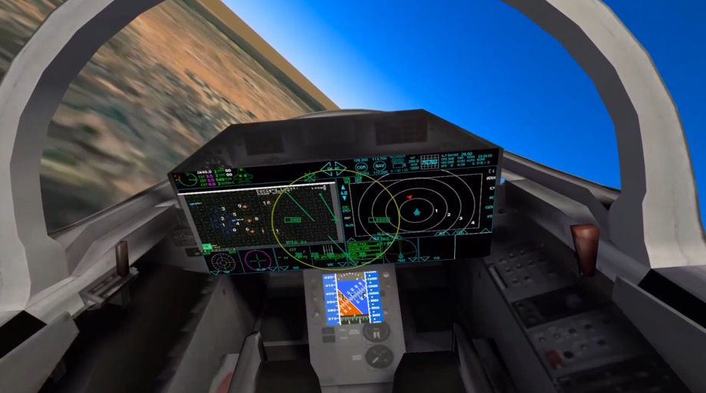
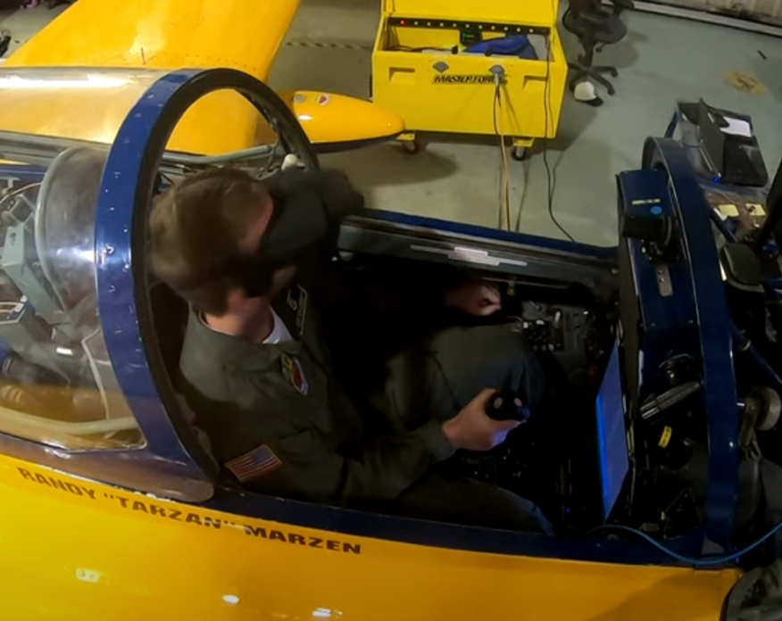
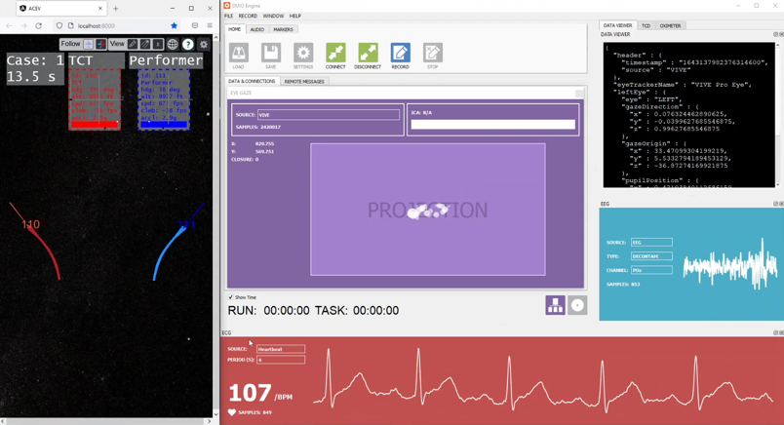
Assessment Design

Slide 54
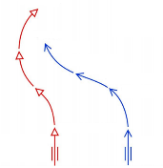
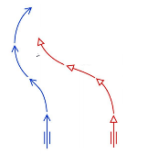
Assessment Design
AI Autonomous Agent
All scenarios were modeled on BFM (basic fighter maneuver) training setups.
Each scenario began from a perch setup (line abreast) to an offensive, defensive, or a high aspect position at “Fights on”.
At “Fights on” the dogfight AI agent automatically began to maneuver the aircraft.
Fight’s on
Fight’s on
Fight’s on

Slide 55
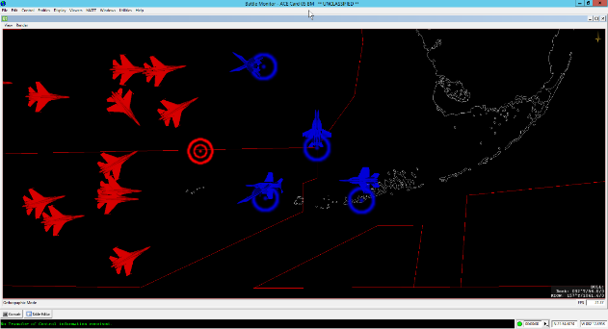
Assessment Design
Summary of Mission Briefing
Advancing Red Force
Blue Force that you can control
Engagement Limitations
Each blue fighter can hold only one target assignment in memory. Therefore, it is not possible to give one blue fighter multiple targets.
You have 6 blue fighters. Each has 4 missiles. There are 24 red air entities. Therefore, you should target red air very carefully and not waste any missiles.
To maneuver blue fighters: Click blue fighter, and a data panel and arrow appears.
Drag the yellow arrow and release to give command
Directional command: aircraft will hold a heading until it auto-engages
Target individual enemy: aircraft will move to intercept
Blue forces will auto-engage as soon as an enemy enters their weapon engagement zone
Area you need to defend
Bullseye marker

Slide 56
Assessment Design
Procedure
Baseline Orientation Phase
3 dogfight scenarios with each agent (against weak, medium, and strong performing adversary)
Experimental Phase
Dogfight from each of 3 starting positions (offensive, defensive, high-aspect) with each agent against medium capability adversary (chance of loss)
Active Paddle Phase
Repeat experimental phases, but participants can “paddle” the autonomy on and off
Common Ground Orientation: Establishing Trust Attitude
(Observation of Autonomy)
Experimental Scenarios: Detecting Trust
(Performance with Autonomy)
Medium Capability Opponent
Defensive Starting Position
Low Capability Opponent
Neutral Starting Position
Performance with Autonomy
Opponent = Medium Capability
Neutral Starting Position
Medium Capability Opponent
Neutral Starting Position
High Capability Opponent
Neutral Starting Position
Performance with Autonomy
Opponent = Medium Capability
Offensive Starting Position
*Randomized Order
*Randomized Order
3x baseline orientation
Once with each agent

Slide 57
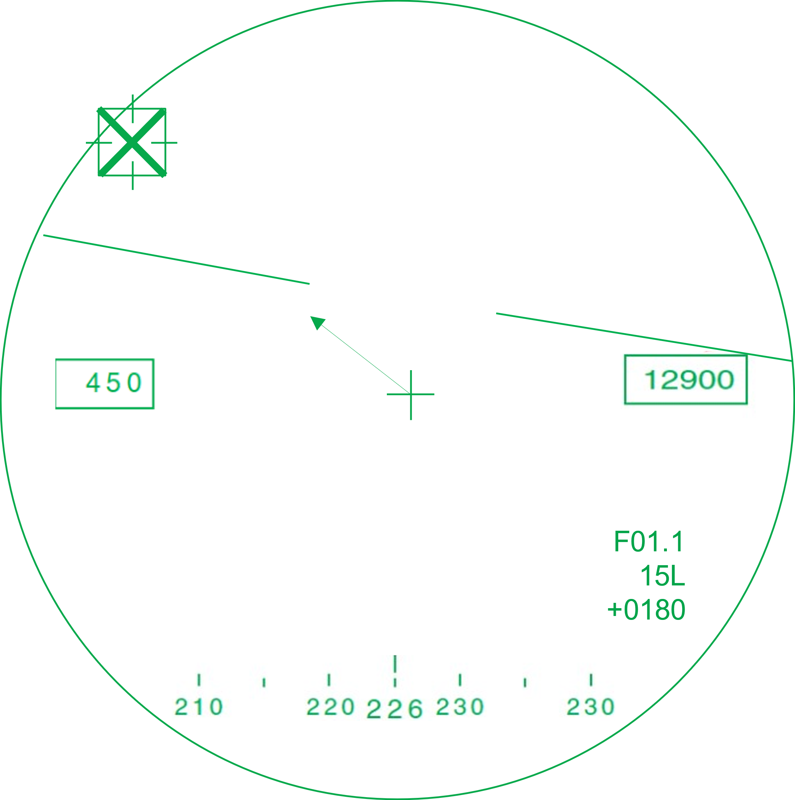



AI Transparency Elements
Manual Control
Autonomy Mode Indicator (orange ring = autonomy on)
Maneuver Indicator
>
O
Offensive/Neutral/Defensive assessment and trend from AI
N
R01.1
15L
0180
D
W10: 75
Probability of win in next 10 seconds assessment from AI

Slide 58
Analysis
Team task performance
Eye tracking showed pilots viewed battle management more than the AI dogfight.
Pilots checked on the AI least in the intentional loss / low-ability AI condition.
Paddle on / paddle off
Pilots attended to battle management more when given paddle control to switch from autonomy to manual mode.
Pilots generally paddled off the AI when it struggled. In a few cases this choice led to an avoidable loss, in even fewer cases this saved the win.
Pilots appropriately paddled off the AI in all but two of the intentional loss scenarios.
Effect of Agent, Starting Position, Merge Status, and Paddle Affordances on CrossCheck
Effect | df | F | p | η²_{p} | Observed Power
Agent | 2 | 1.74 | .236 | .303 | .264
Position | 2 | 3.81 | .069 | .488 | .520
Paddle | 1 | 7.72 | .050 | .659 | .557
Merge | 1 | 22.49 | .009 | .849 | .936
Agent * Position | 4 | 1.19 | .354 | .229 | .289
Agent * Paddle | 2 | 0.92 | .436 | .188 | .158
Position * Paddle | 2 | 1.29 | .328 | .243 | .205
Agent * Merge | 2 | 2.58 | .137 | .392 | .373
Position * Merge | 2 | 6.91 | .018 | .633 | .784
Paddle * Merge | 1 | 2.48 | .190 | .383 | .230

Slide 59
Analysis
Transparency HMI greatly depended on the AI to give useful, reliable info
Assessment of situation and lookahead predictions
Not all AI implementations produce equivalent data
The rate of info change must be dampened to user perception / decision speeds
Autonomy in constant reappraisal, producing many updates in sub-second timeframes
Multiple different interface designs and manipulations could impact trust
The interface itself can negatively affect trust even if the autonomy performs well
Suggests design-time and continuous runtime estimates of trust calibration

Slide 60
Analysis Implications
The in-situ assessments measured pilots’ trust in a simulated wingman
Correlation between physio measures, behavioral measures, and self-report
Real-time trust estimates provide input to calibrate trust
Physiological measures provide objective, real-time estimates of whether AI is trusted
Bounds on AI reliability and robustness support estimating when AI is trustworthy
Manipulating the interface can keep these aligned to calibrate appropriate trust in AI

Slide 61
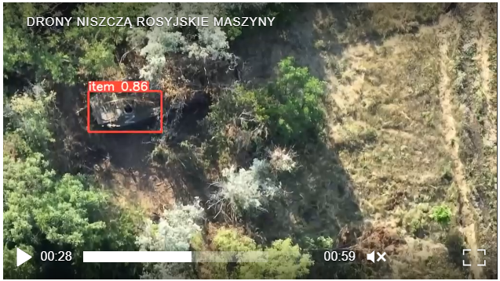
The Future of Trust
Ukrainian news report, July 2022
A pair of AI engineers wrote computer vision algorithms so their unit’s handheld drones can find targets under tree cover
AI was deployed to lethal effect in days, not months
Whether true or propaganda, global forces may soon be ready to employ untested, untrustworthy AI in combat
We must arm our warfighters with AI they can trust through continuing advances in trusted AI
As related in a 2023 white paper from the Center for Strategic and International Studies (CSIS) by Greg Allen, formerly JAIC Director of Strategy and Policy
https://www.csis.org/analysis/six-questions-every-dod-ai-and-autonomy-program-manager-needs-be-prepared-answer

Slide 62
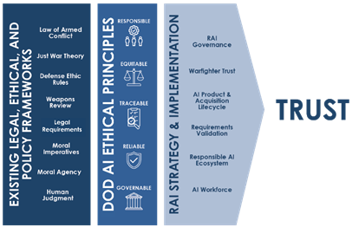
US DoD
Chief Digital and Artificial Intelligence Office (CDAO)
AI.mil
Responsible AI Strategy and Implementation Pathway
Education and training resources
DoD Directive 3000.09
“Autonomy in Weapon Systems”
Predicts the type of concrete guidance to expect for other AI

Slide 63
US Federal Government
National Artificial Intelligence Initiative Office
AI.gov
President Trump: Executive Order 13960 Promoting the Use of Trustworthy Artificial Intelligence in the Federal Government
President Biden: May 2023 National AI R&D Strategic Plan
Institute for Trustworthy AI in Law and Society (TRAILS)
NIST and NSF partnership with academia and industry
Established in May 2023 with five-year funding of $20M

Slide 64
International
NATO Data and Artificial Intelligence Review Board
AI Strategy and Data Exploitation Framework publications
One of the nine Emerging and Disruptive Technologies
EU Digital Services Act
Addresses ubiquitous platforms for social media, messaging, and online retail
Requirement for algorithm transparency
European Commission’s 2019 Ethics Guidelines for Trustworthy AI with self-assessment
Political Declaration on Responsible Military Use of Artificial Intelligence and Autonomy
Signed in Feb 2023 by 60 countries, including China and US Dept of State

Slide 65
Technical Standards
Guidelines mentioned in the assessment section
Mainly require expert or subjective application
A few signposts on the path to a future standard
Space Trusted Autonomy Readiness Levels
VDE SPEC 90012 project group (Germany, France)
IEEE Trust and Agency in Artificial Intelligence Systems Committee

Slide 66
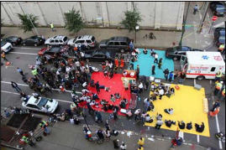
Research and Development
Alignment with different decision-makers on goals and priorities
Even when there is no right answer
Common ground
Real-time monitoring and repair
Longitudinal relationships
Co-training human and AI
DARPA’s In the Moment is tuning AI to align w specific decision-makers in a mass casualty event or VUCA setting
Image credit: https://odemsa.net/wp-content/uploads/2022/04/ODEMSA-MCI-Plan-2022.pdf

Slide 67
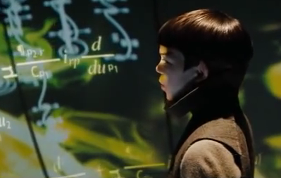
Training and Education
Systemic context of trusting AI for teaching and training
Monitor equity in access, use, and learning gains
Incorporate teacher and trainer input in AI design
Learner differences
Long tail of learners underserved by AI
Guard against potential for harm from unforgiving AI
Social learning
AI impact on relationships with the expert teacher and other learners
Future school: Star Trek (2009)
Image credit: Paramount

Slide 68
Learning Objectives
Define trustworthy, trustable, and trusted in human-AI teaming and recognize examples of each
List five theoretical and applied frameworks that are useful to evaluate trust in human-AI teaming case studies
Discuss how to incorporate trusted AI into product specifications, design requirements, objective measurements, and fielded processes

Slide 69
Questions?
Dr. Mike van Lent vanlent@soartech.com
Dr. JT Folsom-Kovarik jeremiah@soartech.com

