Slide 1

Introduction to HLA 4
Björn Möller, Pitch Technologies
Dr. Katherine L. Morse, Johns Hopkins University / APL

Slide 2
Agenda
The High-Level Architecture (HLA)
  Purpose
  Terminology
  Object model template
  Services
Use cases
HLA IEEE 1516-2010 – “HLA Evolved”
HLA IEEE 1516-202x – “HLA 4”
LVC gateways, performance, tools and security
Common federation object models
Summary and additional reading

Slide 3
Learning Objectives
After taking this tutorial you should be able to:
Describe the requirements for interoperability in distributed simulation
Explain the principles of the HLA standard
Explain how the HLA standard is used for distributed training purposes
Describe the new features of HLA 1516-2010 and HLA 4
Describe some common Federation Object Models (FOMs) for defense training

Slide 4



Purpose of HLA
Provide one single interoperability standard
  Meet a broad set of distributed simulation requirements
  Support training, analysis, test & evaluation, concept development, engineering, etc.
  Support a variety of domains and sub-domains with different and evolving object models
Enable reuse of simulation components, thus reducing cost
  Vendor-neutral interoperability through open standardization
  Facilitate an open eco-system for COTS, GOTS and in-house simulations
COTS = Commercial-off-the-shelf
GOTS = Government-off-the-shelf
IEEE = Institute of Electrical and Electronics Engineers
SISO = Simulation Interoperability Standards Organization

Slide 5
HLA is an Open International Standard
IEEE
Simulation
Developers &
Users
Government
Industry
Academia
Etc.
Sponsor
HLA
IEEE
1516
Standard
COTS
GOTS
In-house
Open source
Other
Simulation
Interoperability
Standards
Organization
RTI and Tool
Developers
Academia
Research
Student projects
Courses
Community feedback

Slide 6



Overview of HLA Capabilities
Connect
Exchange
information
Synchronize
Manage &
Monitor
Object
models
Connects simulations running on different hosts
Services for information exchange using publish-subscribe and filtering
Services for synchronization of startup, execution and simulation time
Services for managing and monitoring the simulations
Support for object models for different domains

Slide 7
HLA Timeline
(HLA 1.0)
(HLA 1.1)
(HLA 1.2)
IEEE
1516-2010
“HLA Evolved”
IEEE
1516-202x
”HLA 4”
DMSO
HLA 1.3
IEEE
1516-2000
Proto-federations
1995
2000
2005
2010
2015
2020
HLA was initiated in the US DoD in the early 1990s
After developing several proto-federations, HLA 1.3 was released in 1998
It was brought to open standardization through IEEE, resulting in
HLA IEEE 1516-2000
The standard was updated in 2010 with several new features – “HLA Evolved”
The standard is currently under revision – “HLA 4”
  Passed balloting 2023, now in comment resolution

Slide 8
The HLA “Lollipop View”
Federate A
Federate B
Federate C
Federation Object Model
<FOM>
<Shared object classes>
<Shared interaction classes>
<More>
</FOM>
Runtime Infrastructure (RTI)
Each participating member is called a Federate
Information is exchanged using a Runtime Infrastructure (RTI)
The information exchange follows a Federation Object Model (FOM)
The federates together with the FOM and the RTI are called a Federation
A session with a federation is called a Federation Execution

Slide 9
Objects vs. Interactions
The HLA shares data between federates via two mechanisms:
  Objects
    Persistent
    Usually represent long-lived entities in the federation
    State is represented by attributes
    State can be partially updated by owning federate
    Example: Aircraft, Human
  Interactions
    Not persistent
    Usually represent events in the federation
    State is represented by parameters
    Full state must be sent in the interaction
    Example: Fire, Radio signal

Slide 10
HLA Implements the Publish Subscribe Design Pattern
A federate can publish the information that it produces to the federation.
Publish truck,
aircraft, command
Publish aircraft,
command
Publish weather
Publish truck,
aircraft
Subscribe truck,
aircraft
Subscribe aircraft,
weather, command
Subscribe aircraft,
weather, command
Subscribe command
Federate A
Federate B
Federate C
Federate X
Runtime Infrastructure
A federate can publish the information that it produces to the federation
Another federate can subscribe to information that it requires.
  Publishing and subscribing is based on the Federation Object Model (FOM)
The RTI routes any relevant information to a subscribing federate – no need for federates to connect directly to other federates.
  Allows for multiple RTI implementations, including central server and peer-to-peer
Enables interoperability and reuse

Slide 11
Structure of the Formal Standard
HLA Rules – For the federation and the federates
HLA Object Model Template – A standardized format for Information Exchange Data Models
HLA Interface Specification – A standardized set of services for interoperability
  Also provided in C++, Java and Web Services format
  Implemented in an RTI (Runtime Infrastructure)

Slide 12
Object Model Template – Minimal Version
Object Class
Identification
  Name, version, purpose, etc., of the Object Model
Object Classes with Attributes
Interaction Classes with Parameters
Data Types
  Simple, records, enumerations, etc.
  Used for Attributes and Parameters
Aircraft
Type
Marking
Position
Interaction Class
MunitionFire
FiringObject
TargetObject
MunitionType
Data type
PositionRecord
Latitude
Longitude
Altitude

Slide 13
Object Model Template – Full Version
Object model identification table
Object class structure table
Interaction class structure table
Attribute table
Parameter table
Dimension table
Time representation table
User-supplied tag table
Synchronization table
Transportation type table
Update rate table
Switches table
Datatype tables
Notes table
Interface specification services usage table

Slide 14
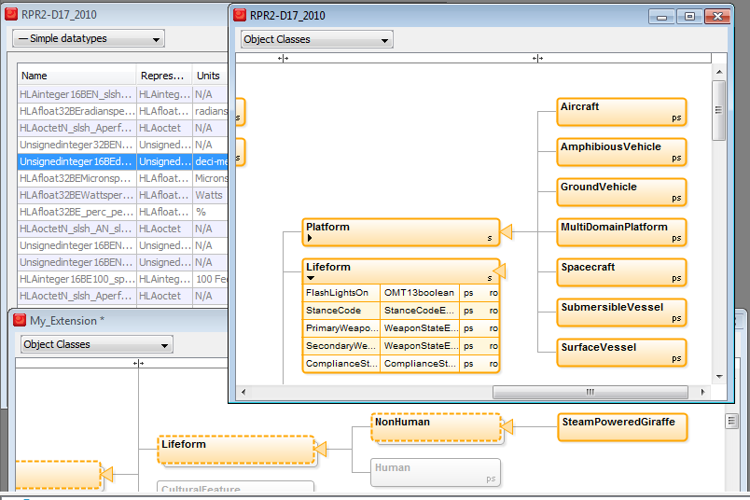
Object Class Structure Table Example
A hierarchical visual representation

Slide 15
Interface Specification
Defines the services of the RTI. Also includes the C++, Java and Web Services APIs for these services
Federation Management
Declaration Management
Object Management
Ownership Management
Time Management
Data Distribution Management
Support Services

Slide 16
Overview of Federation Execution Lifecycle
Federate
RTI
Create Federation Execution
Join Federation Execution
Startup
Establish Initial Data Requirements
via Publish and Subscribe
Register Object Instances
Update Attribute Values
Discover Objects
Operations
Update/Reflect Attribute Values
Send/Receive Interactions
Register/Discover (Late) Objects
Advance Time Request/Grant
Delete/Remove Objects
Shutdown
Resign Federation Execution
Destroy Federation Execution

Slide 17
Federation Management
Purpose: Establish well-managed sessions with a controlled set of simulations.
Functionality: Creating federation executions. Coordinated start-up. Synchronization points. Check pointing.
Essential HLA Services
  Connect to the RTI, create and join federation execution.
  Resign. Destroy federation execution. Disconnect.
  Synchronization points.
  Save/restore.

Slide 18


Declaration Management
Purpose: Declare what data each federate will send or wishes to receive, based on the federation object model (FOM), in order to optimize the data exchange.
Functionality: Publish and subscribe object classes with attributes, and interaction classes with parameters.
Essential HLA Services
  Publish.
  Subscribe.
Publish
Subscribe
Subscribe
Publish

Slide 19
Object Management
Purpose: Data exchange.
Functionality: Create and delete object instances that are shared between federates. Update their attributes. Send and receive interactions.
Essential HLA Services
  Register, discover, delete and remove object instances.
  Update and reflect attribute values.
  Send and receive interactions.
  Request updates.

Slide 20
Ownership Management
Sample use case: enable a constructive simulation to hand over the responsibility for simulating an aircraft to a virtual simulation.
Functionality: Hand over the ownership (responsibility for updating) of attributes from one federate to another during execution. This can be either “push” or “pull,” and with or without negotiation.
Essential HLA Services:
  Request ownership acquisition for an attribute.
  Divest ownership for an attribute.
  Query attribute ownership.

Slide 21
Time Management
Sample use case: run exercises in real-time, scaled real-time, varying speed, as-fast-as-possible. Run Monte-Carlo simulations as fast as possible.
Functionality: Manage the time advancement for federates and time-stamped data exchange between federates for consistency and repeatability. This can be time-stepped or event-driven.
Essential HLA Services:
  Enable/disable sending and receiving of time-stamped data.
  Request and grant advancement to a given time.
  Request and grant advancement to the time of the next message.
  Query the RTI for current time values.

Slide 22
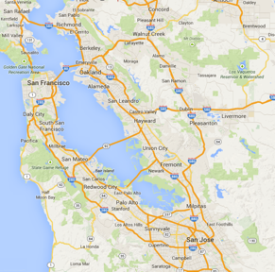

Data Distribution Management
Sample use case: build large federations by enabling federates to focus on a smaller part of the battlefield or on entities belonging to a particular force.
Functionality: Enable federates to filter data not only on class and attribute, but also on their static or dynamic data (like friendly/opposing or latitude/longitude).
Essential HLA Services:
  Create and modify regions that specify data ranges for filtering.
  Send attribute updates and interactions with associated regions.
  Subscribe to attributes and interactions with associated regions.
0
1
2
3
4
5
6
7
8
9
10
11
12
13
14
15

Slide 23
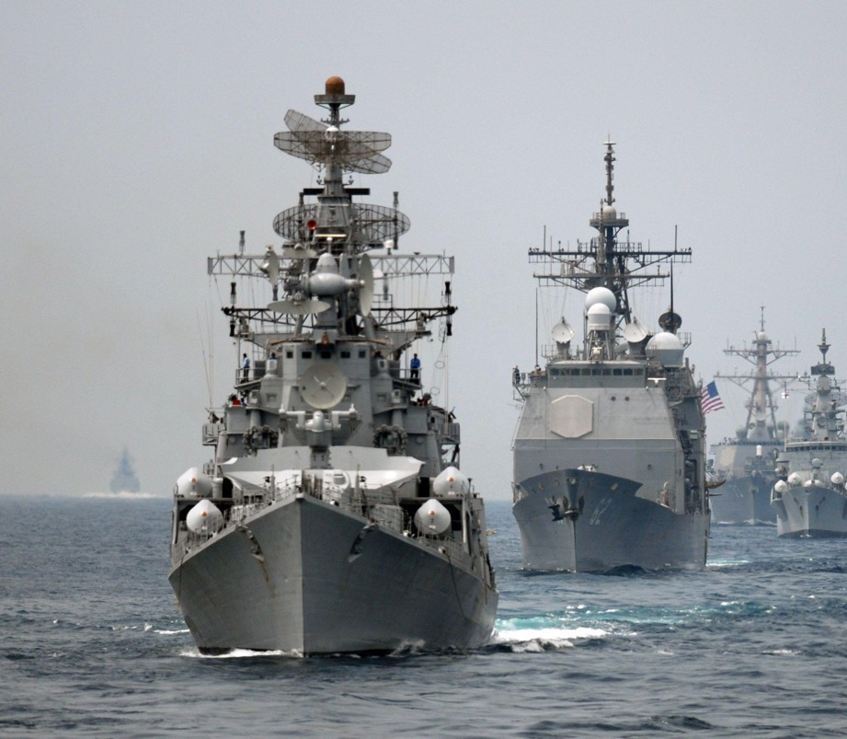
HLA Use Case: US Navy NCTE
US Navy Continuous Training Environment
Navy Enterprise Tactical Training Network
Develops, delivers, and maintains live, virtual, and constructive training environment to support Naval Forces
50 Navy shore sites, 140 combatant ships, 8 networks, 5 classification levels
Based on HLA IEEE 1516-2010, RPR FOM 2.0, Link 16 and Simple
FOM modules (as of 2018):
  29 stable (“core”)
  29 rapid development (“aux”)
RPR FOM = Real-Time Platform Reference FOM

Slide 24

HLA Use Case: UK Air Force – “Gladiator”
Distributed training environment for the UK Royal Air Force
Enables pilots to train collectively with ground and maritime forces from their home bases without the need to co-locate
Initially supporting Typhoon, Other capabilities (F-35 etc) to be added
Based on HLA IEEE 1516-2010, RPR FOM and NETN FOM with several extensions
NETN FOM = NATO Education and Training Network FOM

Slide 25
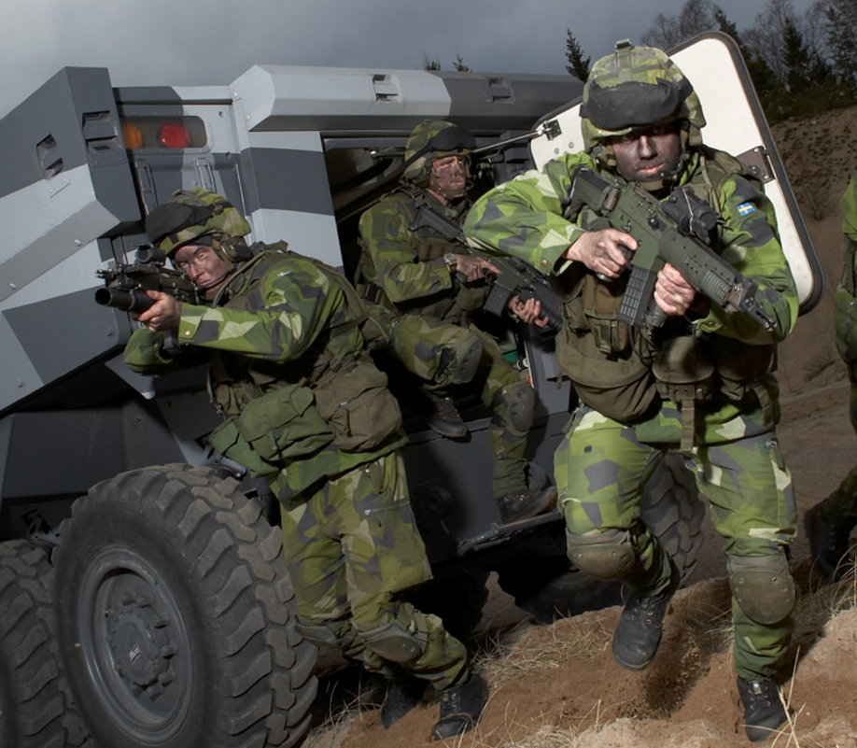
HLA Use Case: Civil Military Exercise “Viking”
Series of US & Swedish-led command and control exercises (most recent in 2022)
Planning and conducting a UN mandated Chapter VII Peace Operation/Crisis Response Operation
Civilian, military and police
2500 participants, 50 nations, 70 organizations, 8 training sites +
2 MSaaS sites
Based on HLA IEEE 1516-2010, RPR FOM 2.0, NETN FOM v3.0, MSDL and additional standards
MSDL = Military Scenario Definition Language

Slide 26
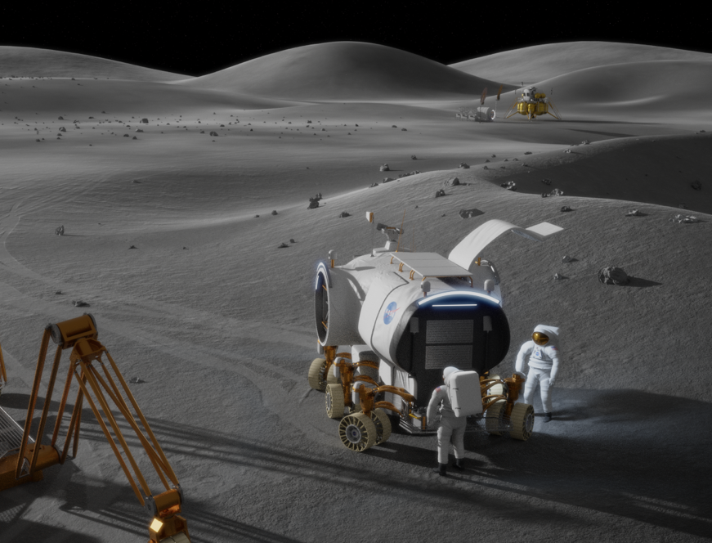
HLA Use Case: NASA and ESA Space Exploration
Engineering and training federations for space exploration
NASA: Federations in support of the Artemis program that will land the first woman and next man on the surface of the Moon by 2024
ESA: Mars sample return and low-gravity landing vehicle
Based on HLA IEEE 1516-2010 and the SISO Space Reference FOM
  Multiple reference frames, HLA time management, hard real-time and more
NASA = National Aeronautics and Space Administration
ESA = European Space Agency

Slide 27
HLA Evolved – FOM Modules
All Objects and Interactions
Weapons
Platforms
Radio
Common Data
The same FOM as before, but split into modules
  Remember: It was a long time ago since we gave up developing computer programs as one large chunk of code.
More efficient and flexible development, maintenance, reuse and standardization
Projects/programs can reuse and extend standardized modules and add their own modules.

Slide 28
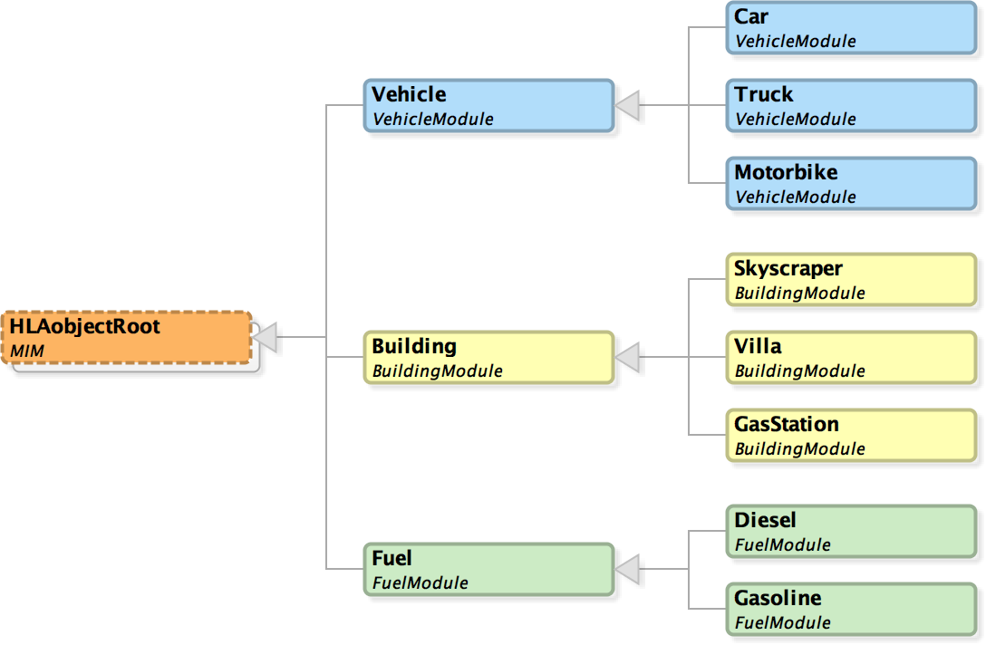
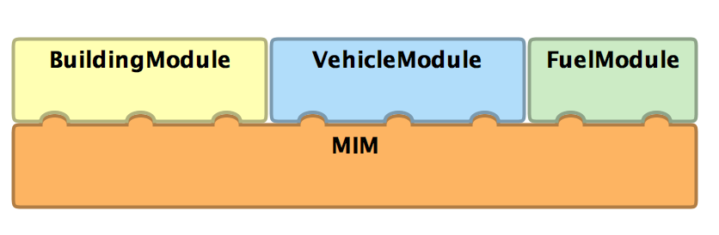
FOM Module Example
Modules
Object Classes

Slide 29
HLA Evolved – Fault Tolerance
Federate
Lost!
Federate
Lost!
Not Connected!
Federate
Federate
Federate
RTI
HLA Evolved introduced a mechanism for fault tolerance
  Connected federates can discover that a federate has been lost
  The lost federate can discover that it has lost connection
Enables several design patterns (fail-over federates, reconnecting federates, …)

Slide 30
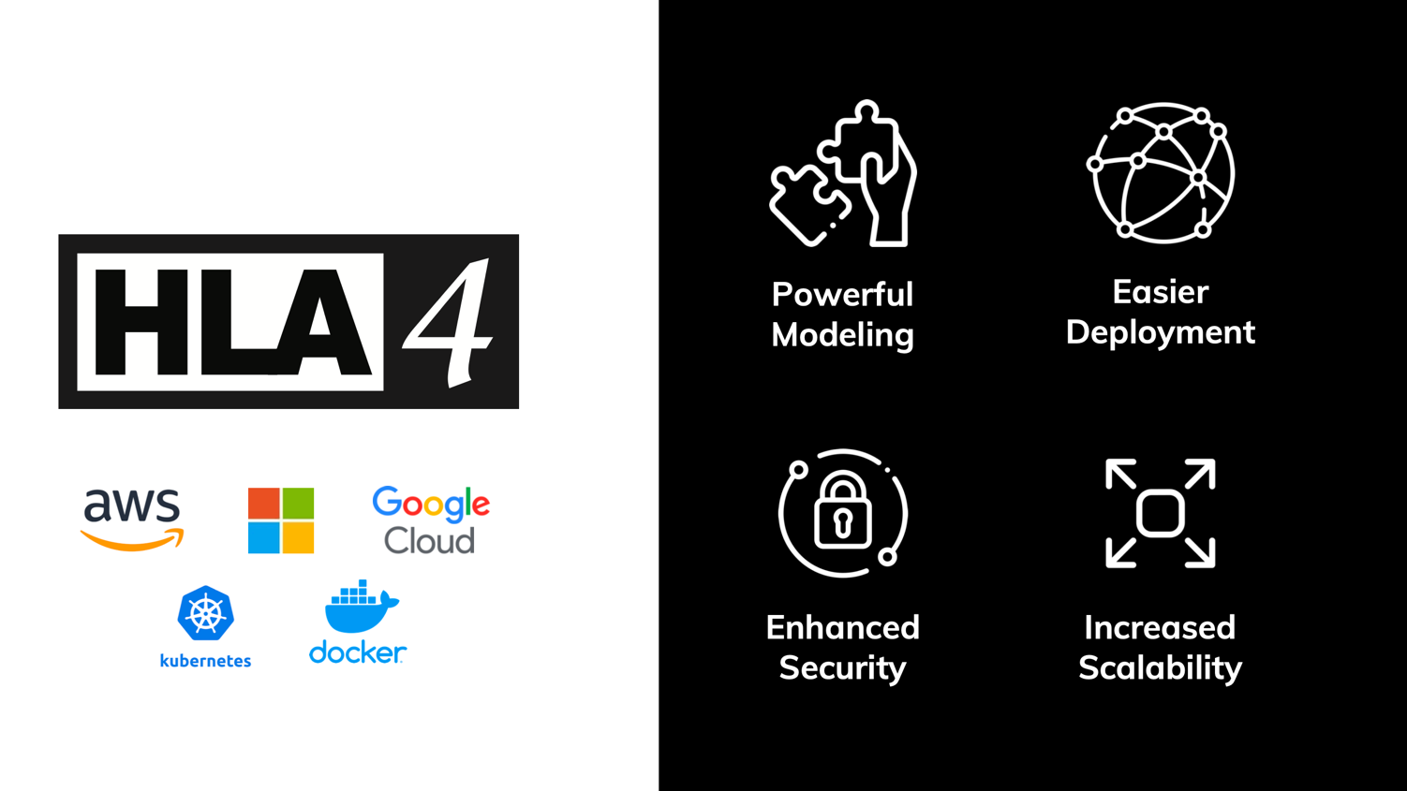

Slide 31
Important New Features in HLA 4
More powerful modeling
  Directed Interactions
  Easier to extend reference FOMs
Security
  Secure authorization of federates
  Secure communication
Deployment
  Support unreliable links, like 3G/4G/5G
  Support more programming languages
  Increased vendor-independence
Scalability
  Cloud-based simulation with local deployment
  “Elastic cloud” scalability
  Improved data distribution management
Business models
  Modeling and Simulation as a Service
HLA 4 passed IEEE Balloting in 2023

Slide 32
Object Modeling: Directed Interactions
Classic “Global” Interactions
Directed Interactions
StartDriving
Delivered to all
subscribing federates.
StartDriving
Delivered to subscribing
federates that model
(update) a particular car.

Slide 33
Object Modeling: Easier to Extend Models
Standardized “Reference Object Models” are one of the key benefits with HLA. They provide a baseline for interoperability. They are key for reuse.
HLA 4 adds several features that makes it easier to extend existing information models with application-specific data.
Example: add attributes to already defined object classes
Standard Aircraft
Entity Type
Entity ID
Side
Spatial (position etc)
Damage State
Extensions
Maintenance Date
Maintenance Type

Slide 34
Scalability: Improved DDM
0
1
2
3
0
1
2
3
4
5
6
7
4
5
6
7
8
9
10
11
8
10
11
12
13
14
15
12
13
14
15
Filter on Lat/Long
Filter on air, land, sea, space
Filter on friendly, opposing, neutral
Modern RTIs can deliver a million updates/second to a federate, but few, if any federates, can process that incoming data rate
Reducing the data flow to each federate is the key to scalability
HLA Data Distribution Management (DDM) provides powerful ways to filter data
HLA 4 makes it possible to extend reference FOMs with tailored DDM

Slide 35


Federate Authentication
Federates may be required to provide credentials to connect and join a federation
Support for passwords, PKI certificates (X.509), etc
Flexible mechanism through plug-in
May connect to existing authorization services
May implement different policies
Also useful for Zero Trust Architectures
Certificate
Authority
Private Key
Certificate
Certificate
Certificate
Federate A
Federate B
Federate C
Runtime Infrastructure (RTI)
Public Key

Slide 36







Federate Protocol
A federate can call the RTI using a protocol instead of calling a local library
Separates the federate from the RTI
Better support for Live with 3G/4G links
More cloud-friendly (containers, etc)
Simplifies accreditation
Additional languages/OS
Standardized API
Standardized protocol
Federate
Federate
Network
“Join” API call
“Join” network packet
RTI Lib (LRC)
RTI Server
Network
Network

Slide 37

Deployment Examples: Cloud and Live Training
Cloud
Live training
CGF
Data Logger
RTI
3G/4G
Radio
3G/4G
Radio
Host
Host
Protocol
Protocol
Host
CGF
Visualizer
RTI
LRC
LRC
Site A
Site B
Federate
Federate
Deploy large CPU consumers in the Cloud
Deploy large GPU consumers locally
Collect Big Data in the Cloud
Connect live systems over 3G,/4G/5G
Point-to-point communication
Fault tolerance and fast reconnect

Slide 38
HLA 4 Based Architecture for Cloud, Scalability and MSaaS
On-site
Public or Private Cloud
Classic Training System
HLA 4 Federate Protocol + Authentication
HLA 4 RTI
RPR FOM
Game Based Trainer
HLA 4 Federate Protocol + Authentication
L16 FOM
Web Based Client
https/html/REST/Vert.x/etc
Web Server
HLA 4 API
or protocol
NATO FOM
C2 System
C2 Sim/C2 Protocol
C2
Gateway
HLA 4 API
or protocol
Space FOM
Data Recorder
HLA 4 API
or protocol
HLA 4 supports mixed cloud and on-site deployment
Scalable CGFs and data recorders may execute in cloud environments
Training audience may operate classic training systems, web-based interfaces or game-based trainers
Custom FOM
Scalable
CGF
HLA 4 API
or protocol

Slide 39
More New Features in HLA 4
Better support for scalability through enhanced DDM
  Easier to specify dimensions for entire object class, inheritance to subclasses
  Add DDM to existing FOMs using separate module
  More complete and flexible Dimension specification
  Relaxed DDM
Many minor improvements
  Ownership management – user supplied tags
  Specify for what attributes values are required vs optional
  Fault tolerance – handling unplanned leaving federate
  New datatypes to better support RPR FOM
  Glyph that follows html conventions
  Switches – defaults
  Exception handling
  Updated sample FOM modules

Slide 40
HLA and LVC – Gateways
DIS
Link 16
Command and Control
Federate
DIS Gateway
L16 Gateway
C2 Gateway
Runtime Infrastructure (RTI)
HLA can handle both Live, Virtual and Constructive simulation
In LVC settings, information may still need to be bridged between different architectures
Standard FOMs exist for bridging
  The RPR FOM matches the DIS information model
  Tactical Data Link (TDL) such as Link 16
  C2SIM – connect to C2 systems
Custom gateways may be needed

Slide 41

HLA and Performance
HLA is a standard
  It has no particular performance
Actual RTI implementations exhibit performance
  May be optimized for different use cases
Sample RTI performance on regular Windows workstations in 2020
  Hundreds of systems
  100 000’s of updates per second, typically up to 90% of the network’s raw bandwidth
    900 Mbps on Gigabit LAN
  100 000 object instances
  Latency of 0.13 ms on 100 Mbps LAN
Common federation bottlenecks:
  LAN bandwidth
  WAN latency and bandwidth
  Federate processing time for incoming data
Plan for performance!
  Analyze performance requirements
  Analyze federate and network capabilities

Slide 42
HLA and Tools
Sample tool chain
OMT Editor
Code Generator
RTI
Data Logger
2D/3D
Visualizer
A wide range of HLA compliant tools and federates are available
Development tools (OMT editor, middleware, code generators, data loggers)
Visualizers (2D, 3D, game based, …)
Federates (Computer Generated Forces, flight models, dynamics, …)
Bridges (HLA-DIS, HLA-HLA, HLA-TENA, HLA-games, HLA-DDS, …)
TENA = Test and Training Enabling Architecture
DDS = Data Distribution Services

Slide 43
HLA and Cross Domain Security/MLS
CDS/MLS solution
Simulation
Simulation
Proxy
Guard
Proxy
Simulation
Simulation
RTI
Policy
RTI
Low Domain
Release
High Domain
It is possible to simulate with controlled data exchange between classification levels
The federation is partitioned into different domains
  May be different classifications within one nation or simulation between different nations
There are security solutions that can connect to multiple domains, provide separation and release data based on a release policy
  Different topologies: one host, several hosts, hardware/software guards, etc
  Different solutions meet different levels of assurance

Slide 44










Common Aerospace and Defense FOMs
NATO NETN FOM Modules
The RPR FOM 2.0 is the most commonly used FOM for defense simulation
  RPR FOM 3 now being finalized
  IFF, InfOps, etc
  Download from www.sisostds.org
NATO Education and Training Network FOM (NETN)
  Builds on top of RPR FOM
  Growing number of modules
  Download from github.com/AMSP-04/
SISO Space Reference FOM
EUROCAE Air Traffic Management FOM
Medical FOM (US Army)
METOC
Communi-
cation
Networks
Entity
Tasking &
Reporting
CBRN
Organization
AIS
Multi
Resolution
Modeling
Transfer of
Modeling
Responsibilty
RPR FOM Modules
Physical
Entities
Aggregates
Radio
Logistics
Synthetic
Environment
Warfare
Underwater
Acoustics
Minefield
Simulation
Management
Emissions

Slide 45
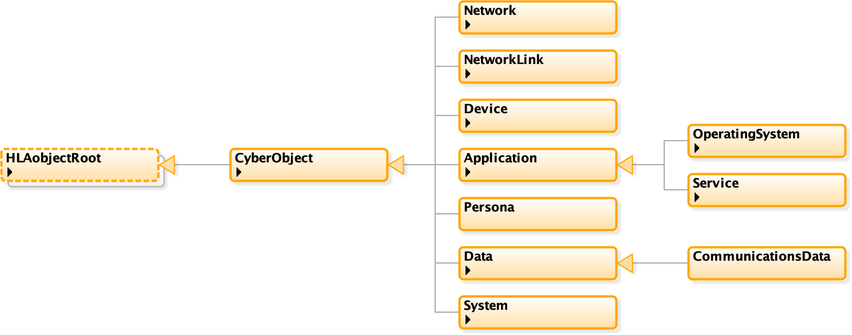
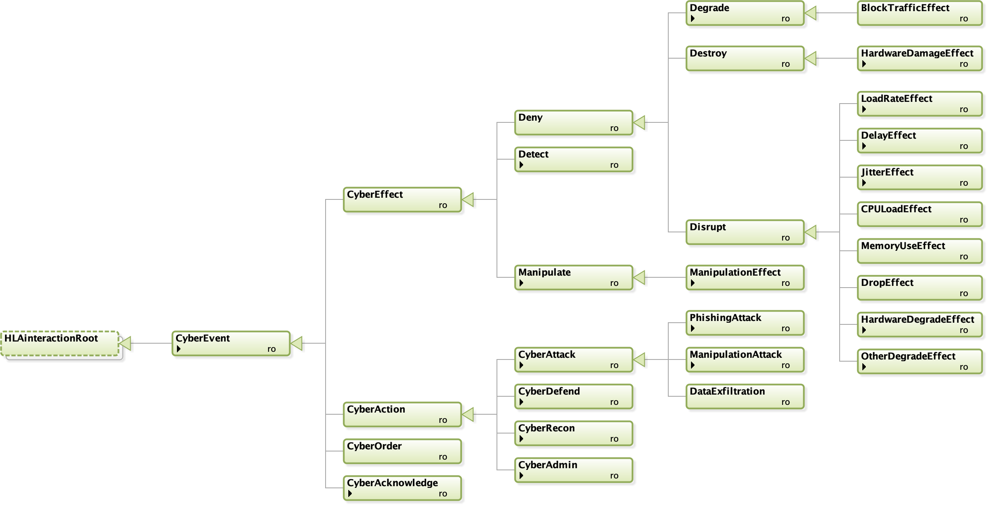
New: Cyber Data Exchange Model (DEM) and
Federation Object Model (FOM)
SISO is developing a Cyber DEM standard to represent cyber events and objects in a format independent of simulation interoperability solutions, but which is unambiguously translatable to those solutions. The Cyber DEM will enable integration of cyber simulations, cyber ranges, and kinetic simulations. A follow-on effort is planned to standardize a Cyber FOM based on the Cyber DEM.
Draft Interaction Class Structure
Draft Object Class Structure

Slide 46
Federation Engineering
The Distributed Simulation Engineering and Execution Process (DSEEP, IEEE 1730):
  A clear, concise systems engineering process for development, integration, and execution of distributed simulations
  Based on:
    Authoritative systems engineering best practices
    Successes and failures of past distributed simulation environments
  Defines a generic, tailorable framework
    Consists of a graphical model and supporting textual description
    Provides a common reference point for communication between federation development team members
    Provides a common foundation for defining functional overlays to the federation development process, e.g. VV&A, security, tools
Define Simulation Environment Objectives
Perform Conceptual Analysis
Design Simulation Environment
Develop Simulation Environment
Integrate
and Test Simulation Environment
Execute Simulation
Analyze Data and Evaluate Results
1
2
3
4
5
6
7
Corrective Actions / Iterative Development

Slide 47
Federation Agreements
FOMs are an essential, prescribed component of a federation, but there are many other agreements that are necessary to establish a fully consistent, interoperable federation.
The DSEEP identifies the need for such federation agreements (simulation environment agreements), but does not prescribe their specific content or format.
The SISO standard for federation agreements, the Federation Engineering Agreements Template (FEAT) [SISO-STD-012-2013] provides a standardized format for recording federation agreements to increase their usability and reuse.

Slide 48
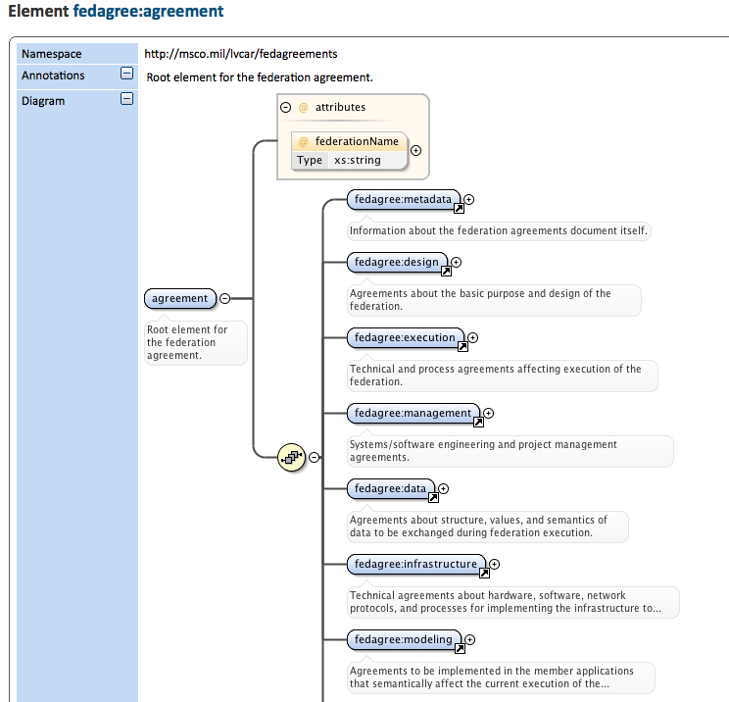
FEAT Overview
The FEAT is an eXtensible Markup Language (XML) schema from which compliant XML-based federation agreement documents can be created. The federation agreements are decomposed into eight categories:
  Metadata — Information about the federation agreements document itself.
  Design — Agreements about the basic purpose and design of the federation.
  Execution — Technical and process agreements affecting execution of the federation.
  Management — Systems/software engineering and project management agreements.
  Data — Agreements about structure, values, and semantics of data to be exchanged during federation execution.
  Infrastructure — Technical agreements about hardware, software, network protocols, and processes for implementing the infrastructure to support federation execution.
  Modeling — Agreements to be implemented in the member applications that semantically affect the current execution of the federation.
  Variances — Exceptions to the federation agreements deemed necessary during integration and testing.

Slide 49
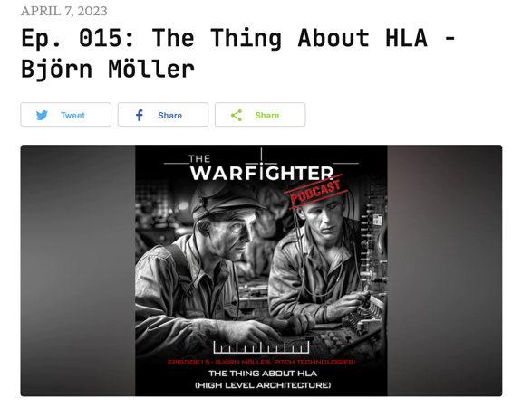
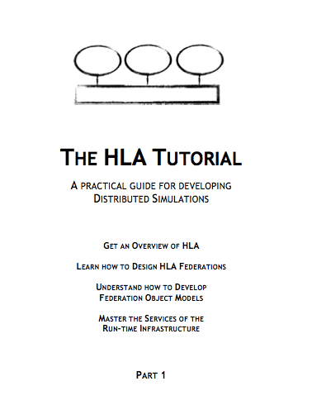
Additional Reading
The standard
  HLA IEEE 1516-2010 www.ieee.org
HLA podcast – an introduction
  https://www.warfighterpodcast.com/
The HLA Tutorial – for developers
  Free, redistributable PDF
  www.pitchtechnologies.com/hlatutorial
Plenty of SISO papers
  www.sisostds.org
  ResearchGate
The HLA Product Development Group
discussion archives
  www.sisostds.org

Slide 50
Learning Objectives Revisited
After taking this tutorial you should be able to:
Describe the requirements for interoperability in distributed simulation
Explain the principles of the HLA standard
Explain how the HLA standard is used for distributed training purposes
Describe the new features of HLA 1516-2010 and HLA 4
Describe some common Federation Object Models (FOMs) for defense training

Slide 51
Questions?
Björn Möller
Dr. Katherine L. Morse
Bjorn.Moller@pitch.se
Katherine.Morse@jhuapl.edu

