Slide 1

Making the Case: Building Strong M&S Verification and Validation Evidence
Simone M. Youngblood
The Johns Hopkins University Applied Physics Laboratory
240-228-7958 Simone.Youngblood@jhuapl.edu
Katherine M. Ruben
The Johns Hopkins University Applied Physics Laboratory
240-228-9148 Katherine.Ruben@jhuapl.edu

Slide 2
Making the Case Tutorial Learning Objectives
Primary Objective: Identify the key steps that can be taken to build strong Verification & Validation (V&V) evidence while accounting for resource impacts.
Key Learning Objectives:
Define and distinguish key verification and validation terms
Identify important characteristics of available verification test strategies
Construct an effective referent in non-ideal circumstances
Recognize the key elements (metrics, methods) that support rigorous validation.
Match validation methods to the available referent
Identify applicable V&V templates and tools

Slide 3
Presentation Outline
Definitions that establish the common lexicon
Terms
Setting boundaries by defining the intended use
Building a strong verification case
Defining M&S Requirements
Leveraging existing verification data
Leveraging developer testing
Supplemental V&V testing
Building a strong validation referent
Developing the referent as the basis for validation comparison
Challenges and obstacles to developing the referent
Best practices and obstacle mitigation
Examples
Building a strong validation case
Defining validation metrics
Selecting and applying the appropriate method
Quantifying validation uncertainty
Examples
Standards, Guidance, Templates, and Tools
Conclusions

Slide 4
Learning Strategy
Learning Strategy | Define and distinguish key verification and validation terms | Identify important characteristics of available verification test strategies | Construct an effective referent in non-ideal circumstances | Recognize the key elements (metrics, methods) that support rigorous validation | Match validation methods to the available referent | Identify applicable V&V templates and tools
Definitions that establish a common lexicon
Building a strong verification case
Building a strong validation referent
Building a strong validation case
Documentation tools and templates and tools

Slide 5
Tutorial Motivation
Historically V&V tutorials focused on
Fundamental relationships and processes
Validation techniques
Recommended Practices and Guidance documents
Rigorous V&V
Ensures credible simulation of complex systems
Reduces risk of negative training
V&V continues to evolve to address
Advances in simulation technology
Integration with agile software development and project management strategies
Increasingly sparse real world referent data
Adoption and integration with Digital Engineering paradigms
Updates to relevant M&S Policies

Slide 6
Presentation Outline
Definitions that establish the common lexicon
Terms
Setting boundaries by defining the intended use
Building a strong verification case
Building a strong validation referent
Building a strong validation case
Standards, Guidance, Templates, and Tools
Conclusions

Slide 7
Terms: Verification and Validation
Verification. The process of determining that a model or simulation, and its associated data, accurately represents the developer’s conceptual description and specifications. [DOD, 2009]
Transformational accuracy [Balci, 2002]
Transform specifications to code
Software engineering quality
Software engineering methods apply
Validation. Determining the degree to which a model or simulation, and its associated data, are an accurate representation of the real world from the perspective of the intended uses of the model. [DOD, 2009]
Comparing model results with experimental data [Velten, 2009]
Representational accuracy [Balci, 2002]
Recreate simuland with results
Modeling quality
Special validation methods needed

Slide 8
Terms: Simuland and Referent
Simuland. The subject of a model or simulation.
A real-world (or notional) system of interest
Object, phenomenon, or process to be simulated
Referent. A codified body of knowledge about something being modeled or simulated.
Quantitative and formal, e.g., differential equations for aircraft flight dynamics
Qualitative and informal, e.g., pilot’s expectation of buffet before stall
Referent: “The best of most appropriate codified body of information available that describes characteristics and behavior of the reality represented in the simulation from the perspective of validation assessment for the intended uses of the simulation.”

Slide 9
Terms: Accreditation, Acceptance, and Certification
Accreditation The official certification that a model, simulation, or distributed simulation is acceptable for use for a specific purpose [DOD, 2009].
Evidentiary requirements and acceptance / acceptability criteria are set by the accreditation authority
Accreditation authority is granted by instruction
Accreditation agents (usually independent of the developers and the accreditation authority organization) can be used to coordinate activities, provide assessment and make recommendations
Acceptance is a concept applied by organization if formal accreditation is not specified.
Certification and / or accreditation is the outcome from an acceptance process
Establishing acceptance / acceptability criteria is fundamental to the process
Model developer / Proponent may provide accreditation recommendation letters that a particular model or simulation provides a credible representation compared to the test objectives and intended use.
Methods, techniques, and criteria are at the discretion of the developer

Slide 10
Terms: Intended Use
Intended use. The purpose for or function of a model; what the model will be used for; the problem to be addressed by the model. [DOD, 2012]
Characteristics [Piersall, 2014]
“Not a capability, solution, or implementation”
Expressed from the perspective of the user
Should be formally specified
“Any attempt to suppress the role of the intentions of the investigator, B, leads to circular definitions or to ambiguities about essential features ...” [Minsky, 1965]
“Modeling and simulation is always goal-driven, … , we should know the purpose of our potential model before we sit down to create it.” [Cellier, 1991]

Slide 11
Intended Use Categories
Modeling and Simulation Intended Use Descriptions [Piersall, 2015]
Concept Evaluation
Developmental Engineering
Testing and Verification
Assessment
Training
Operational Support

Slide 12
The VV&A Proces Overlaid onto the M&S Use Process
PROBLEM SOLVING PROCESS
Define Problem
Establish
Objectives
Accept & Record
Solution
Analyze Results
Repository
Select
Approaches
Non-M&S Methods
Apply
Results
Define Intended Use
M&S USE PROCESS
Execute and Prepare Results
M&S Method
M&s Development/Preparation Process
Prepare M&S for Use
Define
M&S Rqmts
yes
Make Accreditation Decision
no
Verification and Validation Process
Plan
Approach
Accreditation / Certification Process

Slide 13
Level of Interoperability
interoperability: The ability of a member application to provide services to and/or accept services from other member applications and to use the services so exchanged to enable the member applications to operate effectively together.
technical interoperability: A state of a distributed simulation characterized by implementation of a communication protocol for exchanging data between member applications (adapted from [Tolk, 2006])
syntactic interoperability: A state of a distributed simulation characterized by implementation of a common structure to exchange information (adapted from [Tolk, 2006])
semantic interoperability: A state of a distributed simulation characterized by use of a common information exchange model
logical interoperability: A state of a distributed simulation characterized by understanding of the member applications of the context within which information is being exchanged (adapted from [Tolk, 2006])
substantive interoperability: A state of a distributed simulation characterized by understanding of the state changes in the assumptions and constraints of each member application and the ability of the member applications to react to those changes (adapted from [Tolk, 2006])

Slide 14
Setting V&V Boundaries on Intended Uses
Referent Quality
Empirical Data
Simulation Data
Theoretical Data
SME Knowledge
Operational Support
Assessment
Intended Uses
Testing and Verification
Training
Developmental Engineering
Concept Evaluation
Subject Matter Expert (SME) Recommendation
Verification
Certification
Validation
V&V Rigor

Slide 15
Verification and Validation Composite Model
Plan the V&V Effort
Develop the V&V Approach
Identify the V&V Resources
Build the V&V Schedule
Estimate the V&V Costs
Prepare the V&V Plan
Execute & Evolve the V&V Plan
Apply Relevant Historical Information
Collect & Analyze Developer Accounts of Simulation Capabilities & Limitations
Collect & Analyze the V&V and Testing Histories
Collect & Analyze Prior Use History
Integrate & Employ the Historical Evidence
Verify & Validate the Simulation Conceptual Model
Verify the Simulation Conceptual Model
Validate the Simulation Conceptual Model
Verify & Validate Available Scenarios
Integrate & Employ the Conceptual Model V&V Evidence
Perform Supplemental Verification
Determine the Scope of Supplemental Verification Needed
Verify the Simulation Design Products
Verify the Simulation Object Code
Verify the Simulation Executable
Verify the Development Products against the Simulation Conceptual Model
Verify the Development Products for Standards Compliance
Apply the Verification Products to Validation
Infer the Simulation Capabilities from the Verification Products
Infer the Simulation Limitations from the Verification Products
Infer the Information Gaps from the Verification Products
Employ the Verification Evidence
Verify & Validate the Data & Knowledge Sets
Identify the Data & Knowledge Sources & Their Pedigrees
Verify the Data & Knowledge Sets
Validate Data & Knowledge Sets Where Needed
Integrate & Employ the Data & Knowledge V&V Evidence
Validate Simulation Results
Leverage Developer Test Results for Results Validation
Derive Results Validation Test Scenarios
Plan for Results Validation
Collect Simulation Output for Results Validation
Integrate & Employ the Validation Testing Results
Integrate the V&V Evidence
Integrate the V&V Evidence
Prepare the V&V Report
Support Any Archival of the V&V Products
[NATO, 2012]

Slide 16
Tailoring the VV&A Processes
Use Risks
VV&A Resources
Every Verification, Validation, and Accreditation (VV&A) problem differs in:
Uses of simulations
M&S requirements
Tolerable use risks
Resource constraints
Available information
People & skills
Funding
Time
When VV&A starts in the simulation life cycle
No single set of VV&A activities & tasks can efficiently accommodate all of these differences.
Consequences of Any Simulation Limitations on the Intended Use
Information Available to Support VV&A
Use Risk from Uncertainties in V&V Results
Personnel Required to Perform VV&A
Use Risk from Unknown Simulation Uncertainties
Time Available to Perform VV&A

Slide 17
Presentation Outline
Definitions that establish the common lexicon
Building a strong verification case
Defining M&S Requirements
Leveraging existing verification data
Leveraging developer testing
Supplemental V&V testing
Building a strong validation referent
Building a strong validation case
Standards, Guidance, Templates, and Tools
Conclusions

Slide 18
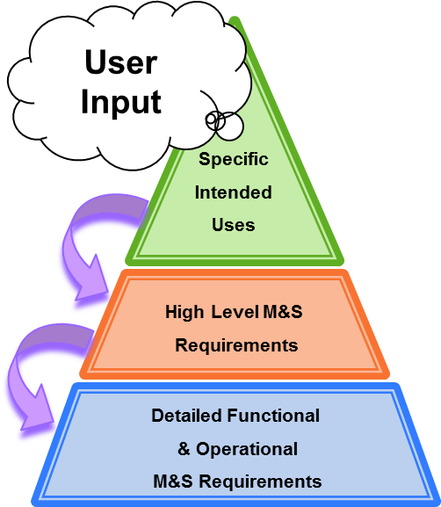
M&S Requirements Framework
M&S
Chosen as part of the solution to a program question
Represents real-world entities, effects and phenomena
Specific Intended Use (SIU)
Describe decisions and information used for that decision that will be provided by the M&S
Are narratives written from the perspective of the user
High Level Requirements (HLRs)
Capability statements derived from SIUs
Intended as executive summary of M&S scope
Describe general categories of the simulation environment
Describe logical groupings of disciplinary factors and effects
Detail Level Requirements (DLRs)
Mandatory provisions written as obligatory “shall” statements
Derived from HLRs
Trace directly between user needs and what developer provides
Ultimate guidance to design, development, and testing activities
Address representational and operational needs

Slide 19
Defining M&S Requirements
Assessment Driven M&S Needs
Simulation Conceptual Model
Stakeholder Intended Uses
Assessment Metrics
Blue Force, Red Force,
Communications, Natural Environment
M&S System Requirements Document
M&S Design and Development
Assessment Plan
M&S Integration and V&V Testing
Scenarios
M&S Execution
Analysis and Assessment
Data for Assessment

Slide 20
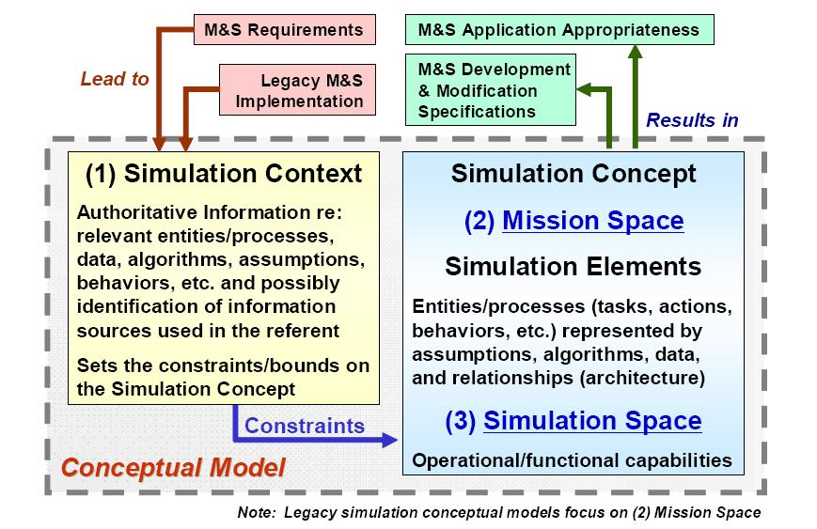
Simulation Conceptual Modeling
Model Based Systems Engineering (MBSE) offers a rich framework for capturing conceptual model artifacts and information; e.g. Use Case, Sequence and Block Definition diagrams

Slide 21
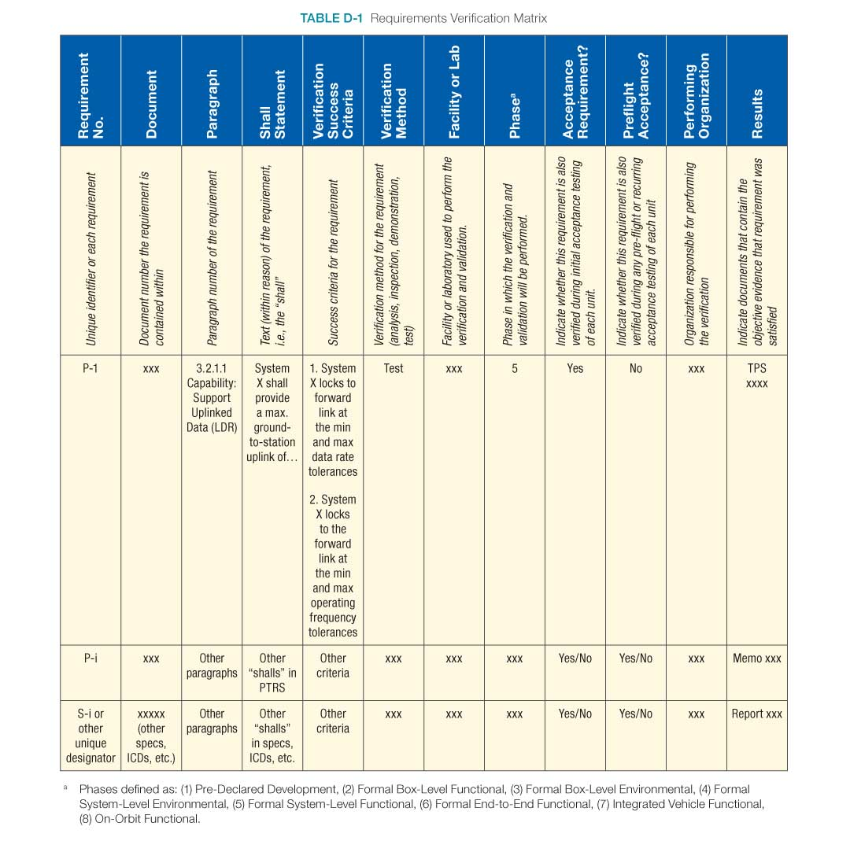
Leveraging Existing Simulation Verification Data
Sample Documentation
Necessitated by widespread adoption of agile software development practices
Supported by rigorous configuration management of M&S requirements, developmental M&S products and strict version control
Enabled by the use of integrated requirements management and testing tools
Evolving requirements
Requirements attributes enabling dynamic status tracking
Synchronous requirements and verification test development
Automated traceability views
Downloaded from [NASA, 2023] on 6/21/23

Slide 22
Leveraging Developer Testing
Federation / distributed simulation development often undergoes levels of testing
Unit
Pairwise
Multi-way
Integrated
At scale
Simulation environment differences
Testing within federated environments
Substitutes for interactions with M&S participants
Testing scope and negative testing

Slide 23
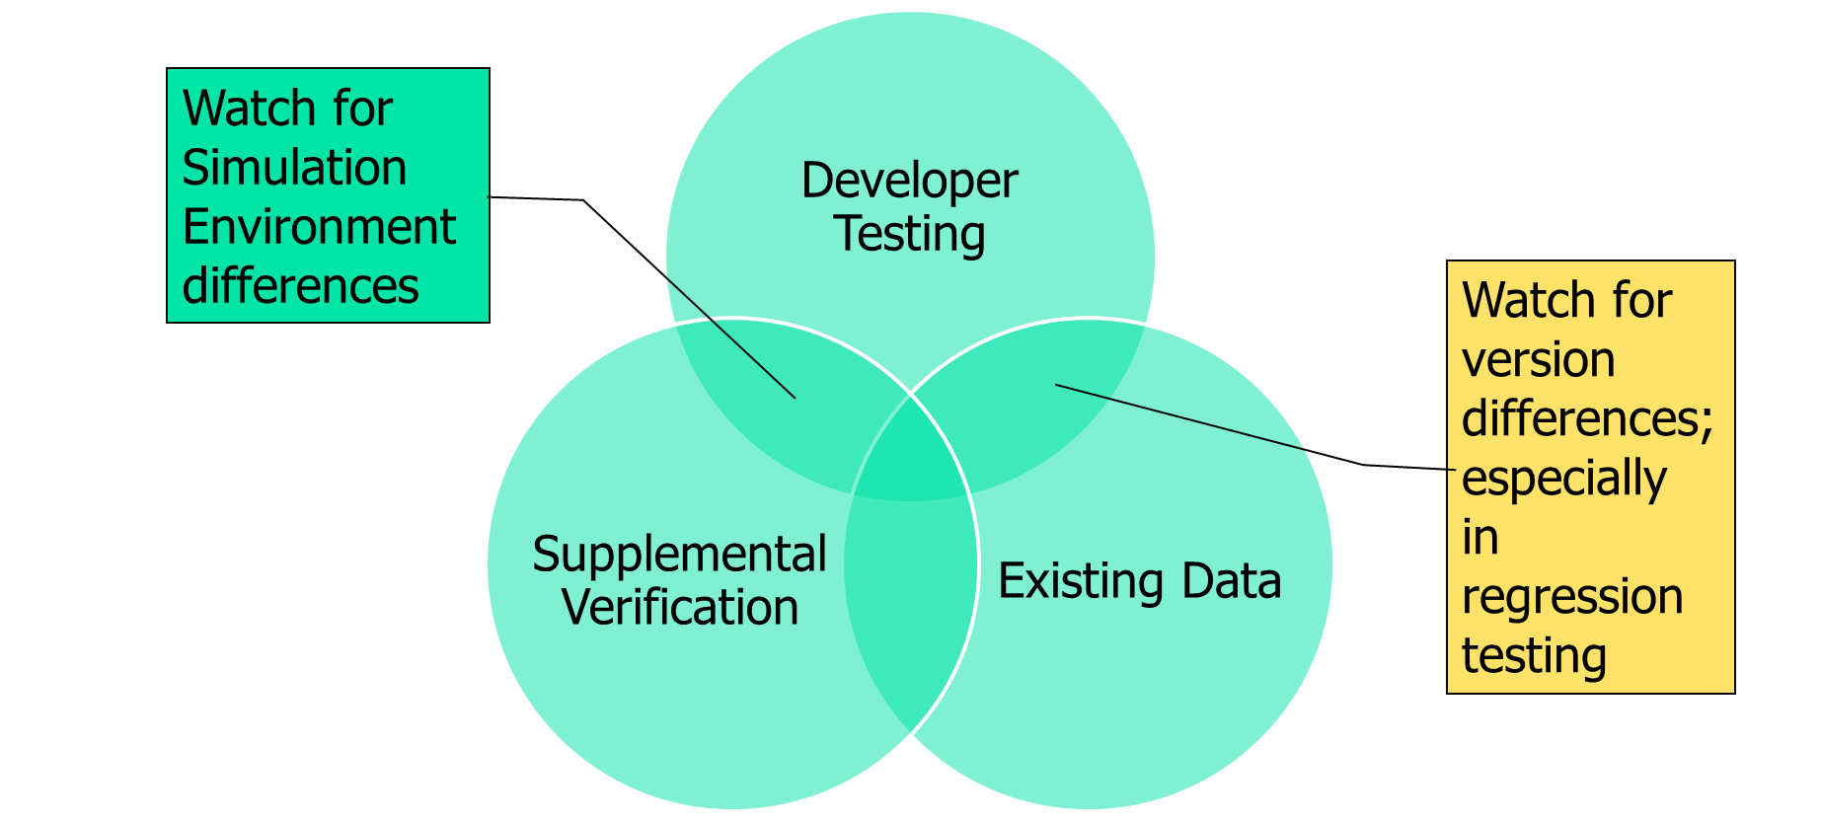
Supplemental Simulation Verification Testing
Supplemental is not Regression
Regression implies an exact duplication of previously executed testing
Supplemental may be
Additional test at the same level
Test case replication at a different levels
Comparison between levels
Benefits from / for digital engineering

Slide 24
Presentation Outline
Definitions that establish the common lexicon
Building a strong verification case
Building a strong validation referent
Developing the referent as the basis for validation comparison
Challenges and obstacles to developing the referent
Best practices and obstacle mitigation
Examples
Building a strong validation case
Standards, Guidance, Templates, and Tools
Conclusions

Slide 25
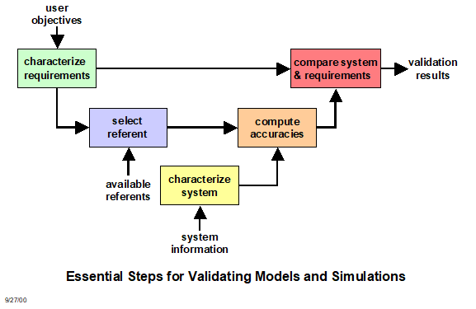
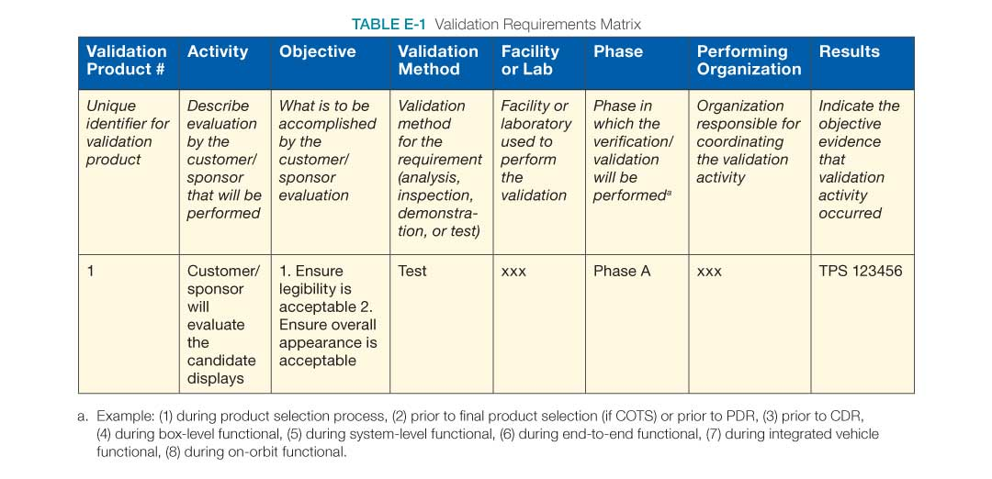
Essential Steps for Validating Models and Simulations
Sample Documentation
Downloaded from [NASA, 2023] on 6/21/23
Retrieved from MSE VV&A RPG content

Slide 26
The Ideal Referent
Covers the operational/domain space of interest as bounded by the intended use [Gilmore, 2016]
Provides data on the aspects of the operational envelope/behavior space that will be covered by the M&S
Addresses variations in factors affecting performance/behavior w. r. t. response variables of interest
Supports interpolation between known data points vice extrapolation
Is drawn from observations of the simuland [RPG, 2011]
Under controlled circumstances such as tests and experiments
Under natural or operational circumstances
Is drawn from authoritative data
Test data adjudicated by Data Authentication Group review to address measurement errors, incomplete data, etc. [ATEC, 2004]
Identifies any areas of known uncertainty

Slide 27
Referent Sources
Empirical data; observations of the simuland, collected either under controlled circumstances, e.g., tests or experiments, or in the field
Theoretical data; calculated using equations or algorithms that describe simuland characteristics, behaviors, and relationships; equations known or assumed to be correct
Simulation data; results generated by simulations; models known or assumed to be valid
Subject Matter Expert knowledge
Combinations of these

Slide 28
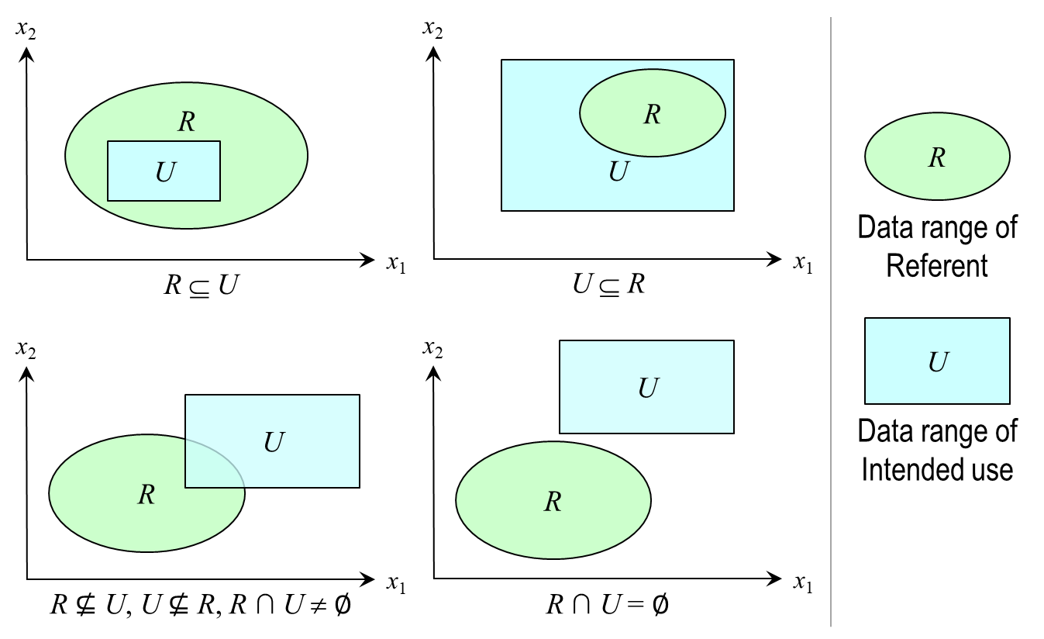
Referent Challenges and Obstacles
Ill defined intended use
Lack of definition of the model/simulation’s coverage of the domain space
Lack of test scenarios that will align test and simulation data
Inconsistencies between referent and simulation data
Metrics of interest
Factors that affect performance
Limited/no referent data available
Complexity of system/behaviors represented imposes limitations (e.g., resource, economic) on the development of quantitative referent data
Domain of Interest does not support quantitative referent development (e.g., Department of Energy, NASA)
Economic limitations

Slide 29
Referent Best Practices
Start early – validation referents take time to develop
Need to identify scope of information needed
Need to coordinate with others (e.g., testers, SMEs) to produce referent data
Need to budget for referent development
Ensure accreditation authority concurrence
“Grow” referent information over time
Leverage all sources of test data (e.g., ground test, Hardware in the Loop (HWIL), live fire)
Maximize extent of referent coverage of the operational/behavioral space as defined by the intended use
Define areas of uncertainty
Limitations of M&S coverage
Limitations of referent data

Slide 30
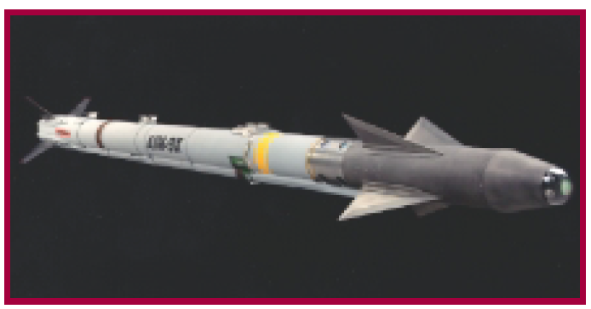
AIM9X: Simulation Enhanced Operational Test
Limited test shots, with maximum operational envelope coverage to support validation referent development
Adopted Model-Test-Model [Mansager, 1994] paradigm to continually assess validation referent development
Applied a statistical methodology (Fisher Test) to validate the simulation
Validated M&S used to satisfy all system performance requirements [IDA, 2001]
Significantly decreased the number of test shots (DT and OT) needed [DOT&E, 2000]
AIM9X awarded NTSA 2001 M&S Industry Award
AIM9X Missile

Slide 31
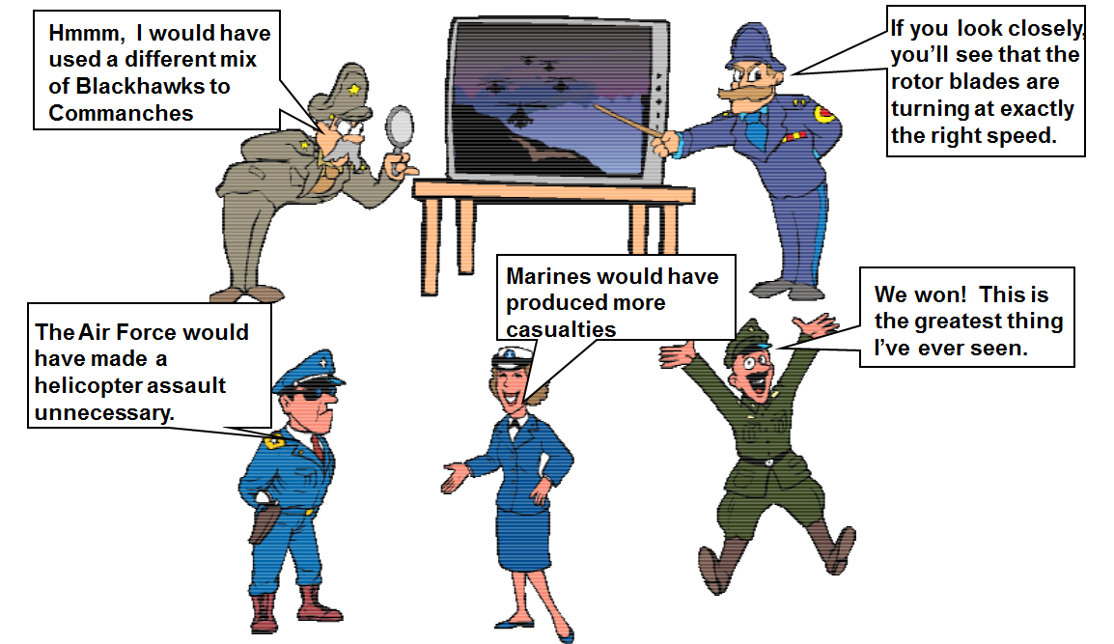
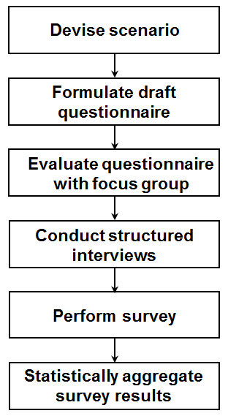
Developing a Rigorous SME Referent
Validation focus was a campaign-level simulation that modeled multi-sided joint theater warfare
No real world referent available for comparison, thus reliant on SME assessment
Increase SME sample size (from one to multiple)
Apply best practice in survey research to develop questionnaire
Statistical aggregation of survey results enables identification of common trends as well as the meaningful assignment of uncertainties to the referent characteristics
Knowledge of referent uncertainty is necessary for evaluating the risk of using a simulation
Simulation Results
Simulation Referent
Differencing
Student’s T-test
Validation Results
Accuracies
Confidences

Slide 32
Challenges Associated with Rigorous Validation
Referent
Coverage
Availability
Selection of Validation Method
Driven by available Referent Data
Characteristics of Validation Metric (e.g., point value, time series, multimodal)
Viability of Validation Method
Measuring the performance of the validation methods used to assess model accuracy
Understanding Uncertainty

Slide 33
Presentation Outline
Definitions that establish the common lexicon
Building a strong verification case
Building a strong validation referent
Building a strong validation case
Defining validation metrics
Selecting and applying the appropriate method
Quantifying validation uncertainty
Examples
Standards, Guidance, Templates, and Tools
Conclusions

Slide 34
Motivation
Decision makers are demanding that previous “informal” methods of validation be supplemented or replace with quantitative, defensible, rigorous methods
All M&S, when used to support operational tests and evaluations, should not be accredited until a rigorous comparison of live data to the model's predictions is done … and those predictions are found to have replicated live results with sufficient accuracy for the intended evaluation in the intended domain [Gilmore, 2016]
I expect the validation of M&S to include the same rigorous statistical and analytical principles that have become standard practice when designing live tests. [Gilmore, 2016]

Slide 35
Validation Metrics
Coming from Accreditation Authority
What if this doesn’t exist
User: Final Measures/Metrics
Not measurable
Many times a result of post-processing
Collaboration with the Test and Evaluation (T&E) community
Basis of Comparison
Accessible measures that combine to create metrics
Insight into performance for the sake of comparison
Relatable to the referent

Slide 36
Deriving Measures and Acceptability Criteria

Slide 37

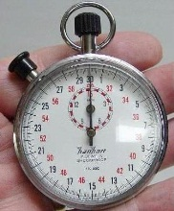
V&V Methods Considerations
01010100010100101
10010101000100101
10101011101010111
10110010100101000
10010101101010101
h(t) = –4.9t² + vt + s
Model
Referent
Certain methods apply best to specific types of model
Certain methods require specific types or amounts of referent data
Method
Some methods require more resources than others
Some methods require specific skills to apply
Resources
Skills
Problems can arise if the considerations conflict

Slide 38
Referent to Validation Method Mapping
Sources of
referent information
Forms of referent information
Applicable rigorous
validation methods
Empirical data
Single observation or few observations
Confidence intervals
Multivariate confidence intervals
Theoretical data
Many observations
Hypothesis tests for means, variances, proportions, and distributions
Simulation data
Paired observations
Regression analysis
Subject Matter
Expert knowledge
Expectations and
experience
Structured face validation
Turing test

Slide 39
Confidence Intervals
Validation concept and interpretation
Useful when only one (or few) simuland observations available
Determine if simuland observation consistent with model results
Calculate confidence interval for model response variable
If confidence interval contains observed simuland value(s), then model considered valid for that response variable
Comments
Interval calculated from simulations is for model, not simuland
Population is all possible simulations with the model, sample is the simulations actually executed
No statistical justification or refutation for validation interpretation

Slide 40
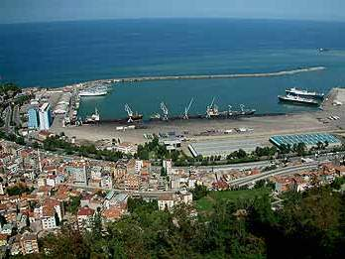
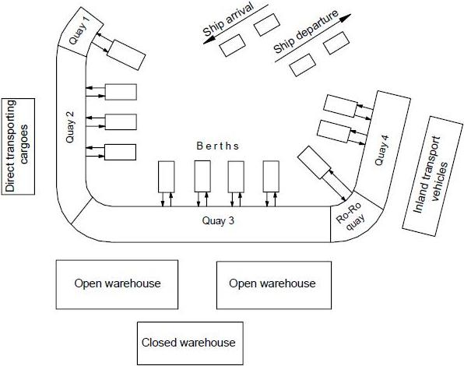
Confidence Interval Example
Comparison of simuland value with model mean
Simuland
Seaport of Trabzon Turkey
Quays for berthing, unloading, loading ships
Three types of ships: G1, G2, G3
Model
Discrete event simulation
Represents ships, cargos, quays, warehouses, cranes

Slide 41
Confidence Interval Calculations
Mean processed (count) for each ship type and total
Sample size (number of model runs) n = 45
Confidence level c = 0.95 (95%)
Distribution: Student t
Degrees of freedom d.f. = n – 1 = 44
Critical value t_{c} = 2.015
Ship Type | Simuland count μ₀ | Model |  | Confidence interval |  | Within Interval?
 |  | Mean x̅ | Std dev s | L | U
G1 | 109 | 111.14 | 14.45 | 106.8 | 115.5 | Yes
G2 | 169 | 174.42 | 16.07 | 169.6 | 179.2 | No
G3 | 19 | 17.28 | 5.26 | 15.7 | 18.8 | No
All Types | 297 | 303.68 | 35.89 | 292.9 | 314.5 | Yes
2 of 4 Intervals Contain Simuland Value
Notes:
Confidence interval procedure
Select model response variable x to use for validation
Select number of model executions, i.e., sample size n
Execute model n times, producing sample x₁, x₂, … x_{n}
Calculate sample mean x̅ and sample std dev s
Select distribution normal z or Student t
Select confidence level c
Calculate confidence interval [L, U]
If known simuland value y within [L, U], i.e., L ≤ y ≤ U, declare model valid (or not invalid) for x

Slide 42
Hypothesis Testing
Validation concept and interpretation
Useful when multiple simuland observations available
Test whether simuland observations consistent with model results
Perform hypothesis test comparing means, variances, and/or distributions of simuland and model for response variable
If hypothesis test does not reject assumption of validity, then model considered valid for that response variable
Comments
Simuland population is all possible observations, sample is the observations actually obtained
Model population is all possible simulations with the model, sample is the simulations actually executed
Conventional assumption (null hypothesis) is that the parameters being tested are equal, i.e., model is valid

Slide 43
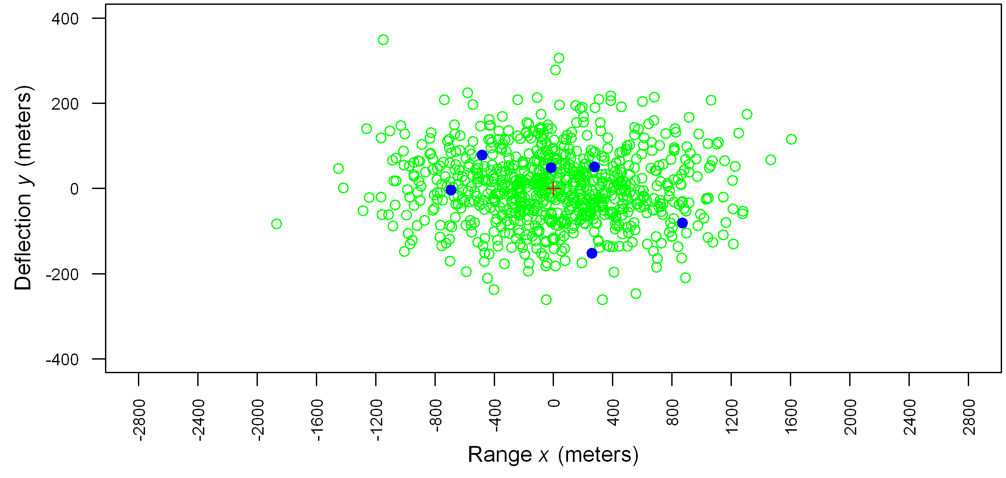
Hypothesis Test Example
s₁ | 535.08 | 85.75
s₂ | 558.52 | 90.35
F | 1.0895 | 1.1102
d.f._{N} | 5 | 5
d.f._{D} | 799 | 799
P-value | 0.3646 | 0.3534
} Model
} Live
F distribution P-value in Excel =FDIST(F,d.f._{N},d.f._{D})
Source | x err s | y err s | n
Model | 535.08 | 85.75 | 800
Live | 558.52 | 90.35 | 6
Test statistic F calculated from simulation results
P-value: probability of test statistic value, assuming H₀ true
Test: P-value < α → reject H₀
Interpretation: Do not reject H₀ → results match, i.e., model valid for x, y variances
Notes:
F-test: Hypothesis test for equality of variances
Obtain samples, calculate sample statistics
Set notation so that
Select level of significance α; often α = 0.05
Formulate hypotheses H₀ and H₁
Calculate test statistic F using formula
Given F, find P-value (table or software)
If P-value ≤ α, then reject H0, else accept H0

Slide 44
Point Value Referent Data vs Time Series
Point Value: A single sample metric from a referent data set
Examples:
Miss distance
Time of flight
Percent of time in a specific mode
Time Series: A time series of single sample metrics from a referent data set
Examples:
Position
Orientation
Regardless of time series or point value, both are considered a single sample of the underlying distribution, since the flight test represents only one sample.

Slide 45
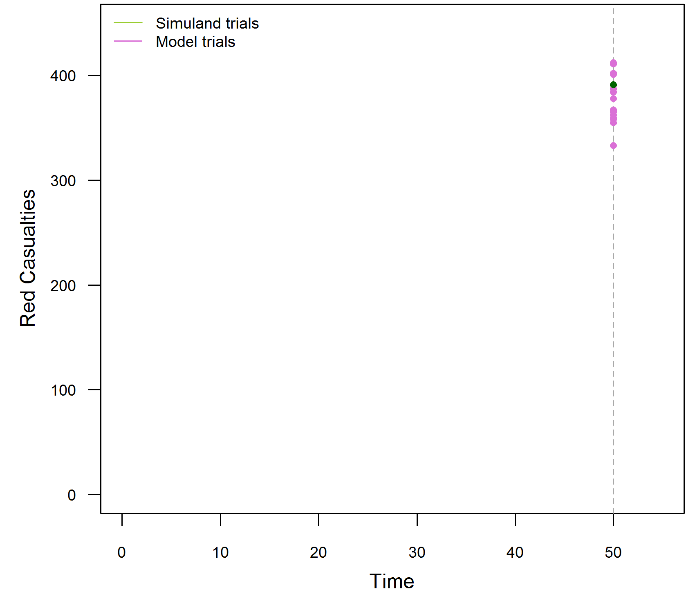
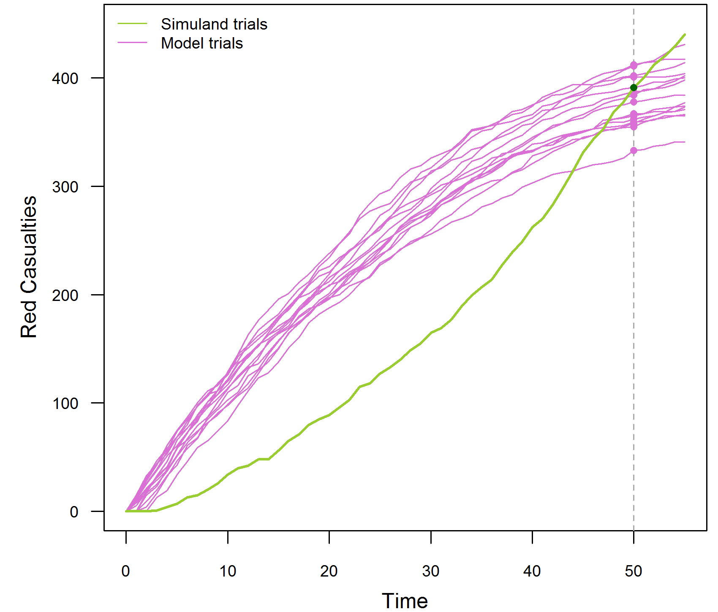
Time Series Example: Red Force Casualties
1 “trial” of simuland, e.g., data from actual battle
15 trials (executions) of a model of the same battle
Red casualties at time 50 only
Model ≈ simuland
→ Model valid?
Red casualties at times 0–50
Model mostly ≠ simuland
→ Model not valid?
[Petty, 2021]

Slide 46
Time Series Validation: Advanced Methods
Method | Simuland Trials | Model Trials | Interval Bounds | OOB Limit | Examples & Sources
A | 1 | 1 | Simuland ± SME ε | SME | [Engel, 1954] [Petty, 2010]
B | 1 | Multiple | Model 95% c. i. | SME | [Herington, 2002] [Champagne, 2007]
C | Multiple | Multiple | Simuland 95% c. i. Model 95% c. i. |  | [Law, 2015]
ε = time step value error tolerance
OOB = time steps out of bounds
[Petty, 2021]

Slide 47
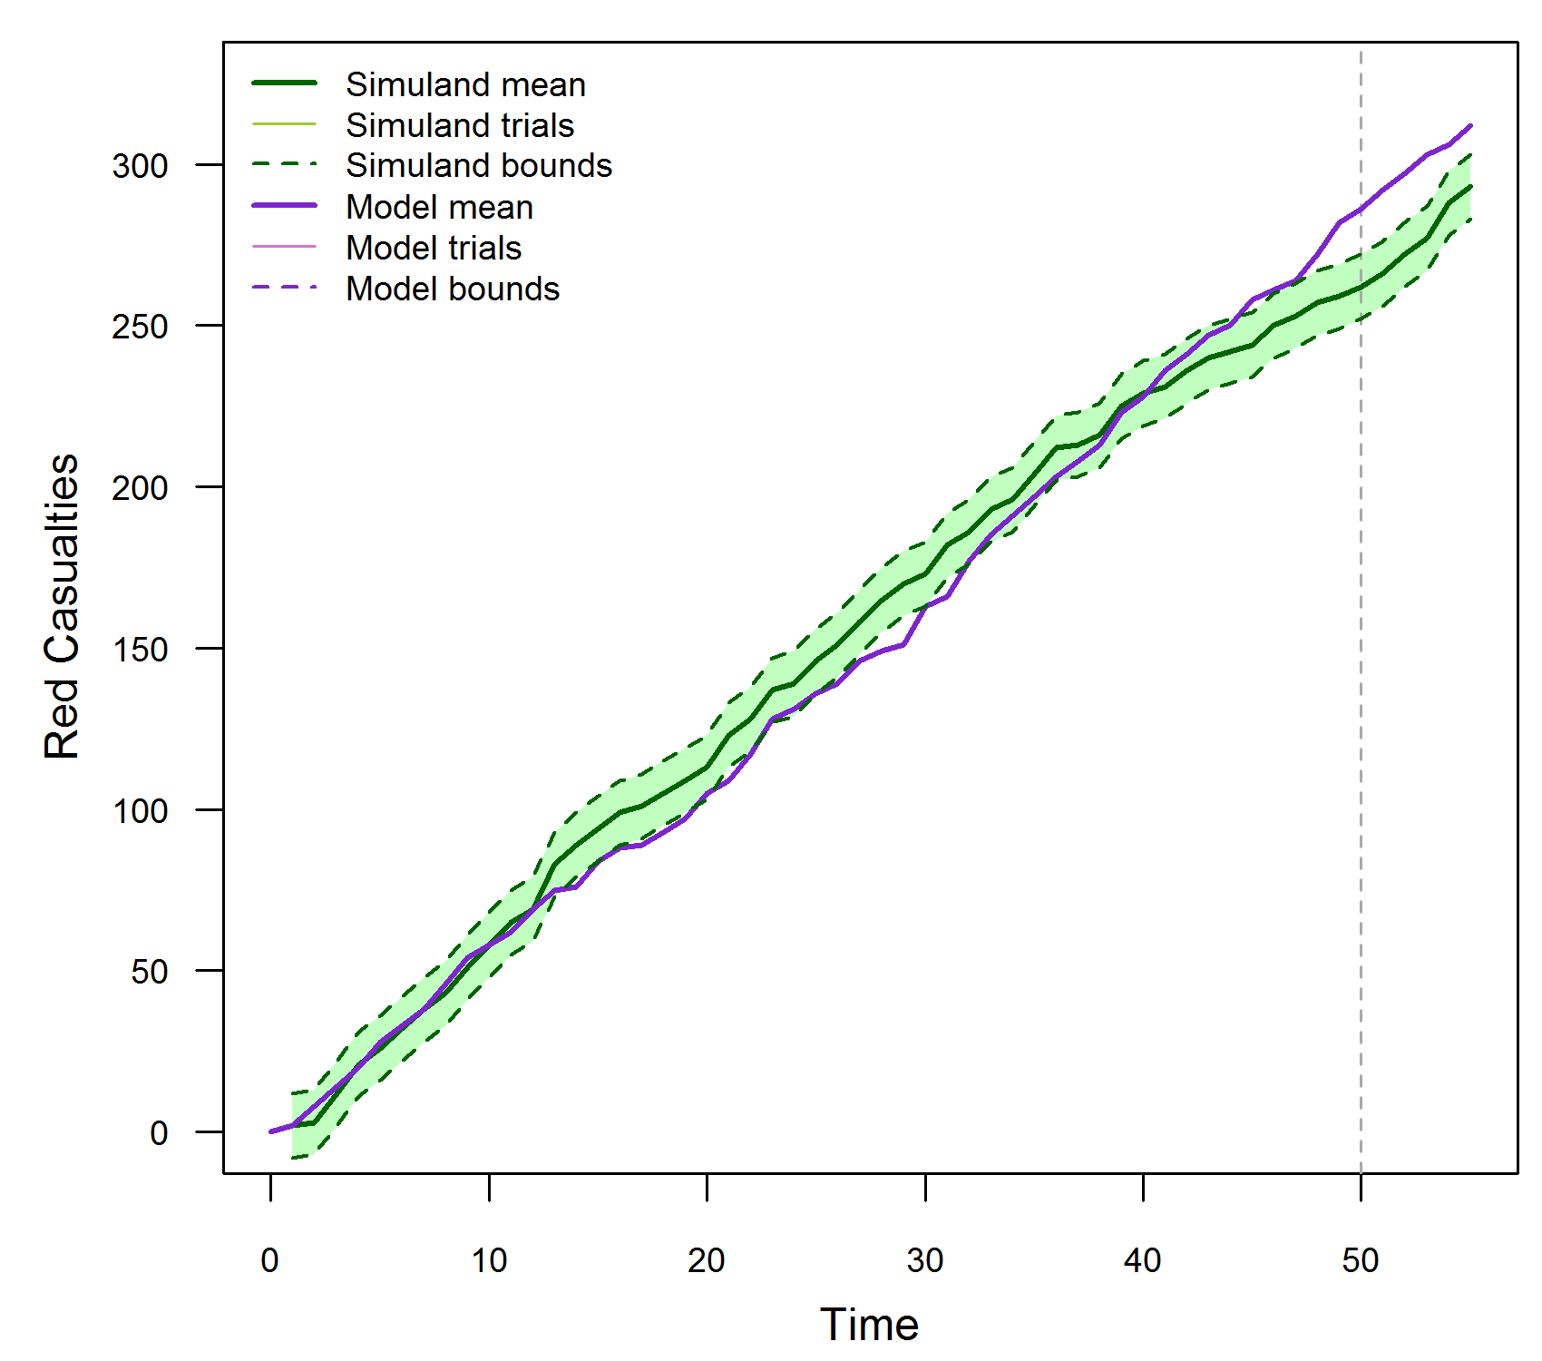
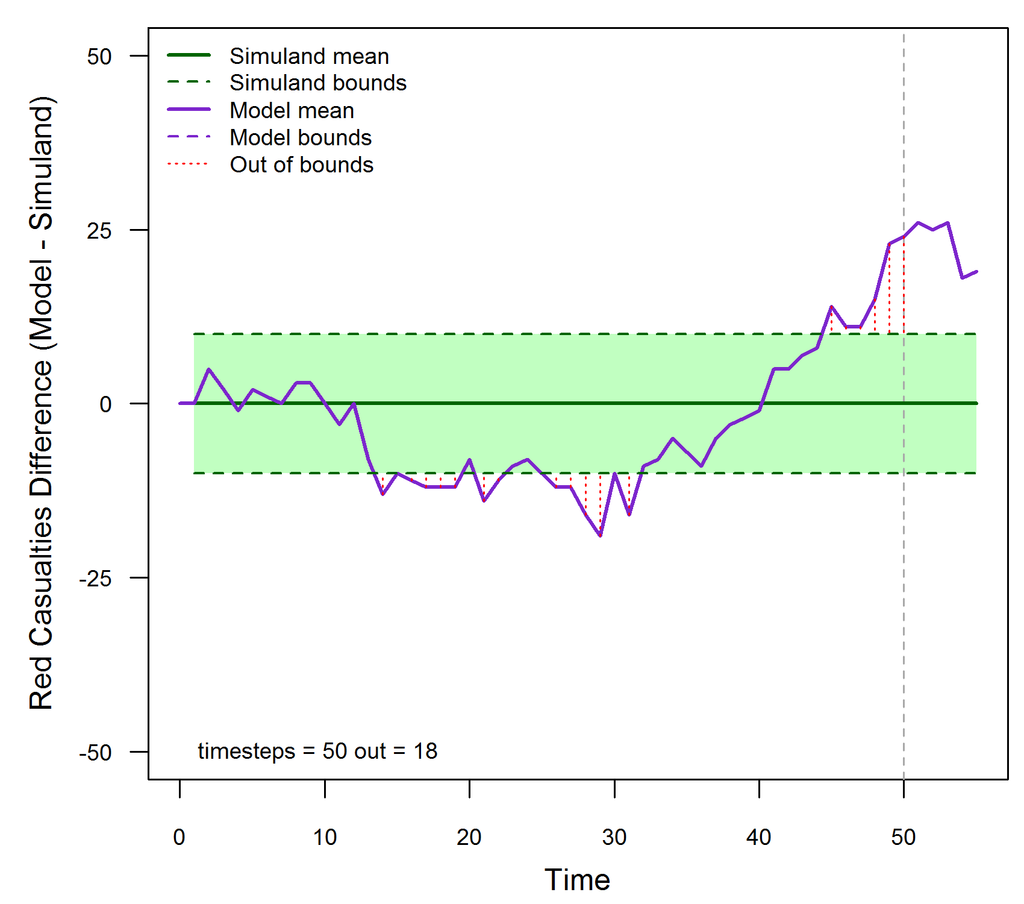
Time Series Method A
SME: ε = 5, Out of Bounds (OOB) limit = 10% = 5 time steps
Simuland: 1 trial with ± SME ε interval per time step
Model: 1 trial
OOB time steps > OOB not valid
[Petty, 2021]

Slide 48
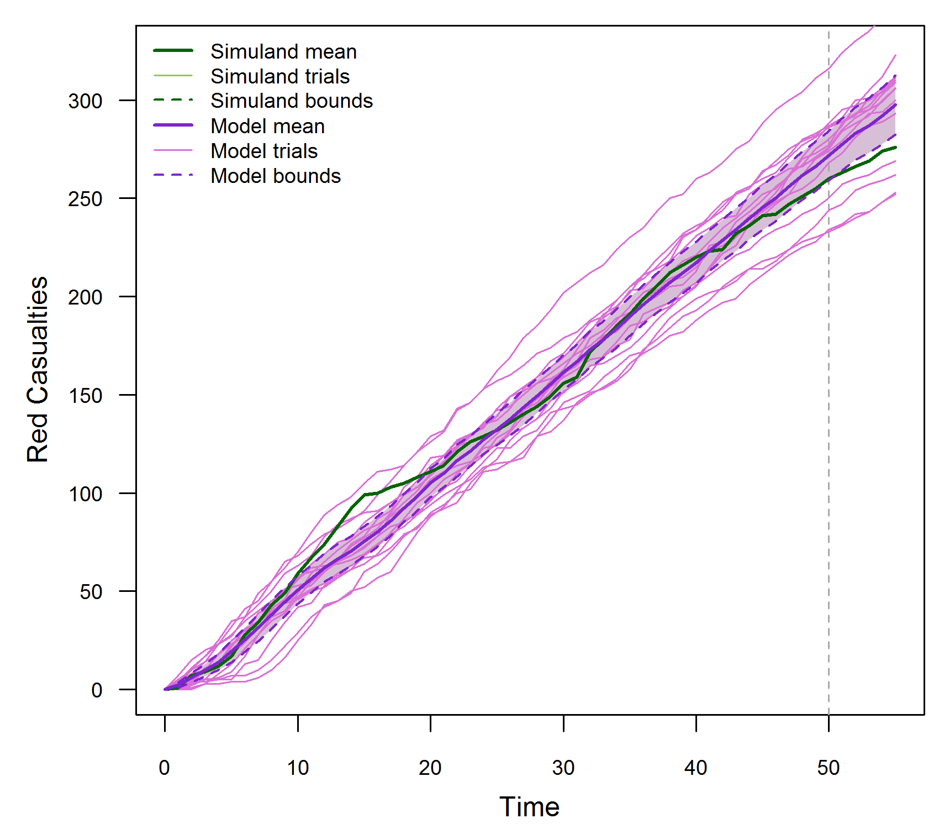
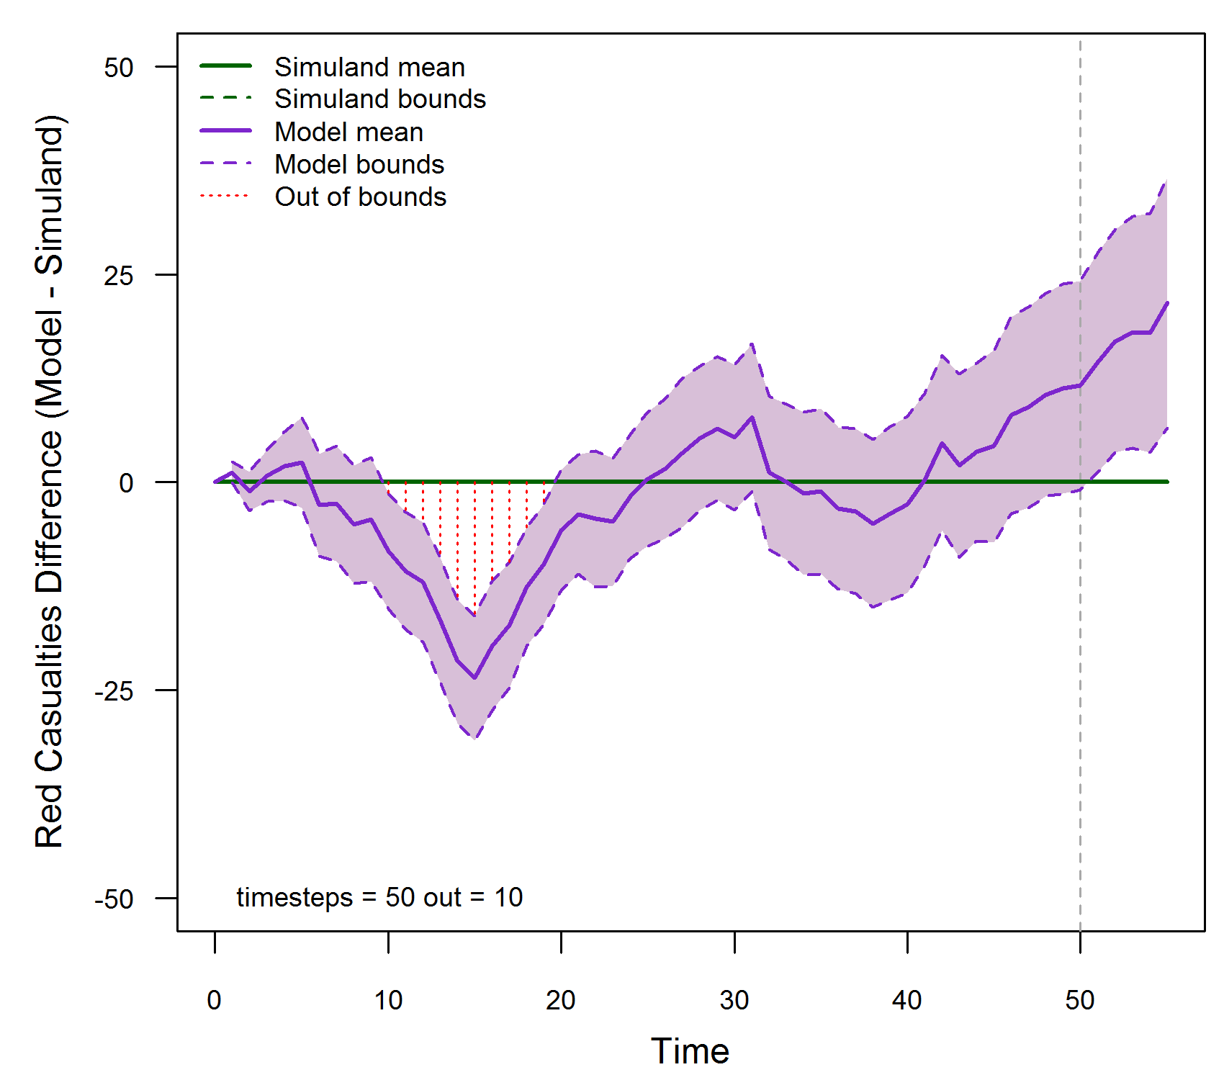
Time Series Method B
SME: OOB limit = 10% = 5 time steps
Simuland: 1 trial
Model: 15 trials with 95% confidence interval per time step
OOB time steps > OOB limit → model not valid
[Petty, 2021]

Slide 49
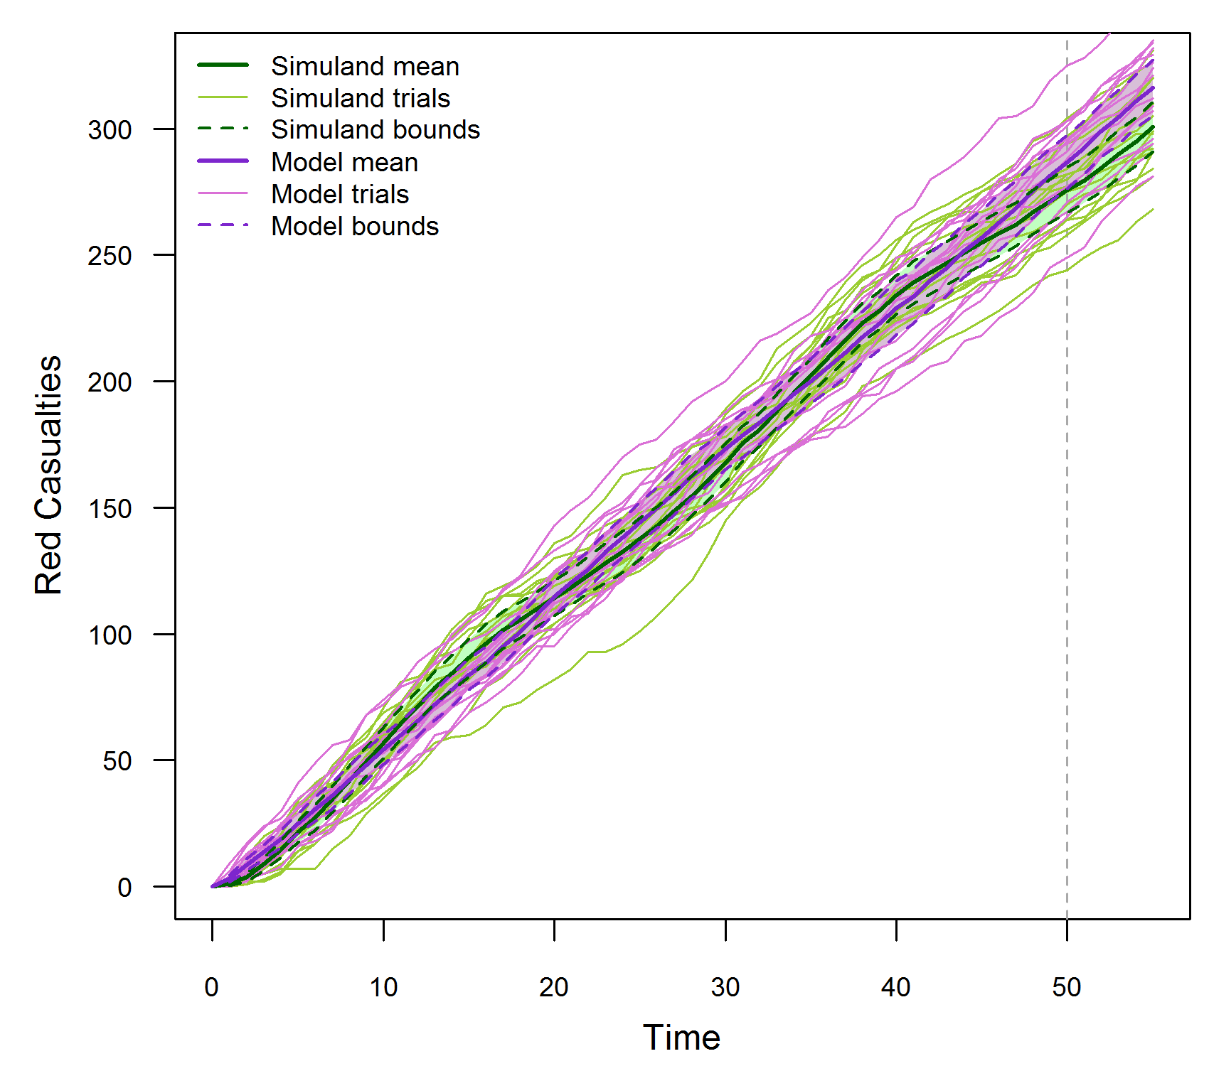
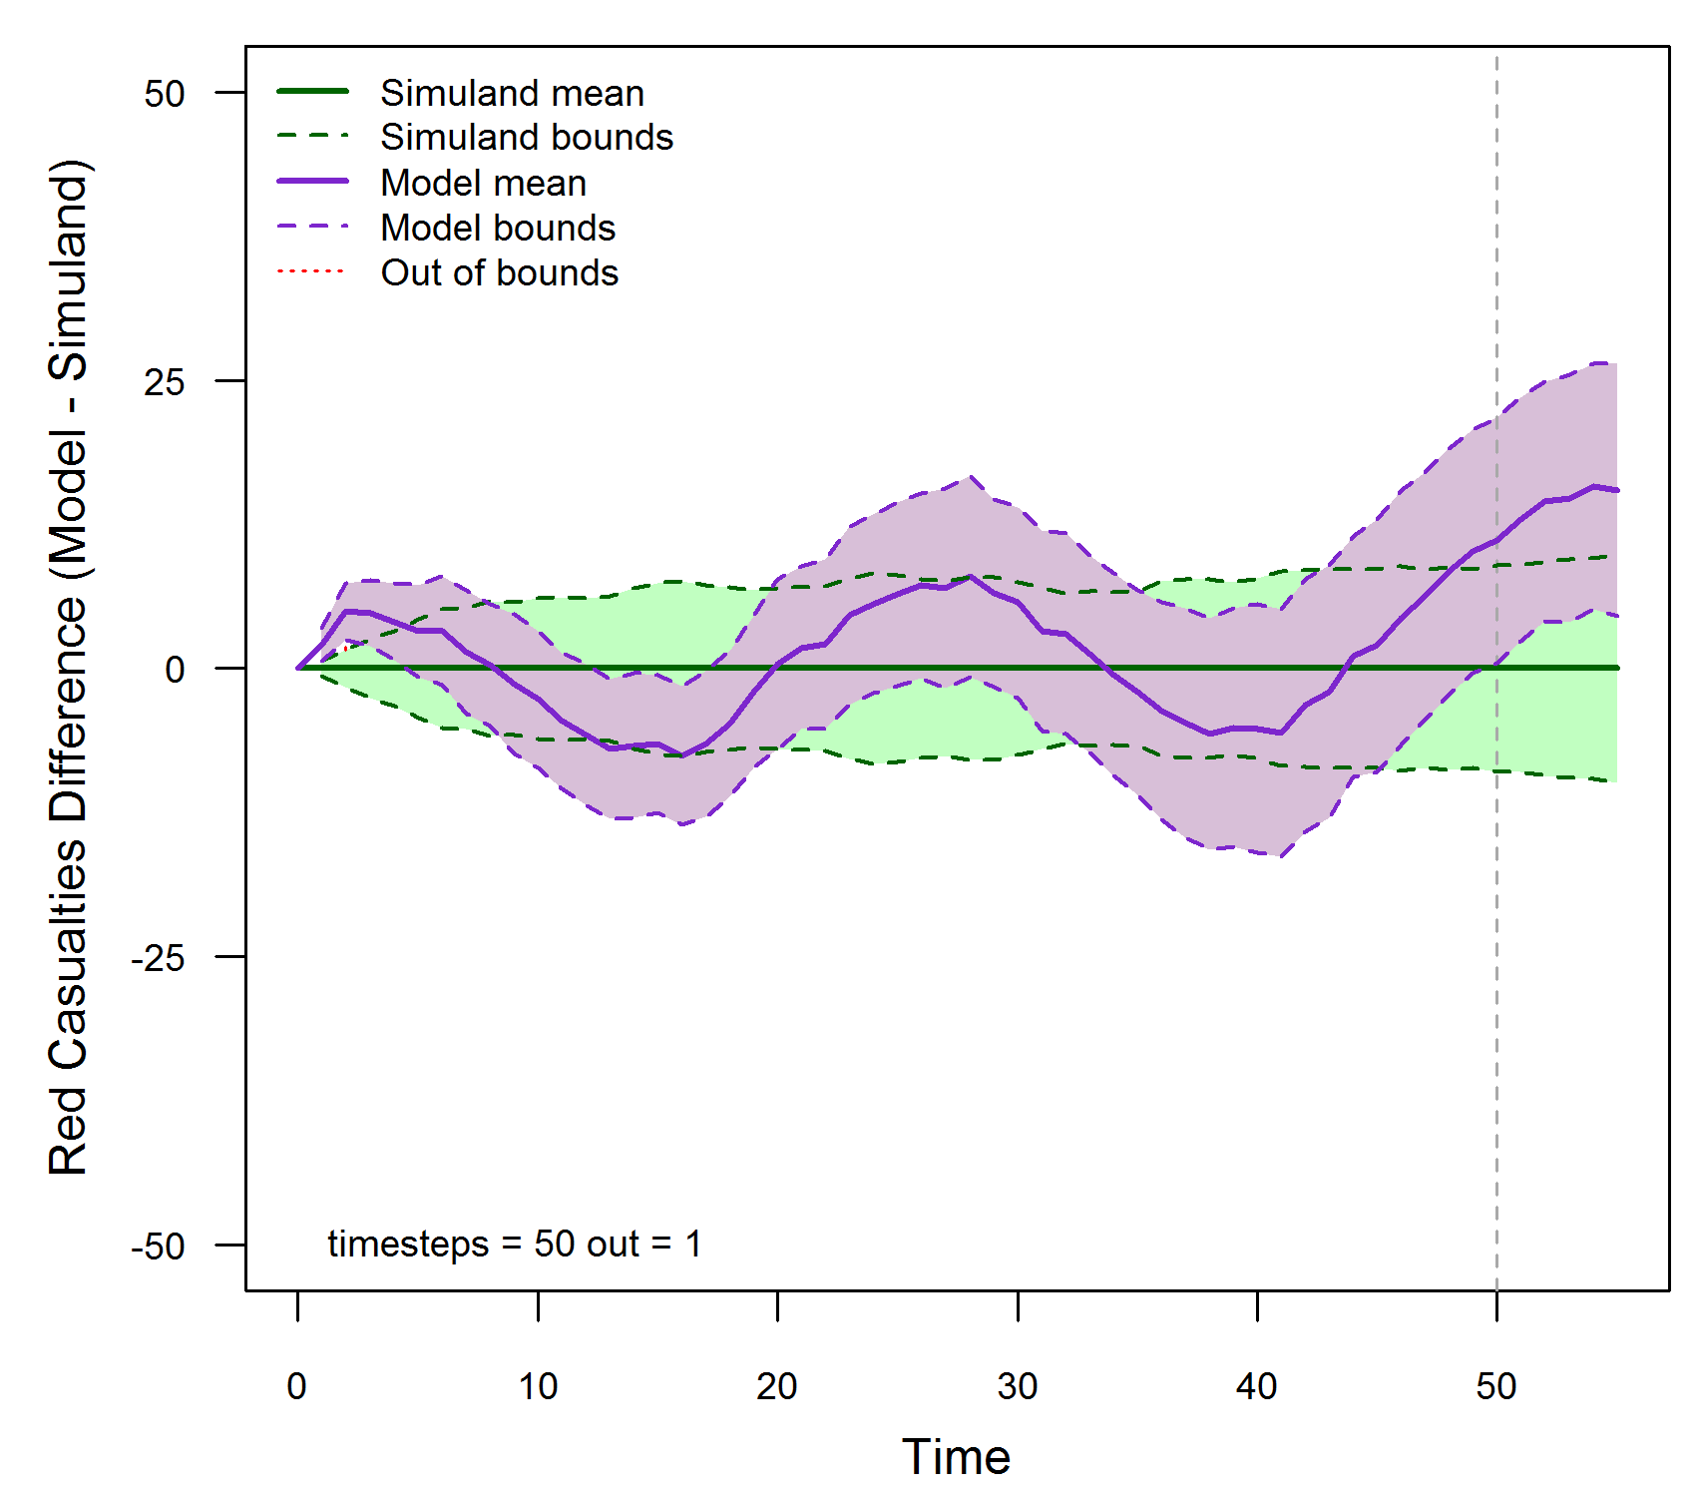
Time Series Method C
SME: OOB limit = 10% = 5 time steps
Simuland: 15 trials with 95% confidence interval per time step
Model: 15 trials with 95% confidence interval per time step
OOB time steps > OOB limit → model not valid
[Petty, 2021]

Slide 50
Advanced Validation Methods
Spectral analysis [Fishman, 1967] [Naylor, 1971] [McNickle, 2004]
Parametric time series model [Hsu, 1977]
Standardized time series [Schruben, 1983] [Chen, 1987] [Goldsman, 1990]
Regression analysis [Kleijnen, 1998]
Bootstrapping [Kleijnen, 2000] [Kleijnen, 2001]
Granger causality [Granger, 1969]

Slide 51
Presentation Outline
Definitions that establish the common lexicon
Building a strong verification case
Building a strong validation referent
Building a strong validation case
Standards, Guidance, Templates, and Tools
Conclusions

Slide 52
Templates and Tools
Basis: MIL-STD-3022
Building the template easily facilitated within many reporting tools
Available as functions in “enterprise” level tools (e.g. IBM DNG)
Opportunities for simplification and efficiency
Base reports with update addenda
Test reporting as Checklists
Linking test automation to reporting and requirements management tools
Advanced visualization methods
Adopting Digital Engineering
Improved integrity
Increased efficiency
Timeliness required to support Agile development
Creating effective collaboration infrastructure

Slide 53
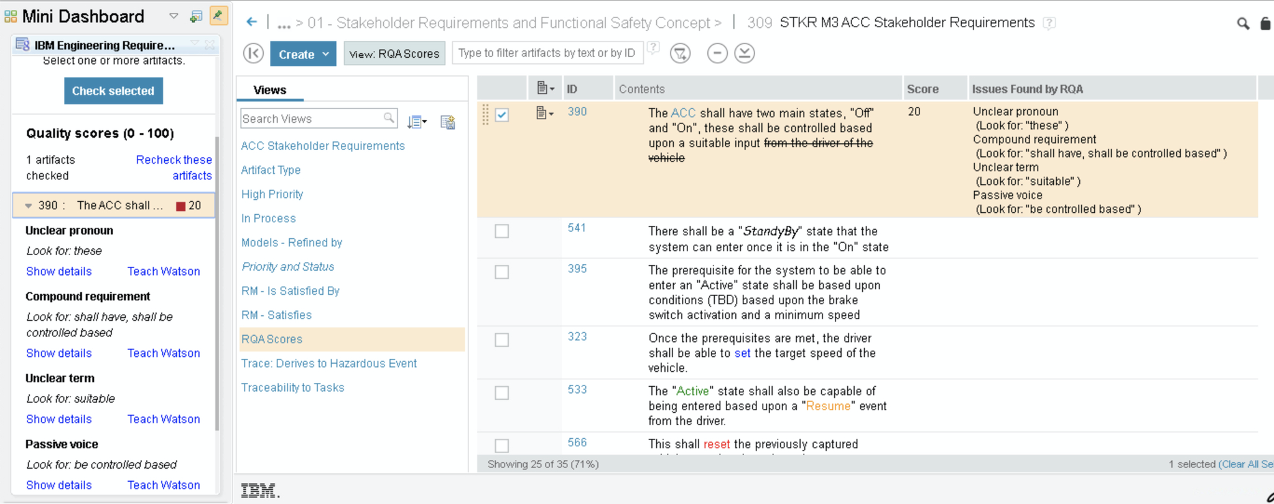
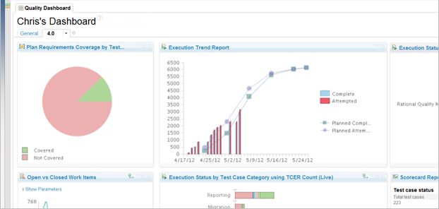
New Ways of Looking at Data
Modern Tools and Collaboration Platforms
Enable Automated V&V Workflows

Slide 54
Standards, Policy, and Guidance
DoD VV&A Policy: DoDI 5000.61 “DoD M&S VV&A”
DoD VV&A Guidance: The VV&A Recommended Practices Guide (RPG)
IEEE 1730.2 “VV&A Overlay to the Distributed Simulation Engineering and Execution Process”
MIL-STD-3022 “Documentation of VV&A for M&S”
Derived policy, standards and guidance within the Services
Generic Methodology for Verification and Validation (GM-VV) Volumes 1(SISO-GUIDE-001.1) Introduction and Overview, 2) (SISO-GUIDE-001.2 Implementation Guide) and 3 (SISO-REF-2013 Reference Manual) / NATO MSG 073
Risk Based Assessment / NATO MSG 054
M&S Use Risk Methodology / NATO MSG 139
V&V Composite Model, Accreditation Composite Model / NATO MSG 019 and 054
Applying the Levels of Conceptual Interoperability Model in Support of Integratability, Interoperability, and Composability for System-of-Systems Engineering, Andreas TOLK, Saikou Y. DIALLO, Charles D. TURNITSA

Slide 55
Presentation Outline
Definitions that establish the common lexicon
Building a strong verification case
Building a strong validation referent
Building a strong validation case
Standards, Guidance, Templates, and Tools
Conclusions

Slide 56
Conclusions and Recommendations
Verification activities provide a necessary foundation for rigorous validation
Quality and quantity of referent effects validation rigor
Rigorous validation is possible, but it depends on an effective referent, i.e., sufficient data, well aligned with the model’s intended use
Acquiring an effective referent should be started early in the simulation life cycle
Given the best possible referent, a range of quantitative validation methods are available
Application of statistical validation methods
Most quantitative (statistical) validation methods make specific assumptions
If a statistical method is used when the assumptions are not met, its results are meaningless and potentially misleading
Validating time series data
Validating a model using output at a single time step can be misleading
Methods exist to validate models using time series output
Confidence interval methods; relatively simple
Advanced methods; mathematically complex

Slide 57
Contact Information
Simone M. Youngblood
The Johns Hopkins University Applied Physics Laboratory
240-228-7958
Simone.Youngblood@jhuapl.edu
Kathy M. Ruben
The Johns Hopkins University Applied Physics Laboratory
240-228-9148
Katherine.Ruben@jhuapl.edu

Slide 58
References and bibliography (1 of 4)
[ATEC, 2004] Army Test and Evaluation Command (ATEC) Pamphlet 73-1, System Test and Evaluation Procedures, April 19 2004.
[Balci, 1998] O. Balci, “Verification, Validation, and Testing”, in J. Banks (Editor), Handbook of Simulation: Principles, Methodology, Advances, Applications, and Practice, John Wiley & Sons, New York NY, 1998, pp. 335-393.
[Balci, 2002] O. Balci, R. E. Nance, J. D. Arthur and W. F. Ormsby, “Expanding Our Horizons in Verification, Validation, and Accreditation Research and Practice”, Proceedings of the 2002 Winter Simulation Conference, San Diego CA, December 8-11 2002, pp. 653-663.
[Brase, 2015] C. H. Brase and C. P. Brase, Understandable Statistics: Concepts and Methods, Eleventh Edition, Cengage Learning, Stamford CT, 2015.
[Cellier, 1991] F. E. Cellier, Continuous System Modeling, Springer-Verlag, New York NY, 1991.
[Chen, 1987] B. Chen and R.G. Sargent, “Using Standardized Time Series to Estimate the Difference between Two Stationary Stochastic Processes,” Operations Research, Vol. 35, 1987, pp. 428-436.
[Champagne, 2007] L. E. Champagne and R. R. Hill, “Agent-Model Validation Based on Historical Data”, Proceedings of the 2007 Winter Simulation Conference, Washington DC, December 9-12 2007, pp. 1223-1231.
[DOD, 2009] Department of Defense, Instruction 5000.61, M&S VV&A, 2009.
[DOD, 2011] The DoD Verification, Validation, and Accreditation Recommended Practices Guide Website, January 2011,
[DOD, 2012] Department of Defense Standard Practice, MIL-STD-3022 with Change 1, Documentation of Verification, Validation, and Accreditation (VV&A) for Models and Simulations, April 5 2012.
[DOT&E, 2000] DOT&E Report, AIM-9X Sidewinder Air-to-Air Missile, 2000.

Slide 59
References and bibliography (2 of 4)
[Engel, 1954] J. H. Engel, “A Verification of Lanchester’s Law”, Journal of the Operations Research Society of America, Vol. 2, No. 2, May 1954, pp. 163-171.
[Fischer, 2001] K. Fischer, “AIM-9X…Surpassing the M&S Challenge,” Unpublished presentation, 2001.
[Fishman, 1967] G. S. Fishman and P. J. Kiviat, “The Analysis of Simulation-Generated Time Series”, Management Science, Vol. 13, 1967, pp. 525-557.
[Gilmore, 2016] Director Operational Test and Evaluation Memorandum, Guidance on the Validation of Models and Simulation used in Operational Test and Live Fire Assessments, 14 March 2016.
[Goldsman, 1990] D. Goldsman and L. Schruben, “Confidence Interval Estimators Using Standardized Time Series”, Management Science, Vol. 36, No. 3, March 1990, pp. 393-397.
[Granger, 1969] C. W. J. Granger, “Investigating Causal Relations by Econometric Models and Cross-spectral Methods”, Econometrica, Vol. 37, No. 3, pp. 424-438.
[Herington, 2002] J. Herington, A. Lane, N. Corrigan, and J. A. Golightly, “Representation of Historical Events in a Military Campaign Simulation Model”, Proceedings of the 2002 Winter Simulation Conference, San Diego CA, December 8-11 2002, pp. 859-863.
[IDA, 2001] AIM-9X: A Modeling and Simulation Success Story, IDA Research Summaries, Vol. 8, Number 1, Summer/Fall 2001, pp. 8-12.
[Kleijnen, 1998] J. P. C. Kleijnen, B. Bettonvil, and W. Van Groenendaal, “Validation of Trace-Driven Simulation Models: A Novel Regression Test”, Management Science, Vol. 44, 1998, pp. 812-819.
[Kleijnen, 2000] J. P. C. Kleijnen, R.C.H. Cheng, and B. Bettonvil, “Validation of Trace-Driven Simulation Models: More on Bootstrap Techniques”, Proceedings of the 2000 Winter Simulation Conference, Orlando FL, December 10-13 2000, pp. 882-892.
[Kleijnen, 2001] J. P. C. Kleijnen, R.C.H. Cheng, and B. Bettonvil, “Validation of Trace-Driven Simulation Models: Bootstrap Tests”, Management Science, Vol. 47, 2001, pp.1533-1538.

Slide 60
References and bibliography (3 of 4)
[Law, 2015] A. M. Law, Simulation Modeling and Analysis, Fifth Edition, McGraw-Hill Education, New York NY, 2015.
[McNickle, 2004] D. McNickle, G. C. Ewing, and K. Pawlikowski, “Refining Spectral Analysis for Confidence Interval Estimation in Sequential Simulation”, Proceedings of the 16th European Simulation Symposium, Budapest Hungary, October 17-20 2004, pp. 99-103.
[Mansager, 1994] B. Mansager, Model Test Model, Naval Postgraduate School Technical Report NPS-MS-94-007.
[Minsky, 1965] M. L. Minsky, Matter, Mind, and Models, Artificial Intelligence Memo No. 77, Massachusetts Institute of Technology, March 1965, Online at http://dspace.mit.edu/bitstream/handle/1721.1/6119/AIM-077.pdf ?sequence=2, Accessed, July 19 2015.
[NASA, 2023] Requirements Verification Matrix, downloaded from https://www.nasa.gov/sites/default/files/thumbnails/image/seh_app-d_table_d1.jpg on 6/21/23.
[NATO, 2012] NATO RTO Technical Report “Risk-Based Tailoring of the Verification, Validation, and Accreditation/Acceptance Processes”, TR-MSG-054, February 2012
[Naylor, 1971] T. H. Naylor, Computer Simulation Experiments with Models of Economic Systems, John Wiley & Sons, New York NY, 1971.
[Petty, 2010] M. D. Petty, “Verification, Validation, and Accreditation”, in J. A. Sokolowski and C. M. Banks (Editors), Modeling and Simulation Fundamentals: Theoretical Underpinnings and Practical Domains, John Wiley & Sons, Hoboken NJ, 2010, pp. 325-372.
[Petty, 2012] M. D. Petty, “Calculating and Using Confidence Intervals for Model Validation”, Proceedings of the Fall 2012 Simulation Interoperability Workshop, Orlando FL, September 10-14 2012, pp. 37-45.

Slide 61
References and bibliography (4 of 4)
[Petty, 2013] M. D. Petty, “Advanced Topics in Calculating and Using Confidence Intervals for Model Validation”, Proceedings of the Spring 2013 Simulation Interoperability Workshop, San Diego CA, April 8-10 2013.
[Petty, 2021] M. D. Petty and S. M. Youngblood, “Addressing the Challenges of Rigorous Validation” presented at the 2021 I/ITSEC, November 2021.
[Piersall, 2014] C. H. Piersall and F. E. Grange, “The Necessity of Intended Use Specification for Successful Modeling and Simulation of System-of-Systems”, CrossTalk, September/October 2014, pp. 20-24.
[Piersall, 2015] W. Seay, C. H. Piersall, D. Lucia, and K. Englander, MDA report 20-MDA-10542, March 2015, (approved for public release 30 Jul 20)
[RPG, 2011] DoD VV&A Recommended Practices Guide, RPG Validation Referent Special Topic Paper, https://www.cto.mil/sea/vva, January 2011.
[Schruben, 1983] L. Schruben, “Confidence Interval Estimation Using Standardized Time Series”, Operations Research, Vol. 31, No. 6, November-December 1983, pp. 1090-1108.
[Tolk, 2006] W. G. Wang, A. Tolk and W. P. Wang, "The levels of conceptual interoperability model: Applying systems engineering principles to M&S," in Proceedings of the 2009 Spring Simulation Multiconference, San Diego, March 22-27, 2009.
[Velten, 2009] K. Velten, Mathematical Modeling and Simulation, WILEY-VCH, Weinheim Germany, 2009.

