Slide 1



HOW TO BUILD A WAR TIME RESILIENT ONLINE LEARNING SYSTEM
Tutorial nr: 23T34
Major General Serhii Salkutsan, MILREP NATO HQ, Ukraine
Col. Maksym Tyshchenko, Director, Scientific Distance Learning Center, National Defence University of Ukraine
Director Geir Belgen Isaksen, Faculty Admin & ADL, Norwegian Defence University College
Assoc. Prof. Piotr Gawliczek, PhD NATO DEEP eAcademy Director, Poland
Notes:
Introduction of the 3 organizations

Slide 2
Learning Objectives
Understand the impact of ADL as a key part of a learning ecosystem in time of crisis/war.
Understand the impact of international military cooperation, when establishing a resilient online learning systems.
Identify lesson identified and lesson learned from the use of online learning systems and distance learning in war time.
Be familiarized with the measures taken to implement a lifelong learning model using distance learning technologies in the Armed Forces of Ukraine.
Notes:
Short presentation of the 3 organizations
The Norwegian Defence University College consists of seven educational departments and one research institute.
We have the Armed Forces and Norway's foremost academic discipline within land power, sea power, air power, joint operations, as well as defence and security policy.
Research and development at the Defence College contributes the Armed Forces' and society's need for knowledge about military forces' practical opportunities and limitations under varying technological, social, political and cultural conditions. The core task of the University College is to educate all commissioned and non-commissioned officers (NCOs).

Slide 3



Introduction of the Partners
Established in 2017
Main task - implementing of lifelong learning model using distance learning technologies in the Armed Forces of Ukraine
NDUC stablished in 1995 - ADL capability in 2003
Main task - implementing of lifelong learning model using distance learning technologies at the University College and in the Armed Forces
NATO DEEP was established in 2007, UKR program launched in 2013
Main task - (DEEP) UKR is designed to assist Ukraine in improving the military education and professional training systems
Notes:
Short presentation of the 3 organizations
The Norwegian Defence University College consists of seven educational departments and one research institute.
We have the Armed Forces and Norway's foremost academic discipline within land power, sea power, air power, joint operations, as well as defence and security policy.
Research and development at the Defence College contributes the Armed Forces' and society's need for knowledge about military forces' practical opportunities and limitations under varying technological, social, political and cultural conditions. The core task of the University College is to educate all commissioned and non-commissioned officers (NCOs).

Slide 4

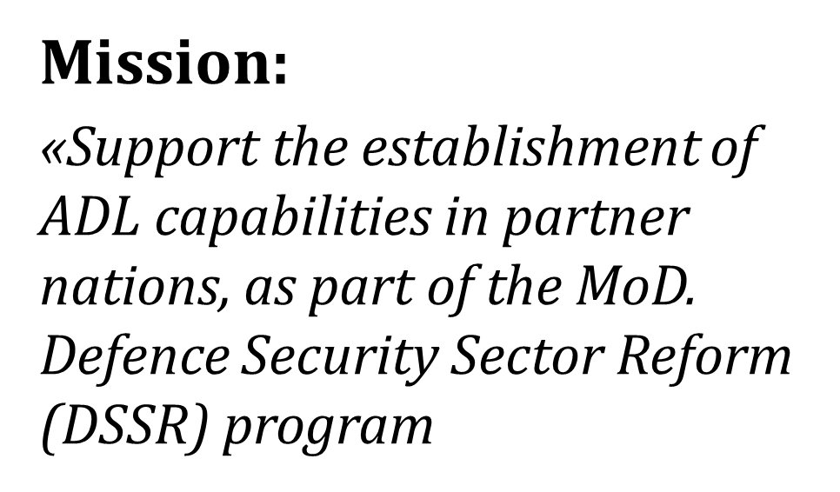
Norwegian Defence University College Mission to Ukraine
From 2012
Notes:
Elaborate on the Norwegian mission with examples from Georgia and the Balkans

Slide 5



NATO DEEP Mission
The program has been jointly developed by Ukraine and NATO.
UKR side requested support in specific areas of PME cooperation:
faculty development,
curriculum development,
Advanced Distributed Learning,
English language training support.
Perspective
Ukraine Prospective
Bilateral Will
Modernization
Military E & T System
Western Model
New Approaches
Notes:
NATO DEEP Perspective
This Defence Education Enhancement Programme (DEEP) is designed to assist Ukraine in improving the military education and professional training systems. This program was formally initiated by the letter of the Minister of Defence of Ukraine to NATO (October 29, 2012), conveying Ukraine's request for NATO to assist the country in the above-mentioned goals. The team was mandated to review requirements from an academic standpoint and prepare the necessary arrangements.
Based on a demand-driven approach, this programme has been jointly developed by Ukraine and NATO according to the needs identified during the DEEP Expert Team entry visit. This assessment was carried out on 20-26 March 2013 in response to the above-mentioned letter of the Minister of Defence of Ukraine to NATO (October’29 2012).
It followed discussions and identified the need for assistance to its institutions in the context of the development of Ukraine’s Professional Military Education plans. This program assumes, that Ukraine strongly desires cooperation with the NATO countries in professional military education. This was demonstrated during the entry visit by the clear desire, without prompting, to request support in specific areas of PME cooperation: faculty development, curriculum development, Advanced Distributed Learning, and English language training support.
UKR Prospective. Cooperation under the NATO-DEEP program was intended to support changes in the military education system in light of the need to modernize it in line with the general course of Europeanization.
In addition, the urgent task was to bring Ukraine's military education system closer to the "Western" model, to adopt approaches inherent in NATO member states, to begin changes in a single coordinate system, to understand problems and find ways to solve them.
A key aspect of the start of cooperation was the will of both sides to introduce changes (on the part of Ukraine) and support them (on the part of NATO).
The cooperation was supposed to start with the training of instructors who, after mastering new teaching methods, would be able to introduce them into the educational process. Later, the scope of cooperation expanded to include the development of training courses, educational programs, modules, etc. In the process of cooperation, the range of mutual interests expanded, including the inclusion of procedures for implementing the latest teaching and learning technologies and educational process management in the educational process.

Slide 6
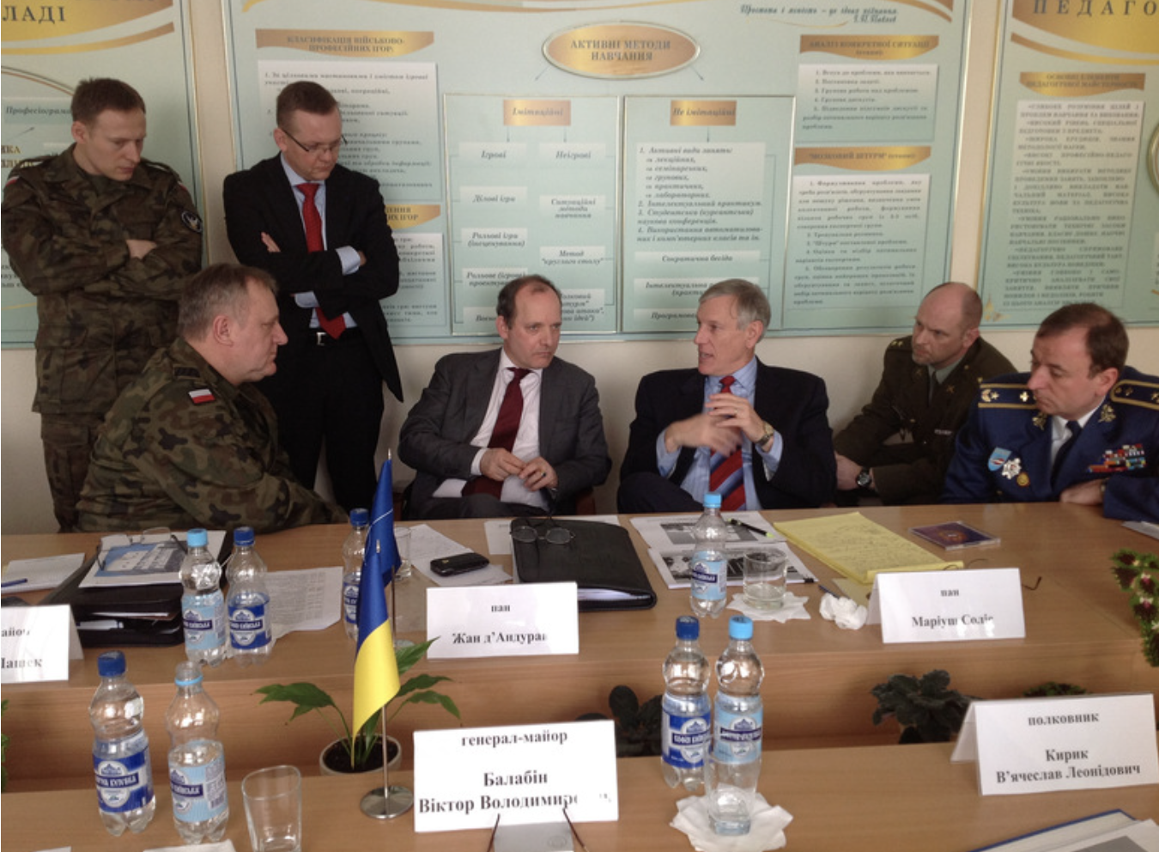
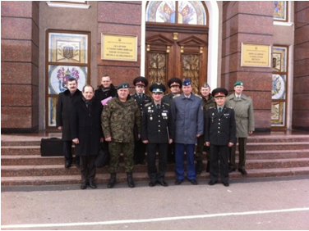
Fact Finding NATO DEEP UKR Perspective - 2013
First NATO DEEP visit to Ukraine, March 2013
Notes:
No less than five defence education institutions located in Kyiv, Lviv and Kharkiv are set on improving the professional military education they have to offer. They have openly articulated their educational needs and requested support in faculty development, simulations, English language training and curriculum development in a broad range of subjects. These include policy and strategy formulation, aviation law, international humanitarian law, economic security and psychological support for combat.
Cooperation is being led through what is known as NATO’s Defence Education Enhancement Programmes – or DEEPs. These programmes provide expertise on “what to teach” and “how to teach”. In concrete terms, DEEPs connect senior educators from NATO countries with their counterparts from partner countries with the objective of enhancing educational curricula and learning methods.
Ukraine made the request for NATO support in October 2012, in a letter from Ukraine’s former Minister of Defence, Dmytro Salamatin, to the Deputy Secretary General of NATO, Ambassador Alexander Vershbow. Since then, the needs of the Ukrainian institutions participating in the programme have been identified by a DEEP expert team, which visited Ukraine end March 2013. The conclusions of this visit form the basis of the three-year programme, which started mid-July 2013.

Slide 7
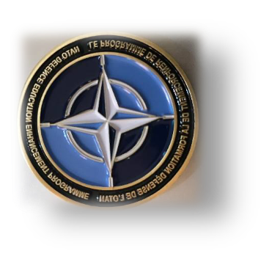
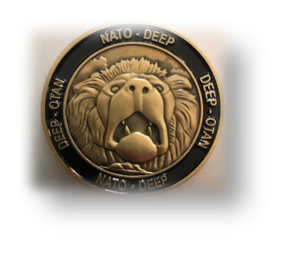
NATO DEEP UKR Perspective - ADL CONCEPT 2015
ADL DEVELOPMENT ROADMAP WITHIN DEEP UKRAINE - 2015
DEEP UKRAINE / BACKGROUND
ADL KEY ACTIVITIES WITHIN DEEP UKRAINE (FROM 2013)
ADL AWARENESS WITHIN UKR MILITARY EDUCATION INSTITUTIONS
ADL PROGRESS AS THE RESULT OF DEEP UKR ACTIVITIES
FUTURE DEVELOPMENTS – KEY ASSUMPTIONS
RECOMMENDATIONS
Notes:
FUTURE DEVELOPMENTS – KEY ASSUMPTIONS
The main assumptions/goals are as follows:
to reach the strategic level decision on the learning management system to be used within the higher military education institutions of Ukraine;
to save the time and resources, the best option is to follow the examples and experiences of the ADL centers/labs already involved in the DEEP UKR, especially from the NDU Warsaw, NDU Bucharest, NATO School Oberammergau and ACT Norfolk;
considering the developmental potential, there’s a need to establish one leading UKR military education institution as the center/hub for further activities;
RECOMMENDATIONS
Having in mind the key assumptions, the recommendations are as follows:
until the end of 2015, in agreement with Ukrainian side, establish the UKR ADL Centre as the hub of the e-learning activities/innovations within the higher military education system. Location - at one of the aforementioned locations (NDU or future MUT), acting as the centre of excellence (competence centre) and the spearhead of the ADL activities.
to recognize the LMS ILIAS (by the end of 2015) as the learning management system best suited for the development of the ADL capabilities for the institutions involved in DEEP UKR. ICT equipment issues will be solved in due time, based on the support of the DEEP UKR partner nations input (financial or material).
to nominate NDU Warsaw (by September 2015) as the main coordinator of the ADL developments within DEEP Ukraine in cooperation with the ADL entities from other DEEP UKR supporting partners.
to further develop ADL capabilities (by May/June 2016) by continuous involvement of UKR representatives in the events focused on the skills and abilities (instructional designing, multimedia designing). The examples scheduled for the second half of 2015 are as follows: PfP Consortium ADL WG meeting (Armenia as the hosting nation) and the events organized by the NDU Warsaw, i.e. the conference on the innovative technology issues organized on December’9.
to make the ADL concept tangible (by April 2016), considering the third year of DEEP UKR program, the following action is suggested: translate the Cyber Security Awareness Course into Ukrainian and to make it available on the LMS ILIAS platform of the NDU Warsaw, and later on the LMS ILIAS platform of the UKR ADL Centre.
The future steps and activities will be determined as soon as the strategic decision on the recommendations is reached.

Slide 8





Fact finding in Ukraine from NDUU prior to 2013
Initial Problem
Lack of Lessons Learned Based Impactful System for Ensuring the Quality of Education
2014 - War Lessons Learned
Lessons Learned
every 6 months
ADL
Equipment
Staff
Experience
Distrust
Misunderstanding
Notes:
The main results of cooperation under the DEEP program were discussed every six months during planning conferences. These conferences discussed current issues and identified critical areas of cooperation.
One of the problems for the military education system of Ukraine was the actual absence of an effective system of quality assurance based on lessons. It had to be introduced in parallel with changes in the educational process.
The outbreak of Russian aggression against Ukraine in 2014 added to the circle of common interests the need to study the lessons of war and implement them in the educational process.
At the same time, the problem of deeper changes based on the experience of NATO member states' military education systems - the transition from improving individual elements of the system to introducing a fundamentally new approach - a new system - became more and more urgent.
In this context, the problem of improving the educational process management system and reaching a large audience of students in accordance with the needs of the defense forces also became particularly important. At this stage, there was an understanding of the active introduction of technology as a means of intensive development of the military education system's capabilities.
At that time, the military education system of Ukraine had simulation centers (NDUU) and some elements of the SRS (in some universities, including NDUU).
Despite the fact that the DL unit had been functioning for quite a long time in the NDUU, all attempts to implement it in the educational process were unsuccessful. The main reasons were: poor technical equipment of the university for the full implementation of the project; the closed nature of the military education system and its focus on deeply professional issues (classified information); lack of sufficient technical specialists; lack of experience of the teaching staff in working with ADL; distrust of the teaching staff in DL; lack of understanding of the benefits of DL in the organization of the educational process.

Slide 9
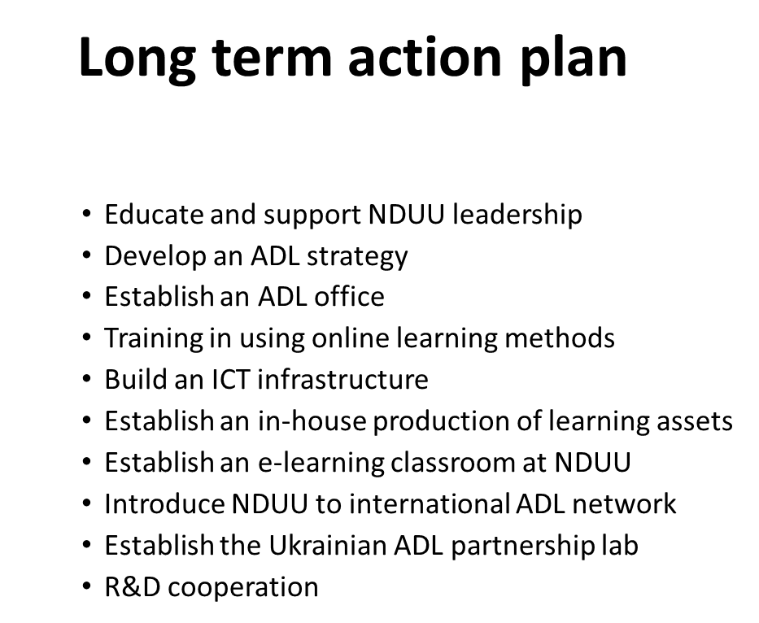
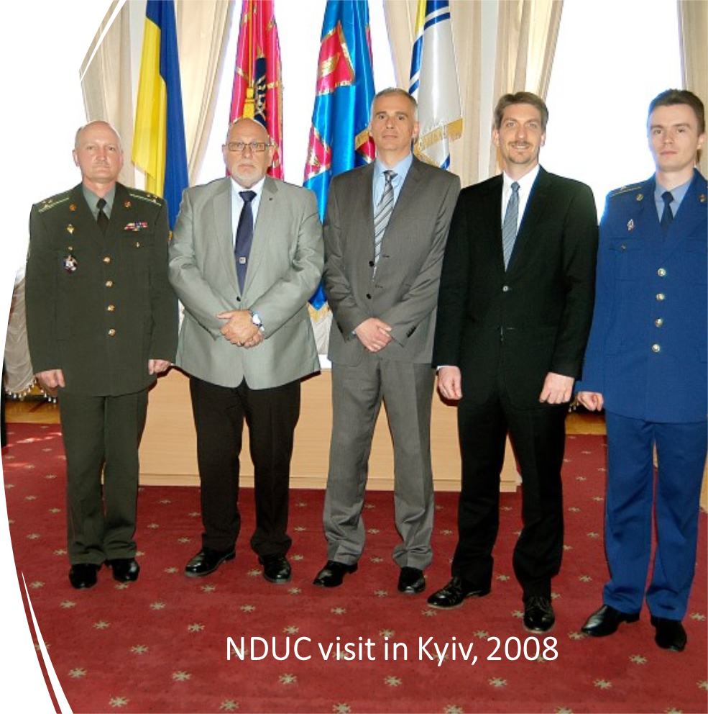
Norwegian Fact Finding in Ukraine Prior to 2013
Notes:
As a result of the fact finding back in 2007 we developed together with our Ukrainian partners , an action plan of 10 measures
Short elaboration of the points

Slide 10
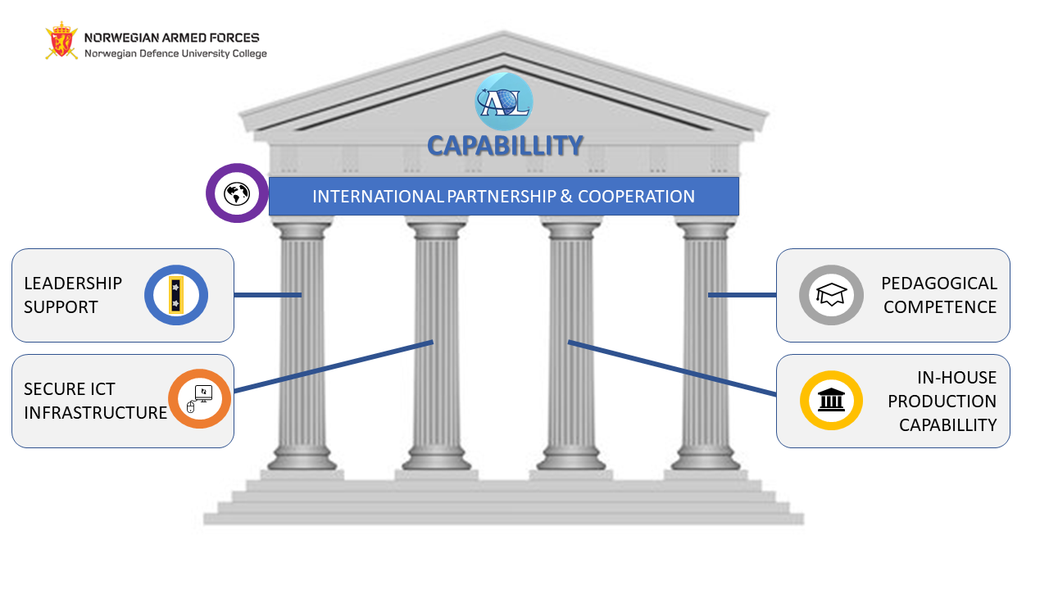
To Build a Advanced Distributed Learning Capability
Notes:
Explanation of the 4 pillars of an ADL capability and the pilar of cooperation

Slide 11

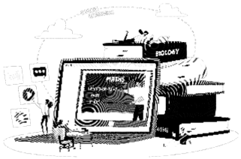

Description of the Ukrainian Situation Prior to 2013
NATO Standards
Bologna System
"Europeanization"
New Methods
New Technologies
Notes:
As of 2013, Ukraine's military education system operated within the framework of the Concept formulated in the late 1990s (1997), which was, in fact, a transitional post-Soviet model of the military education system and regulated national views on how to organize the training of all categories of officers based on their own national capabilities. One of the important aspects of this Concept was the positioning of the military education system as an element of the national higher education system of Ukraine, indicating its place, role and harmonization of military education levels with the national ones in the context of the current education legislation.
In the light of the adaptation of educational legislation, the military education system continued to implement the Bologna system and the overall "Europeanization" of the military education system as part of the transition from a closed to an open educational system in line with harmonization with the national context.
Given the geopolitical realities, the military education system implemented NATO standards and practices, which, at the same time, were not global in nature.
Against the backdrop of deep Europeanization and modernization of higher education in Ukraine (introduction of modern teaching methods and technologies, democratization of the system and its approximation to the European one), military education had to introduce similar profound changes and meet new national requirements (in all components of the educational process).
At that time, new teaching technologies, including distance learning, were being widely introduced in civilian education in Ukraine.
The military education system had to start changing in the context of these challenges and the inevitable competition in the market of educational services.

Slide 12







How to build a strategy and get leaders buy in - NDUU
S 1
Authorities
S 3
Strategic Vision
Teachers
S 2
S 4
Technicians
Notes:
Obviously, the process cannot begin without a deep understanding of the benefits of innovation in education and the will of the management and teaching staff to move to more modern and progressive models that will provide significant competitive advantages and help meet the needs of the defense forces in the broader context of the current and future security situation.
It is advisable to develop the strategy as an element of a more global strategic vision for the development of the educational institution and the education system as a whole. In particular, for NDUU, this process looked like a way of deep transformation with simultaneous development of strategies at several levels with a coherent mission and objectives.
The breadth of the context allows for the correct design of the system parameters in accordance with current needs, prospects for their development, and challenges that may arise in the future.
One of the keys to success should be a team of like-minded people, which should include representatives of management, teaching staff, technical staff, and specialists in a particular pedagogical field.

Slide 13
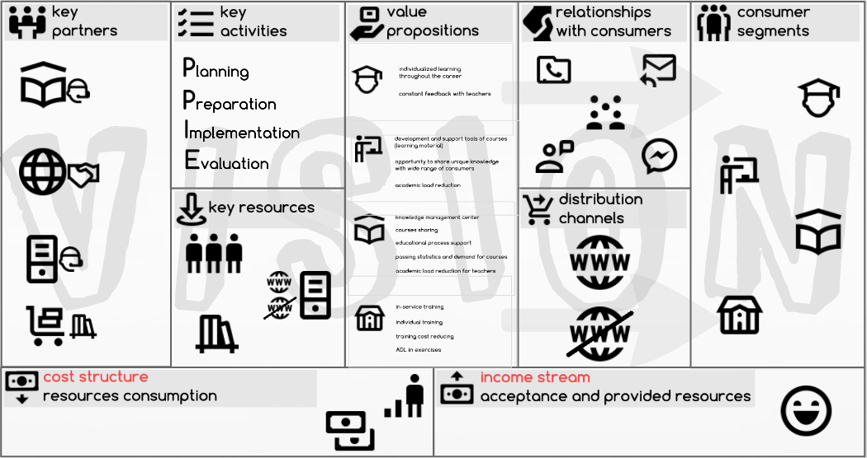
How to build a strategy and get leaders buy in - NDUU
Notes:
Obviously, the process cannot begin without a deep understanding of the benefits of innovation in education and the will of the management and teaching staff to move to more modern and progressive models that will provide significant competitive advantages and help meet the needs of the defense forces in the broader context of the current and future security situation.
It is advisable to develop the strategy as an element of a more global strategic vision for the development of the educational institution and the education system as a whole. In particular, for NDUU, this process looked like a way of deep transformation with simultaneous development of strategies at several levels with a coherent mission and objectives.
The breadth of the context allows for the correct design of the system parameters in accordance with current needs, prospects for their development, and challenges that may arise in the future.
One of the keys to success should be a team of like-minded people, which should include representatives of management, teaching staff, technical staff, and specialists in a particular pedagogical field.

Slide 14
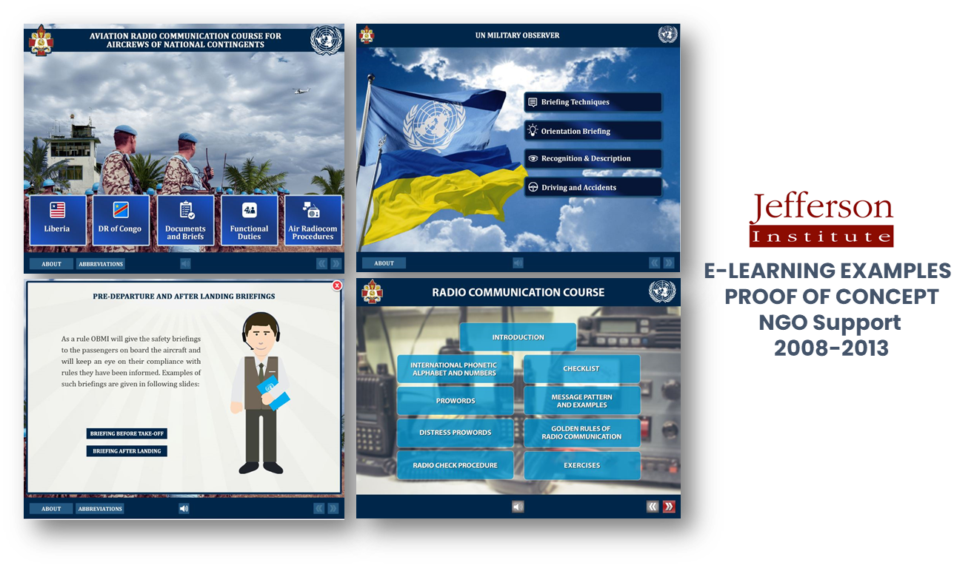
How to Build a Strategy and Get Leaders Buy In
PROOF OF CONCEPT STRATEGY
Notes:
Explenation of the purpose of developing e-learning courses , to be used as proof of consept toward leadership

Slide 15

How to build a strategy and get leaders buy in
Notes:
Elaborate on why this was important.
Examples on some of the statements from the document most relevant for the development of the scientific center

Slide 16

Technical Infrastructure
Challenges:
Providing access to technology for a significant number of users
Internet access
Use of existing third-party facilities on the basis of outsourcing.
ICT security
Tools and hardware for production of learning material
Notes:
Technical infrastructure has long been a major obstacle to the development of Ukraine's military education system.
In this context, we should talk about providing access to technology for a significant number of users (available technical capacities on the basis of the educational institution and outside of it - at the places of residence of users); for a long time, access to the Internet has been a problematic issue; availability of a sufficient number of end devices; availability of modern specific server equipment, etc.
One of the main problems in this regard is the search for optimal models of developing the technical base of the VLE - a full-fledged own base of the educational institution or the use of existing third-party facilities on the basis of outsourcing.
The initial data for the design of the ADL system may be:
the current state of the technical base;
availability of a structural unit (persons) capable of providing technical support;
number of students of different categories;
which categories will be covered by the LMS;
What potential tasks will be solved by the system;
the place of the local technical infrastructure in the ecosystem or higher-level system;
the degree of closure of the future system in terms of information circulation;
the ratio of open and closed information in the system (priorities, the need to combine)
the amount of data that can circulate in the system and the availability of databases (libraries);
the possibility of using the system in wartime (crisis situations)
and others.

Slide 17

Technical Infrastructure
First step: Establishing an online learning portal 2008 - 2010
Notes:
Very early a Learning Management System came in place at NDUU. A Moodle instance was installed on local servers and used to distribute the e-learning course I just showed you. Also a part of the proof of concept.

Slide 18
Technical Infrastructure
Initial Data for ADL System Design
Technical base status
Technical staff status
Learners
Stakeholders
Tasks
Place in ecosystem
Information
Security
Data
Resilience and more

Slide 19


ICT Security
Information Sensitivity
Training Goals
PERSONAL DATA
Notes:
Security is closely related to technical requirements and should be one of the key elements, especially if the system will be used in crisis situations and will be subject to attacks by the enemy.
From this point of view, it may be critical to find a balance between the sensitivity of the information circulating in the system and the goals of training (not memorization of specific classified data, but development of thinking).
In addition, restricting access will significantly reduce the number of subscribers and the scope of the system.
At the same time, the system should be sufficiently resistant to external attempts to penetrate, hack or disrupt its operation, which should be incorporated into the technical design. In this context, it is also necessary to balance the sensitivity and openness of the data circulating in the system, including personal data.
Potentially, the personal data of users (military personnel) may be the most sensitive part of the information stored in the system, and therefore, this aspect should be the focus of the greatest attention in the design.

Slide 20

Dedicate Personnel Resources to ADL
2007 - NDUU ADL center established 10 people
2017 - Re-established as the Scientific Distance Learning center 10 people
2010 - NDUU ADL center downsized to 5 people
Notes:
Undoubtedly, for the successful implementation of the project, a core of specialists must be created who will implement the ADL at the level of idea, technology, method, procedure, and system.
It is advisable to form such a group taking into account the willingness of the teaching staff to improve their skills and introduce innovations.
Perhaps the core of the group should initially include teachers who already have experience in working with ADL.
In the case of the NDUU, instructors were trained from among the faculty who were able to master the technology in a short time and become trainers for the rest of the staff in their departments on a "train trainers" basis.
A special course was developed for the training, with the graduate developing his or her own course as a credit. Later, the best courses were directly used in the university's educational process.
Methodological classes under the guidance of trained specialists and dissemination of their experience in various forms were also elements of experience implementation.
One of the important elements of team building is to create a common understanding of the importance and necessity of technology implementation.
It is also important to motivate the team and transfer the common belief to the entire team.
A valuable argument for most is the feedback from students on the benefits of introducing technology, as this aspect is known to younger generations, and their style of cognition of reality since childhood is based on working with computer equipment.

Slide 21






Dedicate Personnel Resources to ADL
Notes:
Undoubtedly, for the successful implementation of the project, a core of specialists must be created who will implement the ADL at the level of idea, technology, method, procedure, and system.
It is advisable to form such a group taking into account the willingness of the teaching staff to improve their skills and introduce innovations.
Perhaps the core of the group should initially include teachers who already have experience in working with ADL.
In the case of the NDUU, instructors were trained from among the faculty who were able to master the technology in a short time and become trainers for the rest of the staff in their departments on a "train trainers" basis.
A special course was developed for the training, with the graduate developing his or her own course as a credit. Later, the best courses were directly used in the university's educational process.
Methodological classes under the guidance of trained specialists and dissemination of their experience in various forms were also elements of experience implementation.
One of the important elements of team building is to create a common understanding of the importance and necessity of technology implementation.
It is also important to motivate the team and transfer the common belief to the entire team.
A valuable argument for most is the feedback from students on the benefits of introducing technology, as this aspect is known to younger generations, and their style of cognition of reality since childhood is based on working with computer equipment.

Slide 22

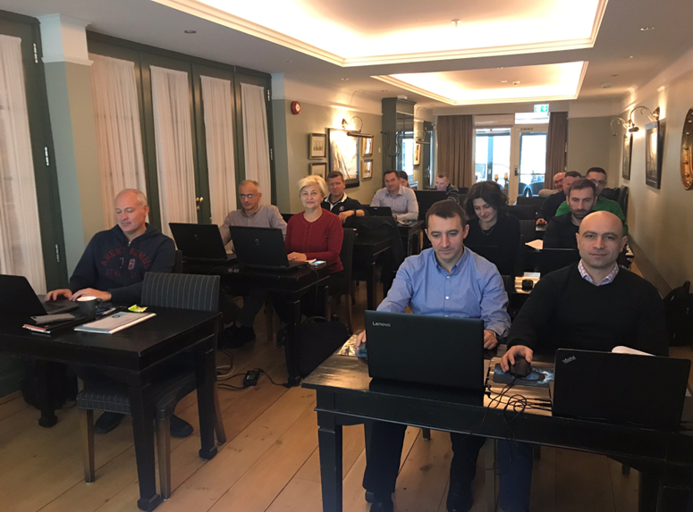
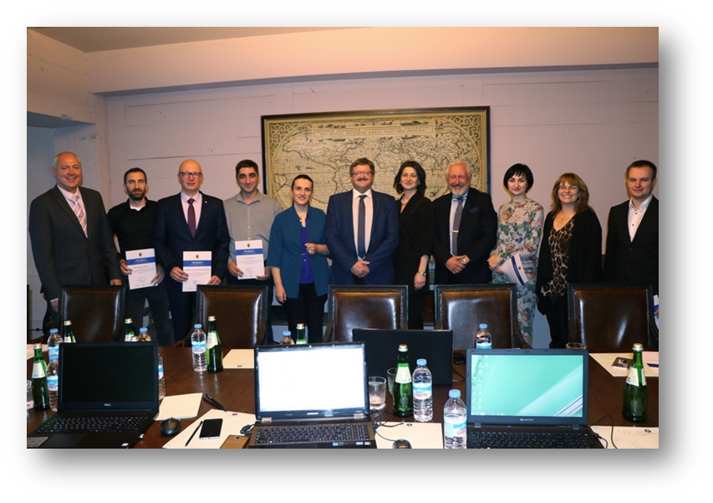
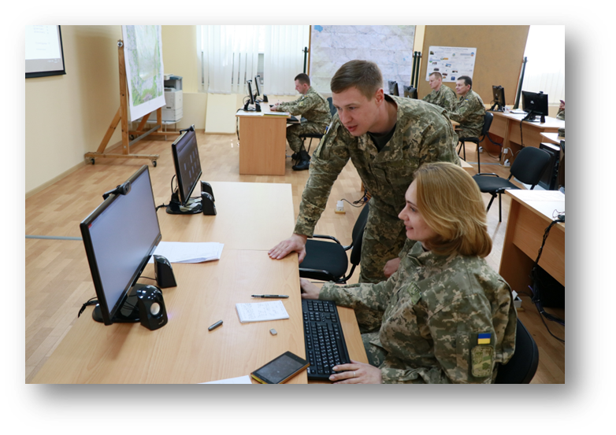
Training and Education
E-learning production course
Oslo, 2018
Video production course
Tbilisi, 2018
Moodle administration course
Oslo, 2016
Notes:
Examples of training activities conducted over the years

Slide 23
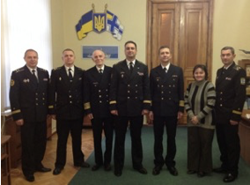
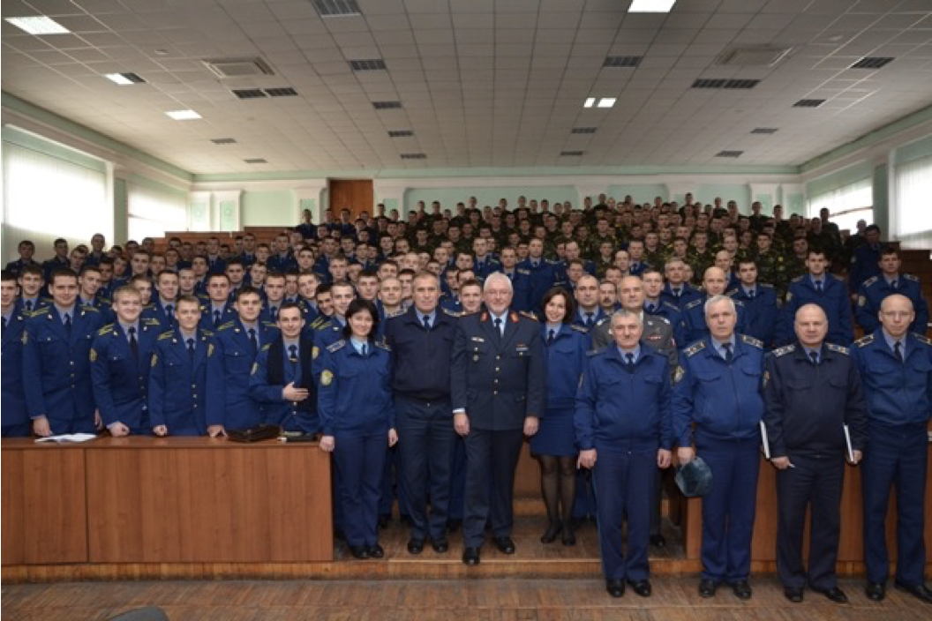
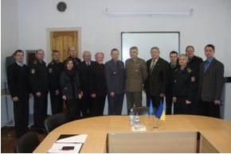
Training and Education/ NATO DEEP Perspective
ADL focused event
Sevastopol, 2013
ADL familiarisation event
Kharkiv, 2013
ADL familiarisation event
Kyiv, 2013

Slide 24
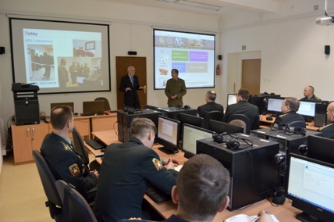
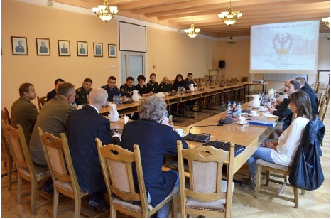
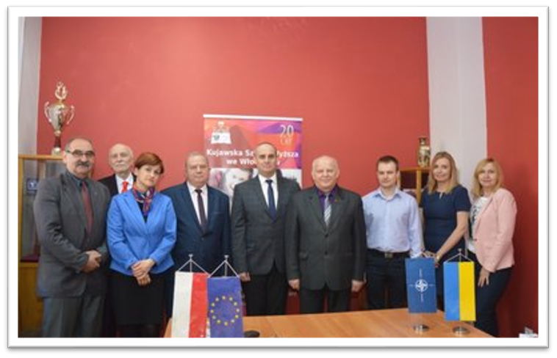
Training and Education/ NATO DEEP Perspective
ADL workshop
Warsaw, 2013
ADL focused workshop
Warsaw, 2014
ADL course development
Wloclawek, Poland 2017

Slide 25

Establishment of An ADL Office in Ukraine
Research
Technical Support
Training
Development
Cooperation
Notes:
The organization of the unit responsible for the development of ADL should take into account its mission and objectives. This may be exclusively technical support, or a broader range of tasks, including developing courses, training staff and conducting research on the effectiveness of implementing ADL technologies (as in the case of NDUU).
The mission is the basic element for the formation of the unit: its number, list of positions, range of duties, etc.
According to the experience of the Ukrainian side, it should be a unit with a wide range of powers and responsibilities and be an element of the university's educational and scientific subsystems to continuously improve the process of implementing ADL.
Also, our experience shows that this unit should have permanent links with the unit responsible for ensuring the quality of education, educational databases (electronic library), etc.
In the case of NDUU, the ADL unit is the basic unit of the AFU in the field of implementation of the ADL.
This aspect requires taking into account additional requirements for the staff of the center, which should probably include a wide range of specialists, both purely technical and scientific and educational.

Slide 26
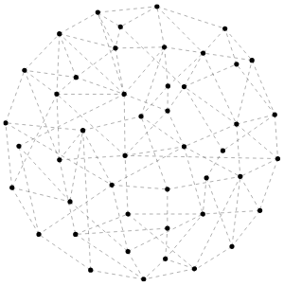




Establishment of An ADL Office
Notes:
Continue slide 24

Slide 27

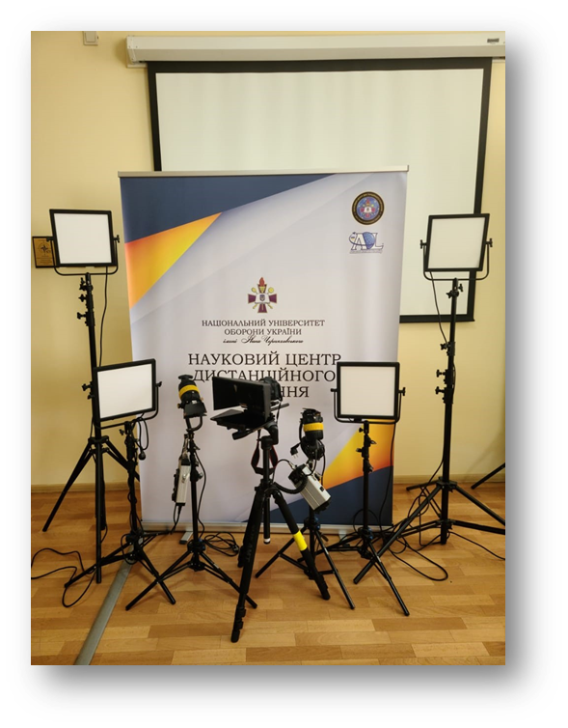
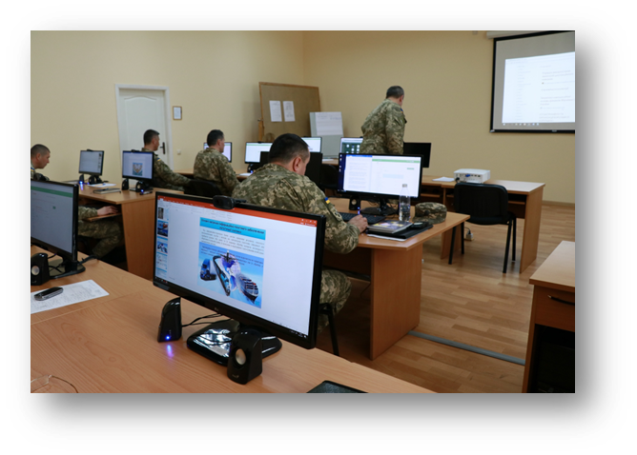
Establishing Learning Facilities
E-learning classroom at NDUU
Video “studio” at NDUU
Notes:
Elaboration on the necessity of such facilities

Slide 28
Establish Capability For In-house Production of Learning Assets
Keystone in a solid ADL capability
An agile capability to produce learning assets when they are needed and distribute to the learners in the theater.
Notes:
Continued

Slide 29
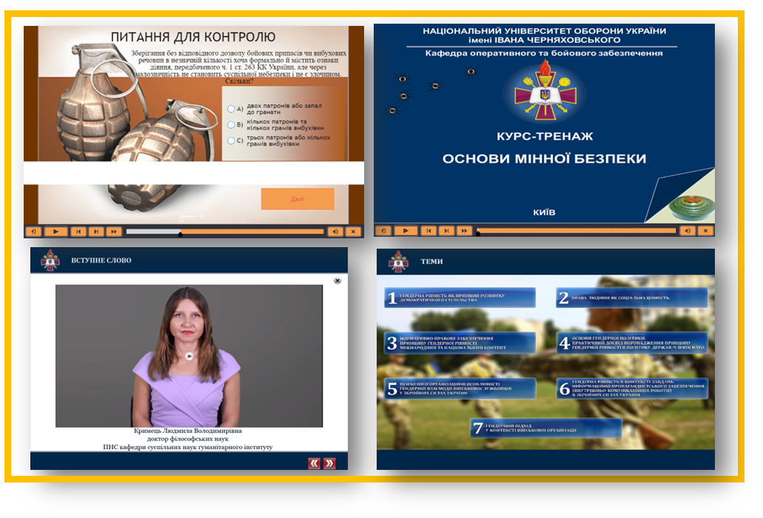
Establish Capability For In-house Production of Learning Assets
2015
NDUU starts
to produce
in-house e-learning

Slide 30


Importance of International Cooperation and Access To a Network
ADL Partnership network
NDUU member in 2019
More than 15 military and academic institutions
Notes:
Info and examples of international ADL community and coperation

Slide 31
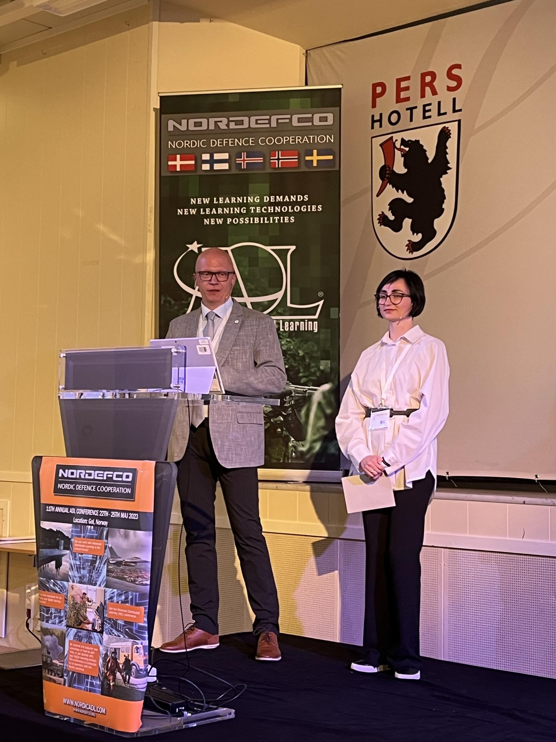

Importance of International Cooperation and Access To a Network
NORDEFCO ADL family
NDUU partners participated since 2018
NNDUU lecture, Gol , Norway 2023

Slide 32
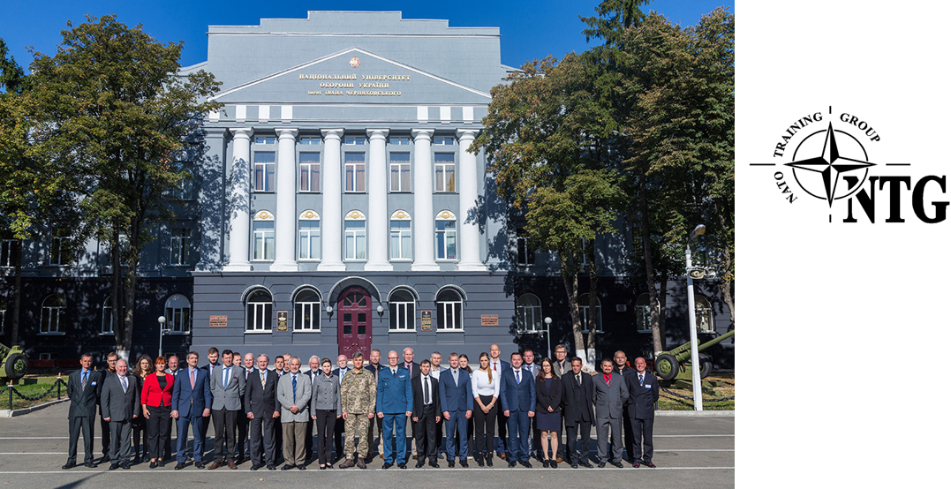
Importance of International Cooperation and Access To a Network
Participated at the
NTG IT/ED meetings
since 2016
Hosted in 2019, Kyiv

Slide 33
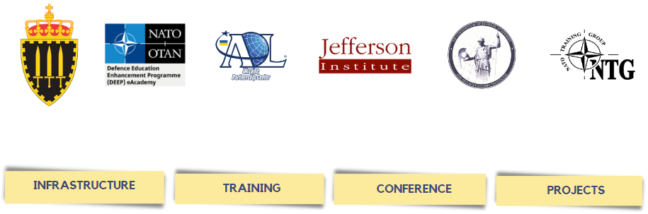
Importance of International Cooperation and Access To a Network

Slide 34


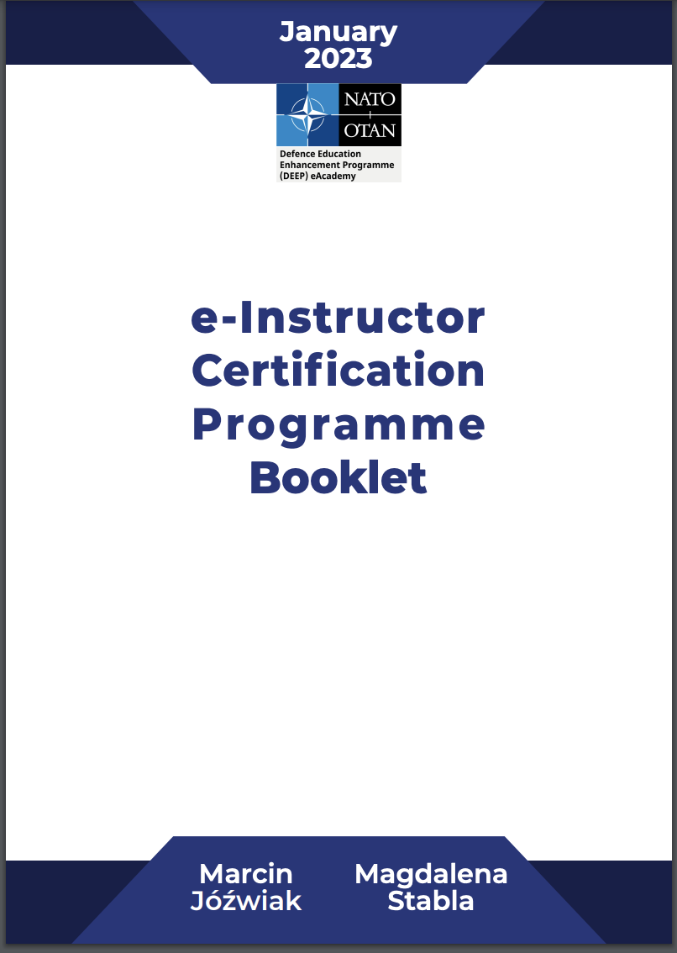
NATO DEEP - Certification of Instructors
Notes:
ADL-oriented involvement of the UKR side participants aiming to develop the capacity:
· postgraduate studies "e-Teacher and e-Instructor within a new learning environment caused by COVID-19"
· e-Instructor Certification Programme (e-ICP)
· workshops / BigBlueButton (How to effectively run e-learning sessions)
· workshops/ H5P application (UKR SMEs also as the tutors)
· workshops/ Multimedia creation - videocasts and podcasts
· workshops/ Canva application (UKR SMEs also as the tutors)
· workshops/ Social media and VR in education and society
· Joint project: Computer Adaptive Language Testing - CALT
· translation of the ADL courses into Ukrainian, involving SMEs from NDUU, i.e.:
Cyber Defence Awareness - CDA,
Introduction to Culture Awareness - ICA,
e-Counterterrorism Reference Curriculum – (based on the agreement with NDUC)
· translation of the book "Modernizing Learning" into Ukrainian
The breakdown for the PME institutions:
H5P - conducted in 2021/2022 (total - 127)
Multimedia creation - conducted in 2021/2022 (total – 100)
Canva - launched in February 2023
Social Media/ VR - launched in February 2023
UKR graduates from e-Instructor Certification Programme (10 UKR personnel):
National Defence University of Ukraine - 2
The Kozhedub Kharkiv University of AF - 1
Odessa Naval Institute - 3
Military Institute of Telecom & Informatisation - 3
Military Institute of Taras Shevchenko National University of Kyiv - 1
Academy of the National Guard - 1
Currently, edition #4 is ongoing, gathering 7 participants, from:
Lviv Land Forces academy - 4
Odessa Military Academy - 1
Military Institute of Telecom & Informatization - 1
Military Institute of Taras Shevchenko National University of Kyiv – 1

Slide 35

NATO DEEP - Certification of Instructors
Notes:
ADL-oriented involvement of the UKR side participants aiming to develop the capacity:
· postgraduate studies "e-Teacher and e-Instructor within a new learning environment caused by COVID-19"
· e-Instructor Certification Programme (e-ICP)
· workshops / BigBlueButton (How to effectively run e-learning sessions)
· workshops/ H5P application (UKR SMEs also as the tutors)
· workshops/ Multimedia creation - videocasts and podcasts
· workshops/ Canva application (UKR SMEs also as the tutors)
· workshops/ Social media and VR in education and society
· Joint project: Computer Adaptive Language Testing - CALT
· translation of the ADL courses into Ukrainian, involving SMEs from NDUU, i.e.:
Cyber Defence Awareness - CDA,
Introduction to Culture Awareness - ICA,
e-Counterterrorism Reference Curriculum – (based on the agreement with NDUC)
· translation of the book "Modernizing Learning" into Ukrainian
The breakdown for the PME institutions:
H5P - conducted in 2021/2022 (total - 127)
Multimedia creation - conducted in 2021/2022 (total – 100)
Canva - launched in February 2023
Social Media/ VR - launched in February 2023
UKR graduates from e-Instructor Certification Programme (10 UKR personnel):
National Defence University of Ukraine - 2
The Kozhedub Kharkiv University of AF - 1
Odessa Naval Institute - 3
Military Institute of Telecom & Informatisation - 3
Military Institute of Taras Shevchenko National University of Kyiv - 1
Academy of the National Guard - 1
Currently, edition #4 is ongoing, gathering 7 participants, from:
Lviv Land Forces academy - 4
Odessa Military Academy - 1
Military Institute of Telecom & Informatization - 1
Military Institute of Taras Shevchenko National University of Kyiv – 1

Slide 36
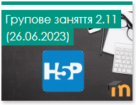
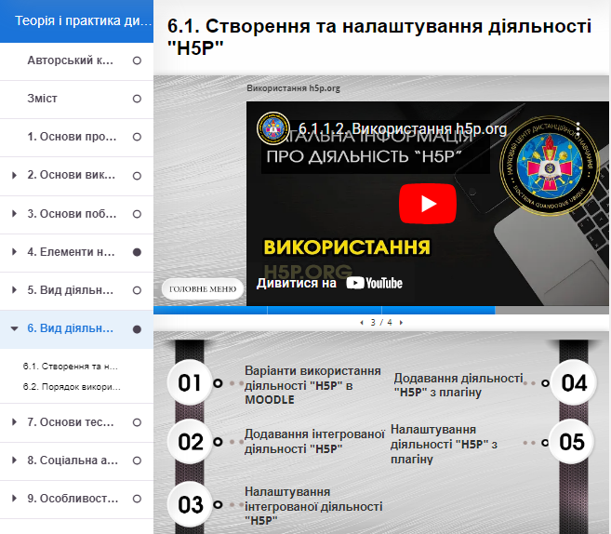



NDUU Certification of Instructors
More than 600 teachers trained

Slide 37




Connection Between NDUU and the Ukrainian Armed Forces
C2 Bodies
Military Units
PMEs
Defence Forces
Training Centers

Slide 38
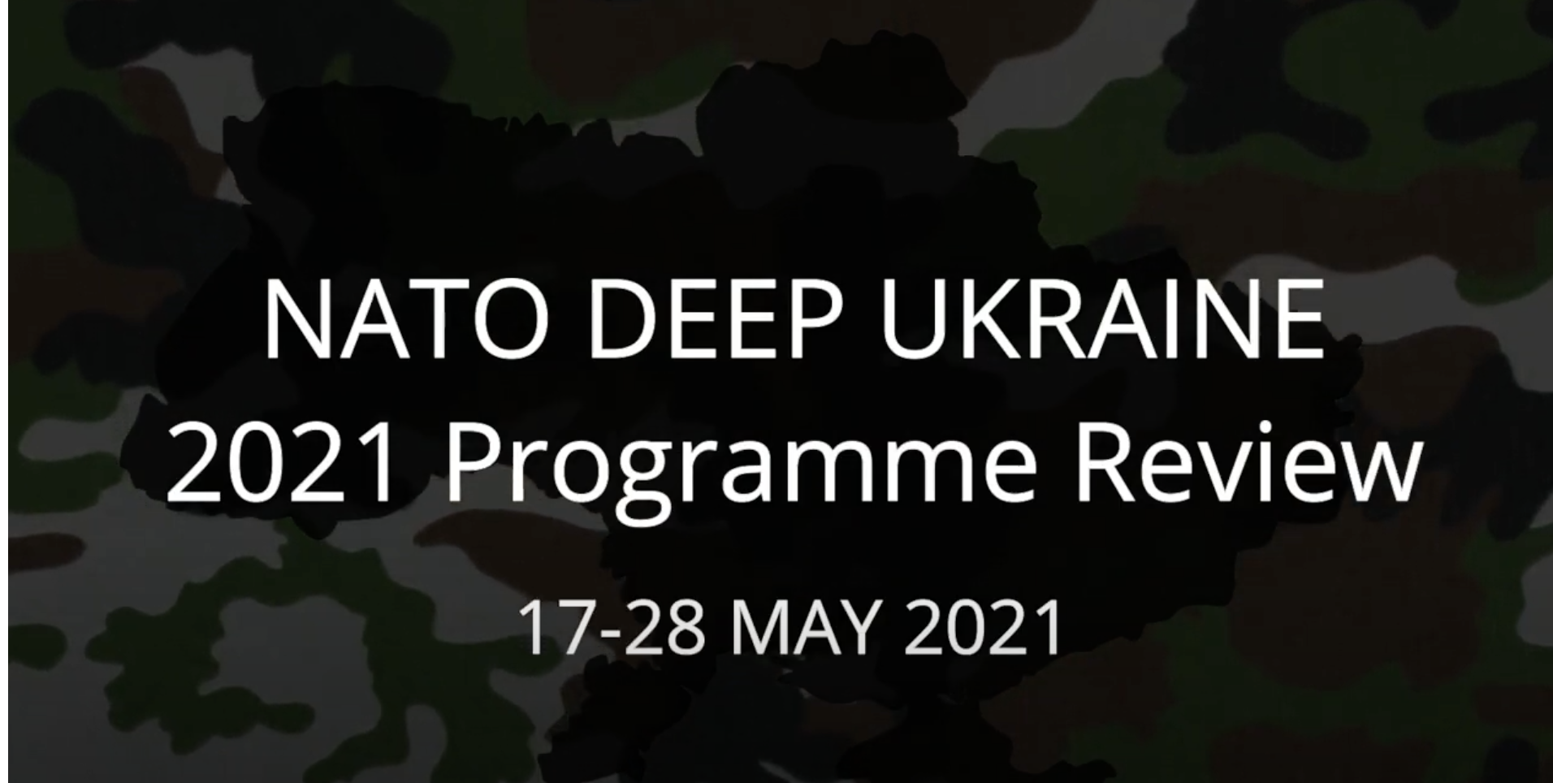
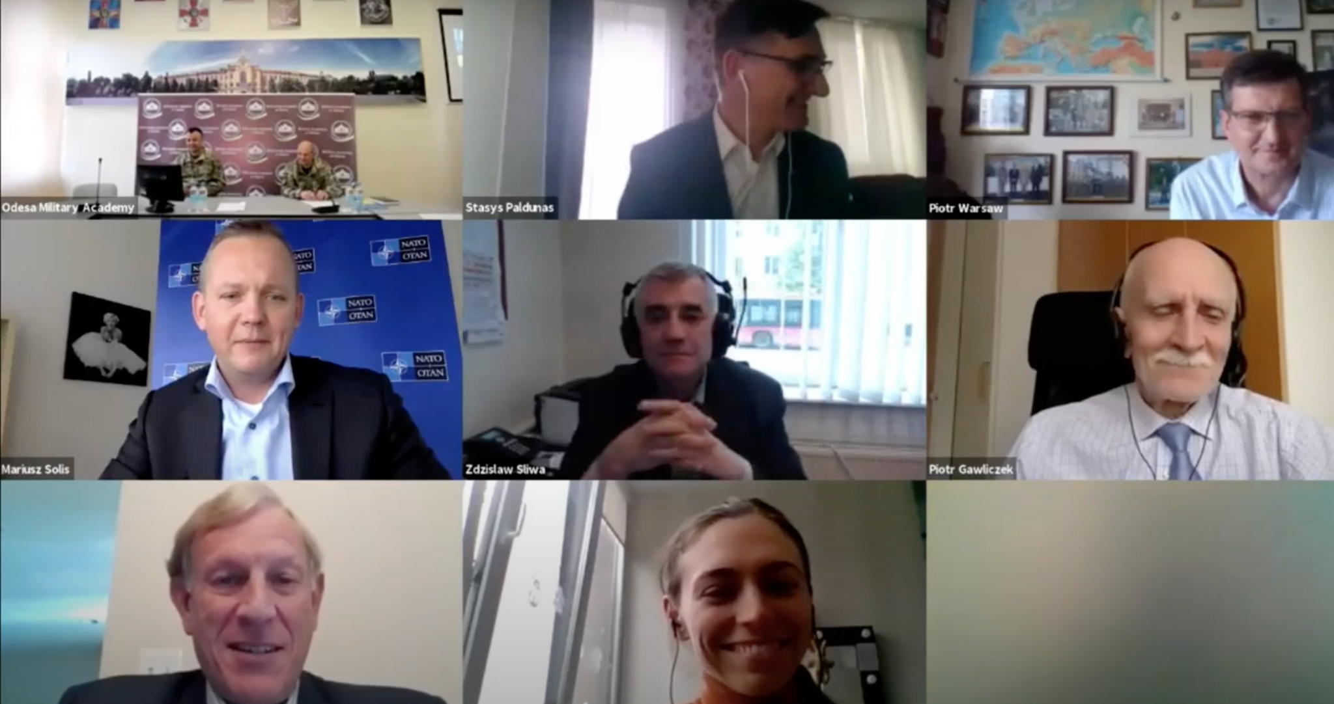
Covid 2020-2021 / NATO DEEP UKR Fully Efficient as On-line Based
Notes:
The efficiency of the UKR ADL system was proven during annual evaluation visits (2020 and 2021) conducted online during the COVID lockdown (BigBlueButton VC). Of importance is to stress the UKR input as far as the development of the NATO DEEP Strategy for Distance Learning Support.
In 2021 50+ participants from NATO and Ukraine took part in the DEEP Ukraine Annual Review 2021 on-line. The following institutions/ entities were visited: Lviv Land Forces Academy, the National Defence University of Ukraine in Kyiv, Odesa Naval Academy, Kharkiv Air Force University, Odesa Military Academy, Kharkiv Tank Institute, Zhytomyr Military Institute, NCO, Military Institute of Taras Shevchenko University

Slide 39



UKR Experiences From the Covid Pandemic
ADL
Admission Company
Final Exams
Group Projects
C & S Exercises
Conferences
Courses

Slide 40
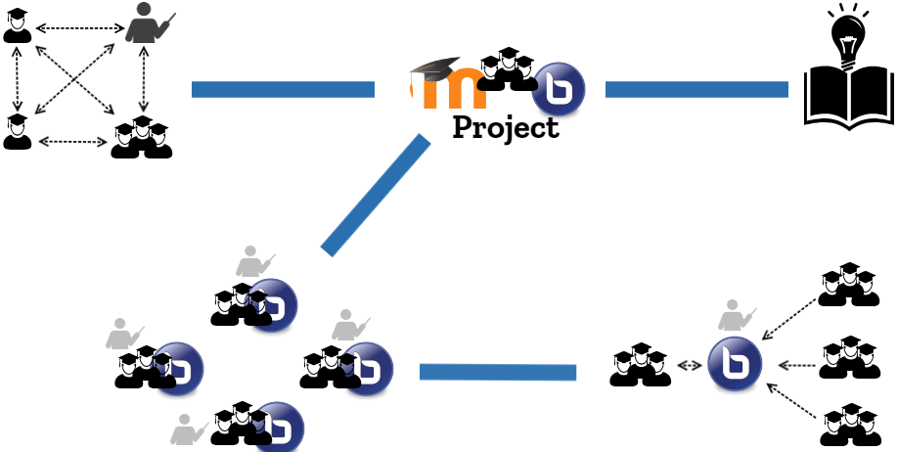
Experiences From the Covid Pandemic

Slide 41

Experiences From the Covid Pandemic
Final Exam
Task Variant
Tactical Task
Map
Symbols

Slide 42
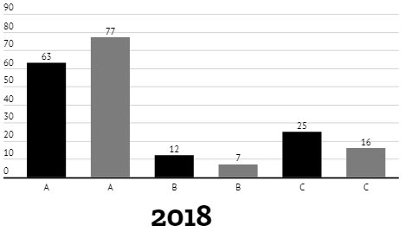
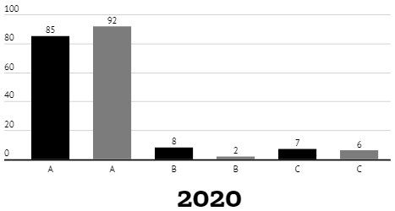
Experiences From the Covid Pandemic
Your attitude to the use of ADL technologies in the educational process of the University?
A - Positive
Teachers
B - Waste of time, traditional methods are better
C - Difficult to answer
Students

Slide 43
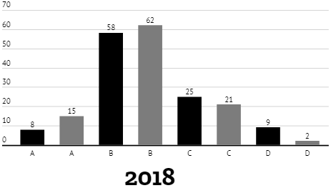
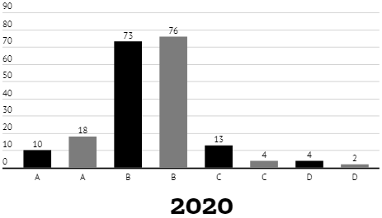
Experiences From the Covid Pandemic
Is it convenient to use the ADL platform?
A - Very convenient
B - Convenient
Teachers
C - Inconvenient
C - No need to use the ADL platform
Students

Slide 44
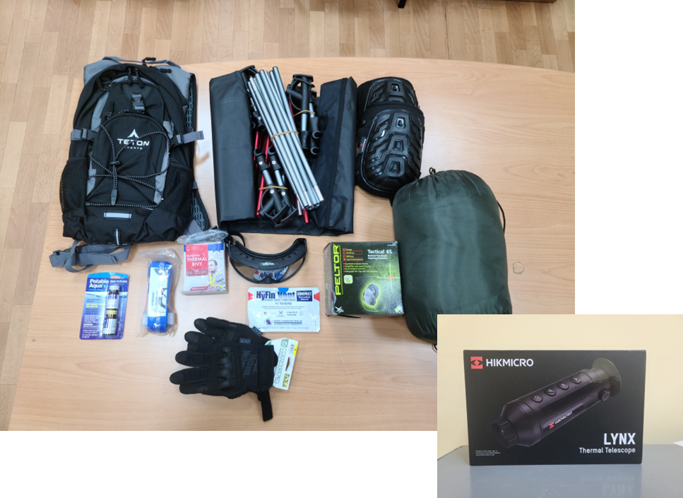
The Attack From Russia on UKR Educational Institutions
New means
of support, spring 2022
Funds already dedicated to ADL training reallocated to defensive equipment for NDUU
In cooperation with Jefferson Institute

Slide 45
The Attack From Russia on UKR Educational Institutions
The Biggest Changes (civilian prospective)
EDUCATION IN CONDITION OF WAR
Lack of resources
People focused on the survival of themselves and their families
Students and teachers defend the country or volunteer
ALL PAPERWORK SHOULD BE REPLACED BY DIGITAL SOLUTIONS
DECENTRALIZED MANAGEMENT
REDUCTION OF REQUIREMENTS FOR STUDENTS
As a consequence of reduced quality of education
Difficulties with decision-making
Notes:
Synchronous-asynchronous mode was introduced for the educational process. This mode assumes that teachers, if possible, conduct classes in synchronous mode, and if this is not possible, they make video recordings and provide access to all educational materials to students. Similarly, students study introductory materials and complete assignments when they can.
If students do not have the opportunity to study, they can either take academic leave for one year or switch to an individual study plan.
Up to ten percent of students take part in internal and external mobility.

Slide 46
The Attack From Russia on UKR Educational Institutions
The Biggest Changes (civilian prospective)
MENTAL SUPPORT
SECURITY OF PERSONAL DATA
NON-FORMAL LEARNING OUTCOMES
INTEGRATION WITH THE INTERNATIONAL EDUCATIONAL SPACE
TRANSITION FROM ONLINE TO F2F LEARNING IN PROTECTED PLACES

Slide 47
The Attack From Russia on UKR Educational Institutions
Challenges (civilian prospective)
COST REDUCTION
REDUCTION OF STUDENTS (TEACHERS) NUMBER
PLACES FOR AN ADMISSION CAMPAIGN
SHELTERS FOR ALL STUDENT & TEACHERS (F2F MODE)
ONLINE LEARNING FROM THE TEMPORARILY OCCUPIED TERRITORIES

Slide 48
The Attack From Russia on UKR Educational Institutions
Challenges (civilian prospective)
OBTAINING DIPLOMAS (ABROAD & TEMPORARILY OCCUPIED TERRITORIES)
REMOTE WORK OF TEACHERS
DORMITORY FOR STUDENTS
OTHER HUMANITARIAN ASPECTS

Slide 49
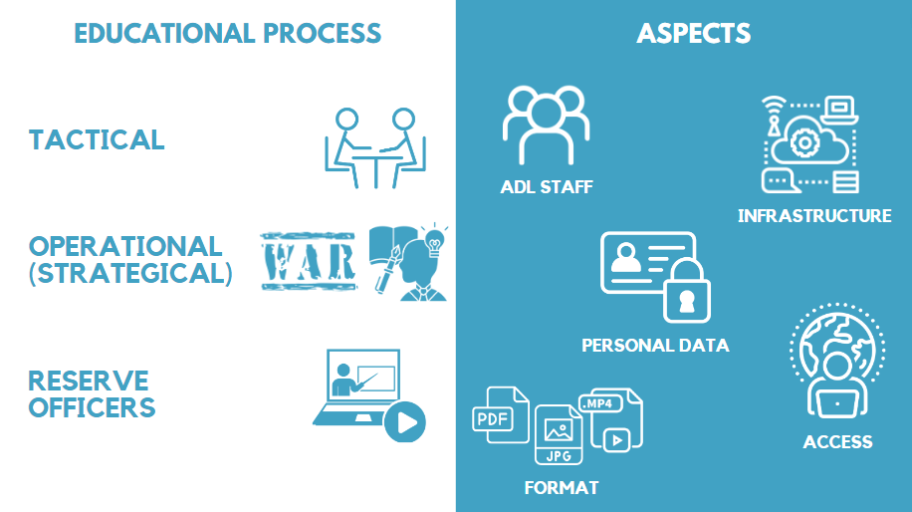
The Attack From Russia on UKR Educational Institutions

Slide 50

Importance of an Online LMS & Maintaining the Capability in Time of War
Ensure E & T
Notes:
It is only through distance learning technologies that it is possible to effectively ensure the education and training of defense forces specialists in times of war.
During times of war, access to traditional educational facilities can be severely restricted or even entirely cut off due to safety concerns. Online learning systems provide a means of continuing education despite these limitations, enabling individuals to continue their studies even in the midst of war. This can be particularly important for militaries who may be deployed in remte locations and unable to access traditional educational facilities.
Online learning can help them to maintain their skills, keep up-to-date with the latest developments in their field, and prepare for future deployments.

Slide 51
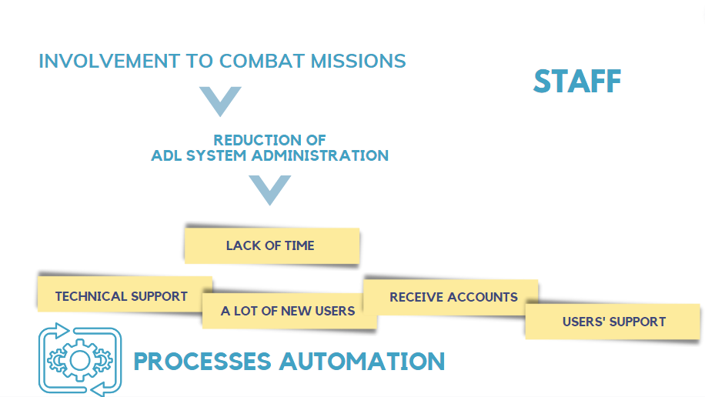
Lesson Learned from February 24th Until Present
Notes:
As a result of the analysis of the use of distance learning technologies during the Russian aggression against Ukraine, four main factors have been identified that must be taken into account in the further improvement of the distance learning system in the Armed Forces of Ukraine, namely
Personnel - the system does not work autonomously and for its functioning it is necessary to have appropriate personnel who will serve both the technical component and the users of the system. Experience has shown that personnel may be involved in combat missions, which will affect the state of the system's functioning (partial (limited) functioning or complete shutdown), and therefore most processes should be automated;

Slide 52
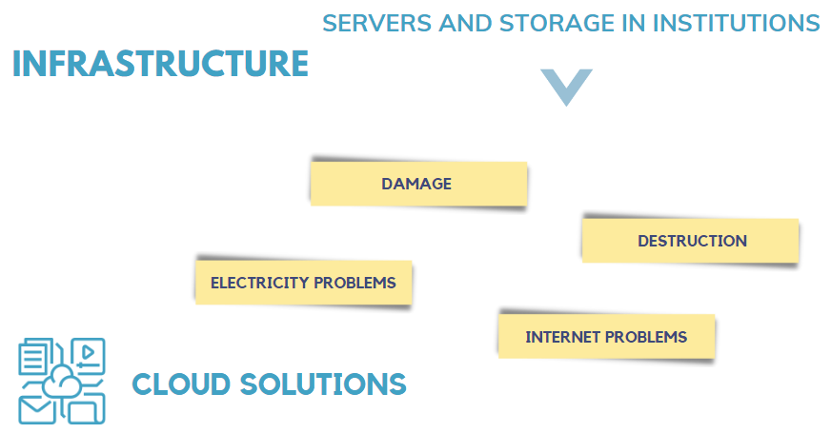
Lesson Learned from February 24th Until Present
Notes:
infrastructure - existing software and hardware solutions that host distance learning platforms and other information resources are mostly deployed directly in educational institutions. Experience has shown that Russian troops are constantly attacking not only the military but also the civilian infrastructure of Ukraine. This leads to an unstable supply of electricity, Internet access, and can also lead to the destruction (damage) of distance learning infrastructure. Therefore, to ensure the smooth functioning of the distance learning infrastructure, it is necessary to consider the use of cloud solutions for its deployment. At the same time, it is necessary to provide resources that will ensure end users' access to information training resources with a high degree of mobility and autonomy. The use of autonomous and mobile power resources and Internet access is critical. In addition, it is extremely important to use mobile interactive training complexes that do not require binding to a specific place of deployment and ensure the acquisition of the necessary level of theoretical knowledge and practical skills by military personnel;

Slide 53
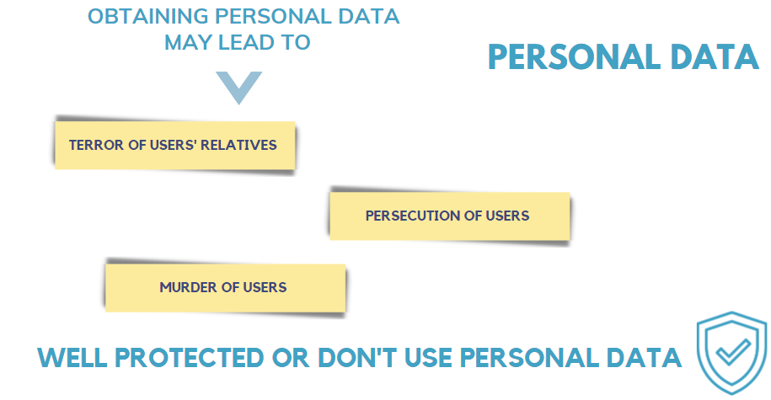
Lesson Learned from February 24th Until Present
Notes:
personal data - the enemy may use personal information to obtain data on active (former) military personnel and their family members, which may pose a threat to their health or life. It is recommended to use any personal information in distance learning information systems to a limited extent or, if it is necessary to use it, to ensure an appropriate level of protection of this information;

Slide 54
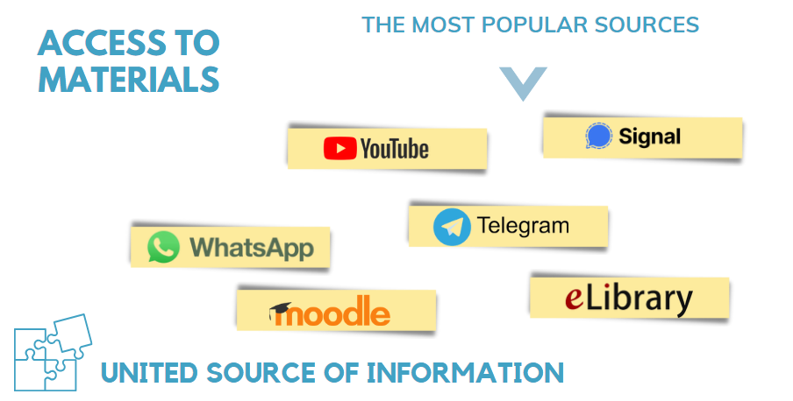
Lesson Learned from February 24th Until Present
Notes:
access to materials - in order to train military specialists in Ukraine, various information resources are used, the most common of which are: YouTube, LMS Moodle, messengers and electronic libraries. Given the large number of such resources, their fragmentation and complexity of choice, there is a need to create and use a single information portal for distance learning. The portal should contain information on existing distance learning platforms, the procedure for accessing them, available distance learning courses, digital libraries, etc.

Slide 55
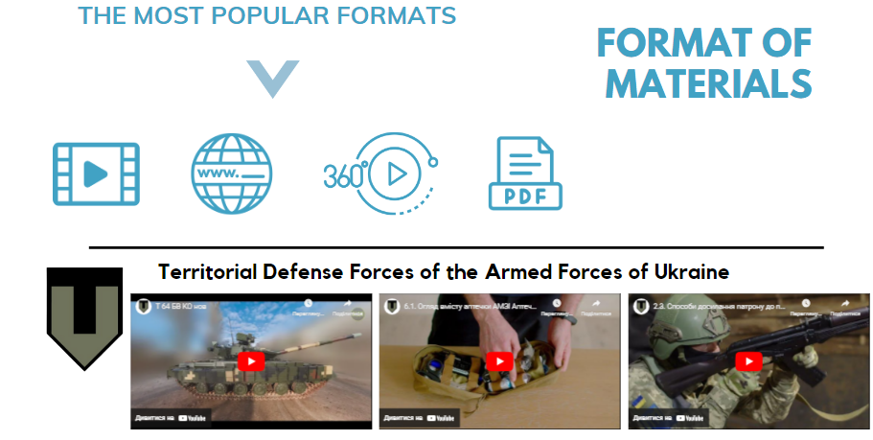
Lesson Learned from February 24th Until Present

Slide 56
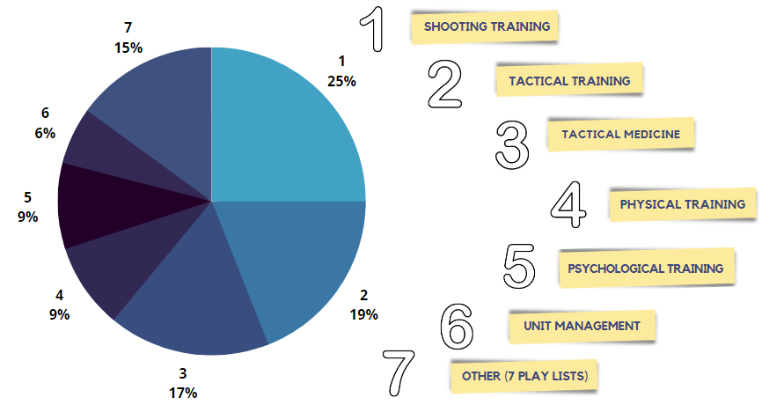
Lesson Learned from February 24th Until Present

Slide 57

Lesson Learned from February 24th Until Present
Notes:
personal data - the enemy may use personal information to obtain data on active (former) military personnel and their family members, which may pose a threat to their health or life. It is recommended to use any personal information in distance learning information systems to a limited extent or, if it is necessary to use it, to ensure an appropriate level of protection of this information;

Slide 58
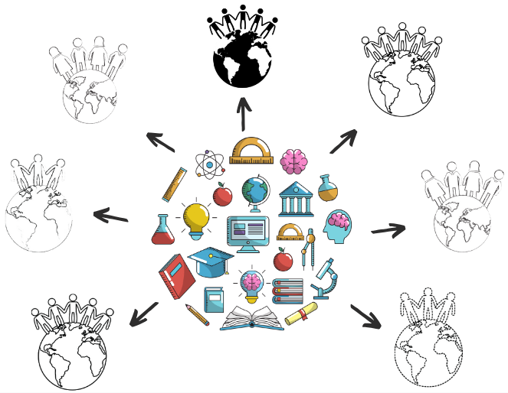
Lesson learned and recommendations

Slide 59
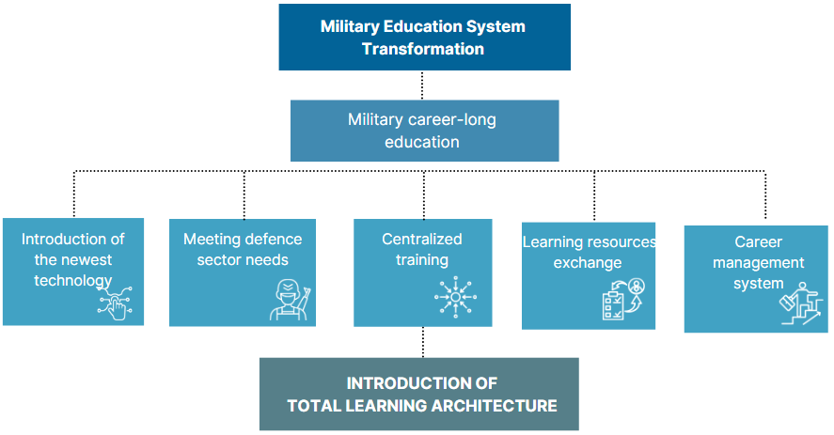
Lesson Learned and Recommendations
Notes:
The military education system should ensure continuous professional development of the state's defense forces throughout their military careers and not reduce their effectiveness during combat operations.
Main tasks and activities set out in order to solve the issue of a systematic informational provision to continuous professional development of the defence forces of Ukraine are the following:
accelerating implementation of modern informational and communicative, as well as ADL technologies;
systematic informational provision of the defence forces of Ukraine;
unified centralized operation and strategic officer training of the Armed Forces of Ukraine and other defence forces components;
ability to exchange educational informational resources in between the institutions of the defence forces sector of Ukraine;
supporting introduction of the career management system.
These activities would be possible through implementing Total Learning Architecture. Total Learning Architecture will include a set of technical specifications, standards, and guidelines that shape a single approach to integration new, current learning technology into the learning ecosystem. The ecosystem would allow managing numerous educational services and capabilities in an integrated, joint environment on the “launch and operate” basis.

Slide 60
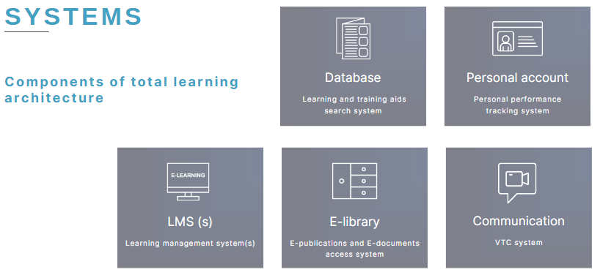
Lesson Learned and Recommendations
Notes:
Total learning architecture has to include systems and services needed for its functioning.
Systems of the architecture are the following:
Database – learning and training aids search system;
Personal account – personal user performance tracking system;
Learning management system (distance learning platform);
E-library – e-publications and e-documents access system;
VTC system.
Each of the systems is to perform a wide range of tasks, allowing for effective use of information technologies in the education and training process for the specialists of the Armed Forces of Ukraine and defense sector of Ukraine.

Slide 61
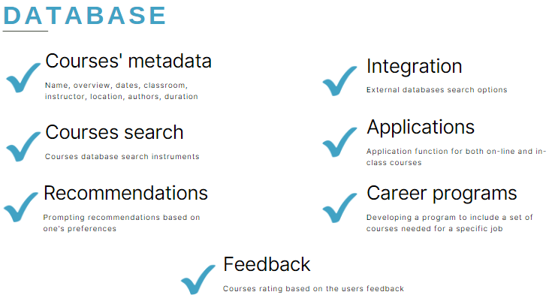
Lesson Learned and Recommendations
Notes:
Saving courses’ metadata: name, overview, dates, classroom, instructor, location, authors, duration etc;
Searching for courses through different filters;
Prompting recommendations based on preferences;
Integration with external databases and course catalogues, allowing to use education and training resources of NATO member states and partners;
Application function for both on-line and in-class courses at education facilities (training centers);
Developing a program to include a set of courses and materials needed as a theoretical basis for a specific position;
Courses rating based on the users’ feedback with the aim of their further betterment.

Slide 62
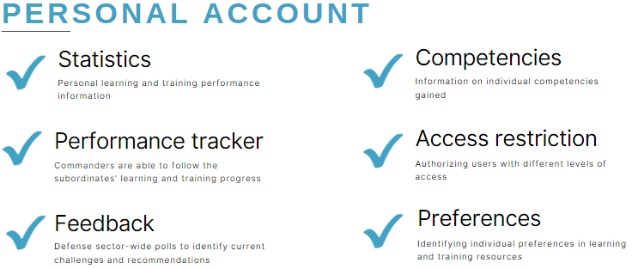
Lesson Learned and Recommendations
Notes:
Saving personal progress information in user learning and training;
Commanders and HR bodies for the defence sector’s ability to follow the subordinates' learning and training progress;
Identifying individual preferences in learning and training aids in order to generate recommendations by the system;
Information on individual competencies gained for HR bodies’ use;
Defence sector-wide surveys (or an individual institution) to identify current challenges and recommendations;
Access restriction function implementation based on authorization levels.

Slide 63

Lesson Learned and Recommendations
Notes:
Ukrainian defence forces’ ability to use a single or multiple combined ADL platforms;
Single E-Library integration;
Integration with a single Video Teleconference service for the defence forces of Ukraine.
Recourses are accessible by all users from the defence institutions of Ukraine;
E-library can be fed with recourses out of all of the education and research institutions of the defence forces of Ukraine.
VTC system has to be integrated and accessible to all user categories, first and foremost for classes attendance.

Slide 64


Way Forward
Social Learning
Micro Learning
Immersive Experiences
Collaboration
AI
Digital Coaching
Guided Learning
Video / Podcasts
Learning Plan
Webinars
Analytics
Courses

Slide 65


Way Forward
Learning solutions for effective E & T
RECOMMENDED INFORMATION PAPER
Partnership for Peace Consortium/George C. Marshall European Center for Security Studies
Subject: Training while we fight: Lessons from Ukraine’s use of distributed learning in war
Annex A: Problem Statement
Annex B: Recommendations, Actions, and Requirements
Annex C: What is “Distributed Learning”?
Annex D: Security Assistance Organizations Supporting Ukraine
Annex E: Acknowledgements

Slide 66



Way Forward
Learning solutions for effective E & T
UKRAINIAN E-LEARNING PORTAL (UKReLP)
Defence Education Enhancement Programme (DEEP)
To conduct/support international E & T, sharing courses
Notes:
The Defence Education Enhancement Program (DEEP) has taken a significant step forward by launching the Ukrainian e-Learning Portal (UKReLP). The platform, as the dedicated and separated area within the NATO DEEP ADL Portal, is tailored to the needs and requests formulated during the annual programme review with Ukraine, conducted on 15-19 May 2023. It provides a collection of ADL courses developed by NATO and partner institutions, both in English and Ukrainian languages. The launch of UKReLP is a strategic move following the experiences gathered during the implementation of the Iraqi e-learning Portal (IeLP), as the unique ADL solution in Arabic language.
A key advantage and utility of the UKEReLP solution is its capacity to enhance learning effectiveness. This is achieved through providing personalized learning experiences, facilitated by the flexibility of digital tools. Access to dedicated areas and subareas enhances the learning capacity, Within the resources, there are for example three gender courses available in English, while the translation into Ukrainian is taking place. This solution is a vital link between traditional learning and the evolving needs of the Ukrainian AF. The platform is an essential tool for Ukrainian AF to improve the quality of defense education and training, to meet the challenges of the new learning ecosystem, and to achieve the NATO standards.
ADL DEEP Ukraine essence:
from 2013 - 145 Events, 1800 Partners Audience.
Total amount of money spent for ADL related events – 700k+ EUR

Slide 67
Way Forward
Norwegian Defence University College and NATO DEEP
stays committed to, together with international ADL partners,
continue to support NDUU and Ukraine on the road to a TLA capability
Major General Serhii Salkutsan, serhii.salkutsan@mfa.gov.ua
Colonel Maksym Tyshchenko, tyshchenkomh@edu.nuou.org.ua
Director Geir Belgen Isaksen, geisaksen@mil.no
Assoc. Prof. Piotr Gawliczek, piotr@deepeacademy.com
Notes:
The Defence Education Enhancement Program (DEEP) has taken a significant step forward by launching the Ukrainian e-Learning Portal (UKReLP). The platform, as the dedicated and separated area within the NATO DEEP ADL Portal, is tailored to the needs and requests formulated during the annual programme review with Ukraine, conducted on 15-19 May 2023. It provides a collection of ADL courses developed by NATO and partner institutions, both in English and Ukrainian languages. The launch of UKReLP is a strategic move following the experiences gathered during the implementation of the Iraqi e-learning Portal (IeLP), as the unique ADL solution in Arabic language.
A key advantage and utility of the UKEReLP solution is its capacity to enhance learning effectiveness. This is achieved through providing personalized learning experiences, facilitated by the flexibility of digital tools. Access to dedicated areas and subareas enhances the learning capacity, Within the resources, there are for example three gender courses available in English, while the translation into Ukrainian is taking place. This solution is a vital link between traditional learning and the evolving needs of the Ukrainian AF. The platform is an essential tool for Ukrainian AF to improve the quality of defense education and training, to meet the challenges of the new learning ecosystem, and to achieve the NATO standards.
ADL DEEP Ukraine essence:
from 2013 - 145 Events, 1800 Partners Audience.
Total amount of money spent for ADL related events – 700k+ EUR

