Slide 1

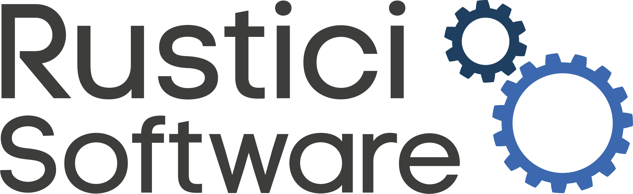
Modernize Your Training by Migrating
Legacy SCORM Content to cmi5
Brian Miller,
Rustici Software

Slide 2
Learning Objectives
At the end of today’s tutorial, you will be able to...
Understand what cmi5 is, how it relates to SCORM (Sharable Content Object Reference Model®) and xAPI (Experience API), and the state of adoption today.
Evaluate whether cmi5 is the best standard for your learning content and goals.
Describe where cmi5 fits into Department of Defense Instruction (DoDI) 1322.26 and Advanced Distributed Learning’s (ADL) Total Learning Architecture (TLA).
Develop new cmi5 content by migrating existing SCORM content to cmi5 to transform your training.
Discover open source cmi5 tools that are freely available and will help you with creating learning and training content.
Notes:
Tutorial objectives
We’ll focus today’s tutorial on why you would want to migrate your existing, legacy eLearning content to the more modern cmi5 specification and the newly available tools that can help you during content migration.

Slide 3

What are eLearning Standards
Standards
Standards govern how different content, platforms, and systems “talk nicely” to one another and how to share and transfer information.
Specifications
Specifications are the rules and requirements that developers need to implement in order for courseware and systems to be interoperable.
Notes:
Specifications and standards are all around us now, you may be familiar with USB, Wifi, ISO 8601 (timestamps) or ISO 27001 (information security). Generally they are created by groups of interested parties (individuals and organizations) which leads to peer review and the need for multiple versions.
When the learning and training industry transitioned from courses and content that were computer-based, like CDs or floppy disks, to web-based online training, it became clear that there were challenges in terms of playing content and interoperability between systems. As more systems were introduced, organizations found themselves having to rebuild content to adapt courses to the context of each new system, which became both inefficient and expensive. A more portable and scalable solution was needed to support the reusability of content across systems. In 2000, the Advanced Distributed Learning (ADL) Initiative created the SCORM standard to address e-learning interoperability, reusability, and durability challenges.

Slide 4
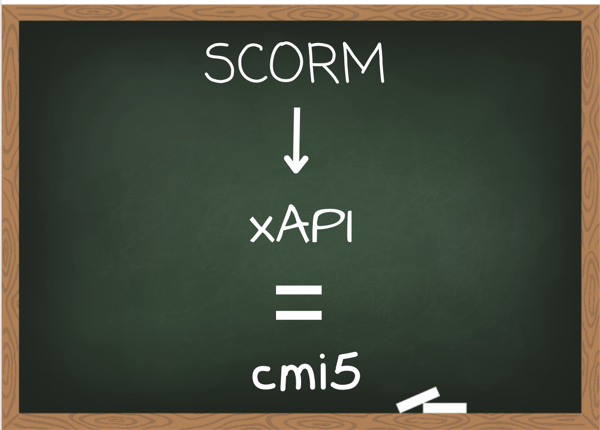
What are the eLearning Standards
Learning objective 1
Understand what cmi5 is, how it relates to SCORM (Sharable Content Object Reference Model®) and xAPI (Experience API), and the state of adoption today.
Notes:
Before we talk about moving from SCORM to xAPI with cmi5, we need to discuss what the standards and specifications are, along with how each is different. Outside of academia, SCORM is the prevalent standard, however SCORM has several distinct limitations. The DoD is currently moving to modernize training through xAPI and cmi5.

Slide 5
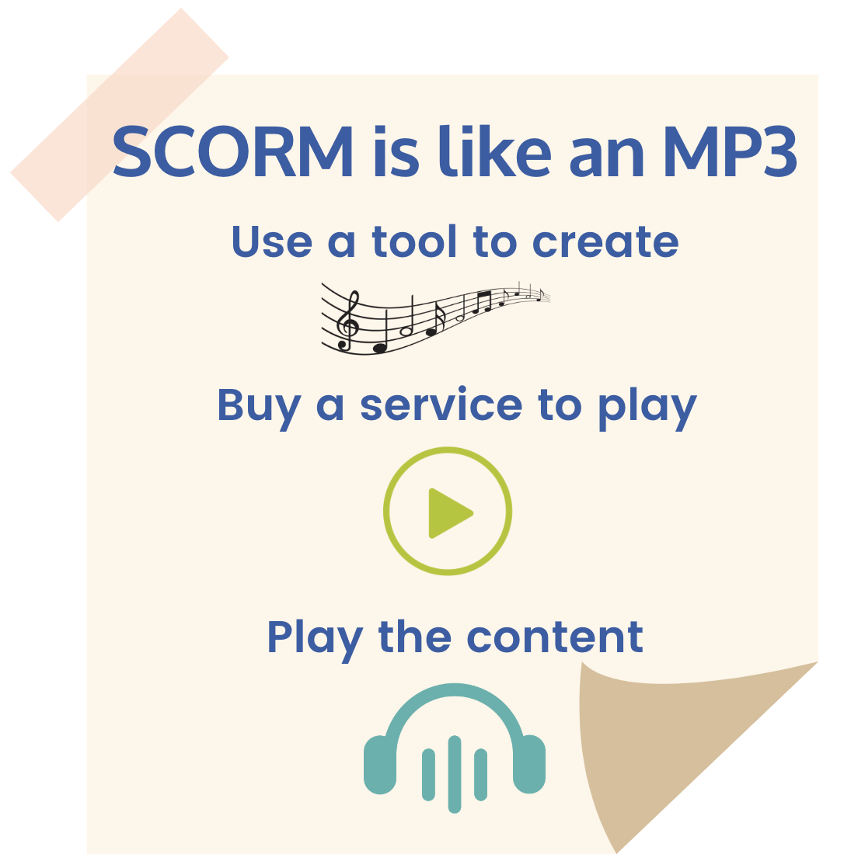
What is SCORM?
The de facto eLearning standard
Set of technical specifications.
Provides an interface that allows eLearning content and Learning Management Systems (LMS) to work together.
Any SCORM conformant content should play in any SCORM conformant LMS.
Standard page-turner courses played within an LMS.
Can include an assessment.
Tracks performance, progress, and interactions.
Notes:
What is SCORM.
Why SCORM matters.
MP3 analogy.

Slide 6
What is a Learning Management System
Learning Management Systems (LMS)
LMSs are software applications designed to track, report, automate, and deliver online courseware. They’re designed to help deliver and track learning and training materials to learners.
Traditional LMSs still play a key role in many learning ecosystems and are core to learning and training departments.
Notes:
Although content is what is delivered by an LMS, the learner is the central figure to an LMS. Bringing a learner (trainee) together with an experience is the initial role of the LMS. All of the modern features of LMSs, analytics, visualizations, pathing, etc. still stem from a learner experiencing training content.
Note: when we say LMS we really mean any sort of learner centered browser experience, so can include any sort of content launch system, such as an LXP, etc.
LMSs are still relevant today and play a key role in many learning ecosystems.

Slide 7
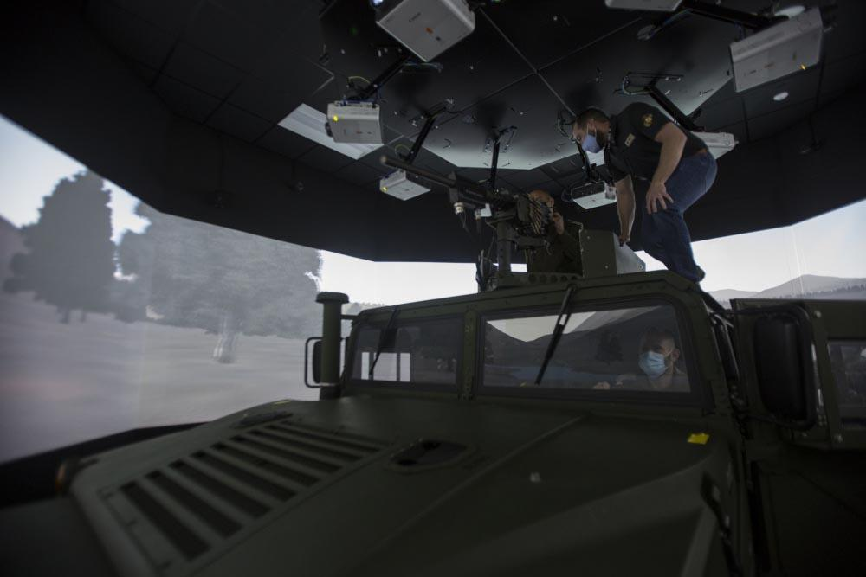
What is xAPI?
xAPI is also known as the Experience API
After 10 years as a specification, it is now an IEEE standard.
Enables tracking data about any type of real-world experience.
Permits transferring data between different systems.
Allows correlation of learning data with other business metrics.
Convoy simulator - U.S. Marine Corps photo by Sgt. Jesus Sepulveda Torres.
Notes:
Notes: Standardization completed in 2023.

Slide 8
What is a Learning Record Store (LRS)
An LRS is a requirement to take advantage of xAPI
Defined in the xAPI standard as: A server (i.e., system capable of receiving and processing web requests) that is responsible for receiving, storing, and providing access to Learning Records.
Essentially, an LRS is a database that receives, stores, and returns xAPI Statements.
LRSs also validate the format of the xAPI Statements to ensure only Statements that are conformant to the standard are accepted and retained.
Notes:
You’ll notice this is a very minimal definition. It’s intentional. Because xAPI was always intended to enable learning data to be communicated between a wider and wider set of system types, the specification focuses on the communication and high-level data model and leaves everything you might do with that data up to the system and the user.

Slide 9
What are xAPI Profiles
About xAPI Profiles
xAPI has the ability to capture nearly limitless data, and without specific rules for how to interpret the information, the data can be analyzed incorrectly.
The xAPI Profile Specification was created to overcome this possibility by defining xAPI data rules. This data can help learning and training professionals better understand the behaviors of their learners.
Essentially, xAPI Profiles are roadmaps that drive successful implementation and semantic interoperability by providing a common vocabulary.
Notes:
What are profiles
Why are profiles important
Give an example of popular profiles, like the video profile.

Slide 10

What to Know About xAPI 2.0
xAPI 2.0 is now an IEEE standard
March 30, 2023, IEEE approved “IEEE 9274.1.1-2023” the “IEEE Standard for Learning Technology— JavaScript Object Notation (JSON) Data Model Format and Representational State Transfer (RESTful) Web Service for Learner Experience Data Tracking and Access.”
Being an IEEE standard means that it is recognized on the same level as the WiFi standard we discussed earlier. xAPI 2.0 is also the first open source specification to become an IEEE standard.
If you’re currently using xAPI, or starting to explore the idea, the biggest changes are that items that were previously listed as “shoulds” are now requirements.
Notes:
Comment that the key is that the standards path is important, but leveraging the 1.x version will still position you well.

Slide 11
Overview of eLearning Standards Before cmi5
SCORM
✔ Loads into an LMS and plays in a browser
✔ Tracking and reporting on completion, pass/fail, score, and duration (“Big 4”)
✘ Can’t work outside browser
✘ Challenging on mobile
xAPI
✘ Weak LMS integration
✘ No normalized information model (no direct “Big 4”)
✔ Use outside a browser
✔ Arbitrary data collection
Notes:
Talk about 5 pillars: package, launch, data model, transfer protocol, information model.
What are the differences between SCORM and xAPI - explain
There’s a large divide between SCORM and xAPI. You’re moving from a very structured standard to one where the options are virtually limitless. But there’s a way to bridge that gap.

Slide 12
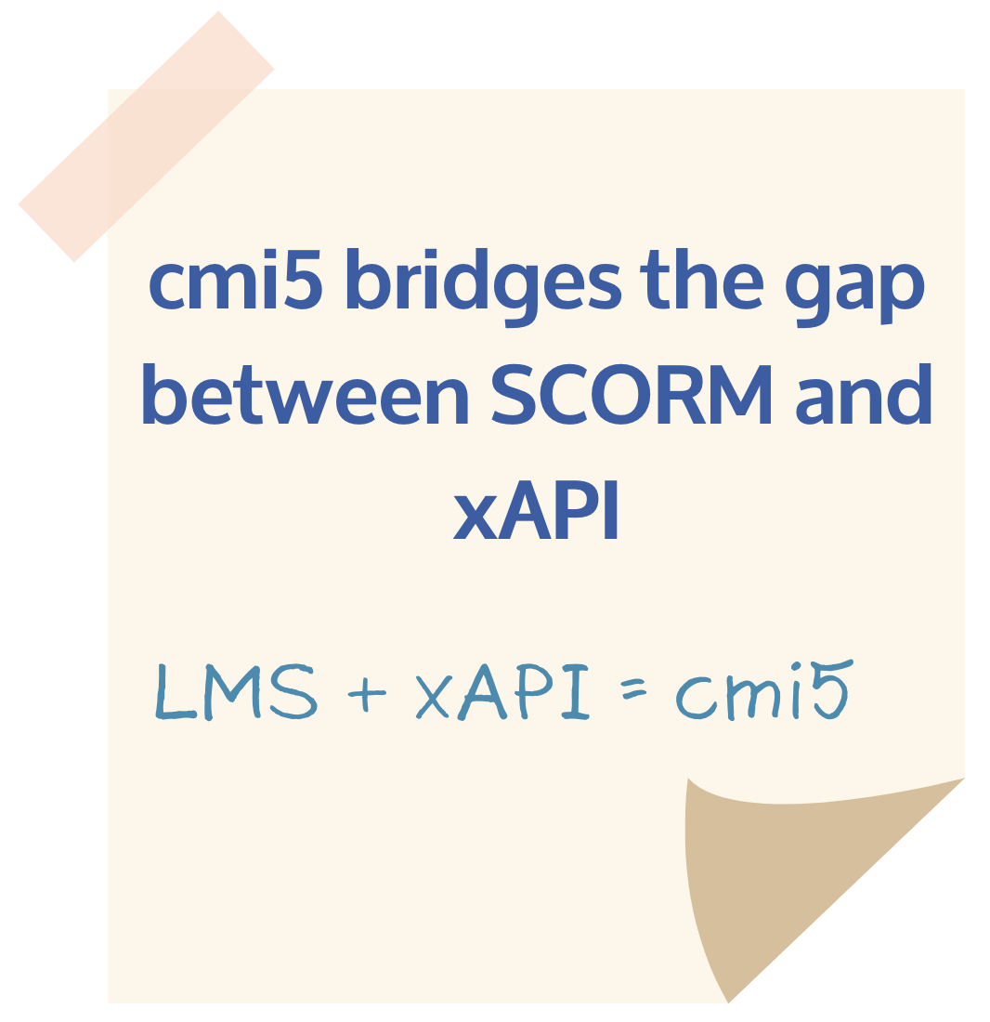
About cmi5
cmi5 is an xAPI Profile
An extra set of rules
Ensures plug and play interoperability between learning content and LMS systems
Designed specifically for when a learner launches from the LMS user interface
Components
Course package/structure
Learning Management System (LMS)
Learning Record Store (LRS)
Assignable Unit (AU)
Notes:
cmi5 specifically solves the use case of using xAPI with an LMS. xAPI doesn’t specifically define rules around launching content like SCORM provided and to ensure that content plays the same way in different systems. cmi5 bridges that gap by providing rules for launch and reporting.

Slide 13
eLearning Standards Timeline
Standards help eLearning content and systems play well together
AICC
IMS LTI 1.1
cmi5
xAPI 2.0
Aviation Industry Computer-Based Training Committee
Learning Tools Interoperability
Name of the xAPI Profile
Became an IEEE standard
1998 |  | 2000 |  | 2009 | 2010 |  | 2013 |  | 2016 | 2021 | 2023
xAPI
cmi5
SCORM
Experience API
(originally Project Tin Can)
TLA
Sharable Content Object Reference Model versions released
Project CATAPULT
Total Learning Architecture introduced
Notes:
How did we get to where we are today?

Slide 14
Where Does cmi5 Fit into the Bigger Picture?
cmi5
Bridges the gap between legacy systems and modern platforms who want to support cmi5 in their products
Total Learning Architecture
Data standards, Technical Specifications, and Business Rules that enable an enterprise-wide data strategy for DoD’s training and education community
Legacy (SCORM) tools
cmi5
TLA
Project CATAPULT
xAPI
EDLM
cmi5 Advanced Testing Application and Player Underpinning Learning Technologies
Enables conformance testing of cmi5 content and tools to support procurement and encourage xAPI and cmi5 adoption
Experience API
A learning technologies interoperability specification that describes communication about learner activity and experiences between technologies
Enterprise Digital Learning Modernization
Data Management infrastructure to enable federated digital learning ecosystems including the enterprise course catalog and enterprise learner record repository
Notes:
Talk about ADL’s and DoD vision for modernizing content.
As I said earlier, cmi5 bridges the gap between SCORM and xAPI. Here’s a visualization of how that looks. The DoD is moving from traditional, page-turner courses, to more modern technologies with ways to track learners through their lifelong learning journey.

Slide 15
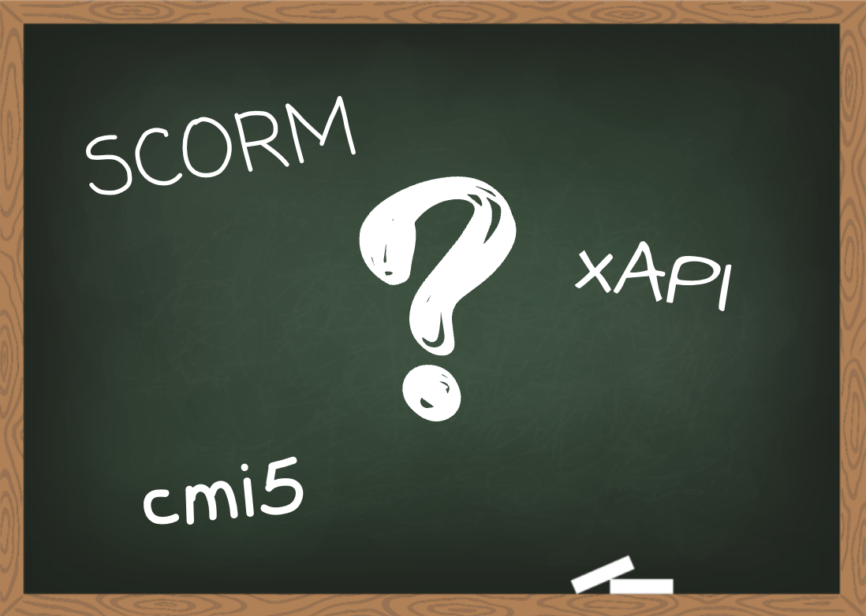
When is cmi5 the right fit
Learning objective 2
Evaluate whether cmi5 is the best standard for your learning content and goals.
Notes:
We’ve mentioned 3 standards so far, SCORM, xAPI and cmi5. We’ll now talk about deciding which one is best for your needs.

Slide 16
SCORM vs xAPI vs cmi5
Features | SCORM | xAPI | cmi5
Defined content launch | ✔ | ✘ | ✔
Track “anything” | ✘ | ✔ | ✔
Normalized reporting | ✔ | ✘ | ✔
Mobile applications | ✘ | ✔ | ✔
Distributed content | ✘ | ✔* | ✔
Data portability | ✘ | ✔ | ✔
Extensibility | ✘ | ✔ | ✔
Normalized completion criteria | ✔ | ✘ | ✔
Multiple lesson support | ✔ | ✘ | ✔
Notes:
Highlight the key differences between the three.

Slide 17
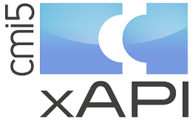
cmi5 Goes Beyond SCORM and xAPI
cmi5 also includes these capabilities beyond SCORM and xAPI
Structured launch capabilities outside an LMS
Wider “session” structure
Firmer profile control to improve “Big 4” reporting
Waiving, with structured tracking
Control of exit behavior
Launch remote content inside an LMS context
Notes:
4 key pieces (capture data, package, data model, information model)... how are we telling the real story of how the learner is taking this training.
“cmi5 really improves on the “information model” piece, while using the far more flexible “data model” that xAPI provides over SCORM.”
cmi5 adds real definition to tracking

Slide 18
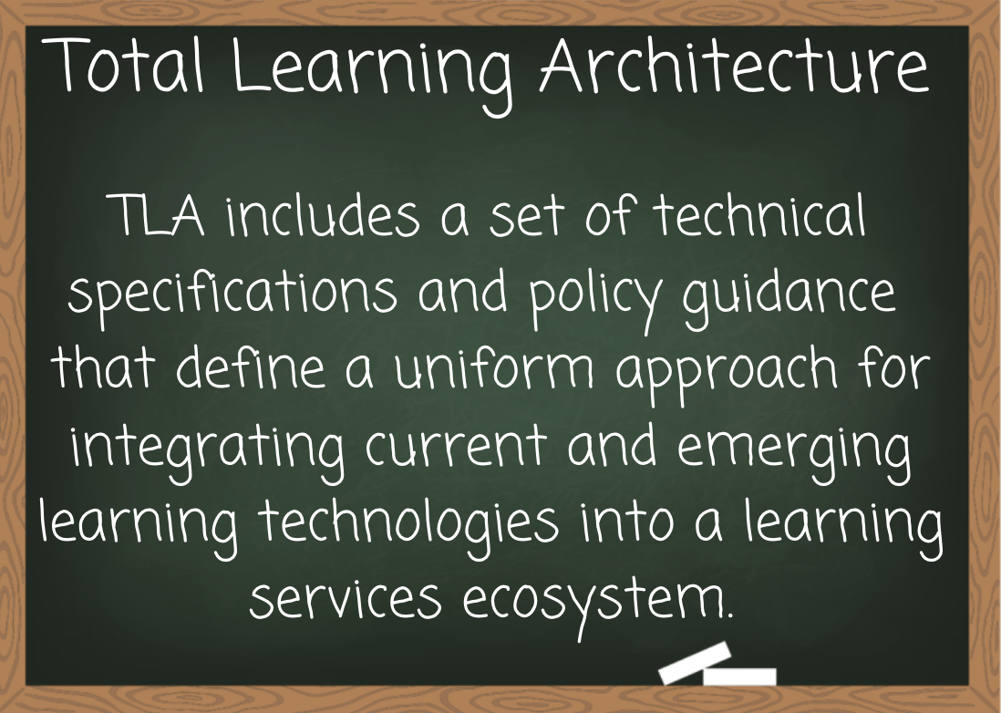
When to Use cmi5
Learning objective 3
Describe where cmi5 fits into Department of Defense Instruction (DoDI) 1322.26 and Advanced Distributed Learning (ADL) Initiative’s Total Learning Architecture (TLA).
Notes:
cmi5 is a preferred specification for eLearning standards and is listed in the Dept of Defense Instruction 1322.26 fungible resources. The TLA is ADL’s vision for how a DoD wide learning ecosystem can be transformed to be learner centered in such a way to provide for efficient building and maintaining of the workforce

Slide 19
TLA and cmi5
“From a modernization perspective, the cmi5 specification and xAPI standard are among the many interdependent components of the Total Learning Architecture (TLA) needed to enable the future DoD-wide learning ecosystem.”
-Advanced Distributed Learning Initiative
Notes:
More about ADL’s TLA.
cmi5 is an integral piece of the TLA which is ADL’s vision for how a DoD wide learning ecosystem can be transformed to be learner centered in such a way to provide for efficient building and maintaining of the workforce

Slide 20
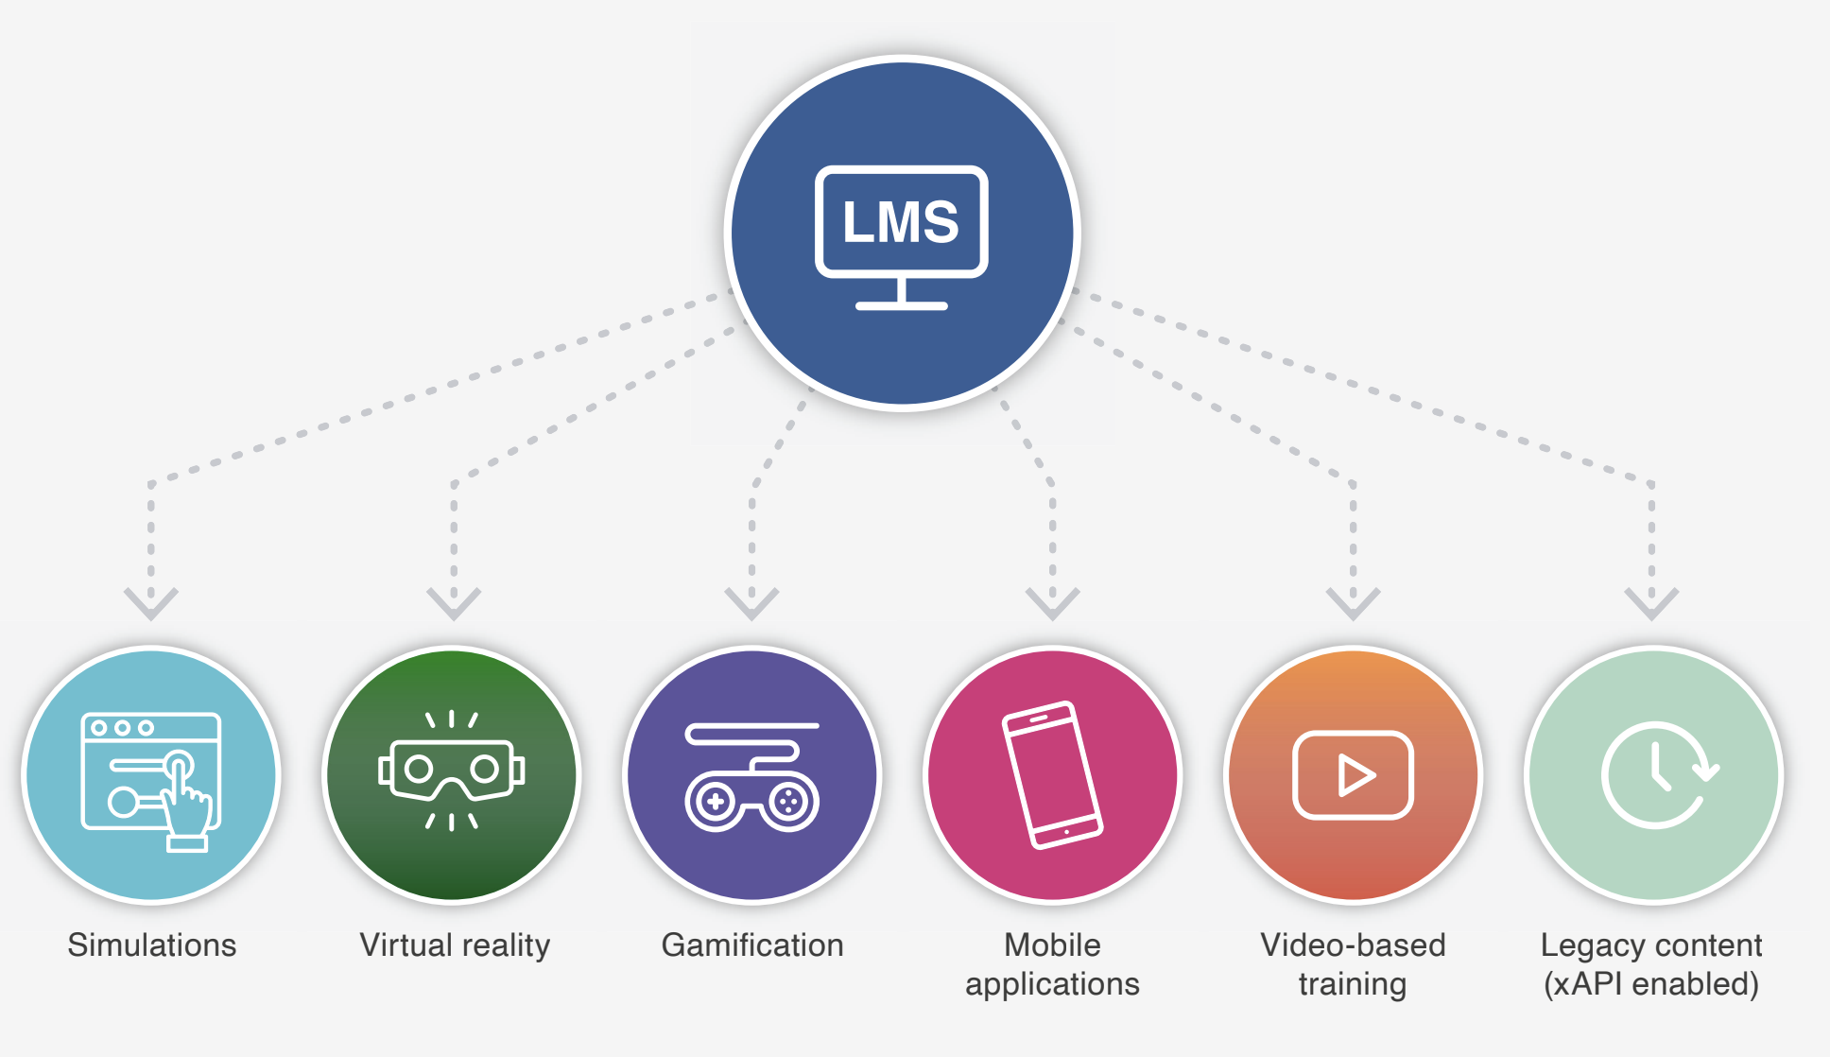
Why cmi5?
From: cmi5 Best Practices Guide: From Conception to Conformance
Notes:
cmi5 is specifically designed to solve the LMS use case where the learner needs to launch xAPI-enabled content from an LMS-based system. What might this look like?

Slide 21

cmi5 Potential Use Cases
Use virtual and augmented reality training and track with an LMS.
Photo: U.S. Army Reserve soldiers from the 82nd Airborne Division used the latest prototype of the Integrated Visual Augmentation System (IVAS) during a training exercise at Fort Pickett, VA.
Notes:
AR and VR help service members train “anywhere” in the world with digital technology. cmi5 helps to track that training through their lifelong learning journey.

Slide 22
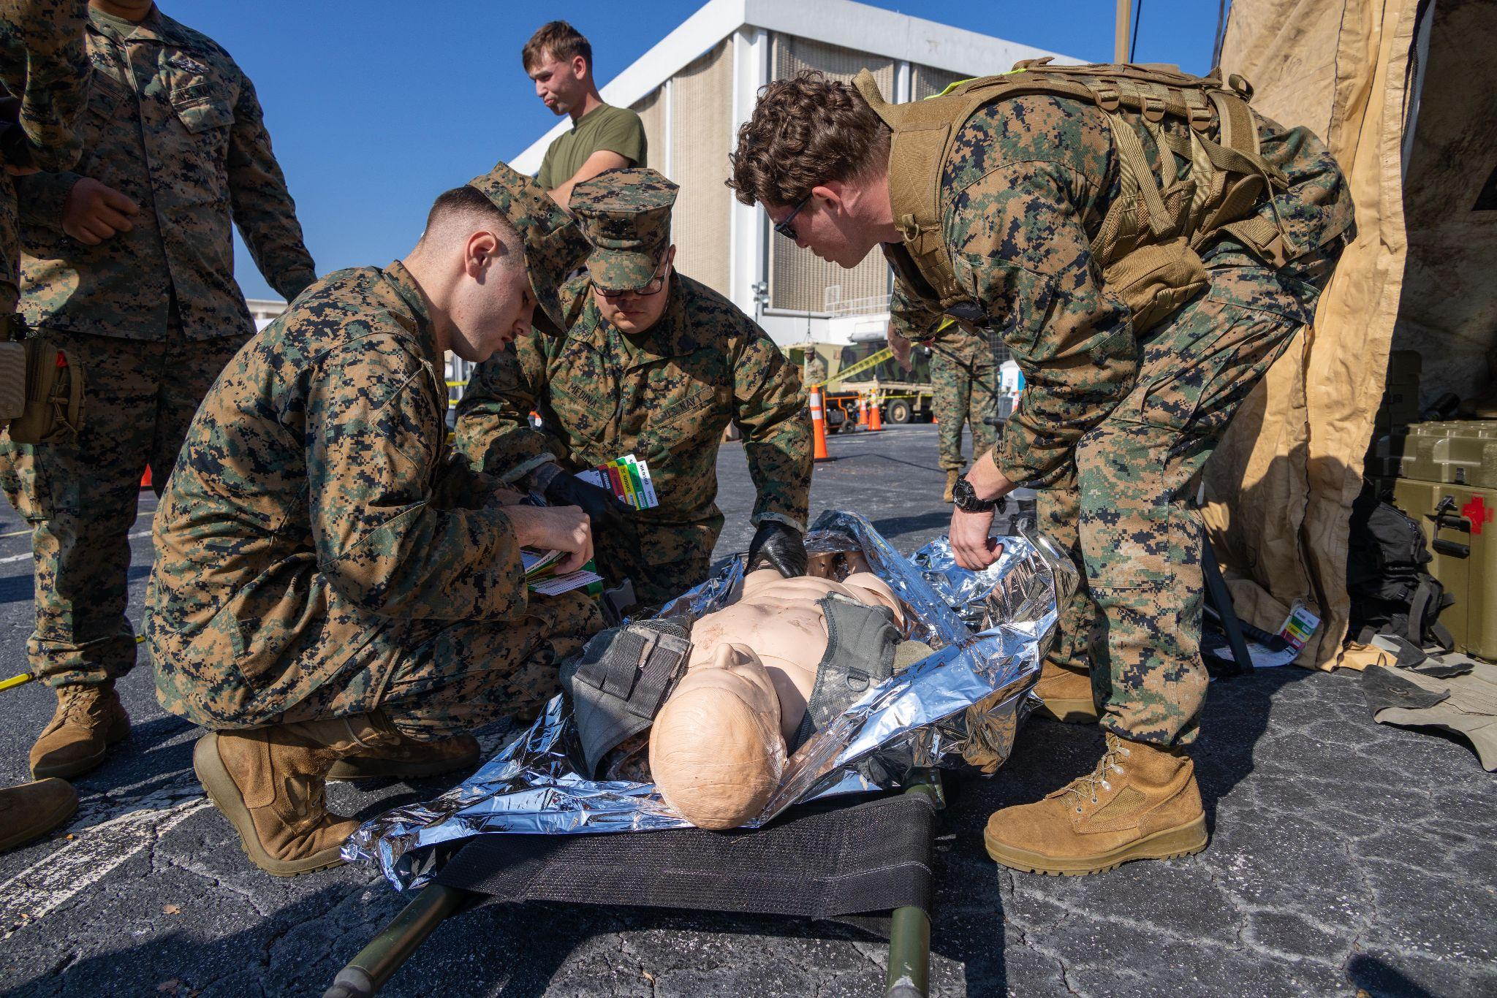
cmi5 Potential Use Cases
Better understand training data with the ability to track “anything.”
Photo: U.S. Navy corpsmen with Chemical Biological Incident Response Force administer a medical examination on a simulated casualty at a medical tent during exercise Vista Forge in Atlanta, GA.
Notes:
CPR dummy as an additional example, compression depths, breath volumes, cadence, etc.
Mention human performance data.

Slide 23
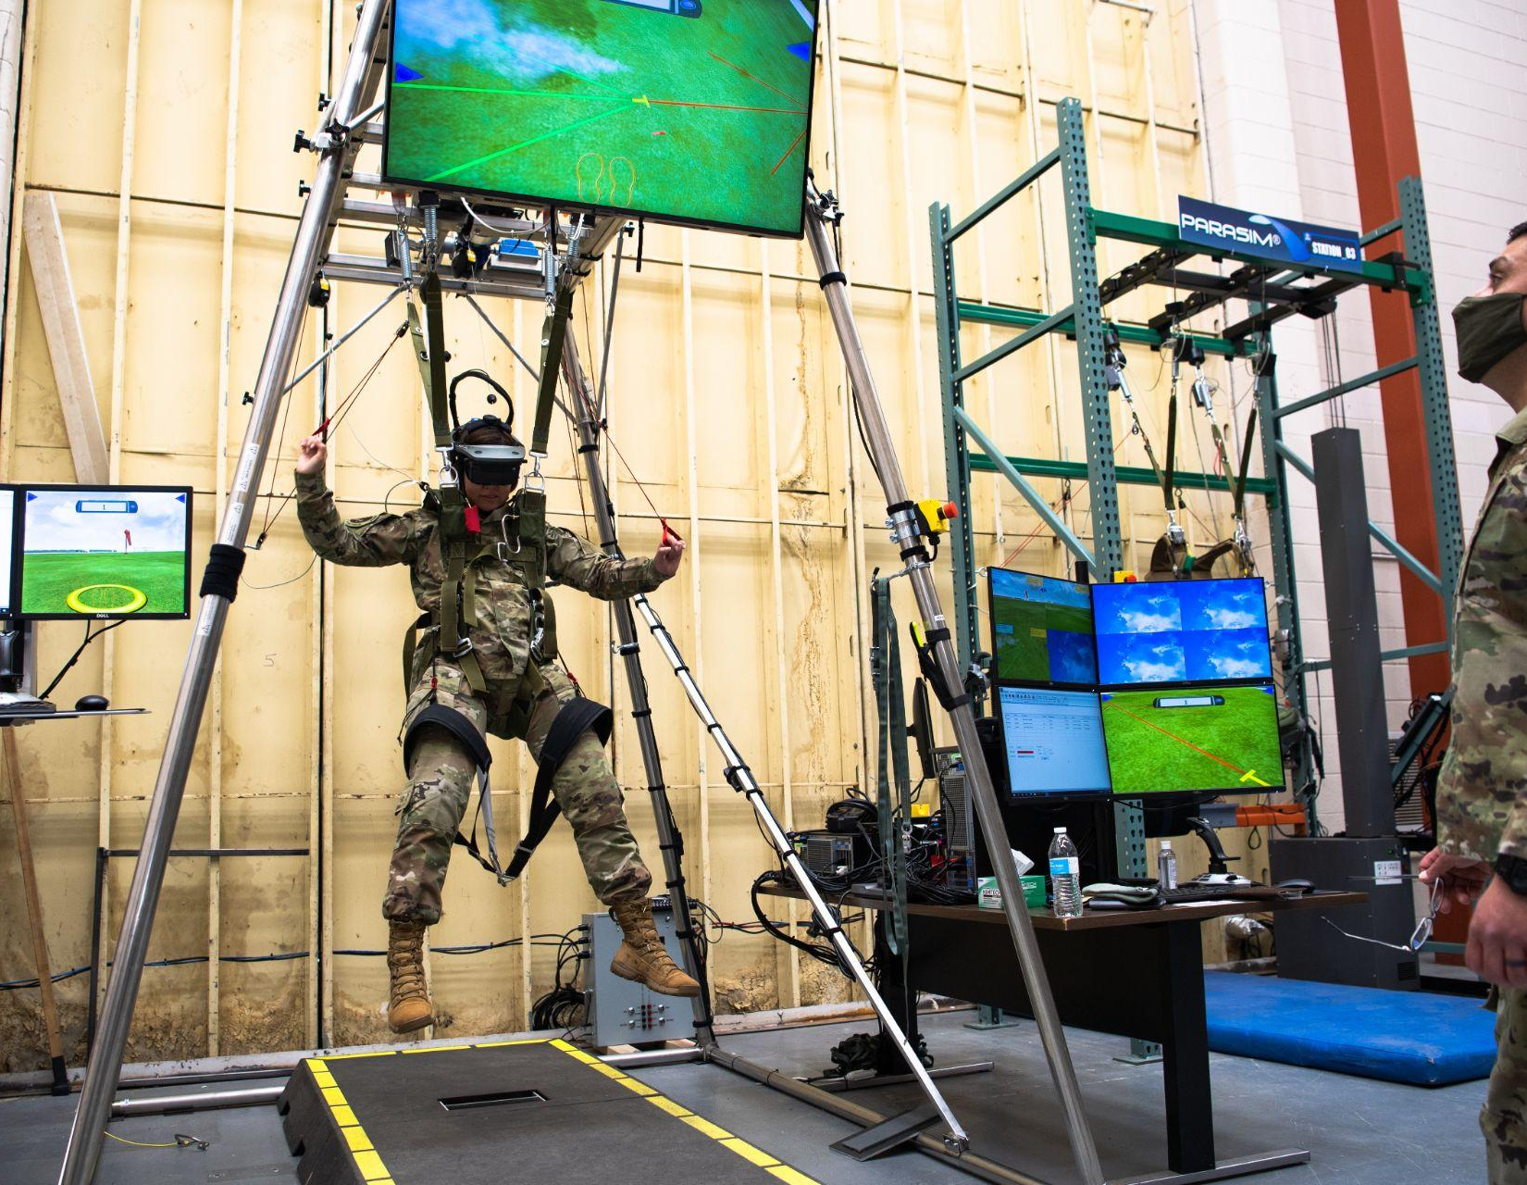
cmi5 Potential Use Cases
Record their lifelong learning journey and experiences.
Photo: Chief Master Sgt. of the Air Force JoAnne S. Bass uses the 2nd Operational Support Squadron’s parachute simulator during her visit to Barksdale Air Force Base, LA. (U.S. Air Force photo by Airman 1st Class Jacob B. Wrightsman).
Notes:
Include example of reservists and their potential skill set outside of what they may do officially for a service.

Slide 24
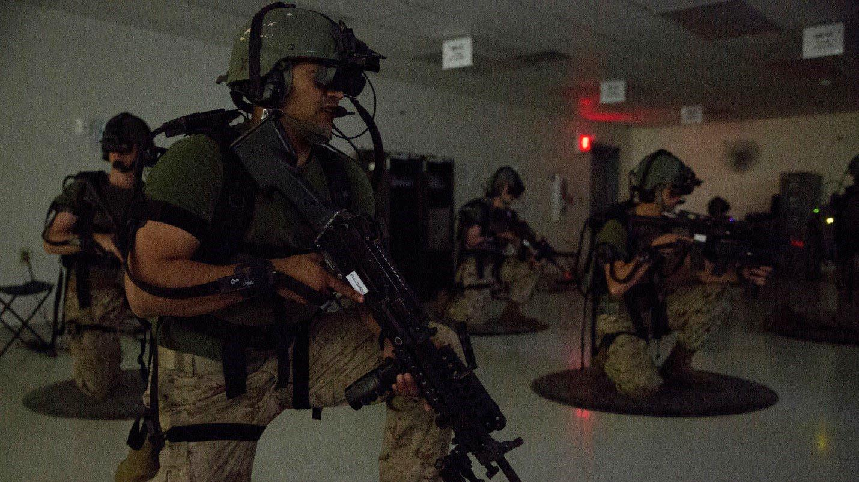
cmi5 Potential Use Cases
Train safely in different scenarios and track with cmi5.
Photo: Motor Transport Marines with 4th Medical Battalion, 4th Marine Logistics Group, Marine Forces Reserve, train on a virtual patrol mission during Exercise Global Medic at Fort McCoy, WI.
Notes:
Increased data capabilities can lead to improved experience development. The feedback loop that instructional designers have longed for.

Slide 25
How to Pick the Best Learning Standard
SCORM
Answers fall mostly in the blue on the left side.
cmi5
Answers are a mix of both colors.
xAPI
Answers fall mostly in the gray on the right side.
Which one is best for your content?
Training Activity Type
LMS
Mobile Apps
Serious Games
Simulations
How do Learners Access?
LMS
Launching System
Directly from Activity
Types of Data
Big 4
Simple Interactions
In-Depth Interactions
Arbitrary Data
Notes:
A sliding scale to see which learning standard is the right fit for your content. You’ll use the gradient scale to determine what standard is best for your content.
Left side (blue) - SCORM is probably the best option for
Simple training courses (typical eLearning, page turner)
Launching from an LMS
Less amount of effort
Captures just essential data
If your needs fall mostly in the blue side, then SCORM might be the best option.
Right side (gray) - xAPI is probably a good fit
Not using an LMS
Advanced learning activities
Capturing lots of data
If your needs fall mostly in the gray side, then consider using xAPI.
Middle - Mix of the two (cmi5) - if you’re content falls somewhere in the middle or on both sides, then cmi5 is the best option.
If you end up with a mix of blue and gray, then you’ll want to choose cmi5 as your preferred specification.

Slide 26
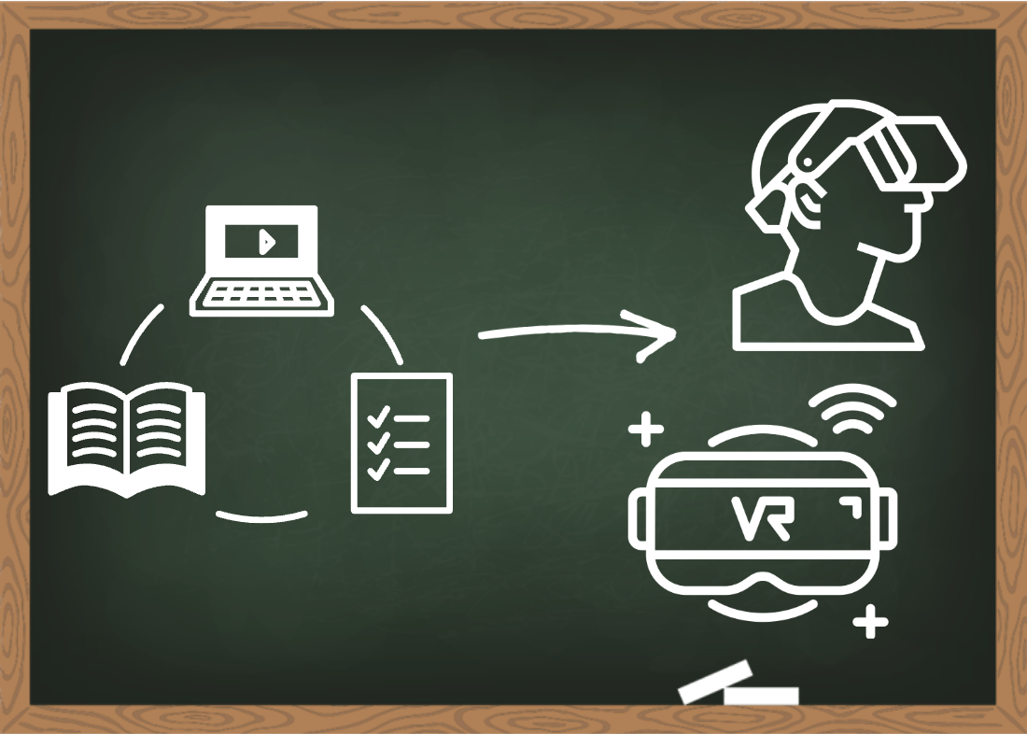
Migrating to cmi5
Learning objective 4
Create new cmi5 content and migrate existing SCORM content to cmi5 to transform your training.

Slide 27
When to Migrate Legacy Content
Revising or updating existing content. This is the perfect opportunity to migrate to cmi5 when you’re updating existing content.
Capturing more detailed learning data from existing courseware. cmi5 provides more detailed data about what happens inside the course or learning activities beyond what the SCORM standards support.
Modernizing your training per the DoDI 1322.26 fungible resources. cmi5 is the recommended path toward replacing SCORM and is an approved and preferred specification in the DoDI fungible resources.
Notes:
walk through the top reasons to migrate

Slide 28
Which Content to Migrate
What content should I start migrating that will have the biggest impact?
Content that needs to be updated already.
Content that is seen by a lot of learners.
When there are benefits to having more detailed learner data.
When you want to use newer technologies.
Content migration is a process, but you don’t have to migrate everything at once. Starting with these points will see the biggest return on investment.
Notes:
Migrating your existing content to cmi5 may be a process depending on how much you want to convert. Remember, you don’t have to migrate everything at once. Start with content that matches these points to have the biggest return on your investment.

Slide 29
DoD Recommended Migration Options
DoD Components shall transition to using the cmi5 specification and the xAPI standard according to the following prioritized list of scenarios: DoD Components shall:
Option 1: Acquire and maintain a cmi5 conformant LMS and an xAPI conformant LRS.
Option 2: If Option 1 is not possible, DoD Components should maintain their SCORM conformant LMS and use with an xAPI conformant LRS.
Option 3: If a SCORM conformant LMS is not possible, then the DoD Component should acquire and maintain a standalone xAPI conformant LRS.
  NOTE: It is possible to leverage an LMS in a manner that is not deploying learning or training content, e.g., for training event administration or other data recording. In these cases, xAPI is recommended to track events, but the SCORM requirement is waived.
From: DoDI 1322.26 References section 3.3.
Notes:
The instruction established by the ADL for acquisition of software components related to eLearning has been updated in 2023.

Slide 30
cmi5 Concepts to Help with Migration
In this section, you’ll...
Compare cmi5 terminology to SCORM terminology.
Identify the key elements in the cmi5 course package and structure.
Apply this knowledge when creating and migrating courses.

Slide 31
SCORM to cmi5 Terminology
SCORM | cmi5
Manifest | Course Structure
Sharable Content Object | Assignable Unit (AU)
Resource HREF | AU URL
Activity (SCO) Identifier | Publisher ID
Aggregation / Cluster | Block
Launch Data | launchParameters
Rollup (partial) | moveOn
Notes:
We’re starting from an assumption of SCORM familiarity because of the audience. If you’ve used AICC previously this should be even more familiar since cmi5 is a closer ancestor of that work.
If you’re familiar with creating SCORM content, here are some of the most common concepts and what the concepts are called in cmi5.

Slide 32
Course Package
What is the course package?
An XML file with a course structure that’s a standalone file or in a ZIP file.
Includes:
The course structure file
Links to Assignable Units (AUs)
Can include any additional static assets, like images, CSS, videos, PDFs, etc.
How is this different from SCORM?
cmi5 allows remote content.
Supports 1,000s of AUs.
Satisfaction criteria is clearly defined.
Control over how content is presented to learner.

Slide 33
Assignable Units (AUs)
AUs are separately launchable content pieces that collect and send learner data.
AUs include the concepts of:
Completion
Success
Score
Duration
The AU:
Launched from an LMS.
Communicates via xAPI directly with the LRS.
Formats all data according to the defined vocabularies.
Sends an “Initialized” and “Terminated” statement to mark the learner’s session.
Notes:
In SCORM, this is a SCO (sharable content object)
Sends an “Initialized” and “Terminated” statement to mark the learner’s session.

Slide 34
moveOn Criteria
moveOn criteria determines overall course satisfaction or if prerequisites were met.
This criteria tells the LMS that the learner has satisfied the AU or Block and can “move on” to the next AU.
Include moveOn criteria for each AU in a course structure.
Not specifying the moveOn criteria will:
Mark the AU satisfied during registration creation.
If an AU does not have a moveOn criteria specified, and the course only has a single AU, then the course would be satisfied at registration creation.
Notes:
Core cmi5 concept.
How the system knows that the learner satisfied the expectations of the AU, whether that is via completion or success.
Including moveOn criteria for each AU is a best practice.
Core cmi5 concept.
This is the odd case for very simple content, or if the content is complicated beyond the normal LMS capabilities.

Slide 35
“masteryScore”
Optional mechanism to control passed or failed status.
If the course is scored and has a “masteryScore” then:
“masteryScore” must be between 0.0 and 1.0.
AU sends a “Passed” statement if the learner met or exceeded the “masteryScore”.
AU sends a “Failed” statement if the learner did not meet the “masteryScore”.
Notes:
Core cmi5 concept.
masteryScore indicates the minimum level needed to be achieved to convey mastery in a particular area. masteryScore is interesting in cmi5 because it can be altered right up until the launch point and can therefore be changed across sessions, but still includes full audit capability because of the data capture requirements.

Slide 36
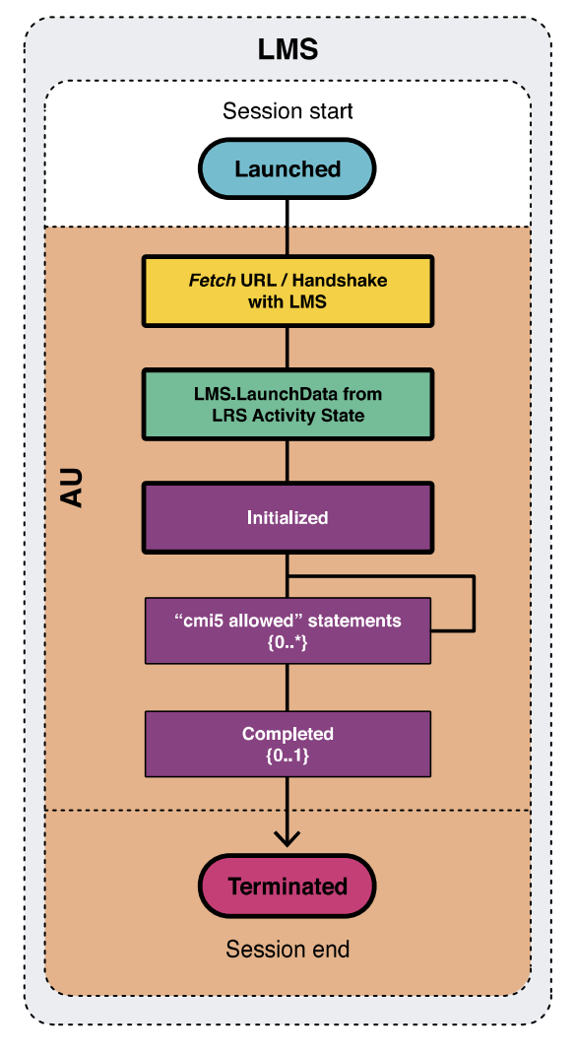
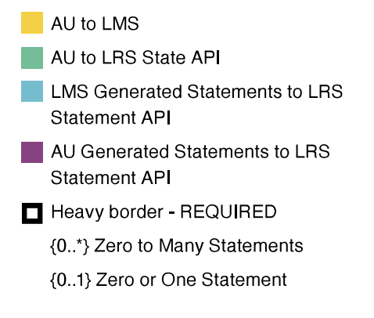
Session Structure
From: cmi5 Best Practices Guide: From Conception to Conformance
Notes:
Talk through what happens when a learner takes a course.

Slide 37
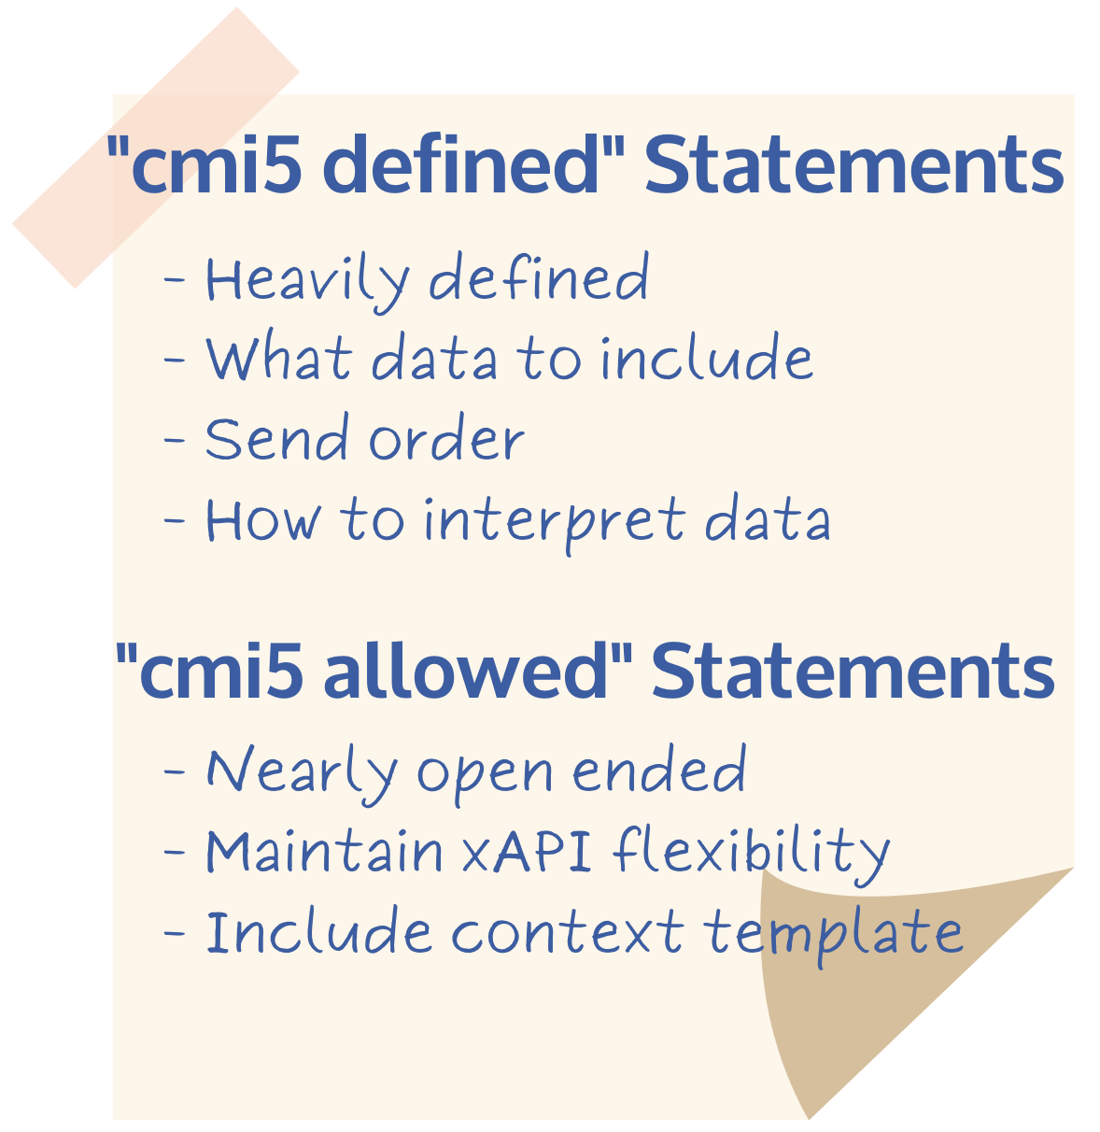
Extensibility
Extensibility
cmi5 has “defined” statements for specific purposes.
The AU may send additional “allowed” (custom) statements.
All statements must contain cmi5 identification and be issued during the session.

Slide 38
cmi5 and Sequencing
Two extensions to cmi5 allow behaviors from “sequencing”
Requires
A property that defines a specified list of AU’s must have met their moveOn criteria before a given AU is accessible by the learner
Effectively allows for an LMS to interpret and “gate” content
  Can’t access an AU or Block UNTIL set of “requires” are met
Collateral credit
A property that defines a List of Block and AUs that the LMS MUST
issue Waived statements when a given AU is satisfied
Effectively allows the LMS to grant credit for satisfied content
  Enables Testing Out or Alternate Delivery Mechanisms
Notes:
Though it really was never as accessible as hoped, SCORM 2004 came with very advanced sequencing rules to allow for the shared SCOs to be combined in complicated ways. The problem was that SCORM 2004 set out to handle all of the most complicated scenarios which meant few people were able to leverage it. The cmi5 approach with a set of extensions was specifically targeted to the 80% use case. In other words, could the most common scenarios be handled well without overly complicating their usage. These two extensions are thought to capture that use case while being only minor additions to the requirements for an LMS.
These extensions are planned to be included directly in the next major release of cmi5.

Slide 39

Tools for Migrating to cmi5
Learning objective 5
Discover open source cmi5 tools that are freely available and will help you with creating learning and training content.
Notes:
What are some open source tools that can help the process?

Slide 40

Authoring Tools
Starting the process
If your content is already in a tool where it can be re-exported, that’s the simplest path.
Notes:
This is the easy path.

Slide 41
Open Source Libraries
cmi5 Client Library. The client library for creating cmi5 content to work with a cmi5 conformant LMS. https://github.com/adlnet/cmi5-Client-Library
cmi5.js. JavaScript implementation of cmi5 AU runtime. https://github.com/RusticiSoftware/cmi5.js
cmi5 Profile Library. A JavaScript library for enabling learning content to speak to learning systems. https://github.com/xapijs/cmi5
All tools are open source

Slide 42

Migrating Legacy Content
Course Templates
Licensed under the Apache License, Version 2.0
Notes:
Easiest way to get started if an authoring tool isn’t sufficient is by using the sample cmi5 course templates as a guide.

Slide 43
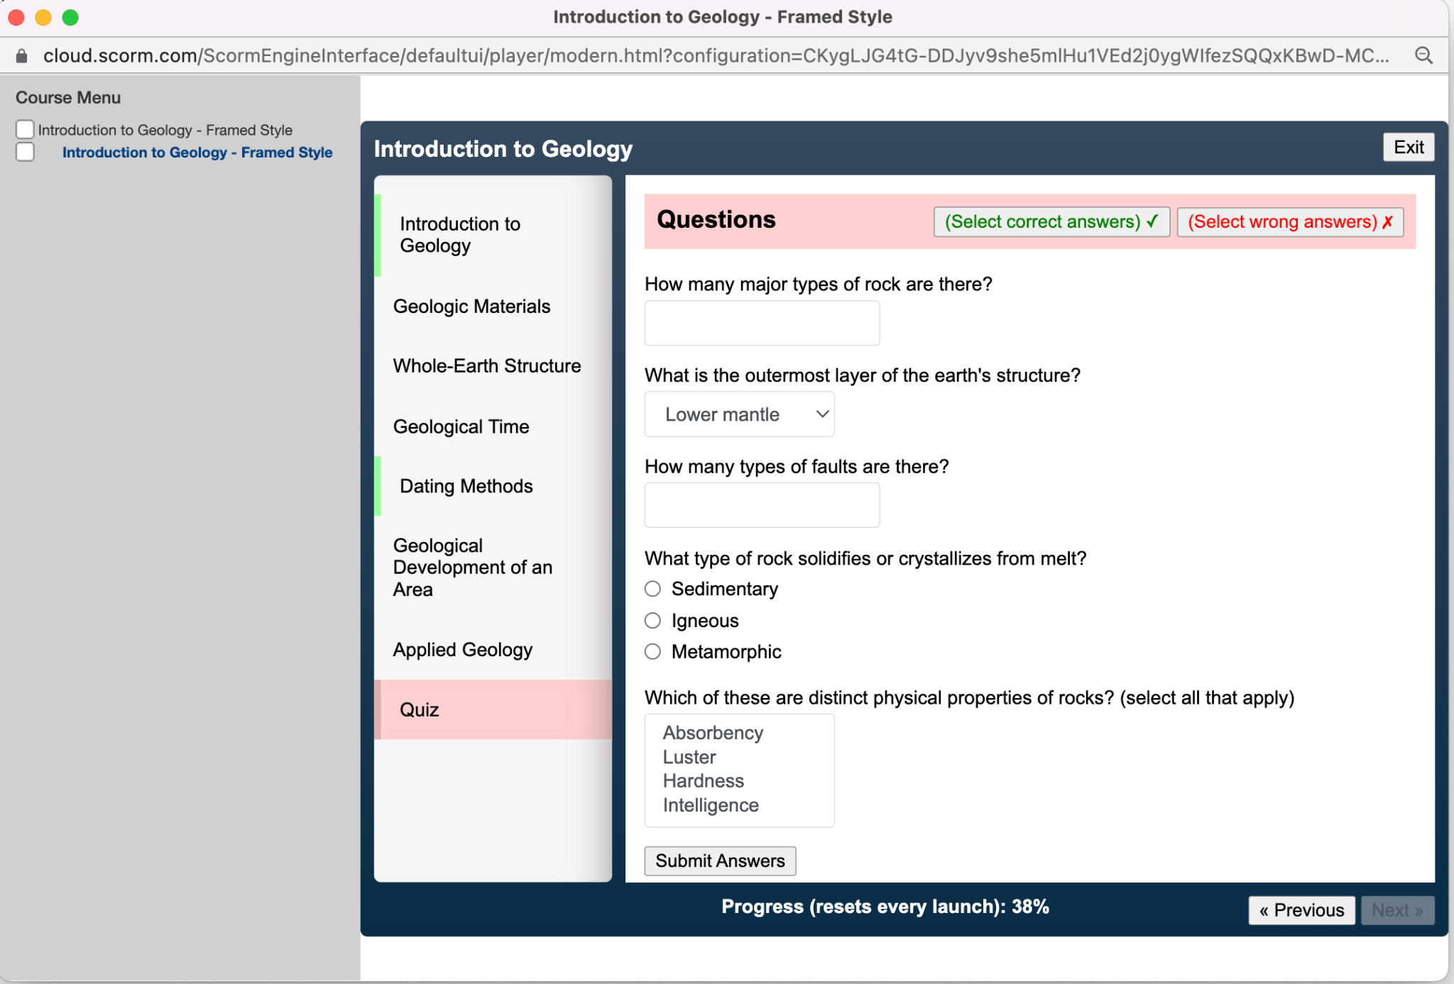
Migrating Legacy Content
Simple Single AU Template
Best for very basic, traditional courses with a quiz at the end.
Can be used with a video module.
Course is “Satisfied” when the course is “Completed” or “Passed”.
Available in Framed and Responsive styles.
All course template images are from CATAPULT cmi5 sample courses.
Licensed under the Apache License, Version 2.0
Notes:
If your course is a basic, traditional page-turner, use the Simple Single AU template.

Slide 44
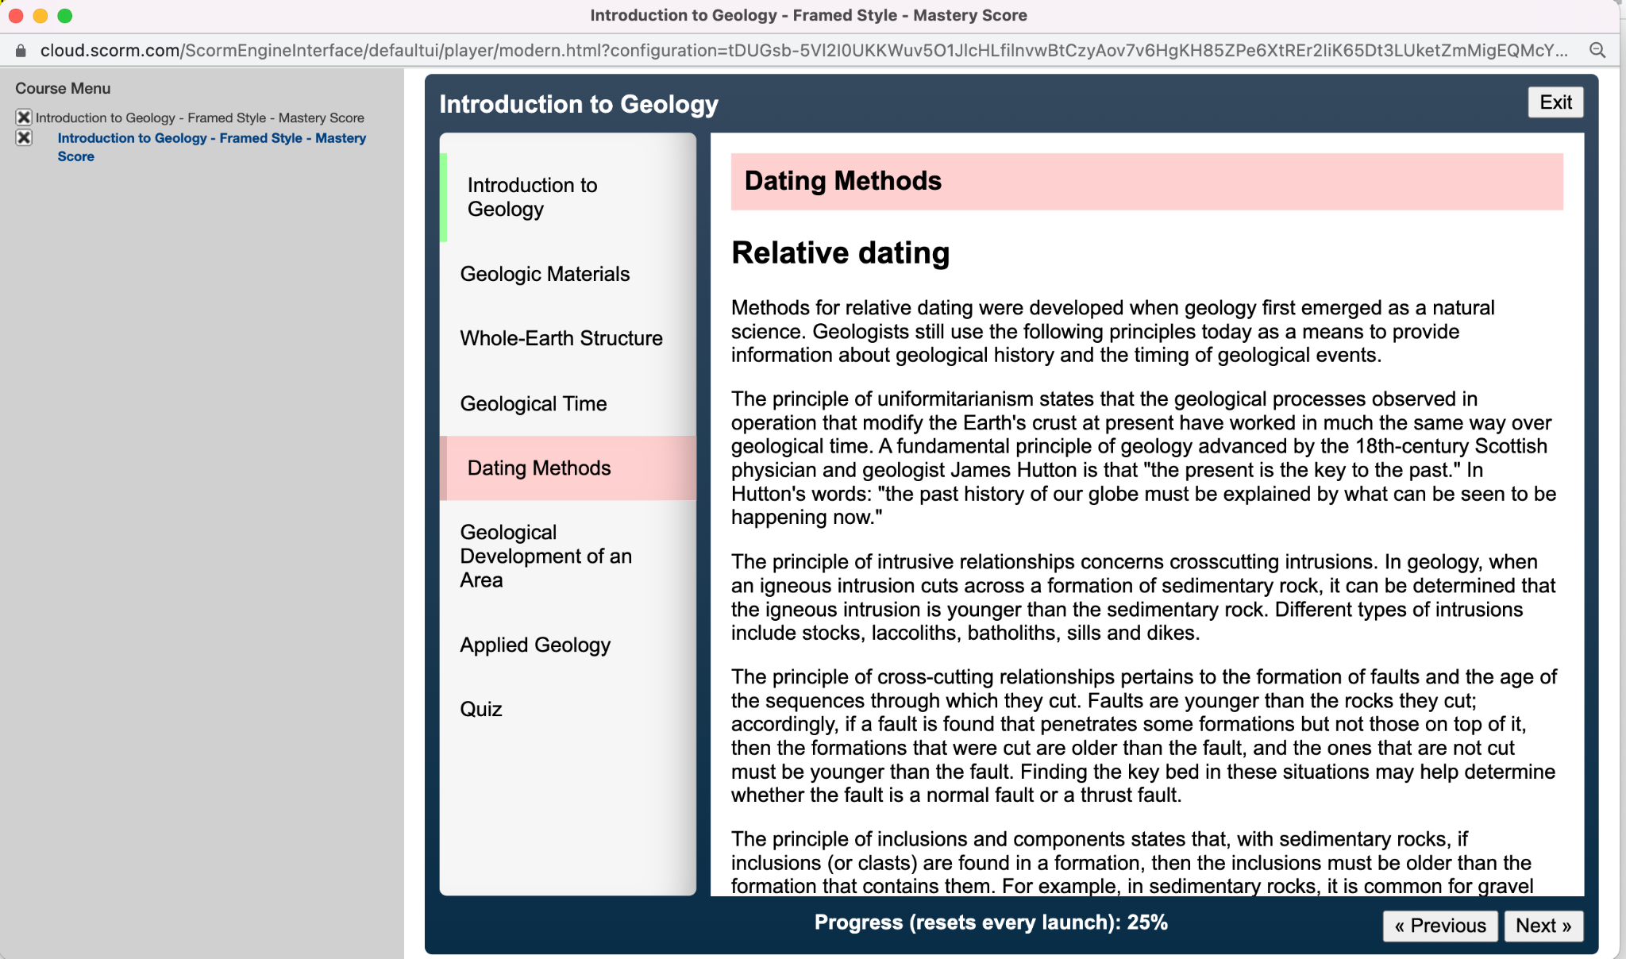
Migrating Legacy Content
“masteryScore” Template
Controls the course’s behavior relative to determining passed or failed status.
Has a simple quiz and requires a certain score.
Several quiz interactions are captured, including simple fill-in and multiple choice.
Available in Framed and Responsive styles.
Licensed under the Apache License, Version 2.0
Notes:
walk through what is masteryscore and the template uses.

Slide 45
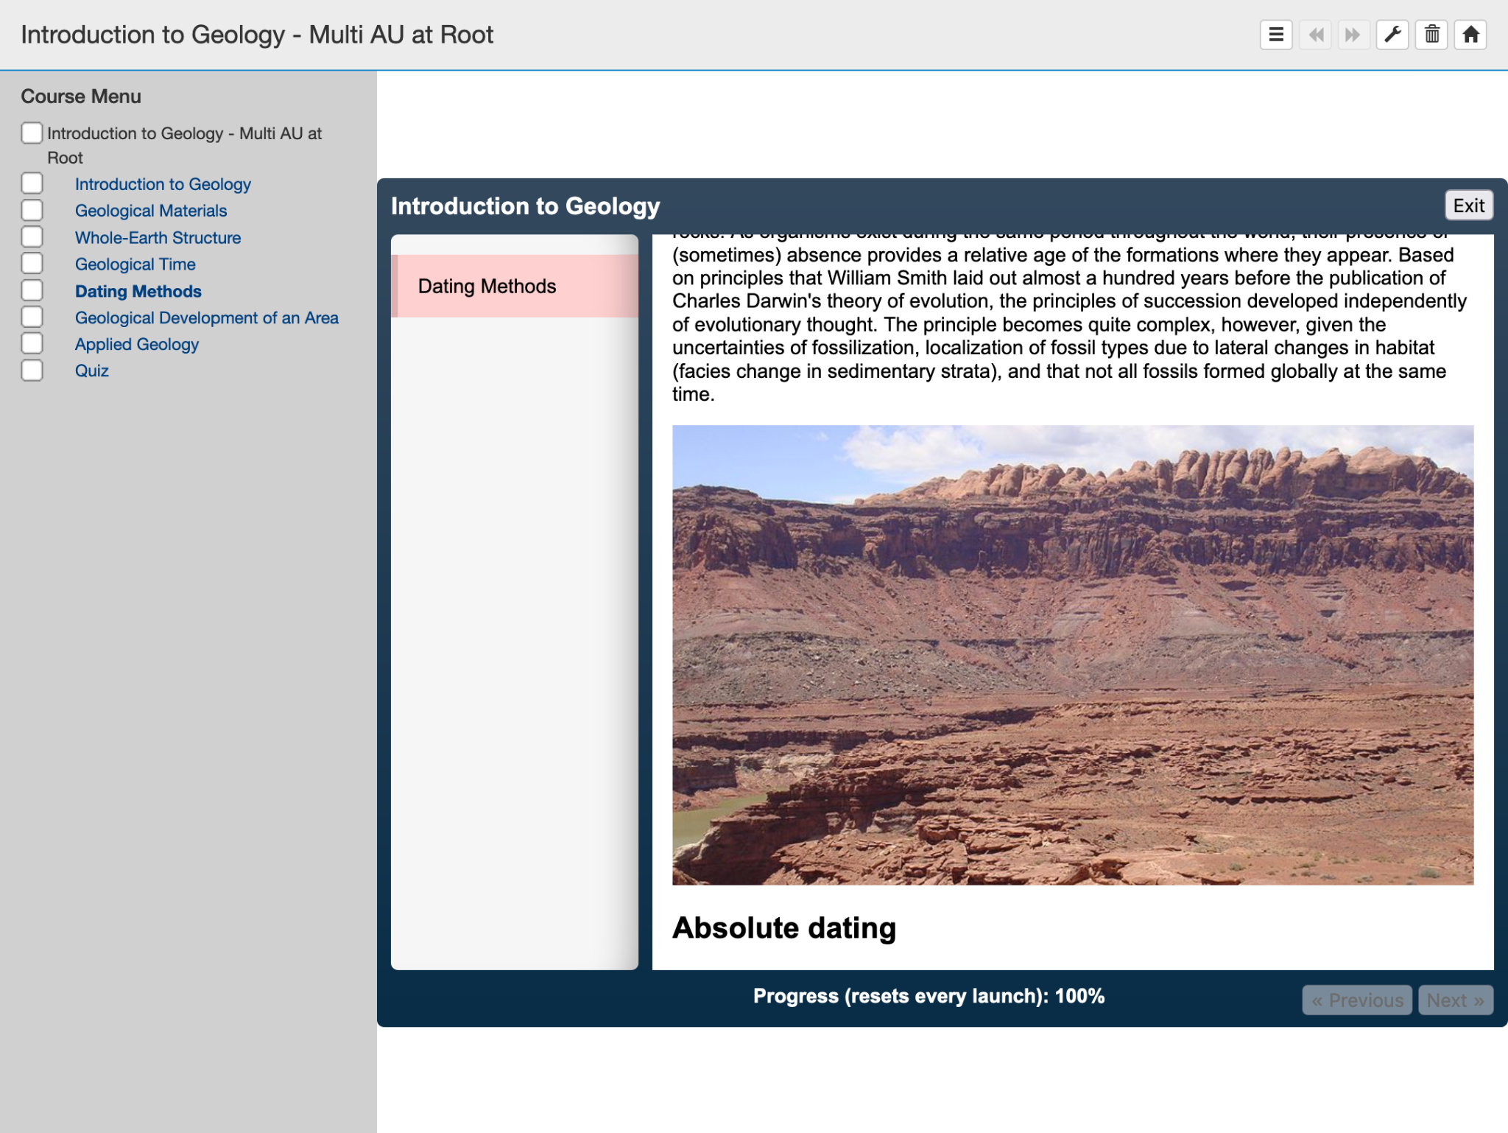
Migrating Legacy Content
Multiple Top-Level AU Template
Spreads the “masteryScore” template contents across several AUs nested at the topmost level of the course structure.
AUs have appropriate moveOn criteria.
Licensed under the Apache License, Version 2.0
Notes:
Add in moveOn criteria discussed earlier.

Slide 46
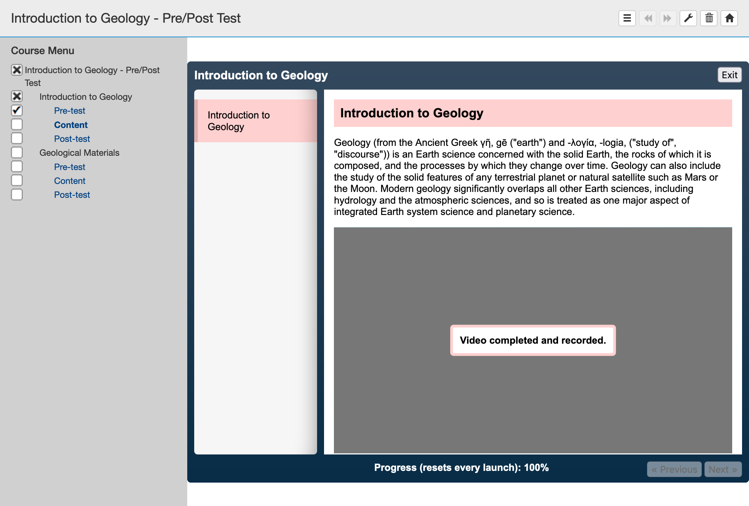
Migrating Legacy Content
Pre/Post Test Template
Demonstrates a course structure of blocks.
Includes a requires extension.
Extensions are not core to cmi5, so LMSs may choose not to implement this behavior.
Licensed under the Apache License, Version 2.0
Notes:
This cmi5 course template demonstrates a course structure of blocks with each block containing a pre-test, content section and post-test AU (three AUs per block).
This template also includes an example of a cmi5 Extension that uses a requires extension, which allows the course author to indicate to the LMS what AUs must have met their moveOn criteria before the block or AU containing the <require> tags is accessible to the learner. Extensions are not core to cmi5, so LMSs may choose not to implement this behavior. Note that this approach to pre/post testing will not necessarily perform equivalently on all cmi5-conformant platforms.

Slide 47
Special Migration Considerations
Repeat statements
“Passed” / “Completed” / “Failed” repeats:
  Worked in SCORM
  Doesn’t work in cmi5
  cmi5 does not allow duplicate statements. A “Failed” statement cannot come after a “Passed” statement.
Notes:
We’ve touched on a few of the cmi5 special considerations earlier. When you’re in the process of migrating, you’ll want to pay special attention to these special circumstances. Because there is nearly unlimited ability to capture data it is possible to capture the concept of “attempts” outside of the cmi5 defined statements that are scoped to the AU as part of the moveOn process.

Slide 48
Special Migration Considerations
“masteryScore”
SCORM: Evaluates and overwrites status after usage
cmi5: Checks at success statement time, MUST reject if mismatched
Notes:
about masteryscore

Slide 49
Special Migration Considerations
Sequencing
SCORM: Only supported in 2004, manifest-based
cmi5: No manifest-based sequencing, can only be done at runtime
  Extensions: “requires”, “equivalences”
Notes:
Sequencing was mentioned earlier but to recap.

Slide 50

The Importance of Testing
Conformance brings compatibility with other systems
Without testing in the cmi5 Conformance Test Suite (CTS), the content creator won’t know what is causing any issues should they arise.
Not using the CTS to test learning activities could result in interoperability issues when launched from different LMSs.
Notes:
Once you’ve migrated content, it’s imperative that you test it in the free CTS. The CTS is specifically designed to assist in the development of compliant content to avoid needing to redo or ship new versions of content just to fix interoperability issues. The more strictly content vendors follow the specification, the less likelihood of vendor lock in for the experiences later on (based on no need for “custom” settings to work around interoperability issues).

Slide 51
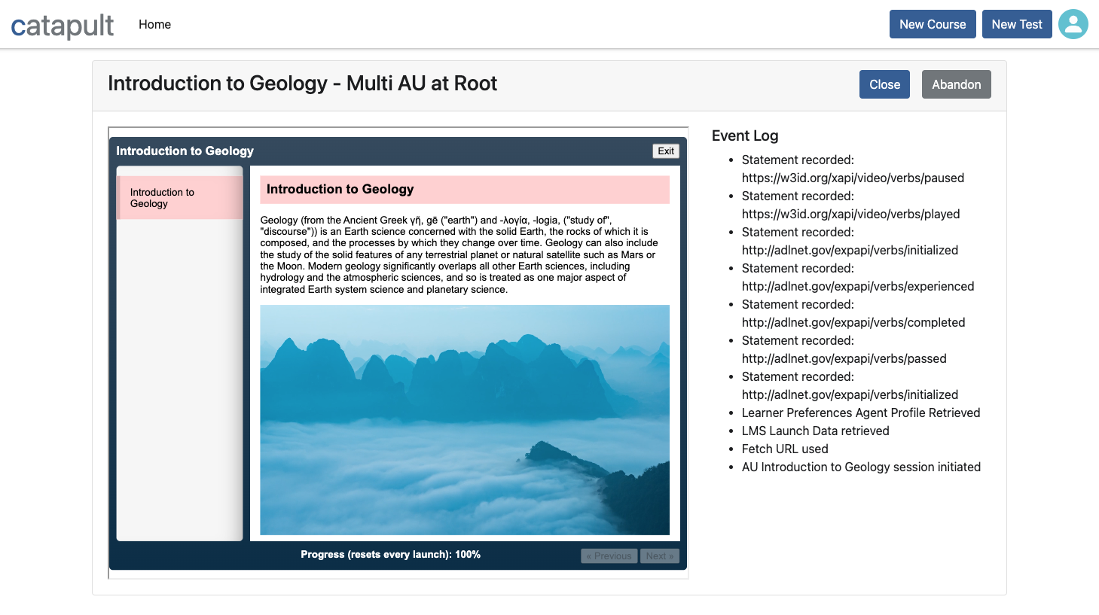
cmi5 Content Test Suite
Licensed under the Apache License, Version 2.0
Notes:
The cmi5 Content Test Suite
Mention the OSS license. The CTS serves as both a way to verify content is conformant, and to provide a meaningful UX for development of the content beyond spec adherence.

Slide 52

cmi5 CATAPULT
cmi5 Advanced Testing Application and Player Underpinning Learning Technologies
Developed the following freely available assets for ADL:
Sample cmi5 course templates
cmi5 Content Test Suite (CTS)
Best practices guide and documentation for implementing the assets
Open source cmi5 player Prototype
cmi5 LMS Test Suite (LTS)
Licensed under the Apache License, Version 2.0
Notes:
These tools are all part of an ADL contracted project called cmi5 CATAPULT.
What is catapult, why ADL contracted out the project, what is available. Open source, freely available.

Slide 53
The Road Ahead
In this section, you’ll...
See the state of cmi5 adoption.
Analyze how cmi5 will impact DoD learning and training.
Discover next steps for adding cmi5 content into your training programs.

Slide 54
State of cmi5 Adoption
Seven years in, there hasn’t been a tremendous amount of adoption of cmi5
Why is that?
Many are already familiar and satisfied with their SCORM and AICC implementations.
Some are using xAPI in their localized environments, which doesn’t lead to much interoperability.
Until recently, there was no conformance test suite or way to test content to ensure conformance to cmi5 available.

Slide 55
Path to Success
“The cmi5 CATAPULT project will play an essential role in acceleration of cmi5 adoption and support our necessary shift to a more distributed learning ecosystem approach.”
- Advanced Distributed Learning Initiative

Slide 56

cmi5 CATAPULT Outcomes
Accelerate the adoption of cmi5 and xAPI
Enable organizations to develop and implement cmi5.
Offer course creators options for migrating legacy content.
Provide resources to vendors and industry members to incorporate support for cmi5 in their products.
Support procurement by providing a mechanism to validate existing products and applications.
xAPI and cmi5 adoption curve
Licensed under the Apache License, Version 2.0
Notes:
Starts with DoD to fund the project, but impacts the entire industry
In order for cmi5 to gain adoption, a conformance test suite was needed to ensure that stakeholders are able to confidently procure and implement cmi5 tools and applications. In addition to a test suite to validate existing products and tools, providing sample content templates and open source tools will also help to increase adoption of both xAPI and cmi5 more broadly across the Department of Defense.

Slide 57
cmi5 CATAPULT Innovates By...
Eliminating barriers to entry
Lack of LMSs and authoring tools that support cmi5 and xAPI in a consistent manner.
No software conformance test suite for validating whether courseware or platforms adhere to the cmi5 specification.
Leveraging lessons learned from SCORM
Open Source cmi5 Player and Conformance Test Suite (CTS) follow a similar approach to what SCORM did to facilitate adoption. The CTS is used in the acquisition pipeline to ensure conformance of delivered courses and to determine if an LMS correctly plays cmi5 courses.
Notes:
What is the purpose of cmi5 CATAPULT and how will it impact the audience.

Slide 58


Adoption Thermometers
Currently, cmi5 adoption rates by LMS vendors, authoring tools, and content creators are still low.
With the addition of new conformance tools and course templates, coupled with TLA guidance, cmi5 adoptions rates will increase.

Slide 59

What’s Next?
Adopt cmi5
Assess where you are with cmi5 and determine where it fits with your plans.
Start having open conversations on where cmi5 fits in your existing tools in your ecosystem.
Request your vendors to add cmi5 in their product roadmap and ask when will they have support for cmi5.
The cmi5 specification is now in the IEEE standards pipeline to become an IEEE Open Standard.
Notes:
In order to move the thermometers, more learning and training professionals need to ask their systems and tools to provide support. The addition of the CATAPULT tools provides ways to test content and systems for conformance.

Slide 60
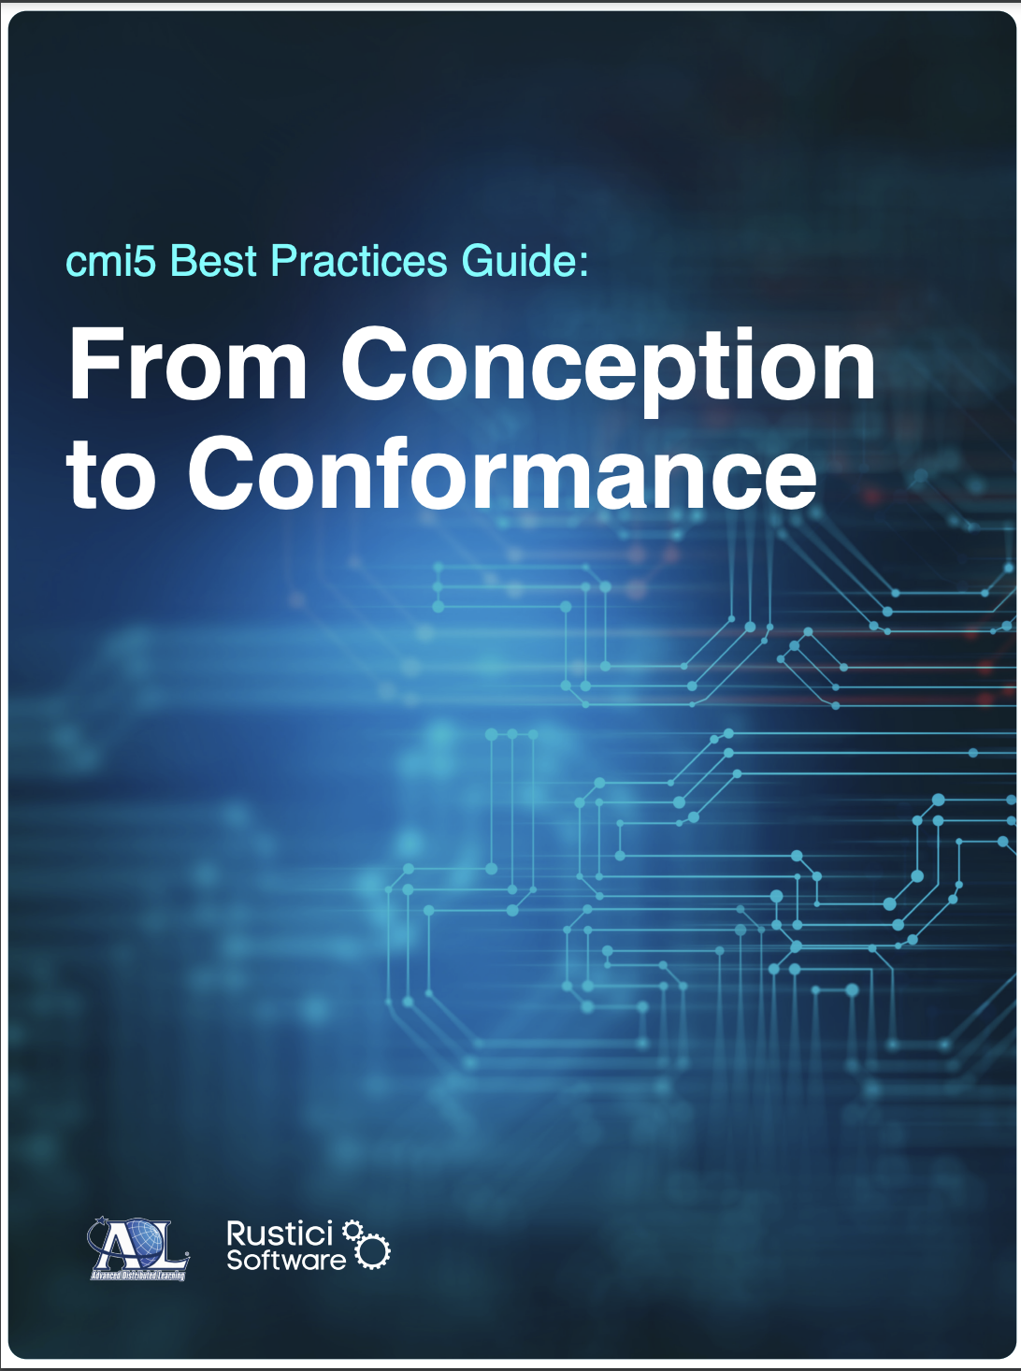
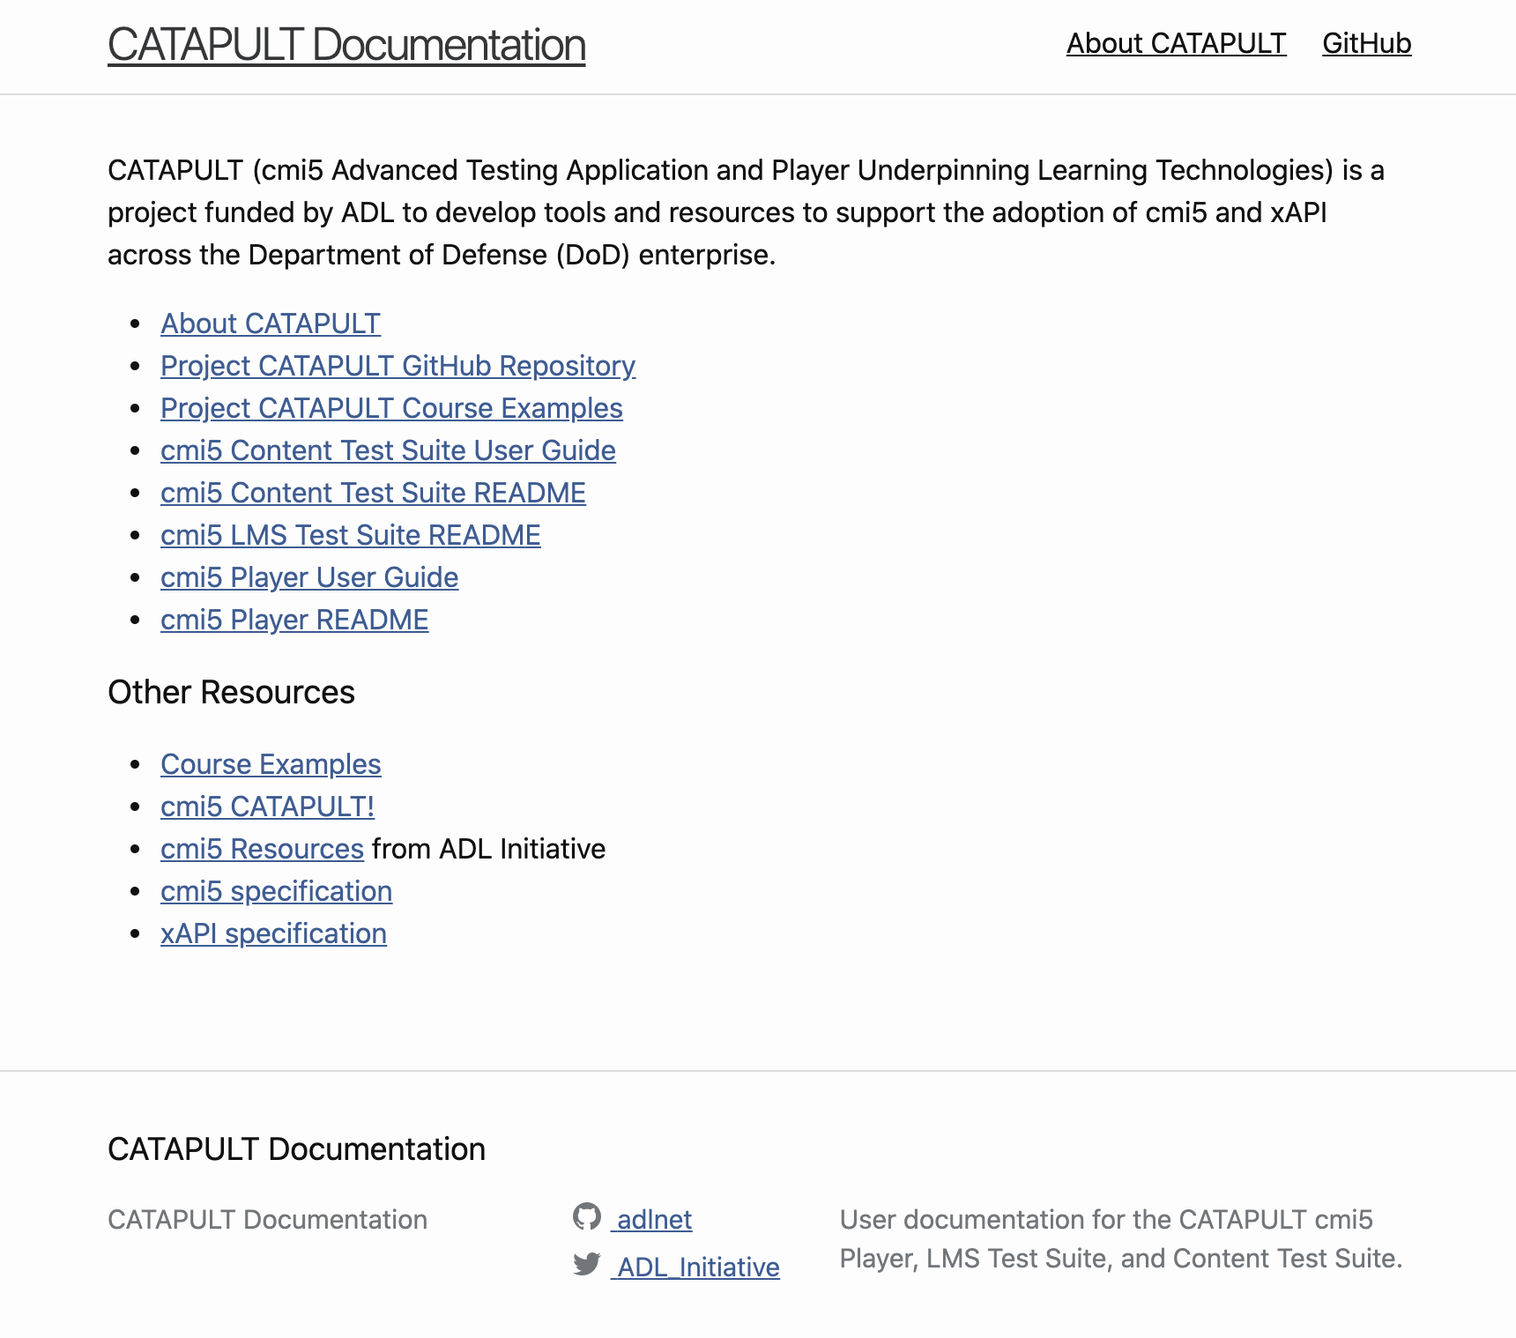
Resources
Ready to use cmi5? Here are resources to help you get started.
Keep up-to-date on cmi5 CATAPULT
https://adlnet.gov/projects/cmi5-CATAPULT/ & https://xapi.com/cmi5-project-catapult/
Visit ADL’s cmi5 page and xapi.com’s cmi5 page for more background
https://adlnet.gov/projects/cmi5-standard/ & https://xapi.com/cmi5/
View ADL’s cmi5 resources
https://adlnet.gov/resources/cmi5-resources/
cmi5 Best Practices Guide
https://adlnet.gov/projects/cmi5-specification/
GitHub repository, course examples, user guides, installation
and deployment instructions can be found at:
https://adlnet.github.io/CATAPULT/

Slide 61
Questions? Ask me anything.
Brian Miller,
Rustici Software
brian.miller@rusticisoftware.com

