Slide 1


Managing Learning Resources through use of Metadata Standards
Andy Johnson (SETA Contractor) ADL Initiative
Phil Barker, Cetis LLP, LRMI

Slide 2
Expected Learning Outcomes
After completing this tutorial, the Attendee will be able to:
Describe the use cases that a metadata strategy enables.
Describe the benefits of technical standards.
Describe what an RDF (Resource Description Framework) Application Profile is and some of the benefits for interoperability with current approaches as related to metadata standards.
Describe how a P2881-centred metadata approach, which re-uses established standards like LRMI (Learning Resource Metadata Innovation) , directly enables many use cases.
Populate a metadata graph and understand how it enables the lifecycle of learning resources and learning events.

Slide 3
Outline of the Tutorial
What is Metadata?
Use Cases Enabled by Metadata
What Do Technical Standards Do?
Metadata Standards
Graphing Metadata
Summary - Metadata in a Learning Ecosystem

Slide 4

What is
Notes:
This is necessary background to all the learning objectives.

Slide 5

What is Metadata?
Definition 1: Metadata is "data about data."
Definition 2: "Metadata is structured information that describes, explains, locates, or otherwise makes it easier to retrieve, use, or manage an information resource."
— J Riley (2004), Understanding Metadata, a NISO Primer
Notes:
The term metadata was coined by a computer scientist as the data about data. The term was trademarked, but widely used to mean resource description (aside: the Greek prefix "meta-" doesn't mean "about" it means "after"; look up the etymology for metaphysics for how this usage came about)
The problem is that most metadata that we deal with now isn't about data, unless we have some very expansive definition of data that include any information, which won't really do for the first use of "data" in that definition.

Slide 6
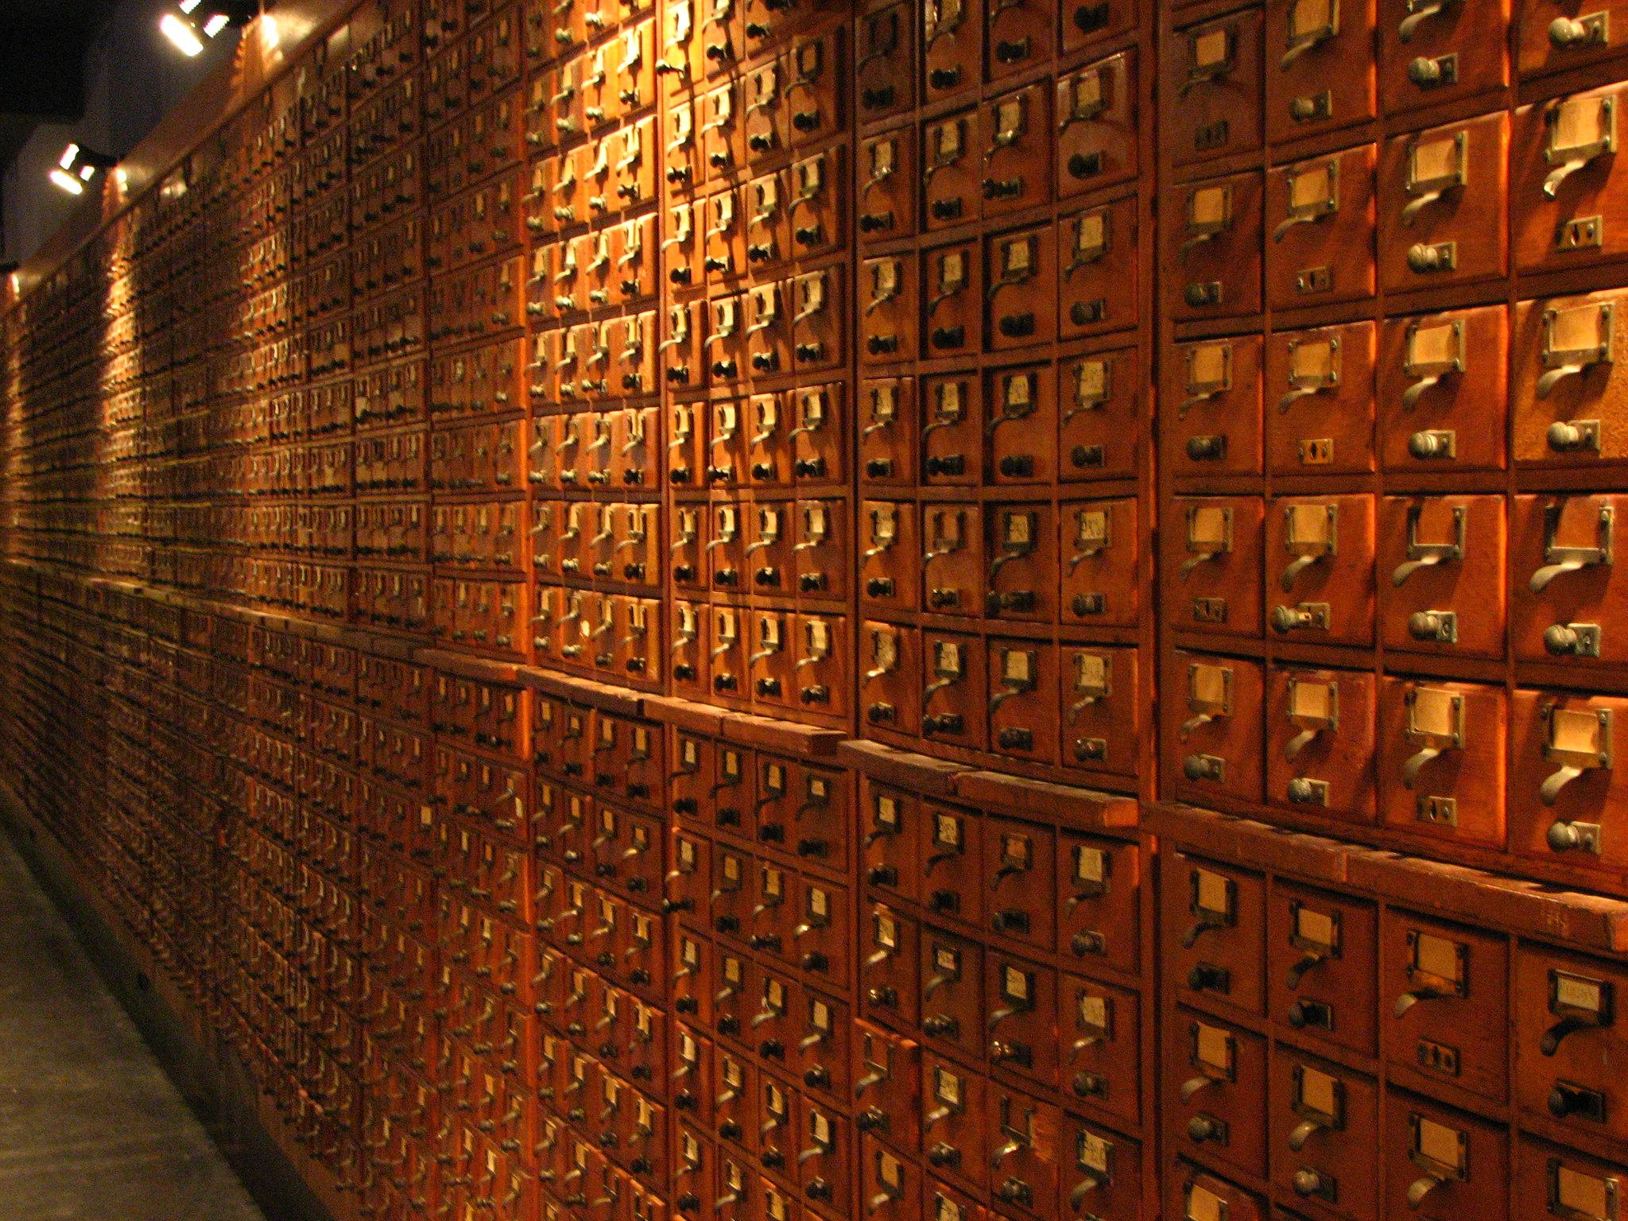
What is Metadata?
250 BCE - The Pinakes, Library of Alexandria
A list of authors and their works held by the library. By Callimachus. ca.
. . .
1895 - Mundaneum at Mons
Classifying all the world's knowledge, initiated by Paul Otlet and Henri La Fontaine.
. . .
1965 - MARC, Library of Congress
Machine Readable Cataloging standard. Led by Henriette Avram.
Drawers by user fdecomite via Flickr, CC:BY, taken 2011 at Mundaneum, Mons. https://www.flickr.com/photos/fdecomite/5471359307/

Slide 7
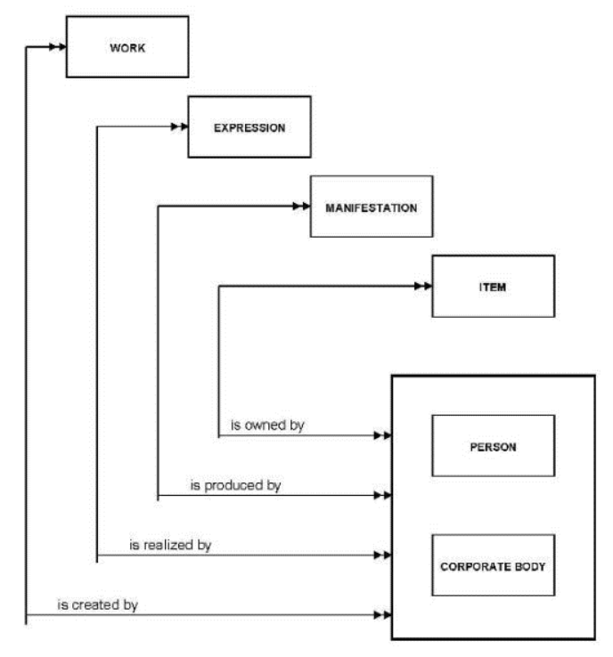
What is Metadata?
Metadata formats and models:
Initially (1965) MARC used fields in a text record.
From mid 1970s Entity–Relationship models.
From late 1990s / early 2000s, various standards in XML hierarchies.
From 1997 FRBR (Functional Requirement for Bibliographic Records) conceptual model.
From 2005 RDF / Semantic web / graph-based models.
From 2010 JSON-LD hybrid object oriented / RDF graph.
Functional requirements for bibliographic records, Final Report. IFLA (1997, rev 2009). https://cdn.ifla.org/wp-content/uploads/2019/05/assets/cataloguing/frbr/frbr_2008.pdf
Notes:
Machine readable formats and data models for metadata have pretty much followed the data formats and models familiar to you from the history of computer science.
Can draw an important distinction between "nesting" of information as if it were fields in a catalog record (XML hierarchies mimic this) and identification of the different entities that need to be described (e.g. the resource, the person who created the resource) and the types of relationships between them (RDF / linked data is based on this). All are still valid, but we are more interested in the latter. Library world was quite early in its use of "relators" and authority files to describe common entities. An important milestone was FRBR around the turn of the century which identified abstract primary and secondary entities.

Slide 8
Use Cases Enabled by Metadata

Slide 9

Expected Learning Outcome #1
After completing this section, the attendee will be able to describe the use cases that a metadata strategy enables. This includes the range of roles and responsibilities in ecosystems and how those roles are enabled through meeting use cases.

Slide 10
What is a Use Case and What Should It Center On?
“
A use case is a written description of how users will perform tasks on your website. It outlines, from a user’s point of view, a system’s behavior as it responds to a request. Each use case is represented as a sequence of simple steps, beginning with a user's goal and ending when that goal is fulfilled.
— Usability.gov (2023)
Metadata is structured information that describes, explains, locates, or otherwise makes it easier to retrieve, use, or manage an information resource.

Slide 11
What is a Use Case and What Should It Center On?
“
A use case is a written description of how users will perform tasks on your website. It outlines, from a user’s point of view, a system’s behavior as it responds to a request. Each use case is represented as a sequence of simple steps, beginning with a user's goal and ending when that goal is fulfilled.
— Usability.gov (2023)
Metadata is structured information that describes, explains, locates, or otherwise makes it easier to retrieve, use, or manage an information resource.

Slide 12
What is a Use Case and What Should It Center On?
“
A use case is a written description of how users will perform tasks on your website. It outlines, from a user’s point of view, a system’s behavior as it responds to a request. Each use case is represented as a sequence of simple steps, beginning with a user's goal and ending when that goal is fulfilled.
— Usability.gov (2023)
Metadata is structured information that describes, explains, locates, or otherwise makes it easier to retrieve, use, or manage an information resource.

Slide 13
What is a Use Case and What Should It Center On?
“
A use case is a written description of how users will perform tasks on your website. It outlines, from a user’s point of view, a system’s behavior as it responds to a request. Each use case is represented as a sequence of simple steps, beginning with a user's goal and ending when that goal is fulfilled.
— Usability.gov (2023)
Metadata is structured information that describes, explains, locates, or otherwise makes it easier to retrieve, use, or manage an information resource.

Slide 14

Metadata User Roles
Roles
A Learner, seeking out an opportunity to advance their career or self.
A Curriculum Administrator, looking for content to bring into their program.
A Content Author, who wants to maintain a library of resources within their organization across a team.
Many more possibilities.

Slide 15

Metadata Responsibilities (By User Role)
Responsibilities
Learner
  Bring goals
  Bring organizational roles
  Bring a schedule
  Bring preferences and history
Administrator
  Bring organizational goals
  Bring a curriculum design
  Bring competency requirements
Content Author
  Bring a content repository
  Bring a versioning system
  Bring a team

Slide 16
Use Cases #1
Describes
Explains
Search Google-style for some sort of media to watch online – expand this to any learning opportunity bullet.
Search Google-style for downloadable material, including entire courses to take and use or rebrand.
Once seeing search results, use other data to make an informed decision about which opportunity is selected.
Remove the disambiguation of “this is the opportunity I need” (as opposed to something very close).

Slide 17
Use Cases #2
Locates
Easier to Retrieve
Manage multiple versions of resources, such that the most recent version is available.
Find the appropriate format of a resource, such that it is optimized for my environment.
Determine if a limited time/location opportunity fits in with my schedule.
Receive notifications when a new version of a resource becomes available.

Slide 18
Use Cases #3
Easier to Use
Easier to Manage
Given a search history or profile, have recommendations for your preferences or role.
Receive recommendations for specific resources related to what you need, such as competencies.
Allow an AI (Artificial Intelligence) to deliver exactly what I need to my device.
Attribute positive or negative effectiveness or other measures to the appropriate resources - Is it “good” or “bad” because of the contents, the technology, the instructor, etc.?
Follow the paths of others who were similar to you to determine best fit for a learning opportunity.
Restrict access and even results of a search for resources based on my credentials or role.
Trace who has used learning resource I have shared, so I can inform them if I make a revision they may want.

Slide 19

Gains through Responsibility and Use Case Satisfaction
Gains
  Learner
    Finds the best learning path forward, aided by AI.
    Delivery in right time and right place of these learning opportunities.
  Administrator
    Saves time and resources by finding applicable content.
    Understands where improvement is needed most (in content, personnel, environment).
  Content Author
    Achieves version control and notifications.
    Knows content is correctly authorized.

Slide 20
3. What Do Technical Standards Do?

Slide 21

Expected Learning Outcome #2
After completing this section, the attendee will be able to describe the benefits of technical standards. This includes benefits related to products and services, risk aversion, and enforceability. The attendee will be expected to understand how standards can work together to become stronger.

Slide 22

Earliest Standards
Calendars
Started with cavemen and tallies.
Marked animal bones based on occurrences of the moon.
Sumerians used the numbers 5, 12, and 60 heavily and made a solar year with lunar cycles.
Egyptians recorded based on re-occurrence of a star every 365 days.

Slide 23
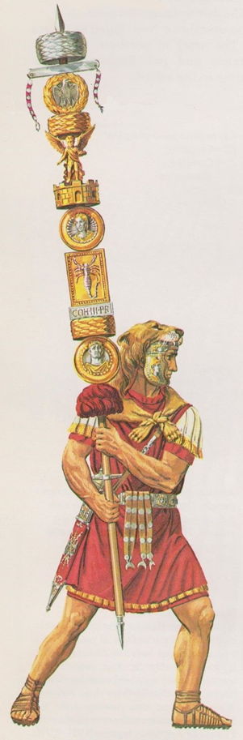
First Use of “Standard”
Used in Battle, a “flag.”
Helps you not attack your allies.
When we talk about making a current standard, it has many of the same characteristics.
  Rallying people around you
  Joining a cause
  Being in a certain “camp”
  Being a champion

Slide 24

Interoperability Enables the Benefits of Standards
Clarify Expectations
Lower Costs
Protect Consumers
Inform Buyers
Support Marketing
Help Developers
Coordinate Other Standards

Slide 25

What If I Don’t Have Interoperability?
Organizations buy software products and services to meet their requirements.
Despite having good products, some companies.
  Go out of business
  Ghost you
  Break promises
  Scale costs/addons unfairly

Slide 26

Speaking the Standards “Lingo”
Four (or Five) Simple Words:
MUST/SHALL
  Drives certification
  Absolute requirement
SHOULD
  Best practices
MAY
  Explore fringes
  Disallow testing of
NOT
  Negation of SHOULD/MUST
MAY NOT and MUST NOT mean the same thing

Slide 27

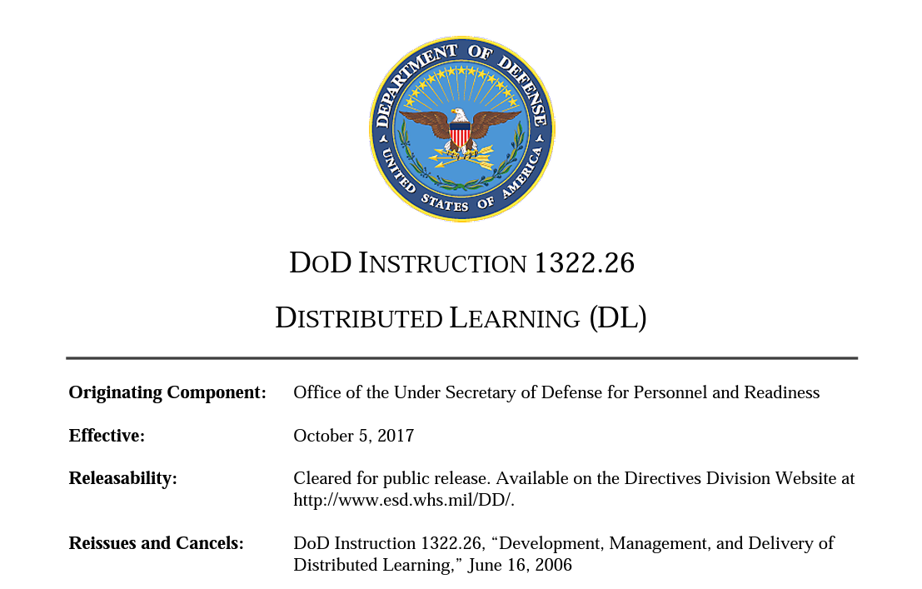
Example of Policy Using Standards
“
"Must use standards in the Defense IT Standards Registry"
“
"Use prioritized standards for all learning system acquisition"

Slide 28


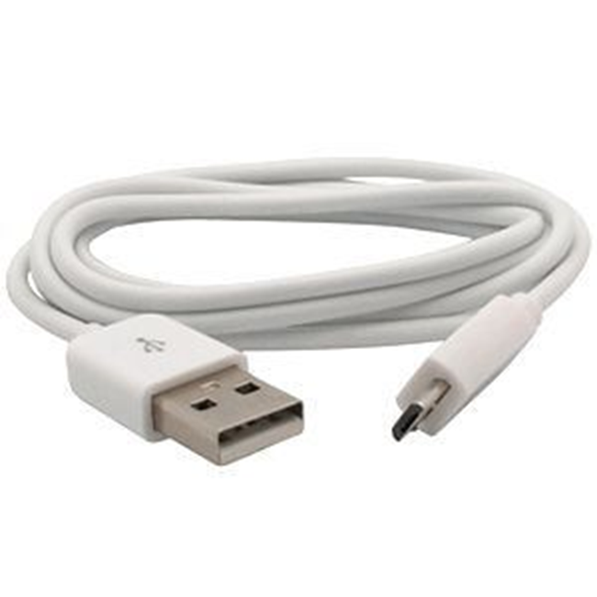
Use of Multiple Standards
Multiples of standards can be okay, but should allow for easy conversion.
  And not force duplication.
Like the power stations at airports or on airplanes that can handle either a regular AC/DC outlet, or a USB.
You just add a converter.
Data is more forgiving than electricity!

Slide 29
“Layered” Standards are Application Profiles
Sometimes, additional specificity is needed from a standard.
While a connection may provide a range of electricity, a device may require a very specific amount.
This is also true for data, more “rules” might be needed.
Videos are ultimately different from pictures and would need additional data.

Slide 30

Communities of Practice
A Community of Practice has a specific domain, or area of expertise they share.
Common requirements can be derived from their expertise.
The collective expertise, when documented as best practices, become requirements.
These requirements, on top of an established standard, creates an application profile.

Slide 31
Metadata Standards
"Standards are great. Let's have lots of them."
a) IEEE Learning Object Metadata (LOM)
b) Dublin Core
Interlude: Application Profiles
c) LRMI
d) IEEE P2881

Slide 32

Expected Learning Outcome #3
After completing this section, the attendee will be able to (a) be able to understand that there exist several metadata standards relevant to describing learning resources, know the general history and benefits of each; (b) describe what an RDF Application Profile is, and the benefits of using one to combine different RDF vocabularies.

Slide 33
Metadata Standards (a) IEEE LOM
The bare facts:
1484.12.1-2020 - IEEE Standard for Learning Object Metadata.
Developed in late 1990s, published 2002, renewed 2020.
Hierarchical structure of ~76 nested elements.
  Nine top-level elements (General, Lifecycle, Technical, Educational, etc.)
  Eleven educational elements.
Describes all aspects of a "Learning Object."
  "any entity, digital or non-digital, that may be used for learning, education or training."
XML based records.
Also basis the IMS (now 1EdTech) Learning Resource Meta-data.

Slide 34
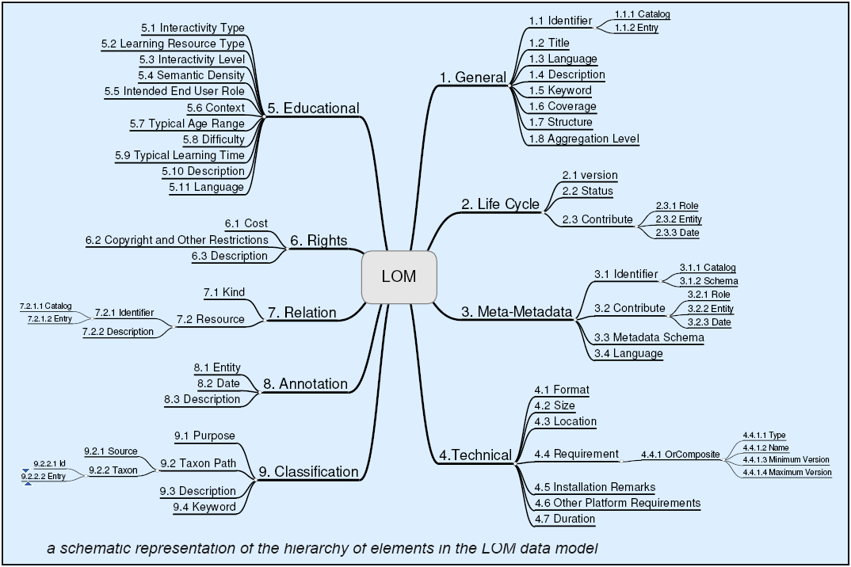
Metadata Standards (a) IEEE LOM
Source: https://meta.wikimedia.org/wiki/File:LOM.PNG

Slide 35
Metadata Standards (a) IEEE LOM
Application:
Basis for metadata in SCORM and other content packaging variants.
Used by some Learning Object Repositories.
Influence:
Pioneer for interoperability in educational technology.
Showed which educational elements were useful (and which were problematic).
Showed difficulty of covering everything in a monolithic standard.

Slide 36
Metadata Standards (b) Dublin Core
The bare facts:
"Simple" Dublin Core / Dublin Core Element Set
  A flat list of fifteen broadly defined elements to describe content on the World Wide Web
  First published 1995
  IETC RFC 5791, ANSI/NISO Z39.85, ISO 15836
Dublin Core Terms (last update 2020)
  A flat list of 55 properties which refine and extend the Element Set
    refine: add detail to existing element; e.g. modified, (date modified) refines dc:date
    extends: add new property; e.g. Instructional Method
  Also adds classes and encoding schemes
Other related specifications
  Abstract Model, Singapore Frameworks for Application Profiles
Notes:
Make sure to mention that the data is unstructured, which is good (for RDF), as opposed to the nested nature of LOM

Slide 37
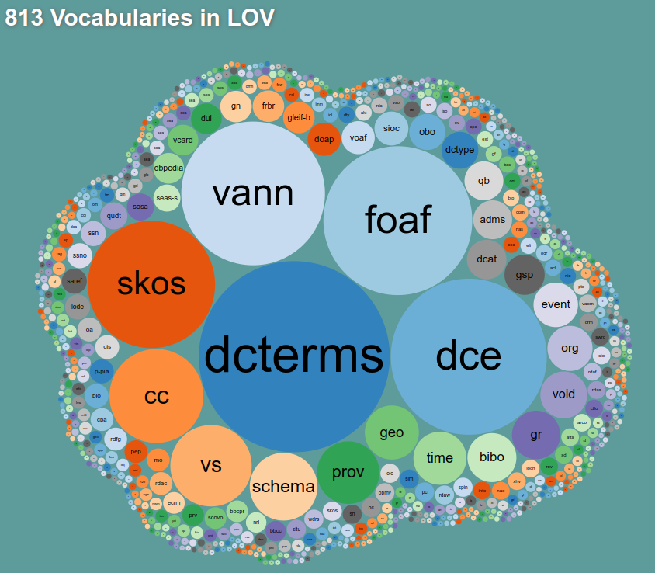
Metadata Standards (b) Dublin Core
Application:
Element Set provides a top-level ontology to which many schema for information resources can map.
DC Terms are very widely used in conjunction with specialized vocabularies.
https://lov.linkeddata.es/dataset/lov

Slide 38
Metadata Standards (b) Dublin Core
Application:
Element Set provides a top-level ontology to which many schema for information resources can map.
  OAI-PMH (Open Archives Initiative Protocol for Metadata Harvesting)
  EPUB (E-Publication) Metadata
DC Terms very widely used in conjunction with specialized vocabularies.
  DCMI (Dublin Core Metadata Initiative) metadata terms were reused by 83.7% of LOV (Linked Open Vocabularies)¹
  DCAT (W3C Data Catalogue Vocabulary)
  European Learner Model
Zhang, Zhang & Jia et al (2023)

Slide 39
Metadata Standards (b) Dublin Core
Influence:
Showed how to design metadata terms that can be used for many applications.
  "Weak semantics"—don't tie users down to specific use cases.
  Broad definitions that can be narrowed later.
Showed power of describing one thing at a time & linking descriptions.
  Don't embed the descriptions of "author" into the description of a book, it might be useful elsewhere.

Slide 40
Metadata Standards : Application Profile
Application Profiles: Mixing and Matching
“Application profiles consist of data elements drawn from one or more vocabulary combined together by implementers and optimised for a particular local application.”
Heery and Patel (2000)
“Application profiles describe, explain, and define rules for how existing vocabularies and models should be used in a metadata instance.”
DCTAP (2023)

Slide 41
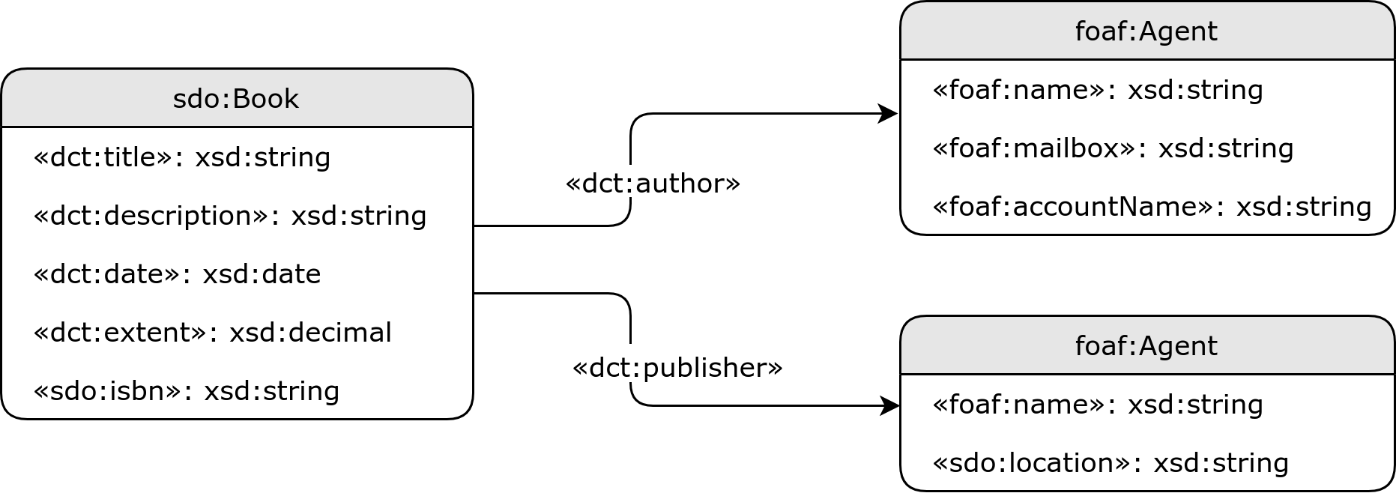
Metadata Standards: Application Profile
Vocabularies
dct: Dublic Core Terms
foaf: Friend of a Friend
sdo: schema.org

Slide 42
Metadata Standards (c) LRMI
The bare facts:
Learning Resource Metadata Innovation.
Initiated in 2011 to enhance Schema.org's ability to describe learning resources.
  Schema.org: RDF/Linked data vocabulary for describing anything that can be found in web pages; sponsored by Google and other big search engines, used to provide descriptions embedded in web pages that enhance search experience
Small number of terms covering education & training designed to be used with other vocabularies that cover the rest.
Now a Dublin Core Working Group.

Slide 43
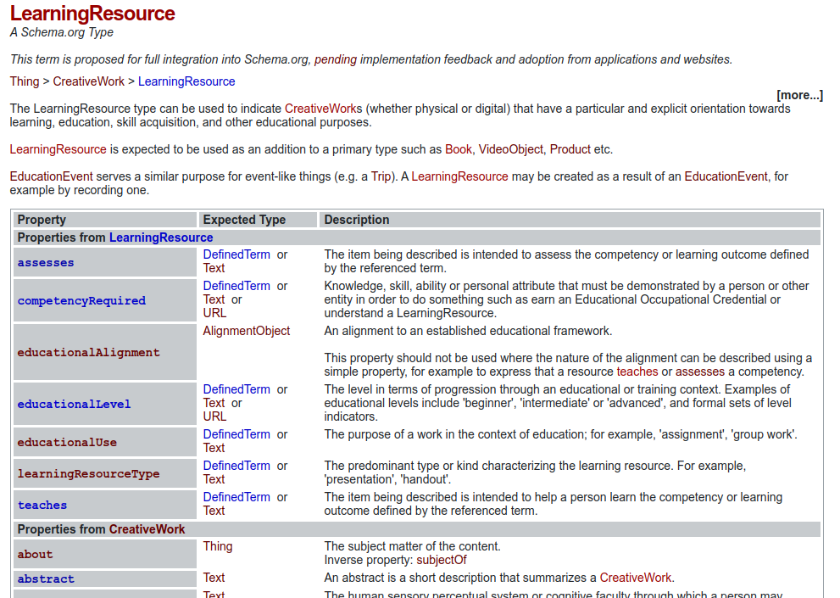
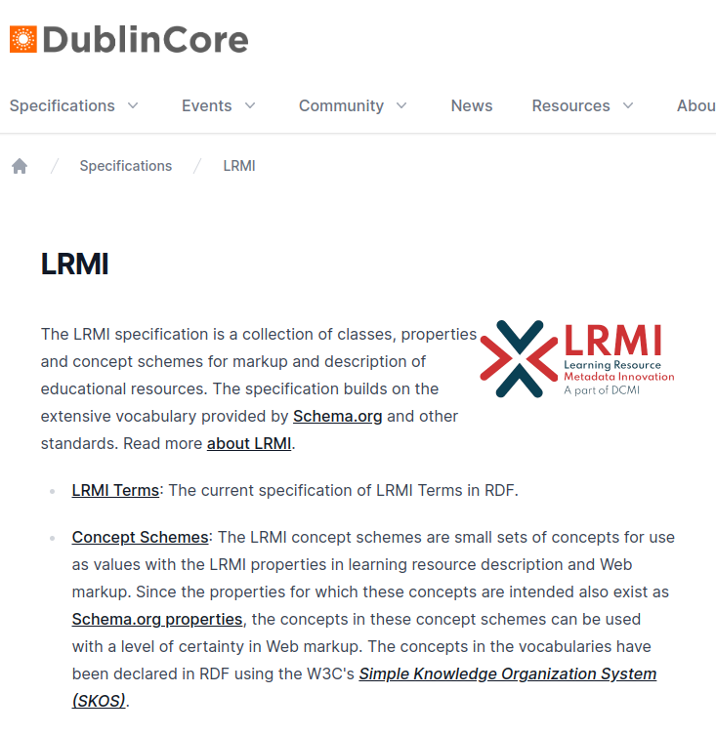
Metadata Standards (c) LRMI

Slide 44
Metadata Standards (c) LRMI
Application:
Used in several specifications to describe learning resources.
  K12-OCX (Open Content Exchange)
  BioSchemas, Earth Sciences Information Partnership
  WirLernenOnline - The OER (Open Educational Resources) Hub in Germany
Influence:
Shows how to apply Dublin Core descriptive principles to learning resources.
Adopted by IEEE P2881.

Slide 45
Metadata Standards (d) IEEE P2881
The bare facts:
IEEE P2881 Learning Metadata Working Group.
Provides an alternative to IEEE 1484.12.1 LOM (does not replace it).
Based on Linked Data, RDF principles.
Adopts Dublin Core Terms and LRMI, along with some other vocabularies.
Current status: Draft Standard in preparation.

Slide 46

Expected Learning Outcome #4
After completing this section, the attendee will be able to describe how a P2881-centered metadata approach, which uses established standards like LRMI, directly enables many use cases. This includes all of the use cases outlined earlier in the tutorial and generalized concepts of properties in the standards.

Slide 47
Learning Resources with Traditional Properties
Search Google-style for downloadable material, including entire courses to take and use or rebrand:
Class of Learning Resource — a reusable resource.
Properties such as description, keywords, language, title to help run the search.

Slide 48
Learning Events with Traditional Properties
Search Google-style for a live-streamed learning opportunity:
Class of Learning Event — an opportunity with time and place (can be “missed”).
Properties such as description, keywords, language, title to help run the search.

Slide 49
Better Search Results
Once seeing search results, use other data to make an informed decision about which opportunity is selected
Properties such as duration, start/end dates, educational or instructional levels or preferences, the instructor, the owner, subject, time required.

Slide 50
Personal Recommendations
Receive recommendations for specific resources related to what you need
Properties that determine if the resource teaches me or assesses me in something specific that aligns to what my employer/school/goals say and how long it is expected to take.

Slide 51
Personal Recommendations
Given a search history or profile, have recommendations for your preferences or role
Properties that align to the learner, such as competencies that it teaches or assesses (as aligning to the goals of an individual) , instructional method, types of the resources/materials, and subject (as interests).

Slide 52
Working on MY Time
Determine if a limited time/location opportunity fits in with my schedule
Properties that have to do with time, as related to Learning Events — duration, location, temporal characteristics, start/end date, and a full schedule (from schema.org).

Slide 53
Avoiding Mistakes and Reducing Time to Find
Remove the disambiguation of “this is the opportunity I need” (as opposed to something very close)
Properties that determine if the resource is a part of something else, who offers it, who owns it, and many of the previously mentioned properties.

Slide 54
Peer-Based Recommendations
Follow the paths of others who were similar to you to determine best fit for a learning opportunity
Understanding competencies that are taught and assessed, who instructors are, what the audience (role) intended for the learning resource/opportunity, and the subject of resources.

Slide 55
Lifecycle Management
Receive notifications when a new version of a resource becomes available
Properties that show the lineage of all versions so that someone using any of those versions can know when a new version is available and who needs to know about that version.

Slide 56
Reusability Throughout Lifecycle
Trace who has used the learning resource I have shared, so I can inform them if I make a revision they may want
Properties that show, within the context of versioning, the different adaptations/derivations that others make and the ability for them to be “known” to the original developers.

Slide 57
Format Management
Find the appropriate format of a resource, such that it is optimized for my environment
Properties that adequately describe the format, all resources/events that are “the same” except for that format and resources that share that format.

Slide 58
Access Management
Restrict access and even results of a search for resources based on my credentials or role
Properties that show the ownership, who offers the resources/opportunities, and audience that it is intended for (with the intention that a system provides the audiences and controls access).

Slide 59
Deep Contextualization of Success
Attribute positive or negative effectiveness or other measures to the appropriate resources
While paradata isn’t defined as metadata, if that were implemented, the separation of all distinct versions, Learning Events as derived from Learning Resource, instructor, offerer, etc. all help determine where the positive and negative aspects are when compared to those with ONLY that property differing.

Slide 60
Extensibility
Define special properties for a Community of Practice that is separate from “what Google might return”
Properties that aren’t in the “core” (the standard is extensible) also a “type” that a Community of Practice can claim and then effectively make a Class of that type and define properties (or provide more requirements on existing properties).

Slide 61
AI-Enabled
Allow AI application to deliver exactly what I need to
my device
Every property mentioned and those specifics by communities of practice, particularly the format options for just-in-time delivery and ensuring the other “recommendation” type of use cases are met.

Slide 62

Expected Learning Outcome #5
After completing this section, the attendee will be able to populate a metadata graph and understand how it enables the lifecycle of learning resources and learning events. This includes the opportunity to put oneself in specific metadata roles during an ISD Process Model (ADDIE).

Slide 63
Graphing Metadata
Example: Online Course
Imagine we are commissioning a Course to be deployed on platforms such as Coursera.
We need to allocate an identifier (such as an Internationized Resource Identifier (IRI)) for the thing we are creating.
Note that this is not the URL of the course when it is deployed, of which there may be several as the course may be deployed more than once on different platforms.
This identifier should resolve to a representation of the course, e.g. a description of it.

Slide 64
Graphing Metadata
So, we have a notional resource and have assigned an identifier to it.
We represent that graphically like this.
https://example.org/resources/0001

Slide 65
Graphing Metadata
We know that this is a Learning Resource, as defined by LRMI.
Let's also assert that it is a Course as defined by Schema.org.
note the "compact URIs":
  prefix lrmi: == "http://purl.org/dcx/lrmi-terms/"
  prefix schema: == "https://schema.org/"
lrmi:LearningResource
schema:Course
rdf:type
https://example.org/resources/0001

Slide 66
Graphing Metadata
In code (terse triple language, ttl, turtle)
@prefix lrmi: <http://purl.org/dcx/lrmi-terms/> .
@prefix schema: <https://schema.org/> .
<https://example.org/resources/0001> a lrmi:LearningResource .
<https://example.org/resources/0001> a schema:Course .
lrmi:LearningResource
schema:Course
or, more compactly
rdf:type
<https://example.org/resources/0001> a lrmi:LearningResource , schema:Course .
https://example.org/resources/0001

Slide 67
Graphing Metadata
In code (JSON-LD):
{
"@id" : "https://example.org/resources/0001" ,
"@type" : [
"http://purl.org/dcx/lrmi-terms/LearningResource" ,
"https://schema.org/:Course"
]
}
lrmi:LearningResource
schema:Course
rdf:type
https://example.org/resources/0001

Slide 68
Graphing Metadata
Example: Online Course
What might we know about / assign to our course at the commissioning stage?
  Learning Objectives
  Audience
  Educational level
Let's assume that our organization uses a well-defined competency framework to define Learning Objectives and has a controlled vocabulary for educational level, but is a bit looser about describing audiences.

Slide 69
Graphing Metadata
Example: Learning Objective
Our organization uses a well-defined competency framework to define Learning Objectives.
Identifier: https://example.org/comp/ec3f
IEEE P2881 doesn't cover how to describe competencies, because several other standards do, e.g. IEEE 1484.20.3 Shareable Competency Definitions.
type: https://opensource.ieee.org/scd/CompetencyDefinition
name: "Graphing Metadata"
competencyStatement: "The attendee will be expected to populate a metadata graph and understand how it enables the lifecycle of learning resources and learning events."

Slide 70
Graphing Metadata
scd:CompetencyDefinition
<https://example.org/comp/ec3f> a scd:CompetencyDefinition ;
scd:name "Graphing Metadata" ;
scd:statement "The attendee will …" .
{
"@id": "https://example.org/comp/ec3f",
"@type": "scd:CompetencyDefinition",
"scd:name": "Graphing Metadata",
"scd:statement": "The attendee will …"
}
rdf:type
https://example.org/comp/ec3f
scd:name
scd:statement
"The attendee will be expected to populate a metadata graph and understand how it enables the lifecycle of learning resources and learning events."
"Graphing Metadata"

Slide 71
Graphing Metadata
Example: Linking Data
IEEE P2881 does tell you how to link a Learning Resource to a Competency
URI | http://purl.org/dcx/lrmi-terms/teaches
Label | Teaches
Definition | The item being described is intended to help a person learn the competency or learning outcome defined by the referenced term.
Comment | A specific Competency that this resource is intended to teach.
Type of Term | http://www.w3.org/1999/02/22-rdf-syntax-ns#Property
Domain Includes | https://opensource.ieee.org/lmt/LearningEvent http://purl.org/dcx/lrmi-terms/LearningResource
Range Includes | https://opensource.ieee.org/scd/CompetencyDefinition https://purl.org/ctdlasn/terms/Competency http://purl.org/ASN/schema/core/Statement

Slide 72
Graphing Metadata
<https://example.org/resources/0001> lrmi:teaches <https://example.org/comp/ec3f> .
[{
"@id" : "https://example.org/resources/0001" ,
"@type" : [
"http://purl.org/dcx/lrmi-terms/LearningResource" ,
"https://schema.org/:Course"
],
"lrmi:teaches": "https://example.org/comp/ec3f"
},{
"@id": "https://example.org/comp/ec3f",
"@type": "scd:CompetencyDefinition",
"scd:name": "Graphing Metadata",
"scd:statement": "The attendee will …"
}]
https://example.org/resources/0001
lrmi:teaches
https://example.org/comp/ec3f

Slide 73
Graphing Metadata
Exercise: Educational Level
Educational Levels are Concepts that can be encoded using SKOS.
  See SKOS Simple Knowledge Organization System Primer, W3C Working Group Note 18 Aug 2009, https://www.w3.org/TR/skos-primer/.
  type: skos:Concept
  useful properties:
      skos:prefLabel, skos:definition, skos:notation
P2881 includes the property dcterms:educationLevel with skos:Concept as a suggested value type.
What does the graph look like to say that the Course is aimed at Level "A2: Beginners level 2."

Slide 74
Graphing Metadata
Exercise: Audience
It is valid to skos properties on untyped objects.
  This puts the onus on the data consumer to make sense of the data.
  The definition of properties can (sometimes) then be used to infer the type of the resource.
  You might not think this is a good idea.
No properties in SKOS (or RDF in general) are inherently mandatory.
So you can just create an object.
  { "skos:description": "Assumes no previous knowledge of RDF." }
P2881 uses the dcterms:audience to link to a description of the audience.

Slide 75
Graphing Metadata
Knowledge Graphs and Semantic Inferencing
T-Box (term definitions)
dcterms:audience
rdfs:range skos:Concept .
* We don't say this, but the consuming application might.
<https://example.org/resources/0001>
dcterms:audience [
a skos:Concept
skos:description "..."
] .
A-Box (assertions)
<https://example.org/resources/0001>
dcterms:audience [
skos:description "..."
] .

Slide 76
Graphing Metadata
Exercise: What else?
What else would you want to say about your course at the commissioning stage?

Slide 77
Graphing Metadata
Example: Online Course
Imagine the course we are building is a Course to be deployed on platforms such as Coursera.
We are good users of Learning Objects, so we will build out of existing components where possible.
What properties defined during commissioning would you use to find existing components?
What metadata would you want about those components?

Slide 78
Graphing Metadata
A Course of Parts
https://example.org/comp/ec3f
lrmi:LearningResource
schema:Course
lrmi:LearningResource
lrmi:Assessment
lrmi:teaches
lrmi:assesses
rdf:type
rdf:type
dcterms:
hasPart
https://example.org/assessment/0001
https://example.org/resources/0001
dcterms:
hasPart
https://example.org/resources/0004
https://example.org/resources/0003
https://example.org/resources/0002

Slide 79
Graphing Metadata
https://example.org/comp/ec3f
lrmi:LearningResource
schema:Course
lmt:LearningEvent
schema:CourseInstance
lrmi:teaches
lrmi:teaches
rdf:type
rdf:type
lmt:
hasEvent
https://example.org/resources/0001
https://example.org/RDFCourse
startDate
endDate
2023-11-20
2023-12-20

Slide 80
Graphing Metadata
Exercise: Deployed Course
What properties might a Learning Event have that the resource of which it is an event?
What properties will a Learning Event inherit from the resource of which it is an event?
What properties will be present on Learning Event and Learning Resource but with different values?

Slide 81
Graphing Metadata
Example: Online Course
Imagine we are revising the course.
We might just make a minor changes to create a new version of the Course.
  Most of the same metadata about objectives, audience, level, etc. will apply.
Or we might make substantial changes in content to create an adaptation of the Course.
  Some of the metadata about objectives, audience, level, etc. will change.

Slide 82
Summary — Metadata in a Learning Ecosystem

Slide 83
Metadata Aligned to Data Standards
LEARNING OUTCOMES
(xAPI IEEE 9274.1.1)
(How did the Learner do?)
LEARNING RESOURCE/EVENT METADATA
(LRMI & IEEE P2881)
(Everything discussed so far)
Competencies
(IEEE 1484.20.3)
(Knowledgee, Skills,
Tasks, etc.)
LEARNER PROFILE
(IEEE P2997)
(What is the summation of what the Learner CAN do?)

Slide 84
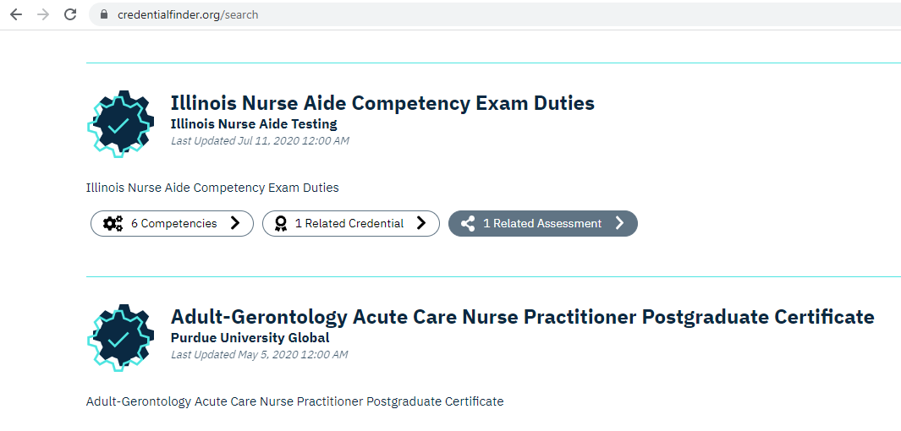
Metadata Aligned to Credentials and Jobs

Slide 85
Learning Objectives (Revisited)
Now that you have completed the tutorial, you should be able to:
Describe the use cases that a metadata strategy enables.
Describe the benefits of technical standards.
Describe what an RDF Application Profile is and some of the benefits for interoperability with current approaches as related to metadata standards.
Describe how a P2881-centred metadata approach, which re-uses established standards like LRMI, directly enables many use cases.
Populate a metadata graph and understand how it enables the lifecycle of learning resources and learning events.

Slide 86
Questions?
Andy Johnson
Specs and Standards Manager (SETA)
Andy.johnson.ctr@adlnet.gov
@AndyJohnsonADL
Phil Barker
Technology and Standards Consultant
phil.barker@pjjk.co.uk
http://people.pjjk.net/phil

