Slide 1


Using OMG DDS for Secure Interoperability Between Multiple Distributed LVC Simulators using MOSA
Presenter 1, Rob Proctor/Real-Time Innovations
Presenter 2, John Breitenbach/Real-Time Innovations

Slide 2
Agenda
The Modular Open Systems Approach (MOSA) and the US DoD Data Strategy
Why is the DoD calling for Data-Centricity
Why are these are required for all DoD systems
Introduction to Interoperability and Interconnectivity
What are the different levels of interoperability
What are the requirements for semantic interoperability
Intro to Data Distribution Service (DDS) an Object Management Group (OMG) Standard
The history and makeup up the OMG DDS standards
How OMG DDS is a data-centric publish-subscribe protocol
How do the features of OMG DDS provide interoperability within and between systems, including APIs, Quality of Service (QoS), Discovery, and Wide Area Network (WAN) connectivity
Intro to OMG DDS Secure, OMG Standard
Authentication, Role-Based Access Control, Encryption, Data Tagging, and Event Logging
Fine-grained security configuration including securing individual data topics
Examples of securing real-time distributed LVC simulations with OMG DDS

Slide 3
Tutorial Learning Objectives
After taking this tutorial you should be able to:
Understand the Requirements for Data-Centricity and MOSA
Understand the different layers of interoperability
Describe the OMG DDS suite of standards
Explain the principles of the OMG DDS Secure standard for securing communications between distributed simulations over WAN/Cloud/RF/Lossy networks
Explain how OMG DDS works with the simulation standards TENA, HLA and DIS
Summarize how OMG DDS works with real-world Hardware In the Loop (HIL) for secure distributed LVC simulations at scale

Slide 4

Data-Centricity Definition
Data centric refers to an architecture where data is the primary and permanent asset, and applications come and go

Slide 5
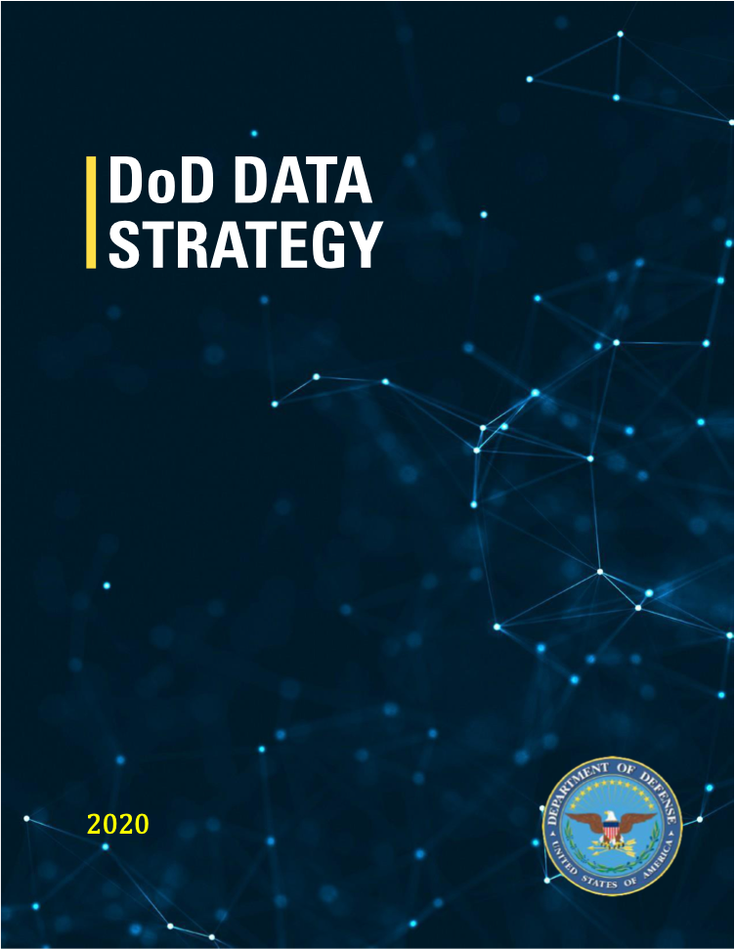
The Demand for Data-Centricity also applies to LVC
DoD Data Strategy
Unleashing Data to Advance the National Defense Strategy
“It is the responsibility of all DoD leaders to treat data as a weapon system and manage, secure, and use data for operational effect”
Vision: “The DoD is a data-centric organization that uses data at speed and scale for operational advantage and increased efficiency”
Notes:
Vision: “The DoD is a data-centric organization that uses data at speed and scale for operational advantage and increased efficiency”
One of the guiding principles:
Data for Artificial Intelligence Training – Data sets for A.I. training and
algorithmic models will increasingly become the DoD’s most valuable digital
assets and we must create a framework for managing them across the data lifecycle
that provides protected visibility and responsible brokerage.

Slide 6
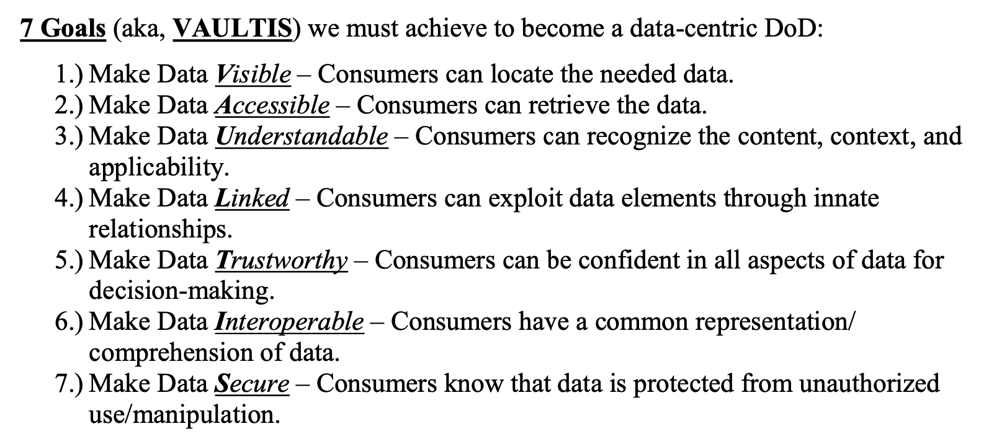
7 Goals to Becoming a Data-Centric DoD
From DoD Data Strategy (https://media.defense.gov/2020/Oct/08/2002514180/-1/-1/0/DOD-DATA-STRATEGY.PDF)
Notes:
VAUL&I: are core DDS data-centric, data-model capabilities
T&S: Trustworthy and Secure are enable by DDS Secure
1. Make Data Visible -- Consumers can locate the needed data
2. Make Data Accessible -- Consumers can retrieve the data
3. Make Data Understandable -- Consumers can recognize the content, context, and applicability
4. Make Data Linked - Consumers can exploit data elements through innate relationships
5. Make Data Interoperable -- Consumers have a common representation / comprehension of data
6. Make Data Trustworthy -- Consumers can be confident in all aspects of data for decision-making
7. Make Data Secure -- Consumers know that data is protected from unauthorized use / manipulation
So, sims for training need to be interoperable meanwhile there are these new MOSA and Data-Centric requirement mandates.

Slide 7
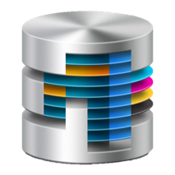
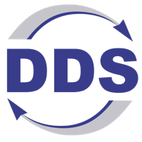
About Data Centricity
Data Centricity Definition
The interface is the data
The infrastructure understands that data
The system manages the data and imposes rules on how applications exchange data
Application
Application
Message centric
Remote Objects
SOAs
Data
Application
Application
Database
Databus
Data centric storage and
searching of old data
Data centric sharing and
filtering of data in motion
SELECT * FROM ShapeData
WHERE color=‘RED’ AND shapesize > 10;
cft = create_contentfilteredtopic_with_filter(
”MyFiltered_topic”, ShapeData_topic,
”(color MATCH ‘RED’) AND (shapesize > 10)”, … );
Notes:
The interface is the data.
There are no artificial wrappers or blockers to that interface like messages, or objects, or files, or access patterns.
The infrastructure understands that data.
This enables filtering/searching, tools, & selectivity. It decouples applications from the data and thereby removes much of the complexity from the applications.
The system manages the data and imposes rules on how applications exchange data.
This provides a notion of "truth". It enables data lifetimes, data model matching, CRUD interfaces, etc.
Databases are data-centric storage. They fit all the above: a) Data tables directly describe data. Unstructured databases also provide direct data access. Applications interact only with the table, not with the location of the data in a file. b) The database provides an environment to search, match, and manage data. I can access data, or write a tool that manipulates the data without talking to whoever put the data there. SQL is a language that leverages this power. c) The database imposes ACID properties. The data won't get corrupted, etc. In a system, the data in the database is Truth. (what's the right value of this data?) DDS is a data-centric communications. a "databus". It also fits all of the above: a) IDL defines data types, and then you interact with those types. b) You can filter data, write tools, & select what you want directly. We also leverage an SGL-like capability. c) The databus imposes QoS rules. The notion of truth is very well defined. It includes timing (how old is this data? how fast will I get it?)
In summary, data-centric systems manage state directly. Applications interact by directly accessing that state. Note that the method of storage or the pattern of interaction is orthogonal. If you want a sound bite, I had one in my 2012 webinar on "The single most important decision in designing your distributed system": Will the apps manage truth & the infrastructure exchange messages? Or Will the infrastructure manage truth& the apps exchange state?
Common “truth” for integration
Extreme reliability & scalability
Right data, right time, right place
Intelligence in the infrastructure
not complexity in the application code
No startup dependencies
Generic tools and analyzers

Slide 8
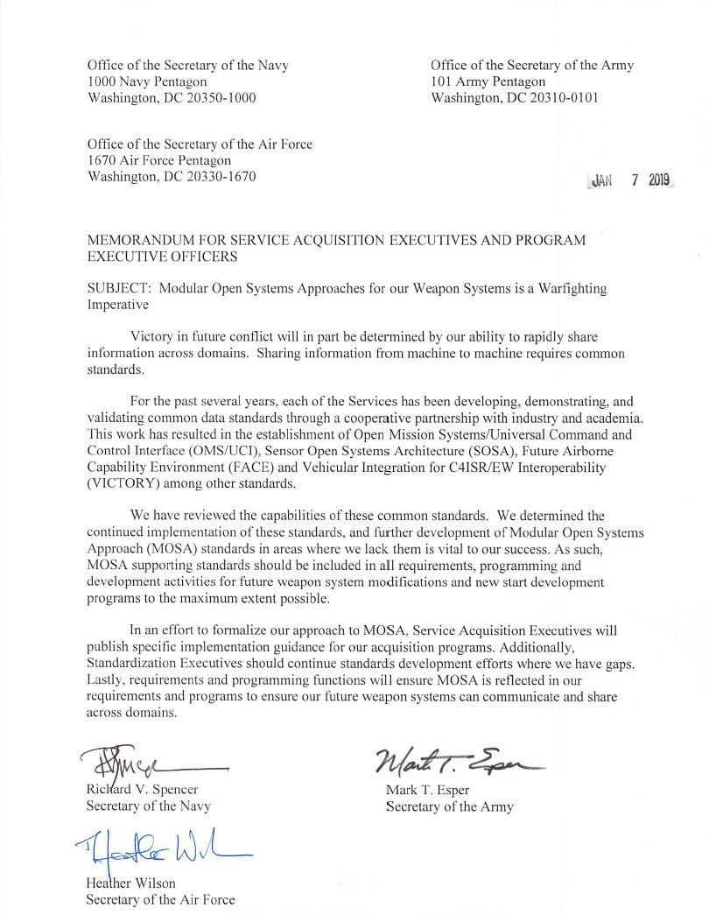
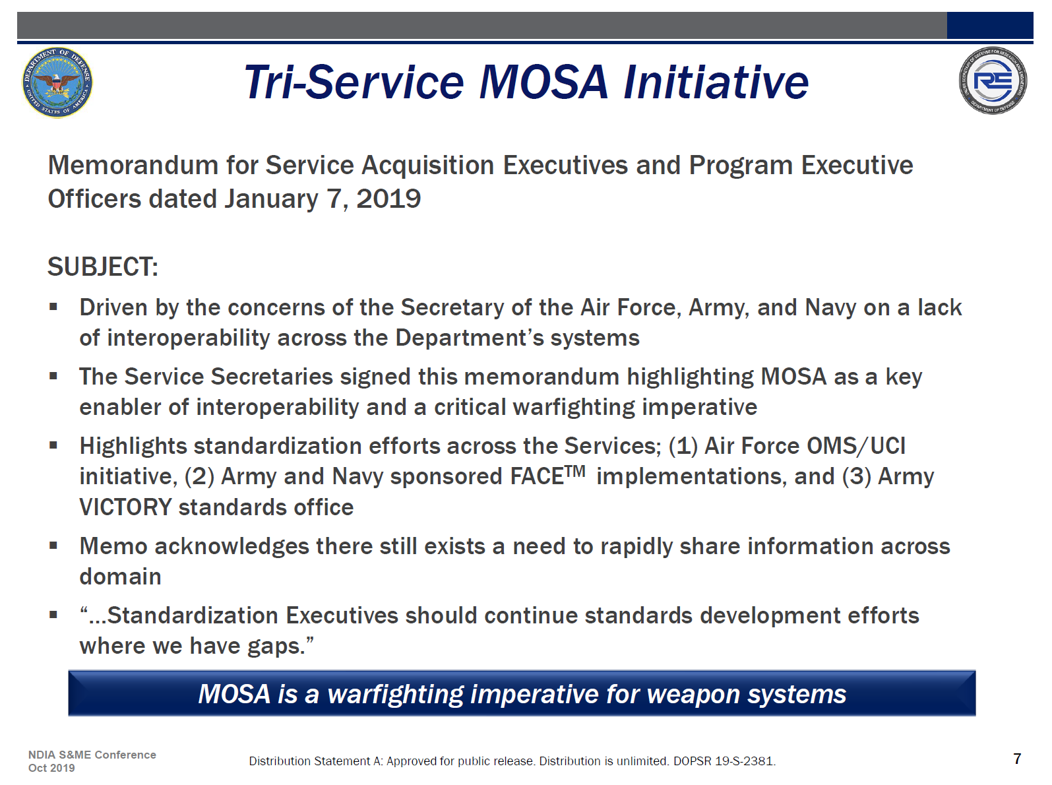
Tri-Service MOSA Initiative builds on Data Centricity

Slide 9
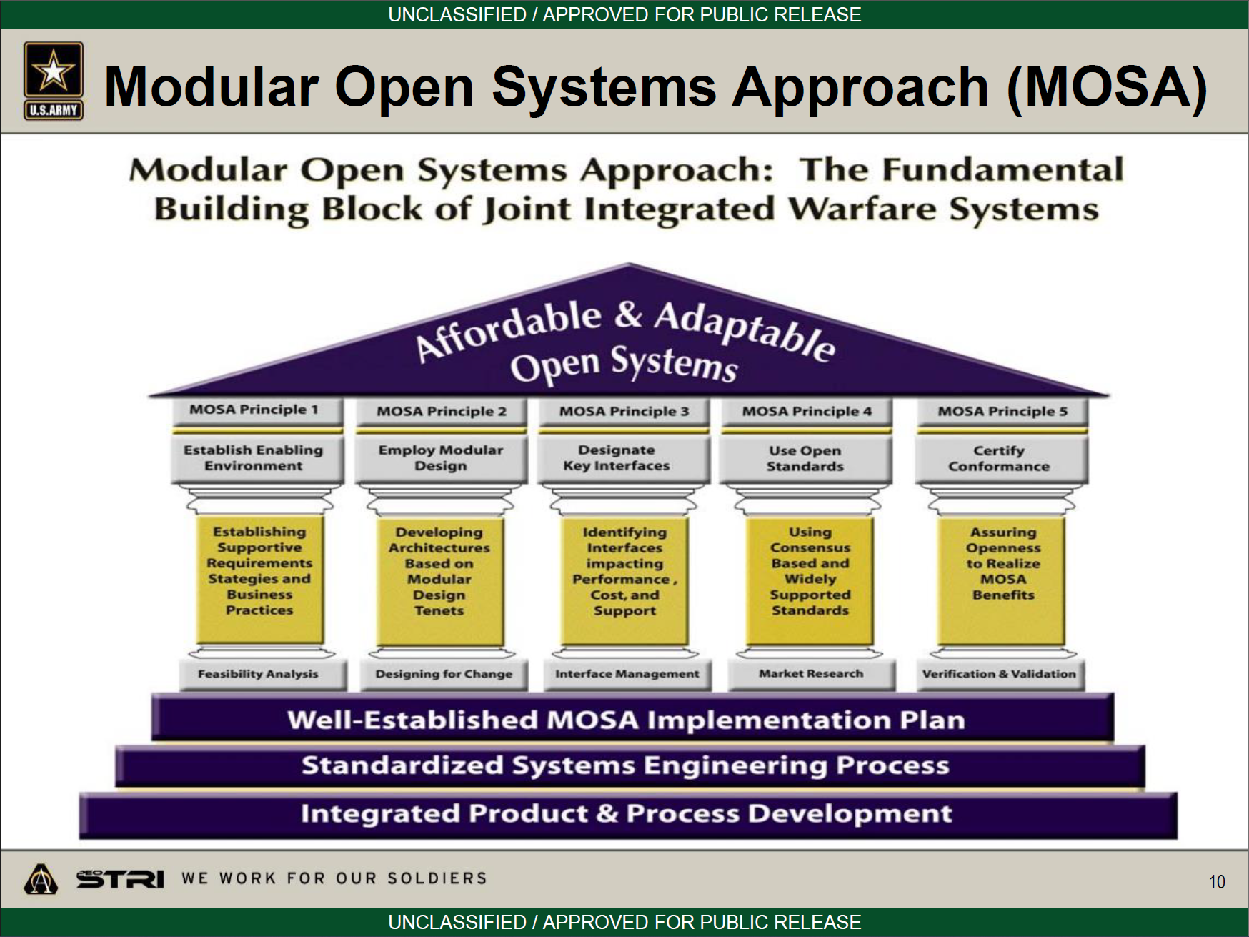

Modular Open Systems Approach (MOSA)
Across the Joint forces in the MS&T community, the need for MOSA has been fully embraced
MOSA has five main principles
Establish Enabling Environments
Employ Modular Design
Designate Key Interfaces
Use Open Standards
Certify Conformance
PEO STRI Presentation

Slide 10
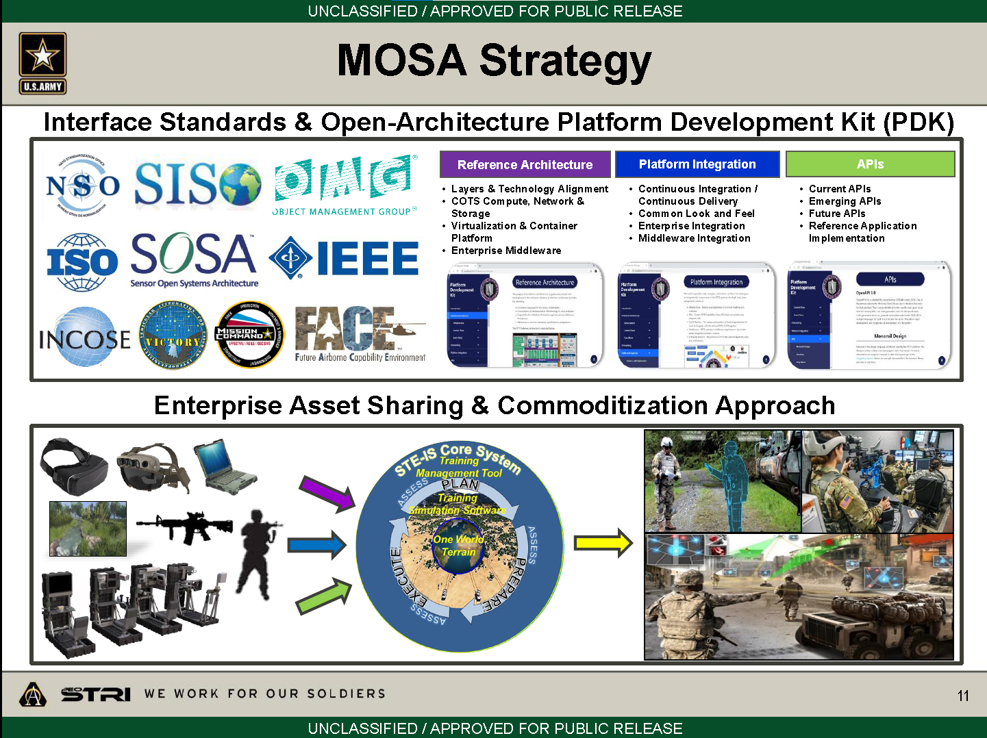


Slide 11
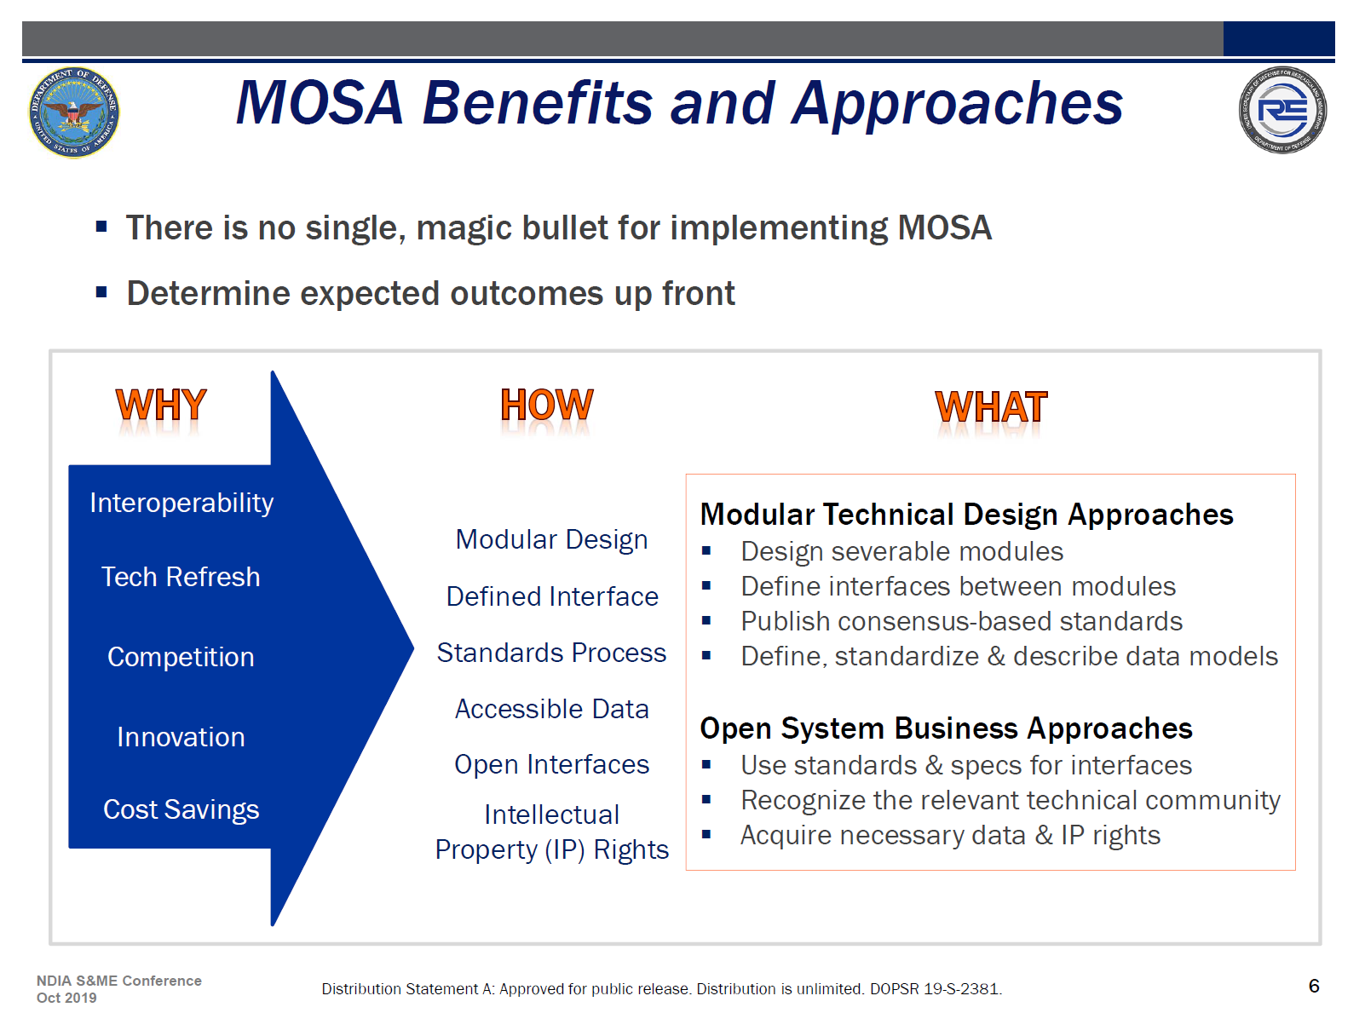
MOSA Goals in Standardization
Enable system components and platforms to be, competed, and independently developed throughout the lifecycle
Support using common, reusable hardware and software components that can be more readily adapted and refreshed, allowing DoD to deploy and support the latest technologies.
Provide the ability for competition of replacement elements, when properly supported by appropriate data rights/intellectual property access
Modular, open systems with standardized interfaces facilitate innovation and competition in future technology insertion and refresh efforts
- Defense Acquisition Guide Ch. 3–4.1.8 Interface Management Process

Slide 12
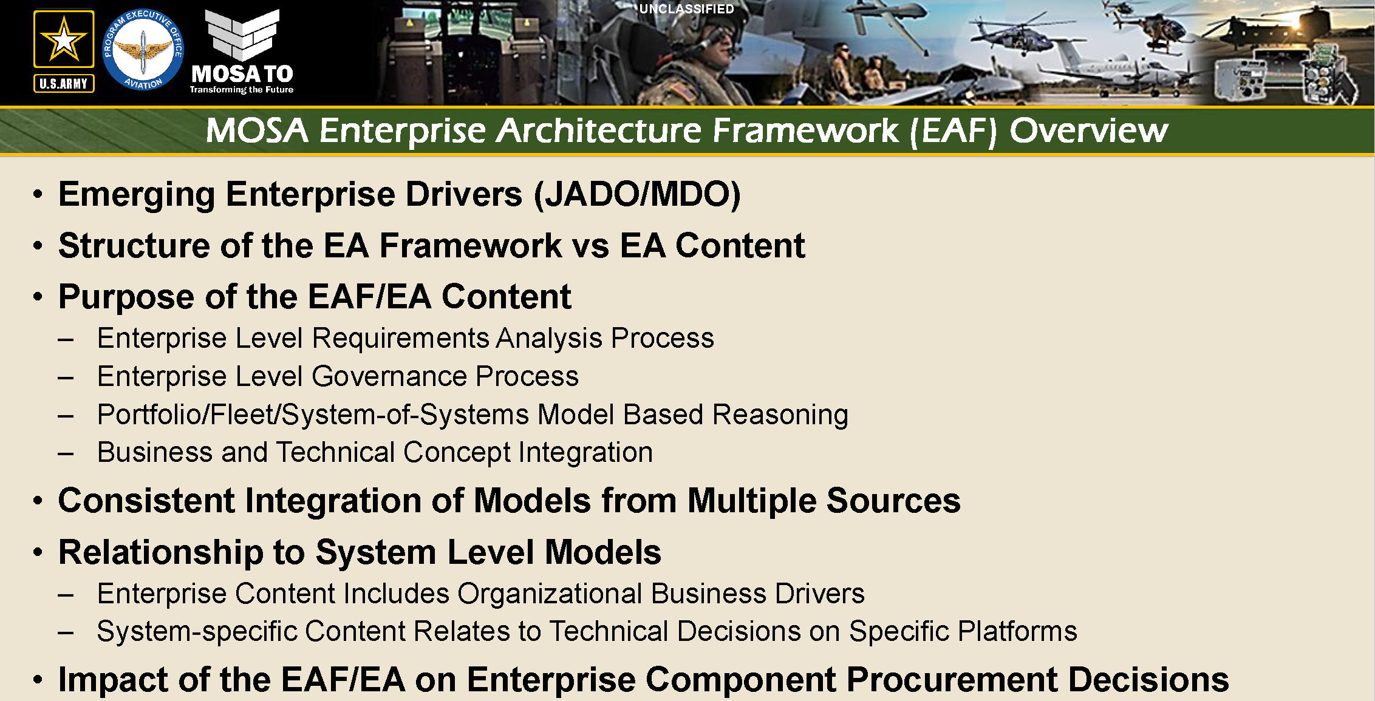
Army PEO Aviation MOSA EAF Overview

Slide 13
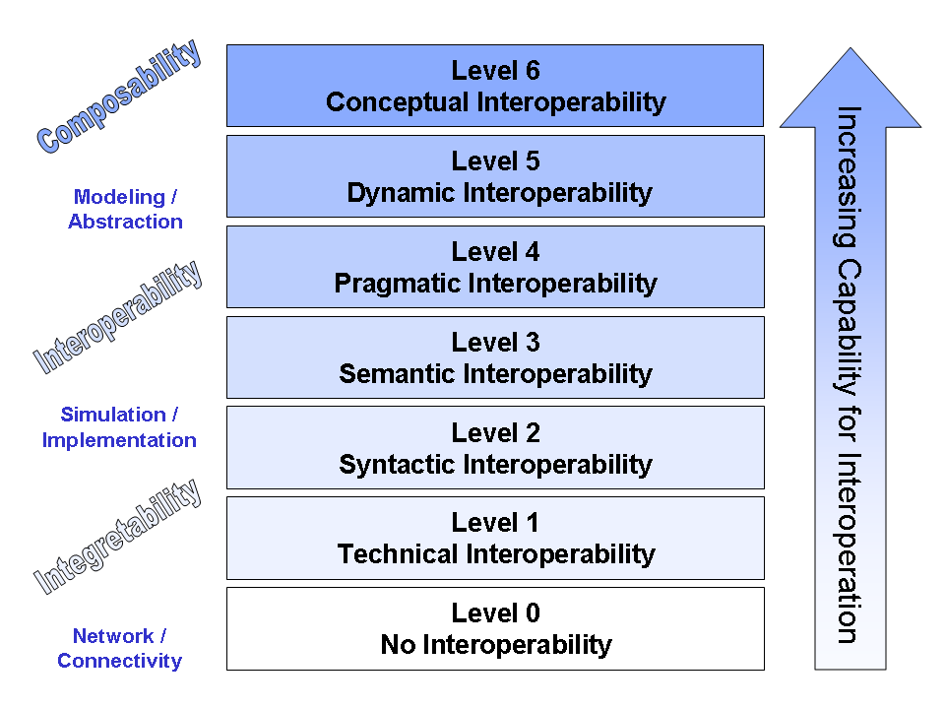
Levels of Interoperability
Shared data context
Shared data structure
Shared opaque data
The Industrial Internet of Things Volume G5: Connectivity Framework https://www.iiconsortium.org/pdf/IIC_PUB_G5_V1.01_PB_20180228.pdf
Notes:
IIRA defines: Connectivity = Infrastructure for Communications Interoperability
Example: Two people are integrable (level 1) if both are able to speak and listen; interoperable (level 2) if they speak the same language; and composable (level 3+) if they share similar educational background so that enables them to collaborate on specific tasks.
Syntactic interoperability: make it easy to share types. Evolve those types. Be typesafe
Semantic interoperability: select an existing or industry-specific model and use it. Generic data modeling is hard. Mandate all lower levels.
Stop here. Above this is human work
Level 0: Stand-alone systems. No Interoperability.
Level 1: Technical Interoperability. A communication protocol exists for exchanging data between participating systems. On this level, a communication infrastructure is established allowing systems to exchange bits and bytes, and the underlying networks and protocols are unambiguously defined.
Level 2: Syntactic Interoperability. A common structure to exchange information; i.e., a common data format is used. On this level, a common protocol to structure the data is used; the format of the information exchange is unambiguously defined. This layer defines structure.
Level 3: Semantic Interoperability. The meaning of the data is shared; the content of the information exchange requests are unambiguously defined. This layer defines (word) meaning. There is a related but slightly different interpretation of the phrase semantic interoperability, which is closer to what is here termed Conceptual Interoperability, i.e. information in a form whose meaning is independent of the application generating or using it.
Level 4: Pragmatic Interoperability is reached when the interoperating systems are aware of the methods and procedures that each system is employing. In other words, the use of the data – or the context of its application – is understood by the participating systems; the context in which the information is exchanged is unambiguously defined. This layer puts the (word) meaning into context.
Level 5: Dynamic Interoperability: As a system operates on data over time, the state of that system will change, and this includes the assumptions and constraints that affect its data interchange....
Level 6: Conceptual Interoperability …

Slide 14
IIoT Connectivity Stack Model
Participant X
Participant Y
Distributed Data
Interoperability and Management
Information (Data in Context)
Distributed Data
Interoperability and Management
Semantic
Interoperability
(data context)
Information
Framework
Data (State, Events, Streams)
Framework
Syntactic
Interoperability
(data structures)
Connectivity
Transport
Messages
Transport
Technical
Interoperability
(bytes)
IICF Focus
Network
Packets
Network
Networking
Link
Frames
Link
Physical
Bits
Physical
The Industrial Internet of Things Volume G5: Connectivity Framework https://www.iiconsortium.org/pdf/IIC_PUB_G5_V1.01_PB_20180228.pdf
Notes:
Framework & Transport Layer
How to get interoperable data?
What is the lingua franca?
Get all parties to communicate!
Assume, Networking layer already setup
People know how to do this
Recognize the other layers

Slide 15
Connectivity Transport Layer
Framework
Distributed Data Interoperability & Management
Transport
Connectivity
Transport
Functions
Messaging Protocol
Technical
Interoperability
Communication Modes
Endpoint
Addressing
Connectedness
Prioritization
Timing & Synchronization
Security
Network
Link
Physical
The Industrial Internet of Things Volume G5: Connectivity Framework https://www.iiconsortium.org/pdf/IIC_PUB_G5_V1.01_PB_20180228.pdf

Slide 16
Connectivity Framework Layer
Framework
Distributed Data Interoperability & Management
API
Governance
Connectivity
Framework
Functions
Publish-Subscribe
Request-Reply
Discovery
Exception Handling
Quality of Service (QoS)
Security
Syntactic
Interoperability
Data Resource Model
Id and Addressing
Data Type System
Lifecycle (CRUD)
State Management
Transport
Network
Link
Physical
The Industrial Internet of Things Volume G5: Connectivity Framework https://www.iiconsortium.org/pdf/IIC_PUB_G5_V1.01_PB_20180228.pdf
Notes:
Data Resource Model = Meta-Model for modeling application data/resources
Exception Handling = e.g. disconnects. Or when QoS cannot be met. System detects changes that cannot be healed.

Slide 17
OMG DDS Interoperability
OMG DDS is
An interoperability framework for Real-Time systems that is transport agnostic
OMG DDS uses the notion of a logical software-based Databus
OMG DDS supports ANY data model, and makes the Data itself the interface
In fact, the OMG DDS connectivity framework is something that you build upon when you set out to create a new interoperability standard based on an industry-specific data model
The result is that OMG DDS underpins a lot of familiar standards…
OMG DDS provides interoperability between
Other implementations of OMG DDS
Any communication standards (DIS, TENA, HLA, Modbus, OPC-UA, etc.)
1000s of DoD live systems
Notes:
Current simulation standards are a great what and why. DDS is the best how.

Slide 18
OMG DDS is under the hood of many standards
Standard | Industry
Modular Healthcare Simulation and Education System (MoHSES) | Simulation / Healthcare
ALert MAnagement Service (ALAMS) | Defense
Application Management and Systems Monitoring (AMSM) | Defense
Future Airborne Capabilities Environment (FACE) | Defense
Generic Vehicle Architecture (GVA) NATO Generic Vehicle Architecture (NGVA) | Defense
Land Open Systems Architecture (LOSA) | Defense
Medical Simulation Training Architecture (MSTA) | Simulation / Healthcare
Open Field Message Bus (OpenFMB) | Power / Energy
Open Mission Systems (OMS) | Aerospace
Open Process Automation Forum (OPAF) | Process Automation
Standard | Industry
Open Robotics Robotic Operating System v2 (ROS2) | Horizontal / Robotics
Sensor Open System Architecture (SOSA) | Defense
Tactical Microgrid Standards Consortium (TMSC) | Energy
Unmanned Systems (UxS) Control Segment (UCS) Architecture | Defense
Robot Operating System-Military; Robotic Technology Kernel (ROS-M and RTK) | Defense / Robotics
Joint Architecture for Unmanned Systems (JAUS) | Defense / Robotics
Naval Open Systems Architecture (OSA) | Defense
Control Architecture for Robotic Agent Command and Sensing (CARACaS) | Aerospace / Autonomous Vehicles
Multi-Robot Operator Control Unit (MOCU) | Aerospace / Robotics
Unmanned Maritime Autonomy Architecture (UMAA) | Defense / Autonomous Vehicles

Slide 19
Why is OMG DDS so widely used ‘under the hood’ for these standards?
Hypertext Transfer Protocol (HTTP) – UNIVERSAL TRANSPORT Representational State Transfer (REST) – UNIVERSAL API
Used together they build the vast majority of web-based applications
Good for human speed, but tends to be 1-1; you connect to the bank, email, website, etc.
But what about real-time applications?
And live real-time systems that might have communication needs such as:
1 to many
many to 1
many to many (thousands of actual participants to millions of entities)
with real-time speeds and security requirements

Slide 20
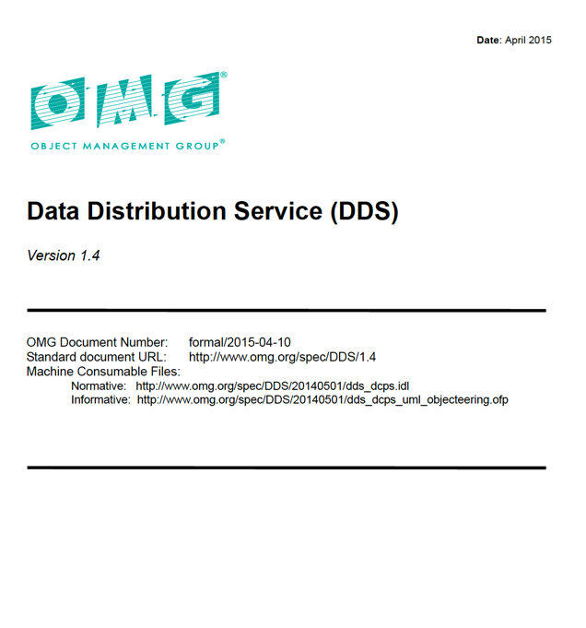
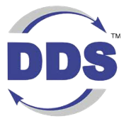
OMG Data Distribution Service Standard
From OMG, systems software standards organization
Digital Twin Consortium
UML, XML, IDL, CORBA, DDS
Standard can be downloaded for free by anyone
More than a dozen commercial implementations available
First version of the OMG DDS standard was released in 2004
Most recent updates were May 2019
A family of 13 standards covering API, wire protocol, security, type evolution, etc.

Slide 21
OMG Data Distribution Service Standard
OMG DDS is a standard for data-centric connectivity and interoperability for real-time systems
Data-Centric Publish-Subscribe model for distributed application communication and integration
Standardizes wire protocol, serialization format and API
OMG DDS is open and multi-vendor
Open Standard and Open Source
12+ implementations
Interoperability between source written for different vendors
OMG DDS APIs: Data Centric Publish Subscribe (DCPS)
OMG DDS Security
Plug-In
QoS
Distribution Fabric
QoS
QoS
Real-Time Publish Subscribe
Wire Protocol (RTPS)
Interoperability between applications running on different implementations

Slide 22
OMG Data Distribution Service Standard
OMG DDS is Publish-Subscribe, Data-Centric, and Peer-to-Peer
OMG DDS also supports request-reply and queueing
Designed for real-time mission critical and safety critical systems
Started in Robotics and SW Defined Radios using Tactical Data Links
Navy wanted it turned into an open standard, now widely used in the Navy
OMG DDS applications share large amounts of data quickly, securely, and reliably at massive scale
OMG DDS provides location transparency, decentralized operation, dynamic scalability, and real-time performance
Its widespread use in distributed real-time military systems has led to strong interest in the modeling, simulation and training community

Slide 23
OMG DDS is made for real-time interoperability
OMG DDS defines
Open API for portability
Open wire protocol for interoperability
Transport agnostic
Open explicit defined QoS and discovery
Highly configurable
Multiple language bindings
C, C++, Java, C# .NET, Ada
LabVIEW, MATLAB/Simulink
Python, NodeJS
Multi platform support
Windows, Linux, Unix, embedded OS, Docker, Kubernetes
Application
Standard API
OMG DDS Middleware
Data Management (QoS)
OMG DDS Security
Standard Protocol
UDP
TCP
RT-WAN
Shmem
Operating System

Slide 24
Data-Centric Model
“Global Data Space” generalizes Subject-Based Addressing
Data objects addressed by Domain ID, Topic and Key
Domains provide a level of logical isolation (Topic name space)
Types define the structure of Topics
Keys are a unique generalization of a subject
Realization of a Topic are:
Instances are a keyed row entry of a Topic
Samples are a time series of updates of an instance
Domain
Data Writer
Topic
Data Reader
Key (subject)
Type
Instance
Airline | Flight | Destination | Time
SWA | 023 | PDX | 14:05
UA | 119 | LAX | 14:40
Data Writer
Data Reader
Data Writer
Sensor | Value | Units | Location
TT201 | 72 | Fahrenheit | Bldg. 405
TT305 | 72 | Fahrenheit | Bldg., 201
IT105 | 467 | Amps | Substation 10
Sensor | Value | Units | Location
TT201 | 72 | Fahrenheit | Bldg. 405
TT305 | 66 | Fahrenheit | Bldg., 201
IT105 | 467 | Amps | Substation 10
Sensor | Value | Units | Location
TT201 | 72 | Fahrenheit | Bldg. 405
TT305 | 64 | Fahrenheit | Bldg., 201
IT105 | 467 | Amps | Substation 10
Sensor | Value | Units | Location
TT201 | 72 | Fahrenheit | Bldg. 405
TT305 | 78 | Fahrenheit | Bldg., 201
IT105 | 467 | Amps | Substation 10
Samples
Data Writer
Data Reader

Slide 25
OMG DDS Data Centric Publish Subscribe API
The OMG DDS API lets applications publish data to, and subscribe to data from the OMG DDS Databus
This OMG DDS API is called Data Centric Publish Subscribe (DCPS)
The API is standardized in the OMG DDS v1.4 standard, as a “Platform Independent Model” (PIM)
API operations are mapped to different languages through a “Platform Specific Model” (PSM)
The DCPS API is divided up into “entities” (way different than a simulation entity) which allow an application to:
connect to the DDS Databus
create topics
get notified of infrastructure-level events (new subscriber, new publisher, …)
publish and subscribe to application data
Each OMG DDS entity has a set of QoS settings that determine the behavior of the entity

Slide 26
OMG DDS Publish Subscribe API: Entities
DomainParticipant
Create & manage connection to OMG DDS Databus

Slide 27
OMG DDS Publish Subscribe API: Entities
DomainParticipant
<< creates >>
Topic
Create a proxy to a topic in the application

Slide 28
OMG DDS Publish Subscribe API: Entities
DomainParticipant
<< creates >>
<< creates >>
Manages group of DataWriters
Manages group of DataReaders
Publisher
Topic
Subscriber
<< creates >>
<< creates >>
DataWriter
DataReader

Slide 29
OMG DDS Publish Subscribe API: Entities
DomainParticipant
Publisher
Topic
Subscriber
<< creates >>
<< creates >>
DataWriter
<< uses >>
DataReader
<< uses >>
Publishes data to OMG DDS Topic
Subscribes to data from OMG DDS Topic

Slide 30
OMG DDS Publish Subscribe API: Entities
DataReaders (DR) and DataWriters (DW) are strongly typed
Their APIs are generated from Interface Definition Language (IDL)
struct ShapeType {
string<128> color;
long x;
long y;
long shapesize;
};
ShapeTypeDataWriter_write
ShapeTypeDataWriter_dispose
ShapeTypeDataReader_read
ShapeTypeDataReader_take

Slide 31
Simple API Interface
void publisher_main(int domain_id) {
// Initialize
dds::domain::DomainParticipant participant (domain_id);
// Create a Topic
dds::topic::Topic<foo::TopicType> topic (participant, "MyTopic");
// Create a Data Writer
dds::pub::DataWriter<foo::TopicType> writer(dds::pub::Publisher(participant), topic);
// Create some data
foo::TopicType sample("Hello World");
// Write the data
writer.write(sample);
}

Slide 32
OMG DDS Topic Data Types
struct MyType {
long sensorID; //@Key
long plantID; // @Key
float sensorVal0;
float sensorVal1;
float sensorVal2;
float sensorVal3;
float sensorVal4;
Version version;
Time currentTime;
}
struct Version {
string firmwareVersion;
string hardwareVersion;
string modelNumber;
string serialNumber;
}
struct MyType {
long sensorID; //@Key
long plantID; // @Key
string data;
string version;
}
Where data =
<SENSOR>
<Value0>21.0546</Value0>
<Value1>43.6</Value0>
<Value2>56.34</Value0>
<Value3>12.11</Value0>
<Value4>20.00</Value0>
</SENSOR>
version =
<VERSION>
<firmware>1.24b</firmware>
<hardware>2.39</hardware>
<model>M56A743</model>
<serial>1429709<serial>
</VERSION>
struct MyType {
string data;
}
Where data =
<SENSOR>
<SensorID>438</SensorID>
<PlantID>192</PlantID>
<Value0>21.0546</Value0>
<Value1>43.6</Value0>
<Value2>56.34</Value0>
<Value3>12.11</Value0>
<Value4>20.00</Value0>
<firmware>1.24b</firmware>
<hardware>2.39</hardware>
<model>M56A743</model>
<serial>1429709<serial>
</SENSOR>
Strongly Typed
Mixed Type
Loosely Typed
Notes:
Tesla vs Hybrid vs DDS as a Truck

Slide 33
Datatype Info with Binary Data Transfer
<SENSOR>
<SensorID>438</SensorID>
<PlantID>192</PlantID>
<Value0>21.05</Value0>
<Value1>43.6</Value1>
<Value2>56.34</Value2>
<serial>14297<serial>
</SENSOR>
<SENSOR>
<SensorID>438</SensorID>
<PlantID>192</PlantID>
<Value0>16.37</Value0>
<Value1>13.9</Value1>
<Value2>88.03</Value2>
<serial>14297<serial>
</SENSOR>
<SENSOR>
<SensorID>438</SensorID>
<PlantID>192</PlantID>
<Value0>8.82</Value0>
<Value1>79.1</Value1>
<Value2>40.17</Value2>
<serial>14297<serial>
</SENSOR>
Data Reader
Filter:
Value1 > 20
Data
Writer
XML or JSON
Second Message
Third Message
struct MyType {
long sensorID; //@Key
long plantID; // @Key
float sensorVal0;
float sensorVal1;
float sensorVal2;
string serialNumber;
}
Data Reader
977a9c7bcb77a212967edfc6c44839323ad12de7e45aa4282216221f293d2b0eeba82a8e8f45a82c
977a9c7bcb77a212967edfc6c44839323ad12de7e45aa4282216221f293d2b0eeba82a8e8f45a82c
Filter:
Value1 > 20
Type Info Optionally Sent
Once During Discovery
Efficient Binary Representation

Slide 34
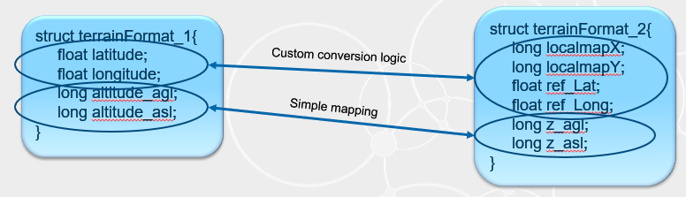
Data Type Extensibility
Final Type
Type definitions are strictly defined
Extensible Type
Newer applications can add fields to existing base types
Mutable Type
Type representations can differ from each other with Additions, Deletions and Transpositions
Support for Optional Fields
struct Track {
long id; //@key
float range;
float bearing;
}
struct Track {
long id; //@key
float range;
float bearing;
}
struct Track {
long id; //@key
float range;
float bearing;
}
struct AirTrack {
long id; //@key
float range;
float bearing;
float elevation;
}
struct Track {
long id; //@key
float range;
float bearing;
}
struct AirTrack {
long id; //@key
float elevation;
}
Notes:
Standard provides a mechanism for a chain of extensibility to evolve over time

Slide 35
Common Distributed Application Challenges
OMG DDS QoS Features
Reliability
In-Order Delivery
Content Filtering
Resource Limits
Partition
Deadline
Batching
Presentation
Ownership
Transports
Time Based Filter
Durability
Lifespan
Flow Control
Multi-Channel
Liveliness
Latency Budget
History
User, Group, Topic Data
Async Publisher
Transport
UDP
TCP
1-1, 1-Many
1 to 1
No Reliability
Reliability
Flow Control

Slide 36


Using OMG DDS QoS to Shape Data Flow
Collision avoidance application
Publisher
Radar Track
Topic
Reliable; 1 Hz; get history
Subscriber
Publish reliably
10 Hz
600 sample history
Best effort; 0.2 HZ; get history
NOC Sim
Subscriber
Nearby tracks with altitude < 5000m
ATC Sim
Subscriber
Discovery matches publishers and subscribers of a topic
Topics tied to Data type, allowing smarter databus
Quality of Service describing application data needs must be compatible to communicate
Specifying and relying only on these data properties enables decoupled, resilient systems

Slide 37
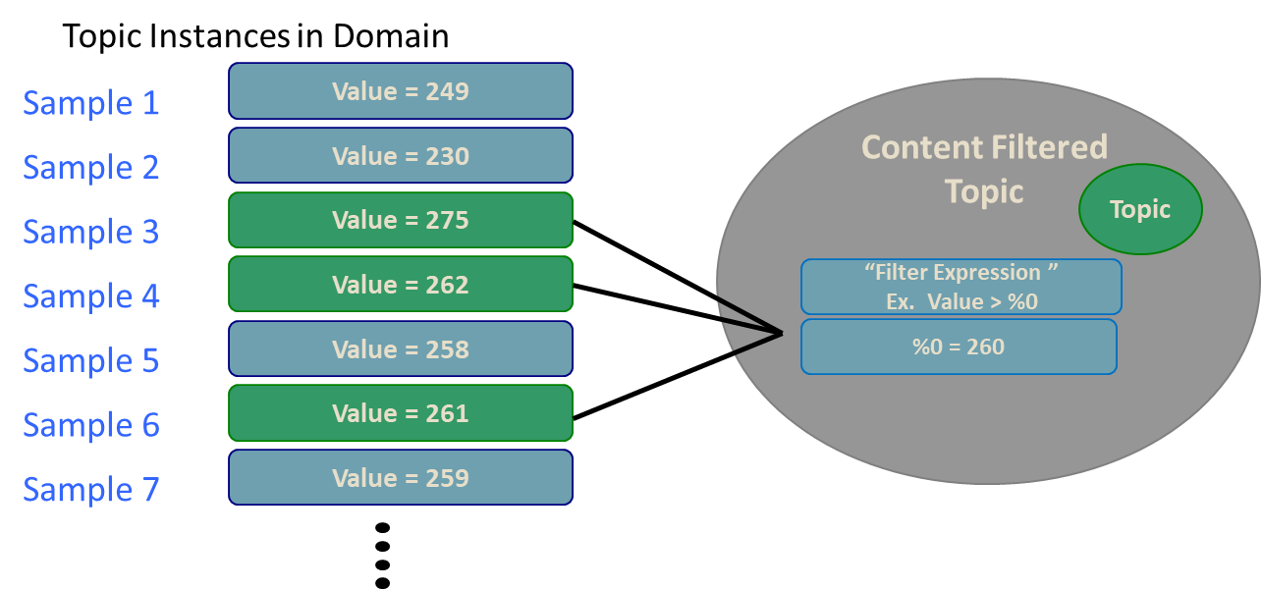
Content Filtered Topics
The Filter Expression and Arguments will determine which instances of the Topic will be received by the subscriber

Slide 38
OMG DDS Publish Subscribe API: QoS conflicts
The DataReader and DataWriter QoS must match if connectivity is to be established
QoS does not need to be equal. It is ok if a DataWriter offers “more” than what a DataReader asks for
Example: DW = Reliable, DR = Best Effort
DataReader
BEST EFFORT
BEST EFFORT
DataWriter
DataReader
RELIABLE

Slide 39
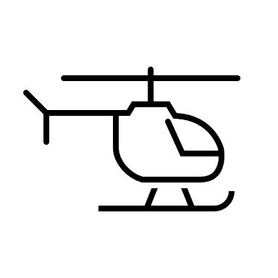
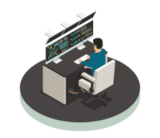
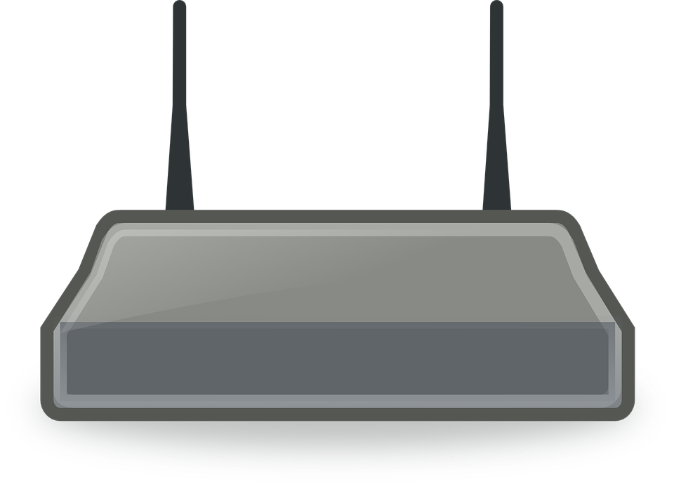

Wide Area Distributed Applications
Asset at the Edge
On-site Operation Center
Wide area distributed applications have more technical challenges
Network changes over time (ex. Wi-Fi to Cellular)
Scalability of data transport and cloud services
Edge device authentication and data security
INTELLIGENT LOGGING AND ANALYTICS, ASSISTANCE
MULTI-VEHICLE ANALYTICS, ASSIST, STORE & FORWARD LOGGING
NAT
NAT
OMG DDS WAN Databus
Cloud
Remote Monitoring, Analytics and Assistance
NAT
MULTI-SITE ANALYTICS & ML, STORE LOGGING

Slide 40

Data Flow Over the Wide Area Network (WAN)
Require:
High performance connectivity across diverse networks
Device mobility support across networks
Scalability with a much larger number of endpoints
Data security at minimal cost (bandwidth, latency etc.)
NAT traversal support

Slide 41
OMG DDS real-time WAN Transport
Smart transport enabling secure, scalable, and high-performance communication over WANs, including public networks
Features include:
UDP based WAN connectivity
Network Address Translator (NAT) traversal
Support for IP mobility
No third-party system dependence, such as STUN servers
Direct Edge-Edge communication
OMG DDS Databus @ Edge
Real-Time WAN Transport
Gateway
OMG DDS Databus @ WAN
Real-Time WAN Transport
OMG DDS Application

Slide 42

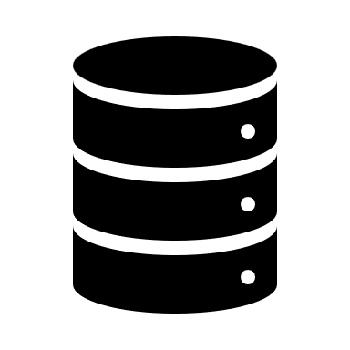




OMG DDS Across a WAN
Edge-to-Data Center connectivity across a WAN
Edge-to-Edge connectivity across a WAN
OMG DDS connectivity within Data Centers and Edge Systems
Data
Center
Analyze
Store
Aggregate
Databus
NAT
Real-Time WAN Transport
OMG DDS WAN Databus
Edge
Systems
NAT
Databus
System Component
Real-Time WAN Transport
Notes:
Not only can edge systems communicate back to a central system, but they can also communicate with each other.

Slide 43
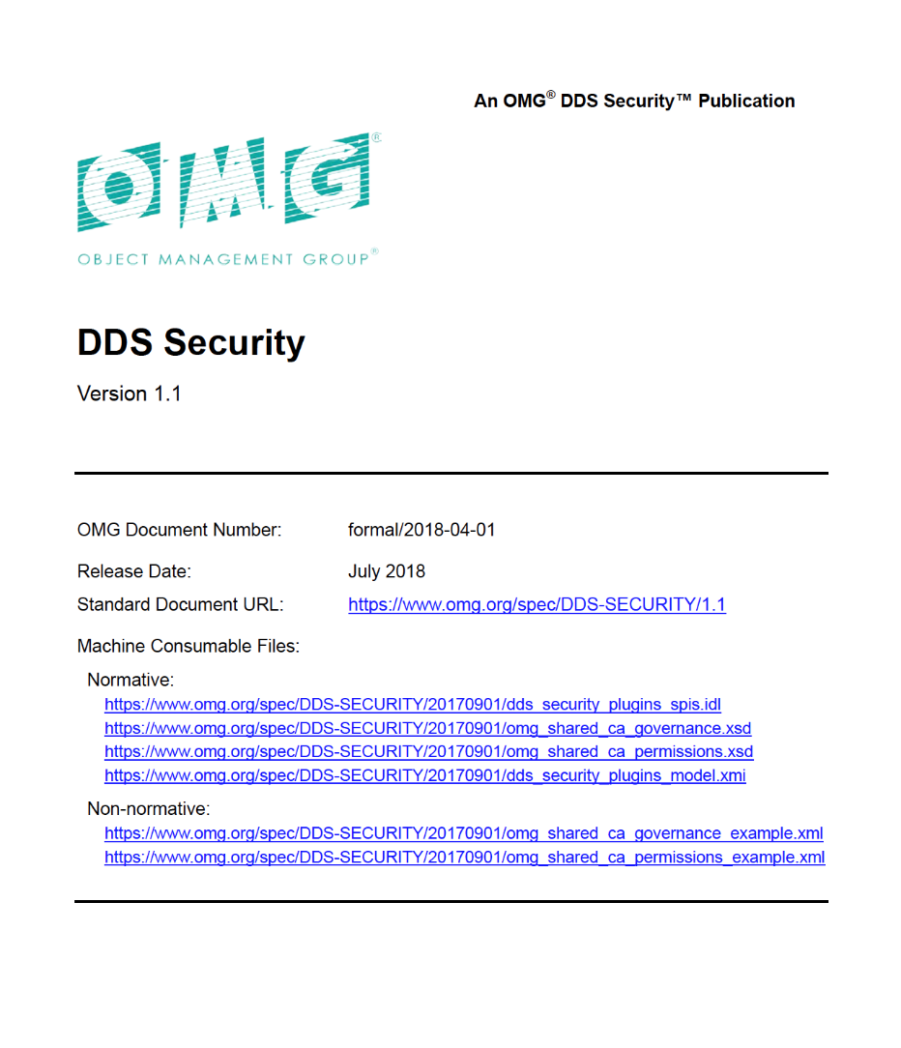

OMG DDS Security Standard
OMG released the DDS Security specification (v1.1) in July 2018
Collaboratively developed by several OMG DDS vendors
Defines:
OMG DDS Security Model
Service Plugin Interface (SPI) Architecture

Slide 44
OMG DDS Security Standard
Security Plugs into OMG DDS Middleware
Secures data-in-motion throughout the system
Can easily take DIS PDUs or TENA / HLA FOMs and convert them to Secure OMG DDS Topics
Programming language and Operating System interoperability
Decentralized, Peer-to-Peer, and Highly Configurable
Fine-grained access control and security levels for each topic and partition
Each participant separately authenticated through mutual authentication
OMG DDS Security has been vetted at the Cybersecurity Warfare ranges at Quantico, VA and Orlando, FL
USAF has funded a SBIR project for Multi-Level Security for LVC simulations
OMG DDS Security is a natural fit for Multi-Domain Operations systems
Joint Battle Command Platform JBC-P
Integrated Air and Missile Defense Battle Control System IBCS
Cooperative Engagement Capability CEC
Universal Ground Control Station UGCS
All branches of the military, including Space Force, use OMG DDS

Slide 45
OMG DDS: Data-Centric, Fine-Grained Security
Per-Data-Topic Security
Control r,w access for each function
Ensures proper dataflow operation
Complete Protection
Discovery authentication
Data-centric access control
Cryptography
Tagging and logging
Non-repudiation
Secure multicast
100% standards compliant
Simulate
Visualize
Control
Operator
Applications
Data Topics
BaseEntity
Detonation
Fire
Data Topic Security model:
Simulate: Fire(r), BaseEntity(w)
Visualize: BaseEntity(r), Detonation(w)
Control: BaseEntity(r), Fire(w)
Operator: *(r), Fire(w)

Slide 46
Pluggable Architecture
Requires trivial or no change to existing OMG DDS apps and adapters
Includes default plugins; customizable
Runs over any transport
Including low bandwidth, unreliable
Does not require TCP or IP
Multicast for scalability, low latency
Completely decentralized
High performance and scalability
No single point of failure
Application
Authentication
OMG DDS Security Library
Access Control
Encryption
Logging
Data Tagging
Any Transport (e.g., TCP, UDP, multicast, RT-WAN, shared memory…)

Slide 47
Standard Capabilities (Built-in Plugins)
Authentication | X.509 Public Key Infrastructure (PKI) with a pre-configured shared Certificate Authority (CA) Digital Signature Algorithm (DSA) with Diffie-Hellman and RSA for authentication and key exchange
Access Control | Configured by domain using a (shared) Governance file Specified via permissions file signed by shared CA Control over ability to join systems, read or write data topics
Cryptography | aes-128-ctr for encryption HMAC-SHA256 for message authentication and integrity aes-128-gcm, aes-192-gcm and aes-256-gcm for encryption with authentication Certicom and Windows CNG for FIPS 140-2
Logging | Log security events to a file or distribute securely over OMG DDS
Data Tagging | Tags specify security metadata, such as classification level Can be used to determine access privileges (via plugin)

Slide 48
Domain Governance File
The domain governance document is an XML document that specifies which OMG DDS domain IDs shall be protected and the details of the protection
It is signed by the permissions CA

Slide 49
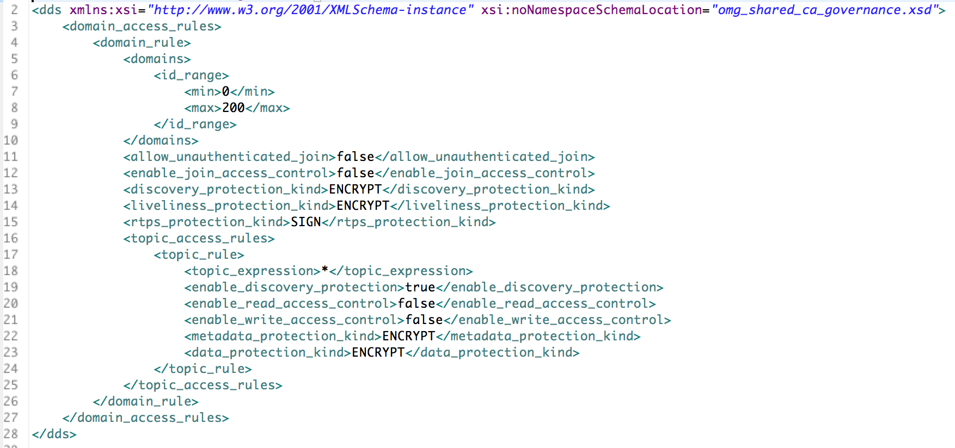
A Sample Governance File

Slide 50
Configuration Possibilities
Are “legacy” or un-identified applications allowed in the Domain?
If yes, an unauthenticated application will:
See the “unsecured” discovery Topics
Be allowed to read/write the “unsecured” Topics
Is a particular Topic discovered over protected discovery?
If so, it can only be seen by “authenticated applications”
Is access to a particular Topic protected?
If so, only authenticated applications with the correct permissions can read/write
Is data on a particular Topic protected? How?
If so, data will be sent signed or encrypted then signed
Are all protocol messages signed? Encrypted?
If so, only authenticated and authorized applications will see anything

Slide 51
Permissions Document
For each participant, specifies:
What domains it can join
What Topics it can read/write
What Partitions allowed for publish and subscribe
What Tags are associated with Readers & Writers

Slide 52
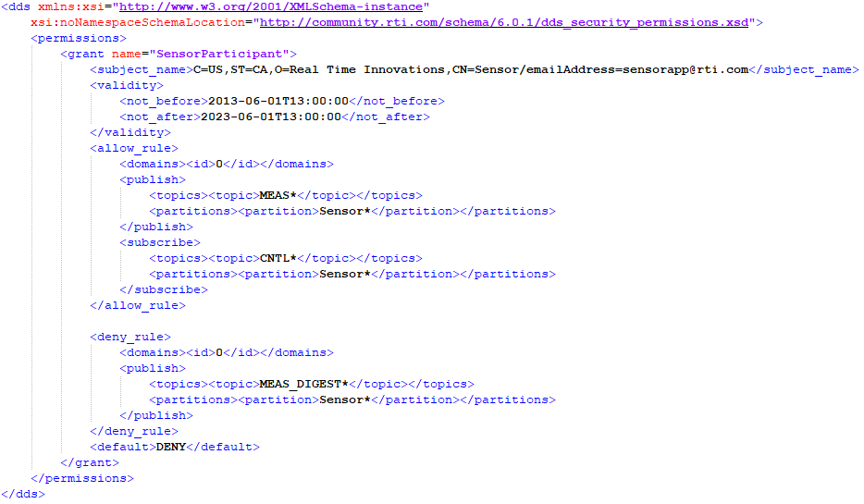
A Sample Permissions File

Slide 53
OMG DDS Publish Subscribe API: Entities
DomainParticipant
OMG DDS Security
OMG DDS Security
Publisher
Topic
Subscriber
<< creates >>
<< creates >>
DataWriter
<< uses >>
DataReader
<< uses >>

Slide 54
Configuring & Deploying OMG DDS Security
Participant 1
Participant 2
P1 Permissions File
P2 Permissions File
P1 Identity Certificate
P2 Identity Certificate
P1 App
P2 App
P1 Private Key
P2 Private Key
Shared By All Participants
Domain Governance
Document
Identity CA Public Certificate
Permissions CA Public Certificate

Slide 55
Using OMG DDS with distributed LVC simulations
Can leverage/ integrate existing system software
Over one thousand separate DoD systems (Navy, Air, Army) use OMG DDS
OMG DDS is mandated by Navy OA for combat management systems
OMG DDS specified by US DoD for the unmanned vehicle control (OSD-UCS)
OMG DDS specified by UK-MOD for all Ground Vehicle Architectures
OMG DDS is a transport for MOSA standards, FACE, SOSA, OMS, UCI
With OMG DDS, simulation systems are able to reuse and integrate software components from actual systems
This has already been happening for years
OMG DDS is the logical technology for integrating disparate data models in distributed LVC

Slide 56
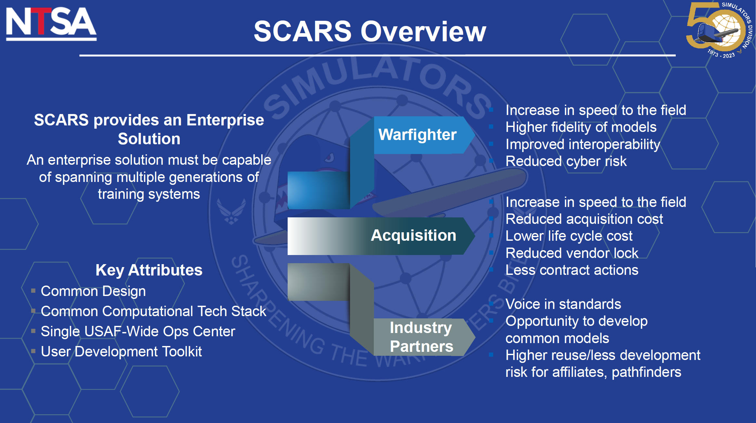

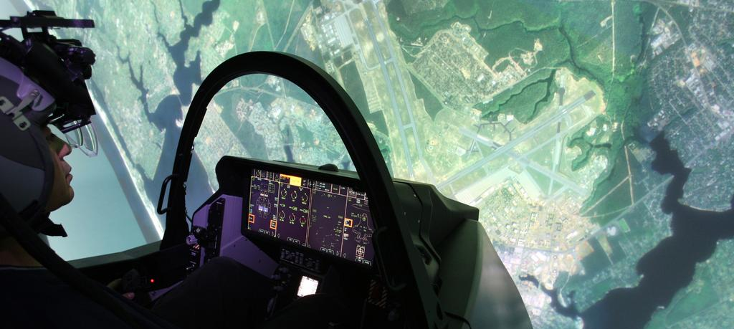
Air Force’s Simulators Common Architecture Requirements and Standards (SCARS) program

Slide 57
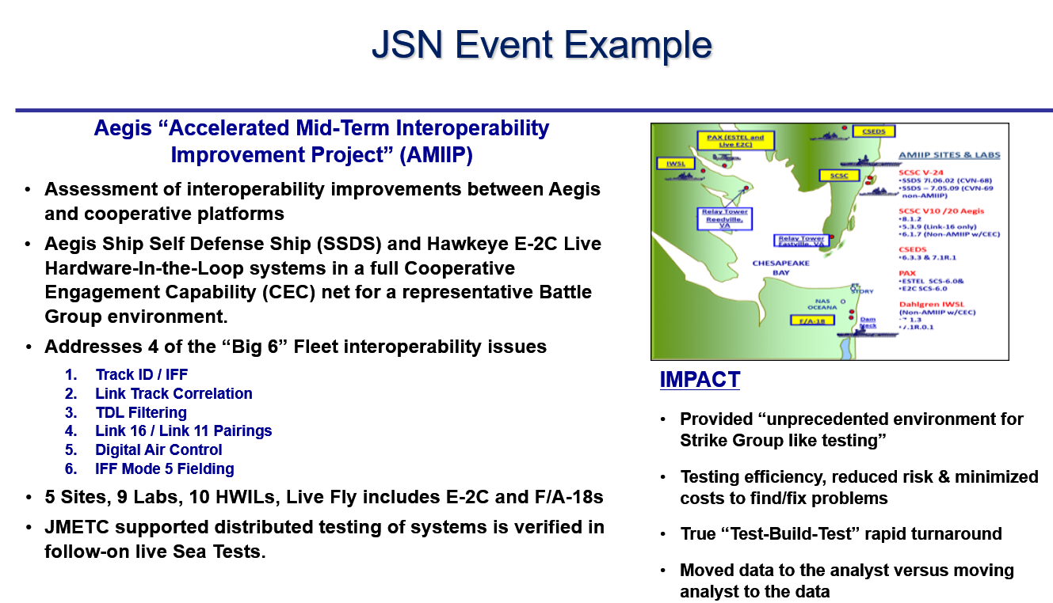
OMG DDS in Simulation: JMETC

Slide 58
Securing distributed LVC simulations with OMG DDS
Can leverage/integrate mission data
Recorded data from actual mission execution could be combined with simulation data and be used for training
This approach is already followed in the US Navy OATM
Rapid feedback from mission to training is key to an agile and effective force.
Can leverage/integrate OMG DDS Security into new distributed simulations
Secure training and simulations over WAN/Cloud/RF/Lossy Networks/TDL
Role-based access allow for joint Coalition forces to train alongside US forces
Multiple SBIRs with different defense agencies for secure LVC simulations

Slide 59
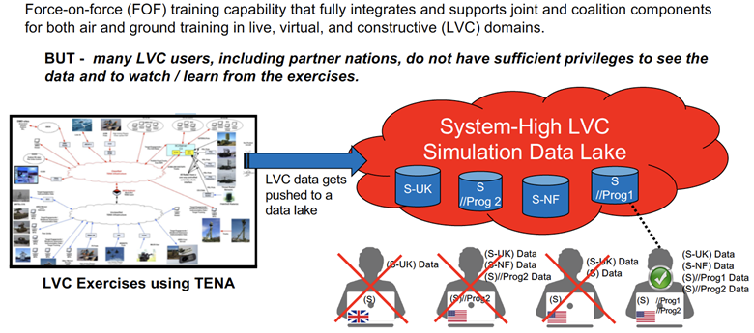
Multi Level Secure MLS, Live Virtual Constructive LVC Simulations

Slide 60
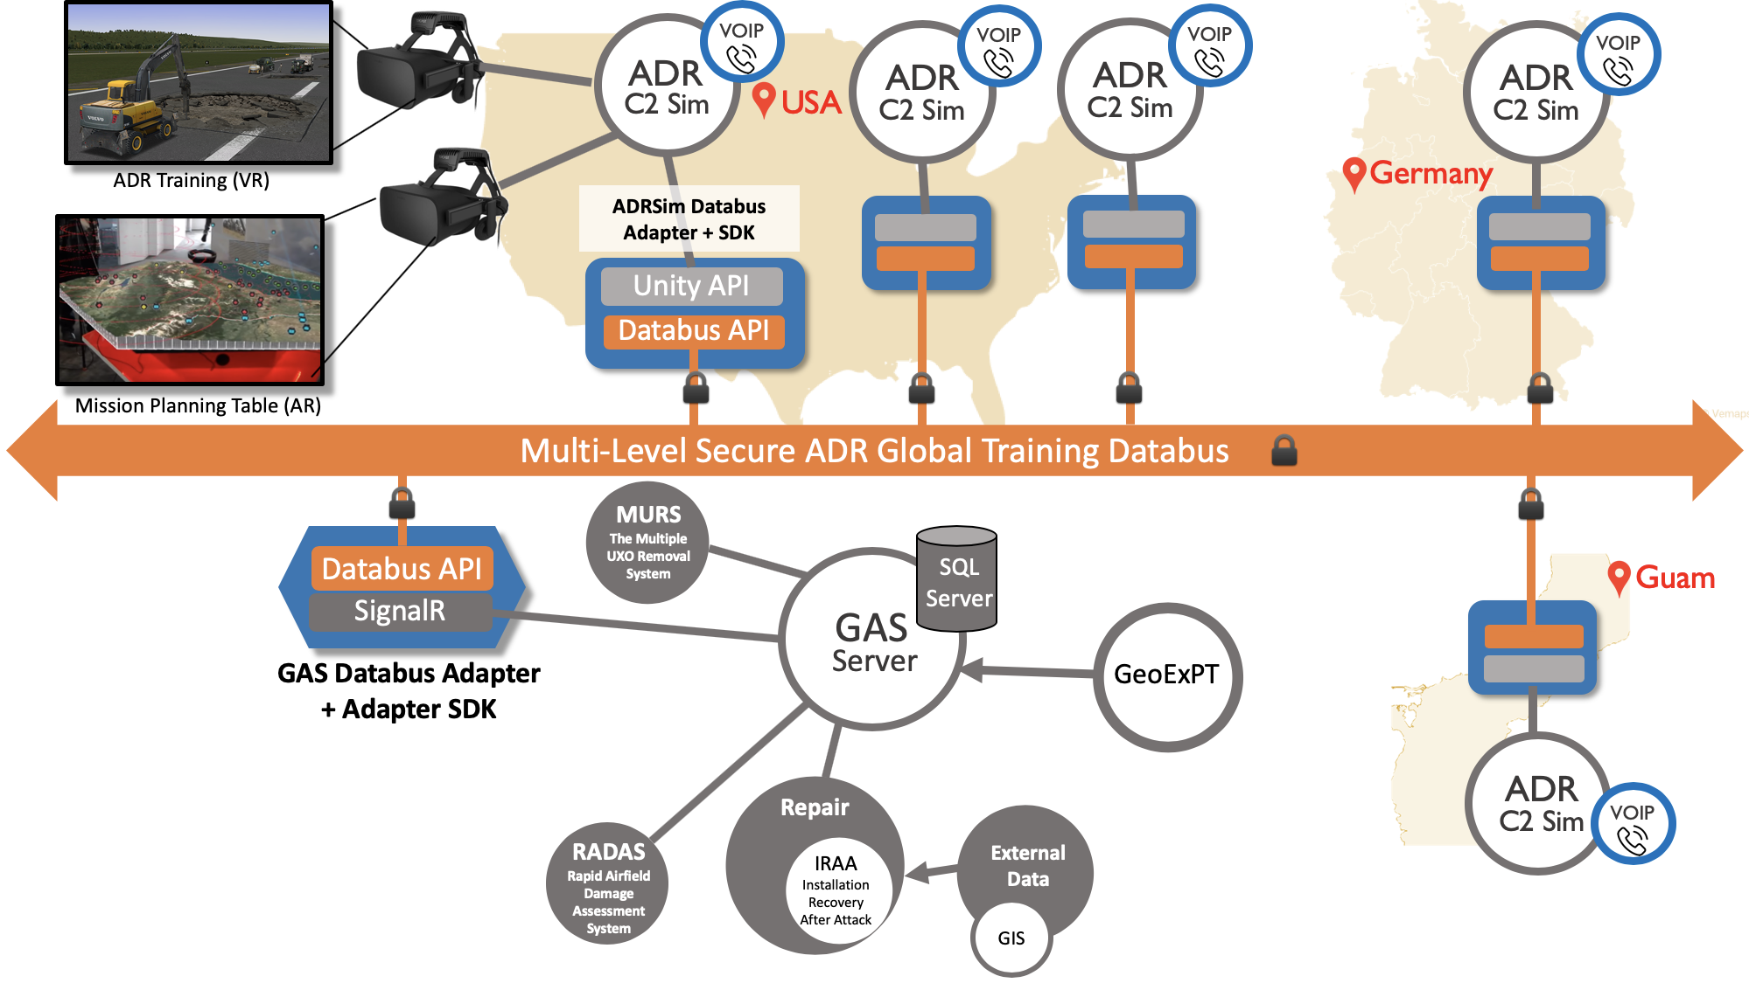
Global Connectivity for USAF Training Simulations

Slide 61
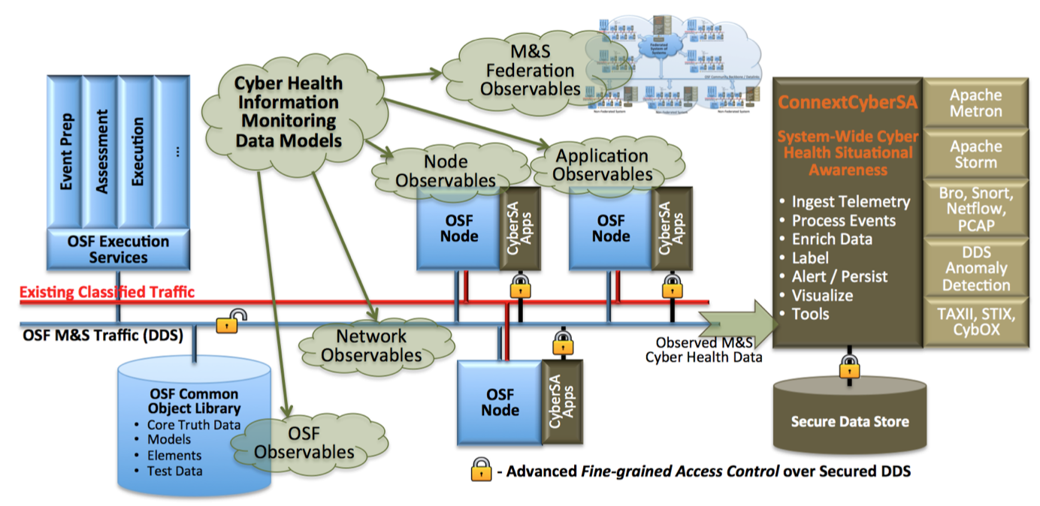
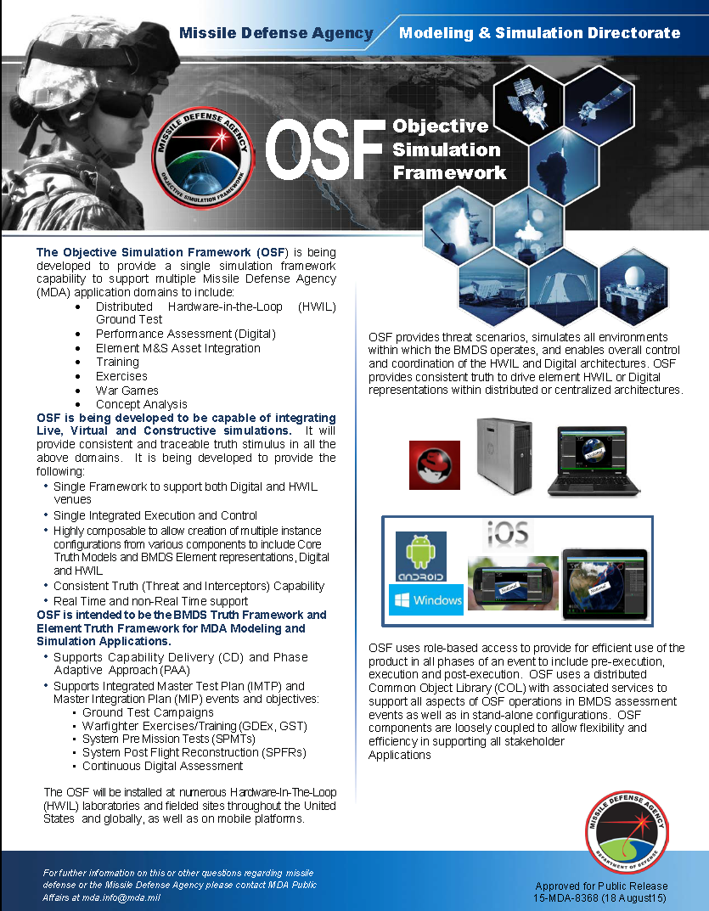
Missile Defense Agency – Objective Simulation Framework
Fully Distributed, Real-Time,
Secure Cyber Situational Awareness for MDA OSF

Slide 62

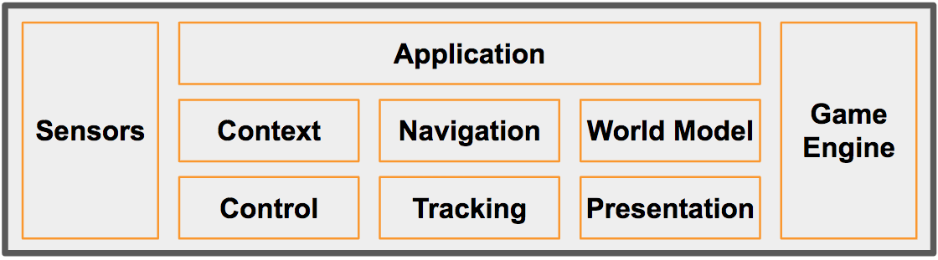
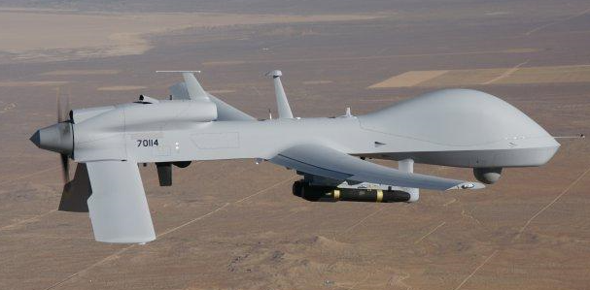
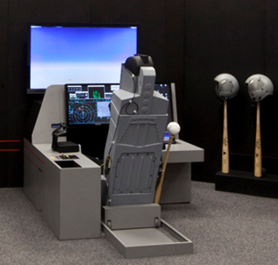

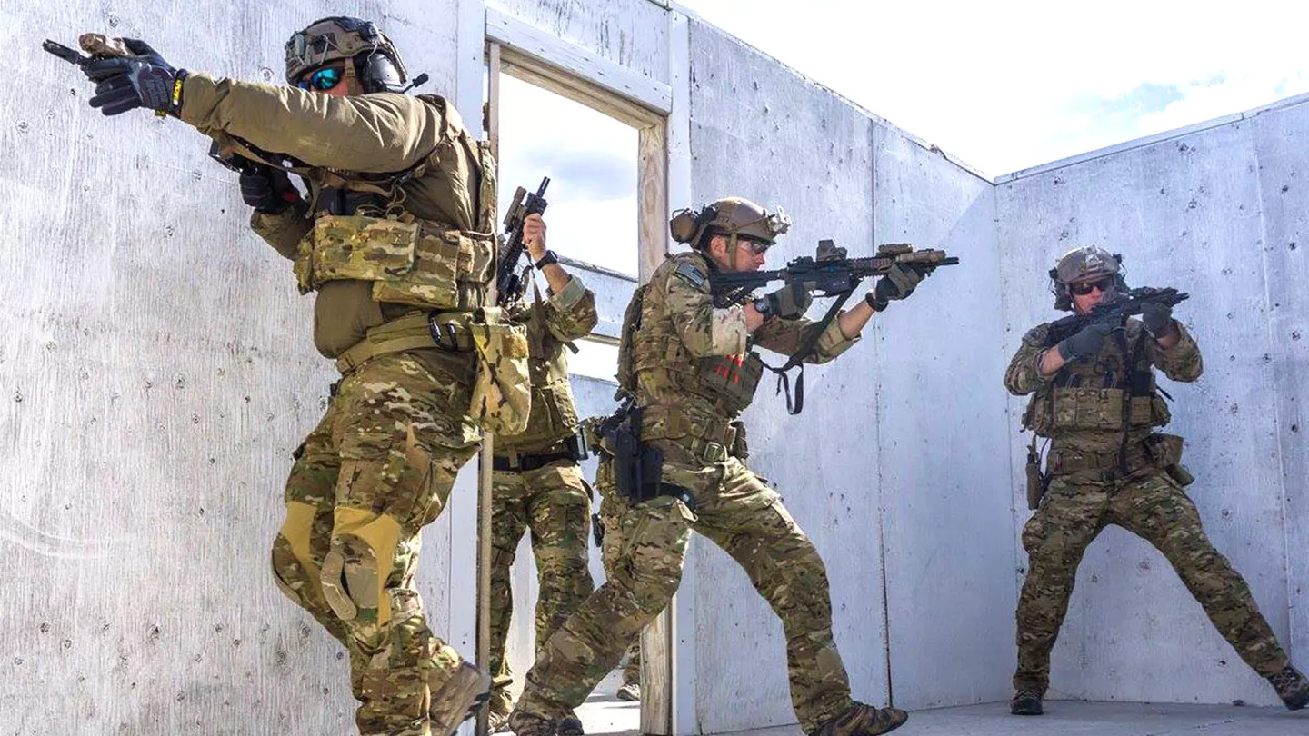
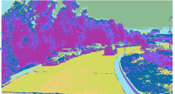
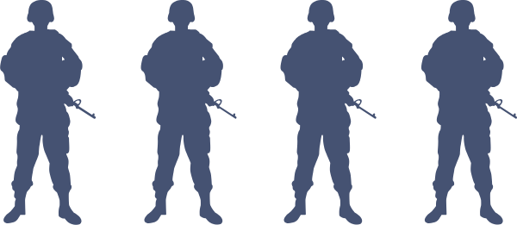
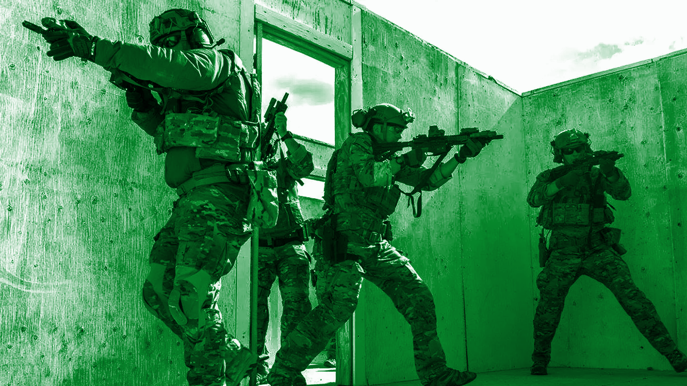
Mixed-Reality Wargaming Platform
Cloud
A Hierarchical, Loosely-Coupled Design Enables:
Local Ownership
Disconnected Operation
Open Architecture
Capability-as-a-Service
e.g., AI, Simulation, Data, Devices
Management
Logging
Analytics
Other
Services
Secure Global OMG DDS Databus
Secure
Gateway
Protocol/Data Interoperability
Data Routing/Filtering
Management
Logging
Analytics
Secure Cross-System OMG DDS Databus (Local/Regional)
OMG DDS
Processing Location Agnostic / Transparent
DataBus
Gateway
AI Training
Scenarios
Protocol
Gateway
One World
Terrain
Protocol XYZ
OtherSim
Autonomous Systems
AI/ML/DL
Augmented
Reality
Real World Twin
Local Mgmt
Simulated Worlds
Simulation DataBus
Simulation DataBus
Real World
Sim@ NATO 2
Simulation Connext DataBus
Sim@ NATO 1
Air
Helo
Sim@ SOCOM
Edge
Unity
Unreal
Maritime
Ground
Simulated
Actors
Digital
Twins

Slide 63
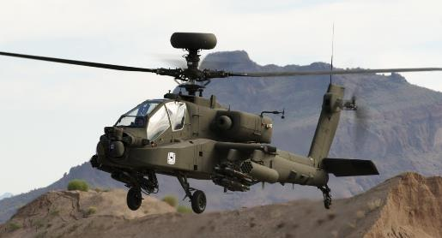
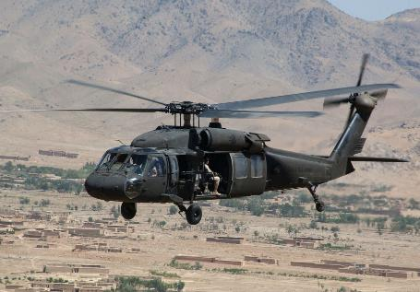
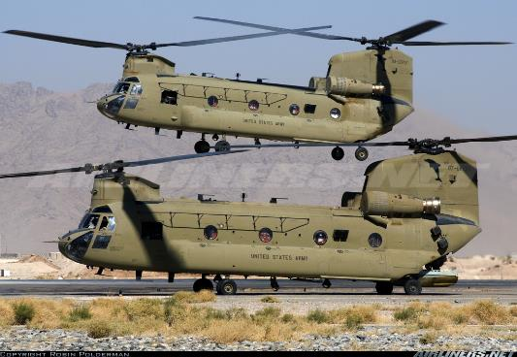
CCDC Aviation& Missile Center - SED System Integration Labs
Hardware-in-the-Loop labs for the UH-60V, CH-47F and AH-64E Army Helicopters

Slide 64
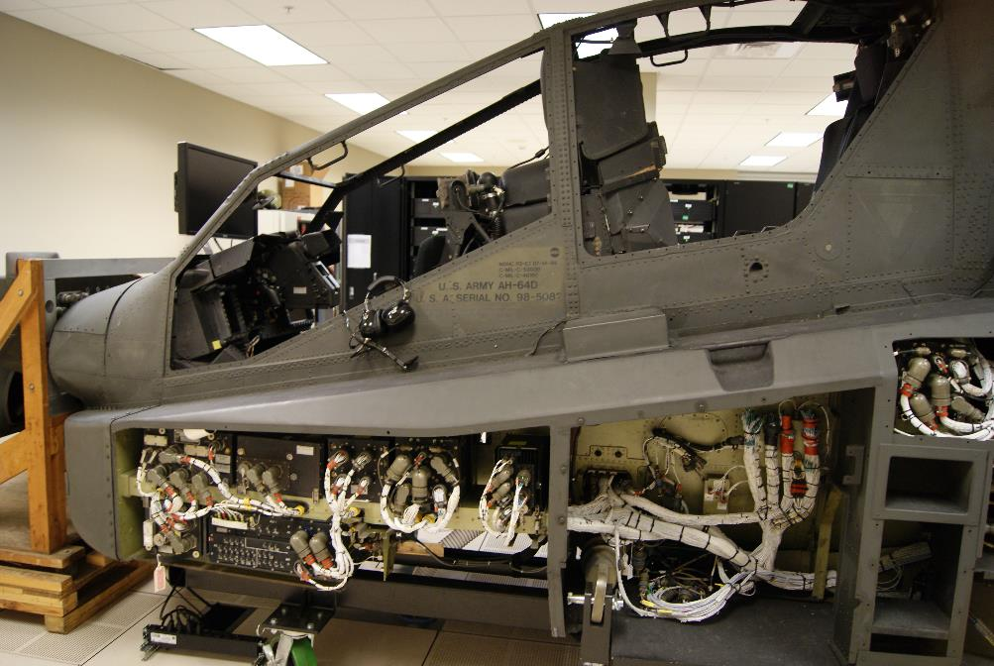
CCDC AvMC S3I - Apache AH-64E
HAT/HOT
Flight Model
Visuals
Flight
Controls
Visuals
Image Generators
Database
OMG DDS
Data Record /
Playback
Data Analysis
Workstation
TBD
LabVIEW
Science
Experiments
RadAlt Model
Aberdeen I/O
ADC Model
EGI Model

Slide 65
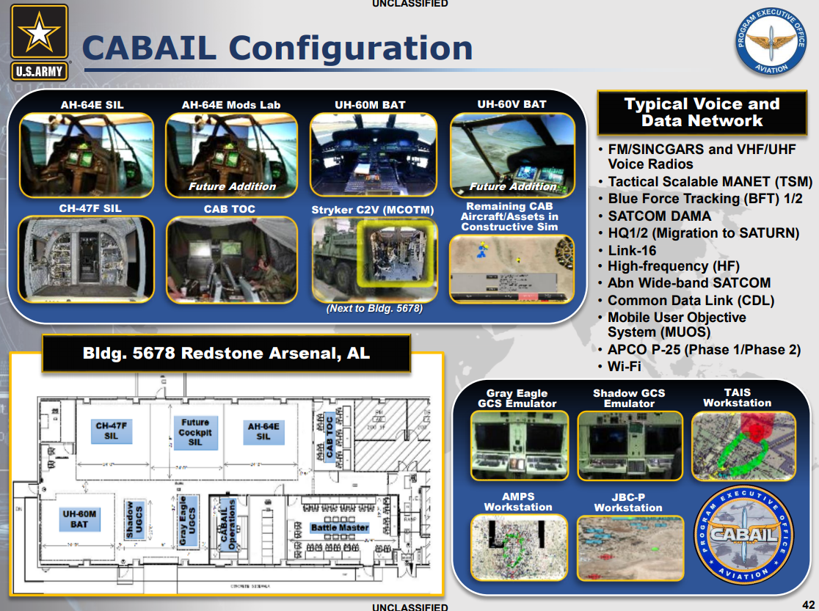
PEO Aviation - Combat Aviation Brigade Architecture Integration Lab CABAIL
AH-64E and CH-47F SILs already use OMG DDS to reduce hardware and development costs for HIL experimentation
JBC-P Network Operations Center(NOC) was re-architected using OMG DDS for significant code reduction and performance improvement

Slide 66
Conclusions
DDS is a mature standard from the OMG
Platform neutral: Operating Systems and Programming Languages
Mandated and deployed worldwide in many military systems with demanding real-time applications
Portable API DCPS and Interoperable Wire Protocol RTPS
Deployed DDS Security Standard specification
OMG DDS focuses on efficient data-distribution for real-time & high-performance systems
OMG DDS is suited for integration of distributed training systems
Authentication, Role-Based Access to data, Multiple Levels of Security (MLS)
Evolvable Type System
Real-Time Quality of Service (QoS)
Integration and reuse of operational system software and mission data

Slide 67
Original Tutorial Learning Objectives
After taking this tutorial you should be able to:
Describe how OMG DDS enables semantic interoperability
Describe the OMG DDS standard
Explain the principles of the OMG DDS Secure standard for securing communications between distributed simulations over WAN/Cloud/RF/Lossy networks
Explain how OMG DDS works with the simulation architectures TENA, HLA and DIS
Summarize how OMG DDS works with real-world Hardware In the Loop (HIL) for secure distributed LVC simulations at scale
Describe how OMG DDS is working within SISO

