Slide 1
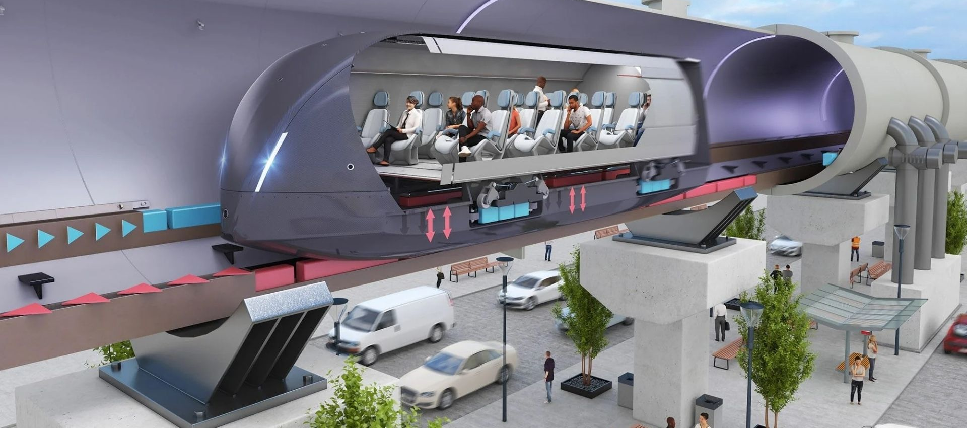

Transportation Systems: A Survey of
M&S Applications in Mobility, Sustainability, and Logistics
Kevin F. Hulme, Ph.D., CMSP

Slide 2
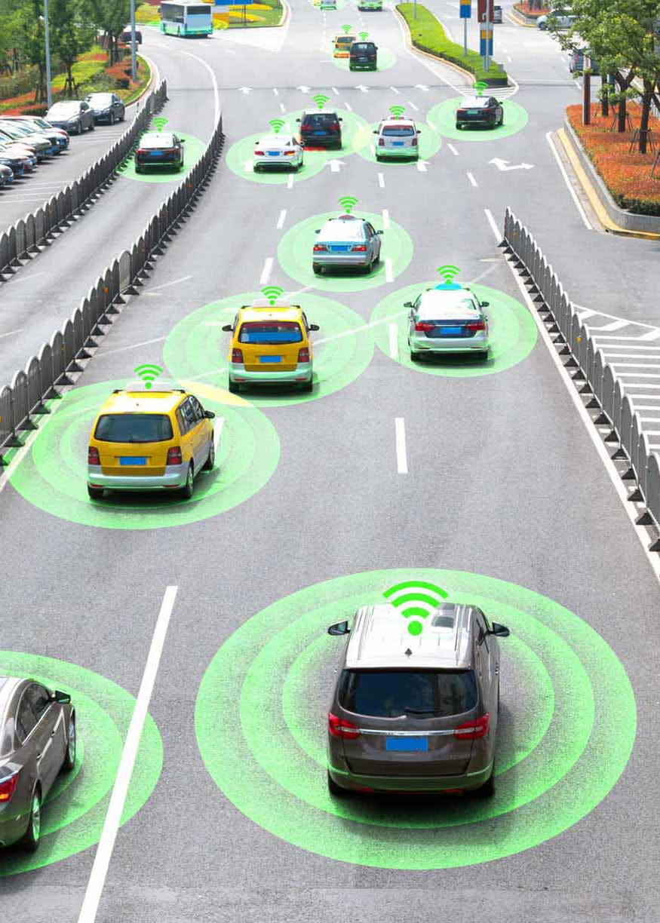
Agenda
Introduction (5 mins)
Tutorial Learning Objectives
I/ITSEC 2023 themes
CMSP relevance
M&S in Transportation Systems (60 mins)
Examples: core/foundational
Examples: emerging
Tutorial Summary (10 mins)
Confirm Learning Objectives
Acknowledgements
Bibliography
Q/A (15 mins)

Slide 3
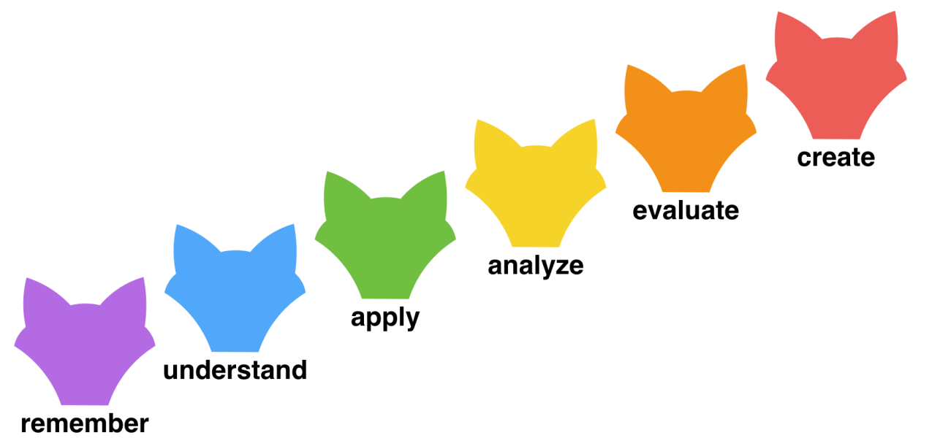
Introduction
Anderson et al., 2001
Tutorial Learning Objectives
Describe basic concepts (M&S) that are foundational to I/ITSEC.
Classify applications in M&S with relation to transportation and human mobility.
Analyze modeling methods and implementations aligned with NTSA CMSP.
Distinguish mathematical fundamentals related to mobility, sustainability, logistics.
Formulate future pathways to advance sustainable human mobility in a digital world.

Slide 4

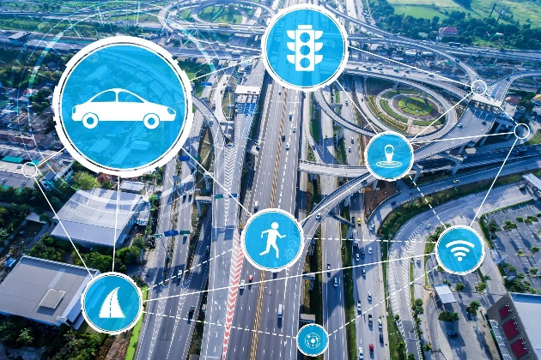

Introduction
NTSA, 2023
2023 I/ITSEC themes
“Sustaining a Global Force in a Digital World”
This Tutorial addresses as follows:
Technological sustainment: Evolution of sustainable technologies to improve mobility
Global: SCM technologies to advance a broad workforce amidst uncertainty
Digital engineering: A cornerstone of M&S implementations for Transportation

Slide 5
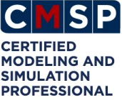
Introduction
Oswalt, 2022
Tutorial content can assist with M&S certification preparation
Certified Modeling & Simulation Professional (CMSP)
Provides the M&S community with its own professional certification
Host Organizations
The National Training and Simulation Association (NTSA)
The National Defense Industrial Association (NDIA)
Program is now three-tiered
Apprentice, Practitioner, and Master
Core CMSP Modeling Methods prevail in this Tutorial

Slide 6
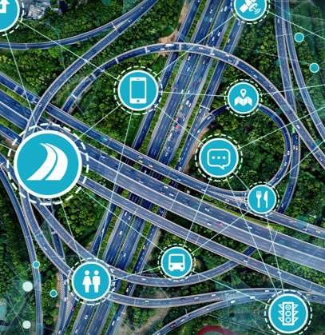

M&S in Transportation Systems
Vanek et al., 2014
Transportation Systems
Mobility Fundamentals (terminology/basics)
Transportation: movement of humans/goods/services
Intermodal: multiple modes of transport | different carriers
Multimodal: multiple modes of transport | same carrier
Sustainability: fulfilling today’s needs without compromising tomorrow
Green concerns: protecting environment (fuel/noise/emissions)
Life cycle: managing a product from inception to disposal
Logistics: process of moving resources from source to destination
Supply Chain: management of the flow of goods and services (SCM)
SCM works toward improving processes to create competitive advantages
Logistics emphasizes meeting customer needs/expectations

Slide 7
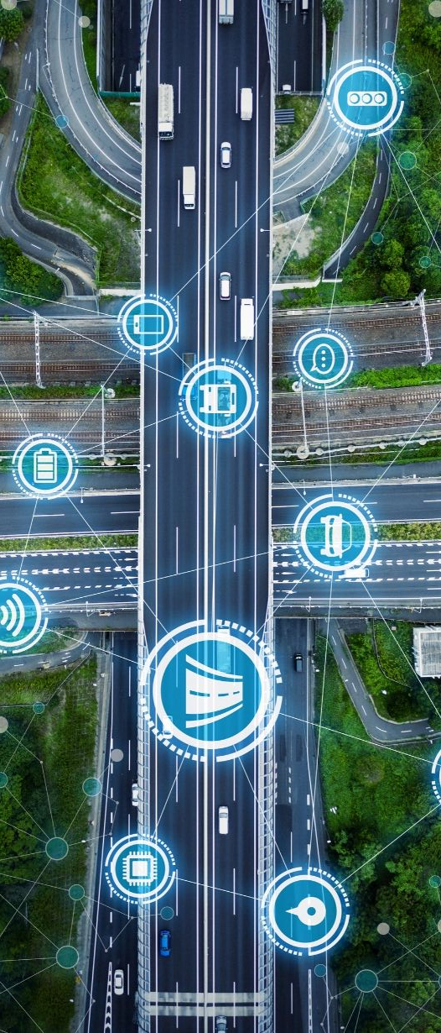
M&S in Transportation Systems
Transportation Systems
Modeling & Simulation (M&S)
Model: A product (physical or digital) that represents a system of interest
Simulation: Using a model to study the performance of an actual system
High-level overview of common modeling methods
Targeted focus on topics related to:
Human mobility & multimodal transportation
Sustainability | Life cycle
Supply chain and logistics
Media-driven examples
Problem description | Mathematical model | Simulation implementation

Slide 8
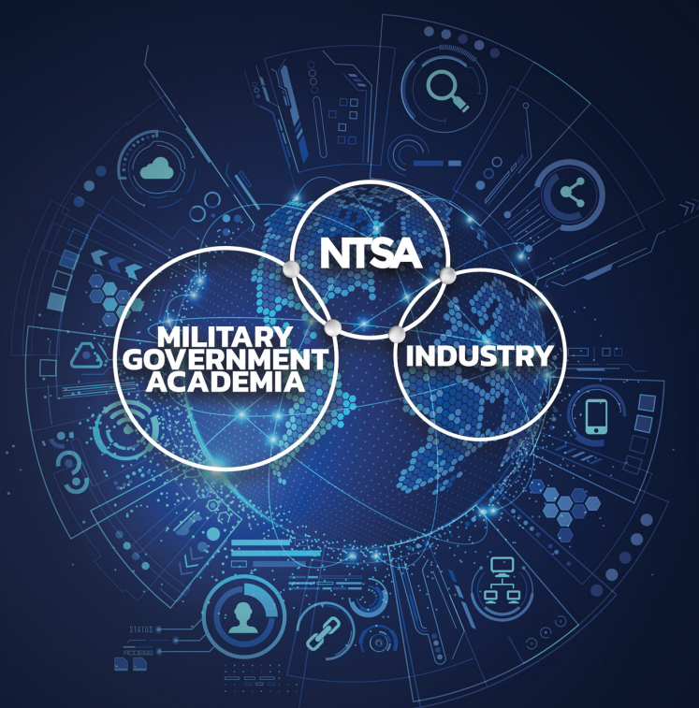
M&S in Transportation Systems
DoD, 1998
Transportation Systems
Subject Matter (both Foundational and Emerging)
Core/Foundational topics:
Conceptual Modeling | Physics-based Modeling
Monte Carlo/Stochastic | Finite Element Modeling (FEM)
Discrete Modeling | Continuous Modeling
Human Behavior Modeling | Multi-Resolution Modeling (MRM)
Semi-automated Forces (SAF) | Human-computer Interaction (HCI)
Emerging/Innovative technologies:
Virtual Environments | Game Engines
eXtended Realities (XR) – VR/MR/AR
Machine Learning (ML) | Artificial Intelligence (AI)

Slide 9
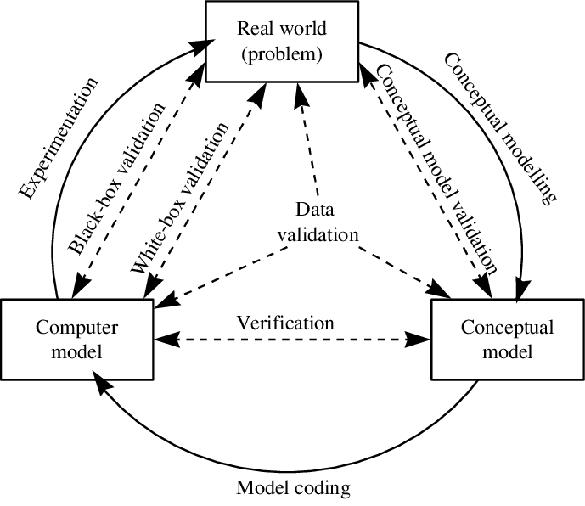
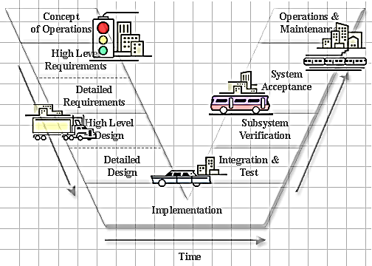
M&S in Transportation Systems
Robinson, 2000
Conceptual Modeling: the abstraction of a model from the real-world system that is being simulated (i.e., what to/not model, assumptions, constraints)
Within a simulation study, Conceptual Modeling is typically the most difficult, least understood, and most critical task
How to state versus how to solve the problem
Required early in the design cycle when change/revision is less costly

Slide 10
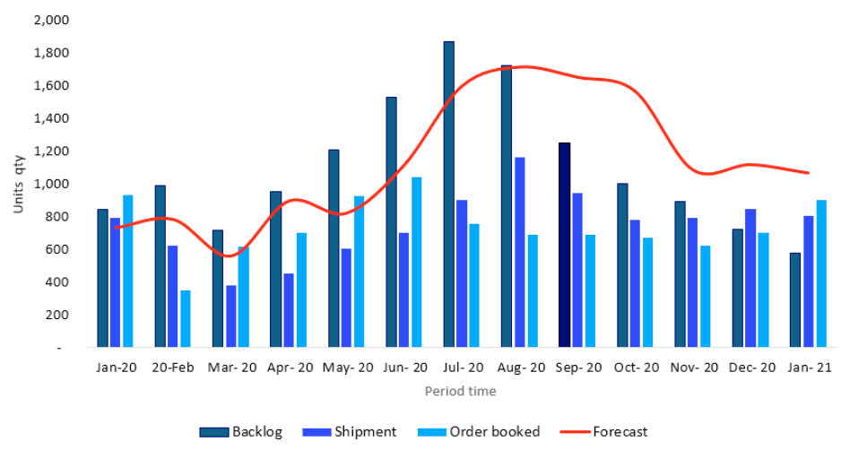
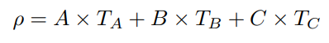
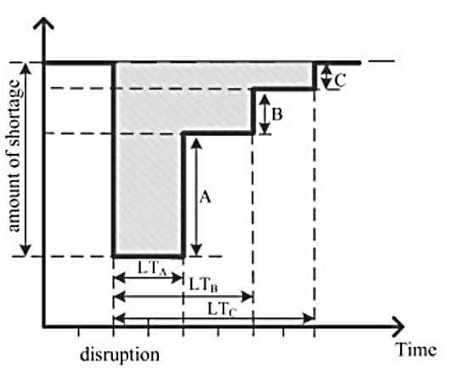
M&S in Transportation Systems
Alvim et al., 2022
Conceptual Modeling (example)
Problem statement: Conceptual Modeling for Supply Chain Resilience
Tutorial focus area: Supply Chain & Logistics
Disruptions (COVID-19, wartime situations) impact global supply chains
Need to improve supply chain robustness
In this research, a theoretical framework and conceptual model is applied
ρ = math model for Resilience Loss
Supply Chain disruption (COVID-19)

Slide 11
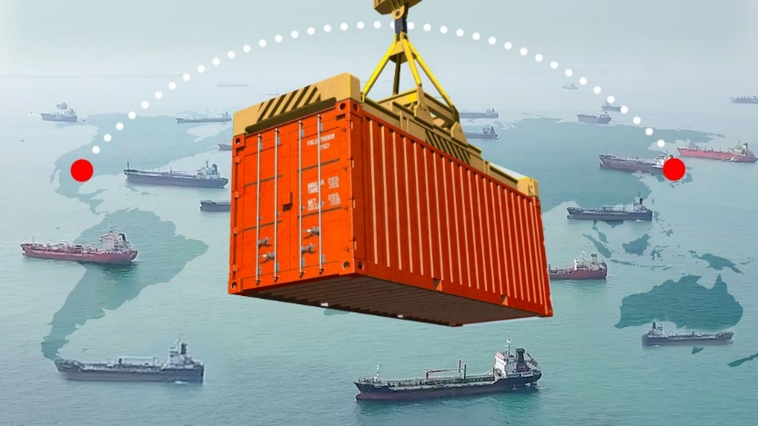
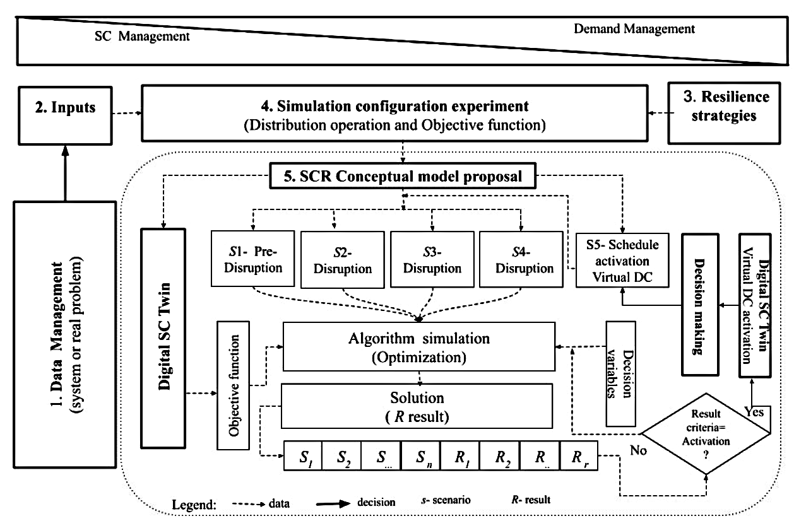
M&S in Transportation Systems
Barykin et al., 2020
Conceptual Modeling (example)
Framework: Supply Chain Resilience (SCR) concept model, which includes a supply chain digital twin
Enables automatic actions for certain events (e.g., activating a virtual Distribution Center)
Scope: deliver an outcome to support decision-making, minimize cost and build resilience against supply chain disruptions

Slide 12
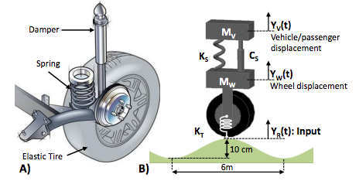
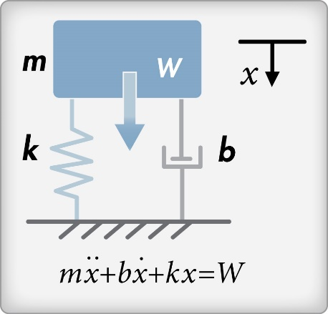
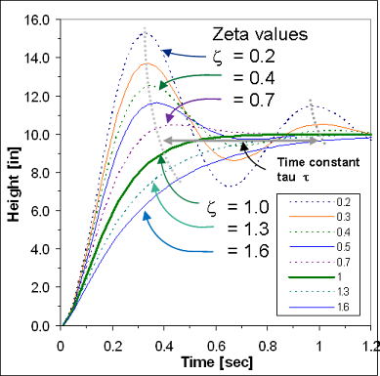
M&S in Transportation Systems
Avesh & Srivastava, 2020
Physics-based Modeling: a mathematical representation that incorporates physical characteristics (e.g., forces, moments, accelerations) directly into the model
A cross-disciplinary (e.g., math, physics, computer graphics) approach to model and visualize motions of rigid objects, often for animation/simulation
In Transportation: spring-mass-damper second order differential equation

Slide 13
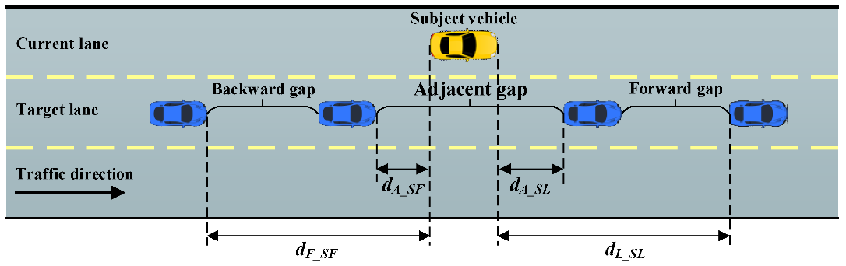
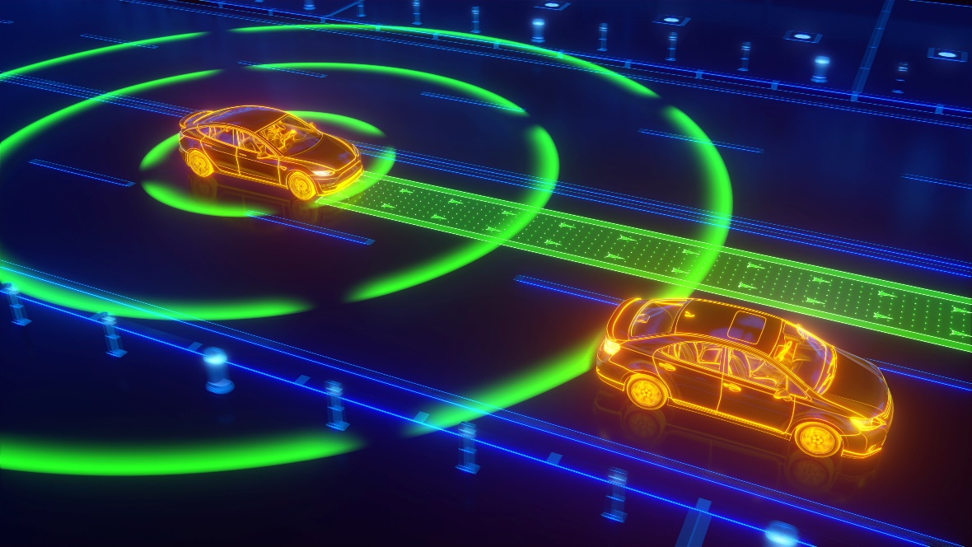
M&S in Transportation Systems
Ahmed et al., 2021
Physics-based Modeling (example)
Problem statement: Modeling tools for autonomous driving behaviors
Tutorial focus area: Transportation/Mobility
Mixed-traffic: transition period during which autonomous and conventional human drivers share the roadways
Car-following and lane-changing behaviors of autonomous vehicles (AVs) require specialized modeling efforts

Slide 14
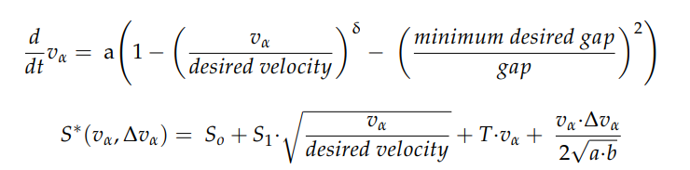
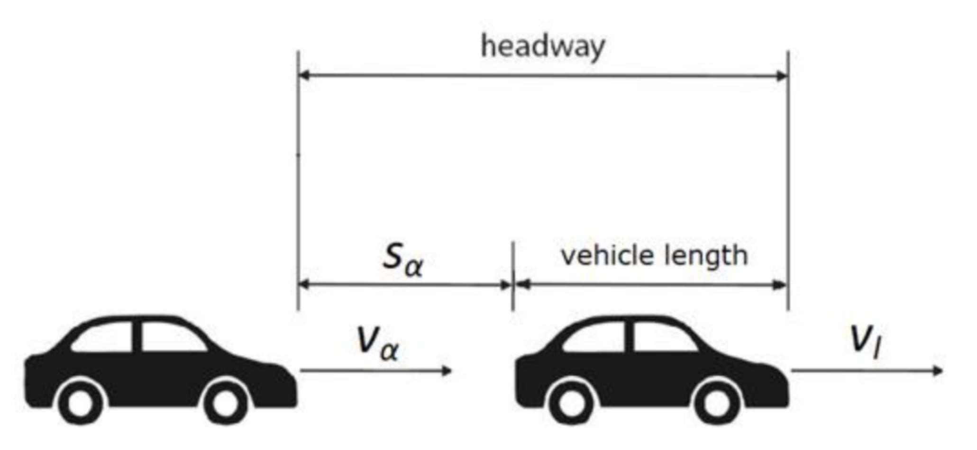
M&S in Transportation Systems
Albeaik et al., 2021
Physics-based Modeling (example)
Framework: existing models for human-driven vehicles
Car-following model (i.e., acceleration)
Collision-avoidance (i.e., safety distance)
Perceptual threshold (i.e., headway/speed)
Scope: modifications for AVs are necessary
Optimal Velocity Model (OVM)
Intelligent Driver Model (IDM)
Adaptations of automated cruise control (ACC) approaches
time change in velocity (acceleration) of vehicle: α
IDM: physics-based model
desired (headway) gap: S*

Slide 15
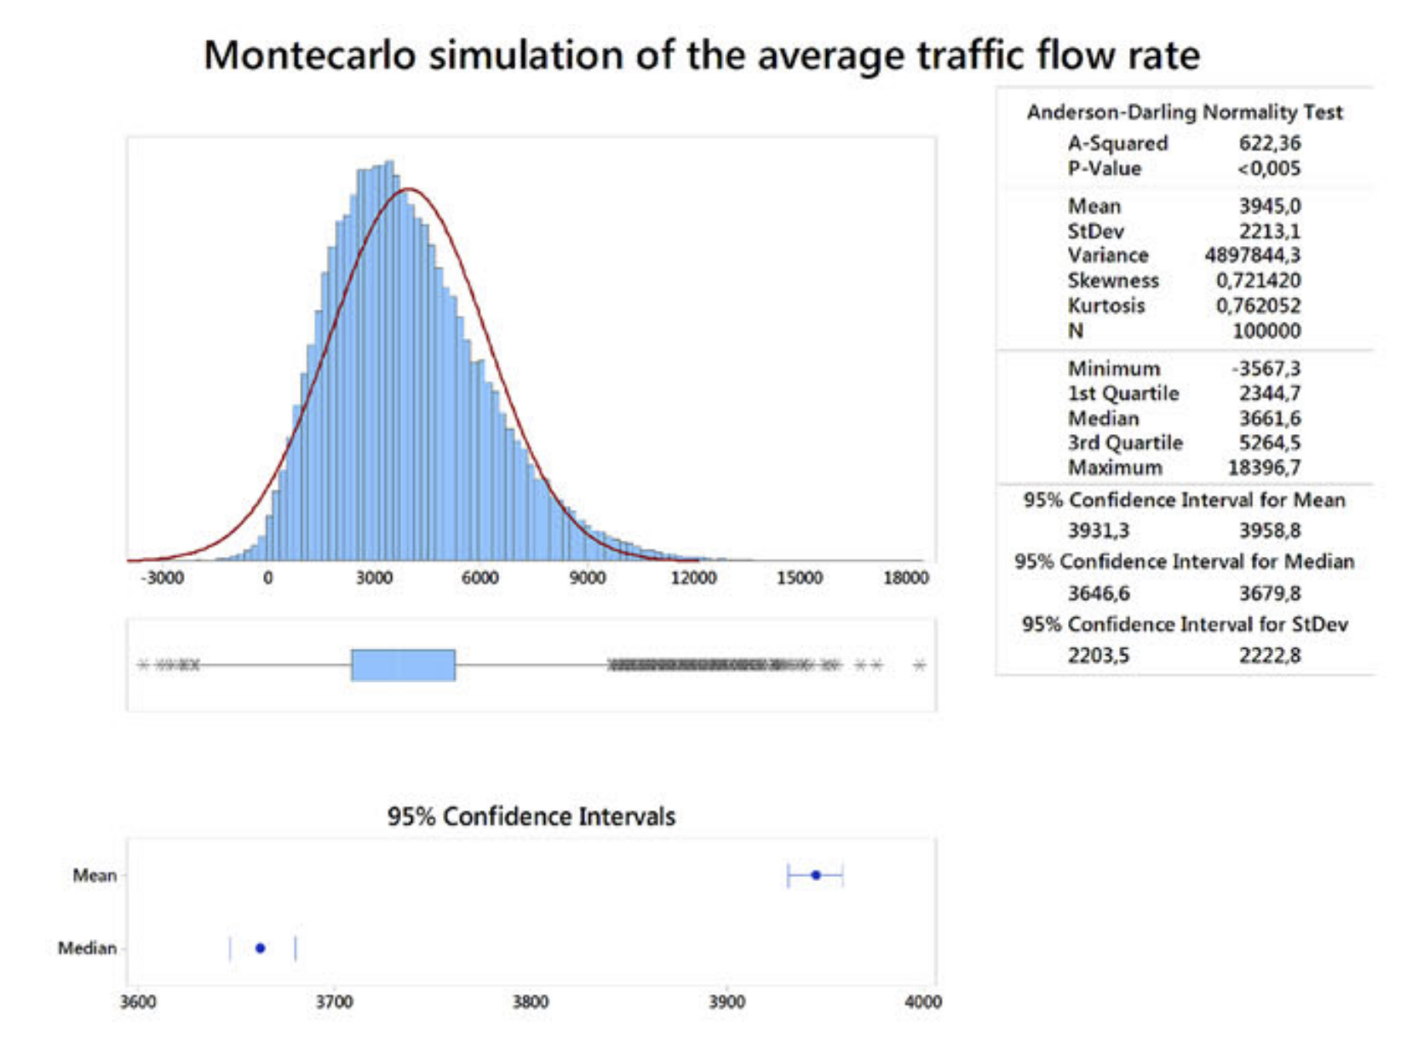
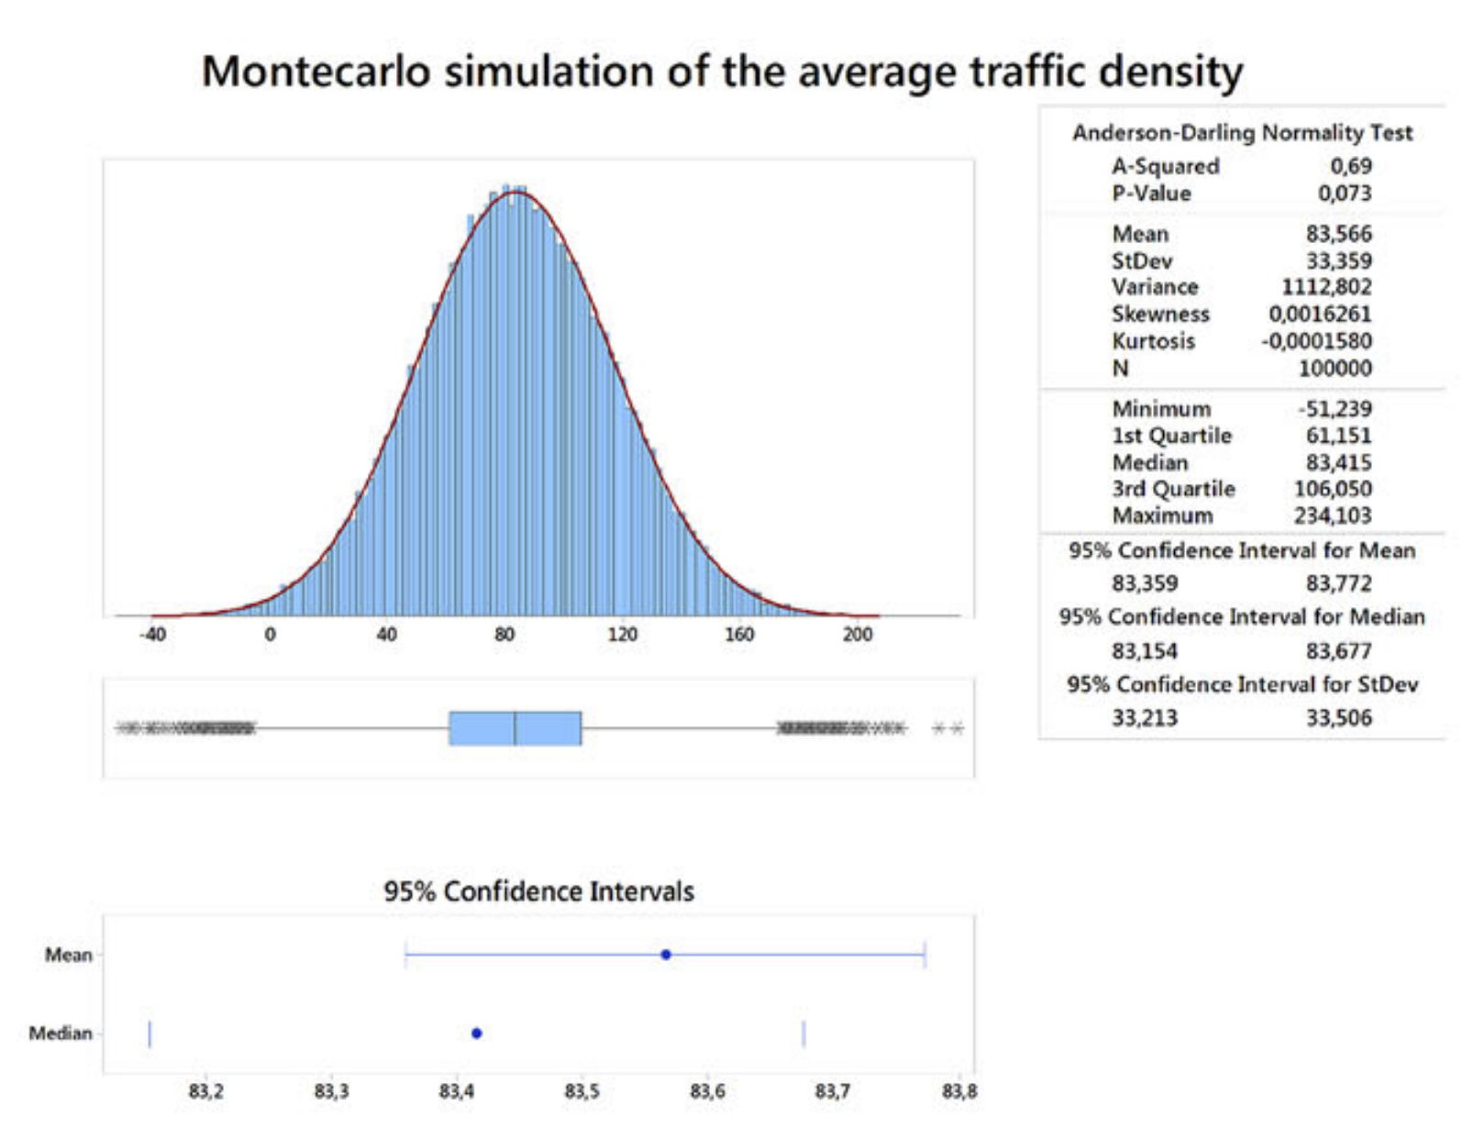
M&S in Transportation Systems
Wuthishuwong & Traechtler, 2019
Monte Carlo / Stochastic Methods: modeling approaches that approximate solutions to problems through statistical sampling
The inputs describing a system are uncertain (i.e., each has a probability distribution) hence the predicted system output is also uncertain
In Transportation: microsimulations predict traffic flow and density with uncertain parameters (e.g., day of week, time of day, weather, construction, accidents)

Slide 16
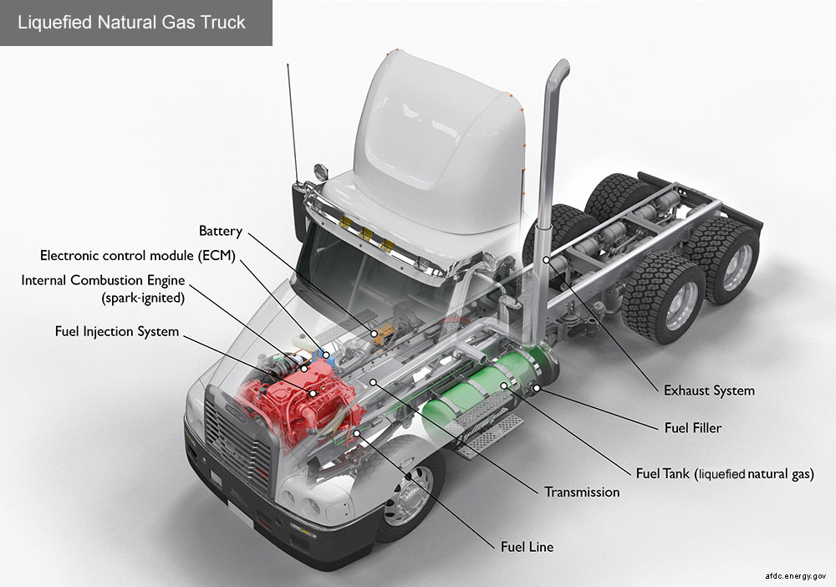
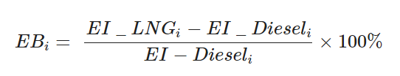
M&S in Transportation Systems
AFDC, 2023
Monte Carlo (example)
Problem statement: Environmental impacts of alternative fuels | liquefied natural gas (LNG)
Tutorial focus area: Life Cycle (sustainability)
LNG is a more expensive option than compressed natural gas (CNG); often used in heavy-duty vehicles for longer range requirements
This study demonstrates a Monte Carlo simulation to evaluate the potential environmental benefits of promoting LNG heavy-duty diesel vehicles
Model for Environmental Benefit (EB):
Environmental Impact (EI) of LNG:
Monte Carlo analysis variable

Slide 17
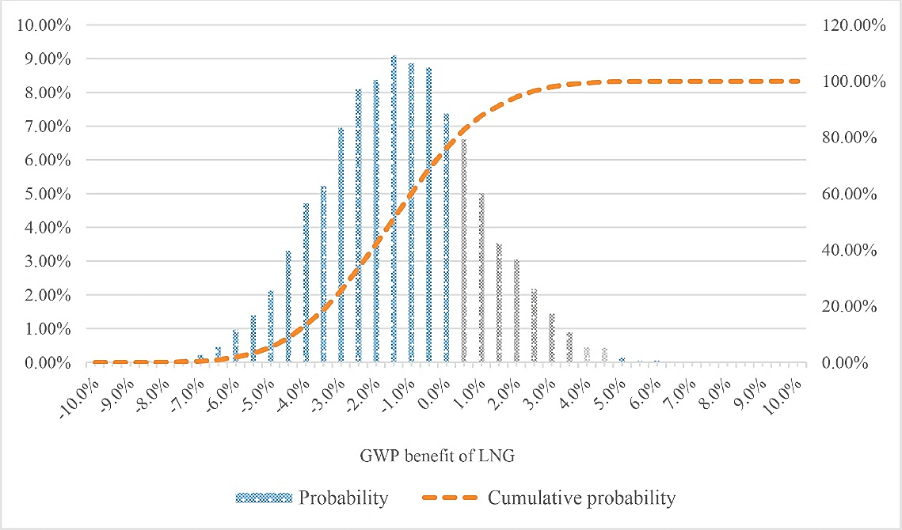
M&S in Transportation Systems
Sun & Ertz, 2020
Monte Carlo (example)
Simulations investigated utilization, energy consumption, emissions
Life cycle environmental benefit: 50,000 Monte Carlo simulations
Global Warming Potential (GWP):
Μ = −1.55% | σ = 2.18%
Probability that LNG has a reduced GWP impact compared to diesel: 76.2%
 | Min | Avg | Max | σ
Filling station utilization | 30% | 58% | 86% | 0.0933
LNG energy consumption | 10% | 15% | 20% | 0.0167
Methane emissions | 0.4% | 0.8% | 1.2% | 0.0013

Slide 18
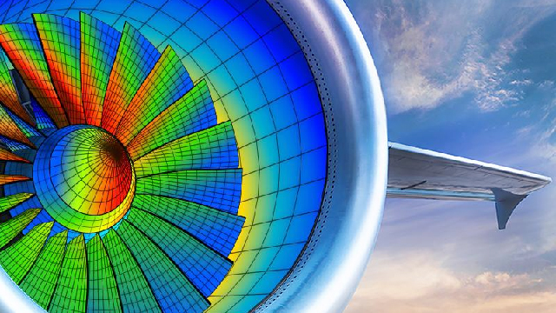
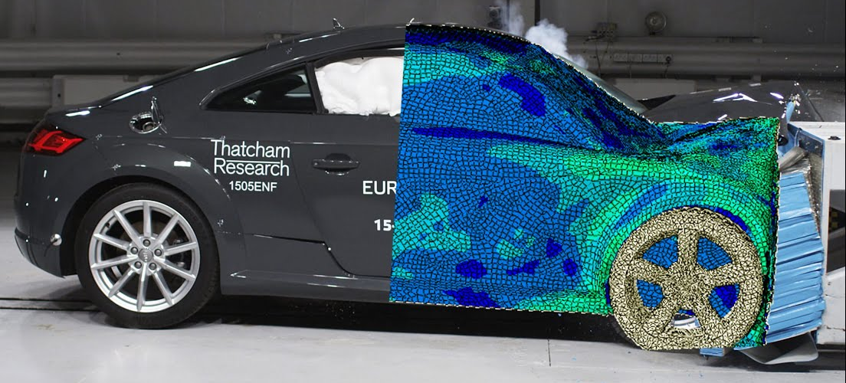
M&S in Transportation Systems
Harish, 2022
Finite Element Modeling (FEM): identifying approximate solutions to boundary value problems for partial differential equations
Subdivide a large system into smaller objects (i.e., a “mesh”) called finite elements
System of equations models the entire system
In Transportation: determine vehicle stresses, displacements under extreme load conditions

Slide 19
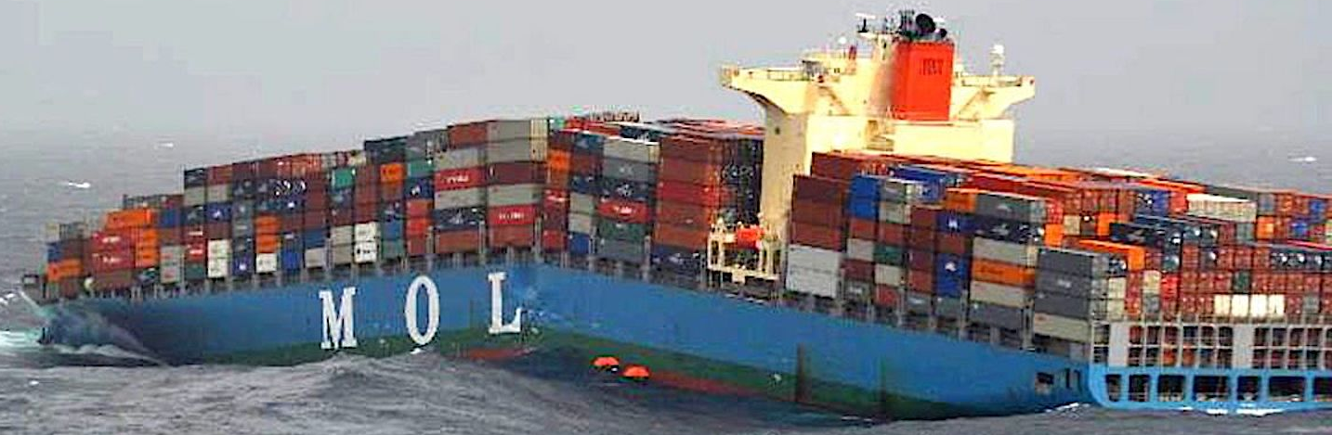
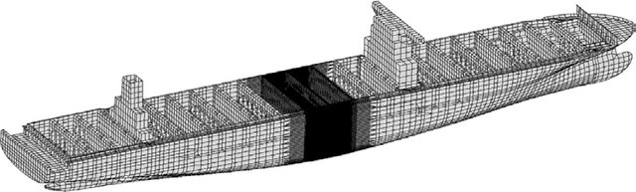
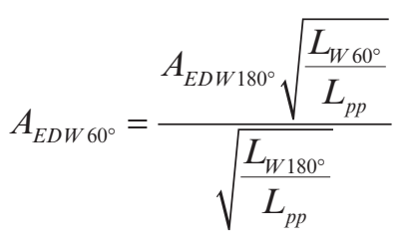
M&S in Transportation Systems
Darie & Rörup, 2017
Finite Element Modeling (example)
Problem statement: Hull strength of container ships
Tutorial focus area: Supply Chain & Logistics
Objective: apply FEM to analyze extreme loading conditions on container ships in the oblique sea
Mesh models: 4M degrees-of-freedom | 60 hours to calculate ultimate strength for one sea state
Boundary conditions: four boundary nodes selected based on buoyancy/hydrodynamic equilibrium
very fine mesh region
ship length
wave length
wave amplitude

Slide 20
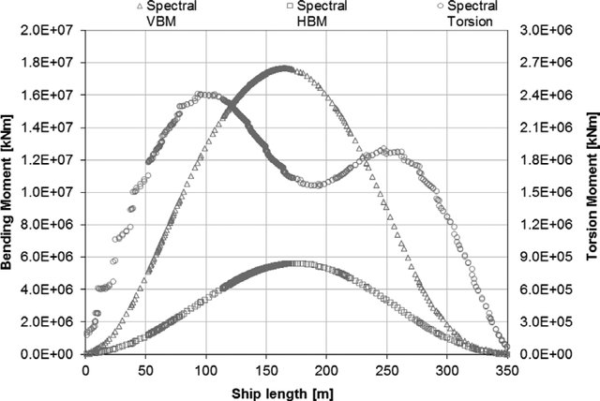
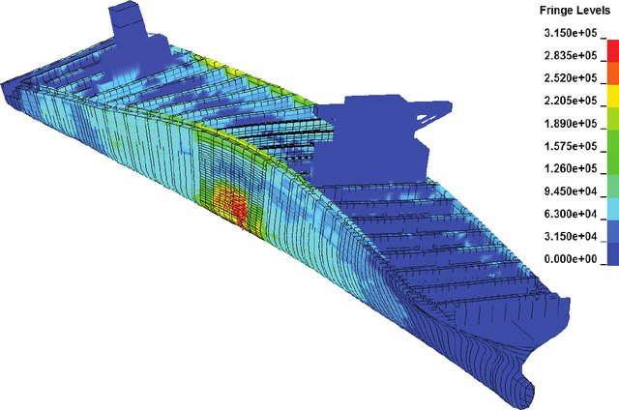
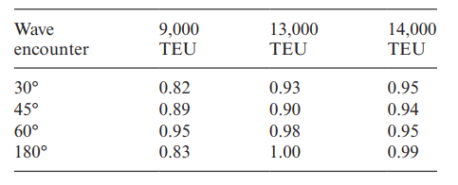
M&S in Transportation Systems
Ergin et al., 2007
Finite Element Modeling (example)
Loading conditions: full spectrum hydrodynamic analysis includes torsion, and horizontal/vertical bending moments (HBM/VBM)
Outcomes: critical situations were analyzed for three container ship sizes (“TEU”) by systematically varying length/position/heading of incoming waves

Slide 21
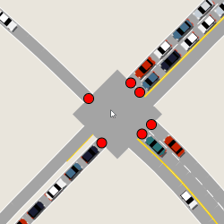

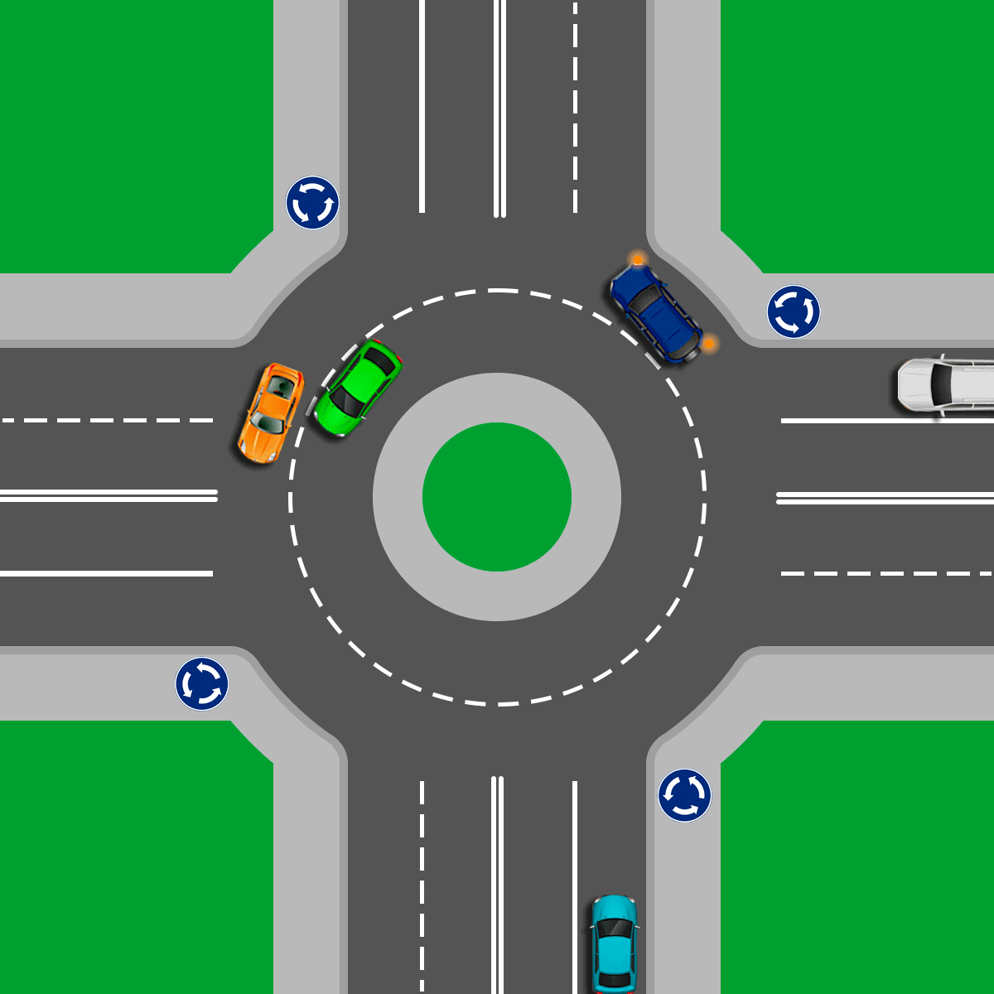
M&S in Transportation Systems
Mumayiz, 1990
Discrete Modeling: a model that emulates the system as a discrete sequence of events in time
Only alters when some “change of state” occurs
In Transportation: (discrete) state of a signalized intersection (“go” or “stop” or “caution”)
Continuous Modeling: a model that continuously monitors a system response (i.e., time and space)
Typically derived from the laws of physics
In Transportation: (continuous) flow behavior of vehicles in an intersection

Slide 22
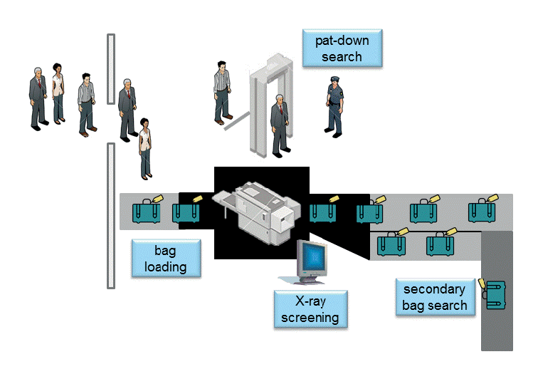
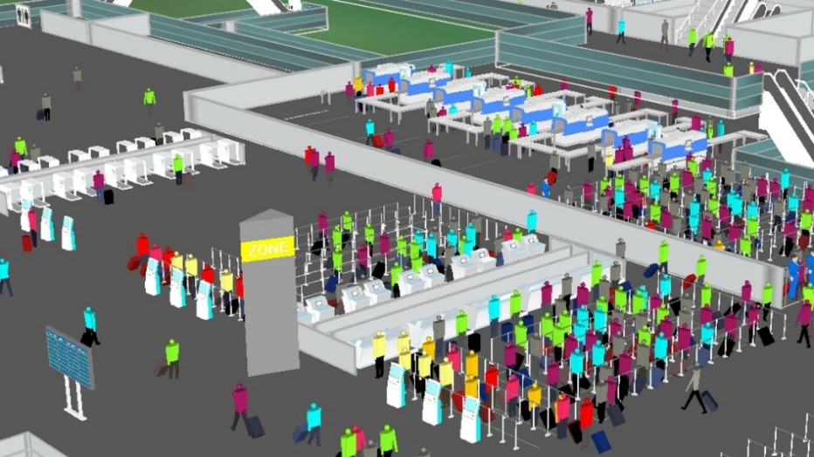
M&S in Transportation Systems
Guizzi et al., 2009
Discrete Modeling (example)
Problem statement: Airport Terminal passenger flow
Tutorial focus area: Human mobility
Mobility at airports - a series of discrete events:
Enter terminal | obtain boarding pass | bag check
Security line | shuttle to gate | standby at gate | board
Objective: Apply discrete event theory to optimize operations within an airport terminal (Naples, IT)
Passenger experience – minimize wait times
Airport resources – total expense

Slide 23
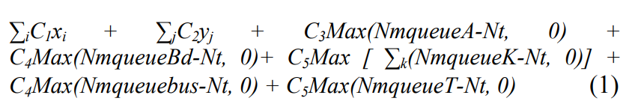
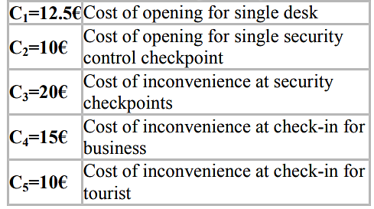
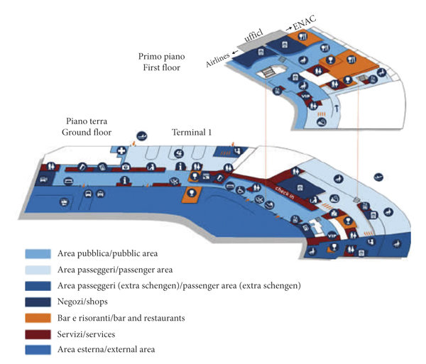
M&S in Transportation Systems
Guizzi et al., 2009
Discrete Modeling (example)
Objective function (cost) model:
Opening check-in desk
Opening security checkpoints
Associated customer inconvenience metrics
Outcomes: Preliminary model feasibility to produce a logical and rational management of check-in and security checkpoints inside the airport terminal
Demonstrated future potential for model adaptation to enhance operations at other airport terminals
Terminal 1: Naples Capodichino Airport

Slide 24
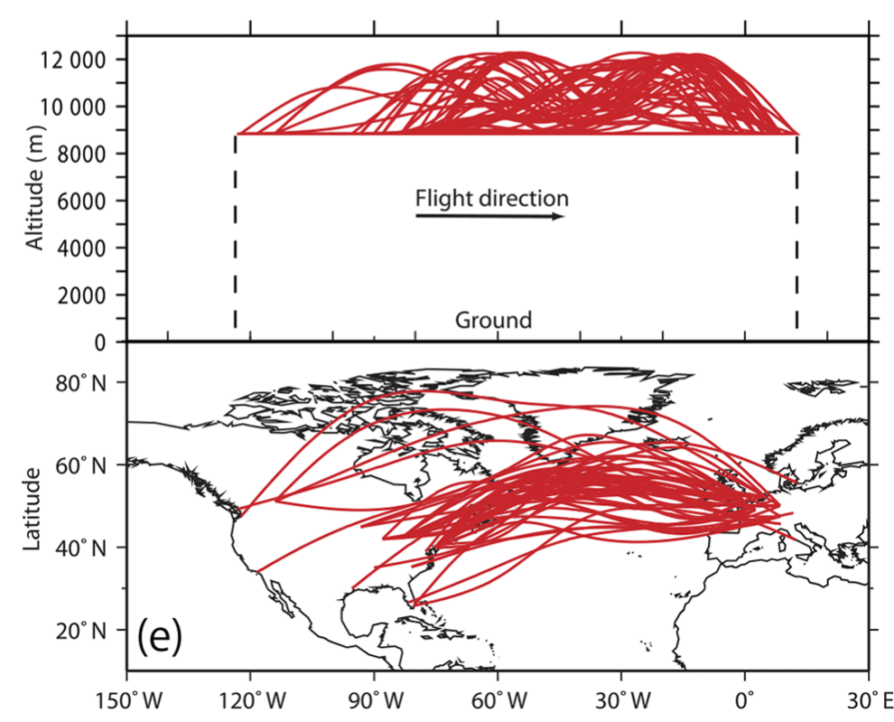
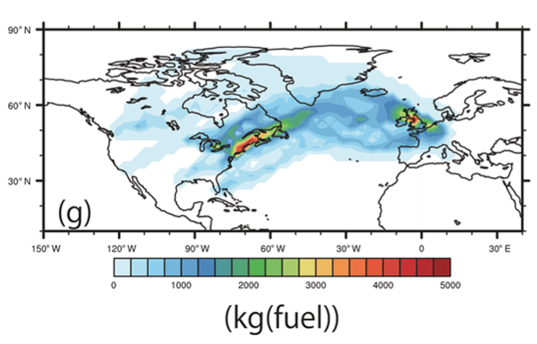
M&S in Transportation Systems
Yamashita et al., 2020
Continuous Modeling (example)
Problem statement: Aircraft routing and climate modeling
Tutorial focus area: Sustainability/environment
Objective: Implement continuous modeling for estimation of climate change mitigation
Simulation objectives:
Optimize flight trajectories
Minimize fuel consumption
Flight trajectory optimization components:
Fuel, emissions, operating cost, contrail avoidance
Climate impact (global temperature response: ATR20)
a)
b)

Slide 25
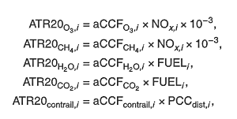
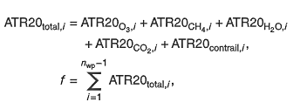
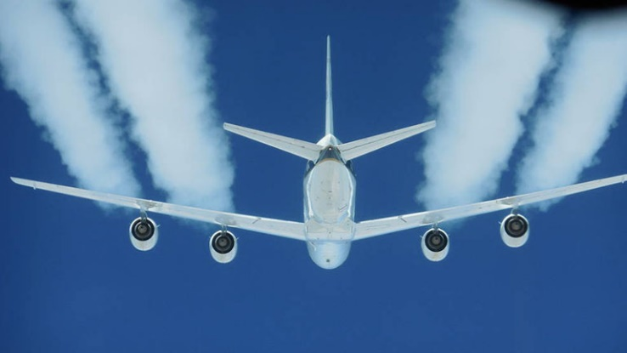
M&S in Transportation Systems
Yamashita et al., 2020
Continuous Modeling (example)
Optimization Model considerations:
Oxone, methane, water vapor, carbon dioxide, and contrails
Outcomes:
Operating cost: inversely proportional to flight time and fuel use
ATR20 minimization tends to increase aircraft operating costs
Trade-off between aircraft operating costs/climate impact
Confirms data observed in previous literature

Slide 26

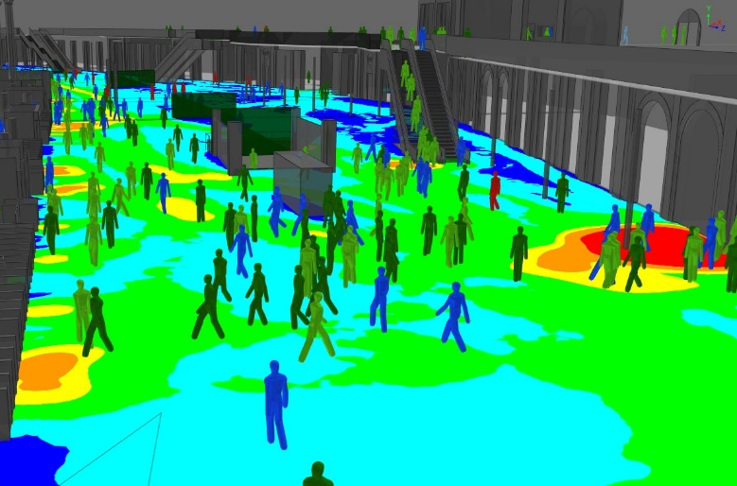
M&S in Transportation Systems
Kim, 2012
Zou & Liu, 2022
Human-behavior modeling: process that replicates how humans perform, given assignment of initial conditions
Typically, not implemented to predict human behavior
May instruct a new behavior
May influence frequency of a previously learned behavior
May increase frequency of a similar behavior
In Transportation: often implemented to understand the aggregate outcome of a complex system (e.g., pedestrian behavior; the “shortest path” principle)

Slide 27
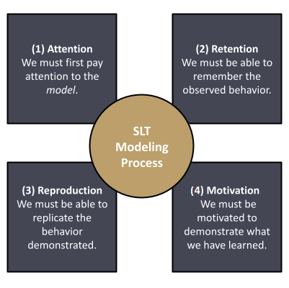
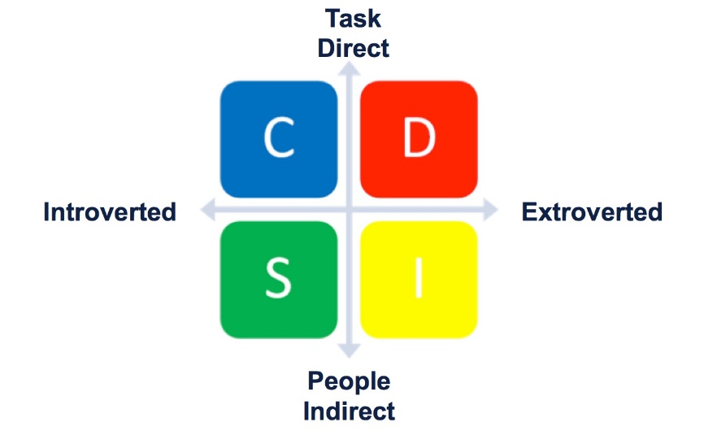
M&S in Transportation Systems
Marston, 1928
Bandura, 1977
Related modeling approaches:
Social learning theory emphasizes 4 components:
Attention | Retention | Reproduction | Motivation
The DISC model assumes that individuals tend to follow patterns of behavior
Dominant – confident; focus on results
Influence – place emphasis on relationships
Steadiness – are dependable and cooperative
Conscientiousness – emphasize accuracy and competency

Slide 28



M&S in Transportation Systems
Moussaïd et al., 2011
Human-behavior Modeling (example)
Problem statement: Cognitive behavior modeling of pedestrian behavior in large crowds
Tutorial focus area: Human mobility
Objective: Apply cognitive heuristics to achieve an improved understanding of crowd dynamics
Crucial for future preparation of large events
Guided by visual information - pedestrians apply simple cognitive procedures to adapt walking speeds and directions (i.e., to avoid collisions)
Distance to destination

Slide 29



M&S in Transportation Systems
Moussaïd et al., 2011
Human-behavior Modeling (example)
With overcrowding, physical interactions may occur, causing unintentional movements – less predictable
Outcomes: model predicts the emergence of self-organization phenomena (e.g., stop-and-go waves)
Integrated handling of human interactions overcomes limitations of physics-based modeling approaches
Future applications: biological swarms; autonomous technologies (e.g., vehicles/drones)

Slide 30


M&S in Transportation Systems
Davis & Bigelow, 1988
Lee et al., 2020
Multi-Resolution Modeling (MRM): construction of a single model (or family of models) to describe the same system at different resolutions
A trade-off between a high-resolution model that may be unnecessarily rich with detail and a simpler low-resolution model that is not as accurate
Often implemented for LVC interoperability to integrate pre-existing model characteristics
Also implemented to vary finite element mesh density (e.g., high stress concentration)

Slide 31


M&S in Transportation Systems
Kesting et al., 2008
Casas et al., 2011
Multi-Resolution Modeling (example)
Problem statement: Macro, Meso, & Microscopic Modeling for Traffic Simulation
Tutorial focus area: Transportation/Mobility
Objective: develop an integrated transport framework that combines three modeling fidelities:
Macro: traffic stream characteristics like density, flow, mean speed – like a fluid (aggregated)
Meso: imparts simplified flow dynamics
Micro: emulate the dynamics of individual vehicles; car-following/lane-changing (disaggregated)

Slide 32


M&S in Transportation Systems
Barceló et al., 2005
Winder & Lutz, 2016
Multi-Resolution Modeling (example)
Origin-destination (OD) matrix maps demand to maintain network consistency under assumption of (static/dynamic) equilibrium
Outcomes:
Computer modeling: established an approach to overcome the limitations of transport models based on different network representations
Traffic modeling: demonstrated compatibility between system representations implemented at each level

Slide 33


M&S in Transportation Systems
Fawkes, 2017
Semi-automated forces (SAF): Standardized military software frameworks (e.g., JSAF, OneSAF, ModSAF)
Computer-controlled networked assets that appear as though commanded by human operators
Typically implemented for realistic training/evaluation on a virtual battlefield
Opposing forces (to train against)
Friendly forces (to practice unit coordination)

Slide 34


M&S in Transportation Systems
Liu et al., 2022
Semi-automated forces (example)
Problem statement: Automated Air Traffic Simulation for Traffic Flow Management
Tutorial focus area: Sustainability/resilience
The resources and time required to conduct real-time human-in-the-loop (HITL) analysis limits the number of experimental conditions that can be examined
Objective: Leverage an automated simulation capability to analyze the impact of varying levels of airline participation on ground delay and flight time

Slide 35


M&S in Transportation Systems
Arneson et al., 2018
Semi-automated forces (example)
Newark (EWR) used for scenario testing
195 total flights
66 different origin airports
Outcomes:
Parametric studies quantify the impact of departure uncertainty on flow management delays
Help determine scheduling paradigms that prioritize internal departures or airborne flights

Slide 36


M&S in Transportation Systems
Brosnan, 2004
Katona, 2021
Human-computer Interaction (HCI): analysis of how humans and computers interact
Human: e.g., communication theory, cognitive psychology, human factors
Machine: e.g., computer graphics, operating systems, programming languages
Design an interface that can accommodate persons with different learning styles
Left-brained: logic, analysis (linear)
Right-brained: creativity, imagination (visual)

Slide 37


M&S in Transportation Systems
Salubre & Nathan-Roberts, 2021
Dix, 2023
Human-computer Interaction (example)
Problem statement: Simulation analysis of human factors related to autonomous driving
Tutorial focus area: Mobility/Automation
The facilitation of takeover requests by the automated system is an emerging issue (in HCI) to ensure the safety and control of drivers
Objective: Analyze driver acceptance associated with autonomous control

Slide 38

M&S in Transportation Systems
Hou et al., 2014
An et al., 2020
Human-computer Interaction (example)
Simulator HCI efforts have numerous advantages:
Identify human tolerances to accelerate the adoption of advanced autonomous technologies (i.e., safety)
Reference point for optimizing route capacity of next-generation transportation systems (i.e., efficiency)
Outcomes:
As headway increases – elevated participant ratings (e.g., acceptance) and reduced driver workload
Most drivers prefer spacing between vehicles by relying on distance, rather than headway (time)
25 mph
Rating (0-10)
Headway (seconds)

Slide 39


M&S in Transportation Systems
Hulme et al., 2023
Virtual Environments and Game Engines:
Tools that optimize and simplify the development of vehicle simulations (e.g., digital twins) for applications in training and research
Game Engines integrate graphics rendering (2D/3D), physics, sound, and animation with artificial intelligence (AI) for gameplay
Unity3D – popular game engine, based in C#, large asset availability, very good graphics
Unreal Engine – cross-platform game engine, based in C++, exceptional graphics capabilities

Slide 40


M&S in Transportation Systems
Dosovitskiy et al., 2017
Virtual Environments and Game Engines
Emerging vehicle technologies mandate M&S:
Connected and autonomous vehicle (CAV) systems
Advanced driver assistance systems (ADAS)
Game-based platforms (e.g., CARLA) feature sensors (e.g., LIDAR, radar, HD cameras), environmental conditions, static/dynamic actors (i.e., vehicles, pedestrians, traffic signals), terrain maps

Slide 41

M&S in Transportation Systems
RubyGarage, 2020
eXtended Realities (XR): VR/AR/MR
XR (aka cross reality): umbrella term for several different but related technologies:
Virtual
Reality (VR)
Interact in a fully
artificial environment
Augmented
Reality (AR)
Virtual objects overlaid on real-world environment
Mixed
Reality (MR)
Virtual environment combined with real-world
Virtual Reality (VR) – a virtual (immersive) experience where entire field of vision is the device’s display
Augmented Reality (AR) - captures live surroundings and adds (augments) artificial visual elements to it
Mixed Reality (MR) – an interactive combination of VR (immersion) and AR (augmentation)
Full immersion in virtual environment
The real world enhanced with digital objects
Interact with both the real-world and the virtual environment

Slide 42


M&S in Transportation Systems
Riegler et al., 2022
eXtended Realities (XR): VR/AR/MR
Analyze user preferences and safety issues for AR windshield displays in automated driving
Single (S) vs Multiple (M) windows
Baseline vs. Personalized context
NASA Task Load Index (TLX) used to assess workload ratings across standard categories
Users prefer customizable, multi-window setups that visualize content-type specific applications
Findings help automotive interface designers to improve experiences in automated vehicles

Slide 43


M&S in Transportation Systems
Samuel, 1959
Somers & Weeratunga, 2015
Machine Learning (ML) and Artificial Intelligence (AI)
AI: the application of computers to mimic human decision-making and problem-solving logic capabilities
In Transportation: machine vision and voice recognition are commonly applied in automated vehicle (AV) technologies
ML: a data-driven approach that allows computers to imitate human learning capabilities (a subset of AI)
Modeling approaches: neural networks and deep learning
Big data analytics often required to process massive datasets (e.g., e.g., real-time HD video)

Slide 44



M&S in Transportation Systems
Haponik, 2021
Behrooz & Hayeri, 2022
Transportation AI market share (by 2030): $13T USD
Benefits of AI in this sector:
Increased network efficiency | Improved operations
Safety (pedestrians and drivers)
Reduced costs | Eco-friendliness
Applications:
Autonomous Vehicles (i.e., cars, trucks, ships, drones)
Intelligent Transportation Systems (e.g., V2X)

Slide 45

Tutorial Summary
Transportation Systems Modeling & Simulation (M&S)
Transportation: broadly impactful upon everyone on this planet
M&S: subject matter is an ideal vessel for core/fundamentals training
Certification: content of this Tutorial can assist with CMSP preparation
2023 I/ITSEC priorities: digital technologies continue to enable global readiness

Slide 46
Tutorial Summary
Confirm satisfaction of Learning Objectives
Describe basic concepts (M&S) that are foundational to I/ITSEC.
Classify applications in M&S with relation to transportation and human mobility.
Analyze modeling methods and implementations aligned with NTSA CMSP.
Distinguish mathematical fundamentals related to mobility, sustainability, logistics.
Formulate future pathways to advance sustainable human mobility in a digital world.

Slide 47


Acknowledgements
The Stephen Still Institute for Sustainable Transportation and Logistics (SSISTL)
Major topics in this Tutorial serve as the charter of our Institute

Slide 48

Bibliography (1/7)
Albeaik et al., 2021
Limitations and Improvements of the Intelligent Driver Model (IDM)
https://arxiv.org/pdf/2104.02583.pdf
Alternative Fuels Data Center (AFDC), 2023
How Do Liquefied Natural Gas Trucks Work?
https://afdc.energy.gov/vehicles/how-do-lng-cars-work
Ahmed et al., 2021
A Review of Car-Following Models and Modeling Tools for Human and Autonomous-Ready Driving Behaviors in Micro-Simulation
https://doi.org/10.3390/smartcities4010019
Alvim et al., 2022
Supply chain resilience in turbulent times: conceptual model and real-world use case
https://doi.org/10.1016/j.ifacol.2022.09.372
An et al., 2020
Car-following model for autonomous vehicles and mixed traffic flow analysis based on discrete following interval
https://doi.org/10.1016/j.physa.2020.125246
Anderson et al., 2001
A taxonomy for learning teaching and assessing a revision of Bloom's taxonomy of educational objectives
https://www.researchgate.net/publication/235465787
Arneson et al., 2018
Using an Automated Air Traffic Simulation Capability for a Parametric Study in Traffic Flow Management
https://doi.org/10.2514/6.2018-3665

Slide 49
Bibliography (2/7)
Avesh & Srivastava, 2022
Active Suspension System Modeling for a Passenger Car Subjected to Random Road Profile Inputs
https://link.springer.com/chapter/10.1007/978-981-15-8704-7_53
Bandura, 1977
Social Learning Theory
https://doi.org/10.1177/105960117700200317
Barceló et al., 2005
Methodological Notes on Combining Macro , Meso and Micro Models for Transportation Analysis
Corpus ID: 17864092
Barykin et al., 2020
Concept for a Supply Chain Digital Twin
https://doi.org/10.33889/IJMEMS.2020.5.6.111
Behrooz & Hayeri, 2022
Machine Learning Applications in Surface Transportation Systems: A Literature Review
https://doi.org/10.3390/app12189156
Brosnan, 2004
The neuropsychology of Human Computer Interaction (HCI)
https://www.witpress.com/Secure/elibrary/papers/CI04/CI04003FU.pdf
Casas et al., 2011
The need to combine different traffic modelling levels for effectively tackling large-scale projects adding a hybrid meso/micro approach
https://doi.org/10.1016/j.sbspro.2011.08.031

Slide 50
Bibliography (3/7)
Darie & Rörup, 2017
Hull girder ultimate strength of container ships in oblique sea
https://doi.org/10.1201/9781315157368-27
Davis & Bigelow, 1988
Experiments in Multiresolution Modeling (MRM)
https://apps.dtic.mil/sti/pdfs/ADA355041.pdf
Dix, 2023
Human-Computer Interaction (HCI)
https://www.interaction-design.org/literature/topics/human-computer-interaction
DoD, 1998
DoD 5000.59-M, DoD Modeling and Simulation (M&S) Glossary
https://biotech.law.lsu.edu/blaw/dodd/corres/pdf/500059m_0198/p500059m.pdf
Dosovitskiy et al., 2017
CARLA: An Open Urban Driving Simulator
https://doi.org/10.48550/arXiv.1711.03938
Ergin et al., 2007
Hydroelastic Analysis of a 1900 TEU Container Ship Using Finite Element and Boundary Element Methods
Corpus ID: 110317632
Fawkes, 2017
Developments in Artificial Intelligence – Opportunities and Challenges for Military Modeling and Simulation
Corpus ID: 140113139

Slide 51
Bibliography (4/7)
Guizzi et al., 2009
A discrete event simulation to model passenger flow in the airport terminal
https://dl.acm.org/doi/10.5555/1949006.1949078
Haponik, 2021
AI, big data, and machine learning in transportation
https://addepto.com/blog/ai-big-data-and-machine-learning-in-transportation/
Harish, 2022
Finite Element Method – What Is It? FEM and FEA Explained
https://www.simscale.com/blog/what-is-finite-element-method/
Hou et al., 2014
A Validated and Integrated Simulation Framework for Human Factors Analyses
https://cse.buffalo.edu/CTS/papers/IITSEC14_14006.pdf
Hulme, 2022
The I/ITSEC Professional Development Primer: M&S Fundamentals, Certification, and Contemporary Applications
NTSA I/ITSEC 2022 (Tutorial)
Hulme et al., 2023
Game Engine Modeling & Simulation (M&S) implementations to evaluate Human Performance in Transportation Engineering
NTSA MODSIM World 2023 (Paper)
Katona, 2021
A Review of Human–Computer Interaction and Virtual Reality Research Fields in Cognitive InfoCommunications
https://doi.org/10.3390/app11062646

Slide 52
Bibliography (5/7)
Kesting et al., 2007
General Lane-Changing Model MOBIL for Car-Following Models
https://doi.org/10.3141/1999-10
Kim, 2012
Human Resource Management – Chapter 11: Behavior Modeling
https://doi.org/10.1002/9781118364741.ch11
Lee et al., 2020
A Systematic Review of the Multi-Resolution Modeling (MRM) for Integration of Live, Virtual, and Constructive Systems
https://doi.org/10.3390/info11100480
Liu et al., 2022
Intelligent Management of Air Traffic Flow Based on Intelligent Motion Coordinate Data Model
https://doi.org/10.1155/2022/3628798
Marston, 1928
Emotions of Normal People
https://doi.org/10.4324/9781315010366
Moussaïd et al., 2011
How simple rules determine pedestrian behavior and crowd disasters
https://doi.org/10.1073/pnas.1016507108
Mumayiz, 1990
Overview of Airport Terminal Simulation Models
https://onlinepubs.trb.org/Onlinepubs/trr/1990/1273/1273-002.pdf

Slide 53
Bibliography (6/7)
NTSA, 2023
2023 Call for Presentations – Sustaining a Global Force in a Digital World
https://www.iitsec.org/-/media/sites/iitsec/get-involved/2023/iitsec2023callforpresentations.pdf
Oswalt, 2022
Certified Modeling and Simulation Professional 3.0
https://content.trainingsystems.org/-/media/sites/ntsa/cmsp/iitsec-2021---cmsp-pdw---course---20211202.ashx
Riegler et al., 2022
Towards Personalized 3D Augmented Reality Windshield Displays in the Context of Automated Driving
https://doi.org/10.3389/ffutr.2022.810698
Robinson, 2000
Simulation Model Verification And Validation: Increasing The Users' Confidence
https://doi.org/10.1145/268437.268448
RubyGarage, 2020
VR vs AR vs MR: Differences and Real-Life Applications
https://rubygarage.org/blog/difference-between-ar-vr-mr
Salubre & Nathan-Roberts, 2021
Takeover Request Design in Automated Driving: A Systematic Review
https://doi.org/10.1177/1071181321651296
Samuel, 1959
Some Studies in Machine Learning Using the Game of Checkers
https://doi.org/10.1147/rd.33.0210

Slide 54
Bibliography (7/7)
Somers & Weeratunga, 2015
Automated vehicles: are we ready? Internal report on potential implications for Main Roads WA
https://trid.trb.org/view/1346030
Sun & Ertz, 2020
Life cycle assessment and Monte Carlo simulation to evaluate the environmental impact of promoting LNG vehicles
https://doi.org/10.1016/j.mex.2020.101046
Vanek et al., 2014
Sustainable Transportation Systems Engineering, 1st Edition
https://www.accessengineeringlibrary.com/content/book/9780071800129
Winder & Lutz, 2016
Computational Ants: Agent Based Visualization Technique with CDR OD Matrix
https://ira.mit.edu/blog/agent-based-visualization
Wuthishuwong & Traechtler, 2019
Distributed control system architecture for balancing and stabilizing traffic…using feedback consensus and route assignment method
https://doi.org/10.1007/s40747-019-00125-3
Yamashita et al., 2020
Newly developed aircraft routing options for air traffic simulation in the chemistry–climate model
https://doi.org/10.5194/gmd-13-4869-2020
Zou & Liu, 2022
Modeling Pedestrian Motion in Crowded Scenes Based on the Shortest Path Principle
https://doi.org/10.3390/app12010381

Slide 55


Contact Information | Q&A
Kevin F. Hulme, Ph.D., CMSP
Program Manager
The Stephen Still Institute for Sustainable Transportation and Logistics (SSISTL)
University at Buffalo
204 Ketter Hall
Motion Simulation Laboratory (MSL) | 106 Furnas Hall
716-645-5573
hulme@buffalo.edu

