Slide 1


A History of Games in Military Training: From Sheep Knuckles to the Metaverse
Tutorial # 23T17
Roger Smith, PhD, Modelbenders LLC
rdsmith@modelbenders.com
Peter Smith, PhD, University of Central Florida
Peter.Smith@ucf.edu
Notes:
This is just one history of games. It is distinctly focused on building a story that arrives at the emergence of serious games in the 1990’s as used for the military.
Bio:
Dr. Roger Smith has over 30 years of experience creating solutions for the Department of Defense, Intelligence Community, and Healthcare. He is the CEO of Modelbenders, a consulting company focused on the applications of new technologies. He was previously a Chief Technology Officer for AdventHealth System; CTO for the U.S. Army PEO for Simulation, Training, and Instrumentation (STRI); and VP and CTO for Titan Corp (an L3Harris company). He holds a Ph.D. in Computer Science, an M.S. in Statistics, and a B.S. in Applied Mathematics. He has published 3 professional textbooks on simulation, 18 book chapters, and over 100 journal and conference papers. His most recent book is "Thinking About Innovation". He has received service awards from the US Army, NSA, Association for Computing Machinery, Society for Computer Simulation, and AFCEA.
Dr. Peter Smith is a professor at the University of Central Florida in the School of Visual Art and Design, teaching classes on game design, doing research on serious games, integrating wearables and sensors in games, and alternate controllers for games. Most of my work in games has been in Serious Games. I am passionate about increasing awareness and viability of work in that sector. I am a founder of the Serious Games Showcase & Challenge, the Indie Galactic Space Jam, a community organizer for the local games community (IGDA Orlando Board Member), and a consultant on or the developer of numerous games.

Slide 2
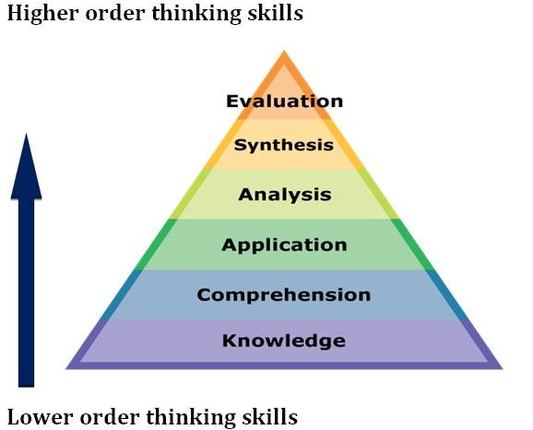
Learning Objectives
Apply commercial/civilian/entertainment technology to military problems, just as previous generations have.
Comprehend the mechanics, mathematics, strategies, and computer technologies that underlie game-based simulation and the historical underpinnings that have led to them.
Knowledge (Understand) the long, slow emergence of ideas that are required to support modern game-based simulation.
Notes:
The Learning Objectives for this tutorial are as follows:
Apply commercial technology to military problems, just as previous generations have.
Comprehend the mechanics, mathematics, strategies, and computer technologies that underlie game-based simulation and the historical underpinnings that have led to them.
Knowledge (Understand) the long, slow emergence of ideas that are required to support modern game-based simulation.

Slide 3
Outline
Introduction
Ancient Games
Military Wargames
Serious Games: The Military Explosion
Metaverse
Evolving VR & AR
Artificial Intelligence
Future Tech
References

Slide 4

Why study history?
Steal good ideas.
It provides professional identity.
Understand the path of progress.
Avoid repeating the same mistakes.
Predict the future.
American Historical Association: Why Study History?
https://www.historians.org/about-aha-and-membership/aha-history-and-archives/historical-archives/why-study-history-(1998)
Notes:
History? It surfaces memories of boring college classes about that founding fathers and ancient Mesopotamian contributions to agriculture. But, now that we are investing our lives in a profession, there are a lot of good reasons to know the history of the field you are working in … especially if you consider yourself a professional in this area.
Steal good ideas.
It provides professional identity.
Understand the path of progress.
Avoid repeating the same mistakes.
Predict the future.
https://journals.sagepub.com/doi/10.1177/1750698018794787
de Regt, S., van der Lippe, T., & Jaspers, E. (2020). On the relation between age and the importance attached to historical events. Memory Studies, 13(6), 969–987. https://doi.org/10.1177/1750698018794787

Slide 5
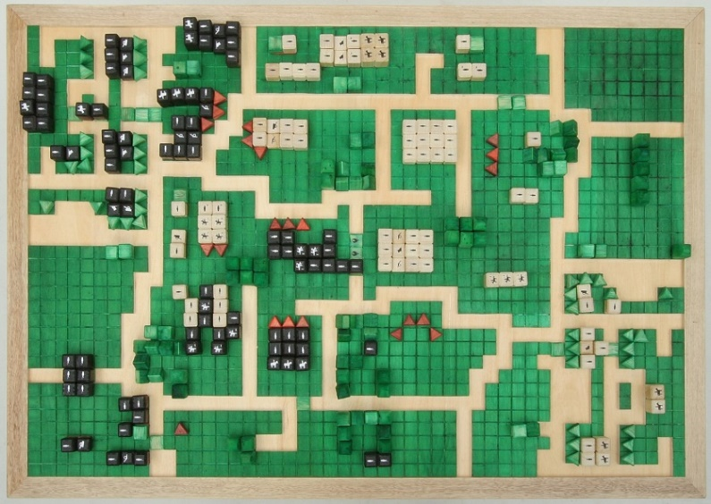
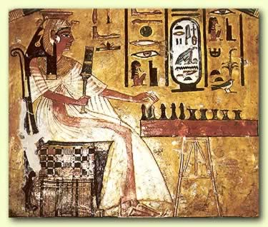
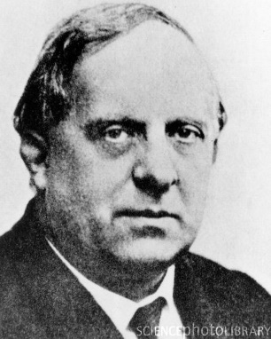
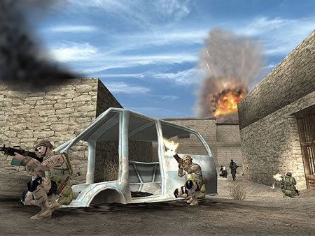
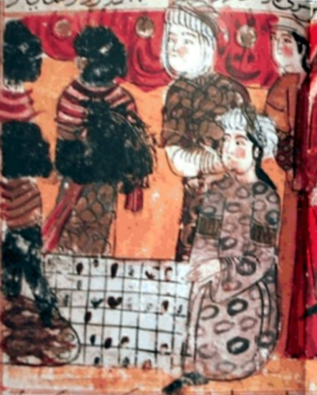
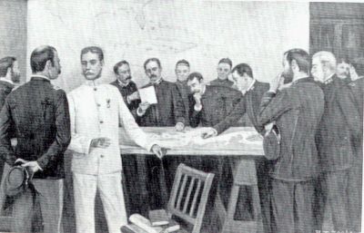
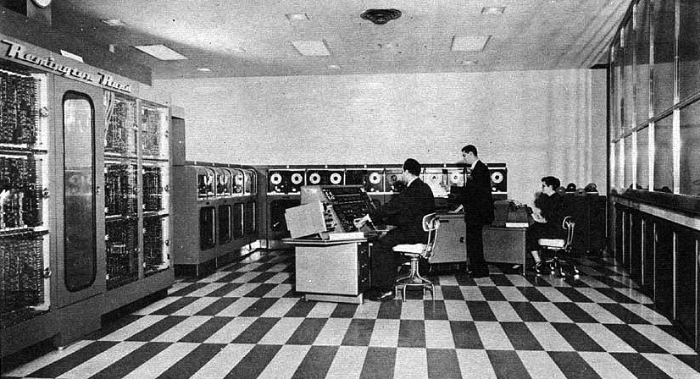
Historical Games Timeline
dD
= -k_{d}A^{t}D^{t}
dt
Mysticism
3000BC
Chess
500AD
Wargames
1644
War College
1895
Mathematics
1912
Computer
1948
PC
2002
Notes:
For the 2023 version of this tutorial, we have significantly shortened the early history sections. This timeline illustrates the changes that have occurred over centuries. We will expand on just a few of these milestones. But there are many fascinating details that just don’t fit into a ninety minute lecture.

Slide 6
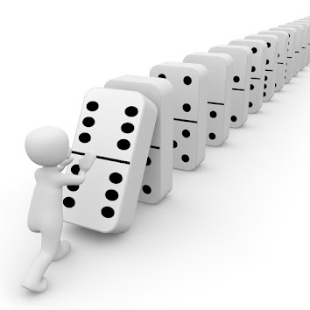
Tipping Points
dD
= -k_{d}A^{t}D^{t}
dt
Mysticism
3000BC
Chess
500AD
Wargames
1644
War College
1895
Mathematics
1912
Computer
1948
PC
2002
Representation
Calculation
Engagement
1
2
3
Notes:
For the 2023 version of this tutorial, we have significantly shortened the early history sections. This timeline illustrates the changes that have occurred over centuries. We will expand on just a few of these milestones. But there are many fascinating details that just don’t fit into a ninety minute lecture.

Slide 7
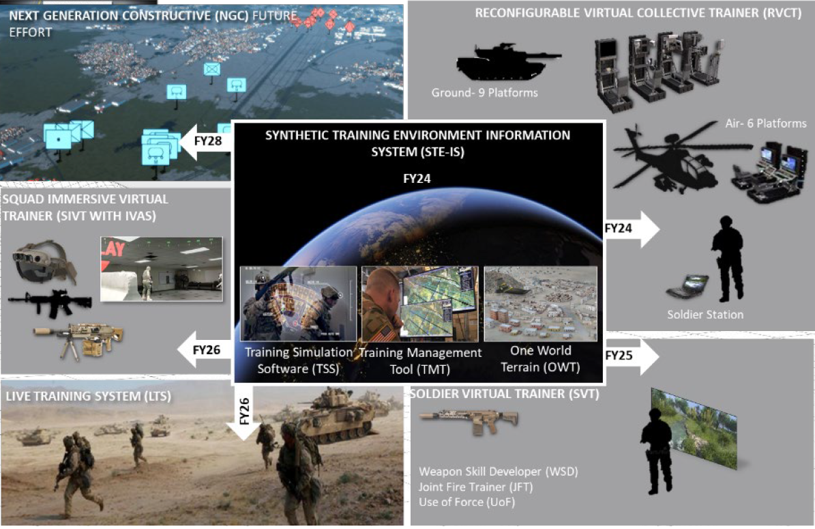
Tipping Point - STE
Unification
4
TSIS
June, 2023
Notes:
The Army STE program is a “revolution” in which the Virtual and Game-based training are unified on the same simulation engine – VBS4. Later iterations bring the Live and Constructive simulation products into this same family, sharing the same foundations.
DESCRIPTION:
The Synthetic Training Environment (STE) is designed to provide a collective, multi-echelon training and mission rehearsal capability for the operational, institutional and self-development training domains. It brings together live, virtual, and constructive training environments into a single STE for Army Active and Reserve Components as well as civilians. It will provide training services to ground, dismounted and aerial platforms and command post (CP) at the points of need (PoN).
The Synthetic Training Environment will interact with and augment live training, which is the primary training approach for the Army. The capability will train all Warfighting Functions and the human dimension across all echelons with Joint and Unified Action Partners in the context of Unified Land Operations.
BENEFIT TO THE WARFIGHTER
Warfighters will benefit from a single STE, built on One World Terrain concepts within a Common Operating Environment (COE), to obtain the sets and repetitions necessary to achieve and maintain skill and collective training proficiency in support of multi-domain operations.
SPECIFICATIONS:
Training and mission rehearsal capability
Interfaces with operational networks and Network-Enabled Mission Command Initial Capability Document-defined platforms and CP
Interfaces with live training instrumentation
Native interoperability with the COE
STE Virtual Military Equipment leverages commercial off-the-shelf (COTS) and government off-the-shelf (GOTS) hardware. It will provide immersive and semi-immersive training capability.
STE is a software solution and will not require production line for custom hardware. It will utilize integration line to integrate COTS and GOTS hardware.

Slide 8
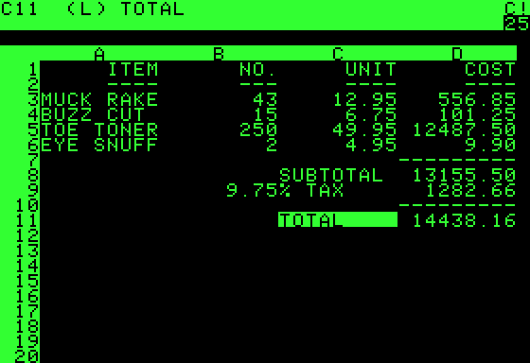
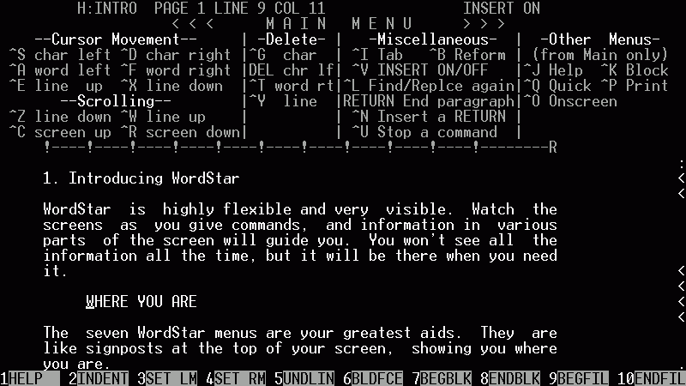
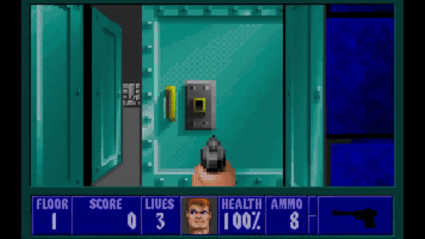
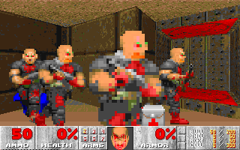
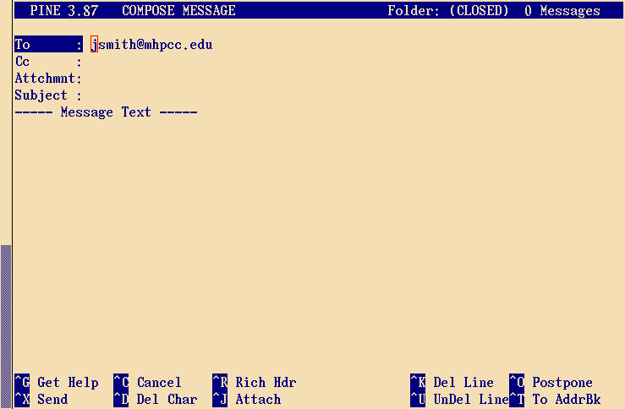
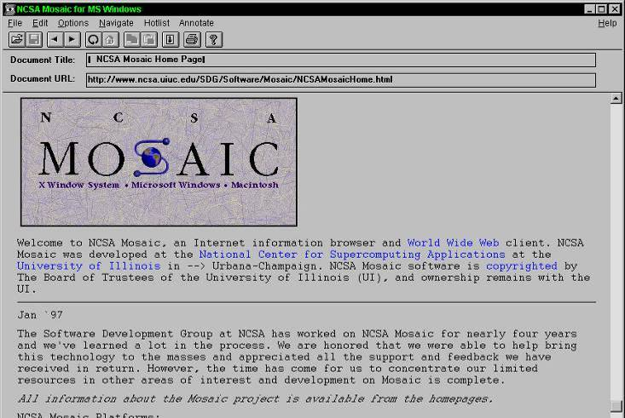
Computer “Killer Apps”
Spreadsheet
Word Processor
3D Game Engine
E-Mail
Web Browser
Notes:
The demand of computer devices is driven by the relevancy of the software applications available. This demand and existing applications provides funding for R&D to create new computer and software products. “Killer Apps” are pursued in this industry because they have the ability to increase hardware sales as much as 10X. The apps create the demand that generates profit and enables the funding of new technology like faster chips, audio cards, graphic cards, smaller disk drives, and network infrastructure.
In the business domain the Spreadsheet and Word Processor were some of the most powerful killer apps. Email and Web Browsers emerged to serve non-revenue generating users, but quickly became valuable and essential business applications as well. The consumer 3D Game Engine was created to provide entertainment to a small niche of computer users. But it spread virally and became an entertainment Killer Apps that rivals business applications in its ability to generate hardware sales. The current multi-billion dollar entertainment game industry is built on the back of the 3D Game Engine. It is just now being adopted for serious applications or “Serious Games” by business and government organizations.

Slide 9
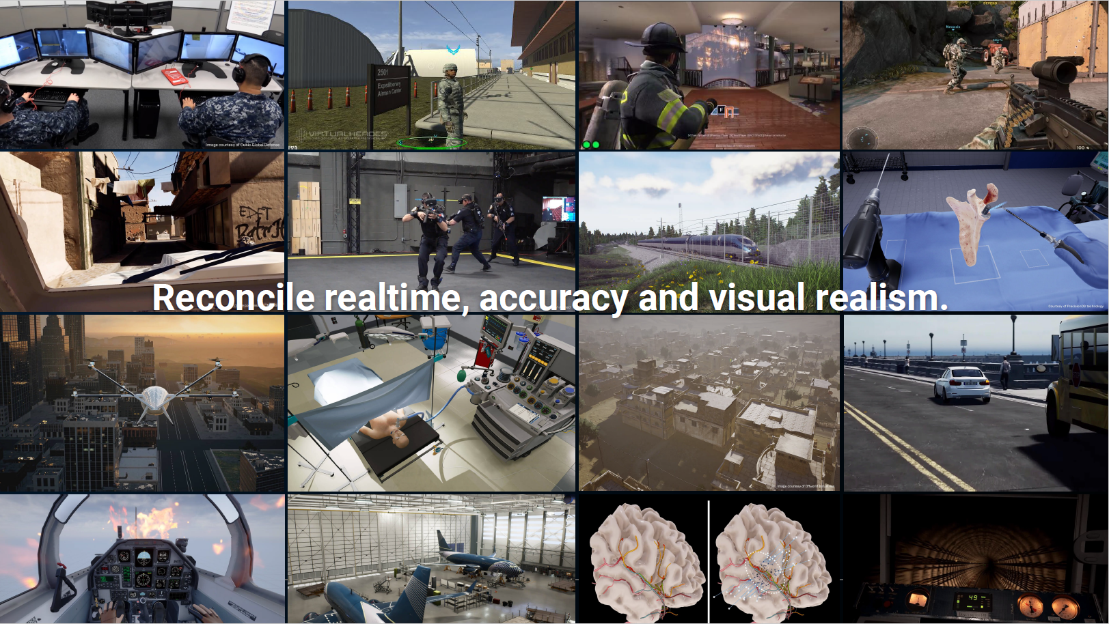
All Industries Now Use GameTech
Notes:
There is literally no industrial domain that does not use game technology today. Many of you have been around long enough to remember when computer games and the 3D engines, scenario builders, and computers were considered toys that were not respectable in military training, or any other real industry. But, today I think everyone recognizes that these technologies are essential for all kinds of training, design, analysis, rehearsal, marketing, and dozens of other functions.

Slide 10
Outline
Introduction
Ancient Games
Military Wargames
Serious Games: The Military Explosion
Metaverse
Evolving VR & AR
Artificial Intelligence
Future Tech
References

Slide 11

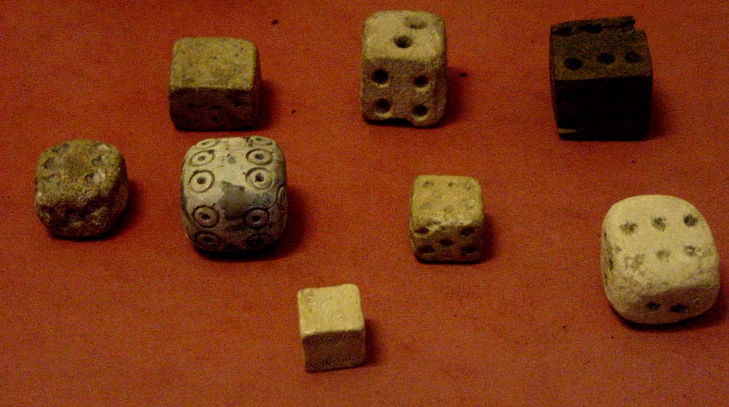
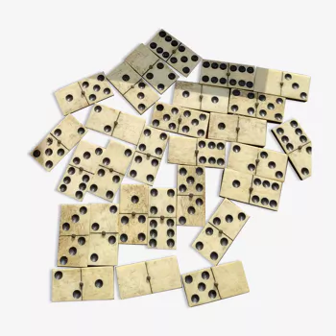
Dice, 3000BC
40,000BC
3,000BC
800AD
Mysticism
Fortunetelling with Sheep’s Knuckle Bones came from India to Africa around 40,000BC
Earliest known dice were from Iran around 3,000BC
Inspired the Italian creation of dominos around 800AD
The randomness of the die roll reveals hidden knowledge, advice, or the will of the gods.
Notes:
People in India brought the idea of throwing the knucklebones of sheep or pigs to tell the future, or to play a game of skill like jacks, when they first came from Africa to India about 40,000 BC. But people in India may have been the first to get the idea of carving those knucklebones and turning them into marked dice. The earliest known dice in the world come from a backgammon set from Iran, from about 3000 BC. Harappan people certainly used dice about 2500 BC, and the Rig Veda and the Mahabharata both tell stories about dice.
URL Link: http://www.historyforkids.org/learn/india/games/index.htm

Slide 12
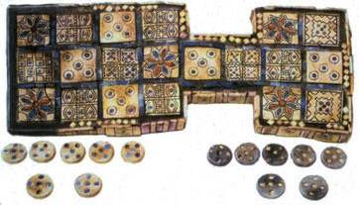
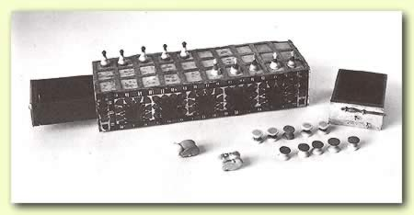
Egyptian Board Games, 3000BC
Mysticism
Senet: Move 7 pieces around the board
Sheep knucklebones as dice
Egyptian Ancestor to Checkers and Draughts
The space you end at forecast good or bad fortune
Notes:
Senet in Egypt: 3000 BC Games with pebbles, in spaces roughly drawn out on the ground, are a pleasant way of passing spare time - of which hunters and gatherers have more than one might imagine. In a settled community a flat and permanent surface is a clear improvement on the rough ground; and pleasantly carved pieces are much preferable to pebbles. The development of board games is an inevitable part of human history. The earliest known example - the senet of the Egyptians - is being played by 3000 BC and is still popular in a recognizable form in Egypt 5000 years later. Beautifully made boards for senet and other such games (with built-in drawers for the pieces) survive from Egyptian tombs.
One of the most popular indoor activities was a board game known as senet. Tourists who visit Egypt with a cautious eye may well run across a simple version of the board, sometimes found at antiquity sites marked out on the pavement or stone. However, much more elegant boards are to be found among the wealthy, including one found in the tomb of Tut. This game was an ancestor of draughts, with a checkered board known as the "perw" (houses) of three rows of 10 squares. Pieces of the opposing sides were distinguished by their size, color or shape. Each opponent usually had seven pieces.
Moves were determined by throwing sticks, or "astragals (knuckle-bones). The object was to move the pieces around a snaking track to the finish, landing on a number of specially marked squares representing good or bad fortune. Senet, which means "passing" became so popular it took on religious significance.
Royal Game of UR, 2600BC
A replica of a game found in a royal tomb at Ur dated around 2600 BC which makes it one of the oldest game boards in existence. The original, truly a special item, is on display at the British Museum.
The rules of the game as it was played around 2500BC are not know at all but the same boards were still in use a century or two before the birth of Christ and archeologists have discovered the rules for the game played at that time on some cuneiform tablet dated at 177/176BC. The early games show a variety of patterns on the board but the consistent factor is that five rosettes always appear. Game historians have argued and conjectured as to how the game might have been played. Some boards that have been found only feature the rosettes and all boards seem to feature rosettes in similar patterns leading most people to suppose that only the rosettes are significant. But, as can be seen from the pictures, others boards have different symbols within the squares. To this author, the other symbols seem to be more than just decoration - they are quite clearly denoted and artistically consistent with the rosettes so it seems possible that these symbols also meant something. So, it's this author's guess, given that the formal gaming authorities presumably didn't exist, that there were probably several popularly played sets of rules going around and also, as likely as not, several types of board. Perhaps the boards found in the tombs, being royal, had not only more ornate boards but also more ornate rules to match?
One factor that has been controversial is the path that the counters take around the board but H.J.R. Murray's original guess is the most elegant. He suggested that entry is made on the row on the fourth square from the left (in the top right picture) going left. One player enters on the top row, the other on the lower. When the counter reaches the corner, it moves to the middle row and travels along. When it reaches the penultimate square in that row it turns again going to the opposite row to that which it started and then travels around the outside of the 2 x 3 rectangle before returning back down the middle row and off the board where it came entered. This makes a path of 27 squares, the 28th move being to bear off the board. A shorter version of this has the pieces departing from the board into the same gap but immediately after the fourth rosette - a path of 16 squares, the 17th being to bear off. Either way, every fourth square of the path is a rosette.
The nature of the rosettes is also up for debate. They could be squares to be avoided - maybe they send the counter back to the start or forced a player to pay a fine into a central pool of betting money. Or some authors have suggested that they are safe squares where a counter cannot be caught (but this author thinks this is unlikely - the suggested tracks taken by the counters mean that some rosettes are in places that the opponent cannot reach so no need for safe squares...). Or the third likely idea is that landing on a rosette gave the player an extra turn. Whatever, the fact that they lie four squares apart from each other suggests that the number four was important. Since the game was played with 3 binary pyramidal lots which give a number from 0 to 3 each throw, many people therefore believe that a throw of 0 would allow the player a move of 4 squares. So, for instance, if Murray's path is used along with the idea that landing on a rosette gives another go, it would be possible by repeatedly throwing fours to get a counter all the way home in one turn.

Slide 13
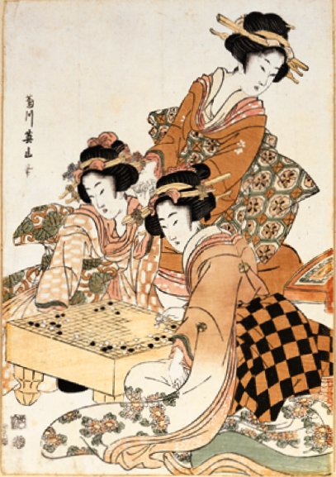
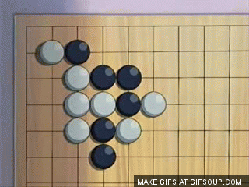
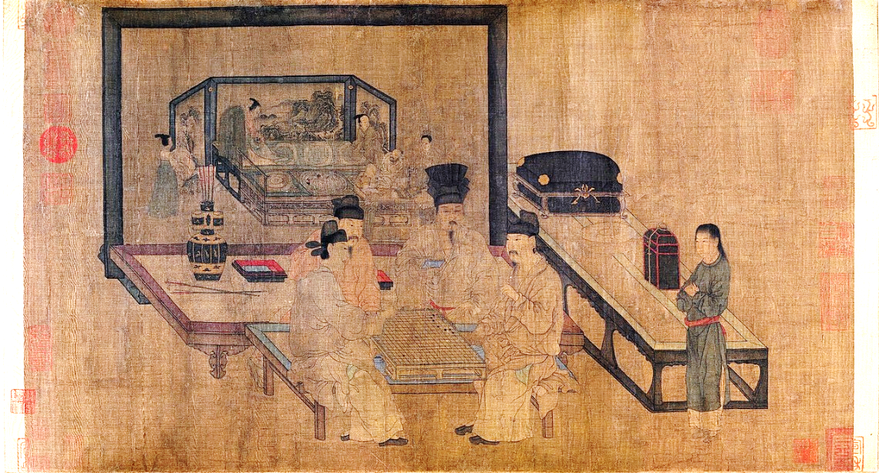
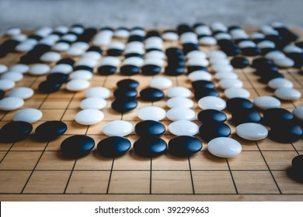

Wei Hai & Go, 3000BC
Strategy
Chinese Wei Hai means “encirclement”
Abstract board on which players placed colored stones
Details of the game have not survived
Believed to be the roots of Japanese Go
Notes:
Wei Hai
No artifacts of the actual game of Wei Hai have survived. Its origins around 3000BC and usage are derived from other references in historical documents. These descriptions lead us to believe that it operated very much like the modern game of Go. The name means “encirclement” and we know it involved and abstract board with colored stones.
Go
go, (Japanese), also called i-go, Chinese (Pinyin) weiqi or (Wade-Giles romanization) wei-ch’i, Korean baduk or pa-tok, board game for two players. Of East Asian origin, it is popular in China, Korea, and especially Japan, the country with which it is most closely identified. Go, probably the world’s oldest board game, is thought to have originated in China some 4,000 years ago. According to some sources, this date is as early as 2356 BCE, but it is more likely to have been in the 2nd millennium BCE. The game was probably taken to Japan about 500 CE, and it became popular during the Heian period (794–1185). The modern game began to emerge in Japan with the subsequent rise of the warrior (samurai) class. It was given special status there during the Tokugawa period (1603–1867), when four highly competitive go schools were set up and supported by the government and go playing was thus established as a profession.

Slide 14
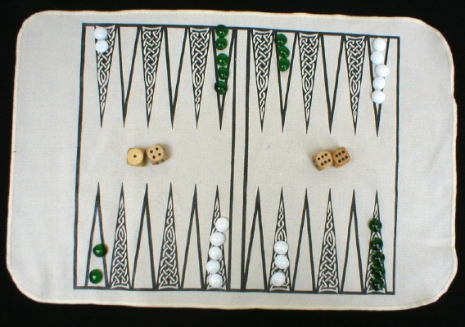
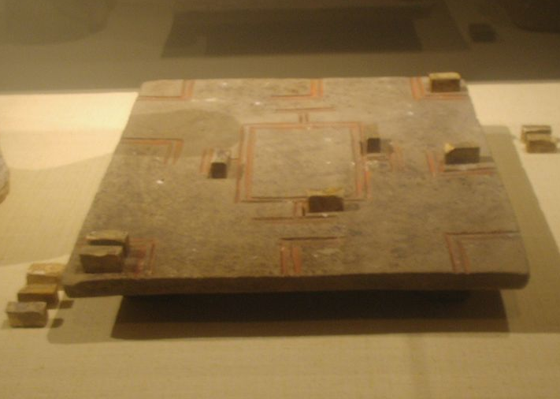
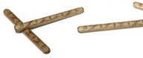
Backgammon, 2500BC
Entertainment or Gambling
Early Backgammon found at Ur, perhaps the gaming capitol of the ancient world
Combines luck (dice/sticks), skill (choice of move), and power of the gods (rules)
Throwing sticks are the equivalent of 2-sided dice or coin toss
Military Strategy
“Liubo” variation appears in China in 1500BC. Battle moves with “Generals” as pieces
Notes:
Backgammon
Among the treasures found at Ur is a board laid out as if for the game of backgammon - which remains to this day one of the most popular board games in the Middle East.
Like senet and other board games of antiquity (but unlike, chess, draughts or the Japanese game of go), backgammon involves a large element of luck - since the movement of the pieces along the board depends on the numbers thrown. At this period a number is established by throwing sticks and counting those which fall with a given side upwards. The more economical method of six-sided dice is developed by about 2000 BC.
http://www.historyworld.net/wrldhis/PlainTextHistories.asp?groupid=2271&HistoryID=ac02
Liubo
The earliest surviving remnant of liubo dates from circa 1500 BC, the Shang Dynasty in China, carved on a slab of blue stone. For a photo of this ancient game, see [1]. Liubo is thought to have lost its popularity by around the 6th century AD.
As with most other games handed down to us from antiquity, exactly how liubo was played may have varied from one time period to another and one player to another and one culture to another. For example, upon analyzing the ancient literature of Greek Board Games Professor Austin remarks that Plato in the 5th to 4th centuries BC originally described petteia as a battle game, but by the time knowledge of that game reached Eustathius Macrembolites in the 12th century AD, Eustathius was calling it a race game. Professor Austin supplies other similar examples as well.
Liubo is no different. Where some may refer to liubo playing pieces as "generals" and "pawns" (see The History of Xiangqi) others refer to them as "fish," "stones" and "owls" (see Cazaux, Is Chess A Hybrid Game?).
Consequently, while some regard liubo as a battle game played with dice, others regard it as a game only akin to playing a game of cards where players accumulate points or "fishes." Though there are a number of surviving literary references to and artistic impressions of the game that date from antiquity, there are no known surviving records of the rules of liubo. Some scholars have attempted to reconstruct the game, most notably Lien-sheng Yang, who discusses the game as it was possibly played on TLV mirrors.
Because we do know that liubo was played by some as a "battle game" (with sticks that were similar to dice) it has gained the distinction of having perhaps spawned the creative development of Xiàngqí (also known as Chinese Chess), another ancient Chinese battle game (played without dice). Furthermore, some may point out how the board design of liubo lends itself to a Xiàngqí-like grid of squares.
URL Link: http://en.wikipedia.org/wiki/Liubo

Slide 15
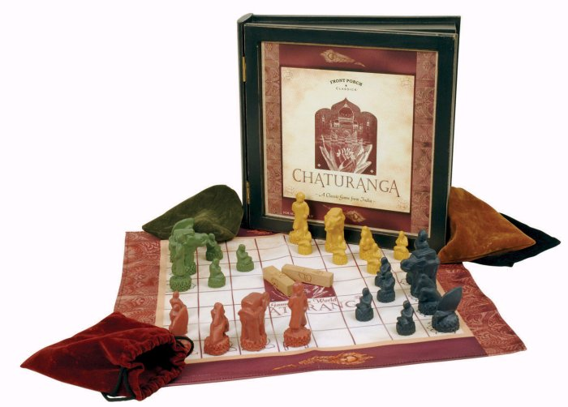
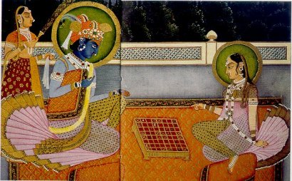
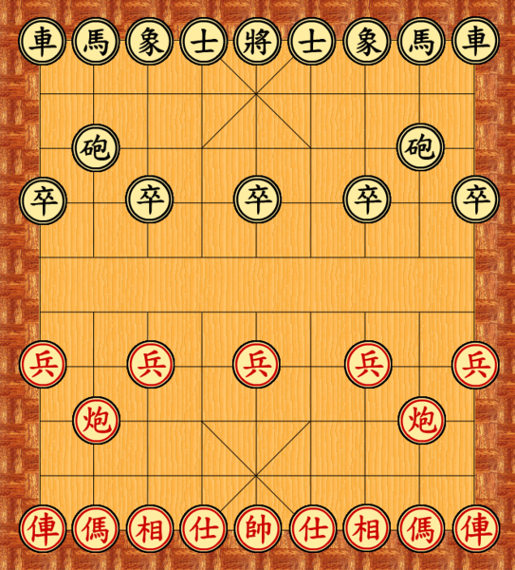
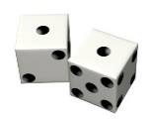
Chaturanga, 500BC
Military Strategy
Indian royal military strategy game with Infantry, Rajah, Elephant, Cavalry, and Chariot pieces.
Dice were eliminated to avoid gambling laws in India
Inspiration for Chinese Xiangqi, Korean Janggi, and European Chess
Notes:
Chaturanga originated in India around 500BC and is found in both 2-player and 4-players versions. It makes use of pieces that closely equate to those found in Chess. These pieces represent the Infantry, Rajah, Elephant, Cavalry, and Chariot (or Boatman). Chaturanga is the direct ancestor of Chess.
Originally the piece to move was selected by rolling dice. But Hindu law prohibited gambling and the dice were eliminated to avoid violating this law.
Xiangqi
Xiangqi has a long history. Though its precise origins have not yet been definitely confirmed, the earliest indications reveal the game may have been played as early as the 4th century BC, by Tian Wen (田文), the Lord of Mengchang (孟嘗君) for the state of Qi, during the Warring States Period. (See chess in early literature or timeline of chess.) Judging by its rules, Xiangqi was apparently closely related to military strategists in ancient China. The ancient Chinese game of Liubo may have had an influence as well.
The word Xiàngqí's meaning "figure game" can also be treated as meaning "constellation game". Sometimes the xiàngqí board's "river" is called the "heavenly river", which may mean the Milky Way; previous versions of xiàngqí may have been based on the movements of sky objects.
During the Spring and Autumn Period and the Warring States Period, wars were fought for years running. A new strategy board game was patterned after the array of troops (according to a hypothesis by David H. Li, this was developed by Han Xin in the winter of 204 BC-203 BC to prepare for an upcoming battle). This was the earliest form of Xiangqi.
During the Cao Wei, Jin and Northern and Southern Dynasties, a kind of strategy game was popular among the people. It laid a foundation for the finalized pattern of Xiangqi. In ancient times, both highbrows and lowbrows enjoyed Xiangqi.
During the reign of Suzong of the Tang Dynasty, Prime Minister Niu Sengru wrote a fictional story about Xiangqi. That occurred during the Baoying period, so it was named Baoying. Baoying had six pieces and produced a significant influence on Xiangqi in subsequent years.
Three forms of the game took shape after the Song Dynasty. One of them consisted of 32 pieces. They were played on a board with 9 vertical lines and 9 horizontal lines. Popular in those days was a board without a river borderline; the Korean game of janggi is derived from this earlier riverless version. The river borderline was added later, and this form of the game has lasted to the present day.
With the economic and cultural development during the Qing Dynasty, Xiangqi entered a new stage. Many different schools of circles and players came into prominence. With the popularization of Xiangqi, many books and manuals on the techniques of playing the game were published. They played an important role in popularizing Xiangqi and improving the techniques of play in modern times.
URL Link: http://en.wikipedia.org/wiki/Xiangqi

Slide 16
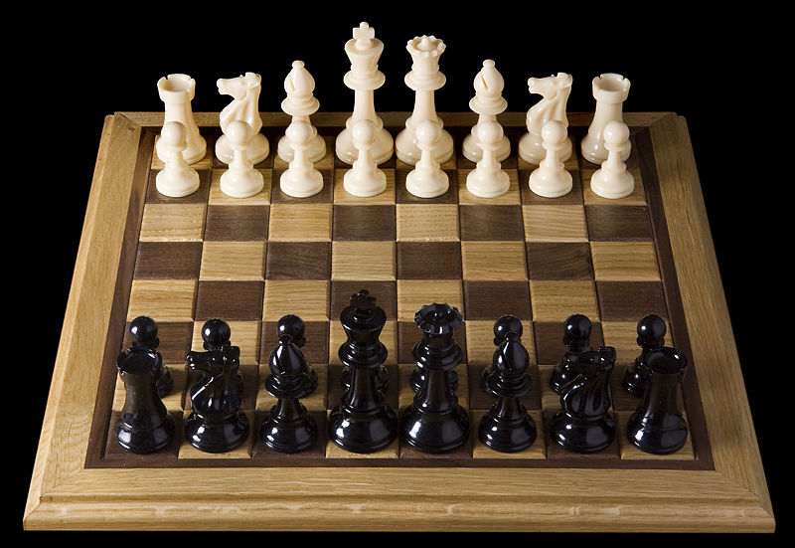
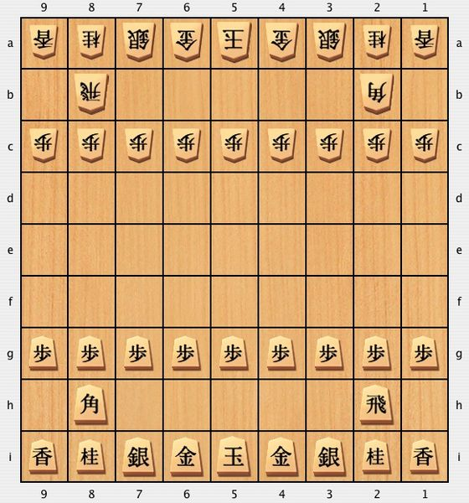

Chess, 500AD
Military Strategy to Intellectual Test/Entertainment
Indian Chaturanga (500BC) inspired European Chess (500AD), which inspired Chinese Shogi (570AD)
“Checkmate” is the English form of Persian “Shah Mat”, which means “dead king”
Separates itself from other games because of its complexity and strategy. Avoids many social prohibitions against mysticism and gambling.
Notes:
Chess
Chaturanga spread from India to Persia to China and then into Europe. Western Chess emerged around 500AD as a derivative of Chaturanga and is one of the most widely played games of strategy in the Western world. The game has always symbolized strategic and tactical thinking. Mastery of the game has always implied some degree of skill in commanding military forces.
NOTE: The term “checkmate” as used in chess is derived from the Persian term shah mat, which means “king dead”.
Shogi (将棋 shōgi?, generals' chess), pronounced /ˈʃoʊɡiː/ (rhymes with yogi) in English, also known as Japanese chess, is a two-player board game in the same family as Western chess, chaturanga, Chinese chess, and janggi, and is the most popular of a family of chess variants native to Japan. Shōgi means general's (shō) boardgame (gi). In early years, however, shogi was spelled 象棋 (the same as xiangqi) where "shō" meant "image", "representation", or "elephant".
Originating in India sometime between the 6th to 11th centuries CE, chess crossed from Tang Dynasty China to Japan, where it spawned a number of variants. Shogi in its present form was played as early as the 16th century, while a direct ancestor without the "drop rule" was recorded from 1210 in a historical document Nichū reki, which is an edited copy of Shochū reki from the late Heian period (ca 1120).
David Pritchard credits the drop rule to the practice of 16th century mercenaries who switched loyalties when captured—no doubt as an alternative to execution. "Perhaps the enduring popularity of Shogi can be attributed to its 'drop rule'; it was the first chess variant wherein captured pieces could be returned to the board to be used as one's own."[1]

Slide 17
Outline
Introduction
Ancient Games
Military Wargames
Serious Games: The Military Explosion
Metaverse
Evolving VR & AR
Artificial Intelligence
Future Tech
References

Slide 18


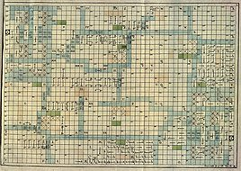
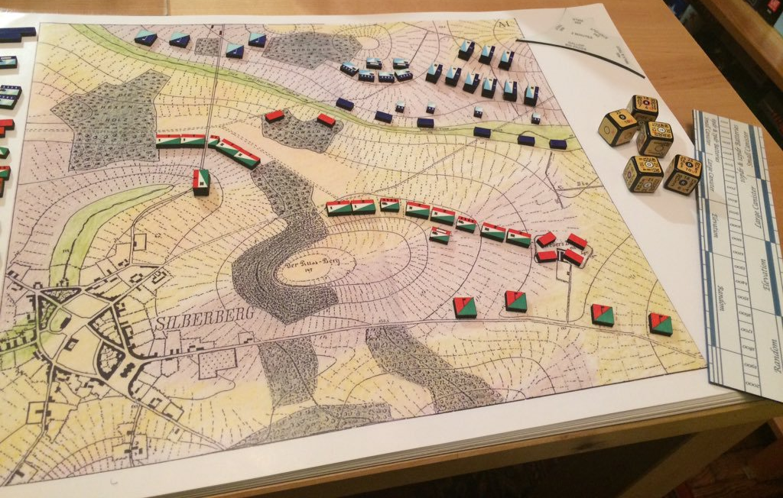
Koenigspiel to Kriegsspiels, 1664 to 1811
1
1664 Koenigspiel, Christopher Weikhmann, Germany
Checkered Board with 30 Pieces - King, Marshall, Colonel, ... Private
1780 War Chess, Dr. C.L. Helwig, Germany
1666 squares, 120 pieces, terrain types for each square, aggregated units
1797 Military School Wargame, Georg Venturini, Belgium
3,600 representing the French-Belgium border
1811 Kriegsspiels, Baron von Reisswitz , Germany
Contoured terrain, miniature pieces, strategic scenarios with winning conditions
1879 The American Kriegsspiel, William Livermore and Hugh Brown, USA
Variable unit icons with strength, type, fatigue, ammunition, and task time indicators
Topographic Maps
Pegs-and-Holes firing board
Notes:
Koenigspiel (meaning “King’s Game”) was invented in Ulam, Germany. Christopher Weikhmann based the game on standard chess, but with a larger board and players named after political and military positions. He maintained that it “was not designed to serve merely as a pastime but that it would furnish anyone who studied it properly a compendium of the most useful military and political principles.” Later historians contend that the game was just a “fancified and overcomplicated” version of chess.
This game maintained the traditional chess board, but transformed the pieces into military figures.
War Chess, invented by Dr. Helwig in 1780, was the first to incorporate three fundamental concepts of wargaming: aggregated unit markers, a multi-color game board representing terrain, and the use of an umpire to supervise the play of the game. The terrain included: mountains (red squares), lakes and rivers (blue), marshes (light green), forests (dark green), open terrain (black and white), and buildings (half-red).
“Rules for a New Wargame for the Use of Military Schools”. In 1797 Georg Venturini improved upon earlier wargames by expanding the size to 3600 squares and specializing them to represent the French-Belgian border. This allowed more realistic training against a potentially real threat from a real country. The aggregate unit icons were also customized to represent the real forces of both sides.
Kriegsspiels. In 1811 Baron von Reisswitz further enhanced the gaming experience with Kriegsspiels (means “War Game”). Reisswitz employed contoured terrain on the playing board and small porcelain soldiers. This began the off shoot known as “Miniature Gaming”. von Reisswitz is also noted for inventing the idea of a unique scenario for each game. This defined unique objectives and specified the conditions under which a game could be won.
The American Kriegsspiel, created by William Livermore, of the Army Corps of Engineers, and Hugh Brown, and infantry Captain and Civil War veteran. They greatly reduced the amount of time to record changes in unit status by adding markings on the unit icons and markers for ammunition levels, fatigue, and task times.
Livermore encouraged umpires to apply their professional judgment in deciding specific situations, rather than resorting to time consuming table look-ups, die rolls, and computations. Wargaming at that time was suffering from the excruciating amount of record keeping and long duration times for a game. One of Livermore’s primary objectives was to reduce this, make the game move faster, and make it more exciting to play.
Lt. Charles A.L. Trotten criticized Livermore’s approach in his own 1880 book, Strategos: A Series of American Games of War Based upon Military Principles. Trotten invented game concepts that are used today. Like the stacking of units. However, much of Trotten’s uniquely American ideas were overcome by the American fascination with German ideas at the time.
http://www.zoi.wordherders.net/?cat=11

Slide 19

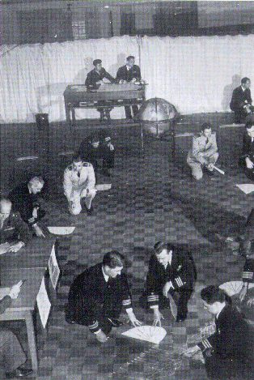
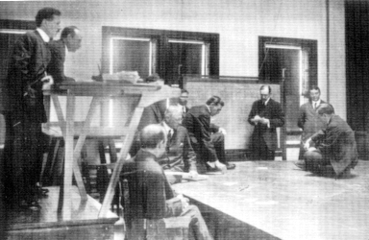
Naval War College, 1886-Present
1895
1914
Wargaming introduced in 1886 by William McCarthy-Little
Cardboard Ships and Gridded Paper, evolving toward massive map boards
1947
Notes:
The 1895 illustration of a wargame at the Naval War College shows the use of a large map board and ship icons surrounded by commanders and referees. That wargame was exploring the options for defending New York Harbor against an invasion by the British Navy.
By 1914 the map board had grown large enough to allow players to walk about on top of it to place their assets and engage in combat.
By 1947 the Naval War College had tiled an entire gymnasium in light and dark wooden grids to allow commanders to conduct wargames. These officers and referees are maneuvering ships and battle groups around the floor to practice specific strategies and tactics.
The officers are also using a small simulator called a “maneuvering board”. These arcs of wood describe the turning radius of individual and groups of ships. They enforce the accurate representation of the time and space required to maneuver ships at sea.

Slide 20
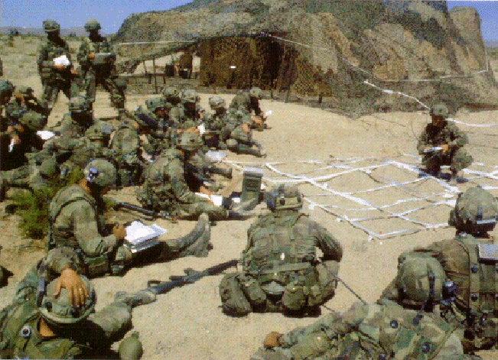
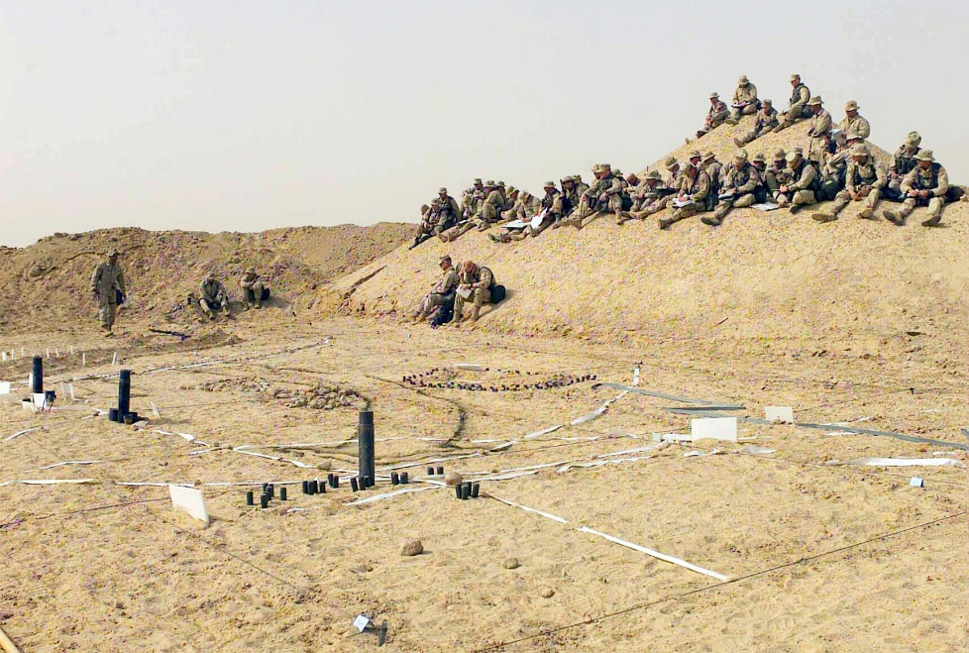
Wargaming in the Dirt, current
The stone age of gaming is still active in modern military training
Practiced at the National Training Center and during the Iraq Wars
One-to-Many communication
Notes:
Commanders at the National Training Center, Fort Irwin, California, use “dirt maps” to represent the terrain at hand. Shovels are used to transform an area of ground into a map of the battlefield. These impromptu sandtables may also be marked with colored powder to indicate the locations of snipers, minefields, and dangerous avenues of approach.
The dirt maps are ideal devices for walking through battle plans with identifiable references to terrain features. These events also allow subordinates to repeat back their portion of the action to convince the commander that they understand their mission.

Slide 21


Lanchester Equations, 1912
2
Indirect Fire:
dD
= -k_{d}A
dA
= -k_{a}D
dt
dt
The General Form:
dD
= -k_{d}A^{s}D^{r}
dA
= -k_{a}D^{r}A^{s}
dt
dt
Direct Fire:
dD
= -k_{d}AD
dA
= -k_{a}DA
dt
dt
Computation
1912 Differential Equations to predict combat outcomes based on historical data
Establish a scientific basis for making combat decisions
Created fundamental mathematical equations that capture the reality of combat
Based on the large force-on-force engagements of the 1800’s
Notes:
Fredrick William Lanchester was a British engineer involved in the development of the aircraft, automobile, and concepts that would later be known as operations research. He was extremely prolific, publishing three to four papers each year and covering automobile and aeronautical engineering, radio mechanics, acoustics, relativity, and music. We remember his efforts to discover a scientific basis for understanding combat, especially engagement and attrition. It was (and is) common to assume that human experience and judgment are sufficient for understanding the intricacies and complexities of warfare, but Lanchester was looking for more mathematical techniques for studying combat. He published his ideas and equations in a paper in 1912 and again in 1916 as part of his book Aircraft in Warfare: The Dawn of the Fourth Arm.
Lanchester’s name has become synonymous with equations of combat. In some circles, the term “Lanchester Equations” can draw instant creditability or derision.
Lanchester’s three core equations are given on the slide, where
D = strength of the defender,
A = strength of the attacker, and
k = coefficients of effectiveness (constants).
It is usually said that the square law applies to “aimed fire” (e.g. tank vs. tank) and the linear law to “unaimed fire” (e.g. artillery barraging an area without precise knowledge of the target locations). Alternatively, it is sometime said that the key feature of the square law is that it describes concentration of fire.
Although the simple Lanchester equations with constant coefficients remain useful for demonstrating some features of combat, the coefficients of those equations change from time step to time step as conditions of terrain, defender preparations, and many other factors change. Good computer simulations recognize that the losing side may choose to break off battle rather than be annihilated. Some use equations in which the exponents are much smaller than called for in the square law and in which there are some differences in exponent between attacker and defender. Lanchester equations continue to have a place in explaining simple points.
Paul Davis, Rand Corp. Paper

Slide 22
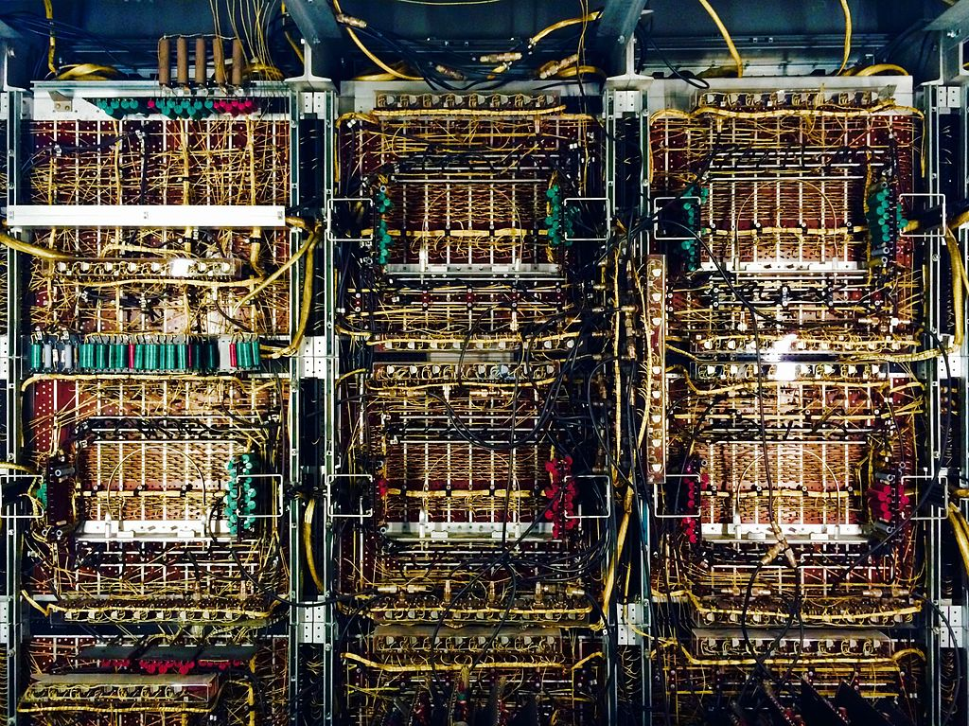
First Computer Wargame, 1948
Army Operations Research Office at Johns Hopkins University
“Air Defense Simulation”
Hosted on the Univac computer
North American air defense using Naval anti-aircraft guided missiles
CARMONETTE
1953 Computerized Monte Carlo Simulation. Tank/Anti-Tank (v.I), Infantry (v.II), Helicopters (v.III), Communications (v.IV)
Notes:
The first computerized simulation was created in 1948 by the newly created Army Operations Research Office (ORO) at Johns Hopkins University. A team lead by R.P. Rich and Alfred Hausrath created an anonymous “air defense simulation” which they used to study North American air defense capabilities and naval anti-aircraft guided missile systems. This simulation operated on one of the first Univac computers.
ORO also created the very first digital computer simulation - the Computerized Monte Carlo Simulation (CARMONETTE) in 1953. It represented a company or battalion sized battle in which units were able to Move, Prepare to Fire, and Fire. This simulation became operational in 1956 and was first used to study tank/anti-tank engagements. In 1960 CARMONETTE II gained the ability to represent infantry, followed by CARMONETTE III in 1966 with armed helicopter support and CARMONETTE IV which added communications and night vision effects.
Note: In 1952 the Univac received world-wide recognition by predicting the presidential victory of Dwight D. Eisenhower over Adali Stevenson. Political analysts were betting on Stevenson, but the Univac extrapolated early election returns and concluded that Eisenhower would be a strong winner.

Slide 23
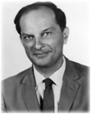
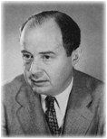

Monte Carlo Method, 1949
Statistical Inference
Originally conceived by Stanislaw Ulam, matured by John von Neumann for military problems
Statistical sampling of model outcomes to get around the need for complete calculation
Generate solution within a certain probability and confidence area
Notes:
Stanislaw Ulam had been developing mathematical models of nuclear reactions. In 1949 he recognized the benefit of developing a probabilistic model of a system and running it multiple times to allow the statistical properties to generate answers around the correct solution. A probabilistic model is valuable in that it does not have to explicitly capture all of the properties and interactions of a system, it may therefore be possible to model systems that are otherwise too complex to specify mathematically.
Ulam suggested this idea to John von Neumann, and with typical von Neumann zeal, John extended, explained, and promoted the idea within the scientific community.

Slide 24
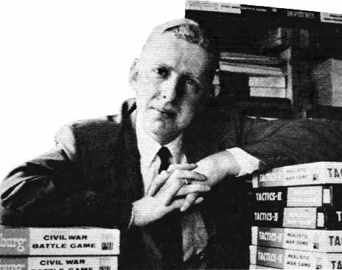
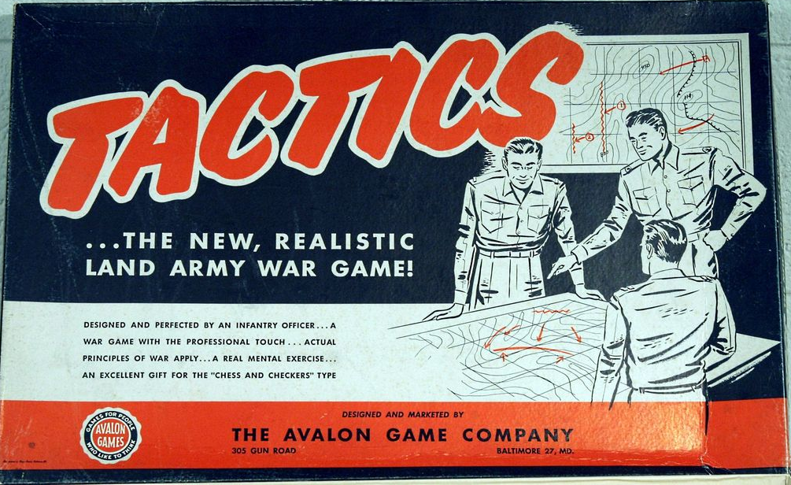
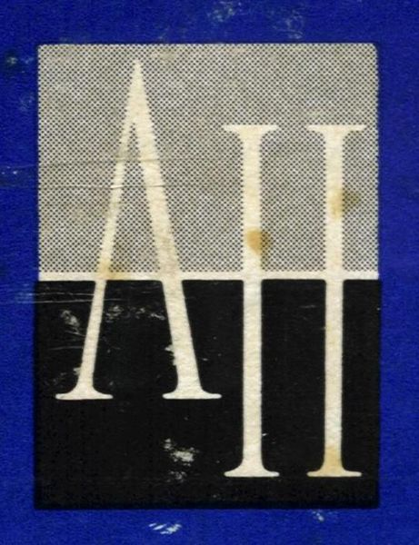
Charles Roberts, 1952
Roberts invents board game to “practice war” while awaiting his commission
Introduces primary pieces: Grid System, Terrain Types, Military Units with Ratings, Combat Results Table, Die Role
Hex grids first used by French officers during WWII. Rand also created them independently from Roberts.
Published as “Tactics” in 1954 (Sold 2,000 copies from 1954-58)
Started Avalon Hill in 1958
Notes:
Charles Roberts is the acknowledged father of the board wargaming community and industry that currently exists in America and extends to other countries. Roberts created the fundamental pieces of a wargame while awaiting his commission into the US Army. Several of the techniques he created were also created independently at the Rand Corp. at the same time. The idea of a Combat Results Table driven by die roll and surrounding conditions was invented by both parties. The idea of using a hex grid over the map was developed at Rand and adopted by Roberts. He had originally gridded the map with squares, but later saw a picture of the Rand map and its hex overlay. Recognizing the advantages of operating in six directions rather than four, Roberts modified his own games.
In 1958 Roberts turned his hobby project into a company named Avalon Hill. They were one of the premiere gaming companies through the golden age of the hobby in the 1980’s. In 1998 Avalon Hill was acquired by Hasbro.

Slide 25
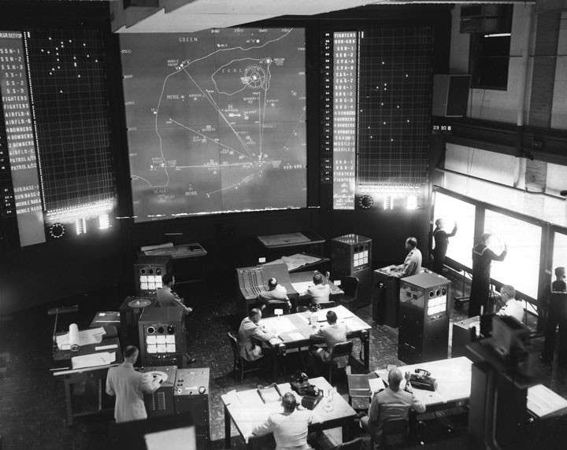
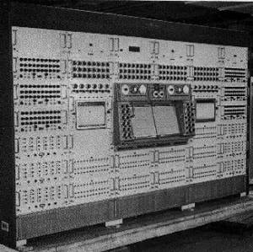
Navy Electronic Warfare Simulator, 1958
First interactive computerized wargaming system
Game rooms designed to resemble fleet command centers
Development time: 13 years
Notes:
The Navy Electronic Warfare Simulator (1958).
The first computerized wargaming system was the Navy Electronic Warfare Simulator, which became operational in 1958 at the US Naval War College. The computer system, being from the pre-microchip era, spanned three floors. The game rooms were designed to the resemble the command centers where the Navy coordinated its fleets.[64][65] When the system was first made operational in 1958, the Navy discovered that it could not model recent advances in military technology. For instance, it could not model ships moving faster than 500 knots. The system had taken 13 years to develop and, like most computers from that era, was difficult to reprogram or upgrade (it predated punch-cards). A variety of improvisational gimmicks were required to run wargames for the contemporary era.
https://www.wikiwand.com/en/Military_wargaming

Slide 26
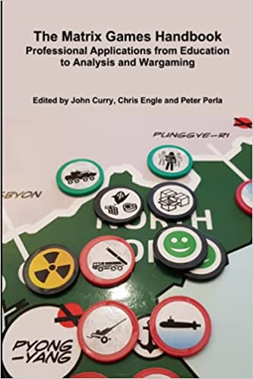
Matrix Games, 1988
Created by Chris Engle. Championed in UK by Maj Tom Mouat
Board games with few rules, players propose an event and reason for its possibility.
May include voting on acceptability by a larger audience (as in this classroom setting)
Notes:
Matrix games are different to normal Wargames. In a Matrix game, there are few pre-set rules limiting what players can do. Instead, each is free to suggest any plausible action or event during their turn. The chances of success or failure, as well as the effects of the action/event, are largely determine through structured argument and discussion. This process allows for imaginative game dynamics that are lively and open-ended, and yet also grounded in reality.
Matrix games are particularly well-suited for complex conflicts and issues involving multiple actors and stake-holders, varying interests and agendas, and a broad range of (diplomatic/political, military, social, and economic) dimensions. The game system crowdsources ideas and insight from participants, thereby fostering greater analytical understanding.
From, “Practical Advice on Matrix Games” by Major Tom Mouat, MBE, MSc, PGCE
https://www.professionalwargaming.co.uk/190216-WhyWargame-Mouat-O.pdf
Major Tom Mouat MBE MSc ato psc sim has been a serving Officer with the British Army since 1979. He is a Graduate of the Army Staff College, Camberley; and has served in Britain, Cyprus, Germany, Iraq, Norway, The USA, Gibraltar, Malaysia, The Oman, Belize, the Falklands and Bosnia. He is currently the SO2 Directing Staff Simulation and Modelling at Technical Division of the Defence Academy of the UK. He has published articles and delivered lectures about simulations, military history and wargames for professional development, education and recreation since 1983. Subject to the exigencies of the Service, he is available as a consultant for any work in these related fields.
From John Schmitt: Glad to help. Obviously, I think they are a valuable tool, especially for exploring complex socio-political situations. Matrix games are the brainchild of Chris Engle (https://paxsims.wordpress.com/tag/chris-engle/#:~:text=Chris%20Engle%2C%20a%20psychiatric%20social,up%20out%20of%20their%20imagination).
Other key players are Tim Price (https://paxsims.wordpress.com/tag/tim-price/) and John Curry (https://www.amazon.com/Matrix-Games-Handbook-Professional-Applications/dp/0244992134).
There’s also an interesting video on YouTube by Pete Pellegrino, who does matrix games for the Naval war College: https://www.youtube.com/watch?v=YLiQWnfzG1E&t=3568s.

Slide 27
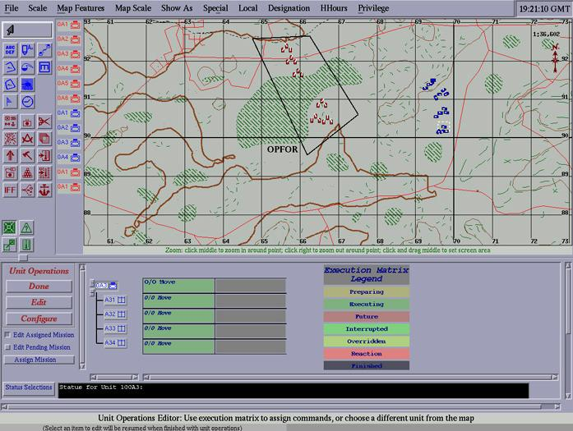

Semi-automated Forces (SAF), 1990’s
SIMNET SAF, MODSAF, CCTT SAF, Joint SAF, OneSAF
Semi-Automated Forces systems are constructive simulations designed to stimulate virtual systems
UI operations like a wargame, external data stream like a virtual simulator
AI augmentation/assistance to human player , especially red side
Notes:
Semi-Automated Forces (SAF) systems are used to drive vehicles in a virtual level exercise. The system presents a 2D map referred to as a Plan View Display (PVD). One operator can use this and other tools to track the battle and control as many as 75 vehicles. The data generated by this system is transmitted on a network and allows individual tank simulators to display and fight against a large number of enemy forces. This provides a great reduction in cost since the opposing forces (OPFOR) does not have to be equipped with expensive tank simulators.
Though a SAF is usually used to drive virtual level simulations, it is itself a constructive level simulation. It does not use immersion in a synthetic environment to train the operator.

Slide 28
Outline
Introduction
Ancient Games
Military Wargames
Serious Games: The Military Explosion
Metaverse
Evolving VR & AR
Artificial Intelligence
Future Tech
References

Slide 29


1970 Serious Games Definition
“Reduced to its formal essence, a game is an activity among two or more independent decision-makers seeking to achieve their objectives in some limiting context. A more conventional definition would say that a game is a context with rules among adversaries trying to win objectives.
“We are concerned with serious games in the sense that these games have an explicit and carefully thought-out educational purpose and are not intended to be played primarily for amusement.”
Abt, C. (1970). Serious Games. New York: The Viking Press.
Notes:
Abt left Germany for the United States in 1937. In 1947, he applied as an aeronautics student at the Massachusetts Institute of Technology, where he graduated in 1951. He then served four months in the merchant navy as a seaman, then spent a year at Johns Hopkins University as an English teacher, eventually obtaining a Master's degree in the Writing, Discourse and Drama Department for his thesis, titled A Year of Poems. In 1965, he earned a PhD from MIT in Political Science. He founded Abt Associates immediately afterwards.[1]
Abt is known for his book Serious Games (1970),[4] where he formally established a basis for the concept of Serious game.[5] In this work and subsequent ones, he described sports games, role playing games and (then marginal) computer games as mediums for educative, political or marketing ideas.[6] This interest probably stemmed from Abt's involvement with the development of TEMPER, an early computer wargame designed for a Cold War context.[5]

Slide 30




Battlezone, 1980
The Video Arcade Game
The US Army Bradley Trainer
Notes:
Battlezone, released by Atari in 1980, was the first popular video game to feature 3D graphics, a technological breakthrough at a time when simple 2D games like Space Invaders were the norm. The player controls a tank, in first-person perspective, on a mechanized battlefield against enemy forces equipped with tanks and guided missiles. It is the direct ancestor of every First-Person Shooter, and the US Army even commissioned a customized variant (The Bradley Trainer) to train its tank troops. Surviving cabinets of the game are still very popular with collectors today.
A version called The Bradley Trainer (also known as Army Battlezone or Military Battlezone) was designed for use by the U.S. Army as targeting training for gunners on the Bradley Fighting Vehicle.[25] It was commissioned by a consultant group of retired generals.[26]
Approaching Atari in December 1980, some developers within Atari refused to work on the project because of its association with the Army,[27] most notably original Battlezone programmer Ed Rotberg.[28] Rotberg only joined the project after he was promised by management that he would never be asked to do anything with the military in the future.[29] According to Rotberg, it took him three months of constant work to develop the prototype version of The Bradley Trainer.[26] Only two were produced; one was delivered to the Army and is presumed lost, and the other is in the private collection of Scott Evans,[30][31] who found it by a dumpster in the rear parking lot at Midway Games.
The gunner yoke was based on the Bradley Fighting Vehicle control and was later re-used in the popular Star Wars game.[29] The Bradley Trainer differs dramatically from the original Battlezone as it features helicopters, missiles, and machine guns; furthermore, the actual tank does not move—the guns simply rotate.
https://en.wikipedia.org/wiki/Battlezone_(1980_video_game)

Slide 31


SGI Flight, 1983
1983 Silicon Graphics demo/sales program
Written by Gary Tarolli
Inspired by Blue Angles air show at Moffett Field
1984 Networking added
Two machines on a serial cable
No interactions, 7 frames-per-second
1985 Interactions added
Added shooting interactions, message packets transmitted at frame rates
10 player max because of bandwidth limitations
Dead reckoning added later to reduce network flooding
Notes:
In 1983 SGI programmer Gary Tarolli created a basic flight simulator that allowed the user to fly an aircraft on their workstations. This program became a successful marketing tool for demonstrations at trade shows, impressing clients, and selling more computers. The software was bundled for free with all SGI machines. However, many systems managers deleted the program because of the strain it put on their local networks when idle engineers were playing the game.
The success of putting multiple desktop pilots in a virtual world lead to the addition of interactions between the two vehicles - the virtual dogfight. This exciting game only exacerbated the problems of the system administrator.
In addition to aircraft interactions, the programmers learned the importance of dead reckoning techniques for reducing the amount of message traffic on the network. These ideas matured in later military systems like SIMNET and interoperability standards like Distributed Interactive Simulation.

Slide 32

Marine DOOM, 1996
Early mod of DOOM II for military training
Nazi’s given modern uniforms, rifle replaced, terrain to look like Iraq
Demo at I/ITSEC ~1996
Wide skepticism of usefulness.
https://en.wikipedia.org/wiki/Marine_Doom
https://youtu.be/8NZ2IBzDBk0
Notes:
Marine Doom is a modification of the first-person shooter Doom II for US Marines, but also available for download to the public.
In the game, a fireteam, comprising four Marines, is supposed to accomplish a specific mission, the default being the destruction of an enemy bunker, although other scenarios such as a hostage rescue in a foreign embassy can be designed. In order to allow coordination of their movements, these soldiers play on separated computers in the same room. The fireteam consists of a Team Leader, two riflemen and one machine-gunner.
History
In 1996, General Charles C. Krulak, Commandant of the US Marine Corps issued a directive to use wargames for improving "Military Thinking and Decision Making Exercises".
Moreover, he entrusted the Marine Combat Development Command with the task to develop, exploit and approve computer-based wargames to train U.S. Marines for "decision making skills, particularly when live training time and opportunities were limited."
A group of U.S. Marine simulations experts originally lead by Major Kirk Skinner, including Lieutenant Luis Velasquez and Lieutenant Scott Barnett as the project officers with Sergeant Snyder as one of the designers and modelers, in Quantico, Virginia of the Automated Information Systems Office, and later Marine Corps Modeling and Simulation Management Office (MCMSMO), obtained a copy of the commercial Doom, released in 1993 by id Software, and started altering to develop a fireteam simulation, which focused on mutual fire team support, protection of the automatic rifleman, proper sequencing of an attack, ammunition discipline and succession of command.
Their code was adapted for the commercial Doom II before its release, and requires a commercial copy of Doom II 1.9 to run. [1].

Slide 33



Spearhead, 1998
MaK teamed with Interactive Magic to create a game version of SIMNET
“DIS-lite” protocol to support network multiplayer for 4 players
Notes:
MAK Technologies was/is a developer of DIS-based military simulations. They also sell a software products to manage the exchange of DIS exchange messages and a 3D viewer for DIS virtual environments. They have joined entered the computer gaming realm with the release of Spearhead, a 3D tank shooter game. The game obviously builds on their experience with distributed military simulation.
Spearhead can be networked across multiple PC’s and uses an optimized form of the DIS PDU’s to communicate game data. MAK calls this optimized protocol “DIS-lite”.

Slide 34


Team Fortress, 1999
Military mod of Half-Life (Huge step from DOOM II, just 3 years earlier)
Unique Soldier role behaviors
Team cooperation to win
Begin to demonstrate capability compatible with military training
© Copyright Valve Software
Notes:
id Software, a master of the 3D shooter game, has been seriously challenged by Valve Software’s Half-Life, and the military modifications known as Team Fortress. These games provide a much richer interactive experience, challenging AI opponents, team behaviors, and excellent graphics. They are some indication of the type of environment that will be available in for your future entertainment.
NOTE: Valve Software is a new start-up company and Half-Life is their first game. Team Fortress was an Australian company that worked on team behaviors in the Quake II and Half-Life environments. Valve purchased Team Fortress and moved all of the developers to America.

Slide 35




Serious Games Initiative, 2002
Ben Sawyer established in 2002
Woodrow Wilson Center for International Scholars
Launched the Serious Games Summit at GDC in 2003
Launched the Games for Health Project with the Robert Wood Johnson Foundation
Notes:
Ben Sawyer is the co-founder of Digitalmill, a game consulting firm based in Portland, Maine. Since beginning his career in game development fifteen years ago, Sawyer has pioneered major initiatives in the field of serious games and has become a nationally recognized leader within the games community. Sawyer has dedicated his professional life to discovering new ways to expand the use of games beyond entertainment. In 2002, he co-founded the Serious Games Initiative, a project of the U.S. Government’s Woodrow Wilson International Center for Scholars. The following year, Sawyer organized the first-ever Serious Games Summit – a conference which introduced thousands of people to the field of serious games. The Serious Games Initiative continues to serve as one of the leading efforts in the field of serious games. In 2004, Sawyer co-founded the Games for Health project, an initiative which has built the primary social and professional networks of the health games industry. Through online resources and regular regional and national events, Games for Health connects health professionals, researchers, and game developers in order to advance the development of health games and game technologies. The Games for Health project received major funding from the Pioneer Portfolio, an initiative of the Robert Wood Johnson Foundation. As a game developer, Sawyer has worked on over two dozen major serious game projects. This work began in 2000, with the executive production of the Alfred P. Sloan Foundation’s university simulation game, “Virtual U,” — an award finalist at the 2001 Independent Games Festival. Sawyer has also served as a designer, producer, advisor, and/or manager on projects for Cisco, DARPA, Yale School of Medicine, Kaiser Permanente, Georgia Tech University, ONR, Leimandt Foundation, Cadbury, USAID, Lockheed Martin, and several other Fortune 500 organizations. Prior to founding Digitalmill, Sawyer was a technical book author, writing about emerging consumer technologies, and game development. His written work has been recognized with awards from Game Developer Magazine and the Independent Publishing Association. In 2013, Sawyer was a Dewey Winburne Community Service Award Recipient for his decade long work helping to evangelize and organize the application of games and game technologies for purposes beyond entertainment.

Slide 36


Americas Army, 2002
Army recruiting tool created through partnership between
Army Accessions Command, West Point, and Naval Postgraduate School
Potential recruits experience virtual Army boot camp before entering death match combat levels
Parents: COL Casey Wardynski and Dr. Mike Zyda
Official Army support terminated in May 2022
Notes:
America's Army (also known as AA or Army Game Project) is a video game developed by the United States Army and released as a global public relations initiative to help with recruitment. The Army Game Project was conceived by Colonel Casey Wardynski and is managed by the U.S. Army's Office of Economic and Manpower Analysis (OEMA) at the United States Military Academy, West Point, New York.[1] Wardynski envisioned "using computer game technology to provide the public a virtual Soldier experience that was engaging, informative and entertaining."[2]
The PC version 1.0, subtitled Recon, was first released on July 4, 2002. Since then, there have been over 25 versions released, the most recent being America's Army: Special Forces (Overmatch) v2.8.4. All versions have been developed on the Unreal Engine and use Evenbalance's PunkBuster technology to try and prevent cheating. The game is financed by the U.S. Government and distributed at no cost. The free Windows version can be downloaded on the Internet. Game discs are also distributed at U.S. Army recruiting centers and events.
The Army Game Project originally partnered with the MOVES Institute at the Naval Postgraduate School to develop the game. Professor Michael Zyda, the director and founder of the MOVES Institute, acknowledged Counter-Strike as the model for the game.
America's Army has ranked among the top ten online PC action games with almost 9.5 million registered players who have completed over 380 million missions from basic training to operations in the War on Terrorism. A Gamespot.com editor asserts "nothing beats going in and seeing what the Army really does...without actually having to do it"[1]
In recent years, America's Army has expanded to console versions for Xbox and Xbox 360, arcade and mobile applications published through licensing arrangements.[3][4]
The Game Project has "grown in ways its originators couldn't have imagined".[2] Dozens of government training and simulation applications have been developed to train and educate U.S. Army Soldiers using the America's Army platform.[5] The Game has also been used to deliver interactive, virtual Soldiering experiences to participants at events, such as air shows, amusement parks, sporting events around the country.
Extensive article on Wikipedia: http://en.wikipedia.org/wiki/Americas_army

Slide 37


DARWARS AMBUSH, 2003
3
DARWARS was a DARPA sponsored project with JFCOM and USMC PM TRASYS to create training systems that incorporate games and related learning technologies
AMBUSH! was the game component built on the Operation Flashpoint game
Transferred to PEO-STRI in 2006 for deployment to Army Units
Deployed to 400 sites
Notes:
DARWARS is a research program intended to accelerate the development and deployment of military training systems. These are envisioned as low-cost, mobile, web-centric, simulation-based, “lightweight” systems designed to take advantage of the ubiquitous presence of the PC and of new technology, including multi-player games, virtual worlds, off-the-shelf PC simulations, intelligent agents, and on-line communities. DARWARS stands for “DARPA’s universal, persistent, on-demand, fill-in-your-own-adjective-here, training WARS,” although this formulation is rarely used. The project started in 2003.
The program is producing an architectural framework, including a set of web services, tools, and system interface definitions that facilitate the development of networked training systems. The scalable framework supports training for individuals, teams, or teams of teams (involving students at PCs interacting on a virtual battlefield). Training systems keep track of student performance in order to offer individual and group feedback. The program envisions an on-line community of students, instructors and developers around the DARWARS family of training systems, although, realistically the creators only hoped to get this kind of training started - not see it to that complete end.
DARWARS Ambush!
DARWARS Ambush! is a PC-based, networked, multiplayer training simulator, or, serious game. It provides military training based on experiences of personnel in the field, and includes capabilities to ensure the capture and dissemination of lessons learned. The initial application involved road-convoy-operations training, while subsequent applications include training for platoon level mounted infantry tactics, dismounted infantry operations, Rules-of-Engagement training, cross-cultural communications training, and other areas. It's based on the technology of Operation Flashpoint.
DARWARS Ambush! is generally restricted to U.S. Military and U.S. Government organizations and personnel. The DARWARS Ambush! software is free of charge. The costs of the underlying game engine and networking infrastructure is nominal compared to traditional simulation-training systems. The most important innovation of DARWARS Ambush! is that it is user-authorable. Soldiers themselves can create new scenarios and training in a few hours or days without a contractor between them and their tactics, techniques and procedures.
https://cacm.acm.org/magazines/2007/7/5616-games-for-training/fulltext

Slide 38



Full Spectrum Warrior, 2004
Joint Army/Entertainment title for the Xbox, by USC ICT and Pandemic Studios
Create a game with entertainment-level quality, but with an embedded Army mission
Microsoft agreed to support the title if it could be sold commercially as well
Famous for having an Army-mode secret key which was immediately released on the Internet
Notes:
Full Spectrum Warrior is a real-time tactics video game. It was developed by Pandemic Studios and published by THQ. It was released on June 1, 2004 for the Xbox, September 21, 2004 for Windows and on March 23, 2005 for the PlayStation 2.
The name Full Spectrum Warrior relates to the Army's program of training soldiers to be flexible and adaptable to a broad range of operational scenarios. The game was originally developed by Pandemic as a serious game training aid for the United States Army. The US Army also developed Full Spectrum Command with the Institute for Creative Technologies as a more strategy-oriented serious game intended for higher ranking military officers. Full Spectrum Command has not been released to the public.
The game uses the Havok 2 physics engine, featuring realistic manipulation of objects in the game environment and ragdoll physics.
Pandemic released a sequel, Full Spectrum Warrior: Ten Hammers, on March 27, 2006 in North America and June 23 in Europe.
The game has been adapted by psychologists[1] to assist veterans from Iraq overcome the effects of Post Traumatic Stress Disorder.
As of September 29th, 2008, the game has been released as a free download, sponsored by the United States Army.

Slide 39


VBS2/Game After Ambush, 2009
VBS2 from Bohemia Interactive and Calytrix Technologies
$17.7M contract to replace DARWARS AMBUSH
Acquired with out-of-the-box capabilities, no new development to meet requirements
Scheduled to deliver 70 suites to 53 locations in 2009
Active, Guard, Reserve and Projection units
3640 total computers configured
Notes:
VBS2 / Game After Ambush. “PEO STRI is pleased to announce the award of Solicitation W900KK-08-R-0049 for Games After Ambush. This effort is a personal computer (PC) game based training solution, a first person shooter that leverages commercial or government off-the-shelf (COTS/GOTS) products. The total contract value is $17,751,569 for a one year basic and four one year options.”
https://www.fbo.gov/index?s=opportunity&mode=form&tab=core&id=ad25ae49d9eb462ac40cbb3abd60dbbc&_cview=0
VBS2™ is to become a new training simulator game to be used in the US Army, dubbed "Game After Ambush" (VBS2 is supposed to replace previously used video game "DARWARS Ambush" that is also based on Bohemia Interactive's technology), that will allow soldiers to drive virtual vehicles, fire virtual weapons and pilot virtual unmanned aerial vehicles in combat situations. The contract for "Game After Ambush" was awarded late December '08 to software developers Laser Shot, of Texas, Bohemia Interactive, of the Czech Republic, and Australia-based Calytrix Technologies.

Slide 40




DARPA Real World, 2011
Created by Intific and delivered in July 2011
Rapid creation of scenarios (dynamic, realistic, immersive, geospecific)
“Reduce the time and cost of simulation creation for planning, operation rehearsal, training, and location familiarization.”
Notes:
Concurrent to both America’s Army and VBS2/Game After Ambush, DARPA was developing “Real World” as a more realistic representation of military objects, terrain, and operations. Extensive searches of the Internet have revealed no artifacts of the project and very few mentions of its existence.
Chatham, R. (Jul 2007). “Games for Training”. Communications of the ACM, July 2007, Vol. 50 No. 7, Pages 36-43 10.1145/1272516.1272537
“Much credit for success also goes to Dan Kaufman, a program manager at DARPA, whose current goal is to develop user-authoring tools that let individual soldiers create their own DARWARS Ambush!-like mission-rehearsal tools, in a geo-specific world, in only a few days. When successful, his program, called RealWorld, will put Ambush! out of business.”
Choose a location, quickly create it, then play out an individual or team scenario in a realistic, fully immersive, simulation environment. The RealWorld operation rehearsal prototype was created by Intific for the Defense Advanced Research Projects Agency (DARPA) and delivered in July 2011. RealWorld operation rehearsal software drastically reduced the time and cost of simulation creation for planning, operation rehearsal, training, and location familiarization.
The RealWorld software toolkit was designed and built to enable any computer user to create an immersive 3D simulation of a geo-specific location. The RealWorld Builder is the editing environment where the terrain is created and the scene is populated with buildings, roads, people, plants, and anything else that the simulation needs. The RealWorld Object Creator allows a user to quickly create a simulated object. The RealWorld Ground Synthetic Environment is where the simulated scenario is played out in either single or multiplayer mode.
https://web.archive.org/web/20130922123258/http://intific.com/index.php/products/rw-simulation/realworld-21
www.RealWorld-Sim.com/About
Intific – Build What's Next
Intific is on a constant quest to deliver what’s next in the world of software. We have a unique group of technologists with a broad range of expertise including computer simulation, animation, human-machine interaction, robotics, neuroscience, education, visualization, gaming, artificial intelligence, and networking. We use our breadth of knowledge to create customized solutions that enable our customers to realize their software product vision. Our goal is to build and deliver effective software that is both technologically aggressive and built upon a rigorous scientific and engineering foundation.
Intific offers a wide range of products including desktop trainers, high fidelity man-in-the-loop system simulations, instructional/educational software, neuroscience tools, software development services, and custom simulation services.
What's next in Immersive Simulation - Our RealWorld® Simulations deliver unparalleled accuracy and realism for whatever your needs might be.
What's next in Desktop Training - Our solutions combine high fidelity emulation software with commodity hardware to deliver highly effective, scalable, cost effective training solutions.
What's next in Education - Our work is focused on bringing the benefits of the engagement of videogames, ubiquitous content delivery, and emerging research to advance traditional learning.
What's next in Neuroscience - The RealWorld NeuroBridge™ brings modern simultation tools into a true scientific frontier.
Our mission is to innovate, exploit cutting edge research, and create technology solutions to build what’s next.

Slide 41






STE with VBS4, 2021-Present
Army Synthetic Training Environment based on the VBS4 game engine.
STE will be the foundation for Army future simulation systems – Games, Virtual, Constructive, and Live
Notes:
The Army Synthetic Theater of War program is a “revolution” in which the Virtual and Game-based training are unified on the same simulation engine – VBS4. Later iterations bring the Live and Constructive simulation products into this same family, sharing the same foundations.

Slide 42
LVCG All with One Game Engine
4
TSIS
June, 2023
Notes:
The Army STE program is a “revolution” in which the Virtual and Game-based training are unified on the same simulation engine – VBS4. Later iterations bring the Live and Constructive simulation products into this same family, sharing the same foundations.
DESCRIPTION:
The Synthetic Training Environment (STE) is designed to provide a collective, multi-echelon training and mission rehearsal capability for the operational, institutional and self-development training domains. It brings together live, virtual, and constructive training environments into a single STE for Army Active and Reserve Components as well as civilians. It will provide training services to ground, dismounted and aerial platforms and command post (CP) at the points of need (PoN).
The Synthetic Training Environment will interact with and augment live training, which is the primary training approach for the Army. The capability will train all Warfighting Functions and the human dimension across all echelons with Joint and Unified Action Partners in the context of Unified Land Operations.
BENEFIT TO THE WARFIGHTER
Warfighters will benefit from a single STE, built on One World Terrain concepts within a Common Operating Environment (COE), to obtain the sets and repetitions necessary to achieve and maintain skill and collective training proficiency in support of multi-domain operations.
SPECIFICATIONS:
Training and mission rehearsal capability
Interfaces with operational networks and Network-Enabled Mission Command Initial Capability Document-defined platforms and CP
Interfaces with live training instrumentation
Native interoperability with the COE
STE Virtual Military Equipment leverages commercial off-the-shelf (COTS) and government off-the-shelf (GOTS) hardware. It will provide immersive and semi-immersive training capability.
STE is a software solution and will not require production line for custom hardware. It will utilize integration line to integrate COTS and GOTS hardware.

Slide 43





GameTech Dominating the LVCG Taxonomy
LIVE
VIRTUAL
CONSTRUCTIVE
GAMES
Gorman, P. (1991). “The Future of Tactical Engagement Simulation.” The Proceedings of the 1991 Summer Computer Simulation Conference. The Society for Computer Simulation, San Diego, 1991. 1181-1186.
Notes:
Military LVCG taxonomy was very useful for organizing programs, funding, engineering & science in military MS&T.
A similar model for medical simulation would be very useful to a much larger community. Such taxonomies have been proposed.
However, Live, Virtual & Constructive are not the appropriate categories for the medical domain. It will require a new perspective.

Slide 44




Serious Games Showcase & Challenge, 2006-Present
2006
2009
2015
Initiated, Led, and championed to success by Capt. (Ret) Kent Gritton
Use Serious Games to identify innovative game-based solutions to training problems
Challenge is open to student teams, small and large business, and government
Notes:
The Serious Games Showcase and Challenge is a competition and a showcase event that was created to encourage video game developers to create products that are useful for non-entertainment purposes. The annual event made its first appearance as an exhibit space at the Interservice/Industry Training, Simulation, and Education Conference (I/ITSEC) in 2006. The event accepts games from universities, businesses, and government organizations as entries in competition for awards prizes.
Each year the event awards a Best Academic, Small Business, Large Business, and Government Game. Attendees at the conference can also vote on the People's Choice Award.
Upon its 10 year anniversary, Capt. Kent Gritton, USN (Ret.), director for Joint Training Integration and Evaluation Center (JTIEC)/Team Orlando and founder of the Serious Games Showcase & Challenge (SGS&C), was recognized during the 2015 Interservice/Industry Training, Simulation and Education Conference as the winner of the NTSA Modeling and Simulation Award for Training, for his vision, leadership, and hard work in the formation, growth, and evolution of the SGS&C.
http://sgschallenge.com/sgsc/

Slide 45
Outline
Introduction
Ancient Games
Military Wargames
Serious Games: The Military Explosion
Metaverse
Evolving VR & AR
Artificial Intelligence
Future Tech
References

Slide 46

Metaverse Emerging
Separating the Metaverse concept from VR immersion …
Notes:
https://www.analyticsinsight.net/if-the-third-world-war-happens-in-metaverse-will-people-be-hurt/
The Metaverse sounds too good to be true. To users it represents a social space where they can play and compete while socializing with their friends. It has been dubbed “a global living room for million of games”. It has become synonymous with a play-to-earn gaming destination that combines video gaming, blockchain technology, and decentralized finance (DeFi). All the things that metaverse is trying to replicate exist in the real world which in my view no game can beat in terms of graphics and entertainment. In actual words, the metaverse is an escape from reality that we don’t feel included in or just simply cannot bear.
For the military it is more likely viewed as a venue for training, planning, and possibly one day executing plans. This is a conversation more suited to a tutorial on constructive simulation, but it is clear that as more infrastructure is linked online, or contains embedded training, the more likely future practitioners will be able to do all of their tasks in the metaverse.
Before we move further with the third world war taking place in the metaverse, let’s take a look at the disadvantages of wars:
The obvious casualties – An inevitable part of war is of course the loss of life. Sadly, lots of lives that get lost are innocent people who get caught up in the situation and of course, many opponents of war (and advocates of world peace) tend to only see that side of war.
Hatred and propaganda – War is often used to justify hatred and discrimination against certain groups, which is obviously not good. The opportunity to rile people up against a certain group of people also gives rise to propaganda, as we’ve seen in World War II, the Cold War, the Vietnam War, and the current Mid-East conflicts.
Environmental damage – Modern warfare has been known to cause damage to the environment. One notable example is the damage done to the oilfields of Kuwait during the Gulf War of the early ’90s. Before the Gulf War, Kuwait’s dessert was healthy, despite centuries of nomadic grazing, and years of oil development. In the 60s and 70s, America
sprayed herbicides over the forests of Vietnam in an attempt to deprive guerrilla fighters of any cover the trees provided them with. This resulted in numerous toxins sinking into the soil and sea, many plants dying, many animals siring deformed offspring, and numerous other dreadful consequences.
There are numerous other disadvantages of war, and it should be avoided as much as possible. But what will happen if the war is taking place in the Metaverse?
In traditional warfare, two nations go to war over something tangible and valuable. Play-to-earn games have economic value in the Metaverse as well as in the real world. This new way of gaming could replace physical wars where nations can battle in a virtual environment.
As a result, this could force real loss onto players when they could “die” and lose all their cryptocurrencies and NFT assets. If something valuable can be taken away, then there is something worth fighting for.

Slide 47

The Metaverse
What is the meta-verse?
μετα in Greek means after or beyond
ϖερσε meaning everything
MIT Technology Review describes it as,
“The metaverse is loosely defined as an extensive online world where interaction happen via digital avatars”
The metaverse “Has gone mainstream as part of ‘Web3,’ the internet’s third act in which users move from consumers to creators to residents in online worlds.”
The popularity of the metaverse concept has been juiced by Facebook’s marketing and the rebrand of the entire company to Meta
Notes:
When Facebook changed their name to Meta many companies began to claim they were moving into the metaverse. It seemed like a “virtual” revolution, lead by my mother’s, and let’s face it, at some point our own, favorite social media platform.
Meta was positioning itself, and its hardware, as the harbinger of a new world. From the Greek for Beyond-Everything, the meta-verse was going to change everything.
For many of us, who have been using the hardware and software that will drive this revolution, we were left wondering how this was actually new. A year ago, I wondered how this was not just a rebranding of virtual worlds and web3, with a little bit of crypto currency thrown in for good measure. This concern was not unfounded but in January a new revolution started as Large Language Model Artificial Intelligence started to become mainstream, and started to fill in some of the gaps left for us, the users, to figure out. The most important one being, who is going to make all the content.
I’ll leave that here, as we talk about the infrastructure and drivers that will lead us to the future metaverse.

Slide 48


Metaverse Technology Map
https://levelup.gitconnected.com/the-metaverse-framework-building-blocks-and-market-map-3bb2ccf0241c
Notes:
The metaverse technology map shown here, shows us that virtually every level of organization that we currently rely on with the internet is likely to be involved with the metaverse.
Underlying Infrastructure will need to be in place. If this is consumer level network infrastructure, StarLink, NMCI, a Hoverfly Tethered Drone, or something we haven’t seen before we will need strong connections for virtually every object in the preverbal Internet of Things.
Engines like Unity, Unreal, and others are going to be providing images for virtually everything.
User Interfaces are being designed now for how we will interact with Augmented and Virtual Reality. This included headsets, Phones, Computers, brain interfaces, and more. This includes how will 3D graphics and play interfaces as well as 2D interfaces and productivity application interactions.
On the user side, this include games, video, encrypted transactions, and asset management. In training this will include, training applications (but don’t call them games), encrypted training records, secured private data, infrastructure for building training, like asset databases, and more.

Slide 49

Unity’s View of the Metaverse
https://www.tweaktown.com/news/81142/unitys-john-riccitiello-is-strong-believer-in-the-metaverse/index.html
Notes:
This graphic provided by unity is adapted from Jon Radoff’s book building the metaverse. As you can see, we have been building a lot of this technology for years.
The infrastructure layout is in process, but includes all of the work we have done to build out the internet from DARPA Net to today, this might also include DIS, HLA and other standards we are using. This is probably too low level for this tutorial, but we can trust
The human interface is being developed by hardware manufactures, software developers, and best practices being developed across multiple industries. It is easier then ever to develop your own interface through software or even developing custom hardware interfaces. Many of these we will be discussing in the next section.
The decentralization includes blockchain, and AI, this is important moving forward. We will likely be using blockchain to track training records, and AI to build content.
These outerbands of 3D engines powering our work in Spatial Computing, Asset Marketplaces supporting the creator economy, and even Discovery to some extent will impact game based training in the future.
The Experience is up to you to create and will be how most users will interact with game based learning in the future.

Slide 50
Outline
Introduction
Ancient Games
Military Wargames
Serious Games: The Military Explosion
Metaverse
Evolving VR & AR
Artificial Intelligence
Future Tech
References
Notes:
We are going to look at what will bring the metaverse by exploring how we got to where we are today in the following areas:
Evolving VR and AR Equipment
Consumer Graphics Cards
Mobile Platforms and
AR Equipment
Moton Controls
Virtual Worlds

Slide 51










Evolving AR and VR
1962 – Sensorama establishes first virtual experience
1979 – First VR Headset appears
1985 – VPL becomes first company to produce Virtual Reality helmets and gloves
1986 – The Furness Super Cockpit introduces HMDs to military training
1989 – NASA VIEW Trainer for training astronauts
1987 – 1995 – Consumer VR including Famicom 3D System Sega 3-D Glasses – Sega VR – Virtual Boy – released to varying levels of success
1996 – Disney’s Aladdin powered by SGI computers research project turned Arcade Game
2013 – Oculus Rift DK1 released from Kickstarter project
Notes:
Everytime a new VR system is announced the creators say something like a never before seen technology, and yet we have a huge history Virtual World systems that start as far back as the 1960s with the sensorama. Of course this was a hulking device that required you to approach it. By 1979 we had our first VR Headset. In the 1980s we saw VPL making headsets and gloves, the military using the Furness super cockpit in flight training, and NASA using VR to train Astronauts.
At the consumer level Sutter Glasses provided a 3D experience on both the Nintendo FamiCom and the the Sega Master System, culminating in the unfortunate failure of Nintendo’s Virtual Boy, a standalone VR system, that’s Red and Black screens can be considered Nintendo’s first real failure in game systems.
This was followed with Silicon Graphics powered VR developed at the Disney Parks, that until recently was still playable at Disney Quest, an arcade that used to be a part of Downtown Disney’s skyline. This system was huge as you can see on the far right housing large screens that had to be suspended from the ceiling.
Of course all of this changed as Palmer Lucky introduced the Oculus Rift DK1 on Kickstarter in 2013. Leveraging small, light, high resolution screens, that were pioneered for cell phones, the DK1 showed us all that VR could be a sustainable, light, and powerful experience, that has shaped the following decade of VR systems.

Slide 52




Consumer Graphics Cards
1981 – SiliconGraphics is founded
1993 – SiliconGraphics computers used in Jurassic Park
1993 – NVIDIA is founded
1996 – 3dfx releases the Voodoo Card
1996 – Nintendo Releases N64 with SGI Hardware
1997 – SGI spins off ArtX with the Nintendo Tech
2000 – ATI Buys ArtX for $400 Million
2001 – NVIDIA is in Xbox
2001 – Nvidia vs. ATI Era Begins, 3dfx closes.
2003 – General Purpose GPU processes found to be faster than CPUs for linear algebra problems
2006 – Nvidia CUDA allows developer to bypass graphical concept and do high performance computing on GPUs
2008 – Nvidia GRID supports cloud streaming of GPU output
2019 – Google Stadia releases, first usable consumer facing could gaming solution
2022 – Cloud based development solutions available from AWS, Azure, and Nvidia, Now powering Artificial Intelligence
Notes:
The Oculus DK 1 had a paltry, by today’s standards, 1280x800 resolution screen running at 60hz. Contrast that to the HTC Vive Pro 2, that has 4896x2448 pixels per eye at 120hz and you have to wonder how we are generating all of those pixels.
I mentioned Silicon Graphics as the hardware running Disney’s VR experiences. They were also the main system generating graphics for Jurassic Park, and various Pixar films. They also worked on the graphics card for the Nintendo 64.
At the same time 3dfx’s voodoo cards and NVIDIA’s GeForce were fighting it out in the consumer space. In my experience in MilSim we were using an IG from E&S at this time as well.
Eventually Silicon Graphics allowed spun out its graphics card division as ArtX, and ArtX was purchased by ATI for $400 million.
ATI had the contract to make graphics cards for Nintendo, and NVIDIA had a contract for the Xbox, leaving 3dfx out in the cold, and they soon closed.
NVIDIA and ATI (Later acquired by AMD) continued to push the graphics card market, and as a result these cards have become general purpose computers as well, powering high performance computing, solving large compute problems, becoming a major component of Crypto Mining, Grid Computing, Game Streaming, and now powering Artificial intelligence.

Slide 53






Mobile
1993 Apple Newton
1997 Palm Pilot
1999 Blackberry
2007 iPhone
2011 Nintendo 3DS
2019 Flexible Screens
The 1990s represent devices that were primarily for productivity and resistive touch screens
The Blackberry brought in thumb keyboards as the User Interface
In 2007 the iPhone introduced capacitive touch screens
In 2008 Apple Introduced the App Store
In 2011 the Nintendo 3DS brought Glasses Free 3D and Augmented Reality Cards
In 2019 Flexible Screens were introduced
Notes:
Mobile technologies explosion from that huge Zach Morris phone in the early 90s to today has been amazing to watch.
Apple introduced the Newton in the early 90s and it was unquestionably a failure, as the User Interface wasn’t ready.
Palm brought the technology back with a trainable input system and a UI that worked for people.
And by the early 2000s we all had blackberry devices in our pockets for work.
In 2007 apple introduced the iPhone, with the App store coming the following year. This introduced capacitive touch, AKA pen-less interaction, accelerometers, decent cameras, the power of all these devices in the palm of your hand. It started a mobile gaming revolution, and led to the development of fast high resolution, yet tiny screens.
Nintendo, of course had game boy, but the 3DS brought us glasses free 3D and Card based Augmented Reality. It is still one of the best examples of AR out there.
Now phones are coming with flexible screens, and the ability to shape a screen into whatever shape you need is going to impact our ability to build VR and AR screens that can wrap around the face of the user.

Slide 54




Early AR Starts
Sony EyeToy
Nintendo AR
Google Glass
Mobile AR
1994 – The QR Code
2003 – Sony EyeToy
2007 – iPhone
2011 – Nintendo AR
2013 – Google Glass
2020 – LiDAR on the iPad Pro
Notes:
In 1994 the QR Code was invented little did we know this would be literally everywhere in 2023. These seemingly random images link us to websites and can act as markers for AR applications.
In 2004 Sony released the eye toy. This was a playstation console controller that could track movement on a camera. This is way before the Kinect came out and made motion gaming a phenomenon. It could be used to move around on screen to interact with objects on a 2D plane. Their game Eye Of Judgement combined trackable trading cards, on a board game interface that showed us what AR board games could look like.
In 2011 the 3DS came out and included AR. I mentioned this already as a major point in mobile as well as this was a completely contained system with handheld AR.
This is all part of the growing movement towards mobile AR. This includes everything from QR codes in windows of restaurants, to playing games around a city based on GPS and video overlays. The image shows off a maintenance trainer.
In 2013 google glass left us speechless as people began wearing a camera and screen in their glasses.
In 2020 Apple put their first LiDAR in a tablet. This is changing how user interfaces work as it will track hands much better then conventional camera methods, and will be another method for how we interact with computers in the future.

Slide 55











Motion Control
1985 – VPL Gloves
1989 – PowerGlove
2003 – EyeToy
2010 – Kinect 1 & 2
2012 – Wii and Sony Wands
2013 – Leap Motion
2013 – Leap motion integrated into many VR headsets
2016 – Oculus releases their own controllers
2018 – Ready Player One Popularizes Omnidirectional Treadmills
2019 – Oculus release controller free hand tracking
2020 – LiDAR introduced on Tablets
Notes:
So how will we interact with computers in the future? We often find ourselves looking at new controllers and thinking this is the future. But more often then not they become a toy on the self as we return to our keyboards and mice.
In the 80s gloves started to get popular. New advances in this space like the HaptX glove are very impressive, but they had humble beginnings. The Power Glove from Nintendo used flexible potentiometers to know if a finger was opened or closed and optical tracking for location.
I mentioned the Eyetoy Earlier, and I was very excited about it when it came out, but it was quickly replaced by the Kinect. The Kinect combined the eyetoy with painting IR dots and multiple cameras to gain a sense of depth.
In 2012 Sony and Wii both had motion wand devices. One tracking from a 2 camera version of the EyeToy and the other tracking a stationary bar of IR lights.
Leap motion soon followed to track your hands over a keyboard, and of course we all attached them to our VR devices to track our hands there.
Most VR devices have used some form of trackable hand controllers. The oculus Rift ones are shown in the image above.
We have also had companies developing full body tracking, and omnidirectional treadmills, and while these probably give you the highest level of interaction, they are probably to cost and space prohibitive for the average use case.
In 2019 Oculus Introduced Inside out hand tracking. So, you can just use your hands. They are tracked by the same cameras that tracked the controllers mounted on the outside of the device.
In 2020 Apple started having LiDAR on their high end tablets, and when their VR system comes out it will use that for hand tracking.
There is still a reason to use controllers though. One they can simulate other objects in VR, also on the Quest Pro, the controllers have their own cameras, so they can track even when they are not in front of the otherwise front facing cameras.

Slide 56








Modern AR/VR
HTC Vive
Meta Quest 2
PlayStation VR 2
XReal Air
Halo Lens
Magic Leap
Notes:
This slide represents basically what you our able to buy today. That being said some things may have come to market after this slide was made, and there are some really high end devices with better field of view, higher resolutions (StarVR and Pimax Vision), and other special features, like color AR Passthrough (quest 3)
There are basically 3 classes of VR headsets
Outside in Tracked devices like the HTC Vive and Valve Index use tracking boxes to track both the user and other objects in a defined space. These usually require a PC as well
Inside out Tracked devices like the Playstation VR 2, that require an external device like a computer or console. This includes the older Oculus Rift as well. These do not require external tracking equipment
Inside out stand alone devices like the Meta Quest Series
In AR there are devices like the Halo Lens and Magic Leap, that are stand alone devices that can run AR applications only. These tend to have some draw backs as they don’t have the fastest computers available, and they do inside out tracking, and the low field of view is an issue.
The other class of AR devices are Pass Trough VR devices. The quest 3 will let you do AR in color inside your VR glasses. This eliminated how obvious the reduced field of view is. Ie the floating screen problem, but it may also introduce some delay to the real world.
I also included a picture of the Xreal Air. This is a 3 Degree of Freedom AR device that is more like a wearable screen, but the form factor is very desirable as it looks like a pair of sunglasses.
The image is of A surgeon at Ohana One, a Los Angeles-based company that cultivates surgical training programs using Vuzix smart glass technology in developing areas around the world, is shown using Vuzix glasses. (Ohana One/Vuzix) A quarter of U.S. surgeons have already started using AR smart glasses, while an additional 31% are considering using them, one study found. (Vuzix)
https://www.foxnews.com/health/doctors-increasingly-using-ar-smart-glasses-operating-room-potential-revolutionize-surgeries

Slide 57






Virtual Worlds
There/OLIVE
OpenSim
Roblox
Second Life
Club Penguin
Minecraft
Notes:
What kind of content will we be using.
There, Forterra OLIVE, IMVU
Second Life, OpenSim
Habbo Hotel/Club Penguin
Roblox & Mine Craft
One issue we will need to deal with, is who makes all the content we need.

Slide 58





Crypto & NFTs in Games
NFT-based games are “pivoting” away from selling or earning NFTs.
Proxi is now a “memory AI” game and Shrapnel and Sandbox are now blockchain games.
Blockchain is one approach to creating a permanent asset or play record.
Military application is difficult to see.
Notes:
Shrapnel is using Avalanche’s subnets architecture, application-specific chains that can be customized to suit the needs and rules of a game. Being able to spin up a blockchain on Avalanche removes a lot of headaches and reduces security risks, said Ed Chang, director of gaming at Ava Labs, the developer of Avalanche.
“We have some game developers who are seeing this as almost like a publishing opportunity,” said Chang in an interview. “If they can build a meaningful enough subnet following for their game, they can attract other games to actually deploy on their subnet as well. So if they have the other games using their token, there’s more value and governance attributes.”
Gallium Studios, an independent game studio founded by legendary video game designers Will Wright (The Sims, Sim City, Spore) and Lauren Elliott (Where in the World is Carmen Sandiego), has raised $6 million in funding to help develop simulation games that utilize blockchain technology.
Gallium’s first projects include VoxVerse, which Wright helped design for Gala Games, and Proxi, a memory simulation game. Both use the blockchain tech in some way. The financing was provided by Griffin Gaming Partners, one of the world’s largest venture funds specializing in gaming.
On The Sandbox, the marketplace is a place where you will be able to purchase tokens such as ASSETs, LANDs and GEMs. Voxel artists are able to upload their ASSETs to the marketplace, thus "converting" them into non-fungible tokens (NFTs). The marketplace is the first initial step to tokenising voxel ASSETs.

Slide 59
Outline
Introduction
Ancient Games
Military Wargames
Serious Games: The Military Explosion
Metaverse
Evolving VR & AR
Artificial Intelligence
Future Tech
References

Slide 60


Artificial Intelligence LLMs
Large Language Models like GPT-4 powering ChatGPT have exploded on the scene
They can help you write code
They can answer lots of questions
They powered an infinite version of the show Seinfeld (but not without issue).
They are not perfect but are still very exciting and can show us a glimpse of the future of content creation.
Notes:
Large Language Models like GPT-4 powering ChatGPT have exploded on the scene,
They can help you write code, but they can’t really write the code for you yet. They are great if you know how to code and like to get a little support. I’ve used them to debug some code in Unity.
They can answer lots of questions, for example if you want to know how eye tracking works they can explain it to you and they may come up with some interesting areas that you had not expected to see.
That said, they can also make things up. This seems especially bad when you ask it for book recommendations.
The lower image is from a show on twitch that is an infinitely long episode of Seinfeld, called Nothing Forever. Because Seinfeld was called a show about nothing. This GPT model was loaded with all of the dialog from the Seinfeld shows and was asked to act like the various characters and chat about topics suggested by the audience on Twitch. The characters are generated by Ready Player Me, the Environment is running in Unity. The dialog is generated by GPT-3 Davinci, and there is some text to speech program running in the background.
The show was a big hit, until ChatGPT became super popular, and the developers downgraded from Divinci to the previous chat gpt version Curie. It of course started making inappropriate comments and was subsequently banned from Twitch. It was eventually let back on, but its back on for season 2 and seems to be problem free.
https://gizmodo.com/seinfeld-nothing-forever-twitch-ai-1850204553

Slide 61

We Want to Use AI To Build Worlds
Expert denoising network to generate photorealistic 4K images.
Temporal layers and novel video denoiser generates high fidelity videos with temporal consistency.
Novel optimization framework for generating 3D objects and meshes with high-quality geometry.
Notes:
There are 3 types of AI Generation that I am interested in.

Slide 62



AI Text to Image Generation
AI Image Generation tools like Midjourney, OpenAI Dall-E 2, Stable Diffusion and more can be used to generate:
concept art
sprite sheets
2 items and descriptions
They can even improve your QR Codes, like the one on the right.
Notes:
AI Image Generation tools like Midjourney, OpenAI Dall-E 2, Stable Diffusion and more can be used to generate:
concept art
sprite sheets
2 items and descriptions
They can even improve your QR Codes, like the one on the right.

Slide 63




AI Text to 3D
Open AI’s Shap-E is open source and can generate models based on a prompts
Try it now at: https://huggingface.co/spaces/hysts/Shap-E
Ready Player Me can generate characters for your application from an uploaded image, and is free at readyplayer.me
Blockade Labs can generate a full environment from a picture you drew that can be imported into any game engine
Notes:
Open AI’s Shap-E is open source and can generate models based on a prompts
Try it now at: https://huggingface.co/spaces/hysts/Shap-E
Ready Player Me can generate characters for your application from an uploaded image, and is free at readyplayer.me
Blockade Labs can generate a full environment from a picture you drew that can be imported into any game engine
With AI tools we can create the basis for full applications.

Slide 64
Outline
Introduction
Ancient Games
Military Wargames
Serious Games: The Military Explosion
Metaverse
Evolving VR & AR
Artificial Intelligence
Future Tech
References

Slide 65



Does Metaverse Replace Social Media?
Mark Zuckerberg believes the Metaverse will replace social media
Why that is true:
More people care about eSports then most Sports
And this gif is from a MineCraft Harlem Shake Video with over 1 million views and there are tons of these on YouTube
Why that is false:
One could argue Facebook is what beat Virtual Worlds last generation
Maybe TikTok is beating Facebook this time
No one cares what your avatar did today
Notes:
Mark Zuckerberg believes the Metaverse will replace social media
Why that is true:
Kids are growing up in virtual spaces. Even more then the last generation. Roblox, Minecraft, even Zoom to some extent.
Babies are growing up interacting with family members on facetime. For them it seems as real as actual face time with family members.
Why that is false:
One could argue Facebook is what beat Virtual Worlds last generation
Maybe TikTok is beating Facebook this time
No one cares what your avatar did today, but what if your avatar and you are more linked? What if it is unclear what you did vs what your avatar did?

Slide 66

There Are Still Issues
The study found that working completely in VR lowered the participant’s productivity by 14% and increased frustration by over 40%. There was also increased stress, anxiety, and an overall reduction in mental health.
Notes:
https://www.digitaltrends.com/computing/working-in-vr-never-made-sense-now-we-have-proof/?fbclid=IwAR0-HoXWwWm8nPfBoFtlzXTrCO7ERJwL-84jpXecVlzLvAoFV0C69DtSBlY

Slide 67





Going From Immersive to Fully Immersive
Notes:
Tripwire Interactive has expanded it’s game Espire 2 to do real world pass through on the quest 3. This new AR experience is showing what it might be like to move from Immersive VR to Fully Immersive AR.
Tripwire Interactive explained in detail how the AR control system works. It's based on the VR model, so players already familiar with the game should be able to jump right in.
"Espire Vision: Raise your hand to your head and squeeze the trigger to use Espire Vision - your real-world environment is tinted green and exposure is adjusted so darker shadows become bright!
Hold Up Guards: Raise your hand to your mouth and speak to the guards. Your spoken commands are interpreted by Meta’s voice SDK AI assistant and translated into game commands. You can hold up a guard right in your living room.
Take Down Guards: Squeeze the trigger on your controller and see a tranquilizer launcher pop out of your own forearm! Aim your arm at guards to fire darts for a silent takedown."

Slide 68




The Work that Needs to Be Done
We need to figure out the correct times to use the metaverse
Virtual Conferences replicate the worst part of conferences and take away the benefits of Zoom.
We need to make hardware more comfortable to more people
Battery power doesn’t last all day in the current head sets
They get very hot relatively quickly
We need more and higher quality connections between humans too
Notes:
We need to figure out the correct times to use the metaverse
Virtual Conferences replicate the worst part of conferences and take away the benefits of Zoom.
We need to make hardware more comfortable to more people
Battery power doesn’t last all day in the current head sets
They get very hot relatively quickly
We need more and higher quality connections between humans too

Slide 69




Future State of the Art?
Notes:
It felt impossible to not mention the Apple Vision Pro in this presentation. It is coming next year. Pricing is maybe questionable, but Apple does have a track record of figuring out how things should be used. Will some of what they build be gimmicky? I’m sure it will be, but other things will be the new state of the art.
Their development documents show they are thinking about how we will go from windows (how we have been computing sense the 90s) to volumes, the virtual spaces we can interact in, to Spaces where the real and virtual are seamless.
It will be worth watching this, and I hope it is revolutionary, but I also hope that it is the first step and that everyone else figures it out and pushes the state of the art even further.

Slide 70

Can Orlando to be center of metaverse?
Orlando and Unity working together to make a digital twin of the city
The Orlando Economic Partnership (regional economic development group) is working to design a digital twin of the 1,000 square miles metro area / which will use 3D technology to map scenarios across all levels, from infrastructure to real estate to talent availability and more.
Unity will take a 3D scan of buildings’ exteriors and interiors. It will help with the analysis of power grid expansions, traffic flow, stoplight timing and climate change.
https://game-news24.com/2022/06/28/orlando-will-test-whether-a-physical-city-might-be-the-center-of-the-metaverse/
Notes:
Orlando is in the process of working with Unity to build a digital twin of the city. This will hopefully contribute to the improvement of the metaverse and show us some great areas that we can continue to work in improving the metaverse. Finding ways it will be useful.
Digital Twins in particular seem like a great opportunity for finding ways to optimize systems and build training scenarios.

Slide 71
Revisiting The Metaverse
https://www.tweaktown.com/news/81142/unitys-john-riccitiello-is-strong-believer-in-the-metaverse/index.html
Notes:
So, I wanted to take a second to review the layers of the multiverse.
We have been building infrastructure for a long time now.
We are constantly improving the interfaces and the decentralization layer is basically what ADL and others have been building.
The Spatial computing layer is coming we just talked about a lot of new hardware that is enabling this.
The creator economy part is also being supported though better tools, and AI.
Finding the right content isn’t usually the biggest issue in training, but it is important when looking for the right tools, or when we use commercial resources like youtube for training.
And we can really concentrate on building the right experience.
If you have been working in one of these areas and are thinking you might be getting left behind it is important to remember that all of these parts are combining to build the future, we are standing on the history we built together, and the future is bright because of the work we have been doing together.

Slide 72

Questions & Discussion
Roger Smith, PhD,
Modelbenders llc
rdsmith@modelbenders.com
Peter Smith, PhD,
University of Central Florida
Peter.Smith@ucf.edu
Notes:
Seed Questions:
Q1. Where would we go for specific medical training plans and curricula?
A1. You can find some fully formed curricula at the four societies that provide accreditations. These also appear in several of the textbooks you saw at the beginning and others you can find on Amazon.
Q2. Are there government agencies that have experience with medical simulation, devices, and teaching curricula?
A2. The two places that I am most familiar with are the US Army PEO-STRI which acquires a lot of the simulator devices, and the Defense Health Agency which is gradually consolidating medical simulation and training from the various services.Also, the Air Force Center for the Sustainment of Trauma and Readiness Skills (C-STARS).

Slide 73
Outline
Introduction
Ancient Games
Military Wargames
Serious Games: The Military Explosion
Metaverse
Evolving VR & AR
Artificial Intelligence
Future Tech
References

Slide 74
References (1)
http://www.tradgames.org.uk/features/board-games.htm
http://www.historicgames.com/gamestimeline.html
http://www.gamespot.com/gamespot/features/video/hov/
http://www.historyworld.net/wrldhis/PlainTextHistories.asp?groupid=2271&HistoryID=ac02
http://www.zoi.wordherders.net/?cat=11
https://cacm.acm.org/magazines/2007/7/5616-games-for-training/fulltext
Digital Illusion: Entertaining the Future with High Technology. Clark Dodsworth.
"Don't Be a Vidiot: What Computer Game Designers Can Learn From Non-Electronic Games". Proceedings of the 1999 Game Developers Conference. Greg Costikyan.
The Art of Computer Game Design. Chris Crawford.
The Art of Wargaming. Peter Perla.
The Wargames Handbook. Jim Dunnigan.
Understanding Computers: The Military Frontier. Time-Life Books
Zyda, M. (September 2005). “From visual simulation to virtual reality to games”. IEEE Computer.
Chatham, R. (Jul 2007). “Games for Training”. Communications of the ACM, July 2007, Vol. 50 No. 7, Pages 36-43 10.1145/1272516.1272537
American Historical Association: Why Study History?
https://www.historians.org/about-aha-and-membership/aha-history-and-archives/historical-archives/why-study-history-(1998)
https://www.wired.com/story/military-metaverse
Wikipedia: History of Games https://en.wikipedia.org/wiki/History_of_games

Slide 75
References (2)
American Historical Association: Why Study History? https://www.historians.org/about-aha-and-membership/aha-history-and-archives/historical-archives/why-study-history-(1998)
Abt, C. (1970). Serious Games. New York: The Viking Press.
Little Wars, by H.G. Wells, 1913
Darfur Is Dying: http://www.darfurisdying.com/
Food Force: http://www.food-force.com/
A Force More Powerful: http://www.aforcemorepowerful.org/game/index.php
Escape from Woomera: http://escapefromwoomera.com/
Peace Maker: http://www.peacemakergame.com/
Howard Dean for Iowa: http://www.deanforamerica.com/
Take Back Illinois: http://www.takebackillinoisgame.com/
Under Ash/Under Siege: http://www.underash.net/en_download.htm
https://computerhistory.org/profile/dan-kaufman/
https://www.afcea.org/signal/chapternews/index.cfm?action=details&id=495
https://www.analyticsinsight.net/if-the-third-world-war-happens-in-metaverse-will-people-be-hurt/
https://levelup.gitconnected.com/the-metaverse-framework-building-blocks-and-market-map-3bb2ccf0241c
https://www.tweaktown.com/news/81142/unitys-john-riccitiello-is-strong-believer-in-the-metaverse/index.html
https://www.digitaltrends.com/computing/working-in-vr-never-made-sense-now-we-have-proof/?fbclid=IwAR0-HoXWwWm8nPfBoFtlzXTrCO7ERJwL-84jpXecVlzLvAoFV0C69DtSBlY
https://game-news24.com/2022/06/28/orlando-will-test-whether-a-physical-city-might-be-the-center-of-the-metaverse/

Slide 76

Best Tutorial Track

