Slide 1

U.S. Export Controls
Considerations for Export Transactions
Jana del-Cerro, Crowell & Moring LLP

Slide 2
Agenda
Overview of Statutory and Regulatory Landscape
Items and Activities Subject to U.S. Export Controls
Jurisdiction and Classification
End User / End Use Controls
Licensing & Exemptions for Government Contractors
Recordkeeping

Slide 3
Overview of Statutory and Regulatory Landscape

Slide 4
What are Export Controls?
Export Controls regulate the transfer:
of certain goods, technology, or services
to certain foreign countries, entities, and end-users
or for certain end uses

Slide 5

Purpose of Export Controls
Advance a country’s foreign policy goals
Restrict exports of goods and technology that could contribute to the military potential of its adversaries
Prevent proliferation of weapons of mass destruction (nuclear, biological, chemical)
Prevent terrorism
Fulfill international obligations

Slide 6


Statutory and Regulatory Landscape
Statute: Arms Export Control Act (AECA)
Regulations: International Traffic in Arms Regulations (ITAR)
Covers defense articles and related technical data and defense services that appear on the U.S. Munitions List (USML)
Statute: Export Control Reform Act (ECRA)
Regulations: Export Administration Regulations (EAR)
Covers just about everything else - commodities, software, and technology
Many appear on the Commerce Control List (CCL)
EAR 99 designation for everything else ‘subject to the EAR’
Statute: International Emergency Economic Powers Act (IEEPA)
Authority for most sanctions programs, e.g. Syrian Sanctions Regulations (SSR), Iranian Transactions and Sanctions Regulations (ITSR)
Foreign Relations Authorization Act
Foreign Trade Regulation (FTR)
U.S. Census
Requirements for filing Electronic Export Information
Enforced by CBP
Data used for statistical purposes and for fact gathering by other agencies and law enforcement

Slide 7

Statutory and Regulatory Landscape
State Department - Defense Controls
DDTC / ITAR
Commerce Department - Dual-use and Commercial Controls
BIS / CCL / Sometime NRC
Treasury Department - Embargoes and Sanctions
OFAC / SDN / Embargoes
Miscellaneous
DEA / DoD / ATF – Import
Take Away
Numerous Agencies
Requires Continual Analysis of Business Transactions

Slide 8
Export Controls: Big Picture Analysis
(1) Evaluate whether an item or activity is subject to U.S. export controls
(2) If yes, determine which agency(ies) has jurisdiction
E.g., Regulated by the U.S. State Department’s International Traffic in Arms Regulations (ITAR) or regulated by the U.S. Commerce Department’s Export Administration Regulations (EAR)
(3) Identify the item or technology’s export control classification
E.g., United States Munitions List (USML) Category such as Cat. IX or an Export Control Classification Number (ECCN) such as 0Y614 or EAR99

Slide 9
Export Controls: Big Picture Analysis
(4) Review whether item/service requires a license based on end user, end use, or country destination?
(5) Obtain export authorization, if required, or identify available license exceptions/exemptions
(6) Get the paperwork right

Slide 10
Step 1. Is Item or Activity Subject to U.S. Export Controls?

Slide 11
Is there U.S. jurisdiction?
U.S. Export Jurisdiction:
U.S. person services, wherever located
U.S.-origin goods, data, and services, wherever located
Foreign-origin items that incorporate U.S. origin goods, data, or software
Foreign-origin items made from U.S. person services, or U.S. origin goods, software, data

Slide 12
U.S. Jurisdiction over Reexports and Retransfers
U.S. controls apply after U.S.-origin products have been exported from the United States
Controls apply to the “reexport” of U.S.-origin products from one third country to a second
Need to analyze whether the reexport destination is also permissible
Controls apply to in-country retransfers

Slide 13
U.S. Jurisdiction over Reexports and Retransfers
Includes controls on non-U.S.-origin items that incorporate U.S.-origin items or are made from U.S.-origin technology or services
ITAR:
“see-through rule” (no de minimis)
EAR:
If foreign-origin item incorporates more than 25% U.S.-origin “controlled” material (10% U.S.-origin with respect to embargoed countries), U.S. export controls apply
Certain types of foreign-origin items that are the direct products of U.S.-origin technology or software

Slide 14
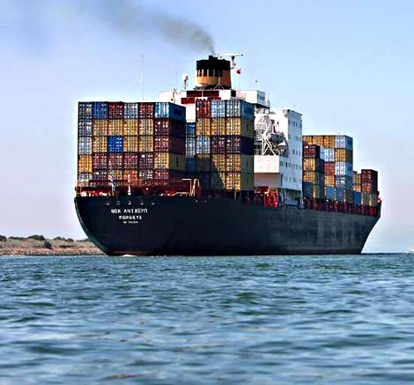


Examples of Controlled Events So What is an Export?
Sending ANY product or technology to a location outside of the U.S.
Traveling outside the U.S. with products or technology
Transferring technology abroad
Oral or visual disclosures of controlled technology
Foreign person access to controlled technology
Transferring items to foreign embassies or their agents in the U.S.

Slide 15
Key Issues for Electronic Exports
E-mails
Providing technical data or technology via e-mail can constitute an export to the e-mail’s recipient
Access to databases
Enabling foreign nationals to download information from an electronic database constitutes an export of that technical data or technology
Traveling with office computers
Does not require disclosure to anyone in a third country; if the laptop contains controlled data, taking it outside the country is a controlled export
Deemed Exports (next slides)
Cloud Computing (next slides)

Slide 16
Technology Exports – ‘Deemed Exports’
The U.S. considers release of technology (or source code) to a foreign national to be an export to that national’s home country
Same concept applies under both the ITAR and EAR
A “foreign national” under U.S. law is everyone who is not:
U.S. Citizen
U.S. Permanent resident alien (i.e., green card holder), or
Other protected class (i.e., protected refugee or asylee in U.S.)
Common examples of “foreign nationals” with U.S. affiliation:
Foreign exchange student in the U.S.
Anyone on a temporary Work Visa
U.S. Person Representing a Non-U.S. Entity is not technically a foreign national or foreign person but transfer to such person likely constitutes a transfer to the foreign person employer

Slide 17

Cloud Computing Issues
‘Physical’ export of controlled data to foreign servers
Primary servers for data storage outside U.S.
Backup or mirrored servers
Server routing for access through VPN
Deemed exports to those foreign persons capable of accessing the data
IT administrators: application and operation level

Slide 18
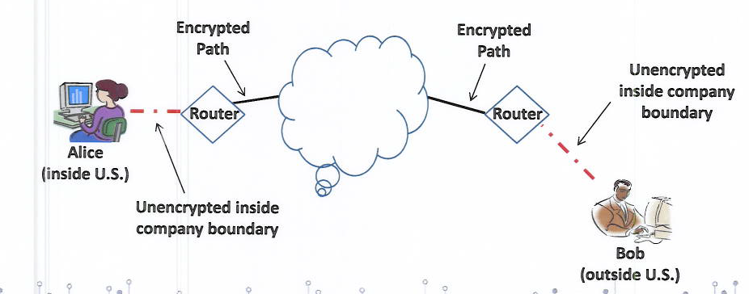
“Not” an Export
BIS Encryption carve-out: Not an export if you are transferring technology or software that is:
Unclassified
Secured using end-to-end encryption
Secured using FIPS-140-2 (or its successors) compliant encryption modules or equivalents;
Not intentionally stored in D:5 country or in Russia
DDTC Encryption Rule (March 2020): + must be encrypted using FIPS-140-2 or by other methods that are at least comparable to the minimum AES 128 bits security strength
- BIS Update 2018, Cloudy with a Chance of Technology Transfers

Slide 19
Step 2. Which Agency has Jurisdiction over the Export? Step 3: Identify the item or technology’s export control classification

Slide 20
Jurisdiction & Classification Overview
Must determine jurisdiction before classification
Order of Review
ITAR (online tool: https://www.pmddtc.state.gov/?id=ddtc_public_portal_dt_order_of_review)
Enumerated
Specially Designed
Other agency (e.g. NRC)
EAR (online tool: https://www.bis.doc.gov/index.php/export-control-classification-interactive-tool)
Enumerated 600 Series (and 9x515)
Specially Designed (online tool: https://www.bis.doc.gov/index.php/specially-designed-tool)
Enumerated non-600 Series (and 9x515)
EAR99
CJ and CCATS

Slide 21

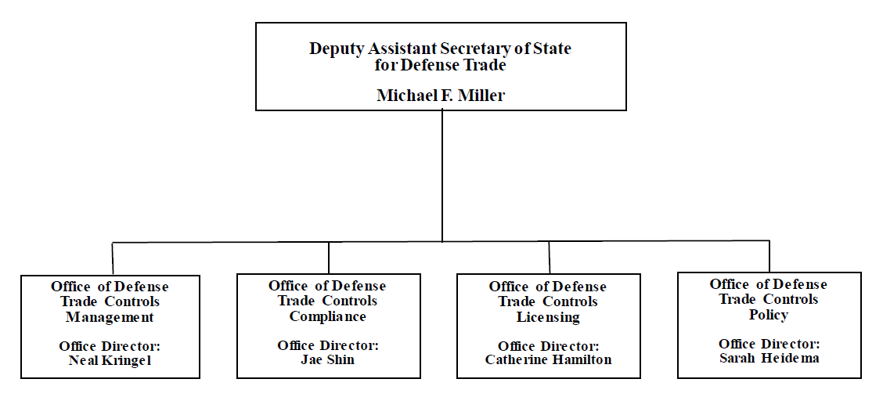
International Trafficking in Arms (ITAR) Overview
U.S. Department of State, Directorate of Defense Trade Controls (DDTC) administers and enforces the ITAR
The ITAR regulates the export, reexport, retransfer and temporary exports and imports of defense articles and related technical data, and defense services

Slide 22
International Trafficking in Arms (ITAR) Overview
Annual registration required
The entity registers with DDTC and renews the registration annually
It is required when the entity manufactures, exports, or temporarily imports defense articles or furnishes defense services
Any material change in registration requires submitting an update to DDTC in 5 days
All exports and temporary imports of ITAR defense articles/services require some form of State Department authorization
Whether license or exemption
Unavailable for certain destinations and their citizens due to arms embargos (ITAR 126.1)

Slide 23
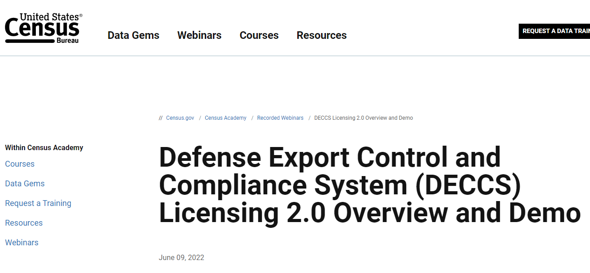
International Trafficking in Arms (ITAR) Overview
DECCS - Defense Export Control and Compliance System
DECCS replaces DETRA, DTRADE, EFS, ELLIE, and MARY
Provides users access to DDTC business applications through a single, cloud-based portal
Currently, Registration, Licensing, Advisory Opinions and Commodity Jurisdictions applications are live in the DECCS Portal. Disclosure application coming soon..
- Lots of training webinars online!
- DDTC FAQs online

Slide 24
International Trafficking in Arms (ITAR) Overview
What is a Defense Article?
An item listed on the U.S. Munitions List (USML)
I. Firearms, Close Assault Weapons & Combat Shotguns
II. Guns & Armament
III. Ammunition/Ordnance
IV. Launch Vehicles, Guided Missiles, Ballistic Missiles, Rockets, Torpedoes, Bombs & Mines
V. Explosives & Energetic Materials, Propellants, Incendiary Agents & their Constituents
VI. Surface Vessels of War & Special Naval Equipment
VII. Ground Vehicles
VIII. Aircraft & Related Articles
IX. Military Training Equipment & Training
X. Personal Protective Equipment
XI. Military Electronics
XII. Fire Control, Range Finder, Optical & Guidance and Control Equipment
XIII. Materials & Misc. Articles
XIV. Toxicological Agents, Incl. Chemical Agents, Biological Agents and Associated Equipment
XV. Spacecraft & Related Articles
XVI. Nuclear Weapons Related Articles
XVII. Classified Articles . . . Not Otherwise Enumerated
XVIII. Directed Energy Weapons
XIX. Gas Turbine Engines
XX. Submersible Vessels & Related Articles
XXI. Articles/Services Not Otherwise Enumerated

Slide 25
International Trafficking in Arms (ITAR) Overview
Category IX - Military Training Equipment and Training
(a) Training equipment, as follows…
(b) Simulators, as follows…
(e) Technical data (see § 120.33 of this subchapter) and defense services (see § 120.32 of this subchapter):
(1) Directly related to the defense articles enumerated in paragraphs (a) and (b) of this category;
(2) Directly related to the software and associated databases enumerated in paragraph (b)(4) of this category even if no defense articles are used or transferred; or
(3) Military training (see § 120.32(a)(3) of this subchapter) not directly related to defense articles or technical data enumerated in this subchapter.

Slide 26
International Trafficking in Arms (ITAR) Overview
What is a Defense Service?
Assistance to foreign persons in the design, development, engineering, manufacture, production, assembly, testing, repair, maintenance, modification, operation, demilitarization, destruction, processing or use of defense articles
Sharing technical data with foreign persons
Military training of foreign units and forces, regular and irregular, including formal or informal instruction (even if no defense article involved)
Why does this matter?
Applies to U.S. persons regardless of their location
Defense article includes foreign defense articles
Such service would require a license
EXAMPLE: Training contractors of foreign MoD, outside the U.S., on military tactics

Slide 27
International Trafficking in Arms (ITAR) Overview
Who is a “broker” under the ITAR? (1) Any U.S. person wherever located;
(2) Any foreign person located in the United States; or
(3) Any foreign person owned or controlled by a U.S. person; that
(4) engages in “brokering activities”:
any action on behalf of another to facilitate the manufacture, export, permanent import, transfer, reexport, or retransfer of a U.S. or foreign defense article or defense service, regardless of its origin
Need 3 parties to the activity
Must be acting “on behalf of” someone else
If captured, brokering registration and licensing requirements may apply, ITAR Part 129

Slide 28
International Trafficking in Arms (ITAR) Overview
Confused as to whether USML captures your item or service?
Commodity Jurisdiction process, ITAR § 120.12
Usually filed by the designed authority of a commodity
Complete DS-4076 Form, cover letter recommended
“A good CJ application tells a story. It is the biography of your product – where it came from, what it was designed to do, and how it is actually being used. What can you tell us about its genesis?”
CJ cases are staffed out to interagency for review.
CJ Determination can be appealed within 30 days to DAS, then DAS’s decision can be appealed to the A/S of PM Bureau
After that, final determination. Not reviewable in court.

Slide 29
Jurisdiction & Classification Overview
Must determine jurisdiction before classification
Order of Review
ITAR (online tool: https://www.pmddtc.state.gov/?id=ddtc_public_portal_dt_order_of_review)
Enumerated
Specially Designed
Other agency (e.g. NRC)
EAR (online tool: https://www.bis.doc.gov/index.php/export-control-classification-interactive-tool)
Enumerated 600 Series (and 9x515)
Specially Designed (online tool: https://www.bis.doc.gov/index.php/specially-designed-tool)
Enumerated non-600 Series (and 9x515)
EAR99
CJ and CCATS

Slide 30

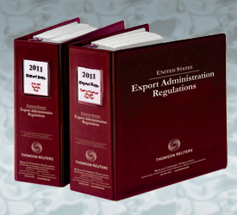
Export Administration Regulations (EAR)
Department of Commerce, BIS administers and enforces the EAR, which controls:
Specific items described on the Commerce Control List based on “Reasons for Control”; EAR Part 774
Exports of all commercial items destined to prohibited end users (e.g., Entity List, Denied Parties) or prohibited end uses (Military End Use); EAR Part 744
Exports to prohibited geographic destinations; EAR Part 746

Slide 31
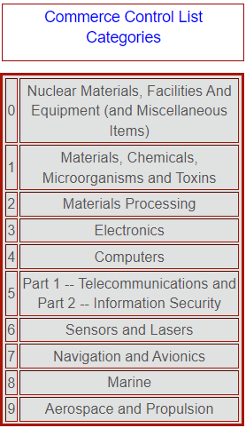
Commerce Control List (CCL)
What is it?
Identifies items subject to enhanced restrictions under the EAR
Items Covered?
The CCL has 10 categories of item groupings
What Restrictions Apply?
It lists the “Export Control Classification Number” or “ECCN,” identifies the applicable restrictions
When the Item is Not Listed?
If the item is not listed in the USML or the CCL, then it is considered “EAR99” and subject to limited controls related to restricted parties or sanctioned countries

Slide 32
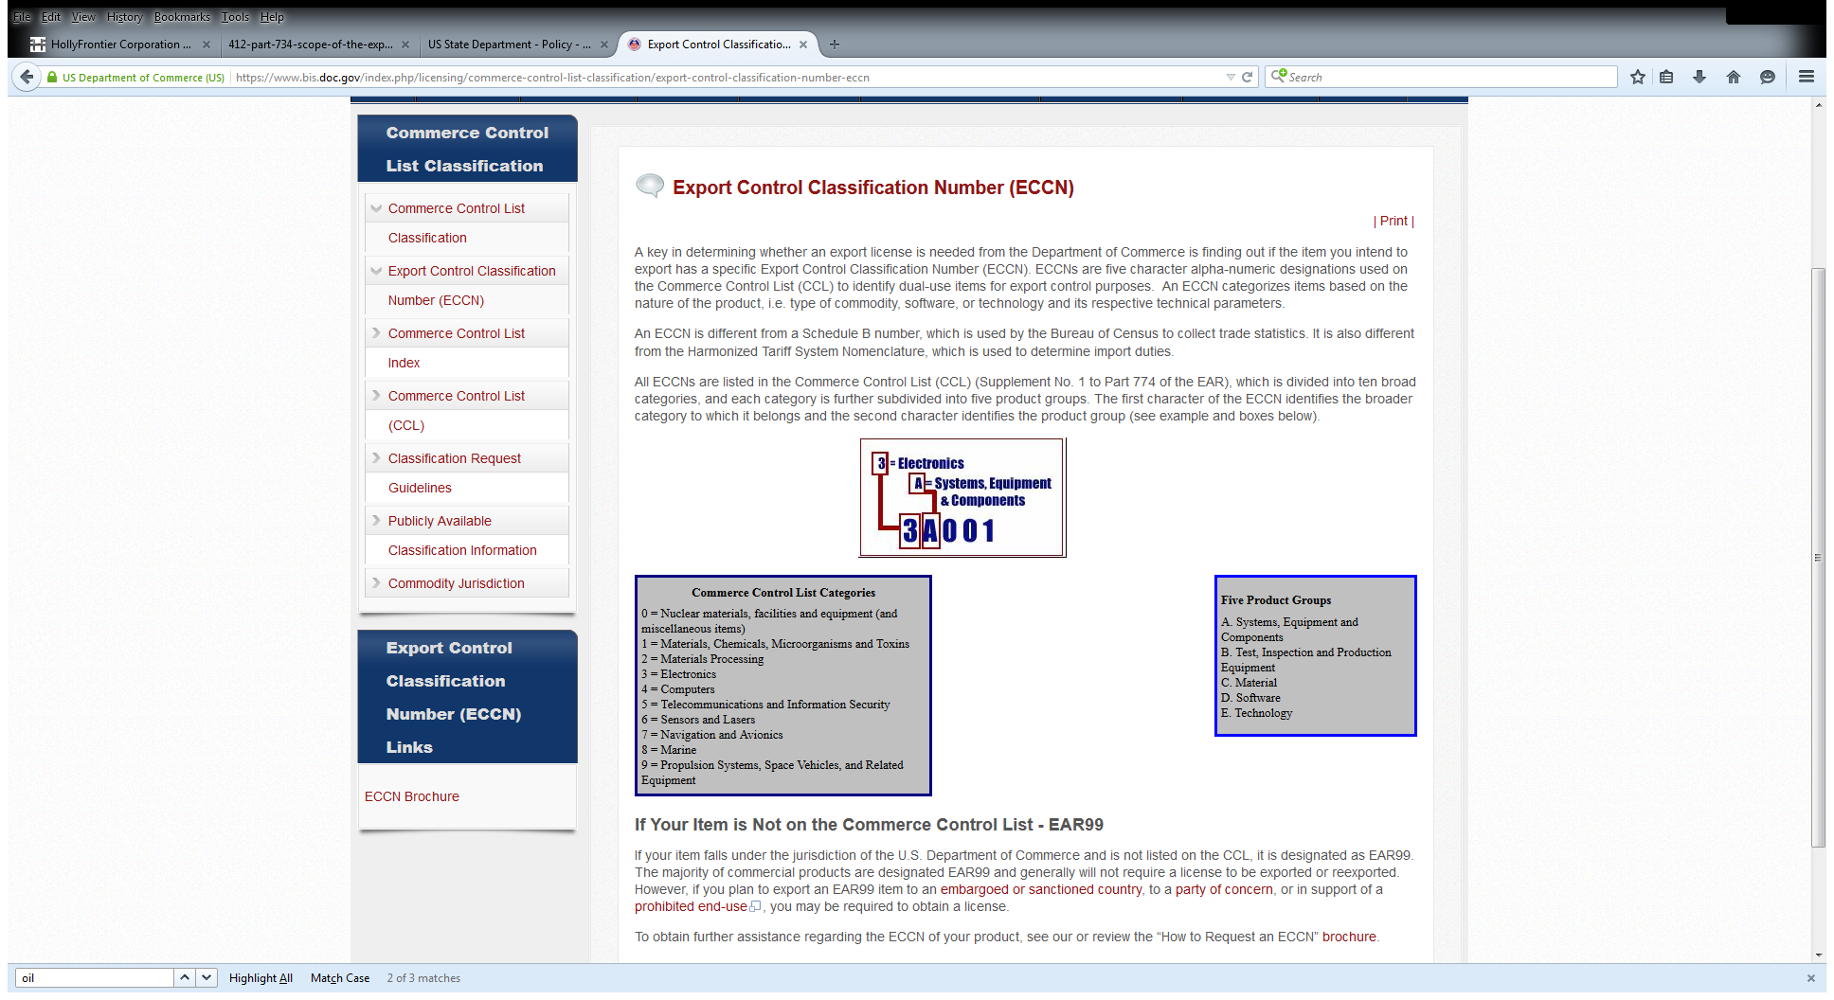
Commerce Control List (CCL)
Export Control Classification Numbers

Slide 33
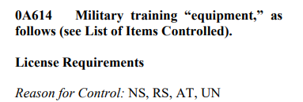
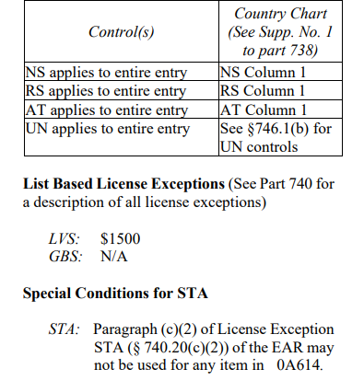
Commerce Control List (CCL)
a. “Equipment” “specially designed” for military training that is not enumerated or otherwise described in USML Category IX.
x. “Parts,” “components,” “accessories” “attachments” that are “specially designed” for a commodity controlled by this entry or an article enumerated or otherwise described in USML Category IX, and not specified elsewhere on the USML.

Slide 34
Commerce Control List (CCL)

Slide 35
EAR99
If your product, material, software, or technology is EAR99:
“Subject to the EAR”
Authorization is required (but typically denied, with few exceptions) for all items (including EAR99):
To a prohibited destination (Cuba, Iran, North Korea, Syria, Russia/Belarus);
To a prohibited end-user (e.g., a denied party, Entity List); or
For a prohibited end-use (e.g., certain nuclear or missile-related applications)

Slide 36
Guns Classification Update
Export Control Reform USML Cats. I, II, III – (modified) mission completed!
Effective March 9, 2020
Non-automatic and semi-automatic firearms to .50 caliber (12.7 mm) or less, and parts, components, accessories, now 0A501
Technical criteria enumerated for items remaining USML-controlled (e.g., flamethrowers designed for military, now only those “with an effective range of greater than or equal to 20 meters)
Ordnance – amended to list ammunition remaining USML-controlled (e.g., ammunition preassembled into links or belts)
Export license required under CCL to all destinations except Canada
License Exceptions STA and GOV available, limitations apply
734.7(c) – unrestricted posting of CAD files on the internet for production of a firearm remains “subject to the EAR”

Slide 37
SNAP-R
Simplified Network Application Process - Redesign (SNAP-R)
Submit export license applications, commodity classification requests, reexport license applications
Must have a Company Identification Number (CIN) and an active user account to access SNAP‑R
Email request form to BIS
Responsibility of the company’s account administrator to update any change(s) to their SNAP-R account information

Slide 38
Step 4: Review whether item/service requires a license based on end user, end use, or country destination?

Slide 39
Background: U.S. Economic Sanctions
ITAR
Easy, all export, reexports, retransfers of defense articles or defense services requires authorization from DDTC.
EAR
CCL-based Reason for Control + country destination
Who is end user? Check Entity List, Denied Parties List
What is the end use? Military End User, Semiconductor End Use?
Also check OFAC sanctions programs..

Slide 40

Background: U.S. Economic Sanctions
What is it?
Economic and trade sanctions to effectuate U.S. national security, foreign policy or economic policy
Programs related to specific countries and, terrorists, international narcotics traffickers, proliferation of weapons of mass destruction, and other threats to the.
Administering Agencies
U.S. Department of the Treasury Office of Foreign Assets Control (OFAC)
Administers most U.S. economic sanctions programs
U.S. Department of State
Administers certain sanctions programs, or select elements of others

Slide 41
U.S. Nexus: Who are “U.S. Persons”?
All U.S. citizens and permanent residents —
regardless of location
All persons physically in the United States
All entities organized under U.S. law, including their non-U.S. branches
All U.S. citizens and permanent residents (so-called green card holders) are U.S. Persons, regardless of their location.
Examples include:
U.S. citizens living in another country
U.S. citizens vacationing or working in another country
All persons physically in the United States are U.S. Persons.
Examples include:
A foreign national while on vacation in Miami
An employee of a foreign financial institution while attending a business conference in New York
U.S-based operations of non-U.S. incorporated corporations
All entities organized under U.S. law, including their non-U.S. branches, are U.S. Persons.
Examples include:
A brank of Citibank, N.A., in London
Note: U.S. Person status generally does not extend to non-U.S. subsidiaries of U.S. companies
But there are exceptions related to Iran, Cuba, and DPRK

Slide 42
U.S. Nexus: Non-U.S. Person Jurisdictional Reach
(1) Causation
Non-U.S. persons that “cause” a U.S. Person to violate sanctions have themselves violated U.S. sanctions
E.g., the “stripping” bank cases
(2) Non-U.S. Entities that Are Owned or Controlled by U.S. Persons
In certain limited circumstances subject to same restrictions as U.S. Person parent
Cuba & Iran: In all circumstances
NOTE: During U.S. participation in Iran Nuclear Deal (JCPOA) (2016-18), a license (General License H) authorized non-U.S. persons that were owned/controlled by U.S. Persons to do substantial Iran activity
North Korea: Only if owned/controlled by U.S. financial institution
Definition of “owned or controlled”
(3) “Secondary” Sanctions
i.e., designation risk for non-U.S. persons who conduct certain types of activity
Not applicable to all sanctions programs
Most prominent in (but not exclusive to) Iran and North Korea programs
Always in context of “knowing” and “significant” activity

Slide 43
General Licenses, Specific Licenses, Advisory Opinions
General Licenses
Typically related to U.S. foreign policy objectives (e.g., humanitarian efforts, democracy promotion)
A common example are wind down general licenses
Some have administrative components (e.g., submitting a report to OFAC)
Specific Licenses
Persons can apply to OFAC for a license to engage in specifically identified activity, if not otherwise covered under a general license
Advisory Opinions
Persons can submit to OFAC an advisory opinion asking for OFAC to confirm the applicants understanding of the regulations

Slide 44
Types of Sanctions Programs: Where, Who, What
(1) Geographic-Based Restrictions (the “where”)
Virtually all dealings by U.S. persons with these geographies are prohibited absent a specific or general license
Cuba, Iran, North Korea, Syria, and the following regions of Ukraine: Crimea and the so-called Donetsk People’s Republic and Luhansk People’s Republic
(2) Person-Based Restrictions (the “who”)
(a) Asset-Freezing Restrictions – the “SDN” List
(b) Limited List-Based Sanctions (aka “Sectoral” Sanctions)
(3) Activity-Based Restrictions (the “what”)

Slide 45
Pitfalls and Risks
Check Ownership
Risk: a person 50% or more owned by persons on the SDN List is also subject to sanctions, even if you do not know their owner
Mitigation: implement restricted party screening and ownership checks for high-risk areas
Hidden Involvement of U.S. Persons
Risk: Using U.S. dollars often requires the involvement of a U.S. person or one person abroad handling the transaction a U.S. citizen expat or dual-citizen abroad
Mitigation: provide training on compliance, implement recusal policies for U.S. person staff
Scope of General or Specific License
Risk: Licenses only authorize specified dealings, not all dealings with sanctioned persons or countries
Mitigation: appoint a compliance officer to coordinate, provide training on compliance

Slide 46
Step 5: Obtain export authorization, if required, or identify available license exceptions/exemptions

Slide 47
ITAR Authorizations
DSP-5: For permanent export of defense article (including tech data), and limited defense services
DSP-73: For temporary export of defense article (no tech data!)
Agreements
Technical Assistance Agreement: Defense services, tech data
License “in furtherance of” an agreement
License “in support of” an agreement
Manufacturing License Agreement
Warehouse Distribution Agreement

Slide 48
License Exemptions under the ITAR
ITAR § 126.4 By or For the U.S. Government
Industry partners may export directly to the USG at its request (can be verbal)
At the “written direction” of USG, an industry partner may make an export, reexport, retransfer that the USG would have been authorized to make itself
Intended to better support international agreements and arrangements and support partners.

Slide 49
ITAR § 126.4
Is the purpose / end use described under (a)(1) through (4)?
determines the availability of the license exemption
Is the exporter the USG or another entity?
determines whether to move to paragraph (a) or (b)
If § 126.4(b), is it to the USG, or to another entity?
determines whether to move to subparagraph (b)(1) or (b)(2)
If § 126.4(b)(2), is it pursuant to an international agreement or arrangement?
determines whether “written direction” from the USG is required

Slide 50
ITAR § 126.4
Special considerations:
126.4(b)(2) not eligible for exports to 126.1 countries
Exemption can authorize transfers of classified data
Form of “written direction” required not prescribed by DDTC, but reasonable person analysis required as to whether the writing actually directed an export, and that USG official had authority to do so
BIS has similar license exception: GOV, EAR § 740.11

Slide 51
Foreign Military Sales (FMS)
Commodities authorized for export pursuant to an FMS Letter of Authorization do not require separate export authorization
Items that would have been “subject to the EAR” are not, if they are exported under FMS case; EAR § 734.3(b)(vi). BIS cannot license these items, no jurisdiction!
Tricky, no way to file accurate export information for these items. See BIS FAQs.
Similarly, items authorized under LOA are not “defense articles” moving under Arms Export Control Act (AECA) Section 38, even if described on USML
ITAR license exclusions/exemptions available: ITAR §§ 126.4 and 126.6
Exports must occur during period that LOA and implementing contracts/subcontracts remain valid
If defense articles will be shipped by U.S. contractor, check out § 126.4

Slide 52
Step 6: Recordkeeping

Slide 53
Census Electronic Export Information
Census EEI filings, Required under FTR (15 C.F.R. Part 30)
Must be filed through Automated Export System (AES) prior to export by USPPI or its authorized agent (except for routed transactions)
Required for all physical exports of goods valued above $2,500
Regardless of value, EEI required for items controlled and requiring a license)(shipped under license or license exemption)
Required data elements include, among others: export classification; value; quantity; description; country of ultimate destination; parties to transaction; license exemption
Failure to file accurate EEI? Shipment can be stopped by CBP & penalties issued
Must transmit any changes to EEI information “as soon as they are known”

Slide 54
ITAR and EAR Recordkeeping Requirements
ITAR, EAR, FTR, and OFAC regulations require companies to retain records of export regulated activity
Retention period of 5 years from the date of export
Must be reproducible and legible
Must be available to USG upon request
Example: BIS investigating diversion of commodities sent by your customer to China. BIS may issue subpoena to your company for all records related to transactions with that customer. You must produce invoices, sales contracts, emails with customer, payment receipts, BIS licensing information

Slide 55

Contact Information
Maria Alejandra (Jana) del-Cerro
Partner
mdel-cerro@crowell.com
Washington, D.C.
+1.202.688.3483
Maria Alejandra (Jana) del-Cerro is a partner in Crowell & Moring's Washington, D.C. office and a member of the firm’s International Trade and Government Contracts groups. She advises clients with respect to U.S. export controls, specifically Export Administration Regulations (EAR) and International Traffic in Arms Regulations (ITAR), and economic sanctions. Jana previously served in the Regulatory and Multilateral Affairs division of the Directorate of Defense Trade Controls (DDTC’s) Policy office at the U.S. Department of State.

Slide 56
Thank you

