Slide 1
Machine Learning and the Benefits of Applying it to XR Training Systems
Adam Kohl, Iowa State University
Roselynn Conrady, Iowa State University
Eliot Winer, Ph.D., Iowa State University

Slide 2
Tutorial Audience
This tutorial is suitable for beginners and has no pre-requisites
  For those interested in gaining a basic understanding of ML for administrative level decision making
  For those seeking detailed methods and integration techniques within XR-enabled training environments
Integrating Machine Learning (ML) with Extended Reality (XR) training systems is uniquely relevant to this year’s I/ITSEC theme: Accelerate Change by Transforming Training – “It’s Time to ACTT”
  Understanding the fundamentals of ML, and its application to XR, will empower managers to make appropriate strategic and costing decisions and allow designers, developers, and engineers to successfully implement effective training systems.

Slide 3
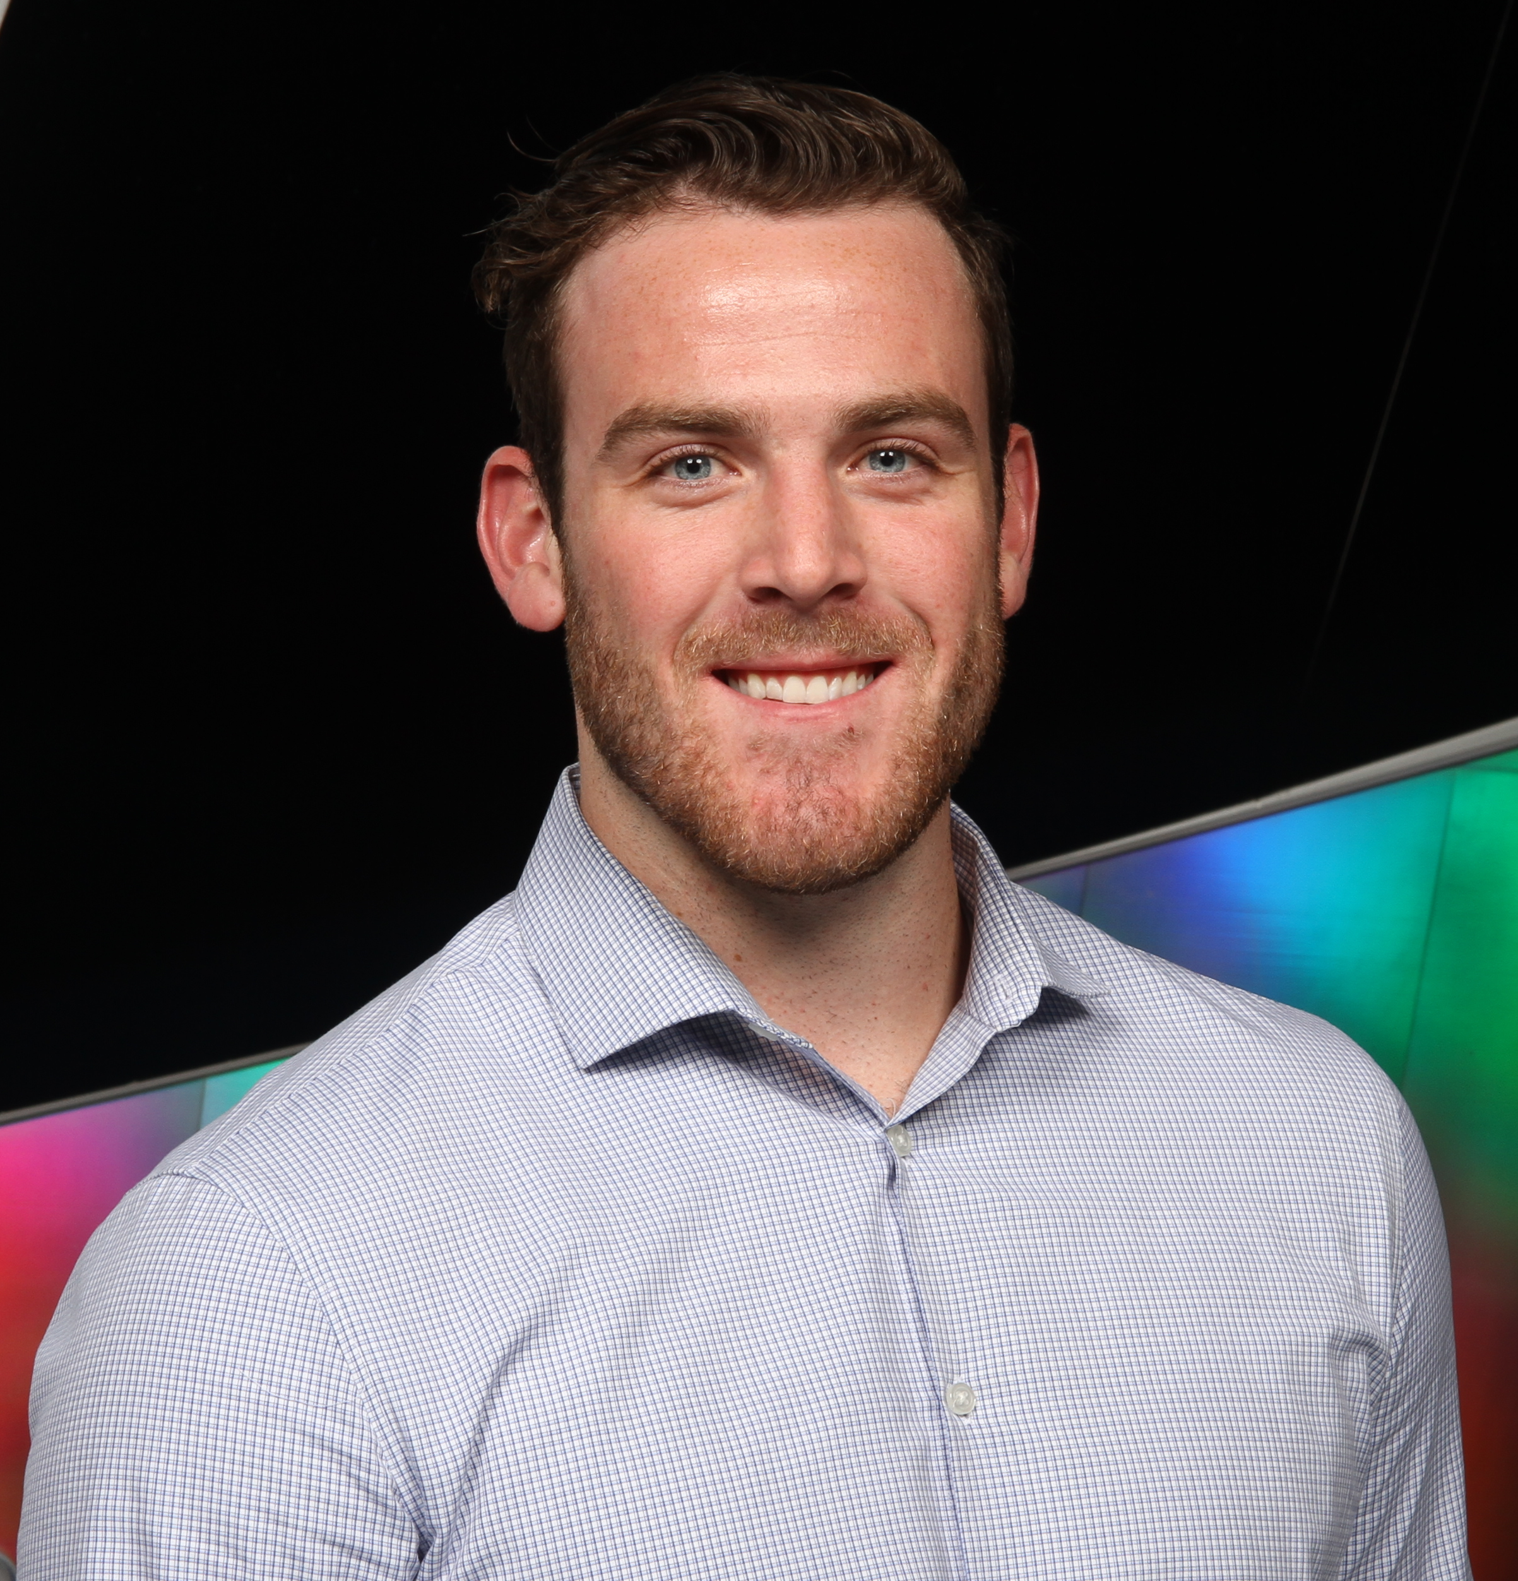


Facilitator Introductions
Adam Kohl is a Ph.D. candidate in Mechanical Engineering and Computer Engineering at Iowa State University’s Virtual Reality Application Center. His current research focuses on utilizing machine learning and visualization techniques in the design of large-complex systems for engineering applications.
Roselynn Conrady is a Ph.D. candidate in Mechanical Engineering and Human Computer Interaction at Iowa State University and a National Science Foundation Graduate Research Fellow. Her research investigates how extended reality can be used to explore and mitigate human stress responses, especially in neurodivergent populations.
Eliot Winer, Ph.D., is the director of the Virtual Reality Applications Center and professor of Mechanical Engineering, Electrical and Computer Engineering, and Aerospace Engineering at Iowa State University. Dr. Winer has over 20 years of experience working in virtual reality and 3D computer graphics technologies on sponsored projects for the Department of Defense, Air Force Office of Scientific Research, Department of the Army, National Science Foundation, Department of Agriculture, Boeing, and John Deere.

Slide 4
Tutorial Overview
Learning objectives
Background – extended reality (XR) and Machine Learning (ML)
Machine learning strategies
Popular machine learning APIs & tools
Current machine learning challenges
Integrating ML & XR
Case studies demonstrating ML use in XR environments
Summation of learning objectives
Questions

Slide 5
Learning Objectives
Describe categories of machine learning technologies and several of their most used algorithm architectures
Describe how machine learning architectures can be leveraged for XR-enabled Modeling, Simulation, and Technology (MS&T) applications
List and compute savings (i.e., time, cost, etc.) from applying machine learning on relevant XR-enabled MS&T applications from recent case studies
Describe several ways of incorporating machine learning technology into warfighter training to increase efficacy, efficiency, cost, or time

Slide 6
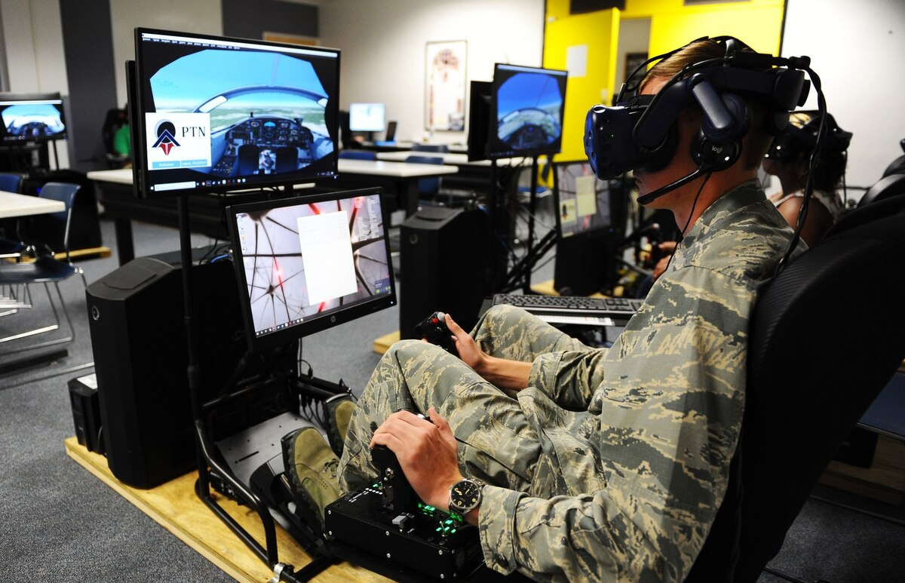
Background - XR
More and more industries are turning to XR technologies (i.e., Virtual, Augmented, and Mixed) for training
Attractive because these technologies:
  Increase performance in psychomotor skills acquisition
  Decrease cost due to errors
  Capable of simulating uncommon and dangerous scenarios
Checa & Bustillo, 2020
Jensen & Konradsen, 2018
Lele, 2013

Slide 7
Background - XR
Extended Reality (XR): encompasses the entire reality-virtuality continuum
Virtual Reality (VR): allows a user to experience a Virtual Environment (VE) that differs from their current reality. Every pixel a user sees is computer generated
Augmented Reality (AR): allows the user to see computer-generated content layered on top of their view of the real world
Mixed Reality (MR): Combination of VR and AR content fused together in a single environment
Azuma, 2001
Milgram, 1994
Notes:
Mixed reality (MR) refers to a more sophisticated version of AR, in which certain virtual components are integrated into the physical environment to create the illusion that they are part of the real scene.

Slide 8


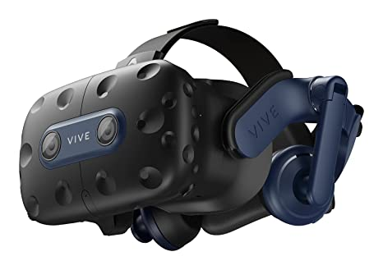
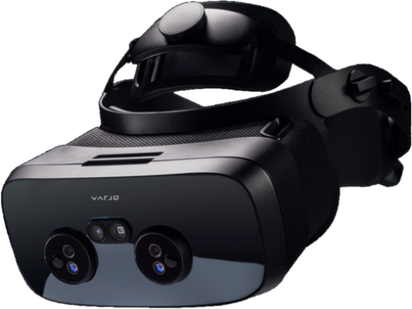
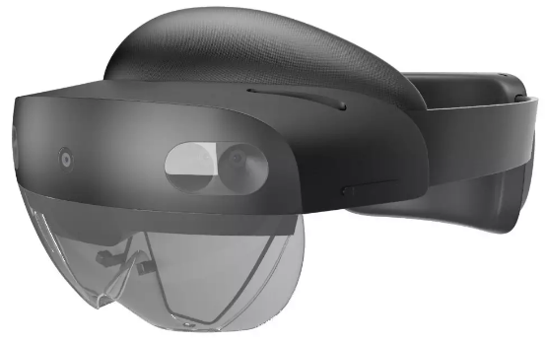
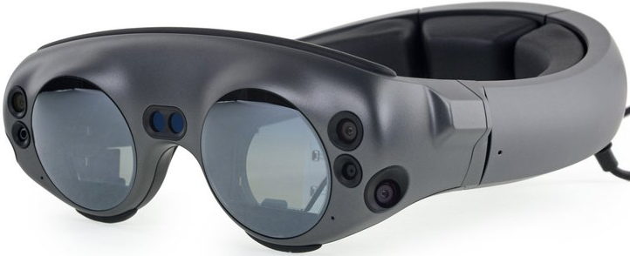
XR Software & Tools
Software – game engines
  Unity & Unreal
VR Head-Mounted Displays (HMD)
  HTC VIVE Pro 2 & Focus 3
  Oculus Quest 2,
  Varjo XR-3
AR HMDs
  Microsoft HoloLens 2
  Magic Leap

Slide 9
XR Software & Tools
 | HTC VIVE Pro 2 | HTC VIVE Focus 3 | Oculus Quest 2 | Varjo XR-3 | Microsoft HoloLens 2 | Magic Leap
HMD Type | VR | VR | VR | VR | AR | AR
Connection | Tethered | Tethered or Untethered | Tethered or Untethered | Tethered | Untethered | Untethered
Resolution | 2448 x 2448 pixels per eye | 2448 x 2448 pixels per eye | 1832 x 1920 pixels per eye | Focus area: 1920 x 1920 pixels per eye | 2048 x 1080 pixels per eye | 1280 x 960 pixel RGB per eye
Colors/Screen | Dual RGB low persistence LCD | Dual 2.88” LCD Panels | Fast-Switch LCD Display | 99% sRGB, 93% DCI-P3 | See-through holographic lenses (waveguides) | 12-LED (RGB) ring with diffuser
Refresh rate | 90/120 Hz (90 Hz with wireless adapter) | 90 Hz | 60, 72, 90 Hz | 90 Hz | 120 Hz | 120 Hz
Cost | $799.00 | $1,300.00 | $299.00 | $6,495.00 | $3,500.00 | $2,295.00
Notes:
HTC Vive Pro 2: https://www.vive.com/us/product/vive-pro2/specs/
HTC Vive Focus 3: https://www.vive.com/us/product/vive-focus3/specs/
Oculus Quest 2: https://store.facebook.com/quest/products/quest-2/
Varjo XR-3: https://store.varjo.com/xr-3
Microsoft HoloLens 2: https://www.microsoft.com/en-us/hololens/hardware https://www.forbes.com/sites/solrogers/2019/09/11/what-we-know-about-hololens-2/?sh=176563cf4662 https://docs.microsoft.com/en-us/hololens/hololens2-display
Magic Leap: https://shop.magicleap.com/#/ https://www.magicleap.com/magic-leap-1

Slide 10
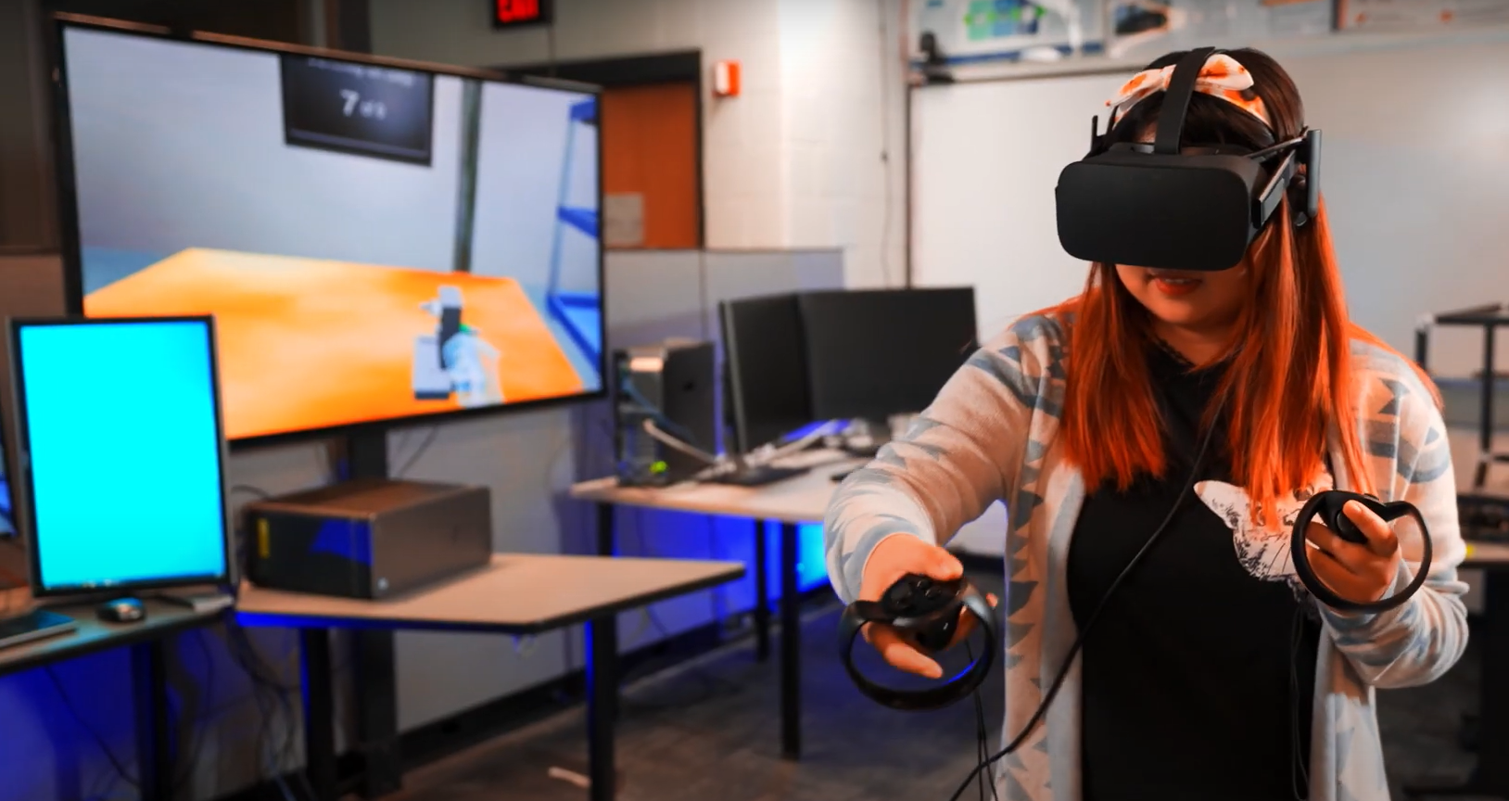
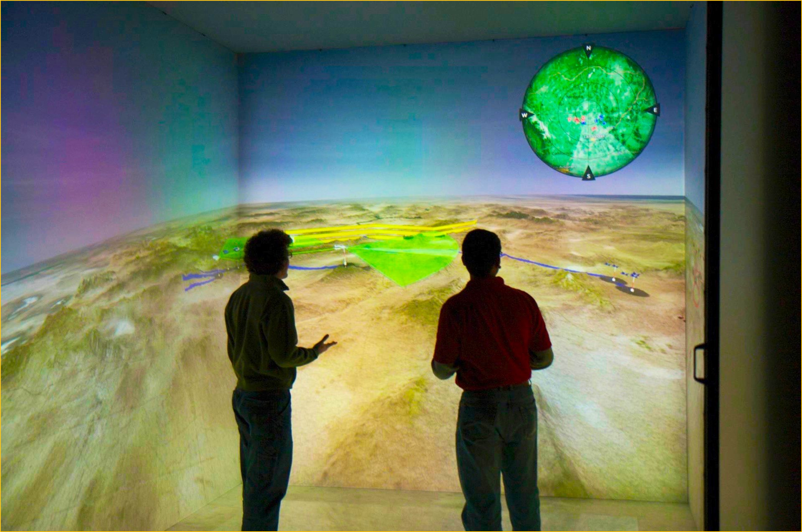
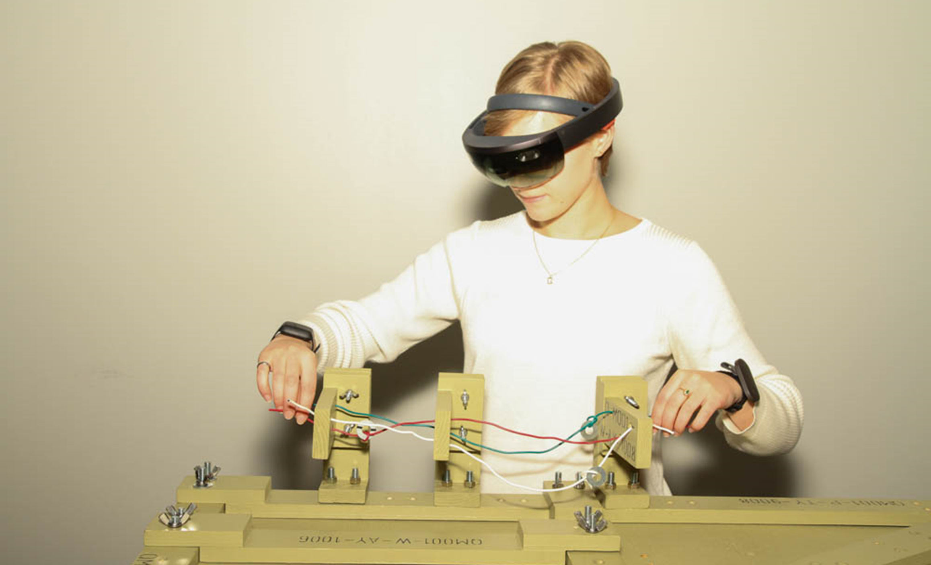
XR Environments
Virtual Reality Applications Center (2022)

Slide 11
XR Environments – Need for ML
As XR environments become more pervasive, demands on their capabilities are increasing
  People expect proper “responses” to almost every interaction that occurs
Impossible to program all these variations
ML provides methods to have an environment react appropriately without an explicit “rule” being put in for every potential user interaction
ML methods can address a series of highly complicated issues and make XR environments more responsive and realistic

Slide 12
Background - ML
US military
  Pentagon’s 2020 budget: $3.7 billion for ‘unmanned and autonomous technologies’
  Serious consideration must be given to how these agents will interact with humans
ML can be combined with XR environments to fundamentally change how humans interact with training systems
  The technology has the potential to aide warfighter training in several key aspects
    Improve efficiency
    Lower costs
    Reduce training time
    A step towards “Obi Wan in the cockpit with Luke”

Slide 13
Background - ML
Arthur Samuel (1959):
  “the field of study that gives computers the ability to learn without being explicitly programmed.”
Tom Mitchel (1998):
  “A computer program is said to learn from experience E with respect to some class of tasks T and performance measure P, if its performance at tasks in T, as measured by P, improves with experience E.”

Slide 14
ML Strategies
Learning addresses three main design flaws
  All possible situations cannot be anticipated
  All changes over time cannot be anticipated
  It may not be understood how to program the solution
Four major factors influence learning ability
  The component to be improved
  Prior knowledge
  Representation of the data and the component
  Available feedback
Unsupervised
Semi-supervised
Learning Strategies
Supervised
Reinforcement
Transfer
Russell, Norvig & Davis (2010)

Slide 15
ML Strategies - Unsupervised
Learns patterns from inputs without being provided explicit feedback
Classify unlabeled data
Reduce the dimensional complexity of data
  Extract features for data-driven design
    Linear and non-linear methods
    Autoencoders
Common Techniques
Boltzmann Machine
Density-based clustering
Gaussian Mixture Model (GMM)
Generative Adversarial Network (GAN)
Generative Topographic Map (GTM)
K-means
Principal Component Analysis (PCA)
Self-Organizing Map (SOM)
Variational Autoencoder (VAE)

Slide 16

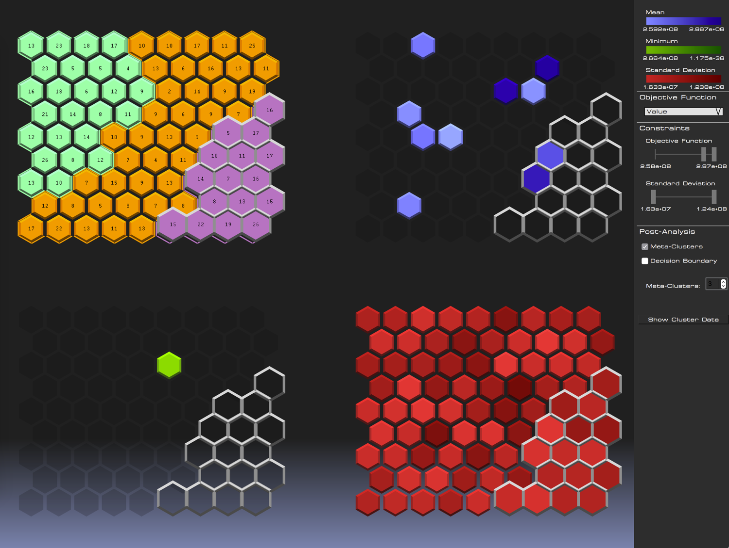
ML Strategies - Unsupervised
Dimensionality Reduction
  Process aimed to identify lower-dimensional latent space capturing design space’s variability
Technique selection is dependent on design space topology
Design space classification and visualization
  Two-Level SOM clustering approach
  Isolate optimal designs and reveal similar characteristics
Isolation of design alternatives with the largest NPV
Kohl & Winer (2019)

Slide 17
ML Strategies - Supervised
Learns a function that maps from input to output based on observing example input-output pairs
Engineering applications
  Classification, control and decision making, monitoring and anomaly detection, performance modeling
Identify, bound, and map feasible design space
  Prevent expensive simulations and experiments
  Guide and improve exploration efficiency
Common Techniques
Artificial Neural Network (ANN)
Bayesian Network
Convolutional Neural Network (CNN)
Deep Neural Network (DNN)
Hidden Markov Model (HMM)
Naïve Bayes
Random Forest
Recurrent Neural Network (RNN)
Support Vector Machine (SVM)

Slide 18
ML Strategies - Supervised
Deep networks
  > 1 stage of non-linear feature transformation
  Three fundamental architecture types
    Feed-forward, feed-back, and bi-directional
The reasoning encompassing why a model predicted a value cannot be simply derived
Model architecture is dependent on the data and application
  New designs are constantly emerging
Input
Hidden
Hidden
Output
Feed-forward network
Feed-back layer
Notes:
Number of trainable parameters is proportional to the number of training samples

Slide 19
ML Strategies - Reinforcement
Reinforcement learning focuses on sequential decision making
An agent is trained to optimize actions that maximize a reward in an environment
  This process is done through trial and error
An agent may consist of the following attributes:
  Policy: an agent’s behavior function
  Value function: how good it is for an agent to be in each state or state-action pair (Q)
  Model: an agent’s representation of the environment
Common Techniques
Policy Optimization
Derivative Free Optimization (DFO) / Evolution
Actor-Critic Methods
Dynamic Programming
Policy Iteration
Value Iteration
Q-Learning
Deep Q-Networks (DQN)
Actor-Critic Methods

Slide 20
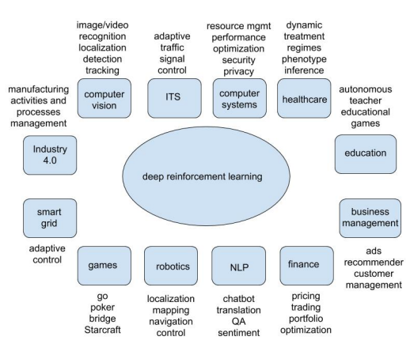
ML Strategies - Reinforcement
Deep reinforcement learning leverages deep neural networks to update key characteristics
  Value function & loss function
  Policy
  Model
Able to employ an approximation function to learn optimal policies
  Yields the ability to make decisions without iterating through all possibilities in the state space
Li (2017)
Notes:
Image Ref: Li, Yuxi. "Deep reinforcement learning: An overview." arXiv preprint arXiv:1701.07274 (2017). https://arxiv.org/pdf/1701.07274.pdf

Slide 21
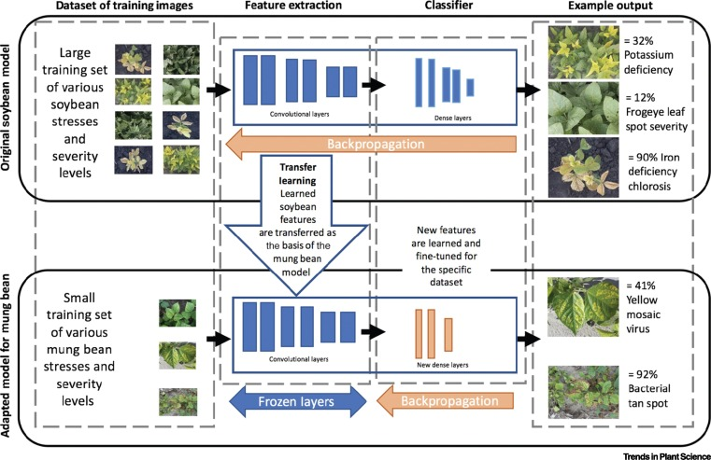
ML Strategies - Transfer
Transfer learning provides an ‘informed’ starting point for a similar design space
Helps with inadequate datasets
Utilizes pre-trained models for a different task
  Saves time and eliminates prior training computation expenses
  Scope of the new task is often limited by the previous training dataset
Singh et al. (2021)
Notes:
Image reference: Singh et al.,2021, Challenges and Opportunities in Machine-Augmented Plant Stress Phenotyping

Slide 22
ML Challenges
Expertise / creativity required to construct an ML model for a desired application
Algorithm selection to meet application demands
Cost of training and evaluating ML models
Interpreting model decision-making
Resource consumption and deployment capabilities in remote environments
Acquisition of reliable data
Limited data resources
  Low volume and high-cost industries
  ‘Cold-start’
  Avoid ML architectures comprised of a large amount of trainable parameters

Slide 23
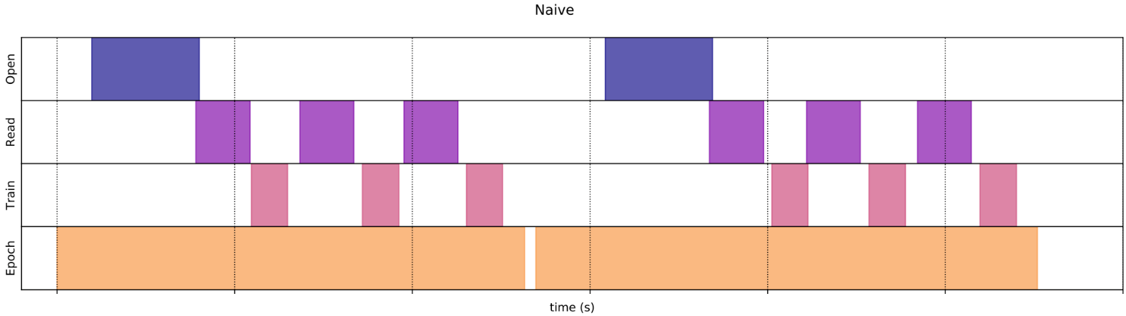
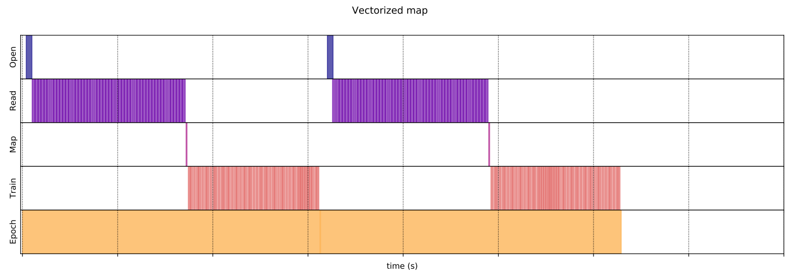
ML Challenges
Data preprocessing and input pipelines
  Dependent on computation resource allocation
TensorFlow naive pipeline using no tricks, iterating over a dataset as-is
Execution time = 0.265 s
Using the same dataset, the input pipeline uses vectorized mapping to reduce overhead and memory footprint
Execution time = 0.0274 s
Notes:
This time, the mapped function is called once and applies to a batch of sample. As the data execution time plot shows, while the function could takes more time to execute, the overhead appear only once, improving the overall time performance.

Slide 24
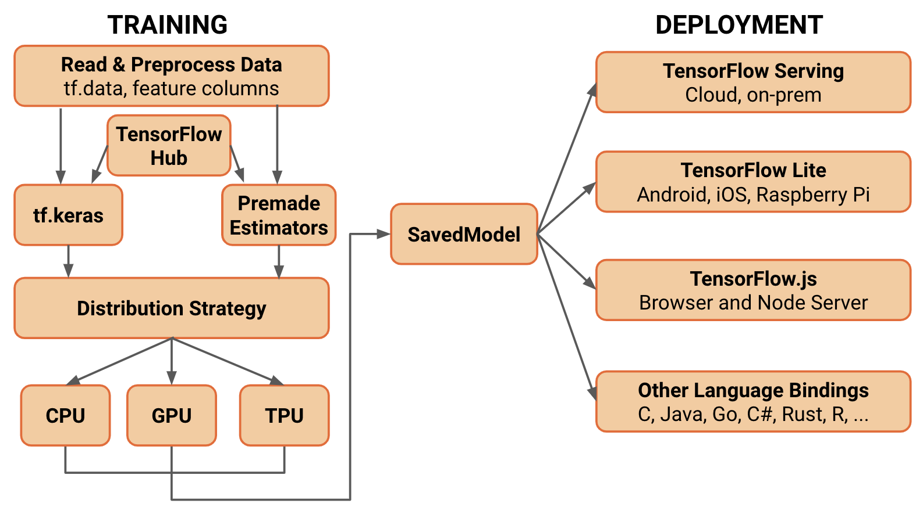
ML Software & Tools
Processing hardware
  CPU, GPU, TPU
Popular libraries and APIs
  Traditional machine learning: Scikit-learn, MatLab
  Deep Learning: TensorFlow, PyTorch, Keras
Distributed computing
  OpenMP, MPI, CUDA
  TensorFlow, PyTorch - Lightning

Slide 25
ML & XR Integration - Communication
Mechanisms
  Allow for simulations to interact with the software encapsulating ML models
  Network-based
    Most flexible approach
    Eliminates the need to integrate additional third-party libraries
    Allows the simulation and model to communicate across different containers
  IPC-based
    Reduced flexibility – the simulation and model must be located on the same underlying host system
    Can provide increased performance when transmitting large quantities of data
  In-process
    Least flexible and most brittle
    In most cases, cost of engineering efforts (i.e., implementation & maintenance) outweigh performance benefits

Slide 26
ML & XR Integration - Deployment
Strategies
  Separate containers - loosely coupled
    Supported communication: network-based
    Well-suited for scenarios with a single simulation and multiple ML models
  Separate containers - tightly coupled
    Supported communication: network-based, IPC-based
    Well-suited for scenarios where the simulation and model relationship are one-to-one
  Single container
    Supported communication: network-based, IPC-based, in-process
    Forces one-to-one relationship between simulation and model instances
* Containers are a form of operating system virtualization
Notes:
1)
Avoid scenarios where multiple agents each require rendered from a unique camera
such as when multiple autonomous agents are interacting in a single shared virtual environment
not well-suited to scenarios where multiple agents each require rendered frames from a unique camera, since the GPUs attached to the simulation container will quickly become a bottleneck as the number of connected agents increases
2)
However, simulation and model both run on host system’s GPU
grouped together using a mechanism such as a Kubernetes Pod. This ensures the containers will be scheduled on the same underlying host system and allows them to share their network and IPC namespaces, facilitating both network-based and IPC-based communication.
However, Kubernetes don’t yet support GPU accelerated Windows containers so linux is the best bet for machine learning workloads
the size of the container image for the simulation can still be kept to a minimum by excluding GPU acceleration support if the simulation does not perform rendering.
3)
Violates industry best practice of containers encapsulating a single concern
Modifications to either the simulation or the machine learning model will necessitate a rebuild of the single shared container image.

Slide 27
Case Study 1
Designing a Deep Learning and Computer-Vision Based Autonomous Vehicle Within a Multimodal Traffic Simulation Framework
  Kalivarapu, Kohl, Miller, & Winer (2020)

Slide 28
Background - Simulated AVs
AV simulators are a platform for development, training, and validation of autonomous algorithms
  CARLA, Microsoft Air Sim, NVIDIA DRIVE Platform/Constellation, Gazebo, etc.
  Virtual cameras and sensors mounted on top of the vehicle capture virtual surroundings
  Images processed exactly like the ones captured from a physical AV
Simulated AV + traffic simulator program
  System behaves like a physical AV in real-world

Slide 29
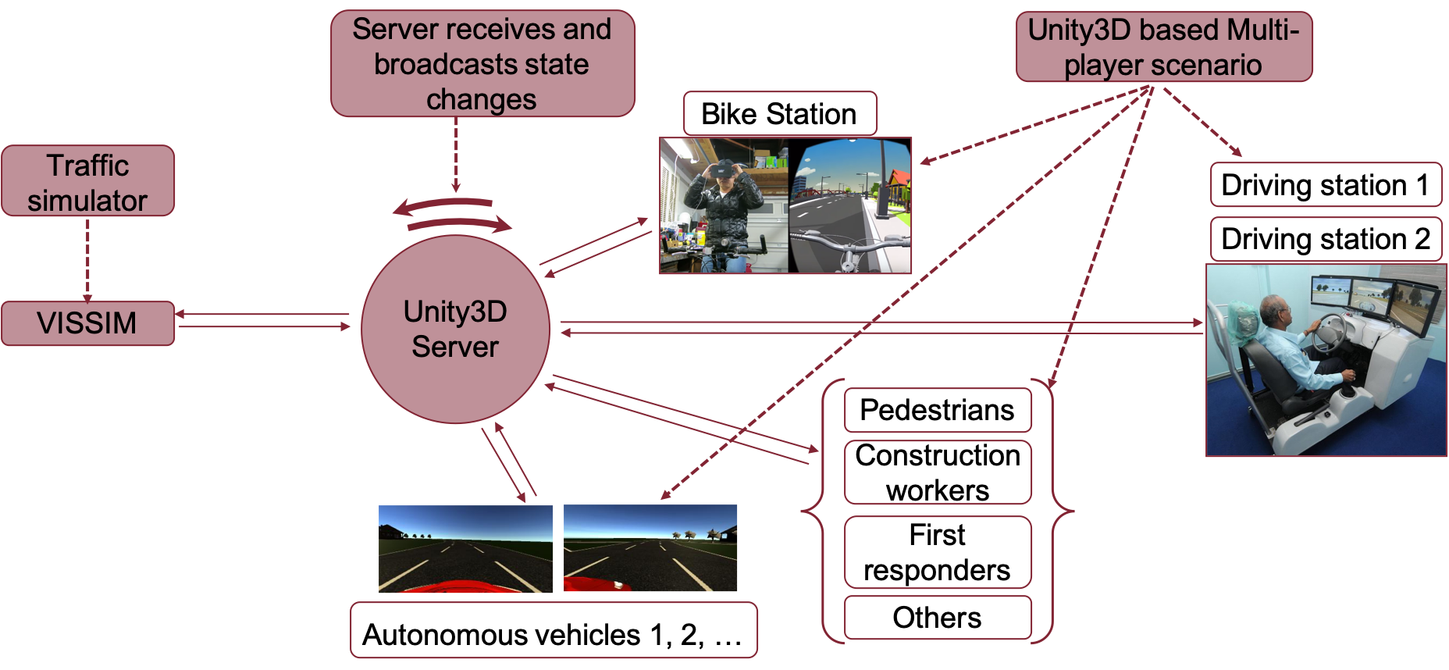
System Architecture

Slide 30
System Architecture
Client-server architecture doubles as the XR environment system
  System platform visualization utilizes VR, AR, and desktop
  Human interaction with ML AV agents is capable with multiple devices
Driving states of the physical agents and AVs are synchronized the client-server architecture with a traffic simulator
  Simulator probabilistically generates vehicle and pedestrian traffic.
Generated traffic computes responses and are network synchronized to form a multimodal traffic simulation system collectively

Slide 31
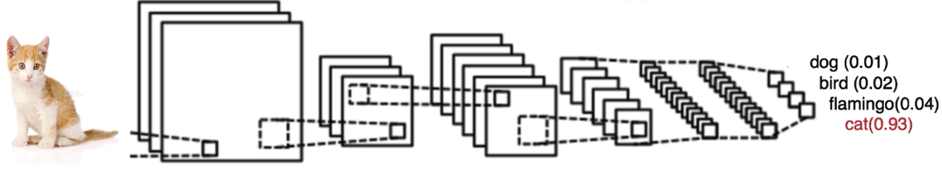
AV Design
AV implemented on a single-lane road and a three-lane highway
  Uses supervised and imitation based machine learning approaches
  Other vehicle traffic, pedestrians, and traffic signs were not implemented
Deep learning using Convolutional Neural Networks (CNN) implemented
  CNNs are highly effective at image recognition and classification
Convolution
layer
Output prediction
layer
Simplified
CNN pipeline

Slide 32
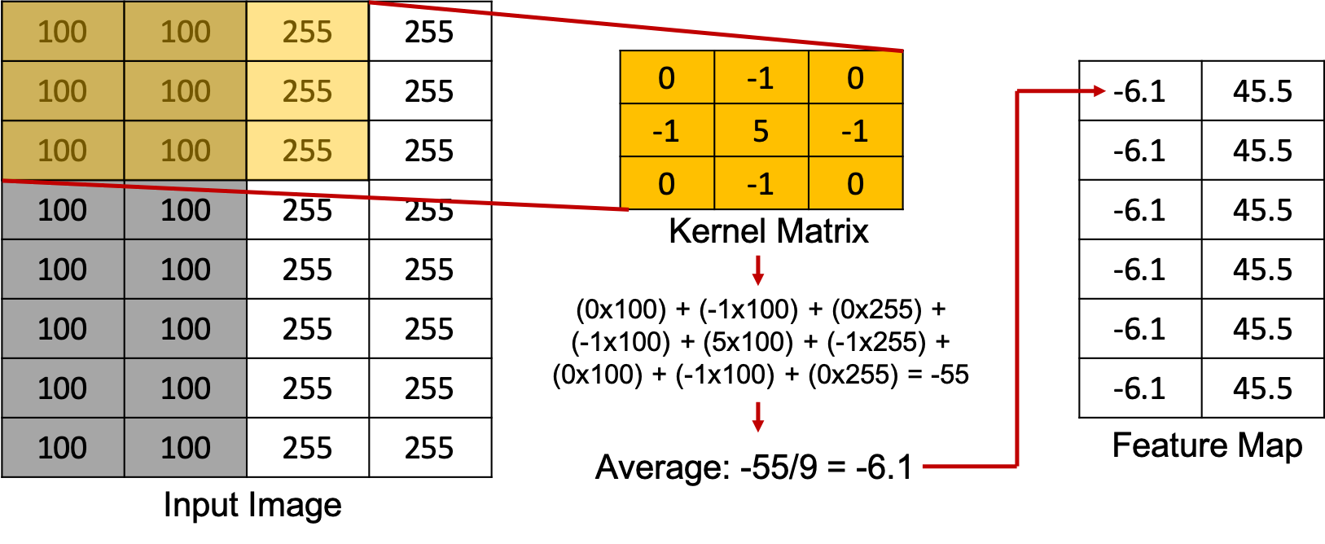
Feature Extraction
Convolution layer for feature extraction
  A kernel Matrix processes each input image pixel
  Feature map computed via element wise matrix multiplication
  Kernel matrices can be different for image sharpening, edge detection, gaussian blurring, etc.
Pooling layer shrinks the image stack by reducing the dimensionality of each feature
A series of convolution and pooling layers extracts essential features from the input image
Feature map value of -6.1 indicates asphalt road while 45.5 indicates white lane markings

Slide 33
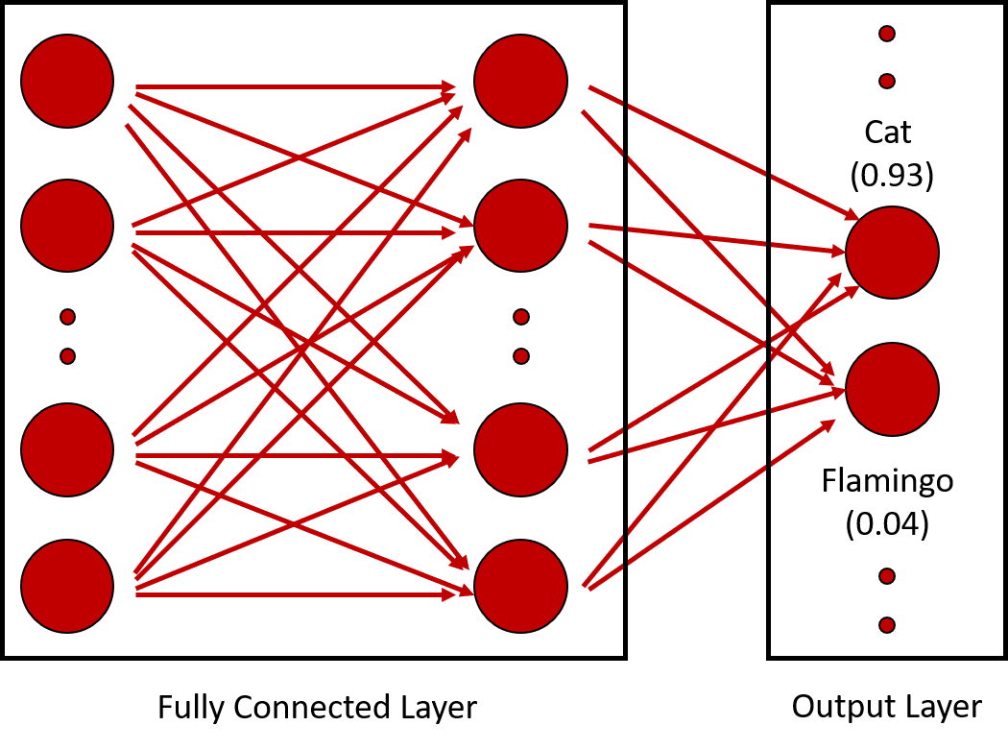
Feature Classification
Output from convolution and pooling flattened into 1D array of pixels
Serves as input to the fully connected network
  Each pixel corresponds to a node in the input layer
Fully connected network processes these features and outputs a probability of the class the input image belongs to

Slide 34
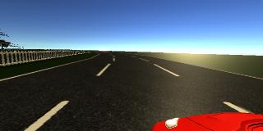
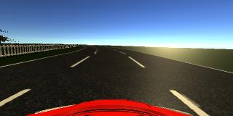
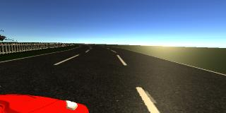
Methodology – AV Implementation
Train an AV using multi-layer Convolutional Neural Network (CNN)
  Required manually driving a virtual car on a specified road track
    Record images and driving conditions (steering, throttle, reverse, speed) – dependent variables
  Virtual cameras mounted on a Unity based car
    Left, center, and right images captured as it drives – independent variables
For a given camera capture from the Unity car, what is the predicted steering value?

Slide 35
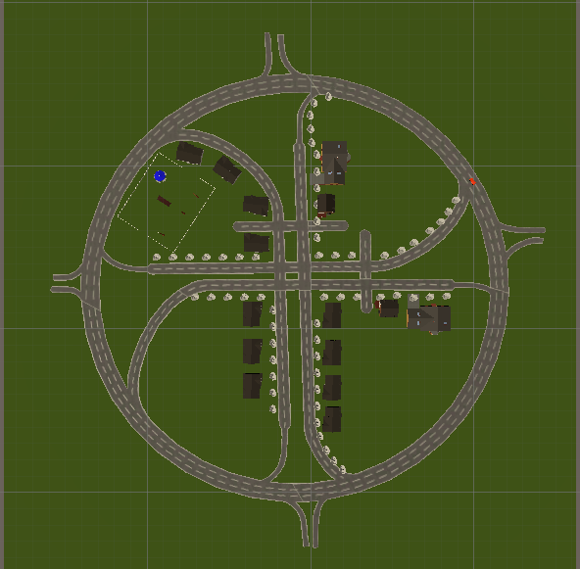
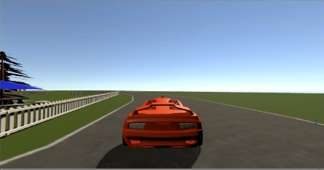
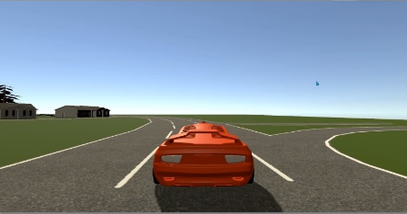
AV Implementation
Two CNNs created
9-layer network Five convolutional layers Four fully-connected layers | 14-layer network Five convolutional layers, each with a batch normalization layer Four fully-connected layers
Batch normalization typically used in improving the performance and stability of a neural network
  Re-centers and re-scales the input convolutional layer
Data captured with training car driving along the perimeter of a single- and a three-lane track three times CW and CCW

Slide 36
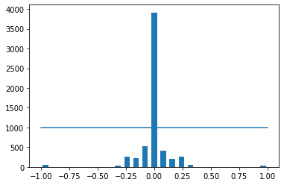
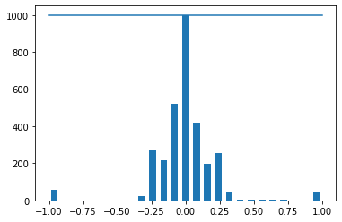
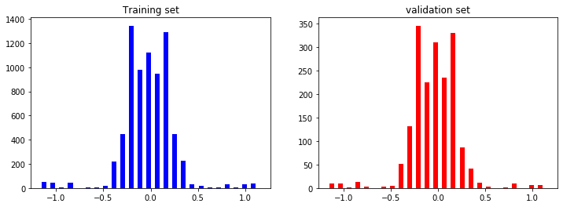
AV Implementation
Biases removed
  Non-zero steering values recorded due to left and right turns
  Data predominantly straight steered, so straight path bias decreased (i.e., outlier reduction)
Split data into training and validation (~20% used for validation)
Training
dataset
Validation
dataset

Slide 37
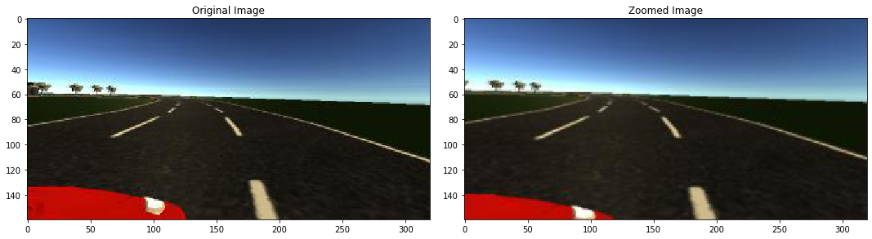
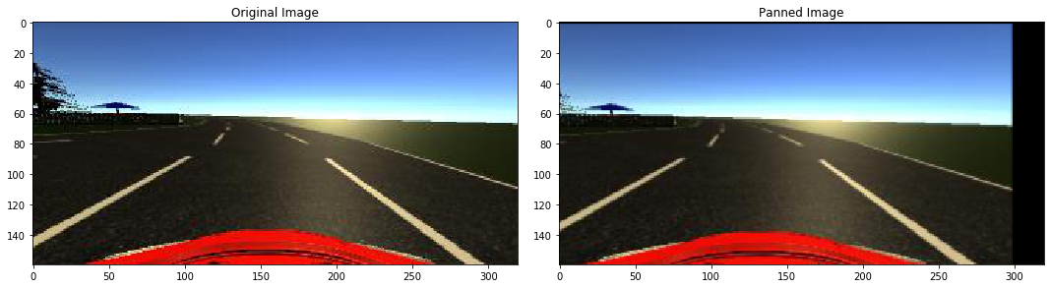
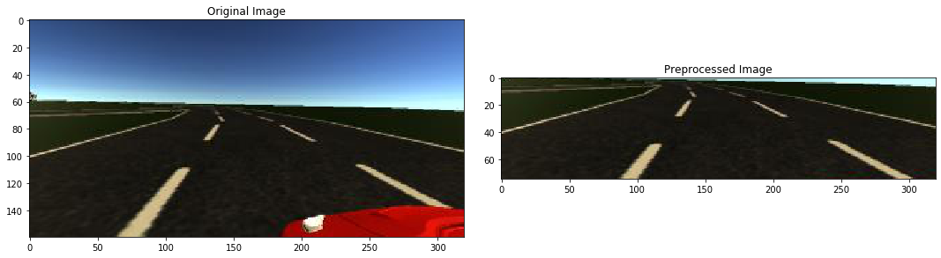
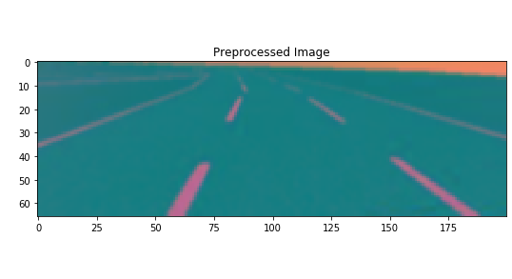
AV Implementation
Augment a subset of training images to increase data diversity
  Helps prevent AV drifting off-road and recover from a poor orientation
  Zoom, pan, flip, brightness alter images with a 50% probability
Crop images to keep only relevant road data and convert from RGB to YUV color space

Slide 38
Results and Discussion – Testcase Setup
Four exits leading in and out of the town
Evaluation metrics
  Model training time
  Lane departures
  Did the AV exit into a local road?
  Did the AV perform path correction?
  Did the AV drift away?
The above metrics were evaluated for single- and three-lane AV
  With and without batch normalization
  With and reduced zero-steering angle bias

Slide 39
Results and Discussion – Single Lane AV
Cases Metrics | With batch normalization |  | Without batch normalization
 | With zero-steer bias | Reduced zero-steer bias | With zero-steer bias | Without zero-steer bias
Model training time | 22.1 minutes | 22.3 minutes | 20.6 minutes | 20.5 minutes
Lane departures | No | No | No | No
Did the AV exit into local road? | No | No | No | No
Did the AV perform path correction? | Did not stray | Yes, recovered from the green grass area | Did not stray | Did not stray
Did the AV drift? | No | No | No | No
Computing environment: 3.6 GHz CPU, Nvidia GeForce GTX 2060

Slide 40
Results and Discussion – Three Lane AV
Cases Metrics | With batch normalization |  | Without batch normalization
 | With zero-steer bias | Reduced zero-steer bias | With zero-steer bias | Without zero-steer bias
Model training time | 48.5 minutes | 47.9 minutes | 45.7 minutes | 45.8 minutes
Lane departures | Continuous fishtailing but stayed in lane | Fishtailed, and deviated | No | No
Did the AV exit into local road? | No | Yes | No | No
Did the AV perform path correction? | Corrected instantly | Eventually drove back to the 3-lane road | Corrected when the edge of lane marking reached | No correction required
Did the AV drift? | No | No | No | No
Computing environment: 4.2 GHz CPU, Nvidia GeForce GTX 1070

Slide 41
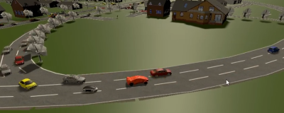
Results and Discussion – AV in a Traffic Simulator
PTV VISSIM traffic simulator
  Can probabilistically generate 1000s of vehicles
  Vehicles auto-steer based on rules stipulated by the computational road network
  Synchronized traffic into Unity based visualization framework using COM server
  AV integrated into VISSIM as another traffic entity via Unity and COM server
    Position and direction updates from Unity are relayed to VISSIM in real-time
AV
Notes:
Each have distinguishing features. For e.g., NVIDIA DRIVE has a suite of hardware and software to perform deep neural network training and generate driving controls in real-time

Slide 42
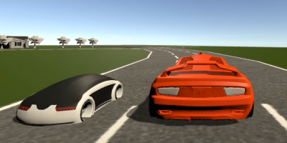
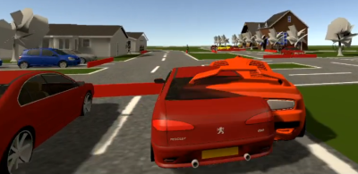
Results and Discussion – AV in a Traffic Simulator
VISSIM is aware of its traffic position and orientation including AV
  None of the VISSIM vehicles ran into the AV
AV ran into a stopped VISSIM vehicle
  It was not trained to veer around an existing vehicle
  Currently, the AV behavior in such circumstances is undefined and is work in progress
VISSIM vehicles veer around the AV
AV runs into VISSIM vehicles

Slide 43
Case Study 2
Machine Learning Techniques for Autonomous Agents in Military Simulations - Multum in Parvo
  Roessingh, Toubman, van Oijen, Poppinga, Hou, & Luotsinen. (2017)

Slide 44
Intro – Multum in Parvo
Not an XR-enabled environment as presented, but easily could be
  However, it demonstrates ability to generate behavior in military simulation systems
  Software/autonomous agents tend to act unrealistically or have primitive decision-making skill
Machine Learning can be leveraged to have agents learn a large variety of desired behavior
  With the criteria that the ML model is compact in its code and physical memory usage
Major ML techniques in this project include:
  Online learning
  Offline learning
  Dynamic Scripting (DS)
  Data Driven Behavior Modeling (DDBM)
  Deep Reinforcement Learning (DRL)
  Evolutionary Computing

Slide 45
Online and Offline Learning
Online Learning
  An agent’s observation action mapping is learned during the operation/simulation
  Agents can dynamically adapt their behavior to that of their human opponents
  Agents’ newly learned behavior cannot be validated prior to deployment
Offline Learning
  An agent’s observation action mapping is learned BEFORE it is deployed for its actual purpose
  Simulations can run faster because the learning is done beforehand
  Is not dynamically adaptable compared to online learning

Slide 46
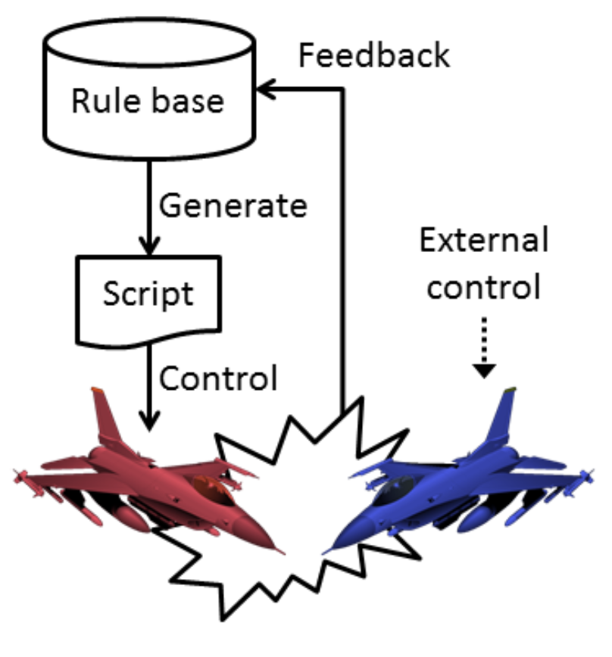
Dynamic Scripting
Dynamic Scripting (DS)
  DS is a Reinforcement Learning-based technique to generate behavior through a series of “if-then” rules
  Rules are drawn repeatedly from the rule base, based on their weight value
  Online and offline learning can be combined with DS
  This technique was applied to simulated Air-to-Air combat
Schematic view of the learning process with the DS technique. A script is generated with rules from rule base. The script is used to control an agent. Success or failure of the controlled agent is fed back to the rules that were used.

Slide 47
Dynamic Scripting
Advantage of DS:
  Simple, transparent, and straightforward
Disadvantage of DS:
  Requires domain expertise from the start
Future work of DS
  Bringing these agents into human-in-the-loop situations to directly learn to counter the tactics of human participants

Slide 48
Data Driven Behavior Modeling
A supervised learning technique that leverages behavior data from virtual characters
DDBM was applied to a 2D simulation of bounding overwatch (i.e., tactical maneuvering of soldiers)
  Agents were created using VBS3 (Virtual Battle Space), a game-based military system
  ID3 was used for decision trees and back-propagation for neural networks
Advantages / disadvantages:
  Recordings of the behavior of virtual characters within an existing simulation environment can be used to generate training data
  Can be used with commonly available data for military simulation systems such as:
    High level architecture (HLA), Federation Object Model (FOM), Real-Time Platform Reference FOM
  Currently, online learning cannot be utilized

Slide 49
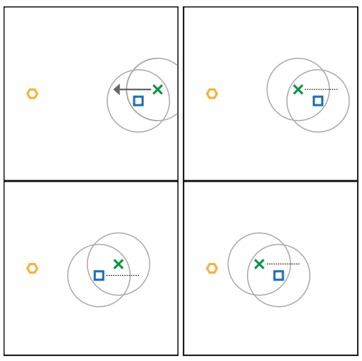
Deep Reinforcement Learning
A neural network reinforcement learning technique
Model-free DRL techniques were applied to a bounding overwatch example
  Agents learn without having knowledge about the dynamics of the environment
  Deep Q-Learning (DQL)
  Asynchronous Advantage Actor-Critic with a Feed Forward Network (A3CFF)
  Asynchronous Advantage Actor-Critic with a Long Short-Term Memory (A3C-LSTM)
From left to right and top to down; a sequence of bounding overwatch movement tactic. The orange hexagon is the target, the blue square is a programmed agent, and the green cross is the autonomous agent.

Slide 50
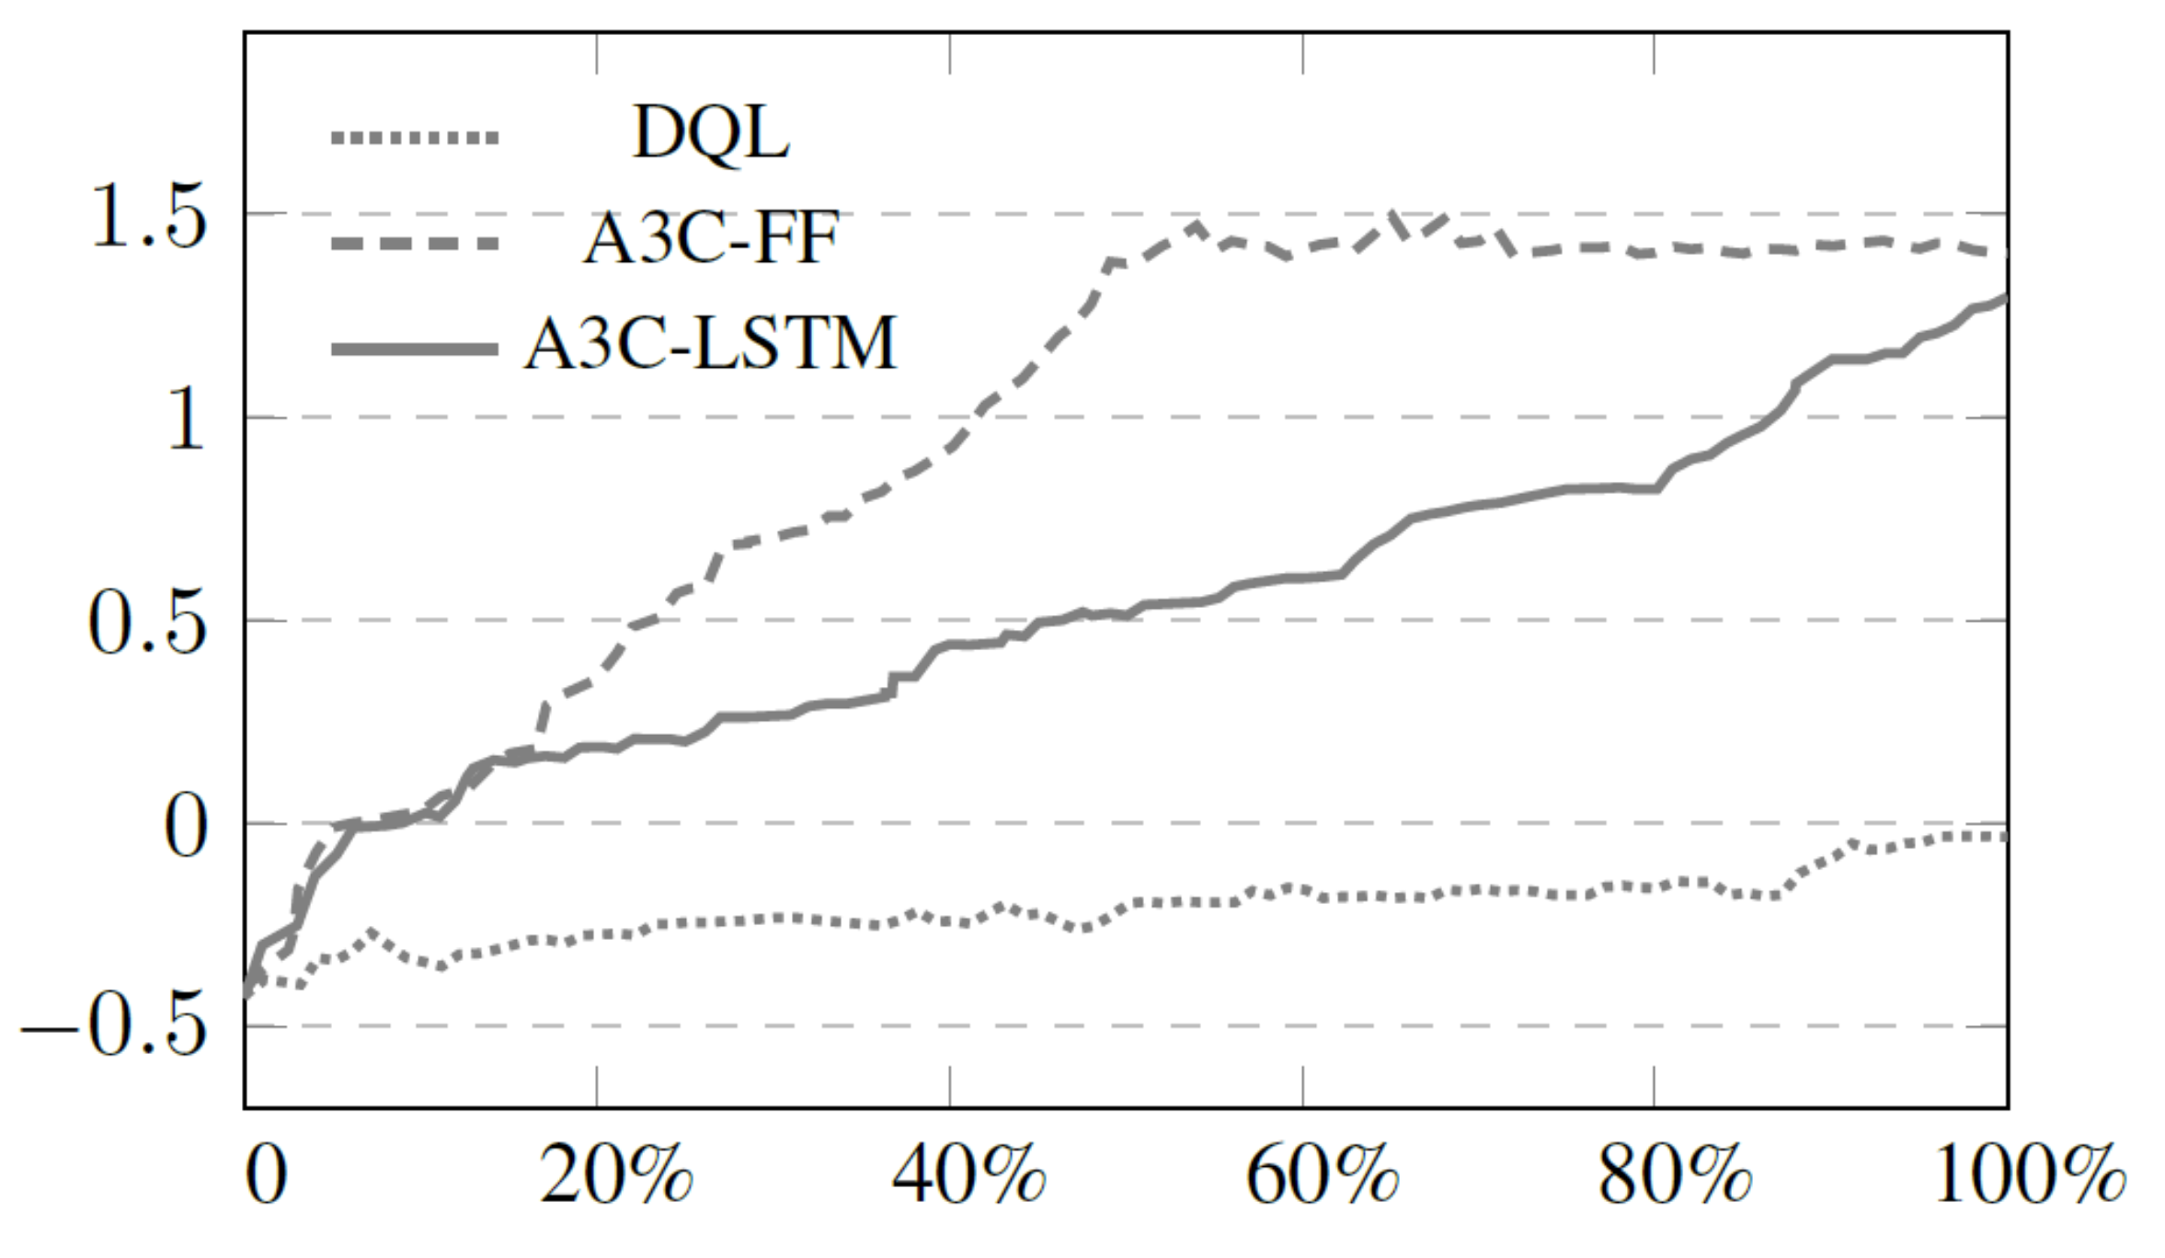
Deep Reinforcement Learning
DQL fails to learn task
A3C-LSTM converges faster than A3C-FF
Line plots representing reward (y-axis) over time (x-axis) for the bounding overwatch learning task where 0% and 100% represents the start and end of training respectively, for each learning algorithm

Slide 51
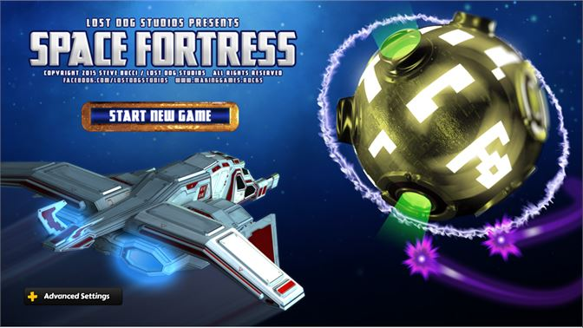
Deep Reinforcement Learning
Additional DRL techniques were explored and used on a serious game called Space Fortress
Emulate similar tasks/skills for Sensor Operators (SOs) for Remotely Piloted Aircraft Systems (RPAS) such as:
  controlling sensors and detecting
  identifying and tracking targets
  visual scanning
  tracking and discrimination
  spatial memory
  divided attention and vigilance to multiple sources

Slide 52
Deep Reinforcement Learning
The DRL techniques for Space Fortress used were:
  Deep Q-Network (DQN)
  Asynchronous Advantage Actor-Critic with a Long Short-Term Memory (A3C-LSTM)
Both algorithms performed poorly
  This may be due to the high complexity and dimensionality of the game
Alternatively, the DQN and A3C-LSTM algorithms were applied to mini-games based on part-task games for an SO which tested for:
  Spatial processing abilities
  Divided attention
  Visual discrimination
Notes:
Poor performance
- E.g. Complicated navigation tasks in conjunction with sparse reward that are only obtained by following procedural tasks in accordance to the game rules

Slide 53
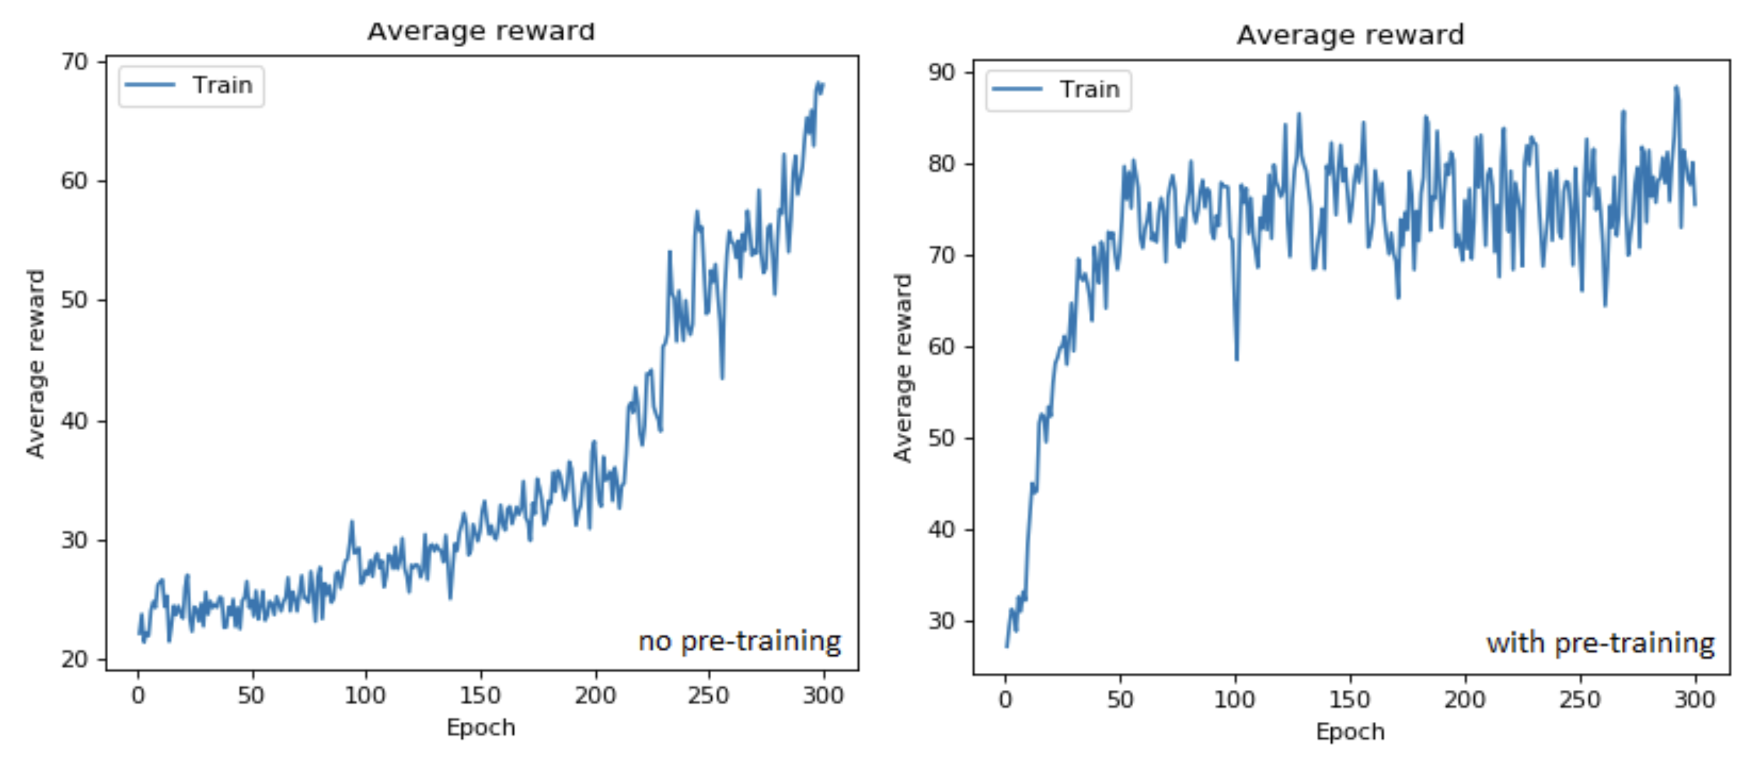
Deep Reinforcement Learning
Progressive part-task training comparison. Positive transfer of training was observed, up to 20% higher scores with equal training time
Notes:
In the mini-games, progressive part-task training was implemented
(i.e. using pre-trained networks to learn new tasks)
Positive transfer of training was observed
Up to 20% higher scores in equal total training time

Slide 54
Deep Reinforcement Learning
In the mini-games, the DQN and A3C-LSTM algorithms had
  Super- or par-human performance in all tasks for dynamic target variation (i.e., tasks that test spatial processing abilities)
  Sub-human performance for the other tasks
Advantage of DRL:
  Works well with large datasets
Disadvantage of DRL:
  Suffers in complex and multi-dimensional games

Slide 55
Evolutionary Computing
Evolutionary Computing is a set of ML techniques inspired by the process of natural evolution:
  Evolutionary strategies
  Evolutionary Programming
  Genetic Programming (GP)
  Genetic Algorithms
Used GP for a predator (the agent) to learn how to tactically devour prey
Predator behavior created by GP surpasses predator behavior manually programmed by humans
Notes:
Genetic Progamming
- Inspired by Charles Darwin’s Natural Selection Theory

Slide 56
Evolutionary Computing
Learning Classifier Systems (LCS) are a collection of genetic-based ML methods
The LCS operates on rules, but not like DS
  A DS system finds optimal combinations of given rules
  LCS mutates the rules
LCS used in an air-to-air combat application to create new combat techniques
LCS advantages / disadvantages:
  In an offline fashion, LCS can generate many high-quality behavior rules
    Can be sent to a DS to form new tactics
  Resulting behavioral solutions may not always be logical

Slide 57
Summary and Next Steps
Case studies highlighted key aspects aiding in the transformation of training
  Supervised and reinforcement learning techniques
  Pros and cons of integrating and utilizing ML in differing simulations
  Implementing autonomous agents in XR-enabled environments
Analyze user experience when incorporating large deep neural networks
  Frame rate fluctuations
  Immersiveness
  Retention rate
  Deployment capabilities for all encompassing XR devices

Slide 58
Tutorial Goal and Learning Objectives
Goal: Understanding the fundamentals of ML, and its application to XR, will empower managers to make appropriate strategic and costing decisions and allow designers, developers, and engineers to successfully implement effective training systems.
Learning objectives
  Describe categories of machine learning technologies and several of their most used algorithm architectures
  Describe how machine learning architectures can be leveraged for XR-enabled MS&T applications
  List and compute savings (i.e., time, cost, etc.) from applying machine learning on relevant XR-enabled MS&T applications from recent case studies
  Describe several ways of incorporating machine learning technology into warfighter training to increase efficacy, efficiency, cost, or time

Slide 59
Thank you for your attention
Any Questions?

Slide 60
References
Abadi, M., Barham, P., Chen, J., Chen, Z., Davis, A., Dean, J., Devin, M., Ghemawat, S., Irving, G., Isard, M. & others (2016). TensorFlow: A System for Large-Scale Machine Learning.. OSDI (p./pp. 265—283).
Bohemia Interactive. (2016) VBS. [Online]. Available: https: //bisimulations.com/virtual-battlespace-3.
Cameron, G. D., Duncan G. I. (1996). PARAMICS – Parallel microscopic simulation of road traffic. The journal of supercomputing, 10(1), pp. 25-53.
Casas, J., Ferrer, J. L., Garcia, D., Perarnau, J., Torday, A (2010). Traffic simulation with aimsun. In fundamentals of traffic simulation (pp. 173-232). Springer, New York, NY.
Checa, D., & Bustillo, A. (2020). A review of immersive virtual reality serious games to enhance learning and training. Multimedia Tools and Applications, 79(9–10), 5501–5527. https://doi.org/10.1007/s11042-019- 08348-9
Dosovitskiy, A., Ros, G., Codevilla, F., Lopez, A., Koltun, V. (2017). CARLA: An open urban driving simulator. arXiv preprint arXiv: 1711.03938.
End to end learning for self-driving cars. arXiv preprint arXiv:1604.07316. Kingma, D. P., & Ba, J. (2014). Adam: A method for stochastic optimization. arXiv preprint arXiv:1412.6980.
Epic Games. (2019). Unreal Engine. Retrieved from https://www.unrealengine.com
Finseth, T. T., Keren, N., Dorneich, M. C., Franke, W. D., Anderson, C. C., & Shelley, M. C. (2018). Evaluating the effectiveness of graduated stress exposure in virtual spaceflight hazard training. Journal of Cognitive Engineering and Decision Making, 12(4), 248-268.
Haas, J. K. (2014). A history of the unity game engine.
Hijazi, S., Kumar, R., & Rowen, C. (2015). Using convolutional neural networks for image recognition. Cadence Design Systems Inc.: San Jose, CA, USA, 1-12.
Ioffe, S., & Szegedy, C. (2015). Batch normalization: Accelerating deep network training by reducing internal covariate shift. arXiv preprint arXiv:1502.03167.
J. R. Koza. (1992). Genetic programming: on the programming of computers by means of natural selection. Cambridge, MA, USA: MIT Press
Jensen, L., & Konradsen, F. (2018). A review of the use of virtual reality head-mounted displays in education and training. Education and Information Technologies, 23(4), 1515–1529. https://doi.org/10.1007/s10639-017- 9676-0
Kalivarapu, V., Kohl. A, Miller. J, & Winer. E (2020). Designing a Deep Learning and Computer-Vision Based Autonomous Vehicle Within a Multimodal Traffic Simulation Framework. Interservice/Industry Training, Simulation, and Education Conference (I/ITSEC) Paper No. 20455
Kohl, A. R., & Winer, E. H. (2019). Visualizing engineering design data using a modified two-level self-organizing map clustering approach. In AIAA Aviation 2019 Forum (p. 3665)
Lele, A. (2013). Virtual reality and its military utility. Journal of Ambient Intelligence and Humanized Computing, 4(1), 17–26. https://doi.org/10.1007/s12652-011-0052-4
Li, Y. (2017). Deep reinforcement learning: An overview. arXiv preprint arXiv:1701.07274
Lockheed Martin Defense (2020). Autonomous and Unmanned Systems | Lockheed Martin. Retrieved June 17, 2020, from https://www.lockheedmartin.com/en-us/capabilities/autonomous-unmanned-systems.html

Slide 61
References
Magic Leap. (2022). Magic Leap 1 AR Information and Pricing. Retrieved from https://www.magicleap.com/magic-leap-1
Magic Leap. (2022). Shop Magic Leap 1. Retrieved from https://shop.magicleap.com/#/
Microsoft. (2022). HoloLens 2 Display. Retrieved from https://docs.microsoft.com/en-us/hololens/hololens2-display
Microsoft. (2022). HoloLens 2. Retrieved from https://www.microsoft.com/en-us/hololens/hardware
Milgram, P., Takemura, H., Utsumi, A., & Kishino, F. (1994). Augmented Reality: A class of displays on the reality-virtuality continuum. Telemanipulator and Telepresence Technologies, 2351, 282–292. http://proceedings.spiedigitallibrary.org/proceeding.aspx?articleid=981543
NVIDIA DRIVE CONSTELLATION. (2020). NVIDIA DRIVE CONSTELLATION – Virtual Reality Autonomous Vehicle Simulator. Retrieved June 17, 2020 from https://www.nvidia.com/en-us/self-driving-cars/drive-constellation/ Gazebo (2020). Gazebo Vehicle and City Simulation. Retrieved Jun 22, 2020 from http://gazebosim.org/blog/car_sim Alvarez, S. (2020). Tesla’s controversial vision-based full self-driving approach is finally paying off. Retrieved June 21, 2020. Retrieved from https://www.teslarati.com/tesla-autopilot-full-self-driving-vision-based-approach- validated-video/
NVIDIA DRIVE Platform. (2020). NVIDIA DRIVE – Autonomous Vehicle Development Platforms.
Oculus Quest 2. (2022). Quest 2 Specs. Retrieved from https://store.facebook.com/quest/products/quest-2/
Paszke, A., Gross, S., Massa, F., Lerer, A., Bradbury, J., Chanan, G., … Chintala, S. (2019). PyTorch: An Imperative Style, High-Performance Deep Learning Library. In Advances in Neural Information Processing Systems 32 (pp. 8024–8035). Curran Associates, Inc. Retrieved from http://papers.neurips.cc/paper/9015-pytorch-an-imperative-style-high-performance-deep-learning-library.pdf
Roessingh, J. J., Toubman, A., van Oijen, J., Poppinga, G., Hou, M., & Luotsinen, L. (2017, October). Machine learning techniques for autonomous agents in military simulations—Multum in Parvo. In 2017 IEEE International Conference on Systems, Man, and Cybernetics (SMC) (pp. 3445-3450). IEEE.
Rogers, S. (2019, September 12). What We Know About HoloLens 2. Forbes. Retrieved July 7, 2022, from https://www.forbes.com/sites/solrogers/2019/09/11/what-we-know-about-hololens-2/?sh=176563cf4662
Russell, S. J., Norvig, P., & Davis, E. (2010). Artificial intelligence: a modern approach. 3rd ed. Upper Saddle River, NJ: Prentice Hall.
Shah, S., Dey, D., Lovett, C., & Kapoor, A. (2018). Airsim: High-fidelity visual and physical simulation for autonomous vehicles. In Field and service robotics (pp. 621-635). Springer, Cham.
Singh, A., Jones, S., Ganapathysubramanian, B., Sarkar, S., Mueller, D., Sandhu, K., & Nagasubramanian, K. (2021). Challenges and opportunities in machine-augmented plant stress phenotyping. Trends in Plant Science, 26(1), 53-69.

Slide 62
References
The College Tour. (2022, July 3). Graduate College and College of Veterinary Medicine at ISU | The College Tour. YouTube. Retrieved July 7, 2022, from https://www.youtube.com/watch?v=AE-9-nYBN4w
V. Mnih, A. P. Badia, M. Mirza, A. Graves, T. P. Lillicrap, T. Harley, D. Silver, and K. Kavukcuoglu. (2016). “Asynchronous methods for deep rein- forcement learning,” in International Conference on Machine Learning.
Varjo XR-3. (2022). Varjo XR-3. Retrieved from https://store.varjo.com/xr-3
Virtual Reality Applications Center. (2022). Public Tour Slide Deck.
Vive Focus 3. (2022). VIVE Focus 3 Specs. Retrieved from https://www.vive.com/us/product/vive-focus3/specs/
Vive Pro 2. (2022). VIVE Pro 2 Specs. Retrieved from https://www.vive.com/us/product/vive-pro2/specs/

