Slide 1

Secure Private Wireless Network Architecture Applied to LVC Environments
Andrew Stewart, CAPT, USN (Ret.), Cisco Systems, Inc.
Jason Hester, COL, USA (Ret.), Cisco Systems, Inc.
Mr. Kevin McFadden, Cisco Systems, Inc.
Notes:
Introductions:
Jason Hester, Colonel United States Army (Retired) -- At Cisco for approx. 2 years, supporting customers across the Department of Defense. Previously served as the Director of Plans at the US Army Network Enterprise Technology Command in Fort Huachuca Arizona; as well as tours as Chief Information Officer at the United States Army War College, CIO, Special Operations Command Pacific, and the Director of Information Technology, Second Infantry Division, US Army, Korea, and Chief of Enterprise Services at the United States Military Academy West Point. He is a graduate of the College of Information and Cyberspace, National Defense University; holds a Master of Science in Computer Science from the University of Illinois Urbana-Champaign and Bachelors of Science in Computer Science from the United States Military Academy, West Point and is a graduate of the U.S. Army War College.
Andy Stewart, Captain United States Navy (Retired ) -- At Cisco for the last 4 years supporting customers across National Security, Defense and Global Government. Previous tours of duty included Chief of Operations (N3) and Maritime Operations Center Director (MOC-D) at Fleet Cyber Command / U.S. TENTH FLEET, Commanding Officer and Program Manager at Navy Cyber Warfare Development Group (NCWDG), and other Cryptologic Warfare Officer tours of duty afloat and ashore, including a Joint tour of duty at the National Security Agency (NSA). He is a graduate of the Sellinger School of Business, Loyola University Maryland and the Cybersecurity and Policy Executive Program from the Harvard Kennedy School. He is also a graduate from the Naval Postgraduate School Monterey, CA, the United States Naval Academy, the National Defense University, and the Naval War College.

Slide 2


Why Private Wireless for LVC?
Private Wireless ==
LVC Experiences
Legacy Wireless ==
LVC Connectivity
Notes:
It’s likely you’ve heard about 5G as one type of wireless technology . . .
Today, we’re going to talk about 5G and its capabilities --especially in the context of how using Private 5G along with other Private Wireless technologies can, together, provide not only connectivity to mobile users and devices, but also how Private Wireless technologies can be applied to enable more immersive experiences and new options to an LVC operational environment.

Slide 3

Relevant Characteristics for LVC Environments
Many Options for Highly Mobile Components
High Bandwidth – Low Latency – Deliver AR/VR Training Experiences
Desired Scalability / Flexibility / Greater Composability Training Environment Options
Best Use of Spectrum Aligned with Use Case (and Cost!)
Available Computing Power from Edge to Cloud
Integration with Enterprise IT
Embedded Security (incl. Zero Trust approach!) →
OMB Zero Trust Memo
Notes:
What are some of the characteristics that Private Wireless can bring to LVC Environments?
Today, we will go through the each of these in greater detail during the session; however, suffice to say, Private Wireless technologies—including 5G, but also including other modern wireless technologies -- can provide more options with greater mobility to significantly enhance any training audience’s experience and the value of the overall LVC event.
By leveraging many of the new and improved features and capabilities from emerging Wireless Technologies (that we will discuss in detail) – like improved bandwidth, latency, edge and cloud computing – together, modern private wireless technologies enable the opportunity to more efficiently and securely deliver enhanced training experiences, with greater flexibility and composability. Private wireless is especially well-suited to better enable training delivered when integrating augmented reality and/or virtual reality (AR/VR) technologies or high-bandwidth video applications to MOBILE users in LVC environments.
As with any Enterprise deployment, trade-offs are necessary in-terms of best capability, cost, and easy of deployment – no one wireless technology can solve every solution, so its necessary to understand what features each Private Wireless technology can offer and how they can work together to support the needs and goals of the LVC environment and training audience. Finally, security cannot be a trade-off – it has to be considered from the start and must following a Zero Trust approach – especially since it is mandated in Federal Environments per the OMB Directive on Zero Trust. We’ll spend some time on that towards the end of the brief. Now, let’s jump into Private Wireless!

Slide 4
Private Wireless and LVC – Executive Summary
I am constantly hearing about 5G . . .
What features does 5G have that makes it an attractive technology for LVC?
How should I be thinking about 5G for LVC?
Does 5G work with other wireless technologies?
Do I need to replace my Wi-Fi that we just deployed?
Are there other wireless technologies available?
What are some of the trade-offs between wireless technologies?
Spectrum, Range, Throughput, Latency, Cost, Operations, Scalability, Flexibility
Is Security a trade-off?!!
How would private wireless technologies be implemented in an LVC environment leveraging the best features of all technologies?
Notes:
This is a broad outline of today’s discussion – I suspect many of you or your team have had these types of question in the context of 5G or other Wireless Access technologies – we hope to help answer them in today’s discussion and, hopefully inspire thought and perhaps questions about Private Wireless your own environment!
First, we’re going to discuss what is 5G and perhaps dispel some myths and confirm some of its capabilities and features – 5G is not the “end-all-be-all” but it is new and emerging and deserves some attention upfront.
So, we’ll go into some technical detail on Private 5G,
Including why the DoD is experimenting with 5G technology so aggressively, but
Particularly, we’ll try to always bring the technology’s features and what it can do in the context of what makes it potentially useful or attractive for the LVC Community.
Next, in addition to Private 5G, we will also look at other Private Wireless technologies, to include Wi-Fi, LoRa, and Ultra-Reliable Wireless Backhaul
We’ll describe the relative strengths and limitations of each – what are the performance and feature trade-offs, and how they can work together
We’ll look at some commercial use cases that employ combinations of private wireless technologies as examples
We will deep-dive into Security – focusing on the need and benefits of taking a built-in, Zero Trust approach
Finally, we’ll apply our learning about all of the capabilities of Private Wireless technology to how they could support LVC Environments.

Slide 5
Learning Objectives
The Learner Will Be Able To:
Understand unique wireless requirements of an LVC network environment.
Differentiate between different wireless access technologies.
Describe the ability of a Zero Trust (ZT) security approach to provide best practices for protecting networks.
Describe the relevant benefits of private wireless technology applied to an LVC environment.
Notes:
Our discussion will support these learning objectives: - Understand unique wireless requirements of an LVC network environment
Differentiate between different wireless access technologies.
Describe the ability of a Zero Trust (ZT) security approach to provide best practices for protecting networks.
Describe the relevant benefits of private wireless technology applied to an LVC environment.
Rather than just providing the “answers” – we hope to inspire new sets of questions that you may have about Private Wireless access technologies! That’s what learning is about, inspiring good questions and curiosity!

Slide 6
Agenda
What is Private 5G?
Private Wireless Use Cases in DoD and Private Industry
Private Wireless Technologies Features Comparisons
Security for Private Wireless
Private Wireless Applied to LVC
Warning: Technical Content Ahead!
Notes:
As discussed in the Executive Summary, we’ll start by deep diving into 5G – and start by focusing particularly on what is Private 5G since there is so much going on in 5G today.
We’ll review DoD’s focus areas on Private 5G technology and how Private Wireless is being applied in Industry use cases
Then, we’ll then go deep into the characteristics and features of several Private Wireless technologies – including some you may not be aware and how they can work together
We’ll spend some time on Zero Trust and discuss how Private Wireless can leverage security across an LVC enterprise using features such as identity and incorporating greater abstraction via software defined networking.
Throughout, we’ll be relating salient features of the technology to the LVC Environment, but we’ll bring it all together to focus on LVC at the end of our discussion.
There is a lot of technical content ahead – but we’ll do our best to make it as painless as possible and leave you with some references to follow up and learn more.

Slide 7
What is Private 5G?
New and unique capabilities of 5G suitable for LVC
5G Features and Deployment Considerations
Notes:
So – Let’s jump into 5G and start to uncover some of its capabilities that can make it suitable for an LVC Environment
SPOILER ALERT: 5G does not solve world hunger and all your LVC needs, but it does have some impressive capabilities that we’ll call out along with deployment considerations

Slide 8








What is 5G?
2025
Rel18
Cellular Radio Technology
2021
Rel17
User Experience
Cloud-Native
Business Focused
Service Based Infrastructure
Decentralized & Disaggregated
Defined by 3GPP (3rd Generation Partnership Project)
Operated in Regulated Spectrum
Uses SIM based Authentication
Sophisticated features (e.g., macro-mobility, carrier roaming)
2017
Rel16
Rel15
5G
20 Years
Evolution
Voice to data to Business focused capabilities
SP-only spectrum to Options for Private/Shared Spectrum
Domain of SPs to Viable option for Private Networks
4G
Enhanced LVC Experience
20 Years
New Radio called 5G NR (New Radio)
20 Years
3G
Broadband Data and Video
Ultra-Reliable Low Latency connectivity
Analog Voice
2G
New Spectrum
1G
Voice and Data
Integrating Unlicensed Bands
Digital Voice
New Core Networks (N/W Slicing)
Notes:
First – as you can see from this graphic there is A LOT happing in 5G – too much to put on one slide alone! (but we tried . . . )
I. First, what is important to LVC? Why would the LVC community want to even consider 5G as a candidate technology?
(Upper Right in green) 5G delivers a lot of capabilities that can enhance the experience to the training audience – be that human-to-human OR human-to-machine
It is built as a User Experience focused technology that is optimized to not only work with Applications/Data from the cloud, but it is also built to be managed and run the cloud (private or public) while enabling data advantages at the edge.
It is business or mission-focused; designed to bring low-latency / high-bandwidth data transport to the users/applications that need those features the most – helping to enrich their experience.
As a service-based infrastructure, 5G allows you to turn on capabilities as a service – you don’t have to completely own/operate all of your own infrastructure or compute resources, you can spin them up quickly for a training event and then spin them down after the event is over – consuming them as a service.
5G is designed to operate in a decentralized and disaggregated manner that allows network transport to be rapidly set up / shifted / dispersed. It expands computed and data storage capabilities closer to the user/edge – this not only adds mobility and improves performance, but it also provides more flexible deployment options -- Versus – always being tied down to a Centralized architecture
II. Rest of the slide:
Understand that 5G is part of an ongoing evolution of multiple technologies – defined by the 3GPP with new Releases progressively coming out – things got going in 2017, but we’re really beginning to see capabilities roll out over the last three relases.
Just like we lived with overlaps from 1G to 2G to 3G to 4G, there will be overlaps with 4G and 5G – it is part of an ongoing evolution
But the big new improvements with 5G are related to the new radio, URLLC, new Spectrum, New Bands, and network core slicing – we’ll be discussing what these are and what that means for mission application.
III. Finally, of import to LVC is that 5G enables mobile technology – formerly, cellular/wireless was part of the “big service provides” -- it lived outside your Enterprise and span of control. Now, with 5G, you can bring Private Cellular into your enterprise and integrate it with what you already have – increasing performance and offering new mobility options – and the option to work coherently with other wireless technologies that are already deployed.
Let’s dig deeper . . . .

Slide 9
5G Mobile Wireless Release Capabilities
Enhanced LVC Experience
5G Features:
Clean Spectrum
Service Based Architecture with Disaggregation
Cloud Scale Network Automation and Orchestration
Multi-access Edge Computing (MEC)
Virtual Network Functions
Open APIs
Stateless Microservice
Control/User Plane Separation
Network Slicing
Access agnostic 3GPP & non-3GPP RAN
LVC will benefit from eMBB, URLLC, and mMTC
Notes:
Going deeper into 5G, there are 3 Big Capabilities that are part of the last large 3 releases – and they are often depicted as points of this triangle in terms of the capabilities they bring – we’ll be referring back to these a few times.
First – Enhanced Mobile Broadband (eMBB) came out very much geared towards your typical mobile or cellphone user – providing higher data rates to support higher data needs for users for Video, Apps, etc. – well-suited for high-throughput with reasonable latency
Next -- Ultra-Reliable and Low Latency Communications (URLLC) – which is geared to HIGHLY CRITICAL applications that need low-latency and very high reliability – like self-driving cars, or Industrial Machinery, or any application that involves safety – Note that the low latency features especially support capabilities like Virtual / Augmented Reality where a user-to-user or user-to-machine interface is time critical and the link’s performance must be highly reliable
Third – Massive Machine Type Communications mMTC or M2M – enables the large-scale communication of many, many, many devices speaking machine-to-machine – think “Massive IOT” – this could include Telemetry from of all types of machines, endpoints, platforms TO support monitoring, sensor-ing, and platform to infrastructure communications. Like things on a Range!
Taken together, you can see in the Green-stared capabilities can support and perhaps enable new capabilities for a mobile training audience – Multiple assets in an LVC environment could benefit from Features and Capabilities from all 3 of these releases.
Of the 5G Features listed on the right. We’ve talked about a few of these already – like Cloud Native and service-based architecture. We’ll talk about Spectrum and Network Slicing in a few more slides; however, I want to introduce this feature called Multi-access Edge Computing (MEC), because we’ll bring it up when we talk about network slicing in two slides.
Multi-access edge computing (MEC) brings compute power and storage closer to the end user. Data is processed and stored closer to the network’s edge, not at a distant data center. This significantly reduces latency since the data does not have to go as far. MEC enables power at the edge and leverages cloud computing capabilities to help enable the enterprise. Specifically, in addition to faster processing and increased bandwidth, MEC provides benefits such as locally empowering more IoT computational power, adding more locally contextual aware data, and of course providing low latency performance – we’ll revisit MEC when we discuss network slicing in a few slides.

Slide 10
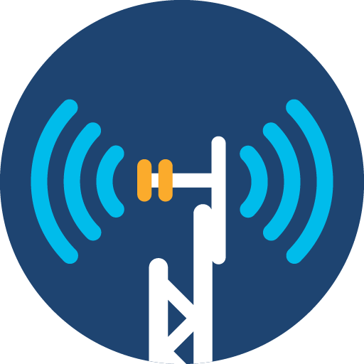
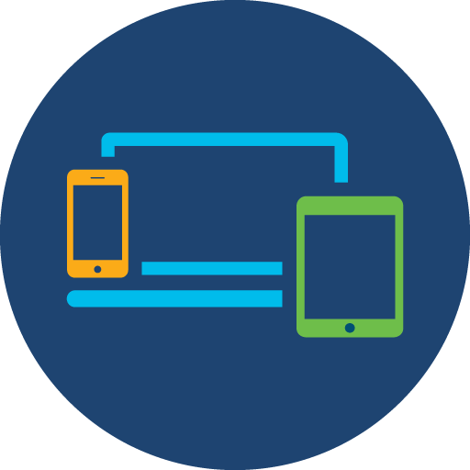



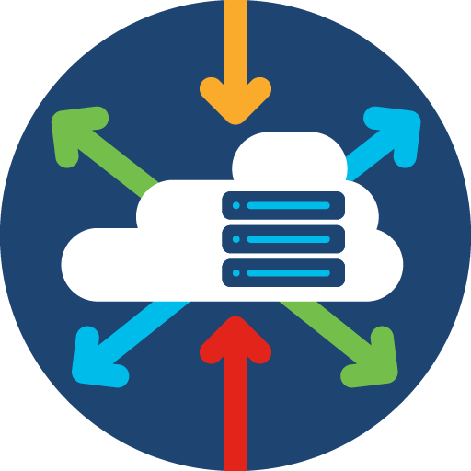




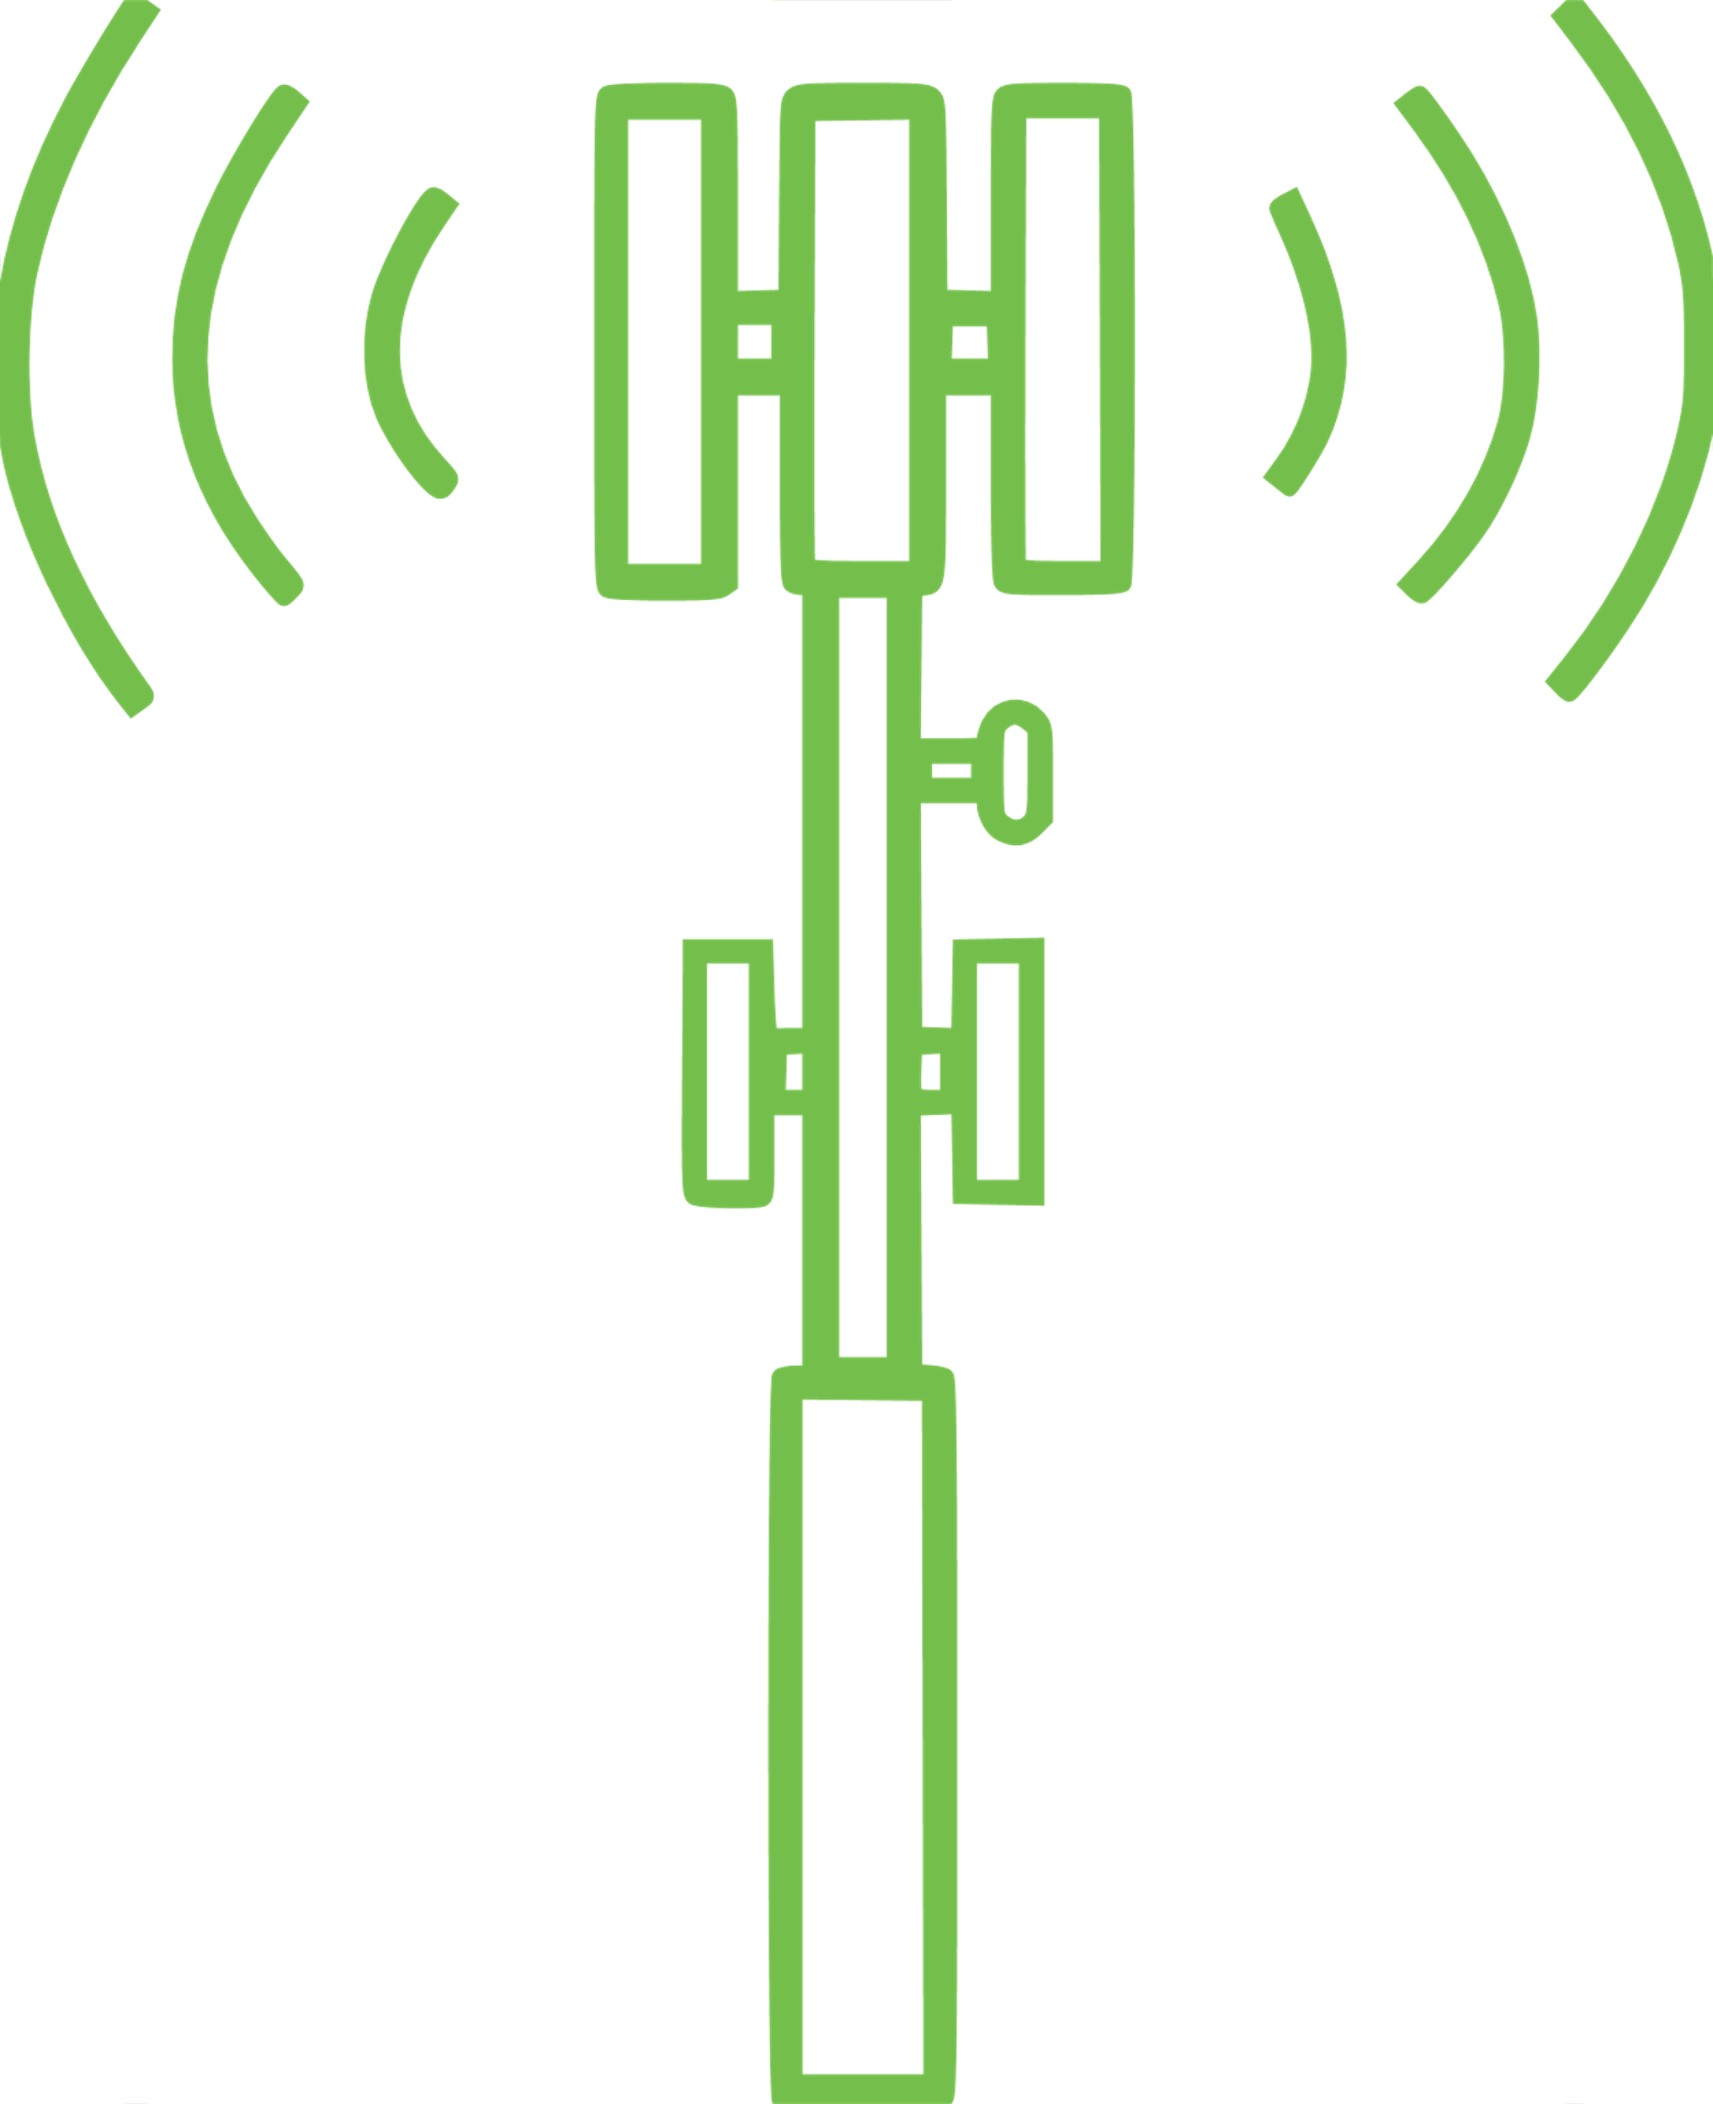




What is Private 5G?
Private 5G Defined: A private cellular network built using 5th generation 3GPP standards-based technology, dedicated to carrying traffic from a specific entity (e.g., an enterprise or public sector agency) in licensed or shared radio spectrum
Devices
Spectrum
Radio
Access
Mobile Core
Endpoints Connected
via 5G
Licensed Spectrum
Available for
Private Use
Radio Network
Radios &
Antennas
Access Network
Enterprise
LAN & WAN
Mobile Packet Core
Session
Policy & Control
Notes:
We’ve used the term Private 5G a few times, so let’s define what we mean by 5G more explicitly. It takes several “ingredients.”
From earlier, we understand that the technology is the 5th Generation of of the 3GPP cellular standard . . . . But,
With the emphasis on Private – we mean that the 5G cellular network is Private only to move traffic for specific entities/endpoints across an Enterprise’s Network . . . .
Through Licensed Spectrum made available for Private use via 5G radios and infrastructure . . . .
Which is controlled by a Mobile Packet Core that provides Session and Policy Control across the 5G cellular network – it “runs the cellular network.”
Notice how a Private 5G Enterprise is the sum of all these components -- 5G enabled endpoints, infrastructure, enterprise, packet core, AND SPECTRUM!
Let’s talk about spectrum for a moment . . .

Slide 11
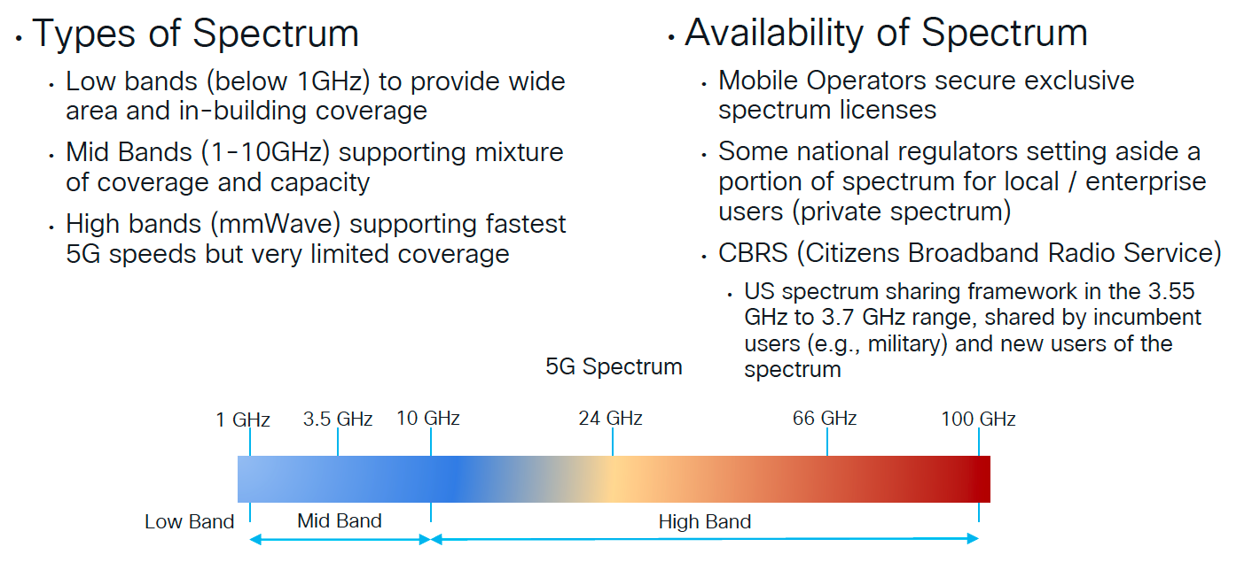
5G Spectrum – Key Consideration!
Notes:
Spectrum is a key consideration with 5G as it is in regulated, licensed spectrum – there is no free lunch, here!
Mobile Operators have secured exclusive use of spectrum and access to that spectrum must be obtained through the owner of the spectrum license. This is a cost that needs to be considered in the design and deployment of any system. 5G offers the capability to share spectrum with mobile operators between private and public operations that allows for more effective cost-sharing models depending on the deployment geography and desired capabilities. For example, large sports arenas / stadiums can share spectrum among providers – and military bases are examining how they can share spectrum with providers as well.
In particular, and new with 5G, CBRS offers a unique spectrum sharing framework within the mid-band range that allows co-use of that spectrum with incumbent users (Military / Navy being highest incumbent) – This could be a highly attractive band for military LVC environments located on or near military installations. There is expected to be a lot of use of CBRS at the “lowest tier” of priority and while the spectrum is shared, it’s still not “free” especially for largescale deployments.
Generally, 5G spectrum is divide into these 3 bands – besides spectrum availability, remember that range/coverage decreases as you increase frequency – and in the high-band/mmWave spectrum, propagation through spectrum is significantly affected by environmental effects such as rain/fog or physical interference.

Slide 12
Network Slicing for 5G
Services are moving to Edge Data Centers for optimized usage of network and provide better experience to user by improving latency
Edge Data Center
5G Transport
Central Data Center
Notes:
When we were looking at the 5G Release Capabilities “Triangle” two slides ago, we discussed Multi-access edge computing (MEC) and Network Slicing. We introduced MEC then so that this view on Network Slicing would make some more sense.
First, “Network Slicing” is really a fancy way of describing the ability to do Network Segmentation together with Quality of Service in order to help Optimize and Prioritize End-User Experience – based on the mission needs.
On this slide you can see how eMBB, URLLC, and mMTC/M2M slices each have different needs in terms of latency, data rates, power, or other requirements. Using Quality of Service to prioritize, and simultaneously leveraging Edge Data Centers, the 5G transport in each slice can be optimized for the needs of the endpoint to improve user experience and assure the best experience with the related mission application in a central Data Center or Private Cloud instance. As we’ll see later there are trades between latency and throughput that can be made depending on the need of the use case.
Taken together, this is what is meant by 5G being focused on User Experience and having an awareness of Business/Mission application – it is far more flexible and adaptable and puts more power at the edge.
For an LVC environment: in this example AR/VR-augmented training audience might want to leverage the URLLC slice for latency – Simple endpoint (laptop/tablet) users could leverage the eMBB slice prioritizing throughput – Range assets could push telemetry in the Machine-to-Machine slice. Non-mission critical / Guests / observers can ride in the “other slice.”

Slide 13


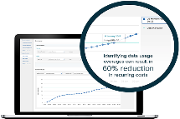


Cloud Managed Private 5G Architecture
On-Premise Enterprise
4G/5G Radio
5G/4G
Packet Core
Constant Upgrades & Enhancements
Public and/or Private Cloud
Network and Device Management
Dedicated Radio
clean spectrum - private or shared
Private Core
enterprise enforced policies and SLAs
A dedicated mobile broadband network connects the enterprise’s most valuable assets: people, machines and applications.
Simplified Management
Common visibility and control across connected assets.
Apps
Enterprise endpoints
Edge Apps
Cloud Apps
Notes:
Earlier we highlighted how 5G was created as a Cloud-aware, service-based infrastructure. Here we can see some of the advantages that such an approach could provide to a Private 5G architecture. Note that in this example we’re assuming a mix of 5G and 4G technologies in the deployment. As providers, vendors, spectrum and existing infrastructure receive upgrades, there are technical guidelines and models for the coexistence and Migration of 4G to 5G that are beyond the scope of this brief. We really are trying to keep this high-level! However, the presence of existing 4G technology (endpoints and infrastructure) is an important consideration when adopting 5G technology – not all endpoints are 5G ready!
In this example, within the On-Premise Enterprise, we’ll highlight the scalability and flexibility that 5G offers via a cloud-managed Packet Core. Here, we have all the needed ingredients we discussed on Slide 10 – 5G endpoints, Clean Spectrum, Radio, Enterprise WAN/LAN resources running close to the edge, and the 5G Packet Core. Cloud-based applications outside the Enterprise are accessible via the Core. Since the Packet Core is Cloud-Native, it is conceivable that the management of One Packet Core, or Multiple Packet Cores could be enabled via any Public/Private Cloud-hosted Instance. Hence, multiple geographically separate Cores could be centrally managed via a Cloud-hosted approach with common controls across multiple environments. This flexibility is what is helping enable Enterprises to adopt Private 5G vs. having to run on public cellular under the control of a Service Provider.

Slide 14







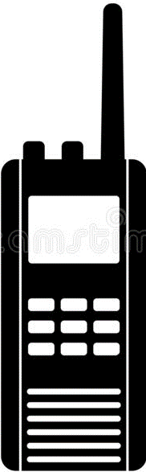
5G Supports Several Radio Network Topologies
Cellular Access
Point to Point / Multi-Point
Fixed Wireless Access
(FWA)
Public 4G/5G
Private 4G/5G
Wi-Fi
LoRaWAN
RFID
Side Link
Multi-hop
Router Controller
Router Controller
Walkie Talkies
Push to Talk
Tactical Mesh
Proximity Services (ProSe)
Router Controller
Peer to Peer / Mesh
Notes:
So far, we’ve mostly been discussing the 5G cellular technology topology in a way that most people think about Cellular Access in the upper left. But, its important to realize that with recent 5G Release versions, there is support for Peer-to-Peer topologies (bottom) and Point to Point / Multi-point with either Fixed Wireless Access or Side Link Multi-hop Topologies (upper right).
These topologies help extend 5G’s reach and ability to allow for more flexible deployments.
The Point to Point / Multi-Point topologies (upper right) are very attractive to extend wireless access to smaller zones or cells – you just need something tall like a light pole or you can use another site to help extend reach.
Peer to Peer topologies allow direct communications between devices and can be useful are when infrastructure-based communication are not available or, when the use case for direct communications to share data between devices is necessary. First responders are a good example of this topology.
As we’re going to explore in the coming sections – as shown in the upper left, multiple radio access technologies, like WiiFi and LoRaWAN, are coming together to enable a more consistent and unified approach to the Radio Access Network – which we’ll see can be particularly powerful in a Private Wireless Environment.

Slide 15
Private Wireless Use Cases in DoD And Private Industry
DoD 5G Use Cases – inclusive of LVC
Private Wireless Industry Use Cases
Notes:
So, in the last section, we took a good (still high level!) look at some of the key features of 5G to provide an understanding of the new capabilities it brings for mobile cellular – especially for Private 5G for Enterprise.
In this section, we’re going to provide a quick overview of how both DoD and Private Industry are experimenting with and adopting Private Wireless capabilities – I think you’ll appreciate the Commercial Use Case given that we’re in Orlando . . .

Slide 16


DoD/OUSD Research & Engineering Experimentation and Transformation Use Cases
DoD Seeking Transformation in:
Smart Warehouse Supply Chain/Logistics
Synthetic Training Environment (STE) Live Virtual Constructive (LVC)
Tactical / Combat Operations Center Mobility & Disaggregation
Flight Line of the Future
Depot Maintenance and Repair
Experimentation
Dynamic Shared Spectrum Analysis
Cybersecurity
Machine Automation, Asset Tracking, Inventory Management
Notes:
This is a great graphic from OSD R&E showing the use cases and specific 5G technologies where DoD is experimenting and seeking Transformation.
Note that the matrix is organized with eMBB, Mass Scale/mMTC, and URLLC horizontally – And, how the columns flow Human to Human // Human to Machine // Machine to Machine.
In the various cells you can see how DoD categorizes many of the use cases for experimentation in 5G.
Note that DoD calls out Synthetic Training Environment (STE) Live Virtual Constructive (LVC) in the upper left. I think this represents a good first start in the upper left-hand corner – but as we’ve already discussed, and just by looking at these use cases, you could imagine how and LVC environment could easily encompass all these cells.

Slide 17
Private Wireless: Industry Use Case Drives Everything
Notes:
When we talk to DoD or Government customers, we often get asked about how private industry is adopting 5G – in many cases, several industries have already adopted Private LTE and are looking towards evolving to Private 5G.
But the common theme across industries is that no single wireless technology solves everything – the Use Case for the technology drives everything, then comes cost, ease of implementation – and always spectrum.
When talking about wireless, industries often think about two classes of users – “Highly Mobile” and “Nomadic” in terms of how far of a distance to the users roam – Do they stay mostly in one area (nomadic)? Or do they traverse long ranges of multiple areas (mobile)?
Users that traverse a large range need good hand-overs and a wide-area of clean spectrum. Some users that move about in one local area need low latency for safety reasons. Everyone wants to make sure they have enough bandwidth to do the job. And everyone demands that they are secure. The big emphasis on going “Private” is their ability to ensure quality of service and retain the freedom to control their own wireless destiny from an Enterprise perspective.
So, the answer is not about shifting everything to Private 5G, it is more about how do we leverage 5G for the right use case and how do we do it with existing wireless investments or are there other wireless technologies that Private 5G can work with?
< Discuss / overview of some of these examples >
Let’s take closer look at one commercial application . . . .

Slide 18







Multi-Wireless Access in Theme Parks and Venues (Example)
Better Together
Ultra-Reliable Wireless Backhaul (CURWB)
High-speed wireless hand-offs for command and control/status of mobile rides
Provides “Fiber Backhaul Performance” for mobile and fixed platforms
Enhances other wireless access technologies
Unlicensed spectrum
High density wireless
Pervasive 5G connectivity
Leverage hi-density / high throughput wireless in customer congregation areas
Supports application pushes across private networks
Supports non-5G devices via 802.11
Pervasive private 5G for customer connectivity
The ability to push application data to customers across private network
Leveraging CURWB for 5G edge devices without cabling
Notes:
Let’s take one example of a Very Large, Very Popular Theme Park (Possibly close to our current location) . . . You may be familiar with this venue if you are familiar with Orlando . . .
They use a combination of 3 wireless technologies to do multiple things inside the park including:
Ensuring customers can get service to call each other and send pictures, chat, post, etc. – If you have kids, you know . . . Over 5G cellular technology or Wi-Fi
They also use Wi-Fi to enhance customer’s visit via information services / Specifically Focused /Themed Applications / and information pushes to customers in different areas of the park or by interest.
Wi-Fi is also very helpful to offload cellular demand in heavy customer areas.
One interesting wireless capability that we’ll talk about in a minute is Ultra-Reliable Wireless Backhaul which is used to provide high-speed, low-latency, high-performance wireless hand-offs between mobile rides – to give you an idea about the hand-off speed performance, this is what was used during the Autonomous Indy Car challenge and is used on high-speed trains in Europe and Japan.
Ultra-Reliable Wireless Backhaul is also used in the park to help provide “fiber-like” connectivity when running fiber is not practical or not an option – think of it like a high-speed wireless tunnel between two switches – In this case, the park can expand 5G and/or WiFi coverage to far areas of the park without digging and tunneling infrastructure.
Note that both Ultra-Reliable Wireless Backhaul and Wi-Fi operate in Unlicensed spectrum.

Slide 19
Private Wireless Feature Comparison
Overview of Private Wireless Technologies
Private Wireless Deployment Considerations
Integrated Wireless Employment Opportunities
Notes:
Hopefully that Theme Park use case got you interested to know about the different performance characteristics of some Wireless Technologies and how they can be used together.
We’re going to go deeper into each one and compare/contrast to help understand what some of employment opportunities would be and how they can work together in an integrated way.

Slide 20












Ultra-Reliable Wireless Backhaul (CURWB)
Extends Network via an overlay technology that emulates a virtual switch over wireless links in unlicensed spectrum (2.4 / 5 / 6 GHz)
Long Range and High Bandwidth Connectivity
Ports - Terminals
Mining
Fast and Accurate Handoff for Mobility
Support for real-time sensitive traffic
Theme Parks
Rail
Enterprise HQ
or
LAN Point-of-Presence (PoP)
Support fixed and mobile architectures
Campus
Smart city
Drones
Enterprise (IT)
Operational Technology (OT)
Ultra-Reliable Wireless Backhaul (CURWB)
Notes:
Let’s start with Ultra-Reliable Wireless Backhaul, since we were just discussing it and not many people are aware of it. Frankly, you would not be aware of it unless you were looking for some kind of wireless backhaul because you either did not want to dig a trench, or you did not have a spool of fiber cable long enough to support a semi-mobile end point. It’s long-range – dependent on power, throughput, and uses directional antennas – 15 miles is probably the outer edge. Most impressive, and this is why high-speed applications like it – is the high-speed hand offs up to 225 Mph with extremely low latency.
You can see some of the Industrial applications on the right. One simple use case for backhaul is high-speed trains. If you are in the car, you are surfing the web on your tablet from the in-cabin wifi – but that wifi traffic is actually being backhauled from the high-speed train to track link that is constantly changing access points as the train moves down the track! Like the theme park, college campus use it to provide connectivity to WiFi hotspots around campus.
Due to its low latency, it is often seen as highly advantageous for OT environments like Maritime Port crane operators who are sitting in an air-conditioned room – no longer up in the – but need to safely operate the crane as it moves along the quay.

Slide 21
LoRaWAN: Standards-based Wireless for IOT Use Cases
A disruptive wireless technology for low data rate secure communication
Long Distance Connectivity
Low Data Rate
Low Power Solution
RF Unlicensed Spectrum
Spectrum: Unlicensed, bands: EU868, US915, AS923…and newly 2.4GHz
Data rate: 250 bit/sec – 5.4 kbit/sec (EU868), 980bit/sec – 21.4kbits/sec (US915)
Range: Up to 15 KM in rural areas -- Connect thousands of devices
Low Power: Battery powered endpoints w/ long life
Modulation: LoRa – Chirp Spread Spectrum
Channel: 125kHz & 500kHz (US915)
Notes:
Let’s look at another Wireless technology that you may not be familiar with – LoRaWAN – which also operates in Unlicensed spectrum.
Unlike Ultra-Reliable Wireless Backhaul, LoRa support relatively low data rate devices and sensors – at low power – which is perfect for things that only need to report in every now and then, or when they move, or when something happens – and do that over a long range. And, it is great because the sensors are cheap and can run on small batteries, you can have many-many of these!

Slide 22

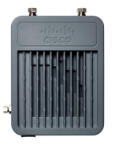





LoRaWAN
Sensors
LoRaWAN
Gateways
Application Servers
P
Measure Data
Network Server
API
Report Events
LoRaWAN Devices
IP Backhaul
IP Transport
Track
LoRaWAN
Radio PHY
LoRaWAN™ MAC
App Data
IP
Tunnel
App Data
MAC Layer encryption
App Layer Encryption
Notes:
Once the Sensor reports back to a gateway, the data can be moved over IP Transport – anywhere – this could be a WiFi link – or a 5G link – or hardwired – These sensors are great for measuring data, reporting events, or tracking – If you have a need for some time of telemetry data to be fed into an LVC environment, LoRa is cheap and easy option – It is certainly a lot less expensive than strapping an iPhone on everything and running your own 5G network just to report some data back for a Machine to Machine application!

Slide 23


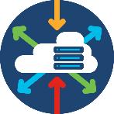




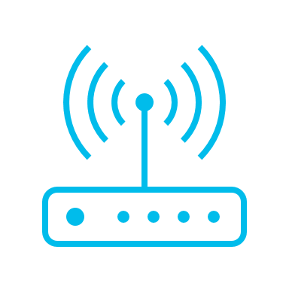








Wi-Fi and 5G Comparable Architectures
Regulated
Spectrum
IP
Transport
Fixed & Mobile Devices
Radios
Network Controller
Apps
IP Packets
User
Equipment
Device with a Wi-Fi
Radio Interface
Unlicensed
Spectrum
2.4 GHz
5 GHz
6 GHz
Access Points
(AP)
Radio Antennas and
Control Functions
Wi-Fi6 = OFDMA
Enterprise
Software Defined Networking (SDN)
Wireless LAN
Controller
User session Policy and Control for Thousands of Devices
Enterprise
10s to 50 Thousand
10s of Feet to 100s of Miles
Licensed
Spectrum
Shared or Private
20-50 GHz
1 – 7 GHz
Sub 1 GHz
Radio Access
Network (RAN)
Radio Antennas and
Control Functions
5G = OFDMA
Service Provider
or Enterprise
Optical
Segment Routing
MPLS L2/L3 VPN
Mobile
Packet Core
User session Policy and Control Millions of UEs
User Equipment
(UE)
Device with a 5G
Radio Interface
Enterprise
10s to > 1 Trillion
10s of Feet to 10,000s of Miles
Open Architecture with Cloud Native Decentralized and Distributed Network Functions
Mobile Edge Compute (MEC) and Distributed Application Architectures
Notes:
Now its time to get to the “big question” that you all have been wondering – what’s the difference between Wi-Fi and 5G?
There’s a lot on this chart to compare and contrast – but he first thing I would point your eyes towards are the number of Users – Typical WiFi you are looking at 10s – maybe into high hundreds and into thousands of end points in a really, really large deployment. In 5G, it’s designed to scale up to 1 Trillion devices (infrastructure permitting). And the next comparison is the size of area to support this number of users – WiFi is great for a relatively well-defined smaller area – Compared to 10,000s of Miles to that of 5G. So, the “Mobile” vs. “Nomandic” user comparison is pretty good here – and the numbers of mobile users moving over that area matter a lot.
Next big difference – Spectrum – We’ve talked about this – WiFI is Unlicensed – 5G is Licensed, and that means cost. Notice though that they both use the same modulation technology – but operating in different bands!
Finally, notice that the brains for WiFi is a WLAN controller – While 5G needs this Mobile packet core to do its job.

Slide 24

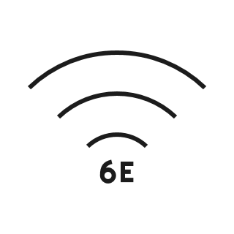
Increasing Demand on All Wireless Networks
Requirements:
Coverage: Indoor/Outdoor spaces
Throughput: More bandwidth per device
Determinism: Guarantees for QoS, Latency, Reliability
Security: comprehensive, multi-layer, end to end
Challenges:
Availability of usable spectrum
Seamless operation across multiple spectrum sources
Convergence across wireline and wireless networks
Unified service experience across: Enterprise / Service Provider / Cloud
New Wireless Technologies
Both technologies built on the same MAC/PHY layer & can deliver:
Highest reliability
Highest availability
Quality of Experience protection
Low latency
Apps and multi-path optimized
Public
Wi-Fi
Orthogonal Frequency-Division Multiple Access (OFDMA)
Outdoor
Outdoor + Indoor
Indoor
Optimized for Coverage
Optimized for Capacity and Density
Carrier managed
Enterprise managed
Notes:
Suffice to say every wireless network has these types of requirements these days – the demand is not going away: Coverage: Indoor/Outdoor spaces
Throughput: More bandwidth per device
Determinism: Guarantees for QoS, Latency, Reliability
Security: comprehensive, multi-layer, end to end
Likewise, every wireless network has these types of challenges:
Availability of usable spectrum
Seamless operation across multiple spectrum sources
Convergence across wireline and wireless networks
Unified service experience across: Enterprise / Service Provider / Cloud
As discussed, Cellular is built for coverage and has been the domain of the Cellular Service Provider
Wi-Fi is built on the same MAC/PHY layer technology as 5G, but is optimized for capacity and density within an area
So which is better and how can an Enterprise take advantage of both?

Slide 25

Private Wireless for Enterprise
Requirements:
Coverage
Throughput
Determinism
Security
Challenges:
Availability of usable spectrum
Seamless operation across multiple spectrum sources
Advantages:
Unified service experience across enterprise
Closed loop solution for data sovereignty
Consume 5G on your own terms.. not metered!
Availability to new spectrum: CBRS (5G), 6GHz (Wi-Fi 6E)
New Wireless Technologies
Both technologies built on the same MAC/PHY layer & can deliver:
Highest reliability
Highest availability
Quality of Experience protection
Low latency
Apps and multi-path optimized
Private
Wi-Fi
Orthogonal Frequency-Division Multiple Access (OFDMA)
Outdoor
Outdoor + Indoor
Indoor
Optimized for Coverage
Optimized for Capacity and Density
Enterprise
Notes:
The answer for Enterprises is Private Wireless. Private Wireless for Enterprise allows us to bring both technologies together and provide unified services, data sovereignty, and security together.
This is part of the large opportunity with 5G – Enterprises can use what they already have in their enterprise and can add 5G as another means of wireless transport without being held ransom by the Service Provider world.
As we saw in the industry use cases, the key is understanding the use case/mission application and applying the best wireless technology fit – So, let’s revisit and explore those trade offs again.

Slide 26
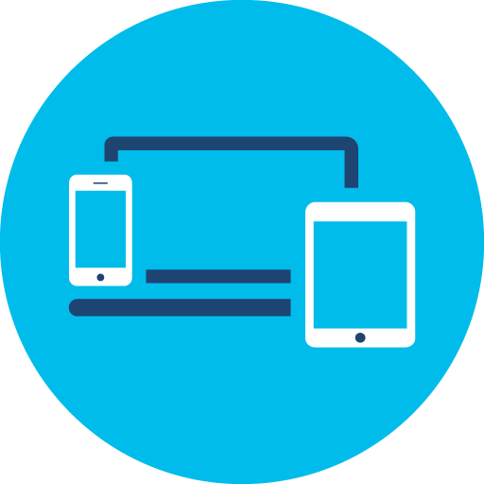









P5G and Wi-Fi 6/6E are Complimentary
Private
5G
WiFi 6/6E
(802.11ax)
Additional Considerations
Judgement
Mission-critical applications requiring ultra-low latency​, or broad geographic coverage​
Applications focused on capacity, client density, mobility, “guest” access, BYOD
Device ecosystem
5G IoT device availability expected to be limited until 2025
Spectrum
Added complexity and cost to acquire licensed spectrum for 5G
Automated Guided Vehicle
Enhanced Mobile Broadband
Wide Area Coverage
Process Automation
Digital Health
Digital Campus
Operations
5G in more complex than Wi-Fi currently → aaS Adoption
Eliminate Interference Roaming delays of ≤ 50ms w/ 5G
2Gbps+ download immersive experience
Advanced care Telemedicine and mobile health
Large indoor and outdoor coverage
(10K+ sq ft per cell)
HA & SLA
Five-9’s to Six-9’s
E2E latency ≤10ms
AR/VR/MR- based Education E-learning
Cost
Unlikely that 5G devices and infrastructure will be cheaper than Wi-Fi in foreseeable future
Performance
IOT Scale
Capacity
Security
Application and Business Model Needs Drive Choice
Notes:
This chart lays down some of the areas and use cases where Private 5G is well-suited – and where Wi-Fi is well-suited.
Notice that there is still a judgement area in between where you can go almost either way! The big trades are usually in range coverage, latency, and throughput.
Let’s take a look at some more factors –
Not all IOT devices are 5G ready – in fact, most of that ecosystem is still under development
Spectrum – we’ve discussed before – but availability and cost of Spectrum is complex – CBRS in the U.S. is great, and even though they say Private 5G is not metered, there is still a cost to get into that spectrum
Certainly operating a 5G packet core is more complex than a WiFi – As a Service option for operations can make 5G less complex; however, that takes us to . . .
Cost – WiFi is going to be cheaper than 5G for a long time – devices and infrastructure

Slide 27














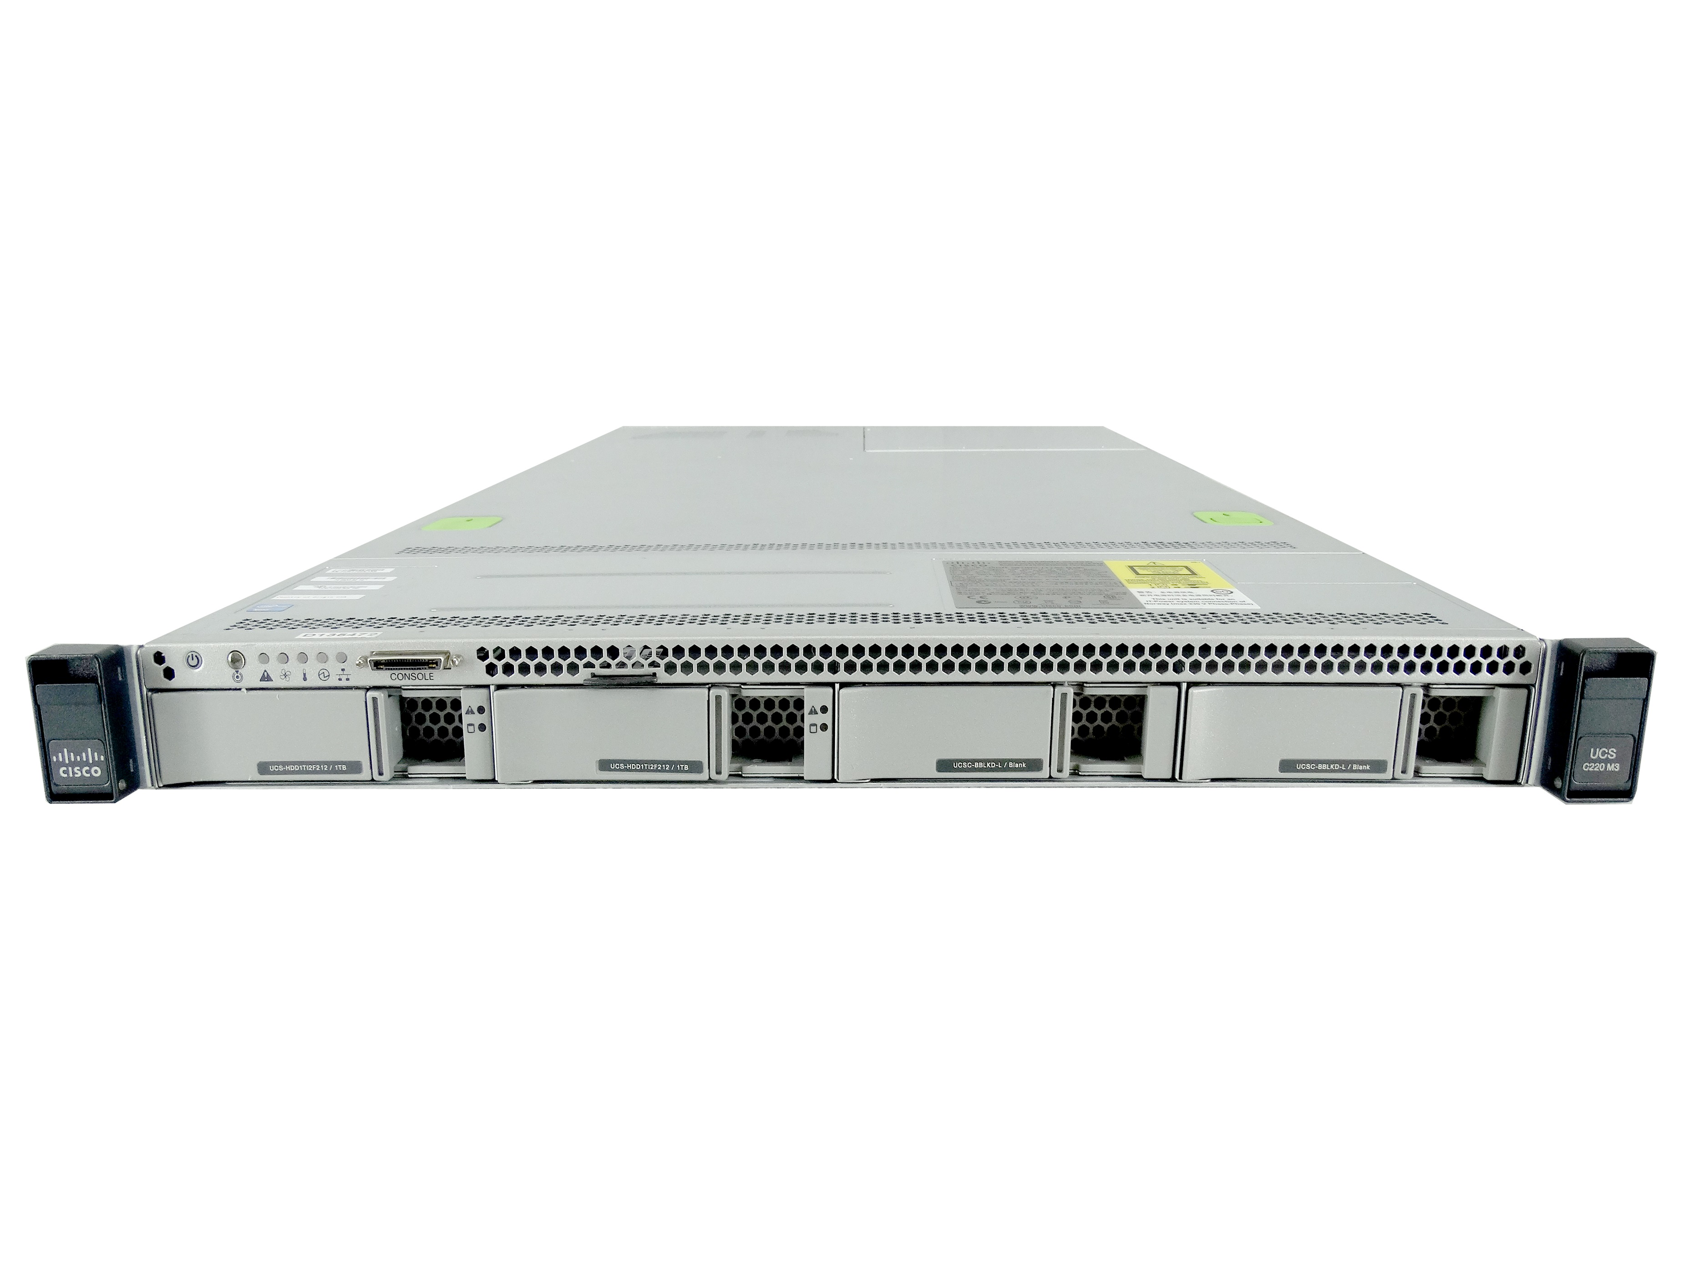
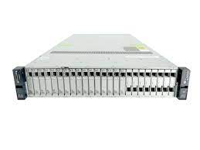
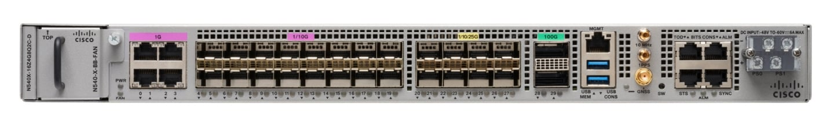

Wireless Technology Choices Converged
Campus
Depots
Transportation Hubs
Metro Areas
Bases
Digital Divide
Rural Locations
Training Ranges
Infrastructure
In Building
Underground
In Venue/Room
Data Center
Infrastructure
Premise
Core Services
Security
Wi-Fi
Wi-Fi
Wi-Fi
Hybrid
Private
Private Wireless
Connectivity Fit
Cloud
Radio Access
Network
Manage-
ment
LoRa
Public Cellular
Public
Distance & Coverage Area
Notes:
There’s a thousand words in a picture . . . Here is one visualization for Distance and Coverage Area
Notice how we push out the area and range going from left to right – as you get farther and farther in coverage, Private 5G supported with Wifi provides a good mix of fit and purpose. And connects the users/things with data/applications that they need for their missions and functions. Although you can get the same distance/coverage from public cellular, you lose the ability to integrate directly with existing Data Center Infrastructure, security and network management – And, you’re less optimally aligned with smaller/dense coverage areas.
Also, notice that LoRa provides a niche role connecting long range sensors back to the enterprise. We could even draw Ultra-reliable Wireless Backhaul connectivity between zones here – but that would become too confusing!

Slide 28
Industry-Related Applications Performance Requirements
Latency
Data Backhaul (Wi-Fi for Passengers, Fixed Networks)
100 ms
Autonomous Mining Vehicle
Train Control & Automated Trains
Video Streaming for Security and Situational Awareness
Remote Crane Operations for Ports / Terminals
10 ms
Immersive Entertainment
Video for Remote Operations
(Trucks, Cranes, etc.)
Autonomous Robots Signaling
1 ms
Throughput
10 Mbps
100 Mbps
1000 Mbps
2000 Mbps
3000 Mbps
Notes:
Here is another visualization with Latency and Throughput on the major axes.
Plotted in the middle is the relative requirements areas of several Industry Use Cases
Notice that, passengers for example, can live with lower performance in latency as long as they have the throughput so that they can stream video and post pictures, etc.
Latency requirements for Industrial applications becomes more austere where safety and high precision is required.
I think it is fair to say that some LVC applications might live in the Immersive Entertainment – Remote Crane – Video Streaming zone – depending on the application needs
So, let’s overlay some of the Private Wireless technologies over this view

Slide 29
Applications Requirements Vs. Wireless Technology
*”Representative Performance” – Highly Dependent on Channel Bandwidth and Spacing, other physical factors, and upstream device performance
Latency
5G eMBB
Std WiFi and 4G
Data Backhaul (Wi-Fi for Passengers, Fixed Networks
100 ms
Autonomous Mining Vehicle
Train Control & Automated Trains
5G
URLLC profile
WiFi-6/6e
Video Streaming for Security and Situational Awareness
Remote Crane Operations for Ports / Terminals
10 ms
Immersive Entertainment
Video for Remote Operations
(Trucks, Cranes, etc.)
Autonomous Robots Signaling
CURWB
1 ms
Throughput
10 Mbps
100 Mbps
1000 Mbps
2000 Mbps
3000 Mbps
Notes:
This visual provides a rough idea of potential latency and throughput performance of each wireless technology (BUT says nothing about functionality and other mission application factors!)
Note that is is representative – performance can vary dependent on actual channel bandwidth and other physical factors in the environment -- including upstream device performance – For example, you can’t drop a Wi-Fi 6e Wireless Access Point into your network and connect it to an older, slower switch that does not support new throughput speeds! Network congestion matters much more for Wi-Fi than CURWB (which is more of a “link”). As always – it depends!
Notice that 5G URLLC and 5G eMBB are very different when viewed this way – we discussed this when we looked a network slicing
And, of course, technology and performance characteristics will continue to change and improve – this not only WILL but IS continuing to change!

Slide 30





Private Wireless Options Better Together
Integrated Strategy for 5G + Wi-Fi
Untether the tethered!
Leverage new wireless speeds, reliability, and agility
Integrated Enterprise capabilities
Apply uniform security and identity policies
Converged network and security reference architecture → Zero Trust approach
Mission Outcomes
Connect more people, places, things, and services – with greater mobility
Enhanced user experience for mobile users
Enable growing mobile workforce
Bring data to the human instead of the human to the data
Accelerate IT and OT integration
Private 5G
Wi-Fi 6E
Integrated
Network Architecture
Enterprise
Integration
Uniform
Security
Secure, Flexible and Scalable Options for LVC Deployments
Notes:
So – which is better for LVC – 5G or Wi-FI?
The answer is that with an Integrated Private Wireless approach you can get the best of both 5G and Wi-FI – and, integrate other Private Wireless capabilities like LoRa and CURWB, where it makes sense too!
It’s important to ask “Why Private Wireless in the first place?”
Mobility is the first answer -- Untether the tethered! Bring more Devices, People, and IOT on the network with more services
New Wireless speeds are enabling great mobility with, reliability, flexibility and agility – And, now it is possible to deliver immersive user experiences to Training Audiences in the LVC Environment with these features and capabilities!
With a Private Wireless environment, you can integrate with existing Enterprise capabilities – and,
Apply uniform security and identity policies which is critical to having a . . .
Converged network and security reference architecture → Zero Trust approach – which is our next topic!

Slide 31
Security for Private Wireless
Security Threats to Wireless
Zero Trust Defined by NIST
Zero Trust Approach for LVC and Private Wireless
“Over the Top Security”
Notes:
We have discussed quite a bit about differing Private Wireless technologies and associated capabilities, but we must specifically consider security as well. For one thing, security (via a Zero Trust approach no less!) is mandated in federal environments by way of an OMB directive on Zero Trust. So let's add security to our discussion within the lens of the Zero Trust security model.

Slide 32
Threats in 5G and Evolving Architectures
Notes:
Contemporary threats to any network environment are numerous, and this is certainly the case in wireless and 5G as well. Along the bottom of this slide we can see the various categories of threats relevant to a typical 5G environment topology. Let's talk about a representative few of them..
So what security approach allows us to counter/mitigate this wide array of threats while preserving the desired characteristics of the network? An increasingly common (and indeed, mandated!) approach is based upon the notion of "Zero Trust."

Slide 33
Five Fundamental Assertions of Zero Trust
The network is always assumed to be hostile
External and internal threats always exist on the network
Network locality is not sufficient for deciding trust in a network
Every device, user, and network flow is authenticated and authorized
Policies must be dynamic and calculated from as many sources of data as possible
The effect of Zero Trust is
Ubiquitous Least-Privilege Access
(i.e. grant access, but make it specific!)
https://www.actiac.org/system/files/ACT-IAC%20Zero%20Trust%20Project%20Report%2004182019.pdf
Notes:
Zero Trust is not a product. It's not a technology. Rather, it is a set of principles utilized to design and implement IT systems with a goal of producing a secure, yet perimiter-less, environment. The "old" way of implementing security was to construct iron-clad logical or physical perimeters around resources in the network, and defend those perimeters. Operating within that environment assumed that resources within those perimeters were safe/uncompromised. Zero Trust takes a decidedly different approach. It minimizes the notion of perimeters by assuming that everywhere on the network is always hostile; that threats (both internal and external) are always present; that any specific logical locale on the network cannot be considered trusted. These assumptions then mandate that every device, user, and network flow be authenticated and authorized. Further, our policies must be dynamic and assessed *continuously*, as we will discuss on this next slide.

Slide 34

Universal Zero Trust Tenants
Establish Trust
Enforce Trust-Based
Access
Continuously Verify
Trust
Original tenets used to establish trust are still true
Traffic is not threat traffic
Any risky, anomalous and malicious behavior
If compromised, then the trust level is changed
User & device identity
Device posture & vulnerabilities
Any workloads
App/service trust
Any indicators of compromise
Applications
Network resources
Workload communications
All workload users/admins
Workforce – Workspace - Workload
Notes:
Our approach for zero trust is to establish trust, enforce trust through polices at the point of access, but it doesn’t stop there as there is a need to continuously verify that the connection can still be trusted after the initial access is established.
1. Establish Trust: We establish trust by verifying: User and Device (assessing the health and posture of the device) both on the network and off the network, Workloads, Applications/Services
2. Enforce Trust-Based Access: We enforce least privilege access to: applications, network resources, workload communications, on all users/devices
3. Continuously Verify Trust: We continuously verify: that original tenants used to establish trust are still true for the duration of the session, that traffic is not introducing risk, detecting risky, anomalous and malicious behavior. If a compromise is detected, then change we adjust the trust level
It is important to both realize and accept that Zero Trust is not a single data point, but is a continual process in the life of any network. The principles applied to Zero Trust are designed for particular threats or to be used in particular areas of the network, but since the network and the environment continually evolve, the protections applied to the network must constantly be inspected and occasionally updated and even replaced or upgraded. The graphic shows the cyclical nature of any security story, and certainly that of Zero Trust. Trust must first be established before access is granted to any resource, but a single trust event does not imply ‘forever’. Access should be continually evaluated. Device posture should be continually evaluated. Threat intelligence should be continually absorbed and applied. Threat activity should be investigated and isolated. All of these actions happen all of the time.

Slide 35
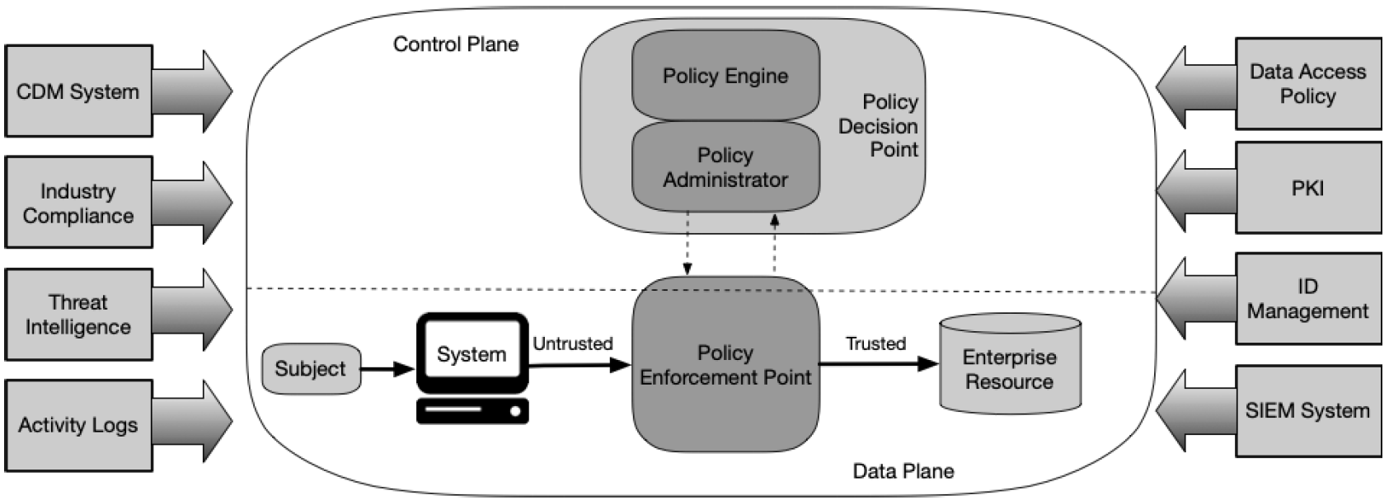
NIST SP 800-207 Zero Trust Architecture
External inputs and influences
User and Device
Access
Application and Workload Access
Network Access and Visibility
Insider Threat and Network Visibility are considered threats associated with ZTA
The network plays a critical role in applied ZT principles!
https://csrc.nist.gov/publications/detail/sp/800-207/final
Notes:
How do we turn these principles into more tangible network design principles?
The National Institute of Standards and Technology has helped with this via their Special Publication 800-207 (NIST SP 800-207). Through this publication, NIST provides "an abstract definition of ZTA and gives general deployment models and use cases where zero trust could improve an enterprise's overall information technology security posture."
At the core of this NIST guidance is the framework shown here to describe the model of interaction between resources, subjects and systems desiring access to those resources, and the policies applied in those interactions that adhere to ZT principles. We can see, for example, that subjects and systems are "untrusted" by default, prior to the enforcement of access policy for each resource request. All this happens within the logical "control plane." And outside of this plane we see the external inputs and influences to consider. We can talk about a couple of those. But this is all sort of abstract for our purposes still. Let's go to the next slide and put this in more tangible terms for application in an LVC environment.

Slide 36
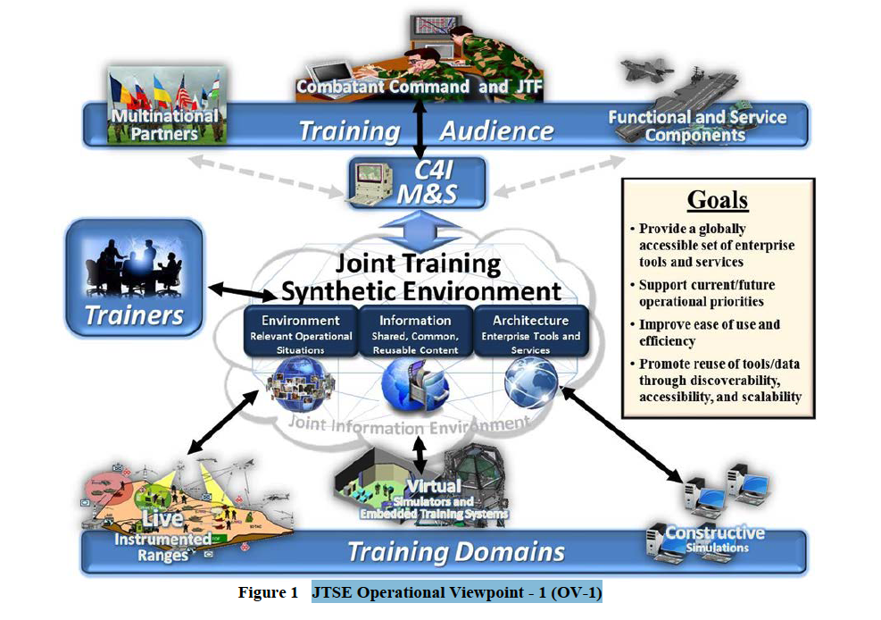
Network Connects Subjects to Resources
People + Things
(Subjects)
Need Data
From Resources
Workforce
(Training Audience, Trainers, Administrators, Devices without users)
Workplace
(LVC Connectivity, Service Enterprises, Range Networks)
Workload
(Servers, Compute Platforms in Cloud or Datacenters)
Networking and Security Architecture
Connects Everything
Notes:
At its core, ZT is about connecting subjects to resources.
In the context of LVC, we can describe these components as the “subjects” who are user/devices of the Workforce,
The Workplace for the subjects are the core networks that connects and secures their access to the,
Workloads–These are the “resources” which are the data and applications the subjects need to get their mission done

Slide 37
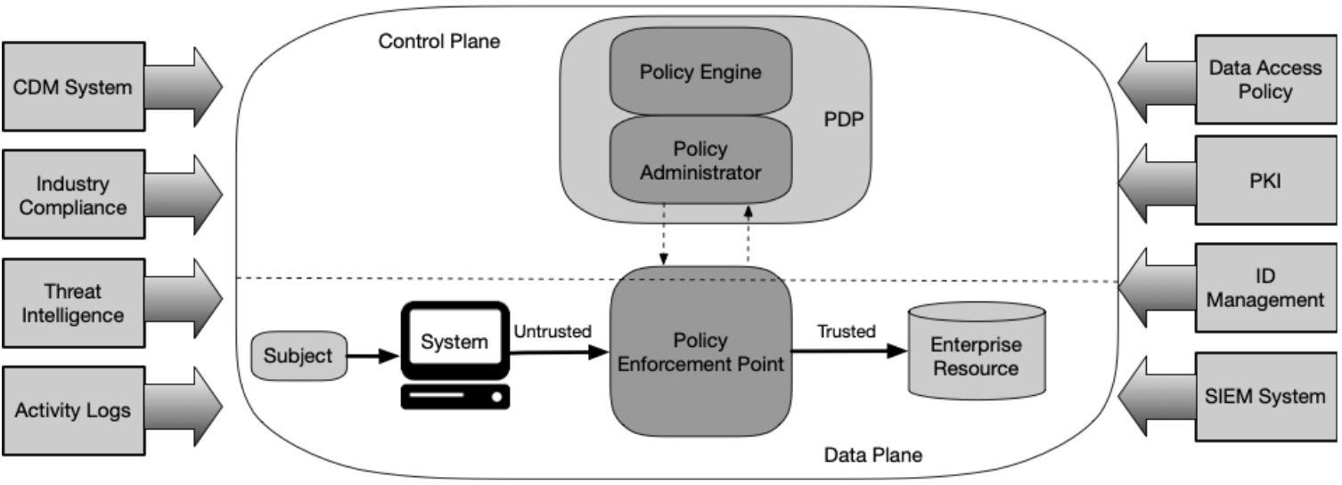
Zero Trust Philosophy
Zero Trust is an evolutionary framework not a revolution
Zero Trust is not a technology but a design approach
Zero Trust augments other cybersecurity tools and practices rather than replacing them
Threat protection remains an important component of Zero Trust
Zero Trust is a maturation strategy and will provide a Positive ROI but may require upfront investment depending on current state
Notes:
We discussed the basic logical components defined by NIST. NIST is not one technology or a single product – it is a philosophy that influence how you design and operate your network.
You don’t have to rip and replace everything – but you do need to take a deliberate approach, especially with regards to Identity of Subject and how you will continuously verify them before access to a Resource is provided.
Threat protection is important – ZT assumes breach and must be continuously informed by the latest Threat Intelligence – as well as understanding network flows to identify insider threats.
Enhanced Visibility / Continuous Monitoring is often overlooked!
Zero Trust is a mature concept, but is also a requires a Maturing Strategy to implement – think of it as a Journey, not a destination.
Besides better security, when implemented, ZT has shown improved efficiencies in operations and high yields on investments
American Council for Technology-Industry Advisory Council – Zero Trust Cybersecurity Industry Trends (April 2019)
- https://www.actiac.org/system/files/ACT-IAC%20Zero%20Trust%20Project%20Report%2004182019.pdf

Slide 38
Zero Trust Applied to LVC Networks
Necessary Security Enhancement in order to realize one Synthetic LVC Environment
Provides visibility and enforcement across hybrid, multi-cloud LVC Architecture
Enables more efficient LVC design approach – Access based on functions and context, not location
Provides holistic Threat-based and Risk-based approach to securing data across entire LVC Environment
Easier to Operate – Greater Efficiencies through software-defined abstraction
Notes:
Let's apply zero trust to LVC networks. it's obvious that in order to realize one synthetic environment across a wide-ranging workforce of many subjects, who are operating across a diverse networking and connectivity workplace, -- And, who are accessing many resources and workloads – That a simplified approach is not only necessary, it is a mission enabler to provide greater visibility and enforcement across a hybrid multicloud LVC architecture.
Taking this approach makes it easier to implement the design since now we are providing access based off of Identity by the function of subjects in context to their mission – not doing so based on location or VLAN assignment or other impositions on the network design. This is particularly important since once you create the policy and access design and implement it through software define networking, you don't have to change the entire network design as subjects and or resources are added or removed from the LVC environment. When you think about this in terms of network accreditation, this significantly enhanced enhances agility and aides the in the ATO process since you have implemented least privilege access by design and you can show how policy is continuously enforced – even if subject or resources must be changed, you are not beginning from square 1.
The approach also includes both threat and risk based approaches to securing data which is critical not only for responding to real time external threats with informed threat intelligence, but also being able to establish and implement protection against internal threats through continuous visibility.
Finally this level of software abstraction makes it far easier to operate the network and operators can focus on the performance of the LVC synthetic environment versus having to spend their time constantly adjusting network access and reengineering the network’s physical layer – which could actually cause greater security problems and degrade the LVC environment during execution
Certification and Accreditation can be applied to the software and hardware infrastructure to ensure a more agile environment. This has been accomplished within the Navy in the Virtual Pilot Ship program. C&A of the infrastructure is decoupled from the actual applications running on the PEO IWS Combat Systems infrastructure.

Slide 39
Authorization
3 Major Authorization Options for ‘Access Control’
Access Control List (ACL)
“DACL” or “Named ACL”
VLANs
Security Group Tags
Downloadable ACL (Wired) or Named ACL (Wired + Wireless)
Dynamic VLAN Assignments
TrustSec Software-Defined Segmentation
Remediation
Security Group Tag
Example:
“ALL_Exercise _
Control_Group”
Guest
VLAN 4
Employees
VLAN 3
Employee
permit ip any any
Contractor
deny ip host <protected>
permit ip any any
16 bit SGT assignment and SGT based Access Control
Per port/Per Domain/Per MAC
Notes:
ACL – permits or denies access to networks and hosts based on the source address of the authenticated user.
VLANs – put users into local networks based on their authenticated credentials.
SGTs - TrustSec uses the device and user credentials acquired during authentication for classifying the packets by security groups (SGs) as they enter the network. This packet classification is maintained by tagging packets on ingress to the TrustSec network so that they can be properly identified for the purpose of applying security and other policy criteria along the data path. The tag, called the security group tag (SGT), allows the network to enforce the access control policy by enabling the endpoint device to act upon the SGT to filter traffic.
The entry point to a network is the first opportunity to apply a security policy, as network entry is one of many possible enforcement points. Enforcement here does not mean that no further enforcement is needed. But enforcement upon entry sets the stage for thorough end-to-end visibility and control.
As a device, or a person on a device, attempts to access a network, there are a number of choices that can be made. One choice is ‘do nothing’. This may be an option if the user/device is completely trusted or there is a belief that future security controls will suffice.
It is also possible to apply an access control list (ACL) immediately upon access. This sets the stage for possible targets and protocols that may be used by the new device.
The entry VLAN can also be changed. This forces the entry device into a situation where an existing, upstream security policy can apply. This also ties an access control policy with an enterprise security policy. This type of integration creates a richer and more complete security policy because existing security controls can be reused.
Finally, an access control policy may ‘tag’ packets as they enter the network. This tag can act as a way to track the packets as they travel throughout the network. The tag can also be used later in the network as access control. A tag is another data point that can be part of an access control list and can provide precise filtering when needed. The tags can also be seen end-to-end, from the entry into the network to the application in the data center.

Slide 40

SD-Access Defines and Applies Group-Based Policies
802.1X for secure network access
Tagging and Segmentation for All
Tags by Function not IP Address (location)
Example Tags:
All_Red_Cell; Sim_BlueForces; Blue_Helos; Real_BlueForces; All_Range_Assets; All_LiveFire; All_OppFor; Blue_Infantry; Blue_Mech
Before: Box by box
Manual | Error-prone
After: Automated
Scalable | Simple
Design¹
2
15
Policy¹
4
5
Provision¹
5
5
hours
minutes
hours
minutes
hours
minutes
Notes:
The IEEE 802.1X standard defines a client and server-based access control and authentication protocol that restricts unauthorized clients from connecting to a LAN through publicly accessible ports. The authentication server authenticates each client connected to a switch port and assigns the port to a VLAN before making available any services offered by the switch or the LAN. Until the client is authenticated, 802.1X access control allows only Extensible Authentication Protocol over LAN (EAPOL) traffic through the port to which the client is connected. After authentication is successful, normal traffic can pass through the port.
Active Identity through a central or local Web Portal means using a web-based authentication mechanism which then reports back the authorized contexts after successful authentication. Authentications can include simple password challenge, or could include things like biometrics or two-factor authentication schemes.
Once a user/device has been authenticated, rules can be enforced to control/limit access as needed. These rules can be enabled a number of ways.
Downloadable/Named ACLs are access control lists that can define access based on Layer3/Layer4 attributes.
VLAN assignment would entail setting the connected port into a VLAN with access to the appropriate computers/servers.
Security Group TAGs (SGTs) - TrustSec uses the device and user credentials acquired during authentication for classifying the packets by security groups (SGs) as they enter the network. This packet classification is maintained by tagging packets on ingress to the TrustSec network so that they can be properly identified for the purpose of applying security and other policy criteria along the data path. The tag, called the security group tag (SGT), allows the network to enforce the access control policy by enabling the endpoint device to act upon the SGT to filter traffic.
URL Redirection is a mechanism used to redirect web queries to a protected server and display pages like “unauthorized access”.
(ASP) Auto SmartPort macros dynamically configure ports based on the device type detected on the port. When the switch detects a new device on a port, it applies the appropriate Auto SmartPorts macro. When a link-down event occurs on the port, the switch removes the macro. For example, when you connect a IP phone to a port, Auto SmartPorts automatically applies the IP phone macro. The IP phone macro enables quality of service (QoS), security features, and a dedicated voice VLAN to ensure proper treatment of delay-sensitive voice traffic.
In this example, the ‘before’ box shows how some unwelcome devices first show up, and are eventually discovered and removed. In this example, all sit on a common network, and each has IP reachability to any other device. The overall architectural concepts show that it would typically take more than 10 hours to hunt down and eliminate the threats that appeared. When this is compared to a model where the (packets from the) devices are tagged as they enter the network, communications are controlled far easier and segmentation becomes something that is simply part of the network, without any expensive upgrade or special purchases. The network becomes both the visibility grid and the enforcement mechanism.

Slide 41




Private Wireless – Zero Trust Approach
End-to-End Architecture
Devices
Wireless
Access
Fabric
Core
Data Center
(Core)
Visibility &
Analytics
Automation &
Orchestra-tion
Enterprise
Applications
Wi-Fi
Apps
Private 5G
Zero Trust Is All About This Relationship
Establishing Trust
Enforcing trust-based access
Continuously verifying trust
Notes:
Another depiction of the principle tenets of ZTA, reinforcing the notion that the relationship between subjects and resources lies at the heart of this security approach across the entire architecture.

Slide 42
Zero Trust Reference Architecture
Workforce
Workplace
Workload
Users & Things
RAN
Transport
Cloud Core
Services
Devices
Spectrum
Radio
Access
Mobile Core
Endpoints Connected
via 5G
Licensed Spectrum
Available for
Private Use
Radio Network
Radios &
Antennas
Access Network
Enterprise
LAN & WAN
Mobile Packet Core
Session
Policy & Control
Attack Surface & Threats
User & Device
Air
Interface
Distributed
RAN
Backhaul &
Distributed Data Center
5GC / 4G EPC
& OAM
SGi/N6 External
Enterprise
Apps & DC
Confidentiality & Assurance Layer
Segmentation & Isolation Layer
Enhanced Visibility & Threat Detection Layer
DNS Protection Layer
App Protection & Policy Enforcement Layer
Next Gen Firewall & DDoS Protection Layer
Advanced Malware Protection Layer
Full Stack Visibility

Slide 43
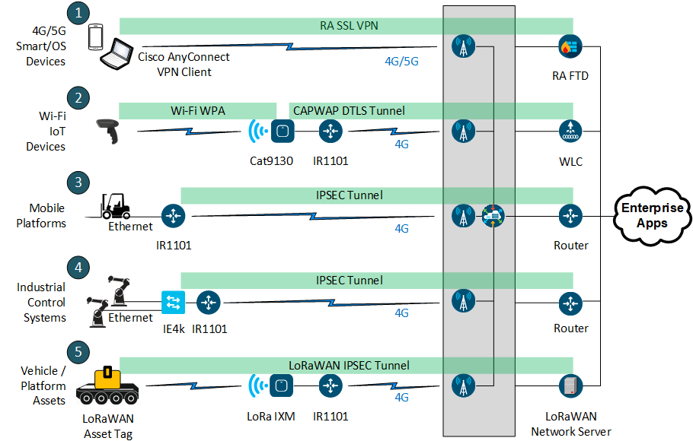

Private Wireless – Secure Connectivity
Workforce
Workplace
Workload
5G Network
FIPS 140 certified options to secure client to enterprise access
Secure Remote Access VPN
Secure Wi-Fi WPA + CAPWAP DTLS Tunnel
Secure IPSec Tunnel
Secure LoRaWAN IPSec Tunnel
4G/5G
Firewall
4G/5G
4G/5G
4G/5G
4G/5G

Slide 44
Private Wireless Applied to LVC
LVC Environment Needs + Wireless Capabilities
LVC Network Benefits from Private Wireless
Integrated Employment Approaches for LVC Networks
Notes:
Now lets focus more directly on the application of Private Wireless capability in an LVC environment.

Slide 45
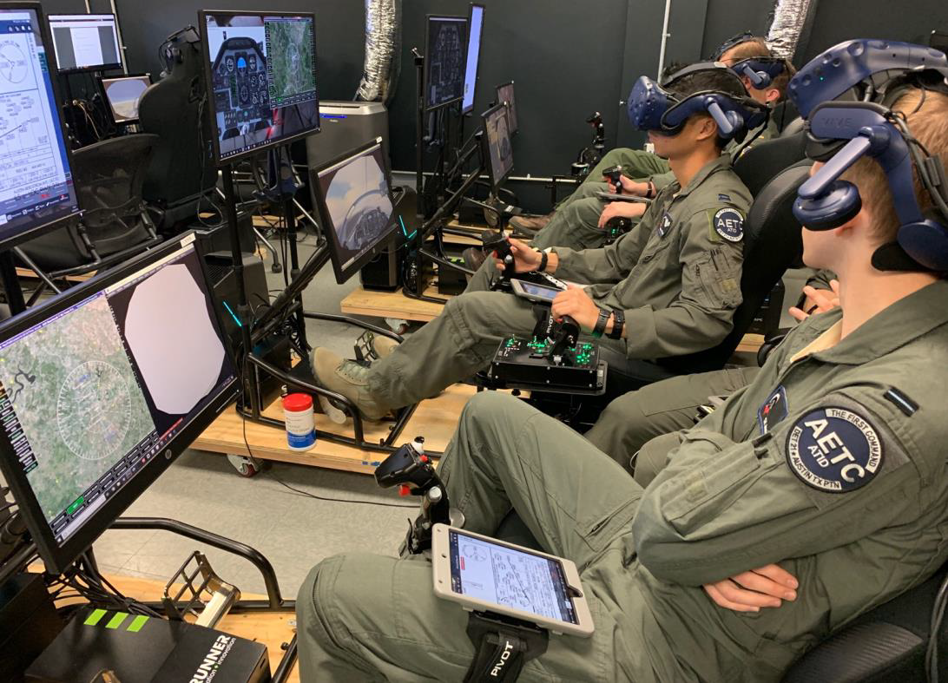


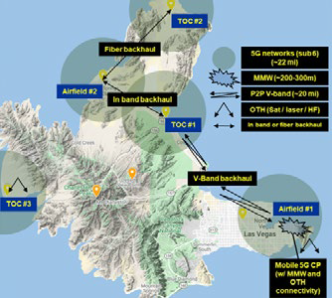



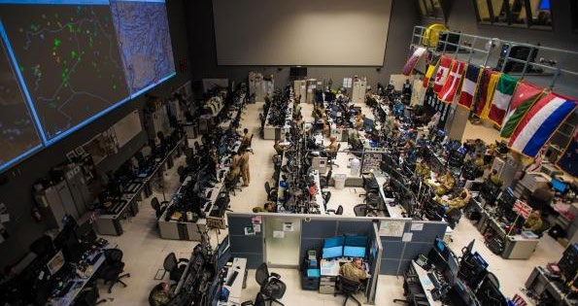
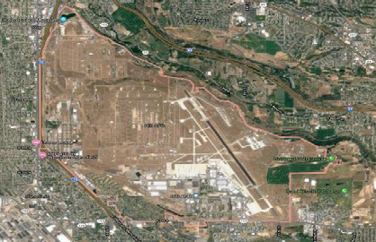

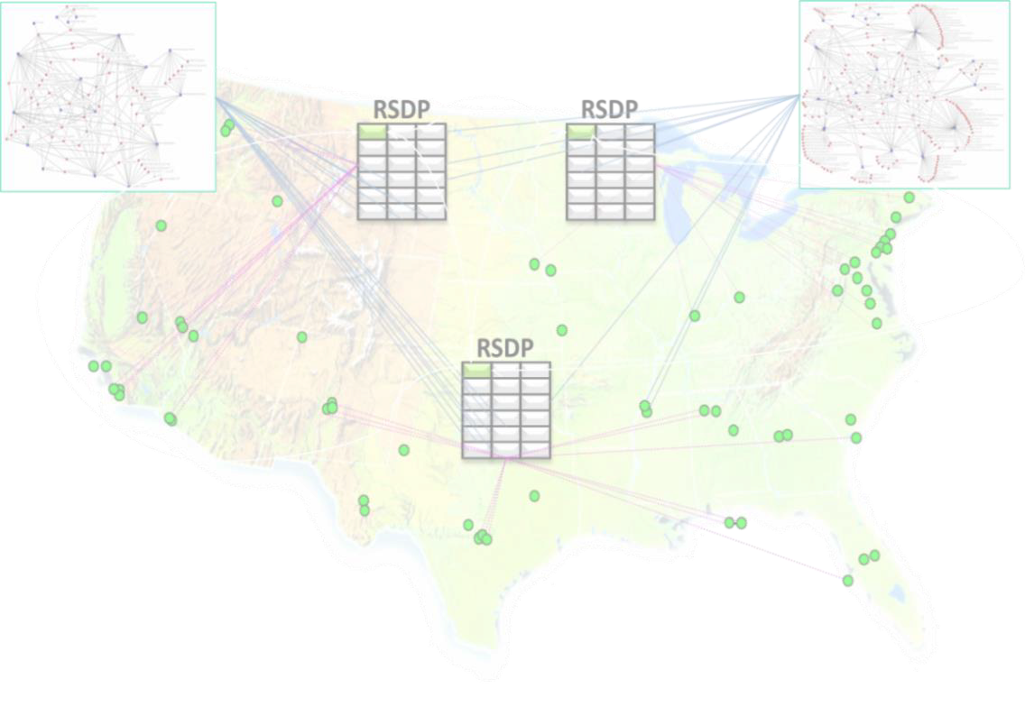
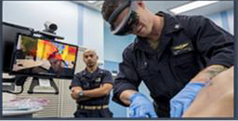


Integrated Private Wireless Applied to LVC Environments
IP
Transport
Regulated
Spectrum
IP Packets
Fixed & Mobile Devices
(User Equipment - “UEs”
Radios
Network Controller
Apps
Hybrid Cloud
Spectrum – Geographies – Transport
Mobility + Software Defined Networking
Data Center
Enterprise IT Ops
Network
Mobile Network Ops
Compute
Policy Assurance
Optimization
Visibility
MPLS
Insight
Action
Private Wireless
SaaS
Multiple Cloud Providers
Optical

Slide 46
Benefits of Private Wireless for LVC
Mobility for Training Audience!
High Bandwidth – Low Latency – Deliver AR/VR Training Experiences
Leverage Computing Power from Edge (MEC) to Cloud
5G Transport and Features Integrated with Enterprise IT
Best Use of Spectrum Aligned with Use Case (and Cost!)
Enable Scalability / More Flexibility / Greater Composability Training Environment Options
Enterprise Security
Central Approach to Identity Management (Leverage Existing Enterprise Capabilities!)
Enforce Micro-segmentation between Users/Devices and Data
Additional Security “over the top” – FIPS 140 VPN, IPSEC, DTLS
Notes:
Recall the relevant characteristics of an LVC environment we referenced in the first few slides.
Through this discussion we have highlighted capabilities that Private Wireless offer in context of those characteristics.
We have shown that Private Wireless technologies—including 5G, but also including other modern wireless technologies -- can provide more options with greater mobility options to any training audience.
By leveraging many of the new and improved features that modern wireless capabilities can deliver – like improved bandwidth, latency, edge and cloud computing – together, modern private wireless technologies allow the opportunity to more efficiently and securely deliver training experiences. Private wireless is especially well-suited to better enable training delivered through when integrating augmented reality and/or virtual reality (AR/VR) technologies in LVC environments.
As with any Enterprise deployment, trade-offs are necessary in-terms of best capability, cost, and easy of deployment – no one wireless technology can solve every solution, so its necessary to understand what features each Private Wireless technology can offer and how they can work together to support the needs and goals of the LVC environment and training audience. Finally, security cannot be a trade-off – it has to be considered from the start and must following a Zero Trust approach – especially since it is mandated in Federal Environments per the OMB Directive on Zero Trust.
Let's highlight a few of these benefits some more on the next slides.

Slide 47









Integrated Enterprise and Private Wireless for LVC
SD-Data Center
Hybrid - Multi-Cloud
SAAS
On-Premise
Cloud
Applications
Open API’s
Enterprise Domain
Service Provider Domain
Enterprise IT
Enterprise Mobility – Private 5G
Mobile Network Operator
SDN Controllers
P5G Controller
Controller
SD-Access
Wired / Wireless
SD-WAN
MPLS / Optic / DIA
Packet Core
EPC / 5GC
Backhaul
RAN
Packet Core
EPC / 5GC
Backhaul
RAN
Granular
Segmentation
Granular
Segmentation
Granular
Segmentation
MEC / UPF
MEC / UPF
Indoor &
Outdoor WiFi-6
CURWB
LoRa
LTE/NR
CBRS
SP Wi-Fi
LTE/NR
CBRS
SP Wi-Fi
LVC Device Ecosystem
Consistent End-to-End Experience for QoS – Zero Touch Deployment and Zero Trust Security

Slide 48




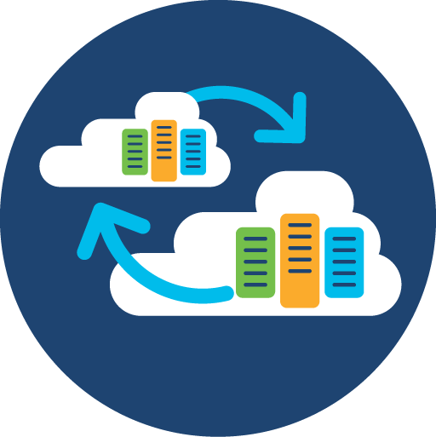


Private Wireless Scalability and Flexibility
Internet and LVC Hybrid Cloud Services
Mobility
OPTIONS!
Internet
Core Network
LVC Ecosystem
5G
5G/LTE Network
Range
5G
5G CBRS
Indoor / Outdoor
Wi-Fi-6 Access Points
CURWB
Location X
Dispersed
Mobile Units
Remote
Site
LoRa
Location Y
Notes:
Private wireless provides tremendous scalability and flexibility for a mobile devices, minimizing investment in fixed infrastructure and maximizing performance for a wide range of mobile use cases within the environment. As depicted on this slide, the LVC ecosystem may contain a wide variation of edge device implementations, each able to leverage the appropriate wireless access technology within the environment for its specific characteristics.

Slide 49
Summary
Private Wireless provides more flexible, mobility options with enhanced performance and security for LVC Environments
Private Wireless options – 5G + WiFi-6 + CURB + LoRa – compliment each other and can “work better together”
Considerations for Private Wireless deployment for LVC must include: spectrum, cost, range, throughput, latency, flexibility, and operational complexity
Taking a Zero Trust approach enhances LVC Enterprise security across wired and private wireless connectivity
Notes:
Through exploration of private wireless access technology and associated capabilities, and comparison with the relevant characteristics of an LVC environment, we can see that private wireless implementation provides many benefits. The various access technologies such as WiFi and 5G compliment each other, each simultaneously leveraged by different components within the ecosystem based on component unique requirements. When designing such an implementation, it is important to consider the relevant characteristics such as spectrum, cost, range, throughout, latency, flexibility, and operational complexity. Like most design processes, we must find the right balance considering various trade-offs. But we also can implement enhanced security throughout by way of adherence to the principles of a Zero Trust security approach. This approach will enhance the LVC enterprise across both wired and private wireless connectivity.

Slide 50
Learning Objectives
The Learner Will Be Able To:
Understand unique wireless requirements of an LVC network environment.
Differentiate between different wireless access technologies.
Describe the ability of a Zero Trust (ZT) security approach to provide best practices for protecting networks.
Describe the relevant benefits of private wireless technology applied to an LVC environment.
Notes:
We hope that this discussion has allowed you to achieve these learning objectives and we're happy to entertain any questions or discussions for the remainder of our time.

Slide 51
Bibliography
3rd Generation Partnership Project (3GPP), Release 17, https://www.3gpp.org/release-17
3rd Generation Partnership Project (3GPP), Release 16, https://www.3gpp.org/release-16
3rd Generation Partnership Project (3GPP), Release 15, https://www.3gpp.org/release-15
CBRS Alliance: https://www.cbrsalliance.org/resource/
Cisco Zero Trust - www.cisco.com/c/en/us/products/security/zero-trust.html
DoD 5G Strategy, https://www.cto.mil/wp-content/uploads/2020/05/DoD_5G_Strategy_May_2020.pdf
Forrester Zero Trust - https://go.forrester.com/blogs/tag/zero-trust/
FCC Part 96: https://www.fcc.gov/wireless/bureau-divisions/mobility-division/35-ghz-band/35-ghz-band-overview
“Future Construct/Architecture for Modeling and Simulation Support to Joint and Collective Training Across the Continuum of Military Operations,” Culton, Parkes and Walrond, STO-MP-MSG-143
Gartner Zero Trust - www.gartner.com/smarterwithgartner/new-to-zero-trust-security-start-here/
NIST, “Zero Trust Architecture,” NIST SP 800-207, Rose, Borchert, Mitchell, Connelly, August 2020
National Strategy to Secure 5G, https://www.whitehouse.gov/wp-content/uploads/2020/03/National-Strategy-5GFinal.pdf
“Opportunities for the Employment of Simulation in the U.S. Air Force Training Environments,” A Workshop Report (2015). The National Academies Press
WinnForumCBRS Components Standardization: https://cbrs.wirelessinnovation.org

Slide 52
Q&A
Jason Hester jasheste@cisco.com
Andrew Stewart andrewst@cisco.com
Notes:
Please feel free to reach out to us afterwards, here at the event or anytime you have questions.
What can we address now?

