Slide 1
IEEE 1278™ Standard for Distributed Interactive Simulation (DIS): Concepts and Techniques
Bob Murray, SimPhonics

Slide 2
Disclaimer
Any comments and interpretations of the IEEE Standards discussed in this tutorial do not represent the view of the IEEE, IEEE-SA, its members or affiliates

Slide 3
Learning Objectives
The student will be able to explain the capabilities of DIS
What problems it solves
Capabilities for Live-Virtual-Constructive (LVC) Simulation Networking
The history of DIS will allow the student to discuss:
How it has evolved
Its future direction
The student will be able to explain the key definitions and concepts of DIS
The student will be able to describe the technical details of:
The type of information conveyed by DIS
Techniques for distributing real-time high-fidelity simulation data over wide area networks

Slide 4
Intended Audience
Modeling and simulation implementors and managers who
Require an understanding of distributed simulation in the Live, Virtual, and Constructive (LVC) domain
Specifics of how DIS meets of the requirements of interoperability between the widely varying types of geographically distributed LVC

Slide 5

Tutorial Outline
The Past
LVC simulation and its use for training, R&D, and engineering
History of networked simulation
The Present
The IEEE 1278TM DIS standard and how it is developed
Key definitions and concepts
Function and organization of DIS Protocol Data Units
Technical details of providing high-fidelity real-time information exchange
Improvements from the 1995 to the 2012 DIS standards
The Future: The current development effort for the next version of the DIS standard with yet more improvements

Slide 6
LVC Simulation
Live – real humans operating real systems not in actual warfare
Virtual – real humans operating simulated systems
Constructive – simulated humans operating simulated systems
LVC is the common term for simulations suitable for:
Human in the loop simulation used for training or engineering test
Hardware in the loop simulation for testing real-world mission systems
Integrating live platforms into a simulation environment
Constructive simulations to add realism to human training or mission system test
The common denominator is real-time simulation execution with sufficient modeling fidelity to immerse a human or system under test

Slide 7
Networked Simulation for Training and Test
By the 1980’s, computers, image generators, and standard networks had become fast enough to attempt connecting separate simulators so that they could interact
Allows more simulation entities to be generated
Result is a more complex simulation environments provides better training and testing under realistic conditions
Geographically distributed simulation also becomes feasible
Long-haul networks connect simulation facilities across the globe
Participants can participate in large training exercises at their home base
Connection between various types of air/land/sea assets at different locations allows more realistic training

Slide 8
Distributed Mission Operations Network

Slide 9
Desired Capabilities of LVC Networking
Real-time simulation at entity level (weapons platforms, munitions, etc.)
Generally, effects-based simulation instead of highly detailed physics models
Simulation interoperability of:
See and be seen with accurate visual and time-space-position information (TSPI)
Weapons engagement with fair fight damage assessment
Radar, infrared sensors, laser designators, underwater acoustics, and associated jamming
Radio communications for voice and datalinks
Collisions, Logistics, Synthetic Environment, Information Operations
Simulation Management
Start/Stop, simulator initialization and control, data logging and analysis

Slide 10
The Beginning - SIMNET
The Defense Advanced Research Projects Agency (DARPA) created the SIMNET program in the 1980’s to test simulation networking techniques
Connected simulators for tanks, helicopters, airplanes
Developed the concept of dead reckoning
Demonstrated long-haul simulation interactions using dial-up network
By the late 80’s, its success was obvious and compelling
SIMNET developers and other experts doing similar work in the defense industry organized in 1989 to create a broader standard
This was the first DIS workshop

Slide 11
Development of DIS
The DIS workshops met twice yearly from 1989 to 1995
Subgroups also had intermediate meetings between the regular workshops
The workshop quickly grew to over 1,000 participants attending
Decision to involve IEEE to learn how to create standards
The first standard in 1993 based on SIMNET
Significant work led to a much-expanded standard in 1995
Additions in 1998 filled out the most needed capability
The 1995/1998 standard became widely implemented

Slide 12
SISO
DIS workshops were replaced by the Simulation Interoperability Standards Organization (SISO) in 1996
SISO is an approved IEEE standards committee for simulation standards
IEEE Std 1278™ DIS
IEEE Std 1516™ High Level Architecture (HLA)
IEEE Std 1730™ Distributed Simulation Engineering and Execution Process (DSEEP)
SISO also develops a wide range of non-IEEE simulation standards
Command and Control, Distributed Debrief, Common Image Generator Interface, Coalition Battle Management Language, Military Scenario Definition Language, and many more
Guidance and Reference products e.g., simulation enumerations
Work restarted on DIS in 2004 within SISO to develop the current 2012 standard
Anyone can join SISO and participate

Slide 13
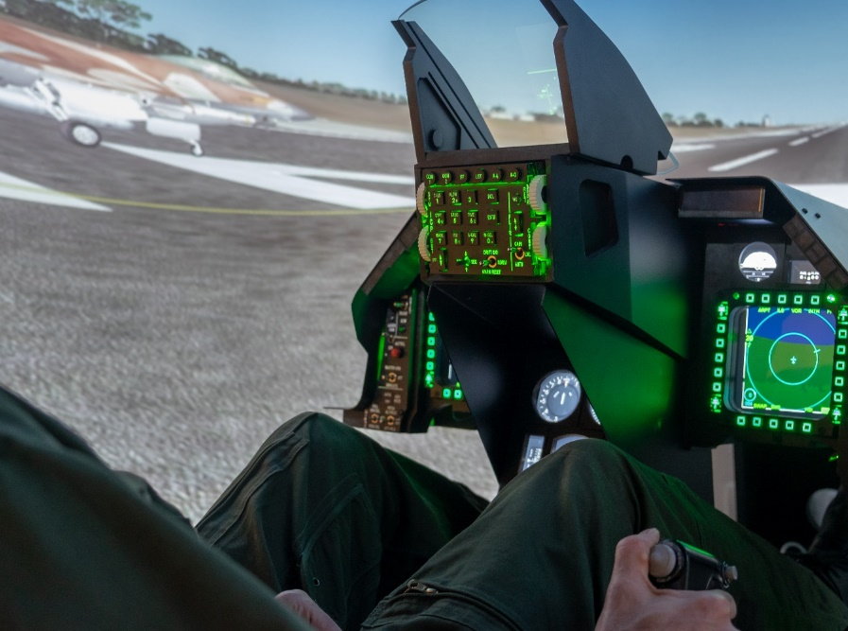
Tutorial Outline
The Past
LVC simulation and its use for training, R&D, and engineering
History of networked simulation
The Present
The IEEE 1278TM DIS standard and how it is developed
Key definitions and concepts
Function and organization of DIS Protocol Data Units
Technical details of providing high-fidelity real-time information exchange
Improvements from the 1995 to the 2012 DIS standards
The Future: The current development effort for the next version of the DIS standard with yet more improvements

Slide 14
Current DIS Development Process
SISO holds a yearly workshop in Orlando in February
Simulation Innovation Workshop (SIW)
But most standards development work is done virtually
Weekly telecons to review proposed standards content
When a significant amount of content is ready, the drafting process starts
This begins the formal IEEE process, expected to be done within 4 years
The draft standard content is reviewed, and comments submitted
Voting process resolves conflicts
When draft is ready, it is handed to IEEE for the final balloting process
Balloting is open to a larger population, even outside of SISO
IEEE publishes the standards after a final edit

Slide 15
IEEE 1278 Distributed Interactive Simulation
Distributed Interactive Simulation (DIS)
Time and space coherent synthetic representation of world environments
Designed for linking the interactive, free-play activities of participants in operational simulation exercises
Synthetic environment is created through real-time exchange of data units between distributed, computationally autonomous simulation applications
Simulators may be present in one location or may be distributed geographically
Defined by the IEEE 1278™ family of standards
DIS defines standard network Protocol Data Units (PDUs)
Syntax (data format) and semantics (rules) for data exchange and simulation interoperability

Slide 16
DIS Documentation Relationships
Distributed Interactive Simulation standards, recommended practices, and related documents
IEEE Std 1278.1TM- 2012
Standard for DIS
—
Application Protocols
IEEE Std 1278.2TM-
2015
Standard for DIS
—
Communications Services and Protocols
IEEE 1730TM-2010
Distributed Simulation Engineering and Execution Process
IEEE 1278.4TM-1997
Rec. Prac. for DIS —
Verification, Validation, and Accreditation
SISO-REF-010 Enumerations for Simulation Interoperability

Slide 17
Protocol Data Unit (PDU) Example
Detonation PDU (Version 8)
DIS PDUs typically use User Datagram Protocol / Internet Protocol (UDP/IP)
Operating System network stack inserts PDU in UDP/IP datagram for transfer on network

Slide 18
DIS Versions
V1 - DIS PDU version 1.0 (May 1992)
V2 - IEEE Std 1278TM-1993 (Gen 1)
V3 - DIS PDU version 2.0 – draft (May 1993)
V4 - DIS PDU version 2.0 – draft (Mar 1994)
V5 - IEEE Std 1278.1TM-1995 (Gen 2)
V6 - IEEE Std 1278.1aTM-1998 (Gen 2)
V7 - IEEE Std 1278.1TM-2012 (Gen 2)
V8 - IEEE Std 1278.1TM – Next Version (Gen 3) In Work

Slide 19
Key DIS Concepts
No central computer controls the entire simulation exercise
No single point of failure
Autonomous simulation applications are responsible for maintaining the state of one or more simulation entities
A standard network protocol is used for communicating ground truth data
Changes in the state of an entity are communicated by its controlling simulation application
Perception of entities or events is determined by the receiving application
Dead reckoning algorithms are used to reduce communications processing
Stateful information is sent repeatedly at a heartbeat rate or faster

Slide 20
Key DIS Definitions (1 of 3)
Simulation application:
Executing software on a host computer that models all or part of the representation of one or more simulation entities
Executing software on a host computer that models all or part of the virtual world phenomena for the purpose of training or experimentation
Receives and processes information concerning entities created by peer simulation applications through the exchange of DIS PDUs
More than one simulation application may simultaneously execute on a host computer IEEE Std 1278.1TM-2012, Clause 3.1

Slide 21
Key DIS Definitions (2 of 3)
Host Computer:
Computer that supports one or more simulation applications
Host computers participating in a simulation exercise are connected by network(s) including local area networks, wide area networks, radio frequency datalinks, etc.
Simulation entity:
A physical object in the synthetic environment that is created and controlled by a simulation application and affected by the exchange of DIS PDUs
It is possible that a simulation application may be controlling more than one simulation entity IEEE Std 1278.1TM-2012, Clause 3.1

Slide 22
Key DIS Definitions (3 of 3)
Simulation exercise:
An exercise that consists of one or more interacting simulation applications
Simulations participating in the same simulation exercise share a common identifying number called the exercise identifier
Simulations utilize correlated representations of the synthetic environment in which they operate
Simulation environment:
The operational virtual environment surrounding the simulation entities
Includes terrain, atmospheric, and oceanographic information
Participants in the same DIS exercise will be using environment information that is adequately correlated for the type of exercise to be performed IEEE Std 1278.1TM-2012, Clause 3.1

Slide 23
Network Considerations
PDUs are sent using broadcast or multicast addressing
Broadcast – every computer on the Local Area Network will receive the PDU
Broadcast does not work on Wide Area Networks
Some type of gateway is necessary at the LAN/WAN boundary to translate addresses
Multicast – every computer that has joined the multicast address group will receive the PDU, an efficient publish/subscribe mechanism
Multicast on WANs is possible, or use Generic Routing Encapsulation (GRE) to tunnel
PDUs are almost always sent using User Datagram Protocol (UDP/IP) transport
Best effort – no guarantee of delivery, but networks can be designed to be very reliable
Unicast addressing with TCP/IP* (reliable) transport can be used, but uncommon
IEEE 1278.2™-2015 has details of design for real-time networks
* Transmission Control Protocol / Internet Protocol

Slide 24
PDU Families
Entity Information/Interaction
Warfare
Logistics
Simulation Management
Distributed Emission Regeneration
Radio Communications
Entity Management
Minefield
Synthetic Environment
Information Operations
Live Entity (replaced with Compressed DIS standard)

Slide 25
DIS PDUs
Entity information/interaction
Entity State – fundamental position and appearance of an entity
Collision – convey details of tactically significant collisions
Attribute PDU (new in Version 7) – adds PDU extensibility for customization
Warfare
Fire – launch munitions or expendables, fire a gun
Detonation – details of a weapons hit or explosion
Directed Energy Fire (new in Version 7) – deposition of an energy weapon
Entity Damage Status (new in Version 7) – damage fed back to firing entity

Slide 26
DIS PDUs (Cont)
Logistics
Service Request
Resupply Offer, Resupply Received, Resupply Cancel
Repair Complete, Repair Response
Simulation Management
Create Entity, Remove Entity
Start/Resume, Stop/Freeze
Acknowledge
Action Request, Action Response
Data Query, Set Data, Data
Event Report, Comment

Slide 27
DIS PDUs (Cont)
Distributed Emission Regeneration
Electromagnetic Emission – Radar and radar jamming, Infrared Jamming
Designator (being renamed to Laser) – all uses of lasers that are not a weapon
Underwater Acoustics – Sonar, passive acoustic sensors
IFF – Identification Friend or Foe, military and civilian transponders
Radio Communications
Transmitter, Intercom, Receiver – state of radio or communications node
Signal – transfer of communications voice and data

Slide 28
DIS PDUs (Cont)
Entity Management
Aggregate State, IsGroupOf – entities grouped into an aggregate
Transfer Ownership – hand off control of an entity to another simulator
IsPartOf – joining two or more entities into one
Minefield
Minefield State
Minefield Query
Minefield Data
Minefield Response Negative Acknowledgment

Slide 29
DIS PDUs (Cont)
Synthetic Environment
Environmental Processes – smoke, contrails, dust, obscurants, toxic chemicals
Gridded Data – soil, vegetation, wind
Point, Linear, and Areal Objects - dynamic objects such as craters, trenches, cultural features with damage
Environment Objects are changing to Entities in DIS Version 8
Information Operations (new in Version 7)
Simulate the use of electronic warfare, computer network attack, military deception to influence or disrupt decision making
Information Operations Action – transmits predicted effects of an attack
Information Operations Response – reports actual effects

Slide 30
Entity Coordinates
Φ = latitude
North Pole
Z
λ = longitude
a = major axis
Geocentric Cartesian Coordinates
Position and Orientation
WGS-84 elliptical Earth model
Units in meters and radians
DIS V8 will clarify that geoid gravity model is not included
Mean Sea Level is modeled as the WGS-84 ellipsoid
Altitude is height above ellipsoid
b = minor axis
Prime Meridian
X,Y,Z = GCC position
b
Z
r
a
Φ
a
Y
λ
p
X
Y
X
Equator

Slide 31
Entity Type Identification
Hierarchical designation of Entity Type
Enumerations are listed in SISO-REF-010
Over 20,000 entity types
ENTITY TYPE RECORD
Entity Kind | 8-bit enumeration
Domain | 8-bit enumeration
Country | 16-bit enumeration
Category | 8-bit enumeration
Sub-Category | 8-bit enumeration
Specific | 8-bit enumeration
Extra | 8-bit enumeration

Slide 32
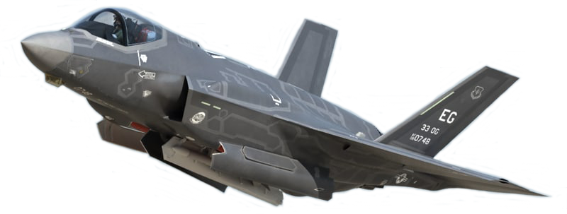
Examples of Type Enumerations
 | Kind | Domain | Country | Category | Sub-Category | Specific | Extra
F-35A CTOL | 1 | 2 | 225 | 1 | 12 | 1 | -
Notes:
Kind – 1 – Platform
Domain – 2 – Air
Country – 225 – USA
Category – 1 – Fighter/Air Defense
Sub-Category – 12 – F-35
Specific – 1 – F-35A CTOL

Slide 33
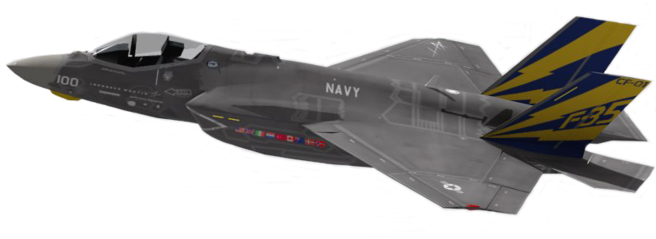
Examples of Type Enumerations
 | Kind | Domain | Country | Category | Sub-Category | Specific | Extra
F-35C Naval | 1 | 2 | 225 | 1 | 12 | 2 | -
Notes:
Kind – 1 – Platform
Domain – 2 – Air
Country – 225 – USA
Category – 1 – Fighter/Air Defense
Sub-Category – 12 – F-35
Specific – 2 – F-35C NAVAL

Slide 34
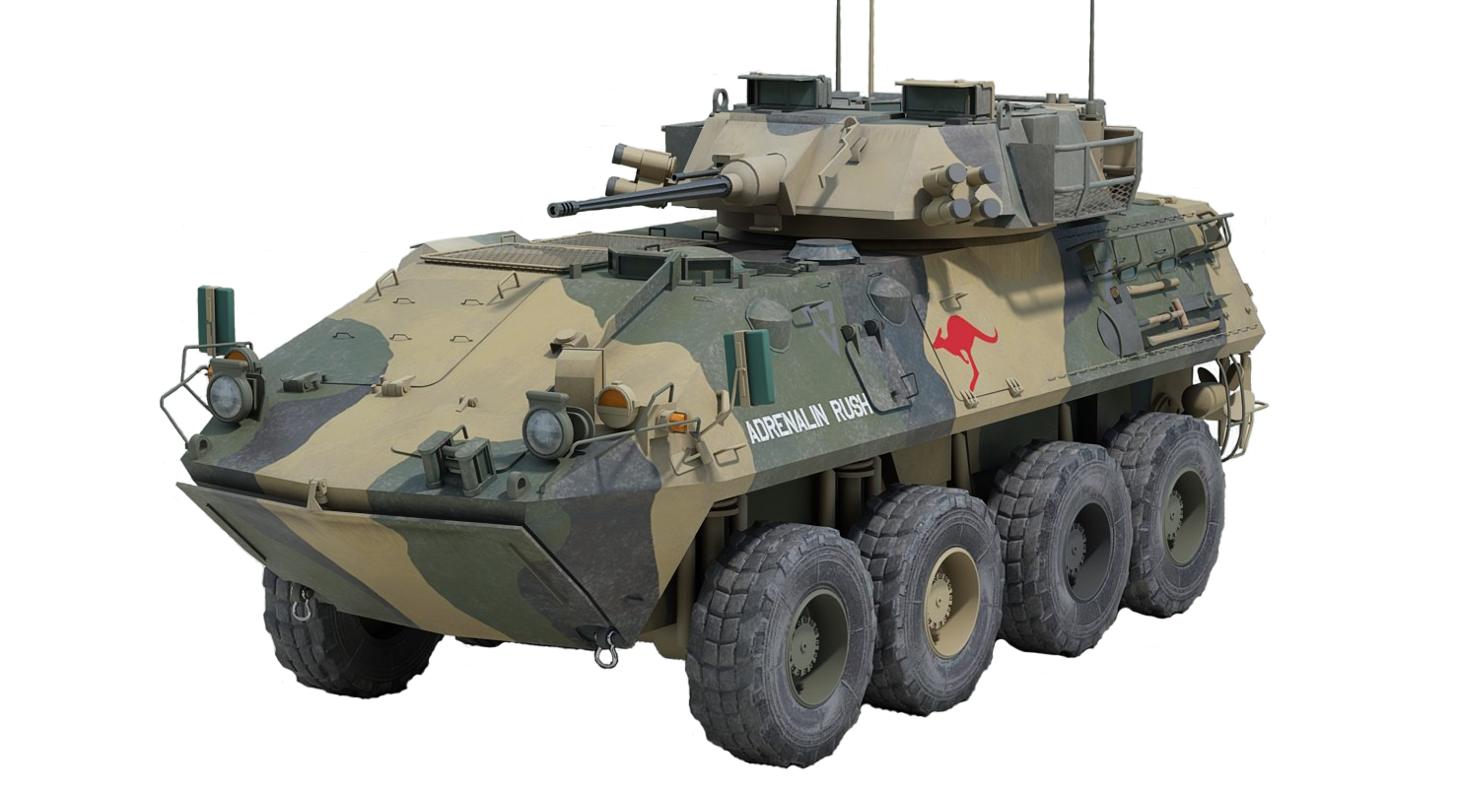
Examples of Type Enumerations
 | Kind | Domain | Country | Category | Sub-Category | Specific | Extra
ASLAV-25 | 1 | 1 | 13 | 2 | 1 | 1 | -
Notes:
Kind – 1 – Platform
Domain – 1 – Land
Country – 13 - Australia
Category – 2 – Armored Fighting Vehicle
Sub-Category – 1 – Australian Light Armored Vehicle
Specific – 1 – ASLAV-25 Reconnaissance

Slide 35
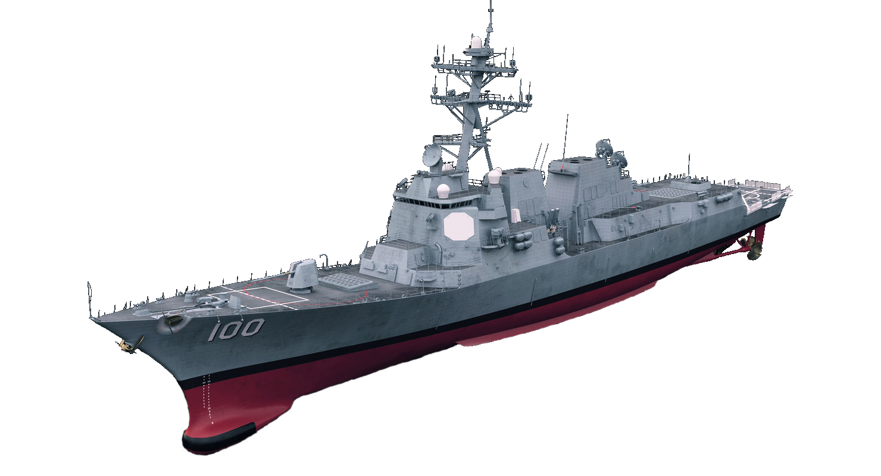
Examples of Type Enumerations
 | Kind | Domain | Country | Category | Sub-Category | Specific | Extra
DDG 100 | 1 | 3 | 225 | 4 | 1 | 50 | -
Notes:
Kind – 1 – Platform
Domain – 3 – Sea
Country – 225 - USA
Category – 4 – Guided Missle Destroyer
Sub-Category – 1 – Arleigh Burke Class
Specific – 50 – DDG 100 Kidd

Slide 36
Entity Instance Identification
Combination of 3 numbers identify individual entities and objects
Exercises can assign site numbers, sites can assign sims at the site, sims can assign entity numbers
Site | 16-bit unsigned integer
Application | 16-bit unsigned integer
Entity | 16-bit unsigned integer

Slide 37
Dead Reckoning Basics
Entity sender publishes state and information needed to predict state over time
Velocity (rate of change), acceleration
Receivers dead reckon (extrapolate) between updates
Entity sender also keeps a local extrapolation model to know what receivers see
Update PDU issued when error between that model and truth exceeds a set threshold
Dead reckoning solves three problems
Significantly reduces the PDU issuance rate, requiring less network bandwidth
Compensates for network latency
Corrects position error due to unsynchronized simulation frame times

Slide 38
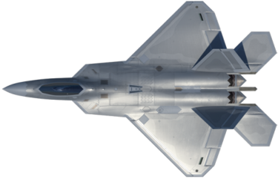
Dead Reckoning and Smoothing
Entity sends update when error > threshold
Receiver extrapolates between updates
Spatial jump at update is smoothed over the next few seconds
Green Line: Internal “truth” model (sender)
Red Line: Dead Reckoned (extrapolated) model
(sender and receiver)
Blue Line: Smoothing model (receiver)

Slide 39
Positional Dead Reckoning, “World” DRA 2-5
Dead Reckoning Algorithm 2 and 3
P = P_{update} + VΔt
where Δt is time since last update
Dead Reckoning Algorithm 4 and 5
P = P_{update} + VΔt + ½AΔt²
Extrapolates to a parabolic path through space
Error checked in each of 3 axes
If any exceeds threshold, send update
No change in DIS V7

Slide 40
Positional Dead Reckoning, “Body” DRA 6-9
DRA 6-9 use rotation rate and body coordinate velocity and acceleration to achieve better prediction of turning vehicles
Extrapolates to a circular or spiral path through space
Math is more complicated and not used as much as DRA 2-5
But it is effective, should be used more
No change in DIS V7 but errors in the math formulas were fixed
See E.7.3 in IEEE Std 1278.1TM-2012

Slide 41
Formula Results Comparison
This shows a 500 knot turning aircraft with 20 seconds of extrapolation
Circular vs Parabolic is apparent
See SISO paper
2019-SIW-034
DIS Version 8 is proposed to have a single algorithm that chooses the best formula

Slide 42
Rotational Dead Reckoning
DRA 2, 5, 6, 9 have no rotational dead reckoning
DRA 3, 4, 7, 8 all have the same rotational DR formula
[R_{D}]_{w->b} = [DR][R₀]_{w->b}
Rotation rates are required
Entity State PDU: rotation rates are given as a vector ω in body coordinates
Direction of vector is axis of rotation
Magnitude |ω| is rate of rotation about axis
Receivers extrapolate orientation by rotating an entity about the axis by angle |ω|Δt, used to form the [DR] matrix
There is no acceleration in this math

Slide 43
Heartbeats and Timeouts
PDUs are categorized as stateful (persistent information) or transient (one-time)
Stateful PDUs are issued repeatedly at a minimum heartbeat rate
This solves two problems:
Late joiners get the full state of the exercise within one heartbeat period
If a PDU is dropped due to network error, the next update arrives within a heartbeat period
The default heartbeat period for each PDU type is listed in the DIS standard
Heartbeats vary from 5 to 60 seconds depending on PDU type and conditions
Exercises can change them by agreement
Receivers keep a timeout timer for each entity
If no information has arrived within 2.4 heartbeat periods, the entity is discarded
Solves the problem of simulation crashes or if the entity deactivation PDU is dropped

Slide 44
Techniques to Solve Network Issues
Network latency and jitter – due to speed of light, network processing time
Dead Reckoning compensates for position error caused by network delay
Issuance and receipt rules mitigate effects of latency
e.g., sender transmits that detonation or collision hit target, receiver determines damage
Bandwidth – both the size and number of PDUs consume network resources
Efficient PDU design with a binary format to send the minimum data necessary
PDU sent only when a parameter change exceeds a threshold value
Dead Reckoning - TSPI data sent every few seconds instead of every simulation frame
Design for reduced data, e.g. receiver lookup table with a single index in PDU
Network Reliability – PDUs get lost, it’s rare but it happens
Efficient PDU design helps prevent overloading networks, reduces dropped data
State data repeated at a regular heartbeat interval

Slide 45
Improvements in DIS 2012 (Version 7)
New and improved rules
Lessons learned from 15 years of use
The 2012 standard is 747 pages
The 1995 and 1998 standards combined were 330 pages
Even if you do not need any of the new features, the 2012 standard is still extremely useful

Slide 46
Compatibility with Version 5/6
Almost every change in the PDU formats and rules are backward compatible with Version 5/6 PDUs
Most changes are also forward compatible (i.e. Version 5 simulations can still make sense of Version 7 PDUs)
Use of former padding fields
New sims can add new information, old sims ignore it

Slide 47
Variable Heartbeat Periods
Entity State default heartbeat periods defined by entity kind, domain, and whether moving or stationary
Other PDU types have individual default heartbeat periods
Standard defines defaults
Exercises can set actual values
Provides flexibility and reduces the number of heartbeat updates

Slide 48
Protocol Version Rules
Lack of rules on use of Versions 5 or 6 led to confusion
Rules for interoperability between Version 5/6 and Version 7 are defined
Mixed version exercises are allowed
A single sim may issue both 5/6 and 7
Must obey rules of the version in the PDU, both sending and receiving

Slide 49
Transfer Ownership
Improved ability to transfer the modeling of an entity to another simulation
The Transfer Control function has been renamed to Transfer Ownership (TO)
The Transfer Control Request PDU has been renamed the Transfer Ownership PDU
The entire Transfer Ownership function has been revised to improve its functionality
It is now closer to how TO has been done in actual simulations for many years

Slide 50
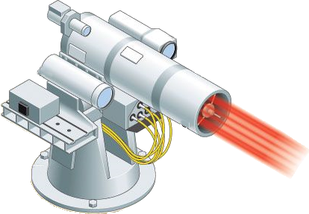
Five New PDUs in DIS V7
Directed Energy Weapons
Directed Energy Fire PDU
Entity Damage Status PDU
Information Operations
IO Action PDU
IO Report PDU
Attribute PDU
Adds a general means of extensibility to the DIS standard

Slide 51
Some Other Improvements
DIS V7 is more easily customized
Variable Parameter Records for Entity State, Detonation PDUs
Standard Variable Records for Transmitter, IFF, DE Fire, Entity Damage, Information Operations
Radar
Better description of radar beam parameters, scan volumes, phased array radar
Jammer field redefined to better support a wider range of multi-resolution simulations
IFF
Mode 5 and Mode S added
The requirements related to each IFF transponder and interrogator system type are clearly specified in a new Annex
Radio
Extensive Transmitter PDU clarifications
New Annex for radio systems specifics

Slide 52
Other Simulation Networking Standards
Test and Training Enabling Architecture (TENA)
Connects systems on a live training range
Common Training Instrumentation Architecture (CTIA)
Connectivity for live soldier training
Compressed DIS
New SISO standard that compresses DIS data to connect live entities on low bandwidth radio data links, designed to be easily translated to/from regular DIS
HLA – High Level Architecture
IEEE Std 1516™ High Level Architecture (HLA)
A general-purpose network solution to connect any type of simulation
Includes time management services for discrete event simulation

Slide 53


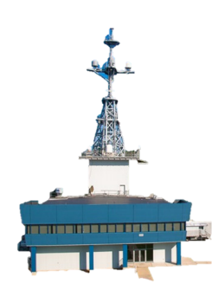






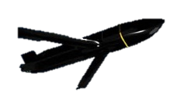



An LVC Exercise with CDIS
Atlantic Test Range (ATR)
SLATE Ground Station
& Link Inject to Live (LITL)
Westover RRU
NAS JAX
Virtual
MH-60R
SAIL
(BFTT)
Pax RRU
Live
EA-18G
Live Guised Red Air
Manned Flight Simulator (MFS)
Constructive Weapons Fly-out
(F/A-18 Cockpit Surrogates)
(F-35 Effects Based Sim)
(LCTs)
LEGEND
Virtual
F/A-18E/F
Blue Live
Blue Virtual
Red Constructive
5GATW
NCTE
SDREN
Virtual
MH-60R
Live
F/A-18E/F
Constructive Threats
Virtual
F-35
NAVAIR Public Release 2021-394 Distribution Statement A - "Approved for public release; distribution is unlimited"

Slide 54
How HLA is Different than DIS
The High Level Architecture standard has three parts
Framework and Rules
Application Programming Interface (API) specification
Object Model Template specification
Template for creating a Federation Object Model (FOM)
HLA provides publish/subscribe services for distributing data and managing time
But doesn’t specify what that data is (syntax) or rules of using it (semantics)
Each federation of simulations is responsible for defining its FOM
Typically, a consensus design among all the simulations that are being federated
The Run-Time Infrastructure (RTI) is middleware that implements the HLA API
The network protocol is designed by the RTI developers, not standardized

Slide 55
RPR FOM
The LVC community can be standardization well beyond HLA alone
Reference FOMs were conceived as the solution for this
SISO developed the Real-time Platform Reference FOM (RPR FOM)
SISO-STD-001
Converts DIS PDU content into an HLA FOM
Actual SISO standard is the Guidance, Rationale, and Interoperability Modalities (GRIM)
Still need the DIS standard for the semantics, i.e., the rules for using the FOM
For example, the DIS is the only standard that defines Dead Reckoning, weapon interactions, etc.
RPR FOM Versions
RPR FOM 2 matches DIS Version 6
RPR FOM 3 matches DIS Version 7 – nearing completion
RPR FOM 4 is planned for DIS Version 8

Slide 56

Tutorial Outline
The Past
LVC simulation and its use for training, R&D, and engineering
History of networked simulation
The Present
The IEEE 1278TM DIS standard and how it is developed
Key definitions and concepts
Function and organization of DIS Protocol Data Units
Technical details of providing high-fidelity real-time information exchange
Improvements from the 1995 to the 2012 DIS standards
The Future: The current development effort for the next version of the DIS standard with yet more improvements

Slide 57
Currently in Development - DIS Version 8
We have learned a lot in the 25 years since the 1995 standard was approved
We are running out of tricks to extend the protocol and maintain compatibility
The time is right for DIS Version 8 to have a new generation of PDU design
This requires breaking PDU compatibility with previous versions of DIS
Version 8 is being designed for “Translation Compatibility” so that run-time translation to/from Version 7 is practical, although not necessarily trivial
Creation of DIS Version 8 is about 75% complete
Hope to have final draft in 2024
But any attempt to estimate volunteer standards development is fraught with peril

Slide 58
Consistent PDU Design
Every PDU type will have this basic format:
Header
Fixed Body
Any number of Extension Records – allows added fidelity & extensibility
The header is the same for every PDU type
The fixed body has the basic fidelity information
Fixed in format and length, no variability allowed
Quick initial processing by receiver for interest management
Extension Records allow added customization for fidelity extended use cases

Slide 59
Example of PDU Extension
Entity State PDU with Articulated Parts extension record

Slide 60
PDU Extensibility
Allows DIS users to add custom information to PDUs to meet their unique needs
Recognized during development of DIS Version 7 as an important capability
A proposal to add a variable record section to the end of every PDU was narrowly voted down
For Version 7, compatibility with previous versions was considered more important
DIS Version 8 breaks direct compatibility so that is no longer an issue
The five new PDUs in Version 7 all had the variable record section for extensibility
This same extensibility mechanism is now available in all PDUs in Version 8

Slide 61
Machine Readable Syntax Definition
Clean PDU design enables formal language to describe PDU format
Enables auto code generation
<DISsyntax xmlns:xsi="http://www.w3.org/2001/XMLSchema-instance"
xsi:noNamespaceSchemaLocation="DISsyntax.xsd">
<PDU name="Entity State" PDUType="1" protocolFamily="1" baseLength=“96">
<FixedRecordField name="Header" type="HeaderRecord"/>
<FixedRecordField name="Entity ID" type="EntityIdentifierRecord"/>
<EnumField name="Force ID" type="enum8" enumTableUID="6"/>
<EnumField name="Dead Reckoning Algorithm" type="enum8" enumTableUID="44"/>
<FixedRecordField name="Entity Type" type="EntityTypeRecord"/>
<VariantRecordField name="Entity Appearance" type="EntityAppearanceRecord"
discriminant="Entity Type" field1="Kind" field2="Domain"/>
<VariantRecordField name="Capabilities" type="CapabilitiesRecord"
discriminant="Entity Type" field1="Kind" field2="Domain"/>
<FixedRecordField name="Entity Location" type=“WorldCoordinatesRecord"/>
<FixedRecordField name="Entity Orientation" type="EulerAnglesRecord"/>
<FixedStringField name =“Entity Marking” length=“12”/>
<NumericField name="Padding" type="uint32"/>
<NumericField name="Padding" type="uint16"/>
<StandardVariableRecord>
<CountField name="Number of Variable Records" type="uint16"/>
<VariableRecordFields/>
</StandardVariableRecord>
</PDU>
</DISsyntax>

Slide 62
Interest Management
Interest Management reduces sim workload by eliminating unwanted PDUs
Send-side interest management uses multicast addressing
Sent only to simulators that have subscribed to that multicast address
Receive-side interest management is commonly called filtering
Software filters (discards) PDUs as quickly as possible
Version 8 PDU design rules promote interest management
Add information necessary to assign multicast address and filter PDUs
Put it in fixed body rather than optional variable records
IEEE Std 1278.2TM-2015 DIS Communication Services and Profiles
Formalized terminology for DIS Interest Management

Slide 63
More Ideas for DIS V8
Better, simpler timestamp
64-bit integer, microseconds since Jan 1, 1970
Single Dead Reckoning Algorithm that works for all moving entities
Choses the best formula (parabolic or circular) based on dynamics of the entity
Eliminate redundant and unused PDUs
Will reduce PDU count from 72 to about 40
Combine entities and environmental objects
Point, Linear, Areal objects now use Entity State PDU
Avoids duplication between the old environmental object types and entity types
New SIMAN Application Control PDU
Simulator device discovery, exercise control, and health monitoring

Slide 64
Obtaining the DIS Standard
The DIS standard can be purchased directly from IEEE
Many companies have access to IEEE products for their employees
SISO members have access to IEEE standards developed by SISO
Annual membership is $95, less than the cost of an IEEE standard publication
Or, 1 year of membership is included in the SISO workshop registration fee

Slide 65
What You’ve Learned
The problem DIS solves
The capabilities of Live-Virtual-Constructive (LVC) Simulation Networking
The history of DIS
How it has evolved
Future direction
Key Definitions and Concepts
Technical details of
The type of information conveyed by DIS
Techniques for distributing real-time high-fidelity simulation data

Slide 66



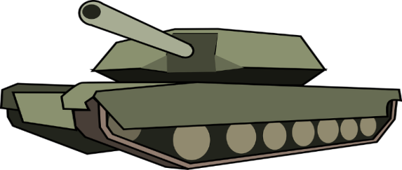
Questions?
You Have Questions

