Slide 1

Adding the “When” and “Where”: Basics of Environmental Representations
S. K. Numrich, Ph.D, CMSP
Institute for Defense Analyses

Slide 2
The Simulation Environment
Terrain Surface
Man-made Features
Natural Features
Atmosphere
Space
Ocean Surface
Underwater Environment
Ocean floor
. . . And more

Slide 3

Learning Objectives
By the close of this tutorial the attendees will be able to:
Identify the key features of an environment including land, sea, and atmosphere
Describe why the difference between weather and climate is important for LVC events
Explain why LVC events face difficulties when using geotypical vs geospecific environments
Explain why environment matters for communications and sensors in multi-domain operations
Identify sources of environmental data for simulations

Slide 4


Far More than Just a Map
The difference between a Map and a Simulation Environment is much like the difference between the novel “Phantom of the Opera” and the Broadway production “Phantom of the Opera”
Both contain the same “information” but one is a sensory, rich, and dynamically changing representation while the other is static and has little real value absent an intelligent reader
A musical by Andrew Lloyd Weber, based on the original French novel Le Fantôme de l'Opéra by Gaston Leroux,
Source: https://en.wikipedia.org/w/index.php?curid=1967136

Slide 5
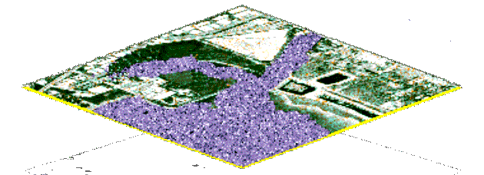
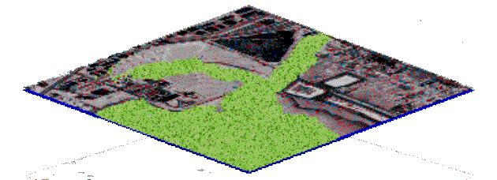
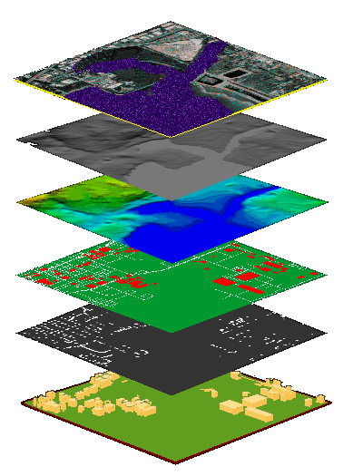
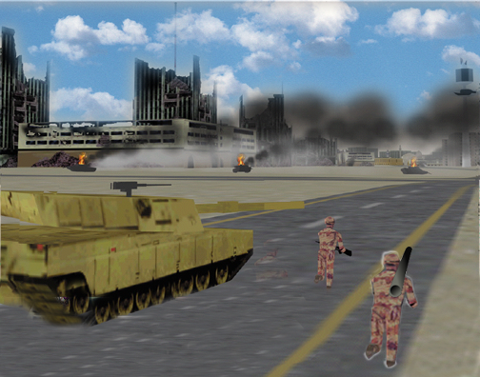
And That’s What Makes It So Hard
Defining the surface allows further content to be added, yielding a much richer representation of the environment
Each addition provides more than just a picture – everything has to be described using feature types, attributes and attribute values
Imagery
Elevation
Materials
Features
Lights
3D Models

Slide 6
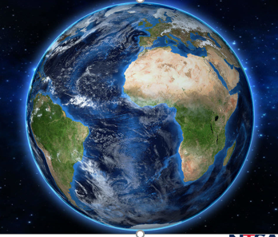
The Ocean: It’s Not Just a Blue Surface
There is the ocean floor – contour maps just like the land: Bathymetry
With mountains and canyons and ridges and volcanos!
And the body of water atop the bathymetry
It has temperature, pressure and salinity – and life – flora and fauna
It is not static, but closer to the surface, it changes hourly
And it’s large – more than 70% of the earth’s surface – how many sensors???
And then there is the surface
Heated by the sun
Influenced by the moon
Driven by the wind and changed by the influx of rivers
And all these factors affect
Military operations
Sensors and weapons

Slide 7
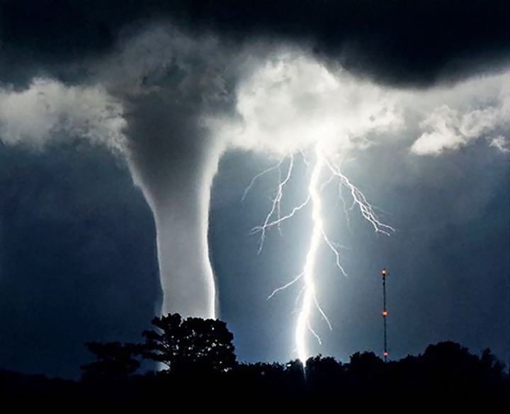
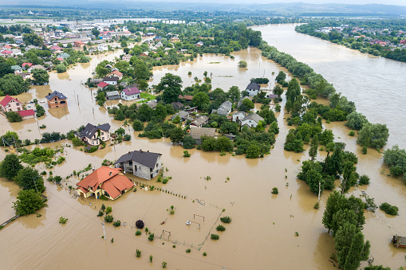
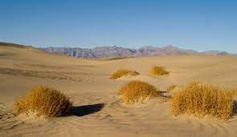
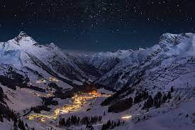
The Atmosphere: Not Just Smoke and Obscurants
Like the ocean, the atmosphere is a fluid and changes continuously
It has pressure, temperature, humidity
It exhibits colliding pressure fronts and violent activity
Its conditions support tornados, rainstorms, wind-blown fires
The rotation of the earth creates day, night, dawn and dusk
Winds drive pollutants, smoke, obscurants, phenomena dangerous to people
The angle of the sun created different climates
Equipment operates differently in desert, forest, snow
The atmosphere affects sensors, weapons, communications, movement

Slide 8
If It’s So Complicated, Why Bother?
The answer depends on what you intend to do with the simulation
Are you representing systems, platforms, sensors, weapons that depend on environmental factors?
What resolution do you require – both spatial and temporal
You always need a WHERE: land, sea, space
The simulation needs to referenced to Mother Earth to some degree of detail
What do the sensors require?
What frequency range for light, sound, electromagnetics?
What about intervisibility?
What uncertainties are inherent and what do you do about them?

Slide 9
Needs for Person and Machine Differ
Modern simulations use multiple representations of the same information
“Out the window” views focus on graphics and imagery to convey information to humans
Computer-generated forces (CGF) don’t need images, but do need topology and attribute information to “perceive” the environment
Sensors and systems need environmental data to function properly

Slide 10
How Much Is Enough: Resolution Costs!
This computation represents only the terrain
For atmosphere and ocean, dynamics and the resolution of the sensors play critical roles
The 1-meter DEM is 900 times the size of the 30-meter DEM
Size is a reasonable indicator of cost to acquire, maintain, and process
How accurate are the “solutions” required to be?
(The vertical axis has 2 units. For the “file size” curve, it represents MB*10, for the “cost increase” curve, it represents % increase in exposure of calculated concealed paths, compared to exposure along the concealed path computed from the 1 meter data. )

Slide 11
Geo-Typical or Geo-Specific?
A “Geo-Typical” environmental database is one that does not model any specific place but is a plausible representation of some fictional place
Nothing defies laws of physics or nature – it has to behave like the real thing
Not necessarily (but often) less expensive to create
Often used for training wargames – a model of “Eastland”
A “Geo-Specific” environmental database is one that is intended to describe a specific location
Is as faithful as possible given performance and budget constraints
Is a necessary (but not sufficient) resource for combining live and constructive forces
Often used for war plan exercises or mission rehearsal

Slide 12
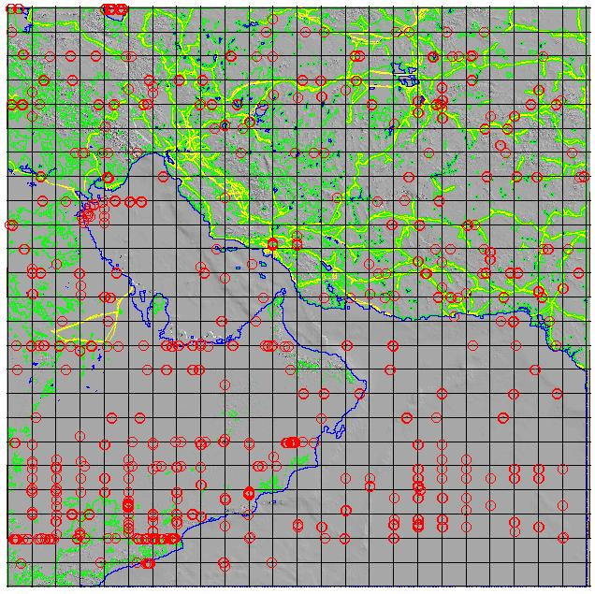
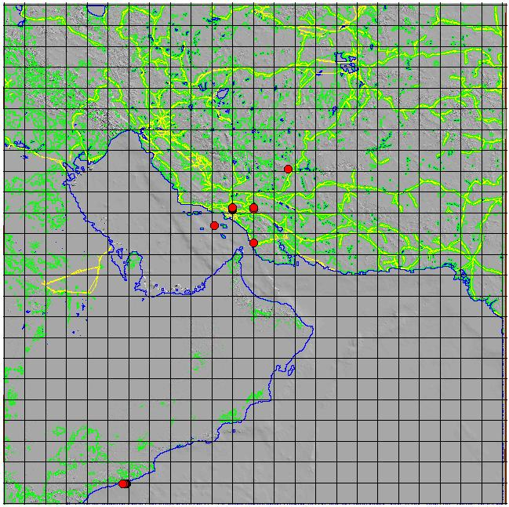
Is the Data Perfect?
Email describing an early build MC02 Database:
“In the j9mod_v3_0201-003 terrain there are big holes and canyons out in water and lots of 'em. And the ships fall into them.
Ships that are down in the holes can't get intervisibility with the ones up on top and visa-versa.
Two ships which are down in the same hole might get intervisibiliity if the sea bed profile doesn't get in the way.
It looks like all the north-south running cell boundaries have such a canyon about 3 miles wide and there's lots of big ones out in the cells too.
Given the size and number of the holes, I'd say we'll likely have a whole bunch of ships in various holes at any one time. So until its fixed, I don't see any alternative other than to turn off the intervisibility checks on the radars.”
Inspect for errors
Determine sources
Repair
Inspect again
… before first use …

Slide 13
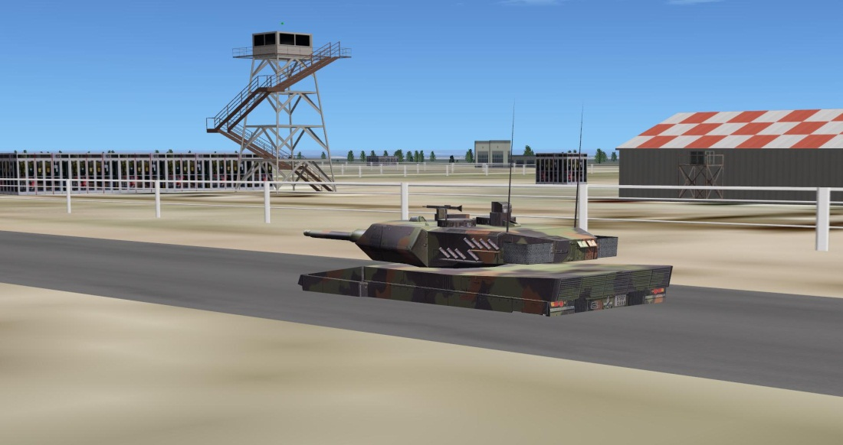
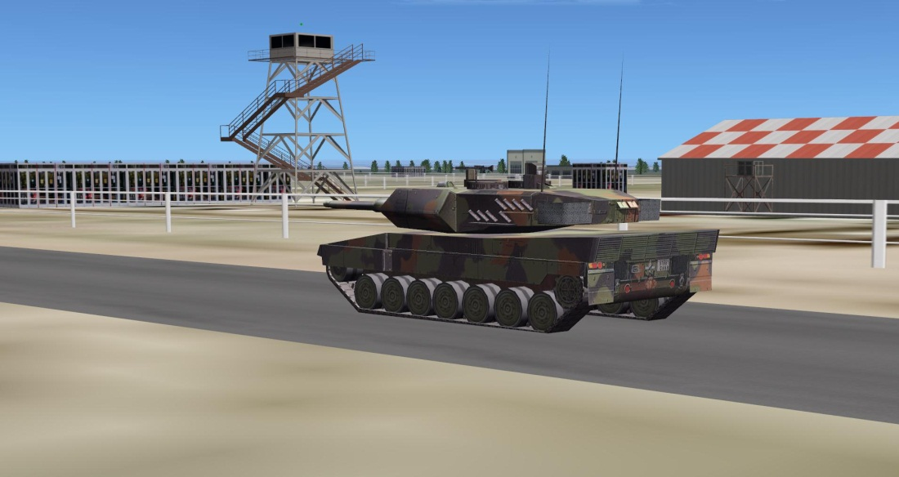
My Tank Is Trying To Be a Submarine!
Terrain surface correlation issues
All the elements must correlate
Land, sea, atmosphere

Slide 14
Ocean & Atmosphere A Coupled Environment
Now Add to that Atmosphere and Ocean
It’s all about
Temperature and Water,
Topography,
Bathymetry, and Sensors

Slide 15
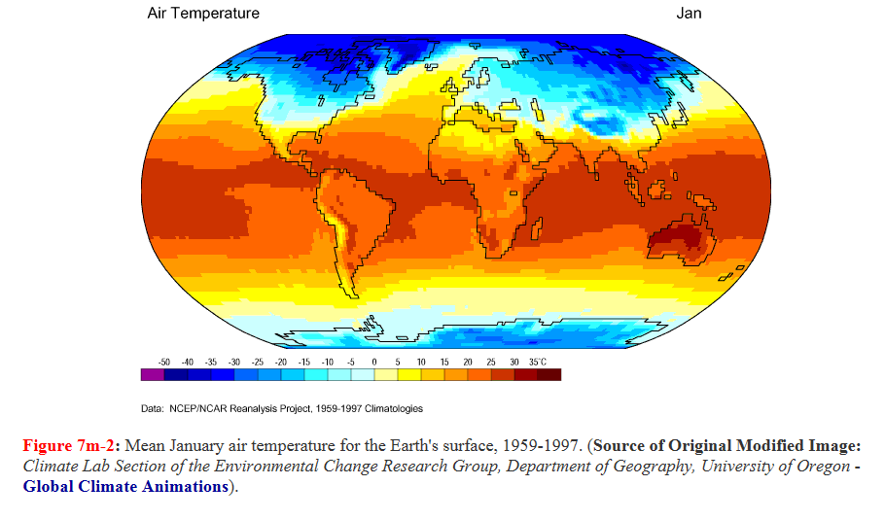
Basic Definitions: Climate
Climate (noun)
The weather conditions prevailing in an area in general or over a long period
“our cold, wet climate”
Synonyms: weather conditions, weather; atmospheric conditions “the mild climate”
http://www.physicalgeography.net/fundamentals/7m.html

Slide 16
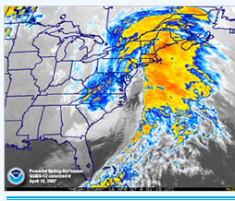

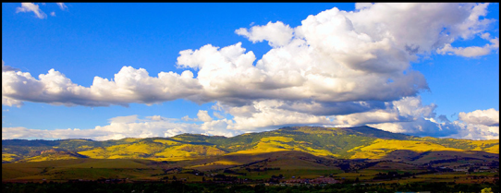
Basic Definitions: Weather
Weather is “NOW”
Weather (noun)
The state of the atmosphere at a place and time as regards heat, dryness, sunshine, wind, rain, etc.
“if the weather is good, we can go for a walk”
Synonyms: forecast, outlook

Slide 17
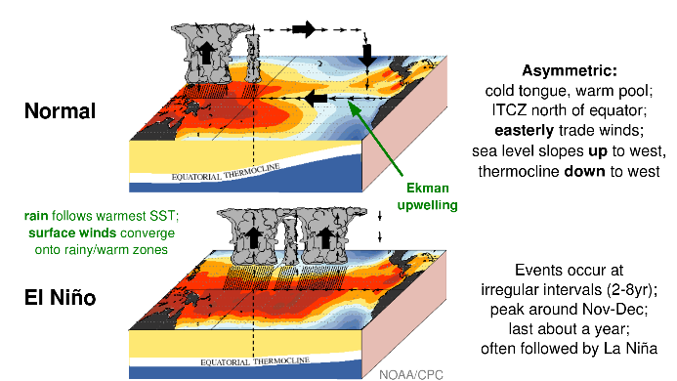
What is the Driver for Weather/Climate?
The ocean is the global weather driver.
Major weather events most often originate in large bodies of water and migrate across water gaining force and reach land expending energy.

Slide 18
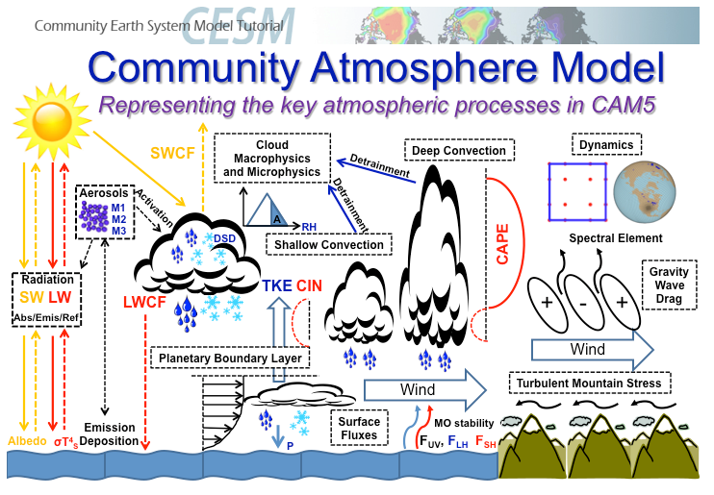
Interconnected World – What must I know?
We don’t need to model it, we need to use it. But we need to know what to request.
National Center for Atmospheric Research

Slide 19
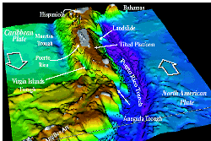
Start with Elevation: Bathymetry No, it’s not the Rockies It’s the Caribbean from the bottom up
On land you see with light, in the ocean you “see” with sound – and mountains make a difference in how sound works and what you can “see” with sound – intervisibility in the ocean

Slide 20
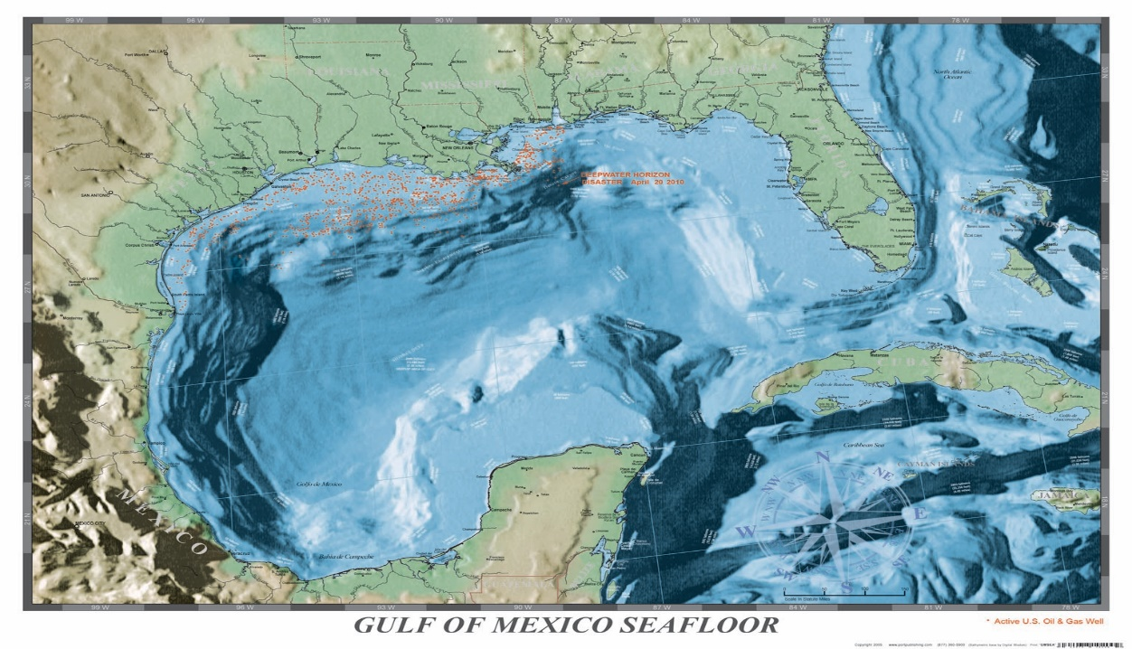
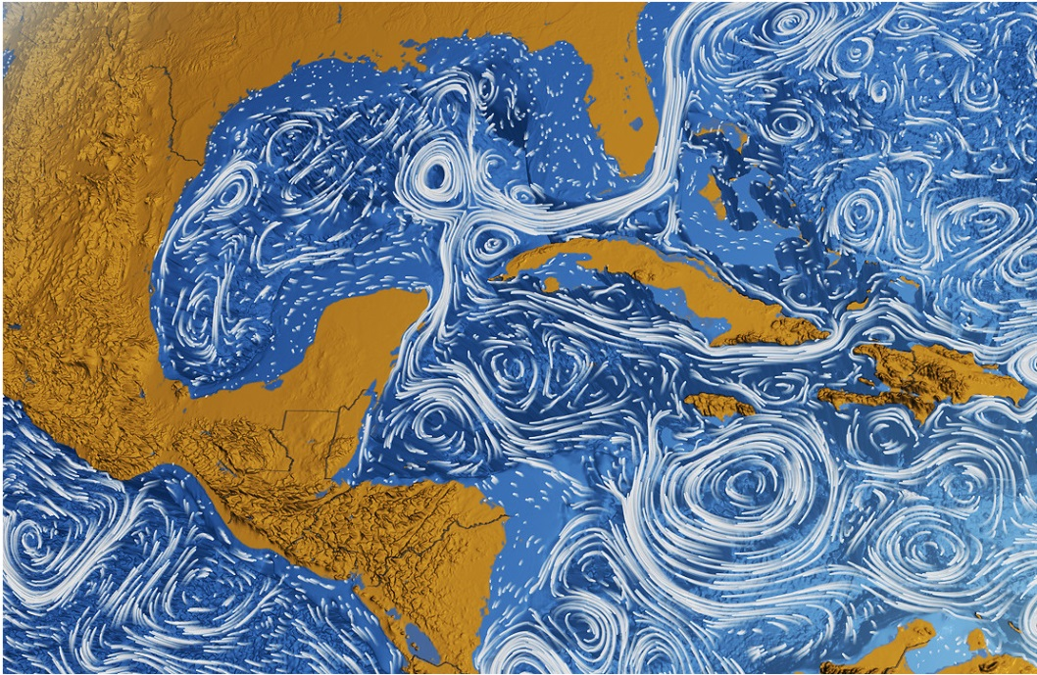
Bottom Contours, Atmosphere, and Ocean Climate
These all work together to create the operational environment at sea, in coastal regions and well into the land area
Bottom contours – the bowls that are the Caribbean and Gulf of Mexico and global wind patterns create the eddies
Eddies affect navigation on the surface and sound within the water column

Slide 21
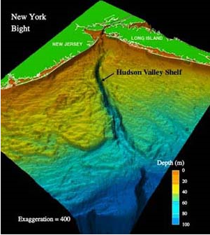
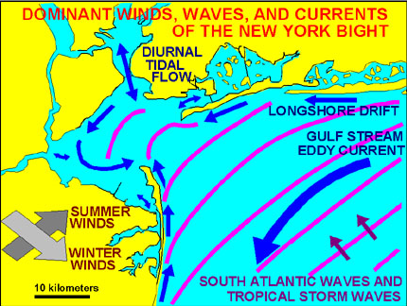
Coastal Areas Are Particularly Complex
Flows in the sea driven by global forces interact with the coastal rise and with the influx of rivers to create a complex environment for detecting undersea events.
The vast majority of the earth’s population lives near coastal regions
This increases the probability that we will have to operate in coastal areas
Weather on land is affected by what goes on in the ocean

Slide 22
Why Should I Care?
Because it has an effect on the mission space for numerous military missions:
Mine Warfare
Undersea Warfare
Ability to Launch Aircraft
Ability to Use Certain Sensors and Weapons
LVC Exercise Planning and Execution

Slide 23
Mine Warfare, Force Protection Hazards Encountered in Breaching the Shore
Mine Warfare and mine “clearance” operations are precursors to successful coastal operations

Slide 24
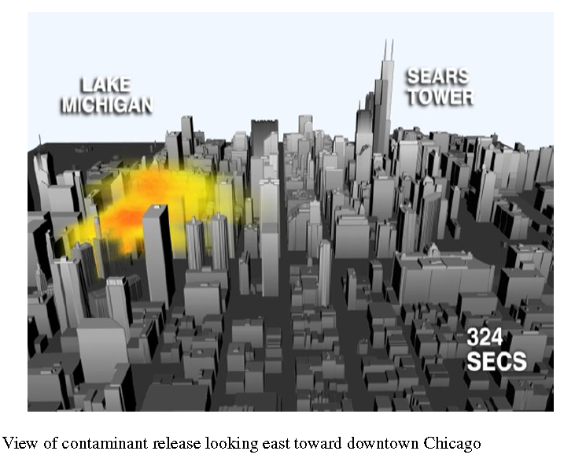
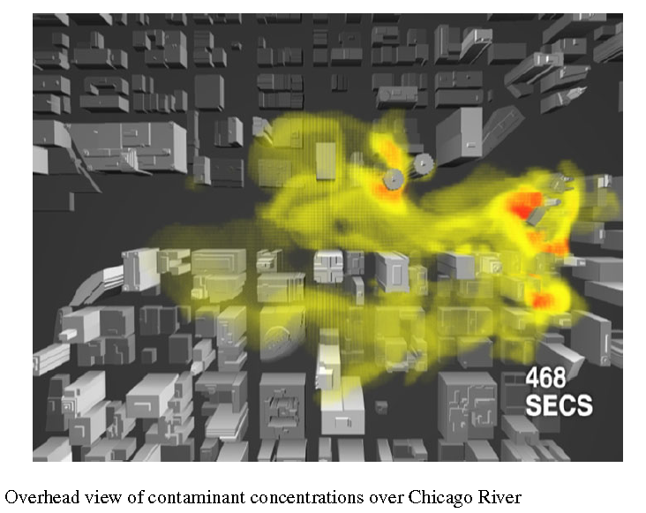
Windborne CBRNE Contamination
Where to direct civilians, rescue workers, forces?
Large Scale Urban Simulations with FCT
Gopal Patnaik, Jay P. Boris, Fernando F. Grinstein, John P. Iselin,
and Denise Hertwig

Slide 25
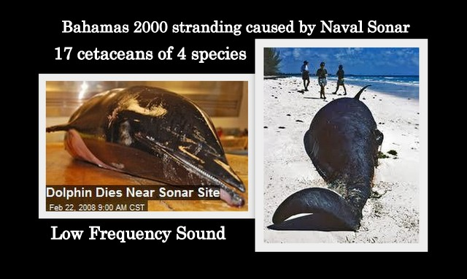
Why Do We Care? LVC Exercises!
Noise-induced mass strandings
Mass strandings associated with Navy sonar activity The Bahamas (2000): 14 beaked whales, 1 spotted dolphin, 2 minke whales -- resulted in Cranial Bleeding – cause: Naval Training Exercise

Slide 26
Climate vs Weather
What Caused the Problem?
Exercise Planning: used best climatological data for Gulf Stream – and in planning using climatological data is proper
Climate is not Weather
Gulf Stream had migrated to the East:
feeding ground migrated to East of the Bahamas – whales migrated with food
Exercise DID NOT migrate East and their sonar tests bounces off the islands to create a megaphone effect
When Live assets play, climate may guide, but weather counts – let’s look

Slide 27
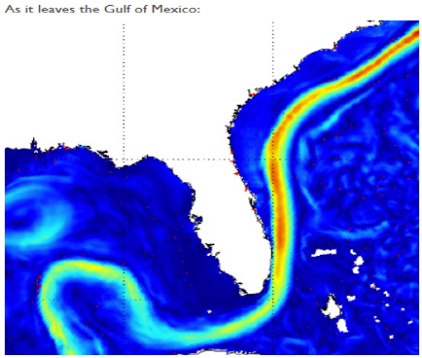
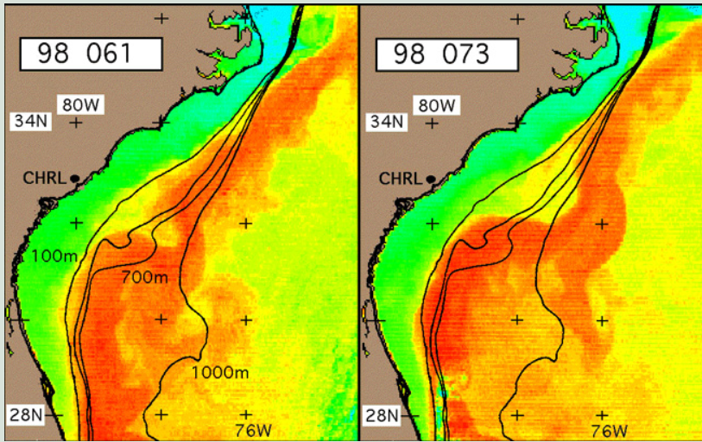
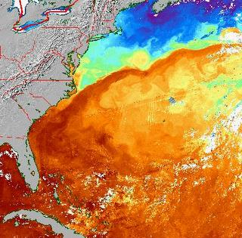
The Meandering Gulf Stream – Weather Is Dynamic Moved away from the historical mean – food sources moved, whale populations moved and sound propagation paths moved
BIG
Change
Result:
Whales got caught in a megaphone of sound
– and Naval training exercises got buried under mounds of environmental effects paperwork from that time
When planning use climatological data, but when operating, makes sure your are within the parameters of the average – sometimes you may not be

Slide 28
Intervisibility: What Sensors Need and In the Atmosphere
Mine Warfare Submarine Warfare Biological Observation (whale song)
Electromagnet waves (light, radar, microwaves)
Sensors all depend on sound or electromagnetic waves
But what does sound and electromagnetic propagation depend on?
What do we need to model to get sensors right?

Slide 29
Weather Effects Weather patterns in the atmosphere are also a matter of temperature and pressure (winds ~ pressure gradients)
In the atmosphere, light propagation affects sensors as does humidity, the formation of clouds and rain
Frequency and wavelength matter – it’s what allows us to see with night vision devices
Winds due to migrating fronts or the on-shore and off-shore breezes affect the way obscurants work and form ducts that bend the radar signals
Winds and humidity also determine how chemicals and radiological materials disperse in the atmosphere
Rain and snow affect mobility and trafficability models
In general, sensor functionality and mobility are to a significant extent affected by the atmosphere and weather, or the ocean and water column.

Slide 30
Factors That Affect Sound
The speed of a wave is the rate at which vibrations move through the medium.
Sound moves at a faster speed in water (1500 meters/sec) than in air (about 340 meters/sec) because the mechanical properties of water differ from air – pressure and density
Temperature also affects the speed of sound (e.g. sound travels faster in warm water than in cold water).
Salinity effects the sound as well, so near shore where run-off from streams creates a different environment from deep ocean
Depth affects the extent of warming from the sun, so in basins like the Persian Gulf, sensors behave differently than they do in the deep ocean

Slide 31
Think: “Hunt for Red October”
When underwater, we sense and track using sound
Long wavelength, low resolution, but travels very long distances -- we can track whales for long distance migration across thousands of miles
Sensing is almost always a scattering problem – just like the sea surface radar, but now with sound under the sea surface

Slide 32
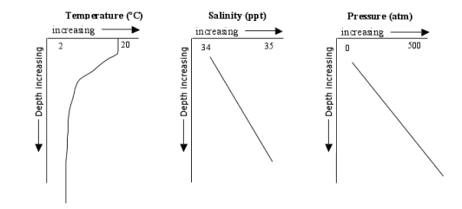
Factors That Affect Sound Speed
Sound Speed Profiles trap sound or drive it to surface or bottom
Temperature varies greatly from the surface to the end of the main thermocline then steadies out.
Salinity is measured in Practical Salinity Units (PSU). 1 PSU = approximately 1 part per thousand. Salinity changes from 34 near the surface to 35 near the bottom.
Pressure is typically measured in decibars. One decibar pressure increase corresponds to 1 meter of water depth.
Speed of sound increases
with temperature T
with salinity S
with depth Z

Slide 33
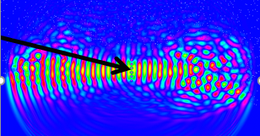
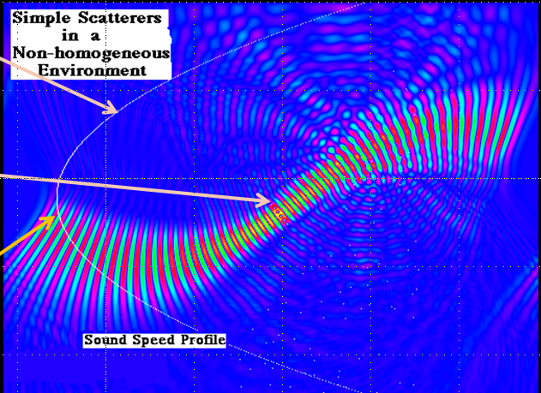
Sound bends and bounces off the ocean surface, the ocean bottom and clutter in the water column and on the bottom (remember mines)
It’s All About Bending, Ducting, and Scattering
Sound produced by a line array propagates left and right
Presence of scatterers – fish blatters – disrupts the sound
Scattering is the way we see things in the water column – like submarines
Scattering is the way we see things on the bottom – like mines
Variation in sound speed is typical of an ocean where the surface is warmed by the sun
Sound from the line array is bent away from the high temperatures and channeled along the minimum sound speed (ocean sound channel)
Presence of biological scatterers to the right break up the sound
The Science Behind The Fish Finder
Sound Speed
Profile
Sound Speed
Profile
Sound Source

Slide 34
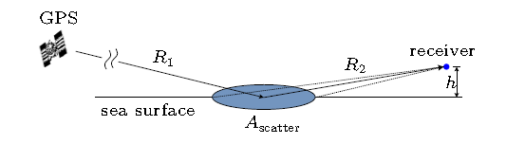
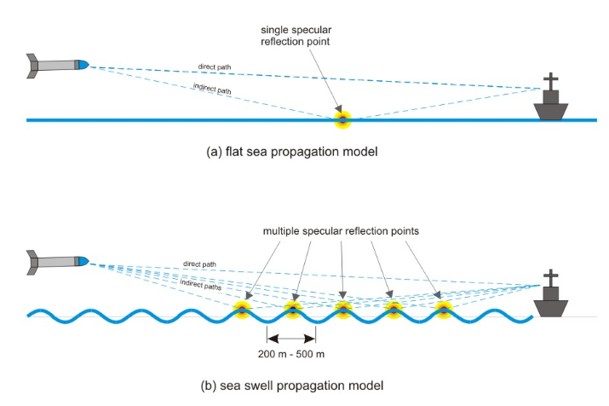
Ocean Surface Effects Create Problems for Radar, GPS Signals and Guided Weapons
Each emitter has a footprint on the ground
Signals propagate from every point in that footprint, complicating the signal along R2 and coming back from any point in the vicinity of the receiver.
Undulations of the sea surface further complicate the signals along path R2 as shown for the sea swell
Wind driven ripples on the swell alter the signal by scattering some of the signal’s strength back toward the source – like a ball hitting the side of a pool table
Both of these effects limit the effectiveness of guided weapons, or radar systems and the receipt of GPS signals

Slide 35
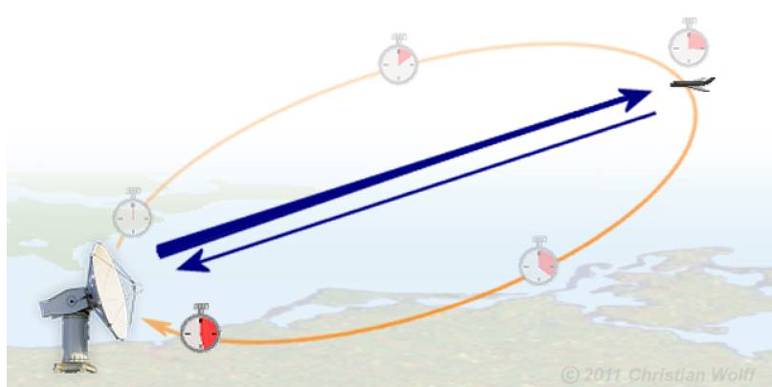
Electromagnetic (EM) and Sound Waves Are Similar in Many Ways
In an uniform environment, EM and sound waves travel in a straight line
When they encounter a reflective object, the wave bounces back to the source (mono-static scattering)
The propagation of the waves are subject to
temperature,
pressure, and
the presence of scatterers in the environment
In the ocean the scatterers are bubbles of air
In the atmosphere, scatterers are typically droplets of water, but could be other types of particulates
Rain and moisture affect radar
It’s all about bending and scattering

Slide 36
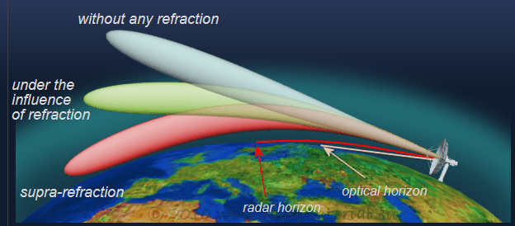
Effect of Temperature & Moisture on EM Propagation
Atmospheric Effects on Electromagnetic (EM) Waves (1 of 2)
Atmosphere = Fluid
Propagation of ElectroMagnetic (EM) waves in the atmosphere are subject to bending and interference from temperature profiles and the presence of water vapor
Atmospheric conditions change the index of refraction of the EM waves causing them to bend and changing the expected location of the signal from the target.
Publisher: Christian Wolff Text is available under the GNU Free Documentation License, and the Creative Commons Attribution-Share Alike 3.0 Unported license,
http://www.radartutorial.eu/07.waves/wa17.en.html

Slide 37
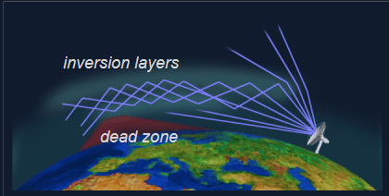
Atmospheric Effects on Electromagnetic (EM) Waves (2 of 2)
Ducting
A kink in the temperature profile causes the formation of ducts (in both sonar and radar waves)
Scattering: ducts create the opportunity for the waves to interfere with each other as they pass through temperature layers
Dead Zones: ducts can create zones where waves are diverted away from that area
Kinks are inversions of temperature
In the ocean the surface duct is formed when the surface water is warmed by the sun
In the atmosphere ducts form when layers of warm air are found above the cooler air
Publisher: Christian Wolff Text is available under the GNU Free Documentation License, and the Creative Commons Attribution-Share Alike 3.0 Unported license,
http://www.radartutorial.eu/07.waves/wa17.en.html
37

Slide 38
Now that you see environmental conditions affect the performance of systems
Where do you get it?
How do might you use it?
Why would you need geo-specific data?
How to handle the complications in Federations

Slide 39
How Do We Acquire and Manage Weather Data?
Find the folks who do ocean and atmospheric modeling and understand the drivers and correlations among the ocean column and air column – so you know what’s important
NO, YOU are not going to do the modeling
Find the people who understand how to model the effects of the environment on your system
Find the people who know how to determine the critical factor:
HOW MUCH IS ENOUGH TO INCLUDE FOR YOUR CASE
Determine how to compute the effects for your case
Will back of the envelope estimates be good enough?
Do you have to use a high powered computer to determine propagation paths for sound, GPS signals, Radar signals, weapons sensors?
What did the developers of these systems use – can you beg, borrow or steal?

Slide 40
Rules of Thumb
Geo-typical vs Geo-specific
Train as close to geo-specific as possible in mission preparation
Train with geo-typical when training for skill development
Constructive or Constructive and Virtual
Use Climatic data for the time of year you want
LVC
If you have live assets with sensors, use WEATHER data (Nowcasts and Forecasts) NOT climate
Remember the whales
War story from MC02:
Where are my @#$^&^%%$%$%# planes?

Slide 41


War Story: Why You Need to Talk to the Experts
Request: I need ocean data for every 6 hours
Answer: Okay, I can do that, but what do your sensor models use to compute sound propagation?
Much head scratching
Response: acoustic sound channel model
Answer: But you are in the Persian Gulf – there are no sound channels in the Persian Gulf – a sound channel is a “blue water” deep ocean phenomenon
Moral of the story: the models and the environment have to work together using the right data for the right models – and at the accuracy and resolution you really need for your problem

Slide 42
Federations Complicate Including Environment
Now that we know we have to correlate the ENTIRE environment…
It’s much easier in a monolithic model or simulation.
One developer controls the entire environment
Direct provisioning is possible, but perhaps not the best choice for the time-varying atmosphere and ocean
Federations are composed of independently built federates
Multiple developers were not thinking across the needs of a larger federation
Terrain developers have long worked the problems of managing different terrain databases
Atmosphere and Ocean have to be mutually coordinated and are time varying
Servers exist and fill the need for serving the same data to all sensors and platforms

Slide 43
Generating an Atmospheric/Maritime Environment
Someone else does the creation
You pull data and make it available
Start with historical data (climate)
Use daily forecasts and nowcasts to update the ocean and atmosphere (can get updates every 4 – 6 hours if needed) – remember the whales – NOW is important
Serve the ocean and atmosphere thus developed to the simulation using a server – they exist!!!
Create an effects server if needed for the sensor, weapons and other systems effects (effects servers handle heavy computational loads and assure consistency across all entities)

Slide 44



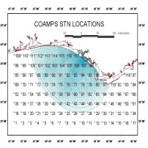

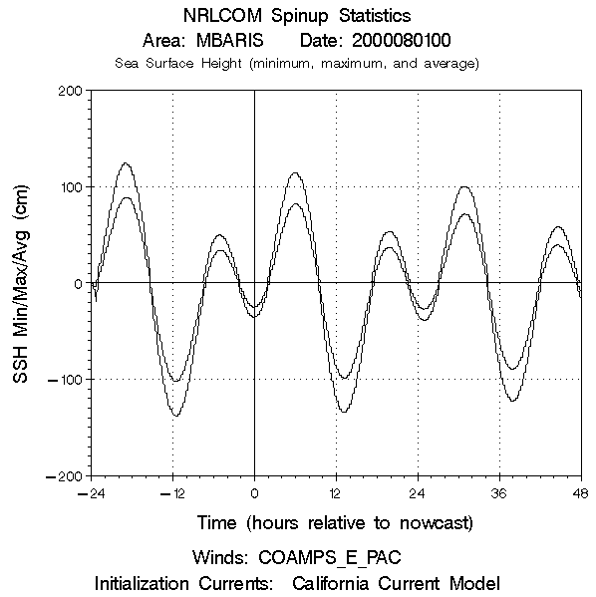
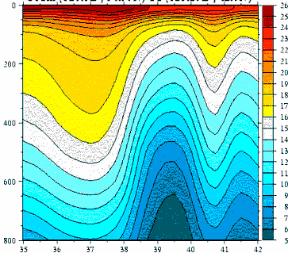
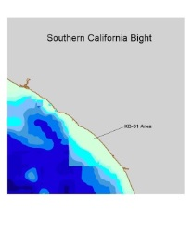
Building a Runtime Environment Primary Issue: Matching simulation and real world for LVC exercise
Assemble Archived Data Sources
Initialize Model
Daily Forecast/Nowcast Process
Creates Data for Fleet and Simulation
Assimilate near-Real time data
0000: Receive COAMPS Forecasts
Create ocean for each Forecast
Compute 48 hours of ocean data
0600: SERVE Maritime Environment to FBE
Replace prior forecasts with new data
2330: Prepare to repeat process
Atmosphere
COAMPS
Data
Ocean
Buoy Data
Wave Height
MODIS and POM
For water column
Bathymetry
Weeks before FBE
Days/hours before FBE
Daily during FBE (Fleet Battle Experiment)
Sources: Naval Oceanographic Office (NAVO), Naval Research Laboratory/Stennis Space Center (NRL/SSC),
Monterey Environmental Laboratory (MEL)
MODIS: Moderate Resolution Imaging Spectroradiometer
COAMPS: Coupled Ocean-Atmosphere Mesoscale Prediction System
POM: Princeton
Ocean Model

Slide 45
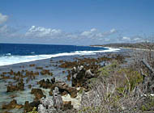
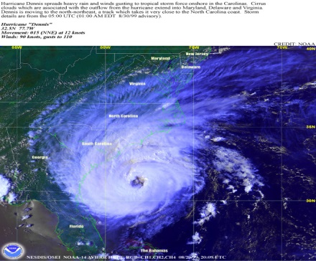
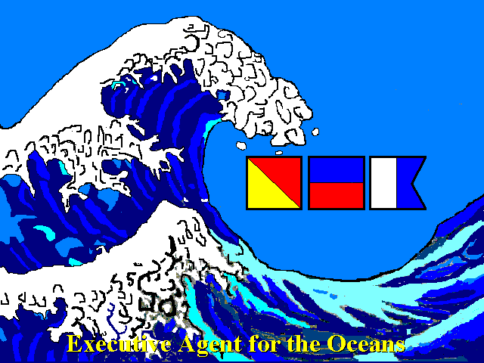
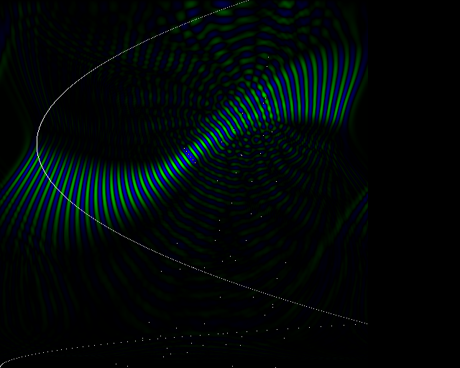
Serving the Environmental Effects
2
3
4
Build the Right Environment
How much is enough?
Determine Serving Strategies
Create Data for Server
Create Performance
Effects Models
Serve Effects
Dynamic Environment
Rain, Tide, etc.
Explosive Neutralization ATD
Environmental Factors
Magic Lantern (Adaptation)
Static Environment
Bathy, Features, etc.
Behaviors
Kinematics
1
SAF Entity
Terrain and Ocean
databases
go here
Hydrodynamic Models
SAF: Semi Automated Force model
Two main components:
kinematic models of the system’s physics, and
behavioral models of what the system should do in the battlespace environment
Runtime
Environment
Server
Environmental Library.
Network
Interface
(HLA / RTI )
User
Interface
Propagation Models
45

Slide 46
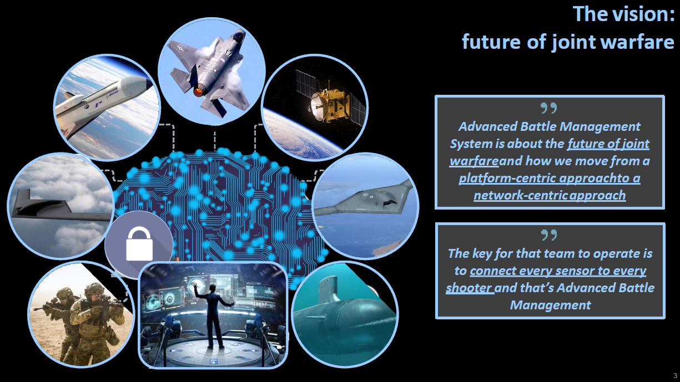
Multi-Domain Operations and Environment
MDO Concepts
Service Concepts Vary
Generally concepts revolve around
any sensor detects,
any capable weapon on any available platform engages,
any sensor detects damage
Essential Elements
Reliable communication
Reliable data transfer
Effective over-the-horizon
Environmental Factors
Atmospheric condition for sensors, image transfer, networked information, EM effects, targeting
Multi-Domain Operations: Bridging the Gaps for Dominance
Congressional Research Service, “Defense Capabilities: Joint All Domain Command and Control, April 5, 2020

Slide 47
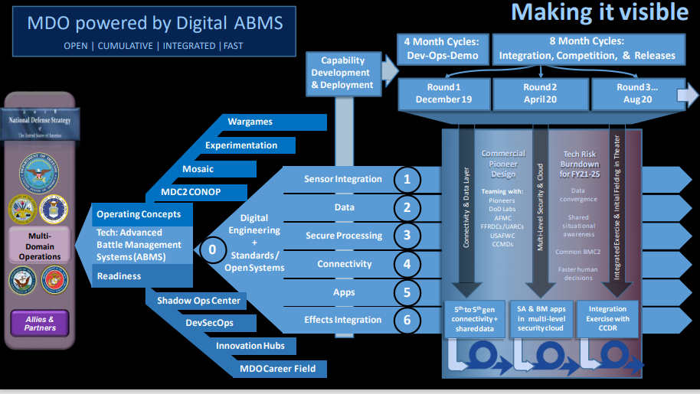
Reliable Information Access
ABMS Tenets
Access data from a wide range of sources
Prepare and present data
Provide instant and seamless access to information
Use AI aided human decision making
Use Seamless and instant communications
Communicate decisions to all stakeholders together with resources
Manage MLS
Simulations involving MDO concepts need to represent the environmental factors that could violate one or more of the ABMS Tenets or the simulations will fall far short of being able to evaluate this concept (Comms, EMS effects)

Slide 48

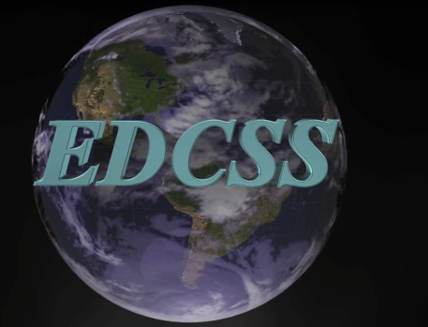
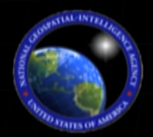

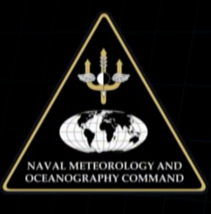

Who provides atmosphere and ocean data?
Environmental Data Cube Support System:
Broker using certified data providers to produce correlated environmental data
Army Corps of Engineers Research and Development Command (ERDC)
National Climatic Data Center
National Geophysical Data Center
National Buoy Data Center
National Weather Service
National Geospatial Intelligence Agency
Commander, Naval Meteorology and Oceanography Command: Fleet Numerical Meteorology and Oceanography Center
Air Force
Weather Agency

Slide 49
Lessons from Past & Current Data Sharing Efforts
Data quality and content can fundamentally influence return on investment and these data characteristics must be managed to assure a favorable return
Sharing simulation-ready environmental data is an attractive goal, but may require working with non-standard data formats and data that has been optimized for use in a specific context
Using “de facto” standards is a viable alternative – neither program-specific data-sharing standards nor widely-vetted international standards are absolute requirements
Does not impose additional costs on the producer thus improving their potential return on investment
Allows data consumers to accept data without changes to the normal work flow, improving their potential return on investment
Sharing and improving data earlier in the transformation process can be more effective than trying to share simulation-ready data (correlate early before specializing it for individual simulations)
See current NATO programs and products from SISO: RIEDP
49

Slide 50
Summary
Foundational Question: How much is enough for my problem
The environment and the results of the simulation are inextricably linked
Sensor performance depends upon the environmental conditions
Data used to construct simulation environment databases originate from many different, usually incompatible sources
Correlation of data within one system is a long pole in the simulation environment database construction tent
Correlation of data across dissimilar systems is really an unsolved problem
Schema semantics and environmental algorithms involved
Potential solutions rely on context of use and usually involve patching
Correlation and error correction are different processes, but both are important
Data sharing – there are exemplars of successful programs, but this remains a largely unmet need within the simulation community
50

Slide 51
Learning Objectives
By the close of this tutorial the attendees will be able to:
Identify the key features of an environment including land, sea, and atmosphere
Describe why the difference between weather and climate is important for LVC events
Explain why LVC events face difficulties when using geotypical vs geospecific environments
Explain why environment matters for communications and sensors in multi-domain operations
Identify sources of environmental data for simulations

Slide 52
Questions?
snumrich@ida.org

Slide 53
Select References
EDCSS https://www.aer.com/contentassets/4e5fd4285aad488e81d95478ca28d87f/edcss_overview-jul-2020.pdf
RIEDP https://www.xcdsystem.com/iitsec/proceedings/index.cfm?Year=2021&AbID=95943&CID=862#View
Hoehn, John R., “Joint All-Domain Command and Control (JADC2),” Congressional Research Service, updated March 18, 2021, IF11493, https://crsreports.congress.gov/produt/pdf/IF/IF11493c
Hoehn, John R., “Joint All-Domain Command and Control: Background and Issues for Congress,” Congressional Research Service R46725, Updated May 24, 2021, Joint All-Domain Command and Control: Background and Issues for Congress
Rouge, Joseph (AF A2/60), Joint All-Domain Command and Control (JADC2) powered by Digital Advanced Battle Management Family of Systems, presented to AFCEA
Gamboa, Elisha, posted by Seapower Staff, “CNO Meets with Project Overmatch Team on Fleet Modernization, Sea Power Magazine, 24 February 2021, https://seapowermagazine.org/cno-meets-with-project-overmatch-team-on-fleet-modernization/
US Army Futures Command, Project Convergence 2021, https://armyfuturescommand.com/convergence/
Thanks to Dr. Robert Richbourg for his contributions to the land portion of this work

