Slide 1



Operational Impact:
Quantifying Training Solution Value
Kelly Hale, PhD, Draper
Amy Taber, Gemini Technologies, Inc.

Slide 2
Agenda
Introduction
Operational Impact using Kirkpatrick’s Evaluation Framework
Re-Framing Evaluation Towards Operational Impact
Use Case Examples
Conclusions

Slide 3
Learning Objectives
Be able to describe Operational Impact Analysis and its importance
Describe Kirkpatrick’s 4 Levels of Training Evaluation
Gain insights on how to incorporate Operational Impact Analysis approaches into training development

Slide 4
Introduction

Slide 5
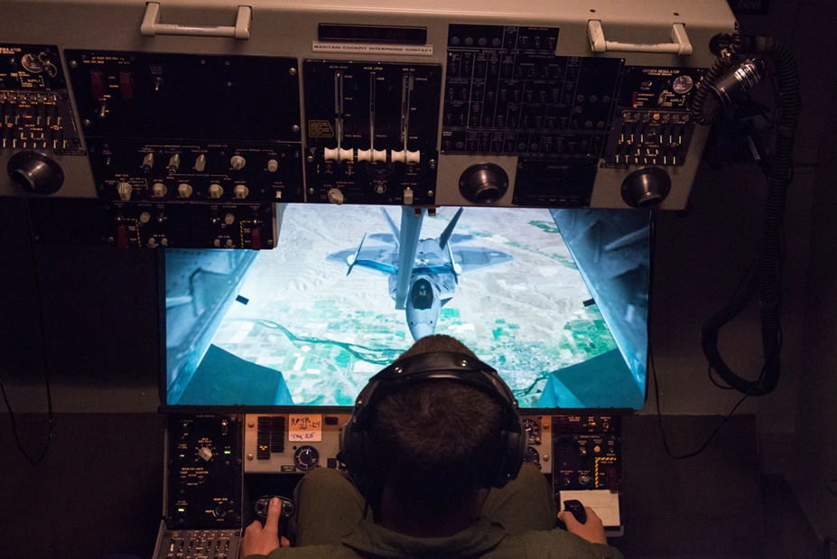

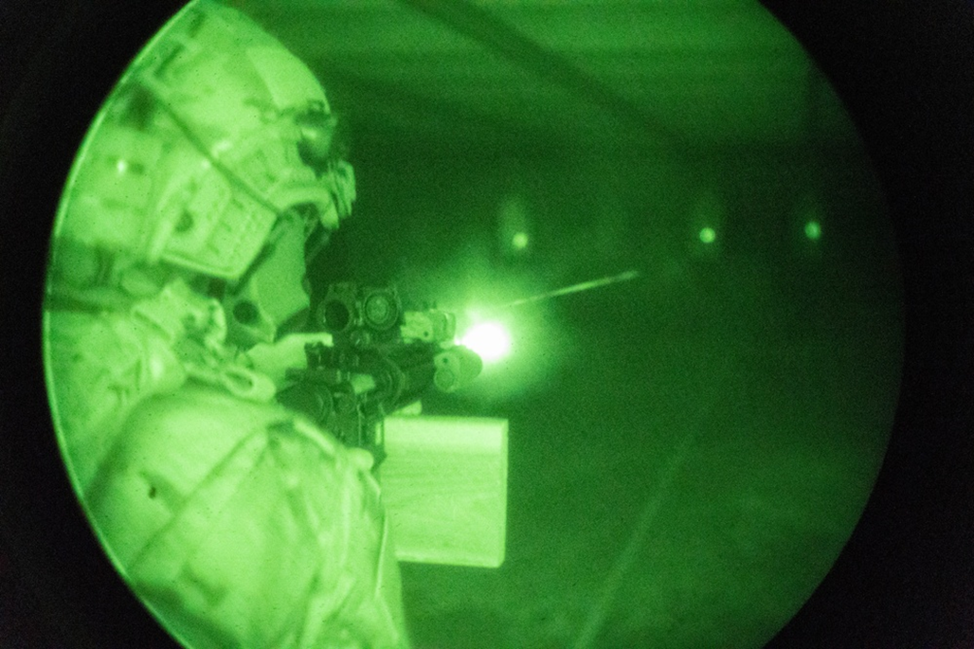
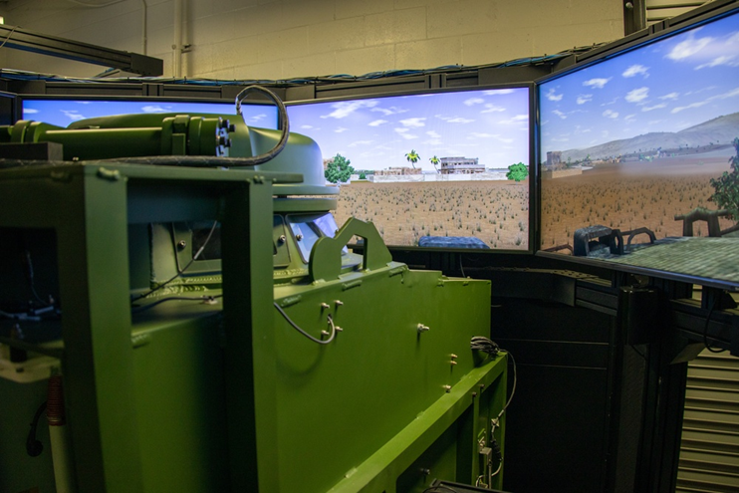

Training Impact
Photo: USAF
Photo: Joint Forces
Enhanced Performance
Photo: US Army
Photo: US Army
OPERATIONAL IMPACT
Simulation-based training solutions
All Photos: Joint Forces - USAF, U.S. Marines, U.S. Army; DVIDS, www.dvidshub.net.
Notes:
We build to a list of requirements – we get in the weeds and check the boxes, and deliver.
What do we really understand about the how the system we deliver will save lives?
Have we demonstrated that warfighters can use and learn from our system?
Have we demonstrated how much warfighters have learned from our system?
Have we demonstrated how well our system changes warfighter behavior?
Have we demonstrated how well any changes in behavior have led to improved warfighter performance?
And have we demonstrated that that improved performance saves warfighter lives?
THAT is the level of training system delivery we should all be striving for. When we deliver and maintain our training systems – that each system does indeed make an operational impact to our warfighters, and we are indeed changing and saving lives.

Slide 6
Training Impact
Why are formal evaluations not common?
  Lack of methods to follow – how to best implement?
  Lack of operational performance metrics
  Complexities of operational performance
    Tradeoffs between safety and mission objectives
    Intentions assessed by experts; not just data
    Training may cover portion of overall operational task
  Sample size to find significance

Slide 7
Training Impact
“The definition of military training is success in the battle.
In my opinion, that is the only objective of military training.”
Lieutenant General Louis Burwell “Chesty” Puller¹
How do we go about measuring this success?
¹https://bootcampmilitaryfitnessinstitute.com/2016/04/18/what-is-the-objective-of-military-training/

Slide 8
The Healthcare Objectives Dilemma
“…not in the business of saving lives, but in the business of providing treatment”
Treatments completed…
Metric measured
vs.
# lives saved
Quality of life
DESIRED operational impact
Notes:
Paid based on the number of treatments provided – NOT on the impact of those treatments

Slide 9
The Training Objectives Dilemma
“…not in the business of saving lives, but in the business of providing training”
“…not in the business of saving lives, but in the business of providing treatment”
Treatments completed…
Metric measured
vs.
# lives saved
Quality of life
DESIRED operational impact
Notes:
Does the same apply to our DoD Training Community?

Slide 10
Refocus on Operational Impact
providing training
“…not in the business of saving lives, but in the business of providing training”
DESIRED impact
=
Operational Impact
making missions effective
Notes:
Why is it so hard to measure operational impact when we have SO MANY high fidelity and advanced training tools?

Slide 11
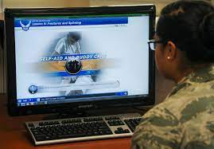
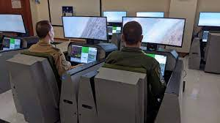
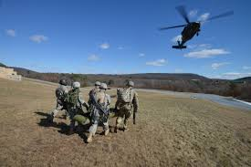
Training Impact
How do we go about measuring operational success?
Collective Task | Conditions | Standards
Individual Task | Conditions | Standards
Self-Development
Institutional
Operational
Notes:
Across the spectrum of training solutions

Slide 12
Training Impact
Needs Analyses
Requirements
User Stories
Storyboards Mockups
MOEs / MOPs
Anticipated Gains
Learning Metrics
Baseline Performance
Operational Gains
Lives | Time | Money
Training Content
& Design
Changes in Learning
Operational Impact
Collective Task | Conditions | Standards
Individual Task | Conditions | Standards
Self-Development
Institutional
Operational

Slide 13
Training Impact
Needs Analyses
Organization
Team Mastery
Individual Mastery
Training Solution
Mission
Operational Impact
Changes in Learning
Training Content
& Design
Notes:
Demonstrating you can do a skill within the training solution, or in a transfer environment does not directly relate to whether you will have an impact at the operational level.
We HOPE that we will, but data examined does not show a high probability (more on that later).
We as deliverers of training solutions need to extend our evaluations to Operational Impact – how does our training solution relate to improved operations? How do we measure that impact?

Slide 14
Operational Impact FIRST
What is the organizational objective?
What needs to be learned?
How is it measured?
Knowledge Recall
Demonstration of Skill
Navigation/Mobility Efficiency
# Incidents
# Hits taken
Throughput
Ammunition Rounds
# Kills
# shots / kill
Time to Kill
Time on Task
Time to change COA
Declarative Knowledge
Procedural / Taskwork
Off-Nominal Cases
Teamwork
Increased Lethality
Air & Sea Superiority
Examples
Notes:
What needs to be learned? TASK | CONDITION
How is it measured? STANDARDS
MOPs and MOEs – really, the indicators for those measures (specific metrics)
- Indicators can be at the individual or team level

Slide 15
Operational Impact using
Kirkpatrick’s Evaluation Framework

Slide 16
Kirkpatrick’s Training Evaluation Framework
Did they like it?
Level 1
Reaction
Did they learn it?
Level 2
Learning
Did learning transfer?
Level 3
Behavior
Did learning result in operational impact?
Level 4
Results
Notes:
There are other evaluation frameworks, but Kirkpatrick’s is most widely known, and is simple in its structure.
Should not assume that the levels are in ascending order of importance; nor that they are causally linked
Highlighted throughout this section will be additional context added by other researchers/evaluators to this basic framework.

Slide 17
Kirkpatrick’s Training Evaluation Framework
Did they like it?
Level 1
Reaction
Most evaluations happen here
Did they learn it?
Level 2
Learning
Did learning transfer?
Level 3
Behavior
These evaluations are real impact indicators
Did learning result in operational impact?
Level 4
Results
Notes:
Alliger, Tannenbaum, Bennett, & Traver (1998) https://apps.dtic.mil/sti/pdfs/ADA368508.pdf
From 1997 report from American Society for Training and Development –
All companies REPORT evaluating Level 1
80-90% evaluate Level 2
60-80% use level 3
30-45% use level 4
Actual evaluations that took place: 90% at Level 1; 33% at Level 2; 10% at Level 3; 0 at Level 4

Slide 18
Kirkpatrick Level 1
Did they like it?
Easiest to Capture
Level 1
Reaction
Measures reactions to the learning product
  Survey/Questionnaire-based
  Individual responses
  Affective reactions: was training engaging/fun
  Perceived utility: value of training
Utility reactions correlated to Level 2 and 3 outcomes more so than Affective reactions
(Alliger et al., 1998)
Notes:
If they “like” it, they potential for learning is greater –If it is invisible to them, does not add to cognitive load, or supports self-actualization ( upper levels of Maslow) then the learner is more engaged and enabled. This cannot be the only measure, and often leads to happy-happy-joy-joy feedback, not tied to any specific measure of success.
‘Liking’ the training has not been shown to influence knowledge acquisition or in whether trainees apply what they learned during training to their job.

Slide 19
Kirkpatrick Level 2
Did they learn it?
Most Popular¹
Level 2
Learning
Measures learning gained relative to training objectives
  Pre/Post comparisons – Immediate / Knowledge retention
  Checks on learning
  Capture learning gains and diagnostics for identifying training deficiencies
  Questionnaire-based; Observation/Performance-based
    ‘Can Do’ behavioral skill tests
¹Bersin, 2003
Notes:
Although research does not support that acquired knowledge and skills necessarily equates to the behavioral changes or on the job performance (Strunk, 1999), it is evident in the literature that Level 2 evaluations remain the most popular level used to evaluate training programs (Bersin, 2003).

Slide 20
Kirkpatrick Level 3
Did learning transfer?
“Forgotten Level”²
Level 3
Behavior
Measures changes in a transfer/application
  Does learning get put into practice? improve task performance?
  Capture learning gains and diagnostics for identifying training deficiencies
  Observation/ Performance-based; Self-Assessments
    ‘Does do’ / application of behavioral skills tests in transfer/operational environment
²Kirkpatrick & Kirkpatrick, 2006
Notes:
Kirkpatrick stated, I believe that level 3 is the forgotten level. Lots of time, energy, and expense are put into levels 1 and 2 by training professionals because these are the levels that they have the most control over. Executives are interested in level 4, and that is as it should be. That leaves level 3 out there on its own with no one really owning it (Kirkpatrick & Kirkpatrick, 2006, p. 83).

Slide 21
Kirkpatrick Level 4
Most Important
Did learning result in operational impact?
Most Challenging
Level 4
Results
Measures results of training on mission impact
  Improvement in mission effectiveness/efficiency as result of training?
  Quantify by metric: money / time / lives saved / productivity gains
  Observation/ Performance-based
    Collective Evaluation – more than an Individual
²Kirkpatrick & Kirkpatrick, 2006
Notes:
Level 4 is the most important and also the most challenging level to assess (Werner & DeSimone, 2005; Kirkpatrick, 1960b; Kirkpatrick, 1998; Phillips, 1996a).

Slide 22
Flip the Framework
Did they like it?
Level 1
Reaction
Did they learn it?
Level 2
Learning
Did learning transfer?
Level 3
Behavior
Did learning result in operational impact?
Level 4
Results

Slide 23
Starting with Operational Impact
Did learning result in operational impact?
Did the training solve the problem?
Level 4
Results
Did learning transfer?
Did they learn enough to apply to the problem?
Level 3
Behavior
Backwards Planning
Did they learn it?
Did they absorb the knowledge/skills from training?
Level 2
Learning
Did they like it?
Could they learn from the training product itself?
Level 1
Reaction

Slide 24
Re-Framing Evaluation
Towards
Operational Impact

Slide 25
Requirements Development Methodology
  Defined Organization Objectives and Metrics of Success
  Detailed Gaps Analysis and Training Needs Analysis
  Requirements draft, budget, resources
  RFP/Management of Development
  Post-project requirements assessment
1
2
3
4
Training Development
5

Slide 26
Training Development Methodology
  Defined Organization Objectives and Metrics of Success
  Detailed Gaps Analysis and Training Needs Analysis
  Training/Training System Design and Development
  Training/Training System Evaluation
  Post-Training Evaluation
1
Carried forward
2
Carried forward
3
4
5
Notes:
Why is it so hard to measure operational impact when we have SO MANY high fidelity and advanced training tools?
These process steps are needed to achieve operational impact assessment. We will revisit these steps in detail. But first, we need a framework to think about training evaluation.

Slide 27
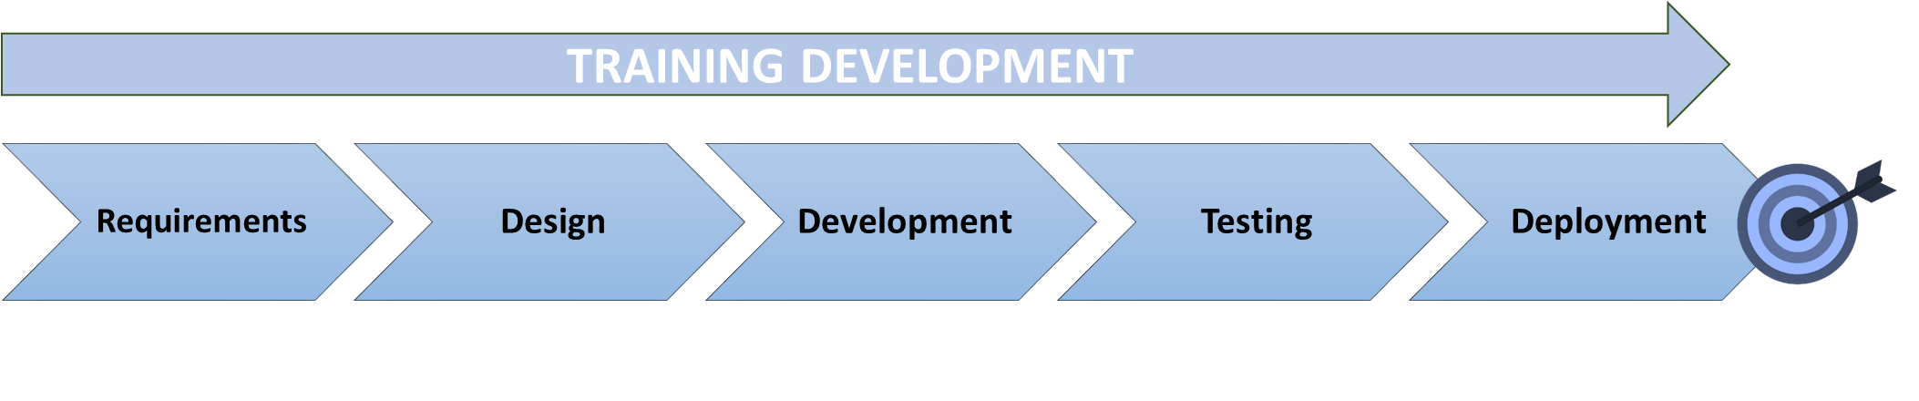
The ADDIE Waterfall
Analysis
Implementation
Evaluation?

Slide 28
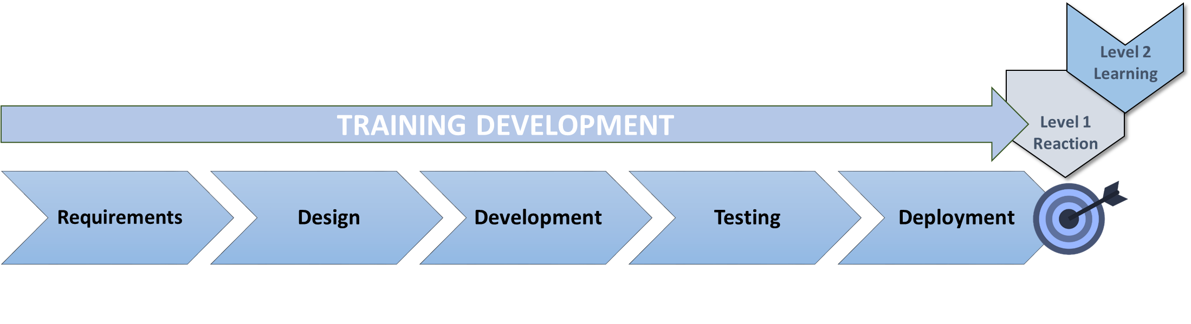
Training Development Evaluation
Assessment post-completion

Slide 29

Identifying the Impact Target

Slide 30
Fitting Evaluation into the Process
  Defined Organization Objectives and Metrics of Success
  Detailed Gaps Analysis and Training Needs Analysis
  Training/Training System Design and Development
  Training/Training System Evaluation
  Post-Training Evaluation
1
Before Training Development
Level 4
Results
2
Level 3
Behavior
3
Level 2
Learning
Evaluations
During Training
After Training
4
Level 1
Reaction
5

Slide 31
Define Objectives and Metrics
1
    What is the REAL problem??
    What job needs to be accomplished?
    What is the desired end result?
Level 4
Results
What is the current baseline performance?
How would we know if there is improvement?
What is the right performance measure?
Segue to Gap Analysis
Notes:
The term objectives here is not the formulation of training objectives to utilize in training development, but to analyze and identify the objectives for the performance problem. - segue to the next slide with the first set of questions--- is it a PEOPLE problem, a PROCESS problem, or an EQUIPMENT problem?
If it is a people problem then the gap analysis will asses if it is a SKILL or KNOWLEDGE issue.

Slide 32
The Problem Statement
Essential Question | Considerations
What is the performance problem? | What should be happening? What is actually happening? Is it PEOPLE, EQUIPMENT or PROCESS?
Is it worth fixing? | What would happen if we did nothing?
Is the fix related to SKILLS? | Do the employees know what is expected? Do they have adequate tools?; Do they get feedback?
Are consequences or poor performance clear? | Is desired performance punishing? Is poor performance rewarding? Are consequences effective and communicated clearly?
Mager and Pipe’s Performance Analysis Model

Slide 33
Gap Analysis and TNA
2
    Is the gap a knowledge, skill or competency gap?
    Who are those performing?
    What are relevant job behaviors?
Level 3
Behavior
What changes in knowledge and skills are expected?
How can changes be measured?
What are the right training objectives?
Segue to Training Development
https://www.researchgate.net/publication/345124094_Training_Evaluation_of_Virtual_Environments

Slide 34
Training Objectives
Essential Question | Considerations
Is there a skill deficiency? | Is it a skill deficiency? Could employees do it in the past? Do they do it often? Is it complex?
Are there other causes? | Can task be made easier? Are there other obstacles?
Which solution is best? | What are the solution options? What are the costs? Does the schedule permit? Will it close the skill deficiency gap?
Mager and Pipe’s Performance Analysis Model
Mager and Pipe’s Performance Analysis Model

Slide 35

Training Design and Development
3
Will the training close the gap?
Will it also solve the problem?
Does Media match the performance issue criticality?
Level 3
Behavior
Level 2
Learning

Slide 36
Training Evaluation
4
Feedback vs. Metrics
Level 1
Reaction
Level 2
Learning
Feedback
Metrics
Utility Reaction
Affective Reaction
Task Assessment
Training Objective Demonstration

Slide 37
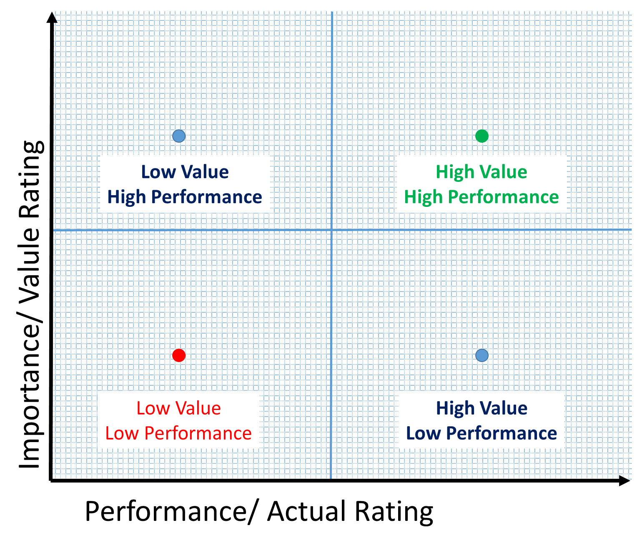
Training Evaluation Priority Scale
Notes:
If a task is low value to address the gap in performance, and there is a low value to the learner, then the investment and resources for training development should be considered for a relational reduction in LOE and development. Focusing on the High Value/ high performance tasks is an important delineatore

Slide 38
Post-training Evaluation
5
Did trainees learn?
Is the original problem solved?
Who will capture performance metrics?
Level 4
Results
Level 3
Behavior
Is this a process, people, or tool problem?
Adapt the process!

Slide 39
Shift to Agile Evaluation

Slide 40
Training Development Evaluation
Assessment post-completion

Slide 41
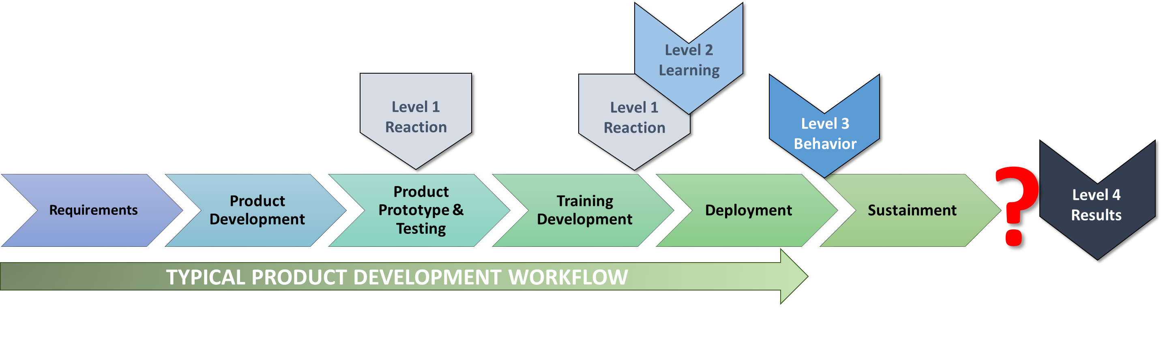
Integration with Product Development

Slide 42
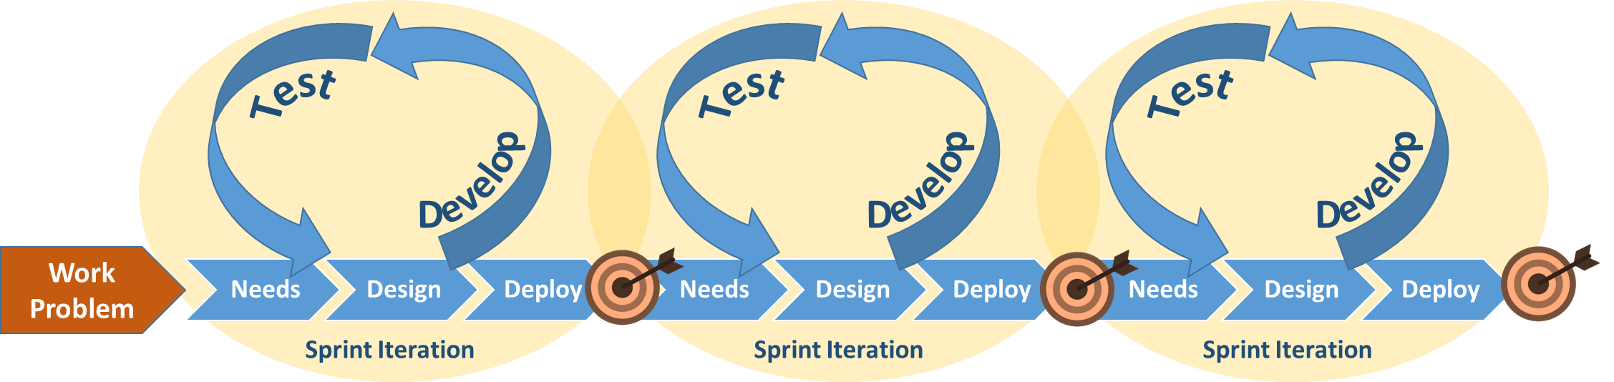
Agile Development Cycle
Iterative
Assessments

Slide 43
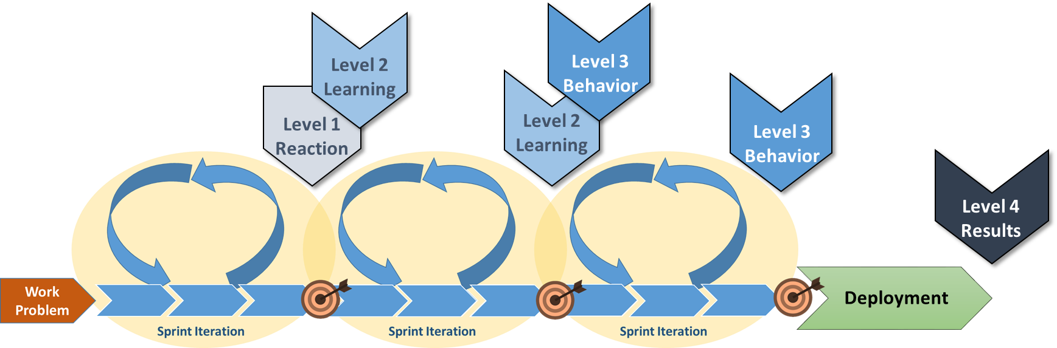
Agile Training Development

Slide 44
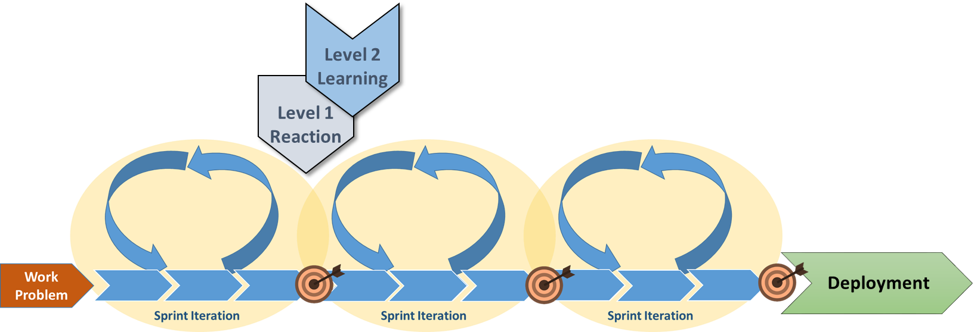
Agile Product/Training Development
Product Development

Slide 45
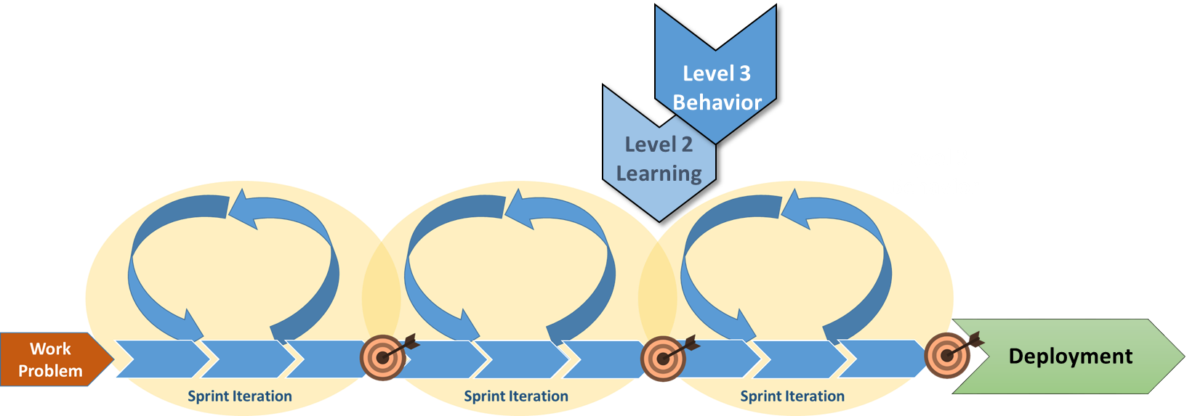
Agile Product/Training Development
Product Development
Training Development
Product Development

Slide 46
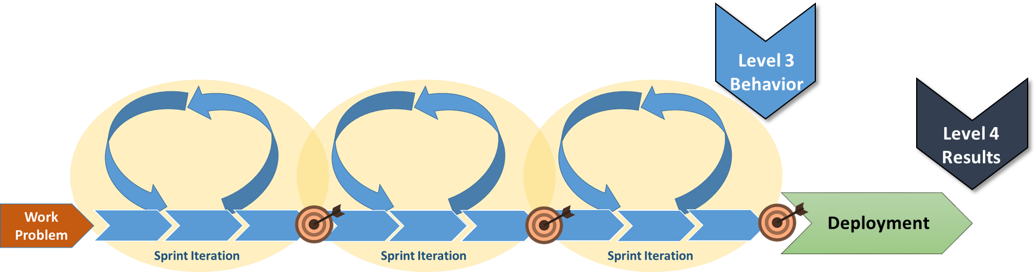
Concurrent Agile Product/Training Development
Product Development
Training Development
Product Development
Training Development
Performance Support Development
Product Development

Slide 47
Use Cases

Slide 48
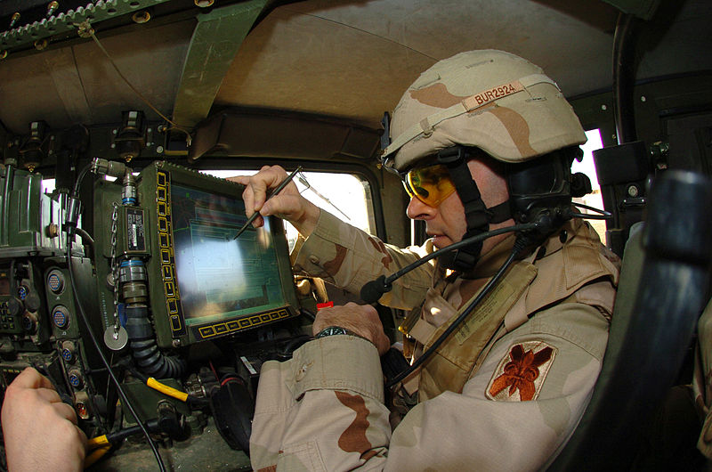
Use Case 1
Maneuver Forces Awareness
Evolution of Evaluating the Impact of SA Software – Stemming from a Real-World Problem

Slide 49
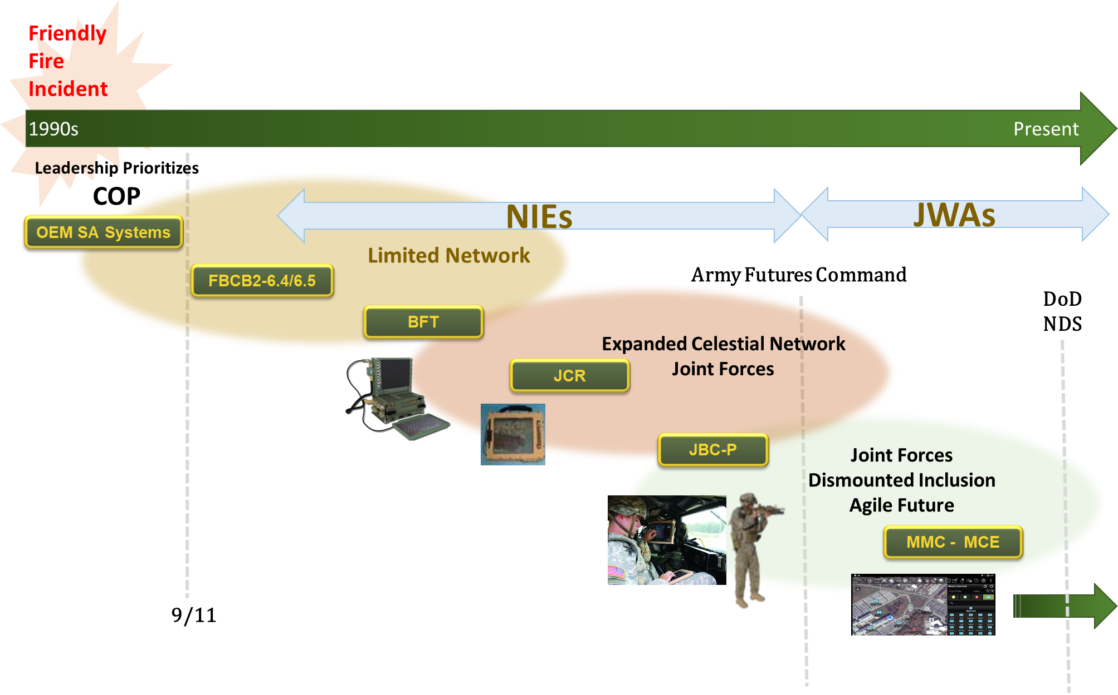
Use Case 1

Slide 50
Use Case 1
SA to Eliminate FF
Soldier & Systems
Eliminate Friendly Fire
1
2
PRODUCTS
Hardware/Software/Networks
SA Family of Systems
HUMAN FACTORS
Behaviors/Use/Maintenance

Slide 51
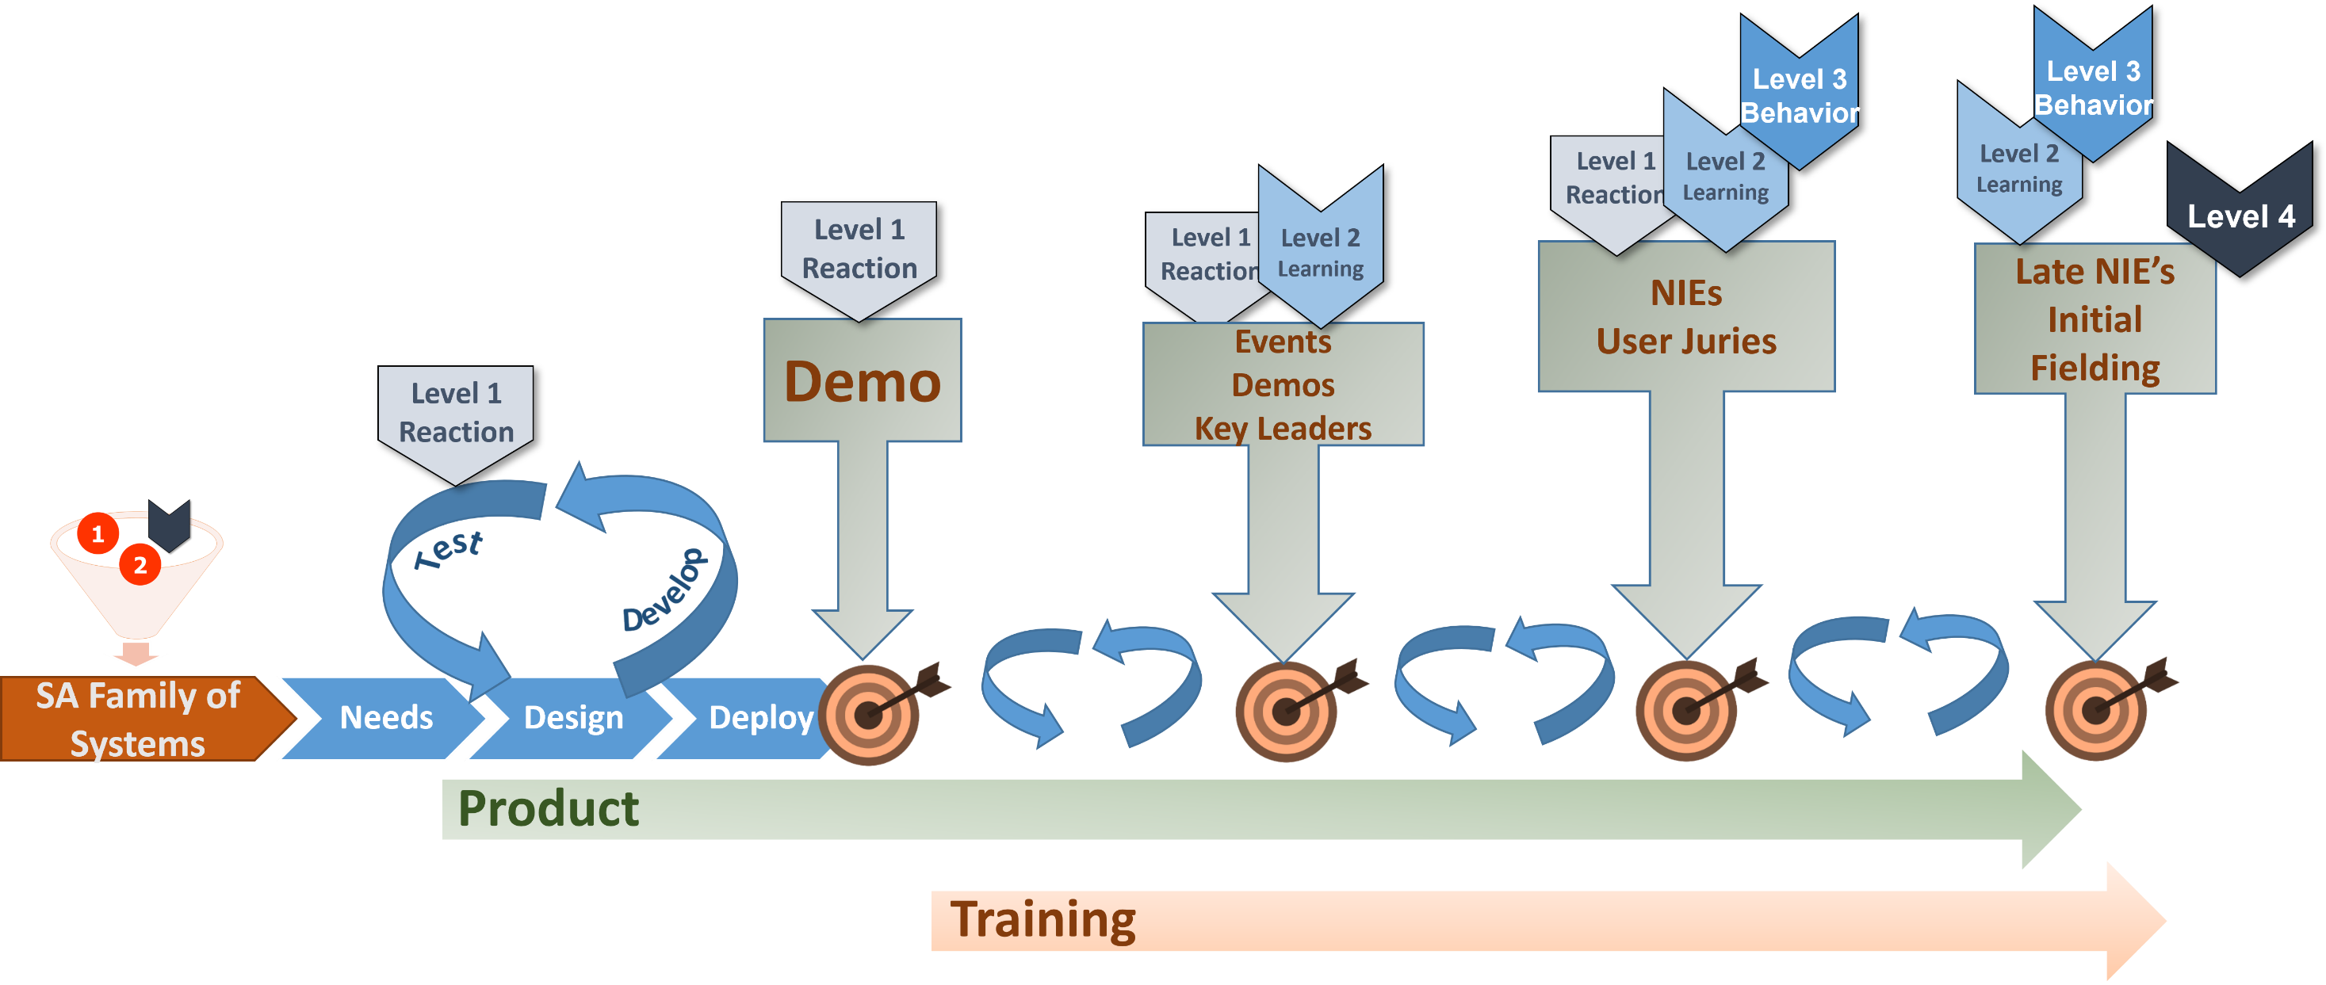
Use Case 1

Slide 52
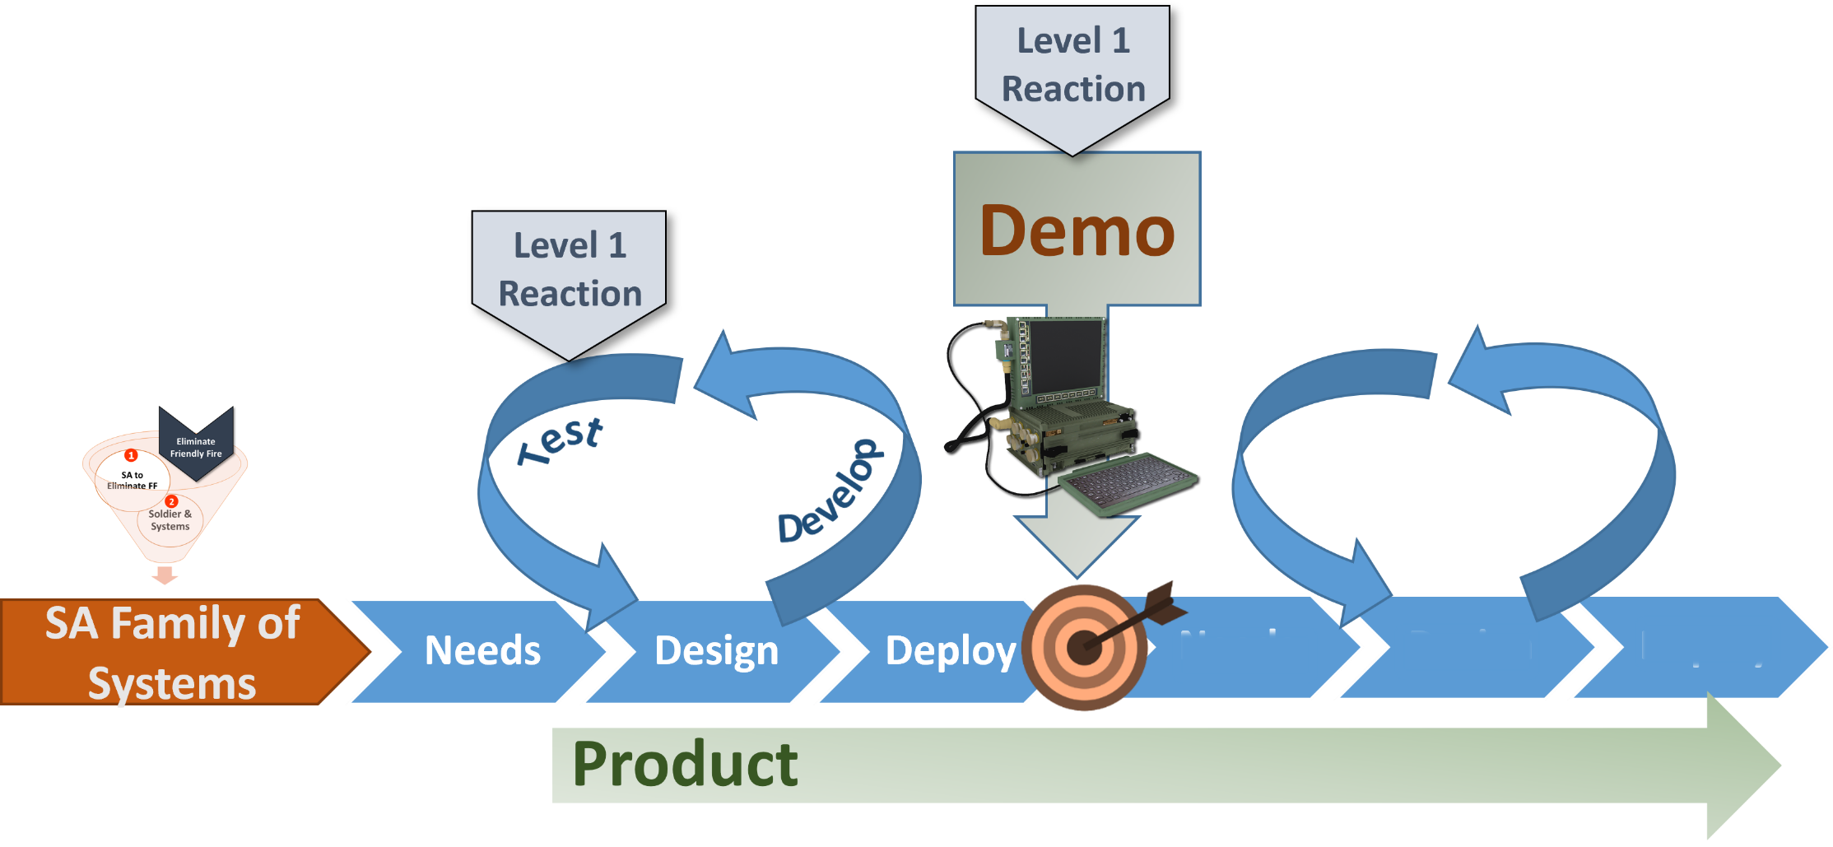
Use Case 1

Slide 53
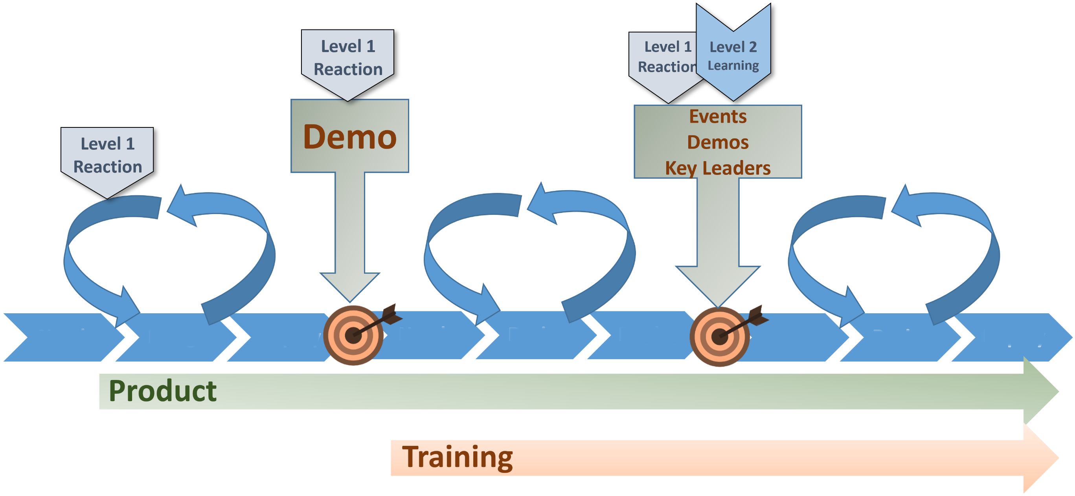
Use Case 1

Slide 54
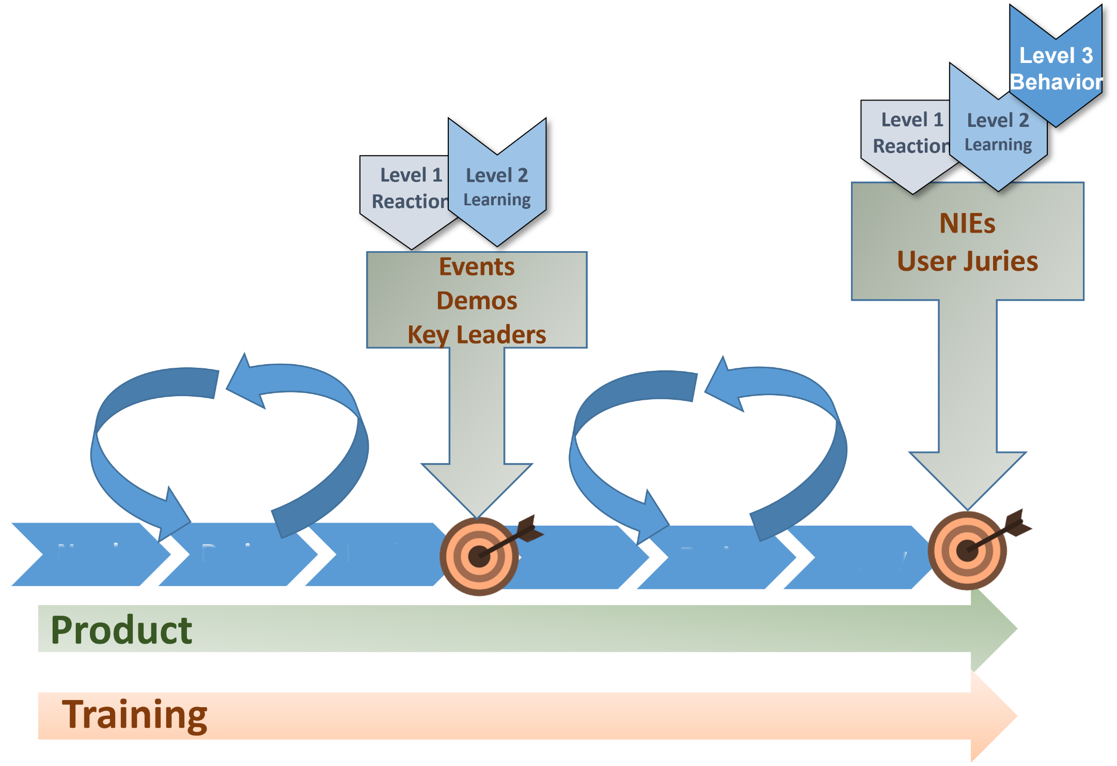
Use Case 1

Slide 55
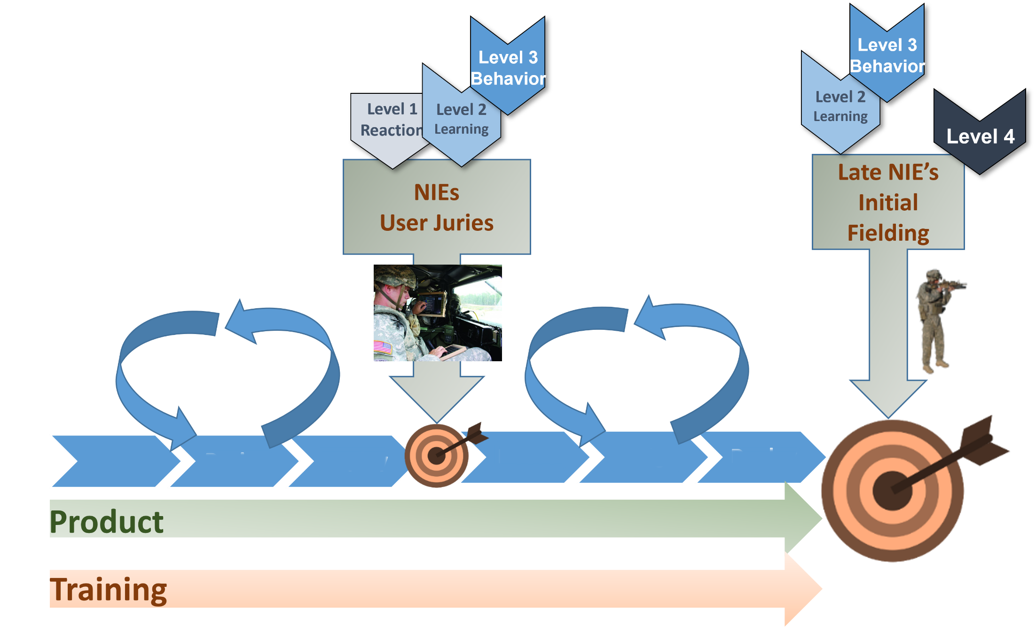
Use Case 1

Slide 56

Use Case 2
Keeping Out of Harm’s Way
Iterative Evaluation of Operational Impact for a new Autonomous Drone
Photo: Draper

Slide 57
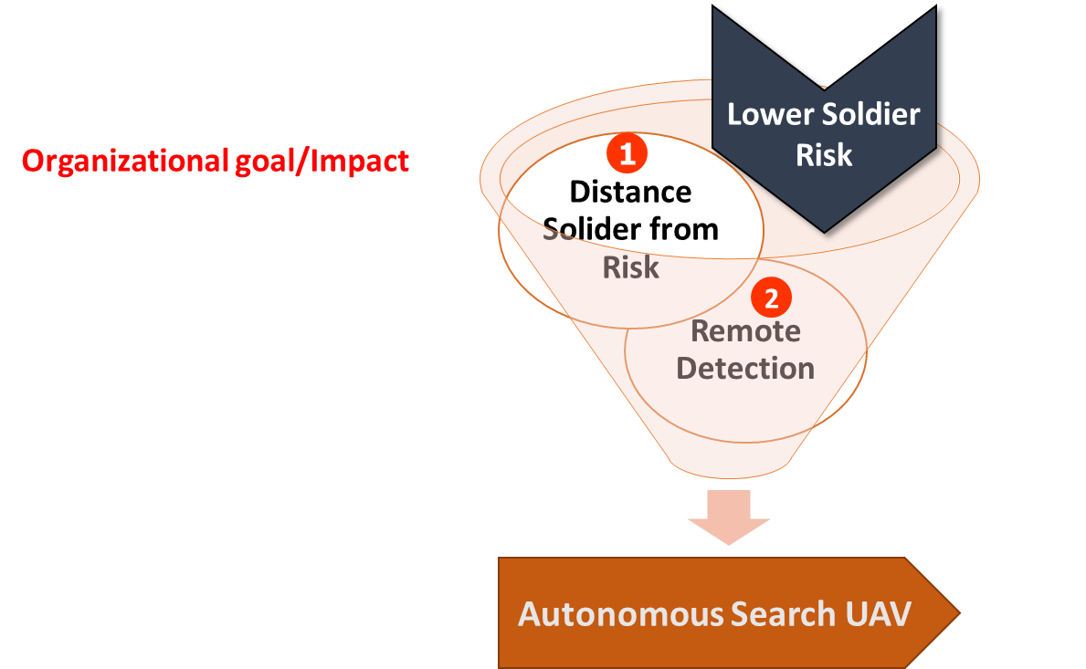
Use Case 2

Slide 58
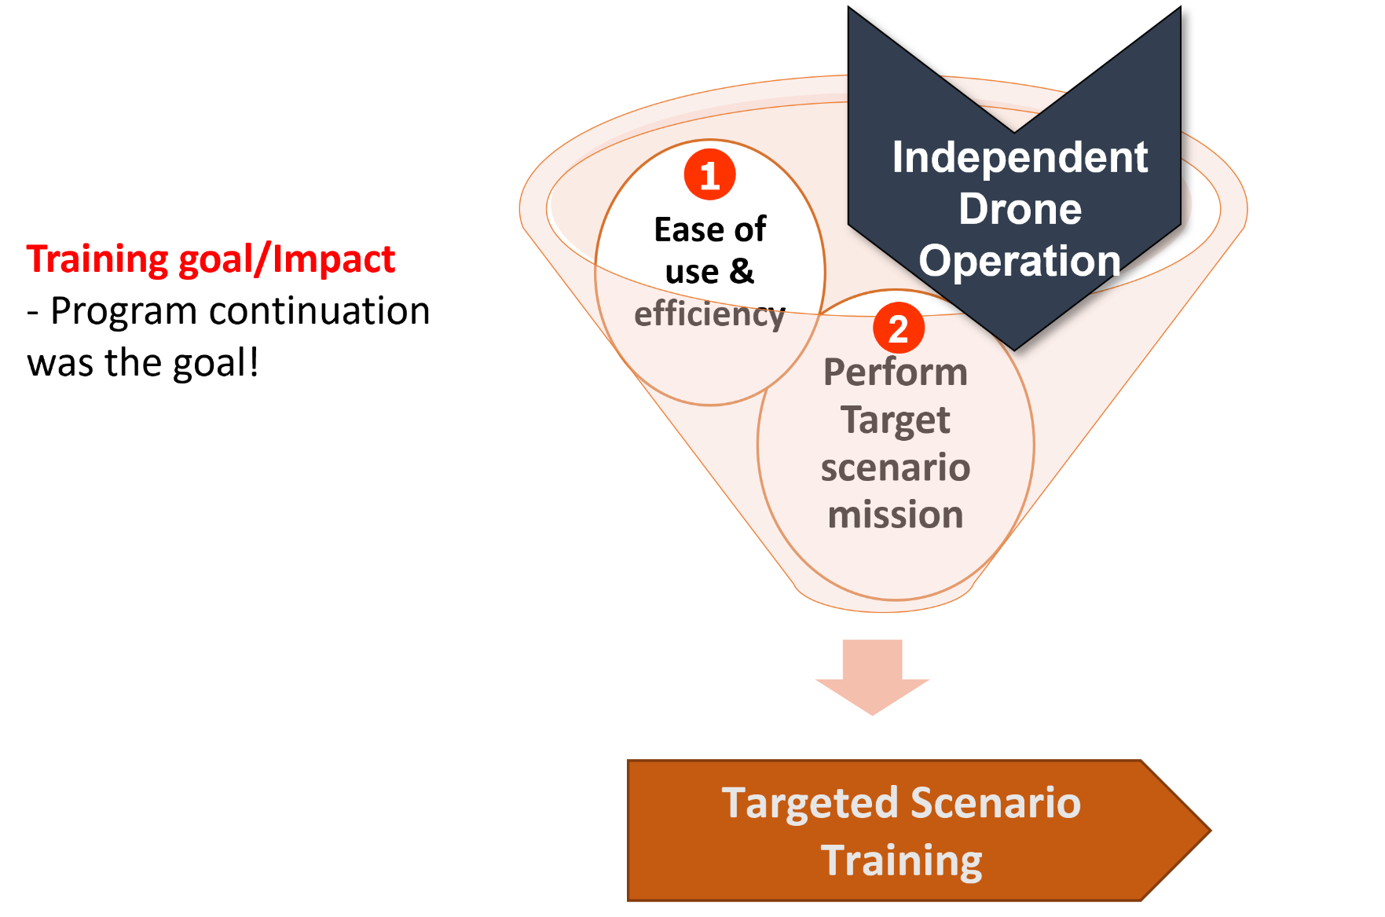
Use Case 2

Slide 59
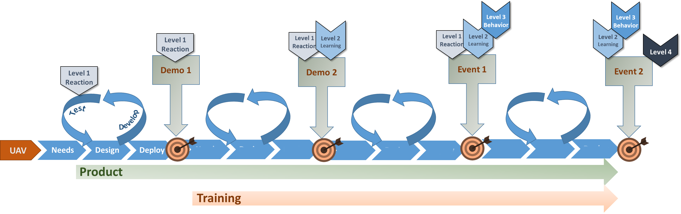
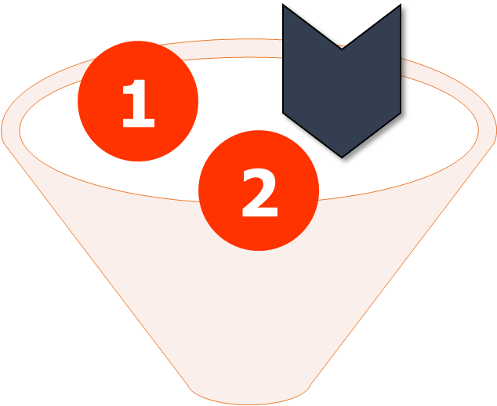
Use Case 2

Slide 60
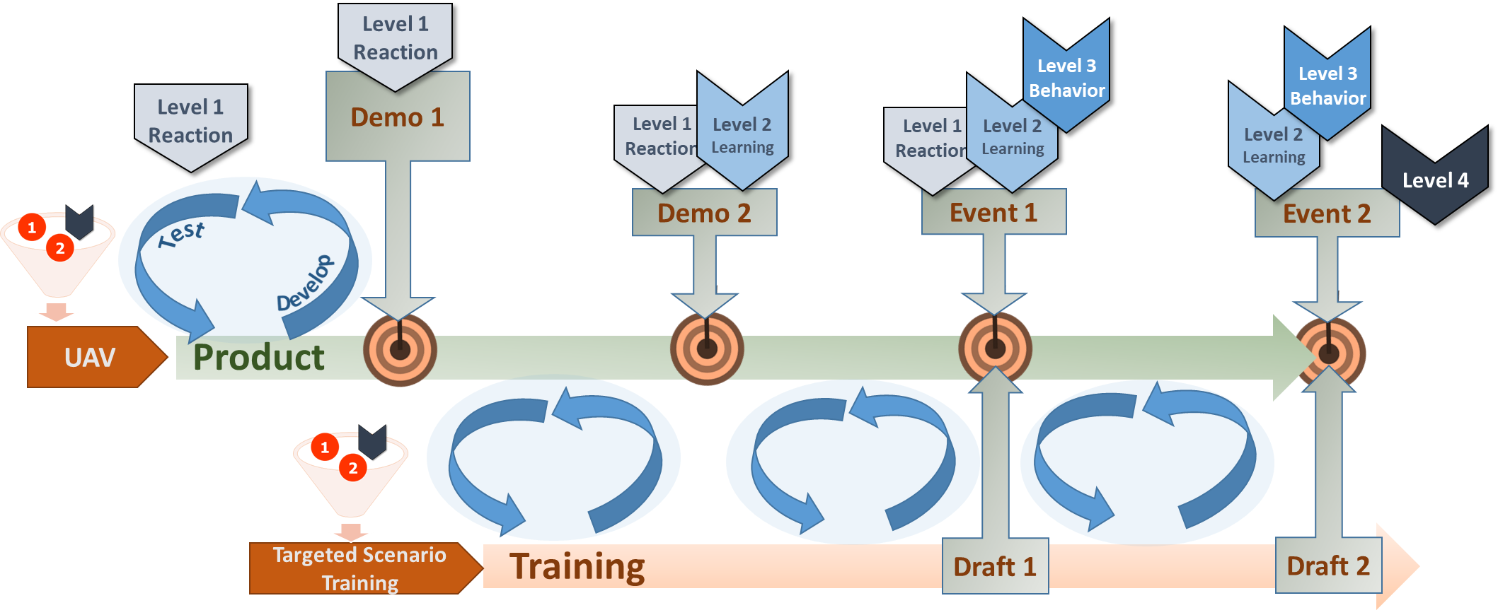
Use Case 2

Slide 61
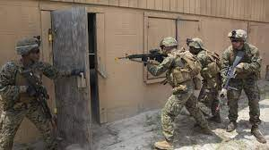
Use Case 3
Evaluating across Simulation-based Training Solutions
How does VR Training Compare to Live Training?

Slide 62
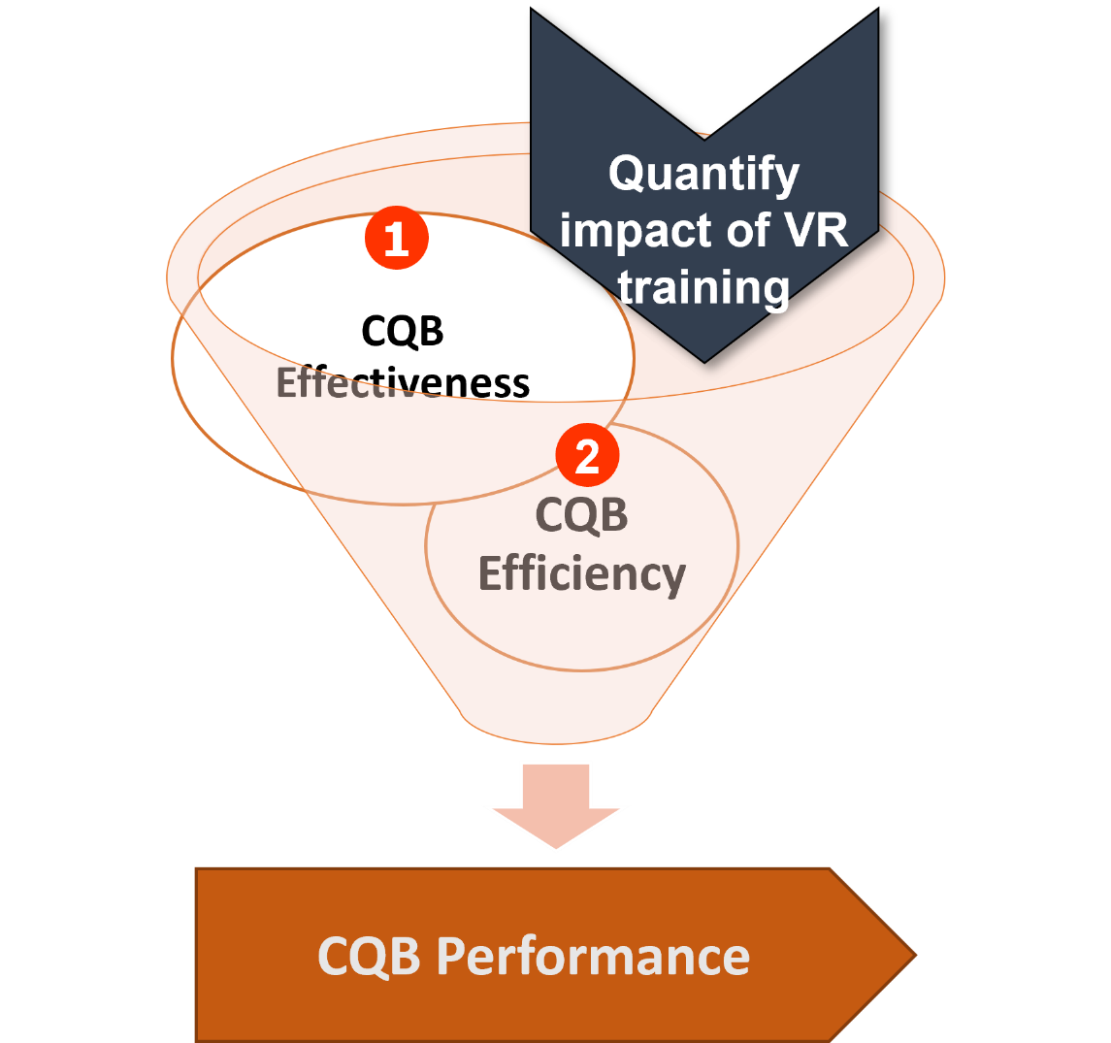
Use Case 3

Slide 63
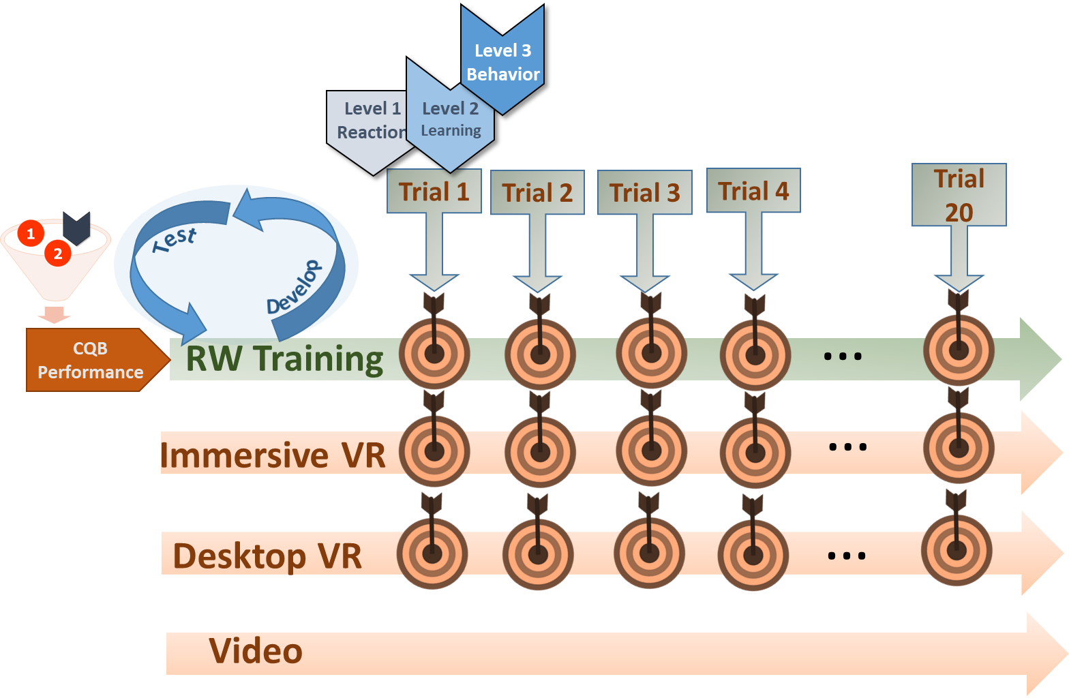


Use Case 3
How many trials to reach criterion?
…
…
…
…
Champney et al., 2017
Notes:
Comparing training trials – how long does it take to reach criterion in each of the VR training environments?

Slide 64

Use Case 3
How many trials to reach criterion?
…
…
2-3 Live Trials Saved
…
…
Champney et al., 2017
Notes:
Comparing training trials – how long does it take to reach criterion in each of the VR training environments?

Slide 65
Use Case 3
Six Immersive VE trials saves 1 Live Trial
(Transfer Effectiveness Raito: 0.165)
…
…
…
…
TER = (Y_{c} - Y_{x})/ X
Champney et al., 2017
Notes:
Yc – RW training group - # live tests to reach criterion
Yx – experimental group - # live tests to reach criterion
X - # trials in training platform

Slide 66
Conclusions

Slide 67
Conclusions
Operational Impact is what every training system sets out to accomplish
Takes up front planning, operational metrics definition to be successful
Agile approach builds evaluation into the process
  Leveraging agile approach allows iterative training evaluation and feedback across Kirkpatrick’s 4 levels of training evaluation

Slide 68
Contact us!
Kelly Hale
Human Factors Engineer; User Experience Group Lead
Draper
(617) 820-8298
khale@draper.com
Amy Taber
Director, Training & Technical Publications
Gemini Technologies, Inc.
(215) 589-2073
Amy.taber@gemintek.com

