Slide 1
Designing Effective, Efficient, and Engaging Training to Accelerate Expertise
Gary Klein, Ph.D., ShadowBox Training LLC
John Schmitt, ShadowBox Training LLC
Reza Jalaeian, Ph.D., ShadowBox Training LLC

Slide 2
Problem Statement
Performance is more complex and more scrutinized than ever.
A challenge for instructional/learning systems designers.
Systematic design of instruction (SDI) can move a large number of performers to certifiable competence.
SDI has less to offer the progression from competent to proficient and expert.
Many studies have been conducted to understand expertise and expert performance.
Few studies have been conducted to systematically develop training regimens that focus on expertise.
Notes:
In today’s world, from surgeons to teachers, performance is more complex and more scrutinized than ever.
In many performance domains, a challenge for instructional designers is to create effective and efficient training that can somehow accelerate the development of performers to higher levels of expertise
systematic design of instruction (SDI), with roots in World War II training, supports the creation of training programs that can move a large number of performers to certifiable competence (Molenda, 2010).
While many studies have been conducted to understand expertise and expert performance (e.g.,Kahneman & Klein, 2009; Salas & Klein; 2001), there have been few studies to develop training regimens that focus on systematically training higher levels of learning and performance associated with experts.

Slide 3
Tutorial Overview
Systematic Design of Instruction (SDI)
Components of the Systems Approach Model
Front-End Analysis
Types of Knowledge and Skill Development
Explicit vs. Tacit Knowledge
Dreyfus & Dreyfus Model
Naturalistic Decision Making (NDM)
Features, Models, and Methods
Accelerating Expertise: Cognitive Dimension Training
Scenario-Based Decision-Making Exercises
Shot in the Crowd
Notes:
This tutorial addresses this challenge. In the first section, we provide an overview of the systematic design of instruction components. We briefly mention the two different types of knowledge. In the second section, we discuss expertise studies, specifically the findings from Naturalistic Decision-Making research. The presentation will review the cognitive aspects of learning (such as diagnosis, sensemaking, decision-making, and immediate feedback) to facilitate rapid learning and specifically guide mental model development.
It will address the application of these cognitive aspects to the design and development of part-task training programs.
And finally, we will discuss a scenario-based method of training emerged from Naturalistic Decision-Making research that allows trainees to practice some of these complex cognitive skills and learn from an expert without an actual expert being present (effective) and in a highly accessible (efficient) and engaging environment.

Slide 4
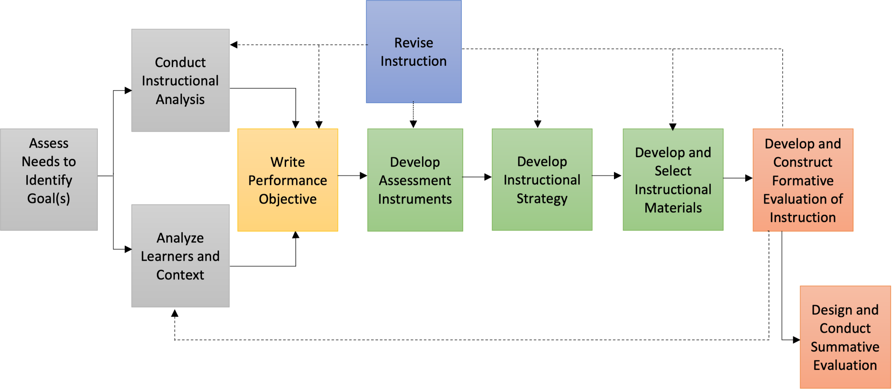
System Approach Model
Dick, W., Carey, L., & Carey, J. O. (2005). The systematic design of instruction. Boston, Massachusetts: Pearson/Allyn and Bacon.
Notes:
it starts with needs assessment and ends with formative and summative assessment.

Slide 5
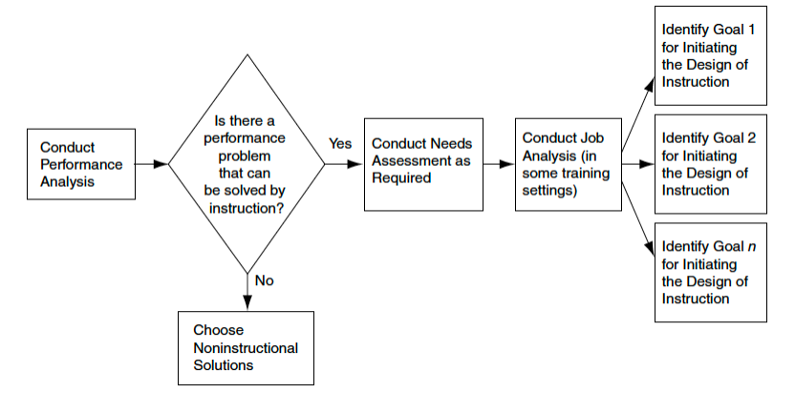
Front-End Analysis to Identify Instructional Goals
Dick, W., Carey, L., & Carey, J. O. (2014). The systematic design of instruction. London, England: Pearson Education Limited.
Notes:
Instructional or training goals are ideally derived through a process of performance analysis that establishes rather broad indications of a problem that can be
solved by providing instruction. Then a needs assessment is conducted to determine more specifically what performance deficiencies will be addressed,
and an instructional goal is stated.

Slide 6
Performance Analysis
Verify and generate a clear description of a problem:
failure to achieve desired organizational results
desired and actual employee performance
evidence of the causes of the problem
Identify and select a solution:
suggest cost effective solutions
can be instructional or non-instructional
usually a multicomponent solution
Non-Instructional problems
Analyzing Performance Problems by Mager and Pipe (1997)
describes decision process for identifying non-instructional problems
Notes:
An ID would apply the three components of needs assessment logic by
working with subject matter experts to develop realistic standards (desired status);
studying work orders through observing, interviewing (actual status);
describing the gaps between standards for performance and actual performance levels (needs).

Slide 7
Need Assessment
A critical component of the total design process
Three components of need assessment:
establishing a goal: desired status
determining the current level of performance on the goal: actual status
gap identification: need
desired status - actual status = need
Need assessment as a tool in the performance analysis
It’s called: Training/Learning Needs Assessment (TNA/LNA)
is used again to identify instructional goals

Slide 8
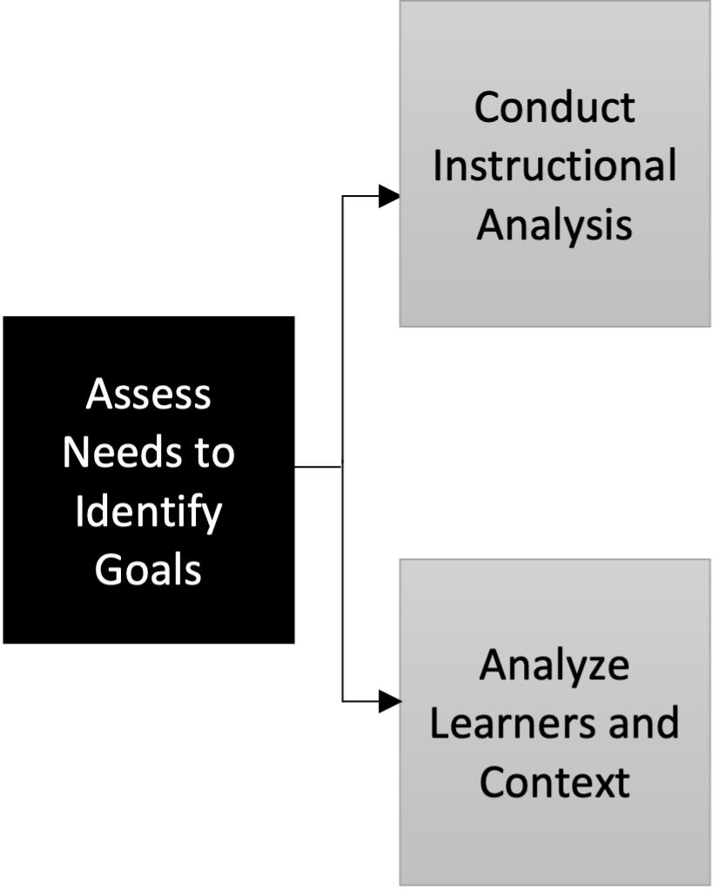
Identify Instructional Goals
The most critical event in the instructional design process.
One step toward a solution to a problem.
Works in conjunction with need assessment.
Four common methods to identify instructional goals:
Subject-Matter Expert Approach
Content Outline Approach
“right type and amount of content”
problem may be due to lack of accountability, lack of incentives, outdated tools, organizational culture
Administrative Mandate Approach
training for the selected goals by mandate
Performance Technology Approach
instructional goals are set in response to problems in an organization
Notes:
An ID would apply the three components of needs assessment logic by (1) working with subject
matter experts in IS to develop realistic standards for workstation first aid performance
by customer service representatives (desired status); (2) studying work orders
and maintenance logs and observing, interviewing, and perhaps testing customer service
representatives (actual status); and (3) describing the gaps between standards for performance and actual performance levels (needs).

Slide 9
Job Analysis/Task Analysis
Job Analysis:
characterize job in general terms
create an inventory of tasks
group similar tasks into categories called duties
screen task inventory by SMEs
create a survey using task inventory and apply final revisions
Task Analysis:
certain tasks are broken into component elements
relationship between elements are explained
tools to perform each element are described
performance standards are written

Slide 10
Case Study: Group Leadership Training
Context:
community volunteer
Problem:
rising neighborhood crime rates
Need:
preparing Neighborhood Crime Watch group leaders
Stakeholder
state department of law enforcement

Slide 11
Performance Analysis
Task Force One: Statewide PA of Neighborhood Policing
Investigating the problem
Identified disparities between ideal community policing levels and the actual level of policing.
conducted a thorough analysis of resources available to local police departments.
conducted an analysis of operational constraints.
Proposing a solution
increasing support for Neighborhood Crime Watch (NCW) organizations.

Slide 12
Need Assessment
Task Force Two: NA for Neighborhood Crime Watch Organizations
determine how to increase the number of active NCW organizations within an area.
improve the effectiveness of existing organizations.
Findings:
1) the NCW leader was the key person in determining the effectiveness of NCW groups.
2) leaders of the most effective groups had well-developed group discussion leadership skills (desired status).
3) there was a chronic deficit of effective NCW leaders (actual status).
Need = develop training for NCW leader volunteers throughout the state

Slide 13
Goal Statement Features
A goal statement should include (Dick et al., 2005):
(a) the learners,
(b) what the learners will be able to do in the performance context,
(c) the performance context in which the skills will be applied,
(d) the tools that will be available to the learners in the performance context
The Acme call center operators will be able to use the Client Helper Support System to provide information to customers who contact the call center.
Tool
Learners
Context
performance

Slide 14
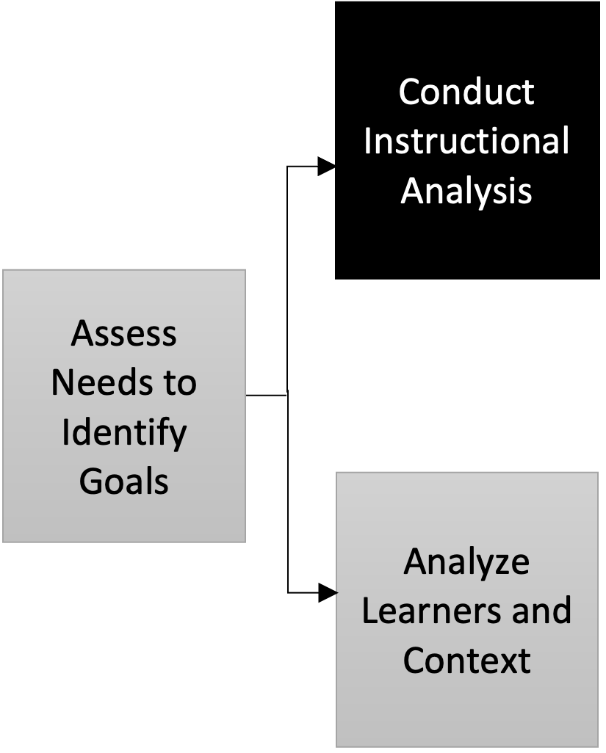
Conduct Instructional Analysis
Also called “Goal Analysis”.
The purpose is to identify the skills and knowledge.
Focused on what learns would be able to do (ID approach) rather than to know (SME approach).
The goal analysis has two major steps:
Link each instructional goal to a learning domain (Bloom) or types of learning (Gagné) & identify and sequence the steps required to accomplish the goal.
identify the appropriate set of subordinate and entry skills for each step.

Slide 15
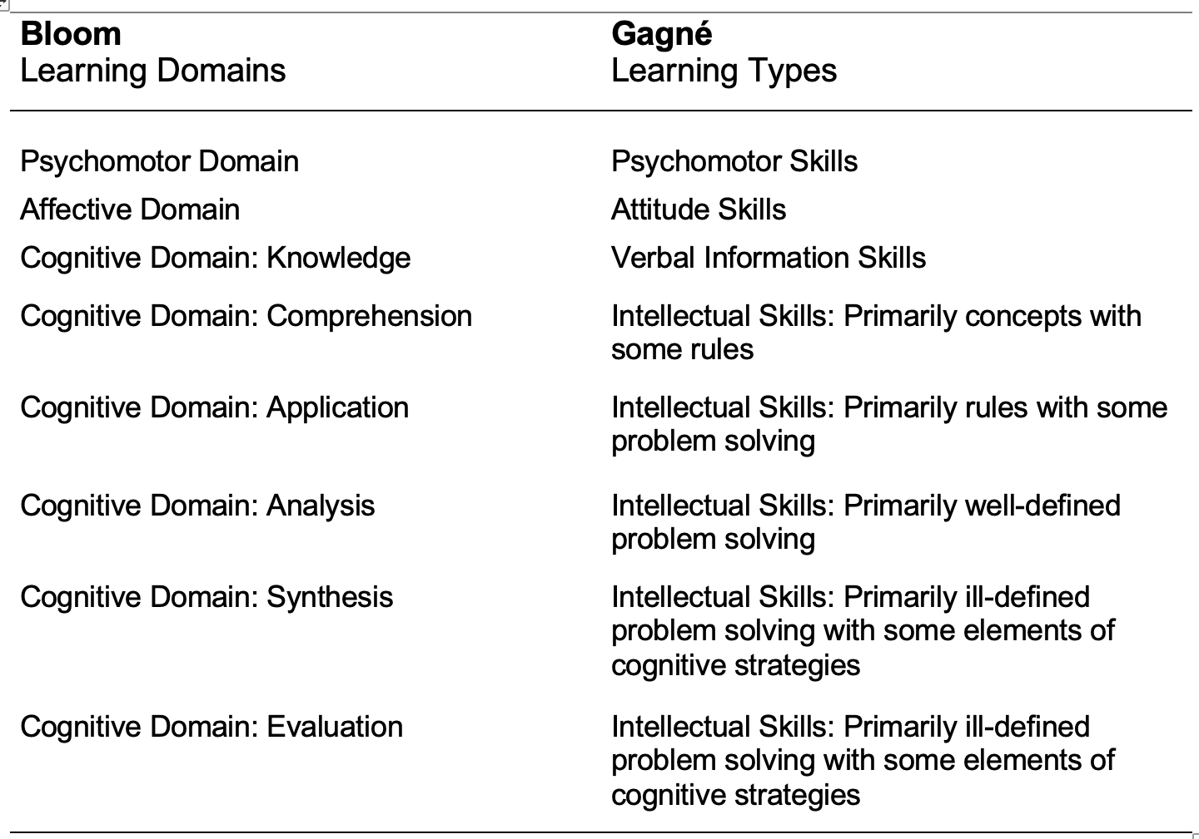
Bloom Learning Domain vs. Gagné Learning Types

Slide 16
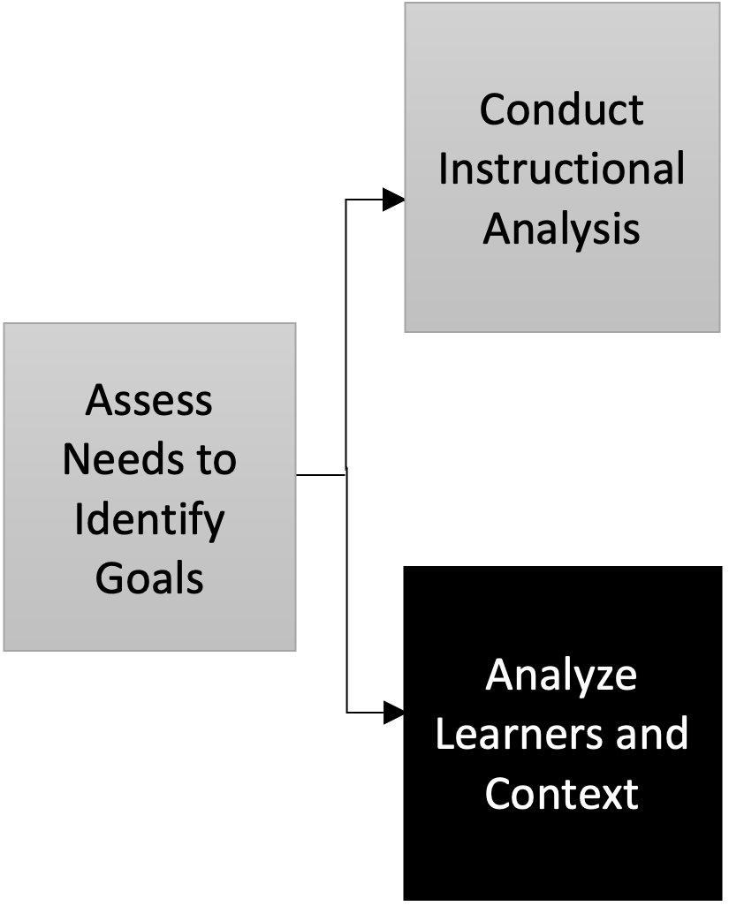
Analyze Learners and Contexts
Learner Analysis Data (LAD) include a description of the learners’:
(1) entry skills and prior knowledge of the topic,
(2) attitudes toward the content and potential delivery system,
(3) academic motivation,
(4) prior achievement and ability levels,
(5) learning preferences,
(6) general attitudes toward the organization providing training, and
(7) group characteristics.

Slide 17
Analyze Learners and Contexts
Performance Context Analysis Data (PCAD) include a description of:
(1) the physical and organizational environment.
(2) a list of any special factors that may facilitate or interfere with the learners’ use of the new skills.
Learning Context Analysis Data (LCAD) include a description of:
(1) the extent to which the site can be used to deliver training.
(2) a list of any limitations that may have serious implications for the project.

Slide 18
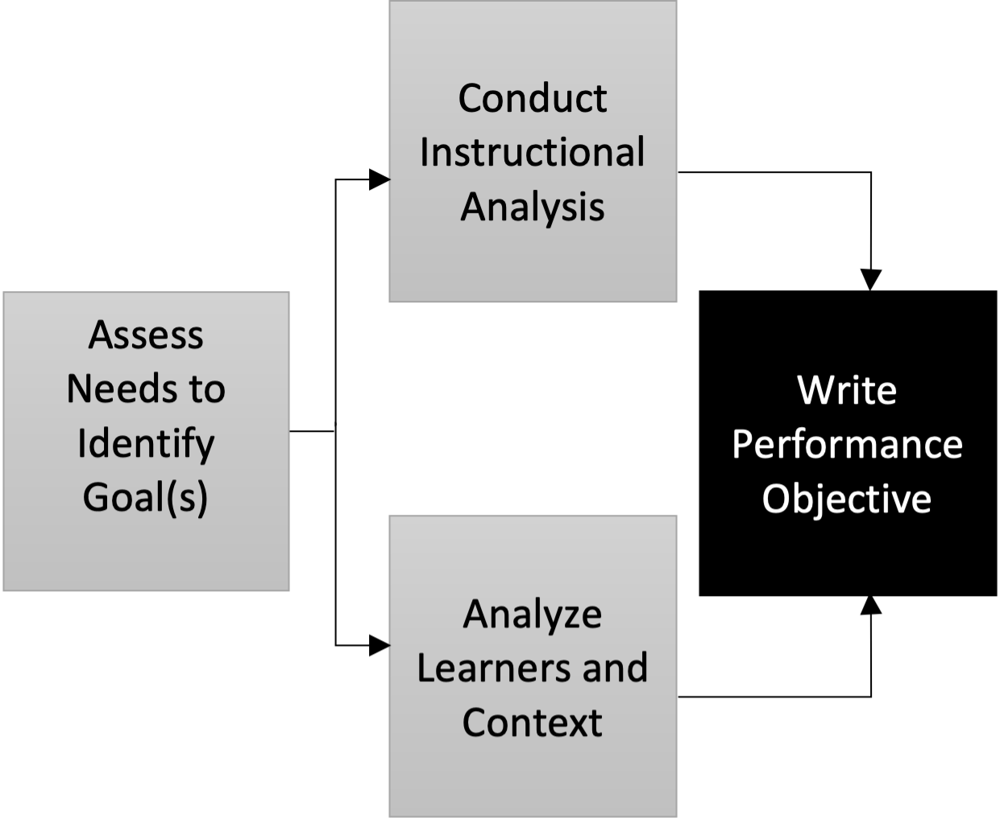
Write Performance Objectives
A detailed description of learner performance:
performance objectives
learning objectives
instructional objectives
behavioral objectives
Terminal objectives
Instructional goals are converted to performance objectives.
Subordinate objectives
Major steps, subskills, and entry skill are converted to performance objectives.

Slide 19
Parts of an Objective
Conditions (CN): a description of the skill identified with the tools and resources needed to achieve the skill.
Behavior (B): a description of the skill including actions, content, or concepts.
Criteria (CR): a description of acceptable performance of the skill.
During a meeting held on campus (CN), successfully demonstrate three different motions on an agricultural issue as the main motion (B). Proper use of motions based on Robert’s Rules of Order will be used to judge achievement of this goal (CR).

Slide 20
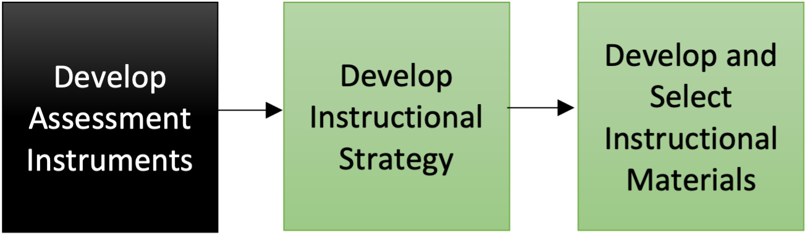
Develop Assessment Instruments
Learner-centered assessment or criterion-referenced testing is a central element of SDI.
Four Types of Criterion-Referenced Tests:
Entry Skills Tests: given to learners before they begin instruction.
Pretests: administered to learners before instruction for the sake of efficiency.
Practice Tests: provide active learner participation during instruction.
Posttests: used to assess learner performance and to assign credit for successful completion of a program or course.
Notes:
Administered to learners before instruction for the sake of efficiency—to determine whether they have previously mastered some or all of the skills that are to be included in the instruction.

Slide 21
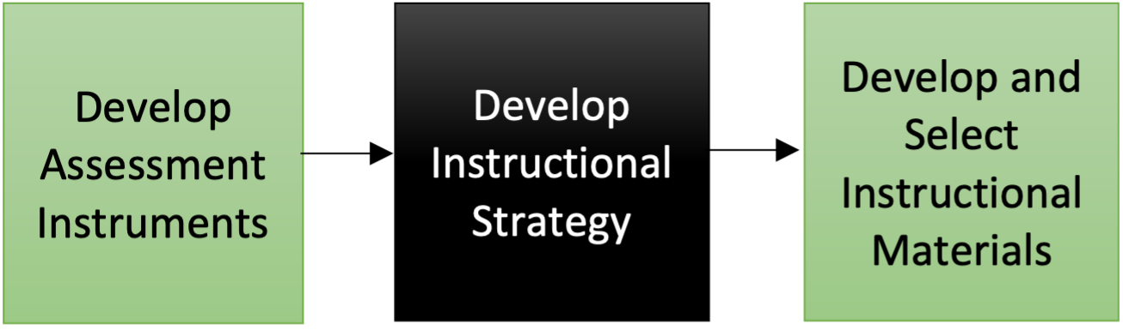
Develop Instructional Strategy
How to teach?
Instructional Strategy includes:
choosing a delivery system,
sequencing and grouping clusters of content,
describing learning components that will be included in the instruction,
specifying how students will be grouped during instruction,
establishing lesson structures, and
selecting media for delivering instruction.
Notes:
a general methodology that is used for managing and delivering the teaching and learning activities that we call instruction. This general methodology is referred to as the delivery system. it is an active decision that is made as part of developing an instructional strategy.

Slide 22
Delivery System
Traditional model—instructor with group of learners in classroom, training center,
or lab.
Large-group lecture with small-group question and answer follow-up.
Computer-based instruction:
Can range from independent study to instructor-facilitated.
Can range from textual drill and practice to fully interactive multimedia.
Can include simulation, gaming, intelligent tutoring, and virtual realit.y
Online Instruction.
Self-paced programs that include a combinations of instructor or tutor and print or mediated learning.
Site-based internship and mentoring.

Slide 23
Learning Components of Instructional Strategy
Cognitive Approach to ID:
Nine Events of Instruction
Bloom Taxonomy
Four-Component Instructional Design
Instructional Transaction Theory (ITT)
First Principles of Instruction
The Elaboration Theory
Integrated Thematic Instruction
Learning by Doing
Notes:
Gagné’s cognitive view of instruction is often characterized as quite purposeful and prescriptive, more teacher-centered than student centered. The Dick and Carey model is based on this cognitive perspective

Slide 24
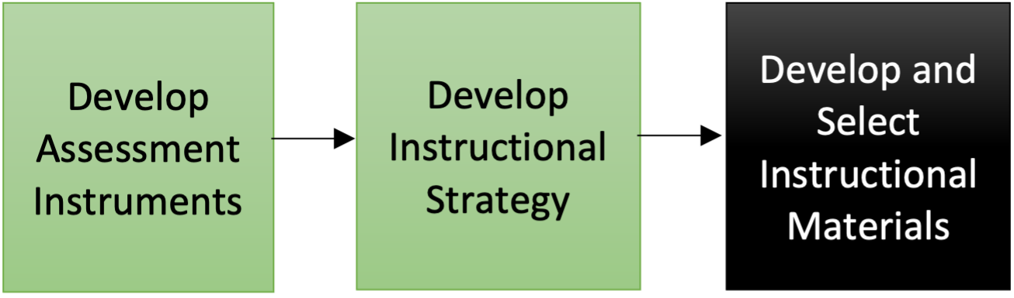
Develop and Select Instructional Materials
Four broad tasks to guide instructional materials development:
Reconsider delivery system and media selection.
Determine components of the instructional package.
Consider existing instructional materials.
Develop instructional materials.

Slide 25
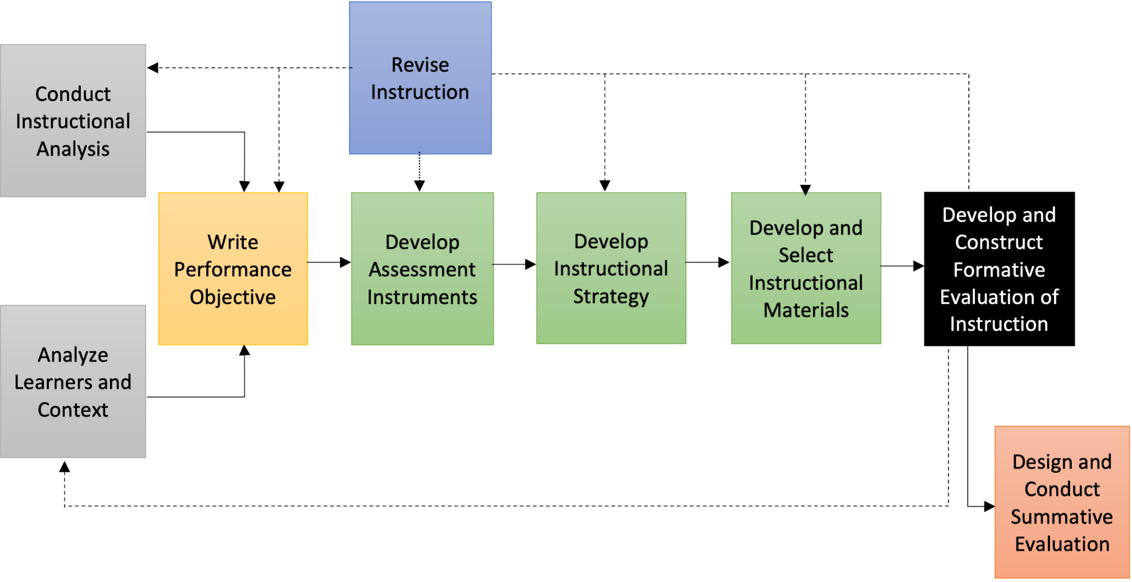
Design and Conduct the Formative Evaluation
The process of collecting and analyzing data to revise instruction.
make it more efficient and effective.
Three basic phases of formative evaluation:
one-to-one or clinical evaluation
small-group evaluation
field trial
Selected methods of performing formative evaluation:
Questioning content
Observations of learners
Interviews
Short quizzes
Discussion

Slide 26
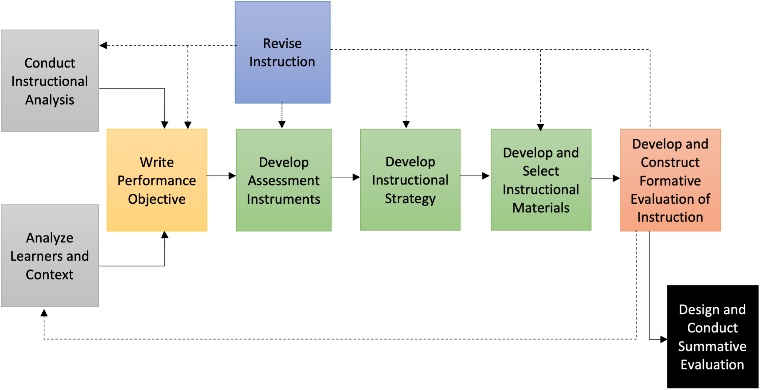
Design and Conduct Summative Evaluation
SE is a collection of data that looks at the effectiveness of instruction as a whole.
Measures an entire unit of instruction and multiple performance objectives.
Objectives should match the summative evaluation.
Summative evaluations differ from formative evaluations:
Formative evaluations identify improvements needed during instruction.
Summative evaluations identify strengths and improvements after instruction.

Slide 27
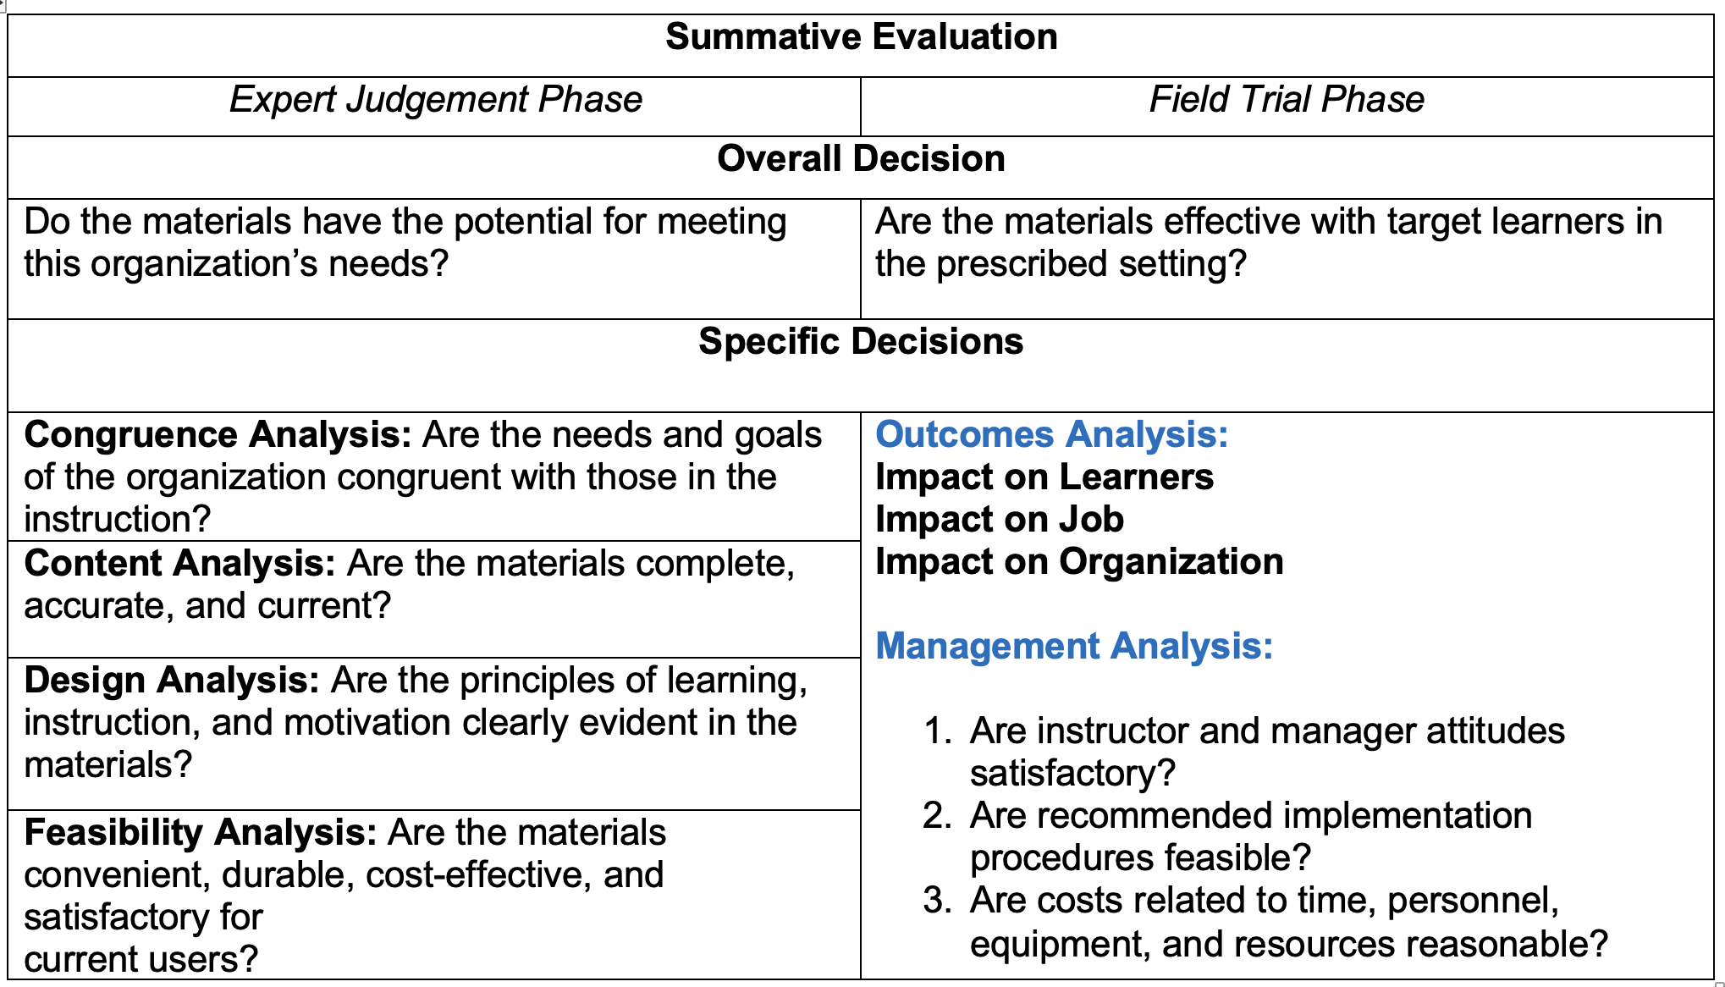
Two Phases of Summative Evaluation

Slide 28
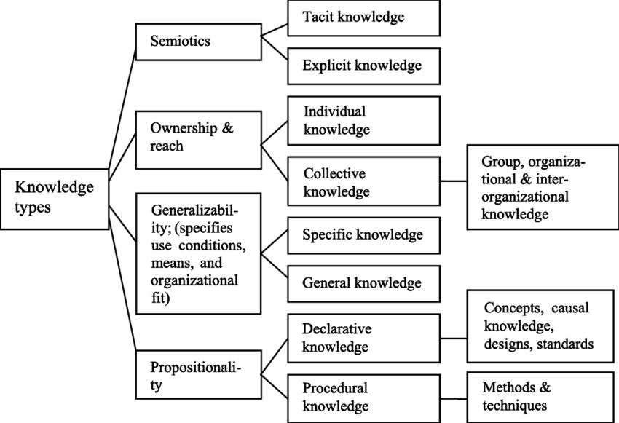
Classification of Knowledge Types in Cognitive Domain
A classification of knowledge types based on Alavi and Leidner (2001). Adapted from Wijnhoven (2008)
Notes:
There are various types of knowledge classification. This specific classification is the most frequently used one in the knowledge management literature.

Slide 29


Explicit vs. Tacit Knowledge
Distinction between tacit and explicit knowledge:
“we can know more than we can tell”
The part that we can tell is the explicit part and the part that we cannot tell is the tacit part of knowledge.
Polanyi M (1966) The Tacit Dimension. Anchor Books, Garden City (NY).

Slide 30
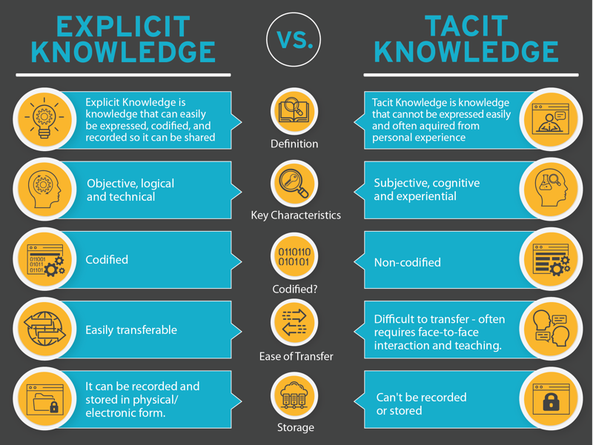
Explicit Knowledge vs. Tacit Knowledge

Slide 31
Types of Knowledge and Skill Development
Explicit knowledge can be:
Conceptual
Factual
Procedural
Knowledge can be transferred from one person to another.
Knowledge can be self acquired through observation and study.
Skills refer to the ability to apply knowledge to specific situations.
Skills are developed through:
Practice.
Trial and error is probably the best way to achieve skills mastery.

Slide 32
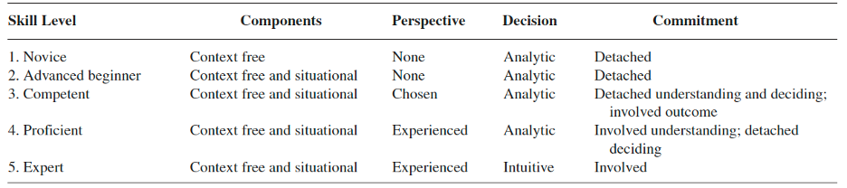
Five Stages of Skill Acquisition
As cited in Dreyfus (2004)

Slide 33
Five Stages of Skill Acquisition
Novice
A novice is just learning the basics of a subject, along with fundamental concepts and specific rules of action. They are unable to exercise discretionary judgment and have rigid adherence to taught rules or plans.
Advanced Beginner
The advanced beginner is beginning to connect relevant contexts to the rules and facts they are learning. Adding to their knowledge of facts, they are recognizing previously undefined facts and increasing their knowledge of relevant concepts, vocabulary, and principles. Individuals at this level may have no sense of practical priority. All aspects of work may be treated separately and will likely have equal importance.
Competence
A competent performer is beginning to recognize more context-free principles and concepts as well as situational elements. A person at this level is able to select rules or perspectives appropriate to the situation, taking responsibility for the approach.

Slide 34
Five Stages of Skill Acquisition
Proficient
A proficient performer has experience making situational discriminations that enables the recognition of problems and the best approaches for solving the problems. At this stage, intuitive reactions replace reasoned responses. A person at this level implements decisions based on intuitive understanding because of their experiences.
Expertise
The expert can see what needs to be achieved and how to achieve it. This level of performer can make more refined and subtle discriminations than a proficient performer, tailoring approach and method to each situation based on this level of skill. The major difference between individuals in the stages of proficiency and expertise is that what experts do almost always works. Proficient people still make mistakes; experts provide an almost perfect performance.

Slide 35
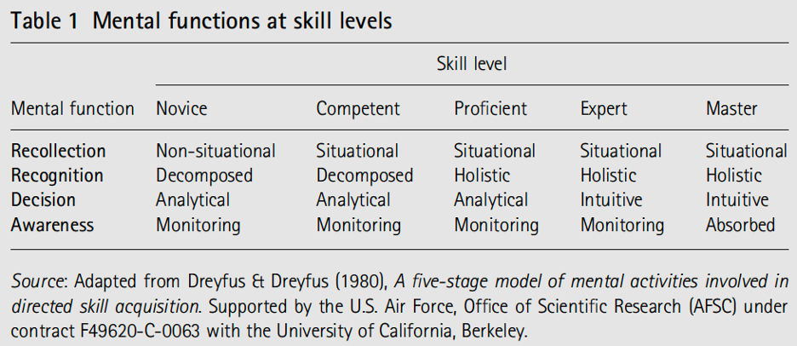
Dreyfus Stages of Development
Notes:
While many models depict stages in the development of performers (see Hoffman et al., 2014 for a summary), we adopt the original Dreyfus and Dreyfus (1980) 5-Stage Model of adult learning and development.
This model positions expert as a level below the penultimate level of master.

Slide 36
Beyond Competent to Proficient and Expert
Proficient, and even expert levels are achieved on the job.
Focusing on the transition points between skill levels.
Highlights changes in mental functions.
Present particularly rich opportunities for accelerated development.
The transition from competent to proficient, for example, is marked by a change in recognition from decomposed (i.e., rule-based) to holistic (situation-based).
Transition from proficient to expert is marked by a change from analytical to intuitive decision making.
Notes:
Proficient, and even expert, are levels that performers can reasonably expect to reach in the course of a career spent in a profession.
Focusing on the transition points between skill levels highlights changes in mental functions that present particularly rich opportunities for accelerated development.
The transition from competent to proficient, for example, is marked by a change in recognition from decomposed (i.e., rule-based) to holistic (situation-based).
The transition from proficient to expert is marked by a change from analytical to intuitive decision making (Klein, 2015).
Based on performers’ maturing mental representations emanating from extended domain experience (Ericsson, 2015).

Slide 37
Cognitive Dimension in Complex Domains
What can go wrong?
What are the tough decisions?
What makes situations difficult?
How can people get confused?
What are the common mistakes newer people make?
How can you recover from mistakes?
How do experienced performers actually manage risks and make tradeoffs?
These aspects of performance are typically gained through experience (and they are typically ignored)

Slide 38



Expertise in Complex Work

Slide 39
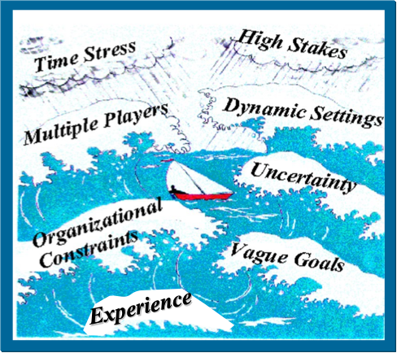
Features of Naturalistic Decision Making

Slide 40
NDM Approach
NDM Approach Analytical Approach
ID strengths ID biases
Unpack expertise Debunk expertise
Tacit knowledge Explicit knowledge
How do people think What do people do
Tough decisions Tasks and flow charts
Work in field settings Laboratory-based
Study incidents Study artificial tasks
Goal: Build skills/biases Goal: Eliminate errors
Make discoveries Test hypotheses

Slide 41
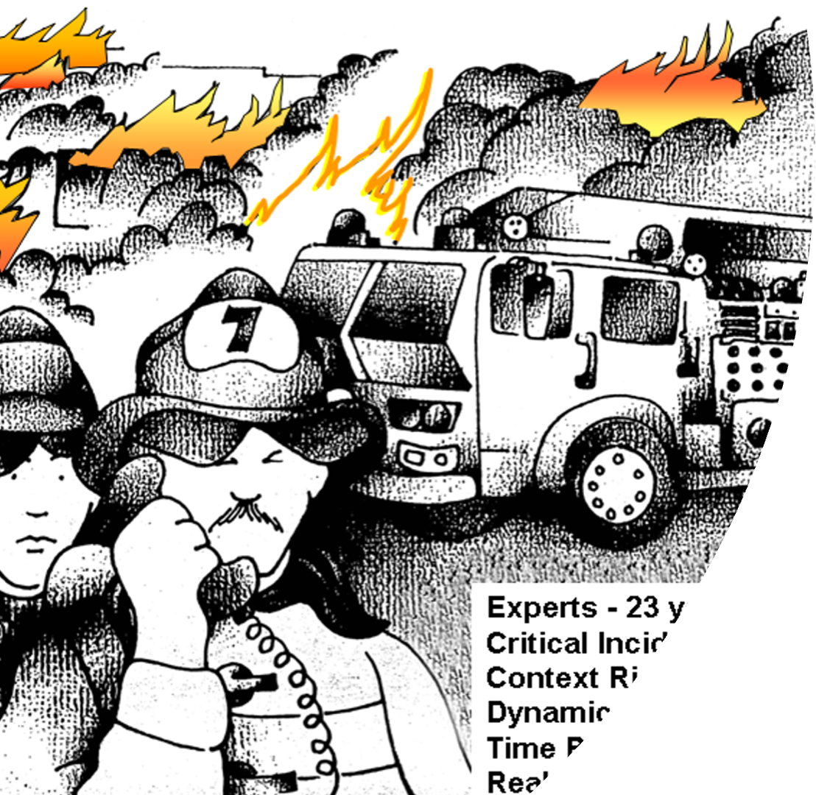
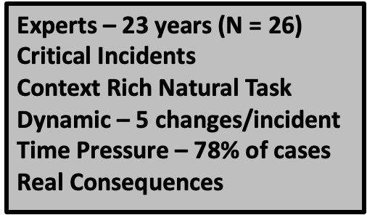
Fireground Decision Making

Slide 42
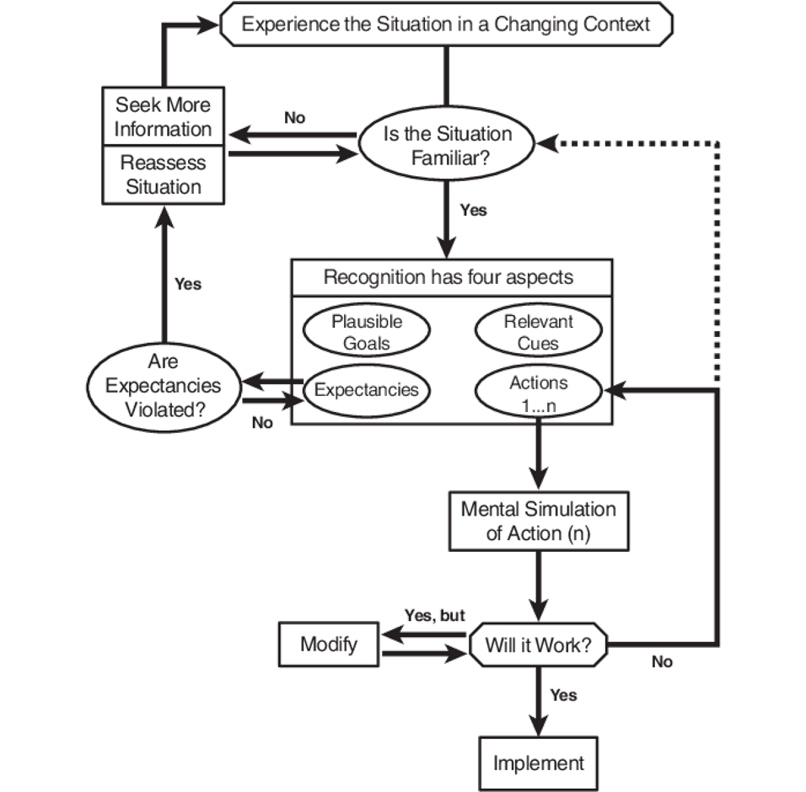
Recognition Primed Decision Making

Slide 43
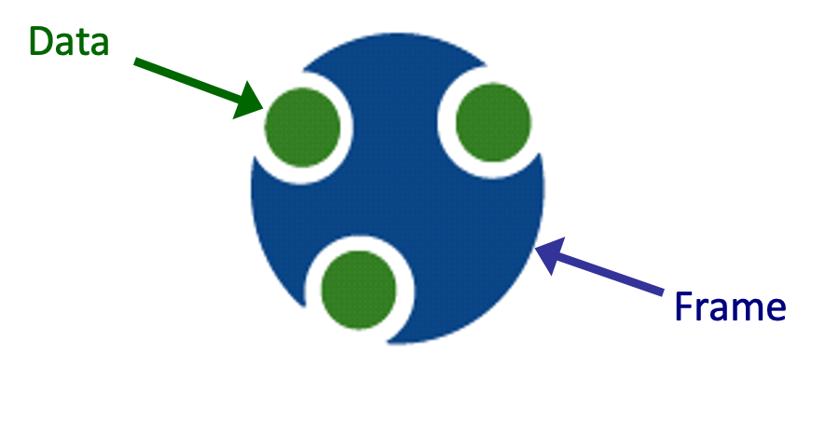
Sensemaking
Sensemaking is the process of fitting data into a frame and fitting a frame around the data.
[As opposed to generating inferences from data]
[Frame = Organizing structure, e.g., story, script, map]

Slide 44
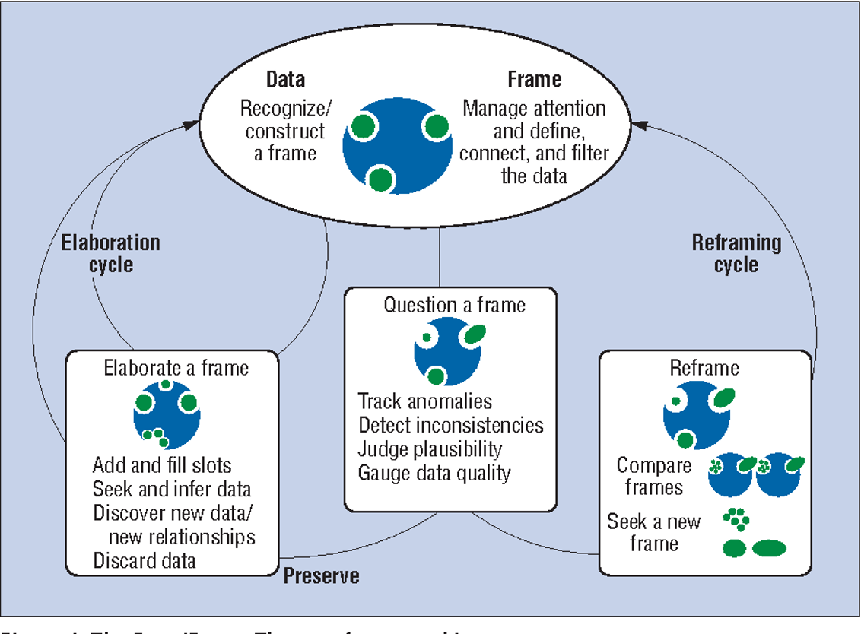
Sensemaking
Motivated, continuous effort to understand connections (which can be among people, places, and events) in order to anticipate their trajectories and act effectively

Slide 45
NDM Models, Methods, & Tools
Models | Methods | Tools
Recognition-Primed Decision (RPD) | Systems Design (Decision-Centered Design, Principles for Collaborative Automation, Principles for Human-Centered Computing) | Training (Decision Making Exercises, ShadowBox, Tactical Decision Games, CAARGO)
Triple Path Model of Insight | Knowledge Elicitation (CDM, SAR, ACTA, Cognitive Audit, Team CTA) | Artificial Intelligence Quotient (AIQ)
Data Frame Model of Sensemaking | Risk Assessment (Pre-mortem) | Human-Machine Teaming Guide
Cognimeter | Critical Cue Inventory | Cognitive Requirements Table
Management-by-Discovery/Flexicution | Contextual Activity Templates | Integrated Cognitive Analysis for Human-Machine Teaming
Naturalistic Models of Explaining | Work-Centered Evaluation | Diagram of Work Organization Possibilities
Problem Detection Model | SA Calibration Questions | Concept Mapping (Sero!)
Cultural Lens Model

Slide 46
Extracting Tacit Knowledge
Cognitive Task Analysis (CTA)
Uncovering the cognitive activities involved in performing a complex task
Sensemaking
problem solving
decision making
Applications
Informs design of training programs, job-aids, interfaces
Techniques
Critical Decision Method
Applied CTA
Concept mapping

Slide 47
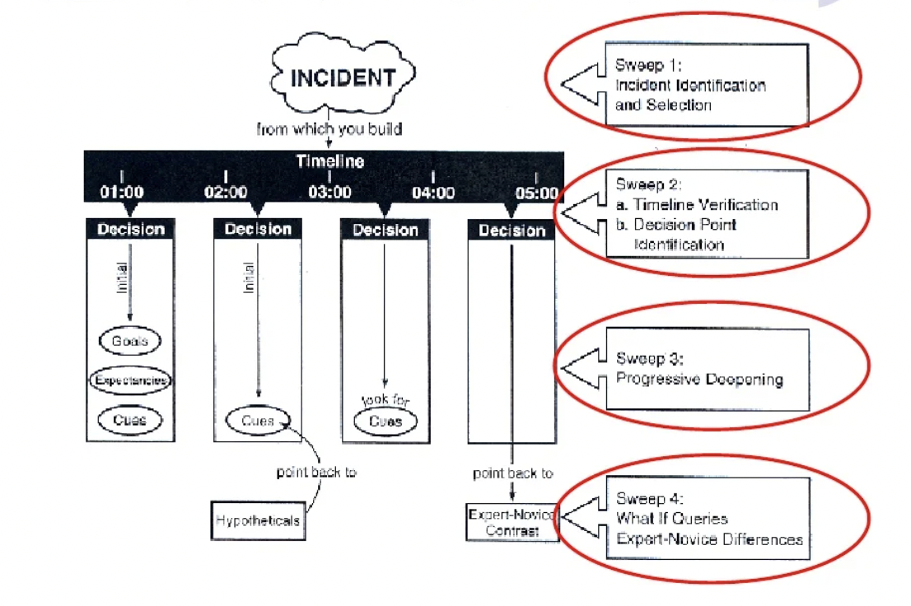
Critical Decision Method
Klein, Calderwood, MacGregor, 1989)

Slide 48


Accelerating Expertise: Cognitive Skills Training
Storehouse metaphor
Identify gaps, introduce information, provide feedback
Facts, rules, protocols, procedures
Problem
Fails to train core components of expertise
Cognitive skills
Scientist Metaphor
Cognitive Transformation Theory (Klein & Baxter, 2008)
Restructuring flawed mental models

Slide 49
Pedagogical Elements to Accelerate Expertise
Cognitive Transformation Theory
Diagnosing flaws in a one’s mental model
Emphasizing sensemaking within learning objectives
Encouraging reflection as part of the learning process to assist mental model refinement, which can include restructuring or abandoning existing mental models that are flawed
Practicing sensemaking strategies to learn what data is relevant vs. noise/irrelevant
Introducing immediate nondisruptive feedback that requires sensemaking and encourages the learner to seek and interpret feedback on their own
Notes:
Building on the work of Klein & Baxter’s Cognitive Transformation Theory (2006), accelerated expertise concepts (Hoffman et al., 2014), and the ShadowBox training methodology (Hintze, 2008; Klein, Hintze, & Saab, 2013; Klein & Borders, 2016), we propose the following pedagogical elements to facilitate the development of expertise in highly complex and dynamic situations:
These teaching elements highlight the importance of practice, diagnosis, sensemaking, and feedback to facilitate learning, and specifically guide mental model development. Mental models are psychological representations comprising of interconnected knowledge and causal relationships about system’s form and function. Importantly, individuals rely on their mental models to describe, explain, and predict how events unfold. Forming and revising one’s mental model is an active and intentional process that involves sensemaking activities (Klein, Moon, & Hoffman, 2006a).

Slide 50
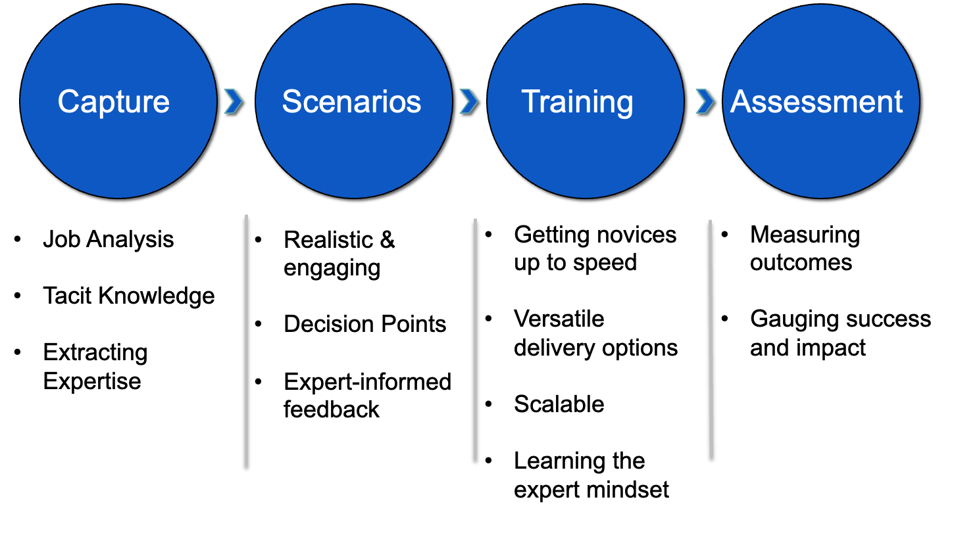
Building Training to Accelerate Expertise

Slide 51
Decision Making Exercises
Encourages cognitive transformation
Facilitates active (un)learning
Building pattern sets
Promotes discovery
Augments on-the-job experience with training exercises:
Presenting a wide range of situations
Providing targeted feedback
Restructuring mental models

Slide 52
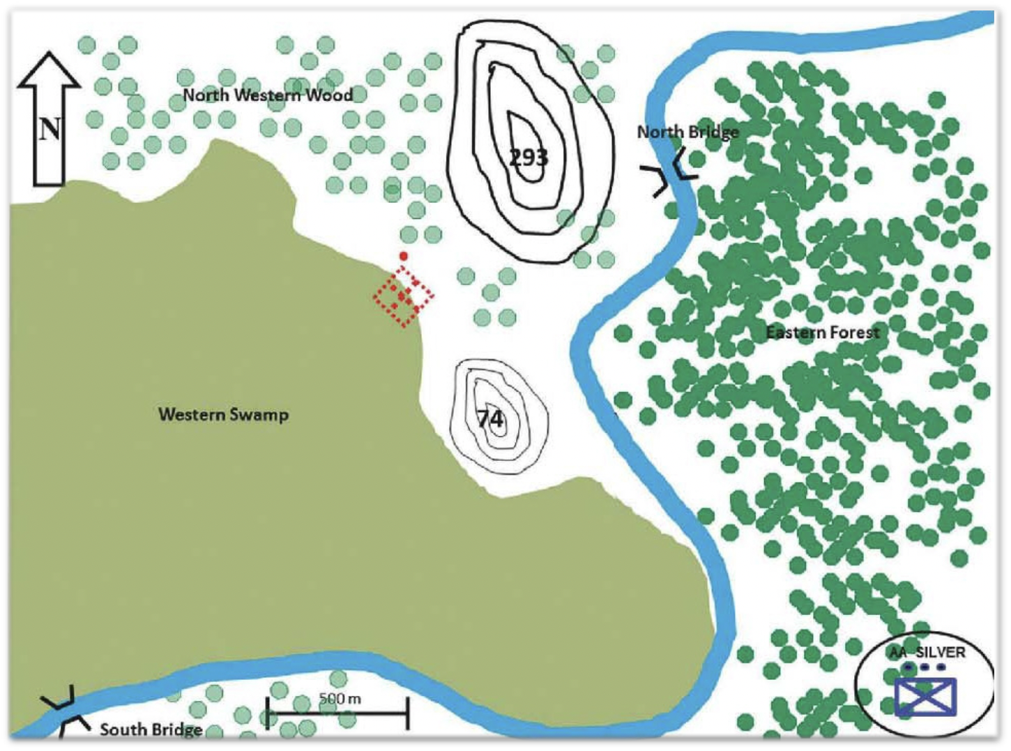
Scenario-Based Decision Making Exercises
Tactical Decision Games
Presents dynamic scenarios using graphics/maps
Places the participate in the action
Assess the situation and make decisions
Facilitator leads the activity
Analyzes the participants’ assessments
Group learning activity

Slide 53
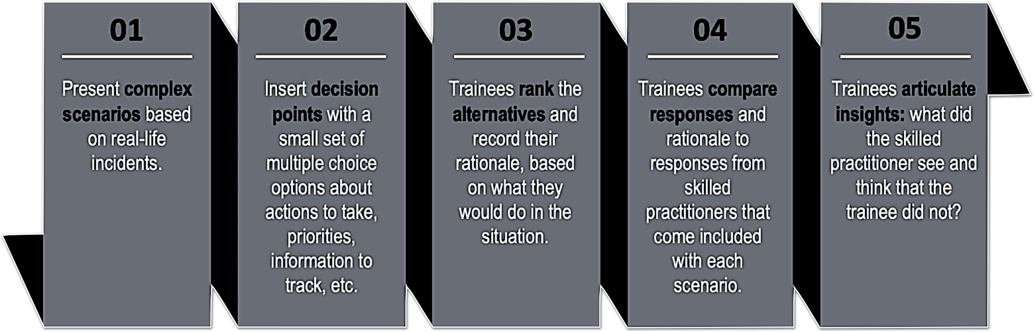
Scenario-Based Decision Making Exercises
Scenario Training with Subject Matter Expert Feedback

Slide 54
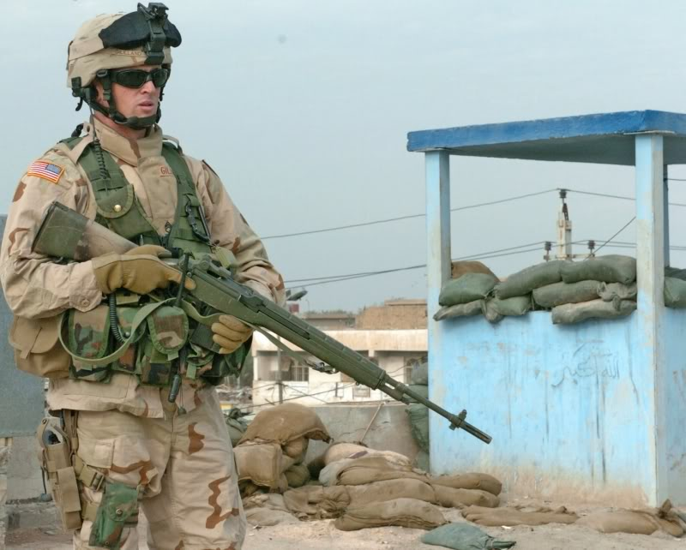
Scenario Training Example
Shots into a Crowd

Slide 55
Scenario Training Example
The following scenario-based method was designed to improve decision-making capabilities. Scenarios are based on real-world experiences. The decisions made by the experts in each scenario have been proven very effective. When you answer the decision questions, try to anticipate how a panel of experts would have answered.
Method
Scenario Passage
Decision Point (rankings & rationale)
Expert feedback (rankings & rationale)
The general procedure is as follows:
Read the scenario passage until you reach a decision point.
You will rank order the decision options according to the instructions. You are not allowed to go back to the scenario.
After recording your decision, write down the rationale for your decision(s). This is the reason certain actions were more important than others. Provide enough information so another person can understand your rankings.
Review the expert responses. How did they respond to the decision point? How did your response(s) align with theirs? What did they pick up on that you may have missed? Be sure to record these notes somewhere.

Slide 56
Shots into a Crowd
Capt Guerra has just discovered that he and his men are being assigned to a Shiite town in Iraq, where Special Forces have arrested the Police Chief. The police chief had been appointed by one of the US intelligence agencies just a few weeks before. The Police Chief was arrested for taking all the weapons from the police armory and sending them to insurgent groups. He was also supplying the insurgent groups with valuable intelligence.
It turns out that he was a leader among the insurgents. He was on the top 20 most wanted list. Why he was appointed by US intelligence remains a mystery. Special Forces were successful in capturing the former Chief, but not before he terrorized the local community.
Capt Guerra has not been given much detail about how all this happened. He knows he is walking into a mess.

Slide 57
Shots into a Crowd
What should Capt Guerra be most concerned about with this new deployment? Rank these options (1 = most concerning, 4 = least concerning).
Rank | Option
 | A) Restoring trust in a community who has been taken advantage of by their own people as well as the Americans.
 | B) Getting his men to shift from fighting to community policing.
 | C) Explaining the rules to the leaders of the community--what they are allowed to do and not do, and what his Marines are allowed to do and not do.
 | D) Taking charge of the situation, exercising authority over the community and local leaders until things calm down and the local leaders can handle things on their own.

Slide 58
Shots into a Crowd
1. A. Restoring trust in the community. Recognizing and admitting mistakes that have been made on all sides will be critical to mending the damage and restoring trust.
2. B. Getting his men to shift from fighting to community policing. Preparing his men to shift from direct combat to fostering trust in a fearful community will take effort and should be a priority.
3. C. Explaining the rules to the leaders of the community. Establishing expectations on both ides will be important to restoring order and will contribute to building trust if applied consistently and fairly, but it is a means to an end rather than an end in itself. The risk for this option is that it can be pursued as a “laying down the law” message—just the opposite of building trust and encouraging collaboration. So it is important to communicate expectancies but in a collaborative rather than domineering fashion.
4. D. Take charge of the situation and exercise authority. This option is a step backward, fostering resentment and mistrust.

Slide 59
Shots into a Crowd
Capt Guerra arranges a meeting with the local council at the community center the next day, Monday. He wants to learn who all the major players are, so he can start to figure out whom he can trust. He also wants to make sure everyone understands the rules by which he will be operating.
Capt Guerra arrives at the meeting with a rifle squad and 3 armored HMMWVs. He enters the community center and is directed to a large meeting room.
Before Capt Guerra can take a seat, two men enter the room and approach him. He learns that one is Mayor Alaan and the other is Fardeen, an English teacher at the local school, who will serve as translator. Capt Guerra gives the list of items to discuss to Fardeen, who translates for the council.

Slide 60
Shots into a Crowd
The meeting lasts two hours. There are no major problems. Several council members have questions about the list. Some council members speak angrily. (Capt Guerra senses that Fardeen may be translating delicately.) Capt Guerra tries to answer their questions as honestly and directly as possible. Some of the elders say they are not ready to trust the Americans. The council arranges to meet with Capt Guerra again the next day to discuss his items.
Capt Guerra walks out of the meeting with Alaan. Just as they get outside they hear machine gun fire. Capt Guerra immediately assumes the worst—an attack on his Marines. He gets on the radio and calls back to headquarters for information. A local youth runs up and says that a 10-year-old boy and two male teenagers have been shot and need medical attention. Chaos has broken out. People are running, screaming. The Marines take a defensive posture around the HMMWVs. The executive officer tells Capt Guerra over the radio that one of his machine gunners had an accidental discharge. The teenagers’ wounds do not seem to be life threatening, but the 10-year-old is “pretty bad.”

Slide 61
Shots into a Crowd
What is Capt Guerra’s best course of action? Rank these options (1 = best action, 3 = worst action).
Rank | Option
 | A) Capt Guerra should get his unit to provide immediate first aid and order an urgent medevac for the victims. The Marines will take the children and their parents to the nearest aid station for the necessary medical care.
 | B) Capt Guerra should direct his company to withdraw immediately from the area. They are no longer safe or welcome, and instead are a provocation. Any chance of gaining local cooperation is now lost.
 | C) Capt Guerra should return to base and to take up a defensive position to repel the inevitable conflict from the local militia. He should call higher headquarters to report that he is expecting an imminent uprising.

Slide 62
Shots into a Crowd
1. A. Get his unit to provide first aid. Since we caused the incident, wh have got to do something to make things right. Security is a consideration here while simultaneously addressing the wounded civilians, Trust and rapport might be by-products of addressing the wounded personnel, but the primary purpose here is to do the right thing while maintaining security,
2. C. Return to base and take up a defensive posture. This option alone is unacceptable. Calling headquarters to report a potential uprising might be prudent, but attending to the wounded civilians should take priority even if reinforcements are necessary. Hunkering down for a fight might prove to be a self-fulfilling prophesy.
3. B. Direct his company to withdraw immediately from the area. This option is unacceptable. Yes, the company is now a provocation, but the important thing now is to tend to the wounded. Failing to do so will ensure the worst consequences not only for the wounded but also for the overall mission.

Slide 63
Shots into a Crowd
Capt Guerra works quickly to de-escalate the situation. He orders his XO to order a MEDEVAC and tend to the shooting victims. The teenagers are not badly injured. They are treated and released. The 10-year-old boy, however, is badly wounded. He is taken (along with his mother) to a larger medical facility several miles away and is subsequently flown to the U.S. for further treatment.
Capt Guerra now has to determine what to do for the next meeting on Tuesday.

Slide 64
Shots into a Crowd
What is Capt Guerra’s best course of action? Rank these options (1 = best action, 3 = worst action).
Rank | Option
 | A) Show up for the 1000 meeting in force, to defend against reprisals.
 | B) Show up with the same contingent as on Monday, not wanting to escalate the situation.
 | C) Show up with minimal protection – walking in (rather than riding), no helmet, only 4 Marines riding in a single thin-skinned vehicle.

Slide 65
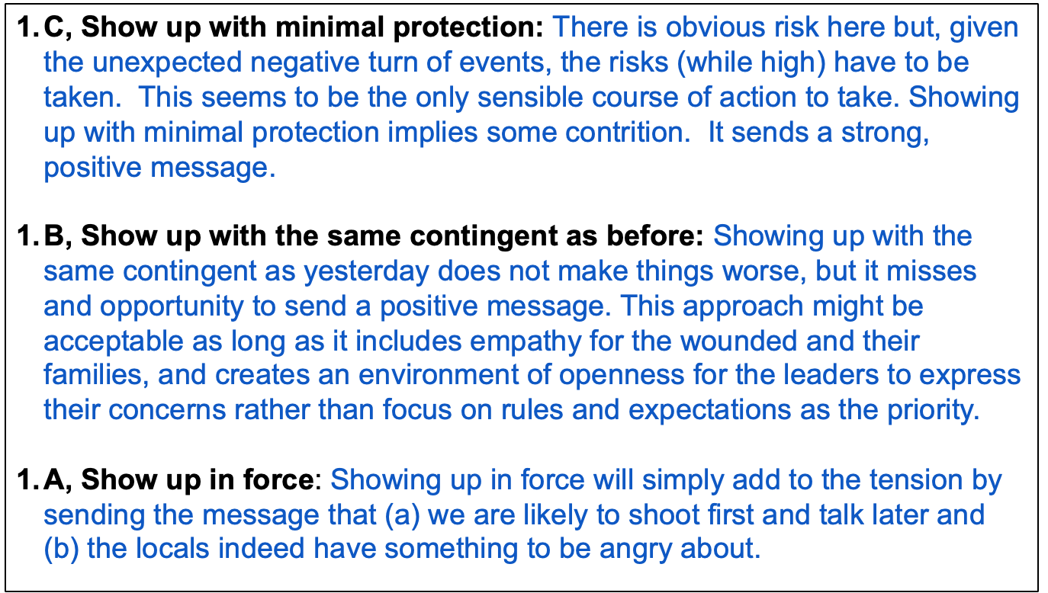
Shots into a Crowd
1. C.
2. B.
3. A.

Slide 66
Q & A
Gary Klein, Ph.D., ShadowBox Training LLC
gklein@shadowboxtraining.com
John Schmitt, ShadowBox Training LLC
jborders@shadowboxtraining.com
Reza Jalaeian, Ph.D., ShadowBox Training LLC
mjalaeian@shadowboxtraining.com

