Slide 1
Introduction to
Competency-Based Experiential Learning
An Alternative Method of Developing Workforce Expertise
Kevin Owens, Applied Research Laboratories: The University of Texas at Austin
Dr. Ben Goldberg, US Army DEVCOM, Soldier Center, STTC
Dr. Robby Robson, Eduworks
Shelly Blake-Plock, Yet Analytics
Sanjay Mishra, Oak Ridge Institute for Science and Education

Slide 2
Learning Objectives
Explain the need for competency-based experiential-learning method.
Describe the theory and principles of competency-based experiential-learning.
Relate to the component processes/resources in competency-based experiential-learning.
Explain the key-phases of competency-based experiential-learning.
Describe an example of a competency-based experiential-learning exercise.
SHOWN HERE

Slide 3
The need for competency-based experiential-learning
3

Slide 4
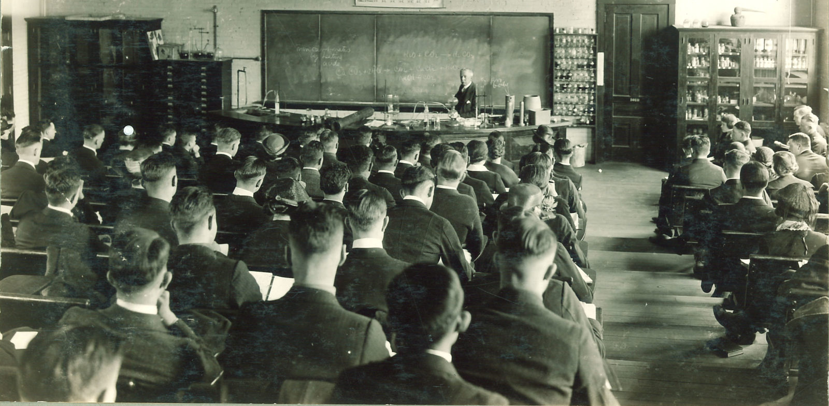
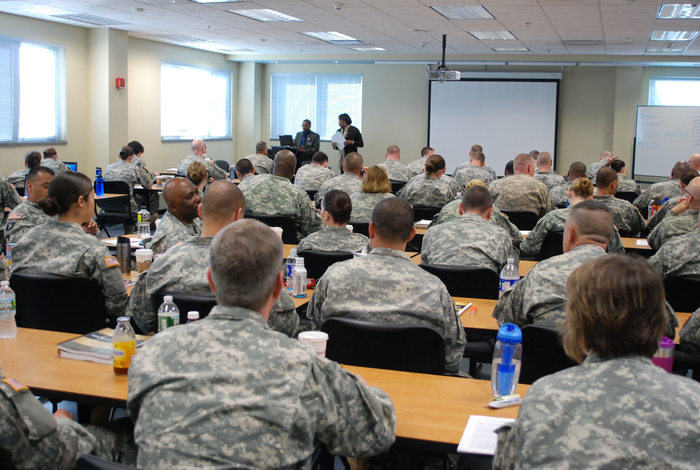
Current Education / Training Paradigm
How we educate today is the same as in 18^{th-}century
How we educate workforce today is a form of Placebo Learning Process – managers assume learners know more than they do.
  Dunning-Kruger effect.
Education and Training not aligned to the same competence framework, measures and criteria for achieving workforce performance outcomes.
Learners don’t build knowledge and skill how they will be required to use it in real application context (transfer). Bottom up vs. Top down.
Learning often “one and done”. No refresher or follow-on measures (qualified for life).
No work-site, longitudinal data collected to measure curriculum effectiveness and validate competence.
1800’s
2022
1. Explain the need for competency-based experiential-learning method
Notes:
Goal: Trying to basically indicate real experiences receiving, producing and conducting training for the US Military and primary, secondary, post-secondary education.
Produce ground work for capabilities required to build competence-based experiential learning into education and training.

Slide 5
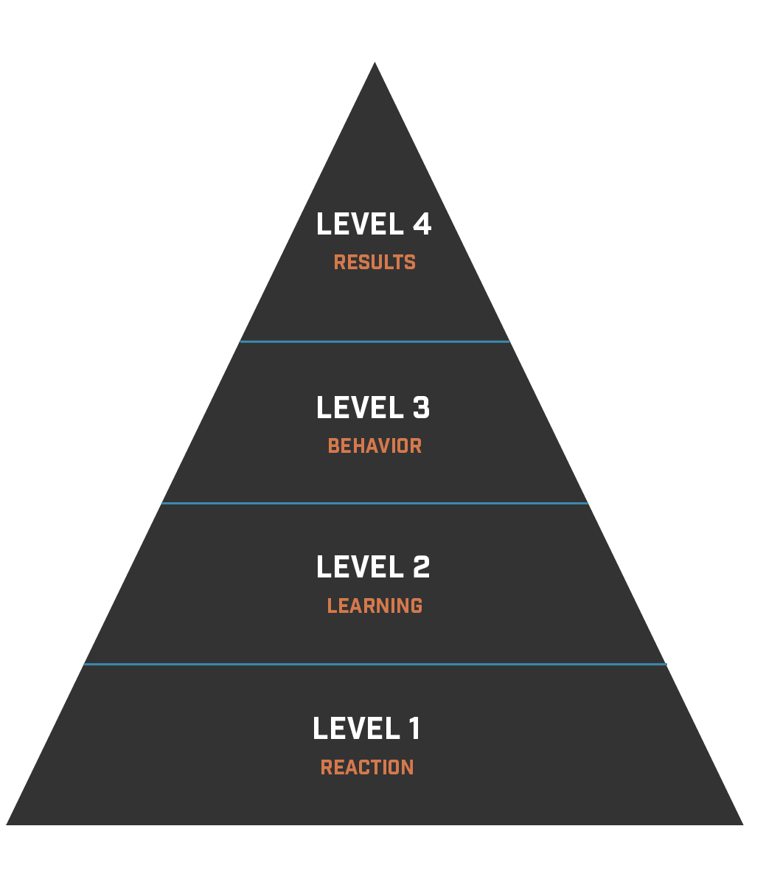

Kirkpatrick Levels of Evaluation
Where
Education
& Training
Transfer &
Competence
Evaluation
Lives
Long-term mission results associated with learning:
  Rarely conducted.
  Shows true value (ROI) of training and content
  May be systemic with impact of other capabilities
Long-term learning/change measured and integration in workplace team (> 6 mos after):
  Rarely conducted.
  Misses point that learned change can be obstructed by occupational setting / culture if training not aligned with workplace practices
Limit of
Education & Training Evaluation Today
MISSION
OUTCOMECHANGE
PERFORMANCE CHANGE
(LONG-TERM)
Short-term learning/change in KSA and Task outcomes:
  Main source of evaluation today.
  Usually constrained experiences and conditions
  Often not based on real-world problems but based on curriculum content/objectives (encapsulated evaluation).
KNOWLEDGE / SKILL / ATTITUDES CHANGE
(SHORT-TERM LEARNING)
Learners react to the learning experience:
  Main source of evaluation today. Sentimental value. How can a learner know value before they perform in real life?
TRAINEE (SUBJECTIVE) VALUE OF TRAINING
Donald Kirkpatrick (1959)
1. Explain the need for competency-based experiential-learning method
Notes:
Used describe experience with designing/developing/implementing/assessing training for military. Ensure audience all knows this model to understand longitudinal problem described later, and to support discussion points in next slide.

Slide 6
70:20:10 Rule: Education / Training Cost-Benefit
Research in 1980’s (McCall, et.al, 1988) found the most effective training that effectively transferred to the work-site followed a 70:20:10 rule.
To achieve expected performance outcomes / mission success, each environment works together in these proportions.
If only formal course training is conducted (typical), level 3 & 4 learner evaluation data will show outcome failure.
10%
Formal Course Education
20%
Work Social Interaction
70%
Workflow
Experiential Learning
1. Explain the need for competency-based experiential-learning method

Slide 7
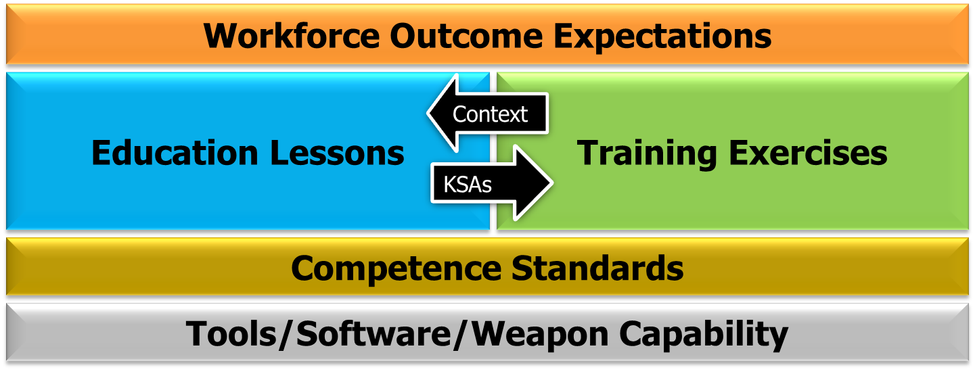
Education and Training Environments Must Work Together
To maximize transfer, how people learn, and how much people learn, needs to match what people need to do in their role in the work environment.
Both environments, must be based on the same workforce outcome expectations, competence standards (not institutional standards), and tools / capabilities.
1. Explain the need for competency-based experiential-learning method

Slide 8
Education and Training Environments Must Work Together
Situation, Constraints, Resources, Problem, Environment
Specific Occupation and Context (Difficulty)
Real
Experience
Events
Experiential Learning
Cue-Attributes and Assigned Team/Role
Specific Team/Role
Task-Condition
Real
Tasks
Conditions
Task-Skill Practice
Task-Step Application and Repetition
Task-Skill Practice
Experiential Learning
Retrieve / Reinforce
Specific Procedural Knowledge
Communications, Operations, Calculations, Behaviors
Formal Instruction
General Skill
Procedural Knowledge
Retrieve / Reinforce
Declarative Knowledge
General
Declarative Knowledge
Facts, Terms, Concepts, Principles, Rules Vocabulary, Formats
EDUCATION
TRAINING
1. Explain the need for competency-based experiential-learning method

Slide 9
The theory and principles of competency-based experiential-learning.

Slide 10
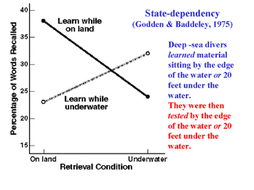

Learning Requires Context
The principle is termed Context-Dependent Memory and was demonstrated by Godden and Baddeley in 1975 “Surf & Turf Experiment”
Memories (cognitive and motor) are formed by many disparate memories of various direct / indirect stimulus.
Memories are encoded with the subject being learned (e.g., content on this slide) and the context that surrounds the learner - including the emotion it elicits. (this room, your interest, etc…)
It’s harder to recall memories (cognitive, motor) when the context/environment/emotion it was learned isn’t present when its needed.
Motor (skill) memories are also encoded by tactile properties
e.g., forces of movement and resistance.
2. Describe the theory and principles of competency-based experiential-learning
Notes:
In 1975 Godden and Baddeley conducted a study testing Context-Dependent Memory in two natural environments: On land and underwater.
They believed that learning information was best recalled when it occurred in the same environment in which it was originally learned.
Godden and Baddeley's experiment consisted of testing 24 subjects (5 females / 19 males) on remembering a list of 36 short-syllable words.
The subjects were taught / tested in two conditions (contexts): underwater (using scuba equipment) and/or on dry-land.
They learned/were tested in one of four randomly assigned condition-sequences:
Learning underwater, then recalling on dry-land,
Learning on dry-land, then recalling underwater,
Learning underwater, then recalling underwater,
Learning on dry-land, then recalling on dry-land.
When learning, the subjects were presented a list of words in sets of three in the “learning condition” they were assigned to. They were also shown the entire list twice.
When tested, the subjects had two-minutes to recall as many words as they could in the “recall condition” they were assigned to.
Godden and Baddeley found results that proved their hypothesis: The number of words recalled was better when recalled in the environment originally learned rather than recalling the words in a different environment.

Slide 11
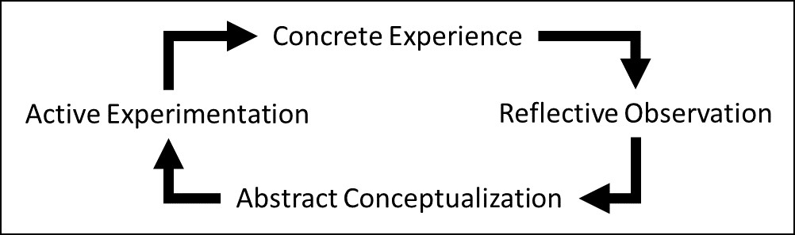
Experiential Learning
Experiential-Learning is based on over a century of practice and scholarly research (Dewey, Lewin, Kolb, et.al).
Experiential-Learning is idea the human brain naturally learns through experience (model below) vs. sequenced instruction.
Learning is most effective when there is tension between what a learner thinks they know / can do and what a task actually requires them to do to be successful.
Original Model (David Kolb and Roger Fry 1975)
2. Describe the theory and principles of competency-based experiential-learning

Slide 12
When is Someone Competent?
They pass a certification or final test?
  They’ve been in a job a long time?
They perform a task really well in a few instances?
  They’ve written a book or taught a subject?
2. Describe the theory and principles of competency-based experiential-learning
Notes:
Reviewer’s Note: This animated slide will be used for engaging audience with open questions – only inviting mental or behavioral engagement but will immediately lead into following points:
Responses:
1. They pass a certification or final test? Can they perform the same 6 months later? Does this mean people never forget or retain skill regardless of time?
2. They’ve been in a job a long time? How do we know they perform correctly or per normal / best practices. Can they perform right now?
3. They perform a task really well in a few instances? How do we know they can perform the same In any condition? In any difficulty level?
4. They’ve written book or taught a subject? So they can talk about what, when, where, why and how but can they actually do it in a real occupational setting?

Slide 13

What is Competence and Competency?
Many interpretations from many authors (e.g., Gilbert, Spencer & Spencer, etc…). Key originator of term used competence to differentiate ability from assumed intelligence (McClelland, 1973). Argued academic grades and education opportunity did not result in professional ability or competence.
  We propose competence is a long-term asserted state of a team or person’s task-expertise in a given work context (occupation + mission + condition + team / role task outcomes and performance measures).
    Must be based on inspectable data from past experiential performance.
    Competence state can be binary (yes | no), quantitative (probability) or qualitative in a taxonomy of levels (e.g., expert, proficient, practiced, novice | atrophied | obsolete)
  A competency is a claimed ability of a given cognitive and behavioral task, skill or affective trait (e.g., a [state] ability to lead a team in combat).
2. Describe the theory and principles of competency-based experiential-learning

Slide 14
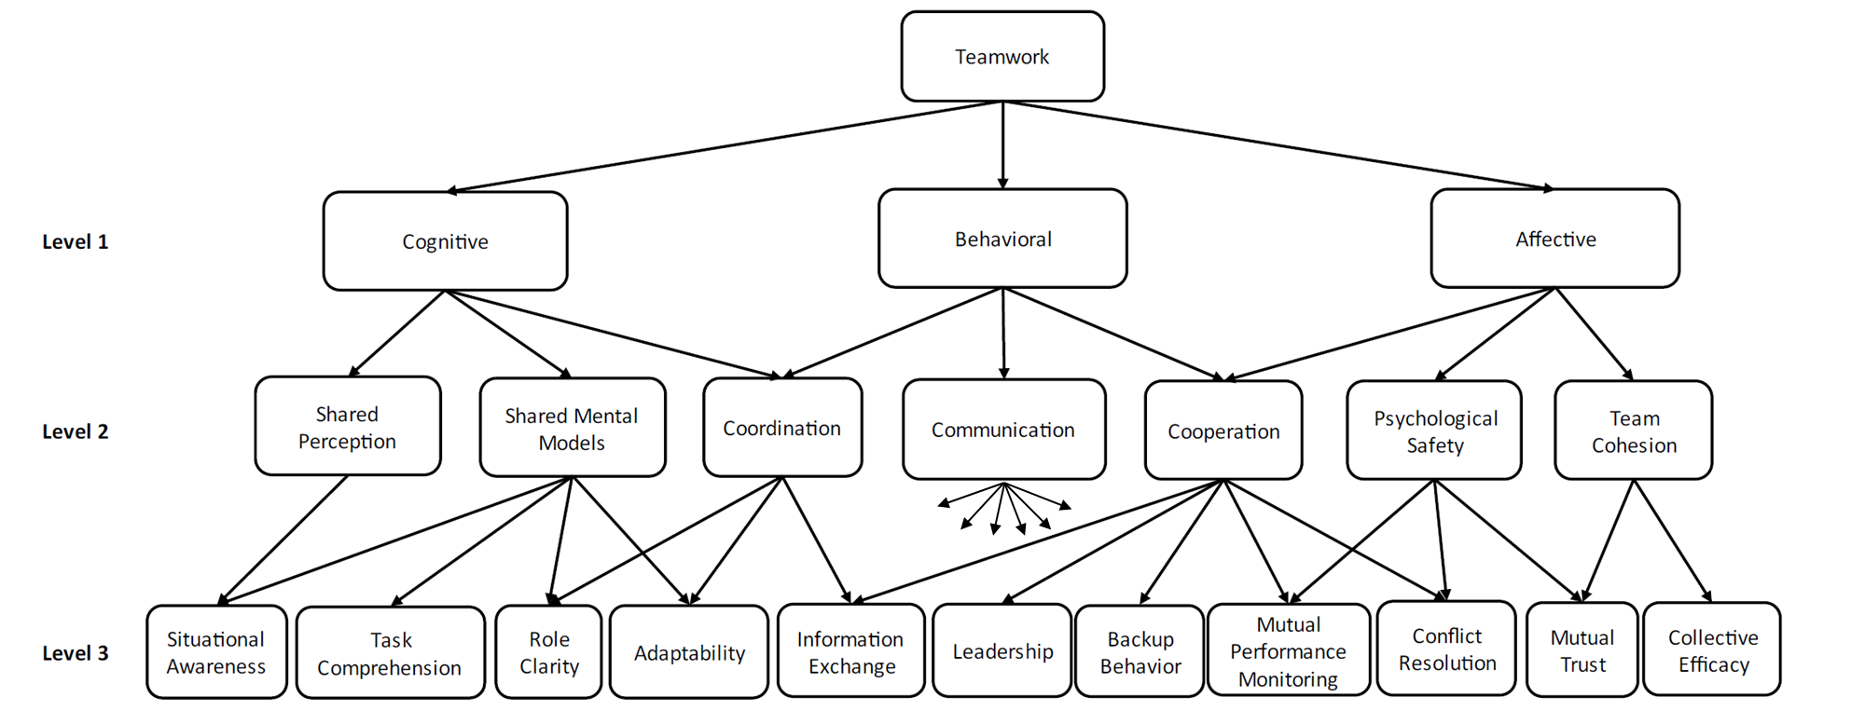
Example Team and Individual Competence Model
Competence can be developed from any point in model
(not only bottom-up)
*
Competency Frameworks: Based on ABC Model
* links from communication (level 2) to individual competencies in level 3 were omitted to avoid overcrowding figure
2. Describe the theory and principles of competency-based experiential-learning

Slide 15

Assessing Competence
Actors (assigned to unit/team/roles)
Framework
Team
Experience
Competency1
(Task)
Competency2
(Task)
Role
Role
Competence Test-Item
A mission event (problem/goal)
Conditions (setting/resources)
Triggers (to dynamically activate)
Strategies (to support learning)
Stress placed on actor
Competency1a
Competency2a
(Task)
Competency1a1
Competency2a1
(task measure)
Role
Role
Competency1a2
Competency2a2
(task measure)
Competency1b
Competency2a21
(skill measure)
Occupational Unit
Competency1b1
Competency2b211
(knowledge measure)
Task / Measure Template
What to perform and measure
When/where/how to measure (data sources)
Normalized criteria* (for condition/difficulty/stress)
How to report result (format)
Competency1b2
*Based on data
2. Describe the theory and principles of competency-based experiential-learning

Slide 16


What is Assessment Validity?
The degree of evidence produced from an instrument to indicate/defend a state of [competence in] a given ability.
  A probability a test outcome represents a future performance.
Validity is NOT a static binary state – i.e., an assessment instrument is never “valid” but has varying degrees of validity. A modern common misconception!
The single written/practical test does NOT measure competence… only certain cognitive abilities at a single point in time – one could say typical tests in formal courses and e-learning are LOW VALIDITY.
For a workforce competence to be defendable, there must be consistent, longitudinal, inspectable and recent evidence / data to produce validity to an assertion
Assessed Performance
Longitudinal Data/
Evidence
Real Performance
Probability
Validity
2. Describe the theory and principles of competency-based experiential-learning

Slide 17
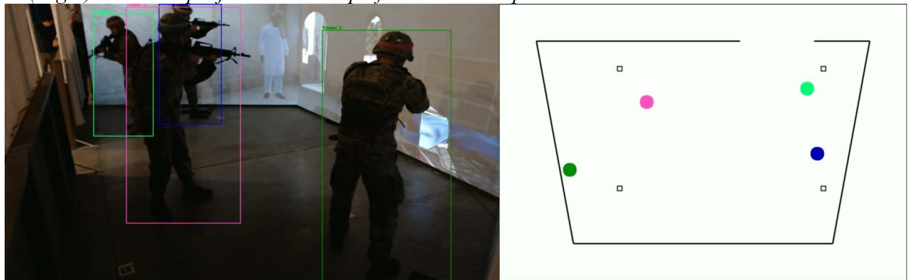
Improving Competence Validity Requires Data
“If its not recorded [measured, saved]… it didn’t happen”
Synthetic Real-Data Immersion Research Concept*
Data-based evidence not only validates what was assessed and learned but provides immediate content for others in future to learn from.
Improves measures using synthetic reconstruction
*Allow experts to share real experiences and lessons with novice/apprentice learners (Owens, K.P. 2020)
2. Describe the theory and principles of competency-based experiential-learning

Slide 18
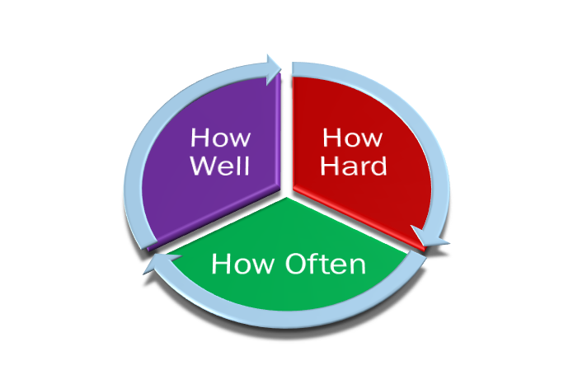


Singular Performance : Longitudinal Competence
Any Task Over Many Experience Events
Any Task in
Experience Event Instance
Environment and Conditions
Expert
Needs Sustainment
Unconscious
Competence
Difficulty and Stress
Needs Deliberate Practice
Conscious
Competence
Above
Expectation
Need
More
Difficulty
Training
Proficient
Assessment vs. Baseline Measure
Task Competence Level
At
Expectation
Matched
Difficulty
Practiced
Needs Practice
Conscious
Incompetence
Below
Expectation
Need
Less Difficulty
or Needs Tutoring
Strategies
Novice /
Unpracticed
Needs Instruction
(Crawl/Walk)
Unconscious
Incompetence
Education
Sent to LRS via xAPI
Unreliable Task Performance
Reliable Task Performance
2. Describe the theory and principles of competency-based experiential-learning

Slide 19
Relate to the component processes/resources of competency-based experiential-learning.

Slide 20
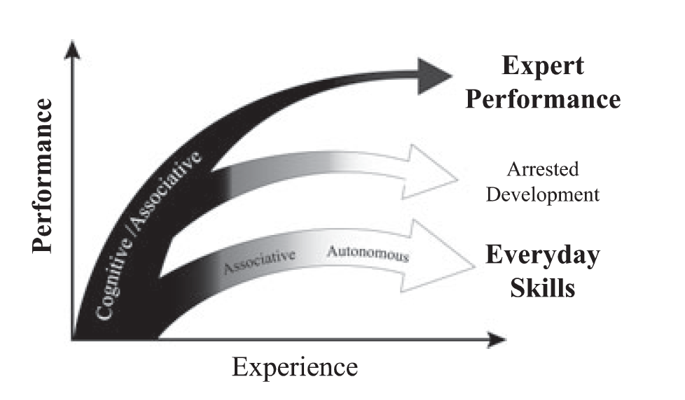
Experiential-Expertise and Deliberate Practice
Development of expertise with experience is dependent upon continuous (deliberate) practice with increasing complexity and difficulty. Intent is to reach a natural state of automaticity at whatever standard is found (from data). Includes re-structure/upgrades and technology and best-practices change / improve (from data).
Deliberate Competency Repetition
Stopped Competency Repetition
No Close-Cycle Competency Repetitive Training
(today’s training practice…
”one-and-done”)
Ericsson, K.A. (2008)
3. Relate the component processes/resources in competency-based experiential-learning
Notes:
Illustration of the qualitative difference between the course of improvement of expert performance and of everyday activities.
The goal for everyday activities is to reach as rapidly as possible a satisfactory level that is stable and ‘‘autonomous.’’
After individuals pass through the ‘‘cognitive’’ and ‘‘associative’’ phases, they can generate their performance virtually automatically with a minimal amount of effort (see the gray ⁄ white plateau at the bottom of the graph).
In contrast, expert performers counteract automaticity by developing increasingly complex mental representations to attain higher levels of control of their performance and will therefore remain within the cognitive and associative phases.
Some experts will at some point in their career give up their commitment to seeking excellence and thus terminate regular engagement in deliberate practice to further improve performance, which results in premature automation of their performance

Slide 21
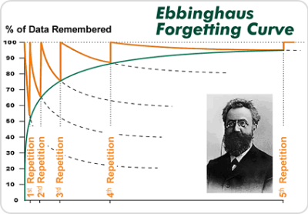
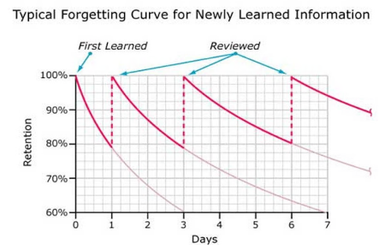
Knowledge and Skill Decay
Competence decays over time:
Knowledge (episodic, semantic, procedural, declarative) atrophy without use/practice.
  Knowledge is lost over time without contextual use and recall.
3. Relate the component processes/resources in competency-based experiential-learning

Slide 22
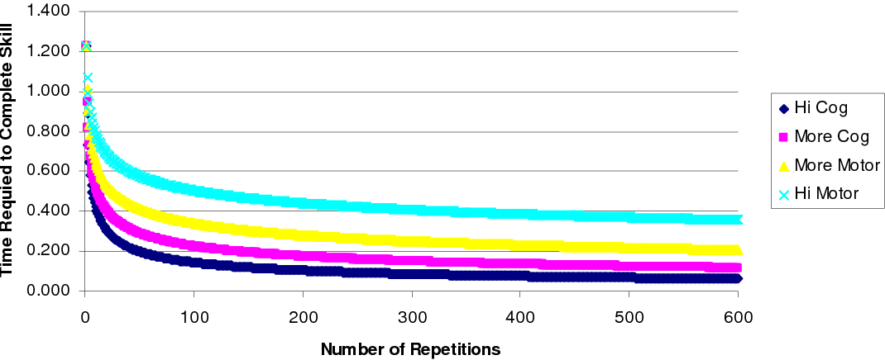
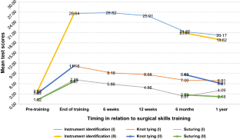
Knowledge and Skill Decay
Competence decays over time:
Skill (motor/cognitive) atrophies as well without use/practice
  Latency increases, responsiveness and accuracy decreases.
Cognitive/Motor Skill State vs. Repetition
Surgical Skill Decay Study
MacKinnon, D.J., Levitt, R., Nissen, M. (2006). Modeling Skill Growth and Decay in Edge Organizations: Near- Optimizing Knowledge & Power Flows. Naval Post Graduate School
Bekele, A, et.al (2019). Trends in Retention and Decay of Basic Surgical Skills: Evidence from Addis Ababa University, Ethiopia: A Prospective Case–Control Cohort Study
3. Relate the component processes/resources in competency-based experiential-learning

Slide 23
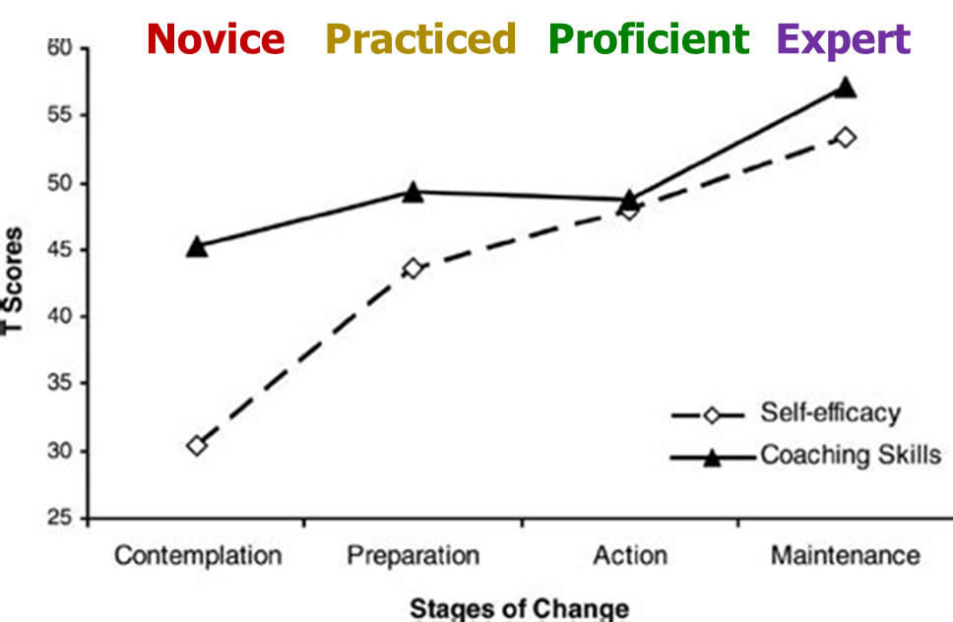
Self-Efficacy Delay/Decay
Competence decays over time:
Self-efficacy – belief in self-ability – atrophy without use/practice AND feedback or confirmation. Not true if learning occurs without real-experiential context.
  Self-efficacy takes more time to re-build or get-back with knowledge and/or skill atrophy.
3. Relate the component processes/resources in competency-based experiential-learning
Notes:
relationships between workplace coaching skills and the perceived costs and benefits of adopting coaching skills from a Stages of Change perspective.
Findings were broadly as predicated by the Transtheoretical Model of Change. Individuals in the early stages of adopting coaching behaviors had lower self-efficacy and lower coaching skills than those in the latter stages.
The perceived benefits of adopting coaching behaviors did not differ across different stages of change.
The perceived costs of adopting coaching behaviors were significantly lower in the latter stages of change, but findings suggest that it takes about six months before the perceived benefits of adopting coaching behaviors outweigh the perceived costs.
Disaffected managers held higher perceptions of the benefits of coaching, and there was no relationship between coaching behaviors and workplace wellbeing.
It is recommended that managers of coach training programs explicitly address ways to overcome barriers to adopting coaching behaviors, rather than primarily promoting the benefits of workplace coaching.
Organizations should give ongoing learning support to those who have recently completed workplace coaching training, in order to help them persevere through the initial adjustment period as they consolidate and develop their coaching skills.

Slide 24
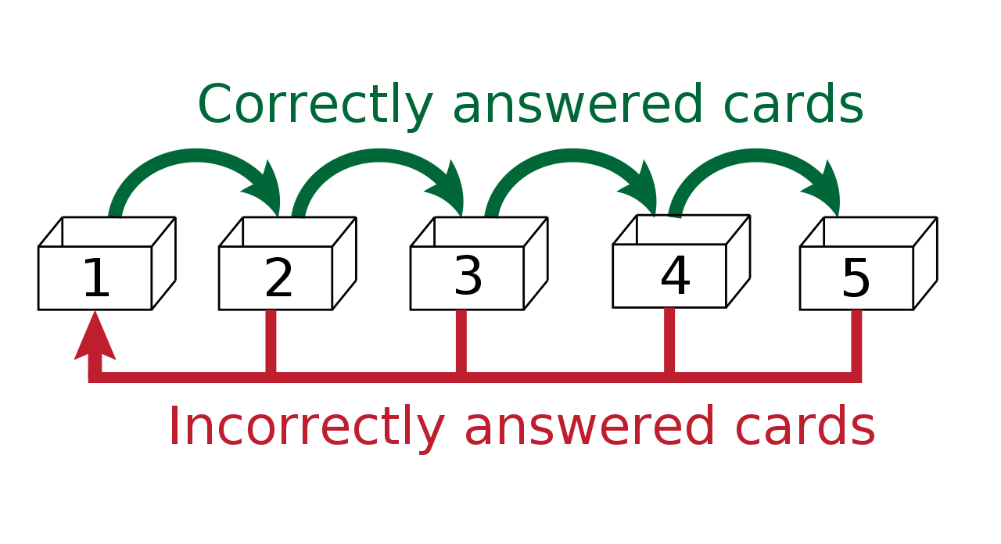
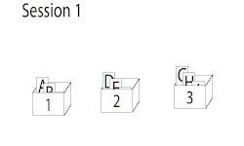
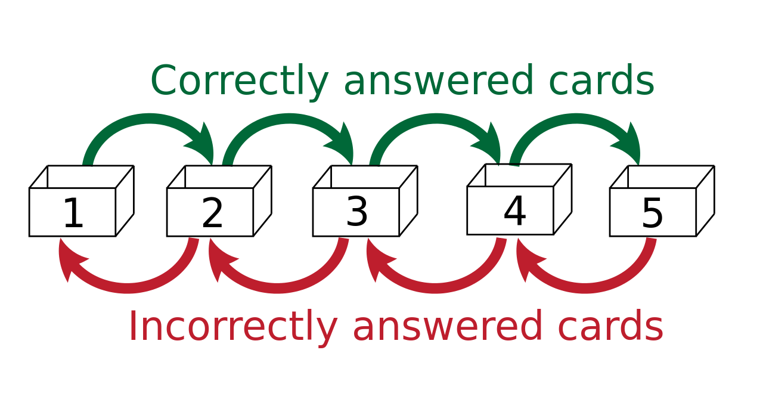
Learning Improves with Spaced Repetition
While knowledge can be lost over time (i.e, the forgetting curve), that loss can be mitigated with spaced-time intervals of prompted performance.
Time-interval based on successful task performance.
Method 1
Method 2
The Leitner learning system: used flash-cards to implement spaced repetition.
The schedule of repetition is governed by the size of each box (number of tasks)
3. Relate the component processes/resources in competency-based experiential-learning
Notes:
In the Leitner system, correctly answered cards are advanced to the next, less frequent box, while incorrectly answered cards return to the first box for more aggressive review and repetition
The Leitner system is a widely used method of efficiently using flashcards that was proposed by the German science journalist Sebastian Leitner in the 1970s. It is a simple implementation of the principle of spaced repetition, where cards are reviewed at increasing intervals.

Slide 25
The Phases of Training/Learning or Scaffolding
As nominal task difficulty increases, predicted task success increases.
Must match difficulty to the competence of the actor, and their phase of learning (i.e., zone of proximal development).
PHASES OF LEARNING
(aka scaffolding)
Crawl: assisted performance. Immediate intervention and supporting instruction.
Walk: unassisted performance. Immediate Feedback (safety/critical items) and supporting instruction. After-action feedback with data
Run: full internalization – automaticity. After-action feedback with data.
Rebilitate: de-automization and update with new practices, techniques or technology. Immediate Feedback (safety/critical items) and supporting instruction. After-action feedback with data
3. Relate the component processes/resources in competency-based experiential-learning
Notes:
The relationship between nominal task difficulty and expected performance as a function of the individual’s skill level. During practice, predicted success becomes a decreasing function of nominal task difficulty.
It is recommended that managers of coach training programs explicitly address ways to overcome barriers to adopting coaching behaviors, rather than primarily promoting the benefits of workplace coaching.
Organizations should give ongoing learning support to those who have recently completed workplace coaching training, in order to help them persevere through the initial adjustment period as they consolidate and develop their coaching skills.

Slide 26
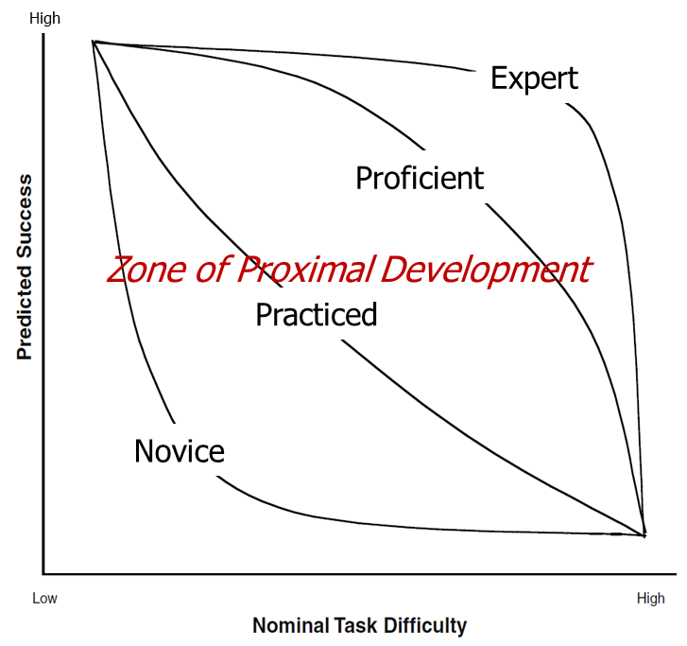
Tutoring or Coaching to Develop Competence
Automated/Human tutors and coaches monitor actor performance and provide intervention or modify the task difficulty to develop a competence state with a degree of self-efficacy. Each state requires these methods of training / learning.
Methods of Training / Learning: (aka scaffolding)
Run: automatic (unconscious) action expected task competence level
Data shows the learner can do a task in the most difficult conditions, and believes/values points without help
Walk: unassisted / conscious action at expected task competence level
Data shows the learner needs help or less difficult conditions to do a task or to believe/value a point
Crawl: assisted action / instruction at expected task competence level
Data shows learner cannot do a task (in least difficult conditions) or does not believe/value a point
Rebilitate: in need to deconstruct / update competence level.
Data shows learner isn’t using latest best practices, techniques, technology
Wood, Bruner, Ross (1976).
Vygotsky(1931)
M. A. Guadagnoli & T. D. Lee (2004)
3. Relate the component processes/resources in competency-based experiential-learning
Notes:
The relationship between nominal task difficulty and expected performance as a function of the individual’s skill level. During practice, predicted success becomes a decreasing function of nominal task difficulty.
It is recommended that managers of coach training programs explicitly address ways to overcome barriers to adopting coaching behaviors, rather than primarily promoting the benefits of workplace coaching.
Organizations should give ongoing learning support to those who have recently completed workplace coaching training, in order to help them persevere through the initial adjustment period as they consolidate and develop their coaching skills.

Slide 27
The Tutoring and Coaching of Competence
Develop the actor through strategic intervention and adaptation - control of the problem space
The Tutor/Coach Scaffolding Process.
Recruitment – find an actor interested in task.
Reduce the degrees of freedom – simplify task by reducing variables
Direction maintenance – keeping actor interested in automating and/or improving task (hint: requires repeated evaluation, publish state and show peers performance to compare).
Mark critical features – notify actor of task features relevant to completing task to standard. Identify areas to improve, changes to make.
Frustration control – save actor dignity, encourage without creating a dependence on tutor.
Demonstration – modeling actions through exemplars by others (peers) and how they progressed from state actor is at.
Wood, Bruner, Ross (1976).
3. Relate the component processes/resources in competency-based experiential-learning
Notes:
The relationship between nominal task difficulty and expected performance as a function of the individual’s skill level. During practice, predicted success becomes a decreasing function of nominal task difficulty.
It is recommended that managers of coach training programs explicitly address ways to overcome barriers to adopting coaching behaviors, rather than primarily promoting the benefits of workplace coaching.
Organizations should give ongoing learning support to those who have recently completed workplace coaching training, in order to help them persevere through the initial adjustment period as they consolidate and develop their coaching skills.

Slide 28
Using Experiential Data (Evidence) to Assert Competence
Event Experience Begins
(Exercise / Scenario)
(Target Activities are Pre-Set and Pre-Modeled as xAPI Profile Templates)
Semantic Data Used as Evidence
to Inform Competence Rating and
next Experience to Learn From
(e.g. CaSS Accesses Transactional xAPI)
Activities/Responses Occur
(Data Sources Deliver Performance Event Streamed Data, Data Assessed, Event Measures Produce xAPI)
Evidence of
Competence
(Experiential Record)
Activities Are Delivered as
Semantic Information
(Validated xAPI is Filtered According to Business
Need and Made Available Transactionally)
3. Relate the component processes/resources in competency-based experiential-learning

Slide 29
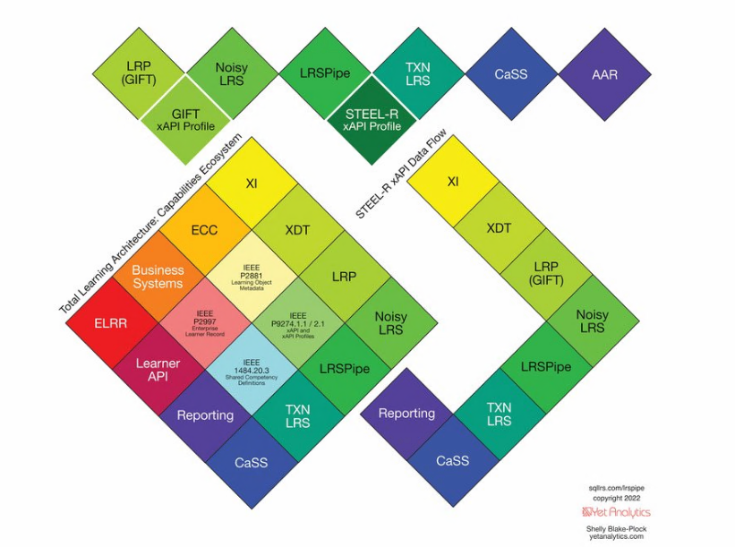
Collecting Data with a Common Format and Profile
3. Relate the component processes/resources in competency-based experiential-learning
29
Notes:
1 min (17 min)

Slide 30
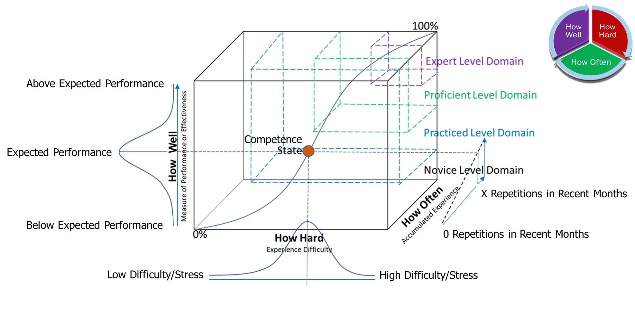
A Competence Validation Model (Conceptual)
K. Owens (2020)
E. Robson, et.al (2021)
3. Relate the component processes/resources in competency-based experiential-learning

Slide 31





Competence Math Model (Actual in Applied Research)
Instance of
Performance
Assessed
xAPI Statement
Created
Competence is
Asserted
Actor Competence State is Computed
Competence
Dashboard
LRS
Query all longitudinal sessions with assessed task for actor
Assertion Score (AS): 0.95
Practice Score (PS): 0.14
An actor (Jones) demonstrates they can do a task (competency) without help and “above expectations” in 89% of all performances during an exercise
Expectation is Based normalized data.
Time:
DDMMYY:HH:SS
Actor:
jones@email.com
Verb:
//Completed
Object:
//fundamentaltask
Context:
//Condition
Difficulty 2
Result:
Success: true
Score:0.89
Is Team/Person Competent at level X, for Y mission / role in Z conditions?
LRS data shows claims that Jones knows how/can-do a task in [condition] and at difficulty 2 without help…
STEEL-R claims
PVT Jones can:
STEEL-R claims
PVT Jones can:
IF NOT: Actor should:
Re-experience object X 3-times, after 2-days delay, at difficulty level 2, with following conditions (…)
(AI + MATH + Business Rules
= Actor Competence State)
Math Model
3. Relate the component processes/resources in competency-based experiential-learning
31

Slide 32
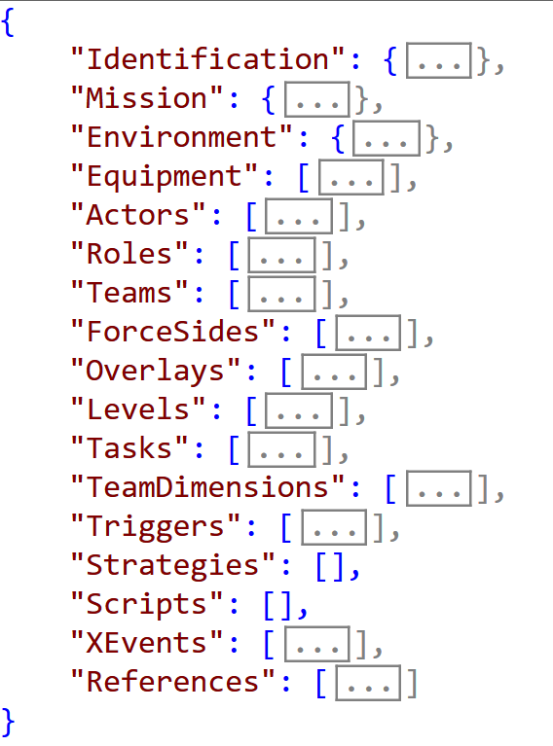
CBEL Curriculum Elements: The Experience Object
A reusable, extensible, mutable, machine-readable form of curriculum to design, setup and execute competency-based experiential learning.
INPUTS:
Who needs the experience?
What experience (conditions) do they need?
Where/How do they need experience?
When (in past time) do they need experience?
Why do they need experience?
How hard / different should an experience be?
FUNCTION
Sets up Real/Synthetic Environment
Sets up Synthetic Entities/Objects
Provide Mission Overview and Event Triggers
Sets up Training Environment Data Generators
Sets up Adaptive Learning Environment
Sets up Adaptive Training System
Experience Object
AUTHORITATIVE DATA:
Problem Space (Goals/Resources)
Expert Knowledge/Skill Measures
Strategies to Support Learning Target Knowledge for Target Actors
Expert Evaluation Methods and Condition-Based Criteria/Criterion
3. Relate the component processes/resources in competency-based experiential-learning
Notes:
Who needs the experience? (organization/team/role – including their profile / level)
What experience do they need? (mission / goal / problem
Where do they need experience? location / conditions
When do they need experience? season / time of day
Why do they need experience? what is the competence gap / goal
How hard / different should experience be? based on learner’s phase of learning / credentials

Slide 33
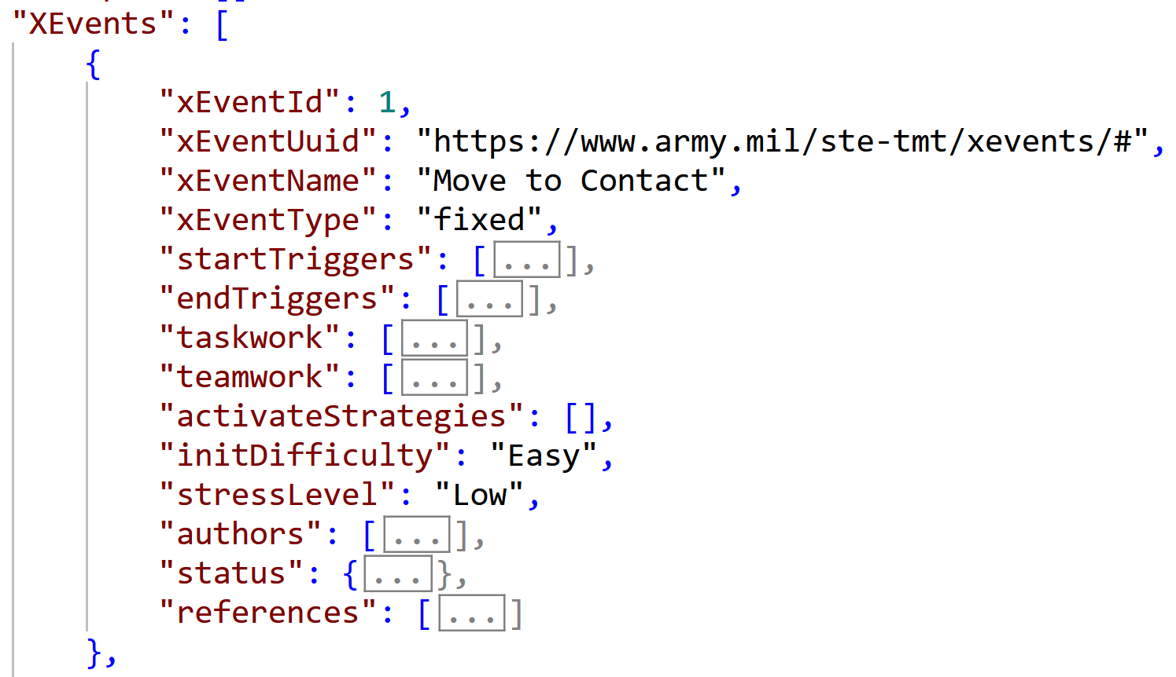
CBEL Curriculum Elements: The Experience Event
A reusable, extensible, mutable, machine-readable item of curriculum to measure real-time performance data for long-term competence assertion.
Experience Event
Experience Object
FUNCTION
Creates an “experiential test item”.
Focuses on providing data on current competency state
Enables a means to “track experience”.
Enables experiential learning to be re-configurable and adaptable to actor competence state (scaffolding).
3. Relate the component processes/resources in competency-based experiential-learning
Notes:
Who needs the experience? (organization/team/role – including their profile / level)
What experience do they need? (mission / goal / problem
Where do they need experience? location / conditions
When do they need experience? season / time of day
Why do they need experience? what is the competence gap / goal
How hard / different should experience be? based on learner’s phase of learning / credentials

Slide 34
Explain the key-phases of competency-based experiential-learning

Slide 35
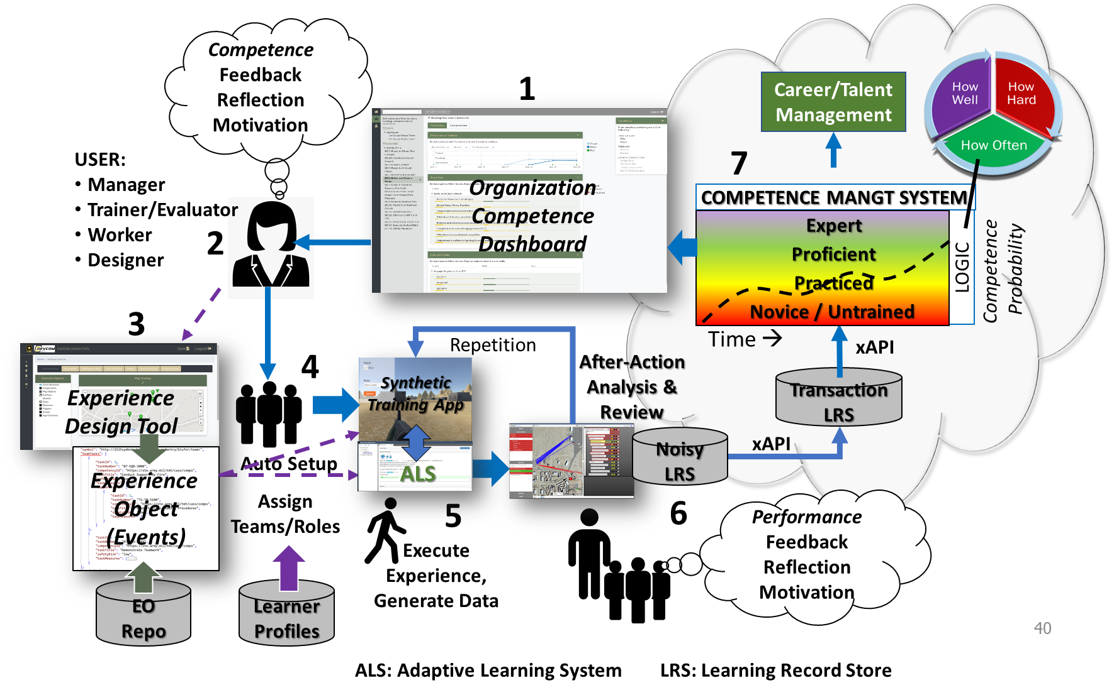
Competency-Based Experiential Learning Cycle
Reviews competence state
Decides on training based on competence gaps/goals
Selects or create experience object / events
Match experience difficulty to actors’ competence-level
Executes synthetic / live experience - collect real-time data
Conduct after action analysis and review (A3R) with expert validating auto assessments.
  Store performance and experience data
Calculate competence and display for review.
4. Explain the key-phases of competency-based experiential-learning

Slide 36
Describe an example of competency-based experiential-learning

Slide 37
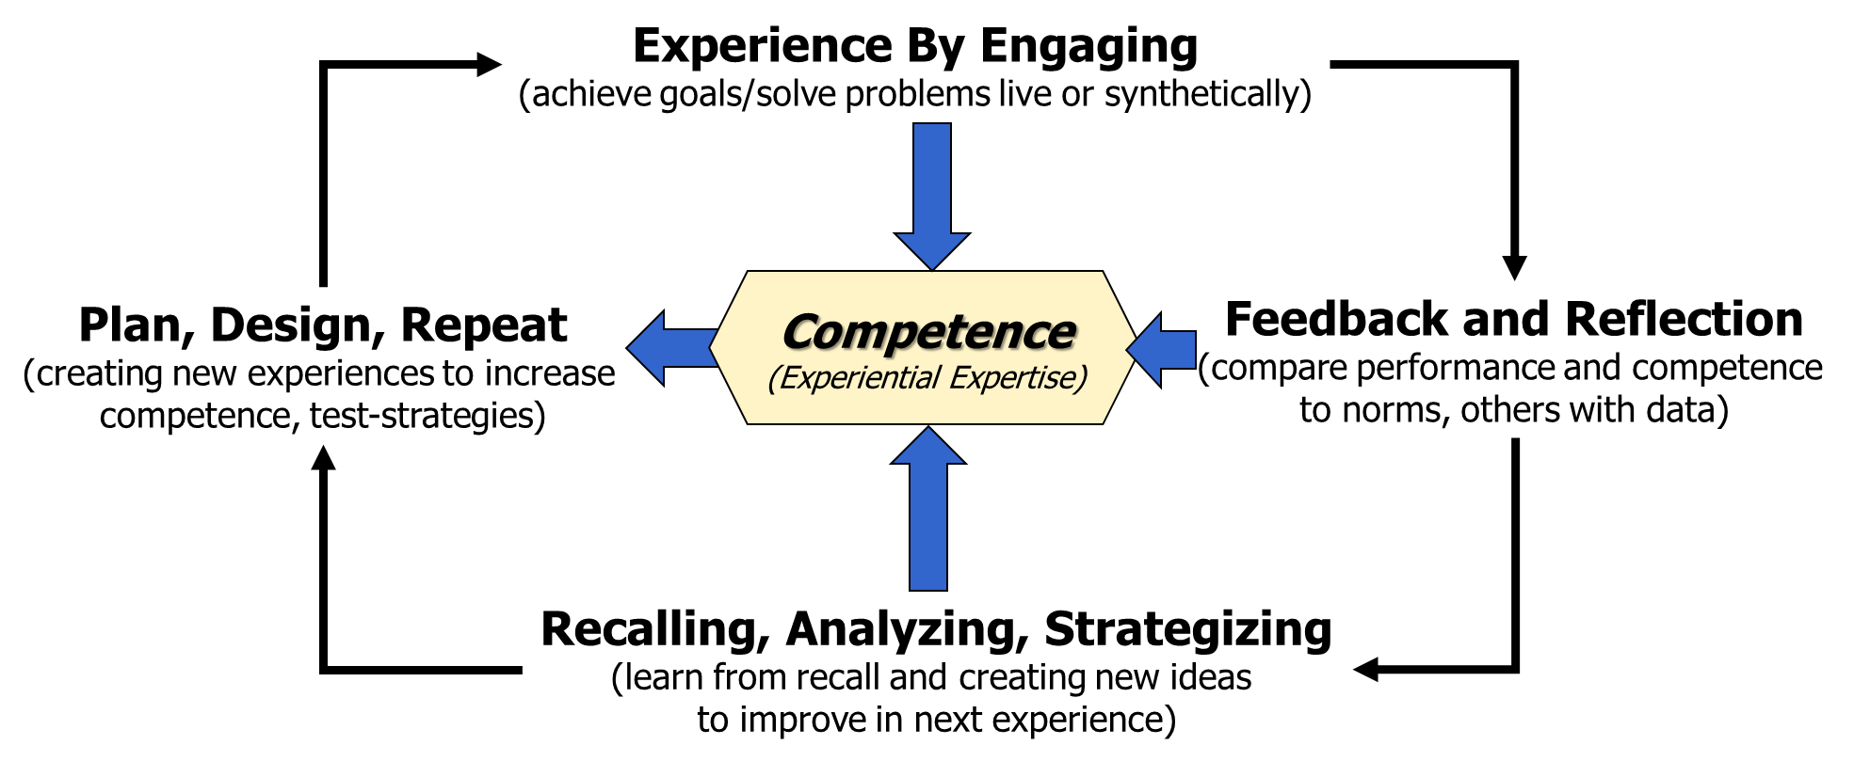
Competency Based Experiential Learning Demonstration
CBEL in the US Army Science and Technology Project:
Synthetic Training Environment Experiential Learning for Readiness (STEEL-R)
Review a Competence
Select Experience Requirements/Goals
Create Experience
Select Measurement Device and Strategies to Assess Performance and Optimize Learning
Execute Experience
Monitor Execution, Label data, and Inject Strategies as Required
Conduct After Action Analysis & Review (A3R):
  Analyze Data
  Playback Data as Feedback on Performance
Reflect on outcomes/feedback
Form new Strategies to Improve Gaps / Achieve Goal
Start again.
5, 6
3, 4
7, 8
1, 2 9
5. Describe an example of a competency-based experiential-learning exercise
37

Slide 38
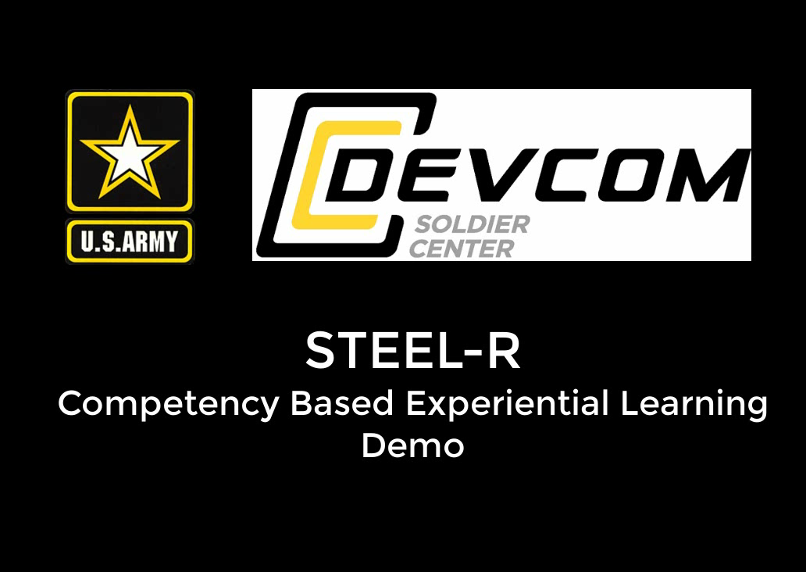
Competency Based Experiential Learning Demonstration
TO BE UPDATED BEFORE IITSEC
5. Describe an example of a competency-based experiential-learning exercise
38
Notes:
This video will be updated in August with new features and possibly with narrative audio. For now we intend to speak to it and control it manually.

Slide 39
Summary
Competency-Based Experiential Learning method…
  is intended to address 70% gaps in current learning practice to maximize training transfer to workforce using high-fidelity experiential learning content.
  works from the premise that education and training must be formed into a single continuum where each “phase” supports one-another, incorporate real experience in education, removes redundant learning, and produces a documented and validated state of competence.
  Is based on a predictable state of competence asserted from longitudinal documented data showing how well, how hard and how often a team or a person has performed a task in various conditions.
  employs actual recorded experiences, modern learning science, deliberate practice and adaptive learning technology to produce personalized data-informed learning content and objectively measured real-time performance/feedback.
  is being researched and tested for the US Army Synthetic Training Environment in the STE Experiential Learning for Readiness project.
39

Slide 40
Bibliography
Brown, P.C., Roediger, H.L, McDaniel, M.A. (2014). Make it Stick: Science of Successful Learning. Belknap/Harvard University Press, Cambridge, MA.
Clem A. (1993) Kurt Lewin and the Origins of Action Research, Educational Action Research, 1:1, 7-24
Dewey, J. (1938). Experience & Education. New York, NY: Kappa Delta Pi.
Ericsson, K.A. (2008). Deliberate practice and acquisition of expert performance: a general overview. Academic emergency medicine. Official journal of the Society for Academic Emergency Medicine, 15 11, 988-94.
Godden,D.R., & Baddeley, A.D. (1975). Context-dependent memory in two natural environments: On land and underwater. British Journal of Psychology, 66(3), 325-331
Goldberg, B., Owens, K.P., Blake-Plock, S, et.al (2021). Forging Competency and Proficiency through the Synthetic Training Environment with an Experiential Learning for Readiness Strategy. Paper presented at the Interservice/Industry Training, Simulation & Education Conference (I/ITSEC).
Guadagnoli M.A. & Lee T.D. (2004) Challenge Point: A Framework for Conceptualizing the Effects of Various Practice Conditions in Motor Learning, Journal of Motor Behavior, 36:2, 212-224
Ingram, J.N., Flanagan, J.R., Wolpert, D.M. (2013). Context-Dependent Decay of Motor Memories during Skill Acquisition. Current Biology 23, 1107
Kirkpatrick, D., Kirkpatrick, J. (2006). Evaluating Training Programs: The Four Levels (3rd Ed). Berrett-Koehler Publishers, San Francisco, CA.
Kolb, D. (1984). Experiential Learning: Experience as the Source of Learning and Development. Englewood Cliffs, NJ: Prentice Hall.
Kolb, A.Y. & Kolb D.A. (2017). The Experiential Educator. EBLS Press, Kaunakakai, HI
Johnson, S., Blackman, D. , Buick, F. (2018). “The 70:20:10 Framework and the Transfer of Learning.” Human resource development quarterly / 29.4 (2018): 383–402. Web.
McClelland, D.C. (1973). Testing For Competence Rather Than For Intelligence. American Psychologist, 28, 1-14.
Merzenic, M (2013). Soft-Wired: How the New Science of Brain Plasticity Can Change Your Life. Parnassus Publishing, San Francisco, CA.
Owens, K.P., & Goldberg, B.S. (2022). Competency-Based Experiential-Expertise. Design Recommendations for Intelligent Tutoring Systems, 9 3.
Owens, K.P. (2021). Competence-Based Experiential-Expertise and Future Adaptive Learning Systems. Springer Nature Switzerland AG
Robson, E., Robson, R., Buskirk, T., Ray, F., Owens, K.P. (2021). An Experiential Competency Application Framework. In: Sottilare, R.A., Schwarz, J. (eds) Adaptive Instructional Systems. Adaptation Strategies and Methods. HCII 2021. https://doi.org/10.1007/978-3-030-77873-6_9
Spencer, L.M. and Spencer, S.M. (1993) Competence at Work: Models for Superior Performance. John Wiley & Sons, New York.
Vatral, C., Biswas, G. Goldberg, B. (2020). Multimodal Learning Analytics Using Hierarchical Models for Analyzing Team Performance. International Society of the Learning Science.
Wood,D, Bruner,J.S, Ross, G (1976). The Role of Tutoring in Problem Solving. J . Child Psychol. Psychiat., Vol. 17, 1976, pp. 89 to 100. Pergamon Press
40

Slide 41
Thank You!
ANY QUESTIONS?
Kevin Owens: kowens@arlut.utexas.edu
Dr. Ben Goldberg: benjamin.s.goldberg.civ@army.mil
Shelly Blake-Plock: shelly@yetanalytics.com
Dr. Robby Robson: robby.robson@eduworks.com
Sanjay Mishra: smishra@smishra.com
______________________________

