Slide 1

Leading by Design: User Experience (UX) for the Department of Defense
Amanda Hawkins, CDR USN (ret), Data Society
Vel Preston, Chief of Innovation and Design, USAF CyberWorx

Slide 2
Learning Objectives
Define core principles of User Experience (UX) and human-centered design
Describe key UX methods and list the correct place for UX activities within the overall structure of a project
List the benefits of a user-centered research and development approach to producing and evaluating learning, training, and simulation products
Assess the UX maturity of projects, teams, and processes

Slide 3
Outline
Prelude for UX
Definition of UX
UX process
Benefits of UX
Evolution of UX
UX case study
UX maturity
Practical tips
Summary and conclusion

Slide 4
Outline
Prelude for UX
Definition of UX
UX process
Benefits of UX
Evolution of UX
UX case study
UX maturity
Practical tips
Summary and conclusion

Slide 5
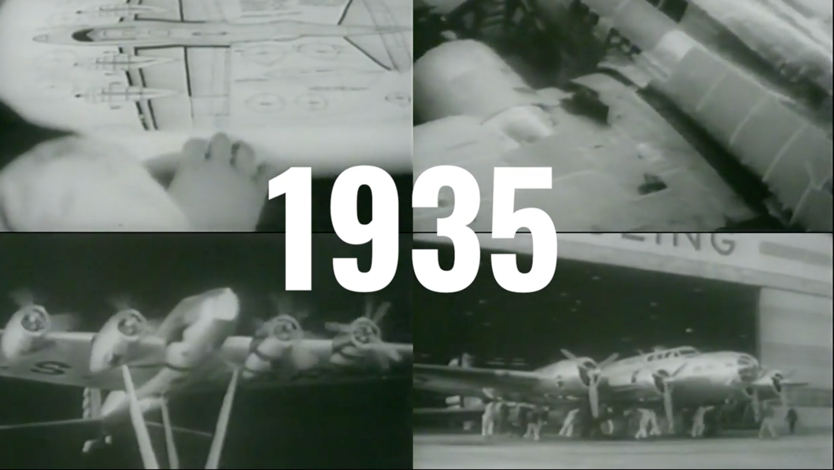
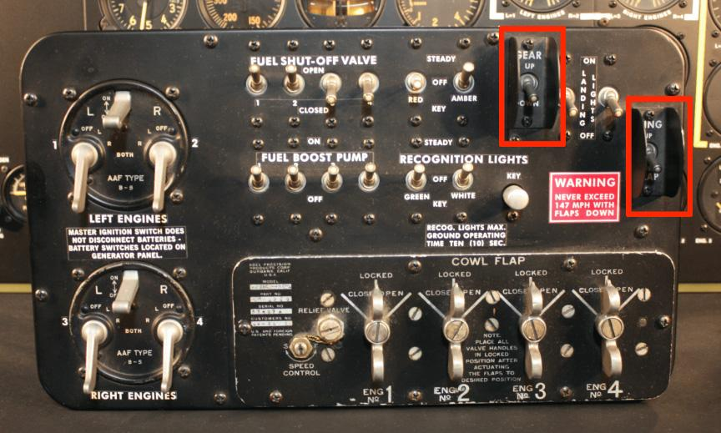
B-17 Flying Fortress
B-17 Flying Fortress – a design problem
Notes:
The B-17 was a marvel of engineering, becoming the third-most produced bomber of all time. Designed, built, and fully operationalized in under a year, the “Flying Fortress” dropped more bombs than any other U.S. aircraft in World War II.
The bomber developed a reputation for toughness, with widely publicized photographs of battered B-17s returning safely to base after sustaining heavy damage. But not all of the damage sustained by the Flying Fortress was caused by the enemy.
Over the course of the war, B-17s crashed thousands of times under peculiar but consistent circumstances. During what should have been routine landings, pilots kept doing gear up landings meaning they landed with their wheels up.
You can probably think of a few actions you’d take if this happened in the military. Maybe there would be a safety stand-down or the Safety team would launch multiple investigations. Maybe you’d review the training records and qualifications of the pilots and make recommendations to the training pipeline. Or maybe you'd look into factors like the runway conditions, maintenance and quality of consumables or environmental factors.
As it turned out, there was no evidence of a mechanical malfunction in any of the crashes, nor were there any pertinent environmental factors apart from more crash landings occurring at night. And in terms of the training pipeline, even seasoned pilots with extensive experience in multiple platforms were experiencing crashes.
Believe it or not, something far less complicated was actually at the root of the problem. A pair of psychologists, Paul Fitts and Alphonse Chapanis, found a much simpler explanation within the design of the cockpit.
What Chapanis ultimately discovered, was that two toggle switches, one for the gear and one for the flaps, were located next to each other – and they were virtually identical. The design of the cockpit made it too easy for a pilot to crash the plane. Thinking they were reaching for the switch in the cockpit to put the gear down, the pilots were actually putting the flaps down.
Solving the problem was much simpler than rolling out a new training program or recalling an entire line of aircraft for mechanical testing. Chapanis fixed the problem with two new knobs, adding a circular and triangular shape so the switch would feel different in the pilots’ hands. As a result, accidental gear up landings dropped to almost zero overnight. And this practice of incorporating tactile design is still present in modern aircraft today.
For the pilots who experienced accidental gear up landings, the B-17 didn’t work as they thought it should, despite their training and competence. The design worked against them. Unfortunately, this is something we tolerate all the time. We accommodate and accept mostly usable products and systems – even when small changes, and a little more attention to the user’s experience, could help avoid serious issues.

Slide 6
Outline
Prelude for UX
Definition of UX
UX process
Benefits of UX
Evolution of UX
UX case study
UX maturity
Practical tips
Summary and conclusion

Slide 7
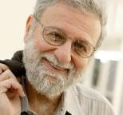
Definition of User Experience
User experience (UX) encompasses all aspects of the end-user's interaction with the company, its services, and its products.
I invented the term because I thought human interface and usability were too narrow. I wanted to cover all aspects of the person’s experience with the system including industrial design graphics, the interface, the physical interaction and the manual….
It’s everything – it’s the way you experience the world, it’s the way you experience your life, it’s the way you experience the service, or an app or a computer system, it’s a system that’s everything. — Donald Norman
Notes:
Don Norman is considered the forefather of modern UX. Who better to define UX than him.

Slide 8
Definition of User Experience
International Standards Organization – internationally agreed by experts – a formula that describes the best way of doing something
ISO 9241 Ergonomics of Human-System Interaction – key principles
The design is based upon an explicit understanding of users, tasks and environments
Users are involved throughout design and development
The design is driven and refined by user-centered evaluation
The process is iterative
The design addresses the whole user experience
The design team includes multidisciplinary skills and perspectives
Notes:
ISO standards: https://www.iso.org/standard/63500.html
2018 first update 30 years after standard created
History of ISO standard: https://measuringu.com/iso-9241/

Slide 9
Definition of UX
Hierarchy of User Needs
Functional – provides a service that is desired
Reliable – timely, consistent, as expected
Usable – right information at the time and place
Pleasurable – emotional connection layered on top
Pleasurable
Usable
Reliable
Functional
Aarron Walter’s
Hierarchy of User Needs
Notes:
https://www.nngroup.com/articles/theory-user-delight/
- A very visually appealing application, that is not functional (i.e. doesn’t have a purpose) will not satisfy users’ basic needs
- A functional interface that doesn’t work all the time, will leave users unsatisfied

Slide 10
Usable vs Delightful
Satisfies basic requirements
Leverages makers’ mental models
Potentially requires users to develop workarounds
Unclear if / how feedback will be implemented
Solves users’ problems
Leverages users’ mental models
No workarounds required
Validated feedback channels

Slide 11
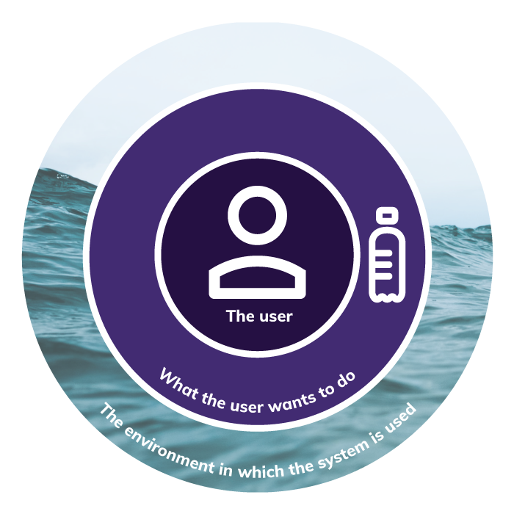
Definition of UX
Trinity
The user
What they want to do with the system/tool/software
The environment in which the system is used
Notes:
https://www.trinityaudio.ai/what-is-user-experience-the-what-why-and-how

Slide 12

Definition of UX - USAF
UX
= Information technology that powers our work
+ Optimized with users for how they use it in the real world
+ Responsive & reliable
= Mission Success
Colt Whittall,
Chief User Experience Officer, U.S. Air Force

Slide 13
Outline
Prelude for UX
Definition of UX
UX process
Benefits of UX
Evolution of UX
UX case study
UX maturity
Practical tips
Summary and conclusion

Slide 14
UX Process – Key Attributes of Processes
Key attributes of any UX process are defined by ISO 9241
The design is based upon an explicit understanding of users, tasks and environments
Users are involved throughout design and development
The design is driven and refined by user-centered evaluation
The process is iterative
The design addresses the whole user experience
The design team includes multidisciplinary skills and perspectives

Slide 15
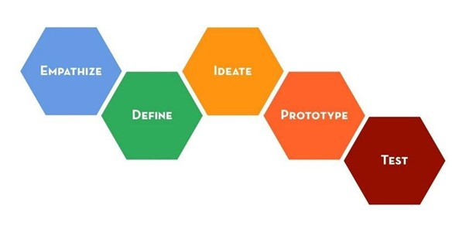
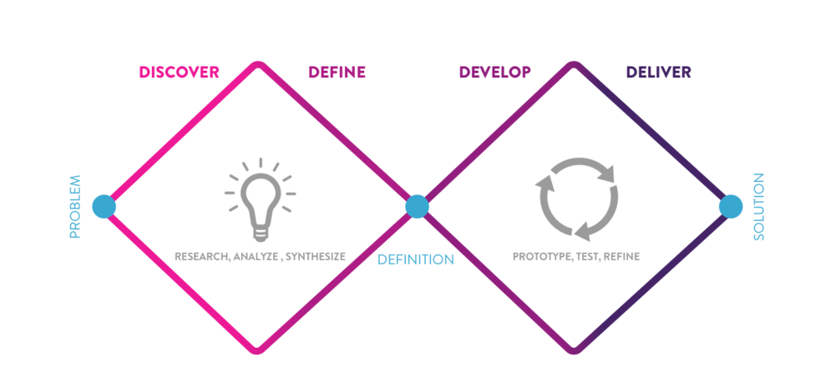
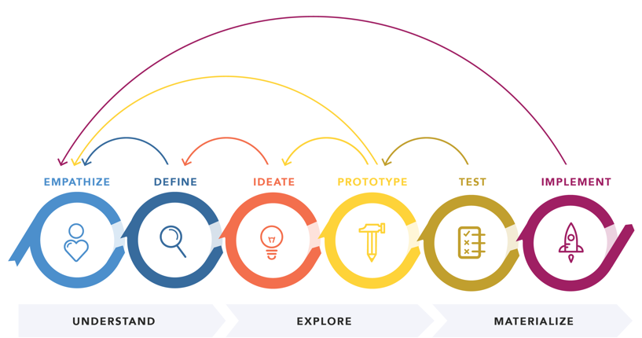
UX Process – Variety of Flavors
Research, Analyze, Synthesize
Prototype, Test, Refine
Problem
Solution
Definition
Stanford School of Design. Image credit Hasso Plattner Institute of Design
Double Diamond – British Design Council. Image credit Phylicia Flynn
Design Thinking 101. Nielsen Norman Group
Notes:
Here are a few different interpretations of the key attributes by leaders in the field
Stanford school of D -
Double Diamond –
Design thinking 101 -
https://dschool.stanford.edu/resources/getting-started-with-design-thinking
https://phyliciaflynn.medium.com/using-the-double-diamond-to-redesign-my-ux-portfolio-4905627fa1ff
https://www.nngroup.com/articles/design-thinking/

Slide 16
UX Process – Variety of Flavors
Stanford School of Design. Image credit Hasso Plattner Institute of Design
Notes:
Here are a few different interpretations of the key attributes by leaders in the field
Stanford school of D -
Double Diamond –
Design thinking 101 -
https://dschool.stanford.edu/resources/getting-started-with-design-thinking
https://phyliciaflynn.medium.com/using-the-double-diamond-to-redesign-my-ux-portfolio-4905627fa1ff
https://www.nngroup.com/articles/design-thinking/

Slide 17
UX Process – Variety of Flavors
Double Diamond – British Design Council. Image credit Phylicia Flynn
Notes:
Here are a few different interpretations of the key attributes by leaders in the field
Stanford school of D -
Double Diamond –
Design thinking 101 -
https://dschool.stanford.edu/resources/getting-started-with-design-thinking
https://phyliciaflynn.medium.com/using-the-double-diamond-to-redesign-my-ux-portfolio-4905627fa1ff
https://www.nngroup.com/articles/design-thinking/

Slide 18
UX Process – Variety of Flavors
Design Thinking 101. Nielsen Norman Group
Notes:
Here are a few different interpretations of the key attributes by leaders in the field
Stanford school of D -
Double Diamond –
Design thinking 101 -
https://dschool.stanford.edu/resources/getting-started-with-design-thinking
https://phyliciaflynn.medium.com/using-the-double-diamond-to-redesign-my-ux-portfolio-4905627fa1ff
https://www.nngroup.com/articles/design-thinking/

Slide 19

UX Process – Fundamental
1. Understand/relate in context
2. Get oriented
4. Observe to learn, iterate to improve
3. Do something

Slide 20
UX Process – Fundamental
1. Understand/relate in context
2. Get oriented
4. Observe to learn, iterate to improve
3. Do something

Slide 21
UX Process – Understand/Relate in context
Discover - explicit understanding of users, tasks and environments
How do we center the user?
Conduct interviews
Observe how they perform tasks
Research their background and environment
Develop personas and scenarios

Slide 22
UX Process - Understand/Relate in context
Why conduct user research?
Understand users’ problems
Learn users’ motivations and mental models
Become familiar with users’ context
Validate and invalidate assumptions / biases

Slide 23
UX Process - Understand/Relate in Context
ATTITUDINAL
BEHAVIORAL
What users say: thoughts, feelings, impressions
What users do:
capabilities,
tendencies,
execution

Slide 24
UX Process - Understand/Relate in Context
Interview techniques
Set context for interview
Establish rapport
They are the expert of their perspective
Don’t ask leading questions
Ask about one topic at a time
Ask specific questions – not generalized ones
Ask probing and follow-up questions
Be attuned to facial expression and body language
Do read-back’s to ensure you are interpreting what you hear correctly

Slide 25
UX Process – Fundamental
1. Understand/relate in context
2. Get oriented
4. Observe to learn, iterate to improve
3. Do something

Slide 26
UX Process – Get Oriented
Personas
Minimalist way of identifying notional user profiles
Can vary in complexity, but should at least contain:
User group name
Fictional user name (and maybe a picture)
Basic demographic information
Occupation/role and brief description
Goals and tasks related to product, system, or service
Context: physical, social, technological

Slide 27
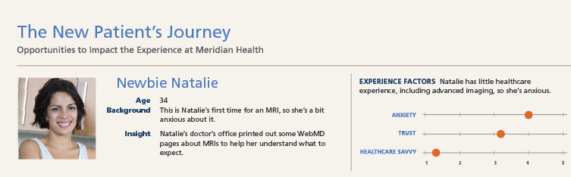
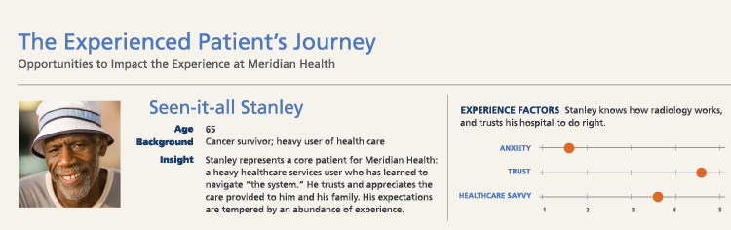
UX Process – Get Oriented
*example personas from “Customer Journey Mapping in Practice”
Notes:
https://heartofthecustomer.com/wp-content/uploads/2016/05/HOC-Meridan-Health-Case-Study.pdf

Slide 28
UX Process – Get Oriented
As a
PERSONA
I want
user story
NEED
So that
GOAL

Slide 29
UX Process – Get Oriented
User-centered, non-technical descriptions that contextualize units of work as end goals, not features
A few sentences that articulate the value of a piece of work in a way that the end user would easily understand
Format facilitates collaboration and creative problem-solving
Can be aggregated, decomposed, and sequenced

Slide 30
UX Process – Fundamental
1. Understand/relate in context
2. Get oriented
4. Observe to learn, iterate to improve
3. Do something

Slide 31
UX Process – Do Something
Inventory
Identify many things you can do
Prioritize
High impact and easy to do
Scope
Break down into a hypothesis testing a single variable

Slide 32
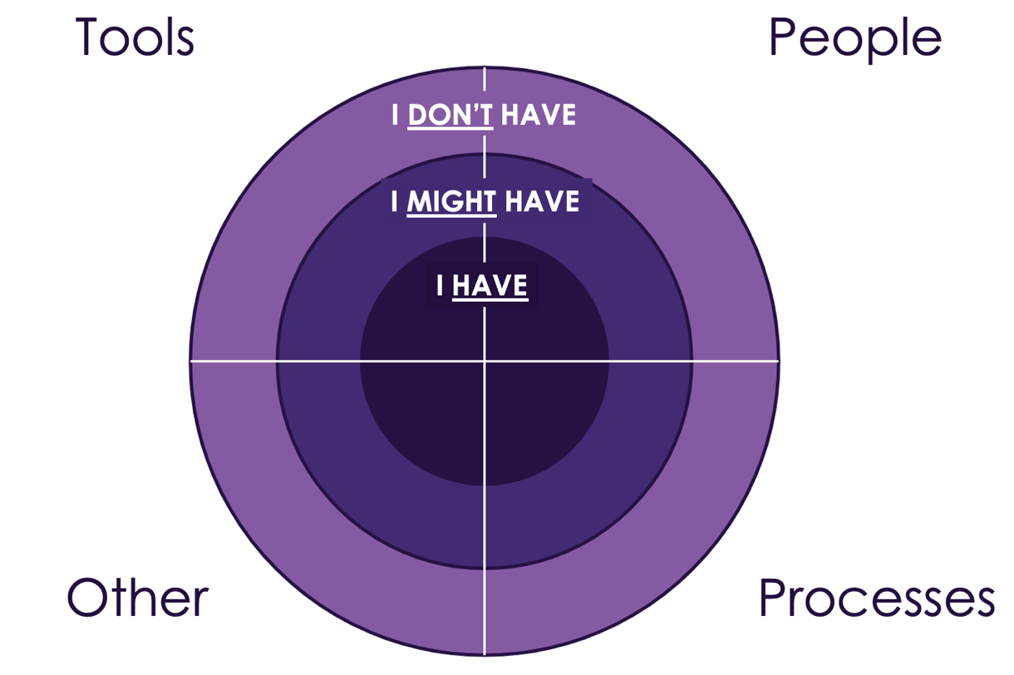
UX Process – Do Something
Inventory
Identify many things you can do
Notes:
Add visuals and break down a few techniques
- wireframe, sketches, low fidelity prototype and psychology behind

Slide 33
UX Process – Do Something
Prioritize
high impact and low effort
High Impact/ Low Effort
High Impact/ High Effort
Impact
Low Impact/ Low Effort
Low Impact/ High Effort
Effort
Notes:
It is important to specify what exactly can be adjusted and then to prioritize the items by what will have an impact that is the most aligned, while also having the lowest cost or burden to implement. Creating an impact/ doability matrix can be helpful in determining where to start and which variable to manipulate. On an impact/ doability matrix, impact is charted from least to greatest along one axis and doability is charted in terms of ease from easiest to most difficult on the other axis. By classifying the variables, the degree of lift versus impact becomes clear.

Slide 34
UX Process – Do Something
Scope - break down into a hypothesis testing a single variable focused on the user
Consider the total user experience
Minimum of invested time and effort for maximum value
Create low-fidelity prototypes
Determine if more understanding of the user is needed

Slide 35

UX Process – Do Something
Cardboard
Allows a test user to accomplish a given task
Notes:
Psychology behind low fidelity prototypes
Cheap and easy to make
Fast to make a new prototype with cardboard
Users will give you feedback more readily

Slide 36
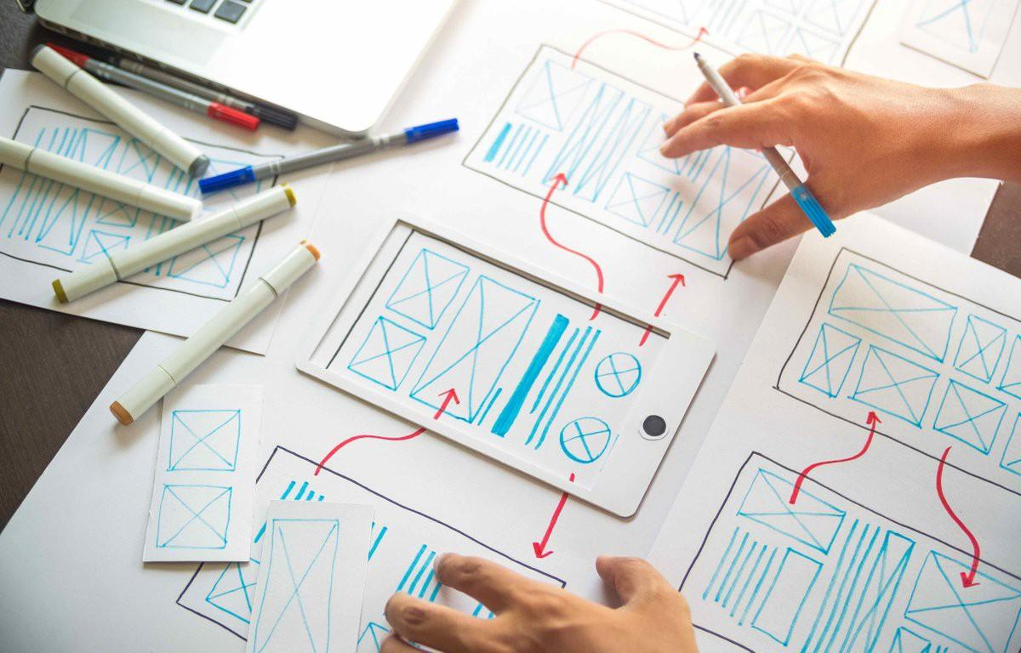
UX Process – Do Something
Low fidelity prototype

Slide 37

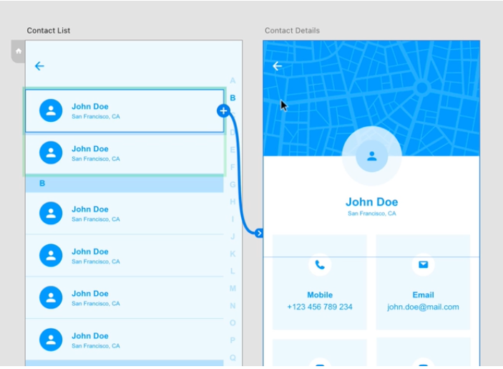
UX Process – Do Something
High fidelity prototype
Wireframe – focus on content structure and functionality

Slide 38
UX Process – Fundamental
1. Understand/relate in context
2. Get oriented
4. Observe to learn, iterate to improve
3. Do something

Slide 39
UX Process – Observe to learn, iterate to improve
Testing ideally with the end user
RUN
USABLE
VALID

Slide 40
UX Process – Observe to learn, iterate to improve
Not exactly “user testing,” since we’re not testing whether users perform well or poorly
Involves the presentation of tasks to end users in order to gather information about their responses and execution
In general, facilitated by a skilled UX designer who can ensure collection of unbiased, high-quality data

Slide 41
UX Process – Observe to learn, iterate to improve
Did we solve the pain point for the user?
What can we learn, about the user – about the prototype
How do we center the user?
Continue to monitor how users interact
Analyze user journeys holistically
Triage and patch to address emergent pain points
Begin the cycle again

Slide 42
Outline
Prelude for UX
Definition of UX
UX process
Benefits of UX
Evolution of UX
UX case study
UX maturity
Practical tips
Summary and conclusion

Slide 43
UX Benefits - End User
Better outcomes for end user
Reduced cognitive load
Less time to train
Better reliability of human user to achieve desired effect
Notes:
– understanding the end-users needs, constraints, and environment, before design begins improves the chances that the product will require fewer iterations.
– when a system can be used effectively and efficiently, even under stress, it produces fewer errors and roadblocks to mission completion.
- when users need less time figuring out how to do something, they can spend more time performing the required tasks.
– when an interface considers the users’ needs, it makes it more intuitive, requiring less training.

Slide 44
UX Benefits – Business Case
Effective UX is good business
Reduced development and maintenance costs
Improved productivity and operational efficiency
Increased production
Reduced training time and costs
Of the top 12 reasons that projects fail, three of the top 12 are directly related to what we would call user experience or user-centered design work, and those three are badly defined requirements; poor communication among customers, developers, and users; and stakeholder politics.
– Dr. Susan Weinschenk, analysis of IEEE article “Why Software Fails”
Notes:
– understanding the end-users needs, constraints, and environment, before design begins improves the chances that the product will require fewer iterations.
– when a system can be used effectively and efficiently, even under stress, it produces fewer errors and roadblocks to mission completion.
- when users need less time figuring out how to do something, they can spend more time performing the required tasks.
– when an interface considers the users’ needs, it makes it more intuitive, requiring less training.

Slide 45
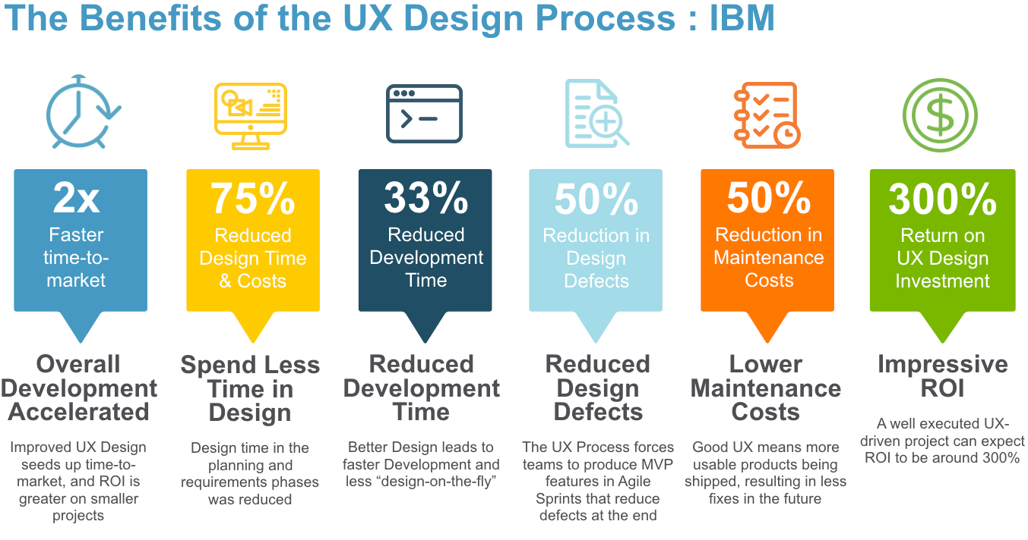
UX Benefits – Business Case
A Forrester Total Economic Impact Study Commissioned by IBM Feb 2018

Slide 46
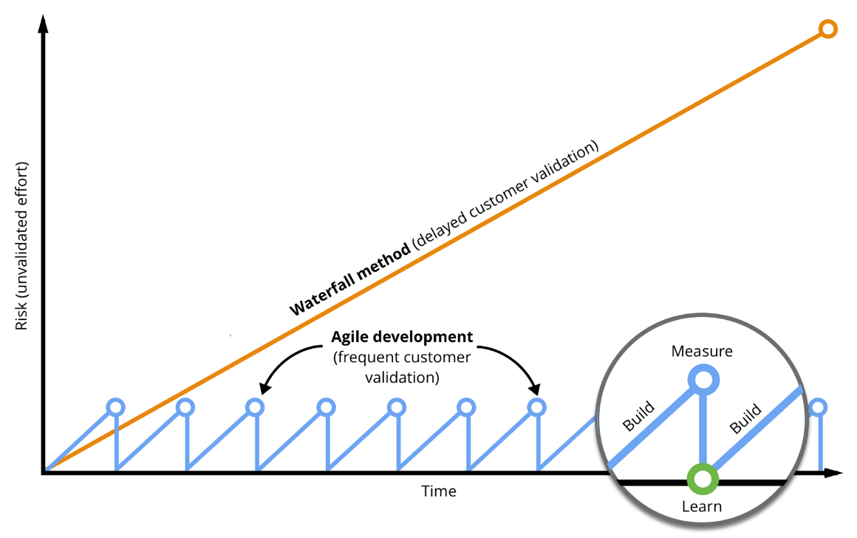
UX Benefits - Risk
Reduce risk at handoff of each cycle and to end user
Reduce Work in Progress
Graphic credit: Drew McKinney
Notes:
https://medium.com/@drewmck/lean-ux-is-about-reducing-risk-1d7d505d2881

Slide 47
Outline
Prelude for UX
Definition of UX
UX process
Benefits of UX
Evolution of UX
UX case study
UX maturity
Practical tips
Summary and conclusion

Slide 48
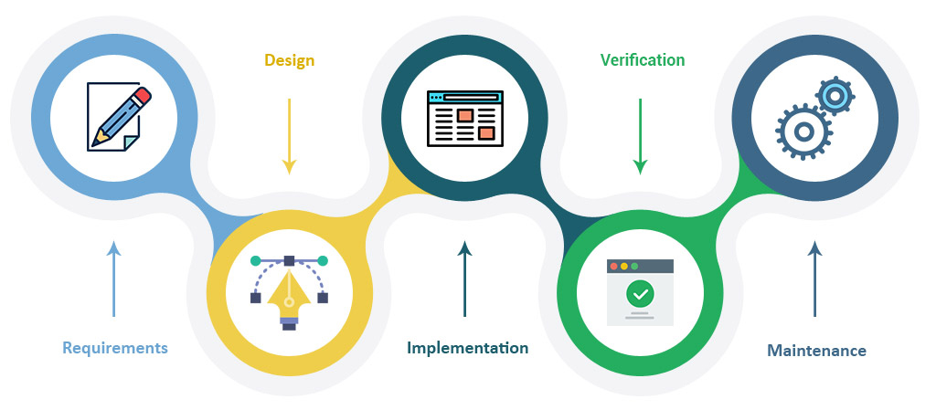
Evolution of UX in Commercial Sector
Classic User Experience Design
Waterfall based
Linear
Sequential
Each phase dependent on deliverables of previous one
Notes:
https://uxplanet.org/the-evolution-of-ux-process-methodology-47f52557178b
waterfall model is a breakdown of project activities into linear sequential phases, where each phase depends on the deliverables of the previous one and corresponds to a specialization of tasks

Slide 49
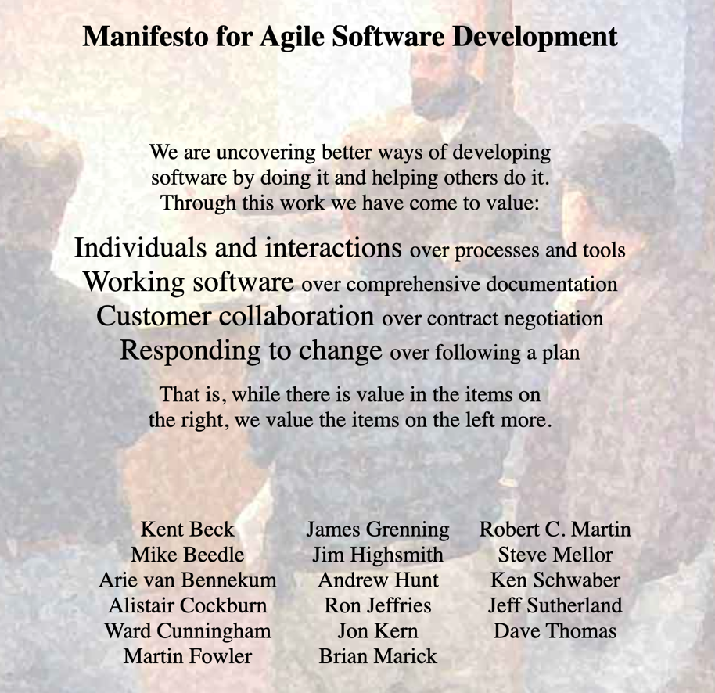
Evolution of UX in Commercial Sector
UI/UX Designer
Agile – focus on rapid iteration
Shippable increments every 2-4 weeks
Product evolves over time
Agile and classic UX waterfall process in conflict
Notes:
Moore’s law resulted in technology being developed more rapidly
UI/UX designer became synonymous with digital and graphic design
Agile manifesto in Feb 2001 – 4 key values and 12 principles
https://agilemanifesto.org/
Originated as practices within mechanical engineering and manufacturing. You’ve probably thought of this as a software-only term, but it can apply to any product-oriented or experience-oriented shop.

Slide 50
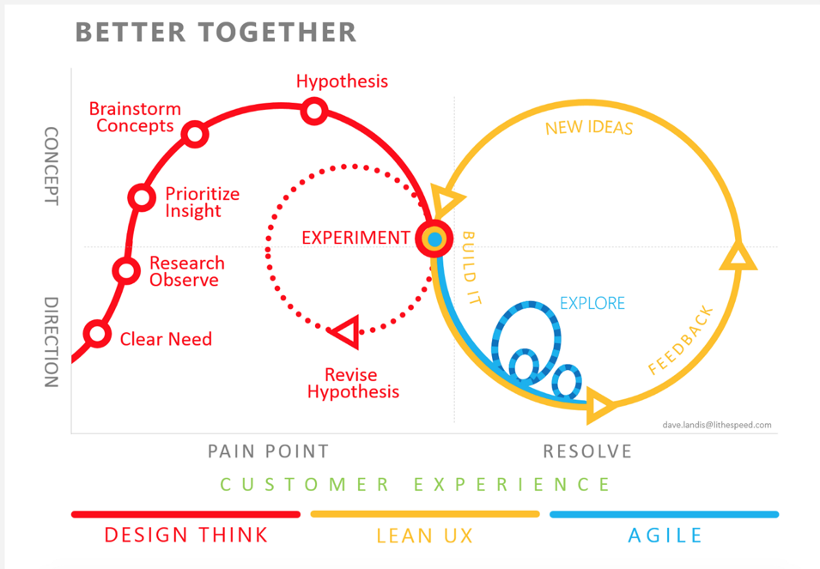
Evolution of UX in Commercial Sector
Lean UX
Outcome based instead of requirements based
UX now worked within Agile cadence BUT broke down if product was vaguely defined
Resulted in a lot of UX work being wasted when user feedback wasn’t readily available yet
Notes:
https://www.oreilly.com/library/view/designing-for-product/9781491971451/ch05.html

Slide 51
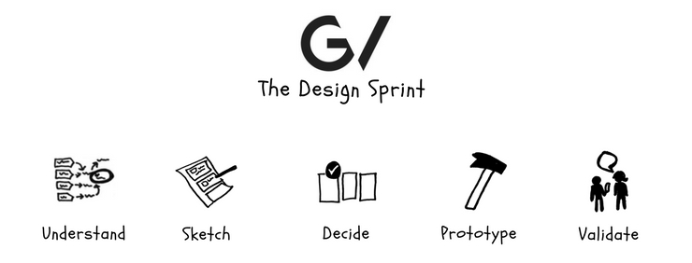
Evolution of UX in Commercial Sector
Design sprint
Classic UX but VERY low fidelity – napkin sketch testing
Notes:
Google developed design sprint back in 2010. By working closely with Google googleVentures over the years, they developed an effective framework that can help you answer the most important business questions, clearly define goals and have a working product ready for launch faster than ever.
https://www.gv.com/sprint/
This five-phase framework helps boost innovation, creative thinking and brings everyone together under the same vision. As mentioned, the framework consists of five phases:
Understand
Sketch
Decide
Prototype
Validate

Slide 52
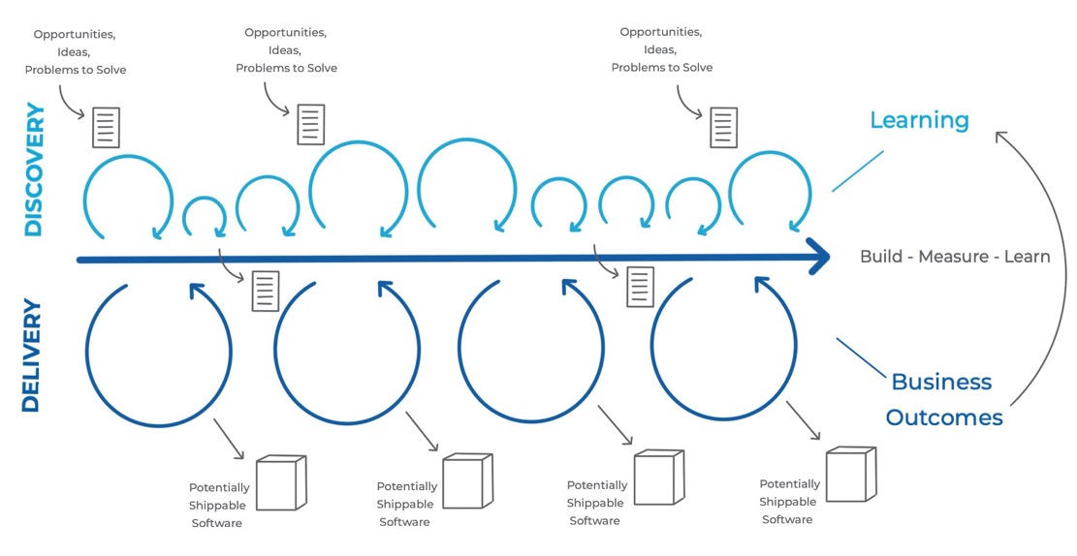
Evolution of UX in Commercial Sector
Dual Track design
Design sprint + Lean UX/agile
Design thinking/research powers design sprint
Lean UX/agile powers iterative experimentation
Typically run in parallel
Opportunities, Ideas, Problems to Solve
Potentially Shippable Software
Notes:
https://aktiasolutions.com/dual-track-agile/

Slide 53
Competing Design Priorities in Government
Reduce human error = remove the human
Research to quantify behavior and identify scenarios where error was likely
Generalized best practices allowed for the removal of user input from design and development process
Notes:
Throughout the defense sector and other high-risk industries, we often view humans as a primary source of error, and that is often the case.
Without proper training, under duress, or when fatigued, users are liable to make mistakes.
To manage human risk first research to quantify human behavior and identify scenarios where error was likely to occur.
With a set of generalized best practices in place, it became possible to remove direct user inputs from design and development processes.

Slide 54
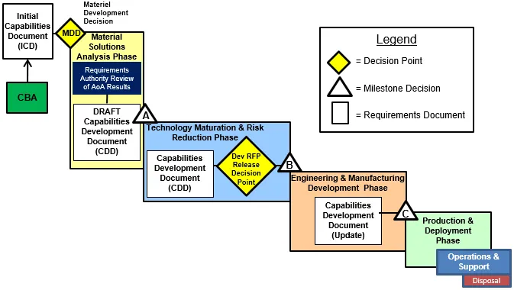
Competing Design Priorities in Government
Proxies – a representation of the actual user, but not the actual user
Government relied on proxies for:
Developing requirements
Testing prototypes where human testing was still required
Generic design for average
Notes:
Using JCIDS as a proxy user can be a passable substitute for working with end users on projects where we’re bending lots of metal, like building a new fleet of cargo aircraft.
These projects require years of resourcing in advance and offer little room for substantial redesign.

Slide 55
Competing Design Priorities in Government
Total quality management - continual improvement of products and services, focus on business processes on meeting needs of customers, both internal and external
Led by Executive Steering Committee
Continuous Process Improvement/Lean Six Sigma - disciplined process improvement methodology to increase efficiency in operations, effectiveness in support to warfighter
ISO - 9000
Notes:
1990’s DoD was focusing on:
Total Quality Management is a management philosophy that emphasizes customer satisfaction, employee empowerment, and continuous improvement. Although TQM first gained prominence in the private sector, it is the growing public sector successes that led to its adoption by the Department of Defense
https://www.investopedia.com/terms/s/six-sigma.asp
DoD TQM: https://www.acqnotes.com/Attachments/DoD%20Total%20Quality%20Management%20Master%20Plan%20-%201998.pdf
Army GAO report on TQM: https://www.gao.gov/assets/ggd-93-17r.pdf
2009 DoD focusing on CPI/LSS
DoDI CPI/LSS https://www.esd.whs.mil/Portals/54/Documents/DD/issuances/dodi/501043p.pdf

Slide 56
Competing Design Priorities in Government
Identifying and eliminating blockages and excesses to maximize flow
Using continuous process improvement to minimize error and risk
Certifying products meet client, stakeholder, and regulatory standards
LEAN
SIX SIGMA
ISO-9000
Notes:
1990’s DoD was focusing on:
Total Quality Management is a management philosophy that emphasizes customer satisfaction, employee empowerment, and continuous improvement. Although TQM first gained prominence in the private sector, it is the growing public sector successes that led to its adoption by the Department of Defense
https://www.investopedia.com/terms/s/six-sigma.asp
DoD TQM: https://www.acqnotes.com/Attachments/DoD%20Total%20Quality%20Management%20Master%20Plan%20-%201998.pdf
Army GAO report on TQM: https://www.gao.gov/assets/ggd-93-17r.pdf
2009 DoD focusing on CPI/LSS
DoDI CPI/LSS https://www.esd.whs.mil/Portals/54/Documents/DD/issuances/dodi/501043p.pdf

Slide 57
Competing Design Priorities in Government
No redundancy, thus no margin for innovation
Focus on process improvement prioritizes data over innovation
Burdensome data reporting drains resources
LEAN
SIX SIGMA
ISO-9000

Slide 58
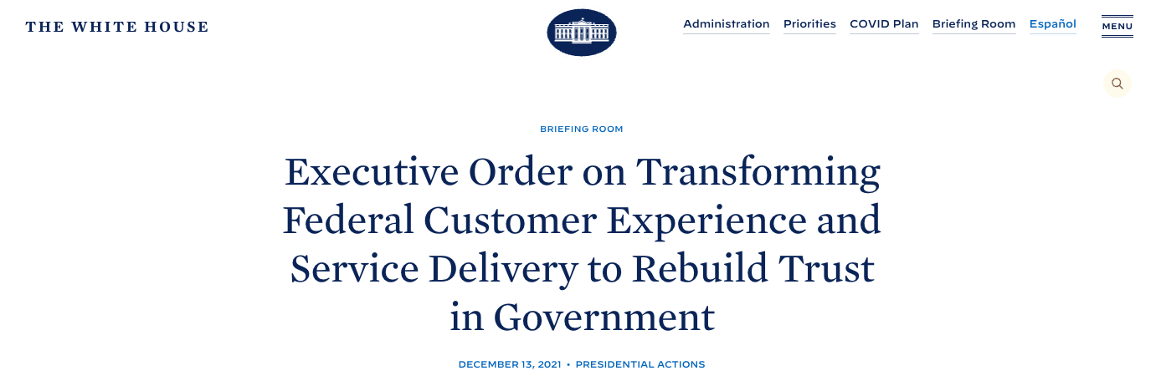
Competing Design Priorities in Government
The Executive Order directs Federal agencies to put people at the center of everything the Government does. Specifically, the Executive Order includes 36 customer experience (CX) improvement commitments across 17 Federal agencies, all of which aim to improve people’s lives and the delivery of Government services.
Notes:
https://www.whitehouse.gov/briefing-room/presidential-actions/2021/12/13/executive-order-on-transforming-federal-customer-experience-and-service-delivery-to-rebuild-trust-in-government/

Slide 59
Outline
Prelude for UX
Definition of UX
UX process
Benefits of UX
Evolution of UX
UX case study
UX maturity
Practical tips
Summary and conclusion

Slide 60


UX Case Studies – USS McCain
In August 2017, the U.S. Navy Destroyer John S McCain veered off course and collided with a Liberian-flagged oil tanker
The collision was the Navy's worst accident at sea in almost 40 years, both in terms of cost and loss of life
Investigators found use of the Integrated Bridge and Navigation System (IBNS) to be a major cause
Notes:
In August 2017, the U.S. Navy Destroyer John S McCain veered off course in one of the busiest global shipping lanes and collided with a Liberian-flagged oil tanker, the Alnic MC.
One of several fleet incidents during that period, the collision was the Navy’s worst accident at sea in almost four decades, with ten sailors killed, dozens more injured, and over $100 million of sustained damage to the vessel.
A National Transportation Safety Board (NTSB) examination of the root causes of the crash illuminated several errors related to a new user interface, the Integrated Bridge and Navigation System (IBNS). It led the NTSB to conclude that errors in system design contributed to the crash.
The IBNS, purchased by the Navy to reduce costs by limiting the number of sailors required to steer a ship, used touchscreen interfaces to pull together data from multiple sources in both automation-assisted and manual modes.
https://www.ntsb.gov/investigations/accidentreports/reports/mar1901.pdf

Slide 61
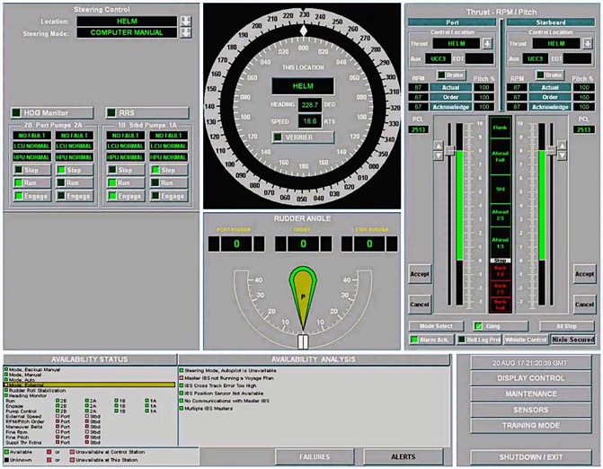
UX Case Studies – USS McCain
Many different kinds of information in single display
No clear information hierarchy
Placement of critical information in non-dominant location
Multiple typefaces
No visual difference between primary and alternate methods of control
Small font relative to real estate
Notes:
After the crash, the ensuing NTSB investigation determined that the IBNS did not conform to the industry-accepted maritime design standards outlined in Standard F1166, Standard Practice for Human Engineering Design for Marine Systems, Equipment, and Facilities approved for use by the Navy.
These standards stipulate that the design of vessels, their systems, and subsystems should place a premium on simplicity and on limiting “potential human error incidence in the operation and maintenance of the system, particularly under conditions of stress.”

Slide 62

UX Case Studies – USS McCain
Lack of faith in system reliability
Unsanctioned workarounds
Misinterpretation of system components
Policy gaps
Notes:
Instead, the IBNS design and implementation were determined to have contributed to a series of errors that led to the collision. These errors are indicative of those commonly associated with poor User Experience (UX) design. These included:
Lack of faith in system reliability – The crew reported multiple false alarms in the months leading up to the crash, reducing crew faith in the fidelity of the system.
Unsanctioned workarounds – The crew of both the John S McCain and other similar ships often used the system in unintended, non-standardized ways (e.g., putting the system in backup manual mode) to eliminate errors in automation, such as the aforementioned false alerts, or to avoid unintended actions associated with accidental screen contact.
Misinterpretation of system components – According to the NTSB, the design for the transfer of thrust between bridge stations contained a level of complexity that did not adhere to approved design principles, and the lack of mechanical throttles stripped operators of the ability to receive “both immediate and tactile feedback”. (more from the report here)
Policy gaps – The complexity of the system required extensive training to ensure user proficiency which had not been fully integrated into associated policies, and the acquisition process left end-users without a means to provide critical user feedback to decision-makers and required them to use the system, despite identified flaws.
The McCain crash underscores the risks and associated costs, including critical mission failures and even loss of life, that can be associated with a disregard for or misapplication of UX principles in the design, development, and implementation of technology.

Slide 63
UX Case Studies – USS McCain
UX process would have helped deliver software that was more delightful
Understand/relate in context
Persona - Helm/lee helm very young new, tech savvy
Environment on a bridge of a ship
Get oriented
Better requirements
Access to training environment
Do something
Low fidelity prototypes tested with user
Usability acceptance testing vice end user testing
Observe to learn, iterate to improve
Multiple iterations and testing in environment
Pleasurable
Usable
Reliable
Functional

Slide 64

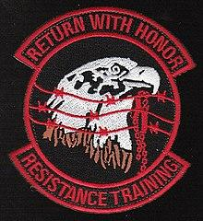

UX Case Studies - SERE
UX can be used to design entire training continuum
Survival, Evasion, Resistance, and Escape (SERE) - training program to teach military members, DoD civilians and military contractors survival skills, training in evading capture and the military’s Code of Conduct.
Notes:
prepares U.S. military personnel, U.S. Department of Defense civilians, and private military contractors to survive and "return with honor" in survival scenarios.

Slide 65
UX Case Studies - SERE
Established by the USAF at the end of WWII – cheaper and more effective to train aircrews in SERE techniques than have them lost or languishing in enemy hands
WWII Navy found 75% of pilots shot down came down alive, yet barely 5% survived
Need for training to keep aircrew and special forces alive resulted in development of multiple trainings
Notes:
The pain point

Slide 66

UX Case Studies - SERE
Understand/relate in context
Training developed based on interviews and feedback from USERS who had successfully Survived, Evaded, Resisted, and/or Escaped
Get oriented
Balanced with risk to physical safety and resources required to create realistic scenarios
Training in context from “start to finish” – an entire experience

Slide 67
UX Case Studies - SERE
Do something
Training evolved as the nature of warfare, technology and the environment evolved
Additional scenarios developed – landscape, technology
Observe to learn, iterate to improve
Every recovery thoroughly debriefed
Observations incorporated throughout training continuum

Slide 68
Outline
Prelude for UX
Definition of UX
UX process
Benefits of UX
Evolution of UX
UX case study
UX maturity
Practical tips
Summary and conclusion

Slide 69
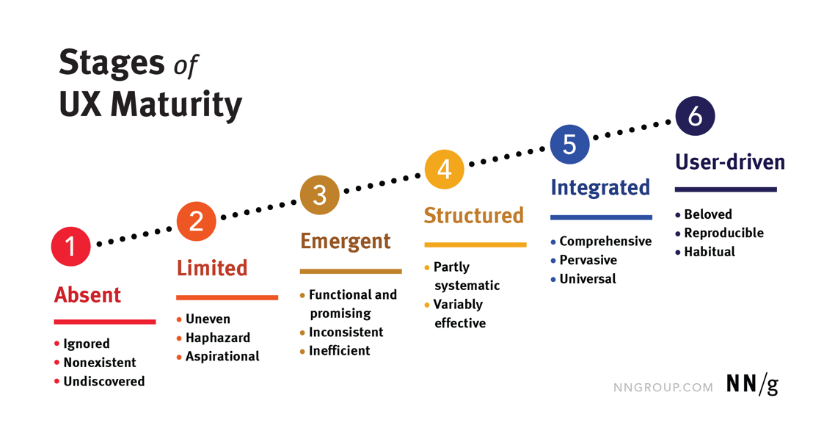
UX Maturity
Notes:
https://www.nngroup.com/articles/ux-maturity-model/

Slide 70
USAF UX Team Maturity Model
Areas of assessment
Culture
Process
Staffing and Skills
Tools
Results
Stages of maturity
Pre-UX
Experimenting
Establishing
Optimizing
Notes:
Process:
“Experts” serve as proxies for users
Developers work directly from traditional “shall statement” requirements, use cases or user stories
DesignOps approach: people, process, tech
Design has budget
Design has community
Engagement leads for outreach to users

Slide 71
Outline
Prelude for UX
Definition of UX
UX process
Benefits of UX
Evolution of UX
UX case study
UX maturity
Practical tips
Summary and conclusion

Slide 72
Practical Tips
Everything is designed and therefore designable
Put the lowest fidelity prototype in front of a user and ask for feedback
Mindset and culture shift – 1% change makes a big difference over time
Talk to a end user of what you are working on

Slide 73
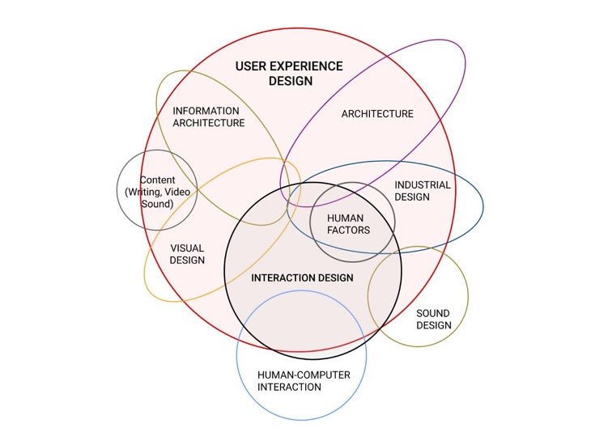
Practical Tips - UX Specialties
UX designers are trained in a multidisciplinary field
No one designer is expert in all of these disciplines
Only some disciplines are relevant to solving particular problems
Researcher – designer – developer ratio 1:5:50

Slide 74
Practical Tips - UX Specialties
UX roles – ALL UX roles exist to serve the design process, know what you need
UX Researcher - User researcher
UX Designer - Interaction designer, UI/UX designer, Experience designer, Product designer
UX Writer – Copywriter, Content strategist
UI Designer – Visual designer, Digital designer
UX Manager/Strategist – UX architect
UX Unicorn - UX designer + front-end development, UX engineer
Notes:
https://uxdesign.cc/understanding-ux-roles-23032b94710d

Slide 75
Outline
Prelude for UX
Definition of UX
UX process
Benefits of UX
Evolution of UX
UX case study
UX maturity
Practical tips
Summary and conclusion

Slide 76
Summary
Define core principles of UX and human-centered design
Describe key UX methods and list the correct place for UX activities within the overall structure of a project
List the benefits of a user-centered research and development approach to producing and evaluating learning, training, and simulation products
Assess the UX maturity of projects, teams, and processes

Slide 77
Conclusion
User experience (UX) encompasses all aspects of the end-user's interaction with the company, its services, and its products
UX process
Understand/relate in context
Get oriented
Do something
Observe to learn, iterate to improve
UX results in better outcomes for the end user and the business
Focus on UX in the government of renewed interest
Getting started with UX is as simple as watching and listening to users

Slide 78
Q&A
Any questions?
Amanda Hawkins
Amanda.Hawkins@datasociety.com
Vel Preston
Vel.Preston@afacademy.af.edu

Slide 79
Recommended Resources
Watch:
It’s not you. Bad doors are everywhere. https://www.youtube.com/watch?v=yY96hTb8WgI
This is Broken! https://medium.com/10x-curiosity/don-norman-and-the-design-of-everyday-things-d187e6a81fd8
Read:
https://www.whitehouse.gov/briefing-room/presidential-actions/2021/12/13/executive-order-on-transforming-federal-customer-experience-and-service-delivery-to-rebuild-trust-in-government/
Listen:
https://userguiding.com/blog/ux-podcasts/
Notes:
Top 5

Slide 80
Resource List
ISO standards: https://www.iso.org/standard/63500.html
Usable vs delightful: https://www.nngroup.com/articles/theory-user-delight/
UX trinity: https://www.trinityaudio.ai/what-is-user-experience-the-what-why-and-how
Mr. Colt Whittall, CXO of the USAF: https://www.youtube.com/watch?v=gaX5drlGpyQ
https://dschool.stanford.edu/resources/getting-started-with-design-thinking
https://phyliciaflynn.medium.com/using-the-double-diamond-to-redesign-my-ux-portfolio-4905627fa1ff
https://www.nngroup.com/articles/design-thinking/
https://heartofthecustomer.com/wp-content/uploads/2016/05/HOC-Meridan-Health-Case-Study.pdf
https://www.usability.gov/what-and-why/benefits-of-ucd.html
https://www.ibm.com/downloads/cas/Z4WBDR8Q#:~:text=Forrester%20concluded%20that%20IBM's%20Design,and%20an%20ROI%20of%20301%25.&text=IBM's%20Design%20Thinking%20practice%20cut%20costs%20by%20accelerating%20projects
https://medium.com/@drewmck/lean-ux-is-about-reducing-risk-1d7d505d2881
https://uxplanet.org/the-evolution-of-ux-process-methodology-47f52557178b
Notes:
Top 5

Slide 81
Resource List
https://agilemanifesto.org/
https://www.oreilly.com/library/view/designing-for-product/9781491971451/ch05.html
https://www.gv.com/sprint/
https://aktiasolutions.com/dual-track-agile/
https://www.investopedia.com/terms/s/six-sigma.asp
https://www.acqnotes.com/Attachments/DoD%20Total%20Quality%20Management%20Master%20Plan%20-%201998.pdf
Army GAO report on TQM: https://www.gao.gov/assets/ggd-93-17r.pdf
https://www.whitehouse.gov/briefing-room/presidential-actions/2021/12/13/executive-order-on-transforming-federal-customer-experience-and-service-delivery-to-rebuild-trust-in-government/
https://www.ntsb.gov/investigations/accidentreports/reports/mar1901.pdf
https://www.nngroup.com/articles/ux-maturity-model/
https://uxdesign.cc/understanding-ux-roles-23032b94710d
https://cyberworx-state-of-ux.netlify.app/cyberworx_state_of_ux_report.nb (password: DataSocietyCyberWorx2021!)

