Slide 1

Avoid the Illusion of Knowing:
Reshaping Design in ADDIE (Reference ID 22T39)
Mrs. Trish Mulligan-Renaud, TTD Learning Solutions
Dr. Heather Seiser, TTD Learning Solutions

Slide 2
Topics
Refreshing the Analysis, Design, Development, Implementation, and Evaluation (ADDIE) Model
Case Studies: Illusion of Knowing
Current training development and management practices
Importance of design
Incorporating Learning Experience Design (LXD)
Learning myths and misconceptions
How we learn and cognitive activities
Learning Experience Design (LXD) strategies

Slide 3
Learning Objectives
The learner will be able to:
Discuss the effects of the illusion of knowing in training development practices.
Identify three key elements to consider in learning design practices.
Describe six key learning experience design strategies.

Slide 4
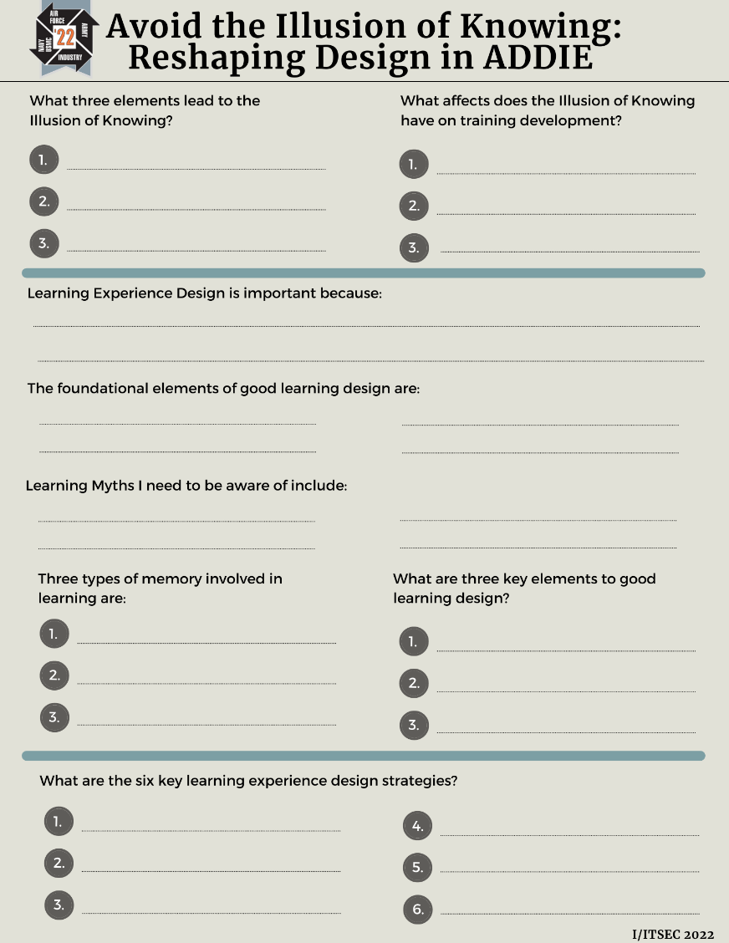
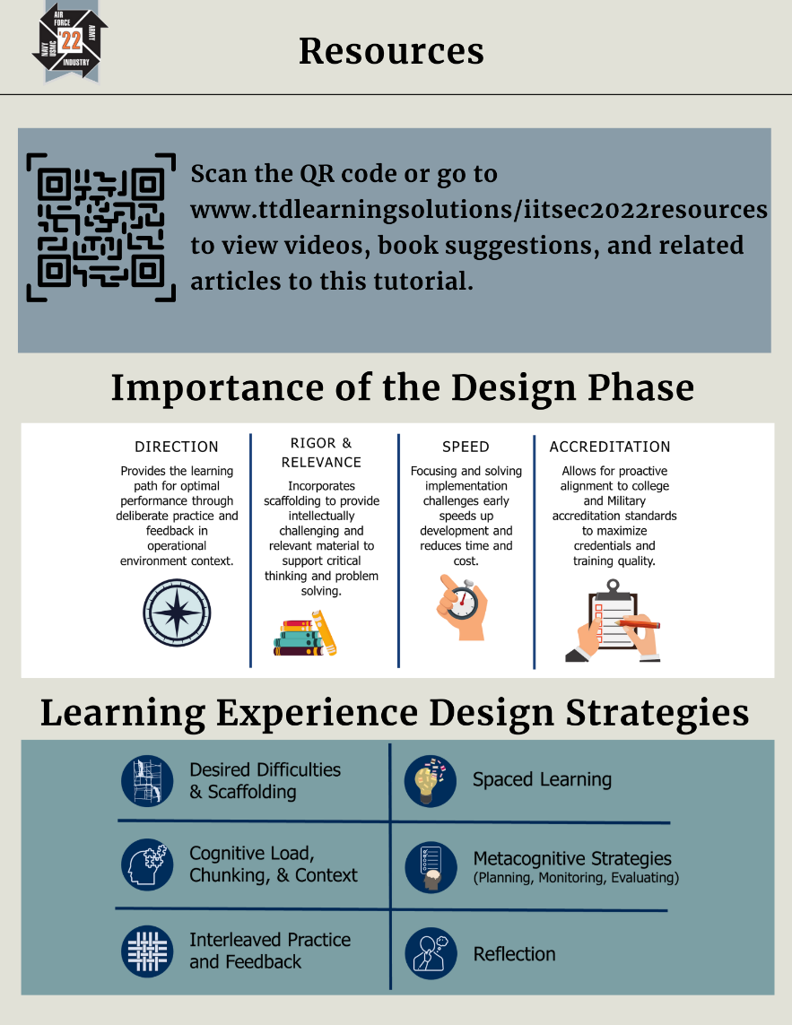
Learning Aid
Use the handout to take notes throughout the tutorial.
Back at the job, when you download the slides, you can refer back to the notes.
Resources are located on the back with some key takeaways.
Notes:
Handout will be on their seats.

Slide 5
Let’s refresh ADDIE!

Slide 6






The ADDIE Model
Analysis
Phase that determines training is the solution and figuring out the who, what, where, why, and how of the training need.
Evaluation
Phase that measures whether training solved the problem, filled the gap, and met the learning outcomes.
Design
Phase that takes the data in analysis and creates a blueprint on where, when, and how learning will take place.
ADDIE
Implementation
Development
Phase that teaches lessons from development to fill gaps identified in the analysis.
Phase that takes the blueprint and develops content, media, and validates materials with SMEs.
Notes:
Analogy

Slide 7
Exploring the Illusion of Knowing

Slide 8
Illusion of Knowing Example
What am I drawing?
Shout it out when you see it!

Slide 9
Illusion of Knowing Example

Slide 10
Illusion of Knowing Example

Slide 11
Illusion of Knowing Example

Slide 12
Illusion of Knowing Example

Slide 13
Illusion of Knowing Example

Slide 14
Illusion of Knowing Example

Slide 15
Illusion of Knowing Example
Fenced off tomato plants
Fence
Rows of Corn

Slide 16
Illusion of Knowing – What Leads Us Astray
The following elements often mislead people and their judgment:
Cognitive Bias
Perceptual Illusions
Memory Distortion
We are all hard wired to make errors in judgment
Good judgment is a skill
We overestimate our competence and stay stagnant
Notes:
The challenge is how we delude ourselves and how our judgements can lead us astray.
: Dave Dunning the social psychologist states: “we convince ourselves of congenial conclusions while denying the truth of inconvenient ones.”
Falling prey to a narrative of illusions can cost lives and cause pilot spatial disorientation.
System 1 illusion can quickly hijack training and professionalism. We need to cultivate a conscious analysis and reasoning system (keep an eye on the instruments).

Slide 17
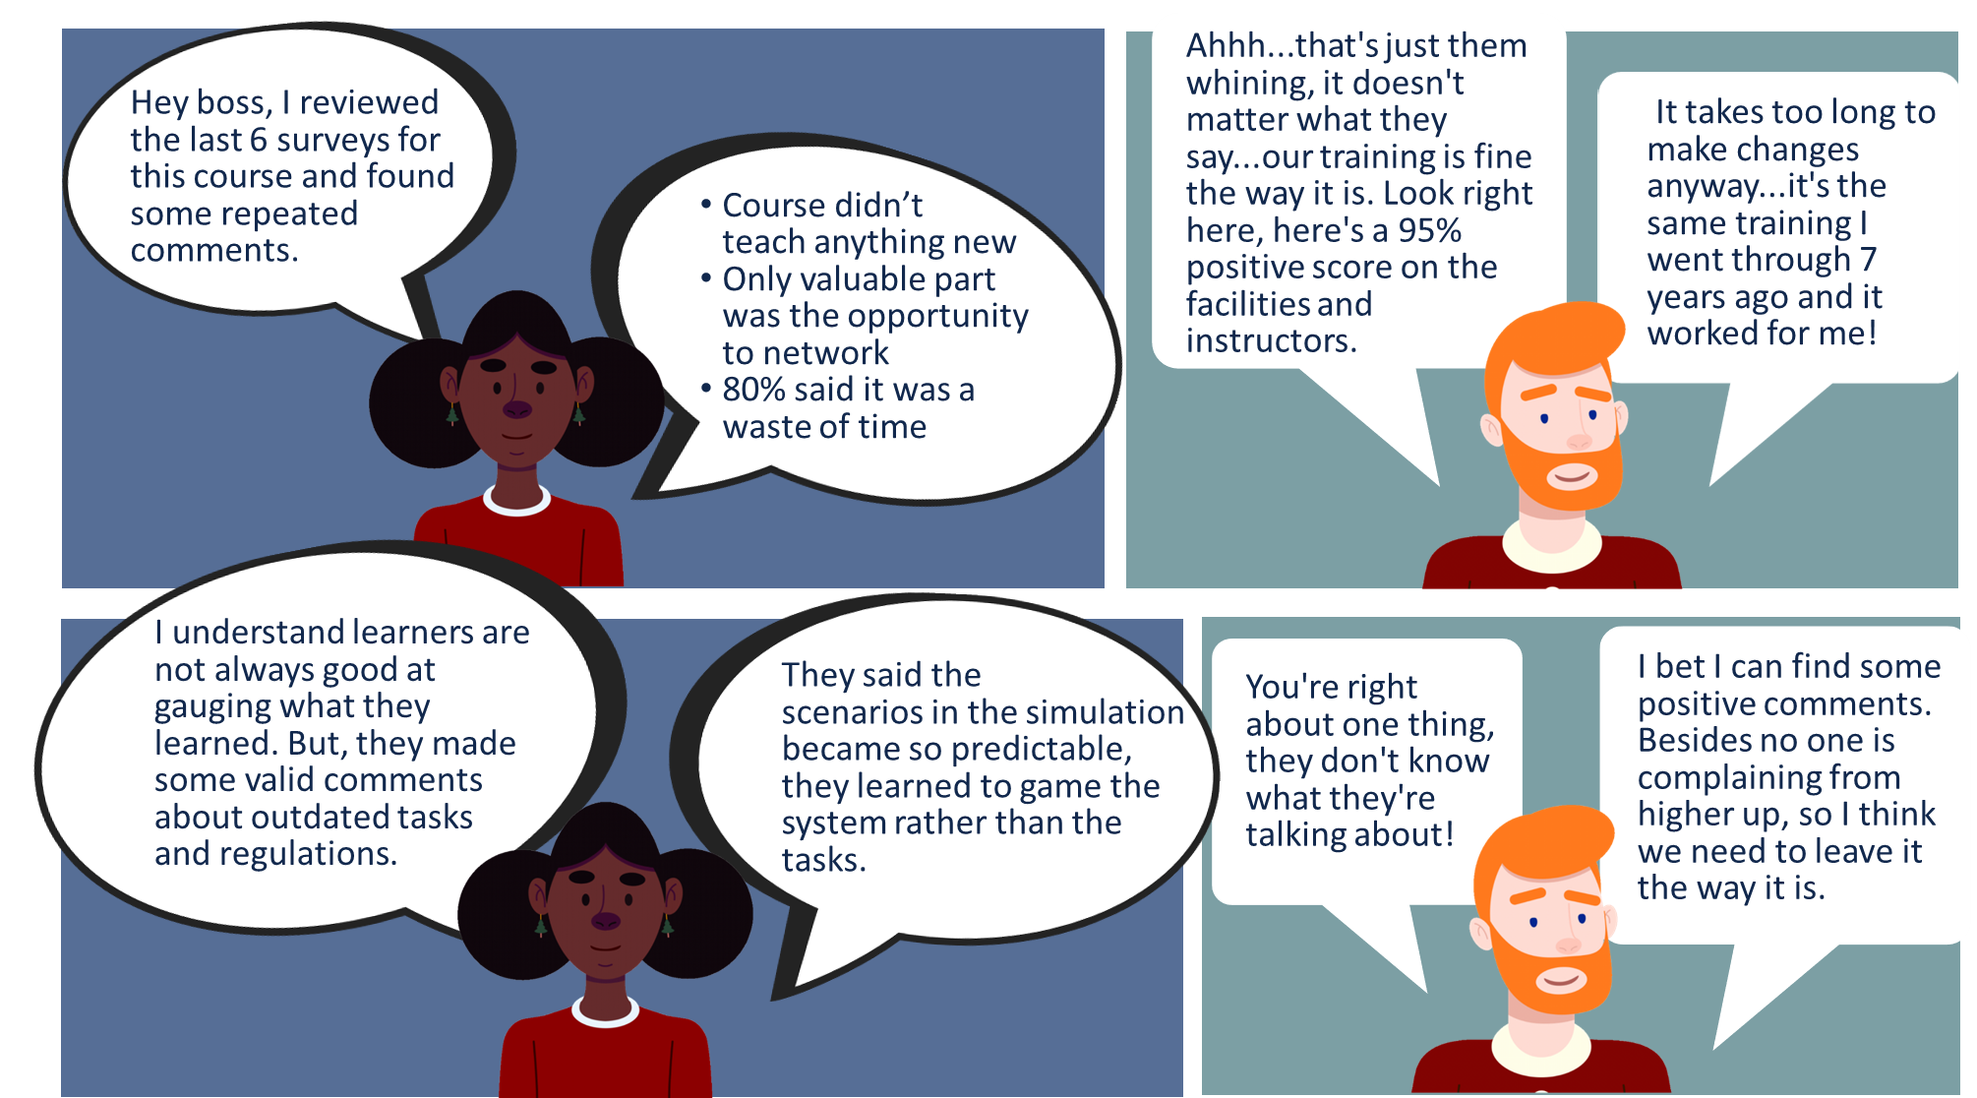
Hey boss, I reviewed the last 6 surveys for this course and found some repeated comments.
Course didn’t teach anything new
Only valuable part was the opportunity to network
80% said it was a waste of time

Slide 18
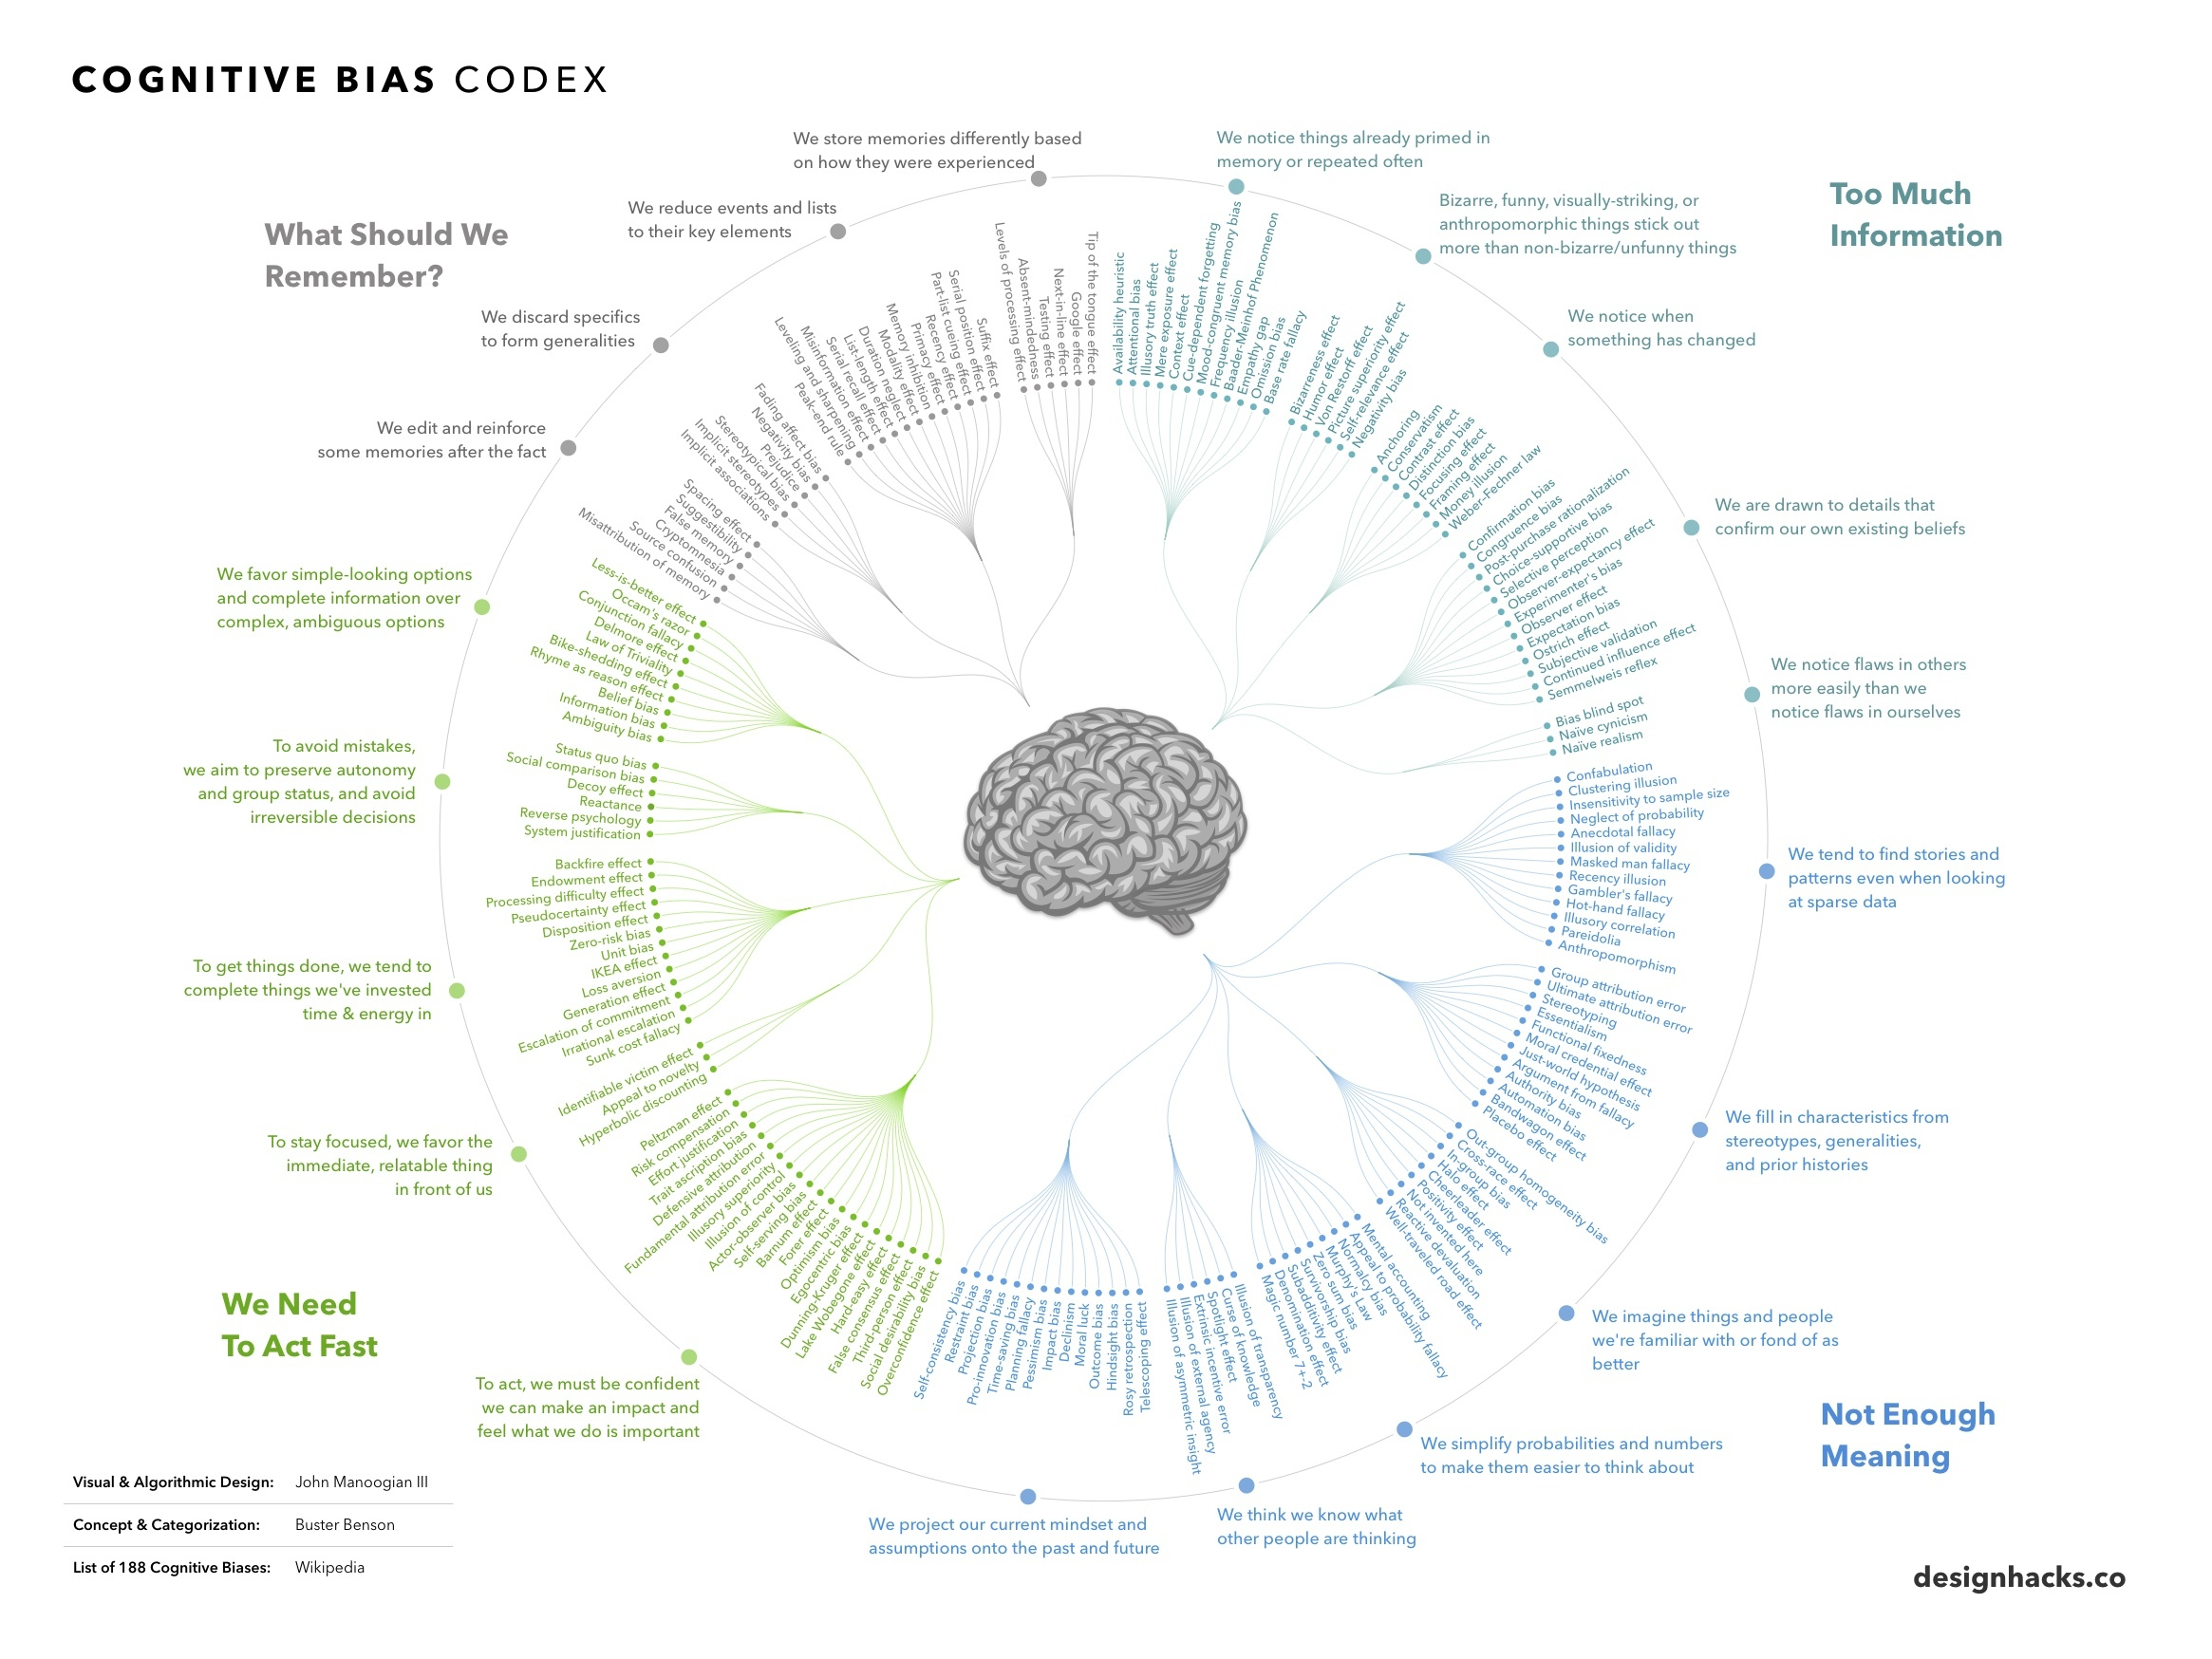
Cognitive Bias
This wheel includes the 188 cognitive biases that have been identified through research.
These biases have profound effects on our training development decisions.
We make poor judgments on what we actually know and do.
We skip the design process because we don’t think it’s important and doesn’t have value.
Notes:
How do we see the illusion of knowing showing up?
Mental mistakes are cognitive biases that affect our thinking
Cognitive biases have been studied for decades by academics in the fields of cognitive science, social psychology, and behavioral economics, but they are especially relevant in today’s information-packed world.

Slide 19
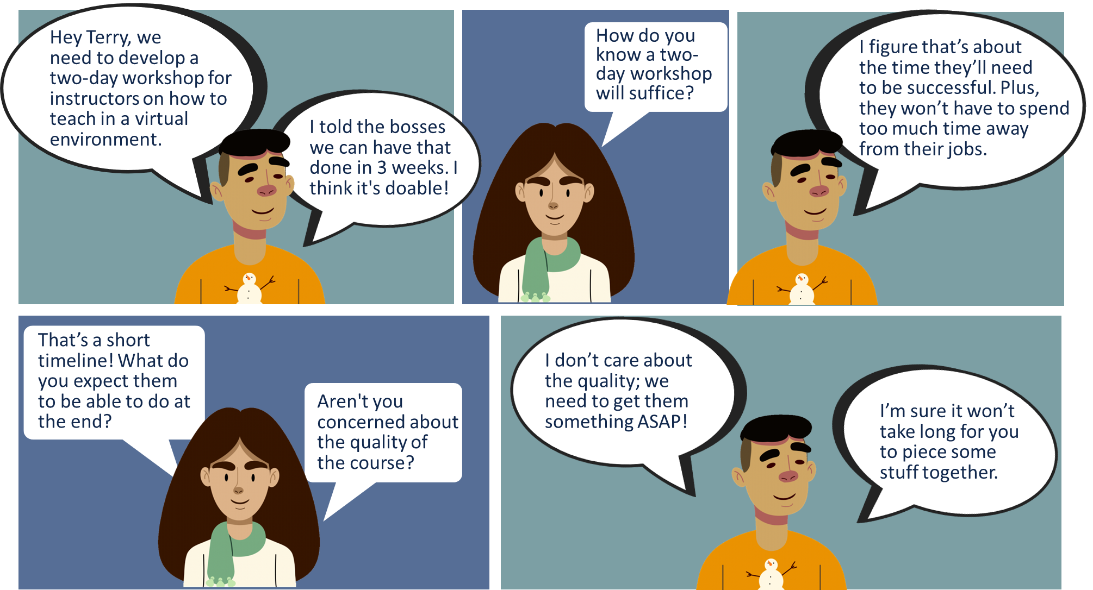

Slide 20
Perceptual Illusions
Analysis
Training Developers and Managers think Design:
takes too long, and they don’t have time to go through the process.
is writing learning objectives and then moving to development.
Design
Evaluation
ADDIE
Implementation
Development
Notes:
How do we see the illusion of knowing showing up?

Slide 21
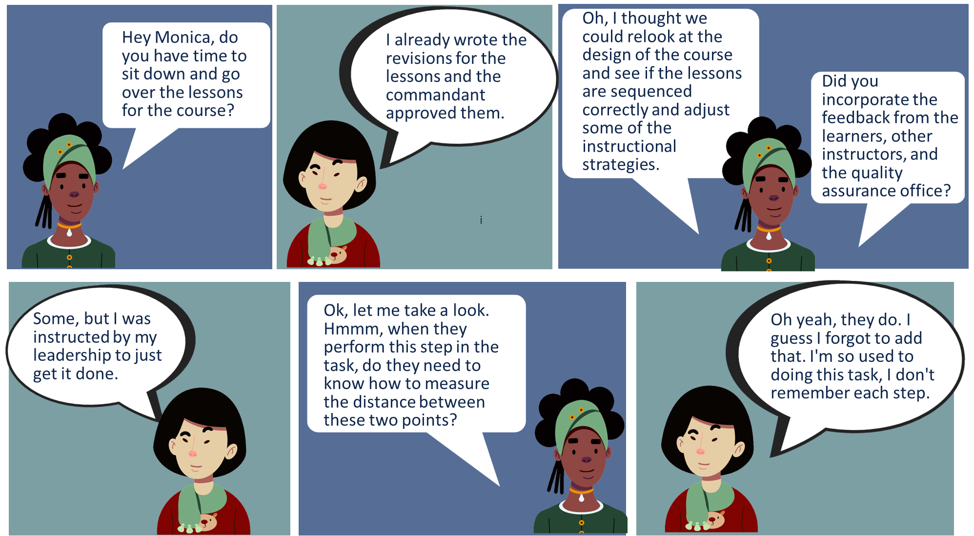

Slide 22
Memory Distortion
Difficult to remember what it’s like to be a novice → skip critical steps
Too much time away from operational experience → not up to date on policies and procedures
Imagination Inflation
Suggestion
Types of
Memory Distortions
Curse of Knowledge
Interference
Knew it all along feeling
Hindsight
Bias
False
consensus
effort
Notes:
Memory Distortions:
Imagination Inflation
Suggestion
Interference
Curse of Knowledge
Hindsight bias
Knew it all along feeling
False consensus effort
We crave a narrative because of discomfort with ambiguity and arbitrary events.
We construct narratives out of experiences and gravitate to the narratives that explain our emotions. The more meaning we give to those narratives the more we remember them; therefore, that narrative of our memory becomes central to our intuitions regarding judgments we make and actions we take.
It’s impossible to avoid basing judgment on subjective experiences.
The changeable nature of memory can skew our perceptions but it’s necessary for learning.
To make connections and memory traces more in grain and stronger to connect to more pieces of knowledge; therefore, more mental clues to retrieve. But it also gives us distortion.
Memory is reconstructed with significant emotional elements then filled with narratives we create even if wrong.
People remember things that were implied but not specifically stated.

Slide 23
Illusion of Knowing Impacts
Mission Readiness
Training Management
Workforce Capabilities
Learning Design Strategies
Notes:
Learning Design Strategies, Training Management, Workforce Capabilities
How do we see the illusion of knowing showing up?
THE problem is you need to understand your own illusion of knowing on developing training, how to do it, the decisions you make about it.
Must be the bridge of illusion of knowing to the ISD can’t do it, because they don’t know, management thinks they know how to do it

Slide 24
Illusion of Knowing Impacts
Mission Readiness
Training Management
Workforce Capabilities
Learning Design Strategies
Managers are not always versed in the ADDIE process due to biases or lack of experience.
Notes:
Learning Design Strategies, Training Management, Workforce Capabilities
How do we see the illusion of knowing showing up?
THE problem is you need to understand your own illusion of knowing on developing training, how to do it, the decisions you make about it.
Must be the bridge of illusion of knowing to the ISD can’t do it, because they don’t know, management thinks they know how to do it

Slide 25
Illusion of Knowing Impacts
Mission Readiness
Training Management
Workforce Capabilities
Learning Design Strategies
Incoming personnel lack adequate learning development knowledge and skills and the process for developing them is not standardized.
Notes:
Learning Design Strategies, Training Management, Workforce Capabilities
How do we see the illusion of knowing showing up?
THE problem is you need to understand your own illusion of knowing on developing training, how to do it, the decisions you make about it.
Must be the bridge of illusion of knowing to the ISD can’t do it, because they don’t know, management thinks they know how to do it

Slide 26
Illusion of Knowing Impacts
Mission Readiness
Training Management
Workforce Capabilities
Learning Design Strategies
Current approaches to creating effective, efficient, and engaging courses are not implemented correctly.
Notes:
Learning Design Strategies, Training Management, Workforce Capabilities
How do we see the illusion of knowing showing up?
THE problem is you need to understand your own illusion of knowing on developing training, how to do it, the decisions you make about it.
Must be the bridge of illusion of knowing to the ISD can’t do it, because they don’t know, management thinks they know how to do it

Slide 27
Current Operations (CUOPS)
Training Management
Workforce Capabilities
Learning Design Strategies
Managers lack the qualifications
Limited professional development opportunities
Lack qualified and experienced mentors
Not keeping pace with professional community
Not using evidence informed learning strategies
Inconsistent training development backgrounds
Lack training development practitioner experience
Not verse in grounded understanding of learning science
Notes:
Dr. Christina Parkers Dissertation and IITSEC paper. Marine Corp Study. 20 Years of DoD Service
"Many leaders and professionals in a TRADOC organization have little to no previous exposure of the ISS and the world
of professional instructional design. If leaders receive training based upon on their own job-related specialties and
courses during pre-command, then they should also receive training related specifically to leading an organization
focused on the education and training of others."

Slide 28
Future Operations (FUOPS)
Training Management
Workforce Capabilities
Learning Design Strategies
Provide managers with the grounded understanding of the learning process
Guide personnel through the training development process by teaching them how we learn and apply learning
Create learning experiences that meet learning outcomes and mission readiness
Focus on implementing Design in ADDIE
Use evidence informed design models and strategies
Create experiences that are relevant and rigorous
Notes:
Dr. Christina Parkers Dissertation and IITSEC paper. Marine Corp Study. 20 Years of DoD Service
"Many leaders and professionals in a TRADOC organization have little to no previous exposure of the ISS and the world
of professional instructional design. If leaders receive training based upon on their own job-related specialties and
courses during pre-command, then they should also receive training related specifically to leading an organization
focused on the education and training of others."

Slide 29



Design is the Blueprint
Design is the blueprint or the path the learner will take to meet the learning outcomes. If you were planning a boat trip, you’d have to make sure you have waypoints, the right equipment, tools, and a map to where you are headed.
Notes:
What happens when you don’t have the blueprint, on click put the life boat
We get the boat in the water, but where's it going?
How do we fix it?

Slide 30





Why Design is Important
DIRECTION
RIGOR & RELEVANCE
SPEED
ACCREDITATION
Provides the learning path for optimal performance through deliberate practice and feedback in operational environment context.
Focusing and solving implementation challenges early speeds up development and reduces time and cost.
Allows for proactive alignment to college and Military accreditation standards to maximize credentials and training quality.
Incorporates scaffolding to provide intellectually challenging and relevant material to support critical thinking and problem solving.
Notes:
29612 series, Military services in their policies and regulations. Doesn’t address the why, how, and what Design needs to look like and how it needs to be implemented.

Slide 31
Learning Experience Design (LXD)
Notes:
Learning Sciences here as an introduction

Slide 32
Moving to Learning Experience Design
ISD
UX
Don Norman, the man who coined the term “User Experience (UX)”, explains that user experience covers “all aspects of the person's experience with the system including industrial design graphics, the interface, the physical interaction and the manual.”
Instructional Systems Design (ISD) involves a systematic process for the assessment and development of training solutions, designed specifically for the purpose of formal training delivery.
Design Thinking
LXD
Design thinking is a collaborative methodology to gain deep insight of human’s needs, motivations, and behavior.

Slide 33
Moving to Learning Experience Design
ISD
UX
Don Norman, the man who coined the term “User Experience (UX)”, explains that user experience covers “all aspects of the person's experience with the system including industrial design graphics, the interface, the physical interaction and the manual.”
Instructional Systems Design (ISD) involves a systematic process for the assessment and development of training solutions, designed specifically for the purpose of formal training delivery.
Design Thinking
LXD
Design thinking is a collaborative methodology to gain deep insight of human’s needs, motivations, and behavior.

Slide 34
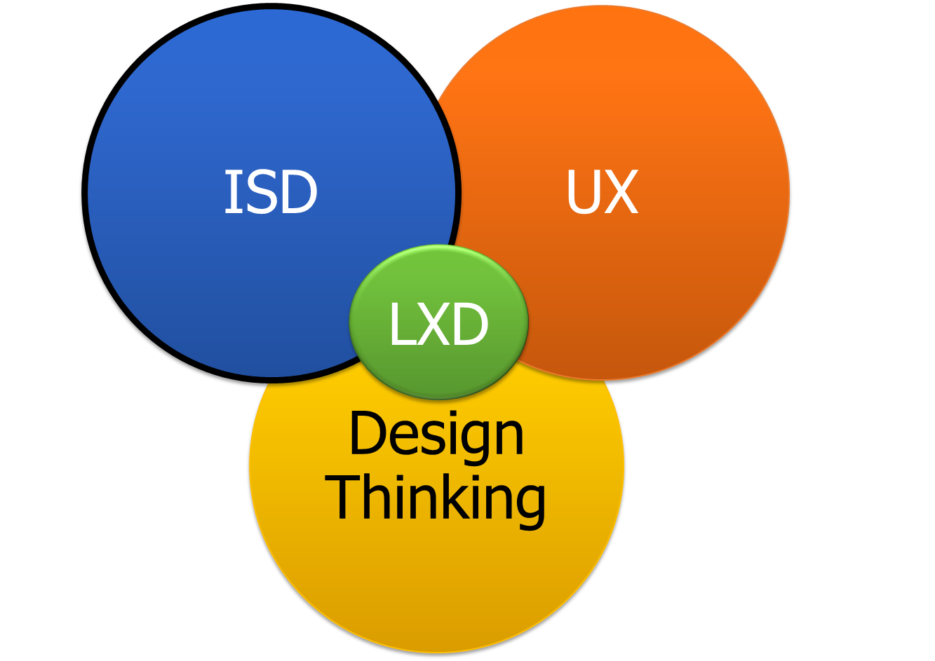
Instructional Systems Design
Provides a system to follow using a model (e.g., ADDIE)
Incorporates multiple design models for structuring learning content
Uses learning theory, instructional strategies, and methods of instruction
Assesses the training process and the learners
Notes:
ATD Competency Model

Slide 35
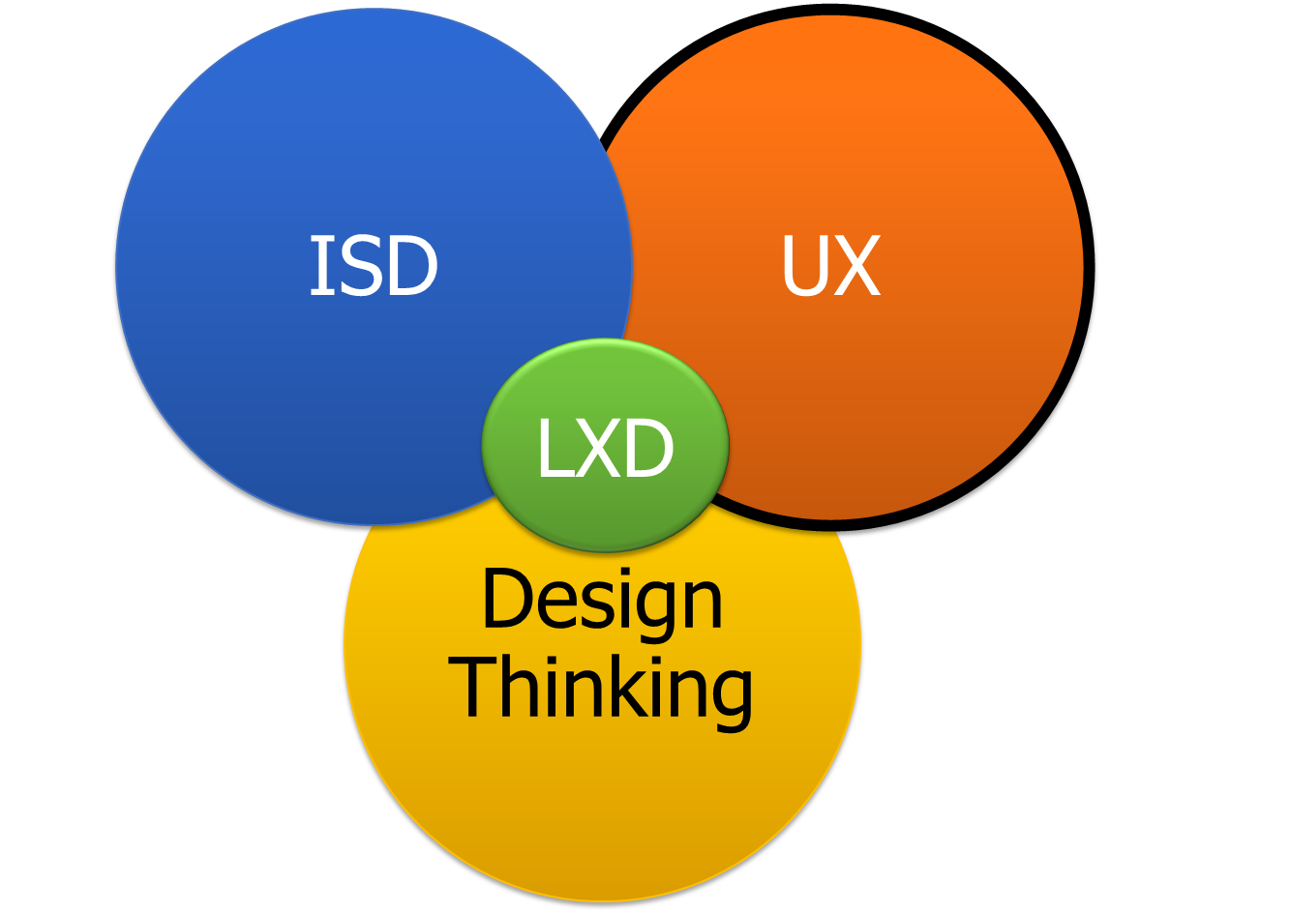
User Experience Design
In learning development, UX principles help:
Design experiences for all learners by drawing from cognitive processes
Create and evaluate prototypes
Analyze learner input and feedback using numbers and statistics
Think through media choices, design, and usability of handouts/resources
Notes:
User experience (UX) Design is common nomenclature in the tech and customer service industries. It’s scientifically stripped-down, repeatable, and probably involves stuff you already do to ensure training is useful, usable, and desirable. Its goal is to ensure learners attain the desired outcomes with as little struggle and as much enjoyment as possible.
In the late 1990’s Don Norman, a cognitive scientist and co-founder of the Nielsen Norman Group Design Consultancy, and author of was credited with inventing the term with the statement:
An LX designer with UX design skills will have the ability to:
identify key UX design principles that form the foundation of an effective learning experience
design experiences for all learners by drawing from cognitive processes
create and evaluate prototypes
analyze learner input and feedback using numbers and statistics

Slide 36
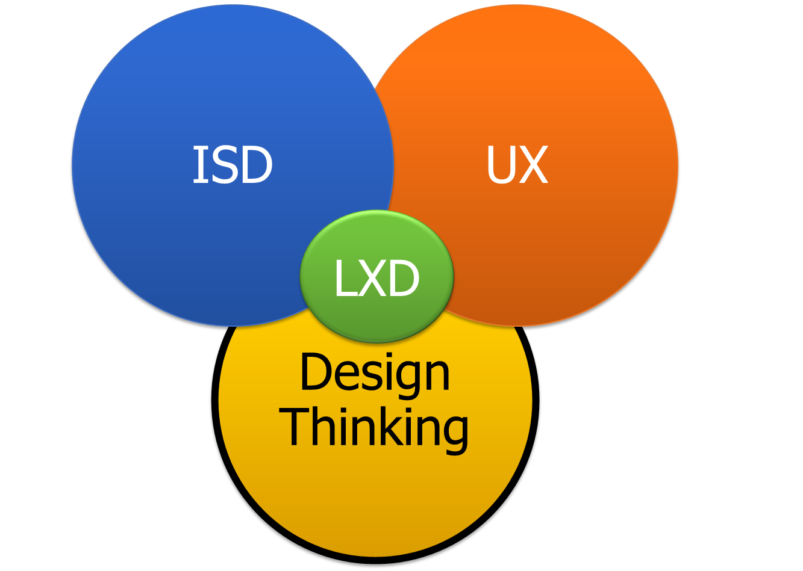
Design Thinking
The most popular model is a five-stage design thinking model proposed by the Hasso Plattner Institute of Design at Stanford.
Empathize: research your users' needs
Define: state your users' needs and problems
Ideate: challenge assumptions and create ideas
Prototype: start to create solutions
Test: try your solutions out

Slide 37
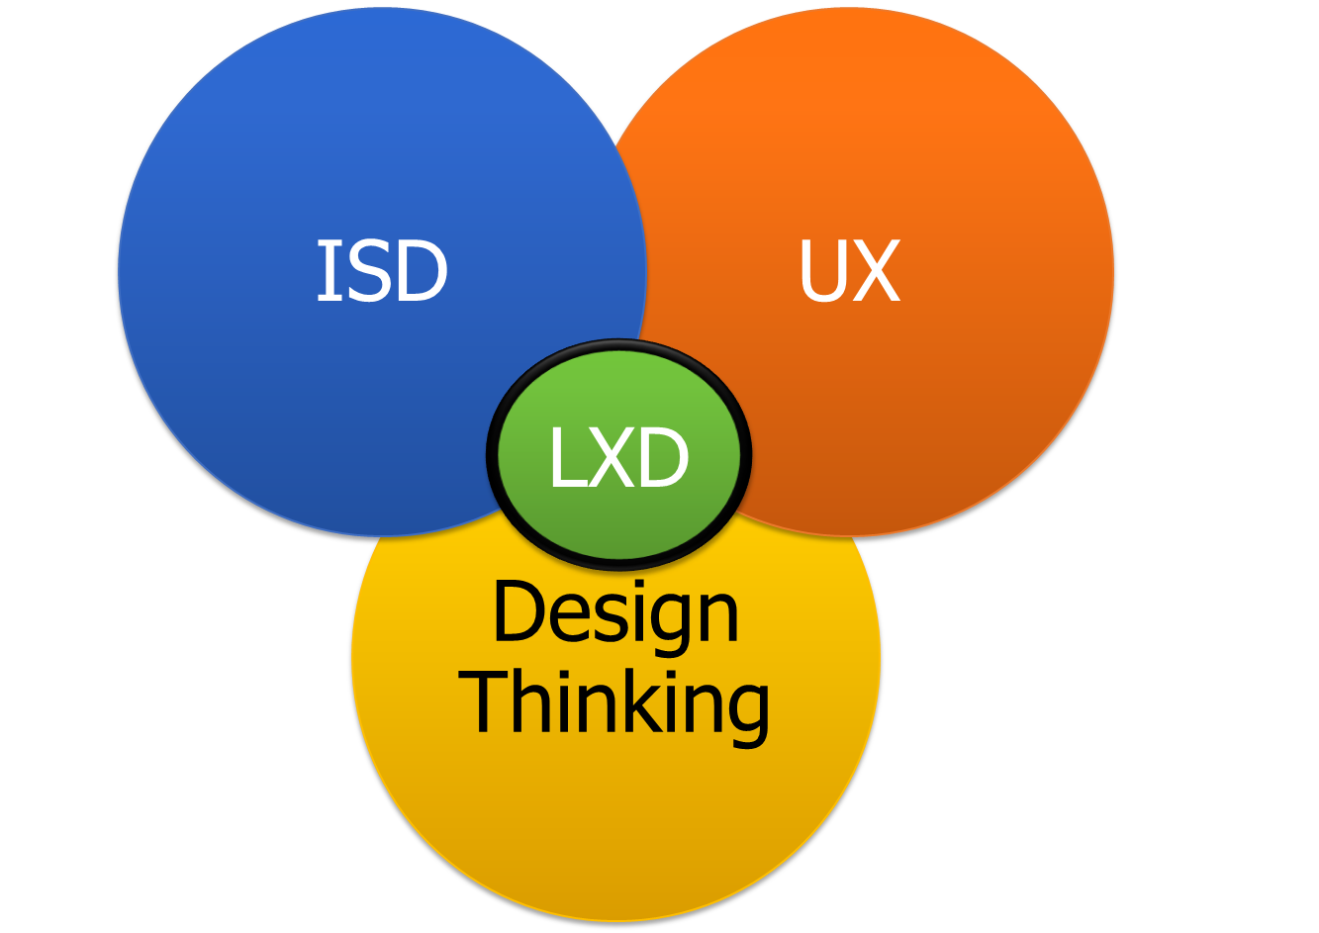
Learning Experience Design
Niels Floor, the person who claims to have coined the term “Learning Experience Design” in 2007 defines it as the process of creating learning experiences that enable the learner to achieve the desired learning outcome in a human-centered and goal-oriented way.
Moves from the “sage on the stage” towards a holistic learning experience or, “guide on the side” structure
Focuses on ensuring the learner's experience is:
Meaningful
Pleasurable
Convenient
Relevant
Notes:
Modern Learning Book
Learning Experience (LX) Design is the process of creating learning experiences that enable the learner to achieve the desired learning outcome in a human-centered and goal-oriented way. With LXD, we move away from the “sage on the stage” towards a holistic learning experience or, “guide on the side” structure.
As its name suggests, LXD focuses on the experience we want the learner to have. These experiences should be:
Meaningful
Pleasurable
Convenient

Slide 38
Learning Experience Design Foundations
Avoiding learning myths and misconceptions
Understanding the role of memory in learning
Being aware of the cognitive activities that support the learning process
Applying evidence-informed learning experience design strategies

Slide 39
Learning Myths and Misconceptions

Slide 40

Knowledge Test = Learning Outcome
Misconception: If a learner can recite knowledge and pass a test or course section, they have learned how to perform those tasks.
What the research says: There is a lack of connection in the brain on how to use the knowledge in multiple contexts to solve problems or perform tasks.
Design Strategies:
Carefully consider the assessment strategy for each learning objective
Provide multiple opportunities to practice
Notes:
Because learning is much more intricate than following the pattern of presenting information/knowledge, testing knowledge by selecting a response, then moving on to next section. During the design phase, it’s critical to carefully consider the assessment strategy for all the learning objectives. Architecting multiple opportunities to practice in order to make solid connections between prior knowledge and new knowledge spaced overtime.
Example Strategy: Develop scenario based multiple choice questions. This strategy allows students to think through scenarios they may find themselves experience on the job.

Slide 41

People Have Different Learning Styles
Misconception: We need to adapt training to an individual’s learning style.
What the research says: Lack of empirical evidence that we have a specific learning style and should adapt our training to incorporate that specific style.
Design Strategy: Incorporate a variety of instructional strategies to support the learner in meeting learning objectives.
Notes:
Learners do have preferences on how they like to learn new material and knowing your target audience is key to designing any type of training program. Incorporating a variety of instructional strategies supports the learner down their learning path to meet the learning objectives.
An example strategy: Use scaffolding. Varying the instructional strategies and create lots of practice. Fading the support as the learner starts to grasp the concepts and tasks.

Slide 42

Presentation Equals Acquisition
Misconception: By providing information, the learner will infer how to apply it.
What the research says: Retrieval practice is required to apply knowledge/skill on job.
Design Strategies:
Provide multiple opportunities for learners to practice applying skills as they would on the job.
Space out the practice and retrieval of tasks.
Notes:
Example Strategy: Create practice situations first as they would happen in the work environment and then add the knowledge and skills in a way that builds the learners knowledge base. Limit bulleted content either in a handout or in a PowerPoint with no context or how to apply on the job without practice.

Slide 43

Generations Differ in How They Learn
Misconception: Generations differ in how they learn, work, and live their lives.
What the research says: No significant differences in how we learn based on the era in which we grew up. The brain’s development stage is a better indicator.
Design Strategy: Use sound learning practices to design training.
Notes:
An example strategy: Review demonstrated behaviors and competencies while considering the brain development stages.

Slide 44
The Role of Memory in Learning

Slide 45

How We Learn
Three Types of Memory:
Sensory
Working or Short Term
Long Term
Cognitive Activities:
Encoding and Retrieval
Schema development
Generation and Elaboration
Reconsolidating Memory
Notes:
MEMORY AS THE FOUNDATION OF LEARNING

Slide 46

Sensory Memory
Why we care:
Unusual sensations will catch attention and turn on the brain’s hippocampus (i.e., hippo-cam). This is our alert to pay attention, run, hide, and/or fight.
How do we use this in our design:
Use a story, provide a problem—this sets up short term memory.
What benefits does it provide:
Keeps the learner focused on what is coming next. It must be activated to keep moving through the memory cycle.
Sensory Memory
Takes in Environmental Information

Slide 47
Working Memory
Why we care:
Has limited capacity on the amount of information it can process and the time it can hold
How do we use this in our design:
Structure Learning Steps Activity information to no more than 15-20 minutes
What benefits does it provide:
Smaller chunks of content can attach to prior knowledge and move into Long Term Memory, where we can retrieve it when we need it
Working Memory
Compares new information to prior knowledge and filters out irrelevant information

Slide 48
Long-Term Memory
Why we care:
This is where prior knowledge is stored
How do we use this in our design:
We attach new information to prior knowledge to build connections and alter the prior knowledge to grow.
What benefits does it provide:
Improves the ability to retrieve knowledge and skills at the point of need
Long-Term Memory
Long Term Memory
Where we store and retrieve information

Slide 49
Cognitive Activities

Slide 50


Schema Development
The brain is an information storage system.
Our brains build schemas, in essence a file cabinet with lots and lots of drawers and files.
Retain
Encode
Transfer
Retrieve
Notes:
When we encode information, we create a schema or mental models (Piaget, 1964). Basically, these are the filing cabinets in your brain filled with drawers, files, and papers of everything you’ve been exposed to that you encoded into long-term memory (Brown, et al., 2014). There are several strategies that support encoding and retrieval, as well as schema development.
The psychological process of learning starts with sensory memory, moves to working memory, then finishes in long-term memory. It seems so easy, but there are several cognitive activities happening. In order for information in working memory to move into long-term memory it must be encoded (Gagne, 1970). We must encode before we can retrieve. Retrieval is often triggered by cues, either externally or internally, a search occurs, then recognition, then a piece of information you encoded is moved back into working memory, also known as short-term memory (Gagne, 1970). This happens to perform some type of task, or it happens to prepare for new encodings or information. When we construct learning experiences, we must find ways to support learners in the process of encoding and retrieving both old and new information.

Slide 51



Encoding and Retrieval
WHAT TYPE OF FILE CABINETS AND ABILITIES DO STUDENTS HAVE?
ORGANIZED AND A GOOD AMOUNT
UNORGANIZED AND LIMITED
FILE EXCHANGE ABILITY
A student can have a well-organized filing system and encode and retrieve information easily. Experts will have a good amount of files, but that does not guarantee organization.
Some students will have unorganized files and limited amount of knowledge to retrieve from.
Students can vary in fast to slow processing ability due to a myriad of factors.
Notes:
NOTE: Need to decide what text we want to keep
Encode–IN order to move information from working memory to long term memory we need to encode it. Encoding is storing information in LTM in specific formats (codes). We do this in three main ways:
Visually, as images
Auditorily, as sounds
Semantically, as meaning
Because most encoding happens semantically meaning we store information along with context (situation, emotions, location, etc…). We will talk more about context and its importance as a strategy to use, for now, it’s important that we design learning using the same context as a learner will use on the job.
The environment in which you encode will become part of the retrieval. That’s why it is key to practice new skills as close to the real-world environment as possible.
Retrieval–remembering is retrieving information from long-term memory. When we encode to long-term memory by meaning, we retrieve by meaning. It’s important to design learning events that are personally meaningful and relevant to the work environment.
When we do not design for how memory works, far less learning occurs and the likelihood of transfer to the on the job application is slim. As Patti shank says in her learnable series of books, anyone drinking from a firehose we die of thirst, you can’t drink from a firehose”.
By taking time to build the learning architecture, we can identify opportunities for working with our memory constraints and not against. We can also visually see the need to remove any unnecessary content or distractions that will not add value to the experience. We have to set the stage for demand of learning on the learners with intentionally focused content and flow.
Encoding and Retrieval are critical processes and they help learners apply what they learn.
The psychological process of learning starts with sensory memory, moves to working memory, then finishes in long-term memory. It seems so easy, but there are several cognitive activities happening. In order for information in working memory to move into long-term memory it must be encoded (Gagne, 1970). We must encode before we can retrieve. Retrieval is often triggered by cues, either externally or internally, a search occurs, then recognition, then a piece of information you encoded is moved back into working memory, also known as short-term memory (Gagne, 1970). This happens to perform some type of task, or it happens to prepare for new encodings or information. When we construct learning experiences, we must find ways to support learners in the process of encoding and retrieving both old and new information.

Slide 52


Generation and Elaboration
Generation
Elaboration
The act of trying to answer a question or solve something without being given the information or solution.
The process of finding additional meaning in new material and of adding onto the existing knowledge or schema.
Notes:
Generation and Elaboration
Generation is the act of trying to answer a question or solve something without being given the information or solution. In other words, the answer is being generated by the learner and not recalled (Brown et al., 2014). Elaboration is the process of finding additional meaning in new material (Brown et al., 2014). It’s the process of adding onto the existing knowledge or schema. Generating an analogy helps to map the new information to existing information and improve that mental model or attach to a new mental model. Both of these cognitive activities help to improve existing schema and to create new schema. Recalling information takes effort. Reflection is an important learning strategy that does not get enough attention and must be intentionally designed into any learning experience. This is the opportunity to help learners fix misconceptions by asking them to summarize what they are learning into their own words either through elaboration or generation.

Slide 53
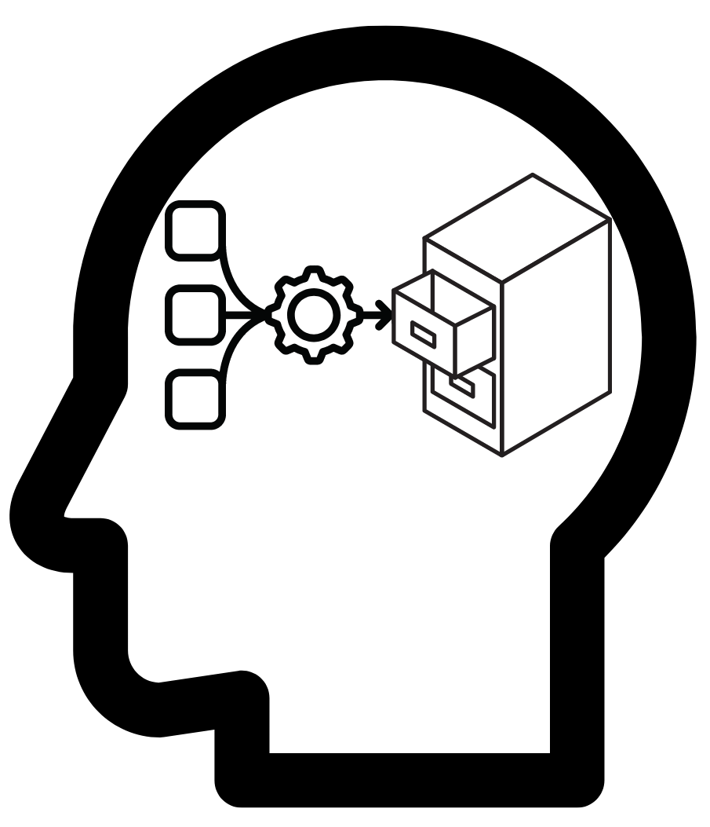
Reconsolidating Memory
Reconsolidation or reconstructing of the components of the skill or knowledge
Helps to strengthen the learning path or memory trace
Activates the cues associated with the information/skill to reinforce the meaning
Takes up to 72 hours to complete
Needs sleep!
Notes:
Has a chance to go wrong, may influence the memory distortion of illusion of knowing.
During this process there’s a reconsolidation or reconstructing of the components of the skill or knowledge, this helps to strengthen the learning path or memory trace, the cues associated with the information/skill, and reinforce the meaning (Brown, et al., 2014). Designing spaced learning requires short sessions of chunked knowledge or skills and then revisiting them often, just before the learner may forget. This strategy forces them to retrieve and reconsolidate each time.

Slide 54
Evidence-Informed Learning Experience Design (LXD) Strategies
Notes:
We can use what we know about how memory works and cognitive activities we engage in to inform our design strategies. Let's discuss these design strategies and how you can apply them in your training development efforts.

Slide 55
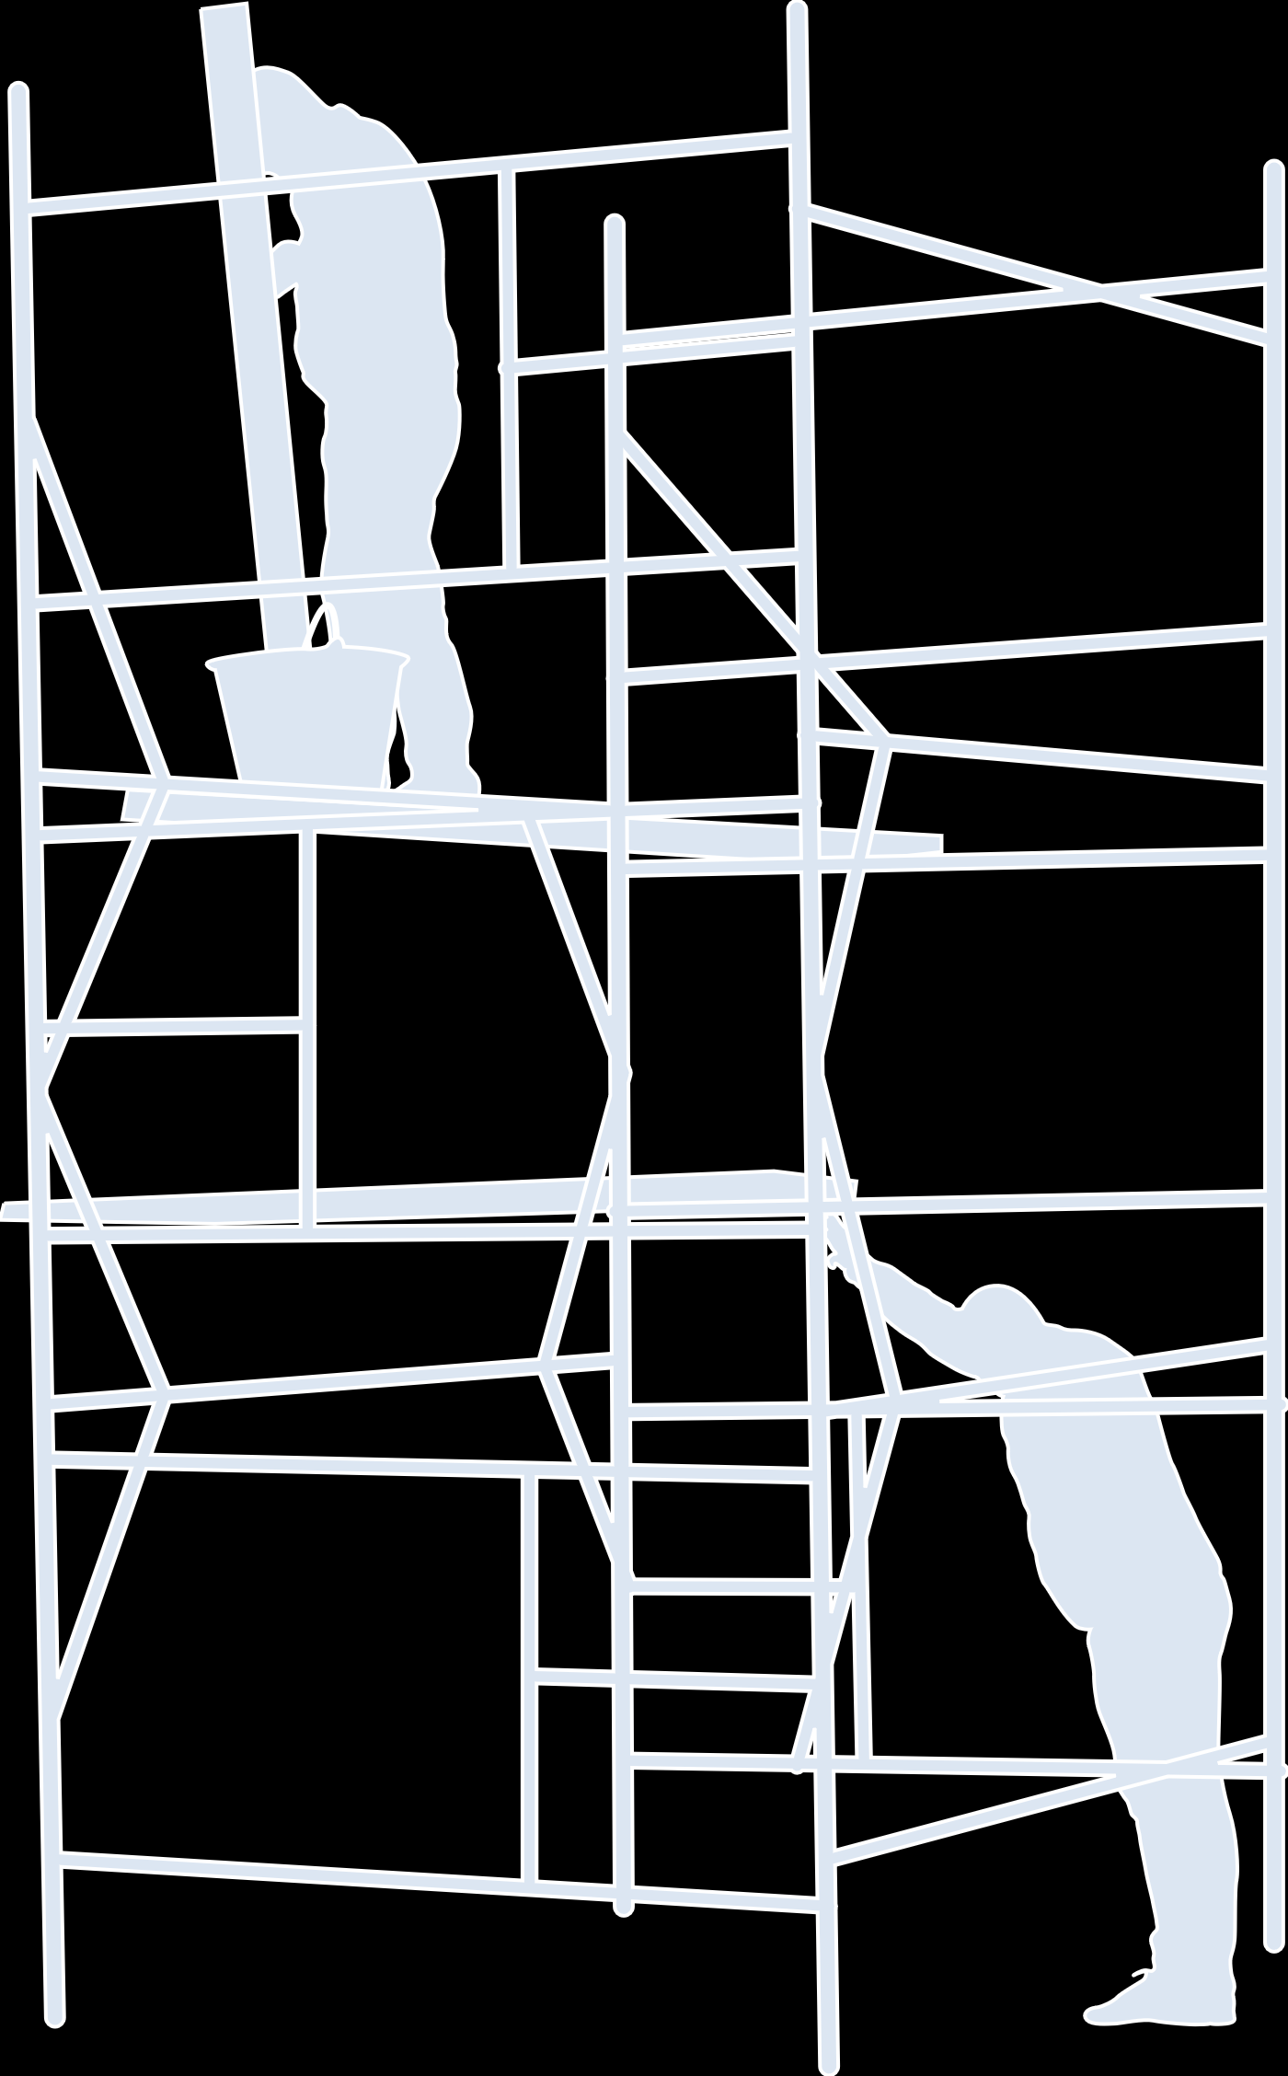






Evidence Informed Learning Design Strategies
Desired Difficulties & Scaffolding
Spaced Learning
Cognitive Load, Chunking, & Context
Metacognitive Strategies (Planning, Monitoring, Evaluating)
Interleaved Practice and Feedback
Reflection

Slide 56


Desired Difficulty
Desired Difficulties & Scaffolding
DISENGAGEMENT
Content just above
intellectual ability
Context on how training
reflects real world
Credible material and varied delivery
FLOW
CHANNEL
FRUSTRATION
Notes:
According to positive psychologist Mihály Csíkszentmihályi, "flow" is a state of "being completely involved in an activity for its own sake. The ego falls away. Time flies. Every action, movement, and thought follows inevitably from the previous one, like playing jazz. Your whole being is involved, and you're using your skills to the utmost."
Excessive difficulty leads to frustration and quitting in voluntary environments, however, in non-voluntary the result is disengagement. A just beyond a capability. Research on working “just” beyond your level of capability. The research sits with social communities as a way to learn. Testing beyond capability is demotivating and frustrating. Just beyond is a technique that challenges thinking to get after more critical thought.
Some key strategies here include:
Summarizing in your own words how tasks, concepts, or procedures relate to each other.
Challenges focused on problem solving
Reflective thought on scenarios and responses
We cannot engage the mind by passively reading text over and over again or passively watching PowerPoint slides.

Slide 57

Scaffolding
Desired Difficulties & Scaffolding
Scaffolding (Rigor is built here!):
Offers learners support in developing a new skill or learning a new concept
Extinguishes as the learner progresses to more independence
Supports the memory process for moving between working and long-term memory
Notes:
Scaffolding is another design strategy used to support the learning process (Brown, et al, 2014). If you think of a scaffold around a building that supports the construction process; the key to this strategy is eventually removing the scaffold. We support learners when learning new knowledge and skills by providing some desired difficulties that are intentionally presented at specific times within the learning experience. Lee Vygotsky referred to this as the Zone of Proximal Development (ZPD) (Doroudi, 2021). Desired difficulties help the encoding and retrieval by slowing down the learning and eliciting more effort (Brown, et al, 2014). These scaffolds need to be intentionally designed to occur at the right time and to support the learner in mastery of a skill. They cannot be added haphazardly.

Slide 58


Cognitive Load
Cognitive Load, Chunking, & Context
Cognitive load is the mental effort we need to process new information.
We can support cognitive load with:
Chunking
Context
Notes:
Cognitive load is the mental effort we need to process new information (Sweller, 2010). If working memory is overloaded with too much information or contains too much distraction and noise, the ability to learn is severely impaired (Shank, 2017). We need to activate our long-term memory and have it work with working memory to make sense of information. To support the cognitive load, we use practices such as chunking and ensuring content and experiences are put into context or made meaningful to what we are learning.

Slide 59


Chunking
Cognitive Load, Chunking, & Context
Smaller Chunks of Information
Existing Knowledge
Notes:
Chunking is a memory device for grouping information into chunks.
One way to support our students is by using the concept of chunking. Chunking is a design strategy to help manage short-term or working memory. George A. Miller formulated the chunk concept in 1956, when he presented research evidence that working memory is limited in capacity. We can think of a chunk as a letter, number, word, concept, a face, or other meaningful unit of information.
Miller helped to establish the discipline of cognitive psychology with his “magical number seven plus or minus two” information processing theory. Some people may only be able to remember four or five bits of information whereas others might be able to remember nine or more. Cognitive researchers now know that the capacity of working memory depends on the type or complexity of information, the features of the information, and the abilities of the individual. The key takeaway is that working memory is finite and, as a training developer (TNGDEV), this is a very important concept to keep in mind.

Slide 60
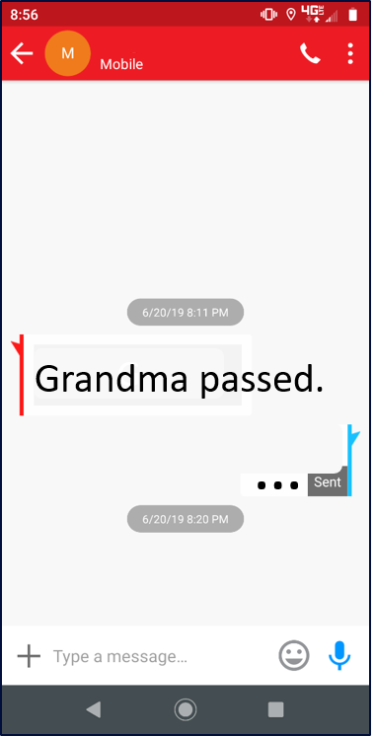
Context
Cognitive Load, Chunking, & Context
Context Matters
What do you think about this text message?
Notes:
Context creates the aha moment. And these aha moments aggregated overtime move students from beginner to novice, to journeymen, to experts. They start to create better mental models, more of them, relate them, file cabinet gets bigger and there's more opportunity to transfer in multiple context becoming better workers, problem solvers, and critical thinkers. At the 10 level we need to support this on a larger scale in order for them to grow and develop personally and professionally.

Slide 61



Context
Cognitive Load, Chunking, & Context
Context Matters
When we leave out clarity, we fill in the wrong information. Context builds relevance!
We build better files with context

Slide 62

Interleaved Practice and Feedback
Interleaved Practice and Feedback
Teach Skill BD
Teach Skill AC
Practice & Feedback
Skill
A + B + C + D
Practice & Feedback
Skill A + B + C
Teach Skill B
Practice & Feedback
Skill A + B
Teach
Skill A
Practice & Feedback
Skill A
Notes:
Practice is extremely important in any learning experience; we must ensure the decisions learners make and the tasks they practice as close as possible to those they need to perform on the job. Interleaving practice; which is the mixing of two or more related concepts and skills together in one study session, rather than studying one concept or skill at a time (Brown, et al, 2014). When we design this strategy throughout a course, it activates the retrieval process, so that each time a person practices, they strengthen the memory trace of those actions. Feedback on practice or assessments must be specific to be effective, especially if we are looking for some type of change in behavior. There are several different types of feedback that can be provided to a learner, the most effective is epistemic feedback (Neelan, et al., 2020). Showing where the mistakes were made and fixing any misconceptions a learner has is imperative to achieving mastery.

Slide 63
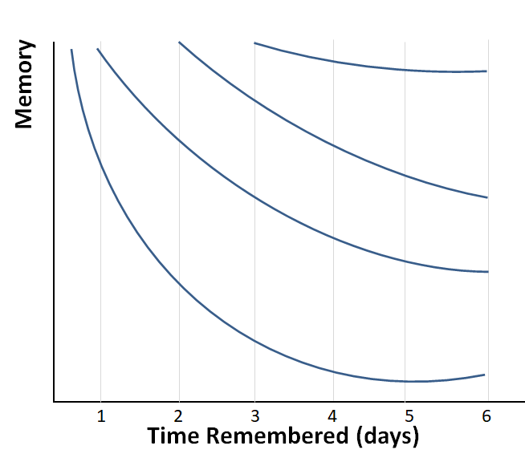
Spaced Learning
Spaced Learning
This graphic illustrates that when information is reviewed, it is forgotten less quickly.
Spacing and interleaving knowledge, skills, and abilities is the heart of using the forgetting curve to an advantage.
Notes:
In 1885, Hermann Ebbinghaus theorized that humans start losing the memory of learned knowledge over time, in a matter of days or weeks, unless the learned knowledge is consciously reviewed time and again. A related concept to the forgetting curve is strength of memory, which states that the time period up to which a person can recall any memory is based on the strength of the particular memory. Memory retention is 100% at the time of learning any particular piece of information. However, it drops rapidly to 40% within the first dew days. After which, the declination of memory retention slows down again.
In simple words, forgetting curve is exponential because memory loss is rapid and huge within the first few days of learning. But, the rate of memory loss decreases and the rate of much forgetting are much slower from then on. Rate of Forgetting
There are various factors that can affect the rate of forgetting. Some of which are
Meaningfulness of the information
The way it is represented
Physiological actors (stress, sleep, etc)
Army refers to this as Learning Decay
Designing spaced learning requires short sessions of chunked knowledge or skills and then revisiting them often, just before the learner may forget. This strategy forces them to retrieve and reconsolidate each time.

Slide 64


Metacognitive Strategies
Metacognitive Strategies (Planning, Monitoring, Evaluating)
In the training environment, the learner will need to:
Plan how they will participate in the learning experience
Monitor how they are doing
Evaluate how well they've met the learning goals
Notes:
We need to help learners improve their metacognitive skills, as these skills translate not only to the training environment, but also to other areas of their lives. In the training environment for example, the learner will need to plan how they will participate in a learning experience, monitoring how they are doing, and evaluating how well they’ve met the learning goals.

Slide 65


Reflection
Reflection
Reflection is an opportunity to help learners fix misconceptions by asking them to summarize what they are learning into their own words either through elaboration or generation.

Slide 66
Putting it All Together
Notes:
We can use what we know about how memory works and cognitive activities we engage in to inform our design strategies. Let's discuss these design strategies and how you can apply them in your training development efforts.

Slide 67
Putting it all together: Desired Difficulty & Scaffolding
Applying to Design
Insert challenging content when you need to slow the learning down so learners connect new knowledge with prior knowledge.
Design content with less complicated examples at the start and gradually increase the difficulty as the learner masters the content while decreasing the amount of support you provide.
Notes:
Supports encoding and retrieval

Slide 68
Putting it all Together: Cognitive Load, Chunking, & Context
Applying to Design
Select relevant content and avoid nice to know material and flashy media.
Chunk similar tasks or topics that follow a sequence, this can be simple to complex, part to whole, or known-to-unknown.
Provide real world examples of when performance looks right, wrong, and somewhere in between.
Notes:
Supports Schema development

Slide 69
Putting it all together: Interleaved Practice & Feedback
Applying to Design
Combine a set of skills that are performed in the workplace, have learners practice them together rather than each one separate.
Create multiple problem sets that support multiple learning objectives.
Design feedback intentionally in lesson plans. Select the feedback type to use when learners are practicing.
Notes:
Example:
Sometimes interleaved practice can feel cumbersome and a waste of time, however, research shows when a final test is taken, those that had mixed practice versus massed practice (repetition over and over of the same skill) did far better.
Education PME example training young leaders on counseling, and including followership, servant leadership, conflict management,
Feedback types, corrective, directive and epistemic
Supports schema development and encoding and retrieving

Slide 70
Putting it all together: Spaced Learning
Applying to Design
Minimize the forgetting curve by determining when spaced practice sessions are best for the length of the training.
Review the chunking strategy selected to outline where the learner can revisit content already taught to reinforce the learning.
Notes:
Supports encoding and retrieval and reconsolidating memory

Slide 71
Putting it all together: Metacognitive Strategies
Applying to Design
Develop learning aids, like an advanced organizer that help learners plan and organize the learning.
Insert low stakes tests/quizzes for learners to monitor how they are progressing.
Build in product or process worksheets to help learners evaluate their work against examples provided.

Slide 72
Putting it all together: Reflection
Applying to Design
Add time in the learning sequence for individuals to write reflective statements on what they learned and what they already know.
For complex material, encourage study groups and provide a list of questions for the group to explore.

Slide 73
Reshaping Design in ADDIE
Design is more than just writing learning objectives; intentional decisions must be made and incorporated into lesson outlines for development:
Incorporate a variety of learning strategies and methods of instruction that support how we learn.
Focus on envisioning how the learner will progress from the learning environment to the job.
Analysis
LXD
Evaluation
Design
ADDIE
Implementation
Development

Slide 74

The Power of Reflection
Refer back to your learning aid and complete any missed sections.
Write in the margins. Summarizing in your own words is a powerful reflection tool!

Slide 75

Today’s Takeaways
Take time for Design; don't just get the boat in the water!
Be aware of the Illusion of Knowing and its effects on training development practices and implementation.
Use learning science and evidence-informed learning experience design strategies to build effective, rigorous, and relevant, training and education that meets readiness goals.

Slide 76

Questions

Slide 77
Bibliography
Andreatta, B. (2016). Wired to Grow: Harness the Power of Brain Science to Master Any Skill. Seventh Mind Publishing.
Brown, P. C., McDaniel, M. A., & Roediger III, H. L. (2014). make it stick: The Science of Successful Learning. Belknap Press.
Csikszentmihalyi, m., & Nakamura, J. (2002). The Concept of Flow. In S. Lopez, & C. Snyder, Handbook of Positive Psychology (pp. 89-105). Oxford University Press.
Dirksen, J. (2012). Design for How People Learn. Berkley: New Riders.
Dros, J., & Murre, J. M. (2015). Replication and Analysis of Ebbinghaus’ Forgetting Curve. PLoS ONE 10(7):, https://doi.org/10.1371/journal.pone.0120644.
Fleming, M. L. (1993). Instructional Message Design: Principles from the Behavioral and Cognitive Sciences. Educational Technology Pubns.
Gagne, R. (1970). The Conditions of Learning. Holt, Rinehart and Winston.
Merrill, M. D. (2002). First Principles of Instruction. Educational Technology, Research and Development, , 50(3), pp43-59.

Slide 78
Bibliography
Morrison, G., Ross, S., Kemp, J., & Kalman, H. (2010). Designing Effective Instruction. Wiley.
Norman, D. A. (1988). The Design of Everyday Things. Basic Books Inc.
Parker, C. and Momeny, L. (2021). Army Training and Talent Management: Finding Development Leverage in the Rediscovery of the Instructional System Specialist. Paper presented at the annual Interservice/Industry Training, Simulation, and Education conference.
Piaget, J. (n.d.). Theory of Cognitive Development.
Quinn, C. N. (2018). Millennials, Goldfish & Other Training Misconceptions. Alexandria, VA: ATD Press.
Reigeluth, C. (1979). In search of a better way to organize instruction: The elaboration theory. Journal of Instructional Development, 2 (3), 8-15.
Shank, P. (2017). Practice and Feedback for Deeper Learning. Learning sPeaks Publications.
Shank, P. (2017). Write and Organize for Deeper Learning. Learning sPeaks Publications.
Thalheimer, W. (2006, February). Spacing Learning Events Over Time: What the Research
Says. Retrieved April 7, 2022, from http://www.work-learning.com/catalog/
Vygotsky, L. (n.d.). Social Development Theory.
Walcutt, J.J, and Schatz, S. (2019). Modernizing Learning: Building the Future Learning Ecosystem.

Slide 79

Contact Information
Mrs. Trish Mulligan-Renaud
ttdlearningsolutions@gmail.com
407-687-6079
www.ttdlearningsolutions.com
Dr. Heather Seiser
ttdlearningsolutions@gmail.com
www.ttdlearningsolutions.com

