Slide 1

Evolution of RF Signal Visualization from Spectrum Analyzers to Augmented Reality (#22T34)
Jad Meouchy, CTO

Slide 2
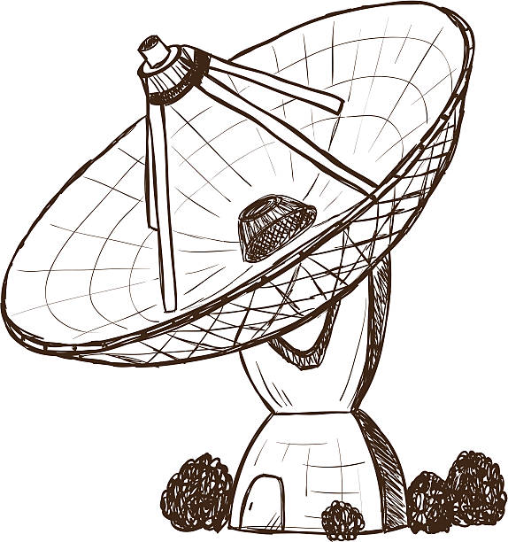
Tutorial Overview
5 min | Introduction and Learning Objectives
15 min | Background on Radio Frequencies
20 min | Traditional Signal Visualization
25 min | Immersive Signal Visualization
10 min | Summary and Conclusions
5 min | Acknowledgements
10 min | Q&A

Slide 3
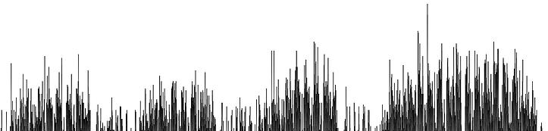
Learning Objectives
Understand challenges of existing tools for RF signal analysis
Differentiate between 1D, 2D, and 3D signal visualizations
Discover fundamentals of immersive technologies like AR/VR and potential applications for signal intelligence and visualization
Identify best practices and applied theory to the design of next-generation signal analysis user interfaces
Notes:
Add bloom triangle but with no words
https://bloomstaxonomy.net/

Slide 4

Terminology and Concepts
Fourier Transform – Mathematical function that converts time-domain signal data into frequency-domain magnitudes and phases
Modulation/Demodulation – Encoding and extracting information from a carrier wave
RSSI – Received signal strength indication, a measurement of received power
TSCM – Technical Surveillance Countermeasures, colloquially understood as “bug hunting”
Immersion, AR, VR – a collection of holographic technologies including Augmented Reality and Virtual Reality
Metaverse – Umbrella buzzword representing the next generation of 3D computing and connectivity
SIGINT – Signals Intelligence, intelligence gathering by interception of signal communications between people
Spatial Anchors – Specific locations in virtual space that persist in the real world

Slide 5
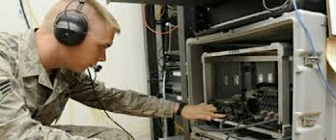
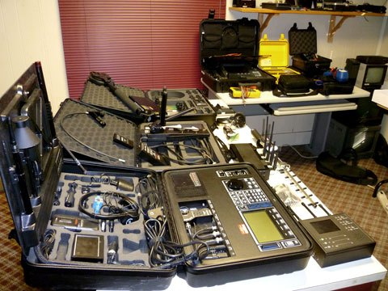
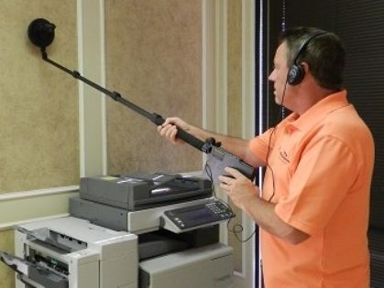
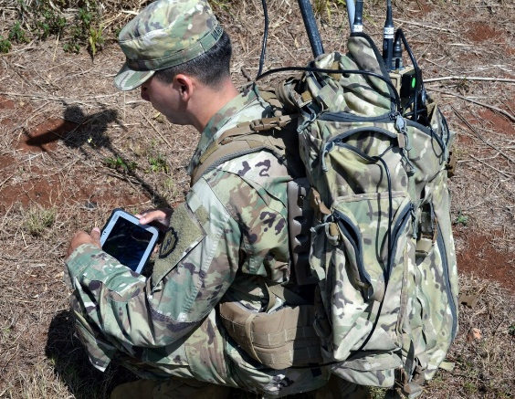
Challenge
Traditional visualization tools are no longer suitable to address the scale and complexity of modern signals
Complicated
Cumbersome
Slow
Distracting
Signals analysis is currently a niche engineering field requiring extensive technical education and training

Slide 6
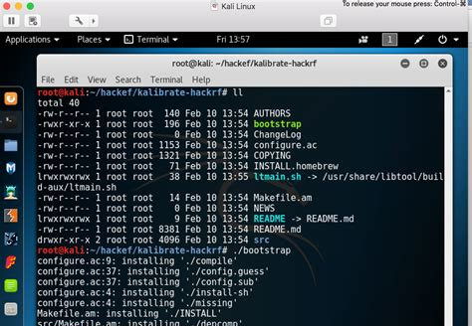
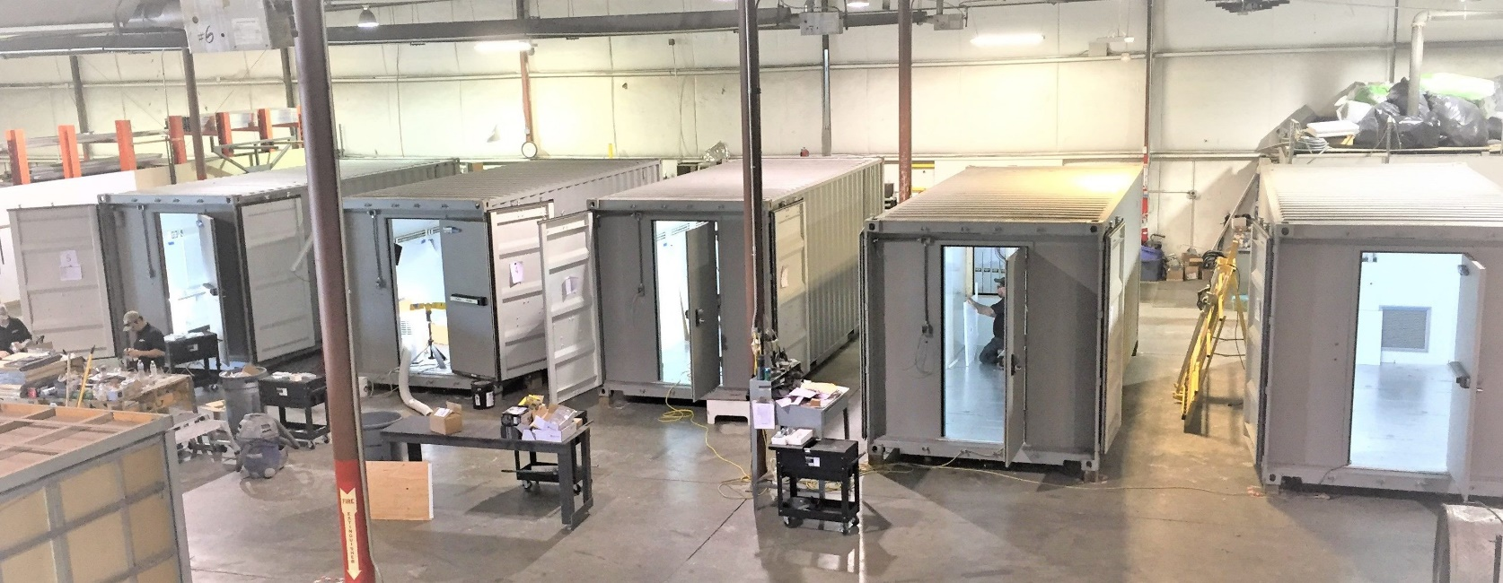
Security Implications
Wireless devices are a primary attack vector
Backdoors are hidden inside chip firmware
290 million people were affected by data breaches in 2021 alone
Defense industry spends billions each year for SIGINT and wireless security
Secure facilities do not allow most wireless devices, and are swept continuously
Meeting rooms are shielded

Slide 7
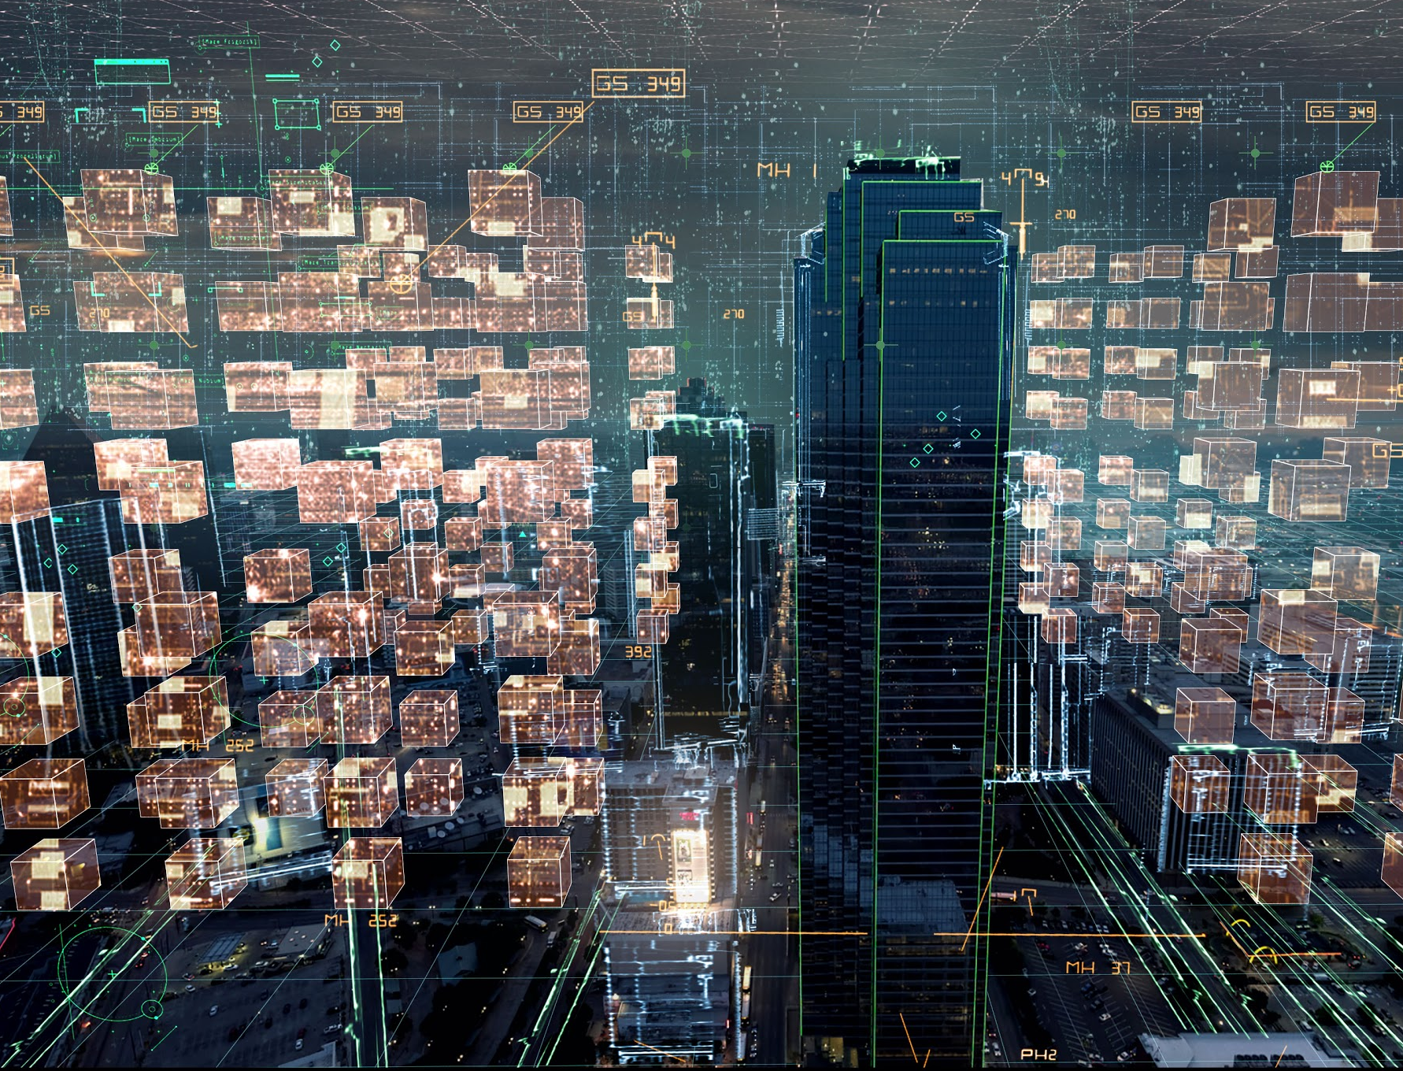
I/ITSEC Relevance
Training
Experiential learning
Signal propagation display
Modeling
Mathematical model visualization incl. AI/ML
Ideation and predictive analytics
Simulation
Reproduction of complex signal fields
Comms systems planning and testing
Notes:
What is the FCC

Slide 8
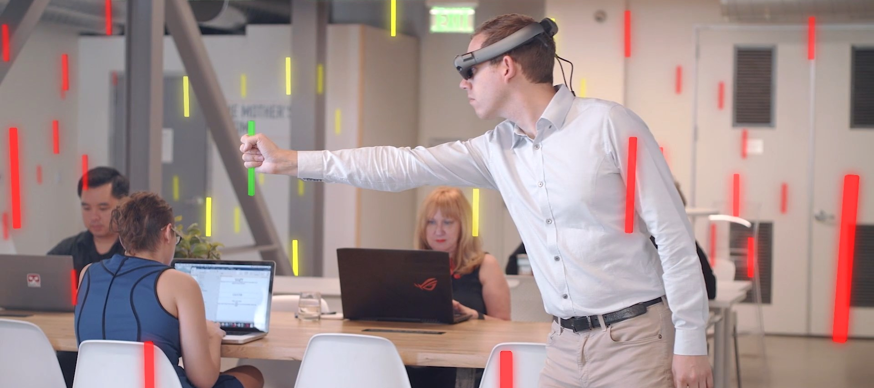
Immersive Signal Visualization

Slide 9
Background on Radio Frequencies

Slide 10
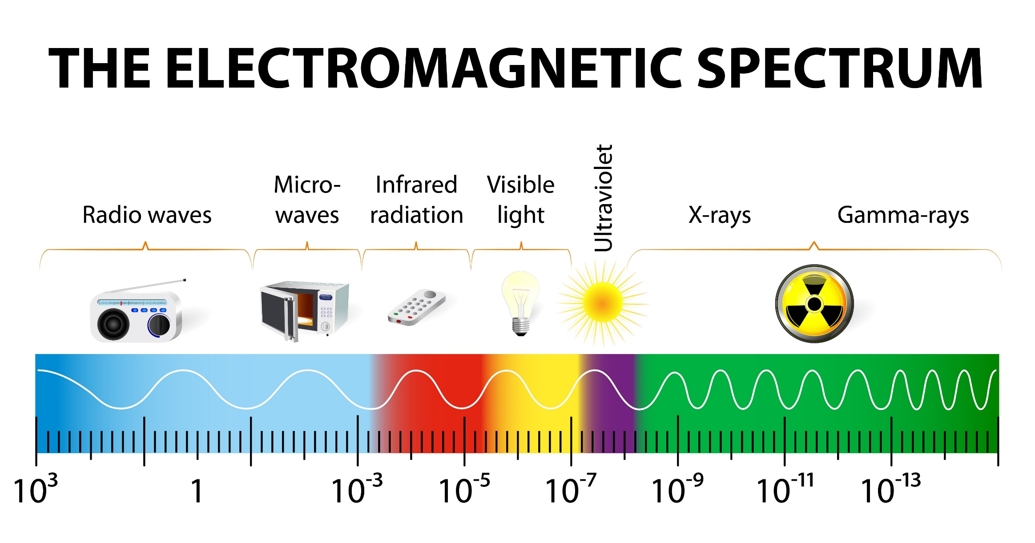
Introducing the Spectrum

Slide 11
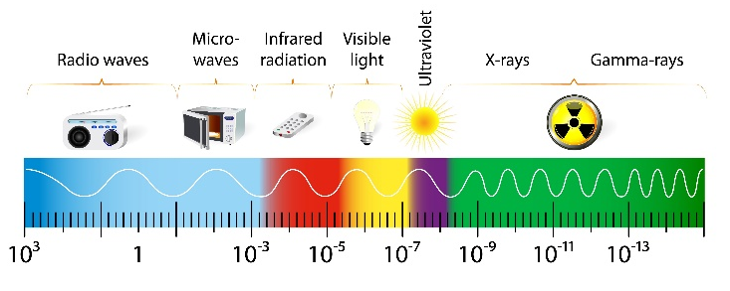
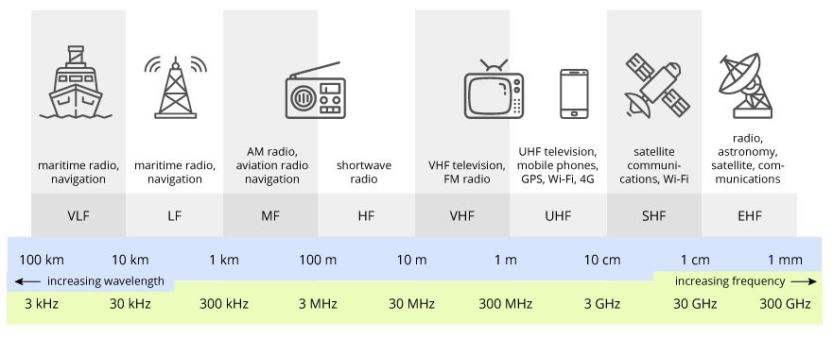
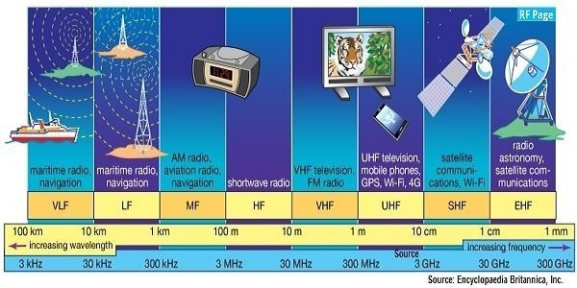
Radio Frequencies
TeraSense

Slide 12
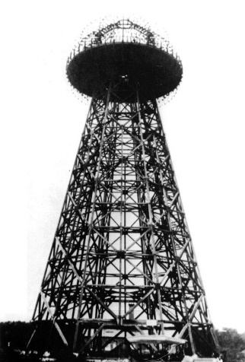

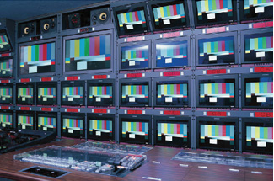
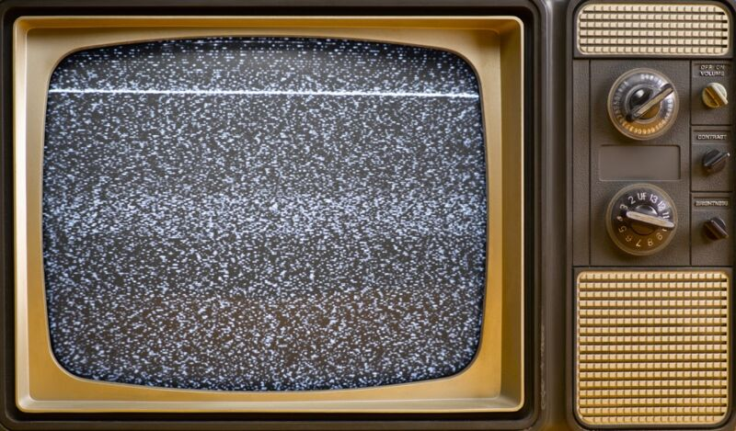
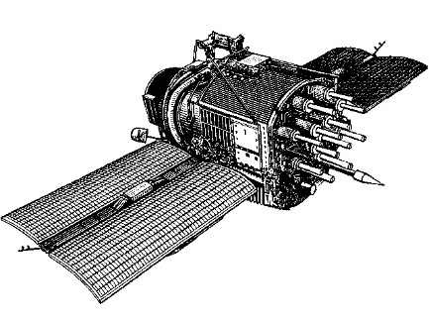

Notable Moments in RF History
Testing radio transmissions
FCC is formed
Digital broadcasting gains popularity
1890s
1928
1934
1978
1990s
Present
First television broadcast
NAVSTAR 1
GPS satellite
5G, smart cities, self-driving cars
Notes:
Primarily used for communication

Slide 13
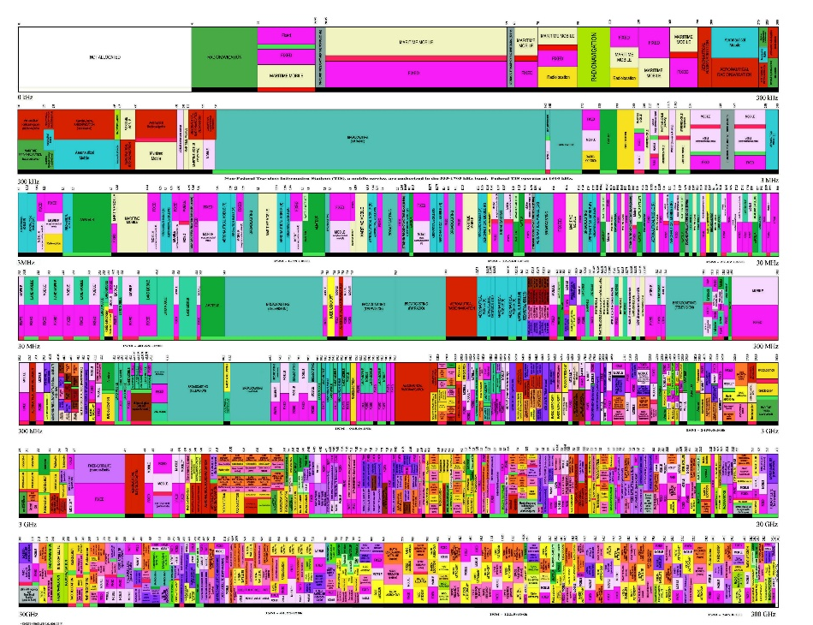
Regulating the Spectrum
Federal Communications Commission (FCC)
Assign operating ranges of RF spectrum in the US
Prevent interference and promote efficient use
Certify RF-emitting devices
Notes:
What is the FCC

Slide 14
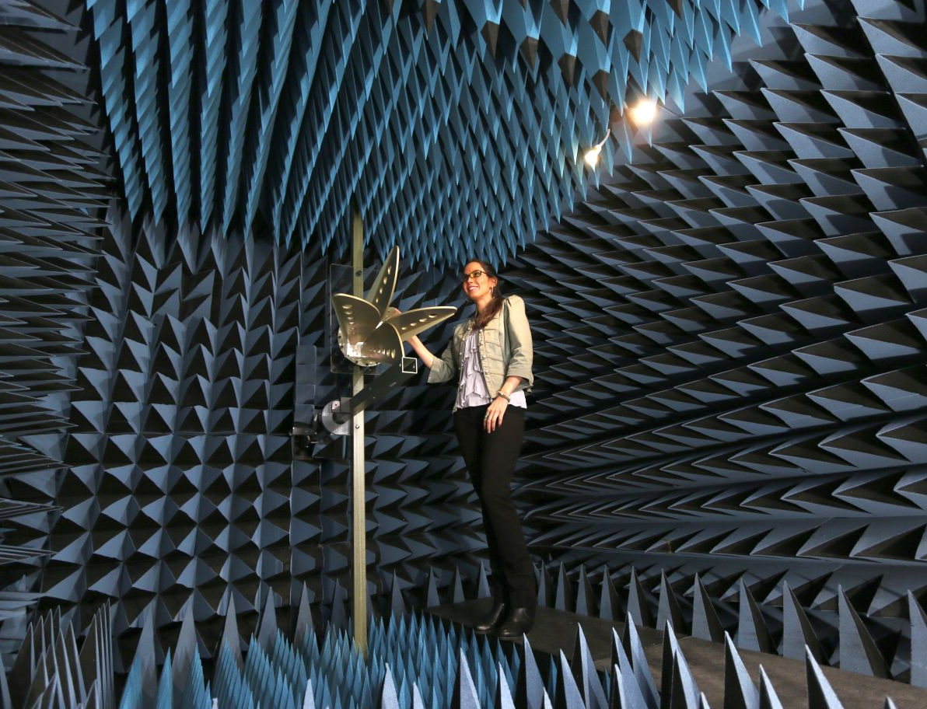
Anechoic Chambers
RF-Shielded Chamber
Measurement of antenna’s gain, efficiency, and radiation pattern
For controlled evaluation of radio frequency emissions
Critical for ensuring compliance with emission standards
Notes:
What is the FCC

Slide 15
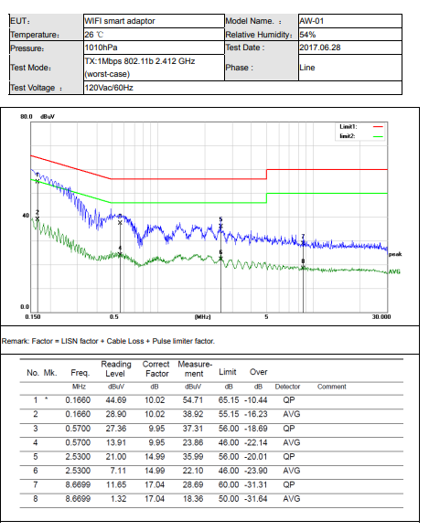
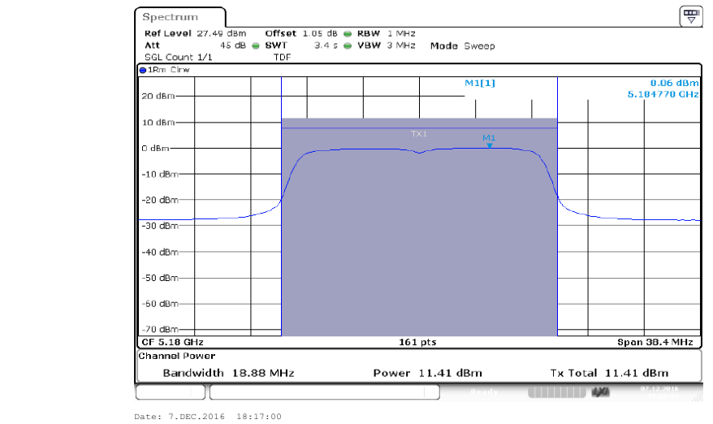
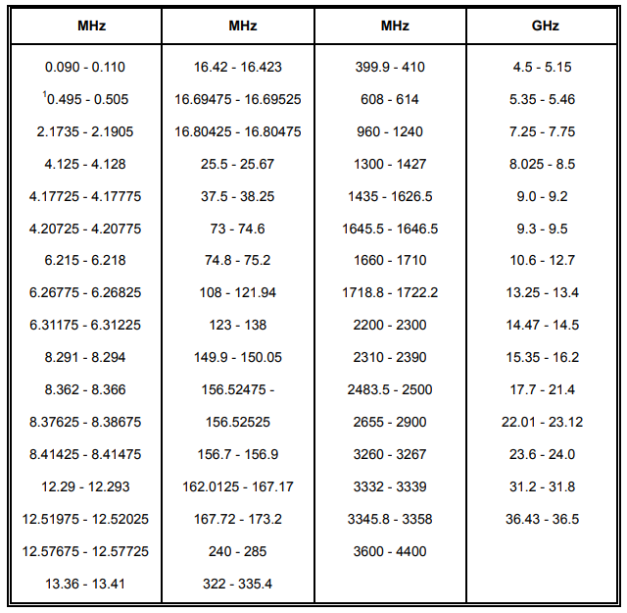
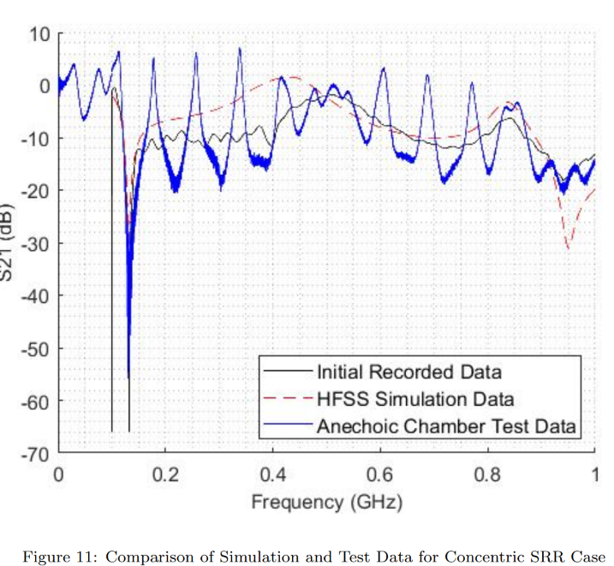
Examples of Lab Testing Reports
FCC (2017)
Notes:
What is the FCC

Slide 16
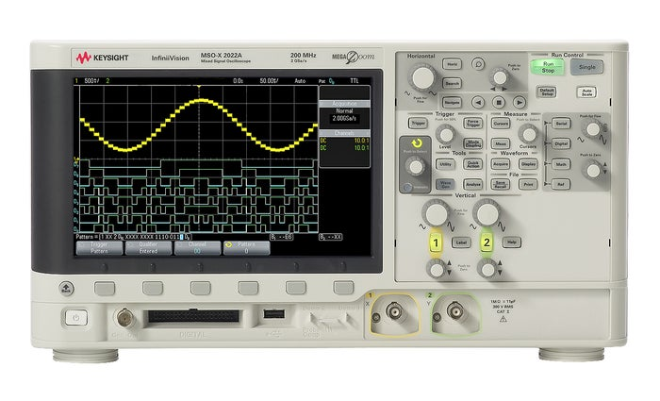
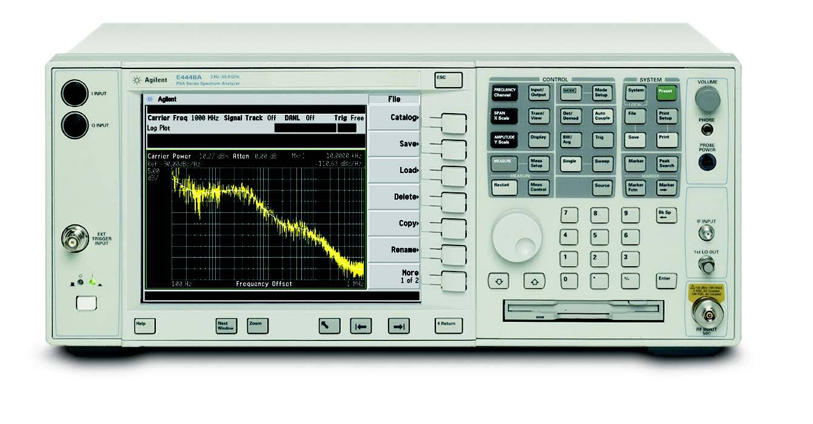
Common Laboratory Equipment
There are many categories and classes of commercial signal analysis tools; the following are among the most common and versatile:
Oscilloscope
Spectrum Analyzer
Analyze time
Analyze frequency
Graphical indication of voltage change
2D plot of 1D signal over time
Measure signal power across a freq range
Display amplitude over signal frequency
HouseTechLab
Notes:
Really high level, groups/classifications of tools and techniques
Scopes
Spectrum analyzers
Emissions graphs

Slide 17
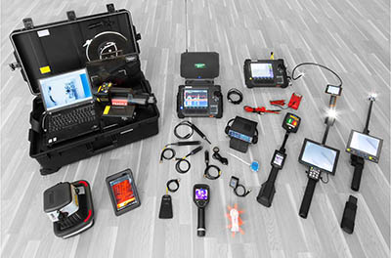
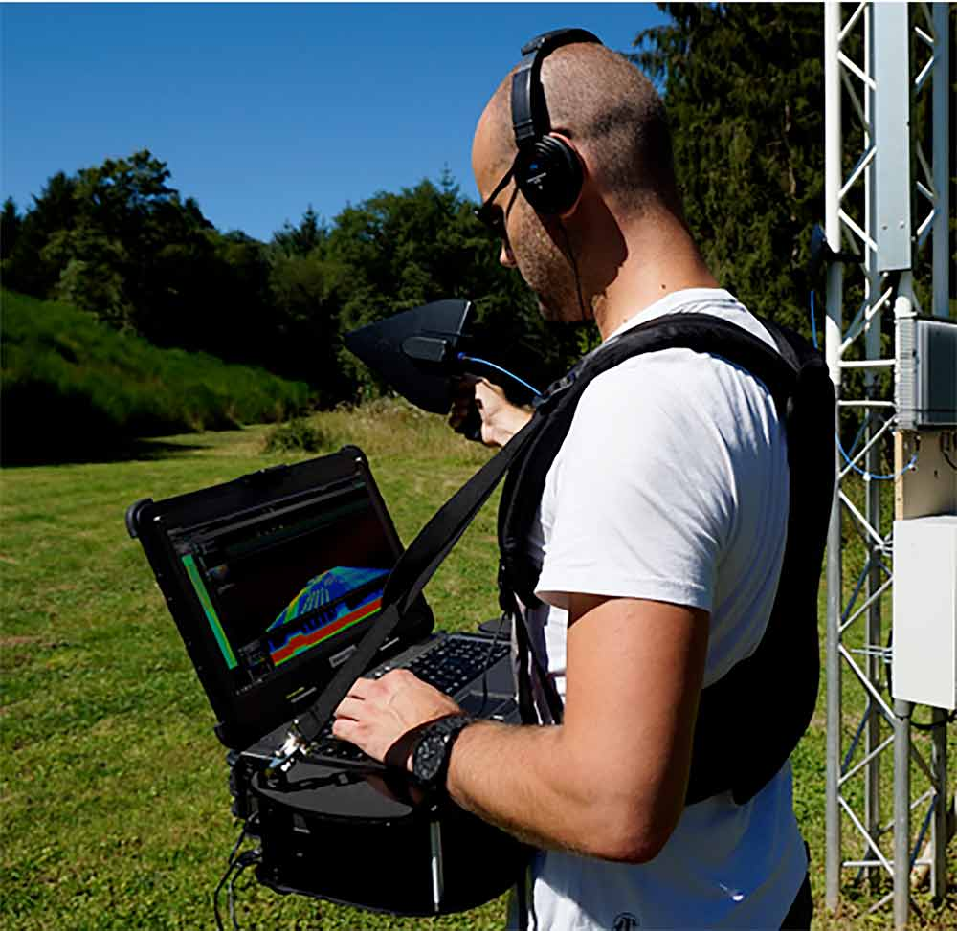
Portable Analysis Tools
In the field, measurement tools are made portable with mounted screens and audio outputs, across a wide range of sizes and form factors

Slide 18
Traditional Signal Visualization

Slide 19
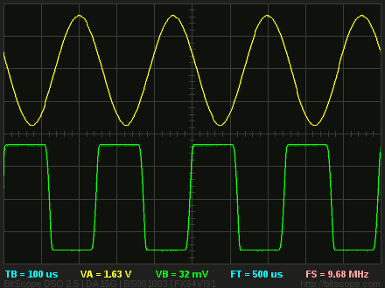
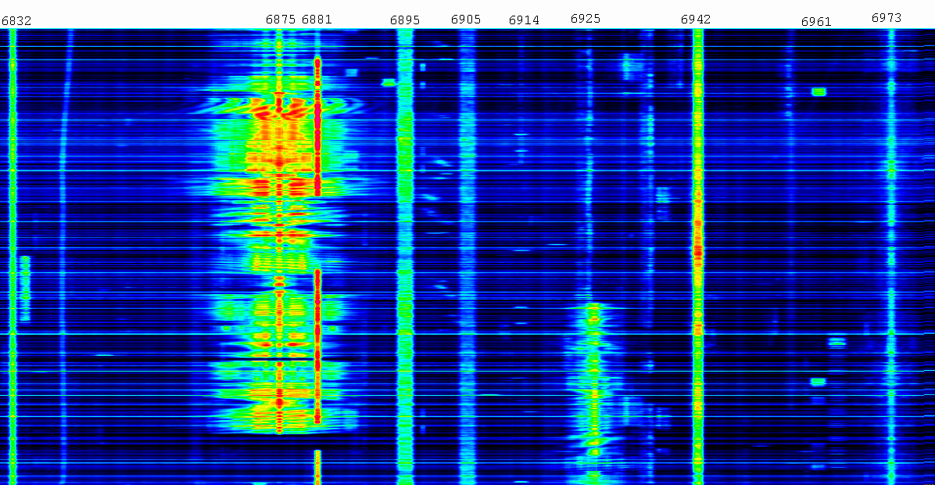
1D Signal Visualization
Oscilloscope
Waterfall Display
Low information density
Small display sizes
Needs logging
High information density
Frequently on laptops and tablets
Continuous scrolling top to bottom

Slide 20
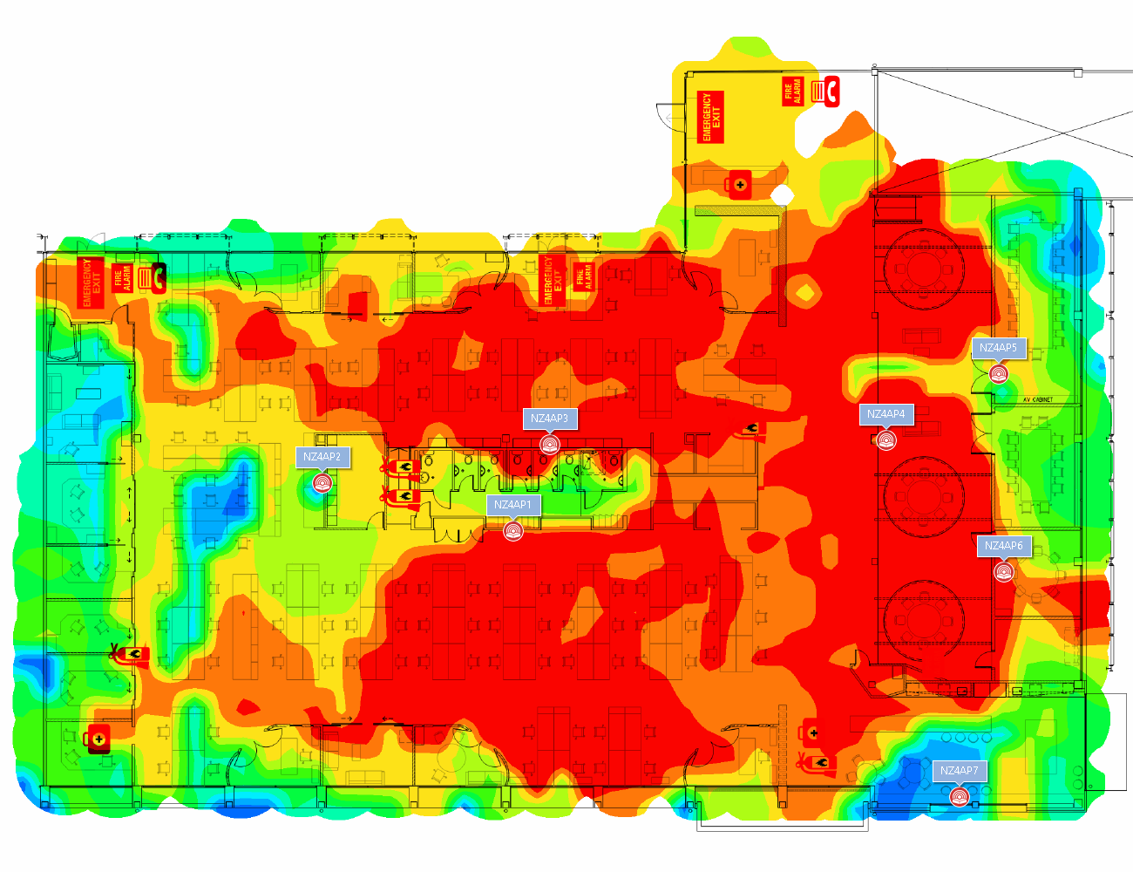
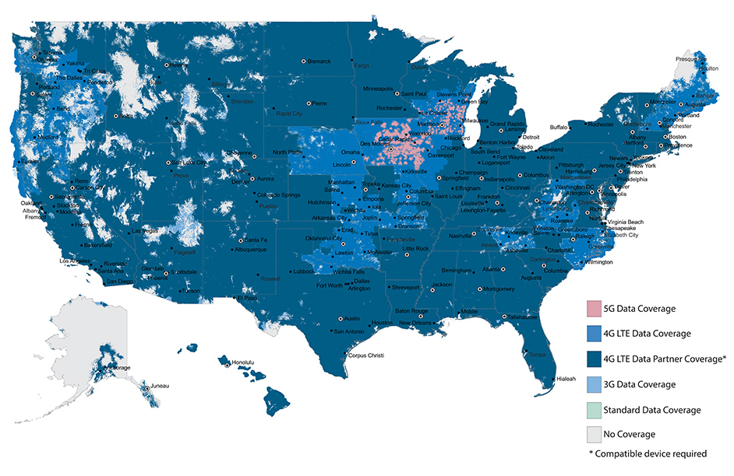
2D Signal Visualization
Heatmaps represent X-Y samples and projected values of signal strength
Reflects real world space
Green is good, red is bad
Typically extrapolated
“Can you hear me now?” only shows outdoor coverage

Slide 21
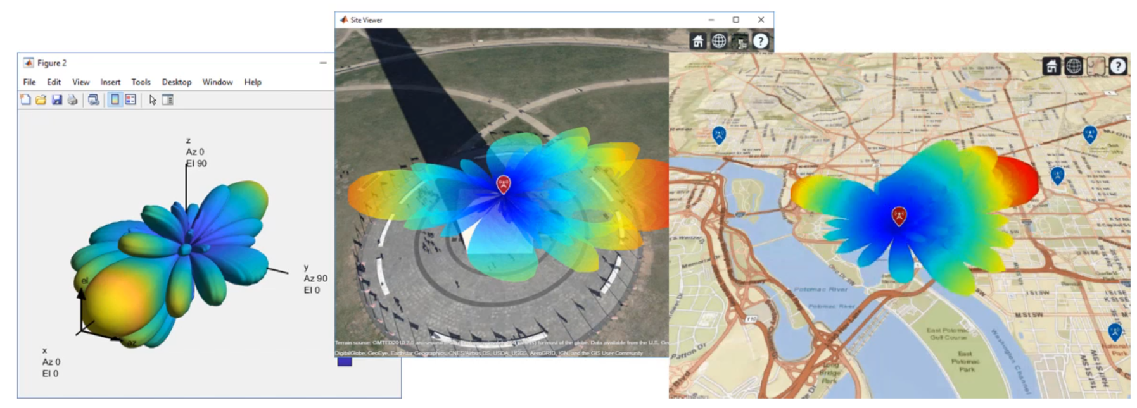
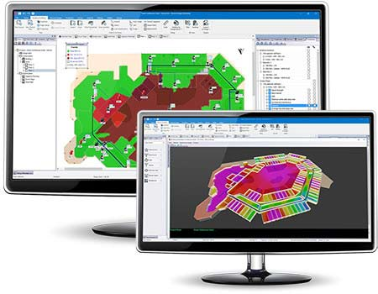
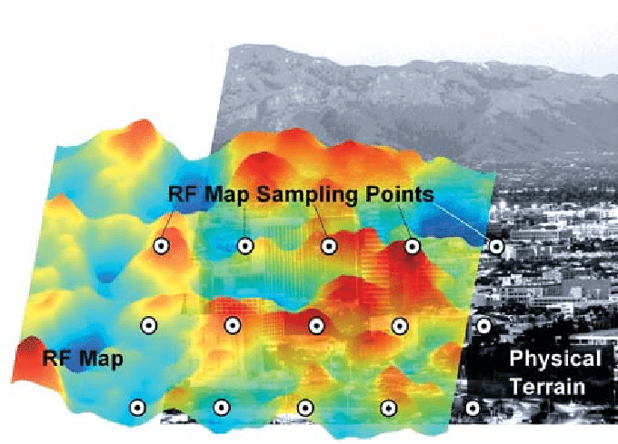
3D Signal Visualization
Adds Z dimension
Performs advanced modeling
Uses graphics and gaming engines
Notes:
Define it, explain how it’s valuable
https://www.researchgate.net/figure/The-RF-Map-and-Sampling-Points-in-a-Geographical-Area_fig1_263889159
https://www.researchgate.net/figure/Visualisation-of-RF-radiation-indoor-with-use-of-special-3D-graphic-effects-in-a-single_fig1_228832254

Slide 22
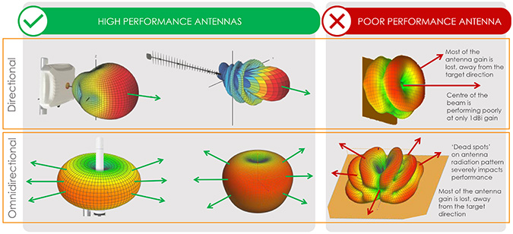
Antenna Radiation Patterns
Graphic of the directional (Angular) dependence of the strength of the radio waves from the antenna or other source, power based on distance
FrontierUS
Notes:
Define it, explain how it’s valuable

Slide 23
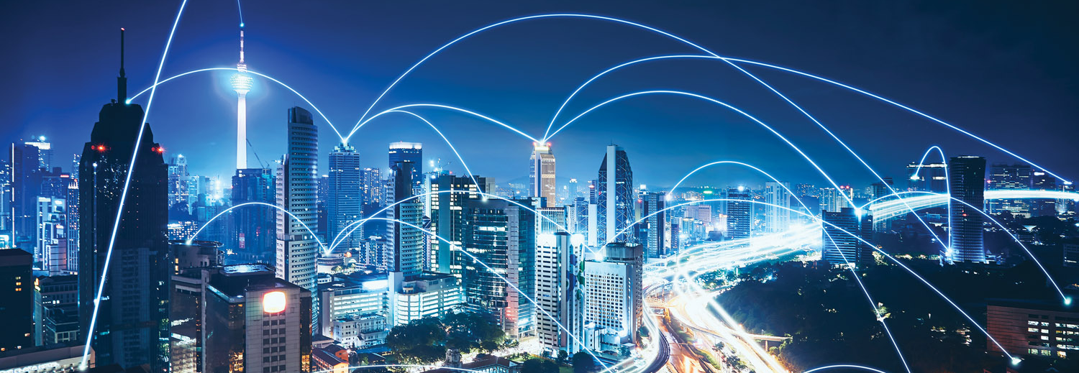
Real World Behavior
All objects, manufactured and natural, interact with wireless signals, especially in dense urban environments

Slide 24

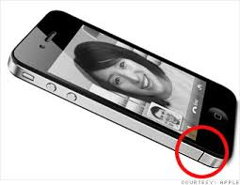
Interference
Modern steel/concrete/tinted glass buildings are “radio opaque”
Material density causes attenuation
Trees and foliage can block RF
Metallic surfaces can cause counterintuitive radio reflections
Human bodies interfere also; remember “antenna gate”
Anderson (2017)

Slide 25
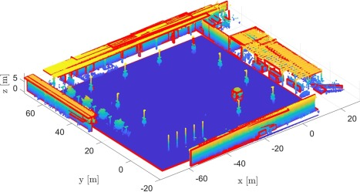
Predicting Propagation
Modeling and Simulation (M&S)
Incorporate 3D models to simulate physical environs
Assess impact of surroundings using high-res environmental data (ex. Material absorption rate, vegetation density, building geometry)
Deterministic models to explore and characterize RF loss
Haneda et al. (2021)

Slide 26
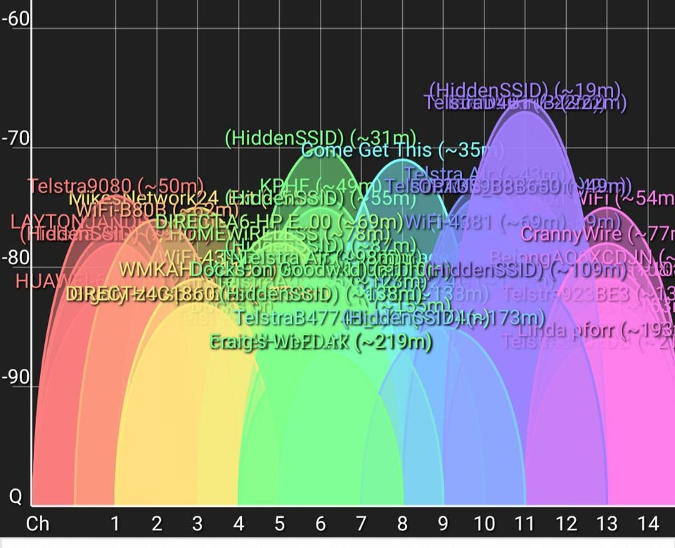
Channel Congestion
There are a fixed number of Wi-Fi, Bluetooth, Cell, etc. channels
With too many connected devices, channels become saturated
Net result is denial of service
Infrastructure was never designed for this volume of devices
IoT is already a worst-case scenario
Anderson (2017)

Slide 27
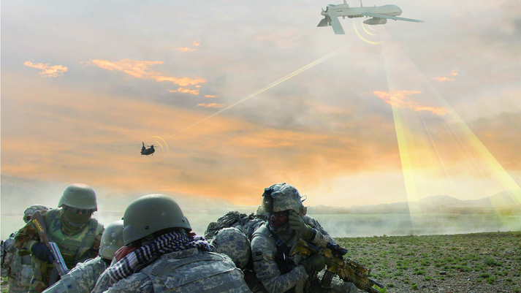
Signals Intelligence (SIGINT)
Ability to seize, retain and exploit the spectrum is critical to battlefield superiority
SIGINT capabilities are being added to manned and unmanned vehicles
BAE

Slide 28
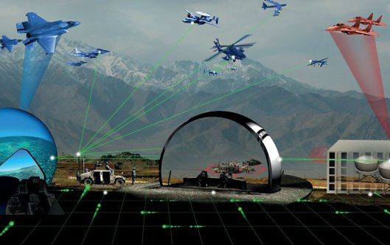
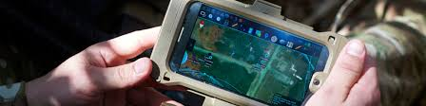
Resilient Training Environments
Live Virtual Constructive (LVC) training environments
Testing and sims to prepare for varying conditions and cyber threats
Need reliable communications fabric for multidomain ops
Ex. Low band RF mesh network with connected Android Tactical Assault Kits (ATAK) during live training
Rockwell Collins (2016)
Notes:
https://militaryembedded.com/radar-ew/test/lvc-demonstration-completed-by-rockwell-collins-in-france-u-k-and-u-s http://www.ds2.com/Services/Training/ATAK

Slide 29
Immersive Signal Visualization
Definition and Impact

Slide 30
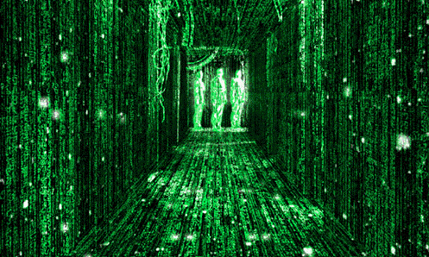
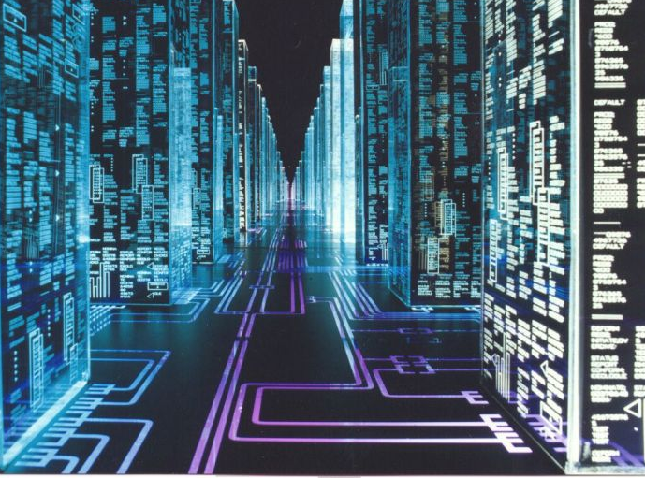
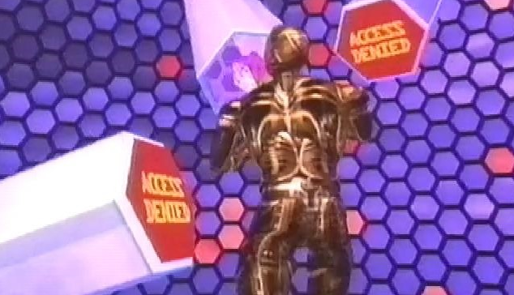
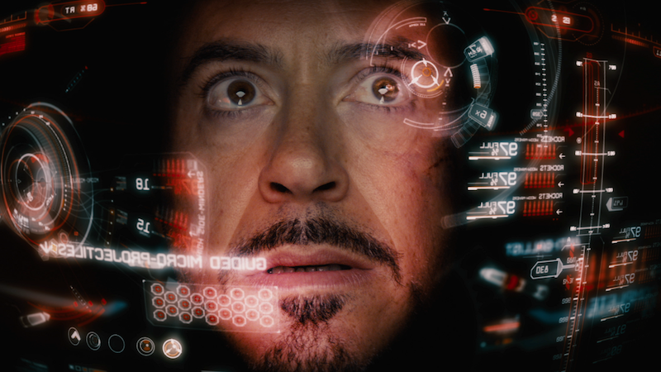
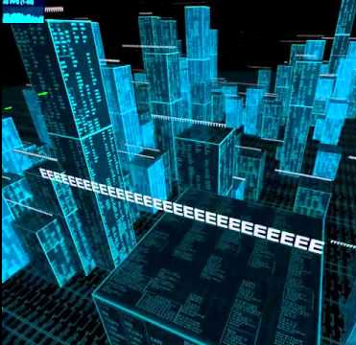
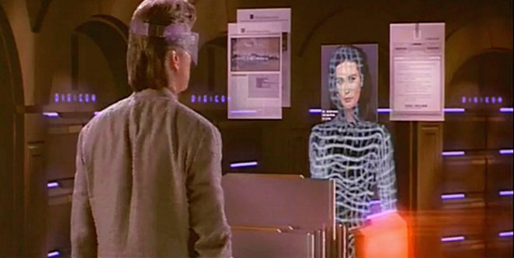
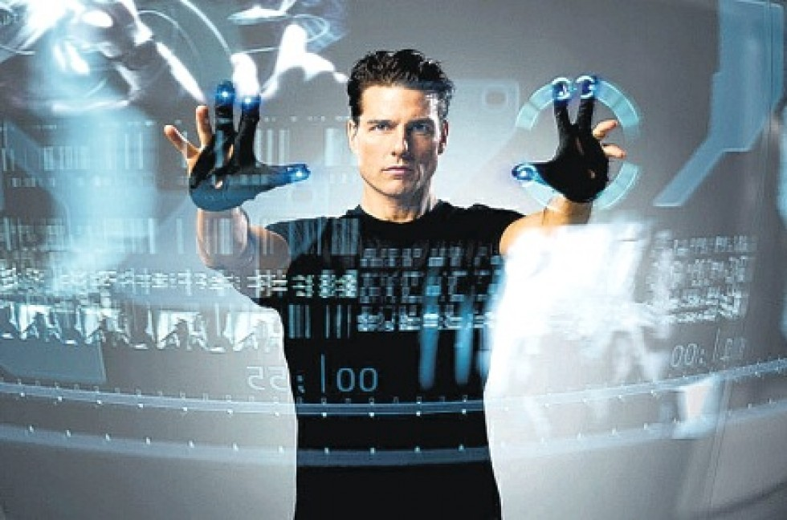
Immersive / AR / VR / Metaverse

Slide 31


Augmented Reality (AR)
Overlay holograms into real-world objects and environments
Merge the real and the virtual using sensors and trackers

Slide 32






Examples

Slide 33

Spatial Awareness
Spatial mapping and computational geometry understand your physical space to provide situational awareness

Slide 34



Equipment
Popular current and upcoming AR headsets
Magic Leap 2
Qualcomm (Reference Design)
Microsoft HoloLens 2

Slide 35






Pros and Cons
Strengths
Good battery life
Wireless connectivity
Spatial awareness
Weaknesses
Limited field of view (FOV)
Durability and brightness
High cost of hardware
Opportunities
Size and weight
Integrated biometrics
AI/ML assistants

Slide 36


Methodology
Modeling and Simulation (M&S) focusing on spatial mapping and channel prediction for visualizing wireless channels in a modeled space
Koutitas et al. (2020)

Slide 37




AR Signal Visualization
Mainstream implementations of AR signals (early days)
ARSensor, ARWave, NBC (2015), Pieper (2018)

Slide 38

DoD Adoption
Recent AR/VR interest sparked by pandemic response
Enhanced use in remote education, training, virtual events, etc.
Example: US Army combat training in Synthetic Training Environment
Ball et. Al, 2021, World Economic Forum, 2022

Slide 39

Industry Impact
M&S
Training
Efficient modeling and simulation of environmental and localized RF conditions
Higher engagement and lower onboarding cost for new and existing users
Education
Analysis
Faster uptake and longer retention of challenging radio engineering concepts
Increased speed and accuracy for discovering and communicating insights

Slide 40
Immersive Signal Visualization
Design & Development

Slide 41

Design Considerations
Hardware Display
Field-of-view (FOV) limitations
Indoor and outdoor lighting conditions can affect holograms
Hands-free interaction ability with gesture and voice recognition

Slide 42

Design Considerations
User Interface
Ergonomics of interactables
Direct interaction with objects versus onscreen controls
Colors, shapes, and symbology
Multi-User interactions
Wikitude (2021)

Slide 43






Example of 3D Spatial Signals
Intuitive perception of Relative Signal Strength Indicator (RSSI)
Notes:
https://app.slack.com/client/T654F77ME/search/search-eyJkIjoiZmluZGVyJTIwYW5kJTIwLnBuZyIsInEiOiJVMDFEVDZMRk5UVSIsInIiOiJmaW5kZXIlMjBhbmQlMjAucG5nIiwicyI6InJlY2VudE1lc3NhZ2VzIn0=/files/F01Q177T46S?cdn_fallback=1

Slide 44

Data Sources
Position
Direction
Signal strength (RSSI)
Frequency (MHz)
Network speed (Mbps)
Network name (SSID)
MAC address (BSSID)
Power level (RSRP)

Slide 45



Interaction Methods
Enable user to access contextual information with simple movements and gestures
Notes:
https://app.slack.com/client/T654F77ME/search/search-eyJkIjoiZmluZGVyJTIwYW5kJTIwLnBuZyIsInEiOiJVMDFEVDZMRk5UVSIsInIiOiJmaW5kZXIlMjBhbmQlMjAucG5nIiwicyI6InJlY2VudE1lc3NhZ2VzIn0=/files/F01Q177T46S?cdn_fallback=1

Slide 46


Holograms
To skeumorphism or not
Density of information
Sizing of symbols
Notes:
https://app.slack.com/client/T654F77ME/search/search-eyJkIjoiZmluZGVyJTIwYW5kJTIwLnBuZyIsInEiOiJVMDFEVDZMRk5UVSIsInIiOiJmaW5kZXIlMjBhbmQlMjAucG5nIiwicyI6InJlY2VudE1lc3NhZ2VzIn0=/files/F01Q177T46S?cdn_fallback=1

Slide 47



Example: Direction Finding
Find the strongest emitting device
Show relative distance and bearing, for navigation
Notes:
https://app.slack.com/client/T654F77ME/search/search-eyJkIjoiZmluZGVyJTIwYW5kJTIwLnBuZyIsInEiOiJVMDFEVDZMRk5UVSIsInIiOiJmaW5kZXIlMjBhbmQlMjAucG5nIiwicyI6InJlY2VudE1lc3NhZ2VzIn0=/files/F01Q177T46S?cdn_fallback=1

Slide 48




HUD
Heads-Up Display
Persistent information
Track head angle
Clear center area

Slide 49


Relative Positioning
Show user in context with all available data
Track according to reference point
Notes:
https://app.slack.com/client/T654F77ME/search/search-eyJkIjoiZmluZGVyJTIwYW5kJTIwLnBuZyIsInEiOiJVMDFEVDZMRk5UVSIsInIiOiJmaW5kZXIlMjBhbmQlMjAucG5nIiwicyI6InJlY2VudE1lc3NhZ2VzIn0=/files/F01Q177T46S?cdn_fallback=1

Slide 50


User Engagement
Augment user’s senses with surface patterns and a “slicing” tool
Notes:
https://app.slack.com/client/T654F77ME/search/search-eyJkIjoiZmluZGVyJTIwYW5kJTIwLnBuZyIsInEiOiJVMDFEVDZMRk5UVSIsInIiOiJmaW5kZXIlMjBhbmQlMjAucG5nIiwicyI6InJlY2VudE1lc3NhZ2VzIn0=/files/F01Q177T46S?cdn_fallback=1

Slide 51




Bridging 2D to AR

Slide 52

Spatial Signal Simulation
Spatial representation of observable signals
Highly dynamic indoor environment
Used for modeling networks
Signal source

Slide 53

Model Validation
On-site signal collection in network telecoms lab
Walk along path with device away from signal source
Collect data on position, direction and signal strength
Notes:
What is the FCC

Slide 54

Affiliation with AI/ML
On-the-fly control and interaction with machine algorithms
assist the user in their quest for discovering insight
Notes:
https://app.slack.com/client/T654F77ME/search/search-eyJkIjoiZmluZGVyJTIwYW5kJTIwLnBuZyIsInEiOiJVMDFEVDZMRk5UVSIsInIiOiJmaW5kZXIlMjBhbmQlMjAucG5nIiwicyI6InJlY2VudE1lc3NhZ2VzIn0=/files/F01Q177T46S?cdn_fallback=1

Slide 55

Testing and Tuning
Only 3-5 min hands-on training
Swift detection of random spectrum attack
Full physical discovery of source attack device

Slide 56




Lightweight Deployment
Mobile immersive headsets allow for a “classroom in a box”
VR
VR
AR
AR
Edge Compute
Appliance

Slide 57
Best Practices
Development
Draw inspiration from media
Leverage real-world concepts
Consider GPU parallelization
Generate visuals procedurally
Profile performance regularly

Slide 58

Best Practices (Cont.)
Usability
Add visual/auditory feedback
Embrace ergonomics
Test early and often
Minimize text
Co-create!

Slide 59
Summary and Conclusion

Slide 60

Future Work
Smart Cities
IoT sensor networks
5G, 6G, 7G, and beyond
Construction preplanning
Transportation
Aviation systems
Connected mobility
Traffic smart metering
Health
Safe training
Remote surgery
Extrasensory perception
Alharbi et Al. (2019)
(c) 2019 Magic Leap, Inc.
Notes:
CASSIE
Thank you, Naomi and the team from Magic Leap, BadVR and the German Space Agency. I hope you have enjoyed the talk and understand how spatial computing can help us meet the challenges of climate change. The team will be around for the next few days to answer questions and give demos. Our big ask is for you to please reach out to us and see where this platform is able to help your country with climate change. This project is going to be developed over the coming years and for 2021 we will be engaging with all 170 of our offices about this platform.

Slide 61



Additional Signals
Chemical, biological, radiological and nuclear (CBRN) sensor data
Software Defined Radios (SDR)
Ubertooth/Bluetooth devices
Medical devices
Utilize AI/ML
NIH (2022) , Wikimedia (2005)

Slide 62

Into Space
Space Defense
Improve modeling effectiveness
Anti-Access/Area denial strategies target RF communications to inhibit movement
Jamming of signals for low-power satellites, and counter-jamming
Reduce freedom of action
Airbus
Notes:
What is the FCC

Slide 63


Takeaway
Immersive technology will enhance modeling of signals in real world
Cumbersome, focused on screen instead of scene, 1D/2D
Preserve use of hands, ​maintain situational awareness,​ expand comprehension in 3D

Slide 64
Revisit Goals
Confirm Learning Objectives
Understand challenges of existing tools for RF signal analysis
Differentiate between 1D, 2D, and 3D signal visualizations
Discover fundamentals of immersive technologies like AR/VR and potential applications for signal intelligence and visualization
Identify best practices and applied theory to the design of next-generation signal analysis user interfaces
Notes:
Add bloom triangle but with no words
https://bloomstaxonomy.net/

Slide 65
Acknowledgements

Slide 66
Bibliography
Airbus. https://airbusus.com/laser-communication/
Anderson (2017). “Reduce EMI to Improve Radio Range”. https://medium.com/tempo-automation/improve-radio-range-by-lowering-emi-dac7135f77f9
Alharbi et Al. (2019). “Roles and Challenges of Network Sensors in Smart Cities”. https://iopscience.iop.org/article/10.1088/1755-1315/322/1/012002/pdf
Altium (2017). “How to Choose a Test Lab for FCC Certification of IoT Products”. https://www.altium.com/subscription
Antenna Test Lab. “What is an Anechoic Chamber?”. https://antennatestlab.com/antenna-education-tutorials/what-is-an-anechoic-chamber
ARSensor. https://play.google.com/store/apps/details?id=com.ken.arsensor&hl=en_US&gl=US
ARwave. https://apps.apple.com/us/app/ar-wave-visualization-of-wifi/id1470866212
Army Futures Command (2022). “Synthetic Training Environment offers multi-dimensional combat preparation”. https://www.army.mil/article/254005/synthetic_training_environment_offers_multi_dimensional_combat_preparation
Ball et Al. (2021). “Virtual reality adoption during the COVID-19 pandemic: A uses and gratifications perspective”. https://www.sciencedirect.com/science/article/pii/S0736585321001672
BAE. "Unmanned SIGINT/Electronic Warfare". https://www.baesystems.com/en/product/unmanned-sigint-electronic-warfare
Bloom (2001). “What is Bloom’s Taxonomy”. https://bloomstaxonomy.net/
FrontierUS. https://frontiercomputercorp.com/specifying-the-right-antenna/

Slide 67
Bibliography
Haneda et Al. (2021). “Inclusive Radio Communications for 5G and Beyond”. https://www.sciencedirect.com/science/article/pii/B9780128205815000080
HouseTechLab. “Difference between spectrum analyzer and oscilloscope” https://housetechlab.com/difference-between-spectrum-analyzer-and-oscilloscope/
iBWave. https://info.ibwave.com/augmented-reality/
Koutitas et Al. (2020). “In Situ Wireless Channel Visualization Using Augmented Reality and Ray Tracing”. https://www.mdpi.com/1424-8220/20/3/690/htm
McKinsey (2018). “The road to 5G: The inevitable growth of infrastructure cost”. https://www.mckinsey.com/industries/technology-media-and-telecommunications/our-insights/the-road-to-5g-the-inevitable-growth-of-infrastructure-cost
NBC (2015). “App Visualizes Radio Waves From Cell Towers, Satellites Around You”. https://www.nbcnews.com/tech/innovation/app-visualizes-radio-waves-cell-towers-satellites-around-you-n469781
NIH (2022). “Electric & Magnetic Fields”. https://www.niehs.nih.gov/health/topics/agents/emf/index.cfm
NTIA (2016). https://www.ntia.doc.gov/files/ntia/publications/january_2016_spectrum_wall_chart.pdf
Pieper (2018). “Introducing WiFiman”. https://blog.ui.com/2018/12/11/introducing-wifiman/
RF Page (2021). “What are Radio Frequency bands and its uses?”. https://www.rfpage.com/what-are-radio-frequency-bands-and-its-uses/
Rockwell Collins (2016). "LVC demonstration completed by Rockwell Collins in France, U.K., and U.S." https://militaryembedded.com/radar-ew/test/lvc-demonstration-completed-by-rockwell-collins-in-france-u-k-and-u-s

Slide 68
Bibliography
TeraSense. “Radio Frequency Bands”. https://terasense.com/terahertz-technology/radio-frequency-bands/
Wikimedia (2005). https://commons.wikimedia.org/wiki/File:An_instructor_at_the_Defence_NBC_Centre_operates_the_Manportable_Chemical_Agent_Detector_MOD_45148143.jpg
Wikitude (2021). “How to Apply UX Design Principles in Augmented Reality”. https://www.wikitude.com/blog-ux-design-for-augmented-reality/
World Economic Forum (2022). “Immersive Media Technologies: The Acceleration of Augmented and Virtual Reality in the Wake of COVID-19”. https://www3.weforum.org/docs/WEF_Immersive_Media_Technologies_2022.pdf

Slide 69

Contact Info
Jad Meouchy, CTO​
jad@badvr.com​
(833) 600-DATA
10312 Norris Ave. Ste. D​
Pacoima, CA 91331

