Slide 1


Sharing Environmental Data for LVC using RIEDP
(Tutorial 22T32 )
Reuse and Interoperation of Environmental Data and Processes (RIEDP)
Jean-Louis GOUGEAT (jlgougeat@sogitec.fr )

Slide 2
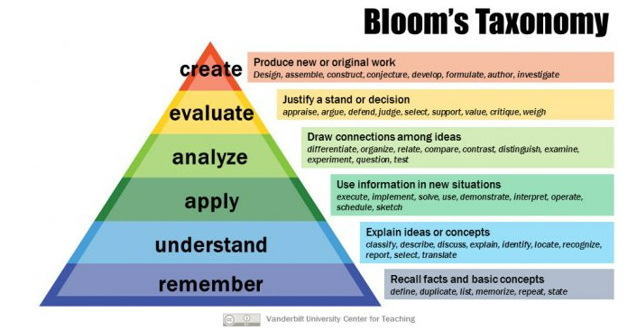
Tutorial Objectives
RIEDP : Reuse and Interoperation of Environmental Data and Processes
At the completion of this tutorial the attendee will be able to:
  Identify the main interoperability and reuse issues associated with use of terrain/environmental data in distributed simulation
  Discuss the general process steps in creation of environmental databases, and the various data involved
  Describe the two SISO RIEDP Products, their role, and their main components
  Employ the appropriate RIEDP products and principles to efficiently share environmental databases
  Contrast details of the RIEDP components with the issues to solve
  Judge the use of RIEDP in a simulation project
  Support the evolution of the RIEDP Products
Product = Result of a SISO standardization effort
Non-commercial !

Slide 3
Problem – Importance - Relevance
What is the problem
  Building terrain databases still very expensive
  Sharing saves cost, and also increases consistency, but …
  Shared data often not clear - Conventions and Semantics not always uniform or standardized
  This leads to interoperability problems and high costs
Why is this important
  Consistency in Terrain Representation key to Fair Fight in Distributed Simulation / LVC
  Consistency required for Services, Joint and International /Coalition Training
Who should care
  Customers/Users, Program Managers, Engineers in Distributed Simulation / LVC
  Interested in stand-alone or networked M&S applications, including visualization, training, analysis, rehearsal, testing (using traditional, VR, or AR visualizations)

Slide 4
How RIEDP adresses this
RIEDP is a SISO standard for communicating and sharing environmental data
Building M&S environmental data products (or databases) requires various types of source data, including (but not limited to) data in popular GIS formats
RIEDP leverages those popular formats and standardizes a comprehensive framework comprising:
  A data generation process model to align/understand completeness of shared terrain data
  A data model to represent and organize terrain data, and
  The semantics, rules, methods and conventions to unambiguously share the data
RIEDP does not impose internal solutions on data producers
RIEDP : Reuse and Interoperation of Environmental Data and Processes

Slide 5
Agenda
The Operational Context
The RIEDP Approach
The RIEDP Components
  RPM Stages
  RADM
  RADM Parts
Semantics for RIEDP data sharing
RIEDP and Other Similar Initiatives
Summary and Q/A
RIEDP : Reuse and Interoperation of Environmental Data and Processes

Slide 6
The Operational Context

Slide 7

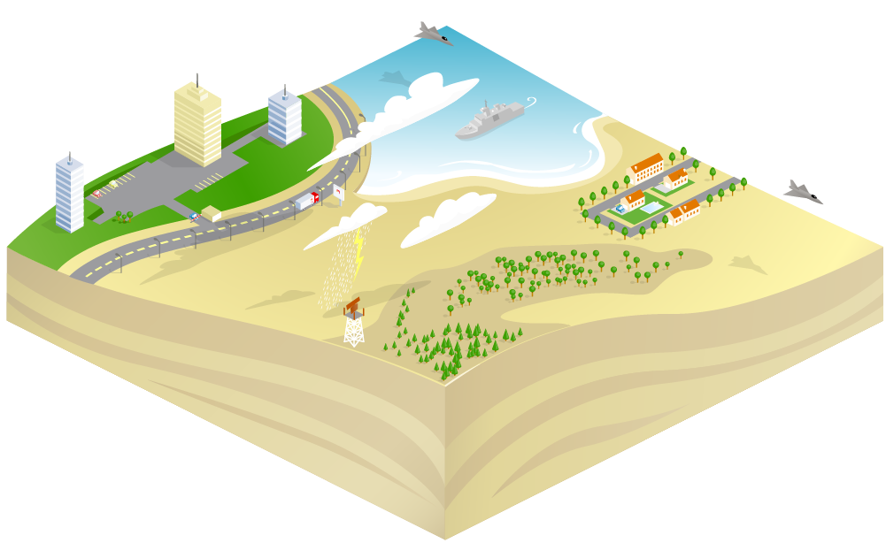



Live Virtual Constructive Training
Full Mission Sim 1
Heavy Constraints on
Synthetic Environment
Full Mission Sim 2
Computer Generated Forces
Real Actors
Exercise Controller
Ground Based Air Defence
HLA or other Protocol
At Stake : Avoiding duplication of costs, Inconsistency during execution, …
Solution : Standard? But not if every Organization has its own!

Slide 8
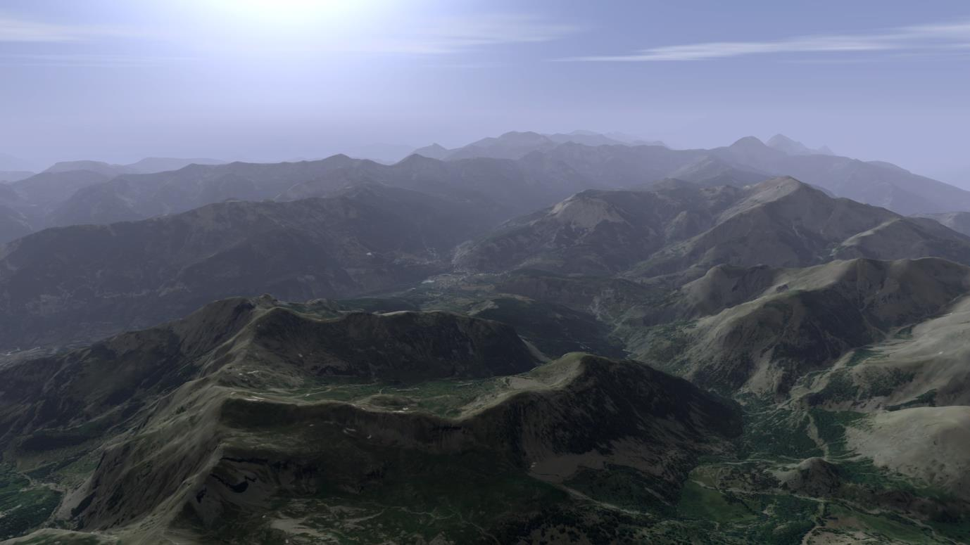
SE Requirements for an Aircraft Simulator (1/7)
Large Areas
Diversity of Terrain Natures

Slide 9
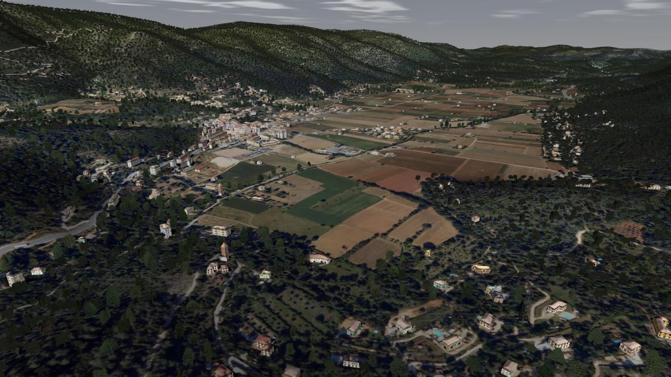
SE Requirements for an Aircraft Simulator (2/7)
Large Areas
Diversity of Terrain Natures

Slide 10
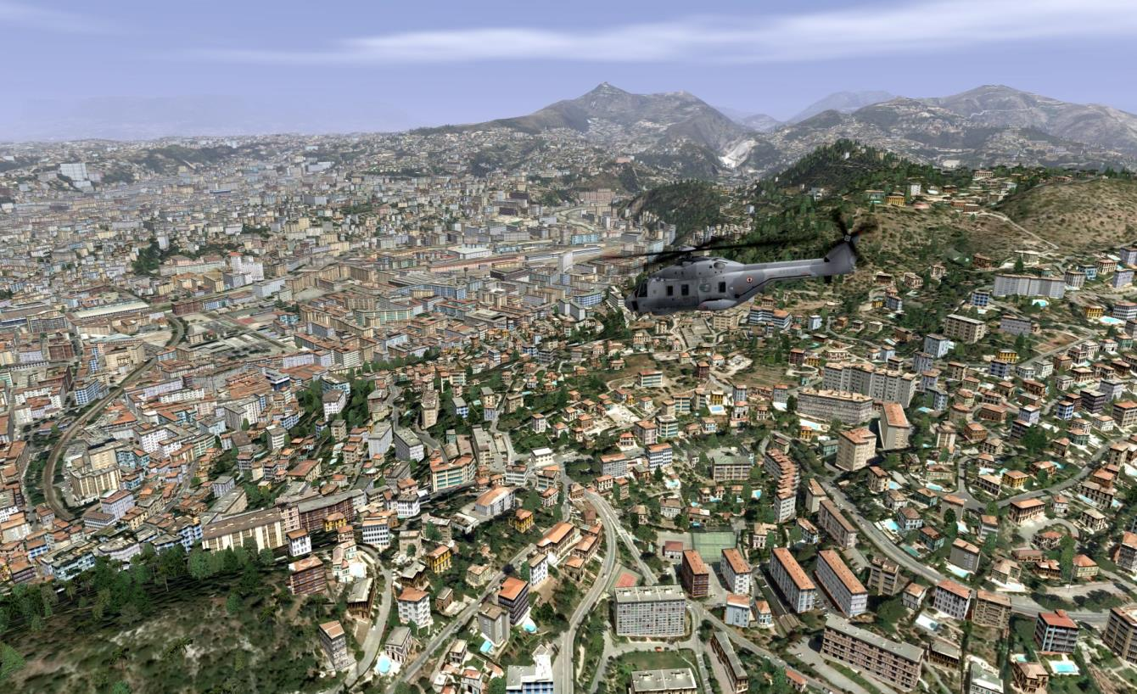
SE Requirements for an Aircraft Simulator (3/7)
Large Areas
Diversity of Terrain Natures

Slide 11
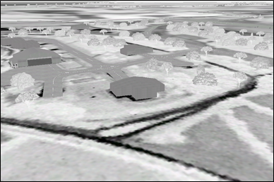
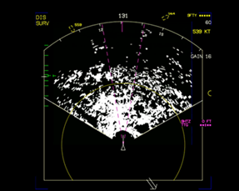

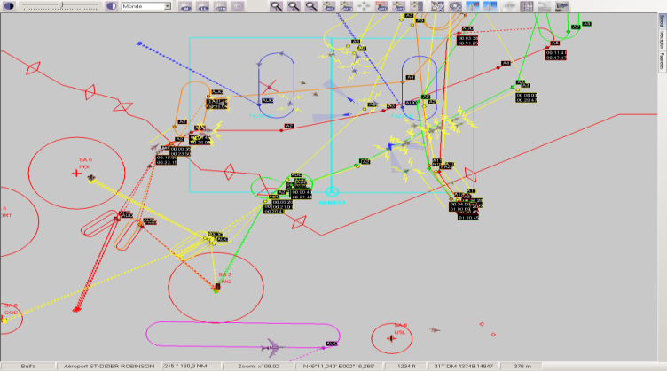
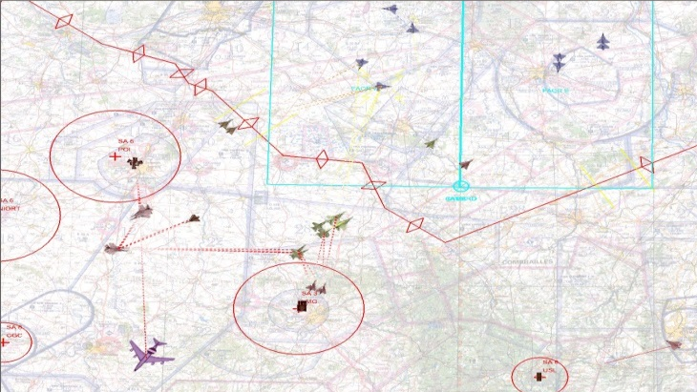
SE Requirements for an Aircraft Simulator (4/7)
Large Areas
Diversity of Terrain Natures
Diversity of Target applications
(Visual, Sensors, IOS, CGF, C2…)

Slide 12

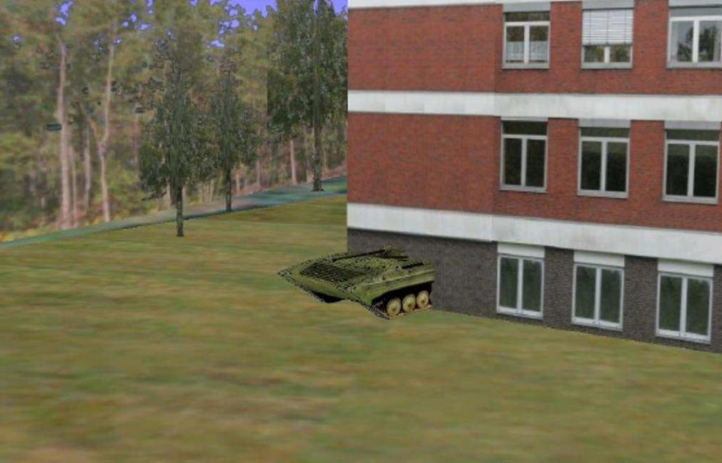

SE Requirements for an Aircraft Simulator (5/7)
Well, it is not really in the edge of the treeline !!
Can you see the Tank at the edge of the treeline ?
© Images courtesy of Aditerna

Slide 13
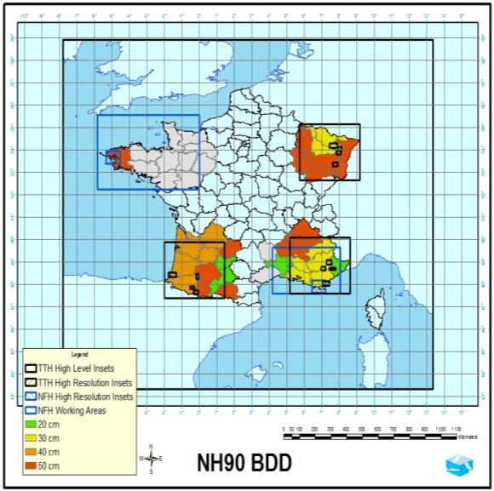
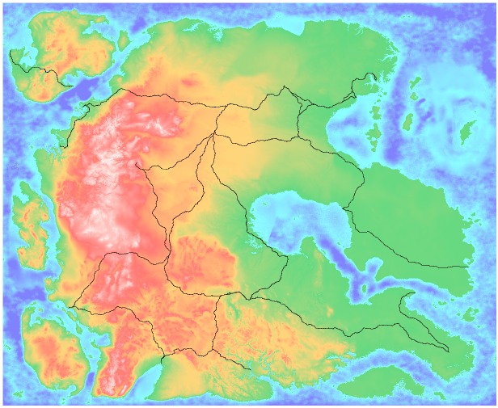
SE Requirements for an Aircraft Simulator (6/7)
NATO “Missionland”
2000x2000 km

Slide 14
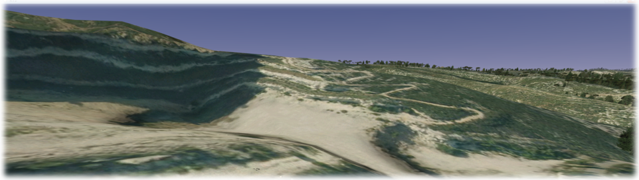
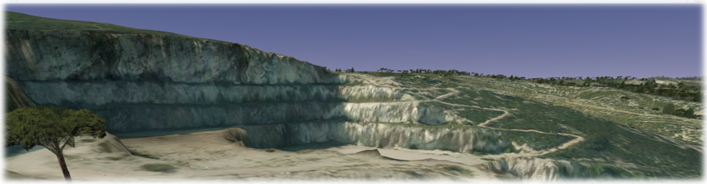
SE Requirements for an Aircraft Simulator (7/7)
  Elevation Grid: 25 m
  Elevation Grid: 1 m

Slide 15





Building a Simulator Database
€ / $
Target
Databases
Database
Requirements
Visual DB
Source
Data
Database
Creation
Radar DB
Infra Red DB
Other Sensors
CGF DB
Operate !
Geospatial & Others
Find the data
Solve IPR
Clean the data
Correlate the data
Create missing data
Format the data
Intensify the data
Specialize the data
Maps
Others
Not so Easy

Slide 16
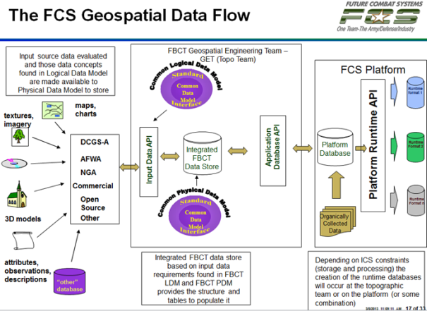
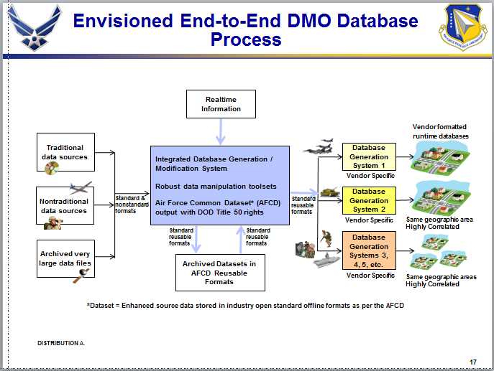
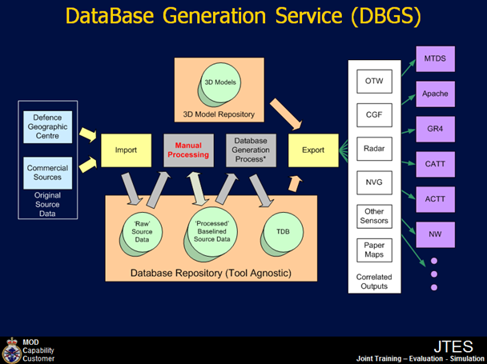
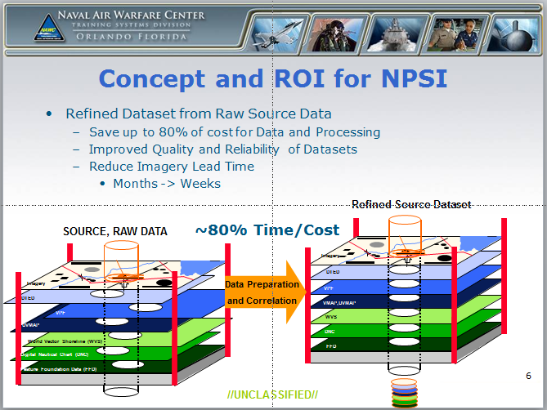
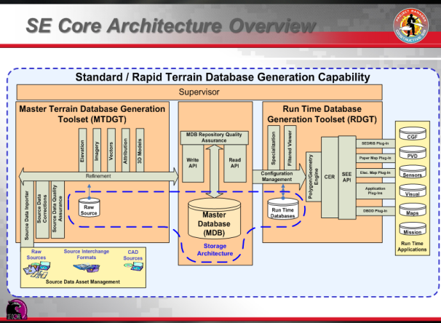
Terrain Database Generation – A Universal Process
It looks very similar
But the Devil is in the details
Images courtesy of their respective programs

Slide 17
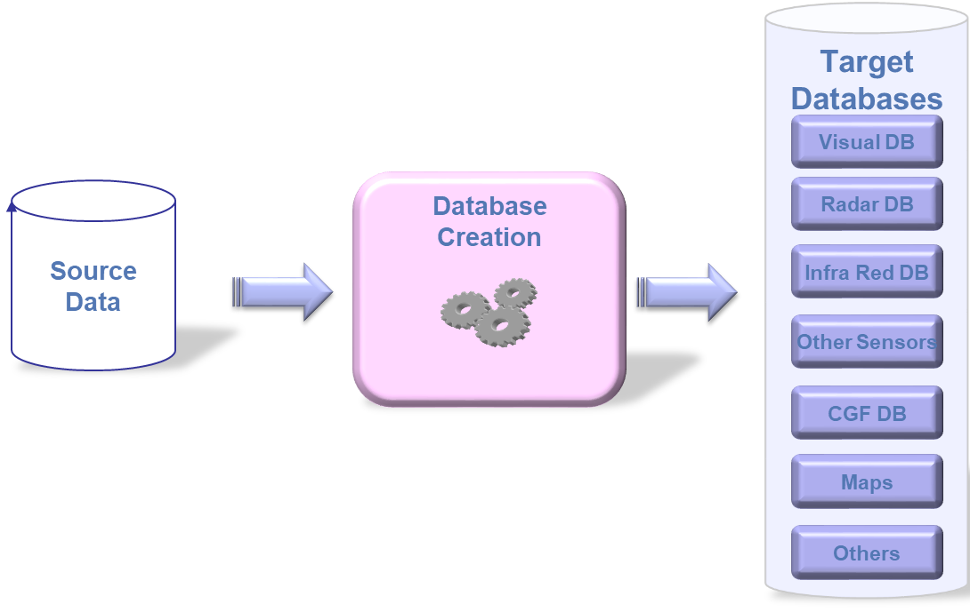



Additional issues for Distributed Simulation / LVC
Reuse – Correlation – Interoperability …. (1/2)
Sim A - Provider 1
Requirements
Sim B - Provider 2
Sim C – Provider 3

Slide 18







Additional issues for Distributed Simulation / LVC
Reuse – Correlation – Interoperability …. (2/2)
Duplication of efforts
Duplication of Cost
Time to market
Sim A - Provider 1
Consistency ?
Schedule ?
Requirements
Sim B - Provider 2
M&S Interoperability is
even more critical in the International Arena
with
Multiple Providers and Multiple M&S Solutions
Sim C – Provider 3

Slide 19
Examples of Interoperability issues in Large Exercises
Events: I/ITSEC Operation Blended Warrior (OBW), NATO MSG-165 Spartan
Typical Issues
  Many points of view: Ops Team, Tech Team, Sim. providers, data providers/consumers …
  Different understanding – sometimes wrong understanding – of the concepts
  Communication/Miscommunication, Semantics (Example case – Sample dialog)
Significant contributors to these Semantics problems:
  Terrain-related issues
  Interchange standards
Interoperability and reuse suffer from these issues
  Critical in the International Arena with Multiple Providers and Multiple M&S Solutions

Slide 20


M&S Interoperability
What it is NOT
  The same Product and associated Solutions for everyone
    Does not work, certainly not in the International Arena
    Puts Innovation at risk
    What product to choose? Single Solution sufficient? What constraints?
What it is
  Consistency in Modelling, associated Data and Semantics at Component Level
  Allowing Components to work together at System & System-of-Systems Levels
  Fostering Multiple-Provider Solutions (e.g. : I/ITSEC/OBW Federations)
Simulation Interoperability relies on Appropriate Standards
  Open, based on Consensus, not Vendor Specific
  Within the simulation community : SISO
SISO : Simulation Interoperability Standard Organization

Slide 21
The RIEDP approach

Slide 22
Data Transformation Process – Two main phases (1/3)
Target
Databases
Visual DB
Source
Data
Database
Creation
Radar DB
IR DB
Other Sensors
CGF DB
Maps
Others

Slide 23
Data Transformation Process – Two main phases (2/3)
Target
Databases
GIS World
M&S World
Visual DB
Source
Data
Synthetic
Environment
Intermediate
Data
Phase 1
Data
Cleaning &
Enhancement
Phase 2
Target
DBs
Generation
Radar DB
IR DB
Other Sensors
CGF DB
Maps
Others

Slide 24
Data Transformation Process – Two main phases (3/3)
Target
Databases
GIS World
M&S World
Visual DB
Source
Data
Synthetic
Environment
Intermediate
Data
Phase 1
Data
Cleaning &
Enhancement
Phase 2
Target
DBs
Generation
Radar DB
IR DB
Other Sensors
Standardize here
at appropriate Intermediate stages
CGF DB
Maps
Manual Work: 80% 20%
Computation Time: 20% 80%
Others

Slide 25
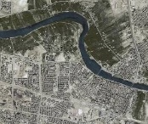

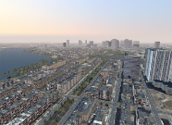
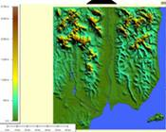
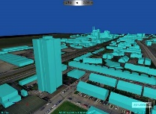
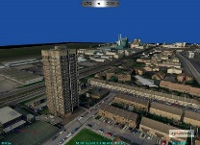

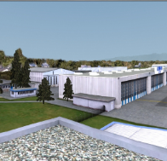
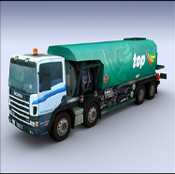
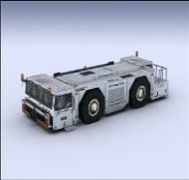

Source Data from Various Origins
  From GIS world : DTED, DFAD, VMAP, SHAPEFILE, GEOTIFF, GML, KML, …
    Application to simulation
      Elevation, Vector (roads, rivers and building positions), Geo-referenced satellite imagery
  From Photography World : BMP, ECW, JPEG, JPEG 2000, RGB, TIFF™
    Application to simulation
      Texture for Terrain or objects to add visual realism, without complex geometric models
  From Architecture/Game Worlds : COLLADA, OpenFlight™, VRML, X3D, …
    Application to simulation
      Formats from 3D modelers (e.g. 3DS ™, Maya ™, Creator ™, ... )
      Application to simulation : Dedicated to 3D Objects modeling for visual Systems.
Notes:
25

Slide 26
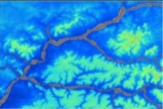

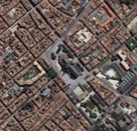
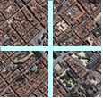
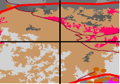
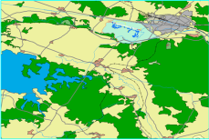




Phase1 : Generation of the Intermediate Datasets
Source Dataset
Projection Conversions
Format Conversions
Tiling (mosaïc)
Harmonisation (between Tiles)
Corrections of Source errors
Reconciliation between Layers
Intermediate
Dataset
Elevation
Geographical
Added Value
Elevation (Tiled )
Imagery
Imagery (Tiled )
Material Classification
Classification
Planimetry
Attribution Definition
Assignation of 3D models to Classes
Definition of Procedural Generation
Rules for Features (Off or on line)
Planimetry
& Attribution
Simulation
Added Value
3D Models
Attribution Definition
Creation of new models in Library
3D Models

Slide 27
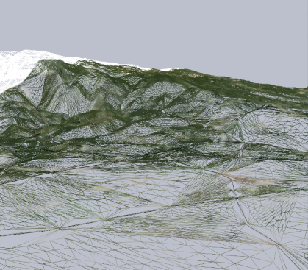
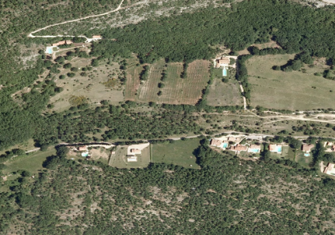
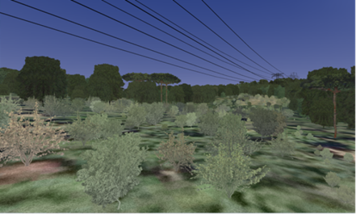
Phase 2 : Generation of Target DBs
Intermediate
Datasets
Runtime DB
Creation of 3D Terrain
(Polygons, Levels of Detail, …)
Elevation
(Tiled )
3D Terrain
Images
(Tiled )
Texturation (projection of
images on the 3D Terrain)
Classification
Enrichment of terrain
with 3D elements
(Cultures, Buildings, Networks,..)
Geo-specific
Textures
Features
& Attribution
Competition
➔ Proprietary
Solutions & Formats
3D Models
3D objects

Slide 28
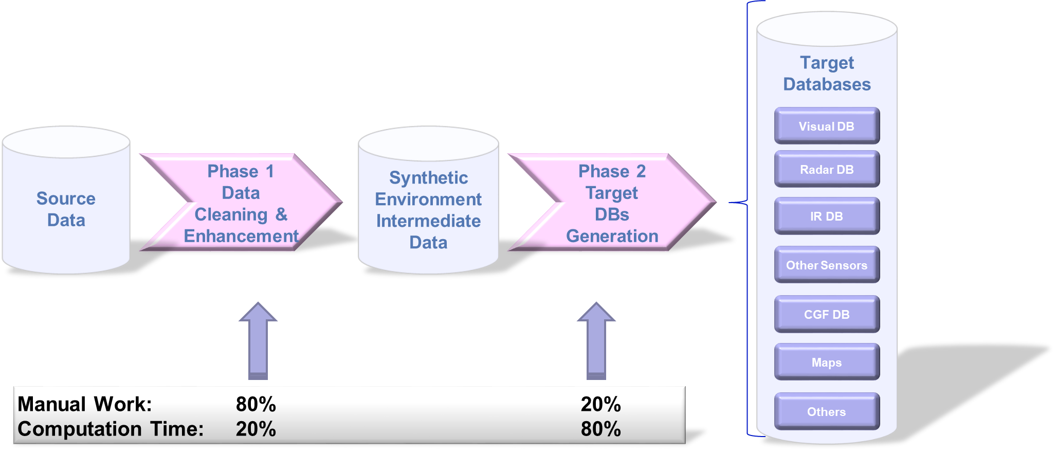
Data Transformation Process – Possible Improvement (1/4)
The process may be made more efficient in Mission Training via Distributed Simulation (MTDS)
Though Manuel work
being reduced with AI/ML

Slide 29

Data Transformation Process – Possible Improvement (2/4)
The process may be made more efficient in Mission Training via Distributed Simulation (MTDS)
Hardly Reusable
(Unless same target platforms)
Competition
Various Trade-offs

Slide 30
Data Transformation Process – Possible Improvement (3/4)
The process may be made more efficient in Mission Training via Distributed Simulation (MTDS)
  If Source data is comprehensive and consistent
    Within each and between the layers → Depends on Data Providers
  If previous creation efforts may be reused
    At Source Data Level (Linked to GIS World)
Hardly Reusable
(Unless same target platforms)
Providers
Data Diversity
Data Quality
Competition
Discovery & Access
Metadata
Repository
Various Trade-offs

Slide 31

Data Transformation Process – Possible Improvement (4/4)
The process may be made more efficient in Mission Training via Distributed Simulation (MTDS)
  If Source data is comprehensive and consistent
    Within each and between the layers → Depends on Data Providers
  If previous creation efforts may be reused
    At Source Data Level (Linked to GIS World)
    At Intermediate Level
    Requires Common Processes, Representations, and Formats at this level
RIEDP
Reuse of Intensification efforts
Hardly Reusable
(Unless same target platforms)
Providers
Data Diversity
Data Quality
Competition
Discovery & Access
Metadata
Repository
Various Trade-offs

Slide 32
Key Topics for Database sharing
When reusing data from a partner, you need to know
  How the database was built → Tasks performed or not
  How the database is represented → Conceptual Model
  How the database is spatially referenced → Spatial Reference Model
  How the database is structured → Physical data model
  How the database is organized on the media → Files/Folders/Hierarchies
  How well the database conforms to Standards → Compliancy & Profiles
  Information about the data product → Metadata
No existing solution fully satisfies all of these requirements

Slide 33
International M&S Initiatives & Standardization Efforts (1/2)
Process oriented
DB oriented
Nature | M&S standards |  | Projects / Initiatives |  |  |  |  |  | Geospatial
Name | SIF | SEDRIS | NPSI | AFCD | MDB | CDB | Mission Land | Other | OGC CDB
Origin | US DOD | US DOD | US Navy | USAF | US Army | US SOCOM | NATO | e.g. French Air Force | PRESAGIS
Introduction Date | 1991 | 1994 | 2004 | 2006 | 2008 | 2004 | 2010 | 2006 | 2013
Publication Date | Yes | 2005 | - | - | - |  |  |  | 2016
Standard | Yes | Formal ISO/IEC | User Standard | User Standard | User Standard | User & Commercial Standard | User Standard | User Standard | Formal OGC
Open Standard | Format according to standard | Yes | limited | limited | limited | Limited | limited | limited | Yes
Approach | Obsolete | Standardized Semantics and Data Model + Format according to standard |  |  |  |  |  |  | Similar to US SOCOM CDB but with formalized semantics and Conceptual Data Model
Availability of Commercial Support Tools | SIF | Tools developed in SEDRIS COI |  |  |  |  |  |  | PRESAGIS tools
Based on de-facto standard formats (GIS Source)
but
- No consistent Semantics or Data Model
- Similar but not Standard Data Generation Process
Commercial tools
for commercial & standard formats
  AFCD: Air Force Common Dataset
  EDS: Enterprise Data Services
  NPSI: NAVAIR Portable Source Initiative
  CDB: Common Database
  MDB : SE Core Master Data Base
  SIF: SSDB (Standard Simulator Database) Interchange Format

Slide 34
International M&S Initiatives & Standardization Efforts (2/2)
Process oriented
DB oriented
Nature | M&S standards |  | Projects / Initiatives |  |  |  |  |  | Geospatial
Name | SIF | SEDRIS | NPSI | AFCD | MDB | CDB | Mission Land | Other | OGC CDB
Origin | US DOD | US DOD | US Navy | USAF | US Army | US SOCOM | NATO | e.g. French Air Force | PRESAGIS
Introduction Date | 1991 | 1994 | 2004 | 2006 | 2008 | 2004 | 2010 | 2006 | 2013
Publication Date | Yes | 2005 | - | - | - |  |  |  | 2016
Standard | Yes | Formal ISO/IEC | User Standard | User Standard | User Standard | User & Commercial Standard | User Standard | User Standard | Formal OGC
Open Standard | Format according to standard | Yes | limited | limited | limited | Limited | limited | limited | Yes
Approach | Obsolete | Standardized Semantics and Data Model + Format according to standard |  |  |  |  |  |  | Similar to US SOCOM CDB but with formalized semantics and Conceptual Data Model
Availability of Commercial Support Tools | SIF | Tools developed in SEDRIS COI |  |  |  |  |  |  | PRESAGIS tools
RIEDP addresses these Topics
(see how in RPM and RADM)
Based on de-facto standard formats (GIS Source)
but
- No consistent Semantics or Data Model
- Similar but not Standard Data Generation Process
Commercial tools
for commercial & standard formats
  AFCD: Air Force Common Dataset
  EDS: Enterprise Data Services
  NPSI: NAVAIR Portable Source Initiative
  CDB: Common Database
  MDB : SE Core Master Data Base
  SIF: SSDB (Standard Simulator Database) Interchange Format

Slide 35
RIEDP – Two Products
RIEDP provides what is needed to share Environmental data :
  A Reference Process Model (RPM)
  A Reference Abstract Data Model (RADM)
  A Tiling Scheme and Spatial Referencing
  A List of Formats from the GIS and M&S worlds
  A Consistent Semantics (through Features, attribution rules)
  An Organization on the Media
  A Metadata structure
  A set of Exchange Profiles
Product 1: RIEDP Data Model Foundations
Product 2: RIEDP Detailed Features Description

Slide 36
Status of RIEDP Products
Product 1 - Published in 2018 as SISO-GUIDE-007-2018
  Included by NATO Standardization Office (NSO) in AMSP-01
    NATO Modelling And Simulation Standards Profile
  Used by NATO Group MSG-156 for semantics in Dynamic Terrain
  Ideas from Product 1 are used in a few initiatives (but w/o credit to RIEDP!)
Product 2 - Development of semantics is in-progress
  Expected completion: 2023
  Addressing challenging problems for the representation of sensor/material semantics while providing non-proprietary XML-based solution
AMSP : Alliance Modelling and Simulation Publication

Slide 37
Building on existing work – Bibliography
Partial bibliography of documents used in Product 1 and/or Product 2
Reference | Date
RIEDP Data Model Foundations - SISO-GUIDE-007 | August 2018
Environmental Data Coding Specification (EDCS) - ISO/IEC 18025:2014 | February 2014
ESRI Shapefile Technical Description - ESRI White Paper | July 1998
GeoTIFF Format Specification - Rev 1.0 - Specification Version 1.8.2 | November 1995
JPEG 2000 image coding system: Core coding system- ISO/IEC 15444-1:2004 | September 2004
OpenFlight Scene Description Database Specification - version 16.5 | February 2016
Portable Network Graphics (PNG): Functional specification - ISO/IEC 15948:2004 | March 2004
SGI (RGB-RG) Image File Format - Draft version 1.00 (ftp://ftp.sgi.com/grafica/sgiimage.html) | 1996
Reference for Enumerations for Simulation Interoperability - SISO-REF-010-2019 (V27) | 14 October 2019
Spatial Reference Model (SRM) - ISO/IEC 18026:2009 | July 2009
Unified Modeling Language (UML) Version 1.4.2 - ISO/IEC 19501:2005 | April 2005
Data elements and interchange formats - Information interchange Representation of dates and times - ISO 8601:2004 | December 2004
Codes for the representation of names of countries and their subdivisions - Parts 1-3 - ISO 3166:2013 | November 2013
AMSP-01 - NATO Modelling And Simulation Standards Profile | 2022

Slide 38
The RIEDP Components:
The RPM
Reference Process Model

Slide 39
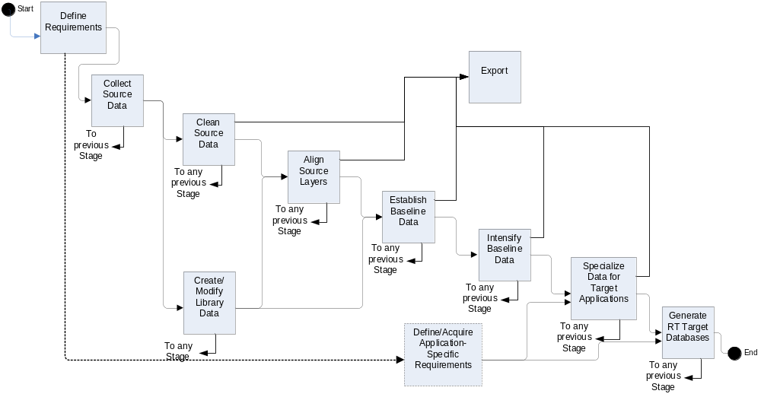
RIEDP Reference Process Model / Process Flow (1/2)
  Standardized model of Typical Generation Process for a Database

Slide 40
RIEDP Reference Process Model / Process Flow (2/2)
Requirements
  Standardized model of Typical Generation Process for a Database
Export Stage
Using RIEDP does not require
changes to the user’s workflow
7 Creation Stages
Target DB Stage

Slide 41
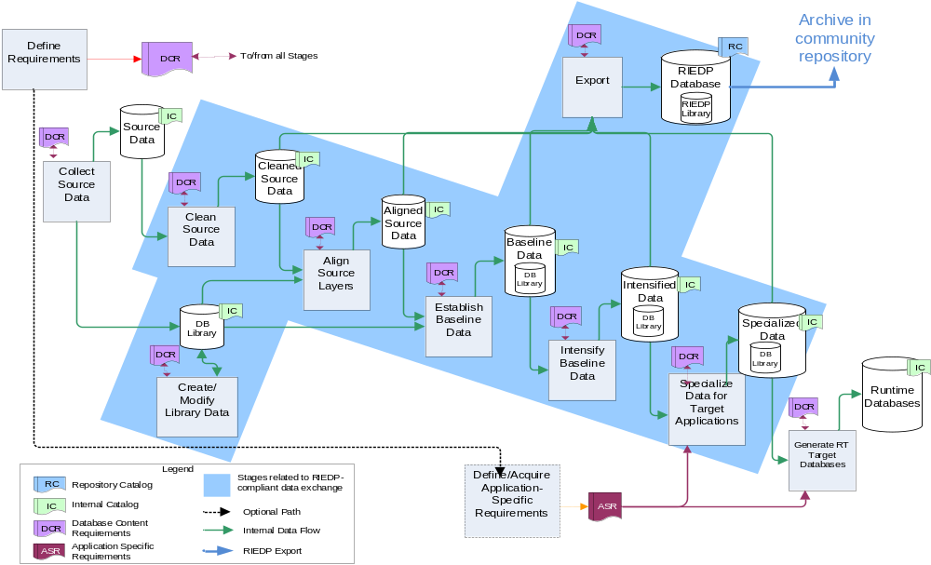
RIEDP Reference Process Model - Data Flow
Export Stage
See RPM details in Product 1 - § 4.2.2
Runtime Stage

Slide 42
The RIEDP Components:
The RADM
Reference Abstract Data Model

Slide 43
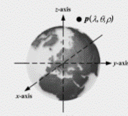

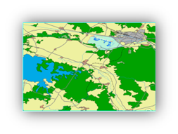
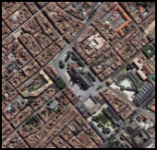
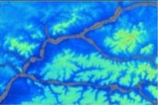
Main Components of a Database
Repository
Spatial
Reference Frame
Catalog
DB
Metadata
Tiling
Metadata
Library
Metadata
Layers
3D Models
Feature
Templates
Metadata
Attribution
Textures
Special Areas
Other Raster
Reference
Tables
Features
Imagery
Elevation

Slide 44
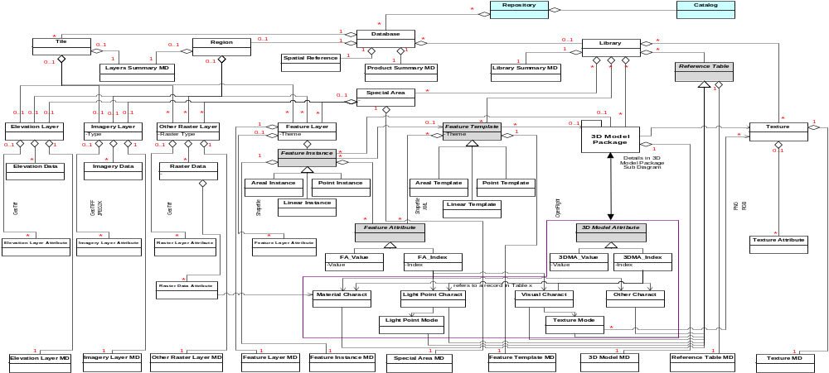
RIEDP Reference Abstract Data Model (upper part - 1/2)

Slide 45
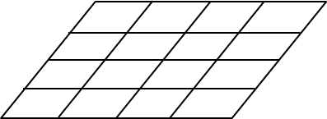

RIEDP Reference Abstract Data Model (upper part - 2/2)
Repository
Catalogue
DB
Metadata
Special Areas
Reference
Tables
Feature
Templates
3D Models
Textures

Slide 46
RIEDP Reference Abstract Data Model (Lower part)

Slide 47
RIEDP Reference Abstract Data Model (Lower part)
Layers
Library
Special Areas
Reference
Tables
Feature
Templates
3D Models
Textures
Attribution
Metadata

Slide 48
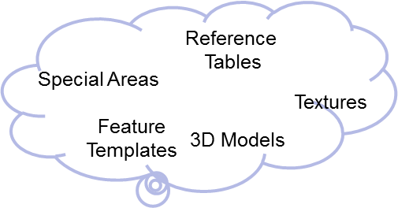
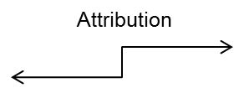
RIEDP Reference Abstract Data Model (Full)
Repository
Catalogue
DB
Metadata
See RADM details in Product 1 - § 4.3.3
Metadata

Slide 49
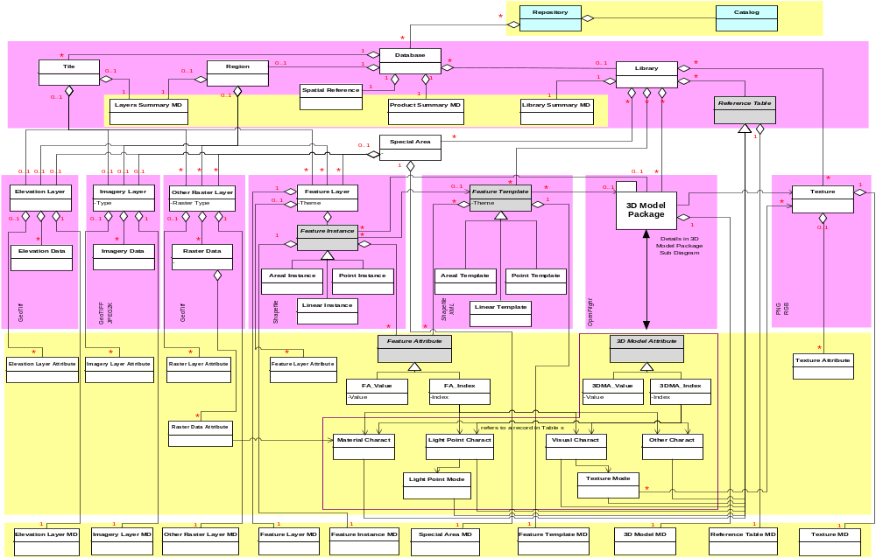
RIEDP Reference Abstract Data Model
High Level Concepts of a Database
Showing areas of convergence and variability among initiatives
Tiles, Layers Library,
Convergence
Common format
Variability
COTS
Attribution
Metadata,

Slide 50
The RIEDP Components:
The RADM Parts
List of Formats
Spatial Reference Frame
Attribution Model
Data Organization on the Media
Metadata Schema
Profiles

Slide 51
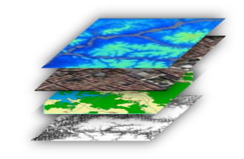
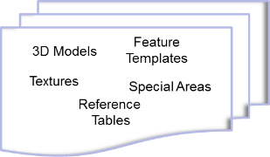
RIEDP-required formats
The data formats required for RIEDP-compliant data exchange:
  GeoTIFF (revision 1.0 October 1995), for terrain elevation data.
  ESRI Shapefile (technical description White Paper July 1998), for instances, and possibly for classes of terrain features and vector data.
  GeoTIFF (revision 1.0 October 1995) or JPEG 2000 (ISO/IEC 15444 – Part 1) for terrain imagery data, as well as other raster-based data.
  OpenFlight (version 16.0 or higher), for 3D models, both natural and man-made, placed on the terrain or dynamically included in the environment.
  PNG (ISO/IEC 15948:2004), SGI RGB or SGI RGBA, image formats for texture maps, used in portraying object surfaces and some terrain surfaces.
  In addition, XML (and associated XML schema) is used to provide those RIEDP-required data that is not supported through the above formats.
NOTE :
  RIEDP does NOT impose RIEDP-required Formats for use within a Data Producer’s internal Processes
  The list of RIEDP-required formats may be extended, updated, or modified through amendment or revision of this specification. Condition : Candidate formats shall comply with the RADM principles.
See details in Product 1 - § 4.4
See details in Product 1 - § 4.6

Slide 52

Export Database
GeoTIFF
Shapefiles
XML
OpenFlight
PNG RGB
RIEDP Exchange Formats
Additional formats can be introduced through
SISO EDRS Product Support Group
XML

Slide 53


RIEDP Geospatial Conventions / Tiling
Tiling:
  Division of the area of interest
  1square degree
Region
  Single Block
  For those who do not consider Tiles
See details in Product 1 - § 4.3.3.2.7

Slide 54

RIEDP Geospatial Conventions / Spatial Reference
RIEDP-compliant <Database> conforms to the following:
  Database_SRF: GEODETIC_WGS_1984
  Database_Origin: longitude value, latitude value, (and optionally, height value)
  Database_Spatial_Domain:
    Coordinate values : longitude, latitude,
    (and optionally height)
    for the Lower Left and Upper Right corners of the database, in that order
  3DModel_SRF: LOCAL_SPACE_RECTANGULAR_3D SRF
  OrientationVectorSpace_SRF: LOCAL_TANGENT_SPACE_EUCLIDEAN
  Orientation_Values_Convention: Intrinsic_Euler_ZYX or ZY’X”
See details in Product 1 - § 4.3.3.2.5

Slide 55
RIEDP Attribution Model
Related to Feature instances and Templates
  Detailed Characterization of their Properties
    For Geospatial information
    For Formats Organization (structure of the data in a format)
    For Process guidance (how to eventually process the data)
  Factored out into Library through Templates
Example : A road
  Concept from the Real World : Polyline + Size + Lanes Number + Type
  Based on GIS Attributes from the Provider
  Augmented with attributes of the instance or from a template in the Library
    Cross Section, Visual representation, Sensor representation
    Rules for conforming to the terrain
    Detailed properties captured in Reference Tables
Standardized Semantics and Attribution Schema (next Part of the Brief)
See details in Product 1 - § 4.3.3.3

Slide 56


RIEDP Data Organization
Physical Organization on the Media
  Layers in Tiles or Region Folder
  Library
  Metadata
See details in Product 1 - § 4.5

Slide 57

RIEDP Metadata - Organization
Metadata
Successful data exchange relies heavily on the appropriate use of metadata
RIEDP Compliant Data products shall include the appropriate metadata classes, as specified by the RADM
  Structured metadata
  Based on XML files for each component of the RADM
  According to rules captured in XML schemas
See details in Product 1 - § 4.3.3.4

Slide 58

RIEDP Profiles
  RIEDP-compliant Data Products shall conform to one of the RIEDP Profiles
  A Profile specifies:
    A stage in the RPM
    Mandatory and Optional Data in accordance with the RADM
See details in Product 1 - § 4.7.

Slide 59
Conformance
RIEDP specifies the conformance requirements for the use of:
  RIEDP RPM stages,
  RIEDP RADM classes,
  RIEDP Profiles, and
  RIEDP-compliant data products.
The conformance requirements apply to any of the following:
  Database generation systems or processes,
  Data models that represent RIEDP products,
  Interchange of RIEDP data products,
  Applications that produce or consume RIEDP data products.
Conformance requirements define the degree of flexibility allowed for all uses of RIEDP.
See details in Product 1 - § 5

Slide 60
Semantics for RIEDP data sharing

Slide 61
Areas of data semantics in RADM
Feature Instances & Feature Templates
Lights Characteristics
Material Characteristics
3D Model Characteristics
Visual Characteristics
Other Characteristics
Elevation and Imagery Attribution
And Process Attributes
(which apply within areas above for data generation and consumption)
4
5
1
7
3
2
6

Slide 62
Product 2 - Detailed Features Description - Goal
Improve Data Interoperability through:
  Identification of List of concepts and associated definitions (next slide)
  Providing the Information needed by the International Training Community
  Allowing future Evolution
  Not reinventing the wheel by using to Standard Dictionaries
    EDCS, + DFDD and AMDB for Airport as needed
    and RIEDP notions when not enough
    Use of Existing definitions (Changes to be requested to Source Organization)
    RIEDP own Code Space

Slide 63
Relating Features and Attributes
List of Tables Related to the Semantics of Features and/or Attributes
  Features
  Attributes
    Including Process-related attributes
  Associated enumerations
  Supplementary
    Including Themes, Units , Scales…
  Prescribed feature-attribute combinations along with their:
    Valid value ranges,
    Their specific enumerations (if any),
    Default values (including enumerates)
    Applicable units, scale
These tables are evaluated through test DB conversion efforts
Table structures are specified in Product 2

Slide 64


Feature Instance & Feature Templates
A template allows to factor out common characteristics of features
(saved in Library).
Note:
The RADM representation for Features is not specific to Shapefiles

Slide 65
Vector data in shapefiles
  A Shapefile stores geographic features (point, linear, and areal) and attribute data as a collection of files
    .shp - the file that stores the geometry of feature instances.
      Each record describes a shape with a list of its vertices.
    .dbf - the dBASE file that stores the attribute information of feature instances.
      Each record contains attributes for a feature.
    .shx - the file that connects the geometry file and the attributes file via index values.
.shp
.dbf
.shx
Records
Shape 1
Shape 2
Shape n
Attrib 1 | Attrib 2 |  | Attrib n
Values

Slide 66

RIEDP Attribution Model : Features (Shapefiles + XML)
Characterization of Feature instances and Templates

Slide 67
Example : Material Characteristics (1/3)
Areal
x
y
z
LinkTo_Template |  |  |  | LinkTo_MatChar
TemplateX
TemplateY
 |  |  |  | Wood
<Feature_Templates>
  <FTEntry>
    <Name>TemplateX
      <Attribute n>
      <LinkTo_LightChar></LinkTo_LightChar>
      <LinkTo_MatChar> Wood</LinkTo_MatChar>
      <LinkTo_VisualChar></LinkTo_VisualChar>
      <LinkTo_OtherChar></LinkTo_OtherChar>
  </FTEntry>
  <FTEntry>
    <Name>TemplateY
    <Name>TemplateZ
<MatChar_Table>
  <MatChar_Entry> Name « Wood »
    <Group> « Basic_Mode »
    <Group> « Advanced_Mode »
    <Group> « Expert_Mode »
  <MatChar_Entry> Name « Metal »
    <Group> « Basic_Mode »
    <Group> « Advanced_Mode »
    <Group> « Expert_Mode »
  <MatChar_Entry> Name « Soil »
    <Group> « Basic_Mode »
    <Group> « Advanced_Mode »
    <Group> « Expert_Mode »
For Basic rendering
For Training purposes
For Physics Experts
12 Feb 2020
Tutorial RIEDP - SISO SIW 20

Slide 68
Example : Material Characteristics (2/3)
Areal
x
y
z
LinkTo_Template |  |  |  | LinkTo_MatChar
TemplateX
TemplateY
 |  |  |  | Wood
<Feature_Templates>
  <FTEntry>
    <Name>TemplateX
      <Attribute n>
      <LinkTo_LightChar></LinkTo_LightChar>
      <LinkTo_MatChar> Wood</LinkTo_MatChar>
      <LinkTo_VisualChar></LinkTo_VisualChar>
      <LinkTo_OtherChar></LinkTo_OtherChar>
  </FTEntry>
  <FTEntry>
    <Name>TemplateY
    <Name>TemplateZ
<MatChar_Table>
  <MatChar_Entry> Name « Wood »
    <Group> « Basic_Mode »
    <Group> « Advanced_Mode »
    <Group> « Expert_Mode »
  <MatChar_Entry> Name « Metal »
    <Group> « Basic_Mode »
    <Group> « Advanced_Mode »
    <Group> « Expert_Mode »
  <MatChar_Entry> Name « Soil »
    <Group> « Basic_Mode »
    <Group> « Advanced_Mode »
    <Group> « Expert_Mode »
For Basic rendering
For Training purposes
For Physics Experts
12 Feb 2020
Tutorial RIEDP - SISO SIW 20

Slide 69

Example : Material Characteristics (3/3)
Areal
x
y
z
LinkTo_Template |  |  |  | LinkTo_MatChar
TemplateX
TemplateY
 |  |  |  | Wood
<Feature_Templates>
  <FTEntry>
    <Name>TemplateX
      <Attribute n>
      <LinkTo_LightChar></LinkTo_LightChar>
      <LinkTo_MatChar> Wood</LinkTo_MatChar>
      <LinkTo_VisualChar></LinkTo_VisualChar>
      <LinkTo_OtherChar></LinkTo_OtherChar>
  </FTEntry>
  <FTEntry>
    <Name>TemplateY
    <Name>TemplateZ
Does it make sense for features ?
Yes, for Predominant Material
<MatChar_Table>
  <MatChar_Entry> Name « Wood »
    <Group> « Basic_Mode »
    <Group> « Advanced_Mode »
    <Group> « Expert_Mode »
  <MatChar_Entry> Name « Metal »
    <Group> « Basic_Mode »
    <Group> « Advanced_Mode »
    <Group> « Expert_Mode »
  <MatChar_Entry> Name « Soil »
    <Group> « Basic_Mode »
    <Group> « Advanced_Mode »
    <Group> « Expert_Mode »
3D Model/Polygon/Texture
For Basic rendering
Wood
For Training purposes
For Physics Experts
or for 3D Model
Metal
Raster/Pixel
Mapping Table
RVB - Index → MatChar_Entry
0/0/255 – 1 → « Water »
or OtherRaster Layer
12 Feb 2020
Tutorial RIEDP - SISO SIW 20

Slide 70
Product 2 Preview - Feature Template Constructs
RIEDP Attribution Model: Features (Shapefiles + XML)
Logical Description of the Table
Realized in XML
Feature Theme |  | Theme Label
 |  |  |  | Geo Attributes List |  |  |  | Org Attributes List |  |  |  |  | Proc Attributes List
Feature Type | FT Name* | FT Descr | Feature Label* | 1st Geo RA Label | → | n^{th} Geo RA Label |  | 1st Org RA Label |  | → | l^{th} Org RA Label |  | 1st Proc RA Label |  | → | m^{th} Proc RA Label
Point | 1st FT Name |  | RF Label | Value for attribute | … | Value for attribute |  | Value for attribute |  | … | Value for attribute |  | Value for attribute |  | … | Value for attribute
 | … |  | … | … | … | … |  | … |  | … | … |  | … |  | … | …
 | n^{th} FT Name |  | RF Label | Value for attribute | … | Value for attribute |  | Value for attribute |  | … | Value for attribute |  | Value for attribute |  | … | Value for attribute
Linear | 1st FT Name |  | RF Label | Value for attribute | … | Value for attribute |  | Value for attribute |  | … | Value for attribute |  | Value for attribute |  | … | Value for attribute
 | … |  | … | … | … | … |  | … |  | … | … |  | … |  | … | …
 | n^{th} FT Name |  | RF Label | Value for attribute | … | Value for attribute |  | Value for attribute |  | … | Value for attribute |  | Value for attribute |  | … | Value for attribute
Areal | 1st FT Name |  | RF Label | Value for attribute | … | Value for attribute |  | Value for attribute |  | … | Value for attribute |  | Value for attribute |  | … | Value for attribute
 | … |  | … | … | … | … |  | … |  | … | … |  | … |  | … | …
 | n^{th} FT Name |  | RF Label | Value for attribute | … | Value for attribute |  | Value for attribute |  | … | Value for attribute |  | Value for attribute |  | … | Value for attribute

Slide 71
Product 2 Preview
Materials, Sensor Bands, and Directionality
Directionality value used in the Expert Modes of Visual Characteristics and Material Characteristics to modulate the intensity depending on the angle of observation and also on the wavelength
λ/ν | Band 1 (or λ1 or ν1) |  |  |  |  |  |  |  |  |  |  |  |  | Band 2 / λ2/ν2
θ | θ1 |  |  |  | θ2 |  |  |  | … | θn |  |  |  | θ1 |  | … | θn
φ | φ1 | φ2 | … | φn | φ1 | φ2 | … | φn |  | φ1 | φ2 | … | φn | φ1 | φn |  | φ1 | φn
Mat 1
Mat 2
…
Mat n

Slide 72
Product 2 – Summary
Detailed Semantics for all components of the RADM
  For Geomatic objects in § 5.2 Ready for review
  for Content Organization in § 5.3 and Ready for review
  for Data Processing in § 5.4 In progress
Including
  Layers Conventions Ready for review
  Detailed Construction and Structure of Reference Tables In progress
    Light, Visual, Material Characteristics, …
    Basic, Advanced, Export Modes
XML Tag and schema Definitions for
  Feature Templates Ready for review
  Reference Tables Ready for review
  Extension of the vector data properties, and In progress
  Use of XML constructs in Comment nodes of 3D Models In progress

Slide 73
The Experts’ Corner
Experts interested in details of the following topics can consult the listed documents/sections:
Topic | In Product 1 | In Product 2
RPM Stages (details) | § 4.2.2 and 4.2.3 | -
RADM Component (details) | § 4.3.3 | § 5.2
Spatial Referencing | § 4.3.3.2.5 | -
Tiling (details) | § 4.3.3.2.7 | -
3D Model Structure (details) | § 4.3.3.2.15 | § 5.3.8
Library Concepts | § 4.3.3.2.6 | -
Feature Templates (Object reuse) | § 4.3.3.2.14 | § 5.3.6
Reference Tables | § 4.3.3.2.17 | § 5.3.10
Material-related Semantics |  | § 5.3.10.5
XML Tag and Schema Definition |  | § 6.4
Profiles | § 4.7 | § 7
Conformance | § 5 | § 9
Metadata details | § 4.3.3.4 | -
Introducing new formats in RIEDP | § 4.6

Slide 74
RIEDP and the other Initiatives
How do they relate ?

Slide 75

RIEDP and other Initiatives - Process view
use of RPM for comparison!
RIEDP Scope
AFCD / NPSI Scope
CDB scope
SE Core Scope
SEDRIS Scope

Slide 76

Comparison of different database sharing solutions
Topics | SEDRIS | AFCD | NPSI | CDB | SECORE | RIEDP
Process Model | û | û | û | û | ü | ü RPM
Data Model | ü DRM | û | û | K | û | ü RADM
Attribution | ü EDCS | û | û | ü | ü | ü EDCS +
Spatial Reference | ü SRM | K | K | ü | ü | ü 3 SRF
Formats | ü STF | ü COTS | ü COTS | ü COTS | ü COTS | ü COTS
Physical Org | ü STF | K | K | ü | ü | ü
Metadata | ü | û | K | K | K | ü
Profile | K | û | û | û | û | ü
Scope (vs RIEDP/RPM) | All stages but "RT Target Gen" | Until stage "Align…" | Until stage "Align…" | "RT Target Gen" | All stages | All stages but "RT Target Gen"
Expressed
Non-existent or unexpressed
Partial or specific or limited

Slide 77
Summary &
Conclusion

Slide 78





RIEDP – Two Products
RIEDP provides what is needed to share Environmental data :
  A Reference Process Model
  A Reference Abstract Data Model
  A Tiling Scheme and Spatial Referencing
  A List of Formats from the GIS and M&S worlds
  A Consistent Semantics (through Features, attribution rules)
  An Organization on the Media
  A Metadata structure
  A set of Exchange Profiles
RIEDP Data Model Foundations
RIEDP Detailed Features Description

Slide 79
Take away
RIEDP
  Takes benefit of the lessons learnt from all related Initiatives
  Reuses and relies on existing standards (such as SEDRIS ISO/IEC standards and PNG ISO/IEC standard), as well as formats commonly used in the community
  Represents the best common denominator by providing a Reference Process Model (RPM), a formal Reference Abstract Data Model (RADM), relying on use of existing Formats, specifying unique Profiles, and focusing on metadata and attribution semantics
  Does not impose internal solutions on producers
  Provides a common data sharing approach that relies on a formal abstract data model (RADM), along with specific metadata and attribution (Product #2)
This allows the best sharing of data, independently from target applications implementation,
  with a current scope addressing static terrain.
  See NATO Group MSG-156 on dynamic terrain and weather

Slide 80
Tutorial Objectives (reminder)
(updated)
At the completion of this tutorial the attendee will be able to:
  Identify the main interoperability and reuse issues associated with use of terrain/environmental data in distributed simulation
  Discuss the general process steps in creation of environmental databases, and the various data involved
  Describe the two SISO RIEDP Products, their role, and their main components
  Employ the appropriate RIEDP products and principles to efficiently share environmental databases
  Contrast details of the RIEDP components with the issues to solve
  Judge the use of RIEDP in a simulation project
  Support the evolutions of the RIEDP Products
Product = Result of a SISO standardization effort
Non-commercial !

Slide 81

Q & A
More information:
  Download the Specification from www.sisostds.org
    PDG SISO Library File Folder – Access PDG Documents
    Select SISO Digital Library > Development Groups > RIEDP PDG
  Get involved in RIEPD PDG and EDRS PSG
Any questions on:
  The Requirements ?
  The RIEDP Products ?
  How is RIEDP different ?
  Other challenges for Environmental databases ?
  Any other Environmental Data related subject ?

Slide 82
Backup slides for the Q&A session

Slide 83
RIEDP-Required formats
Guidelines for Evaluation of Candidate Formats
For the exchange of RIEDP-compliant products and databases, RIEDP specifies existing file formats applicable to the various layers of the RADM.
In response to dynamic changes in technology and evolving requirements, the list of RIEDP-exchange formats may be extended, updated, or modified through amendment or revision of this specification.
All changes shall conform to the following criteria:
  Preservation of RADM and/or RPM compatibility shall be the primary objective, when modifications or replacement of existing formats are being considered.
  Candidate formats shall comply with the RADM principles.
  For instance, the addition of a new 3D model or feature format shall include the definition and compliancy of the corresponding attributes and attribution rules. As needed, open and free tools will be provided to ensure conversion to and from the candidate format are possible.
This is to be analyzed during the Support Phase.

Slide 84


Current Status of RIEDP Products
(updated)
Product n°1
  RIEDP Data Model Foundations
    SISO Guidance Document
    Submitted to Balloting : During March ’18
    Approval During Fall ’18 SIW
    Published
Product n°2
  RIEDP Detailed Features Description
    SISO Standard Document
    Providing non-proprietary solutions for representing semantics
    Development initiated Summer 2017
    Conclusion expected 2023
RIEDP DM Foundations
V 1.2a

